Slide 1
Efficient Optimization on
neutral atoms Quantum Computers
Or… “The unbearable pain of running
quantum algorithms in the 2020’s”
Quminars @ UNIBO 16/04/2024
Simone Tibaldi, University of Bologna

Slide 2
From THIS …

Slide 3
… to THIS
We made it!

Slide 4
Let’s create one
We can control the state with a laser set to a specific frequency

Slide 5
Let’s create one
By applying a specific pulse we can create a superposition
Each state with probability of being populated of:

Slide 6
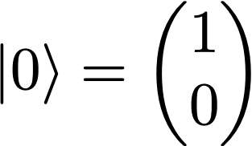
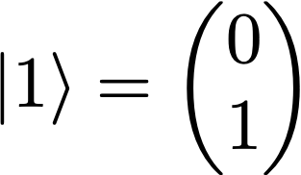
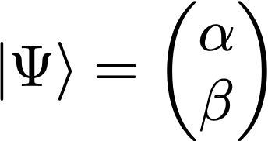
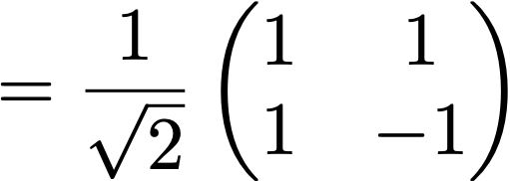
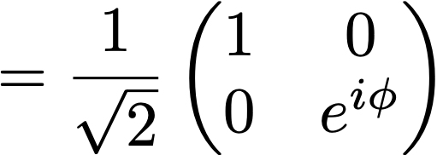
And we can do much more
This is a qubit
Rotating the qubit is like applying (quantum) gates
This is one of infinitely many possible superposition states
Example:

Slide 7
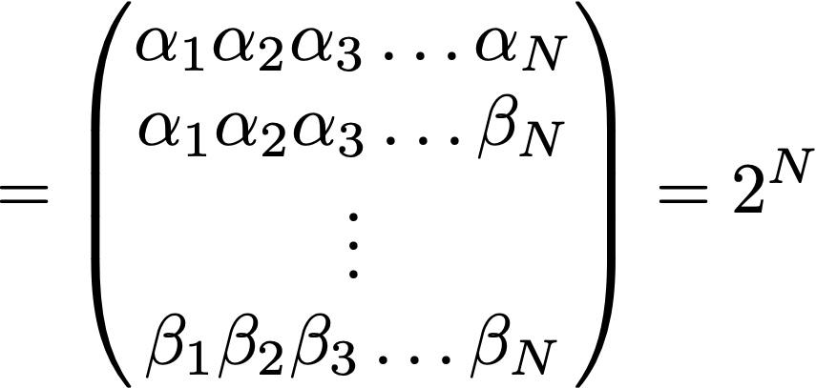
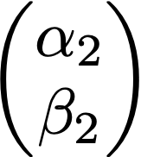
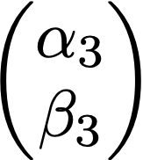
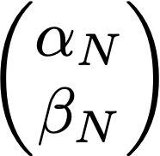
And we can add more qubits as well…

Slide 8
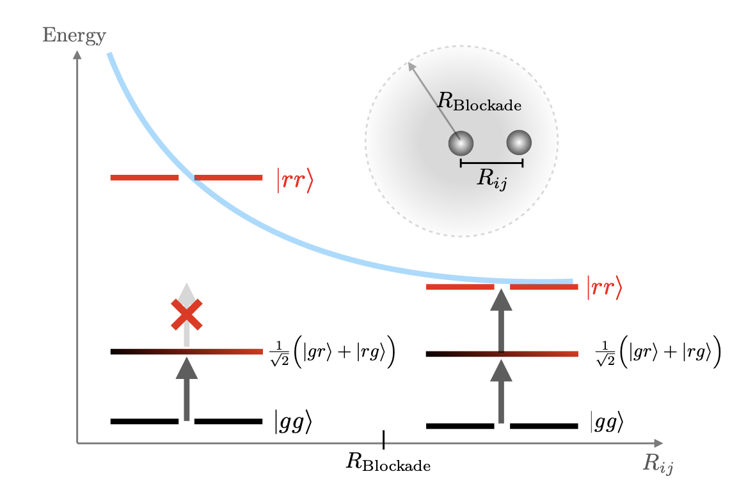
With 2 qubits we can also create entanglement…
… exploiting the Rydberg blockade.
When two atoms are close enough, electrons cannot be excited to |r> at the same time
The result:
Far apart:
Closer than R
Two electrons are entangled!

Slide 9
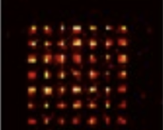
Rotating a qubit + entanglement = quantum computation
Measure
Prepare a state
Apply gates
This is called DIGITAL MODE

Slide 10
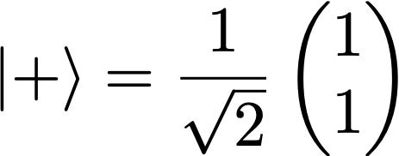
The measurement problem is central in every type of QC because measuring means destroying a state.
Example
A camera flashes the qubits and erases the ones in |r>

Slide 11
DIGITAL MODE
What can we do with digital?
Any algorithm, all of them. Ex: Shor, quantum neural networks …
Why isn’t everything digital?
It’s difficult :(

Slide 12
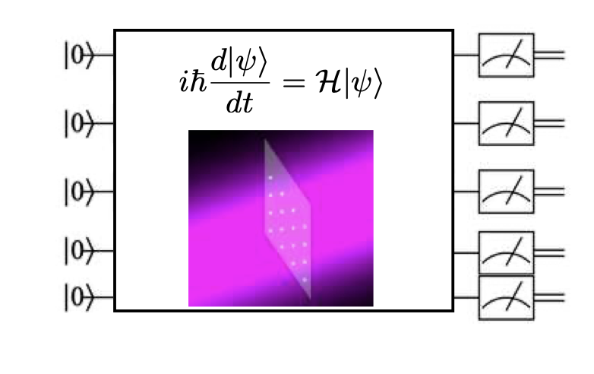
An “easier” approach: Analog Quantum Computation
Prepare a state
What can we do?
Almost every algorithm.

Slide 13
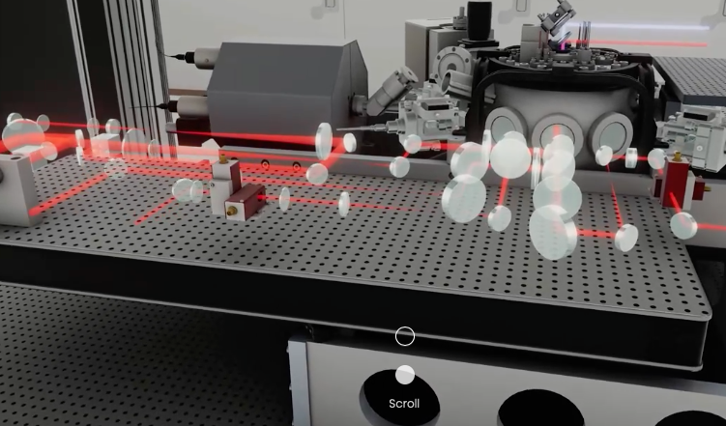
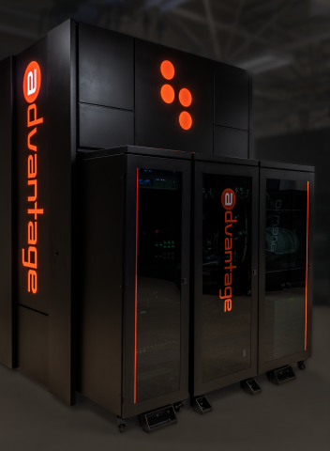
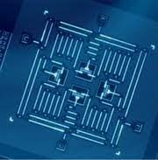
Are there other ways to create a QC?
Yes, a few people are working on it
analog QC,
superconducting
technology
digital QC,
superconducting
technology
analogue/digital QC,
Rydberg atom
technology

Slide 14
Are there other ways to create a QC?
Probably more than a few

Slide 15
Is any technology better than other?
Two main ways to tell: no. of qubits and noise
Each company/university/research center has a roadmap (path) inside this graph over time

Slide 16
Lets run an algorithm
Pick an architecture: neutral atoms
Pick a method: analog, no choice
Pick a classical problem: combinatorial
Pick an algorithm: variational quantum circuit

Slide 17
6
4
THE MIS problem
3
5
1
2
001011
110100
Is a solution
It’s not a solution

Slide 18
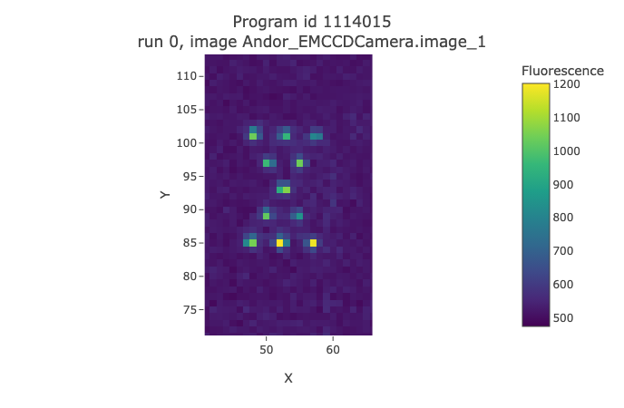
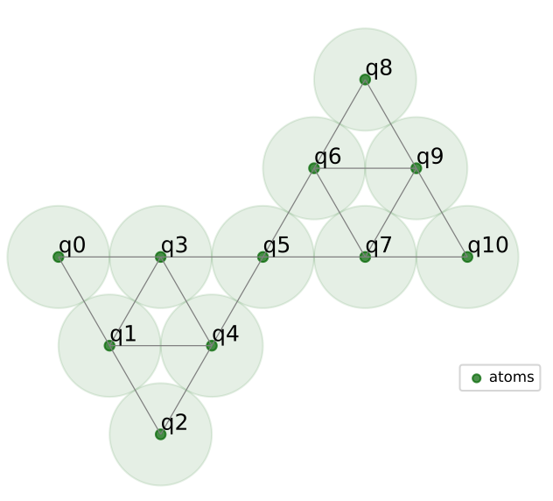
Why MIS?
First:
Ubiquitous
Second: Ising encoding
Third: spatial dependency
Equivalence between graph problem
and atoms positions

Slide 19
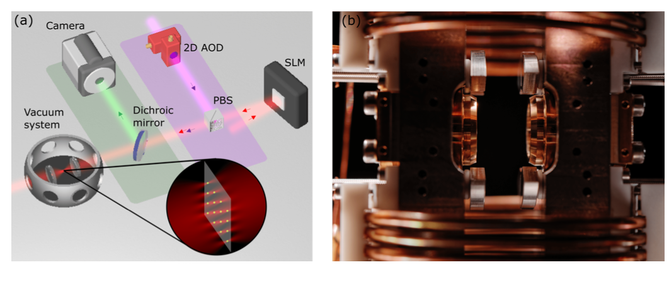
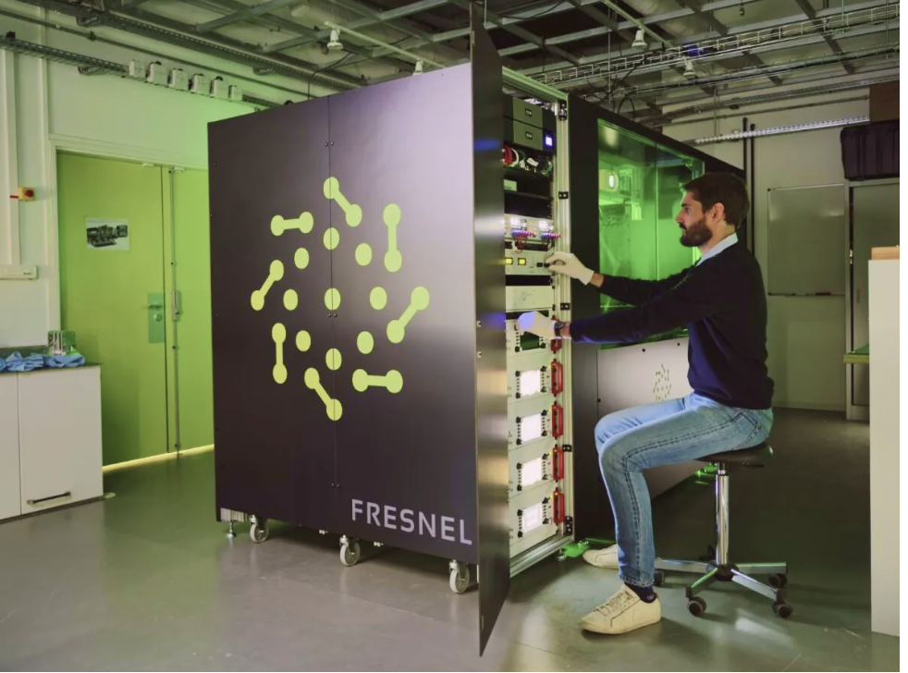
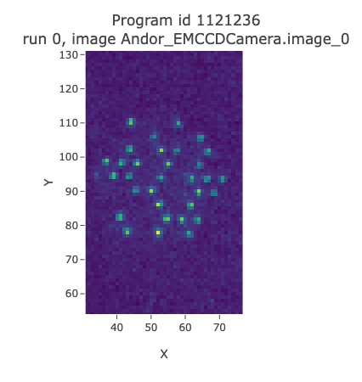
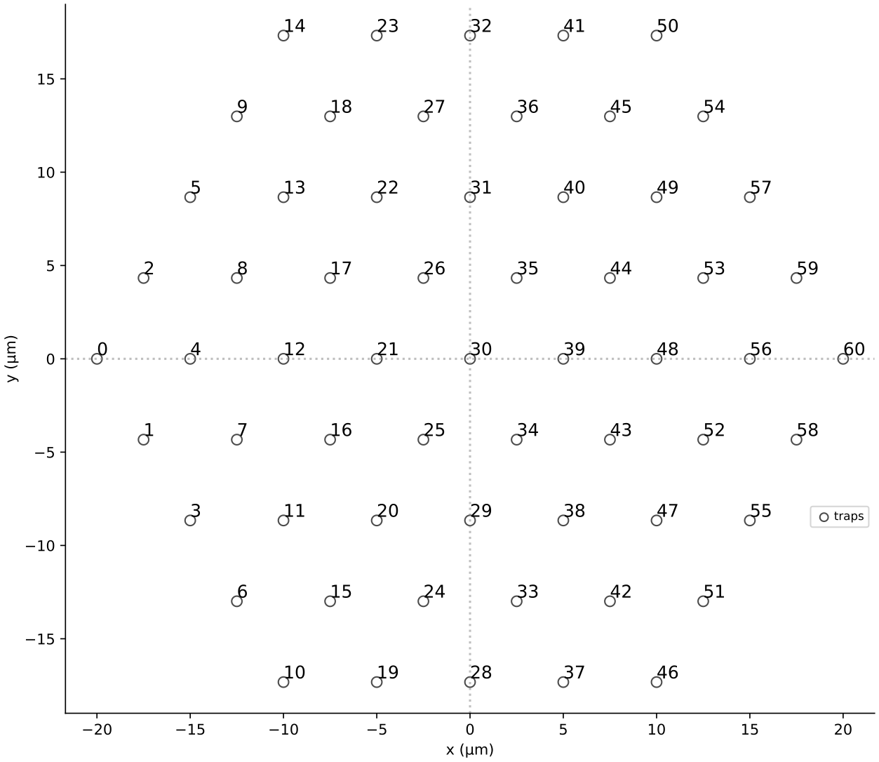
HOW TO RUN AN ANALOG ALGORITHM: 1. Load the graph
First: load randomly
Then, readjust

Slide 20
HOW TO RUN AN ANALOG ALGORITHM: 2. Apply pulses for random times
This durations are initially random
Applies phase according to the energy of the problem
Rotates qubits from |0> to |1>

Slide 21
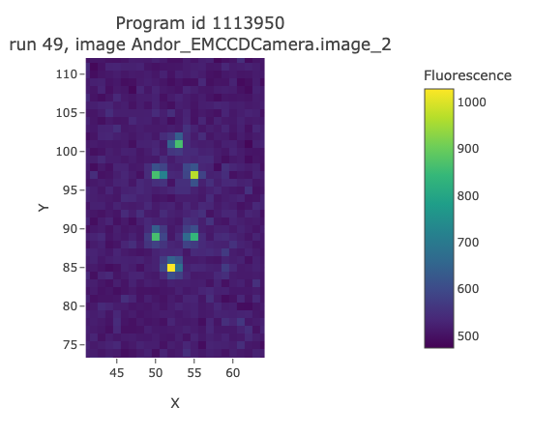
HOW TO RUN AN ANALOG ALGORITHM: 3. Measure and repeat
We measure, obtain a bitstring, repeat N times
An example of a measured solution
How do we go from
Solution

Slide 22
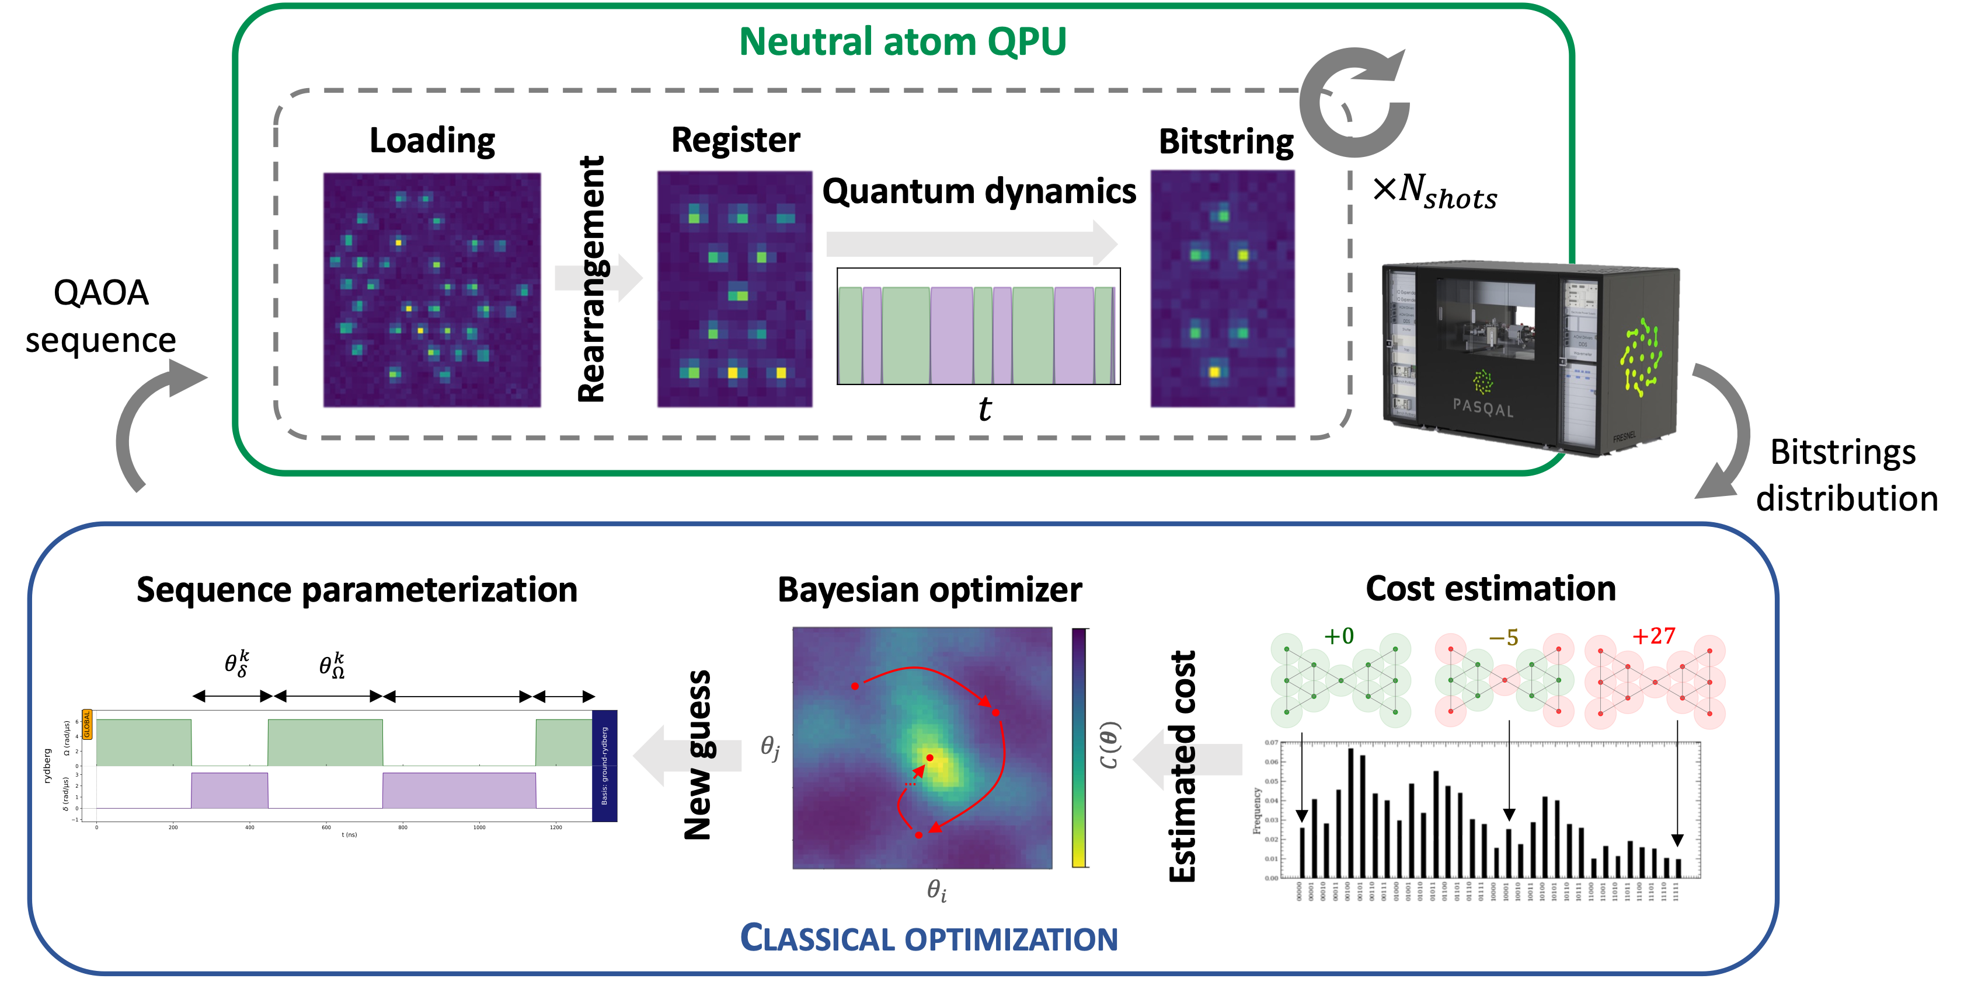
How do we solve it: QAOA
QAOA sequence
Bitstrings distribution

Slide 23
Dynamic errors: Doppler shift waist/amplitude fluctuations rephrasing depolarisation
How do we solve it: QAOA
Measurement errors 5~8% false positive 8~10% false negative
Rearrangement takes 95% of computation time
Loading has 50% succes rate per atom
Low repetition rate ~1 Hz (very bad!!)
QAOA sequence
Descrutive measurement!
Bitstrings distribution
Optimizer needs to converge in a few steps
Ramp Problem!
Min duration 100ns
Error on durations!
Square signal approximation
Very noisy and imprecise energy estimate
Decohernce time! Max duration 5000ns
Can’t exploit the gradient

Slide 24
As a results
Reality
Simulation

Slide 25
So nothing works?

Slide 26
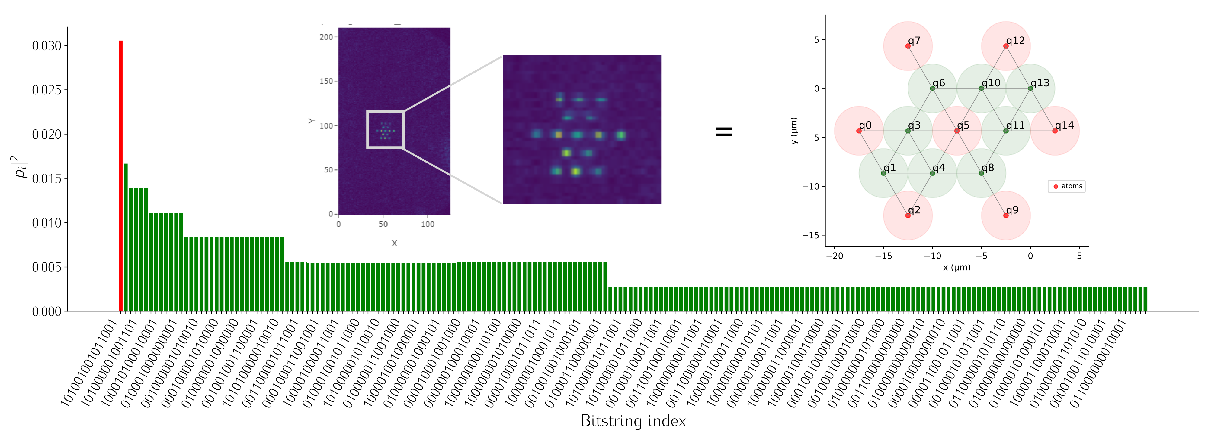
Conclusions
Be careful but be hopeful
Thank you

Slide 27
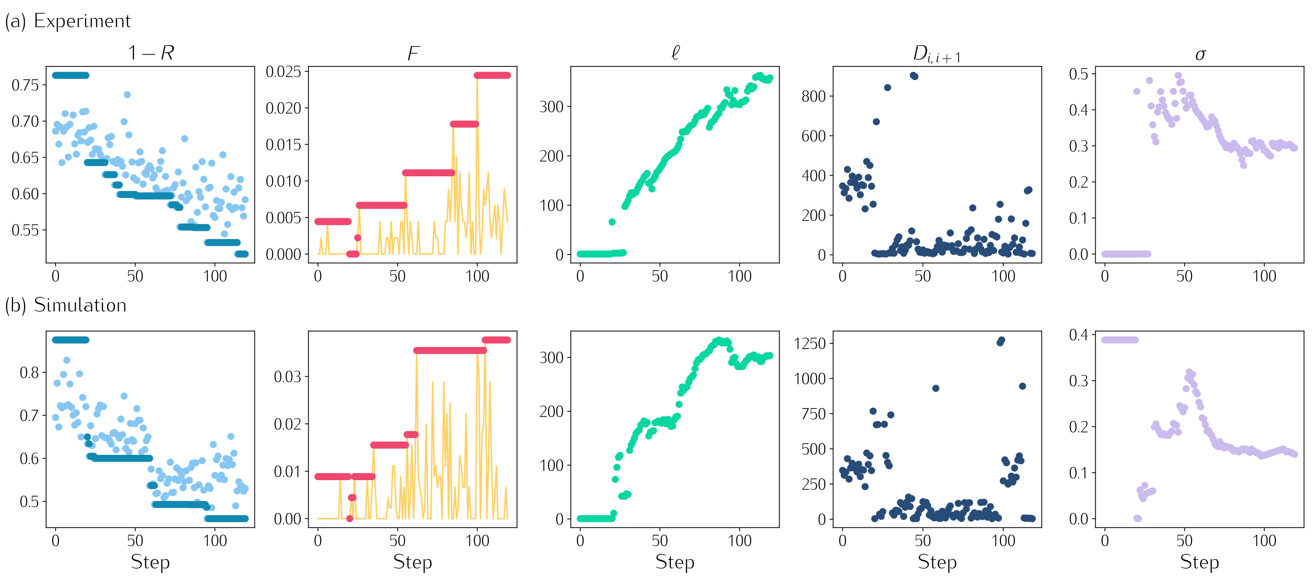

Slide 29
BENCHMARK
CORRECTING FOR SPAM: ONE WAY
CREATE A TRANSFER MATRIX
WITH BINOMIAL PROBABILITIES
N=6
(
)
N=11

Slide 30
BENCHMARK
Another way: discard bitstrings
ORIGINAL DATA
DISCARD 20%
DISCARD 50%

Slide 31
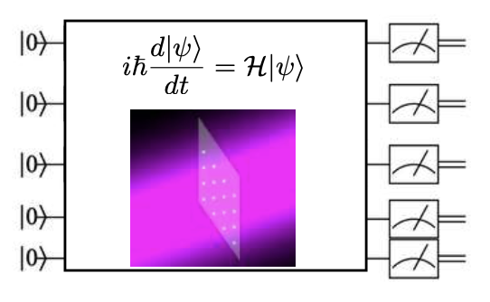
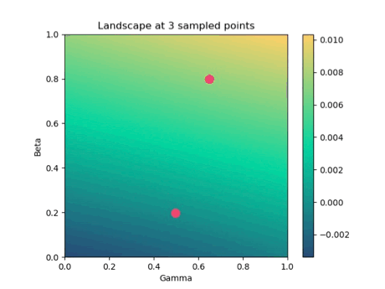
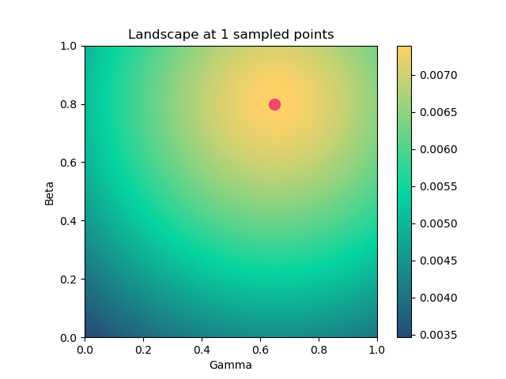
Bayesian Optimization to optimize QAOA
[L Heneriet et al, Quantum (2020)]
Parameters
Output
Acquisition Function
Gaussian Process

Slide 32
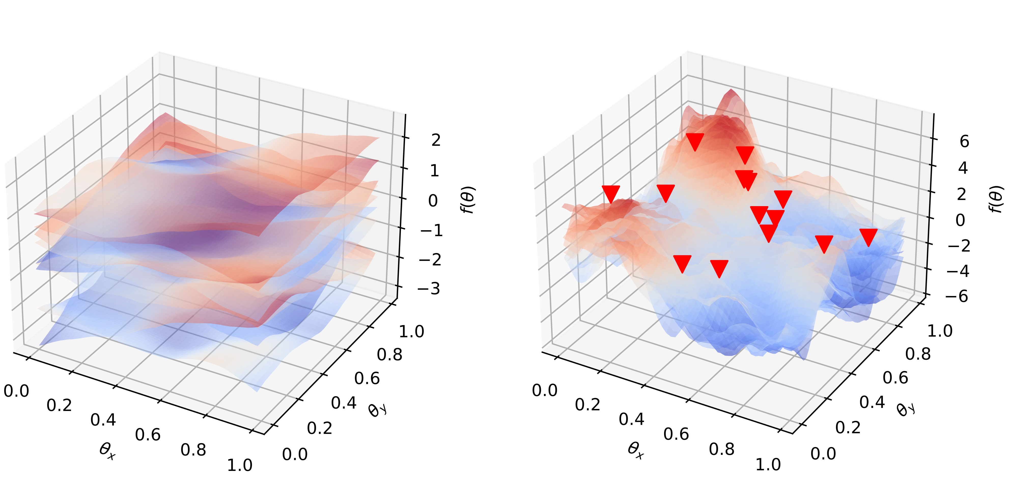
What is a Gaussian Process
PRIOR
POSTERIOR
Kernel
Hyperparameters
Selected with optimization

Slide 33
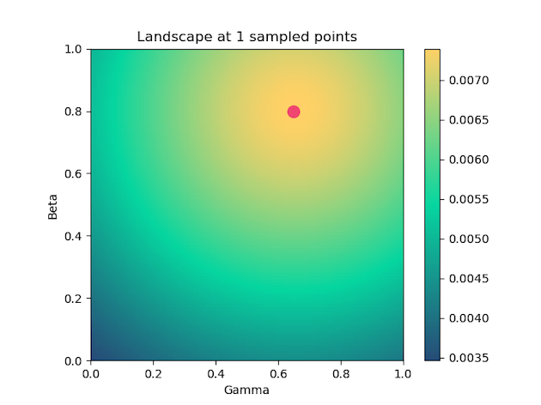
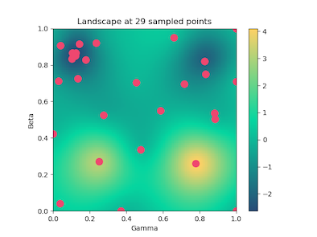
What is a Gaussian Process
After sampling
1 point
After sampling
30 points

Slide 34
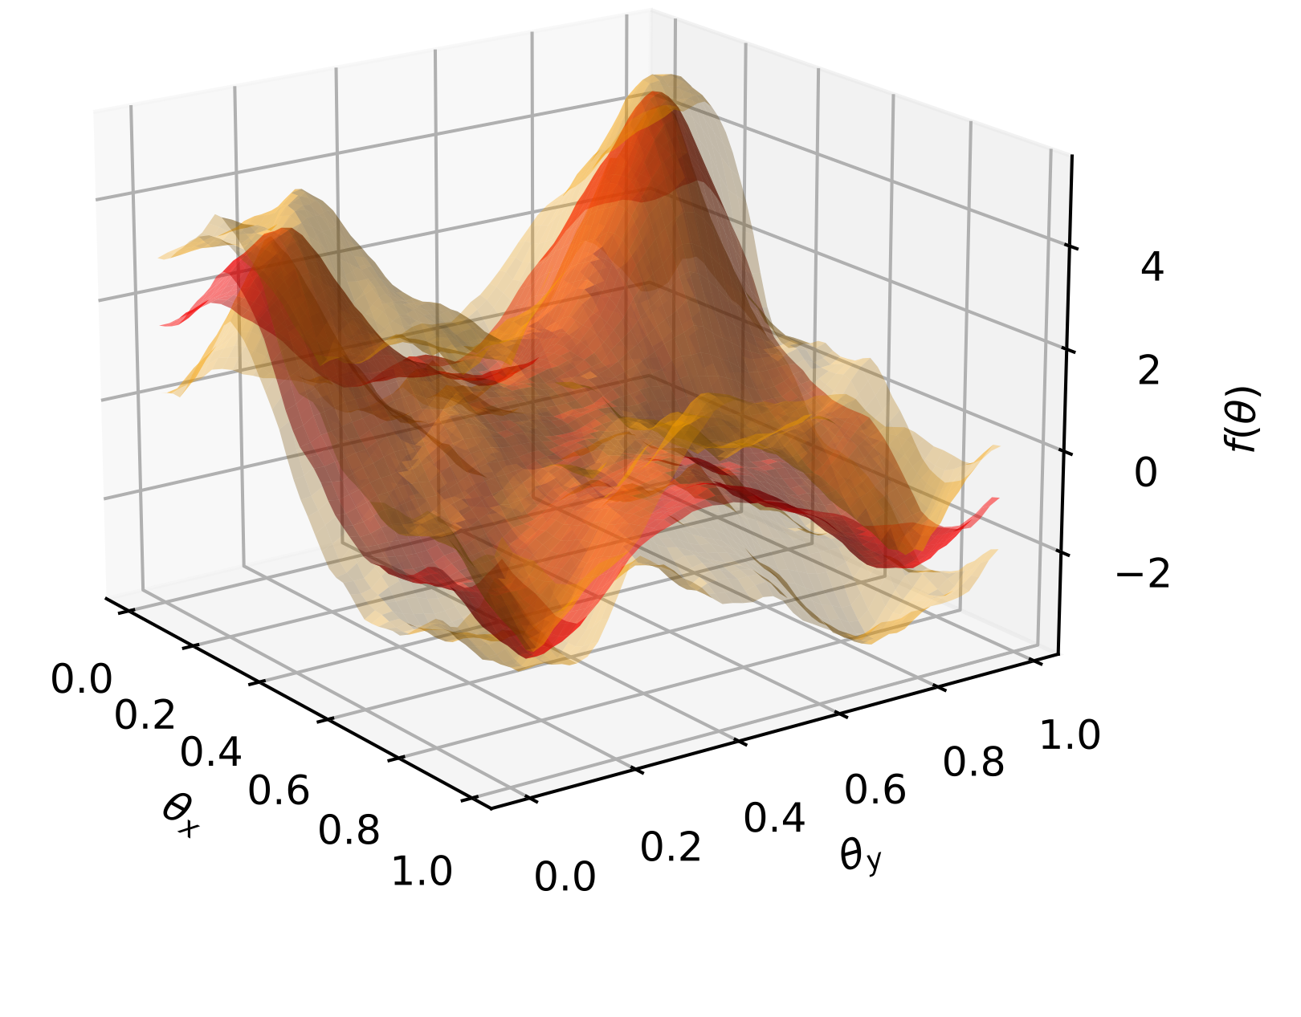
What is an Acquisition Function
CURRENT BEST
p
POSTERIOR
MEAN
POSTERIOR
VARIANCE
RED:
ORANGE:
AT EACH BAYESIAN OPT STEP:

