Slide 1
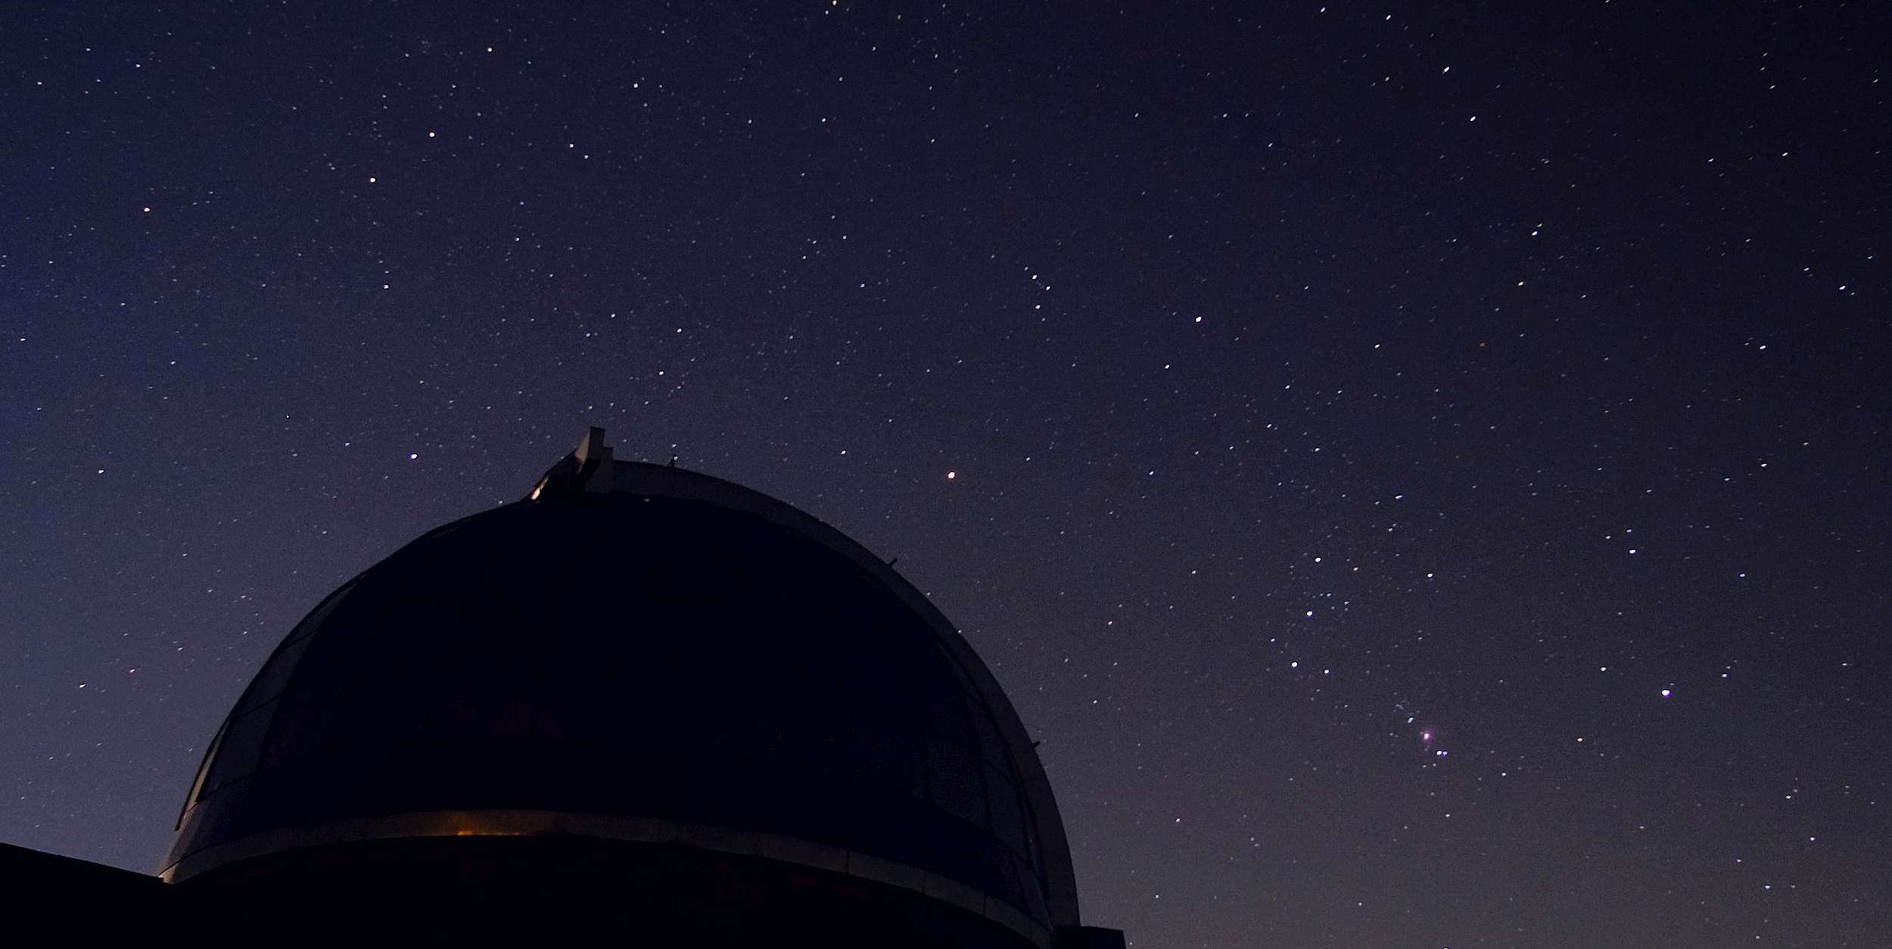
Astro observing tools
Andrea Bianco
Kick-off TFPA PhD course – July 10, 2024, Padova

Slide 2
OUTLINE
INAF introduction;
INAF ground based facilities (optical, radio, Cherenkov);
INAF in future large projects (ELT, SKA, CTA);
INAF in space projects.
It is not exhaustive, just to give the flavour of the different involvement in observing facilities

Slide 3
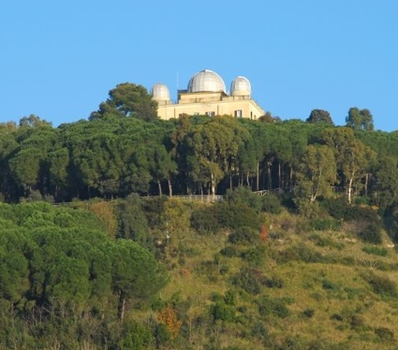
INAF
Headquarter in Rome – Monte Mario
July 23, 1999: INAF date of birth.
The National Institute of Astrophysics is the principal Italian Research Entity for the study of the Universe.
It promotes, realizes, and coordinates research activities in the fields of astronomy and astrophysics, both in collaboration with universities and with other public and private entities, nationally and internationally. This includes participation in programs of the European Union and international organizations.
It designs and develops innovative technologies and cutting-edge instruments for the study and exploration of the Cosmos.
It fosters the dissemination of scientific culture through educational projects and the popularization of Astronomy aimed at schools and society."

Slide 4
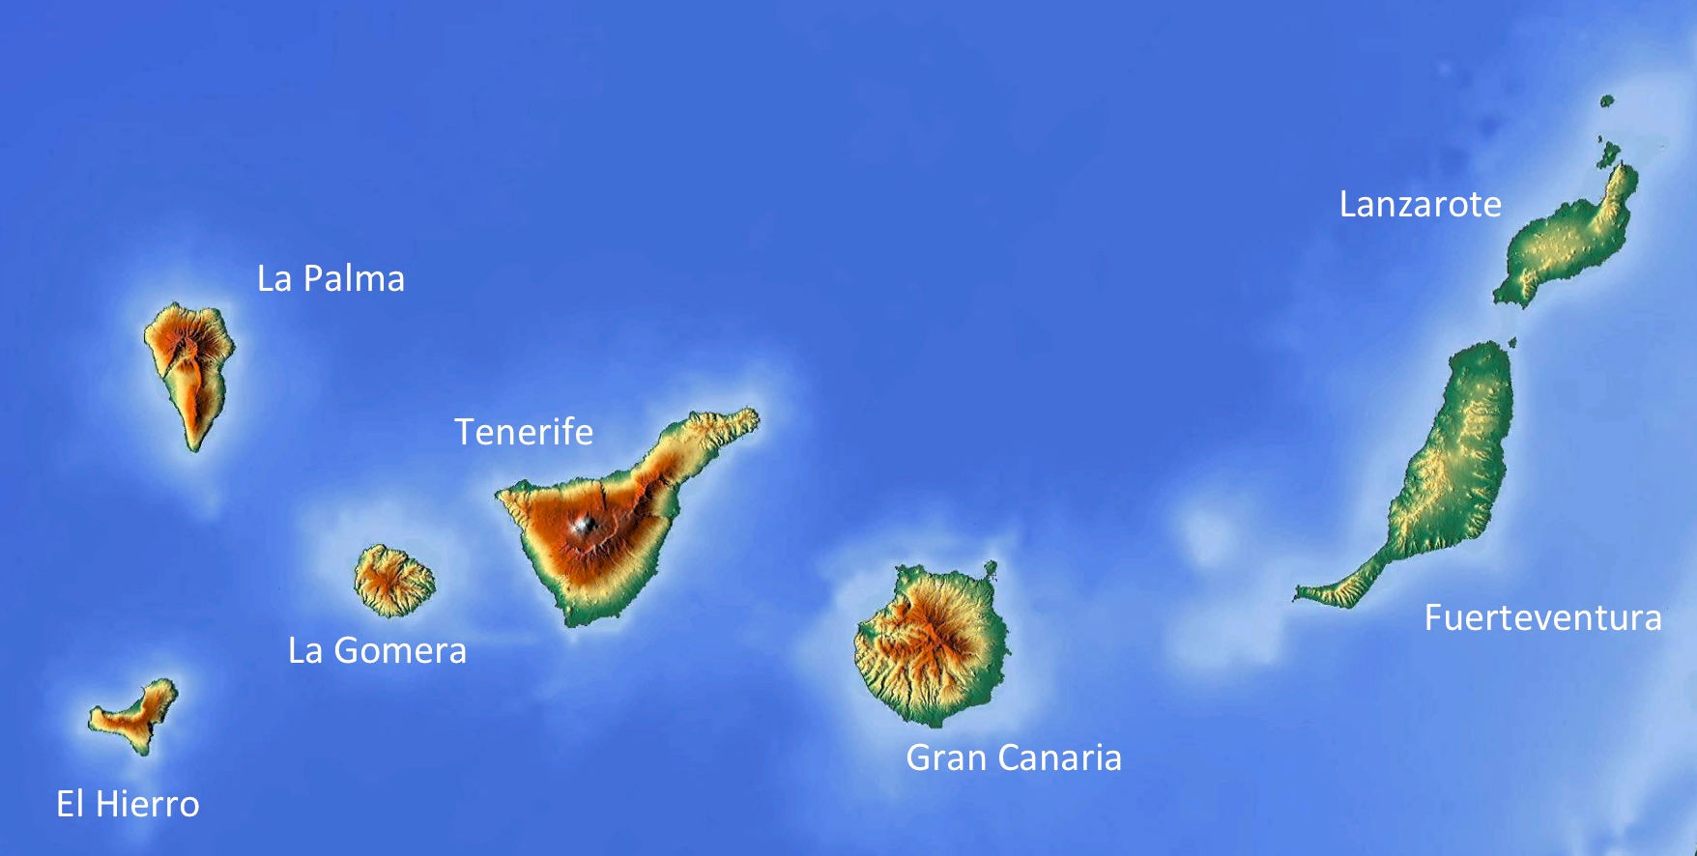
INAF – some numbers
More than 1,400: the number of people that work for INAF, composed of researchers (including research students and post-docs), technicians and administrative staff
19: the number of national research institutes, and one in the Canary Islands which operates the Telescopio Nazionale Galileo - TNG.
200: the number of international research institutes that collaborate with INAF.
Between 3,000 and 4,000: the scientific publications written by INAF researchers each year.
Different optical telescopes: TNG, Copernico, REM, Cassini, LBT.
4 radio facilities in Italy: SRT, Medicina, Noto, Croce del Nord.
Cherenkov telescopes: ASTRI.
125,000: the number of ancient volumes on physics and astronomy in INAF's historic libraries.
Canary Islands

Slide 5
INAF – some numbers
More than 1,400: the number of people that work for INAF, composed of researchers (including research students and post-docs), technicians and administrative staff
19: the number of national research institutes, and one in the Canary Islands which operates the Telescopio Nazionale Galileo - TNG.
200: the number of international research institutes that collaborate with INAF.
Between 3,000 and 4,000: the scientific publications written by INAF researchers each year.
Different optical telescopes: TNG, Copernico, REM, Cassini, LBT.
4 radio facilities in Italy: SRT, Medicina, Noto, Croce del Nord.
Cherenkov telescopes: ASTRI.
125,000: the number of ancient volumes of physics and astronomy in INAF's historic libraries.
Quite unique feature in EU!
Canary Islands

Slide 6
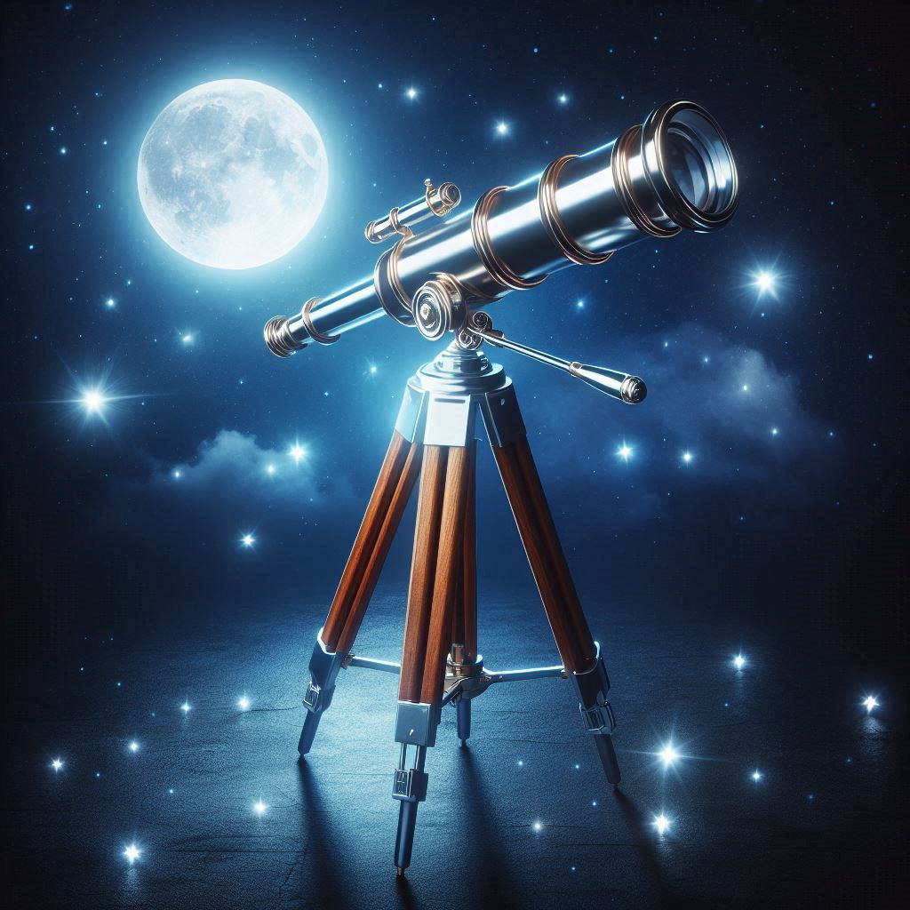
TECNO INAF – ENVIRONMENT
Industries
Astronomical
and Astrophysical
Challenges
Opto-mechanical design
Electronic design
Control software
Scientific Software
System engineering
AIV/AIT
Tech requirements
Manufacturing
Happy astronomers
Tired Engineers
Enabling technologies

Slide 7
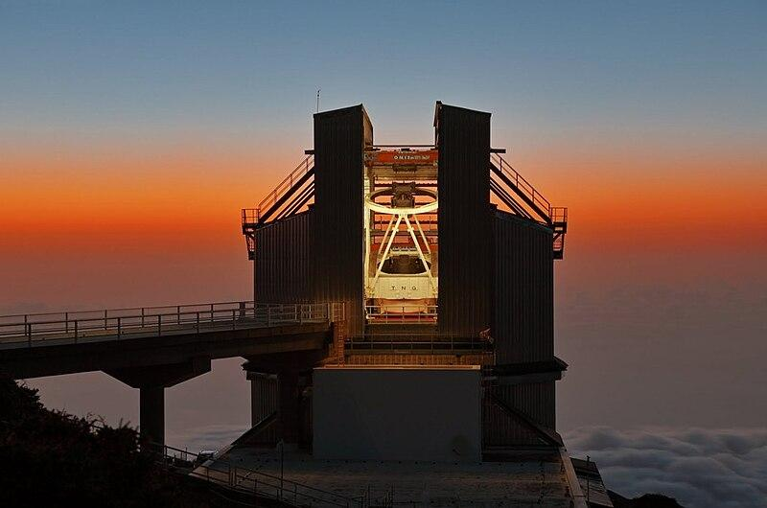
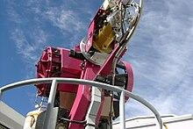
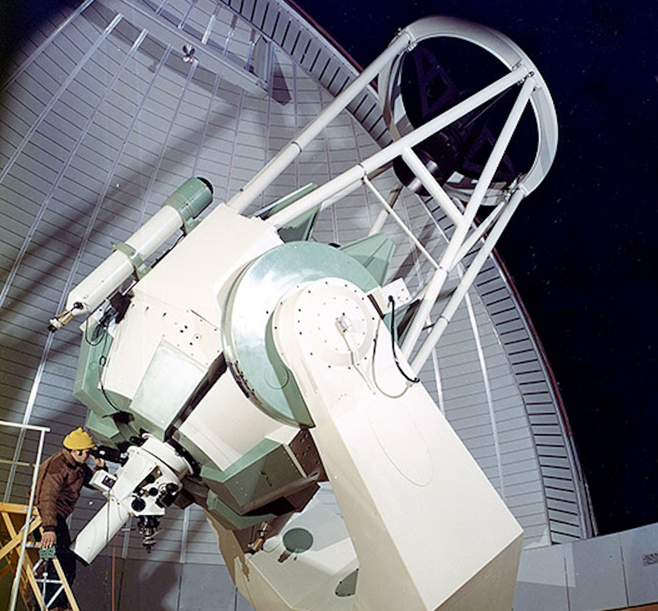
INAF – Optical telescopes
TNG – La Palma (Spain): 3.6 m telescope. Set of instruments:
HARPS-North: Radial velocity Planet Searcher in North hemisphere;
GIANO: near IR high resolution echelle spectrograph
DOLORES: low res multiobject spectrograph in the visible
SiFAP (Silicon Fast Astronomical Photometer) to detect optical pulses from transitional millisecond pulsars and from other slower neutron stars.
REM – La Silla (Chile): 0.6 m fast robotic telescope
REMIR, infrared (zJHK') camera;
ROSS2, multi-channel visible imaging camera.
Copernico – Asiago: 1.8 m telescope. Instruments:
AFOSC: low res multiobject spectrograph in the visible;
Reosc Echelle Spectrograph for the visible;
Coudé focus: general purpose optical bench.

Slide 8
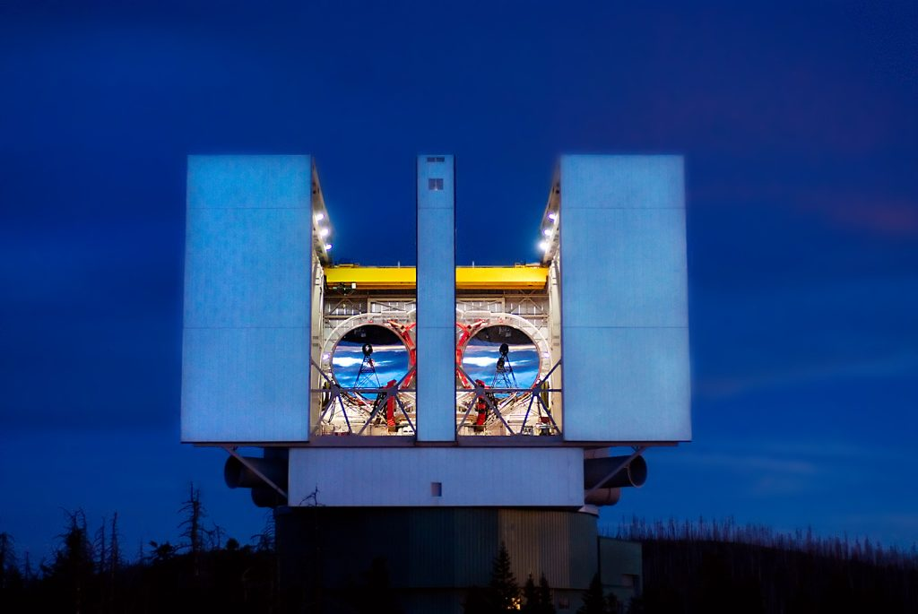
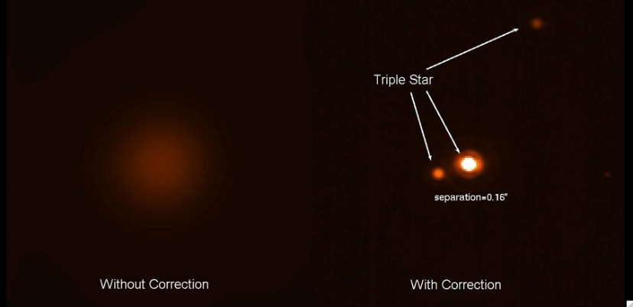
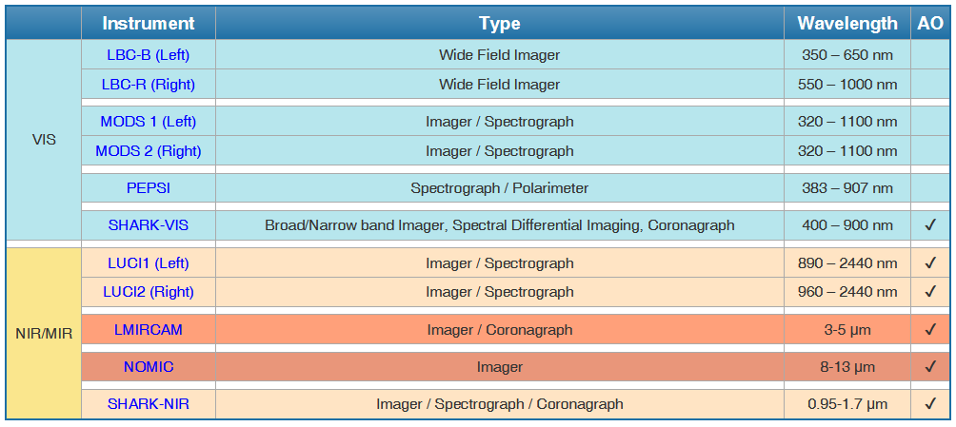
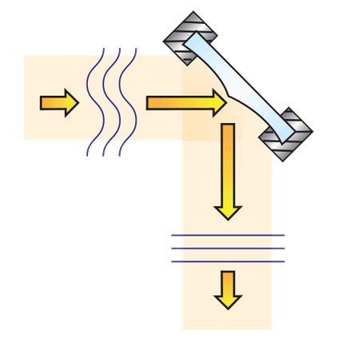
INAF – Optical telescopes
LBT – Mount Graham, Arizona, 2 x 8.4 m mirrors:
25% INAF (+ Arizona + Ohio + Germany)
Adaptive optics fully implemented;
Interferometric mode (almost unique feature);
Large suite of instruments from VIS to NIR/MIR:
Adaptive optics
SHARK-NIR and SHARK-VIS two coronographic INAF cameras for exoplanet science

Slide 9
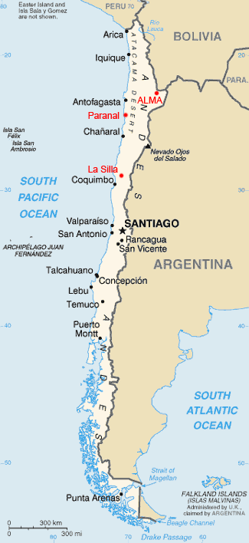
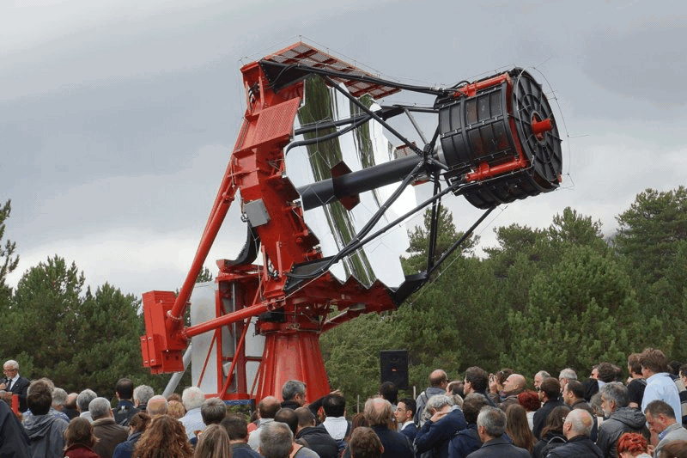
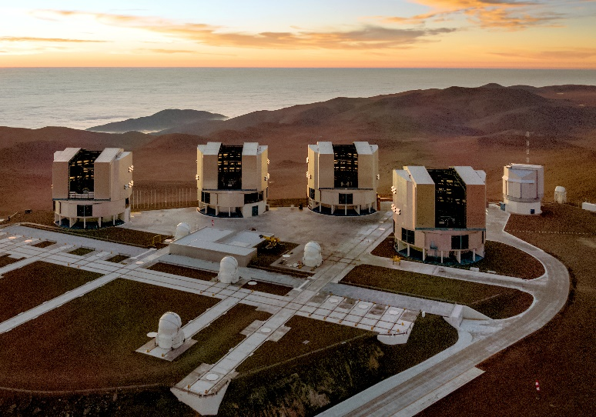
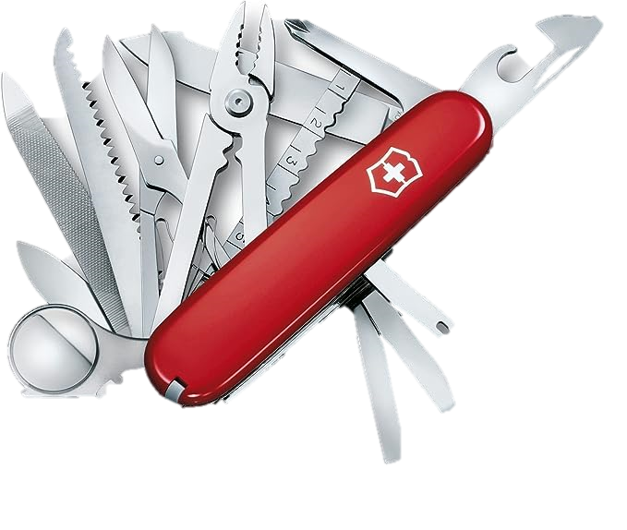
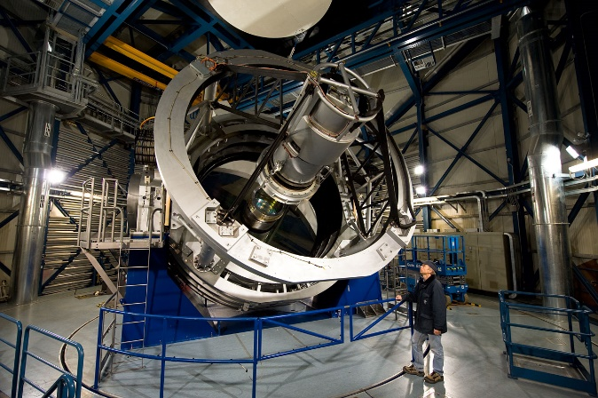
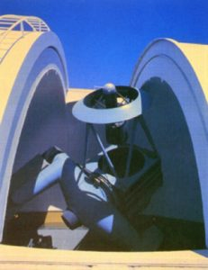
INAF – ESO
ESO – European Southern Observatory, Italy is part of it since 1982. INAF is leading the participation in some instrumentations for the different telescopes;
ESO leads very large observing facilities:
4 Very large telescopes – VLTs (8m class telescope with a huge set of instruments from UV to MIR, img/spec);
VISTA, VST (4 m size telescopes for surveys);
NTT (4 m size telescope).

Slide 10
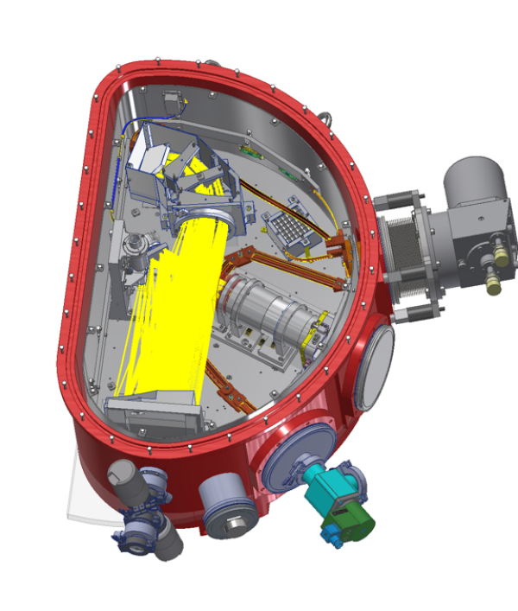
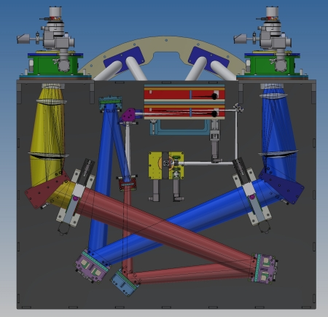
INAF – ESO instruments
SOXS (Son of X-Shooter): spectroscopic facility for the ESO-NTT 3.5-m covering the optical/NIR band (350-1750 nm) + Vis imaging for studying transient sources;
INAF (PI Sergio Campana) responsible of the NIR arm, system engineering, AIV/AIT (here in Padova);
CUBES: (Cassegrain U-Band Efficient Spectrograph), VLT spectrograph covering with a high efficiency the UV ground-based region (300 - 400 nm) with intermediate resolution (about 20K);
INAF (PI Stefano Covino) large contribution, with System engineering, AIV/AIT.

Slide 11
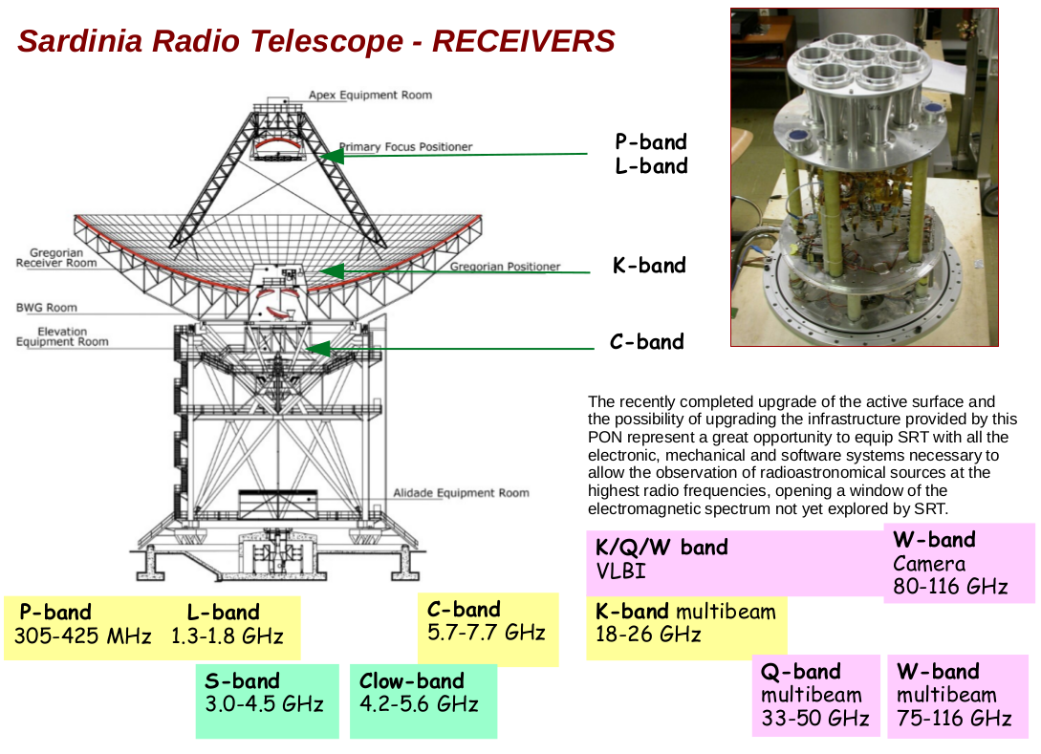
INAF – Radio Facilities
Single dish antennas:
Medicina (BO): 32 m dish operating in the 1.4 – 26.5 GHz band; backends: Spectrometers (XARCOS, Arcos, MSpec0) and Continuum (Analog large-bandwidth backend, Mark IV);
Noto (SR): 32 m dish operating in the 2.2 – 43.5 GHz band through 5 receivers;
SRT (CA): 64 m dish operating from in the 0.3 – 26.5 GHz band. L-P, C and K bands (7-pixel multi-feed configuration). Different Backends (SARDARA, SKARAB, total power).
New receivers able to collect signals up to 110 GHz are/will be mounted on the three antennas, thanks to the triband K/Q/W.

Slide 12
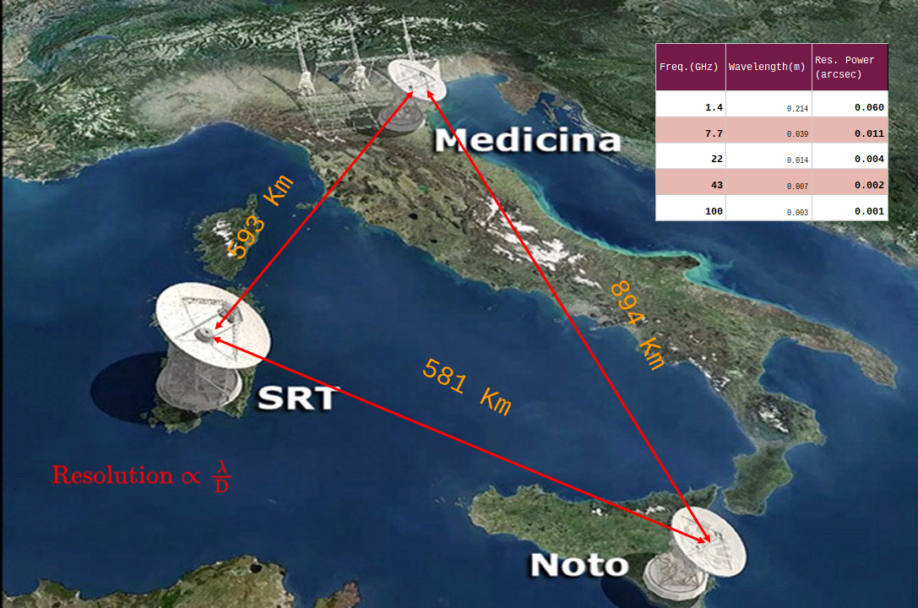
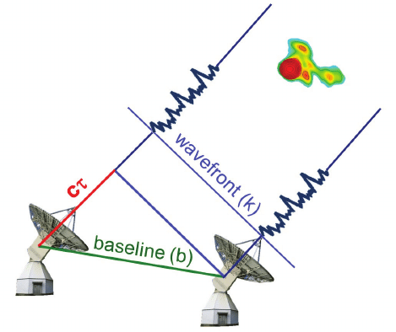
INAF – Radio Facilities

Slide 13
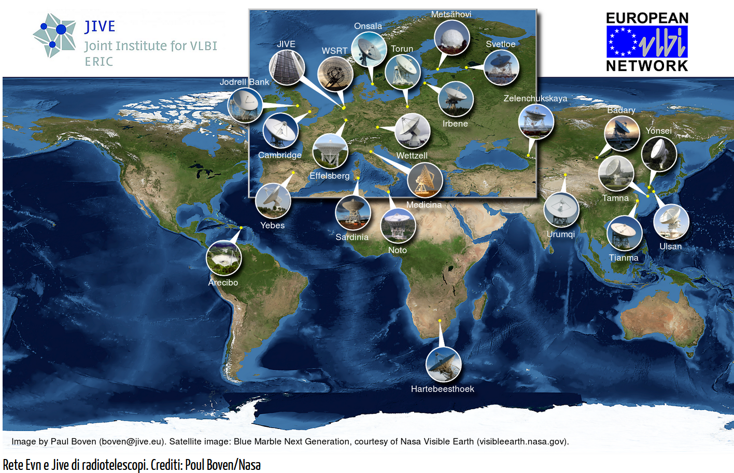
INAF – Radio Facilities: EVN
The European VLBI Network (EVN): network of 19 radio telescopes in Europe and Asia, with additional antennas in South Africa, which performs very high angular resolution observations of cosmic radio sources.
The EVN is the most sensitive VLBI (Very Large Baseline Interferometry) array in the world, and the only one capable of real-time observations.
Access to the EVN is an "open skies" facility.
Rete Evn e Jive di radiotelescopi. Crediti: Poul Boven/Nasa

Slide 14
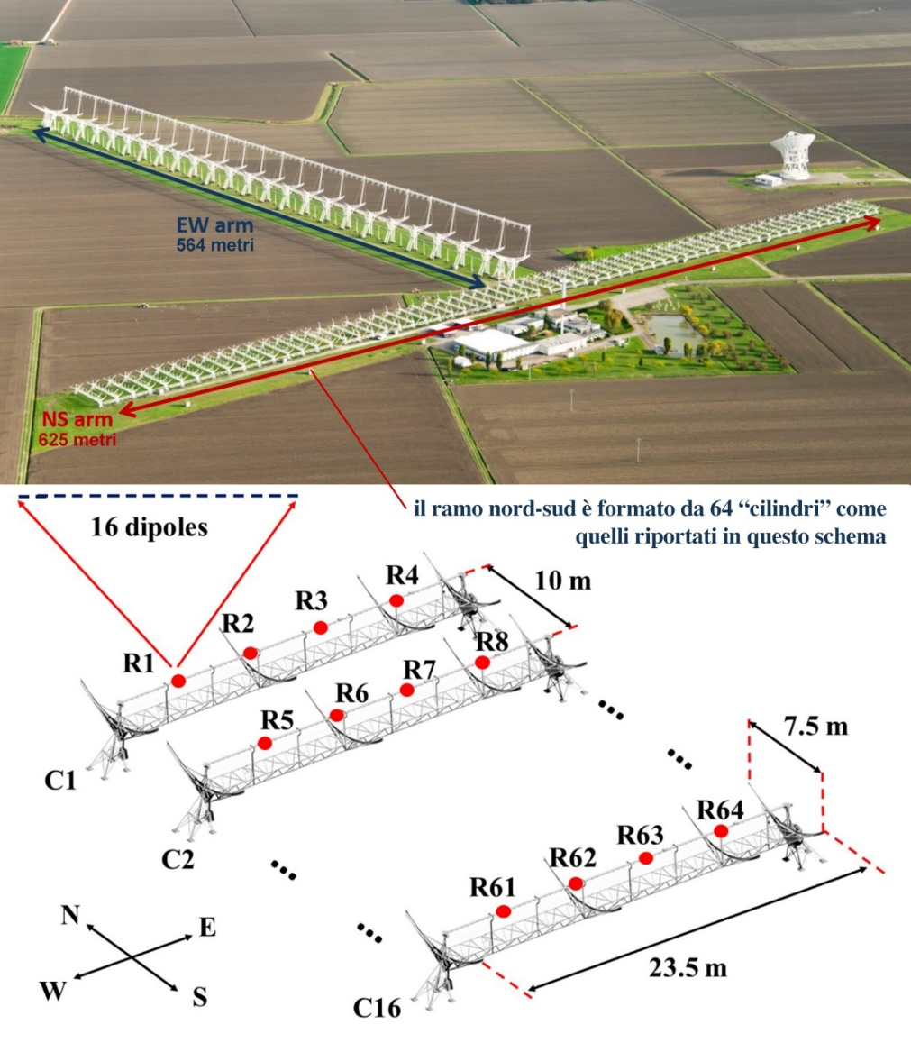
INAF – Radio Facilities
Croce del Nord: The Northern Cross has two perpendicular arms of antennas, respectively 564 m (East/West) and 640 m (North/South), with a total collecting area of over 30,000 m working on the 408 MHz frequency (16 MHz bandwidth);
PNRR project (NextGeneration Croce del Nord) for its upgrade together with the improvement of the performance of the other antennas, monitoring of space debris, new data center.

Slide 15
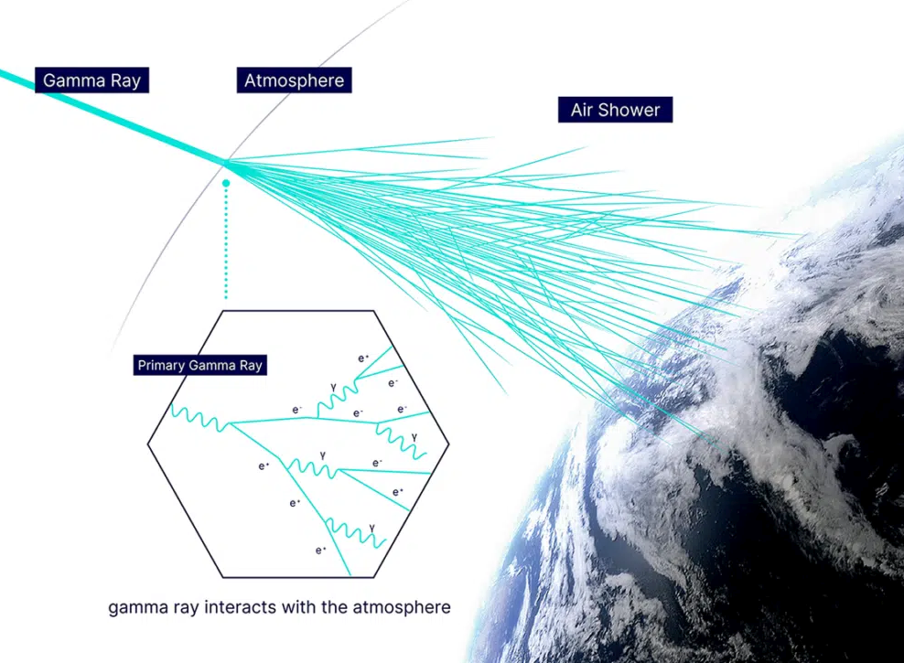
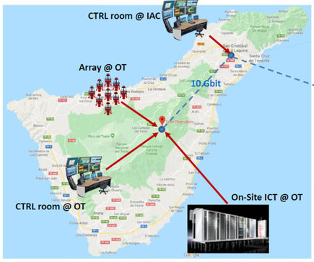
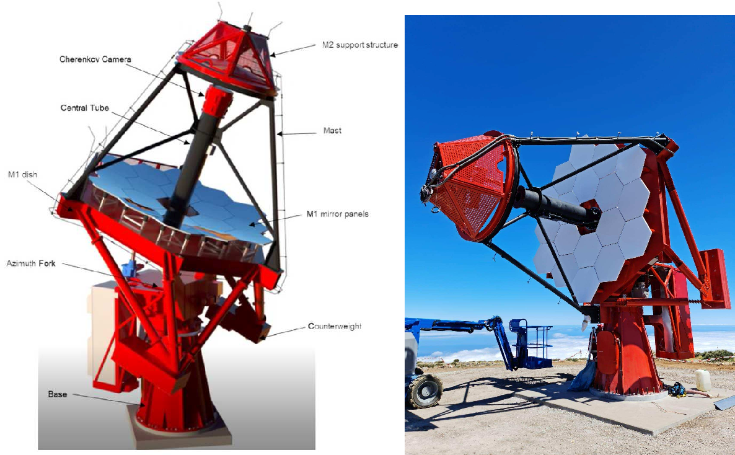
INAF – ASTRI & ASTRI Miniarray
ASTRI (Astrofisica con Specchi a Tecnologia replicante Italiana) aimed at developing the next generation of IACT telescopes (Atmospheric Cherenkov Telescope Imaging) for astronomy in gamma rays from the ground;
ASTRI is the first Cherenkov telescope with the Schwarzschild-Coude optical configuration;
Detection of particle showers released by cosmic gamma rays (energies between 30 GeV and 100 TeV). The gamma rays interact with the atmosphere and produce cascades of charged particles, which emit Cherenkov radiation that the telescopes can detect.
The ASTRI Mini-Array will consist of 9 telescopes at Teide surpass the current Cherenkov telescope array differential sensitivity above a few tera-electronvolt (TeV), extending the energy band well above hundreds of TeV.

Slide 16
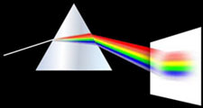
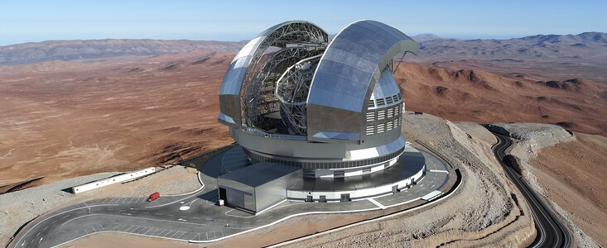
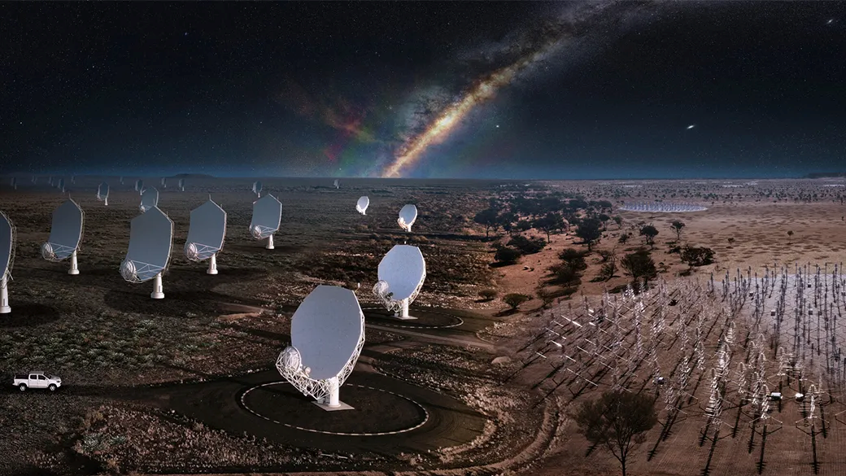
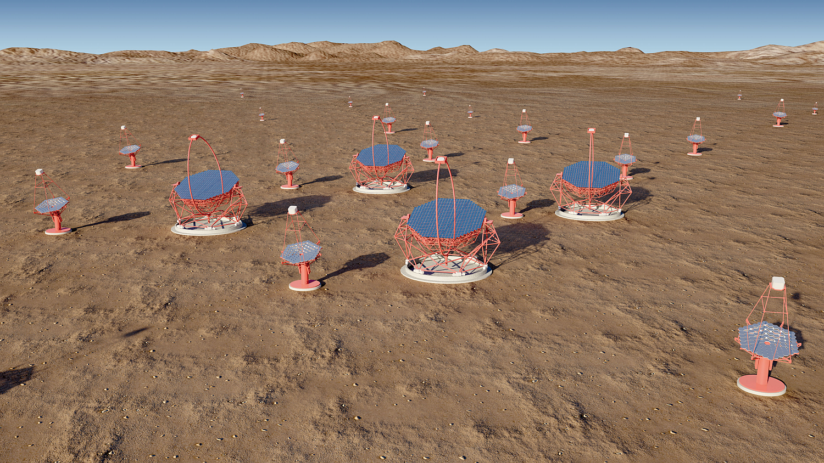
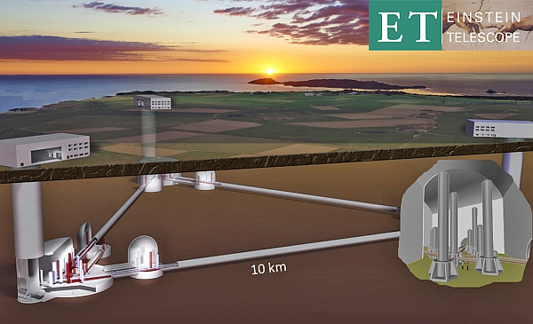
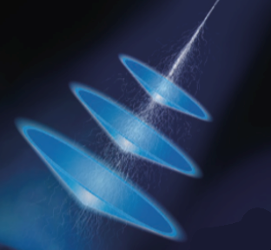
INAF – GROUND BASED LARGE PROJECTS
Extreme Large Telescope
Square Kilometre Array
Key roles in main future large size international facilities that will change astrophysics in the next decade
We have to wait more!
Cherenkov Telescope Array
Einstein Telescope

Slide 17
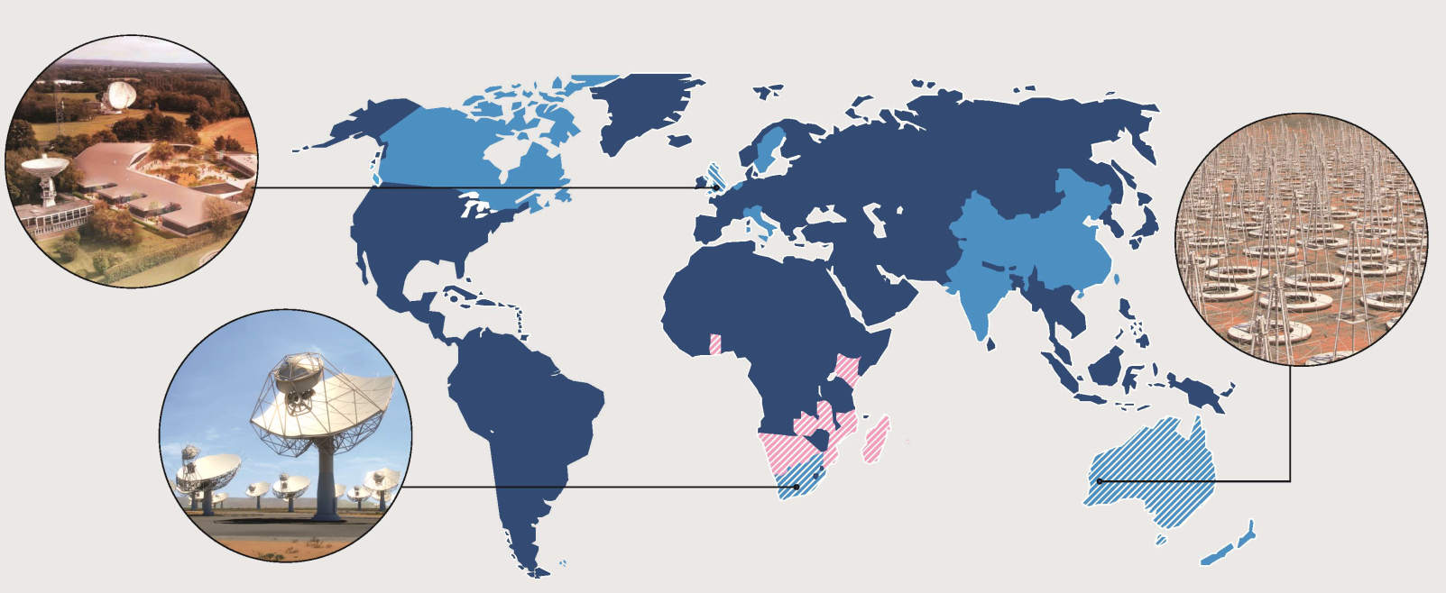
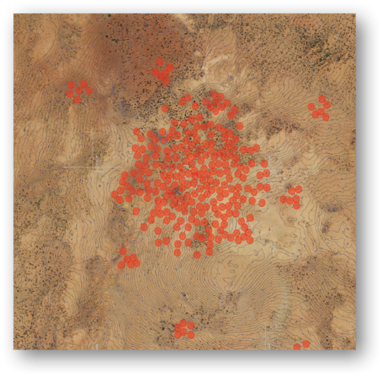
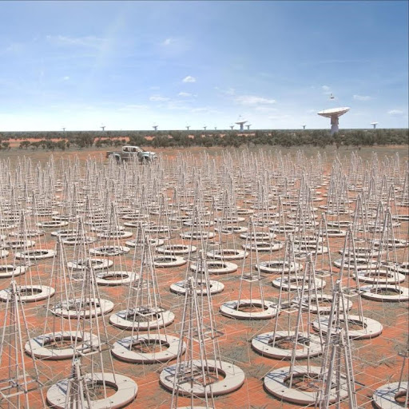
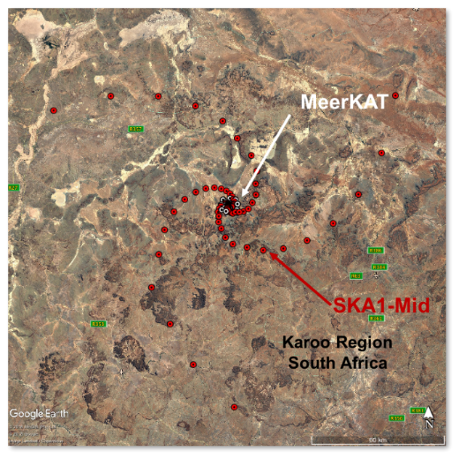
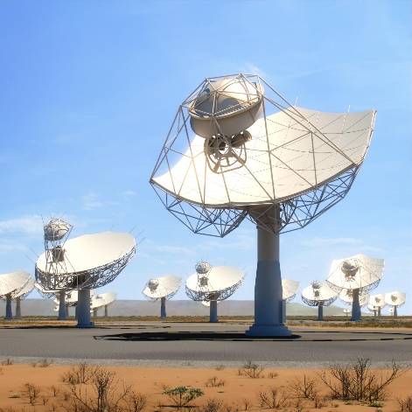
INAF – SKA
More than 1,400: the number of people that work for INAF, made-up of researchers (including research students and post-docs), technicians and administrative staff
19: the number of national research institutes, and one in the Canaries which operates the Telescopio Nazionale Galileo.
200: the number of international research institutes that collaborate with INAF.
Between 3,000 and 4,000: the scientific publications (articles, posters, popular articles) written by INAF researchers each year.
Some optical telescopes: TNG,
3 radio telescopes in Italy: SRT, Medicina, Noto.
125,000: the number of ancient volumes of physics and astronomy in INAF's historic libraries, including twenty or so incunabula, books from the end of the 15th century, amongst the first printed using the movable type invented by Gutenberg.
Square Kilometer Array: the most sensitive Radio observatory worldwide.
SKA1-Low:log-periodic dipole antennas distributed across 512 aperture array stations of 256 antennas each.
SKA1-Mid: 133 15 m SKA dishes and 64 13.5 m Meerkat dishes at the Karoo site in South Africa. The core will be composed of around 50% of the dishes, randomly distributed within 2 km. There are 3 logarithmic spiral arms with a maximum baseline extending out to 150 km.
https://youtu.be/nXcsFWw2qd8?si=ckPEFapwtHjIIN1Y

Slide 18
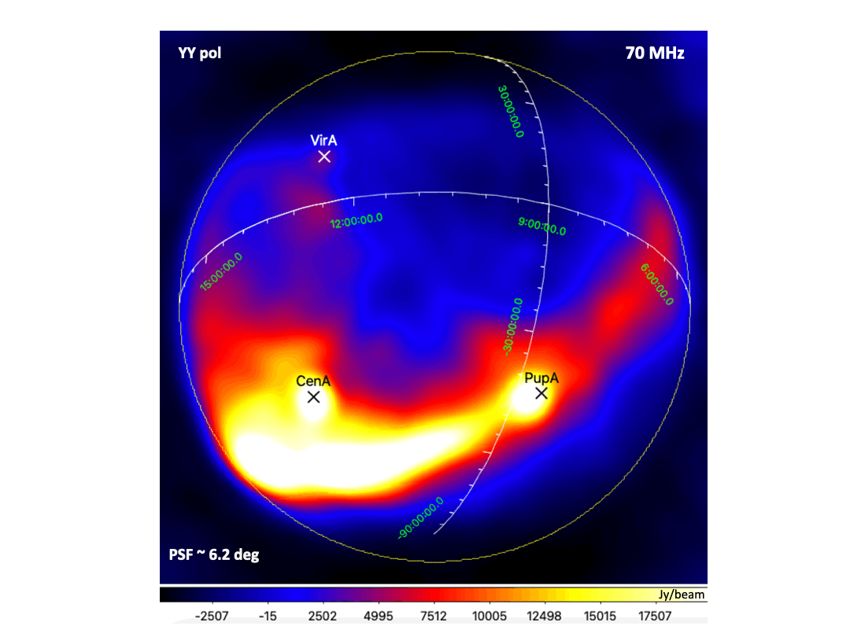
INAF – SKA
More than 1,400: the number of people that work for INAF, made-up of researchers (including research students and post-docs), technicians and administrative staff
19: the number of national research institutes, and one in the Canaries which operates the Telescopio Nazionale Galileo.
200: the number of international research institutes that collaborate with INAF.
Between 3,000 and 4,000: the scientific publications (articles, posters, popular articles) written by INAF researchers each year.
Some optical telescopes: TNG,
3 radio telescopes in Italy: SRT, Medicina, Noto.
125,000: the number of ancient volumes of physics and astronomy in INAF's historic libraries, including twenty or so incunabula, books from the end of the 15th century, amongst the first printed using the movable type invented by Gutenberg.
Square Kilometer Array: the most sensitive Radio observatory worldwide.
SKA1-Low:log-periodic dipole antennas distributed across 512 aperture array stations of 256 antennas each.
INAF: designed and built both the antennas and the receiving chain including digital signal acquisition and processing system. Innovative algorithms have been developed. It has installed Aperture Array System 2 prototype.
Nowadays INAF collaborates with SKAO to fine tune the designs and helps Italian industries for manufacturing the different parts.

Slide 19
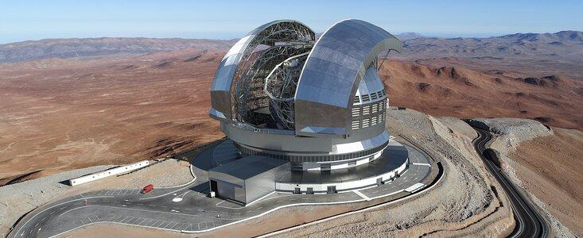
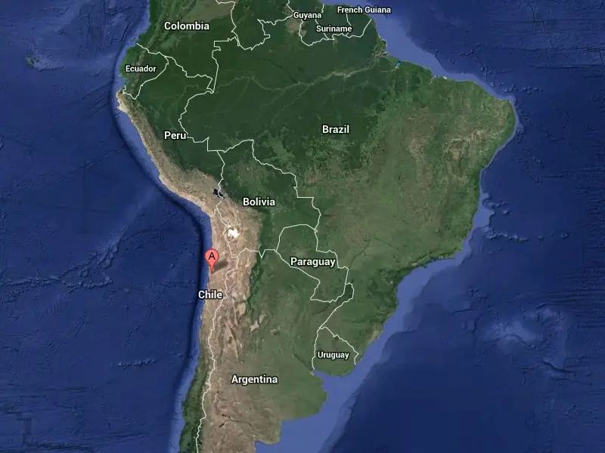
INAF – ELT
More than 1,400: the number of people that work for INAF, made-up of researchers (including research students and post-docs), technicians and administrative staff
19: the number of national research institutes, and one in the Canaries which operates the Telescopio Nazionale Galileo.
200: the number of international research institutes that collaborate with INAF.
Between 3,000 and 4,000: the scientific publications (articles, posters, popular articles) written by INAF researchers each year.
Some optical telescopes: TNG,
3 radio telescopes in Italy: SRT, Medicina, Noto.
125,000: the number of ancient volumes of physics and astronomy in INAF's historic libraries, including twenty or so incunabula, books from the end of the 15th century, amongst the first printed using the movable type invented by Gutenberg.
Extreme Large Telescope: it will be the largest optical telescope in the world with a primary mirror of 39 m diameter, composed by 798 hexagonal mirrors;
5 mirror design with embedded Adaptive Optics to exploit the potential spatial resolution;
First generation:
MICADO (Multi-AO Imaging Camera for Deep Observations),
HARMONI (high Angular Resolution Monolithic Optical and Near-infrared Integral field spectrograph)
METIS (Mid-infrared ELT Imager and Spectrograph) first generation instruments
MORFEO (MCAO module);
INAF deeply involved in MORFEO and ANDES;
First light 2027/2028.
Cerro Armazones (Chile)
https://youtu.be/xJADOkZshUk?si=egLwVqkT0C2gQpt4

Slide 20
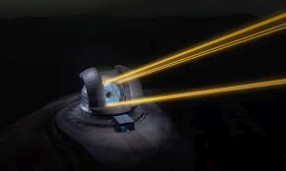
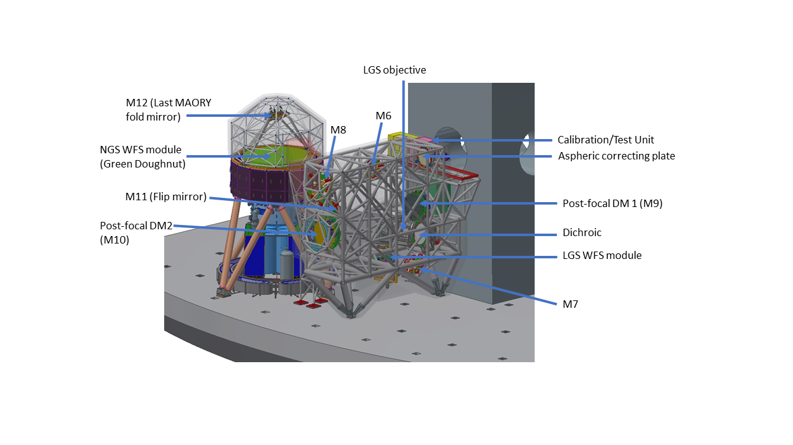
INAF – ELT MORFEO
MORFEO is the Multiconjugate adaptive Optics Relay For ELT providing a corrected FoV of 2 arcmin;
It feeds MICADO and a second generation instrument and it works with 3 deformable mirrors, 6 LGS and 3 NGS;
“INAF” instrument:
Optomechanical design;
System engineer;
Adaptive optics system;
AIV AIT.
PI: Paolo Ciliegi, INAF

Slide 21
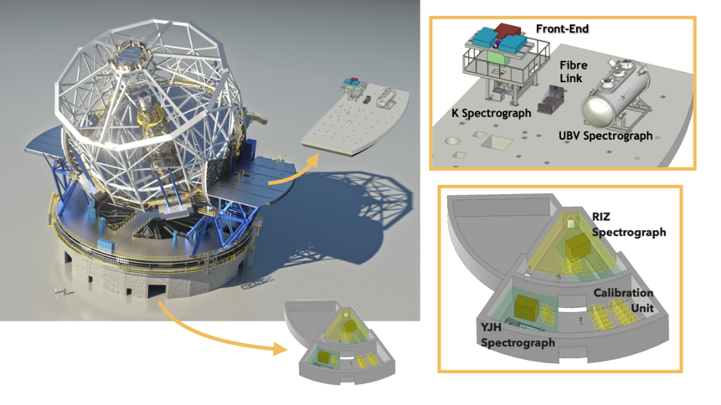
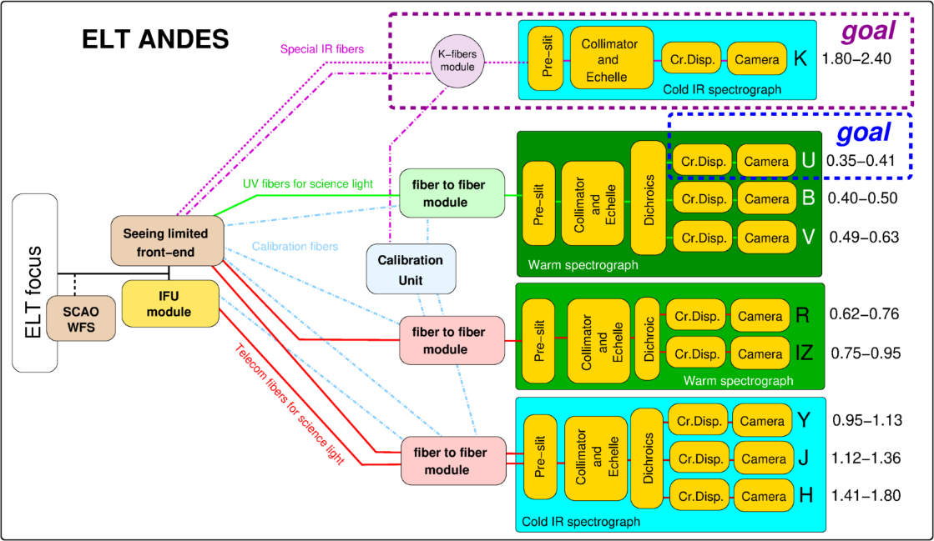
INAF – ELT
the ArmazoNes high Dispersion Echelle Spectrograph for the ELT;
ANDES baseline: modular fiber-fed cross dispersed echelle spectrograph composed by four ultra-stable modules capable of providing a simultaneous spectral coverage of 0.35 -2.4 nm at a resolution of 100,000 with, interchangeable, observing modes.
Science characterization of atmospheres in Earth-like planets in other solar systems; detection of the first generation of stars, through their chemical fingerprint in the primordial Universe.
PI: A. Marconi, Univ. Florence

Slide 22
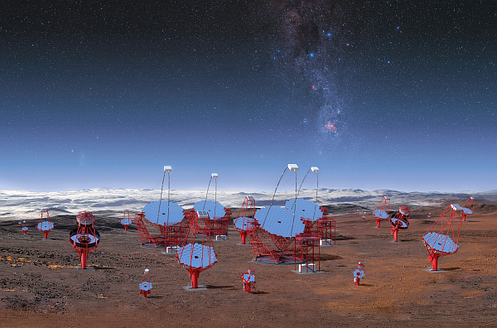
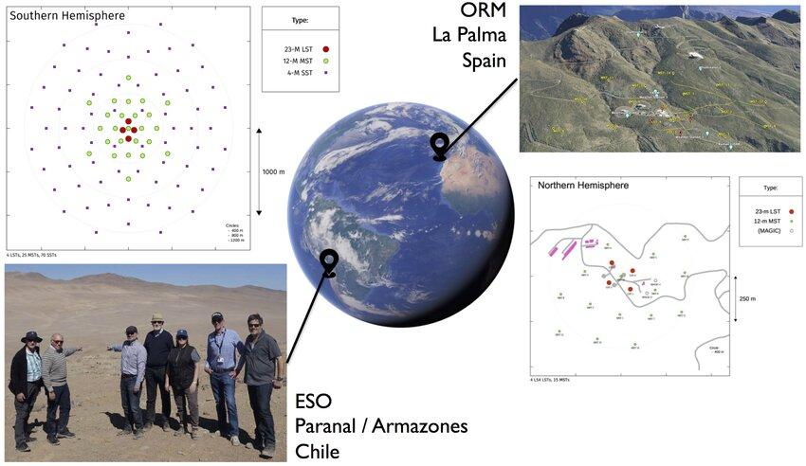
INAF – CTA
More than 1,400: the number of people that work for INAF, made-up of researchers (including research students and post-docs), technicians and administrative staff
19: the number of national research institutes, and one in the Canaries which operates the Telescopio Nazionale Galileo.
200: the number of international research institutes that collaborate with INAF.
Between 3,000 and 4,000: the scientific publications (articles, posters, popular articles) written by INAF researchers each year.
Some optical telescopes: TNG,
3 radio telescopes in Italy: SRT, Medicina, Noto.
125,000: the number of ancient volumes of physics and astronomy in INAF's historic libraries, including twenty or so incunabula, books from the end of the 15th century, amongst the first printed using the movable type invented by Gutenberg.
Cherenkov Telescope Array observatory is a set of telescopes that collect the Cherenkov light;
Two sites: Canary Islands (North), Chile (South);
CTA consists of more than 100 telescopes concentric positioning:
The Large Size Telescopes (LST) with a diameter of 23m (central);
The Medium Size Telescopes (MST) with a diameter of 12m;
The Small Size Telescopes (SST) with a diameter of 5m;
Different size for different energies;
Many telescopes to collect more of the shower;
Large INAF contribution…Software development, SST development through ASTRI;
CTA+ (PNRR) project for building of 2 LST and 5 SST.
https://youtu.be/0QgnKA5AUDY

Slide 23
INAF – SPACE PROJECTS
Currently there are 40 space projects in progress within ASI, all with INAF as prime, in the following thematic/functional areas:
• Astrophysics and Cosmology;
• Heliophysics and Physics of the Solar System;
• Technology;
• Support activities;
• Fundamental Physics.
Credits: Gabriele Minervini

Slide 24
INAF – HERMES-SP
High Energy Rapid Modular Ensemble of Satellites - Pathfinder is a mission based on a constellation of nano-satellites in Low Earth Orbit (LEO);
Miniaturized detectors to probe the X-ray temporal emission of bright high-energy transients such as Gamma-Ray Bursts (GRB) and the electromagnetic counterparts of Gravitational Wave Events (GWE);
Objective: to demonstrate the feasibility of an innovative and cheap space system based on distributed nano-platforms;
The first HERMES Pathfinder payload has been launched on Dec. 1st 2023 onboard the Australian mission SpIRIT.
Yuri Evangelista (Payload responsible)
Riccardo Campana (Integration and calibration)
Credits: Gabriele Minervini, PI: Fabrizio Fiore

Slide 25
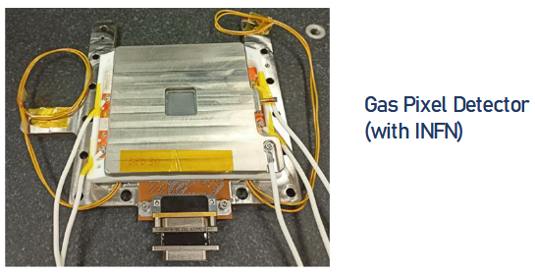
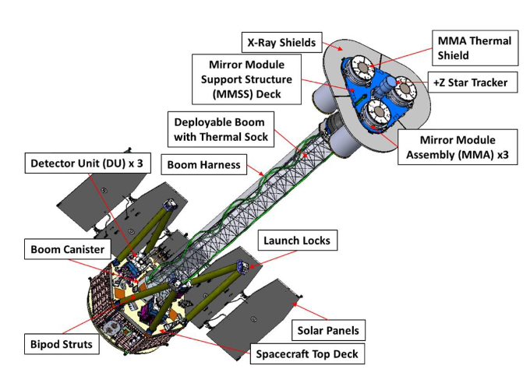
INAF – IXPE
IXPE is a NASA-ASI mission. It has been launched in the end of 2021.
The payload consist in a set of three identical telescope systems co-aligned to the pointing axis of the spacecraft and with the Star-Trackers.
Italy has designed, built and tested the three polarization sensitive X-ray detectors of the telescope system.
INAF Hardware contribution:
Polarization sensitive detector (Co-development with INFN)
On-board calibration system (Polarized & unpolarized sources)
Construction & operation of three calibration facilities
Payload activities held @ INAF
Acceptance test of all the polarization sensitive detectors
Full calibration of 4 Detector Units (DU) system
Electrical AIV&T of the Instrument
Thermal-Vacuum Tests of DU.
Credits: Gabriele Minervini, PI Italy: Paolo Soffitta
2024, Bruno Rossi Prize of American Astronomical Society

Slide 26
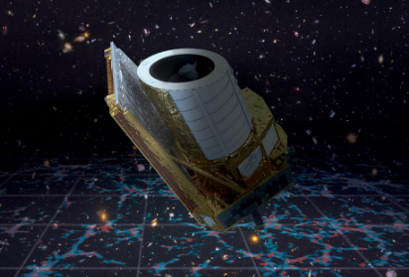
INAF – IXPE
Euclid (ESA+NASA) mission: explore the composition and evolution of the dark Universe. It will create a great map of the large-scale structure of the Universe across space and time by observing billions of galaxies out to 10 billion light-years;
Payload: 1.2-m-diameter telescope +two scientific instruments: a vis camera (the VISible instrument, VIS) and a near-infrared camera/spectrometer (NISP);
INAF: VIS - NISP On board control and data processing SW. Important industrial and scientific contribution.
July 1, 2023

Slide 27
INAF – IXPE
Detection of terrestrial exoplanets up to the habitable zone of solar-type stars through ultra–high precision, long photometric monitoring in the visible band of very large samples of bright (V≤11-13) stars.
Requirements: very large field of view (FoV) + sensitivity of a 1 m-class telescope,the concept is based on a multi-telescope approach: Set of 24 normal 20cm cameras organised in 4 groups resulting in many wide-field co-aligned telescopes, each telescope with its own CCD-based focal plane array;
INAF contribution : Instrument Control Unit (ICU), Telescope Optical Units (TOU).
Lunch 2026 in L2
PI Italy: Isabella Pagano, payload concept: Roberto Ragazzoni

Slide 28
INAF – IXPE
Ariel measurement of the chemical composition and thermal structures of exoplanets, enabling planetary science far beyond the boundaries of the Solar System. Orbit around the Lagrange 2 point (L2);
Elliptical primary mirror: 1.1 x 0.7 m;
Instrumentation: 3 photometric channels and 3 spectrometers from 0.5 to 7.8 μm in wavelength;
Activities: Payload Electronic lead and Instrument Control Unit, FGS Detector Control Unit, Project and realization of the Telescope Assembly, Payload thermal and performances analysis.
Credits: Gabriele Minervini, PI Italy: G. Malaguti, G. Micela

Slide 29
CONCLUSIONS
INAF has observing facilities from radio to high energies going through the optical (Vis-NIR). Quite unique feature!
INAF is involved in the most important future ground-based facilities that will change astrophysics in the next decade working with national and international agencies (INFN, ESO);
INAF has an important role in space missions in collaboration with ASI, ESA and other agencies;
INAF shows widespread technological competences, often stemming from the heritage of individual observatories.
INAF
environment

