Slide 1

ELECTROTECHNICS
PhD on "Technologies for fundamental research in physics and astrophysics“
kickoff Padova 10-11 July 2024

Slide 2
ELECTROTECHNICS STUDENT(S)

Slide 3
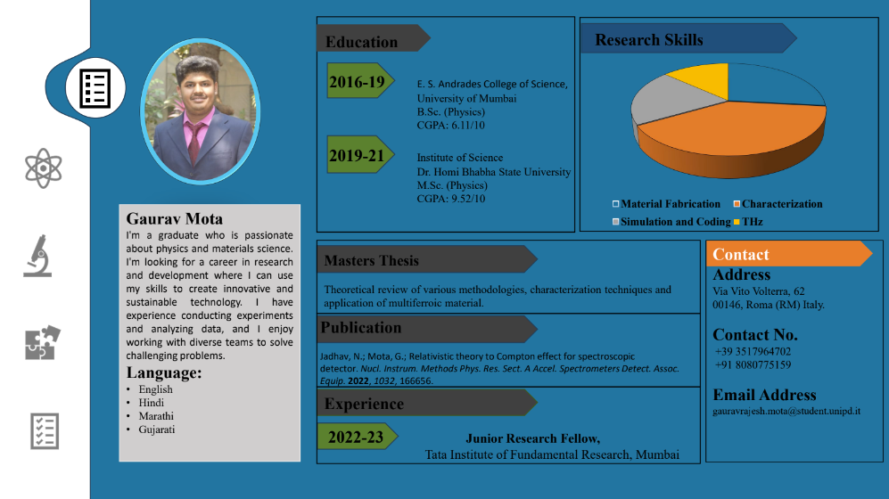
Multiferric materials characterisation, applications
γ-e interactions in targets (non stationary electrons)

Slide 4
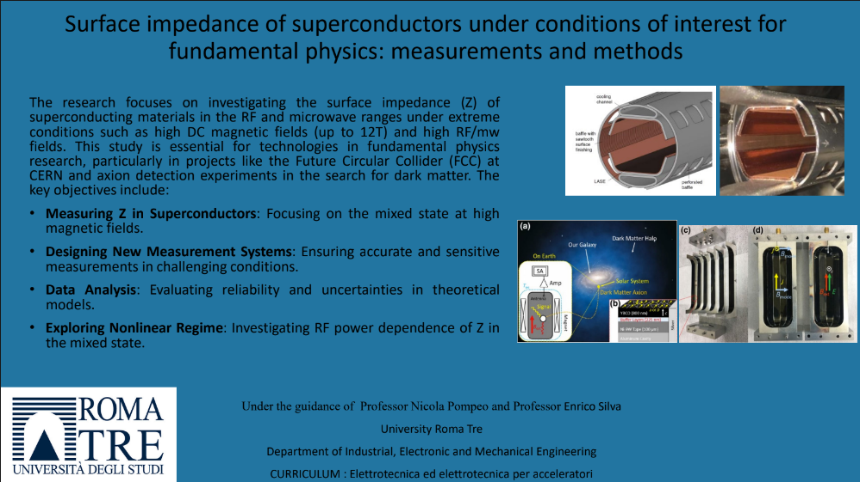
Search of axions with q-limit detectors in m-wave cavities in intense magnetic fields.
FCC-hh collider: HTS to HF wakefields by particle
bunches and to ~16 T
Notes:
High B-field converts the less-than-eV-mass axions into EM-waves, revealed by a EM cavity

Slide 5
EDUCATIONAL PROPOSAL - COURSES
broader
more specific

Slide 6
Other educational activities
broader
more specific

Slide 7
PROPOSED PLAN – YEAR 1
COURSES
1. Applied Superconductivity: Quantum Phenomena and Quantum Systems
2. Advance scientific programming in Matlab
CONFERENCES, SEMINARS, SCHOOLS
1. Superconductivity summer school (CONECTUS ESAS) (June. 24 – 28. 2024)
2. INFN Gran Sasso National Laboratory (LNGS) meeting.
3. IEEE council on Superconductivity Italy chapter meeting.
ADDITIONAL TRANSVERSAL / SOFT SKILLS COURSES
1. IEEE Authorship and Open Acces
Introduction to SC, SC materials and their applications
Applied SC on properties of materials, RF; for QT, infrastructures (TNF), …

Slide 8

Electro-technics
The research topic is a top challenge for future colliders and not only and for detectors (axion quest)
The courses followed in the first year are sound
Other courses/activities of Electrotechnics are recommended for year-2 and year-3

