Slide 1
Astro tech
Andrea Bianco
Kick-off TFPA PhD course – July 11, 2024, Padova

Slide 2
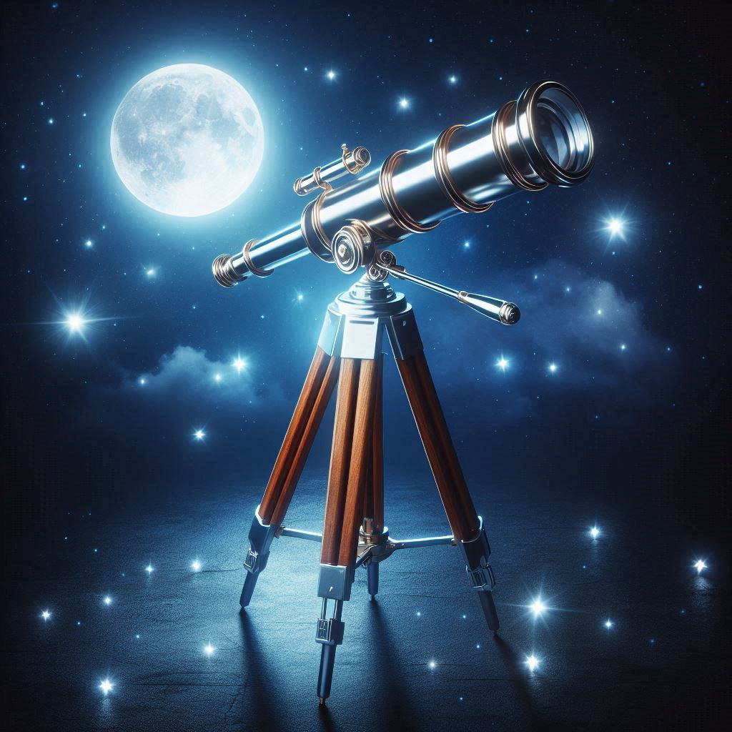
TECNO INAF – ENVIRONMENT
Industries
Opto-mechanical design
Electronic design
Astronomical
And AstroPh
Challanges
Control software
Scientific Software
Enabling technologies
System engineering
AIV/AIT
Tech requirements
Manufacturing
Happy astronomers
Tired Engineers
Enabling technologies

Slide 3
TECNO INAF – R&D
R&D in new technologies is crucial to:
Reduce the (future) risks;
Simplify the instrumentation;
Improve the instrument performances.
New ideas, concepts: fundamental R&D;
Increase the TRL of a technology to a level suitable for being considered in new missions/facilities;
Patenting of the ideas;
Involve industries for taking care of the final manufacturing/production;
Spin-off, start-up;
Laboratories and facilities to support the R&D and as international facilities available for the scientific community.

Slide 4
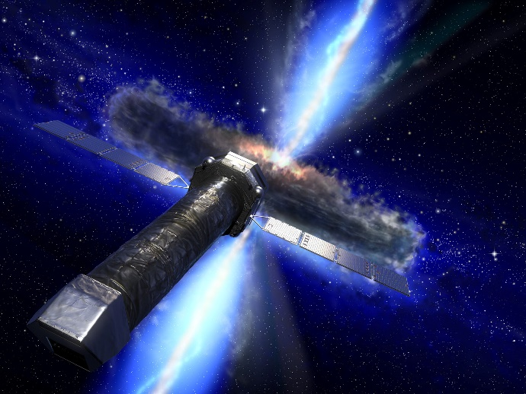
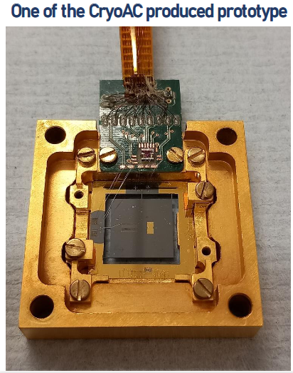
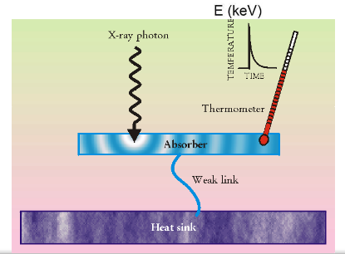
ATHENA sensors
Advanced Telescope for High Energy Astrophysics (ATHENA) is an X-ray telescope and is the second large mission selected by ESA;
The Cryogenic AntiCoincidence Detector is based on superconductive thermometer called TES (Transition Edge Sensor) working at 50 mK;
The energy deposited by a particle heats an absorber and its temperature increases. The TES is a very sensitive thermometer temperature variation (<< 0.001°C). The detector response is an electric pulse lasts in few ms.

Slide 5
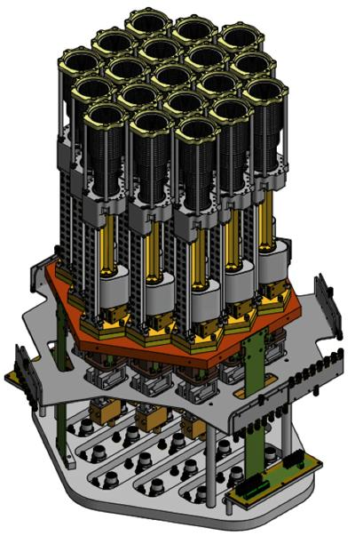
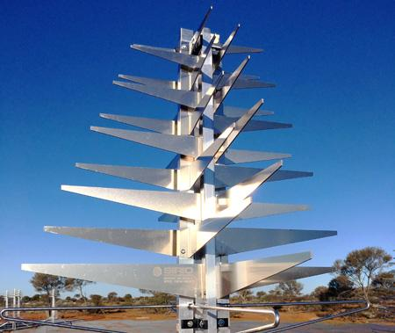
Radio technologies
New technologies for both single dish and low freq. Arrays have been developing;
Multi-feed receivers: multiple receiving chains (up to tens of units) help in: the production of extended radio sky maps, in less time and with a better accuracy with respect to the classic single- or double-feed architectures;
Skala: design @INAF-IRA of the low freq antennas for SKA-LOW together with Low Noise amplifier and RFoF (Radio Frequency over Fibre) technology. SKALA 4.1AL is the name of the prototype mounted at AAVS2 (Aperture Array Verification System 2.0).
INAF-IRA 33-50 GHz 19-pixel receiver
https://youtu.be/lBkhmrccPdI

Slide 6
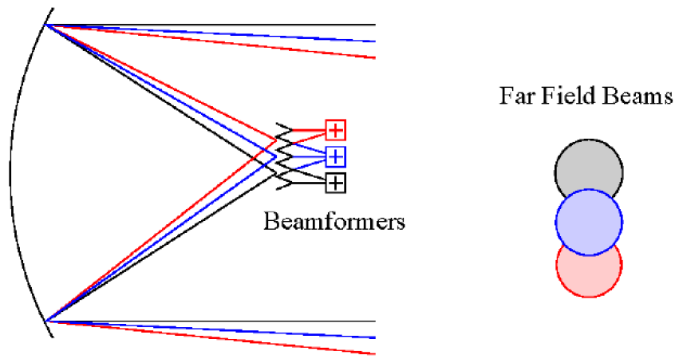
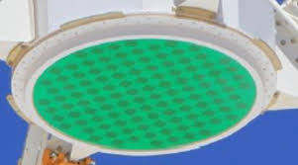
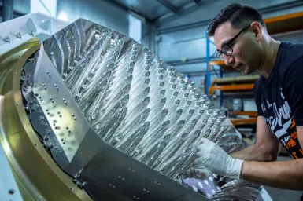
Radio technologies: PAF
A Phased Array Feed (PAF) is an array of densely packed receiving antennas placed at the focal plane of a radio telescope enabling to electronically synthesize dozens of simultaneous beams in the sky.
A PAF is a multi-beam radio camera that enables observing a large angular area in the sky with high sensitivity, thus achieving a high survey speed of extended radio astronomy sources.
The antenna elements act as sensors of the electromagnetic field across the focal plane.
The outputs of the receivers are coherently combined in beamformers with appropriate weights to synthesize several discrete beams.
PI: A. Navarrini, T. Pisanu

Slide 7
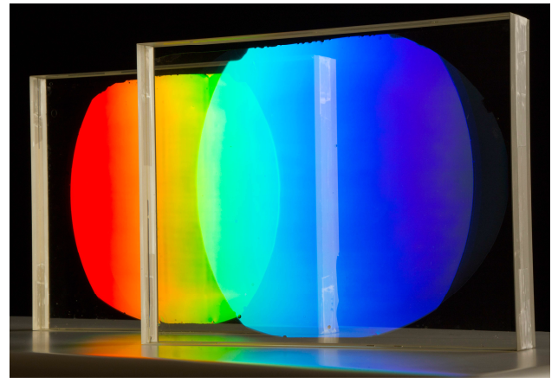
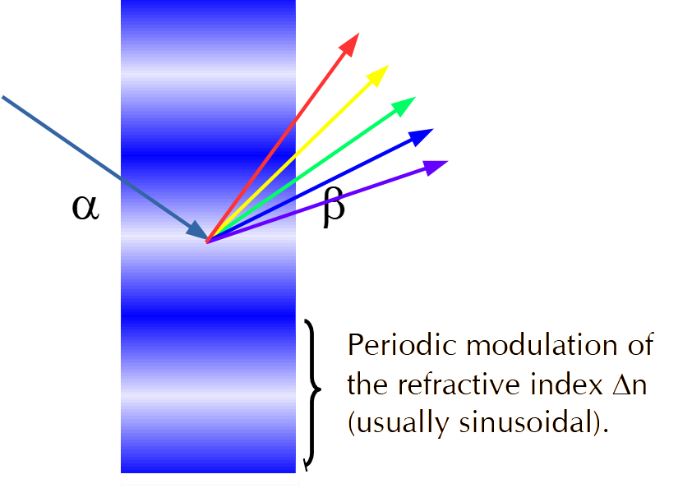
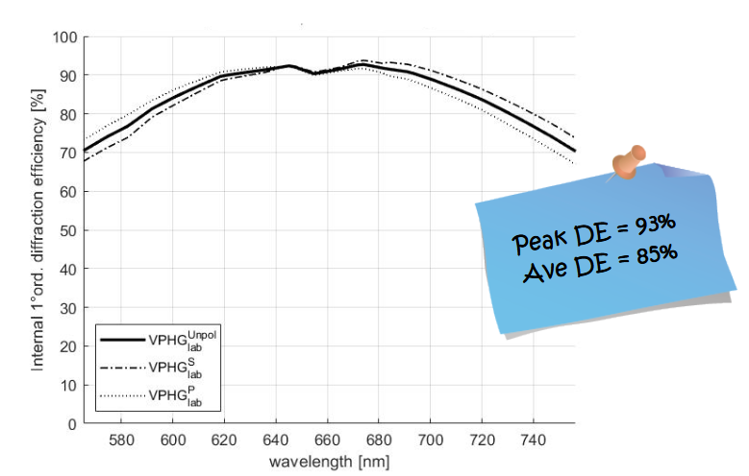
Volume Phase Holographic Gratings
Diffraction gratings with very high diffraction efficiency for the Vis-NIR spectrographs;
Innovative manufacturing process based on polymeric materials to make easier and reliable the production;
Size up to 200 mm at the moment; next year 450 mm elements.

Slide 8
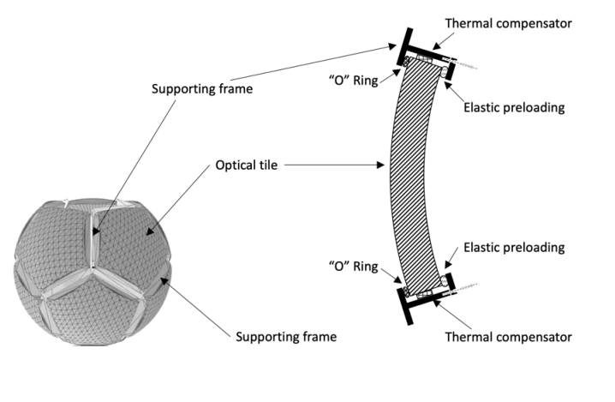
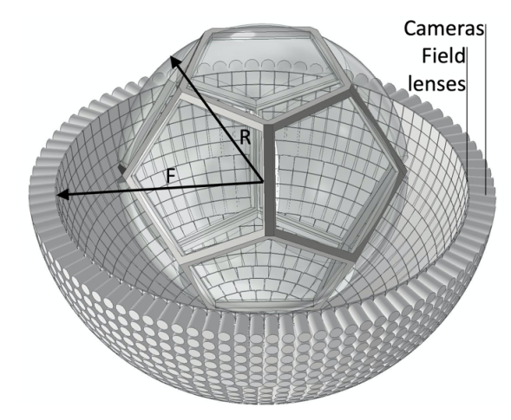
MEZZOCIELO
Mezzocielo (or "half of the sky") is a concept for a single large monocentric optical system composed by a tessellated spherical container filled with low refractive index liquid characterized by an extremely high transparency;
This system allows for a continuous monitoring of the whole sky with a large number of mass produced correcting cameras;
Assuming a one meter class equivalent aperture: collect simultaneously only half of the half of the sky, corresponding to an equivalent of 10 thousand square degrees, the covered FoV is largely superior to most of the astronomical instrument in use.
IDEA: Roberto Ragazzoni

Slide 9
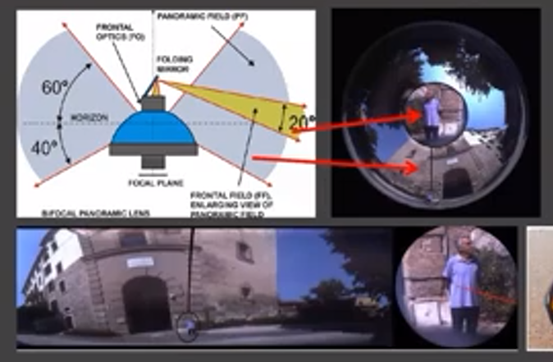
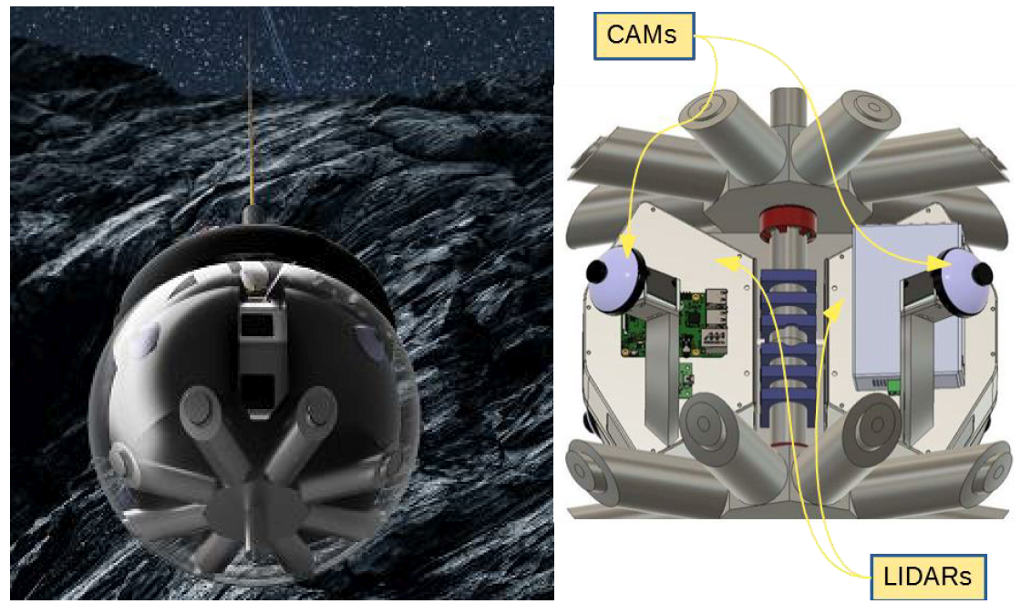
PANCAM
PANCAM - Bifocal Panoramic Camera for Lunar Explorations;
It is a bifocal panoramic lens with: 360° azimuth and 100° zenithal FoV + 20° FoV;
Two magnifications at the same time;
Combination of more than one camera;
Applications to Lunar surface monitoring;
Exploration of lunar caves
PI: Claudio Pernechele

Slide 10
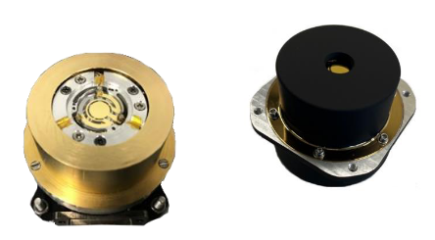
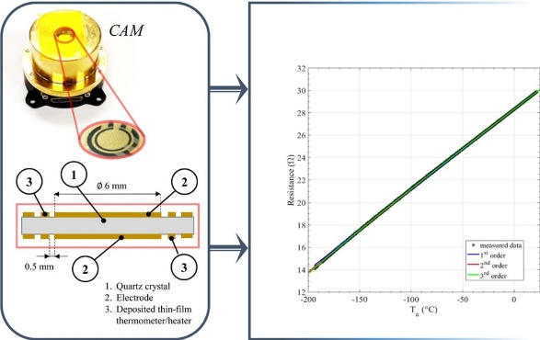
Quartz Crystal Microbalances
Quartz Crystal Microbalance (QCM) sensors used in space missions and satellite missions, for monitoring the contamination generated by outgassing processes of materials onboard satellites and sensitive payloads;
Tiny sensors with limited mass. Very high accuracy and sensitivity;
Combined with thermogravimetric analysis (TGA) for material identification.
PI: Ernesto Palomba

Slide 11
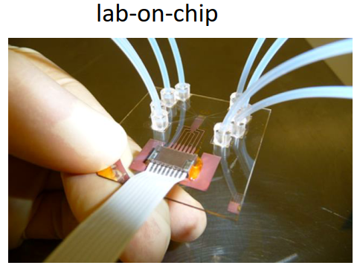
SafeAir
SAFEAIR is a portable automatic system that uses technologies developed for space missions to Mars and on cubesats in Earth orbit to detect the presence of pathogens in the air on Earth, on ISS…everywhere;
Three steps: air/aerosol sampling + Nucleic acid extraction + pathogens evaluation with PCR;
Approaches to minimize the size and maximize the efficiencies.
PI: Francesca Esposito, PCT patent

Slide 12
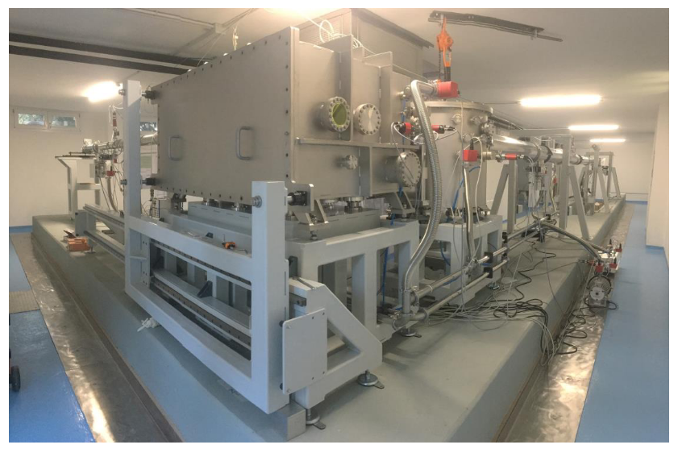
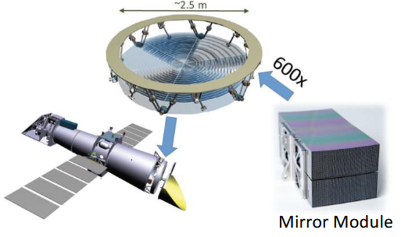
Beatrix
A unique facility that creates a large collimated and monochromatic X-ray beam to test X-ray optics for space missions;
Scope: acceptance X-ray test before integration of the 500 Mirror Modules composing the optics;
The beam is large enough to illuminate the whole module and, at the same time, the size of the instrument is relatively small;
Versatile facility.
PI: Bianca Salmaso

Slide 13
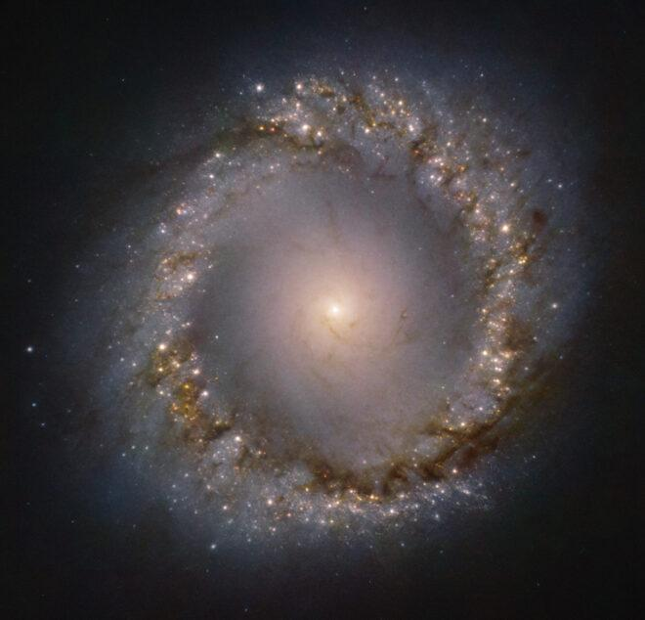
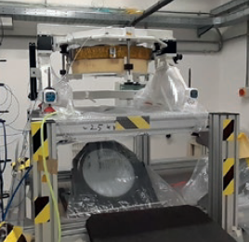
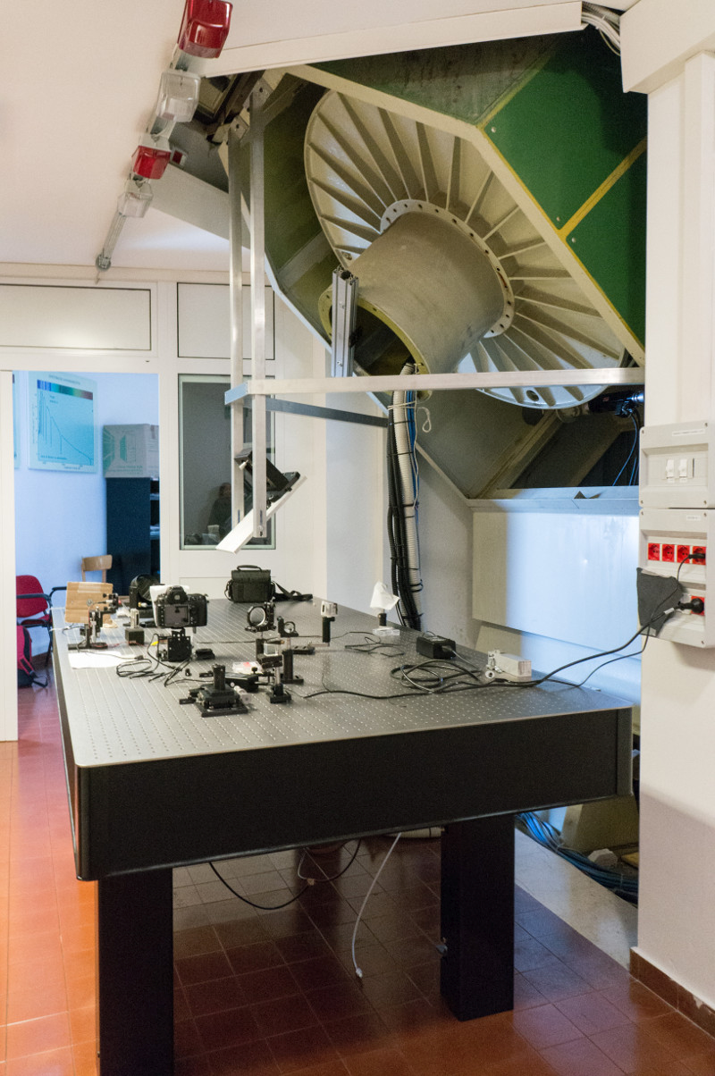
NATIONAL LABORATORY
ADONI is the italian community of researchers and scientist working in the field of adaptive optics.
It gathers together astronomers and technologists from INAF and other institutes and universities, for the study, development and implementations of novel technologies for astronomical imaging, both from ground and space;
Example SPLATT project aims at investigating two key elements: contactless DM as segments of an active primary mirror for space applications;
Testing facility at the Coudé focus of the Copernico Telescope for on-sky experimentation, a permanent laboratory with the aim of hosting visiting multi-purpose instrumentation that may be directly tested on sky.
Credit: Martin Kornmesser/Eso
Credit: Runa Briguglio

Slide 14
PNRR - STILES
Strengthening the Italian leadership in ELT and SKA (STILES) is a 80 M€ project aiming at:
Direct upgrade of the observation capabilities of ELT and SKA, thanks to the construction of instrumentation for ELT and SKA and for their respective precursors VLT/LBT and MeerKAT;
Investments in information technology, acquiring HW and SW infrastructures fundamental for the development of new tools and the analysis of their data. These include a high-performance computing center and machine learning-based software tools for data analysis, as well as a Concurrent Design Facility and other infrastructure for tool development;
Development of laboratories for the study of "exo-atmospheric" conditions, which will allow us to study physical states that have never been observed on Earth, offering us crucial advantages in understanding and interpreting data from ELT instruments;
Development of experiments and R&D laboratories. The goal is to invest in our laboratories to invent and explore new technologies in different fields (adaptive optics, optical detectors and radio receivers) and apply them to the astronomical sector;
National infrastructures for instrumentation verification. A network of facilities will be created capable of providing general services (such as opto-mechanical design and production) and multipurpose facilities for the characterization of tools and methods. These coordinated structures will be available to all Italian and international technology groups.
https://pnrr.inaf.it/progetto-stiles/

Slide 15
CONCLUSIONS
R&D activities crucial for improving the performances of new instruments;
INAF is involved in many R&D activities in collaboration with universities, INFN, ASI, CNR;
Important international role in specific areas (such as adaptive optics, radio technologies,…)
Still to improve the paths to fully exploit the ideas/results (patents, industrial engagement).
Different possibilities to have funds both inside INAF and from other agencies/entities (EC, ASI, ESA,…).

