Slide 1
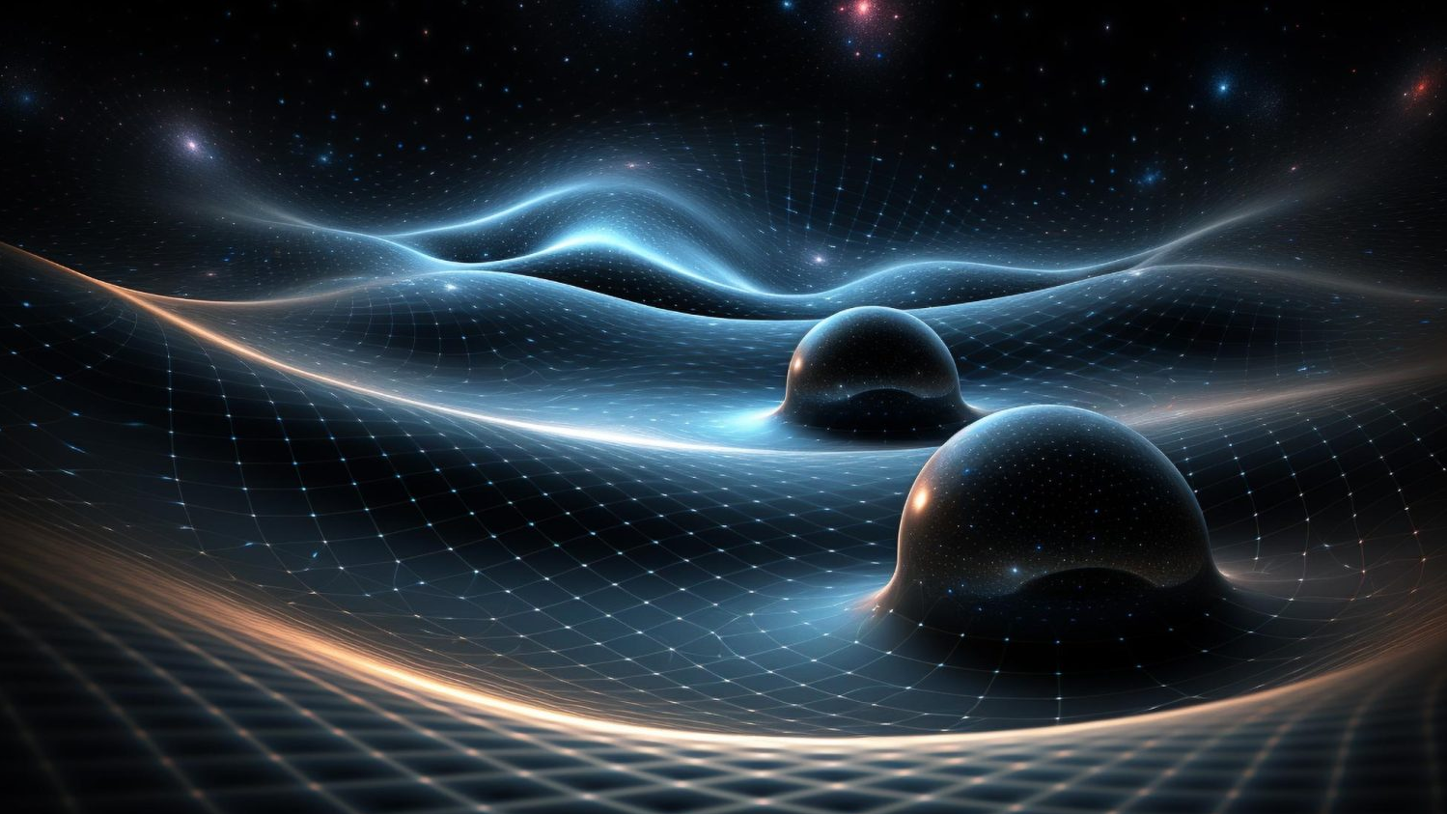
Gravitational Waves Chronicles:
Highlights from the LIGO-Virgo-KAGRA
Collaboration
Lorenzo Piccari
PhD - 39° Cycle

Slide 2
Structure of the talk
What are Gravitational Waves (GWs)?
Astrophysical Sources of GWs
The LIGO-Virgo-KAGRA (LVK) Detector Network
How Interferometers detect GWs?
A (very brief) overview of the most exceptional events detected by the LVK Collaboration so far

Slide 3
What are Gravitational Waves?
Gravitational waves (GWs) are "ripples" in space-time (ripples= Increspature)
They were predicted by Albert Einstein in 1916, as a direct consequence of its theory of General relativity
When a GW propagates, the geometry and, consequently, the proper distance between spacetime points changes in time.
Main features of GWs:
Propagate at the speed of light
Transverse
Quadrupolar
2 orthogonal polarization states

Slide 4
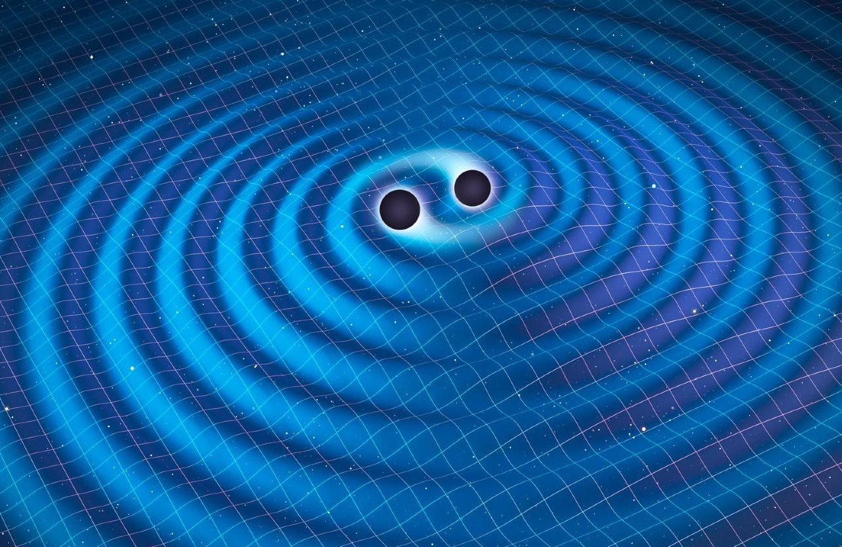
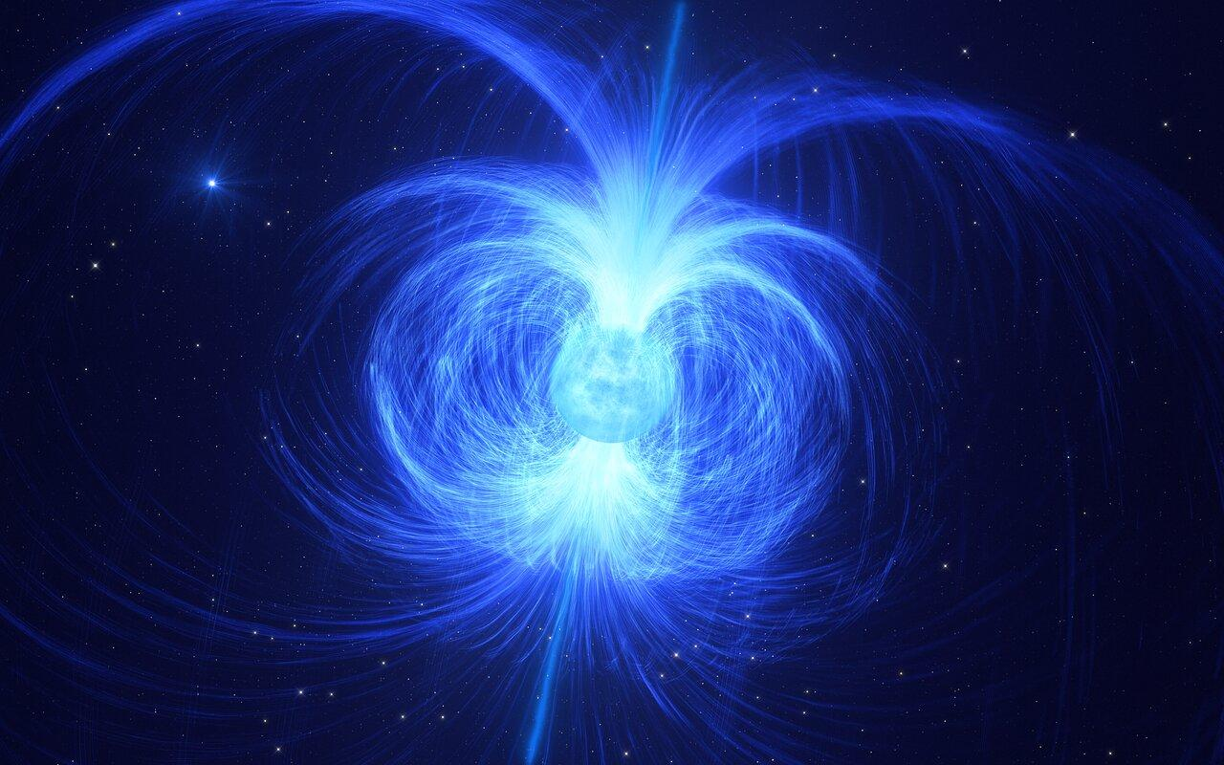
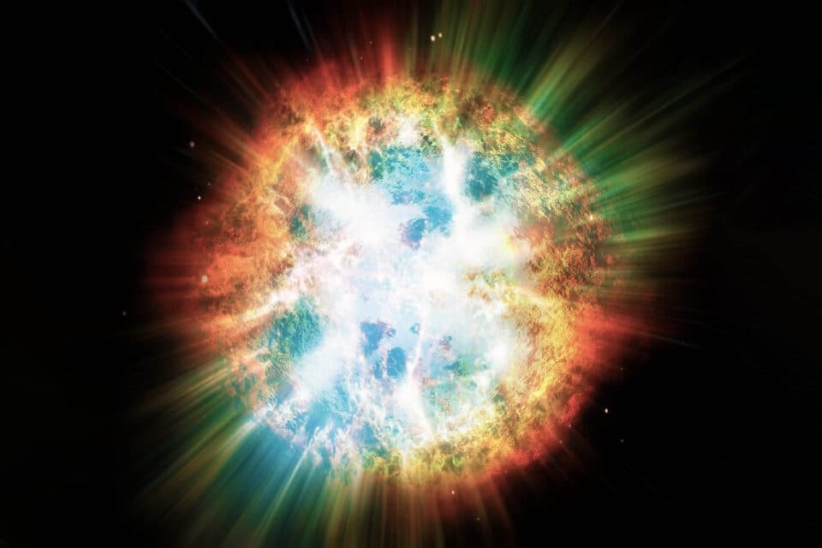
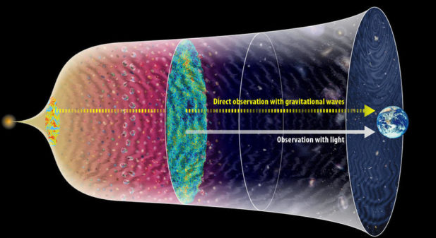
Astrophysical Sources of GWs
Any body with a certain degree of asymmetry able to produce a time varying quadrupole moment
Observable GWs are generated in some of the most energetic and extreme events in the Universe:
Compact Binary Coalescences (CBCs)
Transient
Signals
Spinning Neutron Stars
Bursts
Stochastic GW
Backgrounds
Persistent
Signals

Slide 5
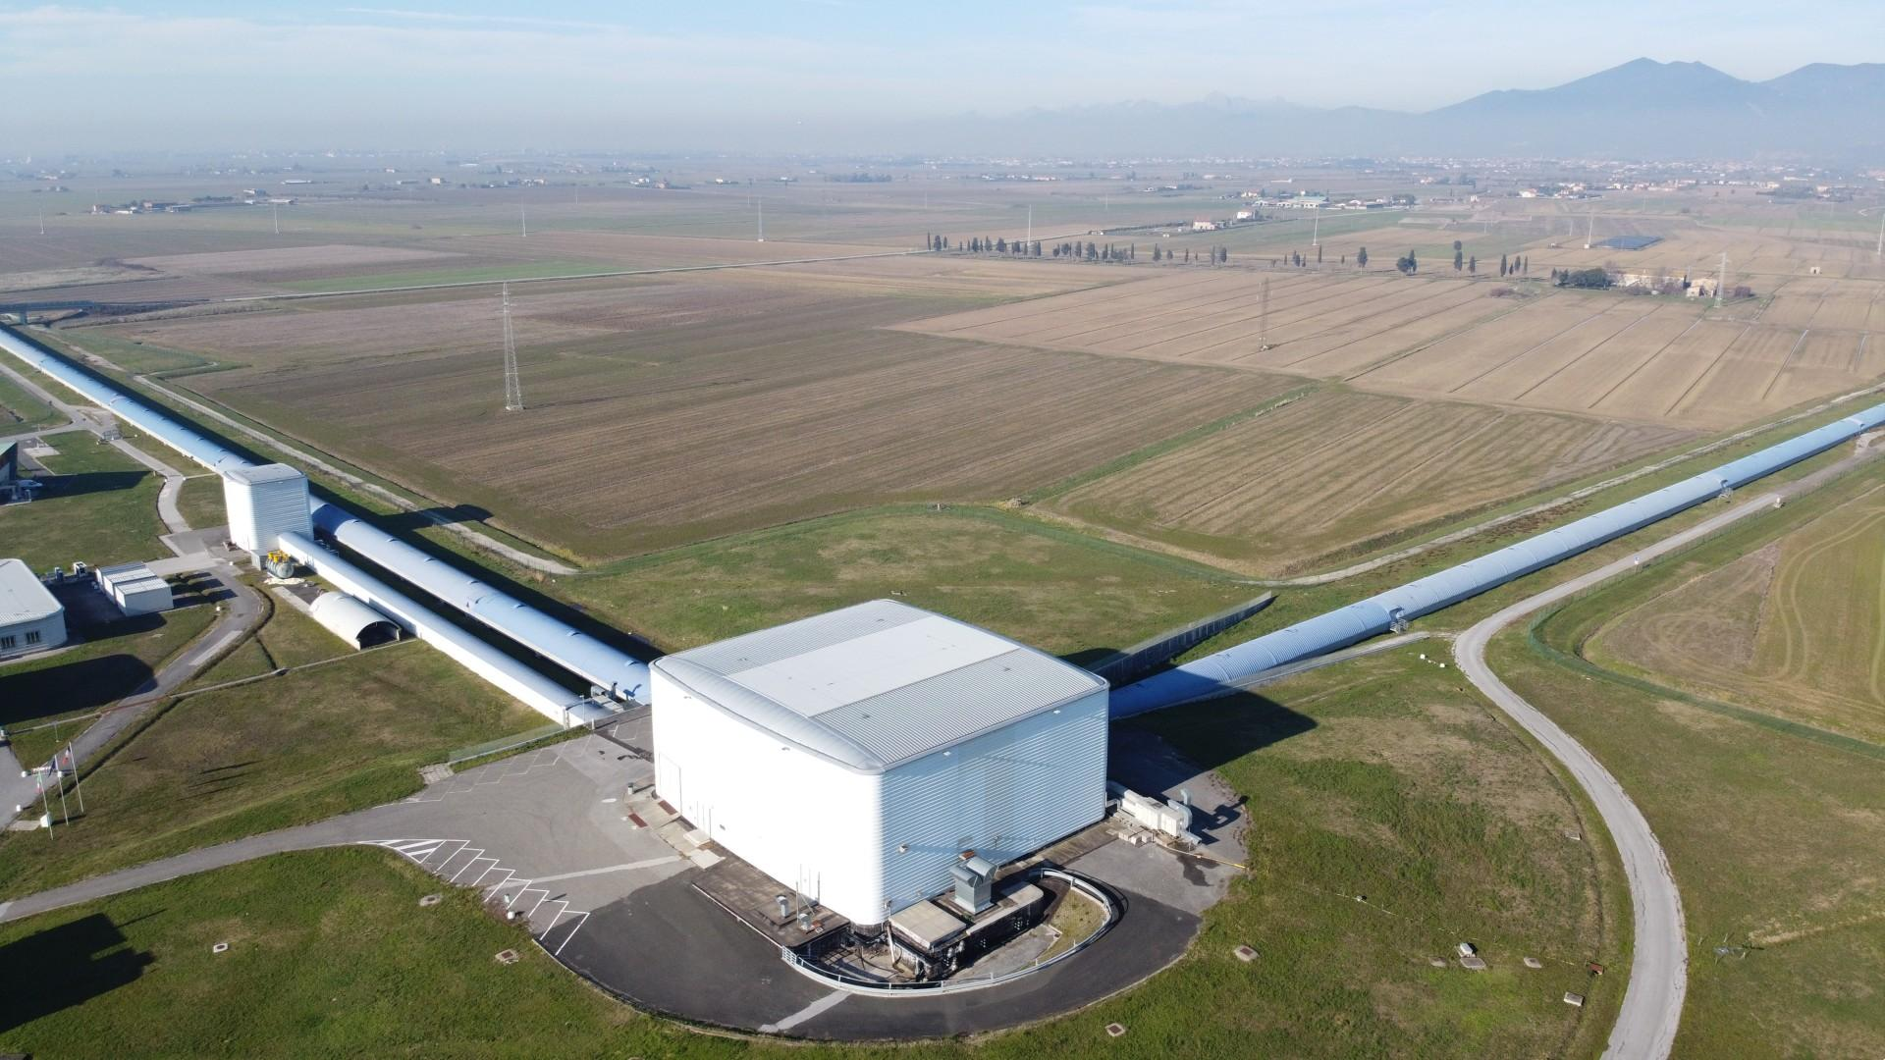
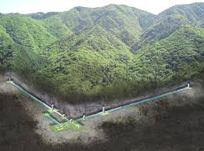
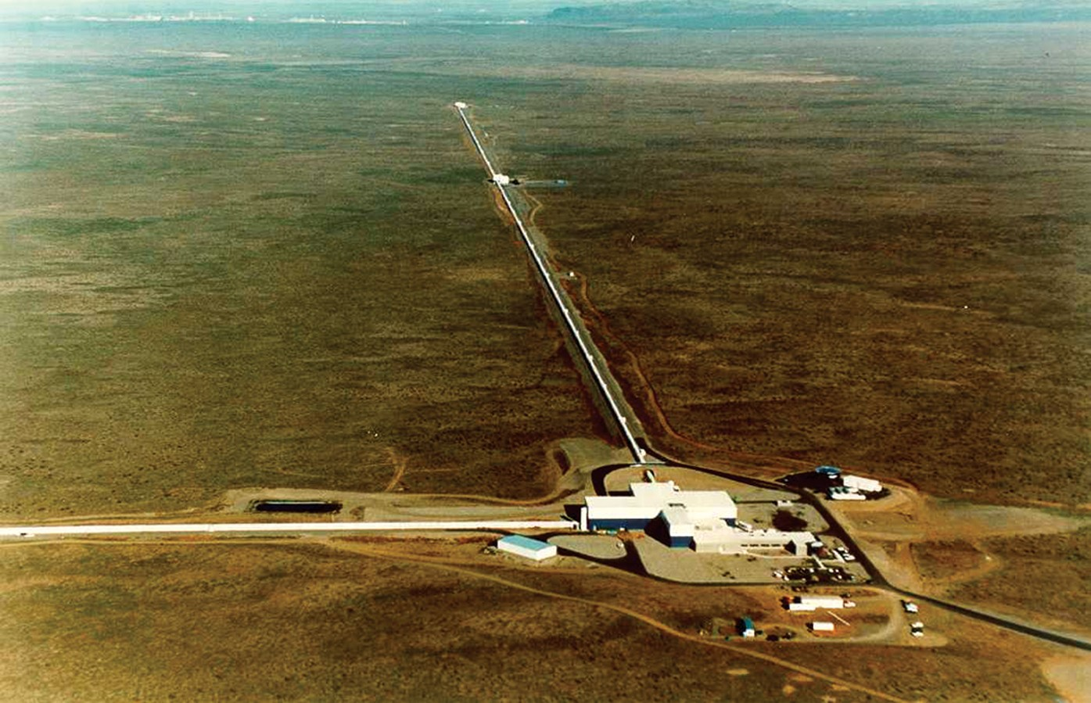
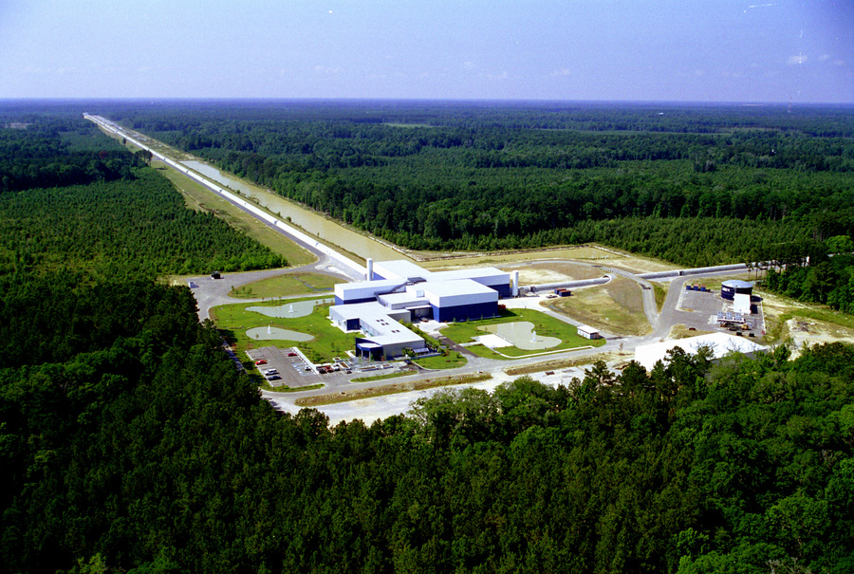
The LIGO-Virgo-KAGRA Detector Network
LIGO
Hanford
(WA)
Virgo
Cascina (PI)
KAGRA
Kamioka mine
LIGO
Livingston
(LA)

Slide 6
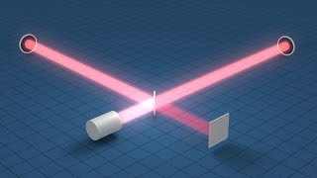
How Interferometers Detect GWs?
https://www.youtube.com/watch?v=tQ_teIUb3tE from LIGO Official Youtube Channel

Slide 7
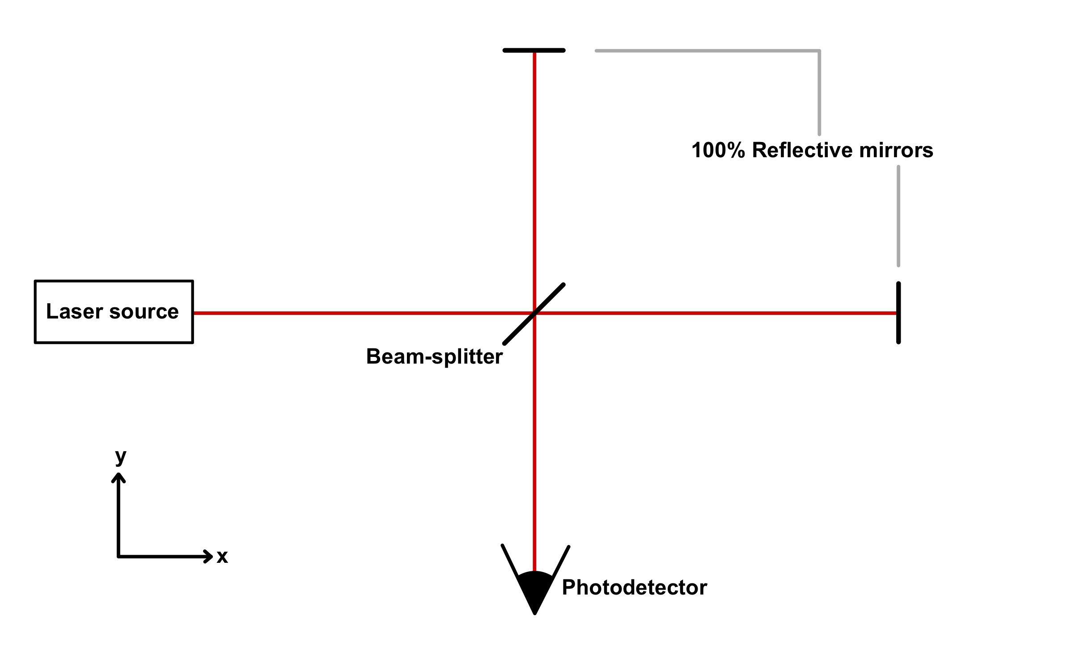
How Interferometers Detect GWs?
Current GW detector are Michelson Interferometers
Let’s give some numbers:
Arms length of LVK interferometers:
LIGOs : 4 Km
Virgo & KAGRA : 3 Km
GWs emitted by astrophysical sources generate an effect equivalent to: ΔL = | L_{x} - L_{y} | ∼ 10⁻¹⁸ m
Sensitive band of LVK detectors spans from ∼ 20 Hz to a few KHz

Slide 8
How Interferometers Detect GWs?
Of course, real detectors have a much more complicated layout!:
Source: https://www.virgo-gw.eu/science/detector/optical-layout/

Slide 9
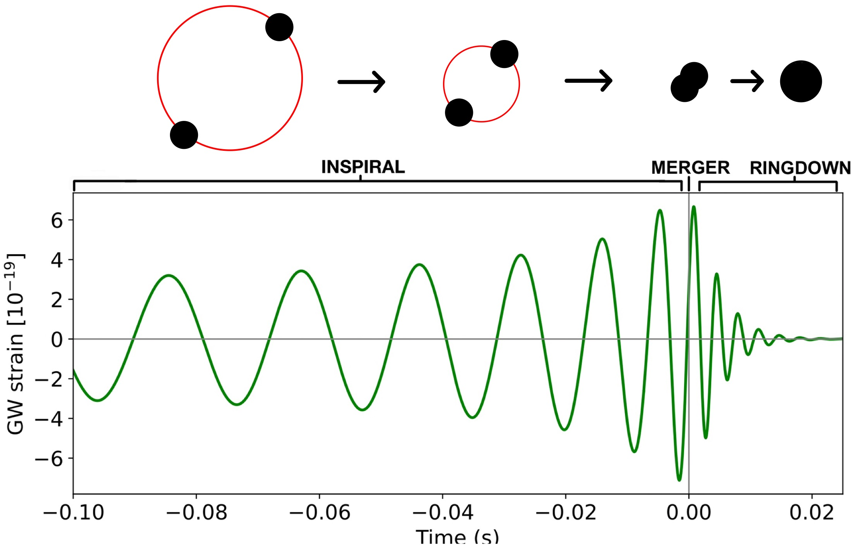
Compact Binary Coalescences
Compact Binary Coalescences (CBCs) are among the most relevant GW emitters in the Universe, and they are the sources of all the GW signals detected so far by the LIGO-Virgo-KAGRA Collaboration network.
CBCs can be formed by:
Binary Black Holes (BBH)
Binary Neutron Stars (BNS)
Neutron Star - Black hole systems (NSBH)
Compact Objects:
High value of Compactness C = M/R

Slide 10
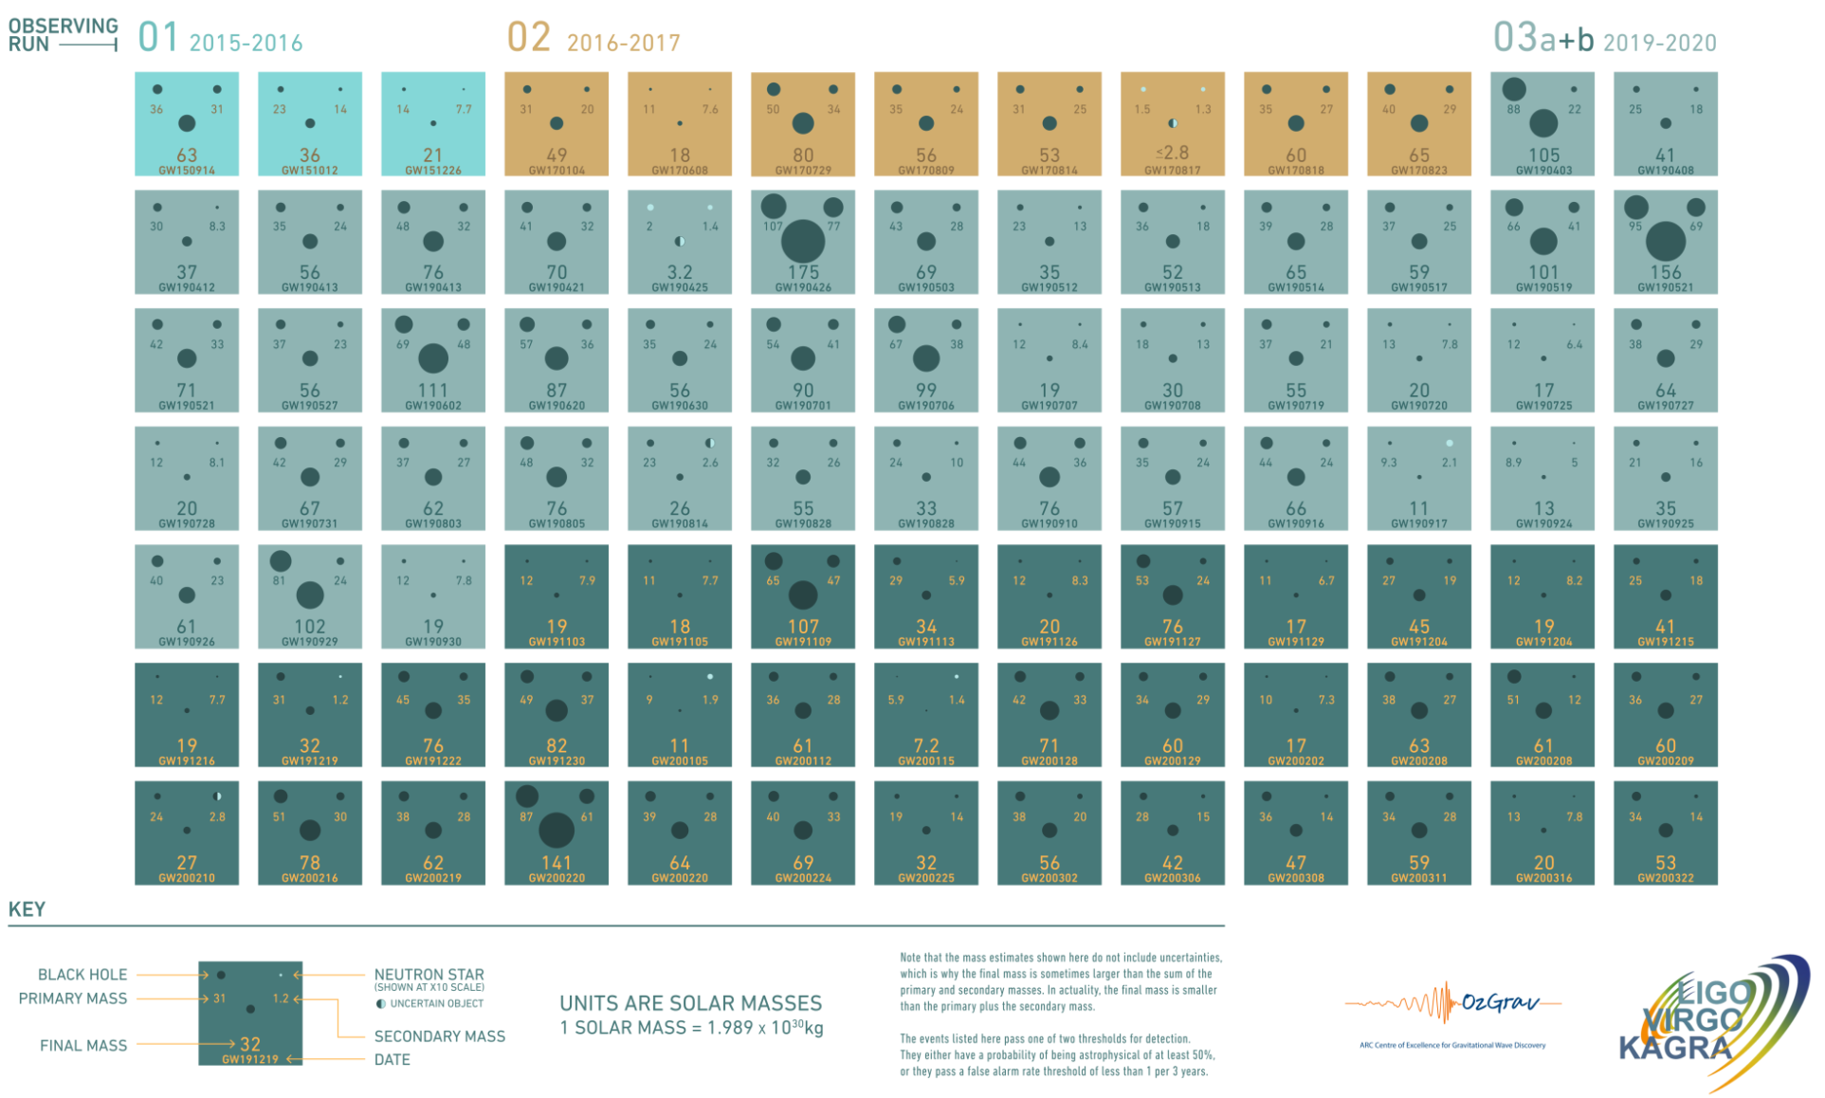
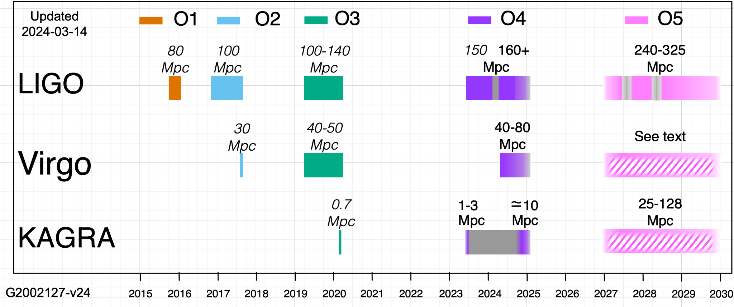
LIGO-Virgo-KAGRA observations so far
90 events in the first 3 observing runs, abundantly more than 100 considering also the ongoing fourth observing run (started in May 2023)
Mostly BBH, but a handful compatible with the presence of at least one Neutron Star in the binary (NSBH, BNS).
https://observing.docs.ligo.org/plan/
https://www.ligo.org/news.php

Slide 11
GW150914 - You never forget the first time!
Source: Binary Black Hole
Component masses:
m1 = 35⁺⁵₋₃ M☉
m2 = 30⁺³₋₄ M☉
Mass of the merge product:
M_{fin}= 63⁺³₋₃M☉
Final BH more massive than any other found in the stellar-mass range.
First observational evidence that BBH actually form in nature, with properties consistent with merge in the local universe
Discovery paper: https://doi.org/10.1103/PhysRevD.93.122003

Slide 12
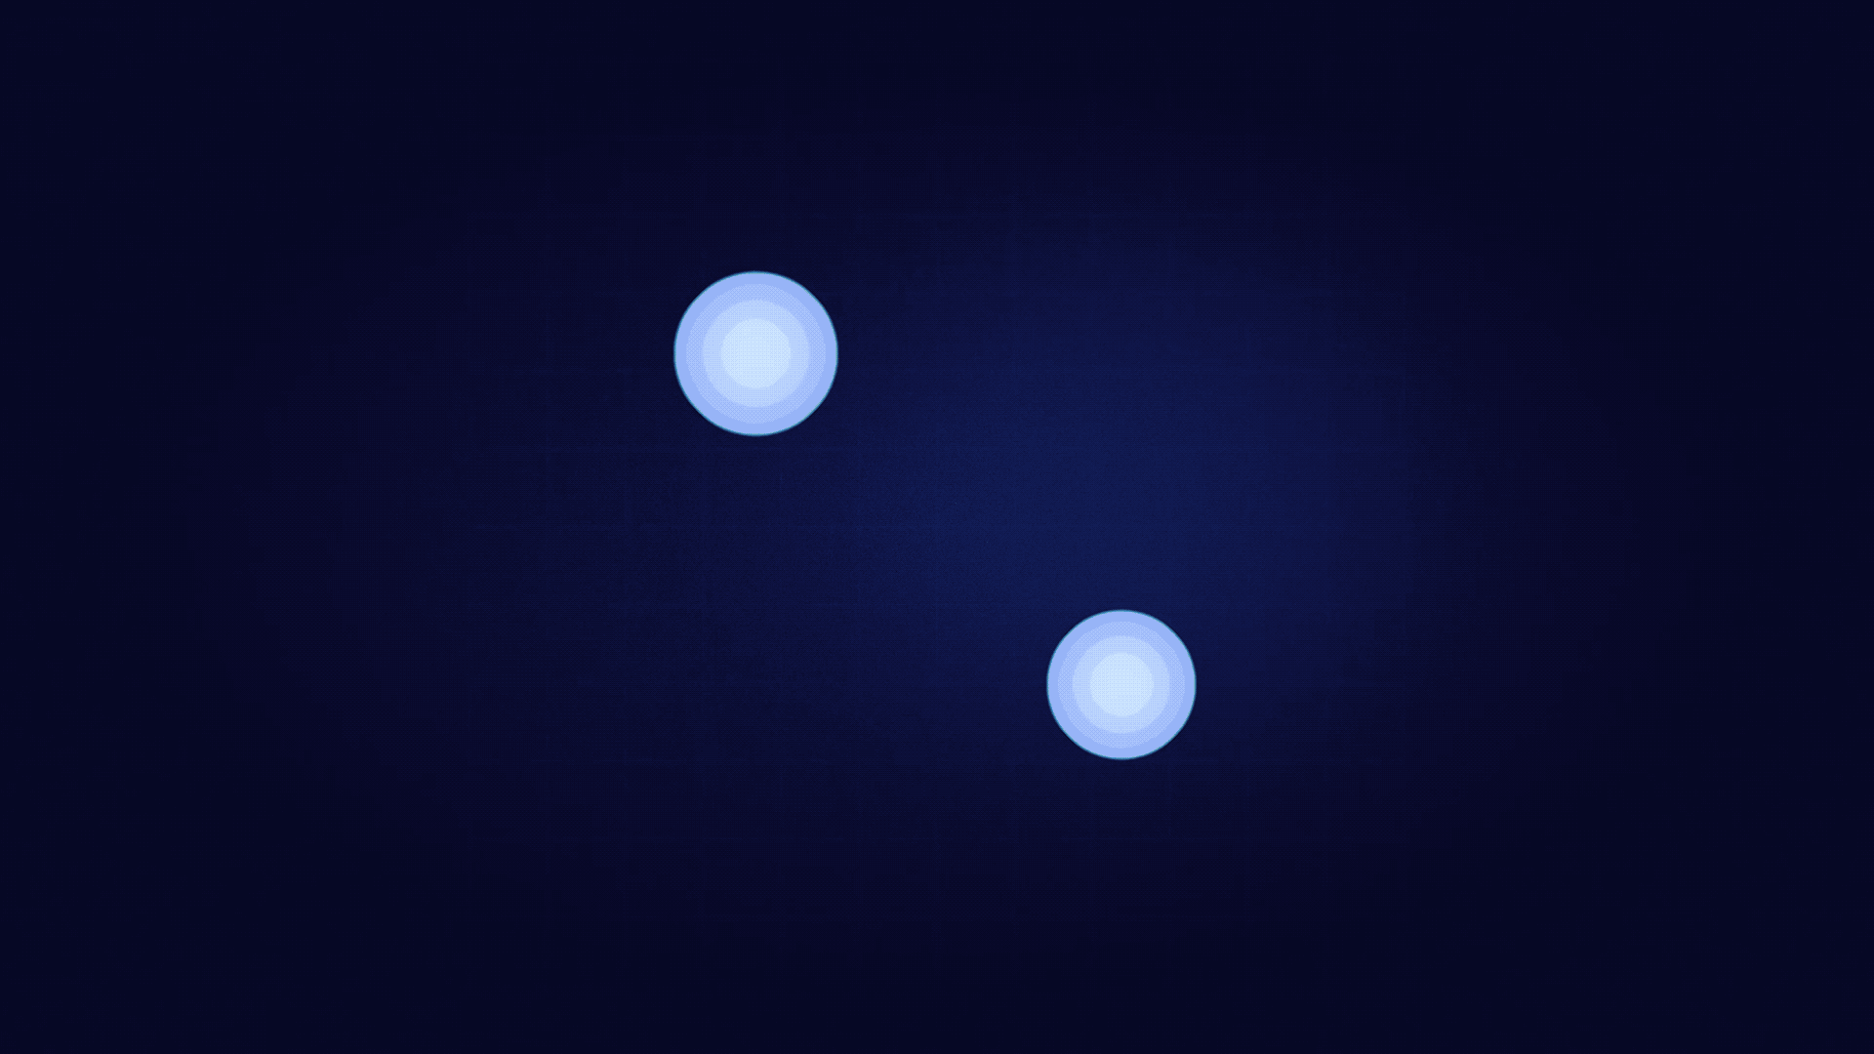
GW170817 - The birth of GW multi messenger astronomy
Source: Binary Neutron Star
Component masses compatible with neutron stars:
m1 = [1.36; 1.89] M☉
m2 = [1.00 1.36] M☉
The first LVK detection of a BNS
The first, and the only to date, multimessenger observation involving Gravitational waves:
Short Gamma Ray Burst
Kilonova
The unprecedented joint GW-EM observation provided insight on astrophysics, dense matter, gravitation and cosmology (sGRB origin, NS equation of state, new tests of GR, Hubble tension, …)
Discovery paper: https://doi.org/10.1103/PhysRevLett.119.161101

Slide 13
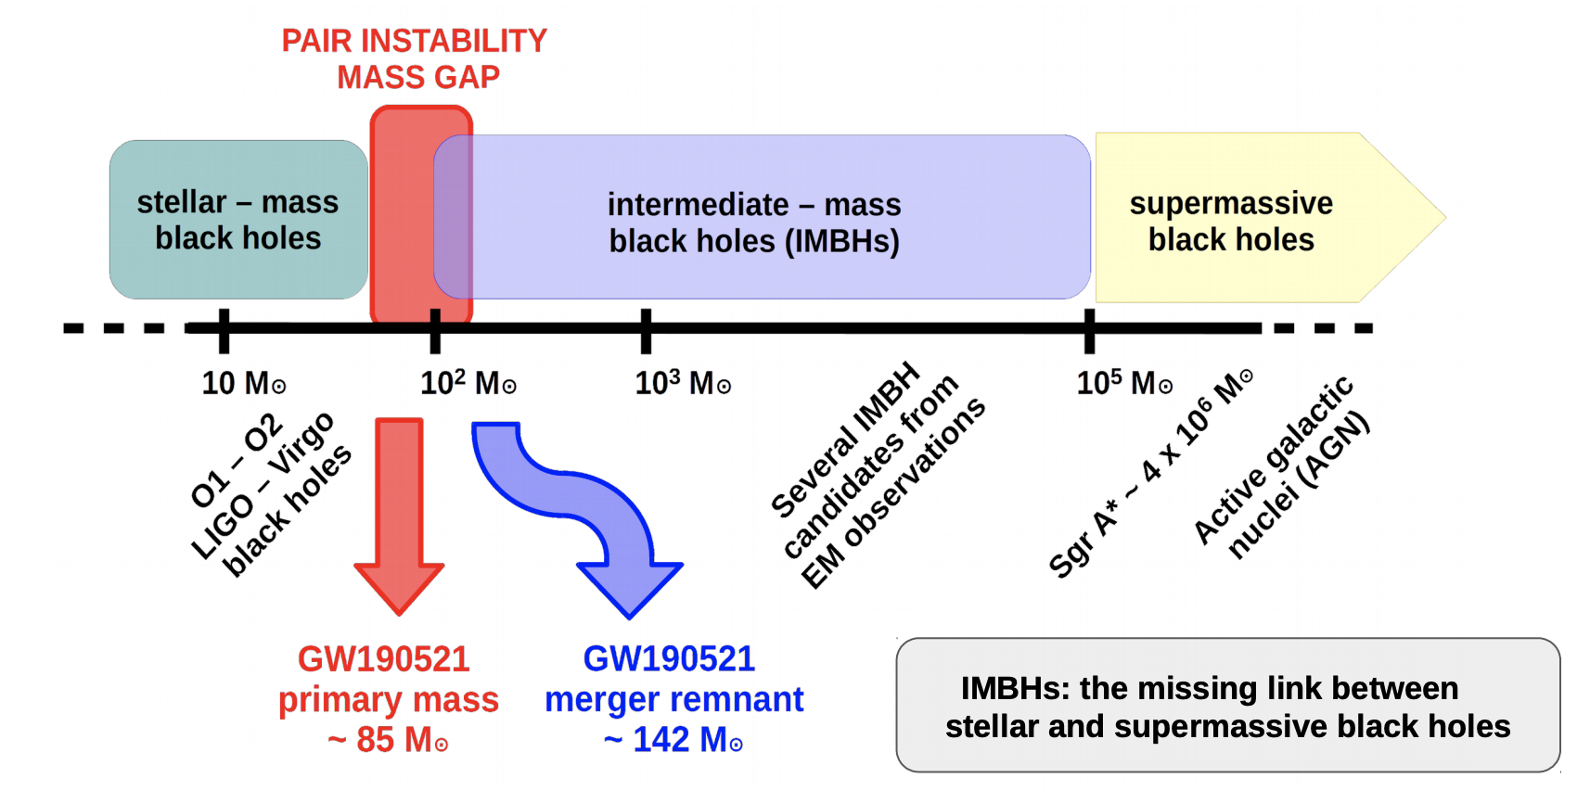
GW190521 - The Big One
Source: Binary Black Hole
Component masses:
m1 = 85⁺²¹₋₁₄ M☉
m2 = 66⁺¹⁷₋₁₈ M☉
Mass of the merge product:
M_{fin}= 142⁺²⁸₋₁₆M☉
Challenged our understanding of black hole formation:
The primary mass falls in the Pair Instability mass gap
The final product falls in the Intermediate Mass Black Holes (IMBHs) Category
Discovery paper: https://doi.org/10.1103/PhysRevLett.125.101102

Slide 14
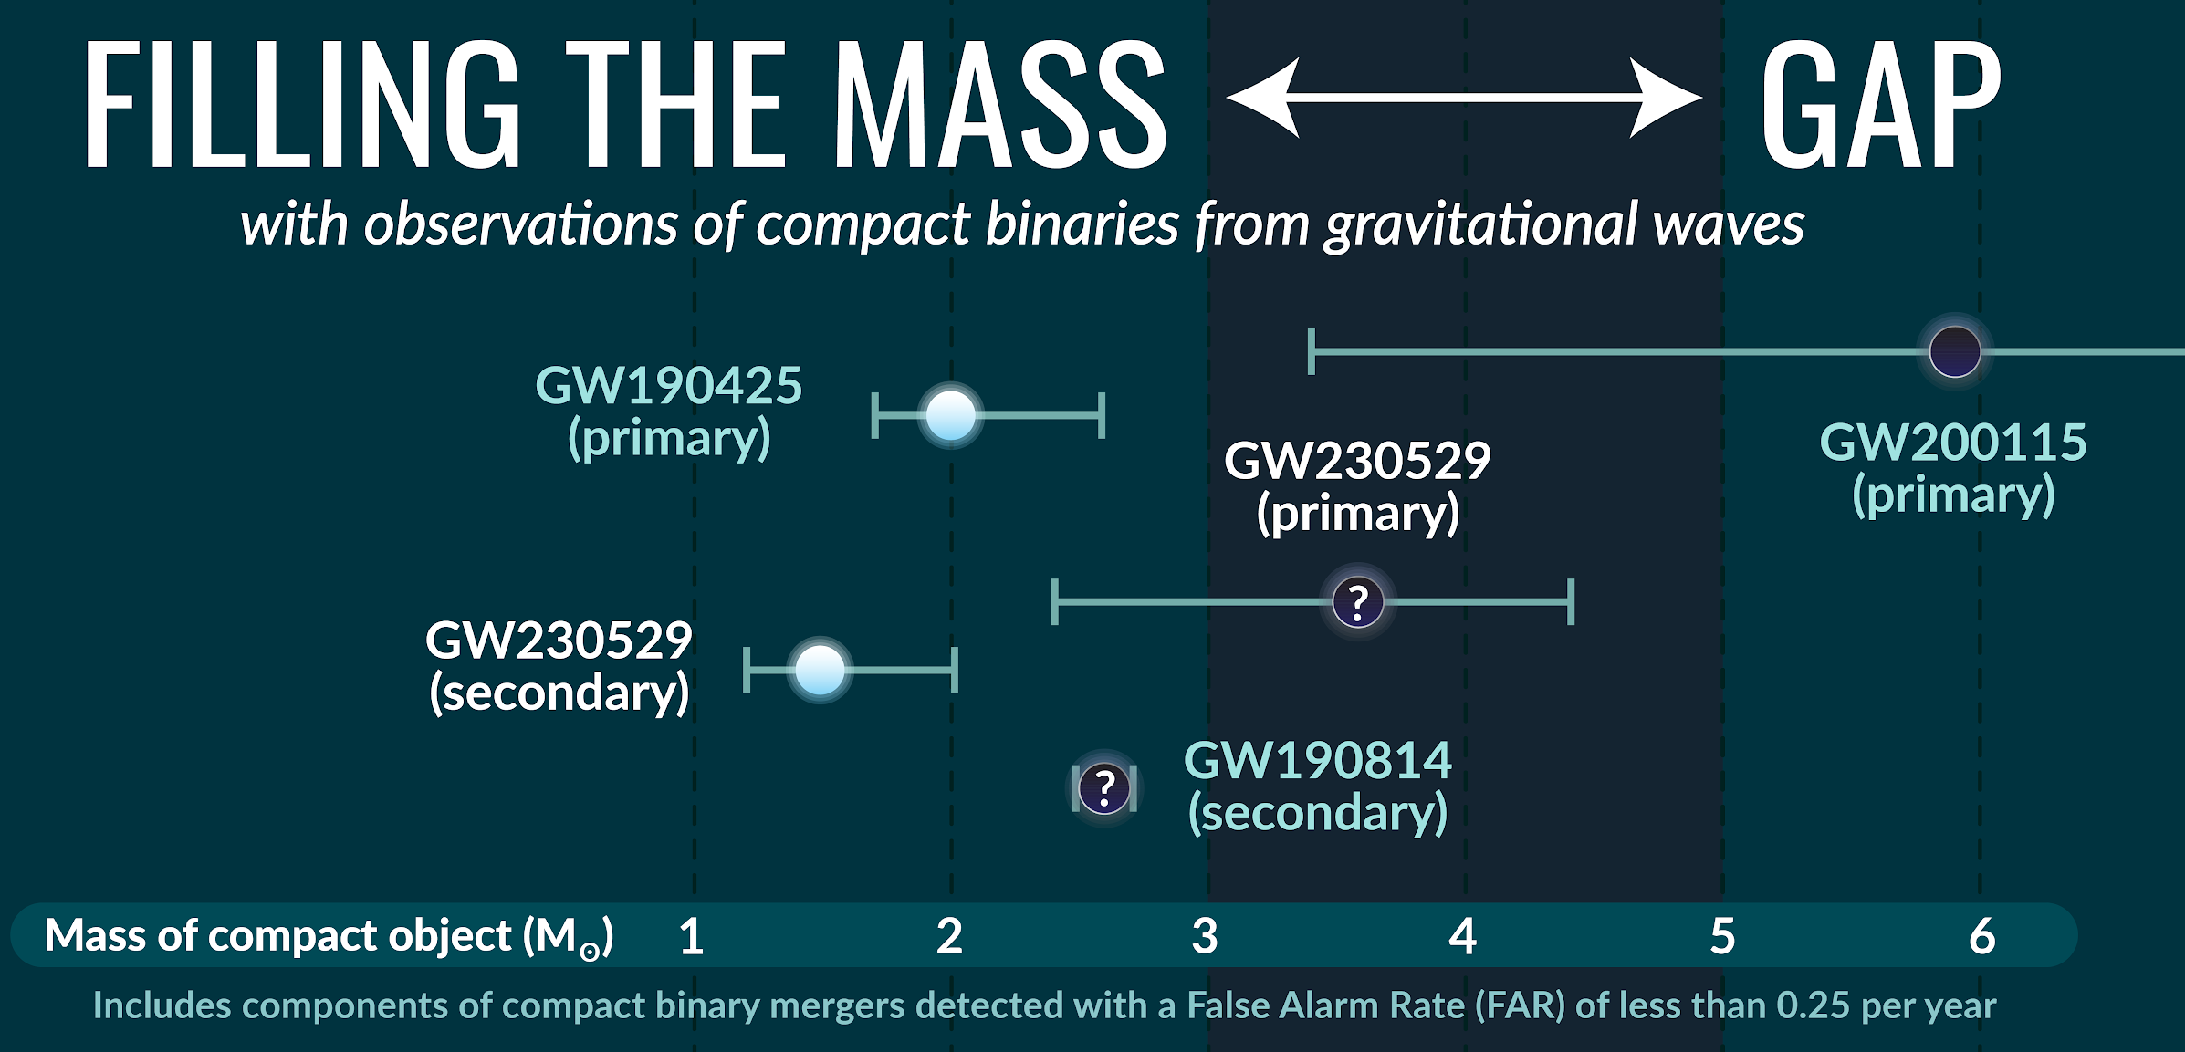
GW230529 - The first exceptional event in O4
Source: Black Hole - Neutron Star system (with high probability)
Component masses:
m1 = 3.6^{+0.8}_{-1.2} M☉
m2 = 1.4^{+0.6}_{-0.2} M☉
It provided a big evidence for compact objects existing within the purported NS-BH mass gap
Discovery paper: https://doi.org/10.48550/arXiv.2404.04248

Slide 15
O4 is ongoing and will last until 2026… Stay tuned!
Thanks for the attention!
Lorenzo Piccari
PhD - 39° Cycle

