Slide 1
A Simple Model of Pentaquarks
Davide Germani
Based on:
D. Germani, A. D. Polosa, F. Niliani, A Simple Model of Pentaquarks (arXiv:2403.04068 [hep-ph])

Slide 2
Outline
Overview of the current situation;
A simple model for pentaquarks
A different point of view
Our ‘Hadro-Charmonia’ model: the role of the exchange interaction
Spin assignment and Mass prediction
Possible new processes
Suppression Mechanism in Baryons

Slide 3
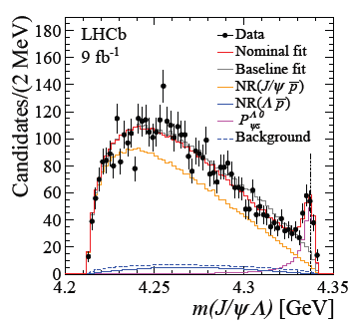
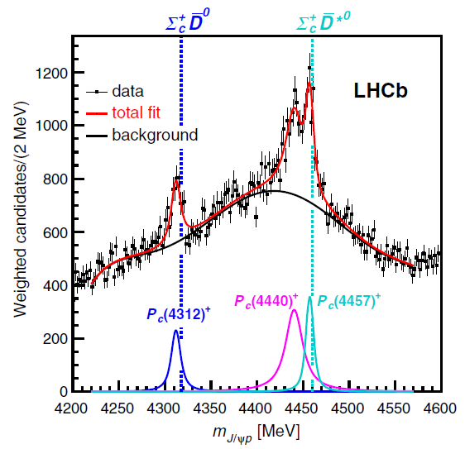
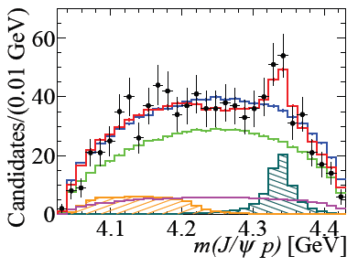
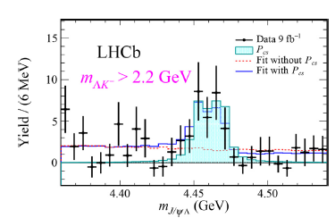
Current situation
R. Aaij et al. arXiv:1904.03947 [hep-ex] (2019), R. Aaij et al. arXiv:2012.10380v2 [hep-ex] (2021), R. Aaij et al. arXiv:2210.10346 [hep-ex] (2021), R. Aaij et al. arXiv:2108.04720 [hep-ex] (2022)

Slide 4
A different point of view
$$P_{c}^{+} [c\overline{c}uud]$$
We divide the spectrum according to strangness content.
Data suggests two different type of production: in association with a $K^{−}$ or with an $\overline{p}$.
$P_{cs}^{0} [c\overline{c}uds]$
Pentaquark seems to appear in triplet
Can we build a model to account for these properties?
$S=\frac{1}{2}$

Slide 5
An ‘Hadro-Charmonia’ Model
The starting point is more or less the same of the Born-Oppenheimer approach. We consider the $c\overline{c}$ system in a color octet as well as the three light quarks sysyem;
Fermi statistics for ligth quarks;
$$q$$
$$8_{C}$$
$$q$$
$$q$$
Interacting fermions…
$$c$$
$$8_{C}$$
$$\overline{c}$$

Slide 6
Exchange Interaction! Three Fermions Case
Generalization of the well known two fermions case
The potential has three distinct eigenvalues

Slide 7
An ‘Hadro-Charmonia’ Model
The starting point is more or less the same of the Born-Oppenheimer approach. We consider the $c\overline{c}$ system in a color octet as well as the three light quarks sysyem;
Fermi statistics for ligth quarks;
$$q$$
$$8_{C}$$
Exchange Interaction. But to use to use the exchange interaction, we need to have a precise symmetry on the spin-orbital part which means a complete symmetry in the color-flavor sector
$$q$$
$$q$$
$$c$$
(flavor)
$$8_{C}$$
$$\overline{c}$$

Slide 8
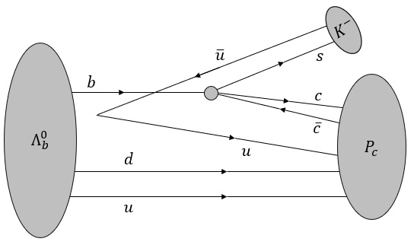
Symmetric and Antisymmetric Combination
1.
$$P$$
2.
$$\tilde{P}$$
The diquark $ud$has initially ${\left[ud\right]}_{3_{F}{ 0}_{S}}^{{\overline{3}}_{c}}$ (good diquark) so it means that is in a symmetric configuration wrt color-flavor. We assume that the color-flavor symmetry is preserved in the process so we choose the $S$ tensor for the pentaquarks produced in association with $K^{−}$.

Slide 9
Our ‘Hadro-Charmonia’ model
Fermi statistics for ligth quarks
Color-Flavour
Spin-Orbital
+
S
$$q$$
$$8_{C}$$
A
A
S
$$q$$
Exchange Interaction
$$q$$
$$c$$
$$8_{C}$$
$$\overline{c}$$
J couplings:
Experimental Data
+
$qq$ interactions in one gluon exchange approximation
+
Spin assignment

Slide 10
J parameters: how do we fit?
$$P_{c}^{+} [c\overline{c}uud]$$
S = $\frac{1}{2}$
S = $\frac{3}{2}$
S = $\frac{1}{2}$
1.
We search for a solution of the sistem that respects the constraints on the sign an ratio of the couplings.
2.
3.

Slide 11
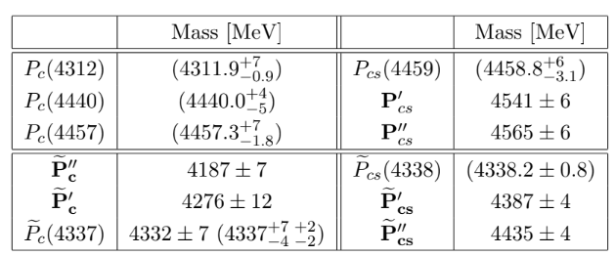
Spin assignment and Mass prediction
We have the spin prediction for these particles. Each triplet is ordered from top to bottom with $S=1/2, 3/2,1/2$.

Slide 12
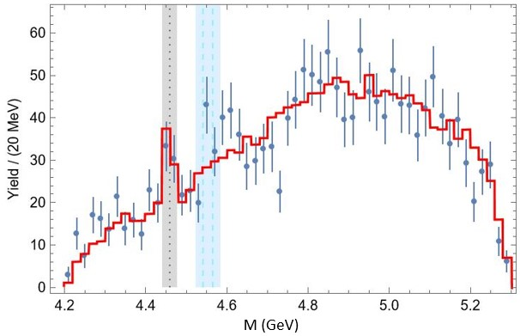
Spin assignment and Mass predictions
$$P_{cs}^{0}(4459)$$
$$Ξ_{b}^{−}→\left(J/ψΛ\right)K^{−}$$
We have the spin prediction for these particles. Each triplet is ordered from top to bottom with $S=1/2, 3/2,1/2$.
Theoretically predicted
$$\text{R}\text{. }\text{Aaij} \text{et} \text{al}\text{. }\text{arXiv}\text{:2012.10380}\text{v}\text{2 [}\text{hep}\text{−}\text{ex}\text{]}$$

Slide 13
Spin assignment and Mass predictions
Not allowed in $B^{−}$ decay
We have the spin prediction for these particles. Each triplet is ordered from top to bottom with $S=1/2, 3/2,1/2$.

Slide 14
Good vs Bad diquarks
$$Σ_{b}^{0}$$
$${\tilde{P}}_{c}$$
Triplet produces $P$ pentaquarks
Sextet produces $\tilde{P}$ pentaquarks!

Slide 15
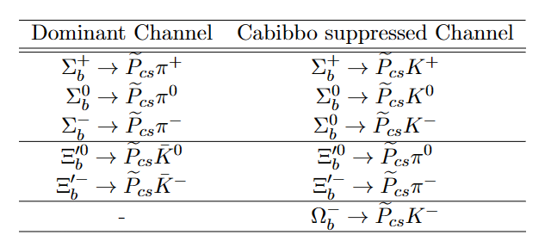
Good vs Bad diquarks
$$Σ_{b}^{0}$$
$${\tilde{P}}_{c}$$
Sextet produces $\tilde{P}$ pentaquarks!

Slide 16
Suppression Mechanism in Baryons
$$Λ_{b}^{0}→P_{c}K^{−}→\left(J/ψp\right)K^{−}$$
Suppression of the antisimmetric
color-flavor part
This is the only possible diagram in this case, but there are processes with other diagrams
We do not observe
$$Λ_{b}^{0}→{\tilde{P}}_{c} K^{−}$$
$$Ξ_{b}^{−}→P_{cs}K^{−}→\left(J/ψΛ\right)K^{−}$$
$$\overline{c}$$
$$b$$
$$c$$
$${ P}_{cs}$$
$$d$$
$$s$$
$$+$$
$$Ξ_{b}^{−}$$
$$Ξ_{b}^{−}$$
$$P_{cs}$$
$$u$$
$$\overline{u}$$
$$s$$
$$s$$
$$K^{−}$$

Slide 17
Suppression Mechanism in Baryons
$$Ξ_{b}^{−}→P_{cs}K^{−}→\left(J/ψΛ\right)K^{−}$$
$$\overline{c}$$
$$b$$
$$c$$
$${ P}_{cs}$$
$$d$$
$$s$$
$$+$$
$$Ξ_{b}^{−}$$
$$Ξ_{b}^{−}$$
$$P_{cs}$$
$$u$$
$$\overline{u}$$
$$s$$
$$s$$
$$K^{−}$$
$$Ξ_{b}^{−}→{\tilde{P}}_{cs}K^{−}→\left(J/ψΛ\right)K^{−}$$
$$\overline{c}$$
$$b$$
$$c$$
$${ \tilde{P}}_{cs}$$
$$d$$
$$s$$
$$+$$
$$Ξ_{b}^{−}$$
$$Ξ_{b}^{−}$$
$${\tilde{P}}_{cs}$$
$$u$$
$$\overline{u}$$
$$s$$
$$s$$
$$K^{−}$$
Suppression of the antisimmetric color-flavor part

Slide 18
Suppression Mechanism in Baryons
$$\overline{c}$$
$$b$$
$$c$$
$${ P}_{cs}$$
$$d$$
$$s$$
$$Ξ_{b}^{−}$$
$$u$$
$$\overline{u}$$
$$s$$
$$K^{−}$$
$Ξ_{b}^{−}→{\tilde{P}}_{cs}K^{−}→\left(J/ψΛ\right)K^{−}$ Suppressed
$$\overline{c}$$
$$b$$
$$c$$
$${ \tilde{P}}_{cs}$$
$$d$$
$$s$$
$$+$$
$$Ξ_{b}^{−}$$
$$Ξ_{b}^{−}$$
$${\tilde{P}}_{cs}$$
$$u$$
$$\overline{u}$$
$$s$$
$$s$$
$$K^{−}$$
Suppression of the antisimmetric color-flavor part

Slide 19
Conclusions
By exploiting Fermi statistics and exchange interaction, we are able to provide a prediction for the spin of the observed pentaquarks and make predictions for the masses of the remaining pentaquarks to complete the triplets;
The data suggests two different types of production for pentaquarks. Our model, based on the existence of two tensors in color-flavor space, could provide a way to account for this experimental fact. Further studies are necessary, particularly to determine the value of the ratio
;
The decay of heavy baryons containing the bottom quark and belonging to the baryonic sextet can be used to study the pentaquarks $P_{cs}$, which are not visible in the decay of $B^{−}$.

Slide 21
Backup

Slide 22
Young Tableau
(Anti-) Symmetric under the exchange of any pair
e.g. $(i,a)↔(b,j)$

Slide 23
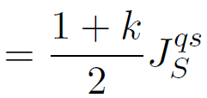
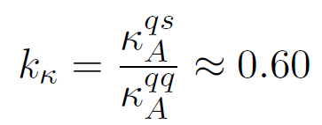

Slide 24
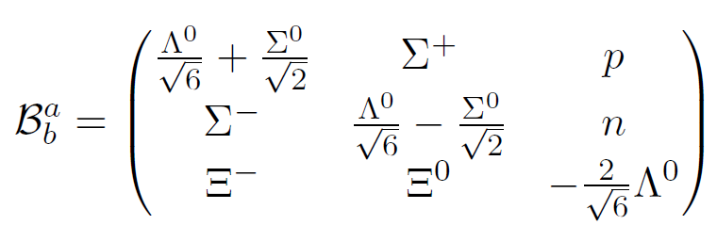
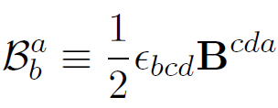
Baryon Octet Matrix
We consider the greek letters to be spin indices and the latin letters to be flavor ones
Baryon Operator
H. Georgi, Lie algebras in particle physics. From isospin to unified theories

