Slide 1
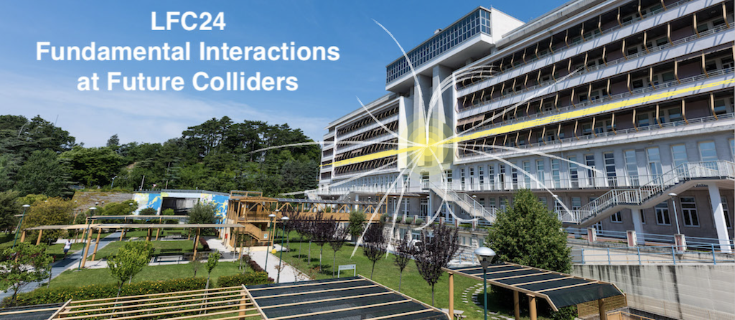
Future collider: technology challenge and roadmap
Lucio Rossi – University of Milan and INFN-Milan
Lucio Rossi

Slide 2

C.o.M.
energy
CERN
LAL DESY
100 TeV
100 TeV
CORNELL U.
JINR
SPPC IHEP
FCC-hh CERN
BNL FNAL
LNF
KEK IHEP
FCC-he CERN
10 TeV
LBNL SLAC
LHC CERN
HILUMI LHC CERN
10 TeV
MUON-C 10T - CERN
LHC CERN
MUON-C 3 T - CERN
TEVATRON FNAL
CLIC CERN
1 TeV
1 TeV
SppS CERN
FCC-ee CERN
LEP2 CERN
HERA DESY
CLIC CERN
CEPC IHEP
EIC BNL
100 GeV
SLC SLAC
LEP CERN
100 GeV
ISR CERN
TRISTAN KEK
PETRA DESY
TEVATRON FNAL
FNAL M.RING
SPS
CERN
PEP SLAC
PROTOSINCROTRONE
10 GeV
CESR CORNELL U.
10 GeV
SERPUKHOV JINR
AGS BNL SPEAR SLAC DORIS DESY
KEKB KEK
SUPERKEKB KEK
COLLISORE ADRONICO
PEP-II SLAC
PS CERN
COLLISORE ELETTRONE-ADRONE
COLLISORE
ELETTRONE-POSITRONE
BEVATRON LBNL
SINCROFASOTRONE JINR
COSMOTRON BNL ADONE LNF
BEPC-II IHEP
1 GeV
ACO LAL
DAFNE LNF
1 GeV
ADA LNF
1960
SUPERCONDUTTORE
2050 2060
1940
1950
1970
1980
1990
2000
year
2010
2020
2030
2040

Slide 3
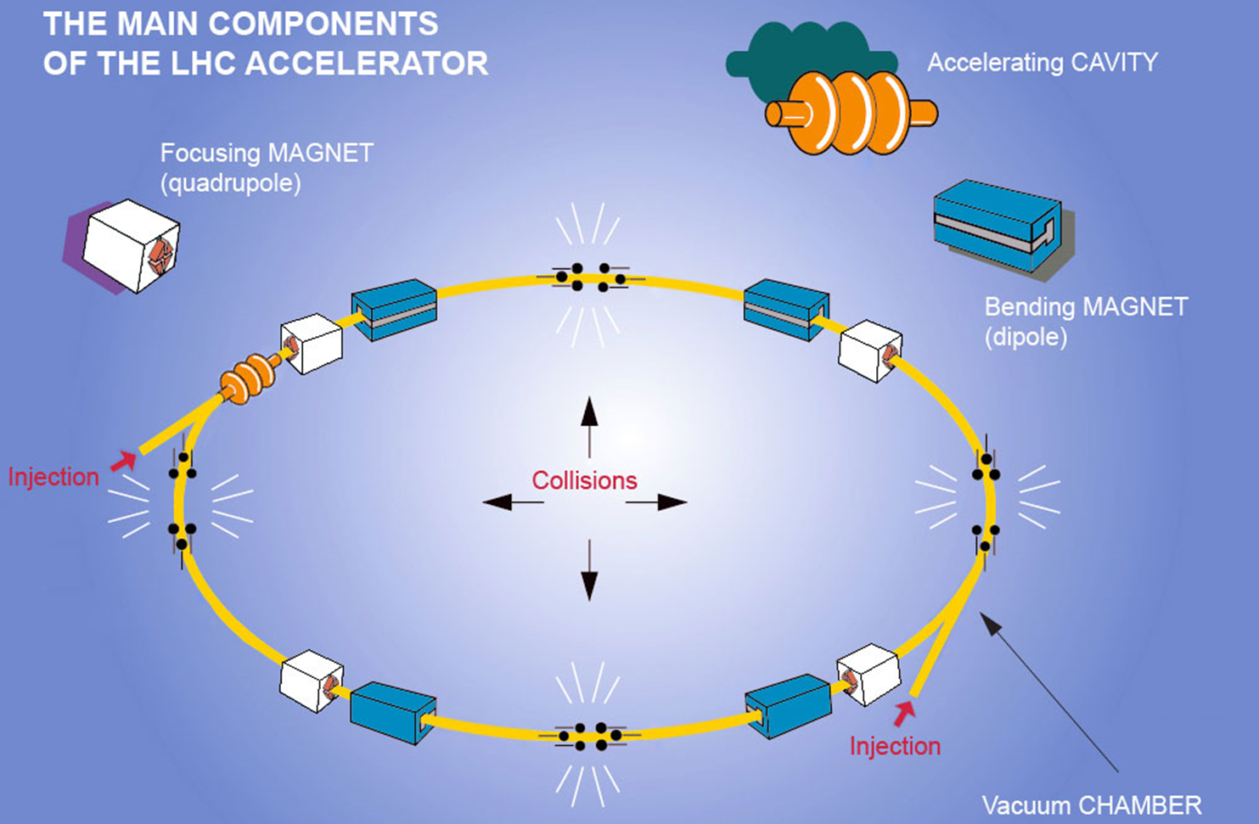

Slide 4
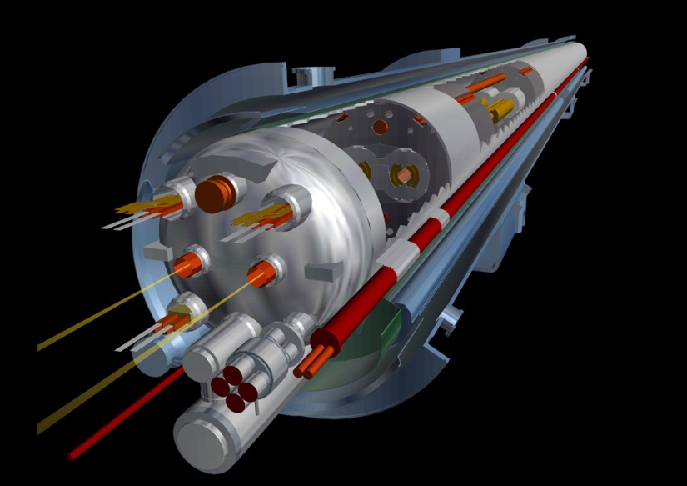
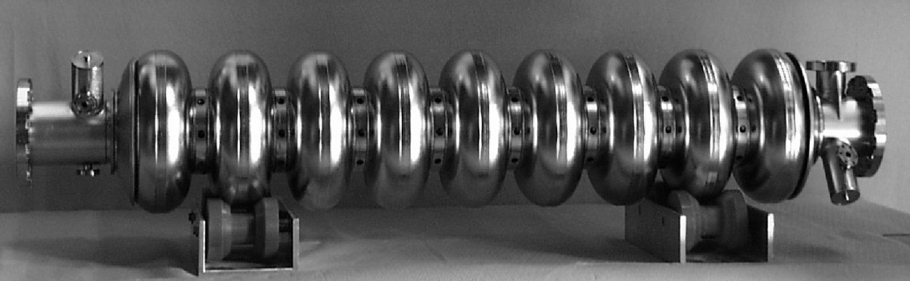
Superconducting accelerators
Rationale for
superconductivity in accelerators
Circular Accelerators
  E_{beam} = 0.3 B r [GeV] [T] [m]
  → superconducting bending and focussing magnets
    high-energy hadron synchrotrons
Linear Accelerators
  E_{beam} = E L [MeV] [MV/m] [m]
  → superconducting acceleration cavities
    high-energy e⁺-e⁻linacs

Slide 5
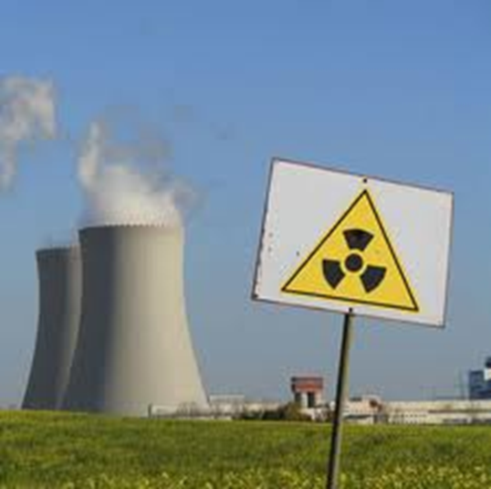
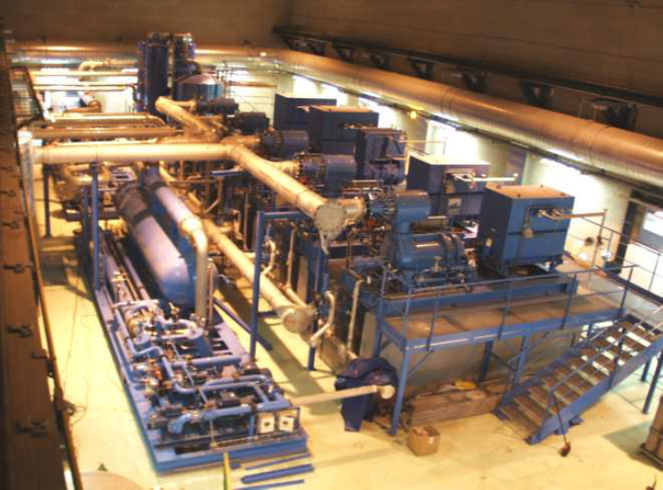
Superconductivity : performance AND sustainability
Superconducting LHC
Normalconducting LHC
Tunnel: 27 km
Field : 8.3 T
Cryoplant power at the plug: 40 MW: always on
∼ 70 MW for LHC. 150 MW for the accelerator complex
180 MW for the whole CERN complex
Tunnel 120 km
Field : 1.8 T
Dissipated power at collision: ∼ 2,200 MW
Average power (0.4 coefficient): 900 MW only for accelerator
However, power is required only when operating while power in SC magnets is needed to keep it cold… a factor 2 favorable in energy for NC

Slide 6
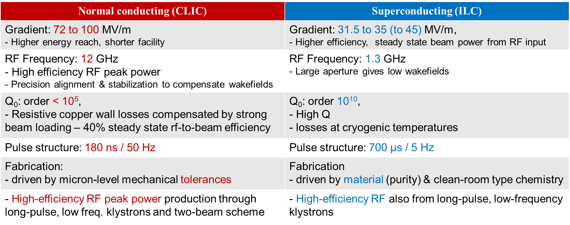

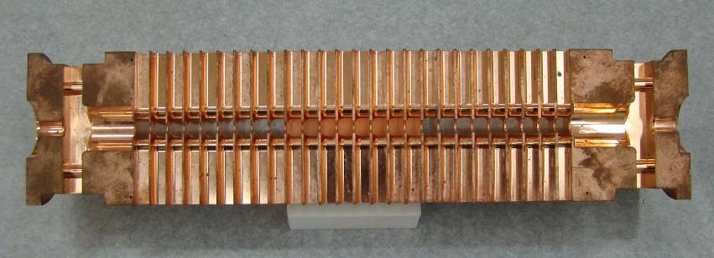
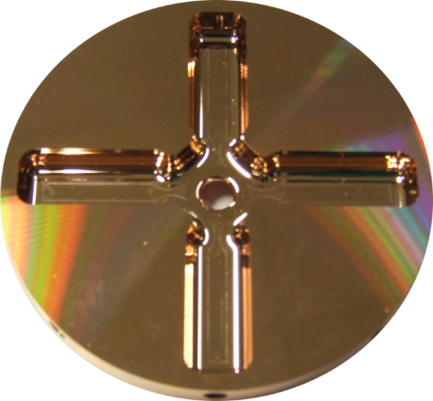
Normal and SC RF : a comparison for HEP colliders
Courtesy: W. Wuensch
Courtesy: A. Yamamoto

Slide 7
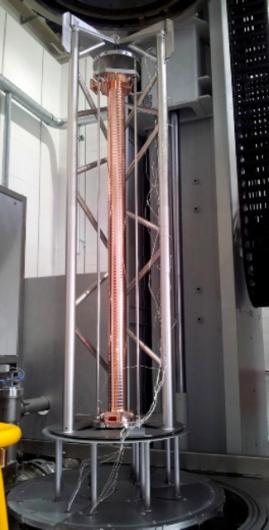
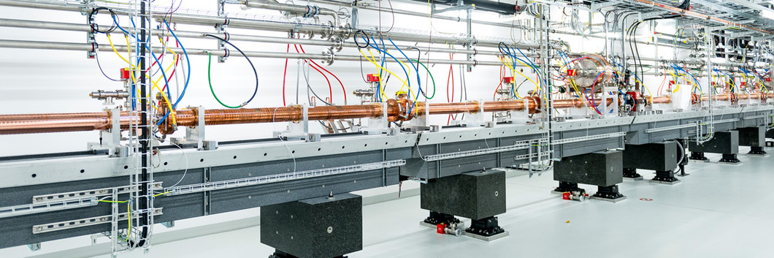

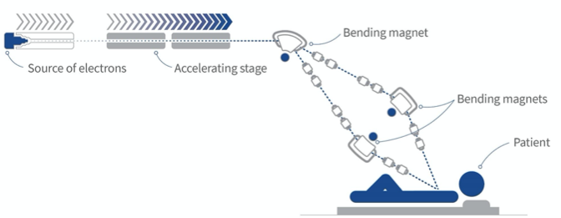
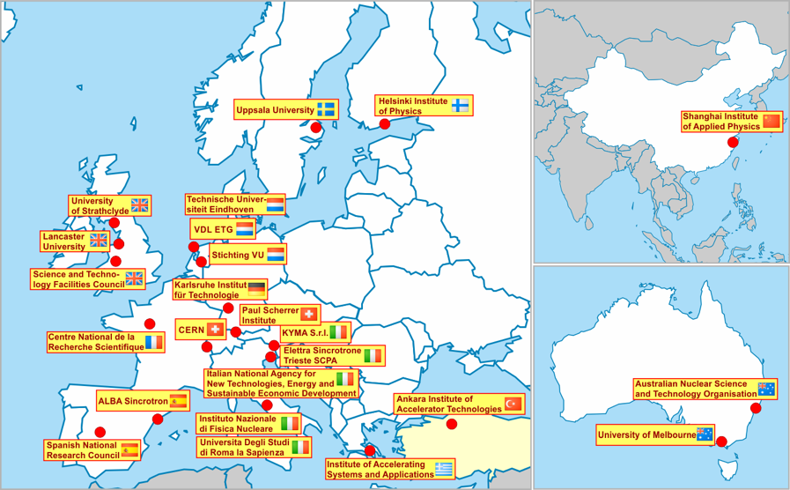
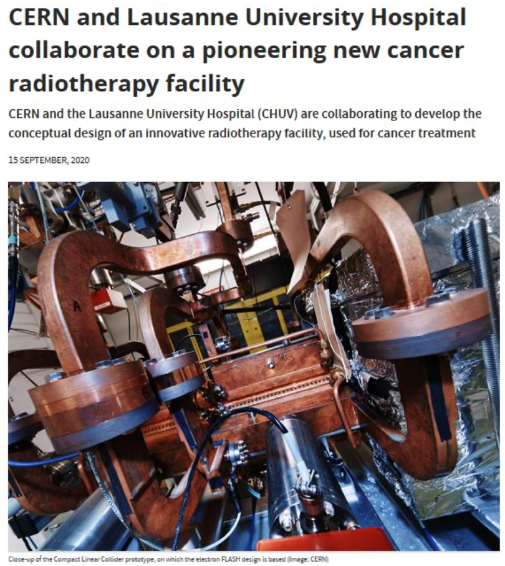
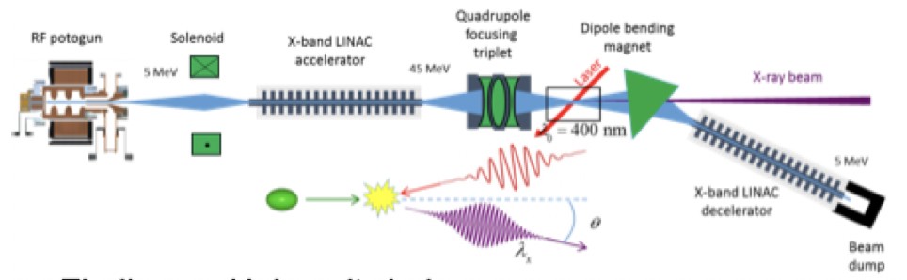
NC RF structures: use in smaller linacs (C and X-band)
SwissFEL: C-band linac
Photo: SwissFEL/PSI
104 x 2 m-long C-band (5.7 GHz) structures (beam up to 6 GeV at 100 Hz)
Similar-to-Clic μm-level tolerance
Length ~ 800 CLIC structures
Being commissioned
X-band structures from PSI perform well
26 academic and industrial partners: http://www.compactlight.eu/Main/HomePage
CompactLight Design Studies 2018-21 (link)
Compact FEL based on X-band technologies
CERN: eSPS study (3.5 GeV X-band linac)

Slide 8
Pushing the NC RF technology – Two lines of basic R&D
CLIC core studies:
Normal conducting accelerating structures are limited in gradient by three main effects (setting aside input power):
Field emission
Vacuum arcing (breakdown)
Fatigue due to pulsed surface heating
Studying these processes gives important input into:
RF design – Optimizing structures also coupled with beam dynamics
Technology – Material choice, process optimization
Operation – Conditioning and recovery from breakdown
Designs for CLIC steadily improving, but also RFQ, Muon collider, XFEL, ICS, etc
Important experimental support
Multi-TeV energies:
High gradient, high wall-plug to beam efficiency, nanobeam parameters increasingly demanding
Improving… building on solid ground making steady progress
Exploring new routes: why not? But much more that a PoP is needed
S. Stapnes et al., CERN
S. Calatroni et al., CERN

Slide 9
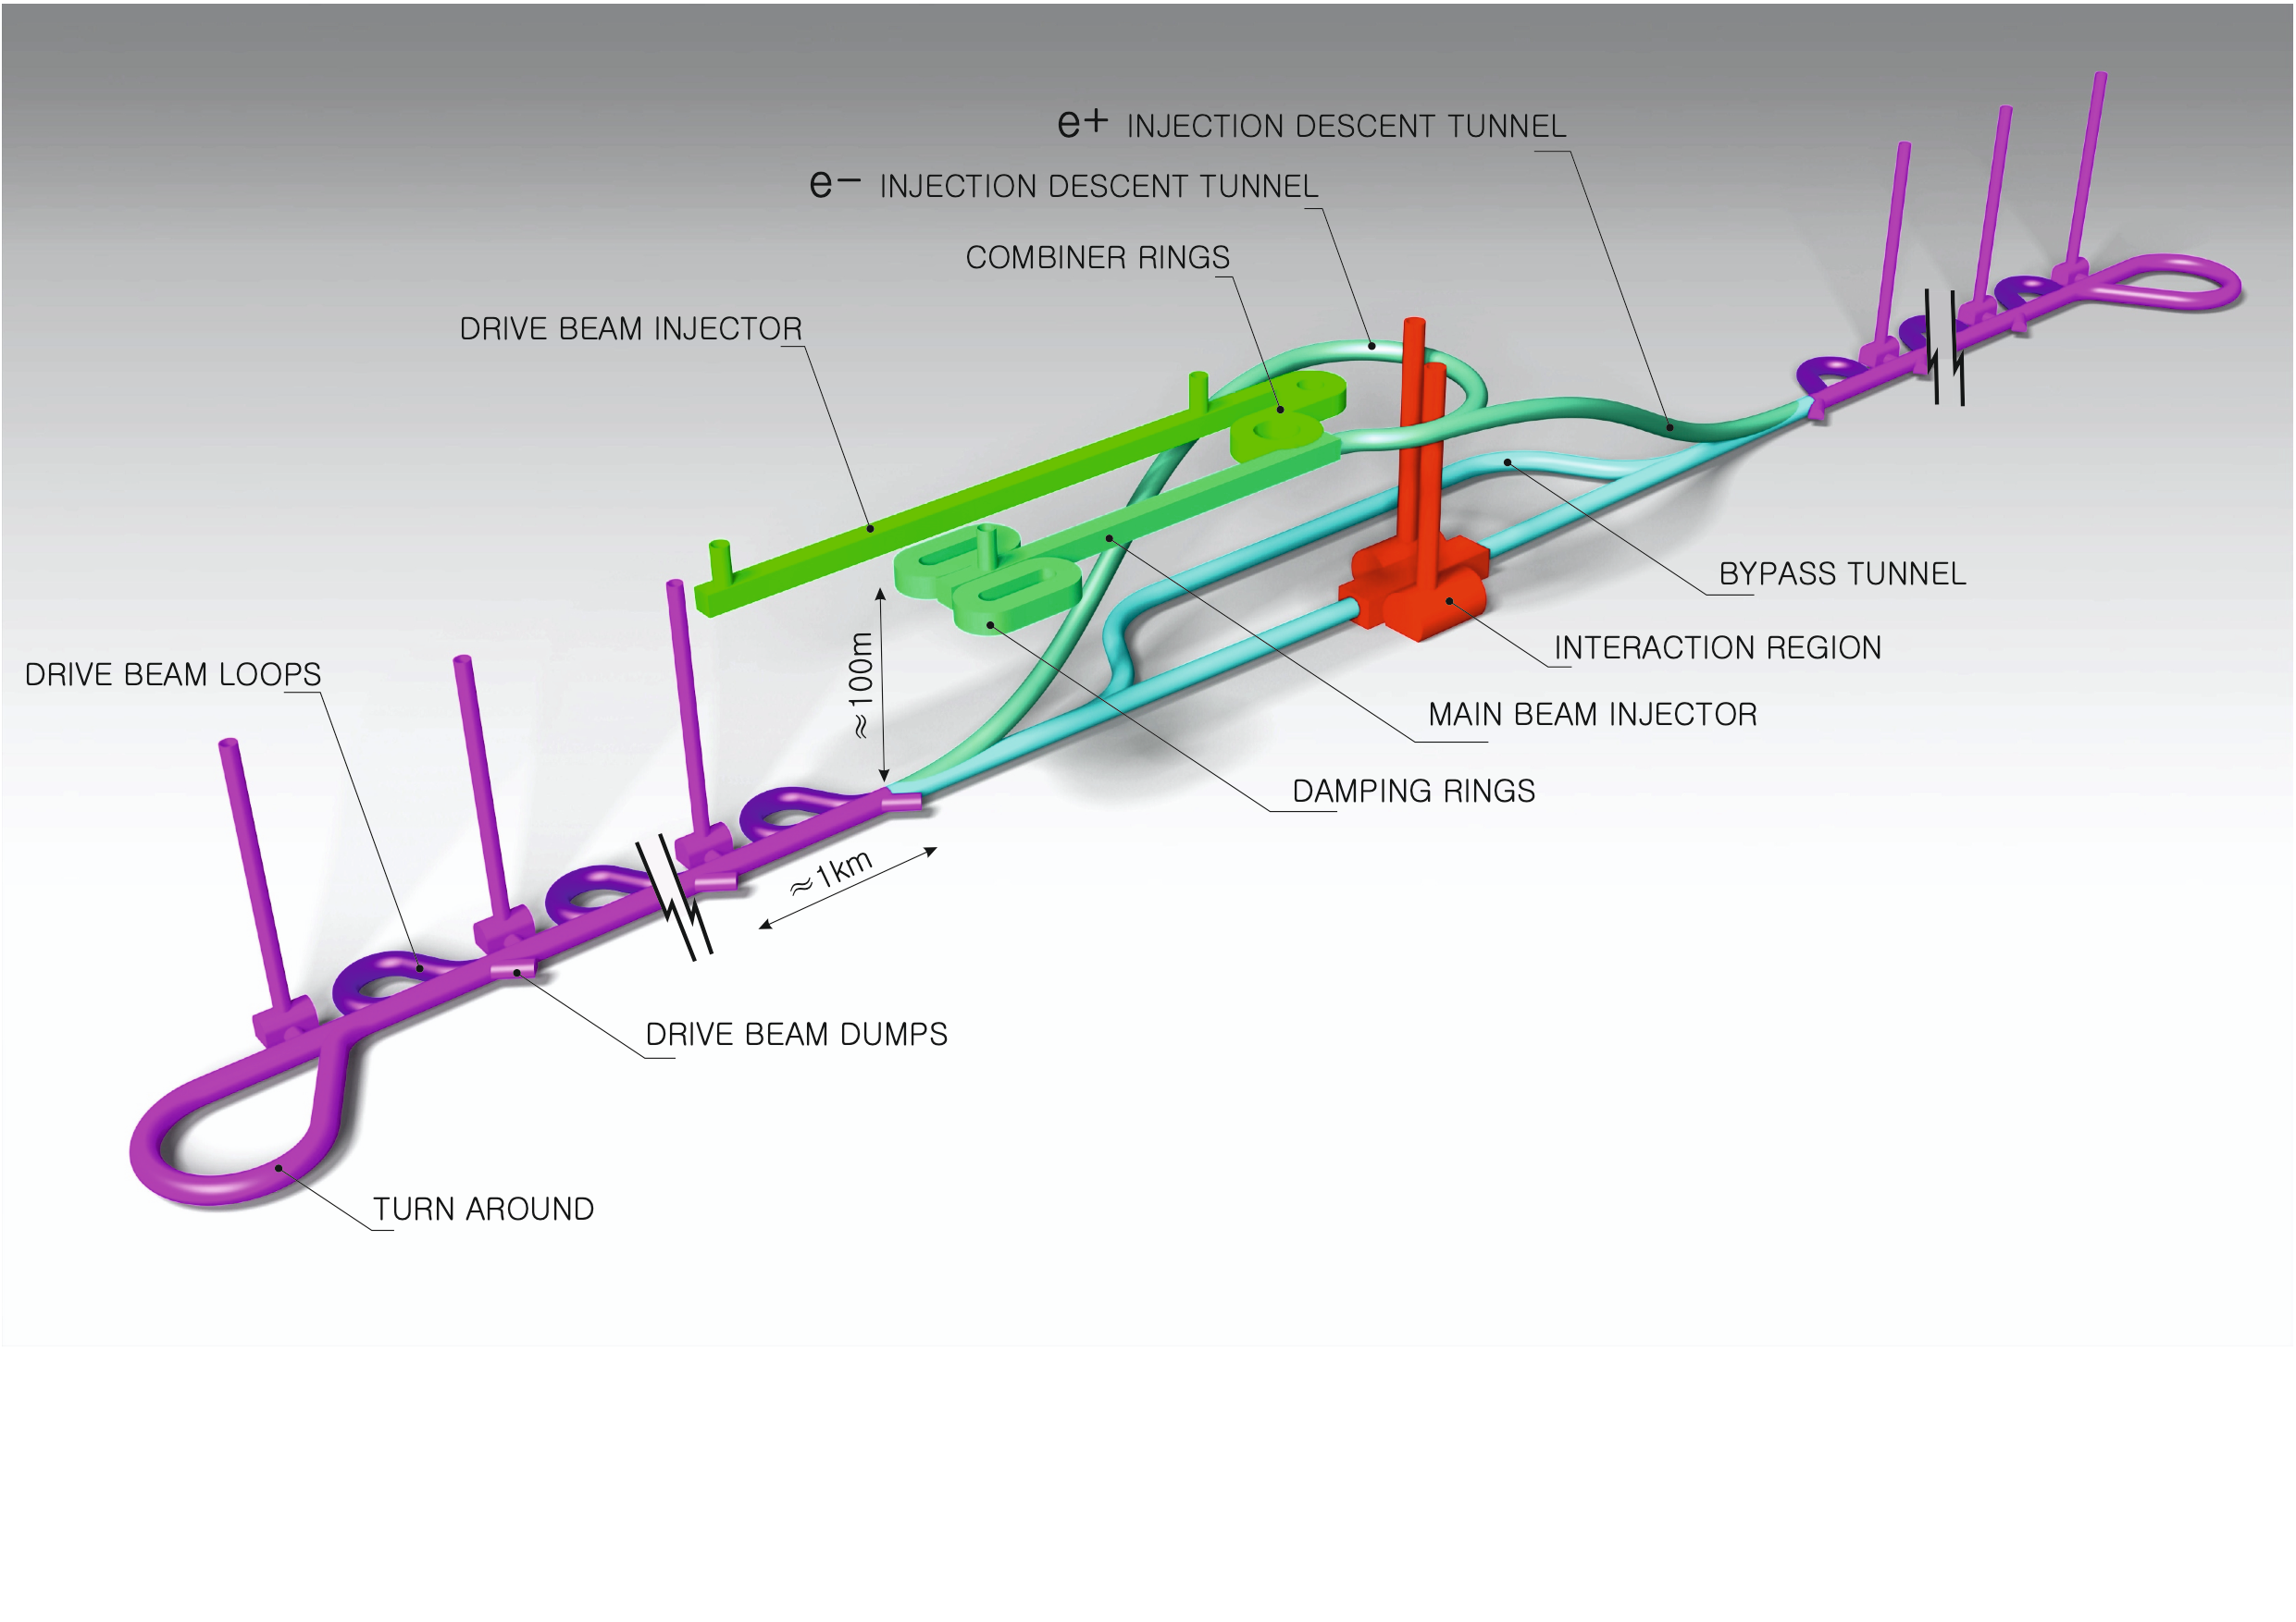
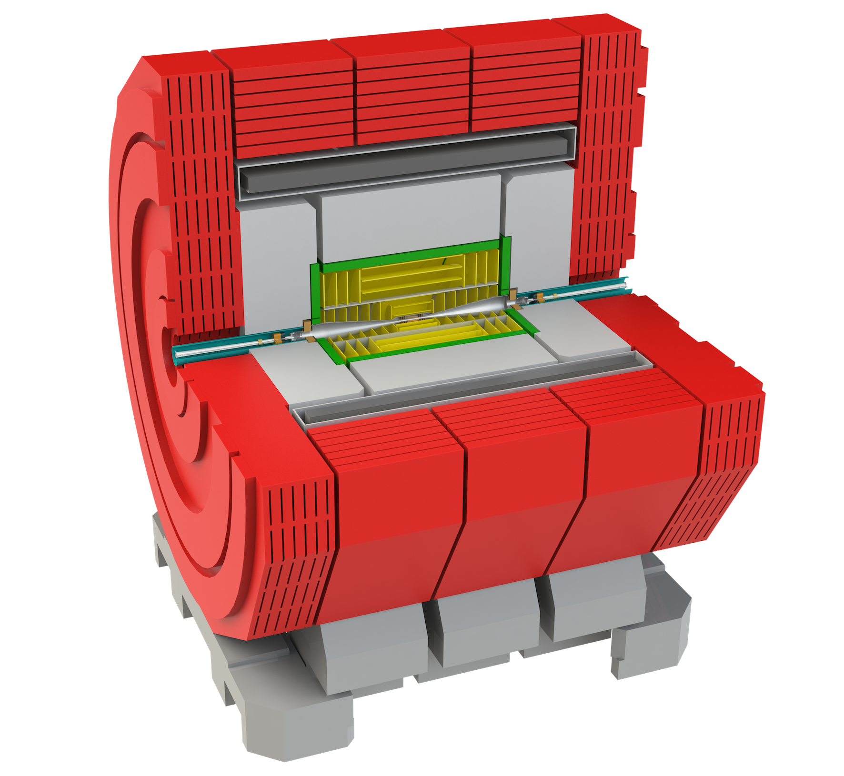
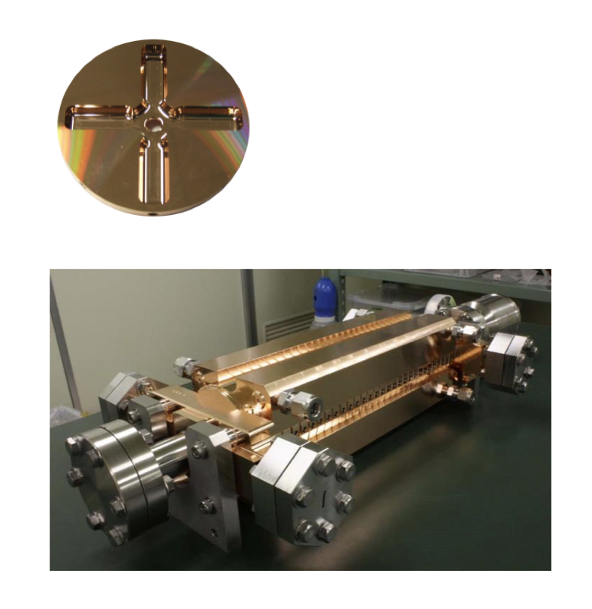
The Compact Linear Collider (CLIC)
  Timeline: Electron-positron linear collider at CERN for the era beyond HL-LHC
  Compact: Novel and unique two-beam accelerating technique with high-gradient room temperature RF cavities (~20’500 structures at 380 GeV), ~11km in its initial phase
  Expandable: Staged programme with collision energies from 380 GeV (Higgs/top) up to 3 TeV (Energy Frontier)
  CDR in 2012 with focus on 3 TeV. Updated project overview documents in 2018 (Project Implementation Plan) with focus 380 GeV for Higgs and top.
  Cost: 5.9 BCHF for 380 GeV
  Power/Energy: 110 MW at 380 GeV (~0.6 TWh annually),
  corresponding to 50% of CERN’s energy consumption today
  Comprehensive Detector and Physics studies
Accelerating structure prototype for CLIC:
12 GHz (L~25 cm)
Notes:
Include Phys and Det studies

Slide 10
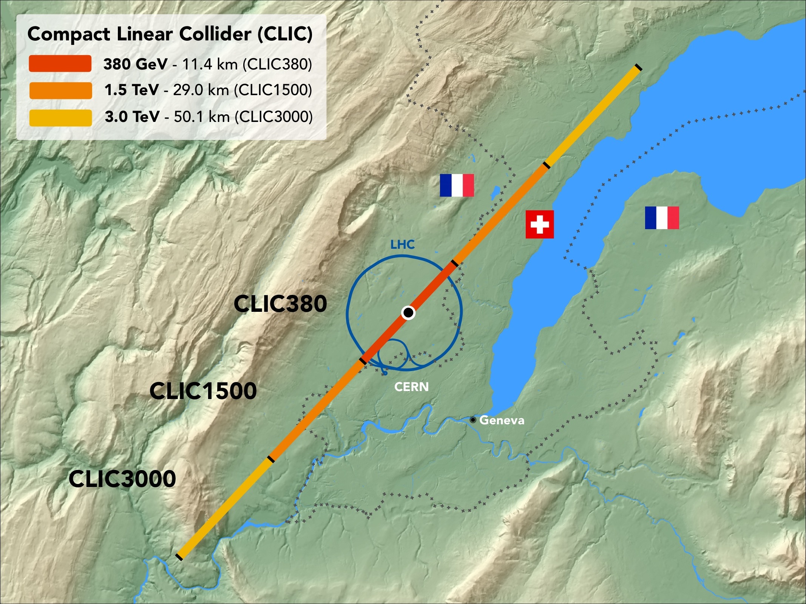
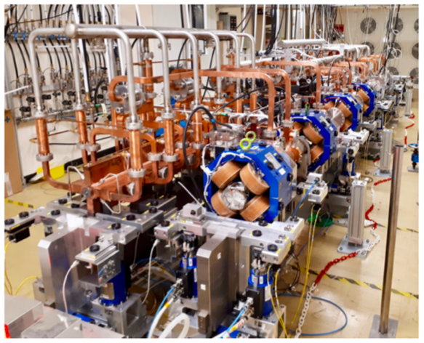
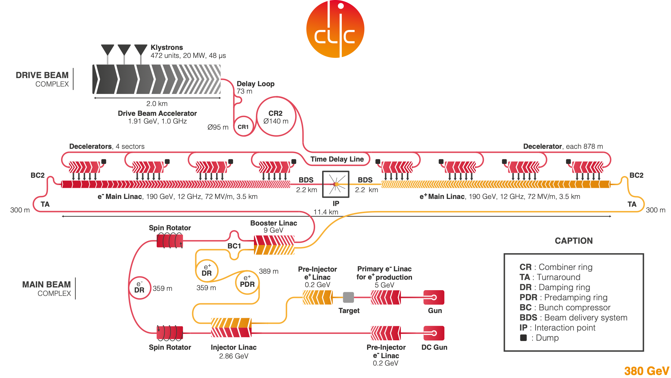
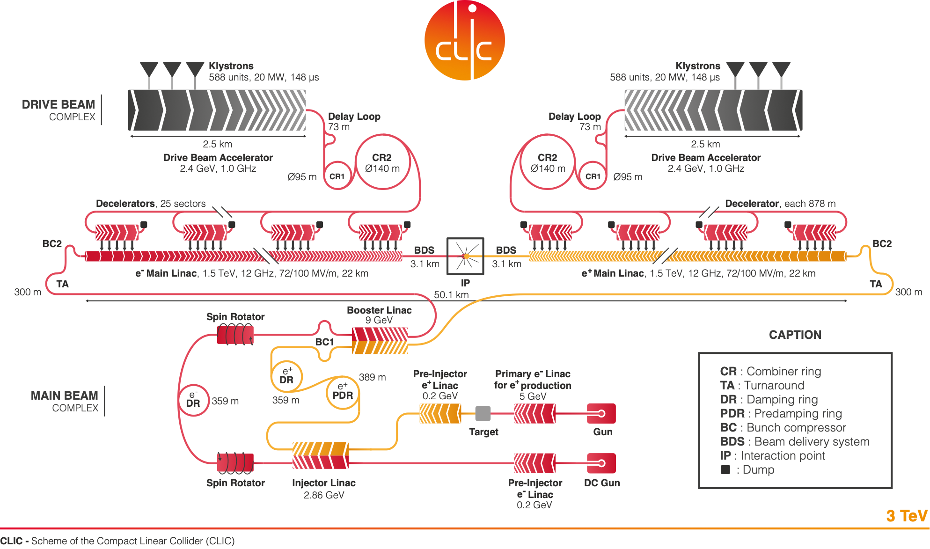
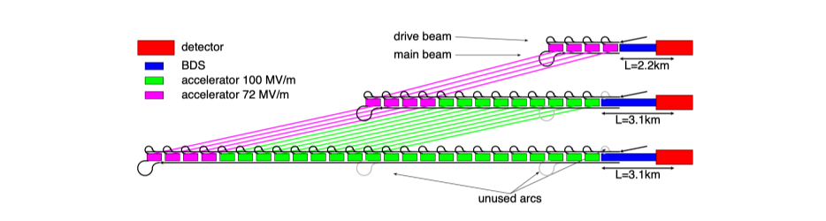
CLIC can be extended into multi-TeV region
  What are the critical elements:
    Physics
    Gradient and power efficiency
    Costs
  Drive beam accelerated to ~2 GeV using conventional klystrons
  Intensity increased using a series of delay loops and combiner rings
  Drive beam decelerated and produces high-RF
  Feed high-RF to the less intense main beam using waveguides
  Extend by extending main linacs, increase drivebeam pulse-length and power, and a second drivebeam to get to 3 TeV

Slide 11



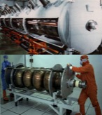


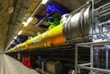

SRF Technology: vast experience, diffuse know-how
Progress (1988~)
TRISTAN
LEP-II
HERA
CEBAF
CESR
KEKB
BES
cERL
In Operation: → # cavities
SNS: 1 GeV
CEBAF 12 GeV → 80
ISAC-II, ARIEL
Super-KEKB
Eu-XFEL → 800
FRIB → 340
Under Construction:
LCLS=II → 300
PIP-II → 115
ESS→ 150
Shine → 600
To be realized:
HL-LHC-Crab → 20
EIC
ILC-250 → 8,000
FCC
CEPC/SPPS
1980
2000
2020
The success of the EU- XFEL at Desy is instrumental for all future projects based on SRF
Courtesy A. Yamamoto
> 2,000 SRF cavities realized, in last 10 years !

Slide 12

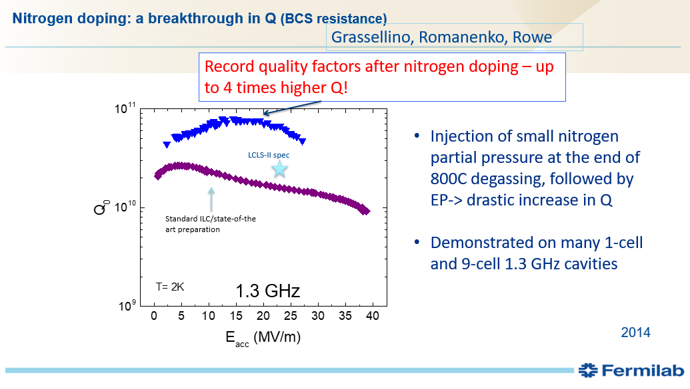
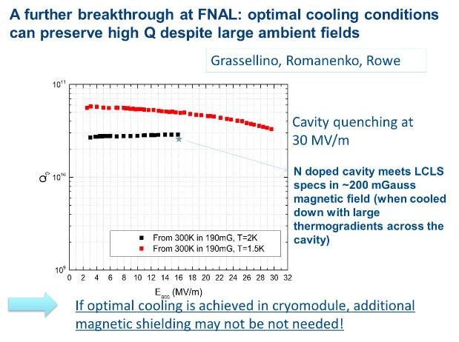
Breakthrough (especially for CW) from Fermilab

Slide 13
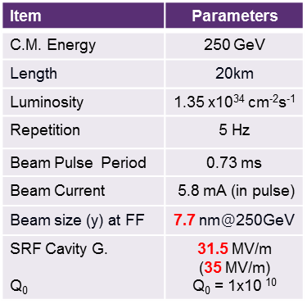

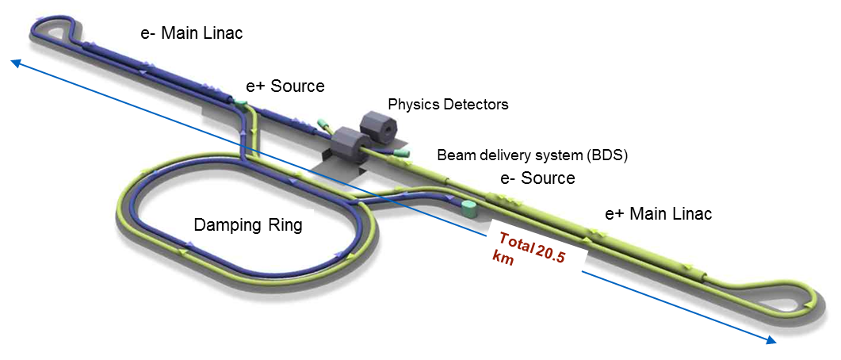
ILC – baseline proposal
8,000 1.3GHz
SRF cavities @ 2K
Cost ~5 B$
Power ~110 MW
Courtesy A. Yamamoto for ILC team

Slide 14

RF. RF – accelerating the beams
RF
Bulk Nb
Thin films
Couplers
NC High Gradient
RF power sources
LLRF, AI, ML
Courtesy S. Stapnes, CERN
Important activities on LLRF, AI and ML, and Couplers
In general for RF, developed in accelerators small and large inside HEP
Make sure knowledge, test-facilities and industries are maintained and developed longer term across projects
Gradient, Q, costs, processing, raw material and manufacturers

Slide 15
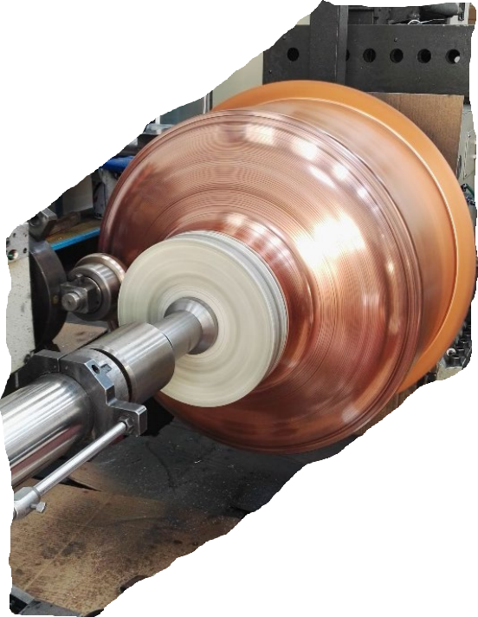
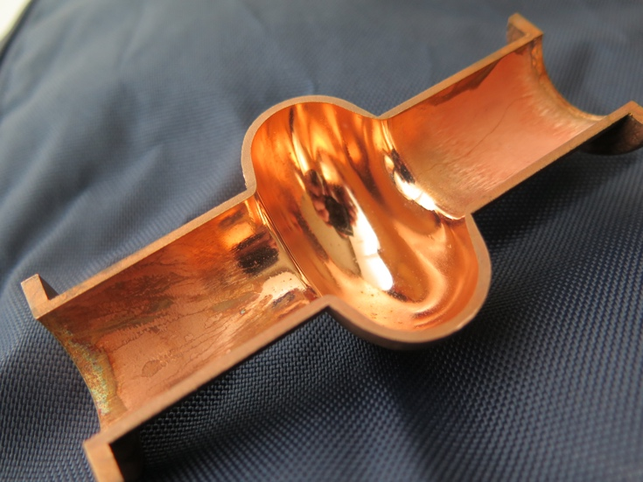
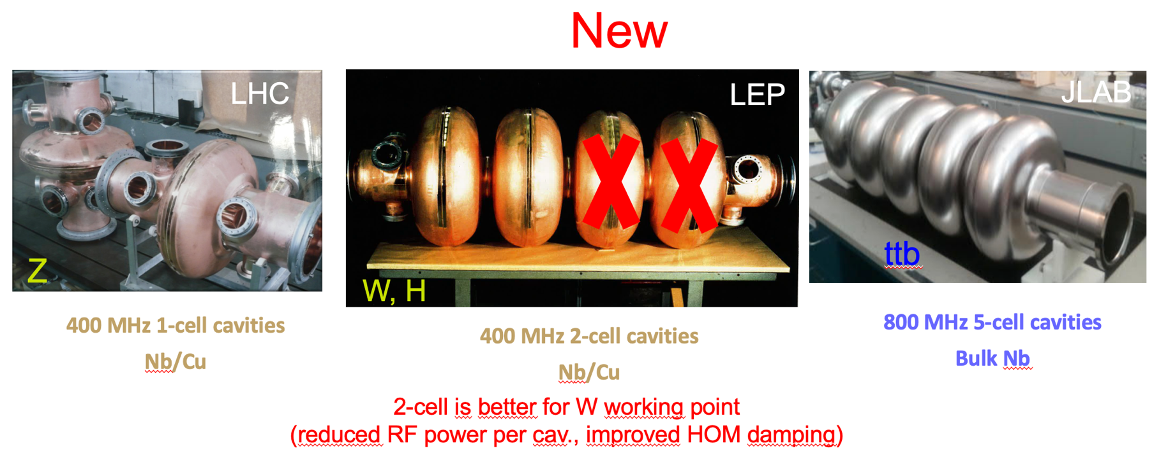
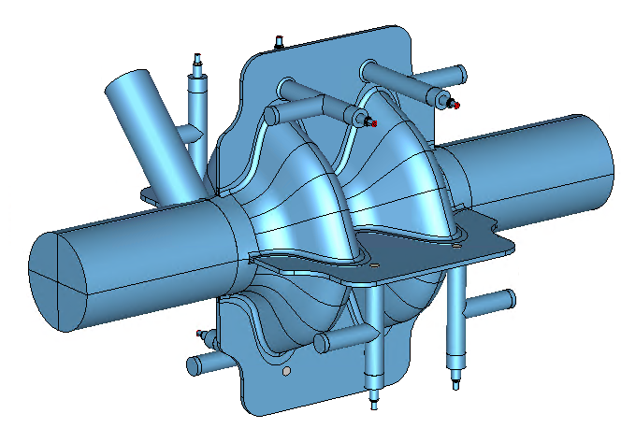
RF =====. RF – accelerating the beams
RF
Bulk Nb
Thin films
Couplers
NC High Gradient
RF power sources
LLRF, AI, ML
  Goals: high Q₀ @ 4.2K operation – reduced power, and higher E_{acc}
Q₀ (Nb₃Sn) @ 4.2 K ~ Q₀ (full-Nb) @ 2 K; E_{acc} ~25 MV/m; more sensitive to trapped flux; brittle (f₀ tuning by mechanical deformation possible?)
FCC-ee baseline left
Right: Swell 2-cell 600 MHz cavity for Z, W, H
Very interesting alternative cavity option which would cover three machines (no need to remove cryomodules after operation at Z)
Highly damped RF cavity for transverse HOMs thanks to four waveguide slots and coaxial RF lines

Slide 16
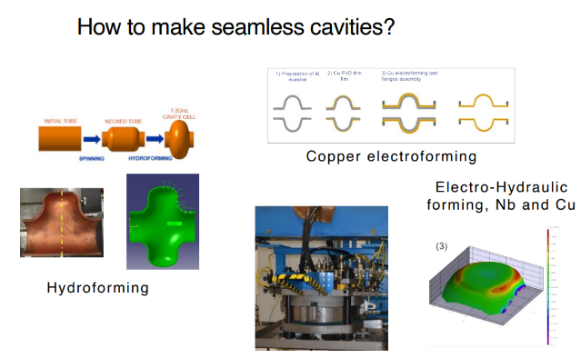
The –possible- advantage of Nb coated Cu cavities
• At cryogenic temperatures copper is a much better head conductor than Niobium, which makes more quench resistant.
• It is also mechanically more stable and cheaper to produce than Niobium.
• Combining the thermo-mechanical characteristics of copper with a tunable superconducting layer seems like a winning combination, provided that you can make a near-perfect film.
Courtesy F. Bordry & F. Gerigk , CERN
Courtesy Frank Gerigk

Slide 17
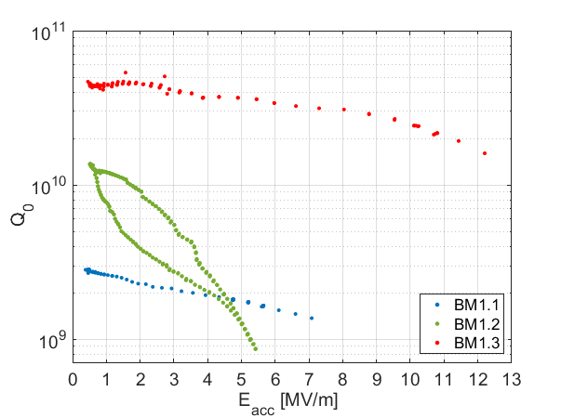
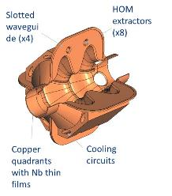
Breakthrough on thin-film SRF technology
Electropolished, 23 μm
Test of a seamless 1.3 GHz copper cavity with Nb coating at 1.85 K.
The test results are comparable with the performance of bulk Niobium cavities: high Q-value and little Q-slope.
These results gave the proof that cost-efficient thin film technology has a lot of unrealised potential.
R&D continues to extend the field reach and to use A15 superconductors (Nb3Sn, Vn3Si).
Key technology for FCC and other high-current accelerators.
SUBU, 12 μm
No chemistry
Superconducting slotted Waveguide ELLiptical cavity (SWELL):
A combination of CLIC technology (slotted waveguide HOM damping) and SRF (elliptical cavities) using technology developed for LEP, LHC and HIE-ISOLDE (Nb on Cu coating).
Made of 4 independent quadrants, machined out of bulk pieces and clamped together.
Easy coating of quadrants.
Cryogenic cooling channels are drilled into the copper instead of building dedicated helium tanks.
No assembly joints in high electromagnetic field regions: potential for high performance.
Courtesy F. Bordry & F. Gerigk , CERN
Courtesy Frank Gerigk

Slide 18


A15 (Nb₃Sn) for SRF
Q
Courtesy C. Pira, INFN-LNL, Italy
Doubling the
ACCELERATING FIELD
(form ∼ 60 to ∼ 100 MV/m)
Nb₃Sn looks a good choice
R&D for future HEP accelerators supported both by European Strategy and Snowmass
Eacc
Material | Tc | H_{sh}
Nb | 9.2 K | 0.2 T
Nb₃Sn | 18.3 K | 0.4T
Outside HEP applications
High Q even above 4 K
For small-scale applications opens up to substitute He cryogenics plants with cryocoolers
60% DECREASE IN
CRYOGENIC COSTS
D. Hall, SRF 2017 tutorials
CONS:
Complex phase diagram
Very brittle (not formable)
Poor thermal conductivity
Thin film
only possible choice

Slide 19
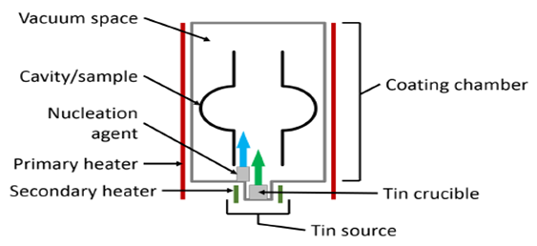
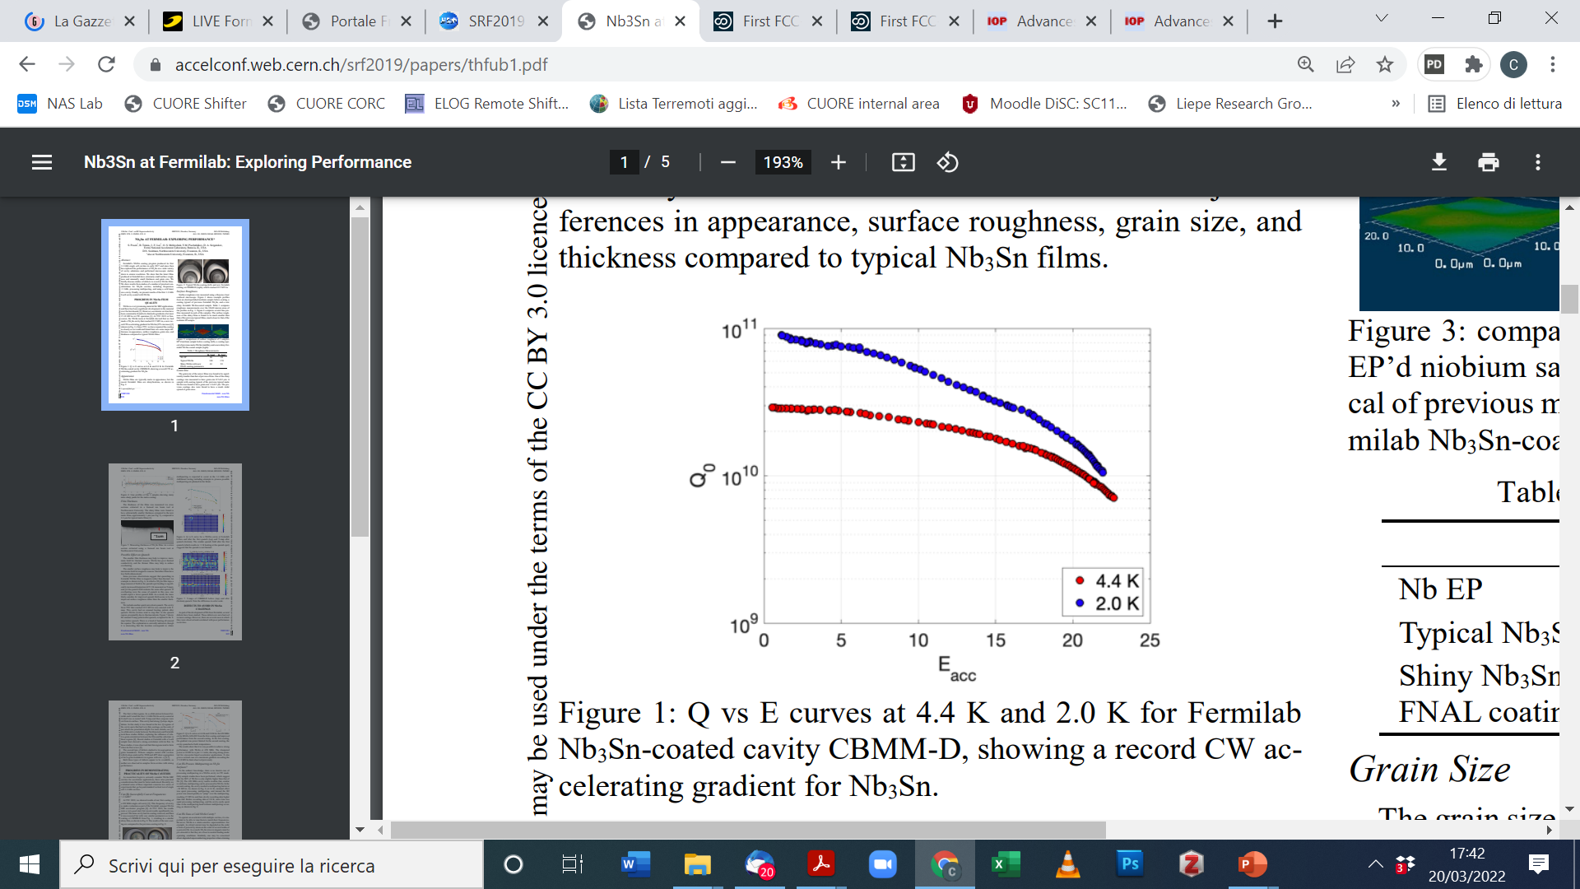



Nb₃Sn on Nb by vapour Tin Diffusion
Courtesy C. Pira, INFN-LNL, Italy
Q₀ @ 4.4 K comparable to Nb bulk @ 2K
1.3 GHz
Nb₃Sn 4.4 K
Nb₃Sn 2 K
Nb bulk 2 K
The process was first developed at Siemens and University of Wuppertal Ongoing research program at:
Nb bulk 4.4 K (Q ∼ 2 * 10⁸)
S. Posen, SRF 2019 proceedings (elaborated)
Limited at high field by surface defects and low thermal conductivity of Nb
S. Posen, SRF 2019 proceedings

Slide 20
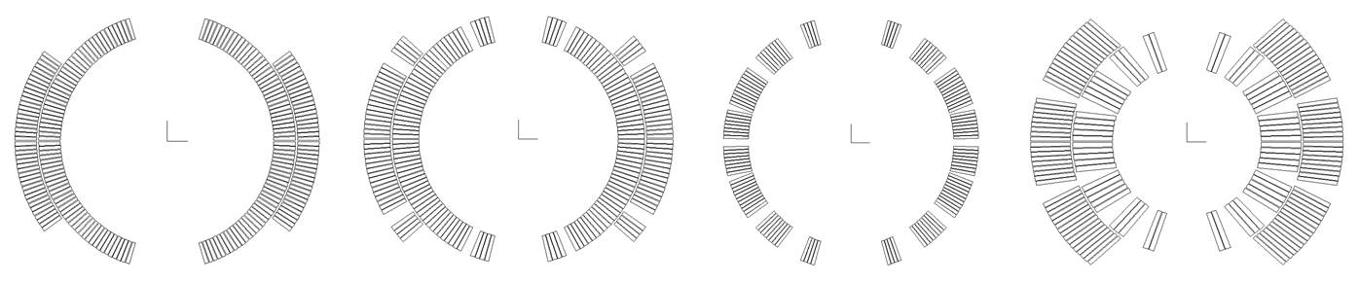

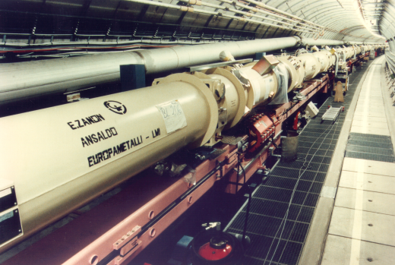
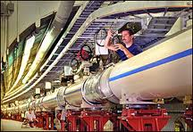

Superconducting Magnets: 40 years of HEP frontier
Main dipoles of various colliders put in operation – all of classical cosϑ (Roman Arch) layout
Tevatron
HERA
RHIC
LHC

Slide 21

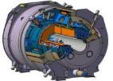

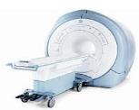
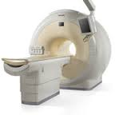
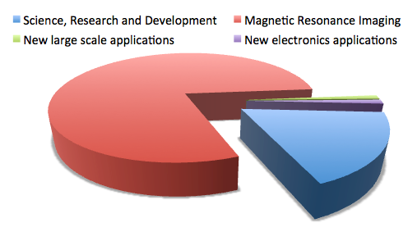
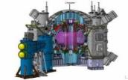
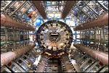
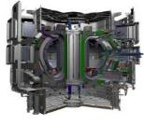

Superconducting magnets: much more than accelerators
At present, the vast majority of the use of superconductors is for magnet applications:
  MRI: 5.5 BUSD/year^{[1]}
  NMR, science and research: approximately 1 BUSD/year^{[1]}
Large scale projects (HEP, Fusion) represent only a fraction of the total market:
  Evaluated cost of LHC magnet system (material): 2 BUSD^{[2]}
  Quoted cost of ITER magnet system (material): 1.4 BUSD^{[3]}
MRI
NMR
LHC
JT60SA
ITER
Sources: [1] from market report at Conectus.org, converted from repored 5.3 BEUR in 2013
[2] Report to the CERN Finance Committee, 2008, reported 1.7 BCHF(2008) escalated to 2013
[3] DOE Assessment of the ITER Project Cost Estimate, reported 1.09 BUSD(2002) escalated to 2013
Courtesy L. Bottura, CERN
Courtesy Luca Bottura

Slide 22
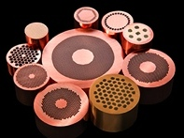
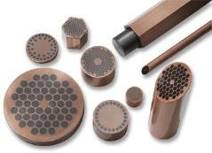





Superconducting materials
- Nb-Ti: 1000 t/year, mostly driven by MRI
- Nb₃Sn: 10 t/year, mostly driven by NMR and laboratory systems
- Big-science projects result in large demands, occasional and time-bound, which need to be accommodated
  - LHC required 1300 tons of Nb-Ti (300 t/year peak production)
  - ITER requires 300 tons of Nb-Ti and 600 tons of Nb₃Sn (250 t/year peak production)
All of HTS (BSCCO, YBCO, REBCO,…) and MgB₂ (MTS) is below 1 ton/year, mostly driven by Fusion and Power application R&D
Recent step forward of REBCO (YBCO) for fusion
few tons/y
Courtesy L. Bottura, and
F. Bordry , CERN
Courtesy Luca Bottura
Notes:
MgB2 is a intermetallic superconductor classified as a medium temperature superconductor.

Slide 23





Why HiLumi is pivotal for future of HF magnets
2045
2055

Slide 24



high-Jc ITD Nb₃Sn: performance with complexity…
Ta or Nb barrier
Nb₃Sn layer
Courtesy C. Senatore, Univ. Geneva
WIRE BEFORE REACTION
SUBELEMENT AFTER REACTION
Sn
Nb-alloy
Complex structure
700 °C solid state reaction
brittle material
whole coil 700 °C → −270 °C
Cu
SUBELEMENT
Ta or Nb barrier
Nb₃Sn microstructure
Critical current density ∝ 1/(grain size)

Slide 25



HiLumi: issue on long magnets – very good short ones
13 T level!
Courtesy E. Todesco, CERN
Courtesy A. Devred, CERN
Performance limitation (repeatable quench performance at a level below nominal) and performance degradation (progressive degradation of quench performance as a function of e.m. and thermal cycling).
Stress management and coil support is more difficult in long magnets → difference to LHC
Evidence of
broken filaments
Evidence of popped strands

Slide 26

2035 demonstration of the 14 T long dipole
FCC-hh range

Slide 27




Strategies to increase the in-field critical current density
Critical current density ∝ 1/(grain size)
Idea from Benz (1968) of an internal oxidation to form fine precipitates in Nb to impede the Nb₃Sn grain growth
Courtesy A. Ballarino, CERN
C. Senatore, Univ. Geneva
HiLumi best
Benz, Trans. Metall. Soc. AIME, 242 (1968) 1067-1070
Use of a Nb-alloy containing Zr or Hf: Zr and Hf have stronger affinity to oxygen than Nb
Oxygen supply added to the composite: oxidation of Zr (Hf) and formation of nano-ZrO₂ (HfO₂)
HiLumi spec
Must demonstrate: scalability to long length and mass production…
Cost: Hilumi is 3-4 x FCC target→ this new material is going to cost more...
More performance makes usually material more vulnerable: reliability…
It is a long route, that takes at least a decade of proof to assess it…
First report on a multifilamentary wire that reaches the FCC specifications
The first evidence of average grain size reduced down to ~ 50 nm (vs ~ 100 nm in regular wires)
Xu et al., APL 104 (2014) 082602
Sumption et al., US-MDT meeting, March 2021
Xu et al., Adv. Mat. 27 (2015) 1346

Slide 28
















Trying new magnet layout, away usual cosϑ shape
L. Bottura, CERN
S.Prestemon, MDP, LBNL
HD2 (2-decks, 36 mm), 13.8 T
FRESCA2 (4-decks, 100 mm), 14.6 T
RMC/eRMC (2-decks, no aperture), 16.5 T

Slide 29















FCC-hh high field dipole R&D: world effort
50 mm aperture B = 12 T
Robust design & procedures
USA → stress management structure
OD < 600 mm, L = 2 m, 50 mm aperture, B = 14T
High Field Magnet technolgy can always serve for a HE-LHC

Slide 30

Superconductivity: the endless race toward high temperatures
Courtesy: Prof. C. Senatore, Univ. of Geneva

Slide 31



High Temperature Superconductors – HTS: next technology step
Transverse fields
solenoids
Opening a new page?

Slide 32

Are we stuck with 15-16 T of FCC? NO! 20-25T is open by HTS but time is needed

Slide 33



HTS – REBCO: ready-to-use material in form of tape
Strong point: at least 4-5 medium-large companies + …
Driver are FUSION and power applications

Slide 34









HTS: EU 2015-1919 --- LBNL 2013 - 2022
4.5 T

Slide 35








10T 20K Test Station Magnet with Cloverleaf-End - Design Sketch
Courtesy of J. van Nugteren
Aperture 80X50 mm
700 mm straight section
B3 B5 geometric field quality
12 mm wide REBCO tape (stack)
1.2 MJ stored energy
10 K temperature margin
11 km of HTS tape (~1 M$)
550 A/mm² cable current density
P. Campana
& L. Rossi, INFN
Simple assembly
(in principle…)
Controlled Insulation
(NON-insulated)
coi technology
J. van Nugteren, G. Kirby CERN

Slide 36

HFM Objectives (2021-2027)
Development of robust and cost-efficient processes
LHC
Robust Nb₃Sn
Logical step for a next phase (2027-2034)
HL-LHC
Fresca2
MDPCT1
Ultimate Nb₃Sn
Exploration of new concepts and technologies
HTS
We have to move in parallel along both fronts !
Notes:
This figure translates the three axes in graphical form, reporting the field generated by a dipole magnet on the horizontal axis, and the total length of magnets produced on the vertical axis.
The horizontal axis is the line of exploration of field limits, new concepts and technology
The vertical axis is the direction of series production, where a robust and efficient process is required.
The blue line represents magnets that have been produced to date. At one extreme is the LHC, with an ultimate field of 9 T and nearly 20 km of magnets installed in the accelerator tunnel. At the other extreme are single realizations such as FRESCA2 or MDPCTI, with field in excess of 14.5 T but single magnetic length of the order of 1 m. In the middle is HL-LHC, with a few magnets built that have reached field levels of 11 T (operation) to 12 T (ultimate).
The search for high fields will push the boundary along the horizontal axis, looking at Nb3Sn (red) and HTS (purple), over the scale of length typical of demonstrators and models (1 m or less)
At the same time, we wish to review results and develop the technology relevant for the production on large scale, i.e. from a few tens of m to (potentially) km of accelerator magnets (blue).
A key of the approach is that both lines proceed simultaneously, the shaded area, to achieve the objective set for the next 5 to 7 years, i.e. demonstrate that Nb3Sn can be used in a large scale accelerator and probe the potential of HTS. There is an obvious interaction among the lines, as many of the technologies are shared, and the results in each line can influence the progress along the other lines.
Finally, and logically, the next step of this R&D should be to take stock of both the push in maximum field and in production scale, to demonstrate on medium scale the maximum field that can be reached with Nb3Sn (green). But this is for the moment only a conjecture.

Slide 37




FCC Integrated Programme
Comprehensive long-term programme maximizing physics opportunities:
Stage 1: FCC-ee (Z, W, H, $\text{t}\overline{\text{t}}$) as a Higgs factory, electroweak & top factory at highest luminosities
Stage 2: FCC-hh (~100 TeV) as natural continuation at energy frontier, proton-proton with options
FCC-ee
FCC-hh
2020 - 2046
2048 - 2063
2074 +

Slide 38

FCC integrated program - timeline
FCC Conceptual Design Study started in 2014 leading to CDR in 2018
2021- 25:
Feasibility Study
2028:
project approval by CERN Council
2032: construction starts
2041:
HL- LHC ends
2045:
Operation of FCC-ee
2070:
Operation of FCC-hh
“Realistic” schedule taking into account:
past experience in building colliders at CERN
approval timeline: ESPP, Council decision
that HL-LHC will run until 2041
Can be accelerated if more resources available

Slide 39
HFM targets for Nb₃Sn magnets
With the present lattice 14 T gives 85 TeV c.o.m
A further optimization of the filling factor from 0.83 to 0.87 could be a viable option – 90 TeV can be achieved with 14 T, and work is ongoing in the optics team (see talk by G. P. Segurana)
  Longer cells give less and less powerful quads, leaving more space to dipoles
  We should consider correctors in HTS – ideal test bed for a first application
 | CDR | 2024-I | 2024-II
Dipole field (T) | 16.0 | 14.0 | 14.0
Tunnel length (km) | 100 | 90.7 | 90.7
Arc length (km) | 82.0 | 76.9 | 76.9
Arc filling factor (adim) | 0.80 | 0.83 | 0.87
Energy c.o.m (TeV) | 100 | 85 | 90
Loadline margin | 86% | 80% | 80%
Courtesy E. Todesco, CERN

Slide 40
Roadmap to full scale prototypes
At the horizon of HL-LHC RunIV, we shall select one or two designs, and have a short model program (at least five models) to explore performance reproducibility This should take about 4 years
During RunV, we shall launch the scaling to 15 m
  To be completed at the end of the decade, when we shall be ready for industrialization
  One could also involve industry already in this phase
15 m long prototypes (>5 of each type)
5 m long prototypes of one selected design
(>5 of each type)
Short model program on two selected designs
(>5 of each type)
Ongoing 12 T and 14 T short models (seven designs, 1 or 2 of each type)
Courtesy E. Todesco, CERN
Selection of final design
to start long magnets
2024
2025
2026
2027
2028
2029
2030
2031
2032
2033
2034
2035
2036
2037
2038
2039
2040
2041
LHC RunIII
HL-LHC RunIV
HL-LHC RunV
HL-LHC RunVI

Slide 41
Industrialization, production, and commissioning
At the end of HL-LHC, tender for the series
  Production and test over nine years
  Installation and commissioning in parallel
Installation and commissioning
Production and test
Industrialization (pre-series magnets)
Courtesy E. Todesco, CERN
Tender for the series
2040
2041
2042
2043
2044
2045
2046
2047
2048
2049
2050
2051
2052
2053
2054
2055
2056
2057
LHC RunVI

Slide 42
Can we go faster ?
Can we have shorten the timeline by 10 years, so to fit the 2045 date for the FCC-hh right after HL-LHC?
  Yes, but with some risks and additional cost
  Go more in parallel between short models and prototpye
  Go in parallel in the scaling to 5 m and to 15 m
  Involve industry in prototypes (as done for LHC)
  The present baseline assumes that scaling in length is not straightforward, as it has been for HL-LHC and that the HL-LHC experience does not apply
The present priority is to get to a short model program for one (or max two) design asap
Courtesy E. Todesco, CERN

Slide 43





How long it will take?

Slide 44

High Luminosity LHC (HL-LHC)
LS2
LHC Injectors Upgrade (LIU) completed
Phase-1 upgrades: major for LHCb and ALICE
LS3
Installation of HL-LHC machine
Phase-2 upgrades of ATLAS and CMS

Slide 45
High Energy LHC «standard»: 16 T → 26 TeV c.o.m.
Are there other possibilty re-usign LHC? Yes…
HTS
In LHC, 14 T dipoles give 25 TeV
But timeline is NOT the same
12 T Nb₃Sn dipoles HiLumi technology in LHC: 22 TeV c.o.m.
LHC1.5
Energy tripler 100km
7 T Nb-Ti dipole (low cost LHC, 4.2 K):
44 TeV c.o.m. (100 km)
2050

Slide 46
Muon Collider: 3 T → 10-14 TeV
Would be easy if the muons did not decay: lifetime is τ = γ x 2.2 μs
Short, intense proton bunch
Ionisation cooling of muon in matter
Acceleration to collision energy
Collision
Protons produce pions which decay into muons
muons are captured
46

Slide 47

Sustainability
Technically limited timeline: 2045 ?
Muon Collider:
Acceleration and collision in multiple turns in rings promises
Power efficiency
Compact tunnels, 10 TeV similar to 3 TeV CLIC
Cost effectiveness
Natural staging is natural
Synergies exist (neutrino/higgs)
Unique opportunity for a high-energy, high-luminosity lepton collider
47

Slide 48

Key Challenges
4) Drives the beam quality
MAP put much effort in design
optimise as much as possible
2) Beam-induced background
1) Dense neutrino flux
mitigated by mover system and site selection
3) Cost and power consumption limit energy reach
e.g. 35 km accelerator for 10 TeV, 10 km collider ring
Also impacts beam quality
48

Slide 49


Cooling Principle
Principle of ionisation cooling with no RF has been demonstrated in MICE at RAL
Nature vol. 578, p. 53-59 (2020)
Needs cooling of orders of magnitude in 6D
Demonstrated 10% ε reduction in 2D… consistent with prediction
No RF in solenoids
Solenoids weaker than needed
Need to develop full cooling demonstrator
MuCool: FNAL demonstrated cavity with >50 MV/m in 5 T solenoid
H2-filled copper cavities
Cavities with Be end caps

Slide 50


Demonstrator Facility is vital for Muon-Collider
Target
+ horn (1st phase) /
+ superconducting solenoid (2nd phase)
Planning demonstrator facility with muon production target and cooling stations
Suitable site on CERN land exists that can use PS proton beam
could combine with NuStorm or other option
Other sites should be explored (FNAL?)
Collimation and upstream diagnostics area
Downstream diagnostics area
Cooling area
Momentum selection chicane
50
R. Losito et al.

Slide 51

Tentative Timeline (Fast-track 10 TeV)
Only a basis to start the discussion, will review this year
Need at least two years of demonstrator operation (better more)
Need RF test stand before
Decision starting in 2036
NOT official, just internal working doc
Estimated10 TeV construction/installation
Different initial estimates for detector
seem to be fast enough
Buit need to develop robust timeline

Slide 52
Conclusions 1 : FCC and CCEP/CSSP
FCC: most complete road, coupling precision with discovery potential
  Builds on decades of experiences of leptons and hadron rings
  FCC-ee has no technical showstoppers. Cost & acceptability are the key issues
  For FCC-hh the 14T magnet Target is realistic (shorten the time) for 90 TeV
  HE-LHC (at 25 TeV): only better than nothing?
  A viable project in the 5-6 BCHF range…
  High intensity beams, high luminosity demonstrated for circular colliders, no big extrapolation, technology improvement needed, but no showstopper
  Key issues:
    Cost means also a growth of the infrastructure (tunnel, shafts), people, operation
    Acceptability in a densely populated area
    Power/energy consumption FCC-ee: 100 MW wasted in the vacuum…;
    FCC-hh (almost) prohibitive cryogenic consumption key issue
    → HTS magnets @ 20 K may be the key but need to be demonstrated yet (5-8 y)

Slide 53
Conclusion 2 : ee linear colliders
ILC
  Mature design, solid concept, main technology (SRF) demonstrated by EU-XFEL
  250 GeV ready to start from technical point of view (organization and politics…)
  Nice upgrade plan (500 GeV maybe does not require much R&D or size increase). 1 TeV seems brute force unless something happens in SRF performance
CLIC
  Step toward maturity
  Swiss FEL is a first step demonstrator; medical and other applications push MV/m
  Reasonable alternative to ILC. Or best upgrade of a first phase ILC (accelerator design must be revised… but possible)
  Big progress in energy saving, but concerns for the 3 TeV option, hardly expandable…

Slide 54
3 – The “new” players: High risk – high gain?
Muon-Collider
  It is based on “classical” technologies, Magnets & RF
  Integration and beam physics are challenging,
  Needs further advance in various technology: Magnets, RF, remote handling, absorbers: all difficult, no apparent showstopper
  Weak point is that those advances are required in many different fields…
  Needs cruelly a demonstrator. It is imperative in 5-6 years for this project.
Plasma
  Game-changer
  Certainly a fantastic tools for a variety of applications
  Need basic demonstration that can work for a collider (positive charges, beam quality, stability, efficiency…)

Slide 55


V. Shiltsev’s
ICGEP 2022

Slide 56
Thanks for the attention!

Slide 57
Plasma: the promise of the future? Maybe…
Instead of laser pulse (LBNL, Desy et al.) , one can use a strong bunch of electrons to generate the plasma bubble (SLAC, LNF, Shanghai, et al.)
Courtesy R. Assmann
Desy & INFN-LNF
Strong focusing

Slide 58



Plasma and Laser Accelerator Principle
Damage limits for metallic walls in RF cavities limit accelerating fields→ replace metal with plasmas or dielectric materials → advance into the many GV/m regime → shorter acc. lengths → reduced cost?
Lasers or THz pulses or e- beams drive dielectric structures (e.g. Silicium)
“Accelerator on a Chip” grant Moore foundation: Stanford, SLAC, University Erlangen, DESY, University Hamburg, PSI, EPFL, University Darmstadt, CST, UCLA
AXSIS ERC Synergy Grant: DESY, Arizona SU
Illustration from EuPRAXIA, A. Ferran Pousa et al
Options for driving plasma and dielectric structures (no klystrons at those frequencies):
Lasers: Industrially available, steep progress, path to low cost
Limited energy per drive pulse (up to 50 J)
e- bunch: Short bunches (need μm) available, need long RF accelerator
More energy per drive pulse (up to 500 J)
p+ bunch: Only long (inefficient) bunches, need very long RF accelerator
Maximum energy per drive pulse (up to 100,000 J)
Tajima & Dawson 1979

Slide 59




beam-driven plasma wakefield accelerator
FEL gain after electron-driven plasma acceleration
M. Ferrario et al, LNF-INFN
Pompili, R., Alesini, D., Anania, M.P. et al. Free-electron lasing with compact beam-driven plasma wakefield accelerator. Nature 605, 659–662 (2022). https://doi.org/10.1038/s41586-022-04589-1
However the game to use plasma for colliders has just started…
Beam quality (controlling primary beam jitters), multiple cells, efficiency…
It takes much more time from PoP to real demos
Breakthrough LNF (see above), SIOM (China): Experimental proof that plasma accelerated electron beams are good enough for free-electron lasers (and colliders?)

Slide 60



Inovative Materilas: HTS
Bi-2212 and especially YBCO / REBCO

Slide 61





Technology landmarks

Slide 62

With HiLumi we prepare the new technology for a future leap in hadron colliders…

Slide 63

200 vertices in 10 cm

Slide 64
High Luminosity LHC (HL-LHC)
LS2
LHC Injectors Upgrade (LIU) completed
Phase-1 upgrades: major for LHCb and ALICE
LS3
Installation of HL-LHC machine
Phase-2 upgrades of ATLAS and CMS

Slide 65

ILC upgrade options
Luminosity
From Ph. Barrow talk,
Friday A.. Session

Slide 66
ILC upgrade options
Energy
Form Ph. Barrow talk,
Friday A.. Session

Slide 67

CLIC parameters

Slide 68
Stage 1: updated parameters
K. Oide, D. Shatilov,
Parameter [4 IPs, 91.2 km,T_{rev}=0.3 ms] | Z | WW | H (ZH) | ttbar
beam energy [GeV] | 45 | 80 | 120 | 182.5
beam current [mA] | 1280 | 135 | 26.7 | 5.0
number bunches/beam | 10000 | 880 | 248 | 36
bunch intensity [10¹¹] | 2.43 | 2.91 | 2.04 | 2.64
SR energy loss / turn [GeV] | 0.0391 | 0.37 | 1.869 | 10.0
total RF voltage 400/800 MHz [GV] | 0.120/0 | 1.0/0 | 2.08/0 | 4.0/7.25
long. damping time [turns] | 1170 | 216 | 64.5 | 18.5
horizontal beta* [m] | 0.1 | 0.2 | 0.3 | 1
vertical beta* [mm] | 0.8 | 1 | 1 | 1.6
horizontal geometric emittance [nm] | 0.71 | 2.17 | 0.64 | 1.49
vertical geom. emittance [pm] | 1.42 | 4.34 | 1.29 | 2.98
horizontal rms IP spot size [μm] | 8 | 21 | 14 | 39
vertical rms IP spot size [nm] | 34 | 66 | 36 | 69
beam-beam parameter ξ_{x} / ξ_{y} | 0.004/ .159 | 0.011/0.111 | 0.0187/0.129 | 0.096/0.138
rms bunch length with SR / BS [mm] | 4.38 / 14.5 | 3.55 / 8.01 | 3.34 / 6.0 | 2.02 / 2.95
luminosity per IP [10³⁴ cm⁻²s⁻¹] | 182 | 19.4 | 7.3 | 1.33
total integrated luminosity / year [ab⁻¹/yr] | 87 | 9.3 | 3.5 | 0.65
beam lifetime rad Bhabha + BS [min] | 19 | 18 | 6 | 9
preliminary – example parameters
for present layout & with 4 IPs
Builts on decades of experience: moderate risk, R&D: almost no “R” only “D” and cost-reduction
Energetically not ideal (100 MW of SR)

Slide 69
Stage 2: FCC-hh (pp) collider parameters
parameter | FCC-hh |  | HL-LHC | LHC
collision energy cms [TeV] | 100 |  | 14 | 14
dipole field [T] | ~17 (~16 comb.function) |  | 8.33 | 8.33
circumference [km] | 91.2 |  | 26.7 | 26.7
beam current [A] | 0.5 |  | 1.1 | 0.58
bunch intensity [10¹¹] | 1 | 1 | 2.2 | 1.15
bunch spacing [ns] | 25 | 25 | 25 | 25
synchr. rad. power / ring [kW] | 2700 |  | 7.3 | 3.6
SR power / length [W/m/ap.] | 32.1 |  | 0.33 | 0.17
long. emit. damping time [h] | 0.45 |  | 12.9 | 12.9
beta* [m] | 1.1 | 0.3 | 0.15 (min.) | 0.55
normalized emittance [μm] | 2.2 |  | 2.5 | 3.75
peak luminosity [10³⁴ cm⁻²s⁻¹] | 5 | 30 | 5 (lev.) | 1
events/bunch crossing | 170 | 1000 | 132 | 27
stored energy/beam [GJ] | 7.8 |  | 0.7 | 0.36
12-14 T @ 20 K ?
70-80 TeV
Could be used for HE-LHC…

