Slide 1



Project Status & CabibboLab
Marcello A. Giorgi
Università di Pisa & INFN Pisa
2nd Collaboration & General Meeting
LNF December 13,2011
Notes:
1
1

Slide 2
Outline
Physics program refined by a great physics community.
Detector community in a good shape.
Accelerator structure under construction.
Move towards TDR’s.
      CabibboLab exists.
Future goals.

Slide 3
The Results from2011 Summer Conferences make stronger the physics program
  Goals:
  Probe new physics observables in wide range of decays.
    Pattern of deviation from Standard Model can be used to identify structure of new physics.
    Clean experimental environment means clean signals in many modes.
    Polarised e⁻ beam benefit for τ LFV searches, CPV and g-2.

Slide 4

The answer is largely contained in a recent document

Slide 5
After London Meeting (on physics )
Workshop on Charm at Threshold (Beijing October 20-22)
Workshop on High Intensity Frontier (Rockville Nov 30-Dec 2)

Slide 6
The lesson from High Intensity Workshop
Heavy Quarks
Charged Leptons
….
…
Neutrinos

Slide 7
The lesson from Charm Workshop
Search for new physics beyond Standard Model, overcome the non‐perturbative QCD roadblock, test pQCD calculations.
  search for new physics effects in rare or forbidden decays;
  remove Dalitz model dependency in D⁰ mixing and CP violation measurements and γ/Φ3 measurements.
  Precision measurement of |Vcs|, |Vcd| and D(s) form factors/
  Precision measurement of decay constants fD, fDs.
  Systematic errors do not seem to be a roadblock for the relevant measurements and future high statistics data sample will be beneficial.

Slide 8
Trivial consideration on D⁰ yields for 1 year SuperB running @Threshold
1 year run at Ψ(3770):
  n(D⁰)=1.5 ab⁻¹⋅3.7 nb⋅2 = 11.1⋅10⁹
1 year running at Υ(4S):
  n(D⁰)=15 ab⁻¹⋅1.3 nb ⋅0.45= 8.8⋅10⁹
Integrated luminosity
Cross section
Average number of D⁰ per event
(from cc events only)
TD analysis is possible @ Y(4s) and @threshold, but here in a cleaner environment and with access to more channels .

Slide 9

Charm @
Run at ϒ(4S):
βγ=0.237
Large improvement in D⁰ mixing and CPV: factor 12 improvement in statistical error wrt BaBar (0.5 ab⁻¹);
time-dependent measurements will benefit also of an improved (2x) D⁰ proper-time resolution.
[≈1KHz of ]
Unique feature of SuperB
Run at ψ(3770):
500 fb⁻¹1 ab⁻¹ at
1 ab⁻¹
βγ from 0.237 to 0.56 (and polarization)
coherent production with 100x BESIII data and CM boost up to βγ=0.56;
almost zero background environment;
possibility of time-dependent measurements exploiting quantum coherence
Study CPV with Flavour and CP tagging.

Slide 10
Some golden

Slide 11
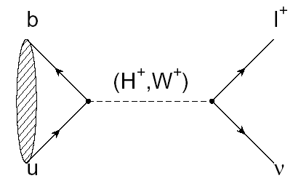
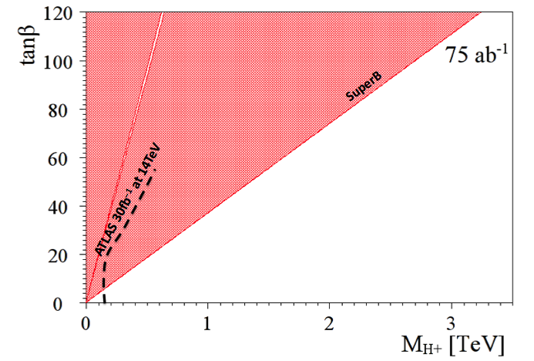
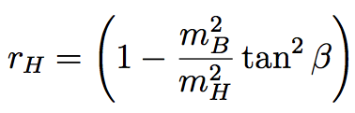
B_{u,d} physics: Rare Decays
Example:
  Rate modified by presence of H⁺
Currently the inclusive b → sγ channel excludes m_{H+} < 295 GeV/c².
The current combined limit places a stronger constraint than direct searches from the LHC for the next few years.

Slide 12
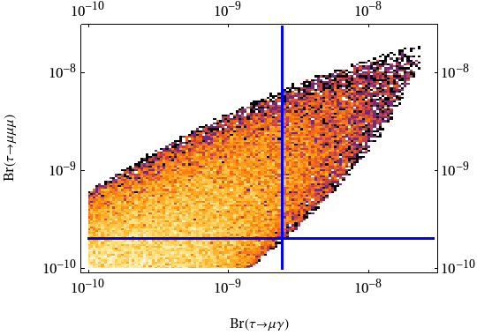
The golden LFV modes
Symmetry breaking scale assumed: 500GeV.
NP scale assumed: 500GeV.
Current experimental limits are at the edges of the model parameter space
SuperB will be able to significantly constrain these models, and either find both channels, or constrain a large part of parameter space.
SuperB
SuperB
c/o M. Blanke
M. Blanke et al. arXiv:0906.5454

Slide 13
The golden LFV modes
Symmetry breaking scale assumed: 500GeV.
NP scale assumed: 500GeV.
Current experimental limits are at the edges of the model parameter space
SuperB will be able to significantly constrain these models, and either find both channels, or constrain a large part of parameter space.
SuperB with polarization
SuperB
c/o M. Blanke
M. Blanke et al. arXiv:0906.5454

Slide 14
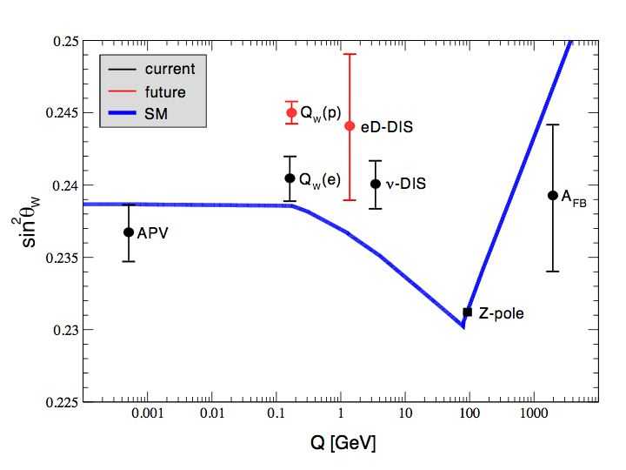
POLARIZATION: Precision Electroweak
sin²θ_{W} can be measured with polarised e⁻beam at
  √s=ϒ(4S) is theoretically clean, c.f. b-fragmentation at Z pole
Measure LR asymmetry in
at the ϒ(4S) to same precision as LEP/SLC at the Z-pole.
Can also perform crosscheck at ψ(3770) and use instead of

Slide 15
POLARISATION: Precision Electroweak
sin²θ_{W} can be measured with polarised e⁻beam at
  √s=ϒ(4S) is theoretically clean, c.f. b-fragmentation at Z pole
Measure LR asymmetry in
at the ϒ(4S) to same precision as LEP/SLC at the Z-pole.
Can also perform crosscheck at ψ(3770) and use instead of
SuperB

Slide 16
Charm @
Run at ϒ(4S):
βγ=0.237
Large improvement in D⁰ mixing and CPV: factor 12 improvement in statistical error wrt BaBar (0.5 ab⁻¹);
time-dependent measurements will benefit also of an improved (2x) D⁰ proper-time resolution.
[≈1KHz of ]
Unique feature of SuperB
Run at ψ(3770):
500 fb⁻¹1 ab⁻¹ at
1 ab⁻¹
βγ from 0.237 to 0.56 (and polarization)
coherent production with 100x BESIII data and CM boost up to βγ=0.56;
almost zero background environment;
possibility of time-dependent measurements exploiting quantum coherence
Study CPV with Flavour and CP tagging.

Slide 17
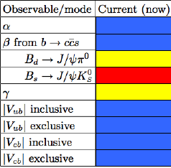
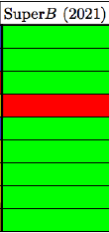


Nevertheless: Golden Measurements of CKM
Precision measurements with semileptonic B decays only in e+e- clean environment.

Slide 18

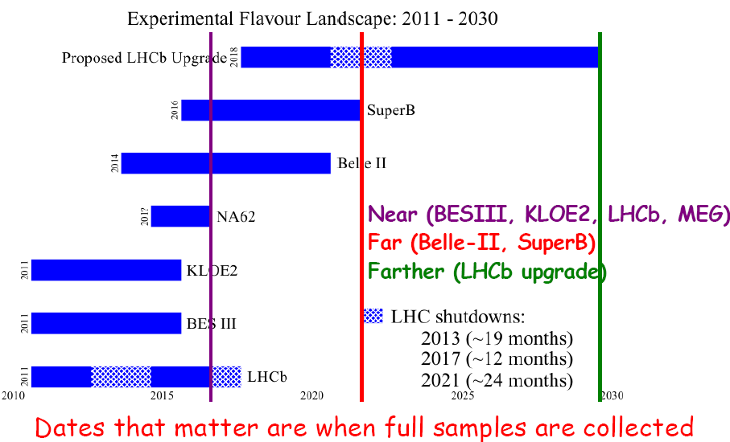
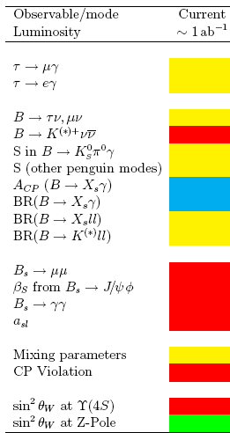
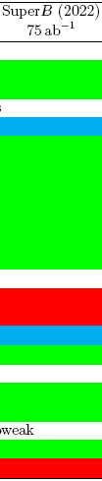

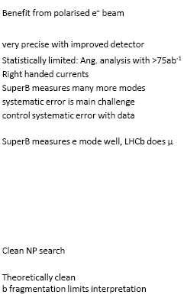

Slide 19
REQUIREMENTS FROM PHYSICS
Parameter | Requirement | Comment
Luminosity (top-up mode) | 10³⁶ cm⁻²s⁻¹ @ Υ(4S) | Baseline/Flexibility with headroom at 4. 10³⁶ cm⁻²s⁻¹
Integrated luminosity | 75 ab⁻¹ | Based on a “New Snowmass Year” of 1.5 x 10⁷ seconds (PEP-II & KEKB experience-based)
CM energy range | threshold to Υ (5S) | For Charm special runs (still asymmetric……)
Minimum boost | βγ ≈0.237 ~(4.18x6.7GeV) | 1 cm beam pipe radius. First measured point at 1.5 cm
e⁻ Polarization Boost up to 0.56 in runs at low energy under evaluation for charm physics | ≥80% | Enables τ CP and T violation studies, measurement of τ g-2 and improves sensitivity to lepton flavor-violating decays. Precise measurements of sin²θ_{w} .

Slide 20
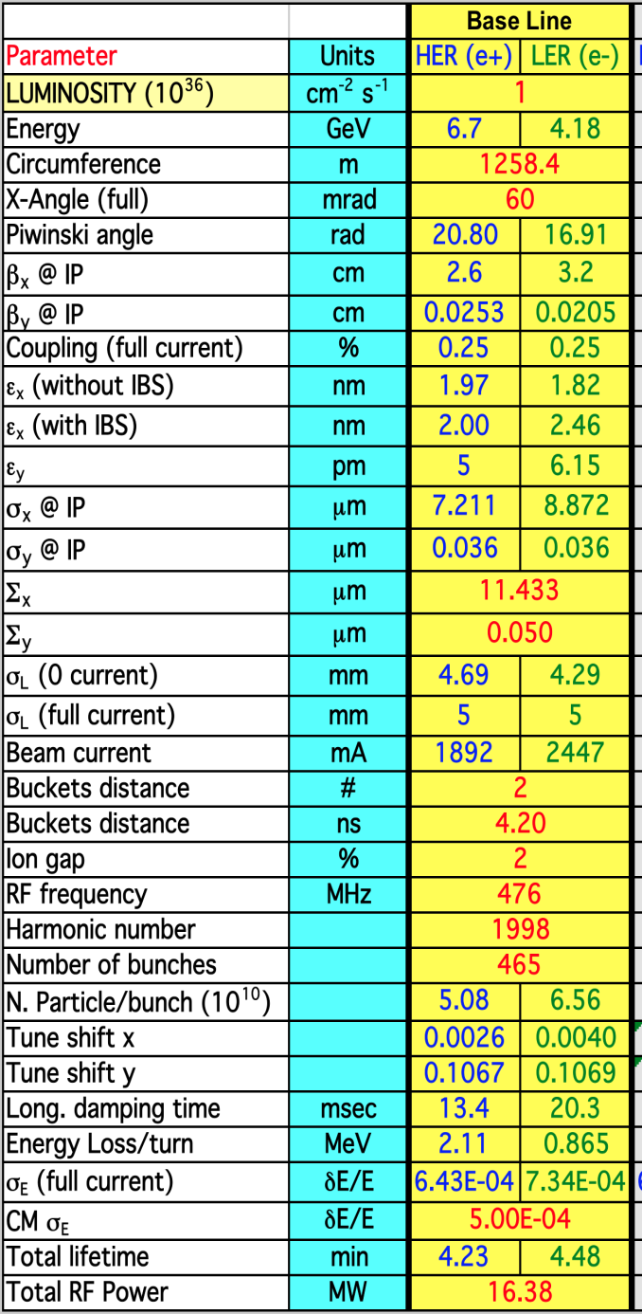
Baseline Collider parameters
The baseline peak luminosity at Y(4s) is 1.0 10 ³⁶ cm⁻² s ⁻¹ .
It ca be increased by adding RF power up to a factor of 4 .
The runs near charm threshold Ψ(3770) pay a factor O(10) in luminosity.
At charm threshold the boost( βγ ) can be increased up to 0.5 for time dependent measurements , still with a reasonable polarization.
Injected 90% polarized electrons
3.5 min beam lifetime . CONTINUOUS INJECTION as in PEPII

Slide 21
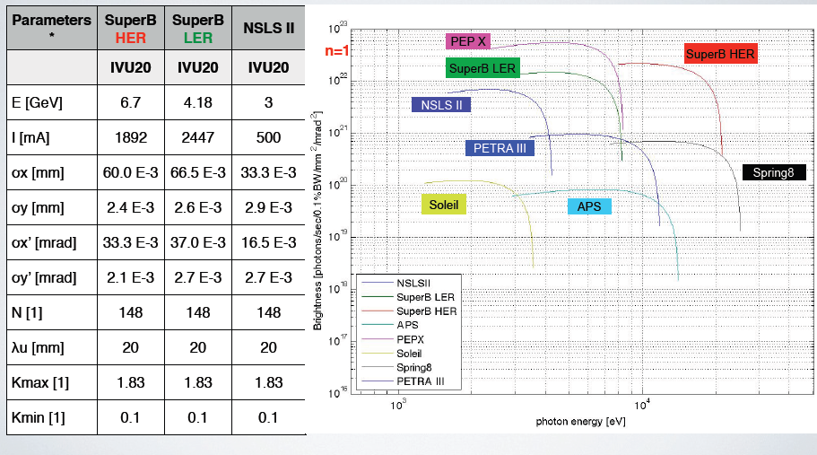
Synchrotron light options @ SuperB
Comparison of brightness and flux for different energies dedicated SL sources & SuperB HER and LER with undulators.
Light properties from undulators better than most SL
With Undulators

Slide 22
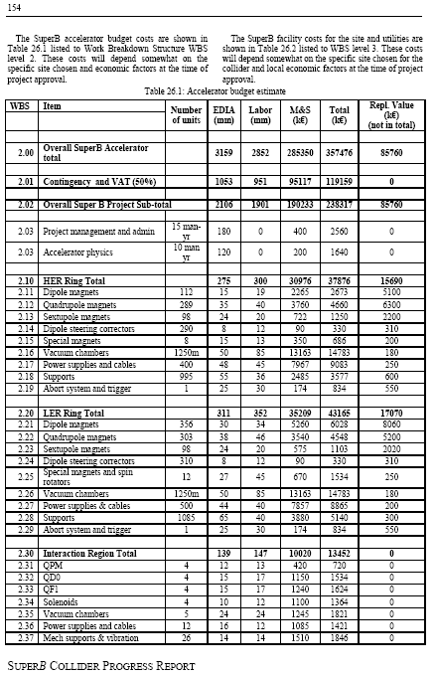
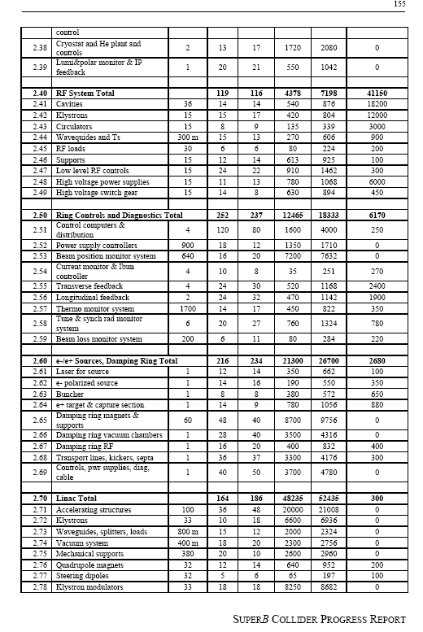
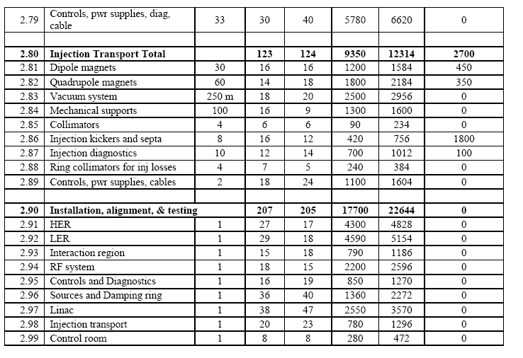
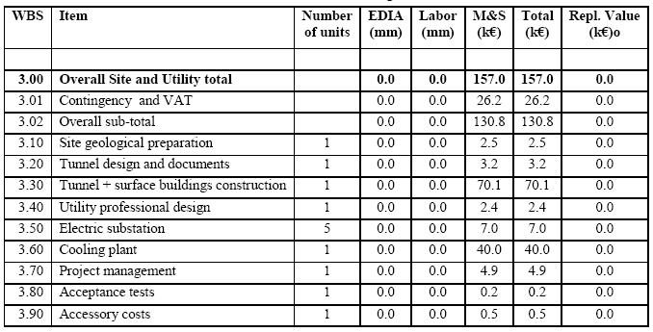
From CDR2 (September 27,2010)

Slide 23
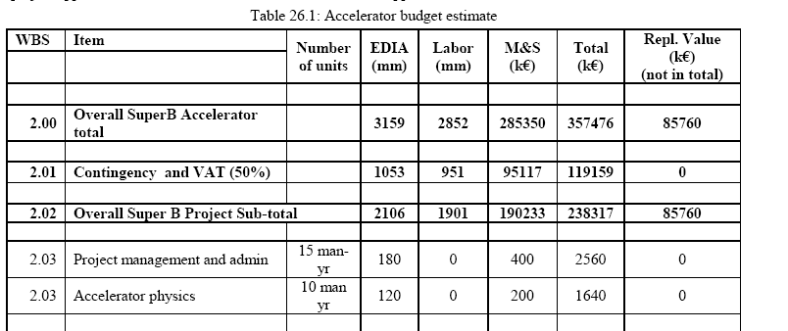
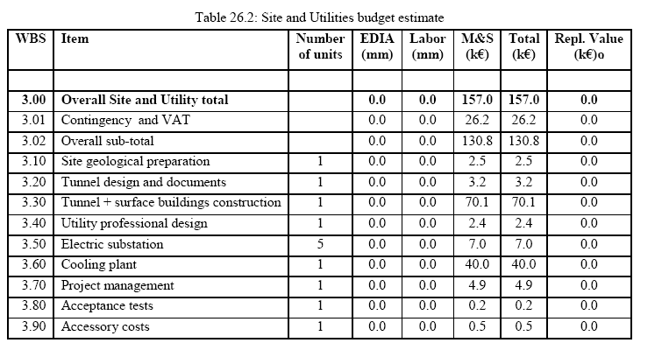
From CDR2 (September 27,2010)
4000→6000 mm
@ 12K€/month
Budget (10 years) hrom 3 years INFN Plan

Slide 24
3Year Plan INFN
Construction + running Euro 650M
250M from Ministry of Science
+43M from Ministry of science for computing
+150 M INFN co-funding
+Components of PEPII from Slac
Expected contribution from IIT to SuperB as a Light source machine to be defined at their meeting before the end of the year.
Other in kind contribution to the accelerator mainly as a man power . Work packages Mou’s needed.
End construction

Slide 25
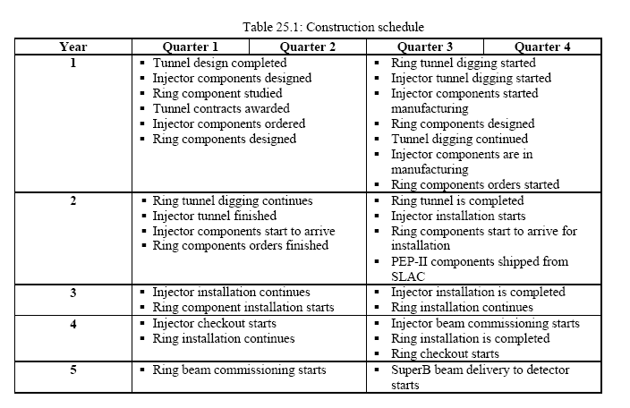
From CDR2 (September 27,2010)

Slide 26

SuperB Luminosity model
75 ab⁻¹

Slide 27
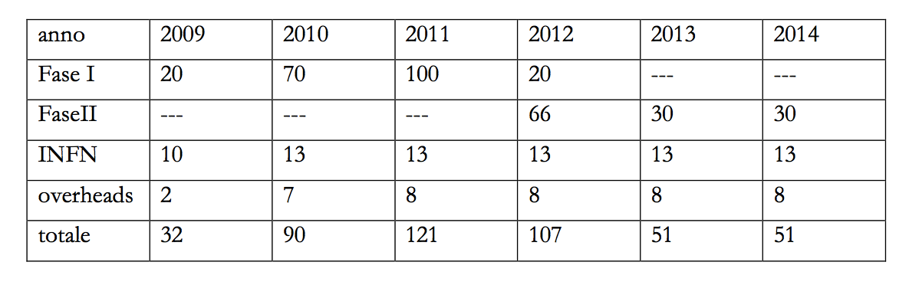
The proposed funding profile
year = year +2

Slide 28
milestones
Past
  The site choice
Present
  The consortium (Cabibbo Lab)legal constitution

Slide 29
The Tor Vergata choice
Autonomous interest from a wide community of the University ( not only physicists)
First contacts for a feasibility evaluation
  Space
  Electricity
  Water
  permits

Slide 30
Site requirements ok in a first approximation
  Extension of the order of 300000 square meters
  2X150 Kilovolt electric supplies nearby
  *** lines available when needed ****
  Water supply adequate and the possibility of additional supply from a number of pits
  Vibration measurements: the good surprise
  Site archaeology free

Slide 31
Added values
Strong role in the civil engineering works: likely civil engineering will be a university task
University expertise available for general services ( 50000 students campus)
A door to the academic non particle physics community

Slide 32
The legal identity
Three phases
INFN: the past and present starting phase
Consortium:
  Approved end of July from INFN and University independently
  Officially registered on October 7 as “Cabibbo Lab”
    Following main European infrastructures
    More flexibility in the organisation
    Can directly associate foreign partners (EGO like)
European consortium (ERIC): the final goal

Slide 33
The consortium governance
A Cern like management structure
  A director general and a directorate
    Departments under director’s supervision
  A scientific evaluation committee
    Science (phase II)
    Machine (phase I)
  A finance evaluation committee
A known and working scheme

Slide 34
The statute of the Cabibbo lab
founders: Tor Vergata University and INFN
Phase I construction, Phase II operation
Open to additional members
  Associate
  Full members
the Italian Institute of Technology joins by the end of the year after the final definition of its economical engagement

Slide 35
The top structure
Council of member institutions delegates
Director general
  Directorate ( accelerator, experiment interface, administration, synchrotron light)
Scientific committee ( phase I a Machine Advisory Committee)
“revisori dei conti”
Voting: Full member with quotas proportional to the contribution

Slide 36
The finance advisory committee
Monitoring the financial flow and the available resources
Updating periodically the cost estimate and its comparison with available resources
Assessing the equivalent financial contribution of in kind deliverables

Slide 37
Accelerator Project management
Accelerator Directorate
Membership:
    Project Director (Scientific)
    Deputy Director (Technical)
    Chief Engineer /(Coordinator)
Accelerator Board
Membership:
    Accelerator Directorate
    WP Leaders
    TA Leaders
  Function:
    Supervises and reviews the status of the project.
    Ensures the resources needed in order to achieve the Working Packages deliverables

Slide 38
Delocalized WP
Working Package Leaders functions:
  Coordinate the single working package
  Responsible to follow and achieve the WP deliverables
  Coordinate Task Manager – WPTL (Persons responsible for the realization of the specific WP tasks)

Slide 39
Resident Activity
Technical Areas Leaders functions:
  Coordinate the technical services staff
  Responsible for the executive design purchasing and installation of the subsystems
  About 60/70 people at start time

Slide 40
Very short term milestones
Consortium
  Start spending money ( already two meetings of the council)
  IIT joined
  Director general appointed and accelerator and physics director enrolled
Team
  Calls for new 30 people launched
    Recognition of INFN personnel achieved
    Letter of intents with foreign institutions of WP share
  Civil construction
    Authorizations for construction advanced

Slide 41
Short term milestones
(By next summer)
First financial assessment
WP at work
Main machine design frozen
First associate foreign partners under negotiation
Light source project defined for the first phase
Civil engineering project in an advanced stage
Site prepared for work
Computing centres construction started
Consortium administration consolidated

Slide 42
Future
Prepare MOU’s and move on to form Accelerator “CONSORTIUM” and Detector Collaboration. We will continue for a while without freezing the collaboration.
Even Governance documents will not be frozen and remain drafts for the time due to allow the stabilization of the community.
SuperB will remain an open entity to contributions and participation.

Slide 43
Future
The TDR is the goal.
TDR of Accelerator monitored and coordinated by the Accelerator directorate.
TDR on detector is in a quite good shape.
We are confident in a covergency about he still open issues. There is not any terible urgency, but in lare part it is already mature to allow the preparation for the funding request to the various agencies.
We should move on without loosing time but in a pragmatic way. Goal should be not to leave back any component.

Slide 44
Contacts with competitors
It will be healty to maintain good relations with the other flavour communities and in particular with SuperBelle.
cabibboLab will negotiate with KEK management periodical contacts.
Topical meetings will be encouraged (for example on Background)
Also topical meeting on Physics with all communities.
However we will aim to the preparation by the end of 2013 of a Physics Book , that will be:
THE SUPERB PHYSICS BOOK.

Slide 45
and now….

Slide 46
and now….
Let’s go to work!

Slide 47
END

