Slide 1
Updates on the R&D for the SVT Front End Readout chips
F. Giorgi – INFN Bologna

Slide 2
Summary
Strip readout architecture
Investigated architecture
Preliminary simulations
3D pixel submissions
Apsel_VI
SuperPix1

Slide 3
Strip Readout Architecture
Updates on Job Status

Slide 4
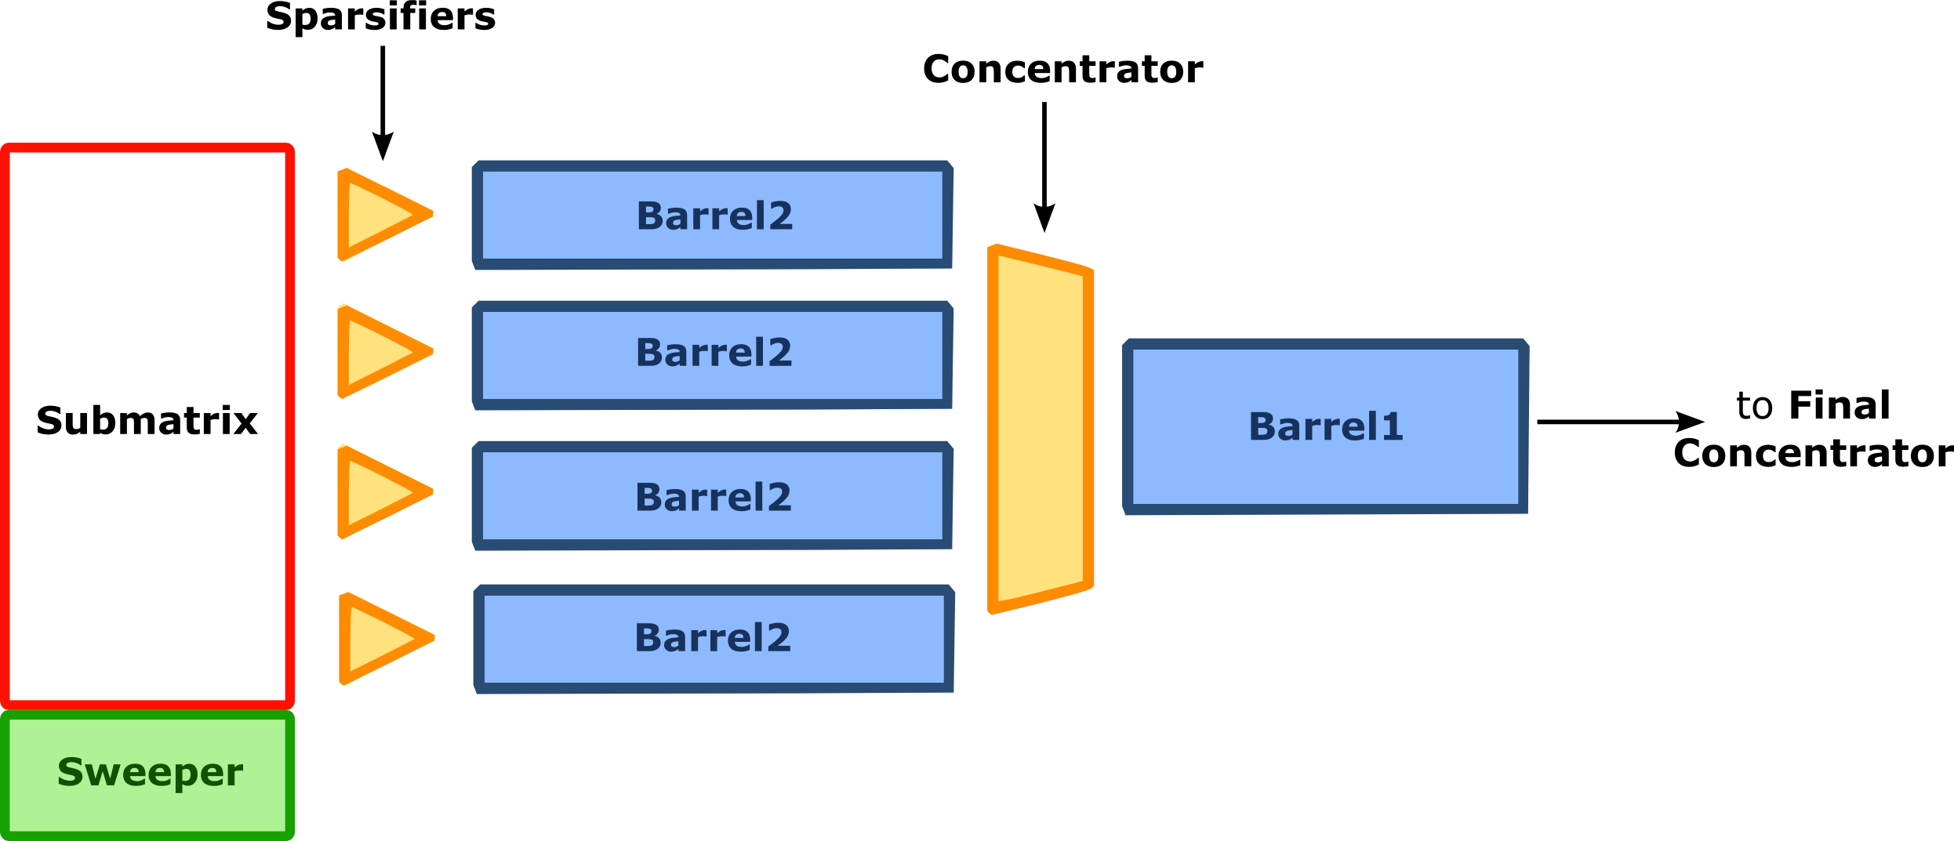
Strip readout architecture under development
BOLOGNA pixel-like hit extraction architecture
Pre-trigger buffer array
PISA
Sparsifiers
strip #127
FE
ADC
Or ToT
Ctrl
logic
Buf
#k
...
Buf
#1
~hit_rate * trig_latency
strip #0
FE
ADC
Or ToT
Ctrl
logic
Buf
#k
...
Buf
#1
BUF #1
Triggered hits only
readout/slow control
How many buffers?
How many barrels?
Asynchronous logic assumed:
Triggered event size not known a-priori
(thus readout time as well)

Slide 5
Development Status
All elements have been modeled on both sides
VHDL for hit extraction system and slow control
SystemVerilog for the strip FE logic and buffers (see R. Beccherle presentation)
CERN SVN repository created and proficiently in use
svn.cern.ch/reps/vipix/StripChip/
Test Benches under development:
Shared Elements:
Monte Carlo hit generator
I2C interaction routines (simulation utility package)
Independent and parallel test benches:
separated test vectors and procedures → enhanced code coverage.
Simulation Tool: ModelSim SE (allows mixed code simulations)
So Far:
Interface defined → must be verified
Separate tests on our own blocks for functional debug
Next to come: full chip simulations and digital efficiency study.

Slide 6
Test Bench Scheme
Reduced and rivisited version of the one used for pixels
FE logic
Trigger buffers, TS tag/request handling ecc.
MC generator
128 Strip channels
FE logic and trigger buffer
Readout equivalent to:
4 sub-matrices
256 rows
1 column
(with minor revisions)
Trigger handling
Hit encoding
Hit de-queue

Slide 7
MC gen self test
MCgen
CMP
loopback
Busy
hit generated with a ToT = 14
another hit generated @ 19775 ns
CMP not re-triggered → total CMP length is 140 ns = prev. ToT (14) *10 ns ToT resolution
busy_hit_count incremented by 1
rough inefficiency estimate due to occupancy by busy_hit_count/hit_count.

Slide 8
Trial analog efficiency study
No physical information included
Pulse widths uniformly distributed over ToT range
ToT range (4 bit TOT used)
Hit Rate (MHz) | ToT freq. MHz | Min (ns) | Max (ns) | Effi
30 | 100 | 10 | 150 | 98.3%
20 | 100 | 10 | 150 | 98.9%
10 | 100 | 10 | 150 | 99.3%
30 | 200 | 5 | 75 | 99.1%
20 | 200 | 5 | 75 | 99.5%
10 | 200 | 5 | 75 | 99.8%
busy_hit_count
hit_count
1 -

Slide 9
3D-IC submissions
Deadline: March 26th 2012

Slide 10
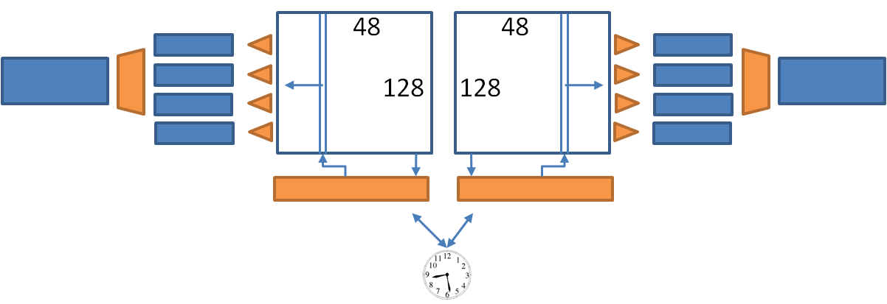
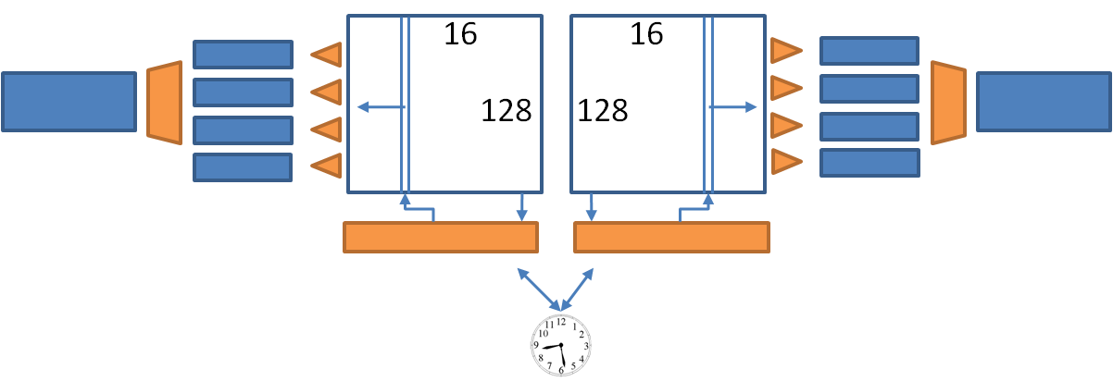
The projects
Apsel-VI
MATRIX 96x128(2 sub-m. 48 x128)
Rows divided in:
4 sparsifiers
32 rows for each sparsifier
8 zones for each sparsifier (Wzone= 4 pixels)
SuperPix1
MATRIX 32x128 (2 sub-m. 16x128)
Rows divided in:
4 sparsifiers
32 rows for each sparsifier
8 zones for each sparsifier (Wzone= 4 pixels)

Slide 11
Readout architecture
Few revisions w.r.t. INMAPS architecture.
In-pixel threshold adjust DAC → serial vs I2C loading? I2C very time-expensive for protocol overhead, till now used to program the peripheral registers and to mask the few defective pixels here and there. Meant for the slow control of several chip with 2 shared serial lines, not to transfer large amount of data (~ 250k bit for the big chip).
New component proposed by PV/BG:
Internal pulser for Gain scans
No external pulser needed, digitally controlled.
Peripheral DAC to trimmer the pulses
An additional mixed signal component in the floorplan → needs Physical synthesis of std. cells and interconnection to peripheral RO.
Injection mask loading? (see above)
Possible in principle. I need to investigate HOW.

Slide 12
Conclusion
Strip
Strip FE architecture defined and modeled, ready to be tested.
Digital readout efficiency goal value: 100%, to be verified.
3D Pixels:
Architectures ALMOST defined and modeled. Specifications must be closed a.s.a.p. to proceed.
Internal deadline: end of Feb. 2012 (Fortunately it’s a leap year!), ~3 weeks before actual submission to CMP.

Slide 13
Back-Up

Slide 14
Strip Rates
Strip rates as given by Riccardo C. (5/13/11):
new values old values
L0: 2060 kHz/strip ~ =
L1: 687 kHz/strip (268 kHz/strip)
L2: 422 kHz/strip (179 kHz/strip)
L3: 325 kHz/strip (52.5 kHz/strip)
L4: 47 kHz/strip (21.9 kHz/strip)
L5: 28 kHz/strip (18.7 kHz/strip)

Slide 15
Max peaking times (ns) at fixed strip efficiency
M. Villa
Target strip efficiency |  | 97.6% |  | 95% |  | 91%
 | SF=5 | SF=1 | SF=5 | SF=1 | SF=5 | SF=1
L0 | 5 | 25 | 10 | 52 | 19 | 95
L1 | 15 | 74 | 31 | 156 | 57 | 286
L2 | 24 | 120 | 51 | 253 | 93 | 466
L3 | 31 | 156 | 66 | 329 | 121 | 605
L4 | 215 | 1077 | 455 | Max | 836 | Max
L5 | 361 | 1807 | 763 | Max | 1403 | Max

