Slide 1
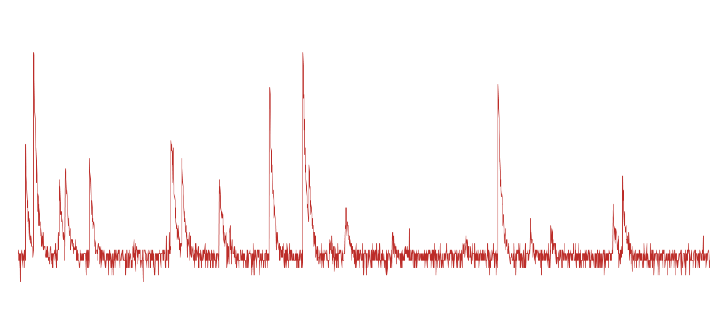
CluTim Algorithm for Drift Chambers Readout Electronics
Luigi Cappelli

Slide 2
Outline
CluTim Approaches
Sigma Approach
Efficiency Evaluation
Simulation Results
State of the art and future steps
Conclusions

Slide 3
CluTim Approaches
Ideal Signals
(no noise)
Derivative Approach
Comparative Approach
Based on first and second derivative
100% Efficiency on Ideal Signals
Based on 3 consecutive samples position
100% Efficiency on Ideal Signals
Noisy Signals
Derivative Approach
Comparative Approach
Critical Points:
Smoothing
Good Efficiency but too many fakes
New Approach
Focusing on noise characterization
Notes:
We started using Ideal Signals, simulated ones, and we developed and tested two different approaches: the former based on first and second derivative and the latter based on the position of three consecutive acquired samples. They both led to a 100% of efficiency on ideal signals but, once moved to noisy signals, they showed few critical points: the main important were the usage of smoothing that alterates the information coming from the signal, as amplitude, and they reached a good efficiency but too many fakes as well. Thus we thought to move to a different approach focusing on noise characterization, what we called “Sigma Approach”.

Slide 4
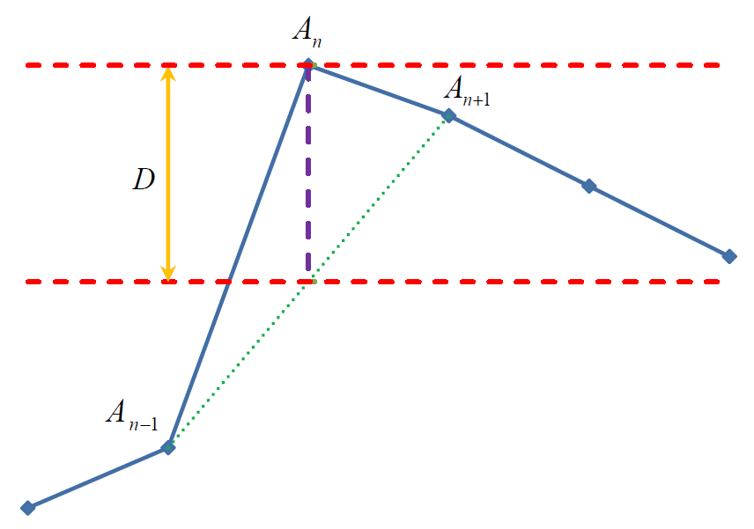
Sigma Approach
Noisy Signals
Sigma Approach
Efficiency Evaluation
Absolute
Efficiency
Relative
Efficiency
Peak Found Condition
Set Threshold
Example:
σ = 3 → D ≥ 11.02 ≈ 11
3σ = cutting 99.7% of noise
Notes:
Assuming that the signal is affected by white gaussian noise, considering the interval between 3sigma, we take into account 99.7% of the noise. So we thought to impose the following peak found condition. Considering three incoming samples, An An-1 An+1, the algorithm measures, for each sample, the difference between the An amplitude and the average of An-1 and An+1, that should (roughly) approximate the ideal trend of the signal. If this distance is lower then a conveniently chosen threshold, then it is considered as noise. If the difference is greater than or equal to the threshold, it means that is a peak. The threshold depends on the noise level and, in particular, on its standard deviation. Since we are using a mean calculation, the sigma to use is the results of propagation of uncertaintly, then the threshold will be set to 3sigmad, not just 3sigma.

Slide 5
Efficiency Evaluation - Noisy Signals
Ideal Signal
Number of peaks is well known
σ = 1
.
.
.
NOISE
σ = 3
.
.
.
σ = 5
Study of efficiency and fakes as function of noise amplitude has been carried out.
Notes:
So we started from the simulated signals, we added white gaussian noise with different standard deviation in a range from 1 to 5 that means a peak to peak noise value going from 6 to 30 mV. The study of the efficiency and fake peaks variation as function of noise has been carried out.

Slide 6
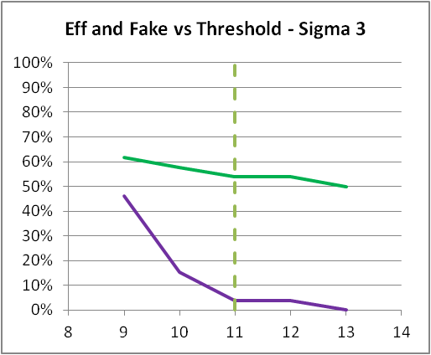
Efficiency evaluation – Absolute Efficiency
TOT PEAKS | 22
AMPL AVERAGE | 54
Book8_sig2 – SNR: 27
THR | EFF | FAKE | MAX
7 | 84.62% | 11.54% | 25
8 | 69.23% | 3.85% | 19
9 | 61.54% | 0.00% | 16
10 | 61.54% | 0.00% | 16
11 | 53.85% | 0.00% | 14
Book8_sig3 – SNR: 18
THR | EFF | FAKE | MAX
9 | 61.54% | 46.15% | 28
10 | 57.69% | 15.38% | 19
11 | 53.85% | 3.85% | 15
12 | 53.85% | 3.85% | 15
13 | 50.00% | 0.00% | 13
Book8_sig4 – SNR: 13.5
THR | EFF | FAKE | MAX
11 | 65.38% | 34.62% | 26
12 | 57.69% | 15.38% | 19
13 | 57.69% | 3.85% | 16
14 | 50.00% | 0.00% | 13
15 | 42.31% | 0.00% | 11
Book8_sig5 – SNR: 10.8
THR | EFF | FAKE | MAX
14 | 57.69% | 15.38% | 19
15 | 53.85% | 3.85% | 15
16 | 50.00% | 3.85% | 14
17 | 42.31% | 3.85% | 12
18 | 42% | 3.85% | 12
Ideal Signal
Noisy Signal
Depending on the peak amplitude, it could be comparable to noise and no algorithm could identify it.
Relative Efficiency Evaluation
Notes:
Here you find the evaluation of Absolute efficiency as function of the noise and threshold. The event you can see above has got 22 total peaks with an average peak amplitude of 54 digitized levels. The Signal to Noise Ratio has been evaluated as the ratio of amplitude average on noise sigma. It means that for sigma = 2 we’ve got SNR equal to 27........ Until SNR =10. The plot shows the efficiency and fake percentage as function of threshold in case of sigma = 3. The absolute efficiency doesn’t take into account the fact that, depending on the amplitude, the peak could be hidden by noise and then no algorithm could identify it. This is why we evaluate the relative efficiency, using, as reference, the number of real potentially identifying peaks. Moreover, in case of superB, the target is to count clusters not single electrons, then the loss of the shown covered peaks doesn’t matter.

Slide 7
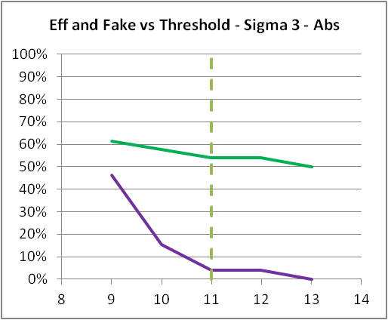
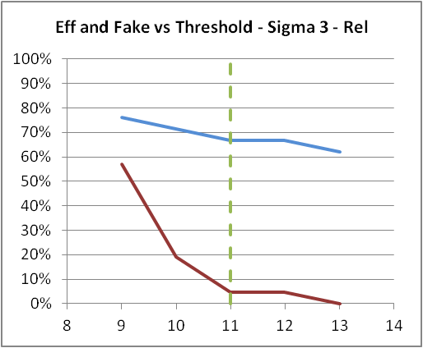
Efficiency evaluation – Relative Efficiency
TOT PEAKS | 22
AMPL AVERAGE | 57
Book8_sig3_abs
THR | EFF | FAKE | MAX
9 | 61.54% | 46.15% | 28
10 | 57.69% | 15.38% | 19
11 | 53.85% | 3.85% | 15
12 | 53.85% | 3.85% | 15
13 | 50.00% | 0.00% | 13
Book8_sig3_rel
THR | EFF | FAKE | MAX
9 | 76.19% | 57.14% | 28
10 | 71.43% | 19.05% | 19
11 | 66.67% | 4.76% | 15
12 | 66.67% | 4.76% | 15
13 | 61.90% | 0.00% | 13
Taking into account just potential identifying peaks.
(in this case 5 are covered by noise)
Reference level for the threshold
with σ = 3
Notes:
Here you can see the comparison between absolute and relative efficiency. The reference level is the calculated threshold in order to cut the 99.7% of noise affecting the signal. In this event, for example, you would have around 67% of efficiency with just 5% of fake.

Slide 8
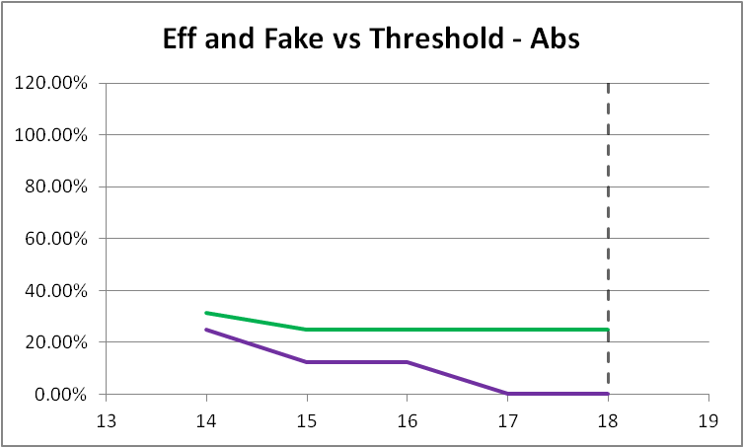
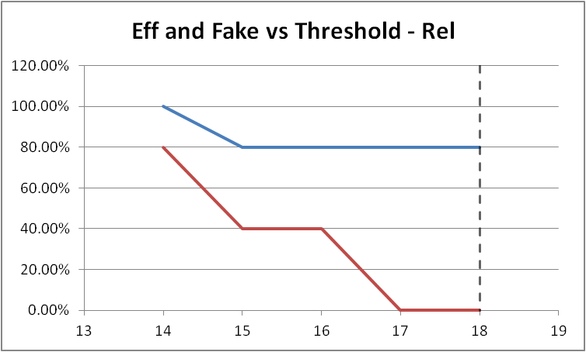
Relative Efficiency - Example
TOT PEAKS | 16
AMPL AVERAGE | 33
TOT PEAKS | 16
COVERED BY NOISE | 11
Notes:
In order to give a better idea of relative efficiency this is an “extreme” situation example. Referring to the total amount of ideal peaks, the efficiency is very low, around 30% since most of the peaks are hidden by noise. Instead, referring to the real number of potentially identifying peaks the efficiency goes up to 80% with an SNR roughly equal to 6.

Slide 9
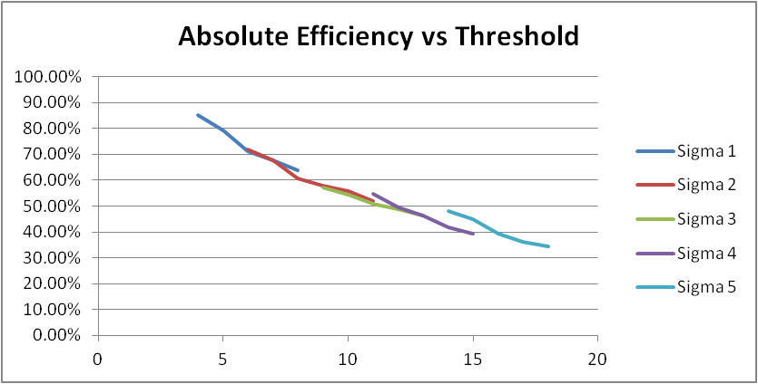
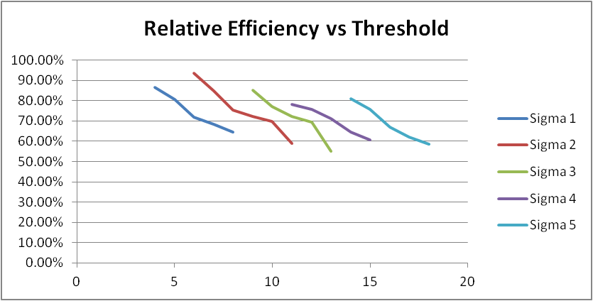
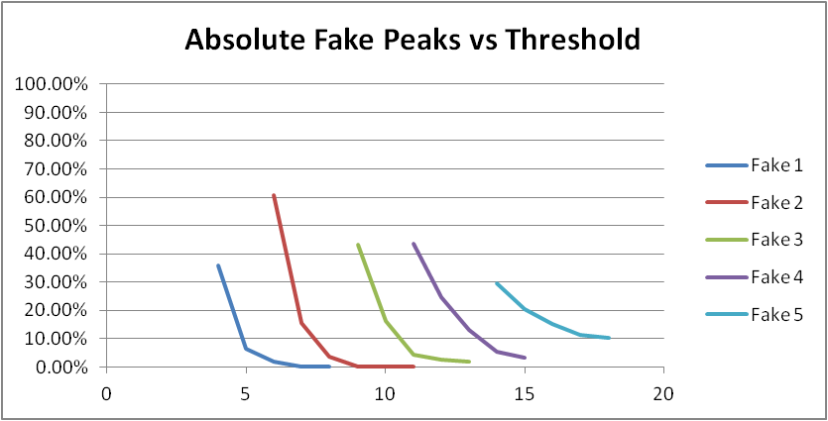
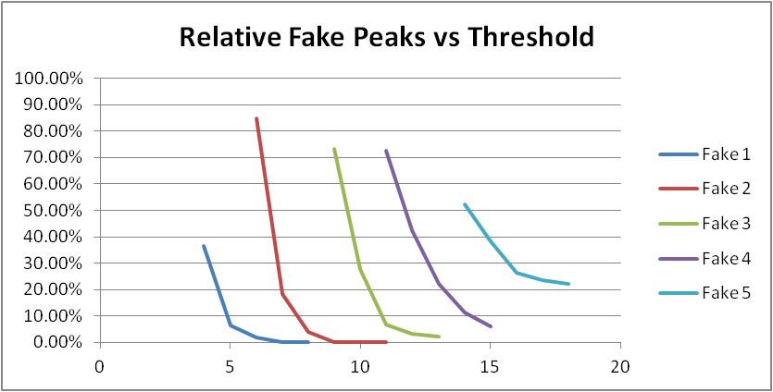
Efficiency – Simulation Results
Absolute Efficiency scales down proportionally increasing the noise
Relative Efficiency is confined within 60 – 90% depending on threshold
Fake peaks obviously increase increasing the noise
Unrevealed peaks are generally part of the same cluster, it means the efficiency could increase referring to clusters, not to single electrons.
Notes:
To have a global view of what happens to the efficiency varying the noise as well as the sigma, here you can see that the absolute efficiency scales down proportionally increasing the noise. On the contrary, the relative efficiency is confined within a pretty acceptable range. Tha fake plots show its trend increasing the noise. It obviously increases with the noise but the relative one is greater than the absolute since the denominator of the ratio is smaller than the absolute one. Indipendently from percentage, what really is interest to is the number of fakes. As previously said, this values could shift upward is we would take into account clusters, not single electrons.

Slide 10
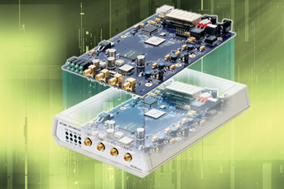
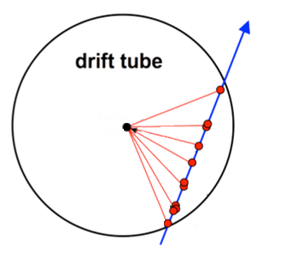
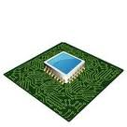
Next Step – Parallel paths
A
Amplifier
ADC08D1500DEV with Virtex 4 from National Semiconductor
Drift Tube
Hittite HMCAD1511
8-Bit 1 GSPS A/D Converter
710 mW – SNR: 49.8 dBFS
Xilinx ML605 Virtex 6
Notes:
Next steps will be to work parallel on a National Semiconductor Evaluation Board, which run at a slower frequency but it could be useful to understand the behaviour of the algorithm, and on the Xilinx ML605 Evaluation Board using a new ADC (that we are waiting ) with 8 bits, 1 GSPS, 710 mW power dissipation and SNR ....

Slide 11
Conclusions and Future Plans
Cluster Timing algorithms have been developed with three different approaches;
Sigma Approach Algorithm Efficiency has been evaluated and it meets the requirements;
Efficiency as function of noise has been evaluated;
Upgrades of the Cluster Timing Electronics:
Use of an ADC – FPGA integrated board from National Semiconductor, (ADC08D1500) are underway;
New Flash ADC interfacing Xilinx ML605
VHDL Code improvements:
Timing performance improvement by pipelining
Mapping Strategies
Final Target: Readout Board with, at least, 4 channels.

Slide 12
THANK YOU

Slide 13
Backup Slides

Slide 14
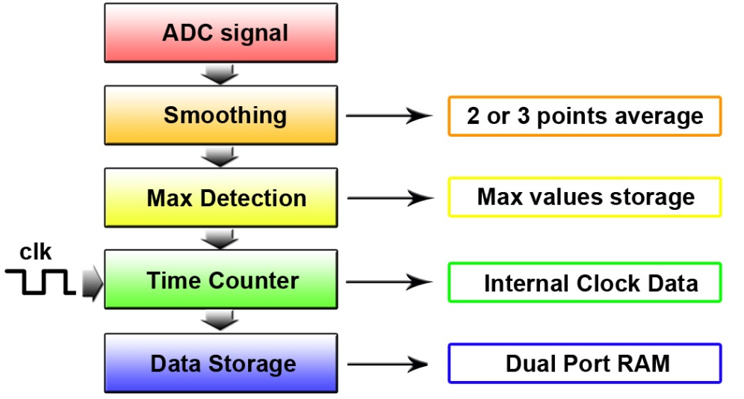
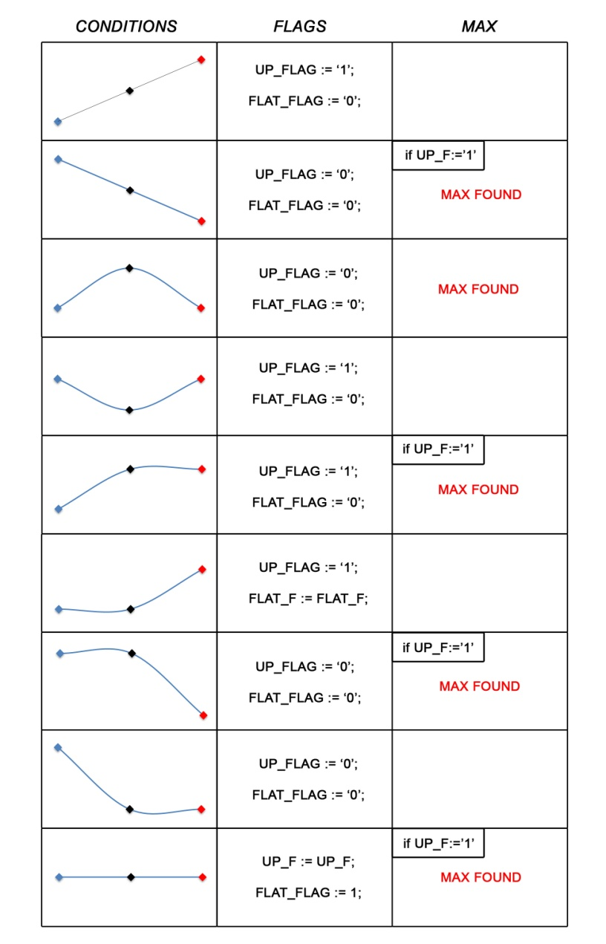
Last Update July 2011
States Based Approach
Results:
100% Peak Found on Ideal Signals
Different Smoothing Approaches
Real Signals:
Critical Points:
Smoothing
Fake Peaks due to noise
Good Efficiency but too much fake

Slide 15
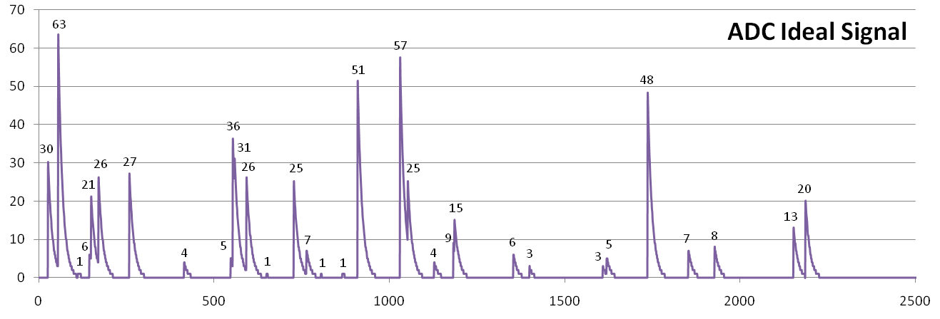
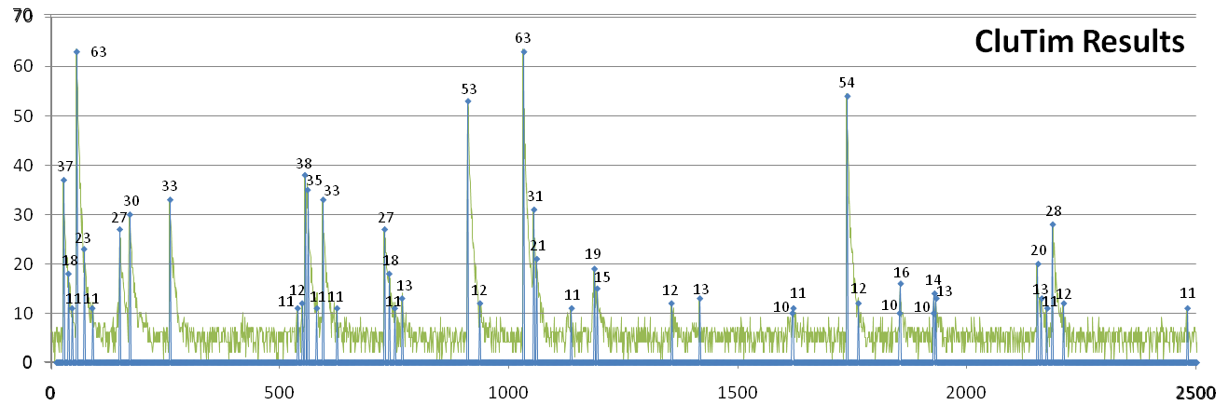
Comparative Approach Results
Ideal Signal
TOT PEAKS | 32
MISSED | 0
FOUND | 32
% | 100
Real Signal
“Tail” Fake Peaks
93 % Efficiency but over 40% of fakes!!!
New Approach

