Slide 1
DCH FEE
LNF GM December 2011

Slide 2
Outline
Design goals
Readout: Charge Measurement Option
  Requirements
  System block diagram
  On-Detector electronics
    Preamplifier simulation and preamplifier boards
    Signal cabling
    HV distribution
  Off-Detector electronics
Readout: Cluster Counting Option
  Requirements
  System block diagram
  On-Detector electronics
    Preamplifiers and cabling
    HV distribution
  Off-Detector electronics
TDR Outline
Conclusions

Slide 3
Design goals

Slide 4
Design goals
SuperB Drift Chamber (DCH) front-end electronics is designed to extract and process the 8056 (to be finalized) sense wire signals to:
measure the electron drift times to the sense wires for tracking purpose (momentum of charged particles)
Measure the energy loss of particles per unit length, dE/dx (particle identification)
provide hits information to the trigger system (trigger primitives)
Measurement of the energy loss of particles per unit length, dE/dx (particle identification) can be implemented by
Charge Measurement Option: measuring the charge collected on the sense wire (discarding high values to remove Landau fluctuations)
Cluster Counting Option: Counting the number of cluster generated by the particle crossing the cell

Slide 5
Charge Measurement Option
Requirements & Block Diagram

Slide 6
Charge Measurement Option: Specifications for charge measurements
dE/dx Goal: measure particle energy loss with precision of the order of 7.5% (BABAR) despite large fluctuations involved in single measurement (“truncated mean” method)
Resolution
Overall expected single cell σ_{E} ≈ 30 % (dominated by chamber contribution)
  Electronic contribution must be enough low to make it negligible; e.g.: σ_{EL}= 15% of σ_{E} corresponds to σ_{EL}= 4.5% → sqrt(σ_{E}² + σ_{EL}² ) ≈ σ_{E}
Assuming ≈ 50 fC the charge released from a mip (gas gain=10⁵) , σ_{EL} ≈ 5%
single channel ENC ≈ 50 fC * 0.05 ≈ 2.5 fC
Dynamic range
σ_{E} dominated by gas amplification effects:
  Lower range: σ_{EL} (2.5 fC ) (could be 3σ_{EL})
  Higher range: ≈ 500 fC (BaBar experience)
Linearity
Linearity of the order of 2% matches system requirements

Slide 7
Charge Measurement Option: Specifications for time measurements
Particle tracks reconstruction based on (ionized) electrons drift time toward the sense wire
Resolution
Overall expected σ_{S} ≈ 130μm → dominated by chamber contribution
  σ_{S} limits:
    Chamber: statistics of primary ionization, electrons diffusion
    Electronic: time measurement uncertainty
  Chamber contribution (σ_{SC} ) raw estimation ≈ 440/sqrt(N_{P}) ≈ 110 μm for a 90/10 He/Iso gas mixture
  σ_{EL} ≈ sqrt(σ_{S}² - σ_{SC}² ) ≈ 70 μm → σ_{t} ≤ 1.5 ns ( 3 * 16 μm/ns drift velocity close to the wire)
    Main error sources are jitter (time walk + noise) and TDC (digitizing noise)
    Jitter
    Noise contribution: Δt = σ_{N}/ (dV/dt) ≈ σ_{N}* τ/V_{max} (τ = peaking time)
      Assuming σ_{N} = 4 mV rms, V_{max} = 30 mV, τ = 4 ns → σ_{EL NOISE} ≈ 0.5 ns
    Time walk contribution: assuming τ = 4 ns a time walk of the order of 1.5 ns with 20 dB input signal dynamic is obtained → quite high → possible (partial) compensation using FADC sampled values
        Digitizing noise ≈ Δ/sqrt(12) with Δ ≈ 1 ns → ≈ 0.3 ns
Time resolution (≈ 1.5 ns) is dominated by signal time walk
Dynamic range
TDC range depends on gas mixture drift velocity and cell size → SuperB DCH max drift time ≈ 600 ns
TDC range ≈ 1us
Linearity
A linearity of ≈ 1% fulfill measurement requirements

Slide 8
Charge Measurement Option: Block diagram
OFF-DETECTOR ELECTRONICS
12 cores Fiber Optical Cable patch-panel
ON-DETECTOR ELECTRONICS
DCH BACKWARD END-PLATE
8056 chs
#16
DAQ
16 OL @ 2Gbits/sec
173 OL
12→1
DAQ
DATA-ECS
CONCENTRATORS
16 (12 cores) OL
12→1
ECS
ECS
16 OL/Copper links
#173 (48 chs)
< 10 m
cables
Data Conversion
Trigger Primitive Generation
Boards
Pre-HV boards
SLayer | chs | Boards | Links
1 | 1504 | 32 | 3
2 | 472 | 10 | 1
3 | 536 | 12 | 1
4 | 600 | 13 | 2
5 | 664 | 14 | 2
6 | 728 | 16 | 1
7 | 792 | 17 | 2
8 | 856 | 18 | 2
9 | 920 | 20 | 2
10 | 984 | 21 | 2
#10 ?!
12→1
TRIGGER
TRIGGER
Superlayers (10) Track Finder
173 OL
18 (12 cores) OL
or Copper Links
OL to Track Finder
Super-layers structure is preserved in Data Conversion Boards (Trigger requirement)

Slide 9
Charge Measurement Option: ON DETECTOR electronics (Preamplifiers & HV distribution)
Charge Measurement
ON DETECTOR electronics

Slide 10
Charge Measurement Option: On Detector Electronics - Preamplifiers
Preamplifier
Front End Boards contain HV blocking capacitors, protection networks, preamplifiers and (eventually) shapers.
Boards are located on the backward end-plate to maximize S/N ratio and are connected to the Data Conversion Boards (located on external crates) through coaxial or shielded twisted pairs cables
Connection up to 10 mt length can be achieved providing good shielded cables
The end-plate will be divided in (sub)sectors → more cells will be grouped in a single multi-channel preamplifier-shaper board (sub-division will be finalized as soon as DCH final design parameters will be available)
Charge measurement caveats
Wire signal is used both for charge and time measurement
  → preamplifier should not worsening too much signal time information (rise time).
Because the gas mixture slow drift velocity and the moderate detector parasitic capacitance a transimpedance configuration with a dominant pole around 25-35 MHz should match the measurement requirements providing that the second pole is enough far to ensure a good phase margin.
Channel density is not so high and circuit design not so complex
  → approach based on SMT technology possible
  → We can profit of high bandwidth, low noise SiGe devices developed for mobile-phone applications
Radiation Environment
BONUS: SiGe HBT transistors technology is inherently radiation hard

Slide 11
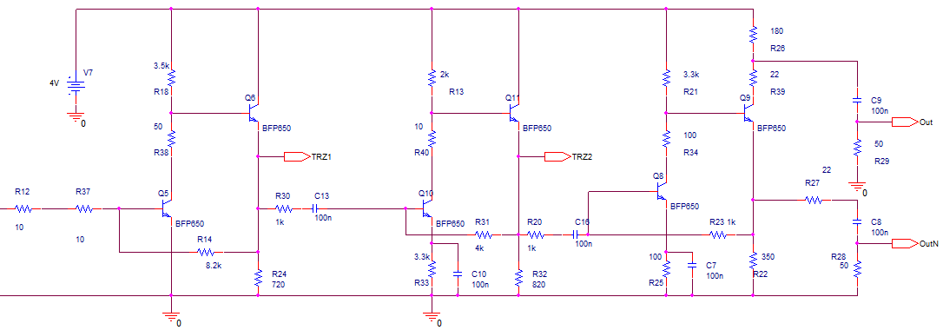
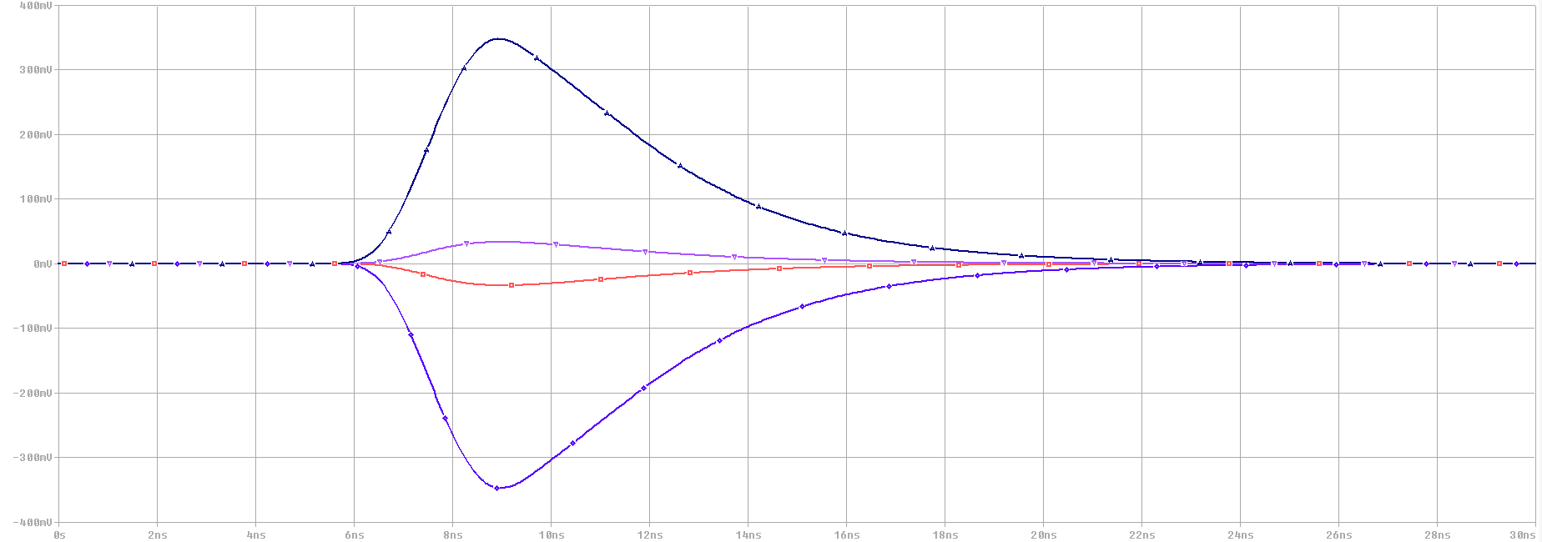
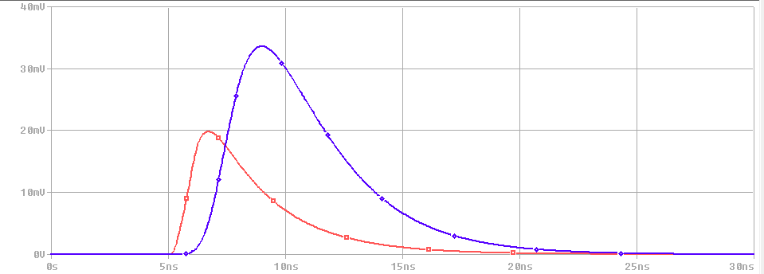
Charge Measurement Option: On Detector Electronics - Preamplifier Simulation
100fC
Head transistor current must be optimized vs C_{D} and shaping time
400 mV
C_{D}=0pF
300 mV
10fC
200 mV
100 mV
0 mV
-100 mV
-200 mV
-300 mV
Preamplifier main features (Pspice Simulator)
Linearity (-2 fC ÷ -200 fC) | ≈ 1%
Output signal balance | ≈ 1%
Z_{IN} | 100 ohm
Gain ( C_{D} = 0 pF) | ≈ 6.8 mV/fC (Differential)
Gain (C_{D} = 24 pF) | ≈ 4 mV/fC (Differential)
t_{r} – t_{f} (Cd = 0 pF) | 2 ns – 7 ns
t_{r} – t_{f} (Cd = 24 pF) | 3 ns – 10 ns
erms (Cd= 0pF) | 1100 erms
erms (Cd= 24pF) | 1900 erms
PSRR | ≈ 20 dB
Vdd | 4V
Pd | 32 mW
-400 mV
0 ns
2 ns
4 ns
6 ns
8 ns
10 ns
12 ns
14 ns
16 ns
Preamplifier topology allows to implement shaping on input signal
Output (driver) stage can be differential or single-ended

Slide 12
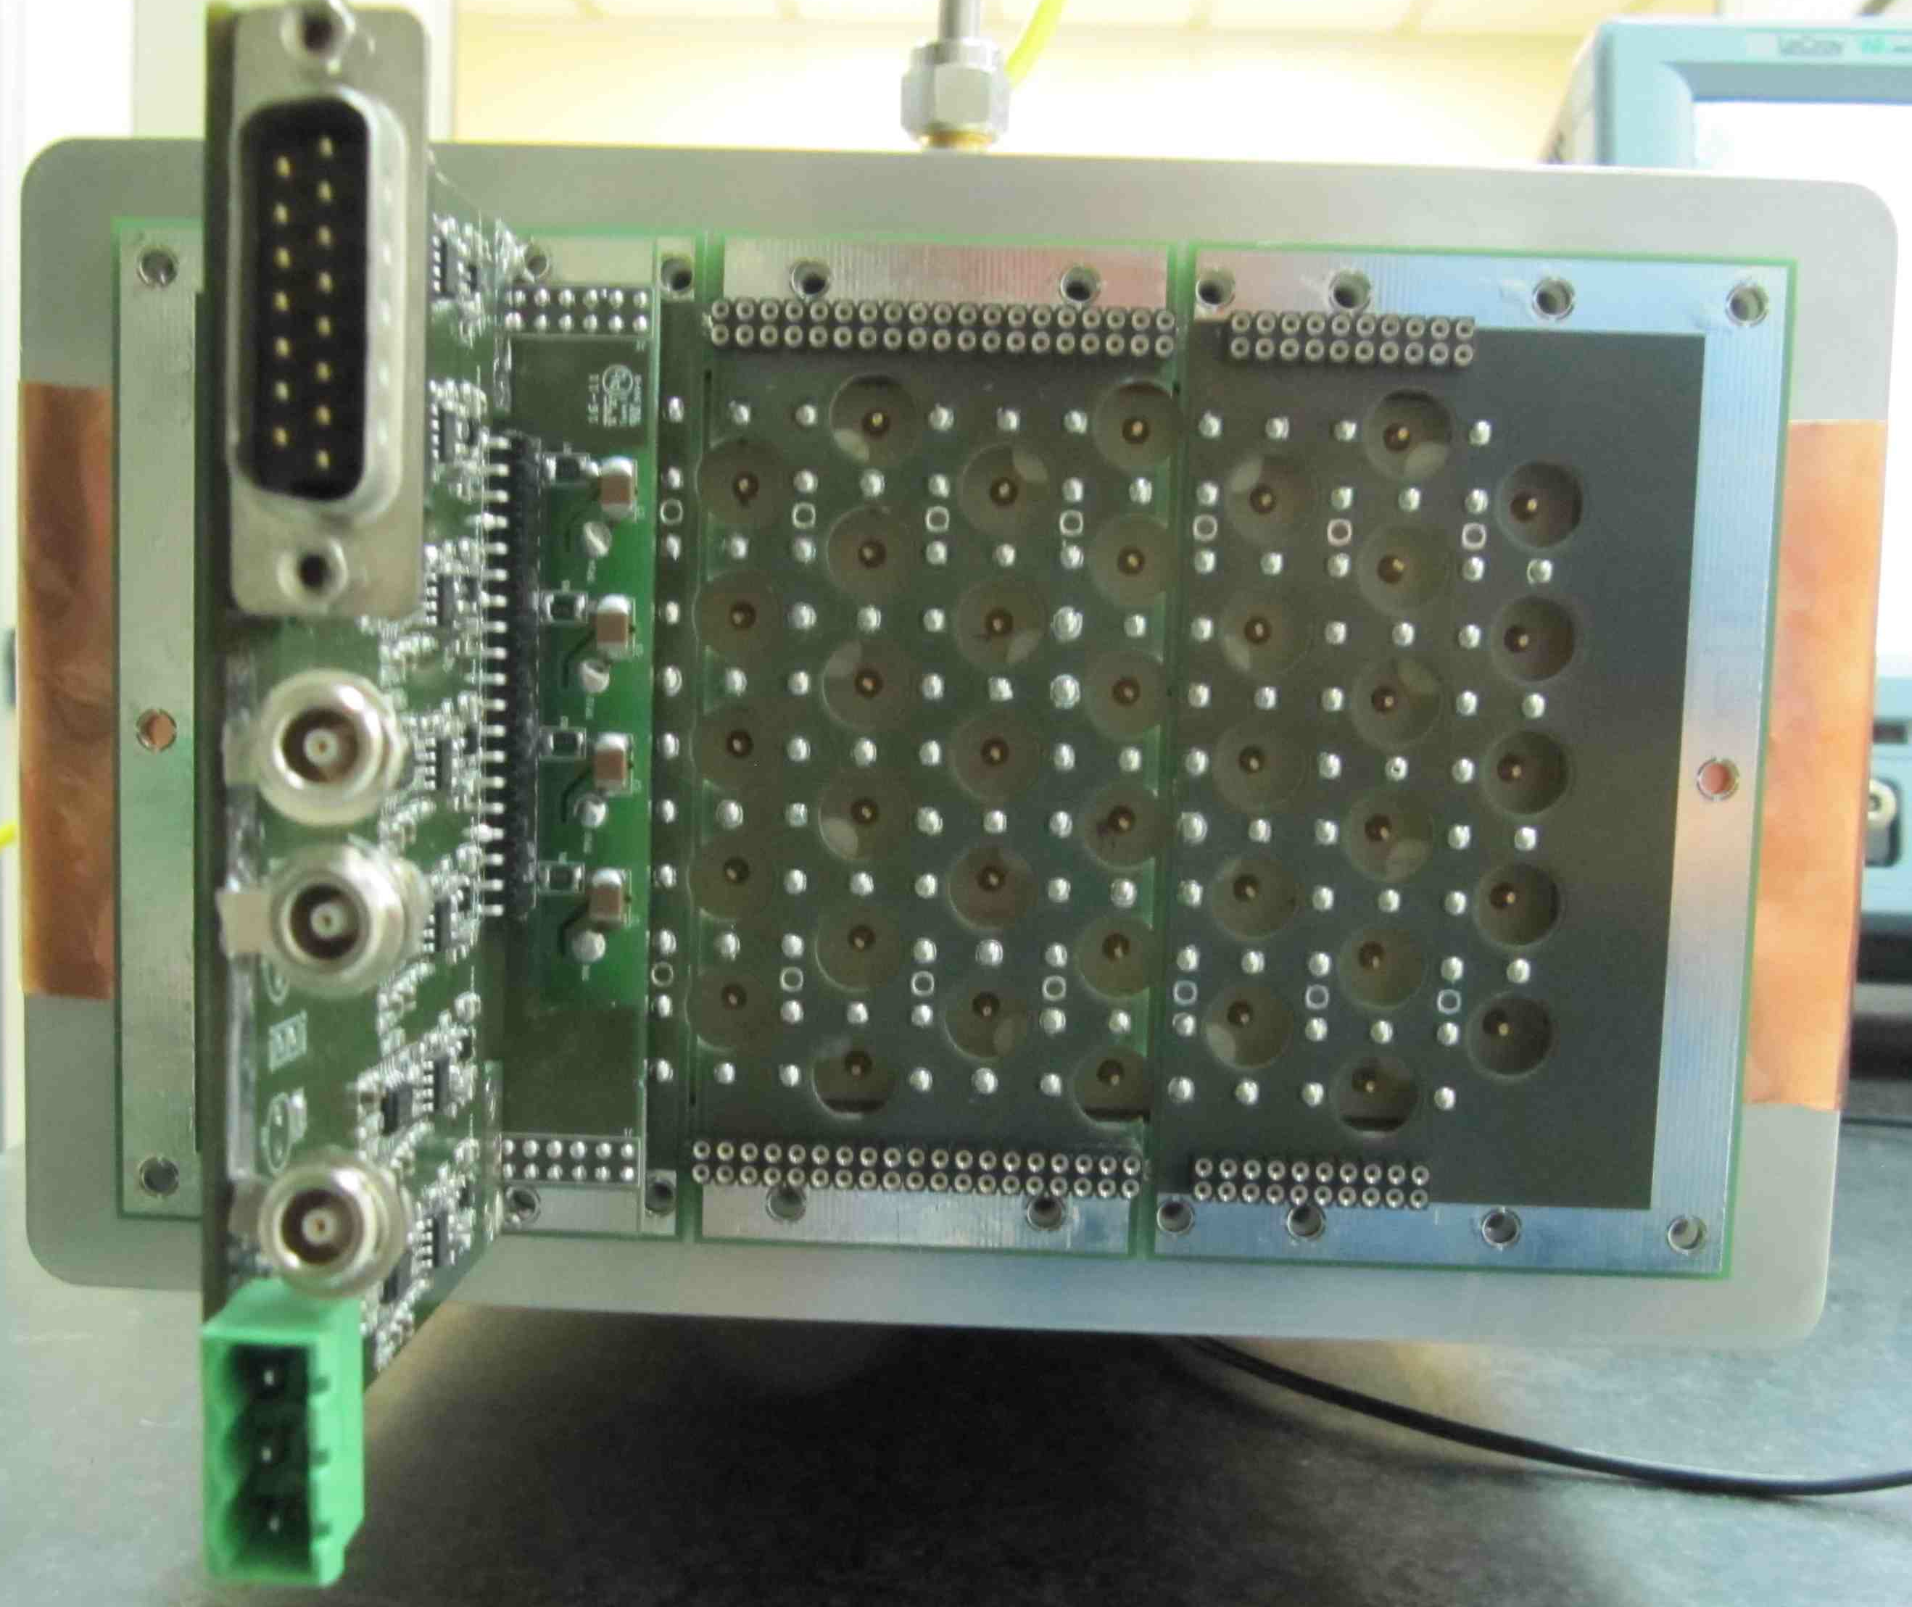
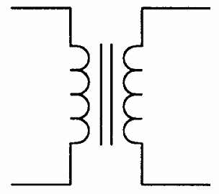
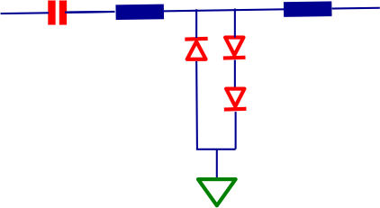
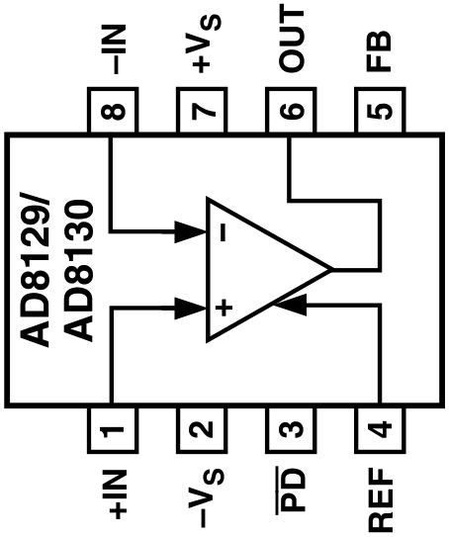
Charge Measurement Option: On Detector Electronics – Preamplifier Boards
Preamplifier boards modularity should match trigger super-layer structure
  i.e. assuming a 48 chs off-detector boards preamplifier (and HV distribution) cards should fit off-detector boards modularity in such a way we can send signal belonging to a single super-layer to track finder trigger boards
Signal output cables can be differential (shielded twisted pairs) or single ended (coaxial)
Cable length can reach up to 10 mt providing good shielding and fully differential receiving stage on off-detector boards (to minimize loop area).
  Twisted pairs cables: shield must be connected only on one side to avoid current flow through the shield (in case of differences in ground potential between the two ends of the circuit).
  Coaxial cables: “The best way to protect against magnetic fields at the receptor is to decrease the area of the receptor loop” (H.W. Ott - Noise reduction techniques in electronic systems)
On Detector electronics possible setup
Driver
Signal decoupling & protection network
Detector ground
Driver
Field wires grounding board
Pre
Shaper
Driver
Detector ground

Slide 13
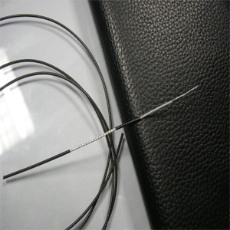
Charge Measurement Option: On Detector Electronics – Cabling
dE/dx based on charge measurement
ON DETECTOR electronics will provide good amplification, but signal levels are still quite low.
Micro-coaxial cables or shielded twisted cables must be used to minimize noise environmental pickup
  Problem can arise due to the cable jacket. Many halogen free cable are quite rigid (large bending radius)
Braid shield twisted pairs offer a good compromise between cost, noise environmental shielding and bandwidth. Nevertheless shielded connectors could be a problem in the on-detector side (because the size)
Both micro-coaxial and braid shielded twisted pairs are available in round and flat assembling. Flat assembling is (generally) better for on-detector front end boards connection, while round cables are better for routing and Digitizing Boards connections.
Micro Coax Cable quotation requirement
A feasibility study (production/cost) for a custom micro-coax cable has been required to a company
Cable main specs:
  Impedance: 50 (±2) Ω
  Shield: copper braid
  Attenuation (dB/100m) : ≈ 36 dB/100 m
  External diameter : < 2 mm
  Halogen free (still maintaining good flexibility)
  Assembling: flat mixed (7 signal cables + 2 LVPS cables + 7 signal cables + 2 LVPS cables)
Micro-coax: 50 Ω
0.83 – 1.3 mm diameter

Slide 14
Charge Measurement Option: On Detector Electronics – HV distribution boards
General considerations
Enough modularity to avoid too many dead channels in case of single chamber channel failure
Modularity is function of the distance from inner layer (example: 2 boards in inner layer – 5 boards in outer layer)
Good feedback of the current dragged by the inner layers (≈ 1 nA) and by the outer layers (≈ 100 nA)
HV Distribution – dE/dx by means of charge measurement
Main Power Supply
Distribution Board
[number of boards is a function of chamber layer]
Filter Box
[Outside Detector]
10MΩ
Ch 1
1MΩ
1MΩ
BOARD #1
2.2 nF
500 pF
10MΩ
Ch 8
10MΩ
Ch 1
1MΩ
BOARD #N
500 pF
10MΩ
Ch 8
NB: HV distribution boards located on forward end-plate

Slide 15
Charge Measurement Option: Off Detector Electronics
Feature EXtraction
Only rad-tol FPGA (Actel ProAsic equivalent devices) will be used for Off-Detector electronics
Locating Off-Detector electronics on the top of experiment could be useful for setup and maintenance (cable length ?)
Off-Detector Feature Extraction can be simply implemented if minimum trigger spacing is ≈ 70 – 100 ns. FEX could be (anyway) implemented by using an intermediate buffer (see CC option).
FEX on Off-Detector Electronics
NO FEX on Off Detector electronics
All events have a fixed structure and a fixed length
Minimum trigger spacing ≈ 50 ns ( ≈ 0.8 mm @ 16 μm/ns drift velocity)
Raw data (minimum amount) - 32 bytes ADC + over-threshold discriminated signals (TDC)
Data stream do not have fixed length (consecutive events properly tagged can be contained in the same data stream)
Data Stream Example (10 bytes)
Digitizer Module Address (2 Bytes)
Flag (1 Byte)
Trigger Tag (1 Byte) – 5 bits in BaBar
Counter (1 Byte)
Charge (2 Bytes)
Time (2 Bytes)
1st ADC sample for time walk correction (1 byte)

Slide 16
Cluster Counting Option
Requirements & Block Diagram

Slide 17
Cluster Counting option
Pros & Cons
Pros
  Particle identification improvement
  Dedicated time measurement not required
  Possible improvement in spatial resolution
Cons
  High sampling frequency digitizers
  Fast processing
  Wide bandwidth and high power requirement for front-end (environment noise sensitivity increases)
  High Bandwidth-Low losses cables for on-detector → off-detector connection required
  Termination resistor required (system noise baseline) with dedicated PCB
Resolution
FADC resolution is a function of the lowest sampled signal and system noise
  6 fC wire signal (gas gain 3x10⁵), 10 mV/fC shaper-amplifier, safety factor = 2 → 30 mV signal
  If we consider only the noise contribution of termination resistor (bottom limit: peaking time = 3 ns - gain = 10 mV/fC ) we get about 2 mV rms
Dynamic range and linearity
Total ionization in 1.2 cm high cell (average) ≈ 30e (90/10 – He/Iso)
Each electron correspond to a different level in output voltage → 3 bits/electron → 8 bits FADC
Linearity ≈ 2%

Slide 18
Cluster Counting Option: Block diagram
ON-DETECTOR ELECTRONICS
DCH BACKWARD END-PLATE
8056 chs
OFF-DETECTOR ELECTRONICS
12 cores Fiber Optical Cable patch-panel
#32
DAQ
32(?) OL @ 2Gbits/sec
# 1152 OL
12→1
DAQ
DATA-ECS
CONCENTRATORS
96 (12 cores) OL
12→1
ECS
ECS
32 OL / Copper Link
#1152 (8 chs) boards
< 5 m
cables
Data Conversion
Trigger Primitive Generation
Boards
Pre-HV boards
#10 ?!
Concentrator
+
12→1
TRIGGER
TRIGGER
Superlayers (10) Track Finder
1152 OL
OL to Track Finder
18 (12 cores) OL
or Copper Links
Increase of trigger latency ?

Slide 19
Charge Measurement Option: ON DETECTOR electronics (Preamplifiers & HV distribution)
Cluster Counting
ON DETECTOR electronics

Slide 20
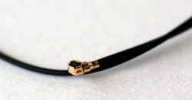
Cluster Counting Option: Preamplifiers and Cabling
Preamplifiers
A wide bandwidth preamplifier has been designed and has been tested on a Drift Chamber. Results will be shown asap.
dE/dx based on Cluster Counting
Cables for Cluster Counting must features high bandwidth, low losses and controlled impedance (Shielded Controlled Impedance cables)
There are several assemblies available. Cost is a function of modularity, type of connector and type of cable, but is generally higher than the solution for charge measurement because the BW requirement.
  Decision on type of cable will depend on the technique adopted for dE/dx measurement
1.88 mm diameter
Our Price: $1.38
Mated height: 1.4 mm (55.12 mil)
Cable diameter: 0.7 mm (27.6 mil)
Length: 5.9" (150 mm)
Connectors: Super micro plug
Frequency: DC-7GHz
VSWR: 1.4:1 max
Standard lead time: 4 weeks ARO

Slide 21
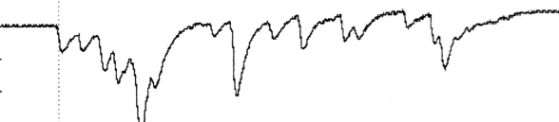
Cluster Counting Option: Off Detector Electronics
Feature Extraction implications
Only high performances FPGA can be used for Off-Detector electronics. Unfortunately they are prone to SEU
  use neutron shielding (pure polyethylene ..) ???!!!
As already said locating Off-Detector electronics on the top of experiment could be useful for setup and maintenance but long cables could be a problem because SNR reduction and cost.
If Off-Detector Feature Extraction is not used complete event data (≈ 1kB) must be moved to DAQ !!!
  8000 (bits) x 8056 (chs) x 10% (occupancy) x 150 kHz (Average Trigger rate) ≈ 967 Gbits/sec
dE/dE by means of Cluster Counting – Latency, FEX, Readout Buffer
L1
State Machine
< 1 μs
FADC
8 bits
Latency Dual Port
SRAM
FEX Dual Port
SRAM
Readout
Dual Port SRAM
16 bits data bus
64 bits data bus
≈ 4 μs for FEX
64 bits data bus
1000 samples (8 bits) @ 1 GHz
Trigger implications
DCH trigger is based on super-layers track finder. Because the Off-Detector boards low modularity we should use concentrators → increase of latency ?

Slide 22
Cluster Counting Option: On Detector Electronics – HV distribution boards
Assuming the same general considerations of Charge Measurement Option
HV Distribution – dE/dx by means of Cluster Counting
Distribution Board
[number of boards is a function of chamber layer]
Main Power Supply
Filter Box
[Outside Detector]
10MΩ
R_{T}
Ch 1
1MΩ
1MΩ
500 pF
BOARD #1
2.2 nF
500 pF
10MΩ
R_{T}
Ch 8
500 pF
10MΩ
R_{T}
Ch 1
1MΩ
500 pF
BOARD #N
NB: HV distribution boards should be located on forward end plate and require high frequency ground connection because the termination resistors
500 pF
10MΩ
R_{T}
Ch 8
500 pF

Slide 23
TDR outline
1 Electronics – (Felici, Martin) 14 pages
  Design Goals
  Truncated mean method
    Specification for charge measurements
      Resolution
      Dynamic range
      Linearity
    Specifications for time measurements
      Resolution
      Range
      Linearity
    System block diagram
    On-Detector Electronics
    Off-Detector Electronics
    HV Distribution
  Cluster Counting method
  Specification for clusters and time measurement
      Resolution
      Dynamic range
      Linearity
    System block diagram
    On-Detector Electronics
    Cabling
    Off-Detector Electronics
  Cabling
Optical links
Patch Panels
Slow control system
Low Voltages Power Supply
Grounding policy
Radiation environment policy

Slide 24
Conclusions
Design goals have been defined
Two different implementation of dE/dx measurements have been evaluated and will be reported in TDR.
The technique used for dE/dx measurement has a NOT minor impact on number of boards, power requirement, interconnections cables, HV distribution boards and grounding (shielding).
HV distribution modularity should follow the chamber layer (less cells for the internal layers, more cells for the external ones)
Only Rad Tol components will be used in front-end boards (charge measurement option). If selected components has no qualification they will be qualified.
Grounding/shielding policy has not been defined yet
    Board design will start after the decision on what technique will be used for
    dE/dx measurement

Slide 25
Front-end and Counting Algorithms on Cluster Counting
LNF GM December 2011

Slide 26
Outline
Preamplifier Impulse response estimation
Garfield simulation
Convolution effects on the generated signal
Counting algorithms
Gaussian noise effects on counting algorithm
Conclusions

Slide 27
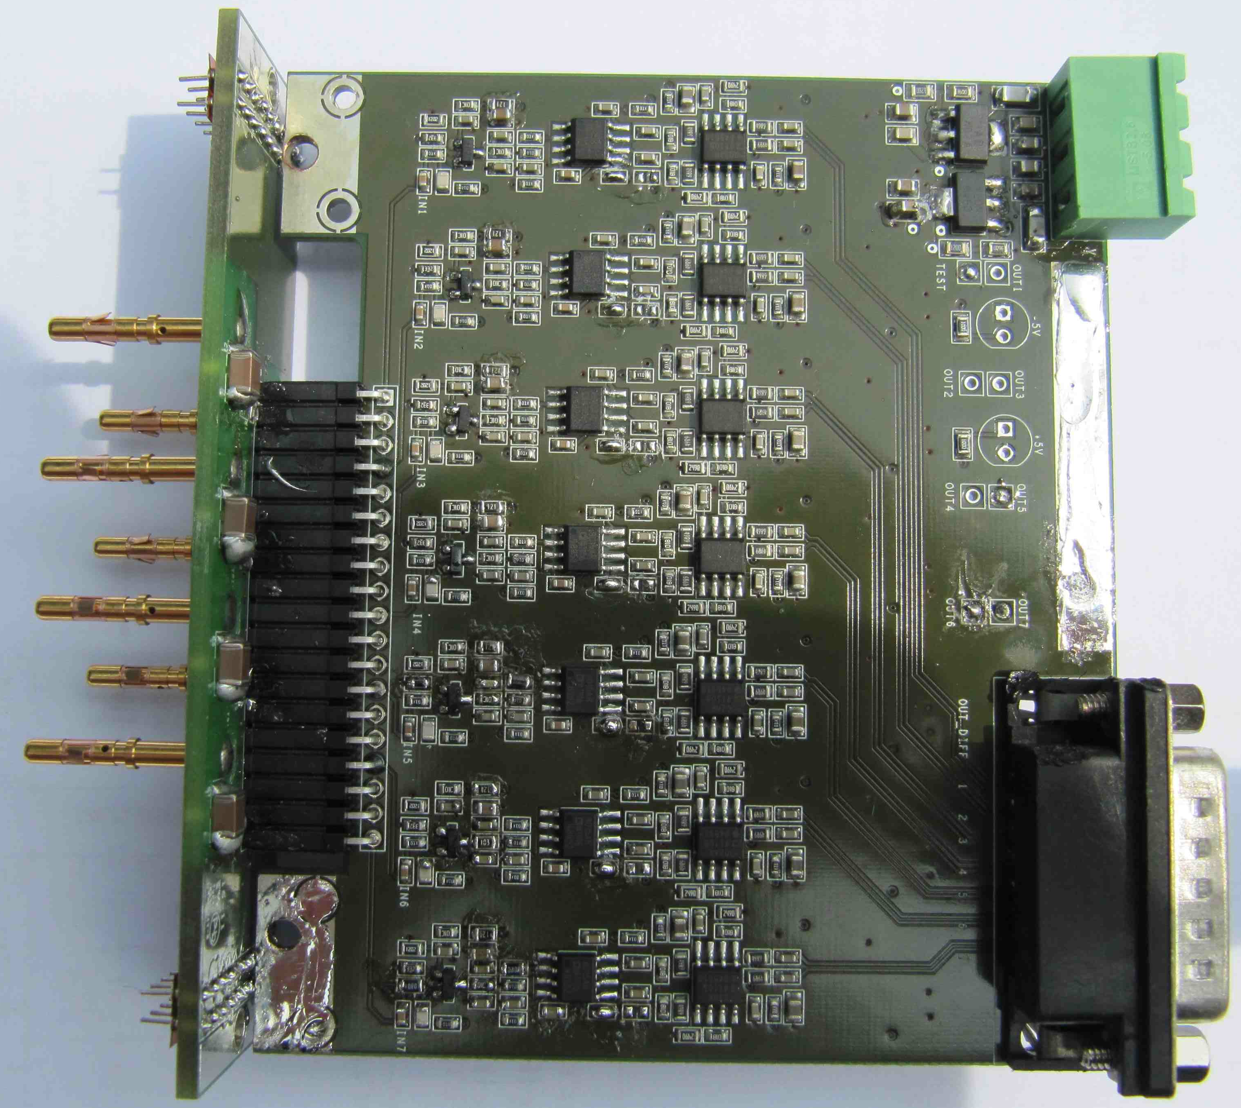
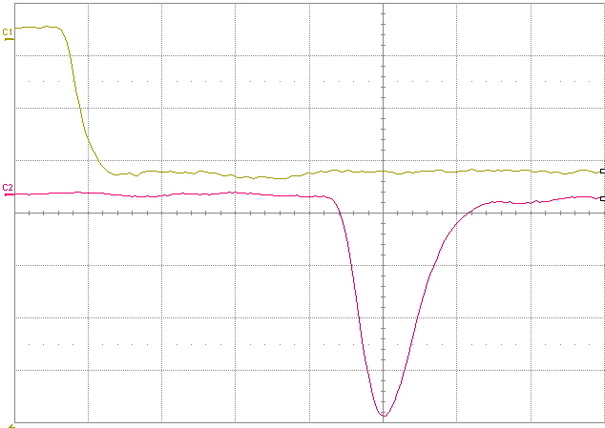
Preamplifier Features
Preamplifier Board
Differential amplifier/shaper output
Transimpedence preamplifier
Unipolar amplifier/shaper output
5 mV/div
Preamplifier main features
Number of channels : 7
Zin ≈ 60 Ω
Gain ≈ 8.8 mV/fC
Noise ≈ 2500 erms @ 250 MHz BW
Rise time ≈ 2.4 ns
Unipolar & Differential outputs (50 Ω – 110 Ω)
Test input
Supply Voltage : + 7V (310 mA) - 7V (190 mA)
Power Dissipation : 490 mW/ch
50 mV/div
average
5 ns/div
1.8 pF injecting capacitance

Slide 28
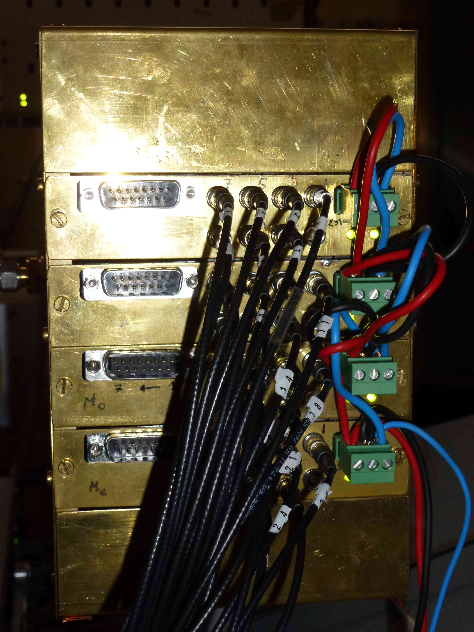
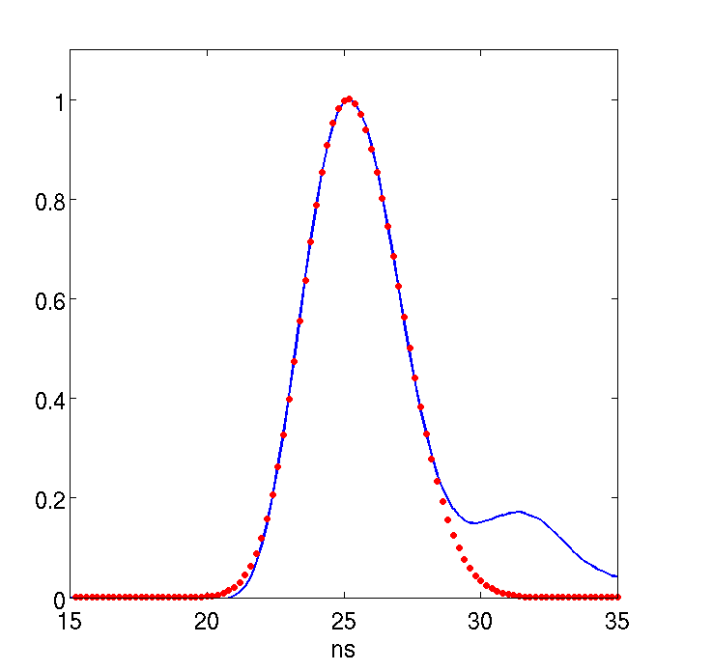
Preamplifier Impulse Response Fitting
Preamplifier board has been connected to the chamber and pulsed through a 1.8 pF internal capacitor.
Output pulse has been fitted to find out the preamplifier impulse response.
Fitting function:
Shape=a1*exp(-((t-b1)./c1).^2)+
a2*exp(-((t-b2)./c2).^2)
Where:
A1= 0.479
B1= 24.367
C1= 1.797
A2= 0.691
B2= 25.983
C2= 2.305

Slide 29
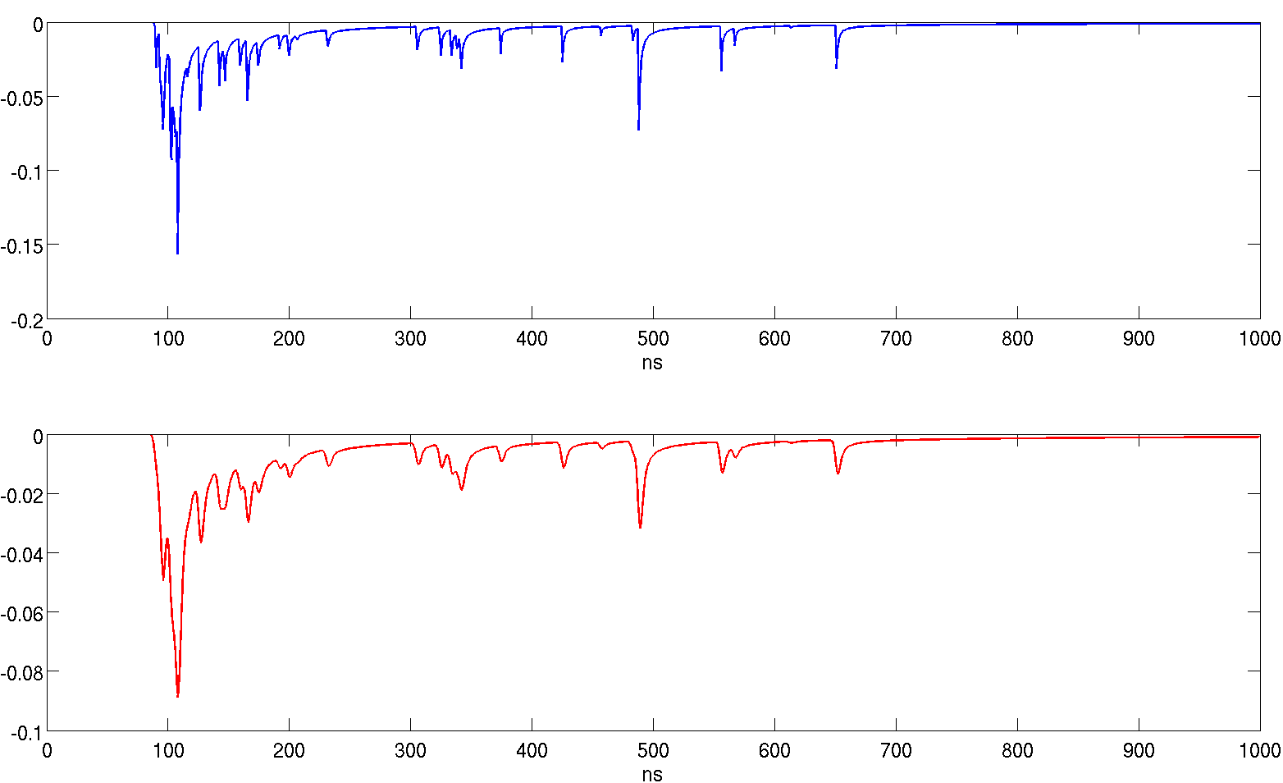
Preamplifier response convolution example #1
Garfield output (Gas gain 3x10^5 – preamp gain 4mV/fC)
Convolution output

Slide 30
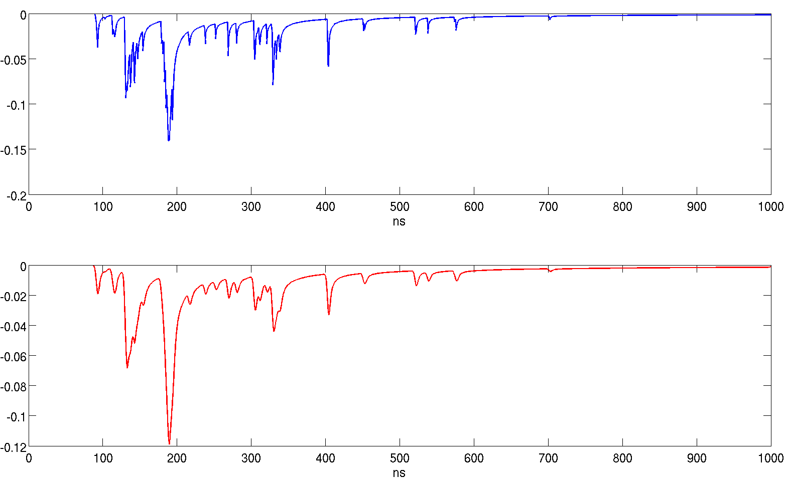
Preamplifier response convolution example #2
Garfield output (Gas gain 3x10^5 – preamp gain 4mV/fC)
Convolution output

Slide 31
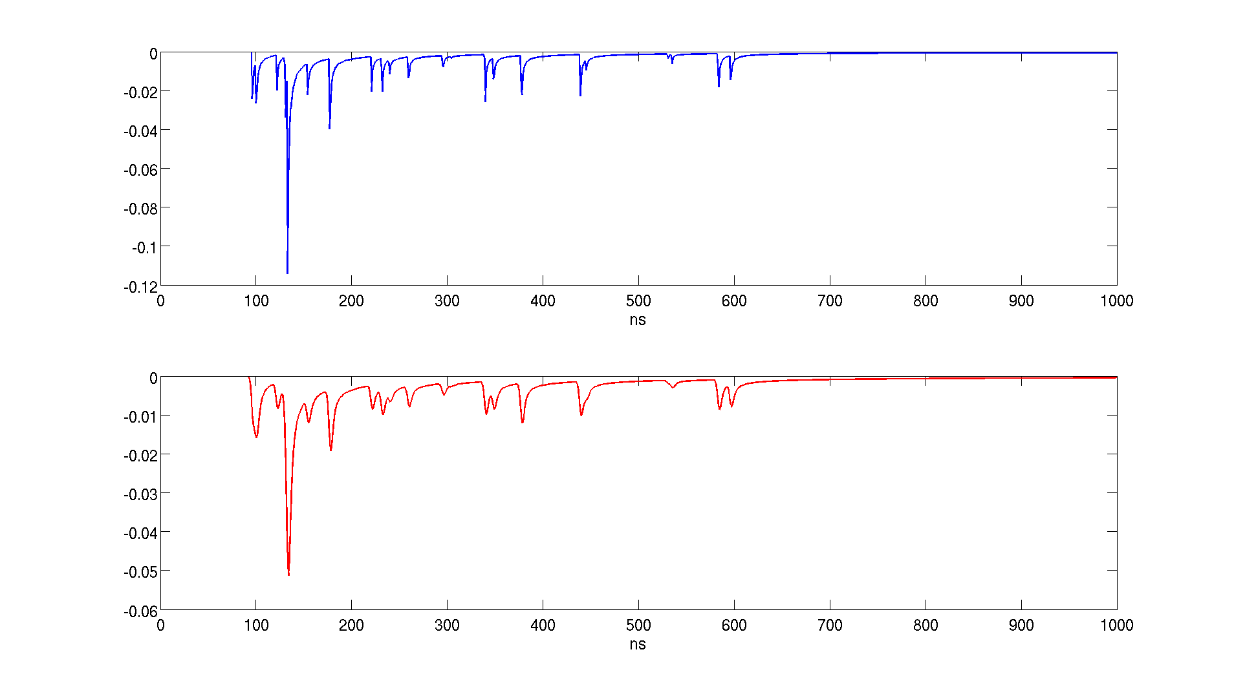
Preamplifier response convolution example #3
Garfield output (Gas gain 3x10^5 – preamp gain 4mV/fC)
Convolution output

Slide 32
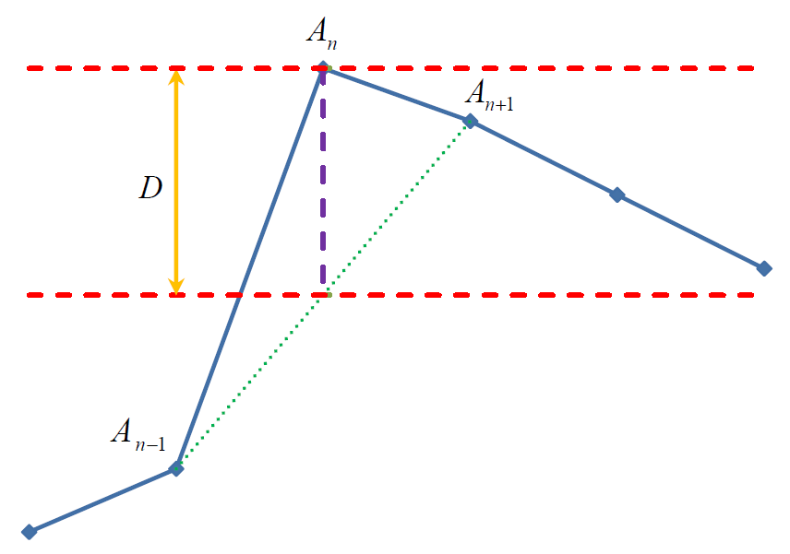

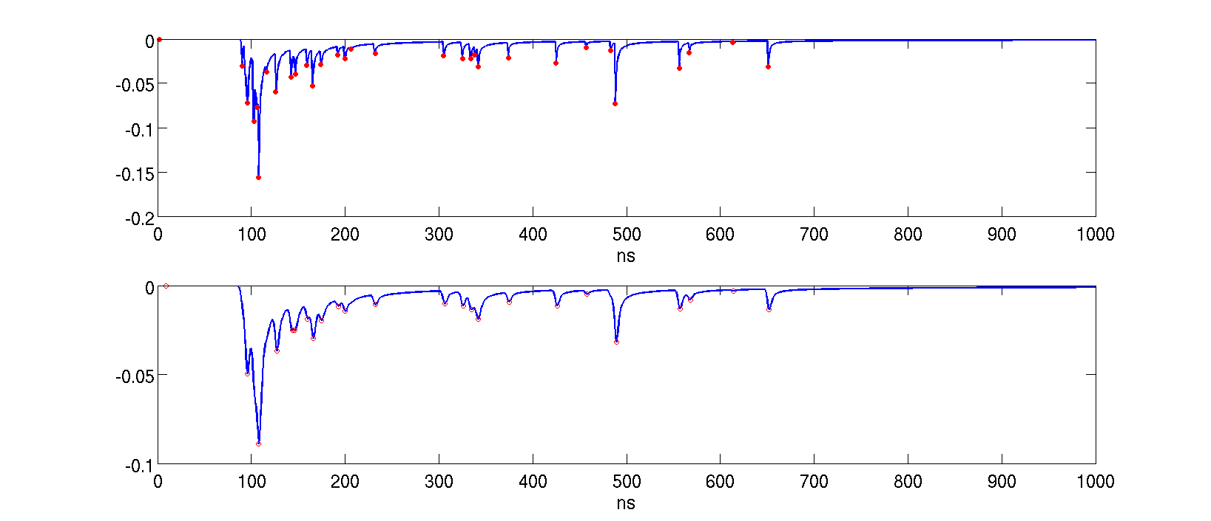
Cluster counting algorithm
Peak Found Condition
Proposed by Luigi Cappelli
on behalf of CLUTIM Group
Algorithm applied to a garfield data set
V

Slide 33
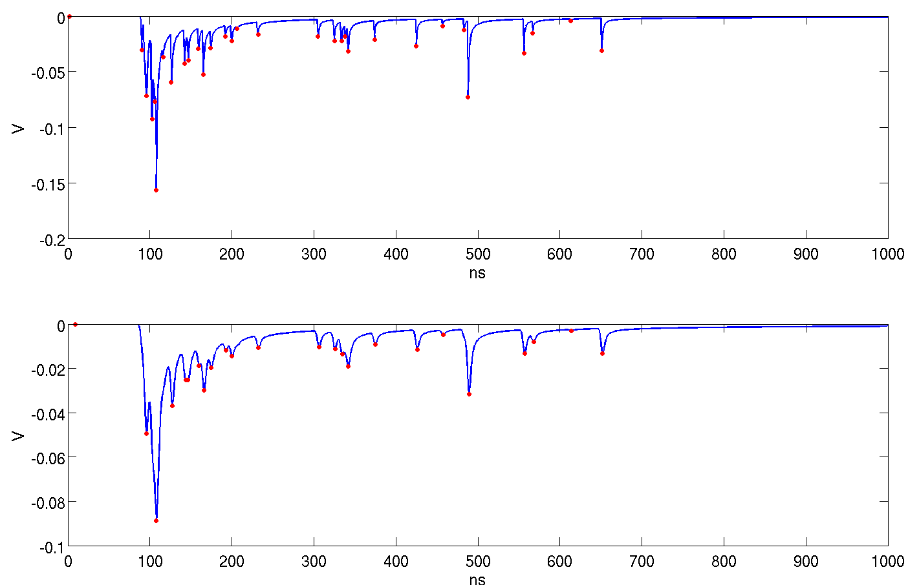
Counting Algorithm applied to example #1
Garfield output (Gas gain 3x10^5 – preamp gain 4mV/fC)
N. Cluster = 31
Convolution output
N. Cluster = 24

Slide 34
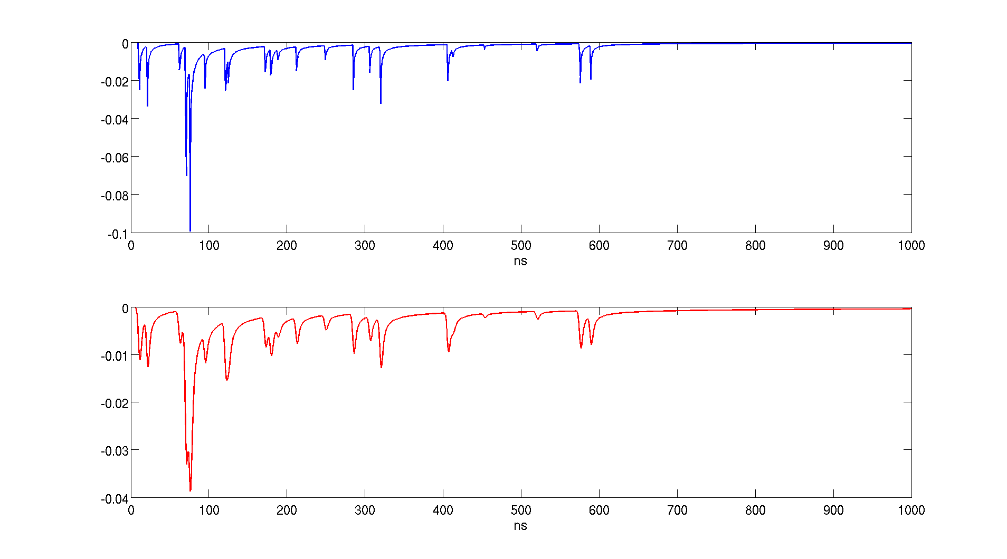
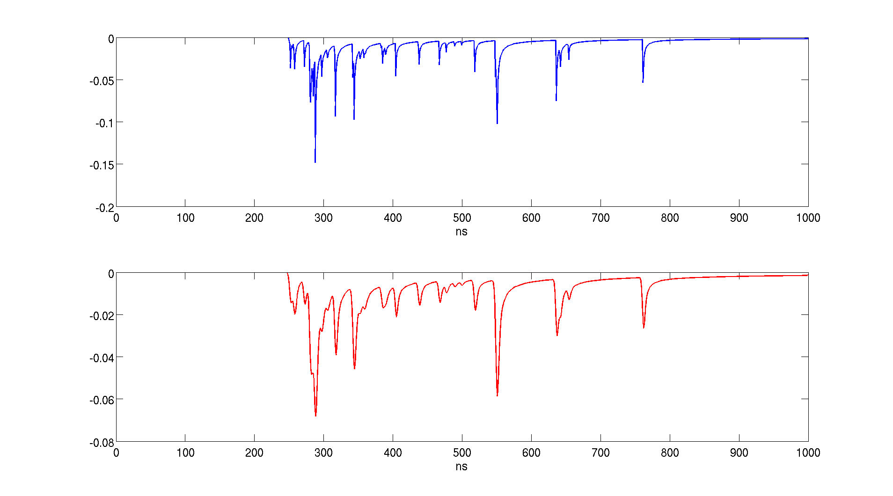
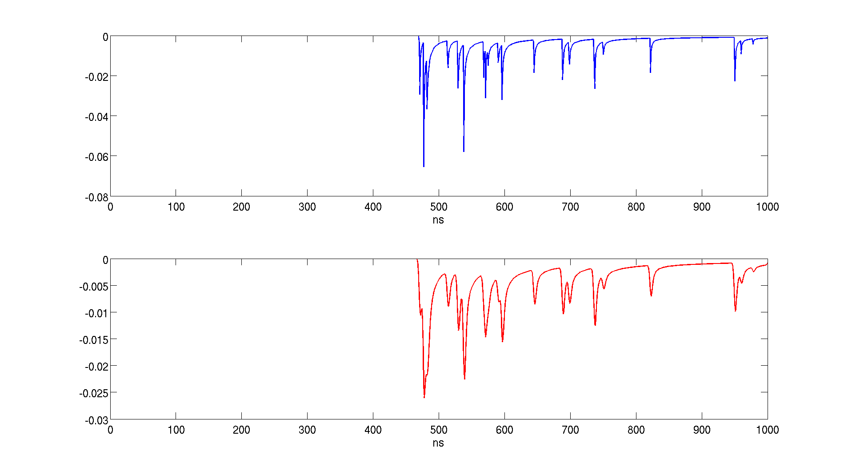
Garfield waveform samples
Garfield output (Gas gain 3x10^5 – preamp gain 4mV/fC)
Impact parameter = 0 mm
Impact parameter = 2.5 mm
Impact parameter = 5.0 mm
Impact parameter = 7.5 mm

Slide 35
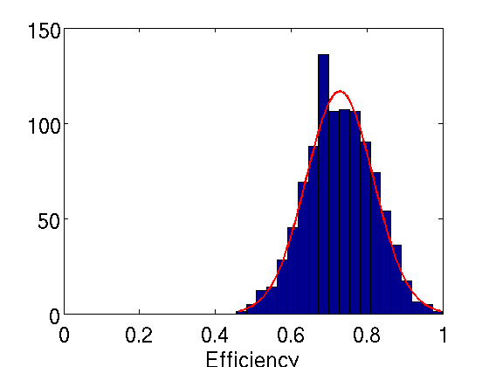
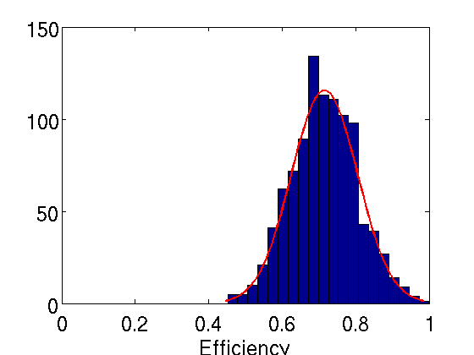
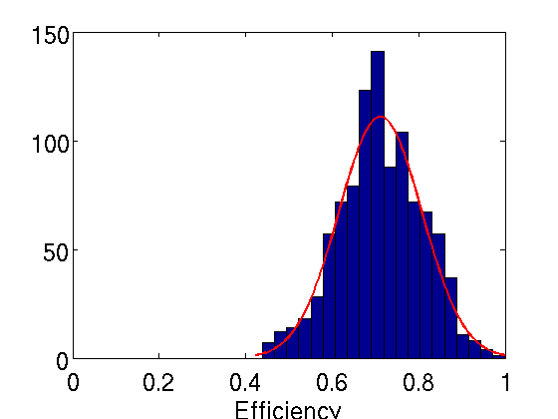
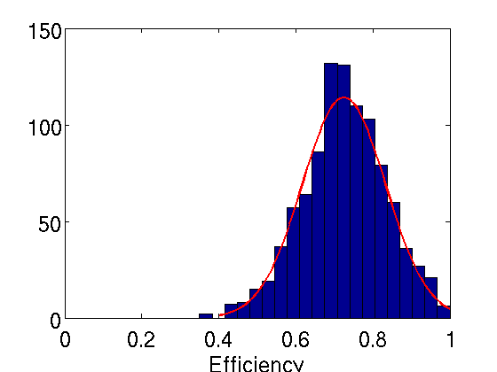
Counting Algorithm @ different impact parameters
Efficiency= Mnc/Rnc
Rnc = Real Number of Clusters
Mnc = Measured Number of Cluster after convolution and noise addition
Impact parameter = 0 mm
Garfield avg. clusters = 29.89
Convolved avg. clusters = 21.5
Impact parameter = 2.5 mm
Garfield avg. clusters = 30.28
Convolved avg. clusters = 21.38
Mean = 0.73
Std = 0.16
Mean = 0.72
Std = 0.16
Impact parameter = 5 mm
Garfield avg. clusters = 31.28
Convolved avg. clusters = 21.92
Impact parameter = 7.5 mm
Garfield avg. clusters = 27.77
Convolved avg. clusters = 19.68
Mean = 0.71
Std = 0.17
Mean = 0.72
Std = 0.19
Analysis performed on 1000 data sets

Slide 36
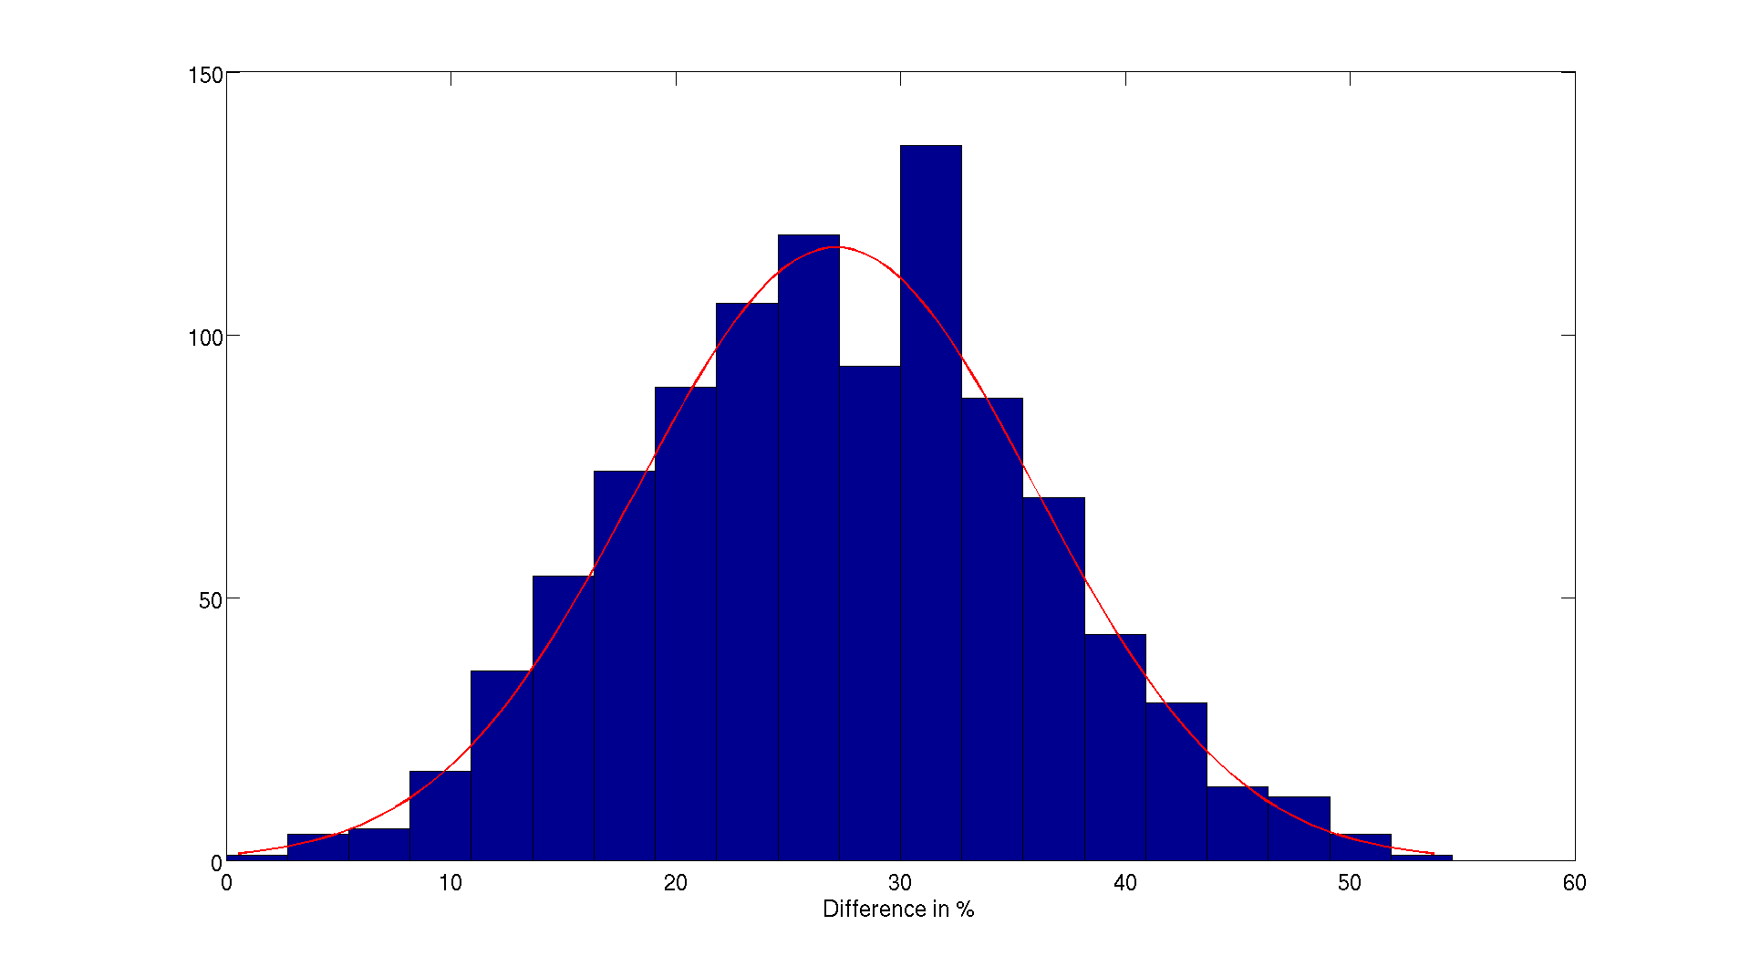
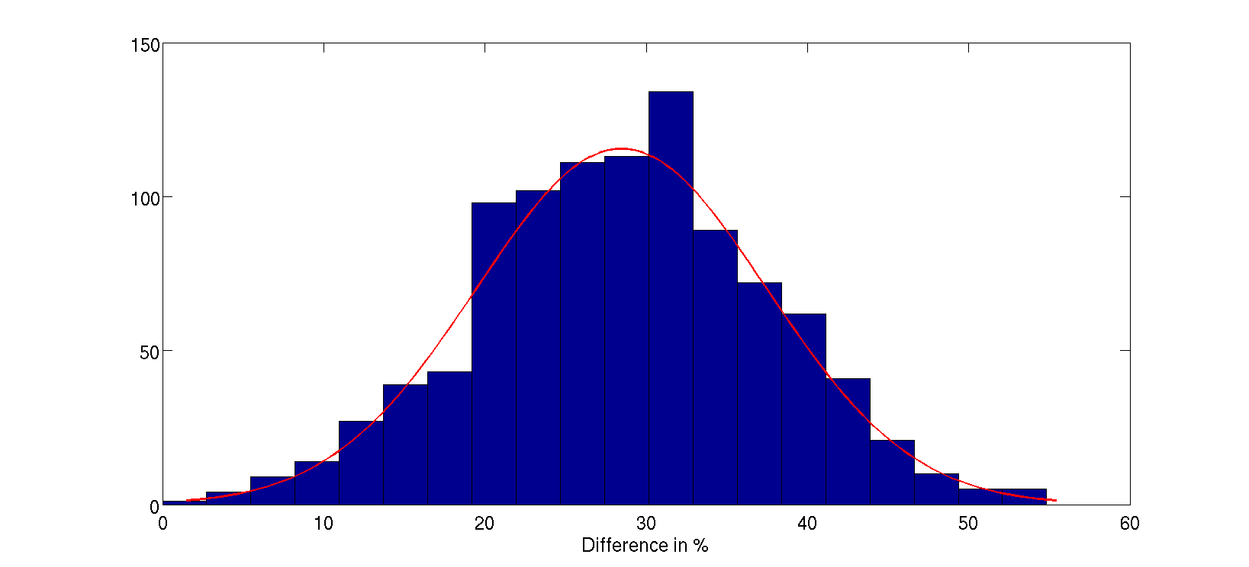
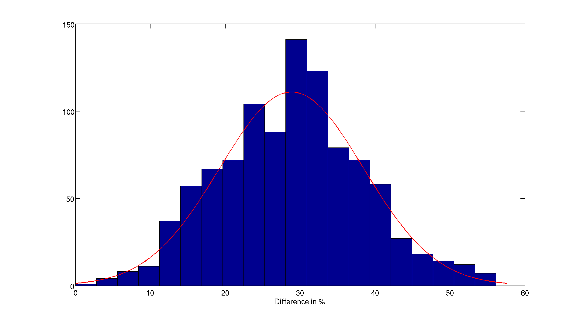
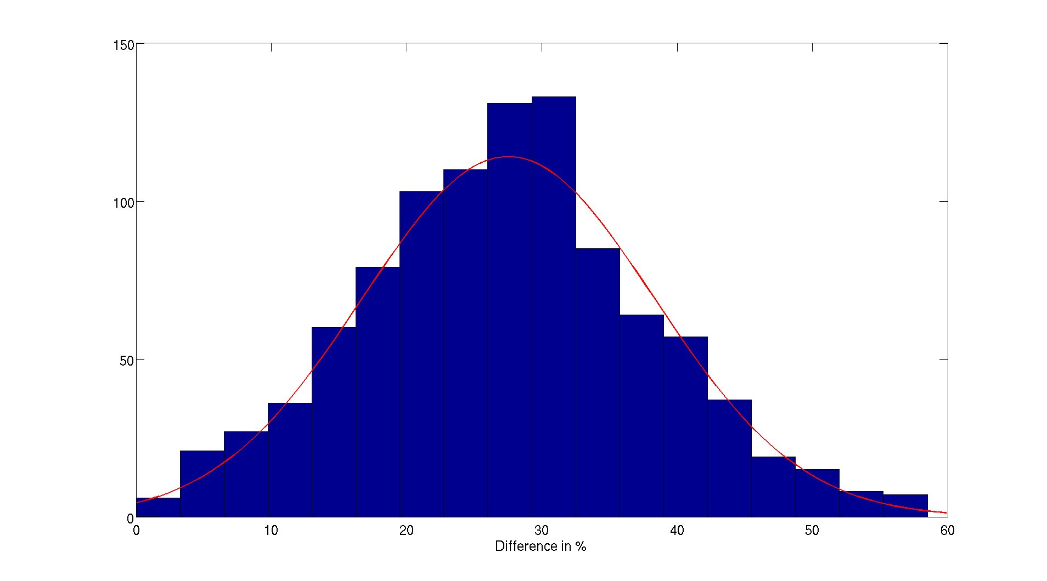
Counting Algorithm @ different impact parameters
% of Detected Cluster= (Rnc-Mnc)/Rnc *100
Rnc = Real Number of Clusters
Mnc = Measured Number of Cluster after convolution and noise addition
Impact parameter = 0 mm
Garfield avg. clusters = 29.89
Convolved avg. clusters = 21.5
Impact parameter = 2.5 mm
Garfield avg. clusters = 30.28
Convolved avg. clusters = 21.38
Mean = 27.27%
Std = 16.13
Mean = 27.42%
Std = 16.22
Impact parameter = 5 mm
Garfield avg. clusters = 31.28
Convolved avg. clusters = 21.92
Impact parameter = 7.5 mm
Garfield avg. clusters = 27.77
Convolved avg. clusters = 19.68
Mean = 28.07%
Std = 16.61
Mean = 28.07%
Std = 16.61
Analysis performed on 1000 data sets

Slide 37
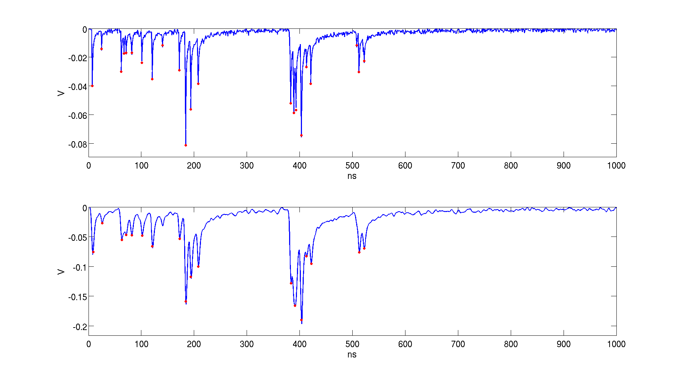
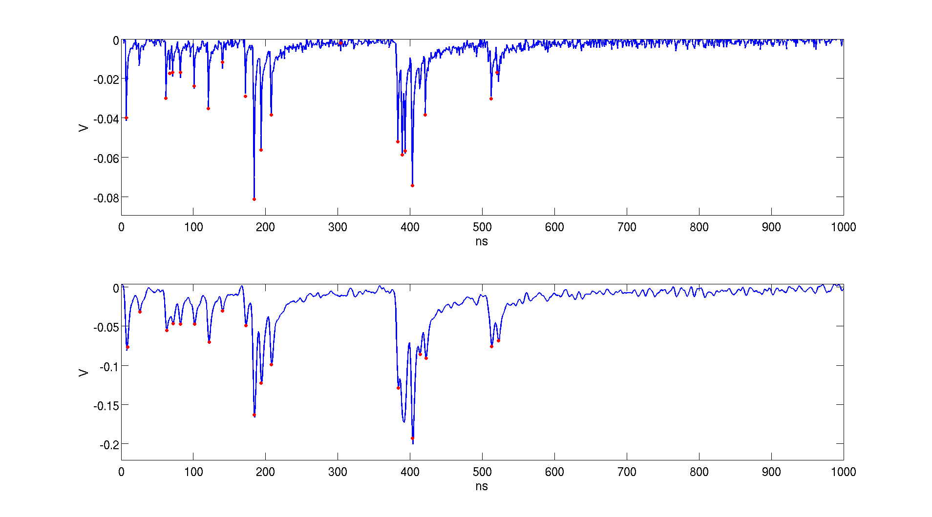
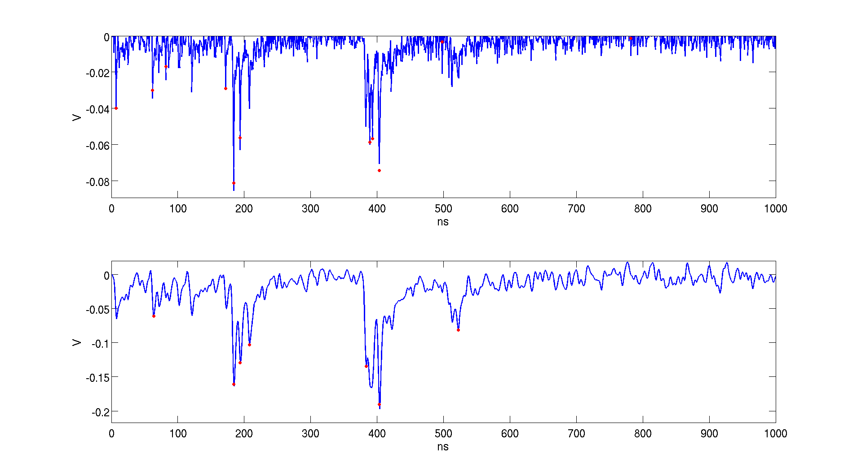
Noise Effect on Convolved Signal
SNR evaluated considering single electron cluster average amplitude (~10mV)
SNR=10
SNR=6
SNR=2
SNR=Signal Amplitude/Noise RMS

Slide 38
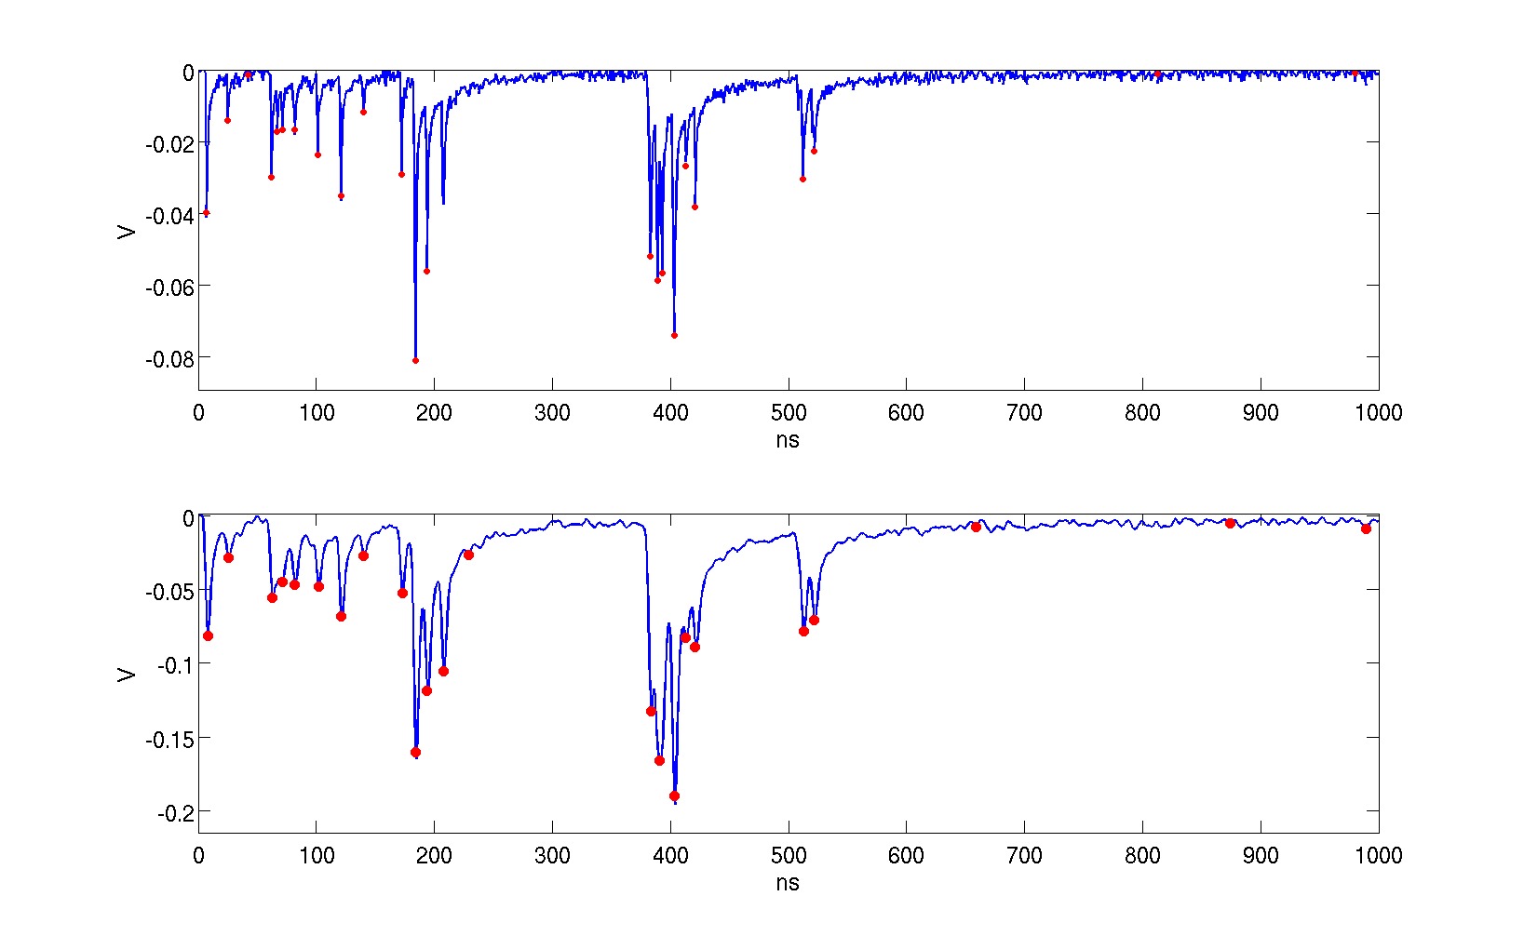
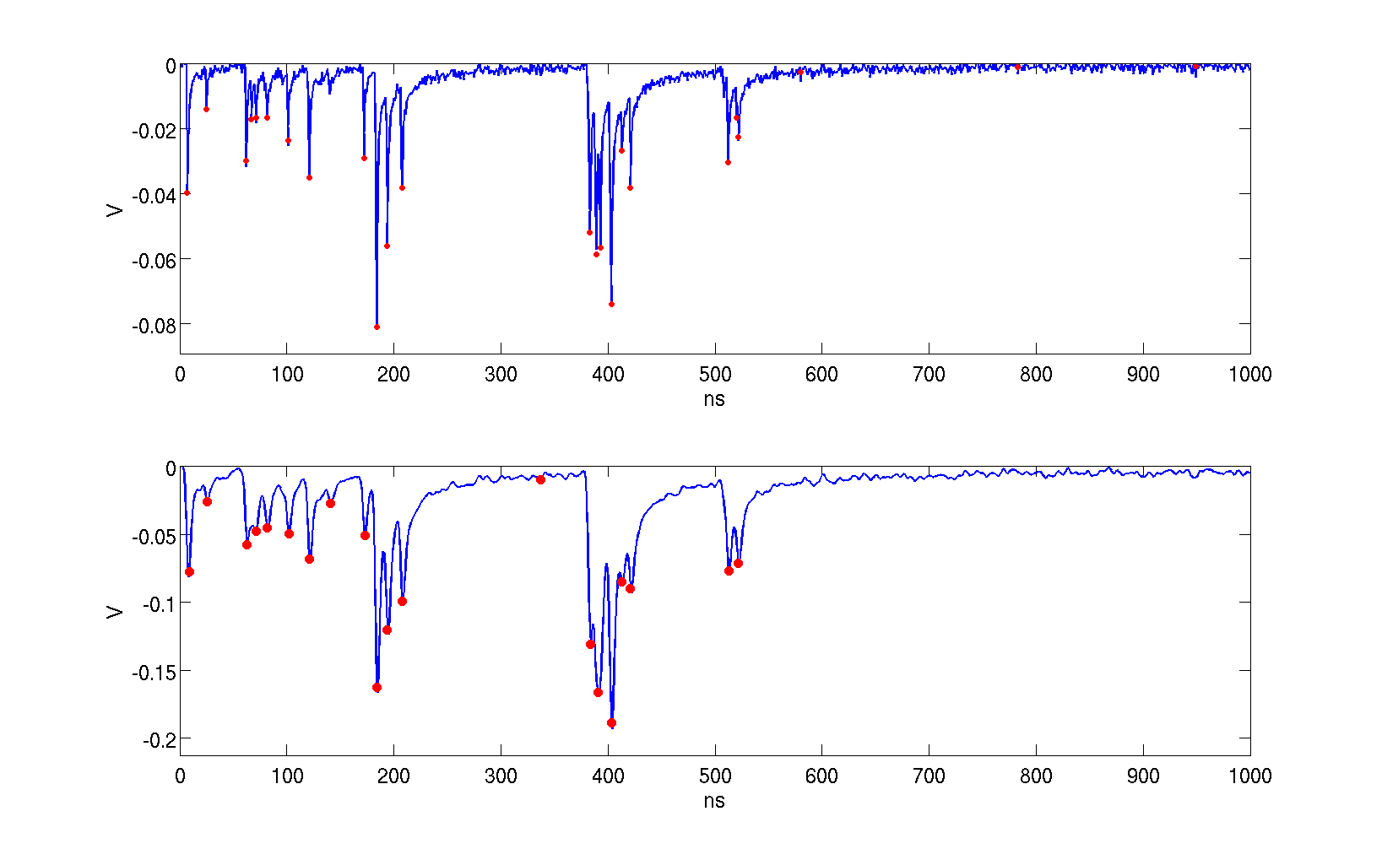
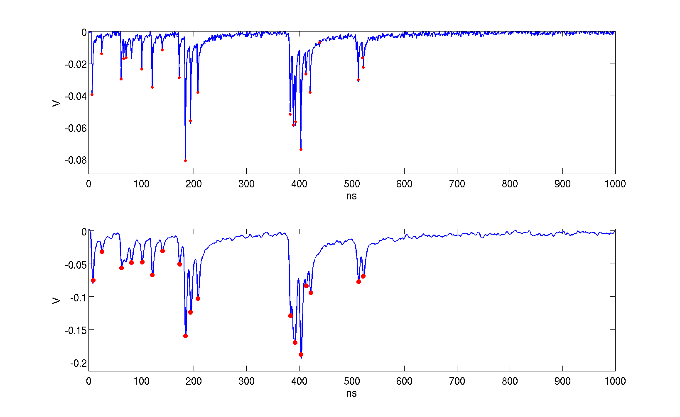
Threshold effect on cluster counting at constant SNR
The RMS of the noise is evaluated on the last 300 samples
Thr=0.8*RMSNoise
N. clusters = 23
Thr=1.0*RMSNoise
N. clusters = 20
Thr=1.5*RMSNoise
N. clusters = 18

Slide 39
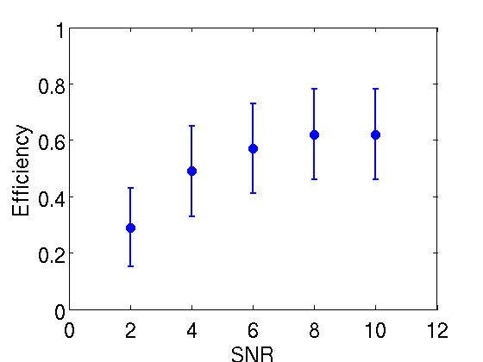
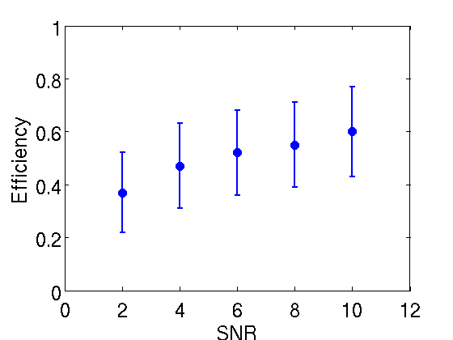
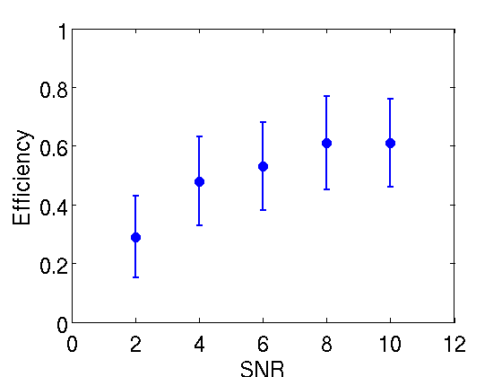
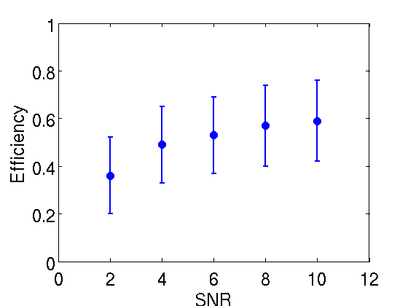
Detected Clusters vs SNR at 1.5* sigma threshold
Efficiency = Mnc/Rnc
Rnc = Real Number of Clusters
Mnc = Measured Number of Cluster after convolution and noise addition
Impact parameter = 0 mm
Impact parameter = 2.5 mm
Impact parameter = 5 mm
Impact parameter = 7.5 mm

Slide 40
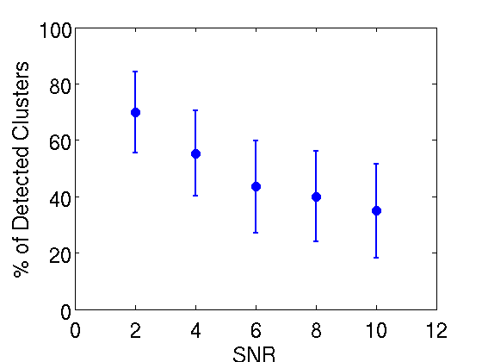
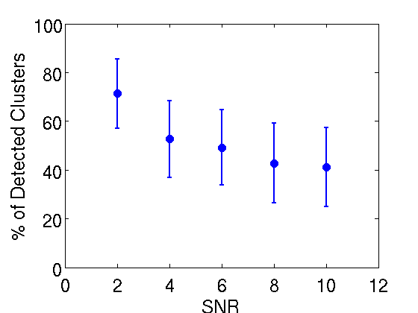
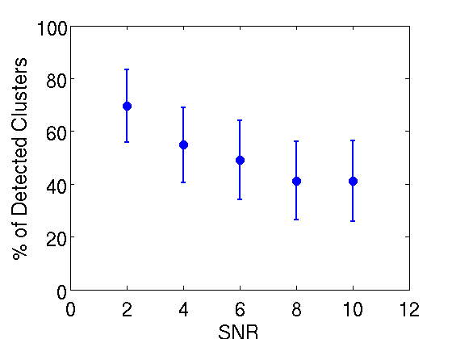
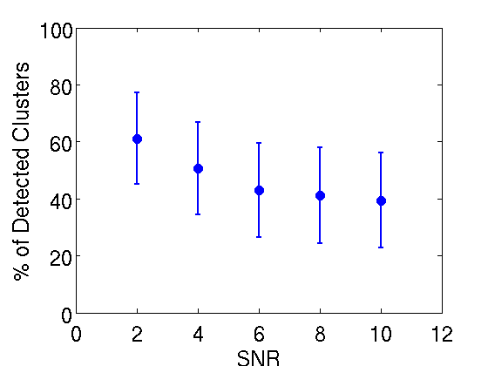
Detected Clusters vs SNR at 1.5* sigma threshold
% of Detected Cluster= (Rnc-Mnc)/Rnc *100
Rnc = Real Number of Clusters
Mnc = Measured Number of Cluster after convolution and noise addition
Impact parameter = 0 mm
Impact parameter = 2.5 mm
Impact parameter = 5 mm
Impact parameter = 7.5 mm

Slide 41
Conclusions
Garfield output has not been tuned to real signals in particular concerning gas amplification fluctuation.
We have carried out a cluster counting feasibility study using an algorithm that can be easily implemented on an FPGA.
The analysis have been performed using data set based on garfield simulations at different impact parameters.
Results show that after garfiled data convolution with preamplifier response there is a loss of about 28% in detected clusters for different impact parameters.
The addition of Gaussian noise with different SRN increase the counting inefficiency from 40% (SNR=10) to about 70% (SNR=2). In any case results show huge fluctuations in the counted clusters due to the noise contribution.

Slide 42
DCH - 1 page x Dominique
Design goals have been defined
Two different implementation of dE/dx measurements have been evaluated and will be reported in TDR.
  Truncated mean method has already been used by other experiments and, according to BaBar experience, should provide a σ_{E} around 7-8 %
  Cluster Counting is under study and measurements both at LNF and TRIUMF are going on. Simulations using GARFIELD data have been carried out as well by using real preamplifier response convolution and different SNR.
Impact parameter = 0 mm
% of Detected Cluster= (Rnc-Mnc)/Rnc *100
Rnc = Real Number of Clusters
Mnc = Measured Number of Cluster after convolution and noise addition
Threshold = 1.5*σ
HV distribution system has been defined and modularity will be finalized as soon as chamber final design will be available. HV distribution boards should be located on FORWARD end-plat.
On-Detector electronics (preamplifier boards) will be located on BACKWARD end-plate. We are investigating the possibility of exiting the cables from the outer layer of the chamber
We are also investigating the possibility of using the top of the detector to locate off-detector electronics then simplifying setup and maintenance of the system

