Slide 1

Update on the activities in Milano
SuperB Meeting: SVT Parallel Session
M. Citterio and N. Neri
on behalf of INFN and University of Milan

Slide 2
Bus status (1 of 2)
  Production of BUS is finally starting
    The layout is final and «single» layers are at the beginning of the production
      Opening on the ground/power planes have been agreed upon
      Production will take approximately 5 weeks
    Bonding Scheme (Bus to Sensor and FE chip) .... We really hope is it acceptable to Pisa → see next slide

Slide 3
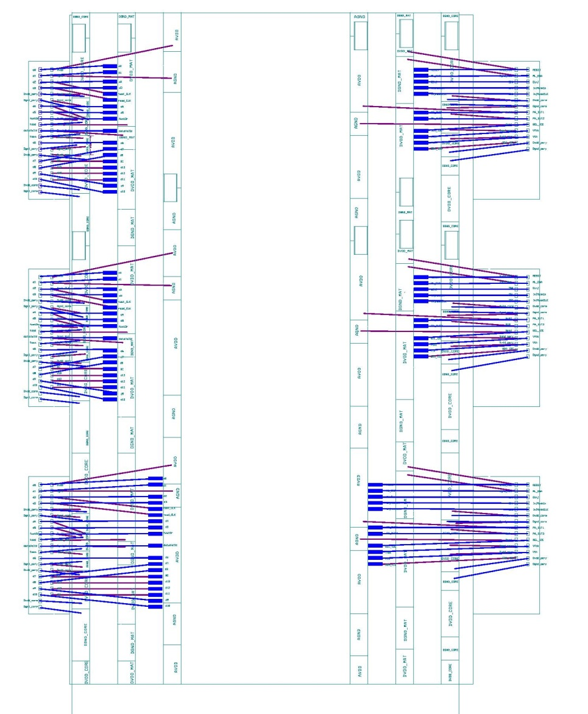
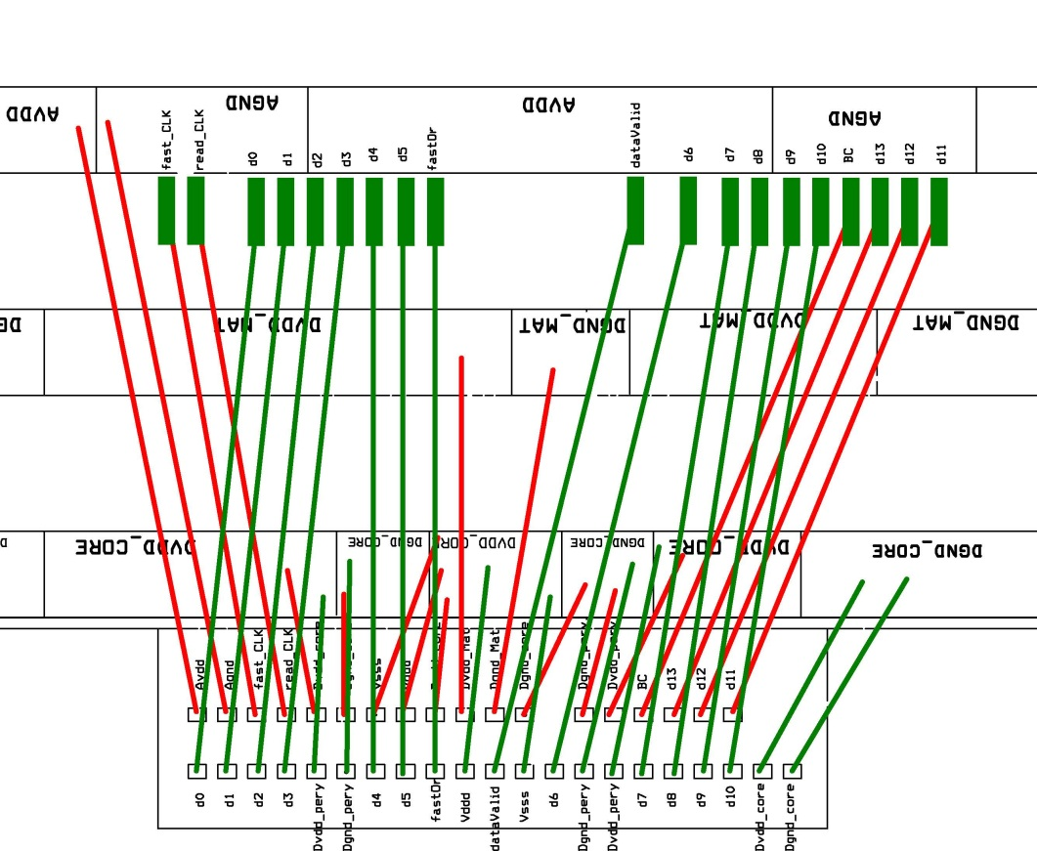
Bus bonding Scheme (2 of 2
It could be feasible at least for the prototype phase

Slide 4
Fan-out layer 0
  First exercise made using CERN information
    Two layer of Kapton + Aluminum
      Kapton thickness ~ 20 um
      Aluminum thickness ~ 10 um
      Glue ~ 10 um
      Pitch ~ 70 um
        It could maybe be reduced if the results on prototypes are encouraging. Real limit could be 60 um

Slide 5
Striplets L0
detector and fan-out: case study
TOP-view
L=97.0 mm
595 full length strips
…
…
W=12.9 mm
ACTIVE
AREA
Z
…
…
Dead-A
0.2 mm2
173 shorter strips
50 um pitch
900 um
shortest strip
From F.B.design:
L=104.0mm-W=12.9mm
R=15.0mm
BACKWARD
side
FORWARD
side

Slide 6
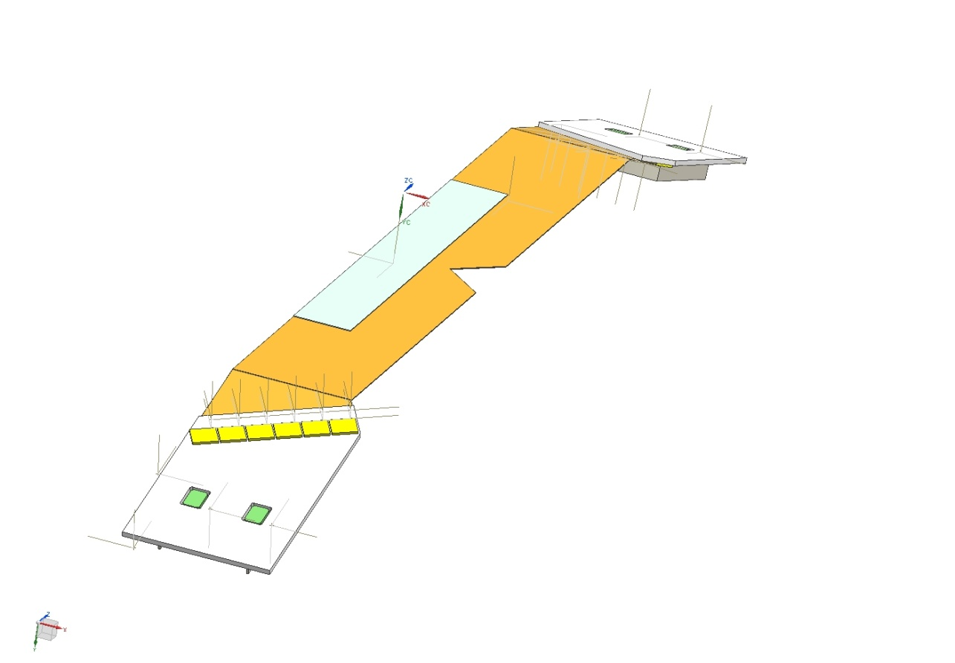
Detector not yet optimized
Reasonable for this exercise
Goal: fan-out widtht ~ 31 mm
~ 595 full length strips
…
…
From F.B.design:
L=104.0mm-W=12.9mm
R=15.0mm
W=12.9 mm of active area
…
…
~ 173 shorter strips

Slide 7
Fan out made of two layers: case study
Staggering to compensate different pitch in bonding
…
…
…
…
Staggering to compensate pitch towards ICs
Drawing not to scale !!!!
173 shorter strips

Slide 8
Outermost layer
~ drives half of the strips
~ 30.1 mm

Slide 9
Innermost Layer
~ drives half of the strips
~ 31.9 mm

Slide 10
Amount of material for Layer side
Material | X0(cm) | Thickness (μm) | X0(%)
Glue | 28 | 40x2=80 | 0.0286
Kapton | 28.6 | 20x2=40 | 0.0140
Al | 8.897 | 10x1=20 | 0.0112
Total |  |  | 0.0538
Al
Kapton
Glue
Cross section
Al
Kapton
Glue
Sensor

Slide 11
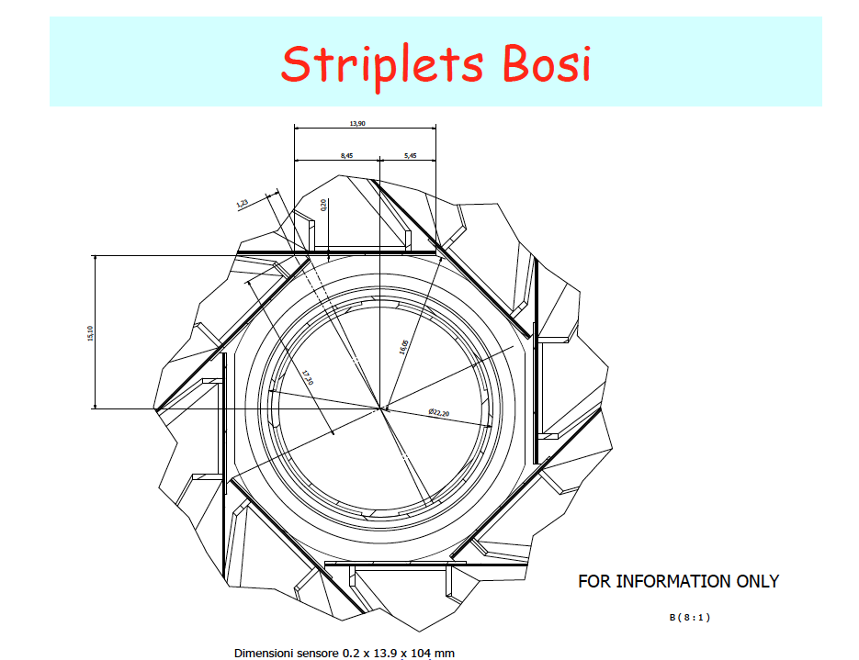
Total amount of Fanout material for Layer0
Fanout | X0(%)
side (x 2.0) | 0.1076
Overlap material is at larger radius wrt L0 sensor
Material | X0(%)
overlap (x 2.0 ) | 0.1076

Slide 12
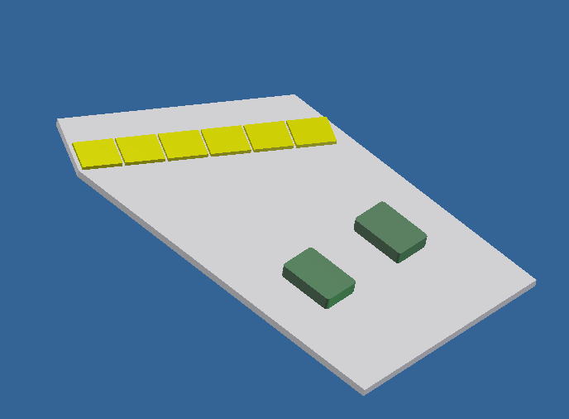
SuperB HDI
Update
Some Open Issues
No systematic impedance control | Limited possibility to change the dielectric layer thickness with the standard process. By print screening company prefers a standard “3 pass” procedure → dielectric thickness ~ 50 um. Some avenue to be pursued: evaluate the usage of dielectric in tape (predefined thickness) → limited choices of thick film materials compatible with AlN Mix AlN and Al2O3 materials. Possible after the first power/ground layer.
Clock lines were “qualified” by try and test in Babar | Difficult prediction of Z → dielectric constant usually not well specified by material manufacturer (ex. in next slide)
Some prototypes were produced to master the technology | Same approach to be pursued. Of particular interest is the implementation of differential lines (digital signal ~ 150-250 MHz) Prototype: small substrate (length counts), two layer (plane and one signal), array of lines of minimum size (number to be defined)
AUREL INTEREST

Slide 13
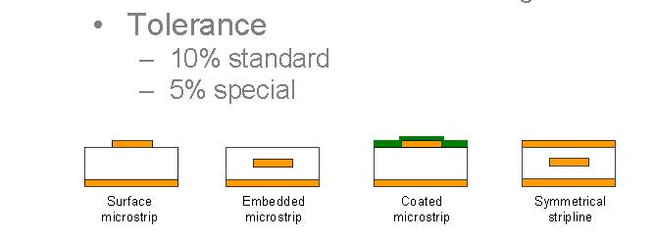
SuperB HDI Impedance Test Structures
  AUREL is ready to produce 20 test structure on standard alumina and on AlNi to measure characteristics of various transmission lines
    Layout is simple, parallel lines with lenght similar to HDI lenght
    Signal integrity tests will be performed both at AUREL production site (Modigliana) and in Milan
    Alumina structrure will be used as reference

Slide 14
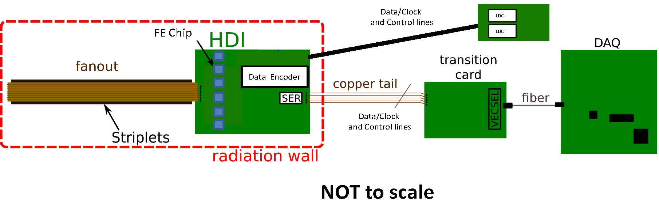
Read-out chain
No real activities on going on the transition card and power distribution card
Some measurements on the copper tails → on-going
Power lines gauges and drops will be revisited a soon as we have a nominal power consumption for the FE and HDIs → next two months

Slide 15
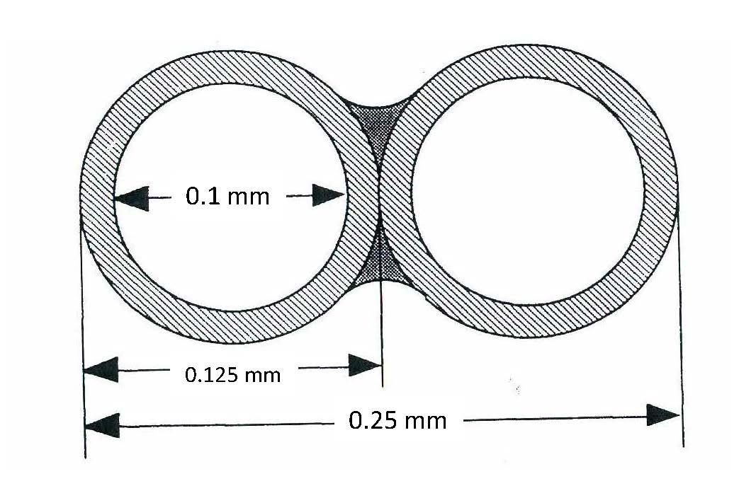
Data/Clock and Control Cables
Signal: 39 AWG, Bifilar magnet wires (Cu)
Differential Impedance: to be measured
Capacitance: 75 pF/m
Propagation Delay: to be measured
Dielectric costant: 2.1
Twisting is not needed for such a small wire
It can not be purchased in tape
- grouping of individual wires could introduce signal degradation
→ NSQP project at CERN
Electrical test on individual pair is starting
- on individual wires
- on few (up to 10 couples) wires with or without a braid around the bundle

