Slide 1
New Science at the Spallation Neutron Source
Presented to:
2nd SuperB Collaboration Meeting
Ian Anderson
Graduate Education and University Partnerships
Frascati, Italy
December 14, 2011

Slide 2
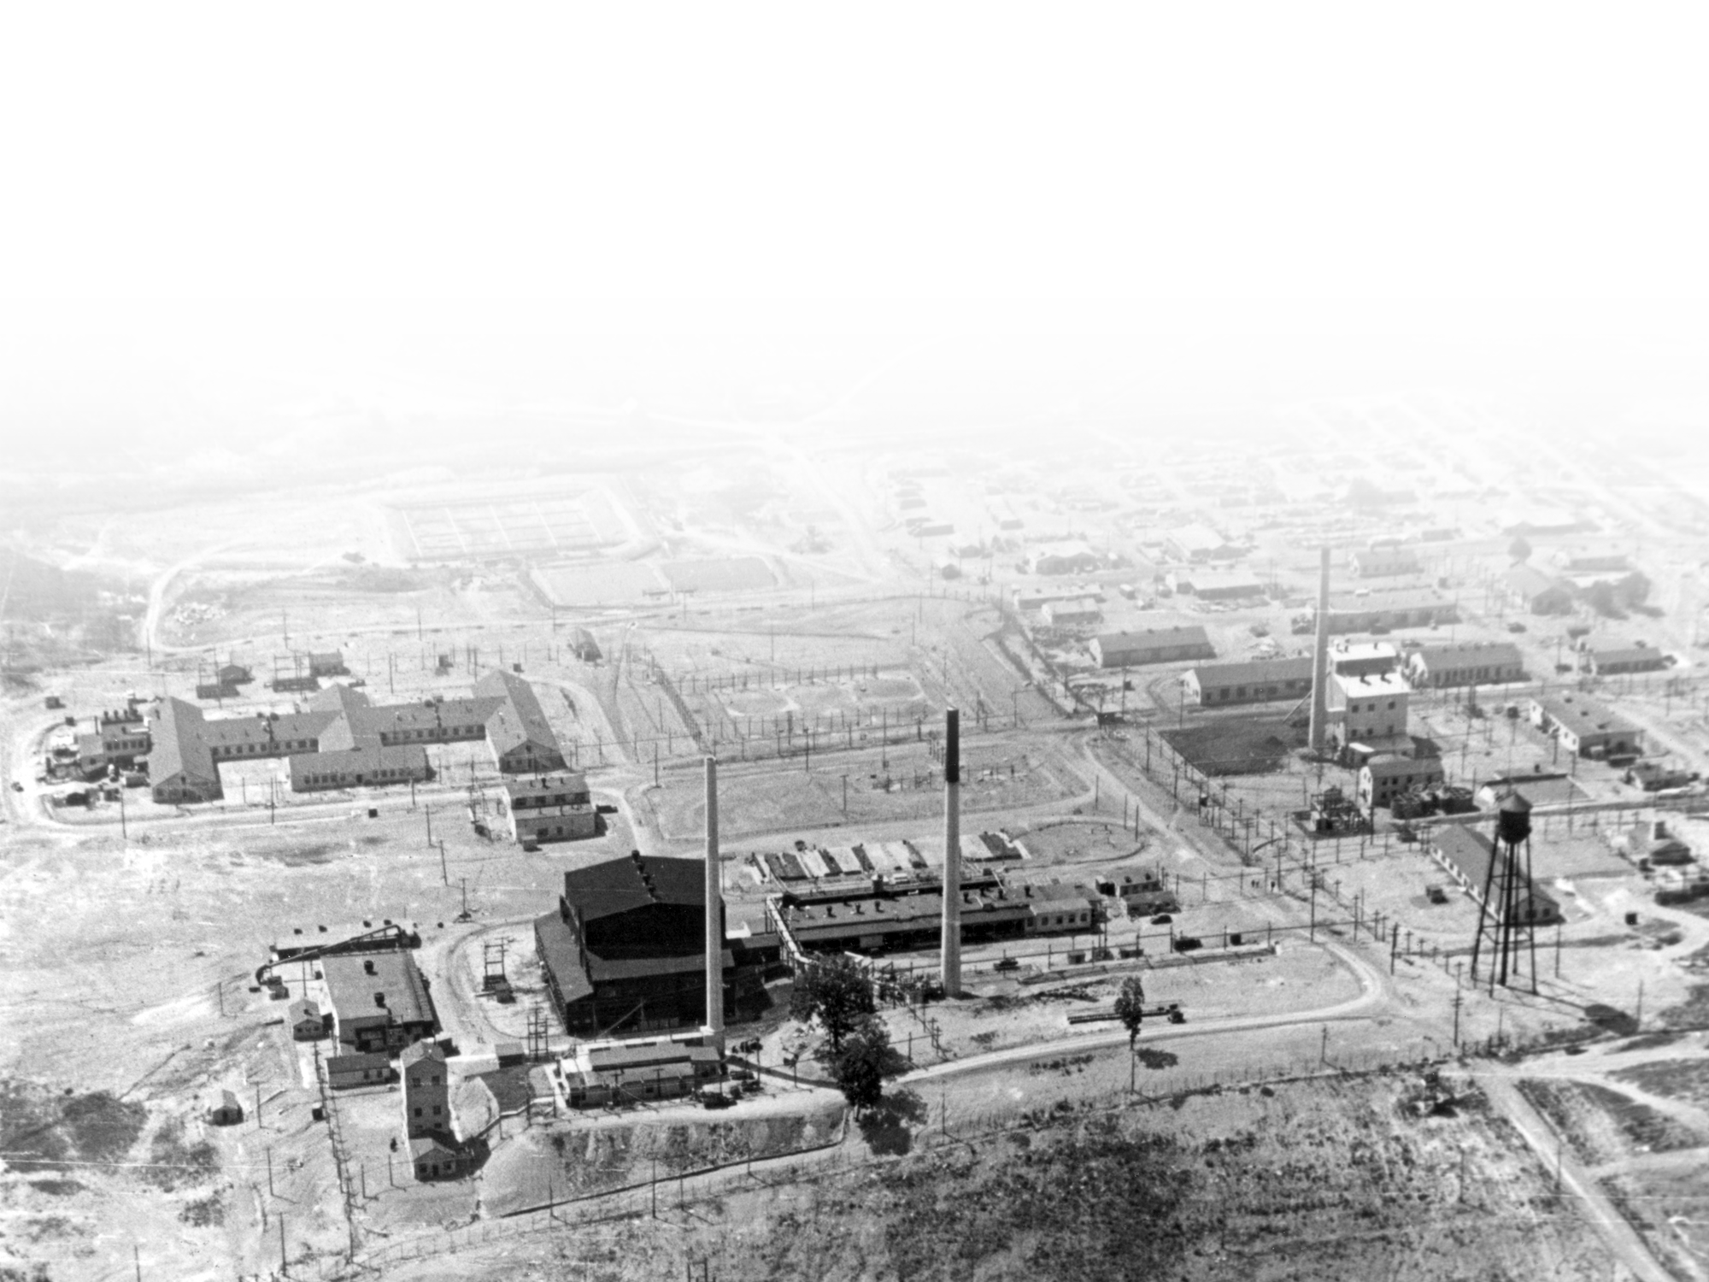

Oak Ridge National Laboratory has a long history in neutron sciences
ORNL in 1943
The Clinton Pile was the world’s first continuously operated nuclear reactor
2 Managed by UT-Battelle
for the U.S. Department of Energy
Notes:
The Oak Ridge area was selected as a site for the World War II Manhattan Project to develop the atomic bomb for its remoteness, the ready availability of power and water (thanks to the presence of the Tennessee Valley Authority), and the climate, which allowed construction close to year round.
To support the three facilities constructed as part of the “Clinton Engineer Works” (K-25: gaseous diffusion of uranium; Y-12: electromagnetic separation of uranium; X-10: production and separation of plutonium), the area went from sparsely populated farmland to a city of 70,000 in about 18 months. The Clinton Pile (later known as the Graphite Reactor) was built in about 11 months – construction started in February 1943, and the reactor went critical on November 4. It operated for 20 years and today is a National Historic Landmark. (in this photo, it is the black building just to the left of center. Several of these buildings are still standing.)
R&D conducted in Oak Ridge was critical in the development of the first atomic weapons. The plutonium production methods used at Hanford were piloted at Clinton Laboratories (the name “ORNL” was not used until 1948).

Slide 3
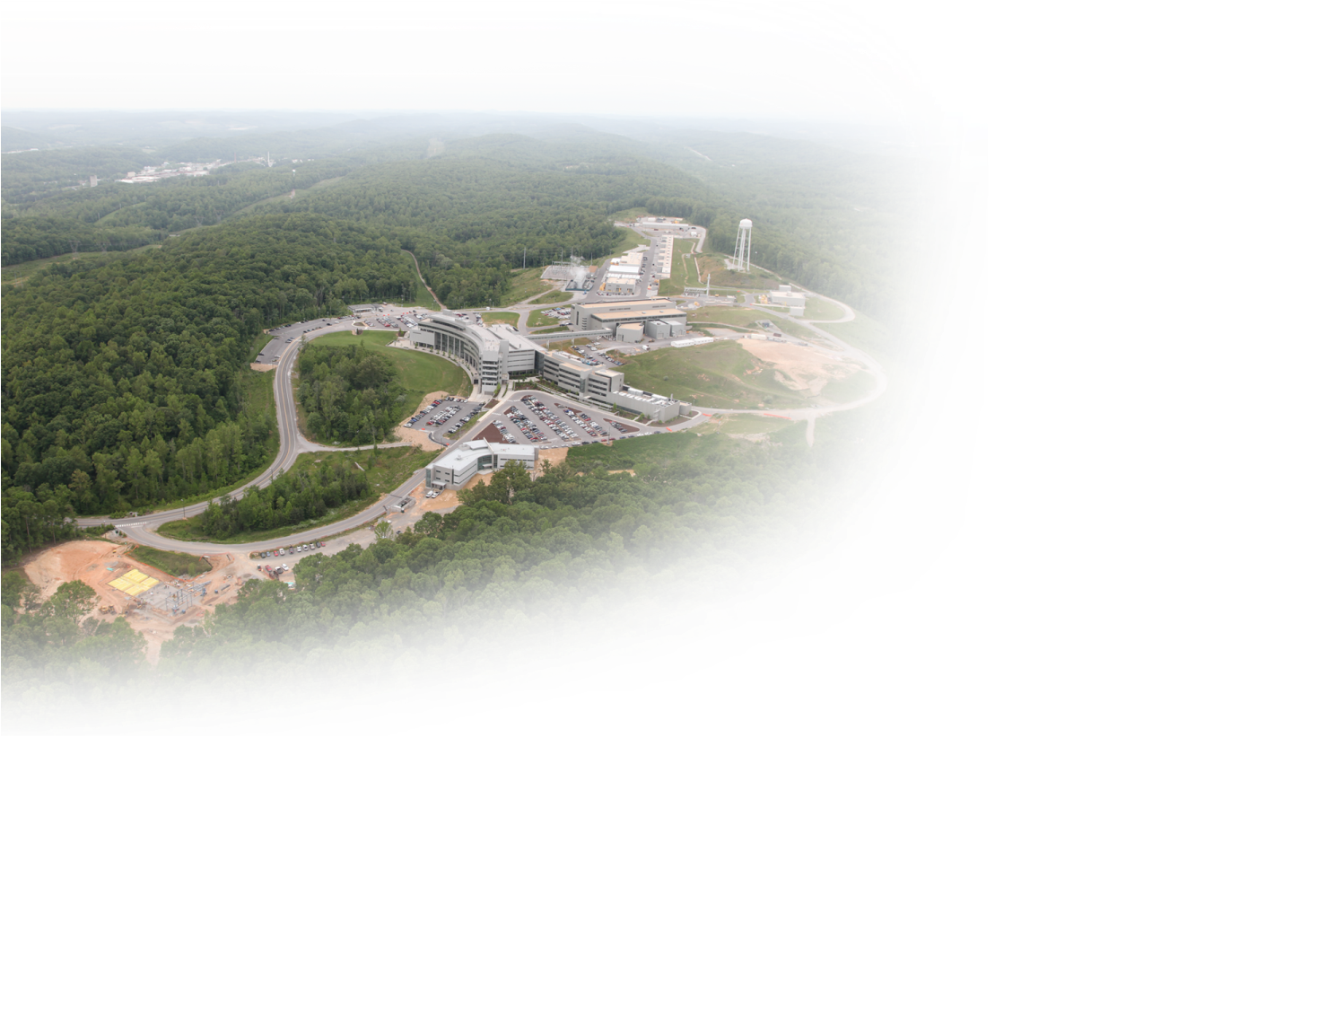

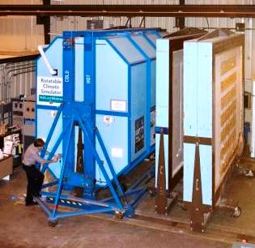

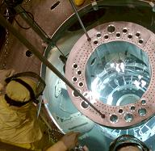
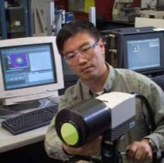


And it remains one of the distinguishing capabilities today
Spallation
Neutron Source
Center for
Nanophase
Materials Sciences
Holifield Radioactive
Ion Beam Facility
Building Technologies Research and Integration Center
Oak Ridge Leadership Computing
Facility
High Flux
Isotope
Reactor
High
Temperature
Materials Laboratory
National Transportation
Research
Center
BioEnergy
Science
Center

Slide 4

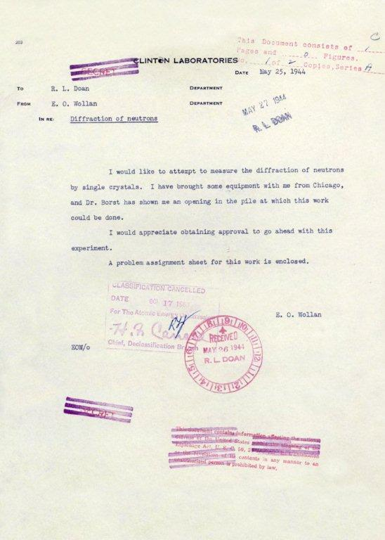
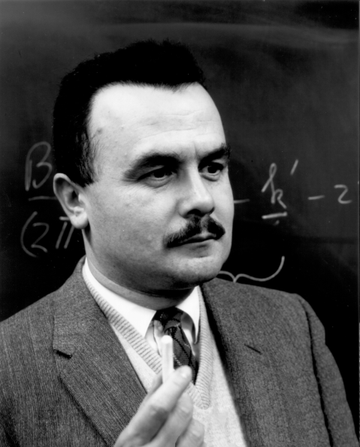
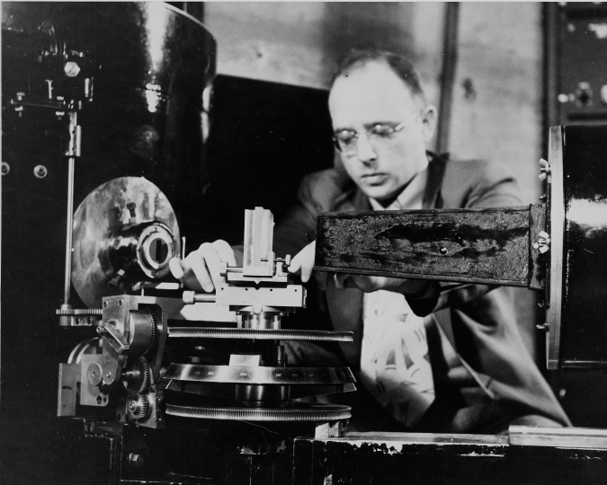
Neutron Scattering was born at Oak Ridge
1994
Awarded for “pioneering contributions to the development
of neutron scattering techniques for studies of condensed matter”
1944
Bertram N. Brockhouse
Clifford G. Shull
Development of
neutron spectroscopy
Development of the
neutron diffraction technique
Notes:
To: R. L. Doan From: E.O. Wollan. May 25, 1944. I would like to attempt to measure the diffraction of neutrons by single crystals. I have brought some equipment with me from chicago, and Dr. Boret has shown me an opening in the pile at which this work could be done. I would appreciate obtaining approval to go ahead with this experiment. A prolem assignment sheet for this work is enclosed. E. O. Wollan. May 25, 1944

Slide 5
26 May 1944
… poor mice!

Slide 6
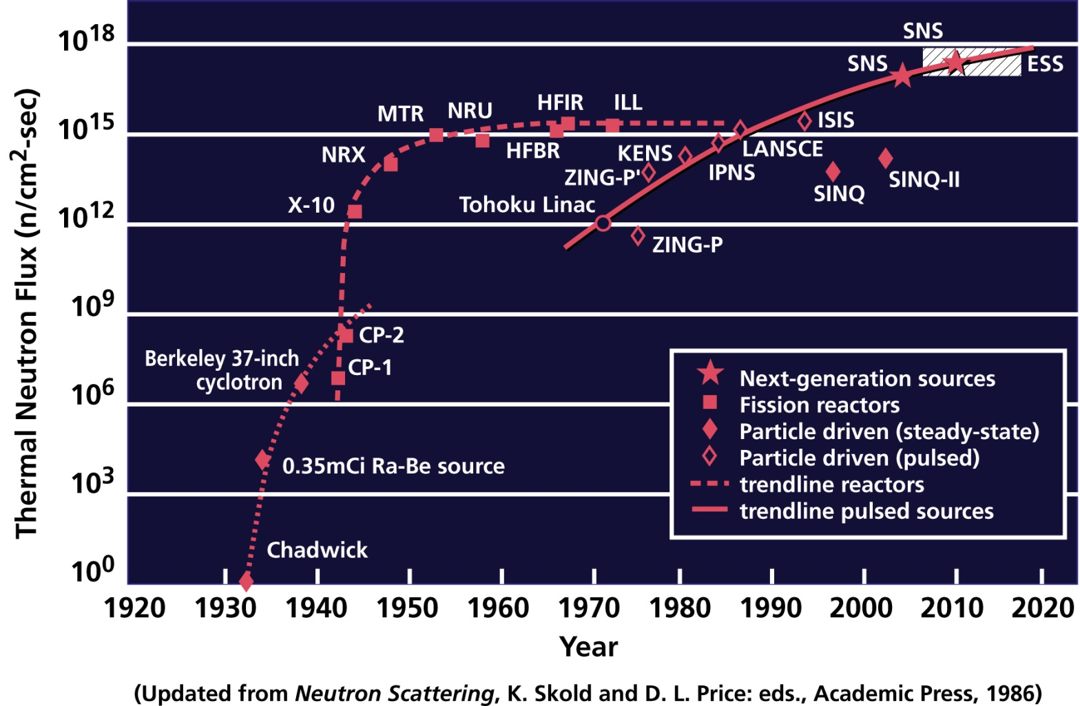
We have continually improved the source flux…
Reactors have reached the limit at which heat can be removed from the core
Pulsed sources have not yet reached that limit and hold out the promise of higher intensities

Slide 7
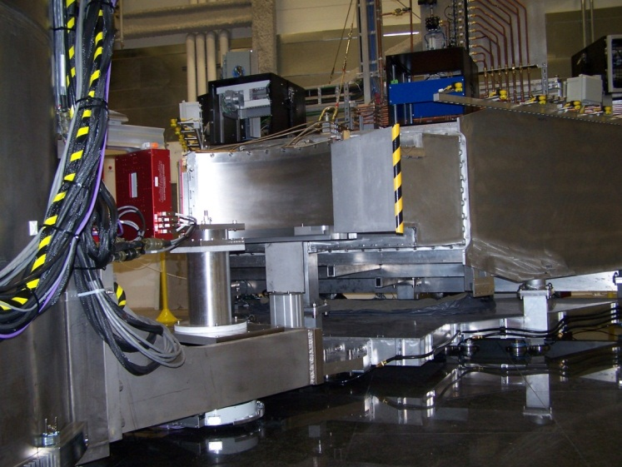
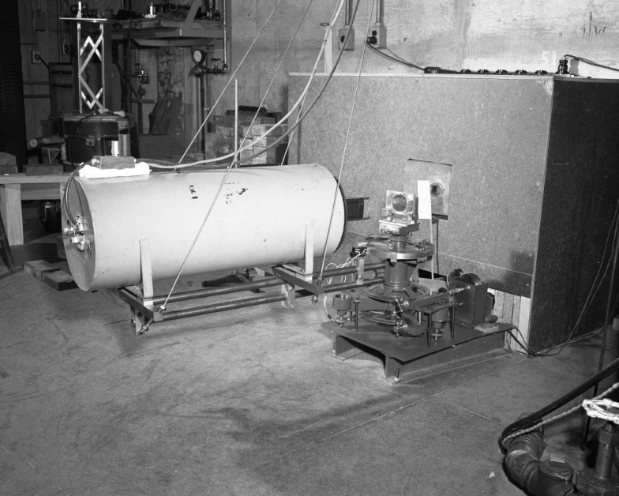
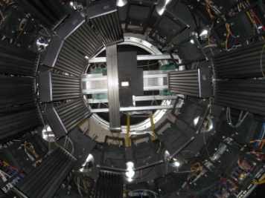
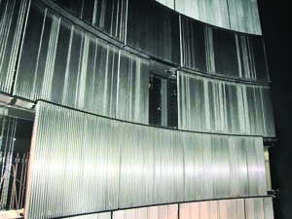
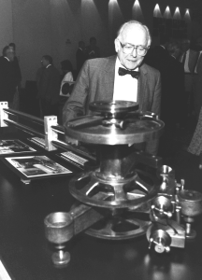
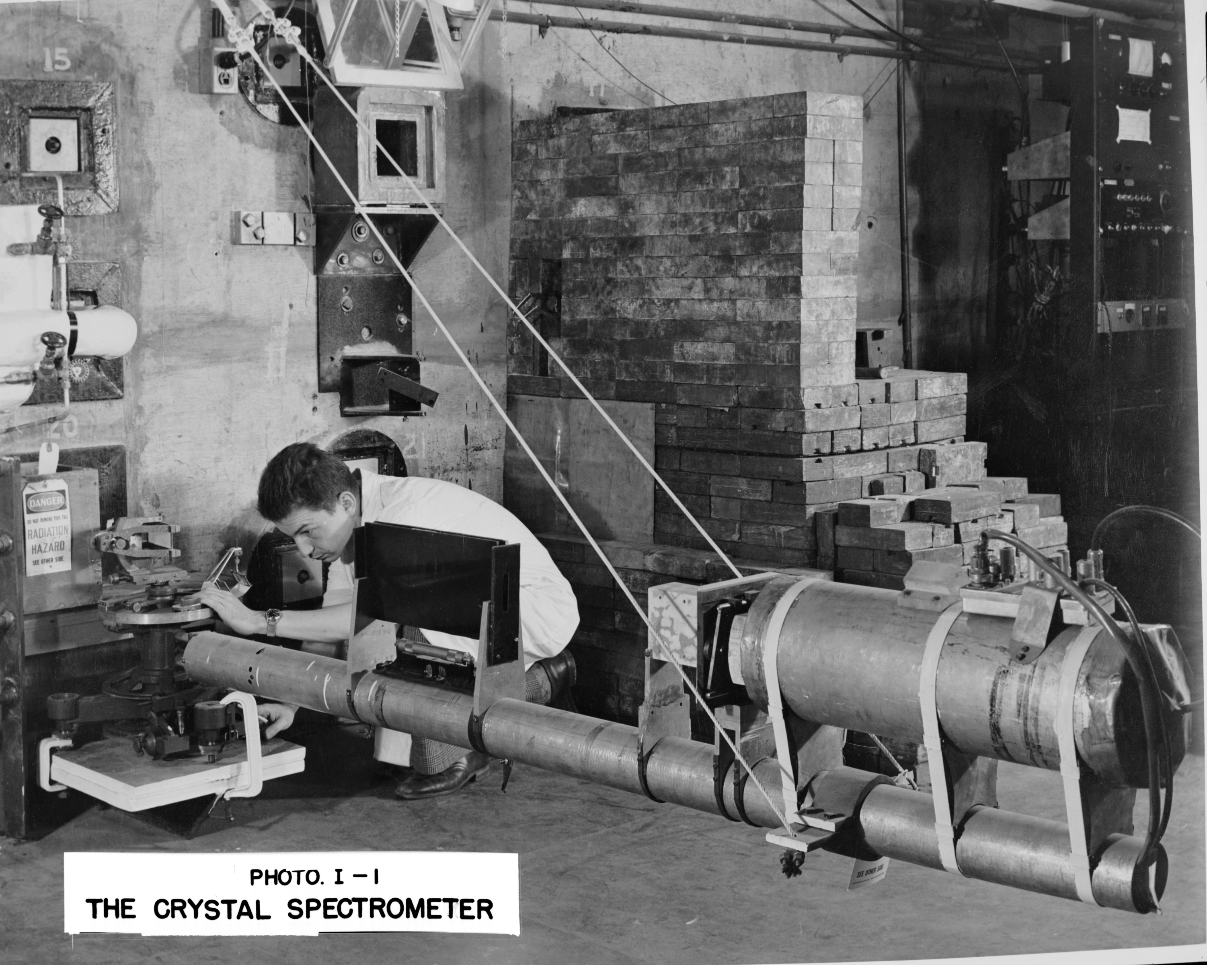
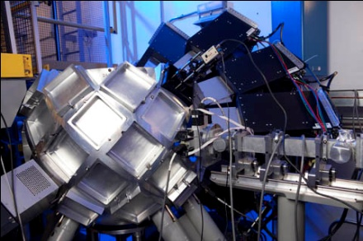
And the instrumentation….

Slide 8
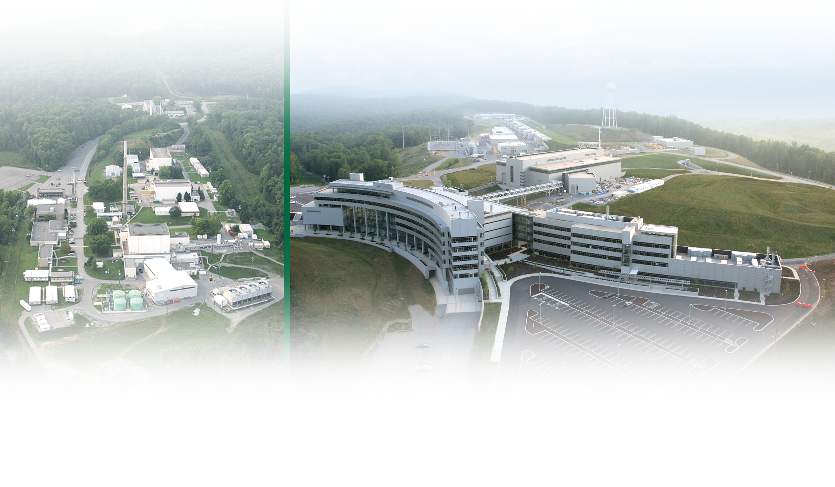
Today ORNL operates two of the world’s best tools for neutron scattering ……
High Flux
Isotope Reactor: Intense steady-state neutron flux
and a high-brightness cold neutron source
Spallation
Neutron Source:
World’s most powerful accelerator-based neutron source
Center for Nanophase Materials Sciences:
A DOE user facility for nanophase synthesis and characterization
Delivering neutrons for high impact science
8 Managed by UT-Battelle
for the U.S. Department of Energy
Notes:
8
FY09 users: 2358 at HFIR, 307 at SNS
SNS construction began in 1999 and was officially completed when the first neutrons were produced in April 2006 (ahead of schedule).
As the world’s most powerful source of pulsed neutrons, SNS is being used to explore the structure and function of materials. When it is fully operational, we expect SNS to bring 1000–2000 researchers from around the world to East Tennessee every year. A well-developed upgrade path (power upgrade, long-wavelength target station) will keep SNS at the forefront during its 40-year operating life.
HFIR provides a continuous cold neutron source of unsurpassed brightness, with two new world-class SANS instruments providing the ability to determine nanoscale structures in a vast array of materials (polymers, biological macromolecules, solids).
The Joint Institute for Neutron Sciences will be housed on Chestnut Ridge in a facility constructed with State of Tennessee funding.
IMAGE: This is a “lightly enhanced” photograph

Slide 9
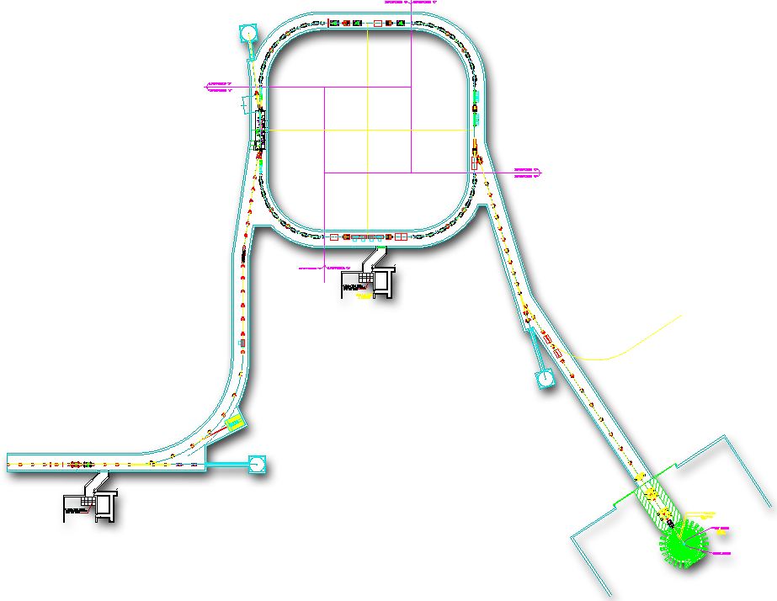


SNS Accelerator Complex
Collimators
Accumulator Ring
Front-End:
Produce a 1-msec long, chopped, H- beam
1 GeV LINAC
Accumulator Ring: Compress 1 msec long pulse to 700 nsec
Injection
Extraction
RF
1000 MeV
RTBT
2.5 MeV
HEBT
Front-End
LINAC
Liquid Hg Target
Chopper system makes gaps
945 ns
mini-pulse
Current
Current
1 ms macropulse
1ms
1 ms macropulse
1 ms

Slide 10
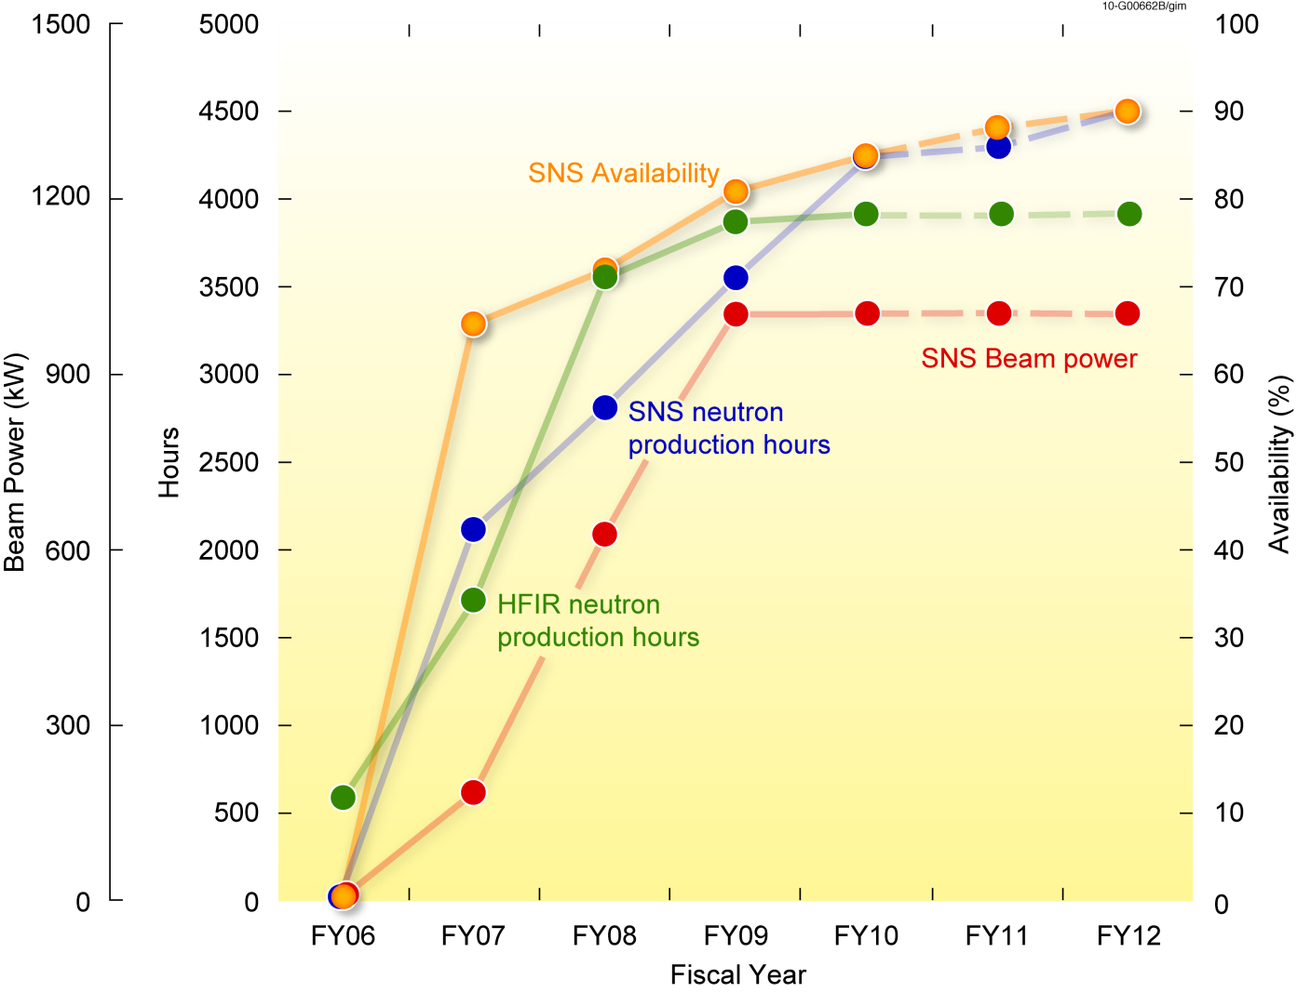
Stable operations at SNS and HFIR have been accomplished
SNS | HFIR
5000 neutron production hours Availability >92% at 1MW | 3900 neutron production hours 100% Reliability

Slide 11
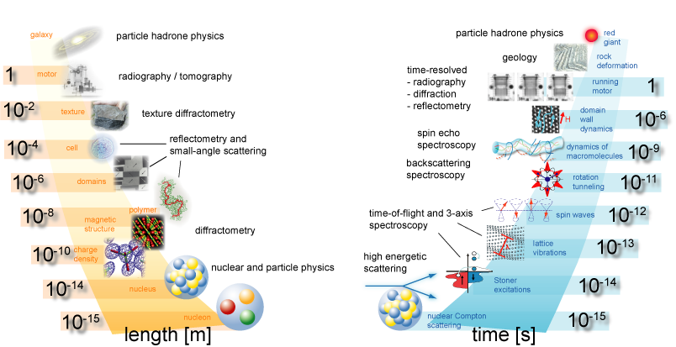
Neutrons measure structure and dynamics
Source: Forschung mit Neutronen in Deutschland - Status und Perspektiven - Komitee für die Forschung mit Neutronen (2002-2005)

Slide 12
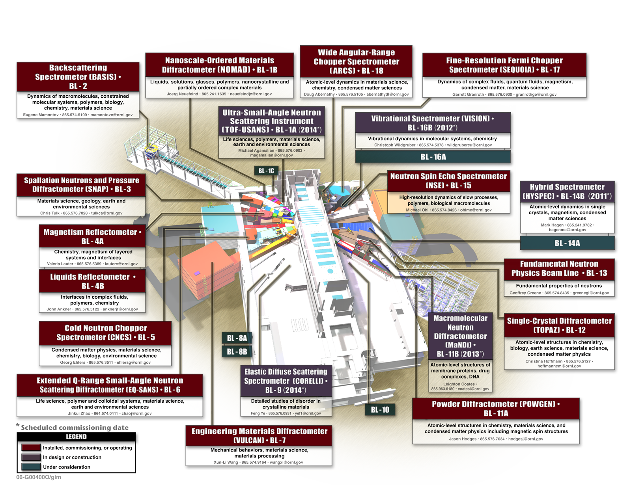
15 instruments operating at SNS

Slide 13
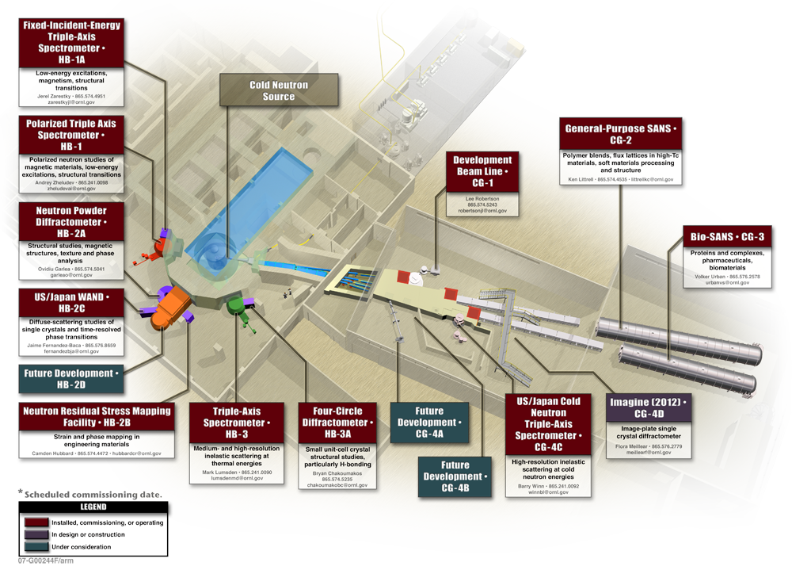
10+ Instruments Operating at HFIR

Slide 14
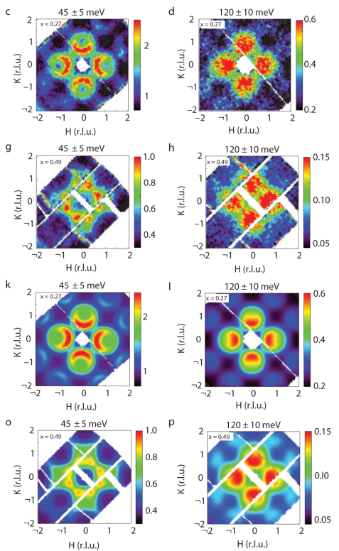
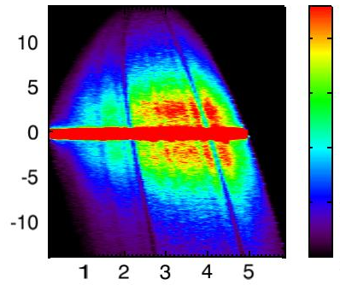


We are impacting a broad range of science
Nanoscience | Soft Matter | Bioremediation | Superconductivity
First observations of conventional spin waves in nanoparticles | Morphological characterization of low-band gap solar cells | Probing molecular interactions between microbial-cell protein and mineral surfaces | Evolution of spin excitations in superconductors: Strong evidence that superconductivity is related to magnetic interactions
Feygenson et al.,
Phys. Rev. B83, 174414 (2011)
Russell et al.,
Published on-line, DOI: 10.1002/aenm.201100128, Advanced Energy Materials
Johs et al., Biophys. J.
98, 3035 (2010)
Lumsden et al, Nature Phys.
6, 182 (2010)
Notes:
The origin of the superconducting state in the recently
discovered Fe-based materials1–3 is the subject of intense
scrutiny. Neutron scattering4–7 and NMR (ref. 8) measurements
have already demonstrated a strong correlation between
magnetism and superconductivity. A central unanswered question
concerns the nature of the normal-state spin fluctuations
that may be responsible for the pairing. Here we
present inelastic neutron scattering measurements from large
single crystals of superconducting and non-superconducting
Fe1CyTe1􀀀xSex. These measurements indicate a spin fluctuation
spectrum dominated by two-dimensional incommensurate excitations
extending to energies greater than 250meV. Most
importantly, the spin excitations in Fe1CyTe1􀀀xSex have four-fold
symmetry about the (1, 0) wavevector (square-lattice (;)
point). Moreover, the excitations are described by the identical
wavevector and can be characterized by the same model as the
normal-state spin excitations in the high-TC cuprates9–11. These
results demonstrate commonality between the magnetism in
these classes of materials, which perhaps extends to a common
origin for superconductivity.
The penetration power of neutron scattering enabled a systematic, detailed in situ investigation of the morphology of the active layer of a bulk heterojunction organic photovoltaic device and of the structure at the interfaces under various processing conditions.
Neutron reflectivity (NR) measured using MAGICS (Magnetic Advanced Grazing InCidence Spectrometer, BL-4A) at SNS provided a detailed depth profile of components in the active layer of bulk heterojunction organic photovoltaic devices.
Small-angle neutron scattering at HFIR (CG-2) showed segregation of PCBM (an electron transporter) after solution casting, and a slight domain purification with thermal annealing.
NR provided evidence that PCBM can diffuse only along the boundaries between the ordered region within the active layer and that it aggregates within the disordered regions of the polymer.
These studies are key to improving the performance of polymer-based solar cells.
We report here the results of inelastic neutron scattering measurements performed on exchange
biased Co core/CoO shell nanoparticles. Superparamagnetic °uctuations of the core are observed
above the 200 K blocking temperature, but at lower temperatures dispersing spin waves originating
in the CoO shells are found, the ¯rst such observation in any nanoscaled system. The spin wave
dispersion is similar to that of bulk CoO, although ¯nite size e®ects dramatically shift the spin waves
populations to higher energies and shorter wavelengths. Exchange coupling to the °uctuating Co
core increases the spin wave population in the CoO shell, suggesting a new mechanism for dissipating
the energy released by reversal of the core magnetization.
Titanium and its alloys are an important class of engineering materials for applications in aerospace, marine and biomedical industries, owing to their unique properties such as high strength/density ratio, high corrosion resistance and outstanding biocompatibility. The α(hcp)-to-β(bcc) phase transformation in titanium at ∼882°C is of technical importance for refining microstructures and achieving desirable mechanical and physical properties. However, the high temperature β-phase can not be retained by quenching to room temperature for ex-situ examinations. As such, there is a lack of knowledge of the β phase and, in turn, the mechanism for the α↔ β transformation. Here we present in-situ neutron diffraction data of commercially pure titanium upon continuous heating and cooling, showing the interplay between the phase transformation and texture evolution in titanium.

Slide 15
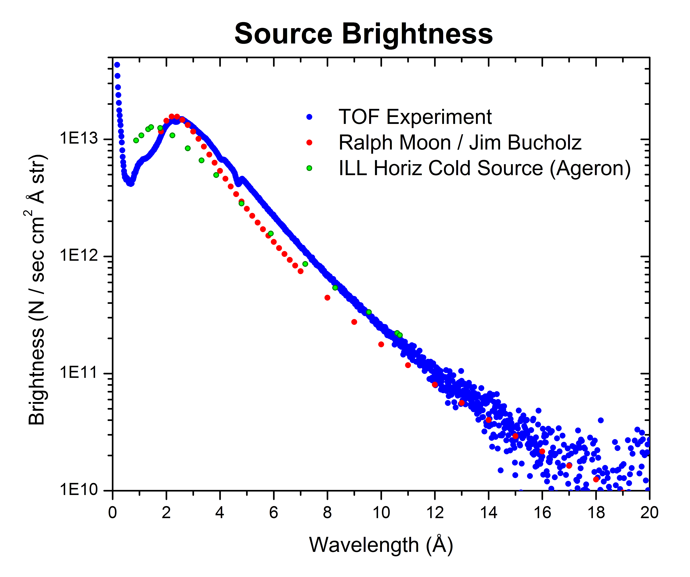
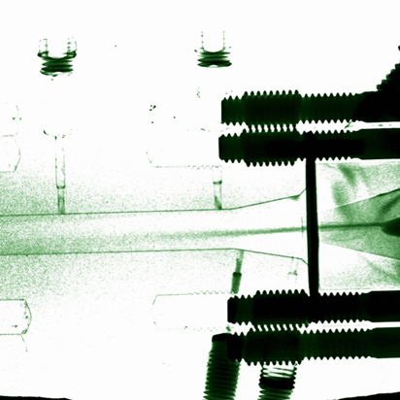
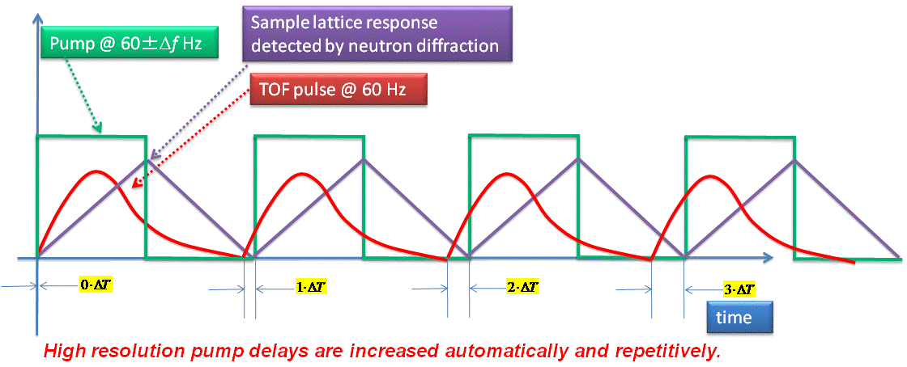
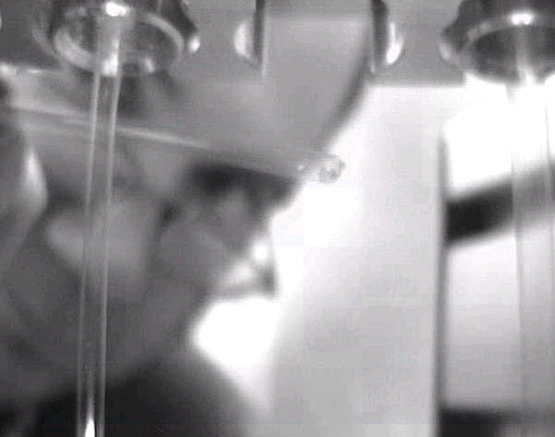
What are our strengths?
What’s new?
What’s next?
HFIR
  Very intense cold source
  New Imaging capability
SNS
  Pulse structure
  High Peak Intensity
  Event Mode Data Acquisition
  Kinetic/Non-equilibrium Measurements
  Very small samples
ESS?

Slide 16

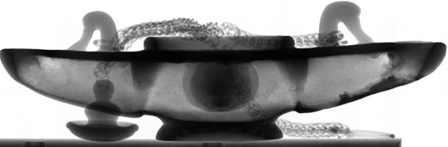
Neutron Imaging Reveals Structural Information, Metallurgical Technique Skills and Environmental Impact of Ancient Bronze
Ancient Greek and Roman artifacts from Petra, Jordan. All of these cultural areas were, in antiquity and the early historical period, places of cross-cultural interaction and exchange, as well as of technological innovation.
Instrument Team:
Prof. Krysta Ryzewski (Wayne University), Susan Herringer Hassina Bilheux, Lakeisha Walker and Jean Bilheux
Top: Photograph of Ancient Greek Lamp
Bottom: Neutron Radiograph of the same Lamp.
Where is the genie?
~ 25 cm

Slide 17
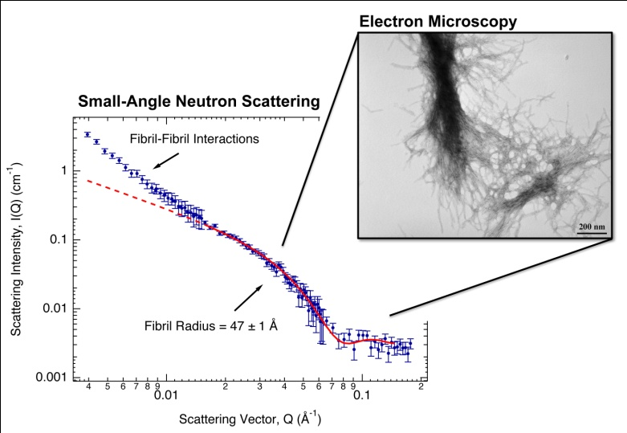
First-ever sub-nanoscale snapshots of renegade protein in Huntington’s Disease
Huntington’s Disease is an incurable, hereditary, neurological disorder caused by a renegade protein that destroys neurons in the brain
Using the Bio-SANS (small-angle neutron scattering) instrument at the High Flux Isotope Reactor (HFIR) the earliest structural formation of the disease type of the protein “huntingtin” was characterized
The size and mass of the protein structures were determined at a scale of less than billionths of a meter―from the earliest small, spherical precursor species composed of two and three peptides―along the aggregation pathway to the development of the later-stage fibrils
The loosely packed internal structure of later-stage fibrils is quantitatively consistent with the hollow tube-like β-helix model proposed in earlier research. Follow-up work will study a normal length 22-glutamine peptide.
SANS data allow the mature fibril structure of the mutant huntingtin peptide aggregates to be more carefully probed. Inset: transmission electron microscopy demonstrates the fibrillar nature of these huntingtin aggregates.
Christopher B. Stanley, Tatiana Perevozchikova, and Valerie Berthelier, “Structural Formation of Huntingtin Exon 1 Aggregates Probed by Small-Angle Neutron Scattering,” Biophysical Journal 100(10) (May 2011). http://www.cell.com/biophysj/
Notes:
In several neurodegenerative disorders, including Huntington's disease, aspects concerning the earliest of protein structures that form along the aggregation pathway have increasingly gained attention because these particular species are likely to be neurotoxic. We used time-resolved small-angle neutron scattering to probe in solution these transient structures formed by peptides having the N-terminal sequence context of mutant huntingtin exon 1. We obtained snapshots of the formed aggregates as the kinetic reaction ensued to yield quantitative information on their size and mass. At the early stage, small precursor species with an initial radius of gyration of 16.1 5.9 Å and average mass of a dimer to trimer were monitored. Structural growth was treated as two modes with a transition from three-dimensional early aggregate formation to two-dimensional fibril growth and association. Our small-angle neutron scattering results on the internal structure of the mature fibrils demonstrate loose packing with 1 peptide per 4.75 Å β-sheet repeat distance, which is shown to be quantitatively consistent with a β-helix model. This research provides what we believe to be new insights into the structures forming along the pathway of huntingtin exon 1 aggregation and should assist in determining the role that precursors play in neuronal toxicity.

Slide 18
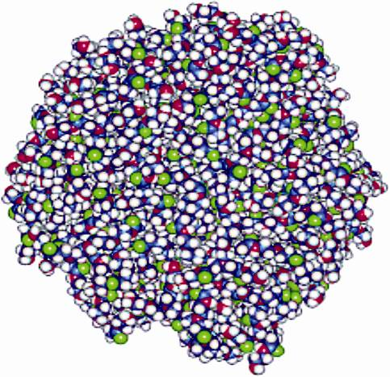
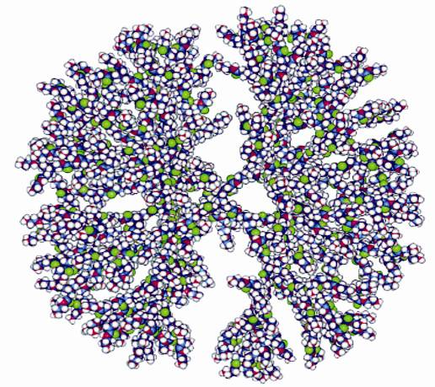
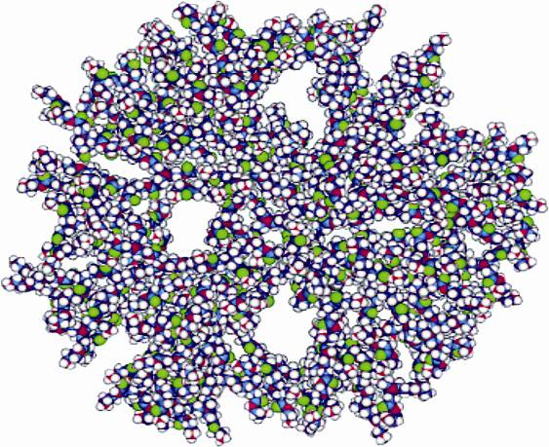
Targeted Drug Delivery Systems
Many disease-fighting drugs are “wrapped” in dendrimers to travel throughout the body, but knowledge of how those dendrimers respond in various environments is limited.
Using a broad suite of elastic and inelastic neutron scattering techniques, we’re studying the structure and dynamics of polyamidoamine star-burst dendrimers for possible use in effective drug delivery
High pH uncharged
Low pH primary and tertiary uncharged
Neutral pH primary charged
SANS studies reveal how molecules, such as dendrimer, function within solutions at different pH levels.

Slide 19
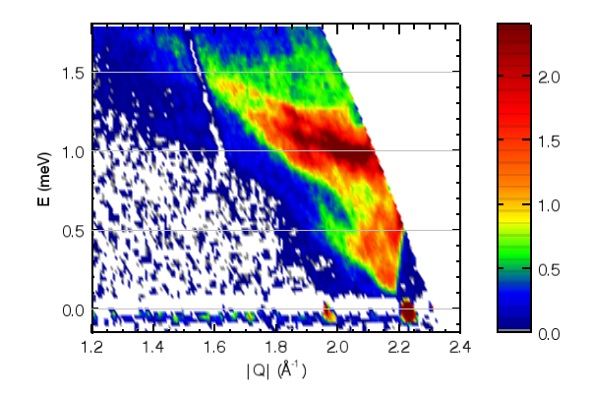
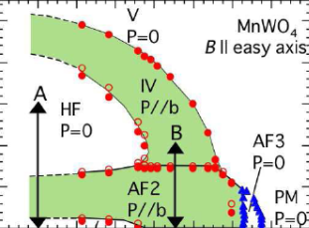
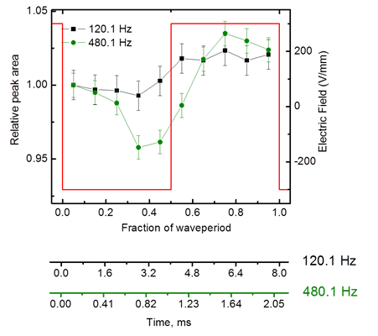
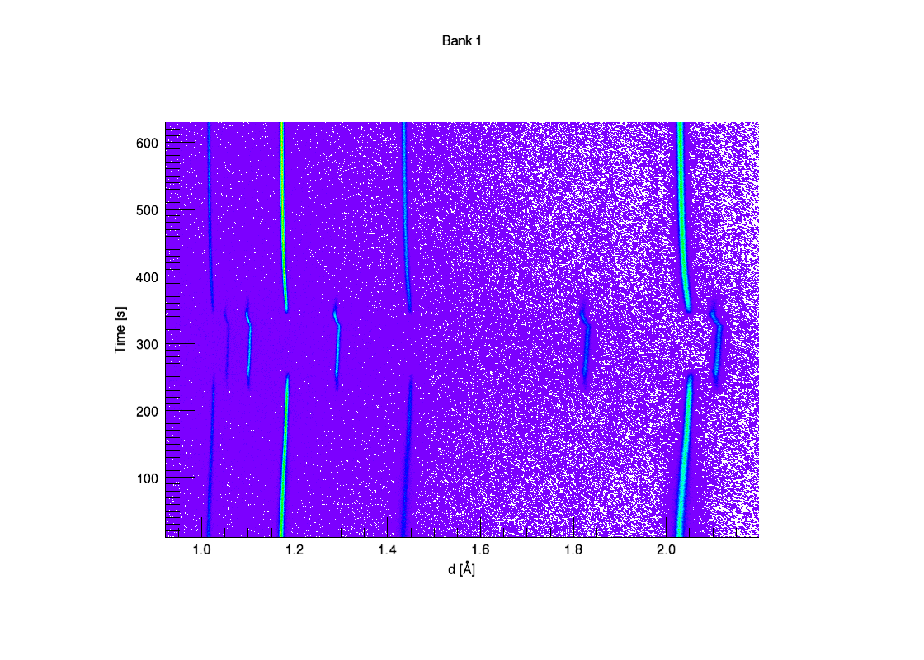
New capabilities enable discovery science
Extreme conditions of magnetic neutron diffraction at high magnetic fields | Inelastic scattering under extremes: Superfluid component in solid helium
Pump probe experiments at 200 μs resolution | Fast data acquisition: Diffraction patterns of steel phase transformation in 1 s
50
40
30
B (T)
20
H. Nojiri et al.,
Phys. Rev. Lett.,
106, 237202 (2011)
10
0
0
4
10
12
16
AF1 P=0
T(K)
600
Natural cooling
400
Time [s]
1050 ºC
200
Heating to
1050 ºC at 3 ºC/s
0
1.2
1.6
2.0
d[A]
Notes:
19

Slide 20
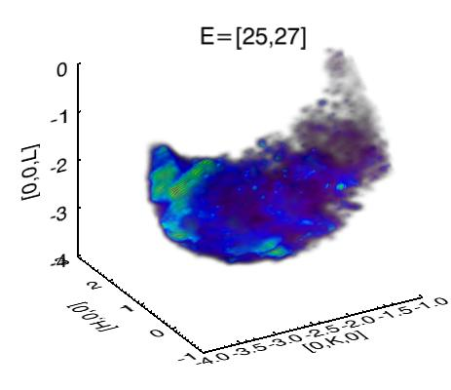
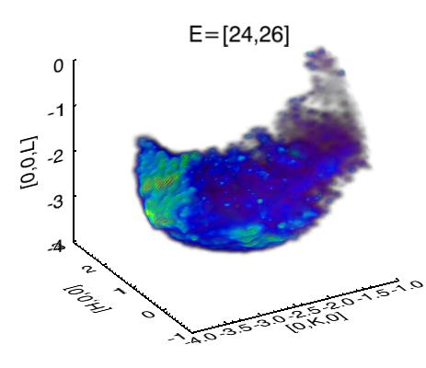
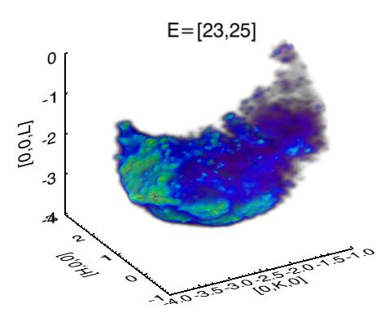
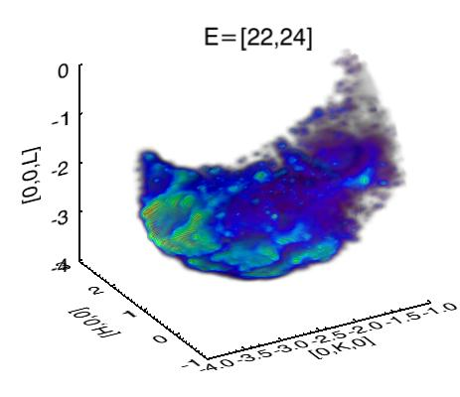
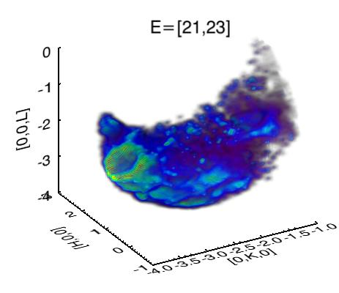
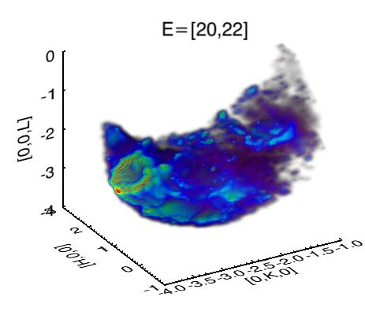
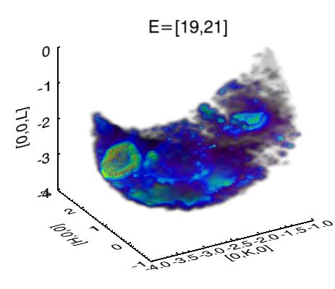
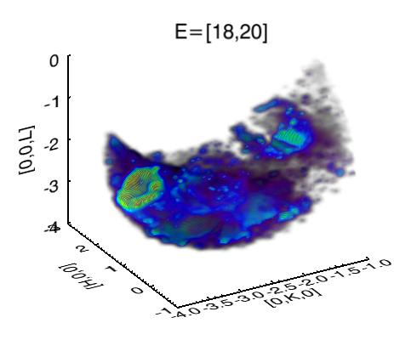
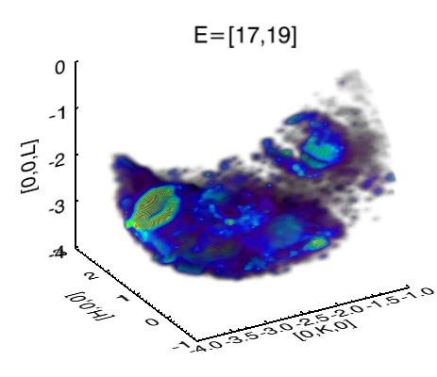
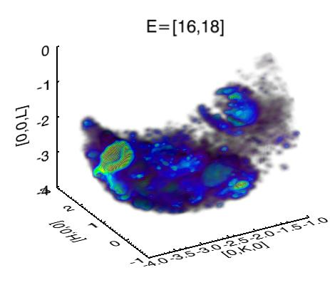
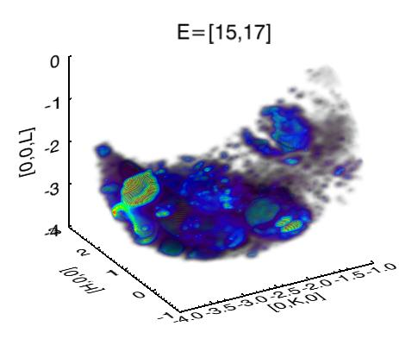
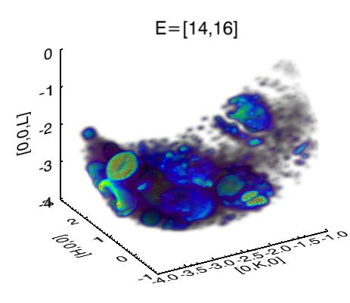
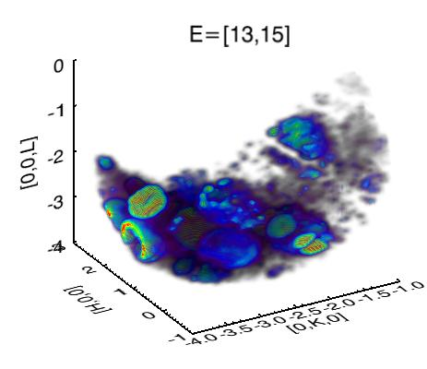












Pushing the limits:
Neutron reciprocal space tomography -
4D phonon mapping
Energy slice:
meV
FeSi 8.5g crystal, ARCS
Sum of 45 orientations
15 h total acquisition time
O. Delaire, PNAS

Slide 21


Fast Data Acquisition (<1 second) – phase transformation under non-equilibrium conditions
New capabilities in sample heating and data collection at VULCAN allowed record-setting measurement of phase transformation kinetics under far-from-equilibrium conditions.
A newly installed resistive heating furnace heated a sample of high-strength steel at 3°C/s from room temperature to 1100°C in 320 s.
Diffraction patterns were resolved in less than 1 s, thanks to the high neutron flux at SNS.
VULCAN can heat a sample and collect data fast enough that the sample does not settle into equilibrium.
VDRIVE data analysis package chops the data set as functions of temperature and time.
Fast resistive heating of high-strength steel in a controlled atmosphere box at VULCAN
Natural cooling
1100 ºC
Heating to 1100 ºC
at 3 ºC/s
Diffraction patterns of steel phase transformation at 3°C/s heating rate. Data were collected continuously and chopped by VDRIVE.
Notes:
A new sample environment and advances in data collection speed at VULCAN allowed users to heat a sample to over 1100°C in 5 minutes and capture diffraction patterns at times of less than 1 second. The experiment demonstrates that VULCAN can heat a sample to an extreme temperature and collect data fast enough that the sample does not settle into equilibrium, allowing investigation of the material behavior in real time. A new resistive heating furnace built in-house was used to heat a sample of advanced high-strength steel at a nominal rate of 3°C per second, bringing it from room temperature to 1100°C in a nitrogen/argon atmosphere in 320 seconds. The material passed through a phase transformation as its lattice planes expanded with the steady rise in temperature. The high neutron flux at SNS allowed direct resolution of the neutron diffraction patterns in less than a second. Heating and data collection operate independently in asynchronous fast data collection: data are collected continuously as the sample heats and cools; and afterward, VDRIVE, a software package created in-house, analyzes the data as functions of time and temperature. Using the newly developed asynchronous stroboscopic technology at SNS, VULCAN instrument scientists expect to be able to improve temporal resolution by another order of magnitude (to ~30°C per second). Non-equilibrium materials research is pertinent to numerous applications, including turbines and high-speed engines. Already, two industry partners, GM and Alcoa, are interested in follow-on work.
Contact: Ke An, kean@ornl.gov
Funding source: Both the user proposal and the development of asynchronous data collection are funded under LDRD.
Resources: Spallation Neutron Source; Materials Science and Technology Division, ORNL.
Research team: Zhili Feng, Zhenzhen Yu, Wei Zhang, and Elliot Specht, MSTD; Ke An, Rebecca Mills, Harley Skorpenske, and Xun-Li Wang, Neutron Scattering Sciences Division.

Slide 22



Study of Deformation Behaviors in Ferritic Superalloys by In-situ Neutron Diffraction at VULCAN
Users: Shenyan Huang, Wei Wu, Zhiqian Sun, Peter Liaw (UTK), Michael Rawlings (Northwestern University
Novel ferritic superalloys have been designed for ultra-supercritical steam-turbine applications. However, the creep and coarsening resistance of beta/beta prime Fe-based alloys need to be further improved, which requires a fundamental understanding of the micromechanisms of high-temperature deformation at the local beta and beta prime levels. The motivation of the proposed work is to study the relationships among the microscopic elastic-lattice strains , microstructure evolution, and macroscopic creep behavior, therefore providing insights into micromechanical deformation. Vulcan has the unique advantages of high neutron flux and improved resolution, which is quite beneficial to precisely determine the low-intensity superlattice peaks. The experiment utilized the newly developed load-under-heat capability to solve the challenging material science problem.
super lattice phase
Superalloys were heated at several
elevated temperatures up to 1100 ºC
In-situ diffraction patterns at loads under heat

Slide 23



In situ measurements of Li-C electrode structure during charge/discharge cycling
Neutron diffraction reveals:
  Electrode phases change with state of charge
  Hysteresis in crystal lattice between charge
  and discharge due to different staging process
Diffraction measurements on VULCAN over 7 charge/ discharge cycles
Capacity (%)
0
25
50
75
8000
2.15
Li_{x}C₆(110)
2.10
Charging
6000
Discharging
d (Å)
1.85
LiC₆(002)
Time [s]
d (Å)
LiC₁₂(002)
4000
1.80
LiC₁₂(004)
1.75
2000
1.70
Graphite (004)
1.65
3.8
3.4
3.0
2.6
1.8
2.0
0
10
20
30
Capacity (Ah)
Voltage (V)

Slide 24


Pushing the limits – pulsed techniques
Diffraction using a 30 T pulsed magnet
Developing signature science research that exploits our unique capabilities
Time-correlated diffraction: “Event mode data acquisition” with 30 T pulsed magnet
New science: Peak shifts in HF phase
    Nojiri et al., Tohoku University;
    Gaulin et al., McMaster University

Slide 25
Realizing the Promise of SNS: Pump-probe experiments for fast dynamic response
Offset duration of pump and probe
  Samples all wavelengths
  Enables correlation of scattering data with pump pulse
  Data analysis gives dynamic structure with good statistics
480.1 Hz
High frequency ac electrical loading of 111 –oriented single crystal domain-engineered BaTiO₃
K. An, VULCAN
200 μs resolution
Notes:
This experiment demonstrates the feasibility of asynchronous data collection technique to probe fast material phenomena. Time-resolution of 200 us (2x10⁻⁴s) is shown in the figure for 480.1 Hz.
Neutron diffraction measurement shows extrinsic contributions to enhanced piezoelectric properties of domain-engineered BaTiO₃ single crystals
Relaxation effects evident in time-dependence of peak area changes. This probably arises due to domain wall broadening

Slide 26


SNS was designed with an upgrade path…
Power Upgrade Project
CD-1 approved January 16, 2009 Increases power to 2-3 MW to enable Second Target Station
Second Target Station
CD-0 approved January 7, 2009 Provides another experiment hall with ~20 more beam lines Optimized for intense beams of cold neutrons, to provide new scientific opportunities Operates in long-pulse mode, taking beam directly from linac New Science Capabilities Order of magnitude more intensity Much smaller samples, opening up new materials to study Kinetics studies to millisecond or shorter time scales Enables much more extensive parametric studies Focusing to provide spatial resolution down to 10 μm Dynamics of larger-scale structures Lateral structures in membranes and other layered systems

Slide 27

Outreach, education and collaborations are key to developing a broad program
Summer Schools and Workshops
International Neutron Scattering Instrumentation School
National School on Neutron and X-ray Scattering
A neutron scattering applications and techniques book series has been contracted with Springer
Collaboration with ORNL’s Partnerships Directorate on outreach to industry
Core graduate and postgraduate education programs
Sabbatical /exchange programs
Interaction with smaller regional neutron facilities for development and training is essential
Italy has developed a core team with expertise in neutron instrumentation
Notes:
Survey distributed by Bryant Research – it’s legit! If you get an invite, we’d really appreciate your participation.

Slide 28


ORNL is well positioned to partner in research and education
We have extraordinary assets for energy-related research
Outstanding capabilities in materials and nanoscience
World-leading systems for open scientific computing
BioEnergy Science Center
Growing strength in climate change impact R&D
The nation’s broadest portfolio of energy programs
Unique resources for nuclear technology and nonproliferation
Opportunity:
Leverage these assets
to expand research
and education
in energy-related science and engineering
28 Managed by UT-Battelle
for the U.S. Department of Energy
Overview _1106
Notes:
28

Slide 29

And…helping to develop the next generation of scientists and engineers
Providing educational and research experiences for students and faculty at all levels
  Graduate education programs with an emphasis on interdisciplinary energy science and technology
  Prestigious postdoctoral fellowships
  Undergraduate research experiences
Investing in facilities and teachers
for area schools
Participating in regional education
and workforce development efforts

Slide 30

Thank you!
30 Managed by UT-Battelle
for the U.S. Department of Energy

Slide 31
Our distinctive facilities bring thousands of researchers to ORNL each year
Spallation
Neutron Source
Center for
Nanophase
Materials Sciences
Holifield Radioactive
Ion Beam Facility
Building Technologies Research and Integration Center
Oak Ridge Leadership Computing
Facility
High Flux
Isotope
Reactor
High
Temperature
Materials Laboratory
National Transportation
Research
Center
BioEnergy
Science
Center

Slide 32

University partnerships are critical to ORNL’s success … and will be for ESS
Major projects | Research collaborations | Guest researchers | Joint institutes | Outreach
Center for Advanced Simula-tion of Light Water Reactors (CASL) BioEnergy Science Center NSF petascale computing facility 4 SNS instruments led by university consortia 13 Energy Frontier Research Centers (2 led by ORNL, 11 led by universities) | Projects with 200+ universities Hundreds of joint research publications (70% of ORNL publications have a university coauthor) | Hundreds of faculty and students Thousands of university researchers at 10 national user facilities | Heavy ion research Neutron sciences Biological sciences Computational sciences | Distance education HBCU/MEI faculty summer research program
Notes:
32

Slide 33


Opportunities for university faculty and students at ORNL
Access to unique scientific user facilities (no cost if research is published)
  Spallation Neutron Source
  Center for Nanophase Materials Sciences
  High Flux Isotope Reactor
  Holifield Radioactive Ion Beam Facility
  Leadership Computing Facility
  Building Technologies Research Center
  National Transportation Research Center
  High Temperature Materials Laboratory
Research collaborations with our staff
  Joint proposals
  Visiting faculty
  Undergraduate and graduate programs
  Partnerships with lab researchers
Graduate research initiative
Notes:
The national laboratory system, created over a half-century ago, represents the most comprehensive research system of its kind in the world.
University research tends to be discipline-focused; industrial development tends to be needs-focused. In contrast, national labs uniquely combine a discipline orientation and a mission orientation.
These laboratories perform research and development that is not well suited to university or private-sector research facilities because of its scope, infrastructure, or multidisciplinary nature, but for which there is a strong public and national purpose: high-risk/high-payoff research, mainly for DOE but also for other federal agencies and the private sector.
The labs excel in the development and application of world-class scientific equipment (including supercomputers), facilities, and multidisciplinary teams of scientists.
Technology transfer was established as an explicit national laboratory mission by the 1980 Stevenson-Wydler Act; additional authority and mechanisms were granted by the 1986 Federal Technology Transfer Act and the 1989 National Competitiveness Technology Transfer Act.
Education: The national labs are a resource for mentoring teachers and students.

Slide 34

Graduate research and education:
The case for Lab–university partnerships
Combines the educational resources of a research university
and the research capabilities of a national laboratory/facility
Provides expanded opportunities
for graduate students in energy-related
sciences and engineering
  Unique facilities and capabilities
  Multidisciplinary research
  Large-scale problem-oriented research projects
  Entrepreneurship
Expands existing graduate research campuses
to include a national lab, increasing research
opportunities and capacity
Leverages Lab staff, facilities, and research programs to increase
the number of graduate students and mentors in energy-related areas
Expands research capacity at the Labs while developing future scientists
and engineers in DOE mission areas
Notes:
34

Slide 35



ORNL graduate research and education initiative: Our vision
Multidisciplinary | Entrepreneurial | Transformational
  Offer multidisciplinary research opportunities
  in energy-related sciences and engineering
Incorporate entrepreneurial experiences, including opportunities to develop business plans for accelerating technology deployment
Engage students in large-scale, problem-oriented programs, enabling scientific discoveries
and innovative solutions
to energy-related challenges
Notes:
35

Slide 36

Guiding principles
Grow (not shift) the graduate student population
Core courses and degrees from home institutions
Research experiences supported by ORNL programs
  Complement and expand university research
Thesis supervision and specialty course development/teaching
by ORNL and university faculty
Business model tailored to each university partner
  First academic year at university
  Summers and thesis research at ORNL
  Specialty courses at ORNL
  Shared commitment by ORNL and the university
36 Managed by UT-Battelle
for the U.S. Department of Energy

Slide 37



An example:
UTK/ORNL Center for Interdisciplinary Research and Graduate Education (CIRE)
UTK-ORNL Distinguished Graduate Fellowships | Energy Science and Engineering Interdisciplinary PhD
Focus areas: Materials science and engineering, including neutron science Computational science and engineering Nuclear science and engineering, including nuclear physics | Focus areas: Bioenergy and biofuels Environmental and climate science Nuclear energy Distributed energy and grid management Energy conversion and storage Renewable energy Also available: Traditional PhD programs with an Energy Science and Engineering concentration
Both programs offer:
Degrees from the University of Tennessee, Knoxville
Internships and thesis research at Oak Ridge National Laboratory
For more information and to apply: http://cire.utk.edu

Slide 38

Benefits
Students | Universities | ORNL/DOE
Offer new research experiences, particularly in energy-related areas Provide expanded research opportunities (larger projects, unique facilities and capabilities, entrepreneurship) Create a dynamic multi-university ecosystem | Increase graduate student population in energy-related areas Increase support for graduate student research Provide expanded research opportunities (larger projects, unique facilities) Strengthen partnership with ORNL (students are glue) Create an extended university center in areas of unique ORNL strengths and capabilities (opportunities for joint proposals, etc.) | Strengthen research programs and capacity through an enhanced graduate student component Increase graduate student population in DOE mission areas Provide mentoring opportunities for ORNL staff Strengthen partnerships with universities
Notes:
38

Slide 39

ORNL has established a home for graduate education
First floor: CIRE and convening space
Second floor: Graduate Education and University Partnerships office
Classroom space available on both floors

Slide 40




We use our R&D assets to create technology partnerships and growth
Technology creation and translation
  556 U.S. patent applications filed
  in past 5 years; 275 patents issued
  128 active technology licenses
  89 new companies since April 2000
Strategic partnerships
  UT, TVA, Southern Growth Policies Board, Tech 2020, Tennessee Valley Corridor, ETEC, Battelle Ventures, Innovation Valley Partners, and many others
  S&T Park at ORNL
  Working with 600 industries annually
156 R&D 100 Awards
(second only to GE)
Technology portfolios
Entrepreneurial support
Partnerships with
industry and universities
Local and regional
economic development
Notes:
40

Slide 41
An opportunity to create education and technology partnerships?
Prepare the next generation of researchers for ESS
  Mitigate the risk of a “generation gap”
  Provide hands on research experience at unique facilities
  Provide the background experience to drive the next level of capability at ESS
  Exposure to a broader energy portfolio
  Enable the development of a research network
Engage industry now
  Industry wants results now - 10 years is outside the time frame of most industrial partners
  Learn the needs and define the future requirements/capabilities at ESS
Graduate Education
Partnerships with
industry and universities
Italian participation
in ESS
Local and regional
economic development
Notes:
41

Slide 42
On-going work:
Superfluid component in solid helium?
Neutron inelastic scattering reveals a solid helium superstructure (⁴He) under pressure of 40 bars and mK temperatures.
A superstructure is identified in the figure by a characteristic feature, zone boundary folding of phonons. Solid helium can show a superstructure only by an ordered composition of two different aggregates, the solid state and the liquid state.
A liquid 3D helium state does not exist under the pressure and temperature conditions in this experiment.
Microscopic many-body theory supports the hypothesis that quasi 2D liquid helium layers are a stable configuration in solid helium.
The narrow line width of the phonons and comparison with other neutron scattering experiments on liquid helium in confinement suggest superfluid liquid layers in solid helium.
The consequences of stable conditions of quasi 2D liquid layers in a 3D solid go far beyond the quantum model system of helium.
Snapshot of phonons in solid helium as a function of neutron momentum Q and energy transfer E in a cut through reciprocal space. Zone boundary folded phonons, charactering the zone boundary folding and hence the superstructure, are highlighted by white lines, and acoustic phonons limiting the phonon space to lower energies, by black lines. Optic phonons constitute the upper phonon band.
Contact: Hans Lauter, 865-576-9612, lauterhc@ornl.gov
Funding sources: ORNL, SUNY–Buffalo
Resources: Spallation Neutron Source, ORNL

Slide 43

Novel magnetic behavior revealed in CoAl₂O₄, “cobalt blue”
Neutron scattering has revealed a novel type of magnetic behavior in the compound CoAl₂O₄, also known as the pigment “cobalt blue.”
Competing magnetic interactions result in frustration, preventing the formation of true long-range order. Instead, at low temperatures the system forms a state with small antiferromagnetic domains.
The domain walls are frozen in place, resulting in irreversible “glass-like” behavior in measured bulk quantities. It is thought that this phenomenon could explain unexpected glassiness in a number of other magnetic materials.
Single crystals were grown in collaboration with ORNL’s Correlated Electron Group. Neutron scattering instruments used included the Polarized (HB-1) and Fixed-Incident Energy (HB-1a) Triple-Axis Spectrometers at the High Flux Isotope Reactor and the Cold Neutron Chopper Spectrometer at the Spallation Neutron Source.
Artist's conception of magnetic domains in CoAl₂O₄. The local pattern of ordered cobalt spins inferred from neutron scattering is shown in the lower left. Sharp walls separate regions of the sample wherein spins are aligned along different axes. The freezing of these walls into place gives rise to glass-like behavior in an otherwise clean single-crystalline sample. (Image courtesy of Reneé Manning.)
G. J. MacDougall, D. Gout, J. L. Zaretsky, G. Ehlers, A. Podlesnyak, M. A. McGuire, D. Mandrus, and S. E. Nagler, “Kinetically inhibited order in a diamond lattice antiferromagnet,” PNAS (early edition),
Contact: Gregory J. MacDougall, 865-576-6121, macdougallgj@ornl.gov
Funding sources: Materials Science and Engineering Division and Scientific User Facilities Division, Office of Basic Energy Sciences, DOE
Resources: High Flux Isotope Reactor and Spallation Neutron Source, ORNL

Slide 44

Building a road map for tailoring polyelectrolyte films using SNS Liquids Reflectometer
Two types of polyelectrolytes of opposite charge are assembled at surfaces in a sequential way, using layer-by-layer (LbL) assembly.
The researchers wanted to know if the structure can be varied by systematically tinkering with the salt concentration, the time in solution, and ultimately, with the introduction of other variables.
Neutron reflectivity on the films at the SNS Liquids Reflectometer showed peaks in the density of the structures that indicate how well ordered they are under different levels of charge.
The work has important applications for controlled drug delivery in medicine, and for such environmental work as oil recovery and water treatment.
Multilayers of two polyelectrolytes PDMA (left) and PDEA (right) were assembled in low-salt conditions and annealed in NaCl solutions to induce layer intermixing. Neutron reflectometry showed materials with lower charge density experienced a faster decay of film structure, with distance from the substrate. Layer intermixing was faster in the case of more hydrophobic PDEA as compared to PDMA, because of the weaker ionic pairing.
Contact: John Ankner, 865-576-5122, anknerjf@ornl.gov
Paper: L. Xu, J. Ankner & S. Sukhishvili, Macromolecules (2011) , published on-line. (DOI: 10.1021/ma200986d)
Funding sources: DOE Office of Science, National Science Foundation Award DMR-0906474
Resources: Spallation Neutron Source, ORNL

Slide 45
Morphological characterization of low-bandgap solar cells
The penetration power of neutron scattering enabled a systematic, detailed in situ investigation of the morphology of the active layer of a bulk heterojunction organic photovoltaic device and of the structure at the interfaces under various processing conditions.
Neutron reflectivity (NR) measured using MAGICS (Magnetic Advanced Grazing InCidence Spectrometer, BL-4A) at SNS provided a detailed depth profile of components in the active layer of bulk heterojunction organic photovoltaic devices.
Small-angle neutron scattering at HFIR (CG-2) showed segregation of PCBM (an electron transporter) after solution casting, and a slight domain purification with thermal annealing.
NR provided evidence that PCBM can diffuse only along the boundaries between the ordered region within the active layer and that it aggregates within the disordered regions of the polymer.
These studies are key to improving the performance of polymer-based solar cells.
At left, neutron reflectivity profiles indicate enrichment of the polymer and depletion of PCBM at the air surface for as-cast and pre-annealed devices, and diffusion of PCBM to the cathode interface after post-annealing. The profiles are in good agreement with the images of water contact angle images at right.
Contact: Thomas P. Russell, 413-577-1516, tom.p.russell@gmail.com
Funding sources: DOE Office of Basic Energy Sciences, Energy Frontier Research Center on Polymer-Based Materials for Harvesting Solar Energy at the University of Massachusetts–Amherst, National Science Foundation, Konarka Inc.
Resources: High Flux Isotope Reactor and Spallation Neutron Source ORNL; Cold Neutron Research Facility, NIST; Advanced Light Source; Materials Research Laboratory at University of California–Santa Barbara
Published on-line, DOI: 10.1002/aenm.201100128, Advanced Energy Materials

Slide 46
Morphological characterization of low-bandgap solar cells
The penetration power of neutron scattering enabled a systematic, detailed in situ investigation of the morphology of the active layer of a bulk heterojunction organic photovoltaic device and of the structure at the interfaces under various processing conditions.
Neutron reflectivity (NR) measured using MAGICS (Magnetic Advanced Grazing InCidence Spectrometer, BL-4A) at SNS provided a detailed depth profile of components in the active layer of bulk heterojunction organic photovoltaic devices.
Small-angle neutron scattering at HFIR (CG-2) showed segregation of PCBM (an electron transporter) after solution casting, and a slight domain purification with thermal annealing.
NR provided evidence that PCBM can diffuse only along the boundaries between the ordered region within the active layer and that it aggregates within the disordered regions of the polymer.
These studies are key to improving the performance of polymer-based solar cells.
At left, neutron reflectivity profiles indicate enrichment of the polymer and depletion of PCBM at the air surface for as-cast and pre-annealed devices, and diffusion of PCBM to the cathode interface after post-annealing. The profiles are in good agreement with the images of water contact angle images at right.
Contact: Thomas P. Russell, 413-577-1516, tom.p.russell@gmail.com
Funding sources: DOE Office of Basic Energy Sciences, Energy Frontier Research Center on Polymer-Based Materials for Harvesting Solar Energy at the University of Massachusetts–Amherst, National Science Foundation, Konarka Inc.
Resources: High Flux Isotope Reactor and Spallation Neutron Source ORNL; Cold Neutron Research Facility, NIST; Advanced Light Source; Materials Research Laboratory at University of California–Santa Barbara
Published on-line, DOI: 10.1002/aenm.201100128, Advanced Energy Materials

Slide 47

New thin copolymer & nanoparticle films show remarkable order and stability
Researchers at ORNL are making new functional nano-composite materials by inserting nanoparticles into block copolymer films, resulting in promising new matrices on which such materials can be constructed
Using the Magnetism Reflectometer at ORNL’s Spallation Neutron Source, they discovered remarkable evidence that if such thin, self-assembled nanocomposite films are confined to two layers and annealed, the copolymer layers and nanoparticles form stable structures that preserve the original morphology.
Neutrons revealed that after spin-coating a layered structure of partial intermixed organization manifests. The following annealing procedure, a process, which is driven by differences in interface energies, creates a well-organized two-layer structure of cylindrical and lamellar domains.
The structural transition between the two morphologies and their interaction with nanoparticles is highly fascinating for further exploitation of their functional properties.
Publication: V. Lauter, P Muller-Buschbaum, H Lauter, and W. Petry, “Morphology of thin nanocomposite films of asymmetric diblock copolymer and magnetite nanoparticles. J. Phys.: Condens. Matter 23 254215 doi: 10.1088/0953-8984/23/25/254215
Contact: Valeria Lauter, lauterv@ornl.gov
Funding sources: This work was supported by the BMBF (German Ministry of Research and Education) grant No 03DU03MU; research at ORNL’s SNS was sponsored by the Scientific User Facilities Division, Office of Basic Energy Sciences, US Department of Energy.
Resources: Spallation Neutron Source, ORNL

Slide 48

Pulsed beam, pulsed 30 T magnet reveal high-field magnetic phases of multiferroic MnWO₄
Pulsed white beam diffraction and pulsed 30 T magnetic fields were combined to elucidate the high-field phases of multiferroic MnWO₄.
The measurement used the unique high-flux pulsed beams at SNS and the large detector coverage and the capability to tailor the incident beam of the SEQUOIA instrument.
In MnWO₄, the peak shape and splitting of the commensurate reflection in the high-field phases were observed for the first time. This splitting is consistent with a long period noncollinear spiral structure.
This is the first study demonstrating 30 T magnetic fields with pulsed neutrons. The technique is being developed to be used on other instruments and to open it to the general user program.
Multiferroic materials, which have both electric and magnetic order, might be used in a variety of technological applications.
The commensurate peak in MnWO₄ observed at
several field conditions. For the plots on the left, note the scattering weight shifts to shorter d spacing as the field increases. This shift is interpreted as the field manipulation of a long period noncollinear spiral structure. The color plot on the right is the same reflection shown in reciprocal lattice units in the plane of interest.
Contact: Garrett Granroth, 865-805-0631, granrothge@ornl.gov
Funding sources: DOE Office of Basic Energy Sciences; ICC-IMR Tohuku University, Japan; National Sciences and Engineering Research Council of Canada
Resources: Spallation Neutron Source, ORNL

Slide 49

BASIS gives experimental proof of fast proton hopping in ice (I_{h})
An Israel-U.S. collaboration used the BASIS Backscattering Spectrometer to study a sample of ice doped with diluted hydrochloric acid by quasi-elastic neutron scattering. The HCl provided the extra protons to initiate the hopping phenomenon.
The researchers studied the effect of HCl adsorption on bulk ice I_{h}, in the temperature range of 140 to 195 K (-133.15ºC to -78.15ºC).
The data gave direct evidence that at low temperatures (between 140 and 195 K) the proton translational jump rate in ice is high, confirming values derived from photochemical experiments. At 242 K (-31.15ºC) the protons in the doped ice diffuse 10 times faster than in liquid water at room temperature.
The research finding has important consequences for future investigations of proton conductivity in solids, opening the door to a new understanding of how electrolytes work in a system.
Hopping times of protons in HCl doped ice obtained from two types of experiments, the quasi-elastic neutron scattering (full circles), and the previously reported photochemical experiments (full squares).
Itay Presiado, Jyotsana Lal, Eugene Mamontov, Alexander I. Kolesnikov, and Dan Huppert. "Fast Proton Hopping Detection in Ice Ih by Quasi-Elastic Neutron Scattering," J. Phys. Chem. C, 115, 10245–10251 (2011).
Contact: Dan Huppert, huppert@tulip.tau.ac.il, phone: 972-3-6407012
Funding sources: Israel Science Foundation and James-Franck German-Israeli Pgm in Laser-Matter Interaction. Experiment at SNS sponsored by the Scientific User Facilities Division, Office of Basic Energy Sciences, U.S. Department of Energy. Work at Argonne National Laboratory performed under the auspices of the US DOE-BES under contract DE-AC02-06CH11357.
Resources: Spallation Neutron Source, BASIS Backscattering Spectrometer, ORNL

Slide 50

SEQUOIA Maps Dynamics of Hydrogen in Muscovite
Underscores the potential of neutron scattering for geological studies
SEQUOIA at SNS revealed hydrogen dynamics in the 10 to 150 meV energy range in muscovite. Signatures of Al-O-H bending modes were found over the whole energy range but were more prominent at100 to 125 meV. Lower energies of these modes were not measurable by other types of spectroscopy.
Experimental findings were compared with computer simulations using density functional theory. Vibrational energies predicted by calculations agree well with the measured values.
The experiment, part of a larger study of hydrogen behavior in micas, provides good information for further study of technologically more important sheet silicates.
The overall study is important to the geophysical community. The team intends to follow up with neutron scattering experiments on other types of micas.
Polyhedral presentation of the crystal structure of muscovite projected along the a-axis. Large balls represent interlayer potassium and small balls intralayer hydrogen atoms.
Notes:
SEQUOIA (the Fine Resolution Fermi Chopper Spectrometer) at SNS was used to map the dynamics of hydrogen in muscovite and relate them to the crystal structure. Vibrations and energies of hydrogen atoms in the 10 to 150 meV energy range were measured. Signatures of Al-O-H bending modes were found over the whole energy range but were more prominent in the 100 to 125 meV range. Infrared and Raman spectroscopy, often used to study hydrogen dynamics in micas, are largely restricted to the 375 to 450 meV energy range. Al-O-H bending modes at lower energies have previously been largely inaccessible to measurement. Neutron scattering results were compared with computer simulations using density functional theory; experimental data and theoretical predictions matched well, allowing the researchers to validate and refine the modeling approach. This experiment is part of a larger study of hydrogen behavior in micas as a class. It provides good preliminary data for further study of the less-ordered but technologically much more important sheet silicates. The overall study is of interest to the geophysical community. This is the first refereed paper published from research done at SEQUOIA.
Research conducted by L. Smrcok, M. Rieder, A. I. Kolesnikov, and G. Granroth.
Research funding: DOE Office of Basic Energy Sciences; Slovak Grant Agency VEGA, Czech Grant Agency, Slovak Academy of Sciences
Resources: Neutron scattering: SNS at Oak Ridge National Laboratory; computational calculations: VASP, aClimax, PLATON, MOLEKEL programs
Publication about this research: L. Smrcok, M. Rieder, A. I. Kolesnikov, and G. Granroth, “Combined inelastic neutron scattering and solid-state density functional theory study of dynamics of hydrogen atoms in muscovite 2M₁,” American Mineralologist 96, 301 (2011).

Slide 51
VULCAN Maps Phase Transformations Under Far-From-Equilibrium Conditions
A new sample environment and advances in data collection speed at VULCAN allowed users to heat a sample to over 1100°C in 5 minutes and capture diffraction patterns at times of less than 1 second. The experiment demonstrates that VULCAN can heat a sample to an extreme temperature and collect data fast enough that the sample does not settle into equilibrium, allowing investigation of the material behavior in real time. A new resistive heating furnace built in-house was used to heat a sample of advanced high-strength steel at a nominal rate of 3°C per second, bringing it from room temperature to 1100°C in an nitrogen/argon atmosphere in 320 seconds. The material passed through a phase transformation as its lattice planes expanded with the steady rise in temperature. The high neutron flux at SNS allowed direct resolution of the neutron diffraction patterns in less than a second. Heating and data collection operate independently in asynchronous fast data collection: data are collected continuously as the sample heats and cools; and afterward, VDRIVE, a software package created in-house, analyzes the data as functions of time and temperature. Using the newly developed asynchronous stroboscopic technology at SNS, VULCAN instrument scientists expect to be able to improve temporal resolution by another order of magnitude (to ~30°C per second). Non-equilibrium materials research is pertinent to numerous applications, including turbines and high-speed engines. Already, two industry partners, GM and Alcoa, are interested in follow-on work.
Contact: Ke An, kean@ornl.gov
Funding source: Both the user proposal and the development of asynchronous data collection are funded under LDRD.
Resources: Spallation Neutron Source; Materials Science and Technology Division, ORNL.
Research team: Zhili Feng, Zhenzhen Yu, Wei Zhang, and Elliot Specht, MSTD; Ke An, Rebecca Mills, Harley Skorpenske, and Xun-Li Wang, Neutron Scattering Sciences Division.
Natural cooling
1050 ºC
Heating to 1050 ºC
at 3 ºC/s
Diffraction patterns of steel phase transformation at 3°C/s heating rate.

Slide 52

Discovery and explanation of interactions between electrons and atom vibrations in thermoelectrics
Research at ORNL shows that features of how electrons are arranged in a crystalline solid have a strong effect on the vibrations of atoms in a solid.
Single crystals of Fe_{1-x}Co_{x}Si were measured at SNS and HFIR at several orientations to reveal their microscopic dynamics.
Ab initio computer simulations directly compared the neutron scattering results with theoretical predictions.
The combination showed that strong temperature-dependent interactions between atom vibrations and electrons cause softening in the alloy as the temperature increases.
Thermoelectric materials have important potential energy applications. These insights will aid understanding of heat transport in a solid and may provide guidance for improving superconductors for long-distance transmission of electricity without energy loss.
Single crystal phonon dispersions of FeSi measured using time-of-flight inelastic neutron scattering. Comparison of these data with calculations (light blue lines) provides clear evidence of the unusual softening of the atom motions with increasing temperature.
O. Delaire , K. Marty , M. B. Stone , P. R. C. Kent , M. S. Lucas , D. L. Abernathy , D. Mandrus , B. C. Sales. Phonon softening and metallization of a narrow-gap semiconductor by thermal disorder. Proceedings of the National Academy of Sciences of the United States of America. PNAS March 22, 2011 vol. 108 no. 12 4725-4730
Notes:
We have shown that sharp features in how electrons are arranged in a crystalline solid can have a surprisingly strong effect on the way the atoms in a solid vibrate. This insight should help us understand better how heat is transported in a solid, and may provide guidance on how to make better superconductors for the lossless transmission of electricity over large distances. Inelastic neutron scattering measurements of Fe_{1-x}Co_{x}Si alloys were combined with first principles calculations to show why the alloys exhibit unusual softening as the temperature is increased. Our results show that for alloys with a rapidly changing concentration of electrons near the chemical potential, there are likely to be strong temperature-dependent interactions between the atom vibrations and electrons.
ARCS

Slide 53
Neutrons detect giant anharmonic phonon scattering that may explain remarkable efficiency of the thermoelectric PbTe
Thermoelectric materials are of intense interest for energy applications, as they can convert waste heat to electricity. Understanding the microscopic origin of low thermal conductivity is crucial for developing new materials of this type.
Lead telluride (PbTe) is one of the current leading materials, largely thanks to its low intrinsic thermal conductivity.
Using inelastic neutron scattering at SNS and HFIR, combined with ab initio computation of the phonons, researchers successfully identified a strong anharmonic coupling between the ferroelectric transverse optic (TO) phonon mode and the longitudinal acoustic (LA) modes.
The results point toward a new direction for finding good thermoelectrics. This newly discovered coupling is likely to play a central role in explaining the low thermal conductivity of PbTe.
Once understood, researchers can design materials that perform better at converting heat to electricity. The present results provide a microscopic picture of why many good thermoelectric materials are found near a lattice instability of the ferroelectric type.
Giant Anharmonic Phonon Scattering in PbTe, O. Delaire, J. Ma, K. Marty, A. F. May, M. A. McGuire, M.-H. Du, D. J. Singh, A. Podlesnyak, G. Ehlers, M. D. Lumsden, and B. C. Sales, arXiv:1103.2564v2, Nature Materials, Published online June 5, 2011.
Contact: Oliver Delaire, delaireoa@ornl.gov
Inelastic neutron scattering data (left) collected at SNS showing the presence of a waterfall effect arising from strong anharmonic mixing of optical and acoustic lattice vibrations (right) in PbTe.
Notes:
Paper: Delaire, O., Ma, J., Marty, K., May, A.F., McGuire, M.A., Du, M.-H., Singh, D. J., Podlesnyak, A., Ehlers, G., Lumsden, M.D., and Sales, B.C.. “Giant Anharmonic Phonon Scattering in PbTe.” arXiv:1103.2564v2 (Nature Materials, Published online June 5, 2011.)
Contact: Oliver Delaire, delaireoa@ornl.gov
Funding sources: The neutron scattering and theory work was supported by the Office of Basic Energy Sciences, DOE, as part of the S3TEC Energy Frontier Research Center (DOE DE-SC0001299). Research at ORNL’s Spallation Neutron Source and High Flux Isotope Reactor was sponsored by the Scientific User Facilities Division, Office of Basic Energy Sciences, DOE. BS acknowledges funding from DOE Materials Sciences and Engineering Division for sample synthesis and characterization.
Resources: CNCS instrument (BL-5), SNS; Triple Axis Spectrometer HB-3, HFIR; Computation at the Oak Ridge Institutional Cluster and the National Energy Research Scientific Computing Center; Correlated Electron Materials Group, Materials Science and Technology Division, ORNL.

Slide 54

Neutron scattering shows novel spin waves in iron chalcogenide Fe_{1.05}Te
SNS ARCS (Wide Angular Range Chopper Spectrometer) was used to study magnetically ordered iron chalcogenides and compared to previous spin-wave data on magnetically ordered pnictides
The magnetic order in Fe_{1.05}Te is different from the related iron pnictide superconducting system, raising the question whether magnetism can drive superconductivity in both pnictides and chalcogenides.
Spin waves in Fe_{1.05}Te were fitted to a Heisenburg Hamiltonian. The dispersion of the spin waves was found to be novel and different from those in the iron pnictide CaFe₂As₂.
The nearest-neighbor couplings are opposite in sign from those in the pnictides, but the next-nearest-neighbor couplings are isotropic and very similar.
The next-nearest-neighbor coupling in these systems suggests superconductivity in both classes of materials has a common magnetic origin associated with antiferromagnetic next-nearest-neighbor exchange couplings.
Magnetic structure of the (a) iron chalcogenide, and (b) iron pnictide systems, showing exchange couplings of the Heisenburg Hamiltonian.
O. Lipscombe, G. Chen, Chen Fang, T. Perring, D. Abernathy, A. Christianson, Takeshi Egami, Nanlin Wang, Jiangping Hu, Pengcheng Dai. Spin Waves in the (π,0) Magnetically Ordered Iron Chalcogenide Fe_{1.05}Te. Physical Review Letters, 2011; 106 (5)
Notes:
We use neutron scattering to show that spin waves in the iron chalcogenide Fe_{1.05}Te display novel dispersion clearly different from both the first principles density functional calculations and recent observations in the related iron pnictide CaFe₂As₂. By fitting to a Heisenberg Hamiltonian, we find that although the nearest-neighbor exchange couplings in the two systems are quite different, their next-nearest-neighbor (NNN) couplings are similar. This suggests that superconductivity in the pnictides and chalcogenides share a common magnetic origin that is intimately associated with the NNN magnetic coupling between the irons.

Slide 55


Pushing the limits:
Single pulse diffraction
In-situ study of structure evolution of Li-ion battery
  Structure changes are clearly established
  Time resolution for the present data ~ 2 min, but this could easily be reduced to seconds
  A new phase forms and dissolves during charge-discharge; more detailed analysis is under way
  Time-resolved spatial mapping is possible
Notes:
Scattering volume used: 2x2x30 mm3, so we can already probe spatial changes
Data obtained over 4 cycles using stroboscopic technique
Taking advantage of the event-based data acquisition, unique at the SNS
Time resolution ~ 2.5 min, but this could easily be reduced to seconds regime, if averaged over 100 cycles. Besides, the measurements were carried out with chopper at 30 Hz in order to cover a broad Q-range. 4x better if (1) Chopper at 60 Hz (2) left and right detectors can be added. Note the differences between left and right detector banks gave texture information
Why neutrons
LiCoO2 a popular anode material
Li – small atom
O – small atom

Slide 56

Test of ITER superconductor on Vulcan
Strain map
Nb₃Sn phase map

Slide 57




Interface-induced Ferromagetism
60 u.c. SrTiO₃
60 u.c. LaMnO₃
SrTiO₃ substrate
STO
LMO
Nuclear
Scattering
Length
Density
STO
substrate
H=1T T=5.4 K
Magnetic
Scattering
Length
Density
30 u.c. SrTiO₃
30 u.c. LaMnO₃
SrTiO₃ substrate
FM
FM
Nuclear
Scattering
Length
Density
H=1T T=5.4 K
AFM?
STO
substrate
Magnetic
Scattering
Length
Density
Notes:
Epitaxial complex metal-oxide films exhibit electronic and magnetic behaviors that are radically different from bulk materials. In particular, recent advances have shown the strong influence of interfaces on the properties of manganite films. Our work on superlattices formed of paramagnetic SrTiO3 and antiferromagnetic LaMnO3 has demonstrated the occurrence of interface-induced ferromagnetism in superlattice structures. Our ongoing neutron reflectometry measurements aim at understanding the properties at a single SrTiO3/LaMnO3.

Slide 58

Neutron scattering reveals stimuli-responsive behavior in polyelectrolyte dendrimers
Neutron scattering at HFIR and SNS used to understand how the molecular charge that results when they are in aqueous solution influences the properties of polyelectrolyte dendrimers
Structural study with SANS: a gradual increase in the molecular size and a continuous redistribution of the intra-molecular density occurs.
Dynamics study with BASIS: when the molecular charge increases, a significant enhancement occurs in the local dynamics.
The findings provide the microscopic picture needed to develop polyelectrolyte dendrimers for specific targeted functions.
This charge-stimulated response may be used in biomedical and sustainable energy applications.
The normalized intra-dendrimer density profile r(r) obtained from SANS data analysis of G3-8 PAMAM dendrimers dissolved in D₂O solutions at a = 0 (neutral, left), 1 (medium charge, center) and 1.6 (high charge, right). Portion of the data with r(r) < 2×10⁻⁵ Å⁻³ is enlarged and given in the insets.
Y. Liu, C.-Y. Chen, H.-L. Chen, K. Hong, C.-Y. Shew, X. Li, L. Liu, Y. B. Melnichenko, G. S. Smith, K. W. Herwig, L. Porcar, and W.-R. Chen, “Electrostatic swelling and conformational variation observed in high-generation polyelectrolyte dendrimers,”Journal of Physical Chemistry Letters 1, 2020–2024 (2010).
X. Li, M. Zamponi, K. Hong, L. Porcar, C.-Y. Shew, T. Jenkins, L. Liu, G. S. Smith, K. W. Herwig, Y. Liu, and W.-R. Chen, “pH responsiveness of polyelectrolyte dendrimers: A dynamical perspective,” ,Soft Matter DOI: 10.1039/C0SM00671H (2010).
Notes:
When polyamidoamine (PAMAM) dendrimers (man-made macromolecules that carry amino groups) are dissolved in water, the association of the amines and free protons causes the macromolecules to become charged. Small-angle neutron scattering (SANS) at HFIR reveals that as the dendrimers become more protonated, the molecular size increases and the intramolecular density is continuously redistributed. Neutron backscattering spectroscopy on BASIS at SNS shows that local dynamics in the dendrimers are enhanced when the molecular charge increases. The findings are contrary to computational predictions and are the first conclusive evidence that protonation induces size increases in PAMAM dendrimers and intramolecular rearrangement. This responsiveness to charge has potential applications ranging from biomedicine to sustainable energy. The findings provide data that are critical to developing polyelectrolyte dendrimers to achieve specific targeted functions and valuable in theoretical and computational dendrimer science.
Funding sources: DOE Office of Basic Energy Sciences, Scientific User Facilities Division; ORNL Laboratory Directed Research and Development Program; city University of New York
Resources: High Flux Isotope Reactor, Spallation Neutron Source, and Center for Nanomaterials Science, ORNL; Joint Institute for Neutron Sciences, ORNL and University of Tennessee; National Institute of Standards and Technology; National Synchrotron Radiation Research Center, Taiwan
Related publications: “Electrostatic swelling and conformational variation observed in high-generation polyelectrolyte dendrimers,” Y. Liu, C.-Y. Chen, H.-L. Chen, K. Hong, C.-Y. Shew, X. Li, L. Liu, Y. B. Melnichenko, G. S. Smith, K. W. Herwig, L. Porcar, and W.-R. Chen, Journal of Physical Chemistry Letters 1, 2020–2024 (2010).
“pH responsiveness of polyelectrolyte dendrimers: A dynamical perspective,” X. Li, M. Zamponi, K. Hong, L. Porcar, C.-Y. Shew, T. Jenkins, L. Liu, G. S. Smith, K. W. Herwig, Y. Liu, and W.-R. Chen, Soft Matter DOI: 10.1039/C0SM00671H (2010).

Slide 59


We are impacting a broad range of science
Nanoscience | In situ imaging for industry | Bioremediation | Superconductivity
First observations of conventional spin waves in nanoparticles | Providing industry with a look inside real materials | Probing molecular interactions between microbial-cell protein and mineral surfaces | Evolution of spin excitations in superconductors: Strong evidence that superconductivity is related to magnetic interactions
Feygenson et al.,
Phys. Rev. B83, 174414 (2011)
Ma et al.,
Scripta Mat. (submitted)
Johs et al., Biophys. J.
98, 3035 (2010)
Lumsden et al, Nature Phys.
6, 182 (2010)
Notes:
The origin of the superconducting state in the recently
discovered Fe-based materials1–3 is the subject of intense
scrutiny. Neutron scattering4–7 and NMR (ref. 8) measurements
have already demonstrated a strong correlation between
magnetism and superconductivity. A central unanswered question
concerns the nature of the normal-state spin fluctuations
that may be responsible for the pairing. Here we
present inelastic neutron scattering measurements from large
single crystals of superconducting and non-superconducting
Fe1CyTe1􀀀xSex. These measurements indicate a spin fluctuation
spectrum dominated by two-dimensional incommensurate excitations
extending to energies greater than 250meV. Most
importantly, the spin excitations in Fe1CyTe1􀀀xSex have four-fold
symmetry about the (1, 0) wavevector (square-lattice (;)
point). Moreover, the excitations are described by the identical
wavevector and can be characterized by the same model as the
normal-state spin excitations in the high-TC cuprates9–11. These
results demonstrate commonality between the magnetism in
these classes of materials, which perhaps extends to a common
origin for superconductivity.
Titanium and its alloys are an important class of engineering materials for applications in aerospace, marine and biomedical industries, owing to their unique properties such as high strength/density ratio, high corrosion resistance and outstanding biocompatibility. The α(hcp)-to-β(bcc) phase transformation in titanium at ∼882°C is of technical importance for refining microstructures and achieving desirable mechanical and physical properties. However, the high temperature β-phase can not be retained by quenching to room temperature for ex-situ examinations. As such, there is a lack of knowledge of the β phase and, in turn, the mechanism for the α↔ β transformation. Here we present in-situ neutron diffraction data of commercially pure titanium upon continuous heating and cooling, showing the interplay between the phase transformation and texture evolution in titanium.

Slide 60


Parametric studies - solid oxide fuel cell electrolyte reaction kinetics
Contact: Ashfia Huq (huqa@ornl.gov)
Pr₂NiO_{4+d} has been observed to react with typical solid oxide fuel cell electrolytes but has also been found to reform as reaction temperature increased. Dr. Stephen Skinner, a senior lecturer of the department of Materials at Imperial College UK and Dr. M.A. Laguna-Barcero of Universidad de Zaragoza conducted an in-situ high temperature experiment in the newly developed gas flow furnace at powgen to probe into the nature of the reaction products and also the kinetics of the reaction process.
They studied the phase decomposition of Pr₂NiO_{4+d} as a function of temperature in an air atmosphere at temperature up to 850°C as a basis for investigating the reactivity of the nickelate with a novel Sc_{x}Ce_{y}Zr_{1-x-y}O_{2-d} electrolyte. Reactivity has been observed from XRD data but a full understanding of the reaction process and kinetics is lacking. So, part of this work will determine if the phase decomposition of the nickelate drives the reactivity with zirconia based electrolytes. If this is the case it may suggest alternative processing regimes for these materials, and will certainly provide valuable insights into the chemistry of these phases at high temperatures. The 2D plot generated using MantidPlot shows the evolution of the parent Pr₂NiO₄ and composite cathode as a function of temperature.

Slide 61



Mercury ion transfer between flexibly-linked domains of mercuric reductase MerA
Many bacteria in Hg-contaminated environments are resistant to toxic levels of mercury. The mercuric ion reductase MerA reduces Hg²⁺ to relatively benign Hg⁰.
Neutron and X-ray scattering combined with computational methods reveal how MerA transfers Hg²⁺ from a flexibly tethered metallochaperone domain to its catalytic core domain for reduction to Hg⁰.
Specific mutations in MerA were used to pinpoint the position and relative orientation of NmerA interacting with its core during Hg²⁺ handoff.
The analysis and modeling approaches can be used to characterize biological macromolecules consisting of domains tethered by flexible linkers.
Pathway for Hg²⁺-ligand exchange and reduction in MerA. NmerA (red), dimeric catalytic core (blue/green).
Contact: Alex Johs, 865-574-7444, johsa@ornl.gov
Funding source: DOE Office of Biological and Environmental Research Resources: EQ-SANS at Spallation Neutron Source, ORNL
Advanced Light Source, LBNL
Reference: Johs at al., Journal of Molecular Biology, in press
doi:10.1016/j.jmb.2011.08.042
Left: Superposition of the five models representing conformational ensemble. Right: Conformation during Hg²⁺ handoff.

Slide 62


Entrapment of green fluorescent protein in nanostructured polymer films
Neutron scattering coupled with deuterated green fluorescent protein (GFP) resolved the architecture of bio-nanohybrid films made by localized incorporation of GFP within ultrathin layer-by-layer polymeric matrices.
Films assembled with a single GFP layer showed a strong localization of highly dense, molecularly thin GFP layers, with a GFP volume fraction approaching the maximum value of a monolayer packing density of randomly oriented GFP molecules.
Films with several GFP layers revealed a partial intermixing of the protein with the polyelectrolyte matrix so that protein-rich and protein-deficient regions alternate in the films.
The results yield new insights into the organization of immobilized proteins within polyelectrolyte matrices and open opportunities for fabricating protein-containing films with well-organized structure, a crucial requirement for advanced sensing applications.
A
B
C
D
“Localized entrapment of green fluorescent protein within nanostructured polymer films,” V. Kozlovskaya, J. F. Ankner, H. O’Neill, Q. Zhang, and E. Kharlampieva, Soft Matter, DOI: 10.1039/c1sm06710a.
GFP (A) entrapped inside an LbL film (B). Scattering density profile of a film with the GFP layer placed in the middle (C). Randomly oriented GFP molecules arranged in a single close-packed sheet, consistent with the GFP layer’s fitted scattering density and thickness (D).
Contact: Eugenia Kharlampieva, ekharlam@uab.edu
Funding sources: DOE Offices of Basic Energy Sciences and Biological and Environmental Research; Air Force Office of Scientific Research
Resources: Liquids Reflectometer at the Spallation Neutron Source

Slide 63

Dynamics of water in the smallest carbon pores
Water and aqueous solutions in small carbon pores are model systems for super-capacitors.
In our experiments, water is confined in the very small, 6 and 8 Å pores of carbide-derived carbon.
Quasielastic neutron scattering on the Backscattering Spectrometer at SNS reveals the dynamics of water in these smallest carbon pores that water can still fill.
The motions of water slow dramatically in the small pores, yet their character remains qualitatively unchanged, even in the narrowest pores.
“Quasielastic neutron scattering study of water confined in carbon nanopores ,” S. M. Chathoth, E. Mamontov, A. I. Kolesnikov, Y. Gogotsi and D. J. Wesolowski, EPL 95, 56001 (2011). DOI: 10.1209/0295-5075/95/56001 http://iopscience.iop.org/0295-5075/95/5/56001
Top: Scattering intensities from water confined in CDC nanopores (CDC-800, produced at 800 °C). The solid squares are the data points and the solid line is the fit with Fourier transformed stretched exponential model with background convoluted with resolution function. The short dashed lines represent the quasielastic contribution (the Fourier-transformed stretched exponential relaxation function) and the long dashed line is the instrument resolution spectrum measured at 4 K. Both lines are shifted down one and two orders of magnitude, respectively, for clarity.
Contact: mamontove@ornl.gov
Funding sources: Based upon work supported by the Fluid interface Reactions, Structures and Transport Center, an Energy Frontier Research Center DOE Office of Basic Energy Sciences
Resources: Spallation Neutron Source, ORNL

Slide 64

Silver Ionic Liquids Powerful New Solvents for Oil Industry
New ORNL research into silver complex–based ionic liquids shows they efficiently and economically separate olefins from paraffin in petroleum waste streams. Room temperature ionic liquids, a promising class of novel materials, are potentially recyclable and environmentally friendly solvents.
The separation of olefins and paraffin, two hydrocarbon compounds in waste streams, is a heavy expense for the petrochemical industry. Companies are looking for techniques that economically recycle these byproducts.
Building on recent investigations into a membrane technology, this hybrid olefin–paraffin separation method uses silver or copper ions to bind to olefin to form an ionic liquid. Two silver compound ionic liquids were studied, whose ions act as carriers to transfer the unwanted olefins through the membranes.
Researchers used quasielastic neutron scattering (QENS) on BASIS, the Backscattering Spectrometer at SNS to study the diffusion dynamics of these new solvents at the microscale. Subsequent analysis points to three distinct components in the mechanism that transports the olefins. These could be a common feature of the ionic liquids’ microscopic dynamics and are likely related to a fundamental lack of order at the nanoscale.
QENS neutron scattering provides fundamental insight into the olefin transport that cannot be obtained through other techniques. A key feature found is that the silver ions are incorporated into the ionic liquid at the molecular level. The silver content is several orders of magnitude higher than that of conventional liquid- or polymer-supported membranes, which makes it easier to drive the olefins through the membrane.
The usefulness of these metal bearing solvents for the extraction and membrane separation of inorganic, organic, and gaseous species; for sensing volatile organic vapors; and for synthesizing novel materials was also investigated.
Mamontov, E., Dai, Sheng, et al., ChemPhysChem (2011) DOI: 10.1002/cphc.201001017.
To get a better understanding of these silver compound ionic liquids, Eugene Mamontov, lead instrument scientist on BASIS, the Backscattering Spectrometer at ORNL’s Spallation Neutron Source used quasielastic neutron scattering to probe the diffusion dynamics that characterize these new solvents.
Contacts: Sheng Dai, dais@ornl.gov
Funding source: DOE Office of Basic Energy Sciences.
Resources: Spallation Neutron Source; Chemical Sciences Division, ORNL

