Slide 1
First doublet system update
P.Fabbricatore
INFN Genova
on behalf
The INFN groups working on this development and based in Genova, Pisa and Naples

Slide 2
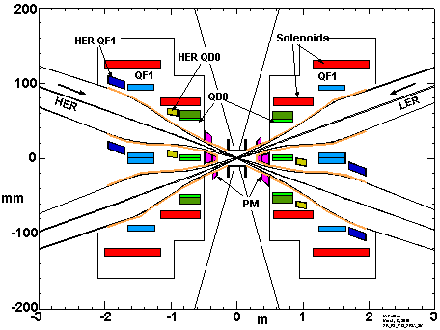
We are developing the magnets of the IR on the basis of the IR design made by M.Sullivan

Slide 3
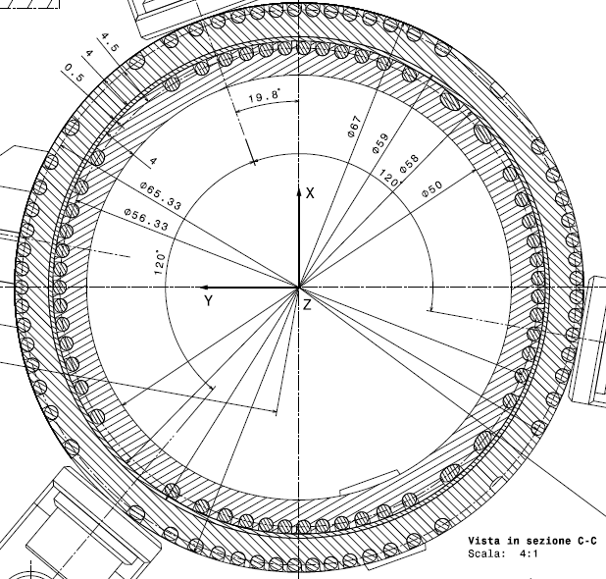
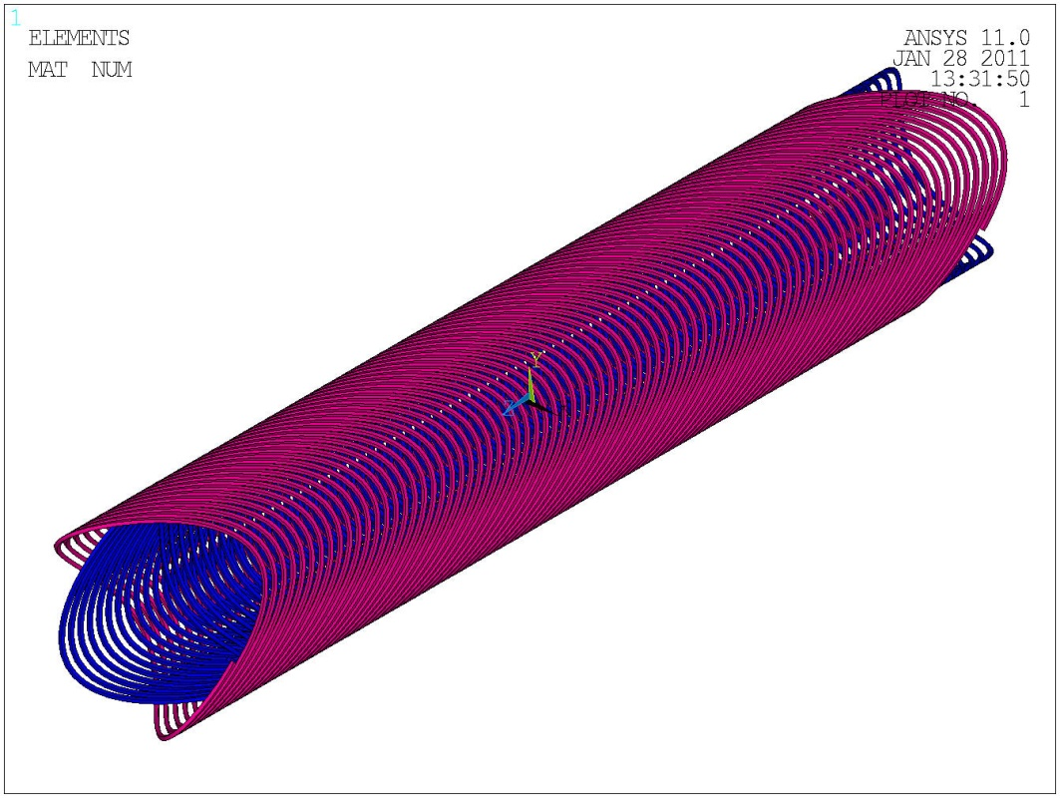
Helical coil technology. Two-layer winding concept.
High Current density→ Potential quench issues (mitigated by quench back effects)

Slide 4
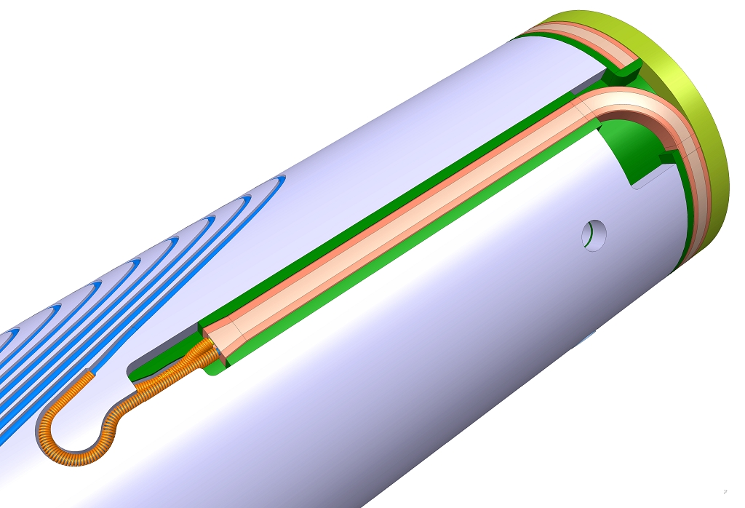
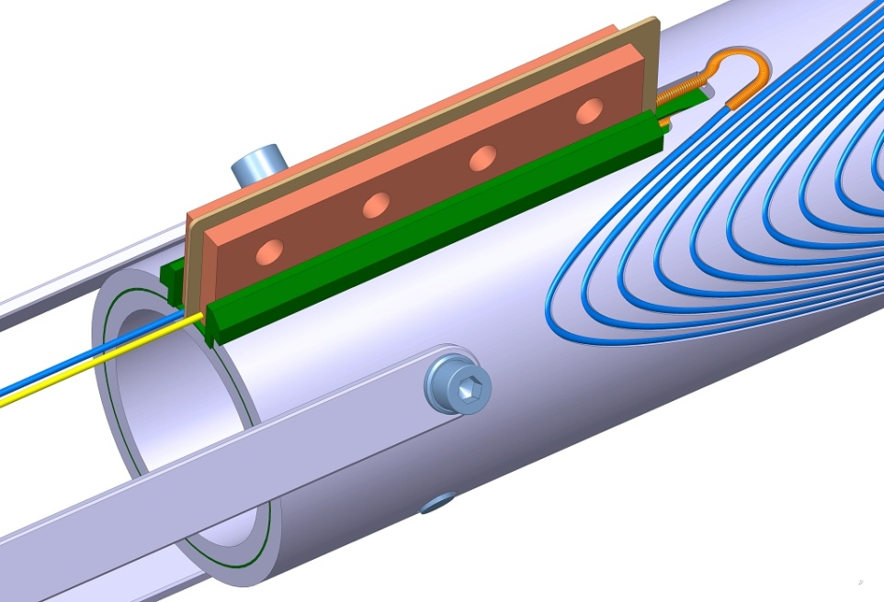
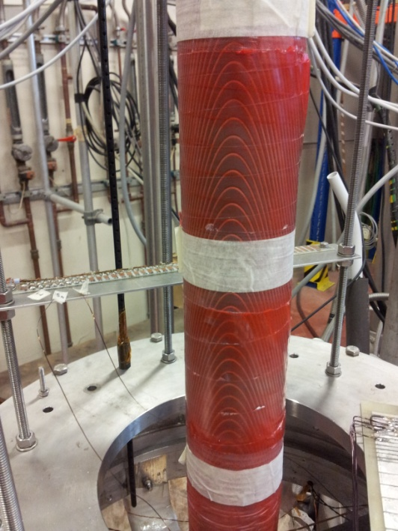
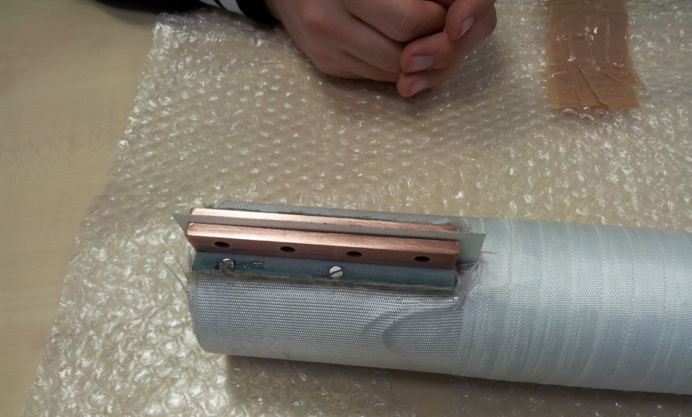
Construction of a model coil for addressing quench issues
The coil has been constructed at ASG Superconductors and now is at INFN Genova for testing at 4.2K. The results of this test are crucial for the design.

Slide 5
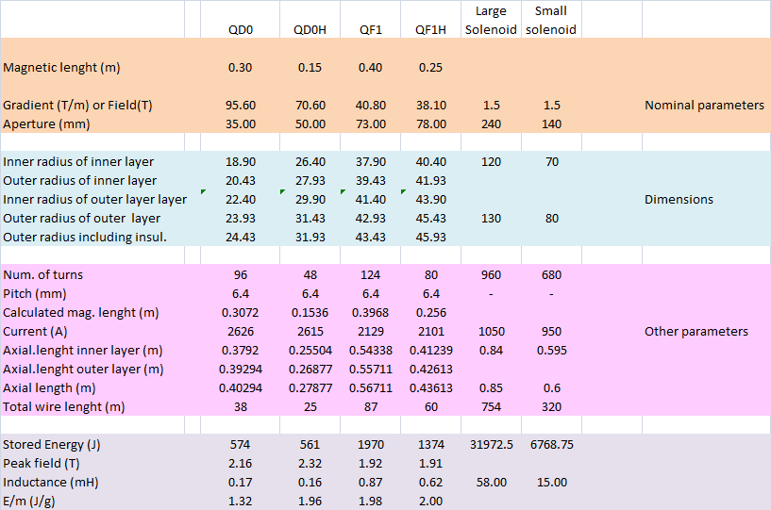
Main characteristics of all magnets/ first version
With such axial lengths we cannot accommodate the magnets in the allowed space!!!!

Slide 6

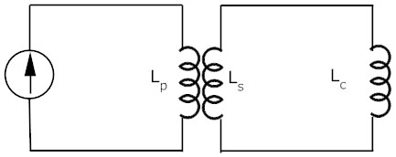
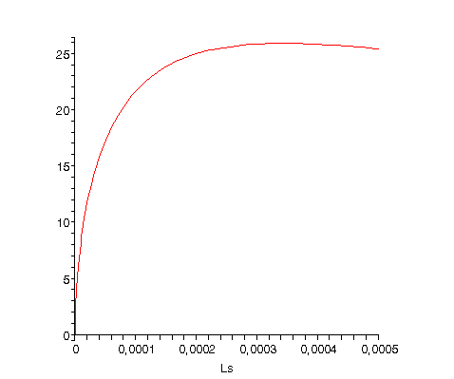
I remind that for limiting quench problems …
…we will use a transformer system for charging the model so to limit the energy which in case of in case of quench can be dissipated as heat (1150 J)
As primary we use a large magnet we have in lab L_{p}=6H ; L_{c}= 340 μH
The ideal current transformer ratio is for Ls=Lc, but the energy would double. Using a reduced secondary inductance L_{s}=90 mH the current transformer ratio is still acceptable. In order to fast dump the current and extract energy from the coil, a heater is placed in the secondary winding.

Slide 7
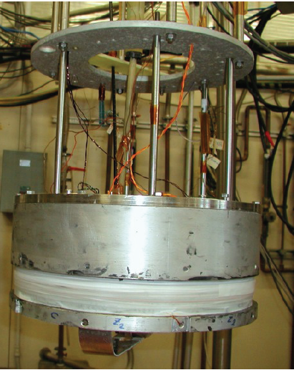
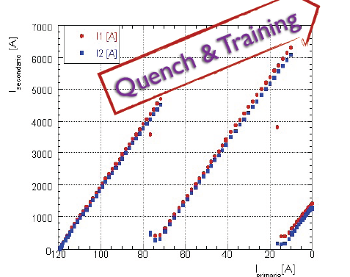
The secondary was built and tested. It is done by a bi-filar wire of the same type involved for the quadrupole. In a single wire current up to 3000 A was induced. After quench the sc conditions were soon restored in the wire.
Very good and promising result!

Slide 8
Moving towards an updated design
The test of the transformer gave indications that higher current could be involved (3000 A) →
We tried a design approach with higher angles and higher current. We also reduced the thickness of each layer down to 2.5 mm (4 mm used for the model). The pitch is the minimum one (turns touch each other at 45º)
The wire is the CMS one with formvar (Φ 1.28 + 0.08= 1.36 mm) or a Nb3Sn wire Φ 1.20 + 0.14= 1.34 mm
R ext II layer
R aver II layer
R ext I layer | R aperture + 2.5 mm
Gap | 0.5 mm
R ext II layer | R aperture + 5.5 mm
Cave hosting wire | 1.4 mm x 1.4 mm
R int II layer
R ext I layer
R aver I layer
R int I layer
R aperture

Slide 9
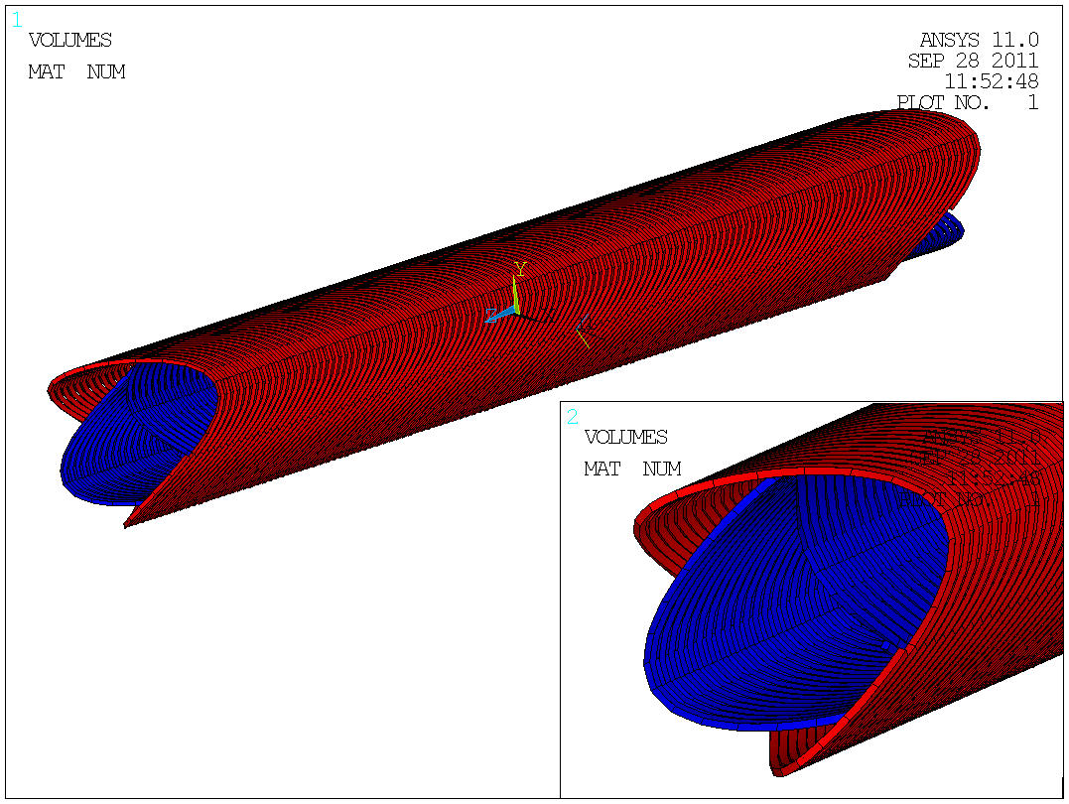

Slide 10
 | QD0 May version | QD0 (updated)
Inner bore radius (mm) | 17.50 | 17.50
Inner radius of inner layer (mm) | 18.90 | 18.64
Outer radius of inner layer (mm) | 20.43 | 20.00
Inner radius of outer layer (mm) | 22.40 | 21.64
Outer radius of outer layer (mm) | 23.93 | 23.00
Angle of turns (degree) | 27 | 55
Turns | 96 | 120
Axial physical length (mm) | 403. | 350.00
Current (A) – Gradient (T/m) | 2626 – 95.60 | 2812 – 95.60

Slide 11
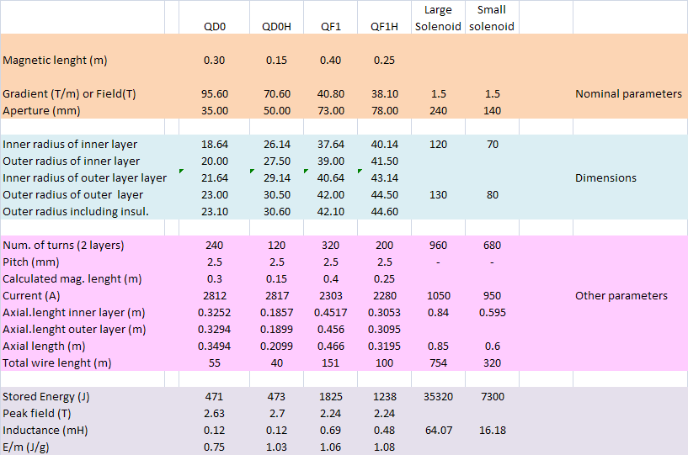
Main characteristics of all magnets/ revised version

Slide 12
Margins (QF1) with NbTi technology
At T=4.2K the margin on the current is 80% ←→ ΔT =0.7K (Too low)
At T=1.9 K the margin on current is 52% ←→ ΔT =3 K

Slide 13
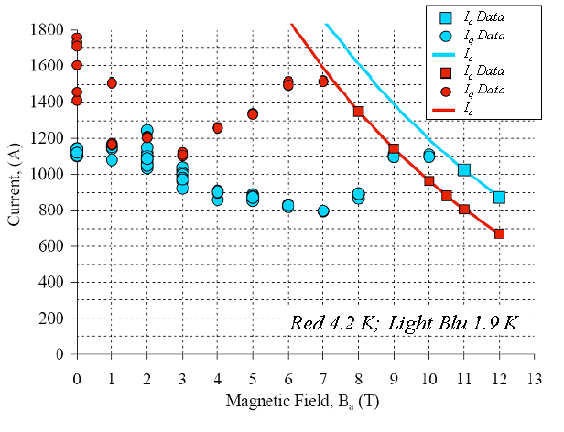
Margins (QF1) with Nb₃Sn technology
Involving Nb3Sn (much more difficult technology) we could operate with a larger margin, but limitations can arise due to thermo-magnetic instabilities at low fields.
It would be better operating at higher temperature (Supercritical helium) or using a wire 1.2 mm diameter but lower Ic

Slide 14
The new coil axial dimensions allows to accommodate them into the cryostat, provided that:
1) The cold bore of the coils coincides with the inner cold bore of the cryostats and it is made of Al alloy
2) The position of the coil is acceptable
The present cryostat has 370 mm OD. The suspension system not yet studied. I remind here that we shall design it to hold high axial forces (4 t)

Slide 16
Region at border QD0 – QD0H

Slide 17
Next Steps of model development and coil design
Test of the coil model Dec 11/Jan 12
Construction of a NbTi prototype of QD0 Funded April 2012
Construction of a Nb3Sn prototype of QD0. Not funded (only wire) July 2012
Cryogenic test of the prototypes | Sept. 2012
Finalize coil magnetic design | Oct. 2012
6) Cryostat preliminary design | Oct. 2012
7) Cryogenic plant design | Dec. 2012
The superconducting wire
Activities in blue to be done in a wider frame (Task 12 of Work Packages) also involving other INFN sections (LNL, ..)

Slide 18
Thank you for the attention and let’s hope for a nice Christmas present

