Slide 1
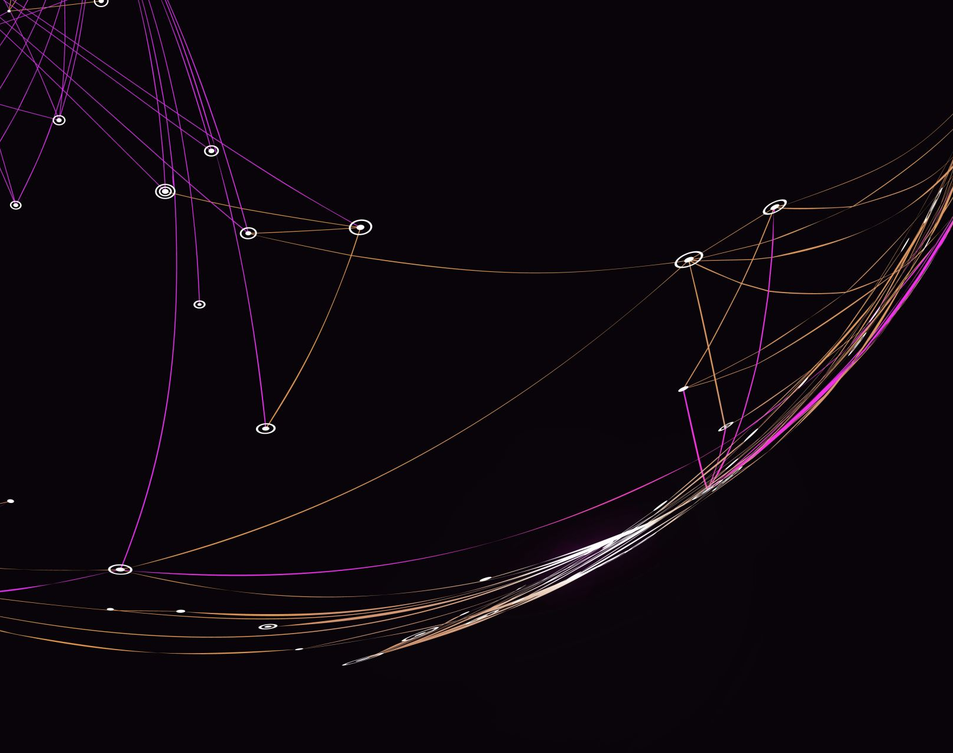


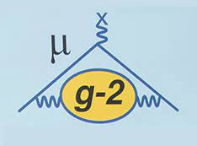
The muon (g-2) experimental measurement
MARIN KARUZA
University of Rijeka and INFN Sezione di Trieste

Slide 2

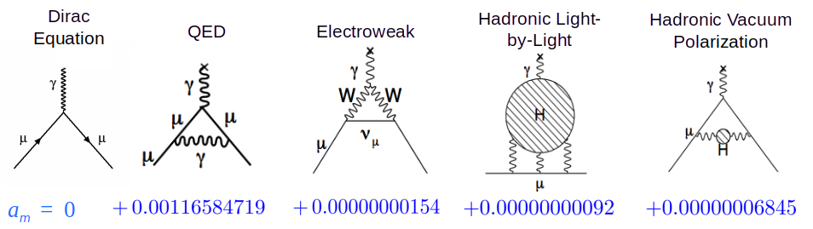

What is it all about?
Information about vacuum properties
Marin Karuza, University of Rijeka and INFN Trieste WIFAI 2024 Bologna, 13.11.2024.

Slide 3

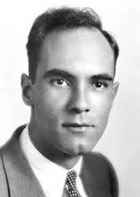
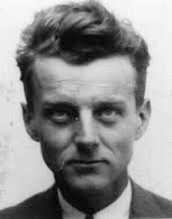
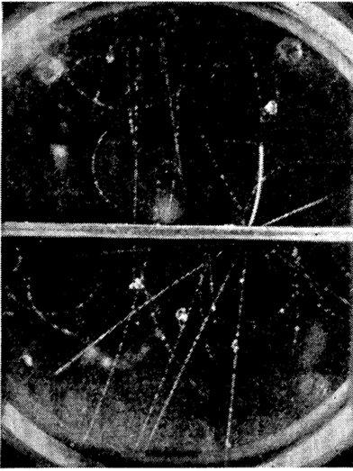


Muon
Discovered 1936
Carl Anderson
Seth Neddermeyer
Long lived
"Goldilocks mass"
Atop Pike’s Peak at 14,000 ft Observing Cosmic Rays
Marin Karuza, University of Rijeka and INFN Trieste WIFAI 2024 Bologna, 13.11.2024.

Slide 4
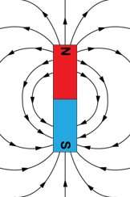
Magnetic dipole moment
Bar magnet, current loop ...
Charged particle (electron, muon, ...)
Marin Karuza, University of Rijeka and INFN Trieste WIFAI 2024 Bologna, 13.11.2024.

Slide 5
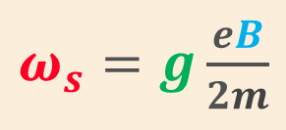
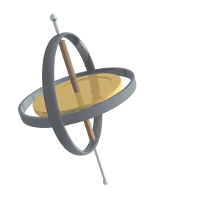
Spin precession (in a magnetic field)
B
Quantum mechanics (Dirac) g = 2
1948 Foley & Kusch measure g_{e} > 2 (electron) ?
g_{e} = 2.00238
Marin Karuza, University of Rijeka and INFN Trieste WIFAI 2024 Bologna, 13.11.2024.

Slide 6
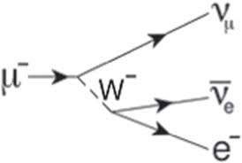
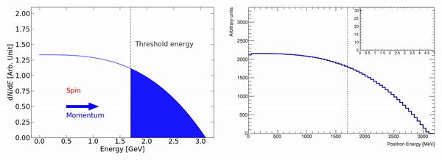
In a magnetic field
Marin Karuza, University of Rijeka and INFN Trieste WIFAI 2024 Bologna, 13.11.2024.

Slide 7
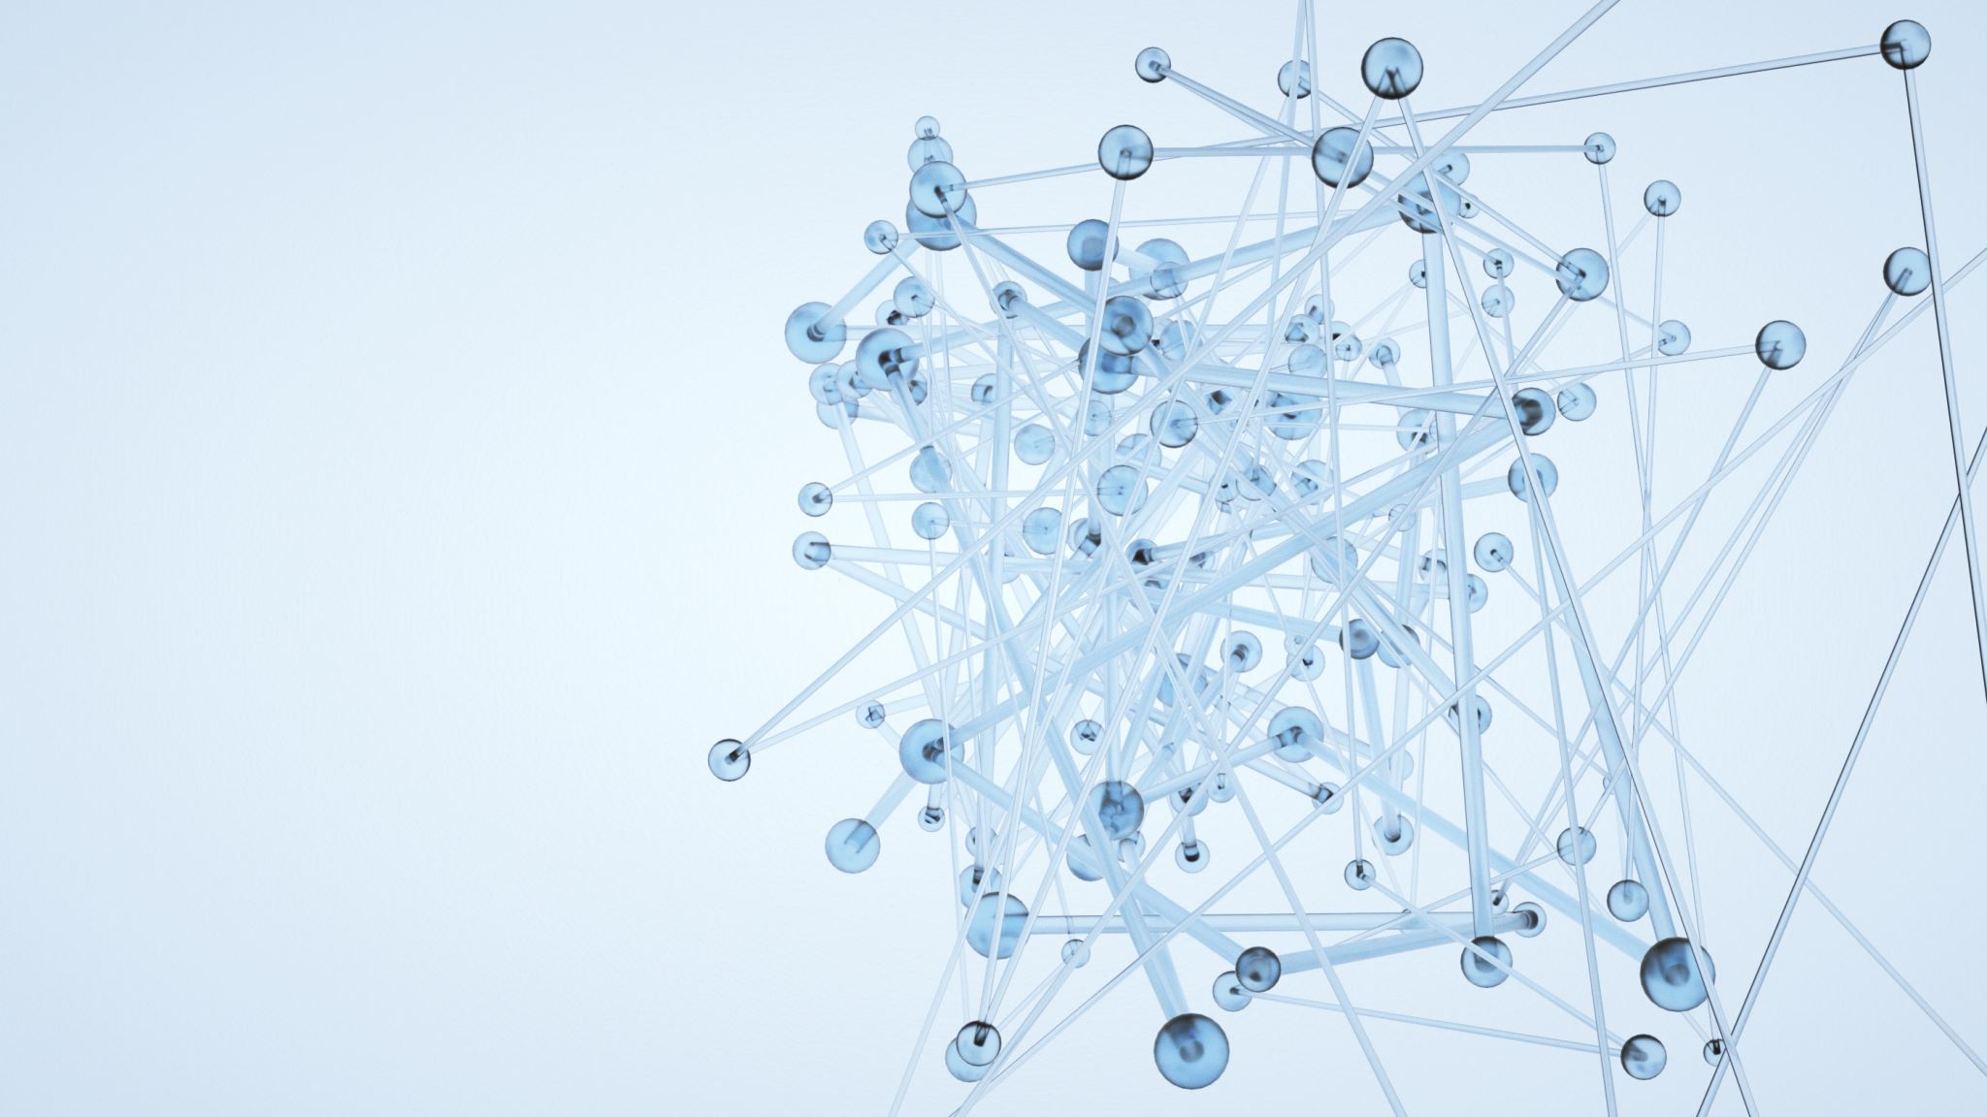
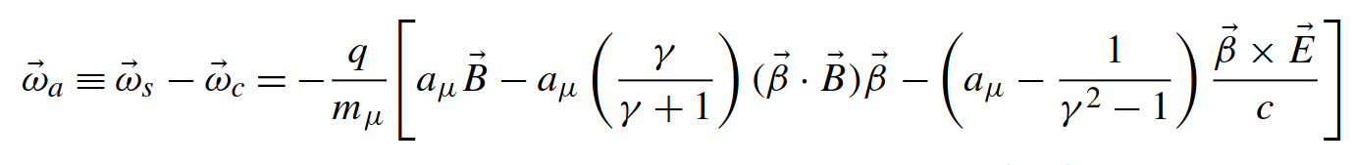
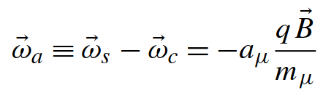
What do we measure?
μ⁺
μ⁺
μ⁺
At "magic" momentum
B
μ⁺
μ⁺
μ⁺
μ⁺
μ⁺
Marin Karuza, University of Rijeka and INFN Trieste WIFAI 2024 Bologna, 13.11.2024.

Slide 8
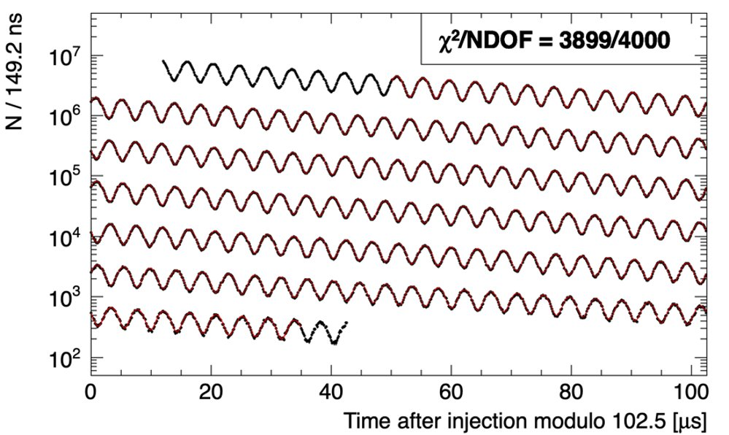
Number of decay positrons
Marin Karuza, University of Rijeka and INFN Trieste WIFAI 2024 Bologna, 13.11.2024.

Slide 9
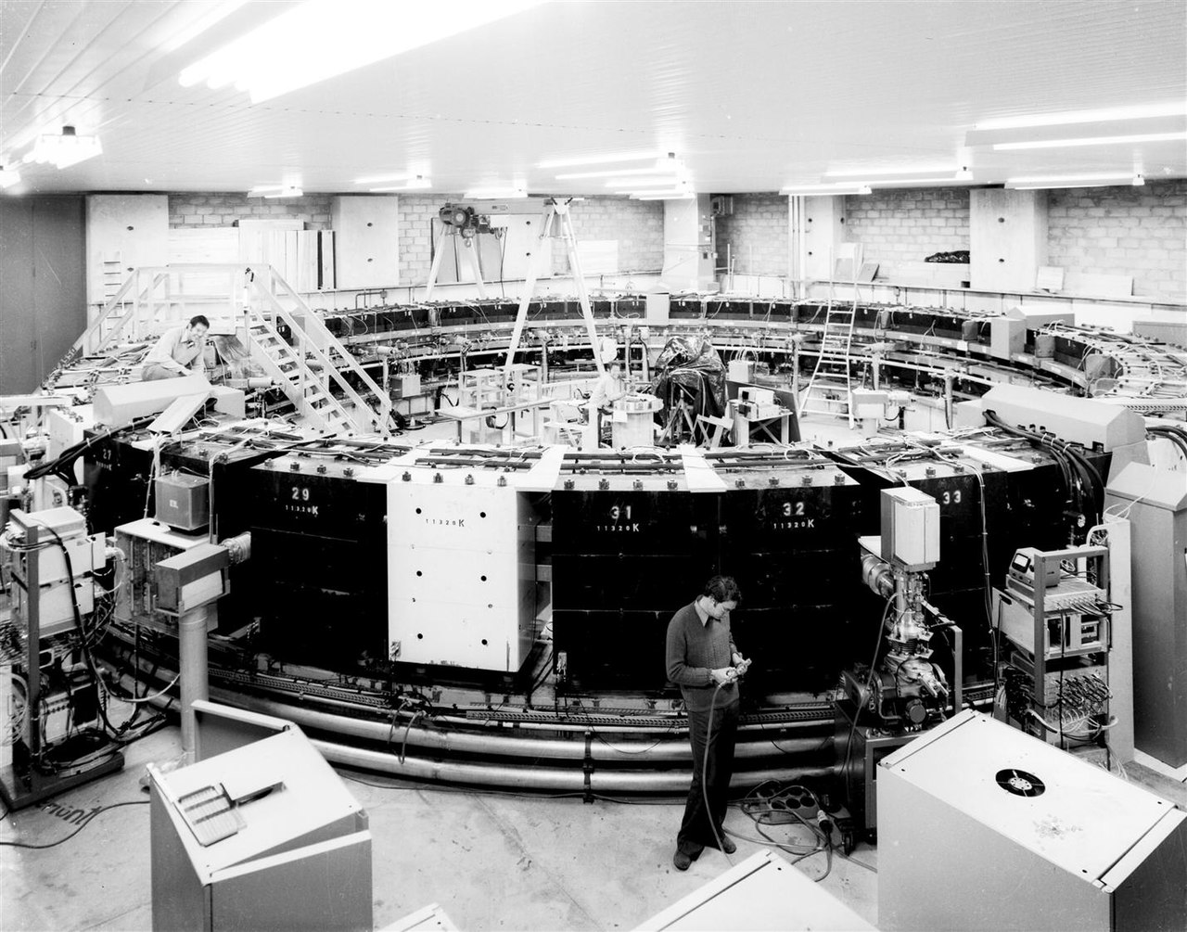
CERN
1960
Confirmation of QED
Precision 1%
By CERN - https://cds.cern.ch/record/41876, CC BY 4.0, https://commons.wikimedia.org/w/index.php?curid=70982470
Marin Karuza, University of Rijeka and INFN Trieste WIFAI 2024 Bologna, 13.11.2024.

Slide 10
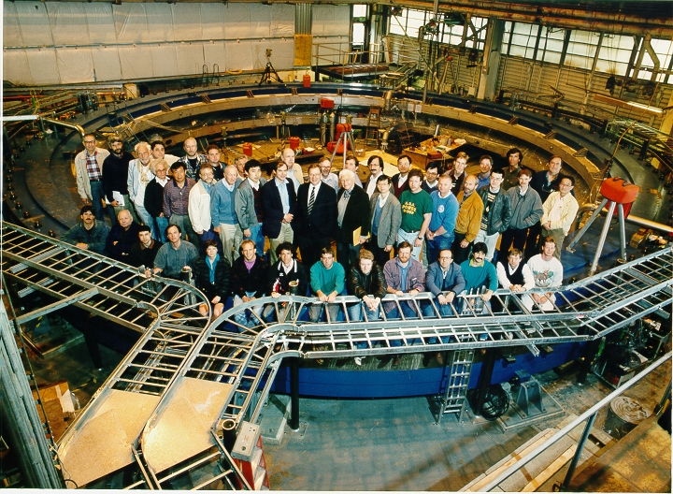
BNL E821
1990
Precision 1 ppm
Is there a problem with the SM?
Marin Karuza, University of Rijeka and INFN Trieste WIFAI 2024 Bologna, 13.11.2024.

Slide 11
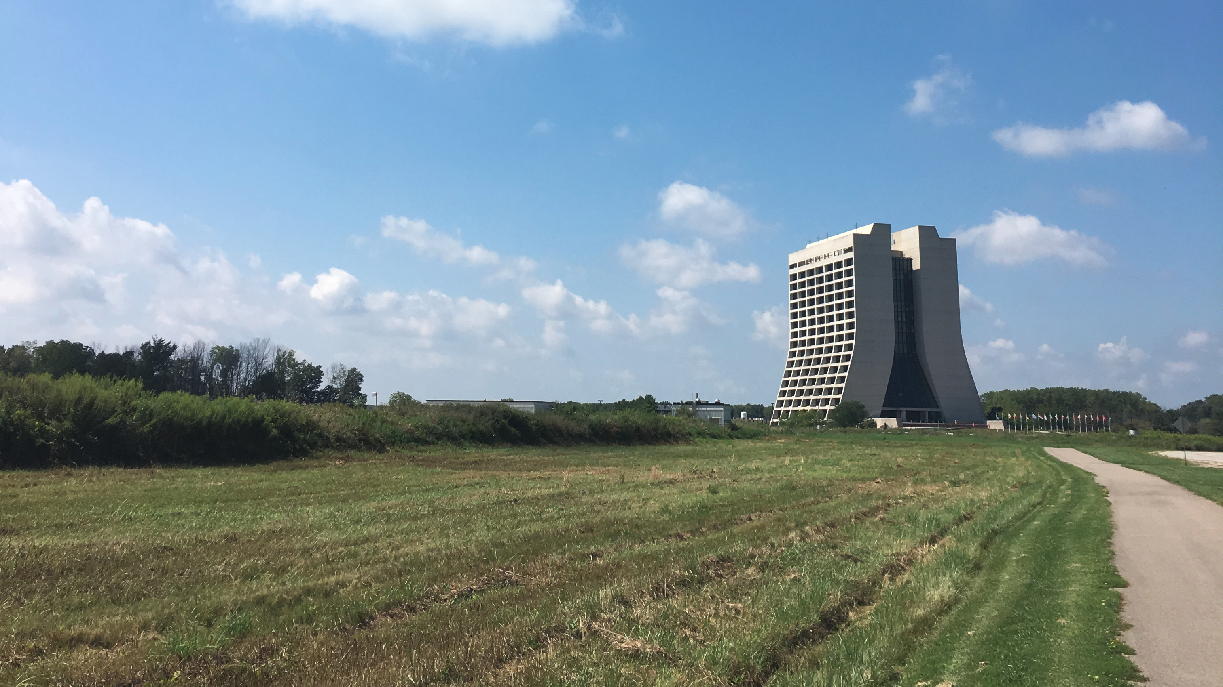



E989
MUON g-2 experiment
Marin Karuza, University of Rijeka and INFN Trieste WIFAI 2024 Bologna, 13.11.2024.

Slide 12
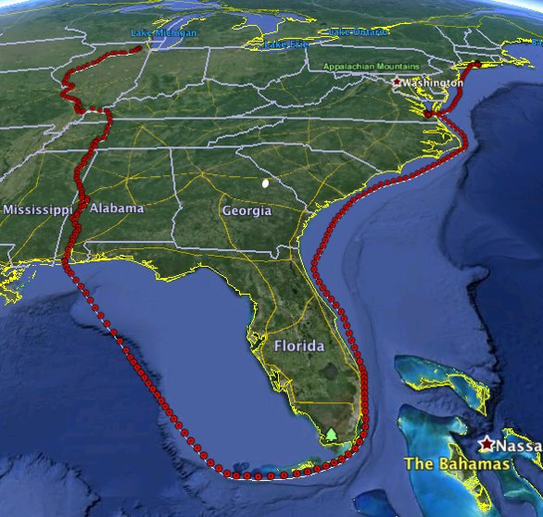



The voyage
Marin Karuza, University of Rijeka and INFN Trieste WIFAI 2024 Bologna, 13.11.2024.

Slide 13
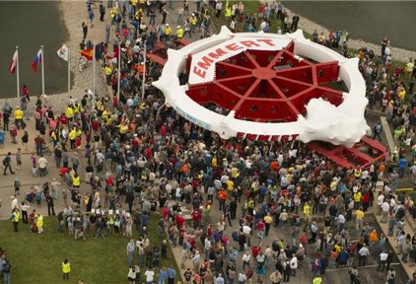
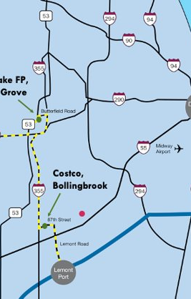

Arrival
Marin Karuza, University of Rijeka and INFN Trieste WIFAI 2024 Bologna, 13.11.2024.

Slide 14
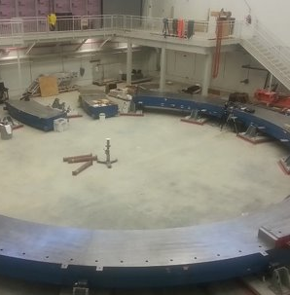
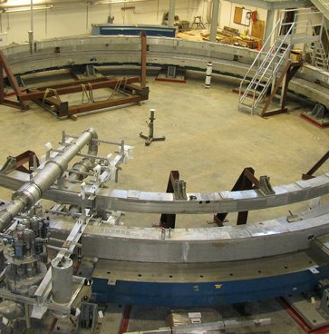
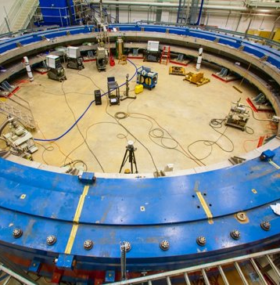
Reassembly
Superconducting ring travelled in one piece
Marin Karuza, University of Rijeka and INFN Trieste WIFAI 2024 Bologna, 13.11.2024.

Slide 15
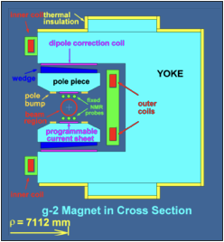
- G-2 experiment Lambertson Magnet
Environmental
2’9” heavily-reinforced floor installed on 12’ deep excavation of undisturbed soil
Temperature control to +/- 1C
Construction tolerances
26 ton pieces of yoke steel (30 of them) placed to 125 micron tolerance
Pole pieces aligned to 25 micron
Marin Karuza, University of Rijeka and INFN Trieste WIFAI 2024 Bologna, 13.11.2024.

Slide 16
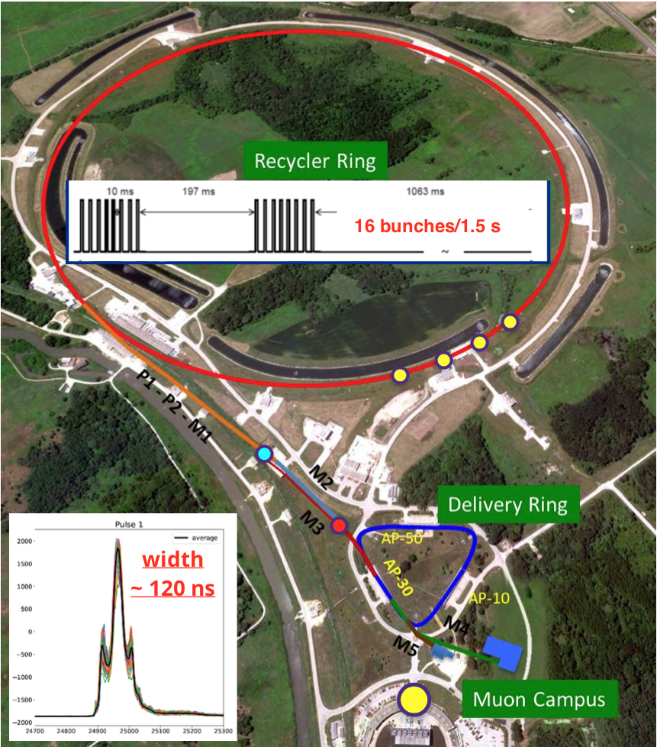
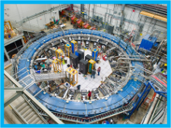
Muon g-2 experiment
16 bunches/1.4 sec
Pion Production Target
Marin Karuza, University of Rijeka and INFN Trieste WIFAI 2024 Bologna, 13.11.2024.

Slide 17
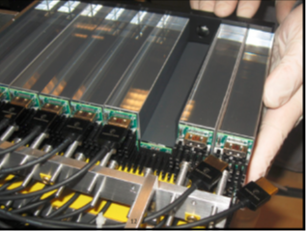
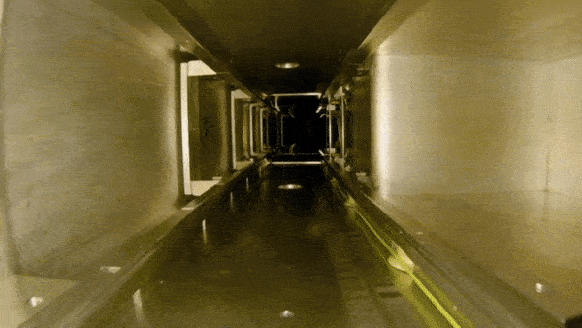
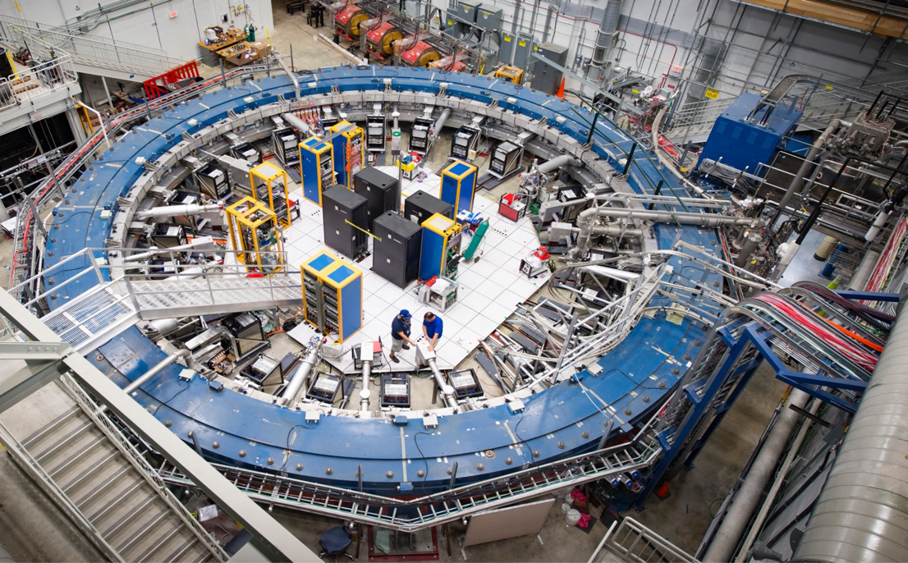
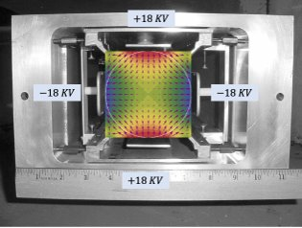
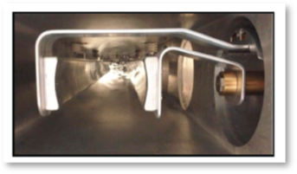
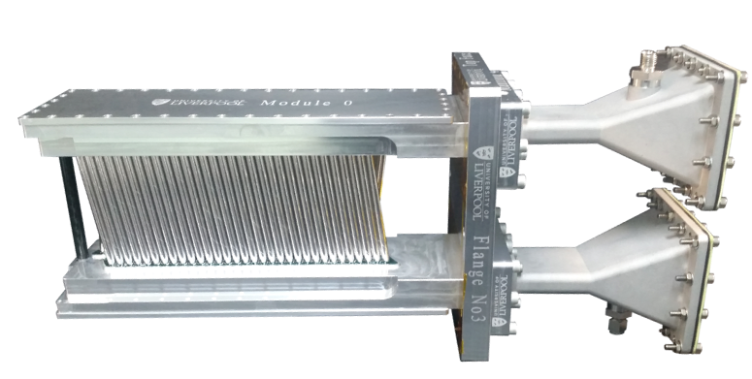
Experiment
Marin Karuza, University of Rijeka and INFN Trieste WIFAI 2024 Bologna, 13.11.2024.

Slide 18
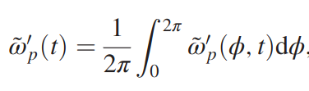
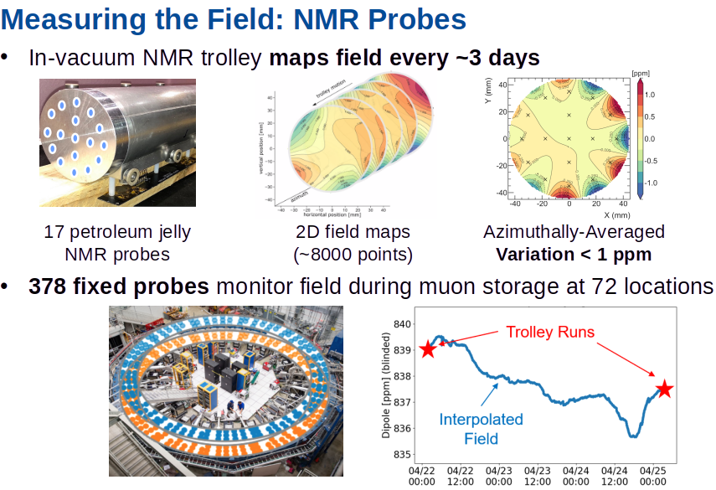
Marin Karuza, University of Rijeka and INFN Trieste WIFAI 2024 Bologna, 13.11.2024.

Slide 19
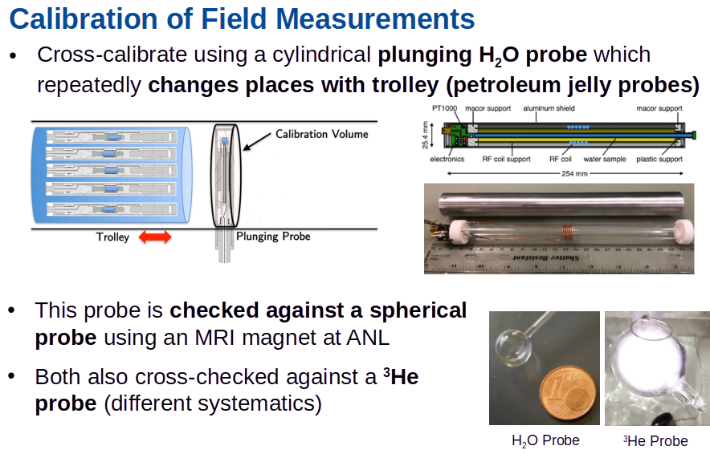
Marin Karuza, University of Rijeka and INFN Trieste WIFAI 2024 Bologna, 13.11.2024.

Slide 20
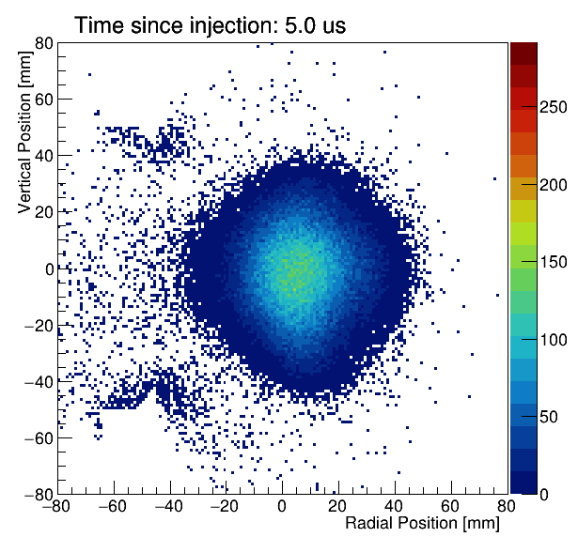
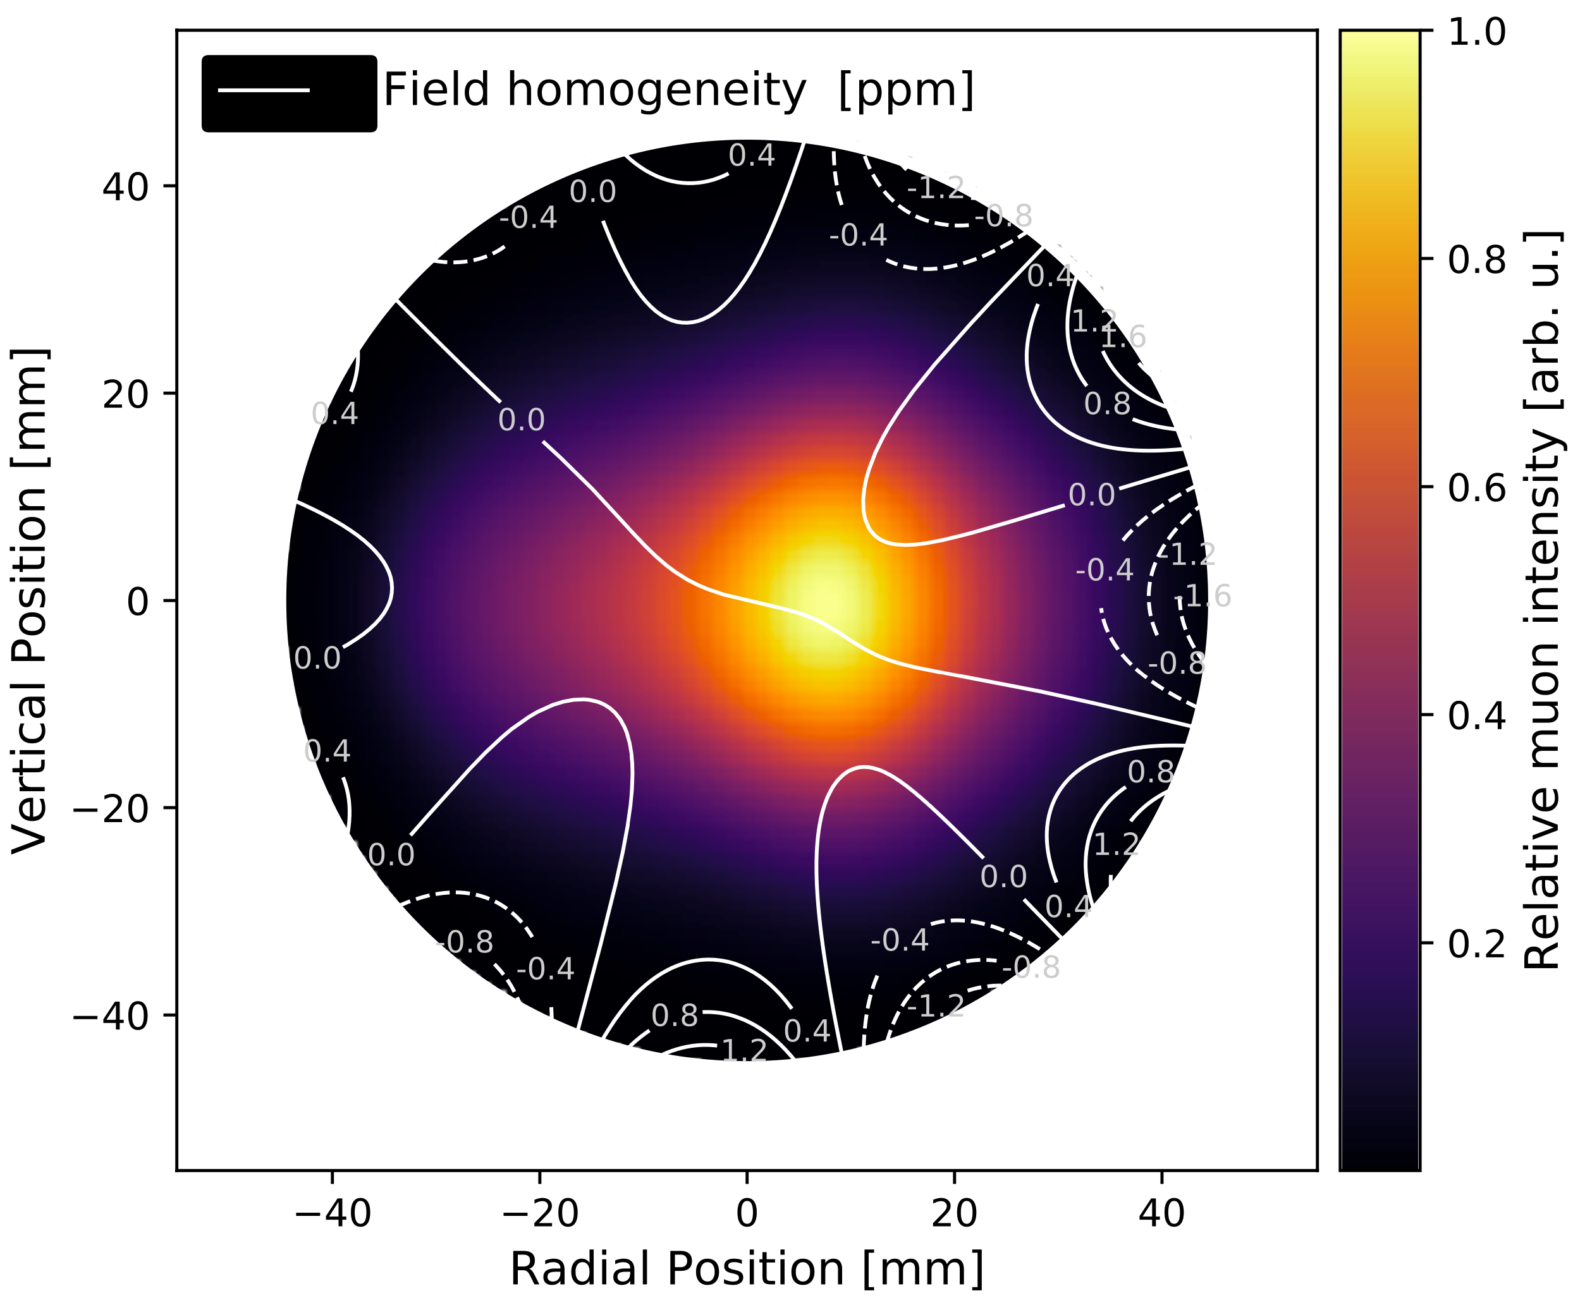
Beam (from trackers)
and field
Marin Karuza, University of Rijeka and INFN Trieste WIFAI 2024 Bologna, 13.11.2024.

Slide 21
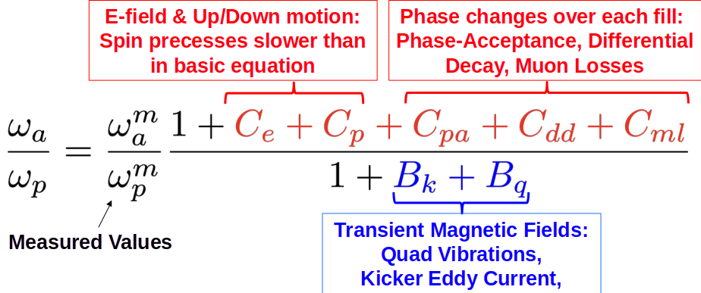
Life is complicated
Total correction is 622 ppb, dominated by E-field & Pitch
Marin Karuza, University of Rijeka and INFN Trieste WIFAI 2024 Bologna, 13.11.2024.

Slide 22
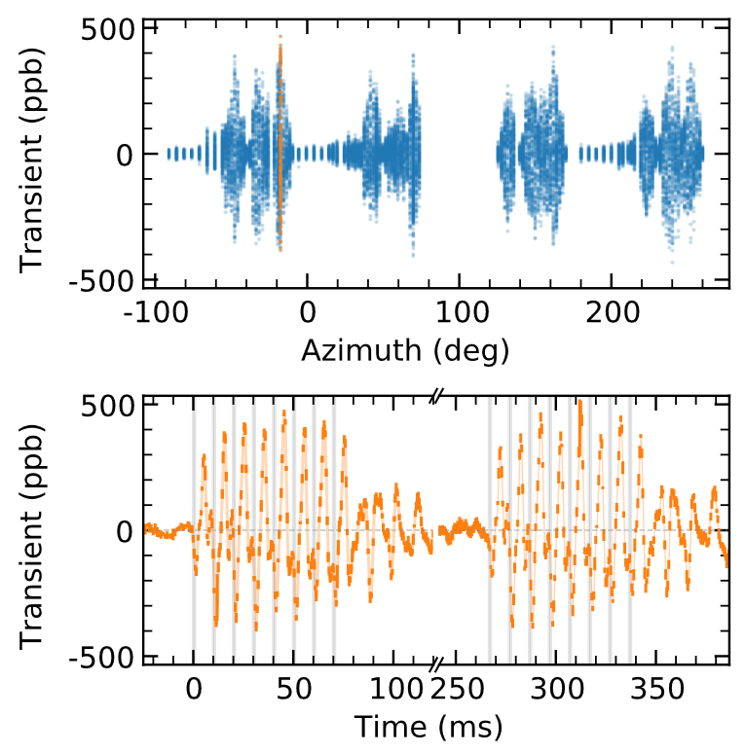
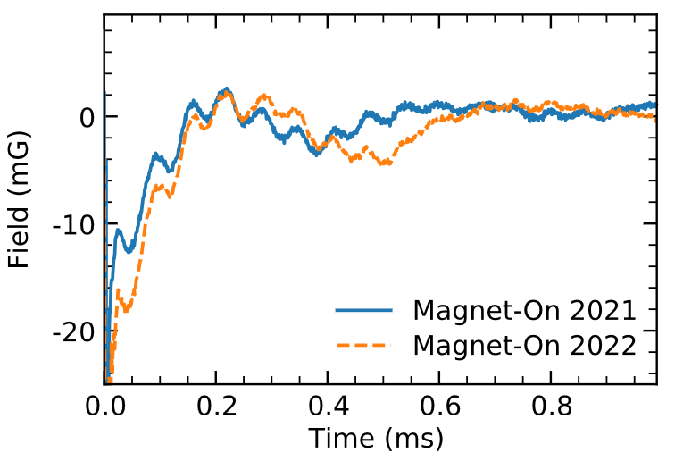
Corrections example
Marin Karuza, University of Rijeka and INFN Trieste WIFAI 2024 Bologna, 13.11.2024.

Slide 23
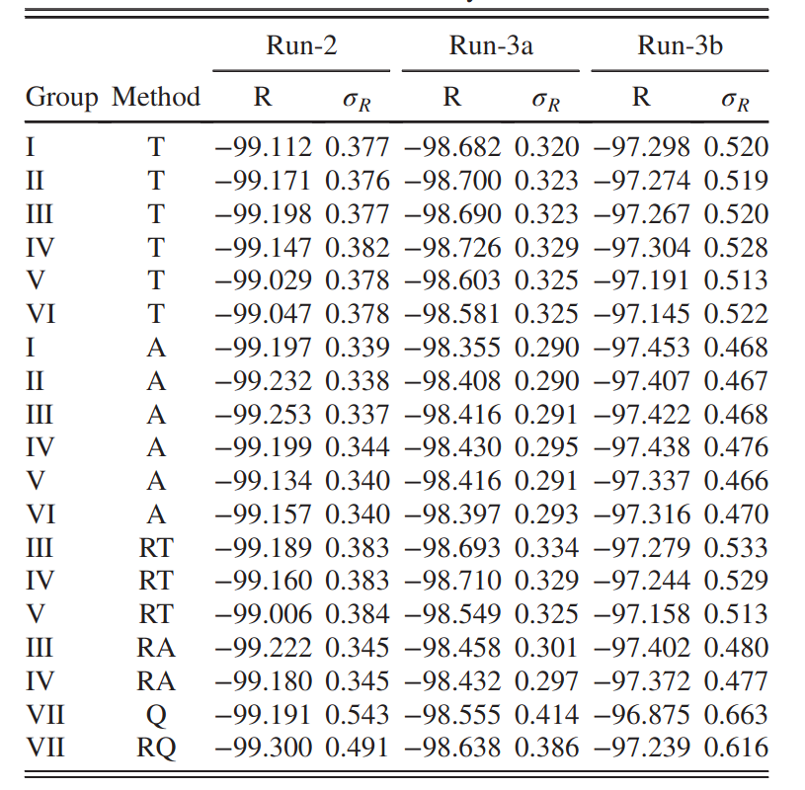
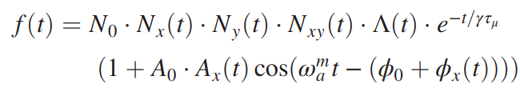
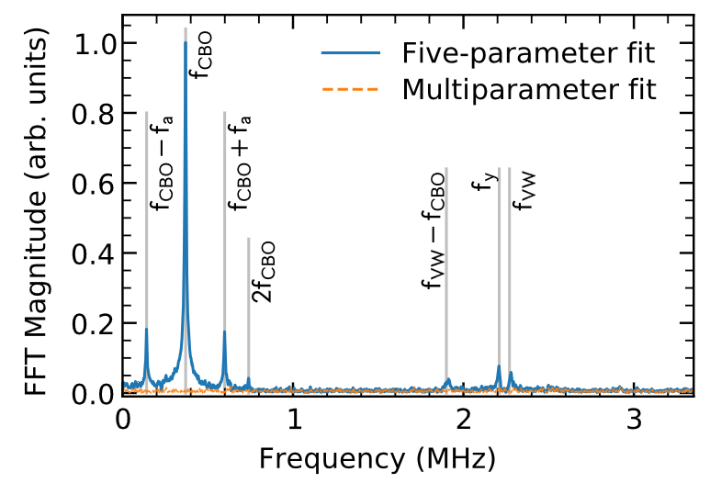
Analysis
Marin Karuza, University of Rijeka and INFN Trieste WIFAI 2024 Bologna, 13.11.2024.

Slide 24
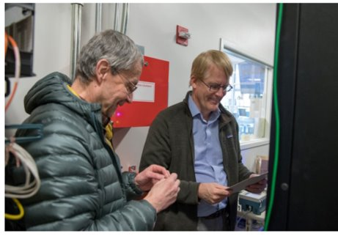
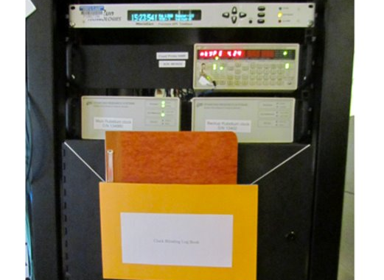
Blind analysis
Marin Karuza, University of Rijeka and INFN Trieste WIFAI 2024 Bologna, 13.11.2024.

Slide 25
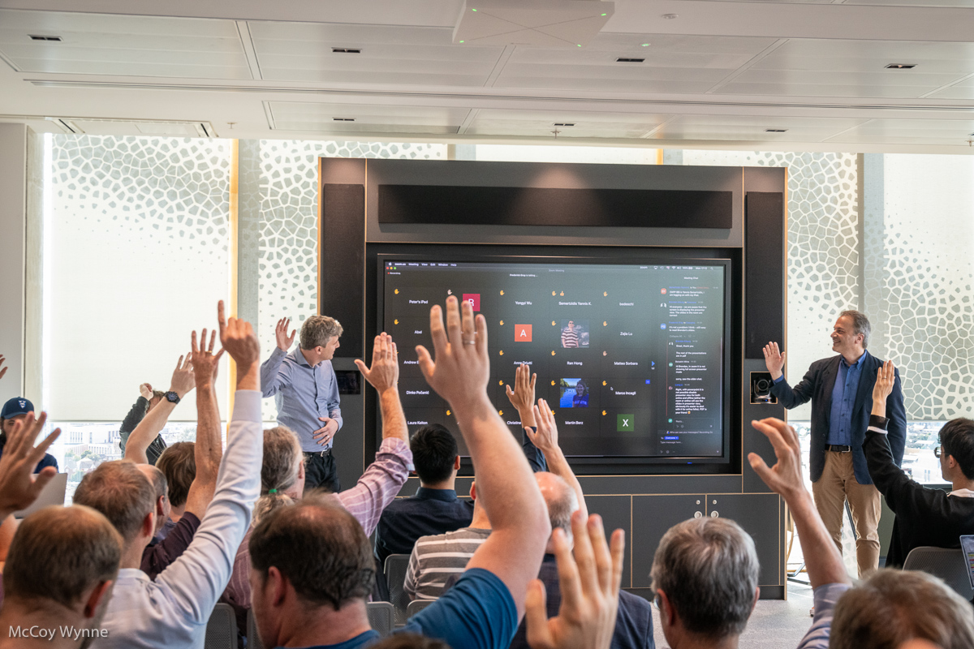
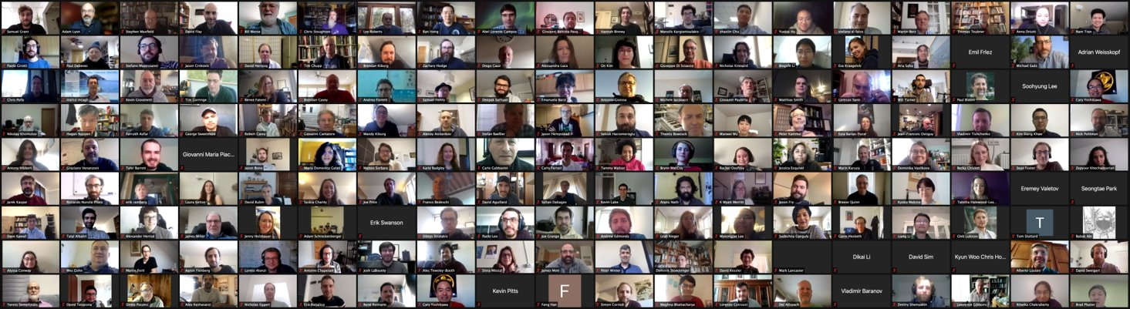
Unblinding
Marin Karuza, University of Rijeka and INFN Trieste WIFAI 2024 Bologna, 13.11.2024.

Slide 26
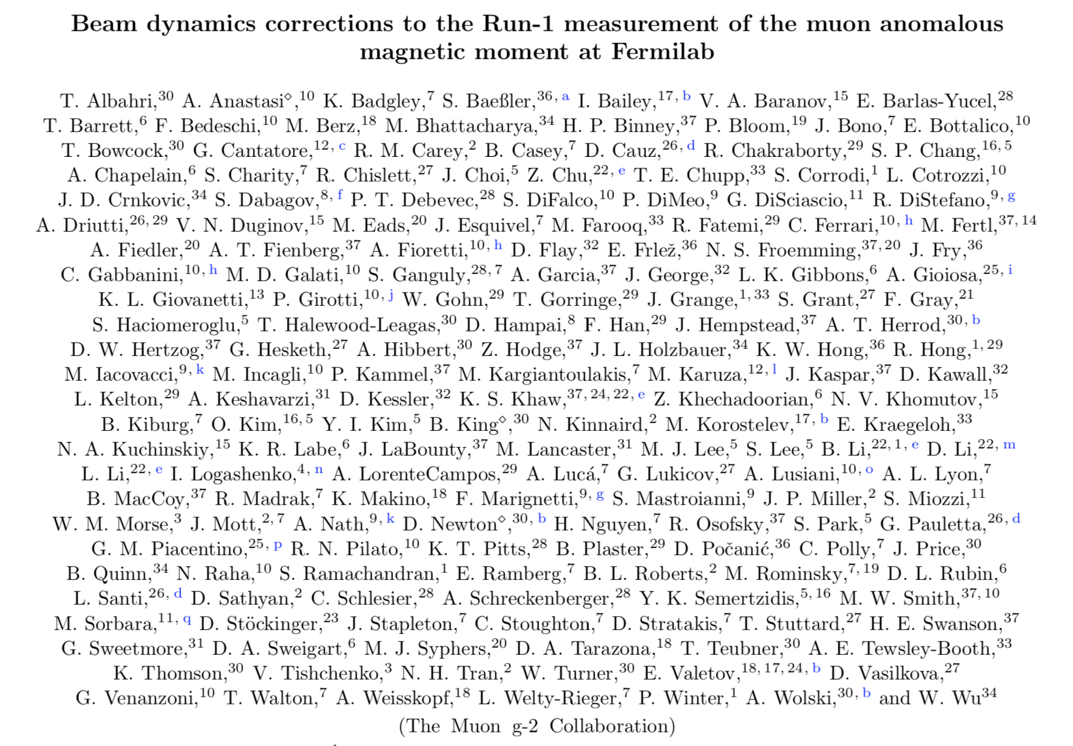
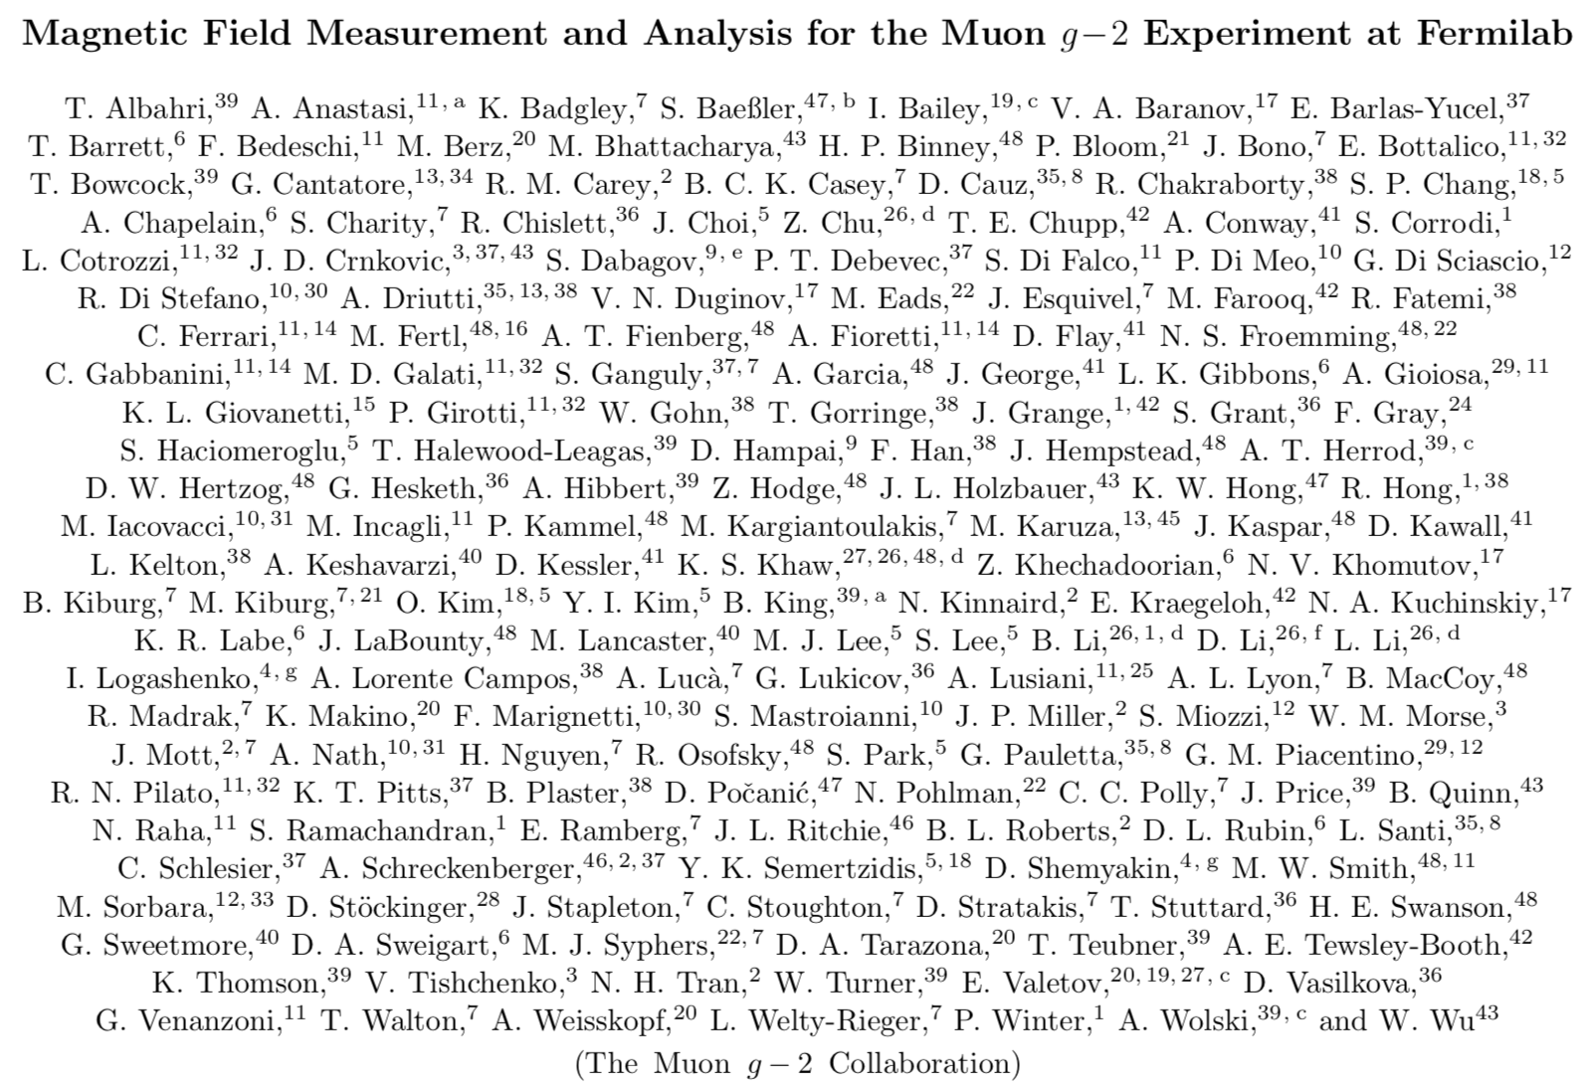



Result – Run 1
One BNL data
Marin Karuza, University of Rijeka and INFN Trieste WIFAI 2024 Bologna, 13.11.2024.

Slide 27










2021 – first result
Marin Karuza, University of Rijeka and INFN Trieste WIFAI 2024 Bologna, 13.11.2024.

Slide 28


Result Run 1-3
Error dominated by statistics
Dataset 1-3, 6 x BNL
Marin Karuza, University of Rijeka and INFN Trieste WIFAI 2024 Bologna, 13.11.2024.

Slide 29

Improvements in all categories
Marin Karuza, University of Rijeka and INFN Trieste WIFAI 2024 Bologna, 13.11.2024.

Slide 30


Improvements
Marin Karuza, University of Rijeka and INFN Trieste WIFAI 2024 Bologna, 13.11.2024.

Slide 31
Improvements over BNL
Marin Karuza, University of Rijeka and INFN Trieste WIFAI 2024 Bologna, 13.11.2024.

Slide 32




Calibration system
Diffuser boxes

Slide 33

Realty check vs TDR
Marin Karuza, University of Rijeka and INFN Trieste WIFAI 2024 Bologna, 13.11.2024.

Slide 34

Comparison with theory
Lattice QCD
CMD – 3, data driven approach
"High precision calculation of the hadronic vacuum polarisation contribution to the muon anomaly"
https://arxiv.org/pdf/2407.10913
Marin Karuza, University of Rijeka and INFN Trieste WIFAI 2024 Bologna, 13.11.2024.

Slide 35


The end?
Conclusion
Experimental results in excellent agreement
Smashed our design goal with systematic uncertainty of 70 ppb.
Theoretical efforts closing the window on new physics

Slide 36


No!
More data to analyze
Run 4/5/6
MUonE
Space-like measurement of HVP
JPARC
Low energy muons
No electric field
Marin Karuza, University of Rijeka and INFN Trieste WIFAI 2024 Bologna, 13.11.2024.

