Slide 1
Theoretical review of light meson spectroscopy
Alessandro Pilloni
WIFAI 2024, November 13th, 2024

Slide 2
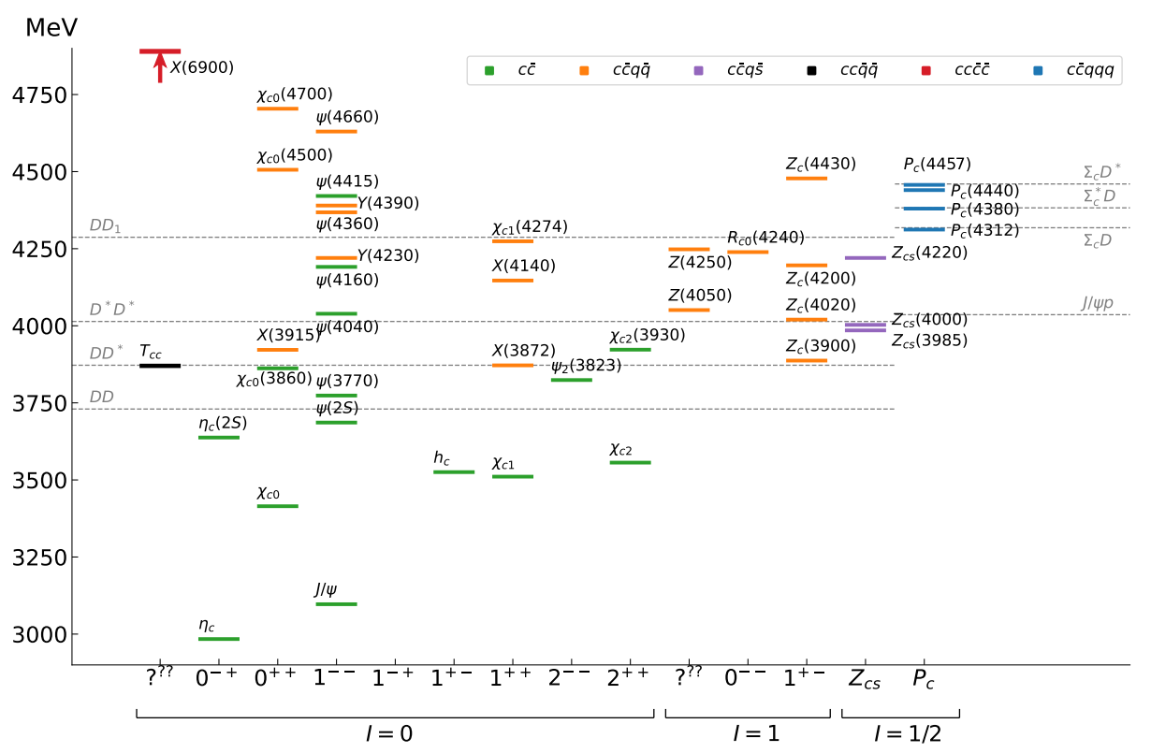
The richness of hadron spectrum
The structures populating hadron reactions are extremely rich
Ultimate goal is to understand them in term of QCD degrees of freedom
To do so, the spectrum of resonances must be correctly reconstructed
JPAC, PPNP 127 (2022), 103981
The quark model is still the simplest tool to organize the spectrum
«Exotic hadrons» are Beyond the Standard (quark) Model
Organizing them teaches us some more about quark-gluon interactions
A. Pilloni – Theoretical review of light meson spectroscopy
Notes:
2 slides su Zc, a Bes e a Belle
2 slide su tetraquark model: dall’hamiltoniana di Jaffe al calcolo delle masse
1 slide su molecular models, dove sono i carichi? (non in Tornqvist, si in Hanhart, vedere Braaten, citare Nefediev)
2 slides su decay channels, dove si dovrebbe vedere, e a seconda del modello, vedere qualche plot
1 slide su Y(4260), tetraquark? C’è lo strano (si vede la f0)
1 slide su Zc a cleo (anche il neutro)

Slide 3
Potential problems
We can’t afford being misguided by simplistic resonance extraction! This is true in particular in the light sector, where states are broader
Amplitude analysis requires collaboration of theorists and experimentalists
However, we don’t have a universal recipe to do things right
We have to proceed:
Case-by-case
Keep in mind the limitations of each approach
Overstudy (the more approaches the better)
No overstatement (do-no-harm)
A. Pilloni – Theoretical review of light meson spectroscopy

Slide 4
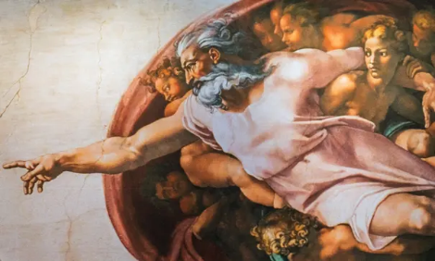
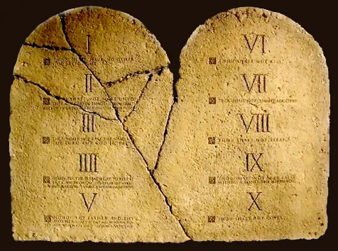
Top-down approach
You are given a model/theory
$$f(s)$$
You calculate the amplitude
You compare with data. Or you don’t.
Predictive power ✓
Physical interpretation ✓ (within the model! ✗) Biased by the input ✗
A. Pilloni – Theoretical review of light meson spectroscopy

Slide 5
Models for every taste
Compact
Hybrids and glueballs
Containing gluonic degrees of freedom
Multiquark
Several (cluster) of valence quarks
Hadroquarkonium
Heavy core interacting with a light cloud via Van der Waals forces
$$π$$
$$π$$
$$J/ψ$$
$$π$$
Rescattering effects
Structures generated by cross-channel rescattering, very process-dependent
Molecule
Bound or virtual state generated by long-range exchange forces
Extended
A. Pilloni – Theoretical review of light meson spectroscopy

Slide 6
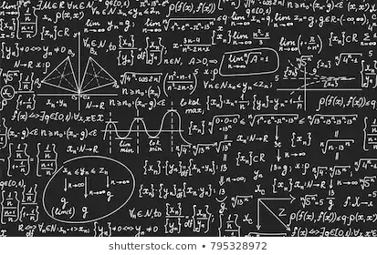
Bottom-up approach
Less predictive power ✗
Some physical interpretation ✗ Minimally biased ✓
You extract physics
You choose a set of generic amplitudes
You start with data
A. Pilloni – Theoretical review of light meson spectroscopy

Slide 7
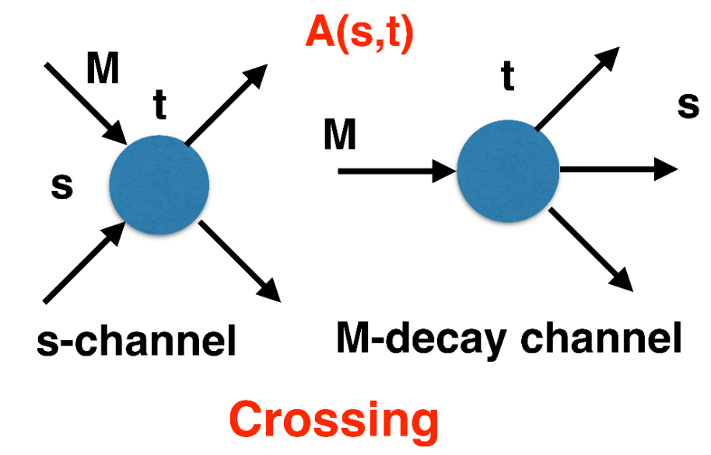
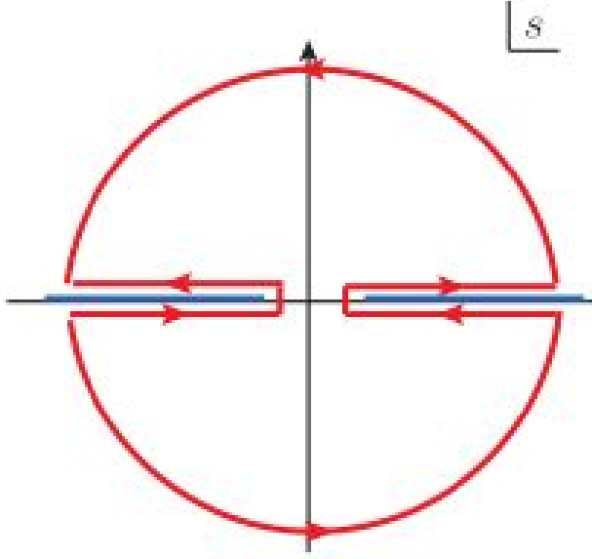
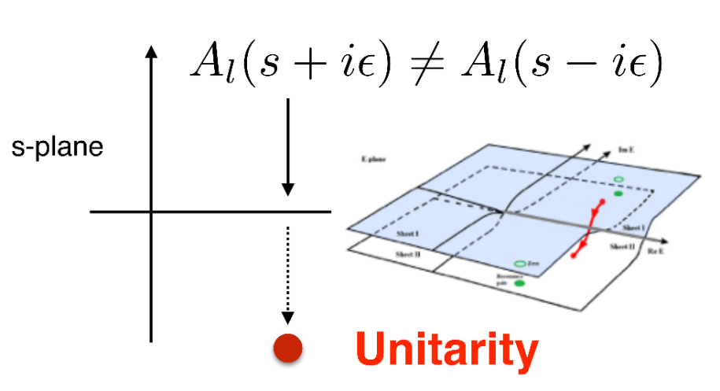
$S$-Matrix principles
$$t_{l}\left(s\right)=\lim_{ε→0}t_{l}(s+iε)⁡$$
Analyticity
$$\text{Im} t_{l}=ρ_{l}{\left|t_{l}\right|}^{2} ⁡$$
These are constraints the amplitudes have to satisfy, but do not fix the dynamics
They can be imposed with an increasing amount of rigor, to extract robust physics information
The «background» phenomena can be effectively parameterized in a controlled way
+ Lorentz, discrete & global symmetries
A. Pilloni – Theoretical review of light meson spectroscopy
Notes:
Controlla la parte su Regge

Slide 8
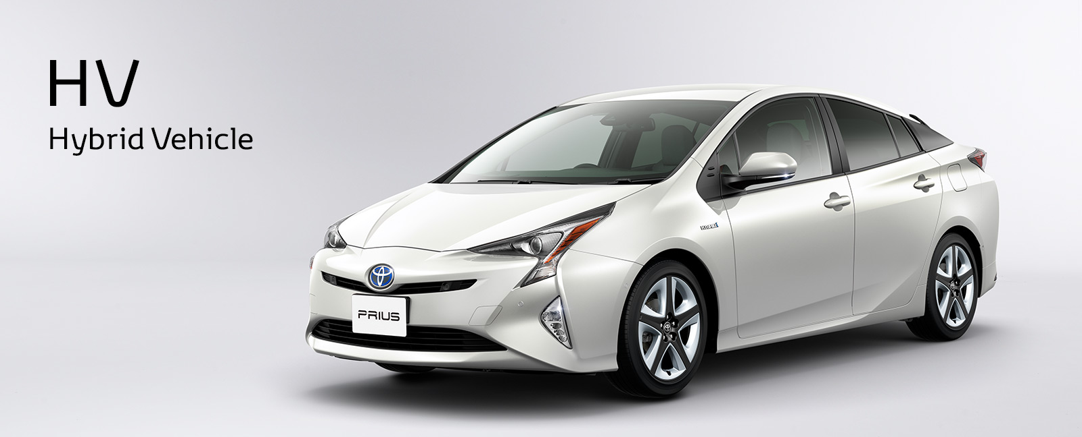
The hybrid $π_{1}$
A. Pilloni – Theoretical review of light meson spectroscopy
Notes:
2 slides su Zc, a Bes e a Belle
2 slide su tetraquark model: dall’hamiltoniana di Jaffe al calcolo delle masse
1 slide su molecular models, dove sono i carichi? (non in Tornqvist, si in Hanhart, vedere Braaten, citare Nefediev)
2 slides su decay channels, dove si dovrebbe vedere, e a seconda del modello, vedere qualche plot
1 slide su Y(4260), tetraquark? C’è lo strano (si vede la f0)
1 slide su Zc a cleo (anche il neutro)

Slide 9
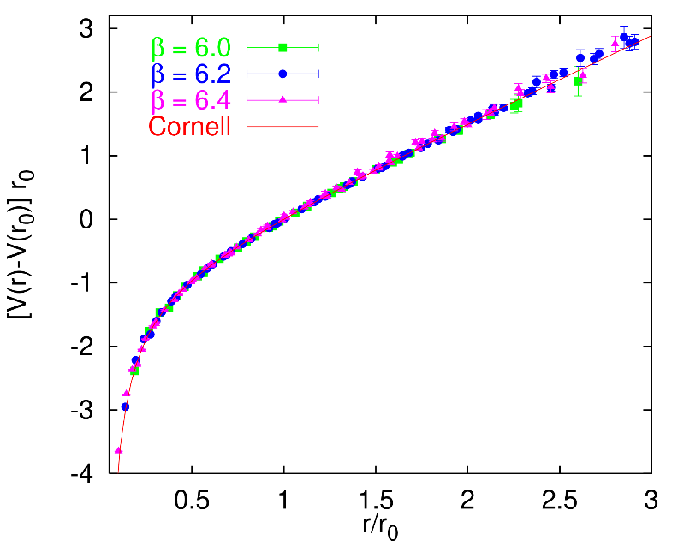
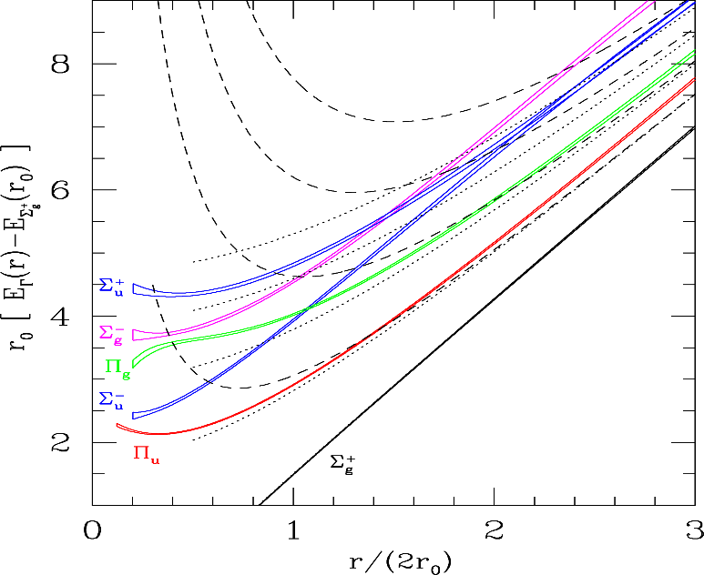
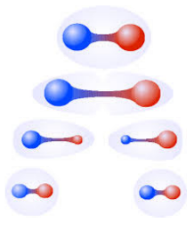
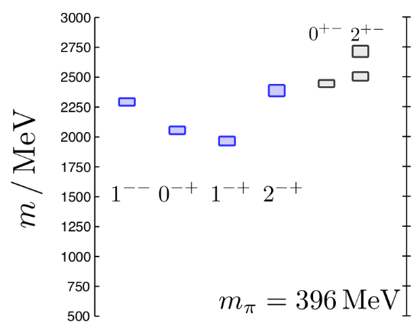
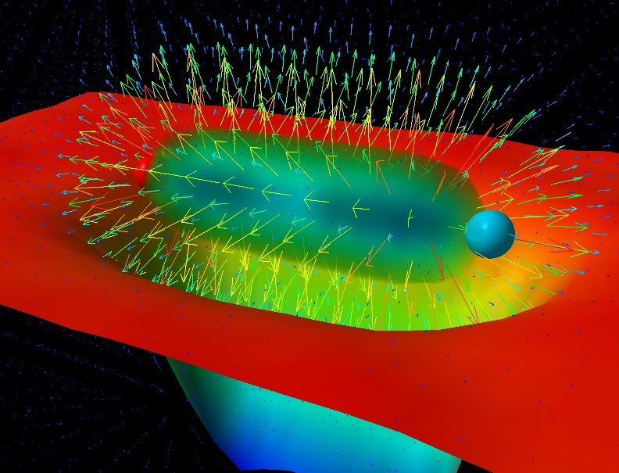
Learning about confinement
If quarks were infinitely heavy, gluonic field is confined in a string
Linear rising potential
What is a constituent gluon?
vibration of the string? → degenerate $J^{PC}={\left(0,1,2\right)}^{−+},{\left(0,1,2\right)}^{+−}$
excitation of a quasiparticle? → degenerate $J^{PC}={\left(0,1,2\right)}^{−+},1^{−−}$
G. Bali
C. Morningstar
J. Dudek
excitation of a quasiparticle! → degenerate $J^{PC}={\left(0,1,2\right)}^{−+},1^{−−}$ says Lattice QCD...
What about real data?
D. Leinweber
A. Pilloni – Theoretical review of light meson spectroscopy
Notes:
Controlla la parte su Regge

Slide 10
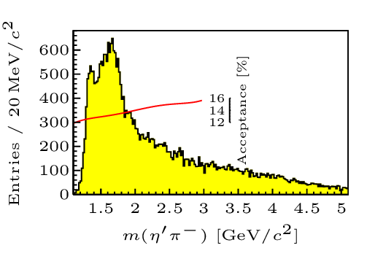
Hybrid hunting
J. Dudek
Excited gluon, $$J^{PC}=1^{+−}$$ mass $∼1.0\text{−}1.5 \text{GeV}$
$$\overline{r}$$
$$\overline{g}$$
$$r$$
excitation of a quasiparticle? → degenerate $J^{PC}={\left(0,1,2\right)}^{−+},1^{−−}$
$$g$$
Look for a $π_{1}$ state with $J^{PC}=1^{−+}$
decaying into $\left\{\begin{matrix}η π \text{and} η^{′}π \\ ρ π→3π \\ b_{1}π→5π\end{matrix}\right.$
Small signal in data
A. Pilloni – Theoretical review of light meson spectroscopy
Notes:
2 slides su Zc, a Bes e a Belle
2 slide su tetraquark model: dall’hamiltoniana di Jaffe al calcolo delle masse
1 slide su molecular models, dove sono i carichi? (non in Tornqvist, si in Hanhart, vedere Braaten, citare Nefediev)
2 slides su decay channels, dove si dovrebbe vedere, e a seconda del modello, vedere qualche plot
1 slide su Y(4260), tetraquark? C’è lo strano (si vede la f0)
1 slide su Zc a cleo (anche il neutro)

Slide 11
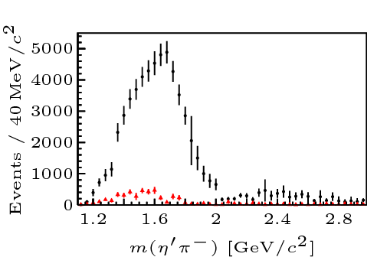
Two hybrid states???
Neither lattice nor models predict two $1^{−+}$ states in this region!
A hybrid meson ($8$) cannot decay into $ηπ$ in the SU(3) limit
Tetraquark ($10⊕\overline{10}$)? Requires doubly charged
A. Pilloni – Theoretical review of light meson spectroscopy
Notes:
2 slides su Zc, a Bes e a Belle
2 slide su tetraquark model: dall’hamiltoniana di Jaffe al calcolo delle masse
1 slide su molecular models, dove sono i carichi? (non in Tornqvist, si in Hanhart, vedere Braaten, citare Nefediev)
2 slides su decay channels, dove si dovrebbe vedere, e a seconda del modello, vedere qualche plot
1 slide su Y(4260), tetraquark? C’è lo strano (si vede la f0)
1 slide su Zc a cleo (anche il neutro)

Slide 12
Amplitudes for $η^{(′)}π$
We build the partial wave amplitudes according to the $N/D$ method
Jackura, Mikhasenko, AP et al. (JPAC & COMPASS), PLB
Rodas, AP et al. (JPAC), PRL
$$a\left(s\right)=\frac{n\left(s\right)}{D\left(s\right)}$$
$$D(s)$$
$$n(s)$$
The $n\left(s\right)$ → background physics, process-dependent, smooth
The $D(s)$ contains all the Final State Interactions constrained by unitarity → universal
A. Pilloni – Theoretical review of light meson spectroscopy
Notes:
Controlla la parte su Regge

Slide 13
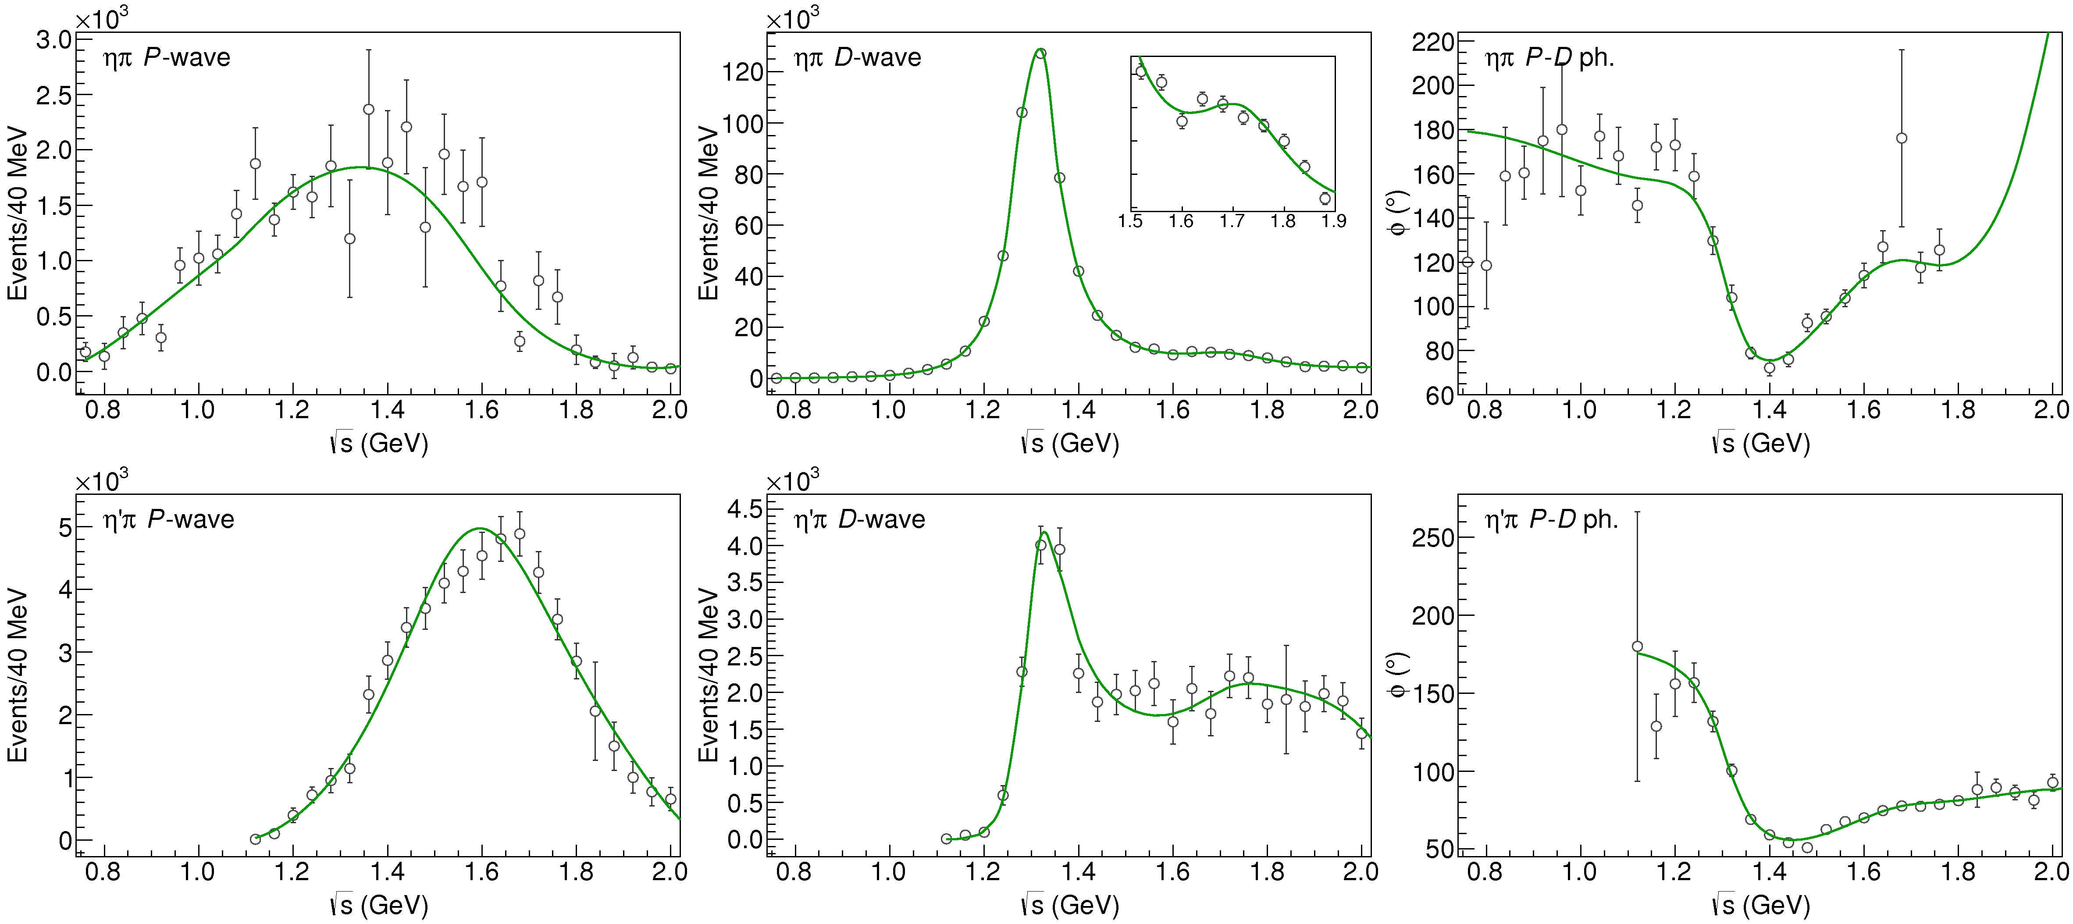
Fit to $η^{(′)}π$
( data)
$$π_{1}\left(1400\right)?$$
$$a_{2}\left(1320\right)$$
$$a_{2}^{′}\left(1700\right)$$
$$π_{1}\left(1600\right)?$$
$$a_{2}\left(1320\right)$$
$$a_{2}^{′}\left(1700\right)$$
$$J^{PC}=1^{−+}$$
$$J^{PC}=2^{++}$$
A. Pilloni – Theoretical review of light meson spectroscopy
Notes:
Controlla la parte su Regge

Slide 14
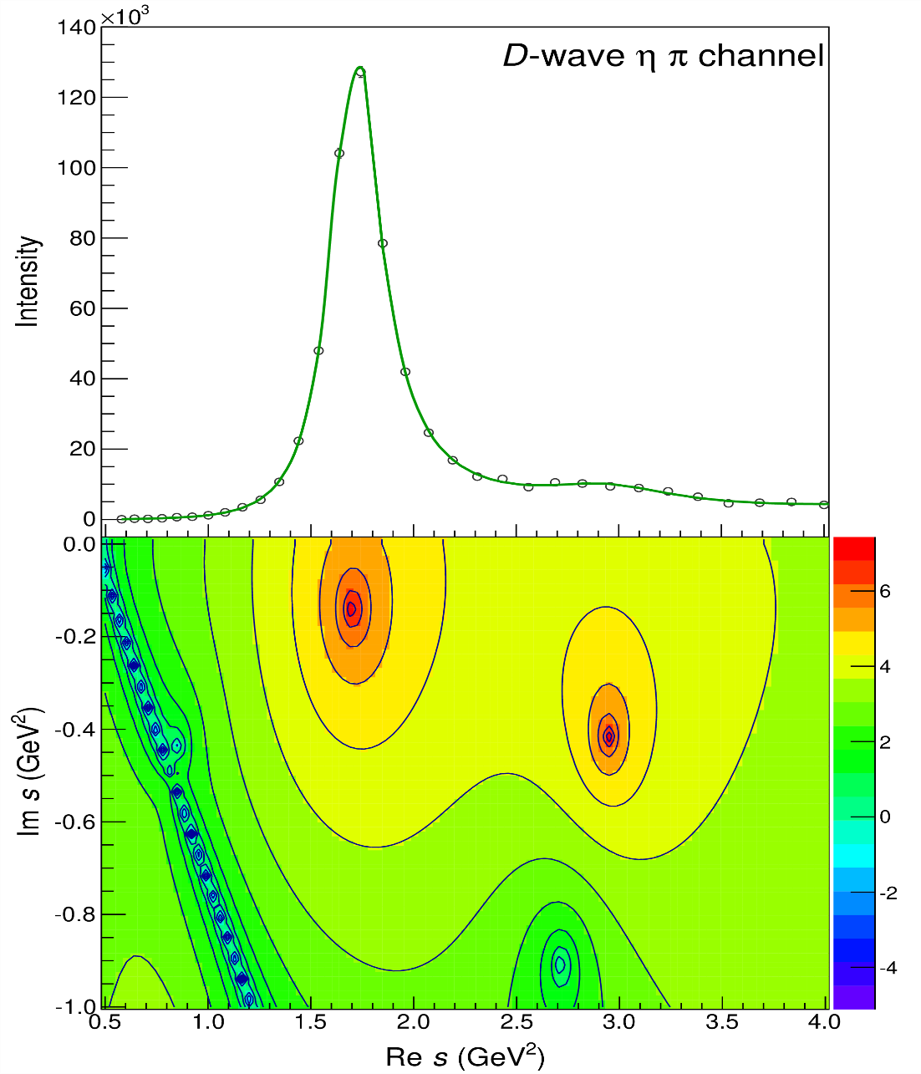
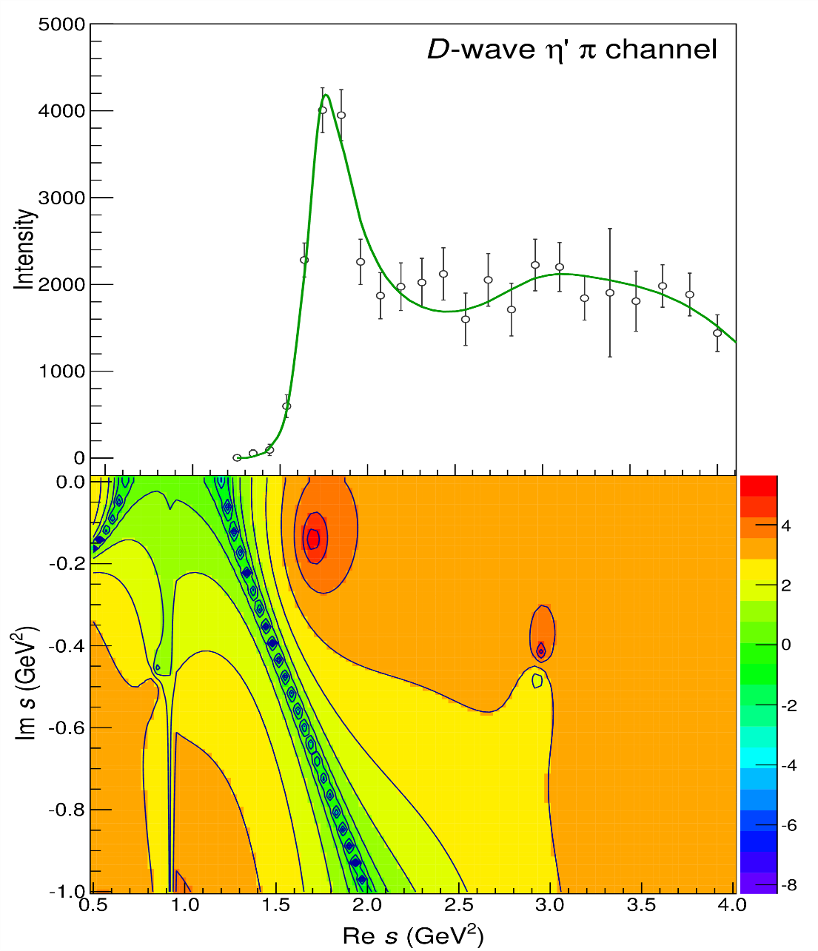
Pole hunting
$$a_{2}^{′}\left(1700\right)$$
$$a_{2}^{′}\left(1700\right)$$
$$a_{2}\left(1320\right)$$
$$a_{2}\left(1320\right)$$
A. Pilloni – Theoretical review of light meson spectroscopy
Notes:
Controlla la parte su Regge

Slide 15
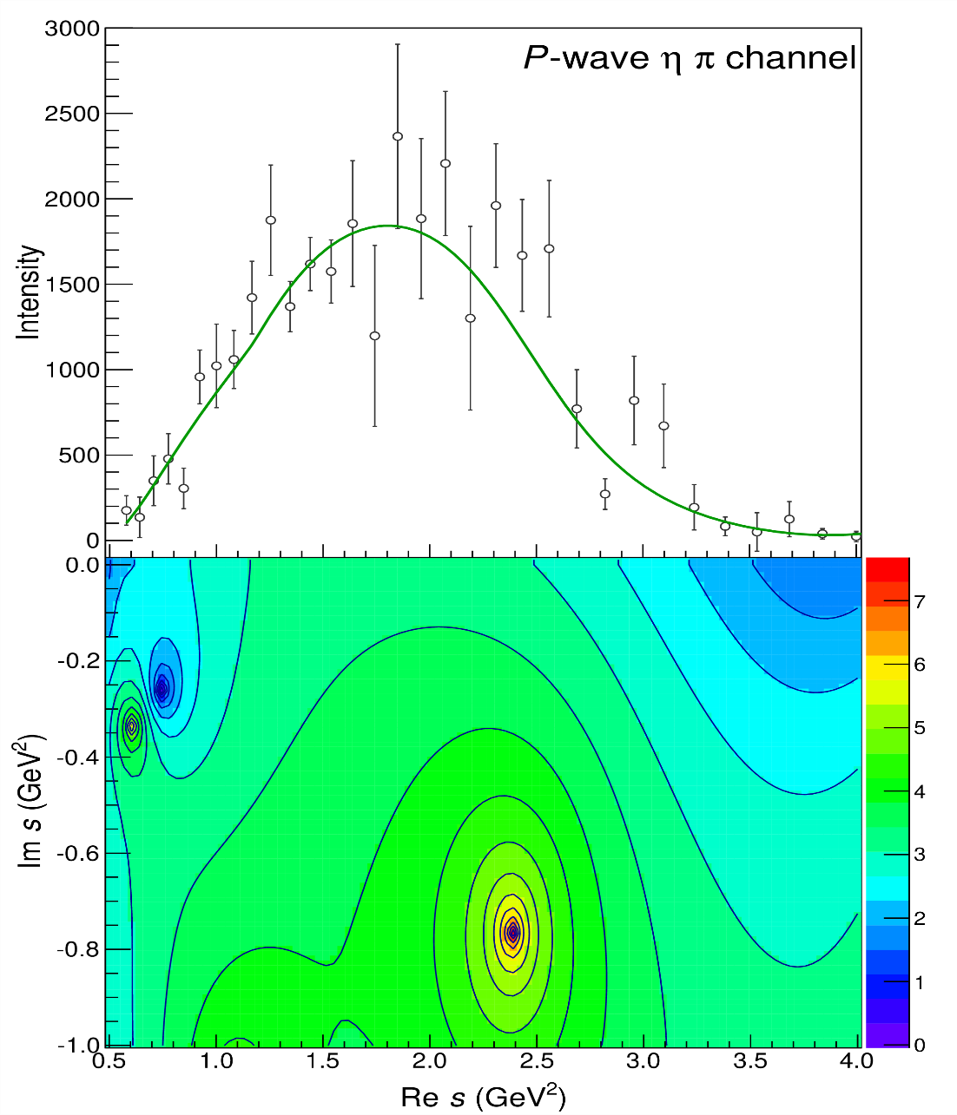
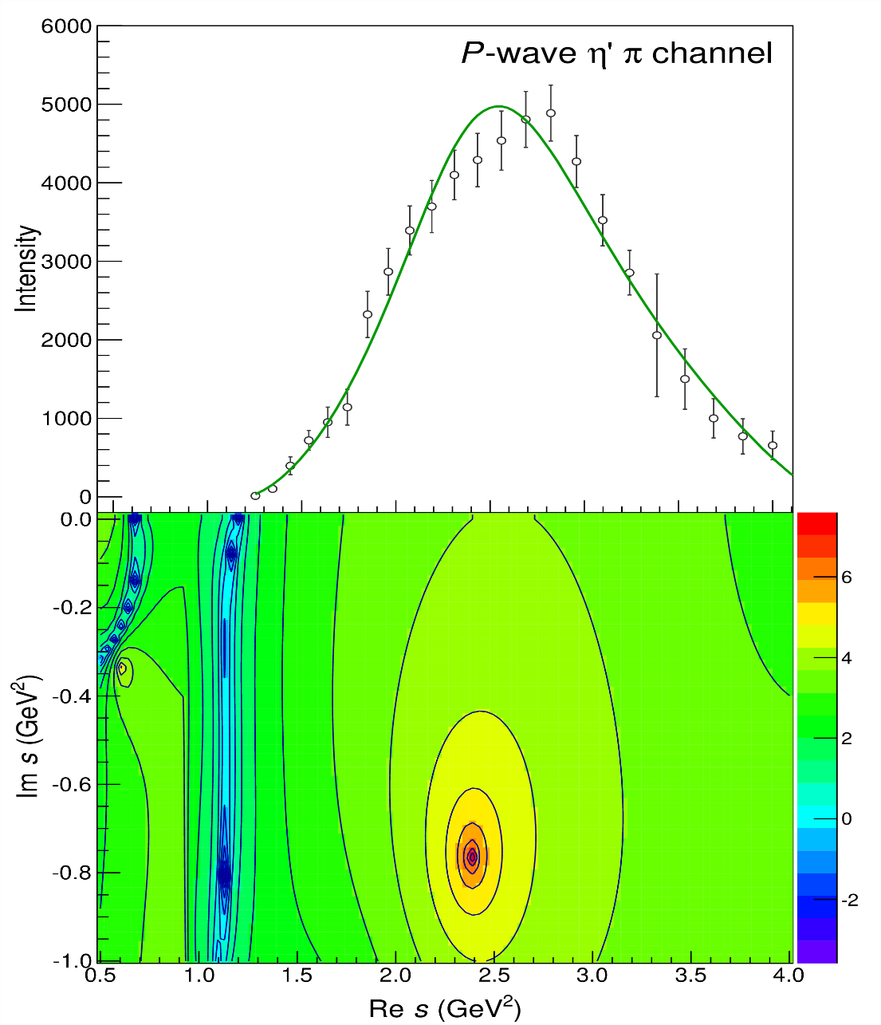
Pole hunting
$$π_{1}$$
$$π_{1}$$
A. Pilloni – Theoretical review of light meson spectroscopy
Notes:
Controlla la parte su Regge

Slide 16
Final results
Agreement with Lattice is restored
That’s the most rigorous extraction of an exotic meson available so far!
A. Pilloni – Theoretical review of light meson spectroscopy
Notes:
Controlla la parte su Regge

Slide 17
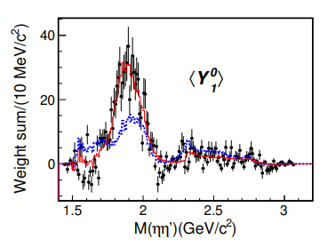
An isoscalar $η_{1}$?
There is a recent claim by BESIII in $J/ψ→γ η η′$ of resonant activity in P-wave
Not enough information to perform a similar analysis but… stay tuned!
BW parameters:
$$M=1855±9_{−1}^{+6} \text{MeV}, \\ Γ=188±{18}_{−8}^{+3} \text{MeV}$$
A. Pilloni – Theoretical review of light meson spectroscopy
Notes:
2 slides su Zc, a Bes e a Belle
2 slide su tetraquark model: dall’hamiltoniana di Jaffe al calcolo delle masse
1 slide su molecular models, dove sono i carichi? (non in Tornqvist, si in Hanhart, vedere Braaten, citare Nefediev)
2 slides su decay channels, dove si dovrebbe vedere, e a seconda del modello, vedere qualche plot
1 slide su Y(4260), tetraquark? C’è lo strano (si vede la f0)
1 slide su Zc a cleo (anche il neutro)

Slide 18
The scalar glueball
$$0^{++}$$
A. Pilloni – Theoretical review of light meson spectroscopy
Notes:
2 slides su Zc, a Bes e a Belle
2 slide su tetraquark model: dall’hamiltoniana di Jaffe al calcolo delle masse
1 slide su molecular models, dove sono i carichi? (non in Tornqvist, si in Hanhart, vedere Braaten, citare Nefediev)
2 slides su decay channels, dove si dovrebbe vedere, e a seconda del modello, vedere qualche plot
1 slide su Y(4260), tetraquark? C’è lo strano (si vede la f0)
1 slide su Zc a cleo (anche il neutro)

Slide 19
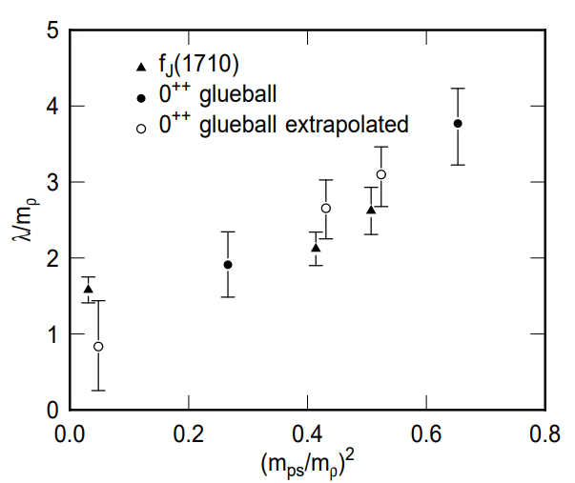
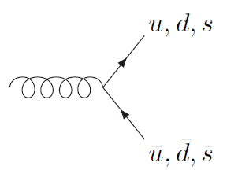
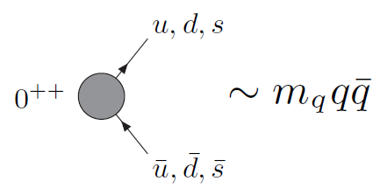
How to identify a glueball
You don’t. Since it mixes with light isoscalars, there is no model-independent way of saying which state is (mostly) the glueball. Only suggestions:
There is one too many wrt QM. Indeed, $f_{0}\left(1370\right),f_{0}\left(1500\right),$ $f_{0}\left(1710\right)$
A glueball couples to photons only throughout mixing, so radiative widths should be small
Their production is enhanced in gluon-rich processes, as $J/ψ$ radiative decays
It couples equally to mesons of all flavors (?)
$$c$$
However, an argument based on chiral symmetry claims the coupling proportional to quark mass
$$J/ψ$$
$$\overline{c}$$
G
A. Pilloni – Theoretical review of light meson spectroscopy

Slide 20
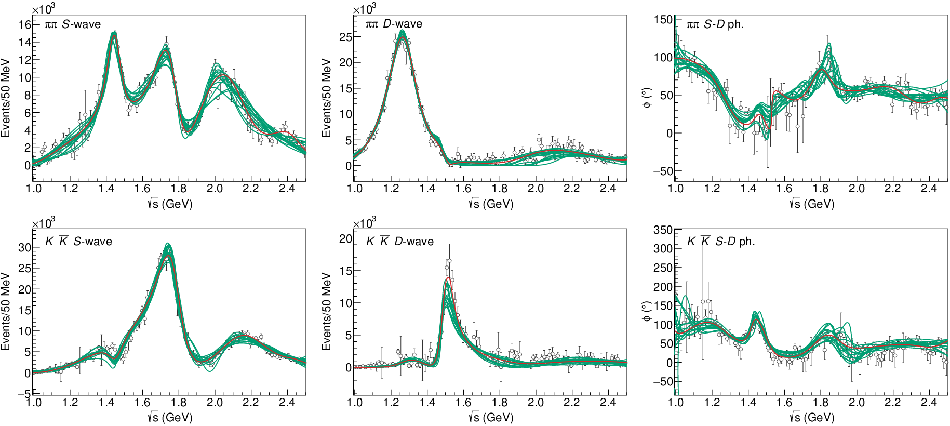
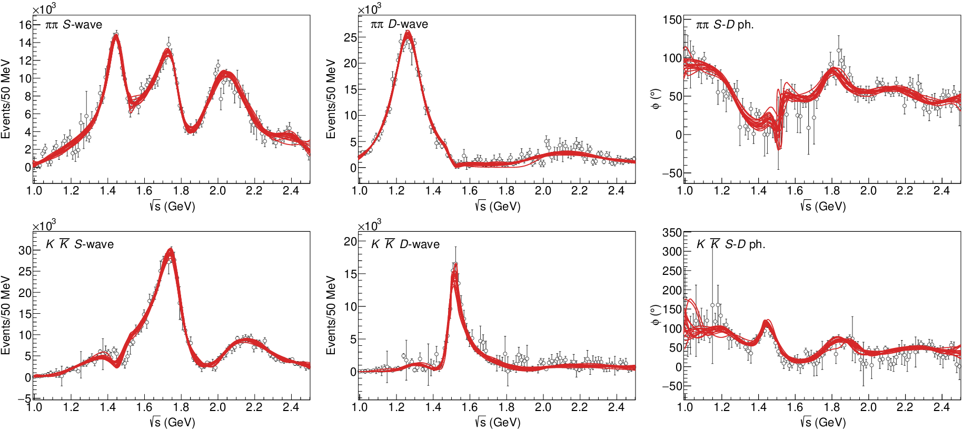
$J/ψ→γ π^{0}π^{0} and→γ K_{S}^{0}K_{S}^{0}$
Same $N/D$ model as before
The fit is decent, but it’s struggling in getting the $f_{2}′$ right Being quasi-elastic, it’s too constrained
Fit quality and local description improve when a third $ρρ$ channel is added
( data)
A. Pilloni – Theoretical review of light meson spectroscopy

Slide 21
Pole extraction
For data-driven pole extractions, see also D. Binosi, A. Pilloni, R.-A. Tripolt PLB 839, 137809
A. Pilloni – Theoretical review of light meson spectroscopy

Slide 22
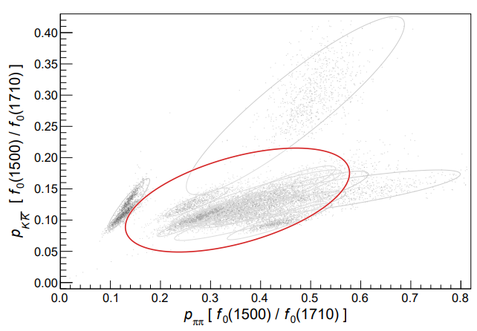
Looking at the residues
Despite the large systematics, the $f_{0}\left(1710\right)$ couples to kaons more than the $f_{0}\left(1500\right)$
Also, the $f_{0}\left(1710\right)$ couples to the initial gluon-rich state more than the $f_{0}\left(1500\right)$
Both these fact suggest a sizeable glueball component for the $f_{0}\left(1710\right)$
Caveats:
some of the relevant channels are neglected, hopefully ratios not affected
Left-hand cuts of scattering processes contribute to scattering. Poorly known and neglected here.
A. Pilloni – Theoretical review of light meson spectroscopy

Slide 23
Conclusions
Light sector is full of surprises!
Long-sought hybrid spectrum give direct insight into gluodynamics
Other exotics like $X(1835)$, $a_{1}(1420)$ offer other examples of near-threshold dynamics, similar to the one invoked for the XYZ
Bottom-up approaches allow us to get the most out of high statistics data
Thank you!
A. Pilloni – Theoretical review of light meson spectroscopy
Notes:
2 slides su Zc, a Bes e a Belle
2 slide su tetraquark model: dall’hamiltoniana di Jaffe al calcolo delle masse
1 slide su molecular models, dove sono i carichi? (non in Tornqvist, si in Hanhart, vedere Braaten, citare Nefediev)
2 slides su decay channels, dove si dovrebbe vedere, e a seconda del modello, vedere qualche plot
1 slide su Y(4260), tetraquark? C’è lo strano (si vede la f0)
1 slide su Zc a cleo (anche il neutro)

Slide 24
ExoHad and JPAC
Funded in 2023 by DoE as a Topical Collaboration in Nuclear Physics
Aims at exploring all aspects of exotics (= hybrids at GlueX)
Joint Physics Analysis Center
Funded in 2013 as theory support originally for JLab exps, but grew up much larger
Creates bridges between theorists and experimentalists
40+ researchers affiliated during a decade
A. Pilloni – Theoretical review of light meson spectroscopy
Notes:
Controlla la parte su Regge

Slide 25
Backup

Slide 26
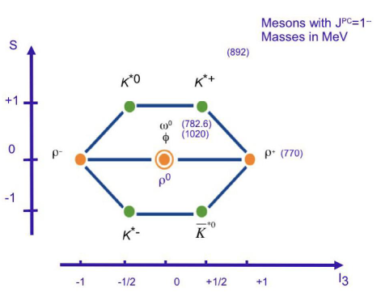
The light vector nonet
$$L=0, S=1$$
$$d\overline{s}$$
$$u\overline{s}$$
$$φ$$
$$2m_{s}$$
$$u\overline{u}+d\overline{d}$$
$$s\overline{s}$$
$$K^{∗}$$
$$m_{s}+m_{q}$$
$$d\overline{u}$$
$$u\overline{d}$$
$$u\overline{u}−d\overline{d}$$
$$ρ,ω$$
$$2m_{q}$$
$$s\overline{u}$$
$$s\overline{d}$$
A. Pilloni – Theoretical review of light meson spectroscopy

Slide 27
The light scalar nonet/1
$$L=1, S=1$$
$$0^{++}$$
$$κ^{0}$$
$$κ^{+}(700)$$
$$a_{0},f_{0}$$
$$??$$
$$f_{0}(980)$$
$$σ(500)$$
$$a_{0}^{−}$$
$$a_{0}^{+}(980)$$
$$κ$$
$$??$$
$$a_{0}^{0}$$
$$σ$$
$$??$$
$$κ^{−}$$
$$\overline{κ^{0}}$$
A. Pilloni – Theoretical review of light meson spectroscopy

Slide 28
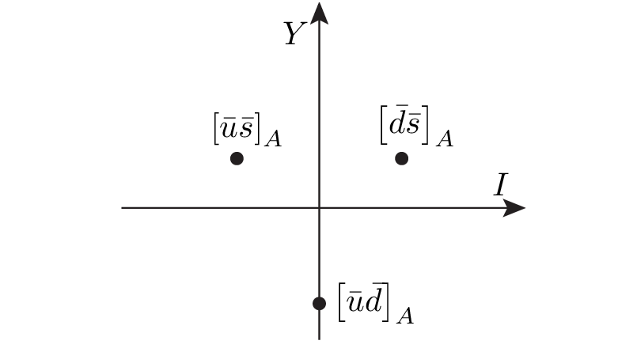
Diquarks
Attraction and repulsion in 1-gluon exchange approximation is given by
$$3_{c}×3_{c}∈{\overline{3}}_{c}$$
Now the two quarks are identical particles, they obey Fermi statistics
If we restrict to the ground state in S-wave, we have two options
$${\overline{3}}_{color}\left(A\right)×{\overline{3}}_{flavor}\left(A\right)×1_{spin}\left(A\right)$$
«Good» diquark
$${\overline{3}}_{color}\left(A\right)×6_{flavor}\left(S\right)×3_{spin}\left(S\right)$$
«Bad» diquark
Because of spin-spin interaction, good diquark are lighter, and easier to produce From the flavor point of view, it behaves like an antiquark
A. Pilloni – Theoretical review of light meson spectroscopy

Slide 29
The light scalar nonet/2
$$L=1, S=1$$
$$0^{++}$$
This also explain the affinity of the $f_{0}(980)$ to kaons
$$κ^{0}$$
$$κ^{+}(700)$$
$$[qs][\overline{q}\overline{s}]$$
$$a_{0},f_{0}$$
$$??$$
$$f_{0}(980)$$
$$σ(500)$$
$$a_{0}^{−}$$
$$a_{0}^{+}(980)$$
$$κ$$
$$[qs][\overline{u}\overline{d}]$$
$$??$$
$$a_{0}^{0}$$
$$σ$$
$$[ud][\overline{u}\overline{d}]$$
$$??$$
$$κ^{−}$$
$$\overline{κ^{0}}$$
A. Pilloni – Theoretical review of light meson spectroscopy

Slide 30
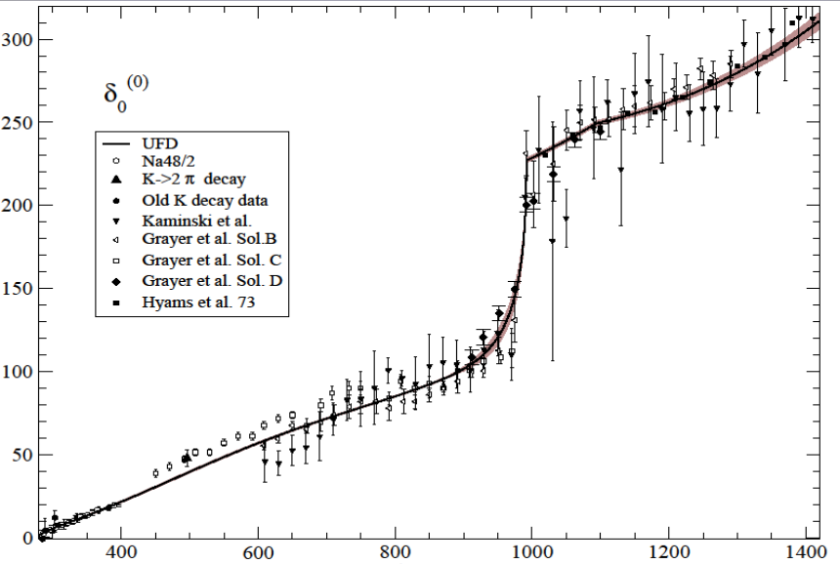
But where is the $σ$?
$$f_{0}(980)$$
The Adler zero is a zero of the $S$-wave amplitude due to chiral symmetry In UχPT it most often generate a pole identified as the $σ$
$$σ???$$
$ππ$ scattering shift for $L=0,I=0$
Really, really need amplitude analysis to get something meaningful about the $σ$
A. Pilloni – Theoretical review of light meson spectroscopy

Slide 31
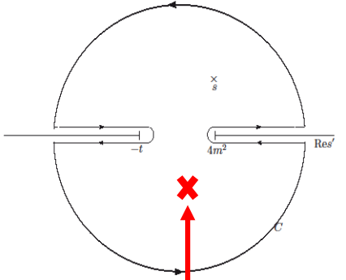
Roy equations (sketched)
1) You use the analytic properties of the amplitude and write Cauchy theorem
2) You use crossing symmetry to rewrite the integral of the left-hand cut as an integral of the right-hand cut
3) You expand the amplitude in partial waves
$$T\left(s,t\right)=\sum_{l}{t_{l}\left(s\right)P_{l}(\cos{θ})}$$
The dispersive integral helps the analytic continuation
Don’t be scared, you’ll have Astrid’s lectures…
A. Pilloni – Theoretical review of light meson spectroscopy

Slide 32
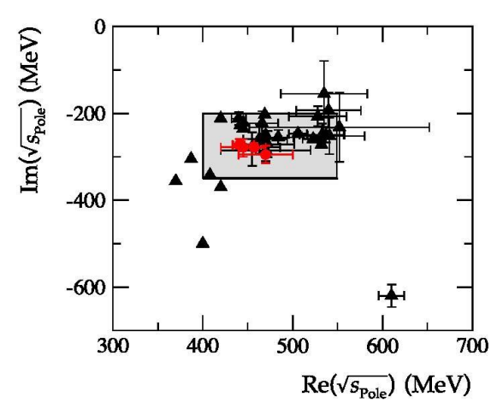
Results
Colangelo, Gasser, Leutwyler, NPB603, 125 (2001)
Caprini, Colangelo, Leutwyler, PRL 96, 132001 (2006)
Garcia-Martin, Kaminski, Peláez, Ruiz de Elvira, PRL107, 072001(2011)
Moussallam, EPJC71, 1814 (2011)
Masjuan, Ruiz de Elvira, Sanz-Cillero, PRD90, 097901 (2014)
Peláez, Phys.Rept. 658 (2016)
Descotes-Genon, Moussallam, EPJC48, 553 (2006)
Peláez, Rodas, arXiv:2010.11222
A. Pilloni – Theoretical review of light meson spectroscopy

Slide 33
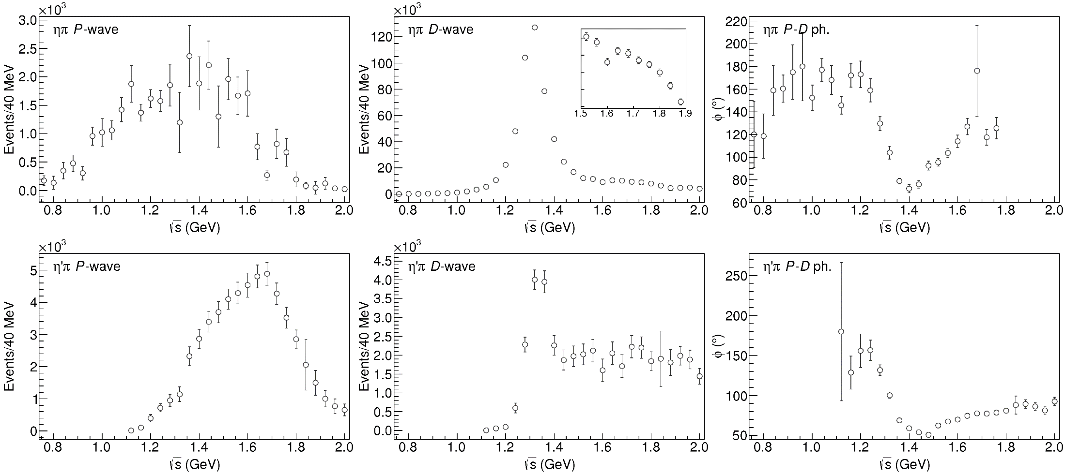
Data in $η^{(′)}π$
( data)
$$π_{1}\left(1400\right)?$$
$$a_{2}\left(1320\right)$$
$$a_{2}^{′}\left(1700\right)$$
$$π_{1}\left(1600\right)?$$
$$a_{2}\left(1320\right)$$
$$a_{2}^{′}\left(1700\right)$$
$$J^{PC}=1^{−+}$$
$$J^{PC}=2^{++}$$
A. Pilloni – Theoretical review of light meson spectroscopy
Notes:
Controlla la parte su Regge

Slide 34
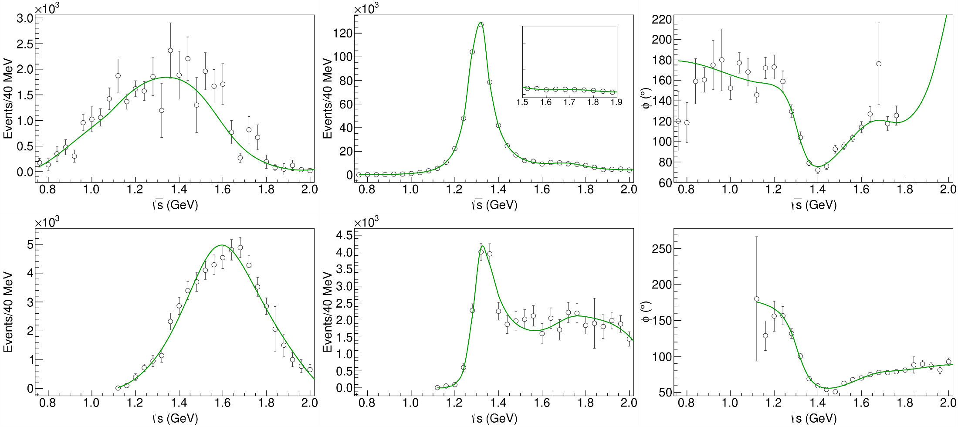
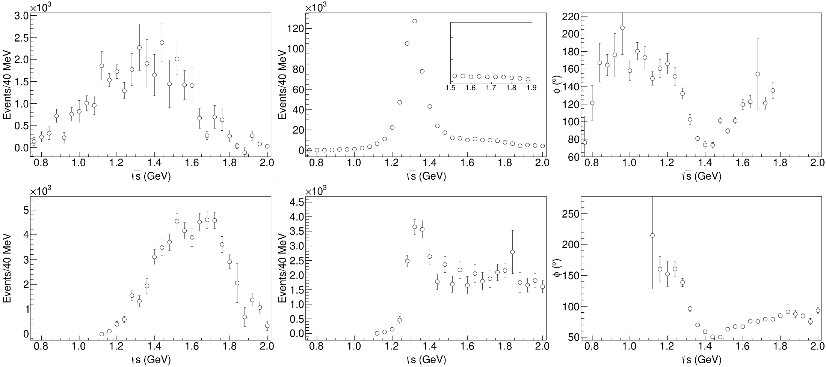
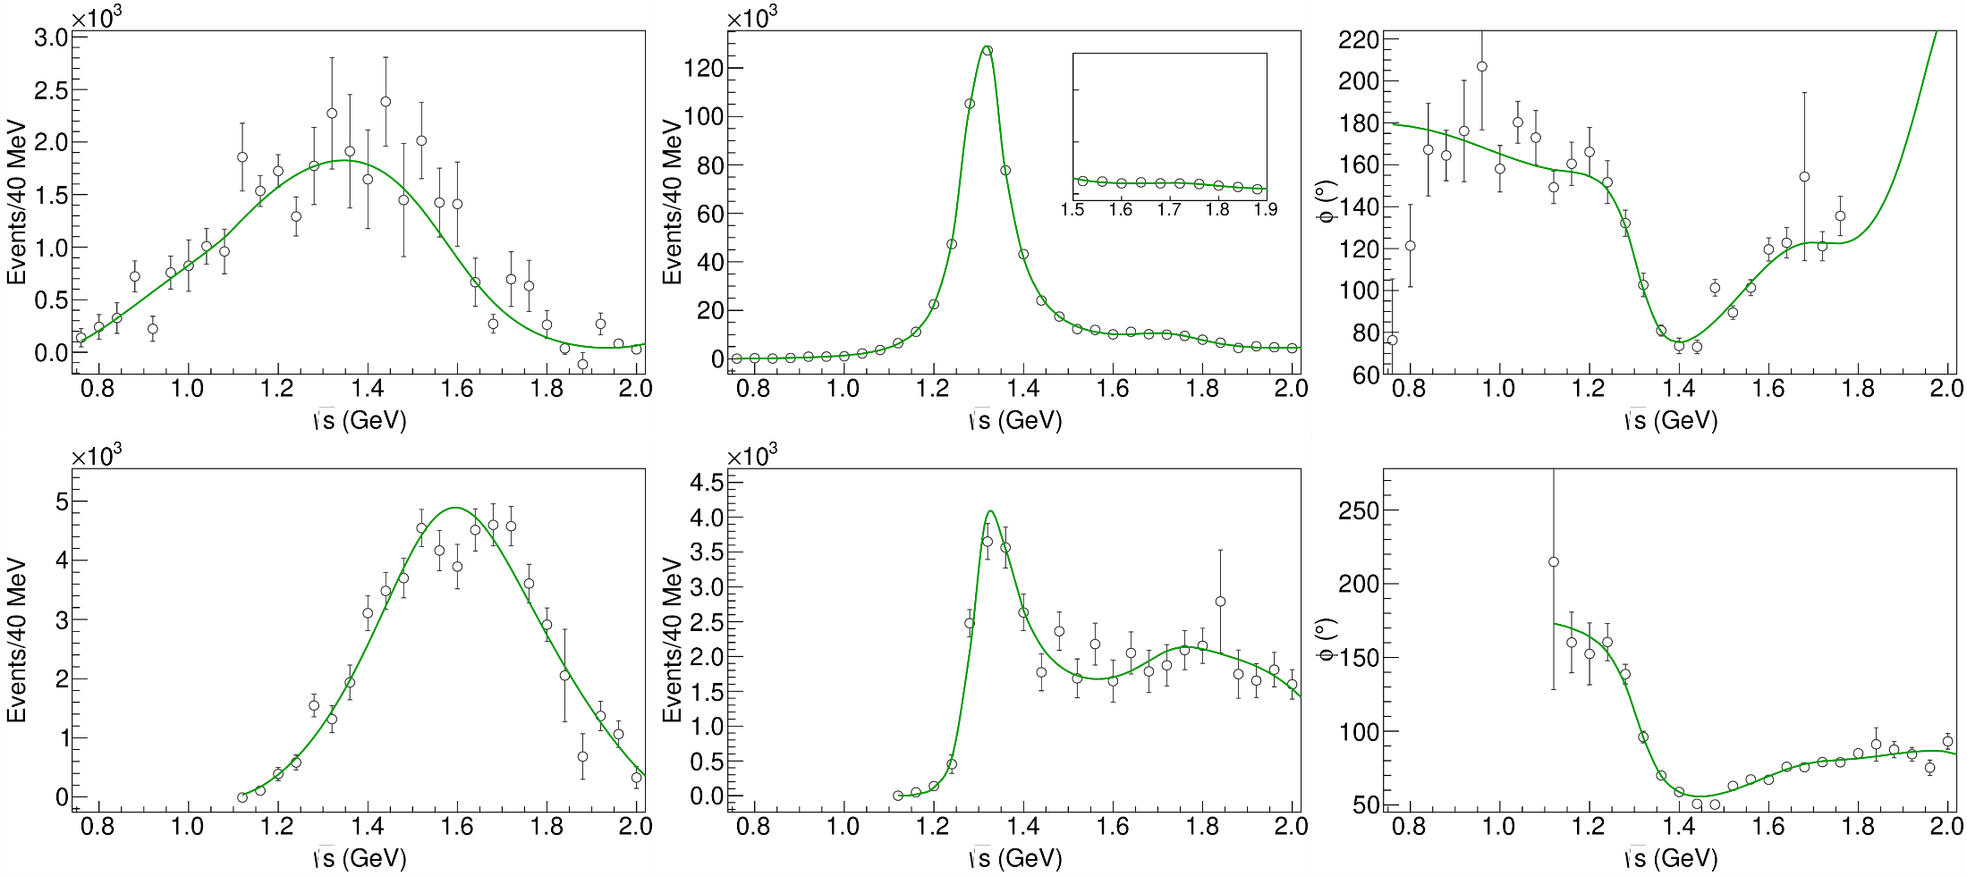
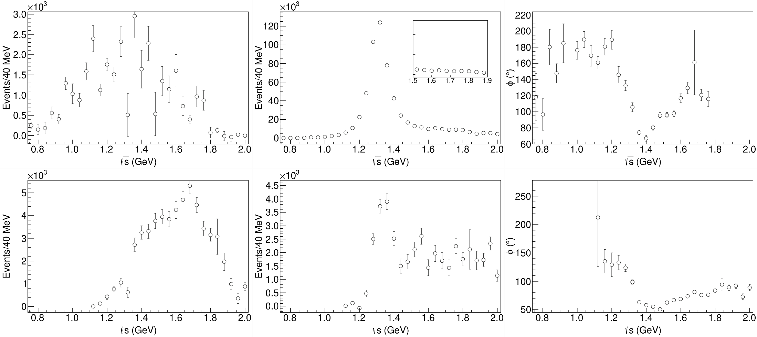
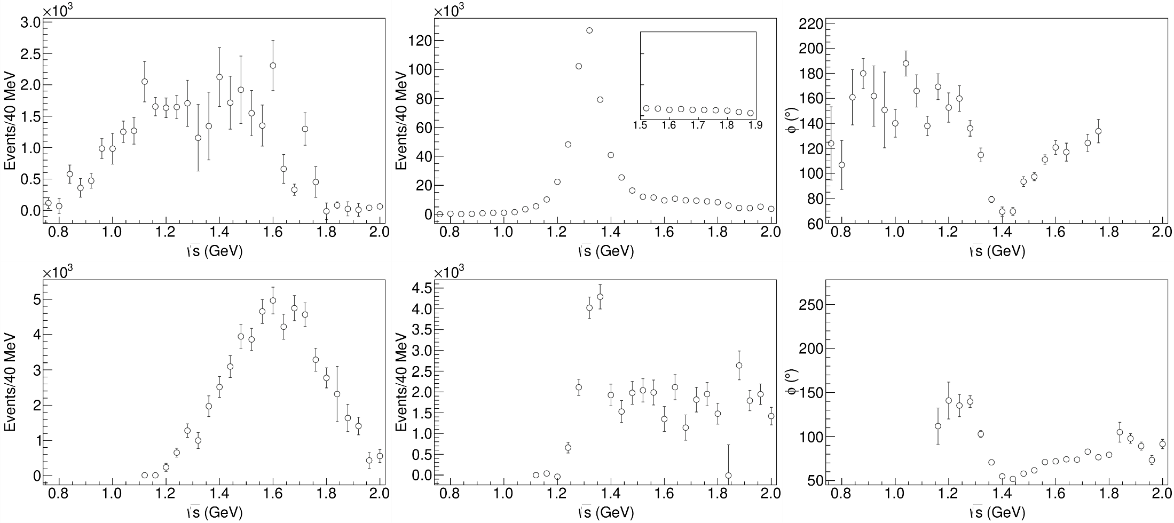
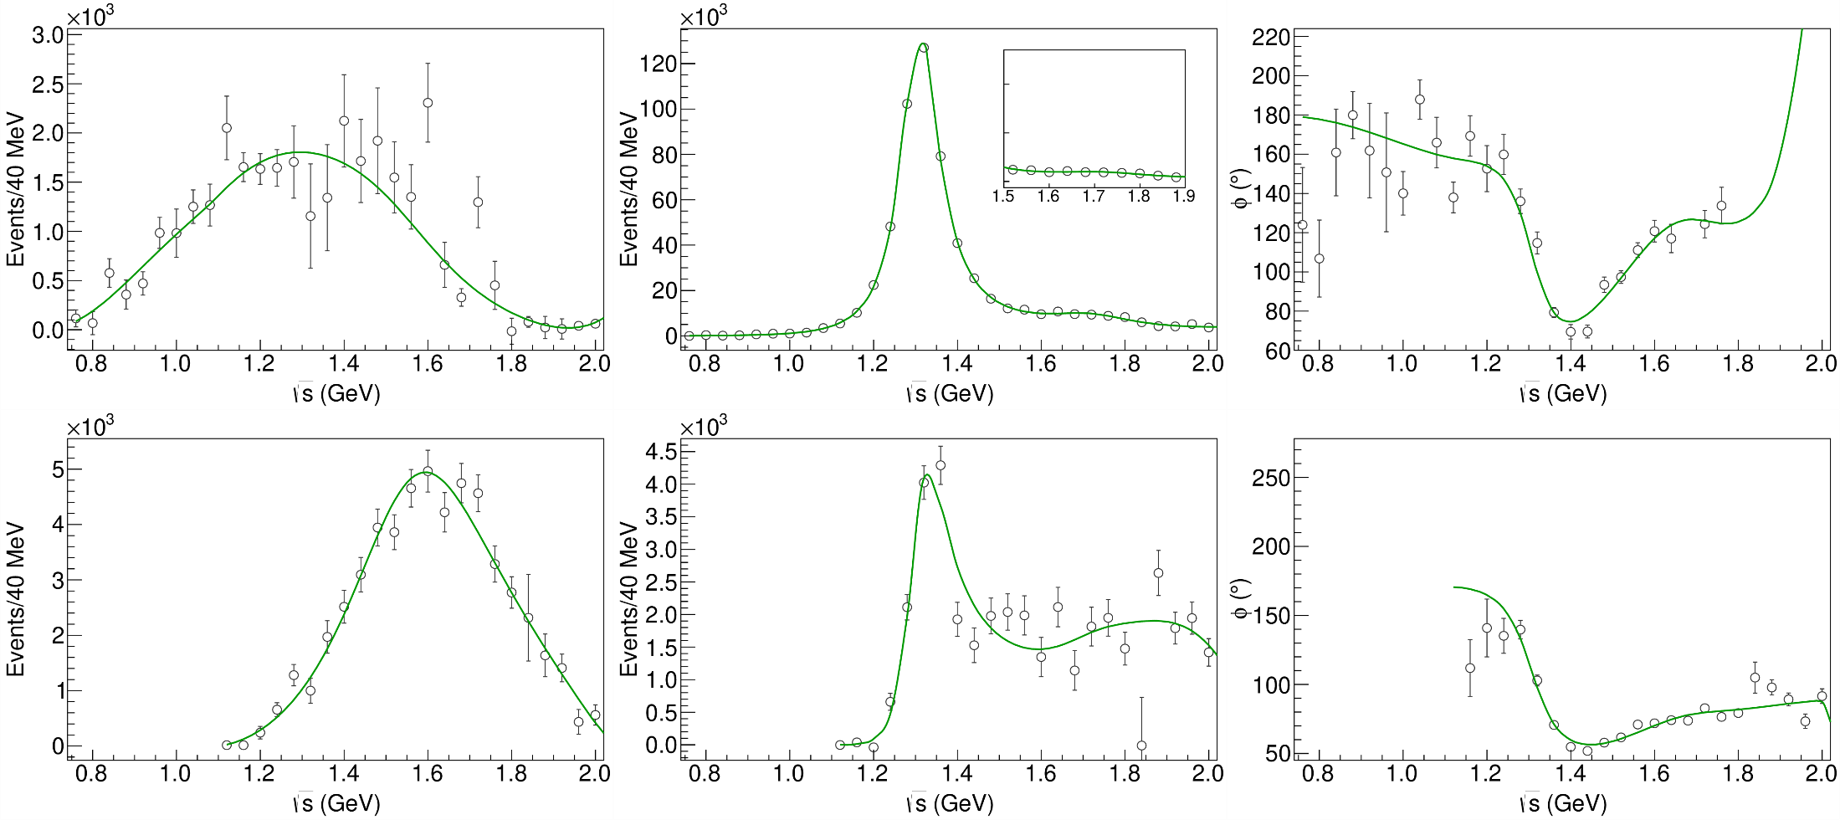
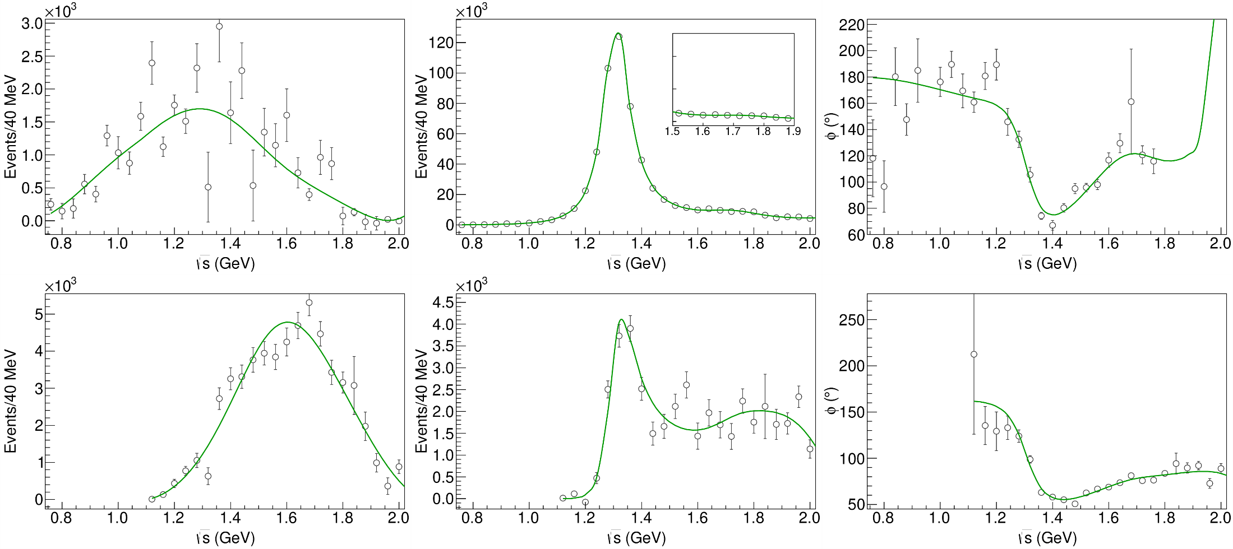
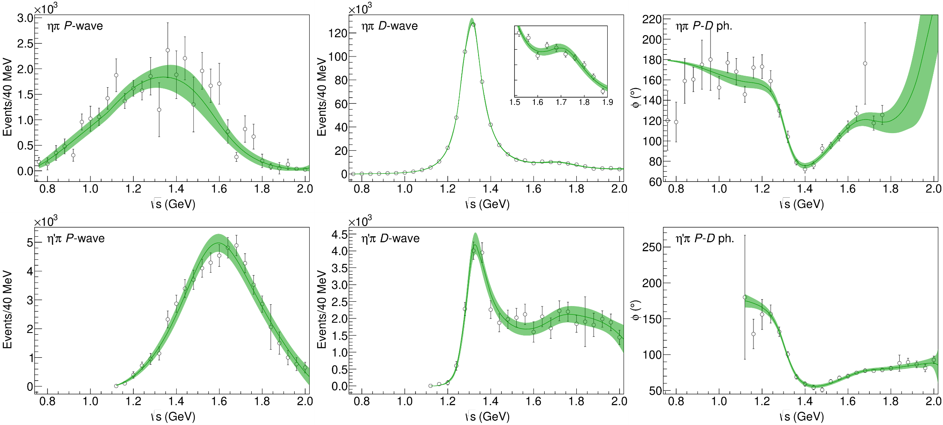
Statistical Bootstrap
A. Pilloni – Theoretical review of light meson spectroscopy
Notes:
Controlla la parte su Regge

Slide 35
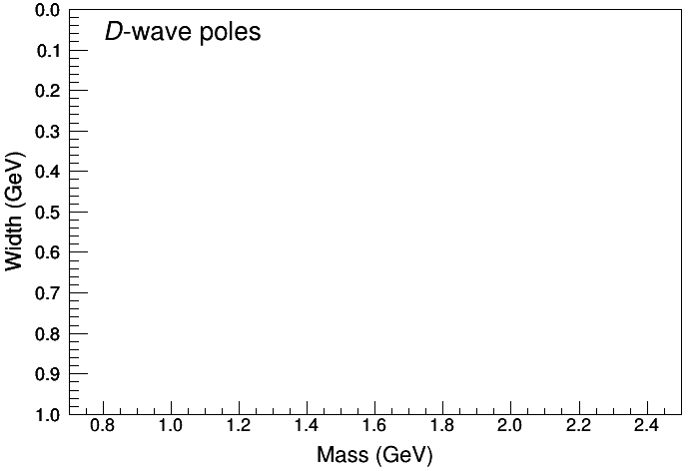
Statistical Bootstrap
For each fit, we search poles: two clusters in D-wave: $a_{2}\left(1320\right)$ and $a_{2}^{′}\left(1700\right)$
A. Pilloni – Theoretical review of light meson spectroscopy
Notes:
Controlla la parte su Regge

Slide 36
Statistical Bootstrap
Only one stable cluster in $P$-wave: a single $π_{1}$
A. Pilloni – Theoretical review of light meson spectroscopy
Notes:
Controlla la parte su Regge

Slide 37
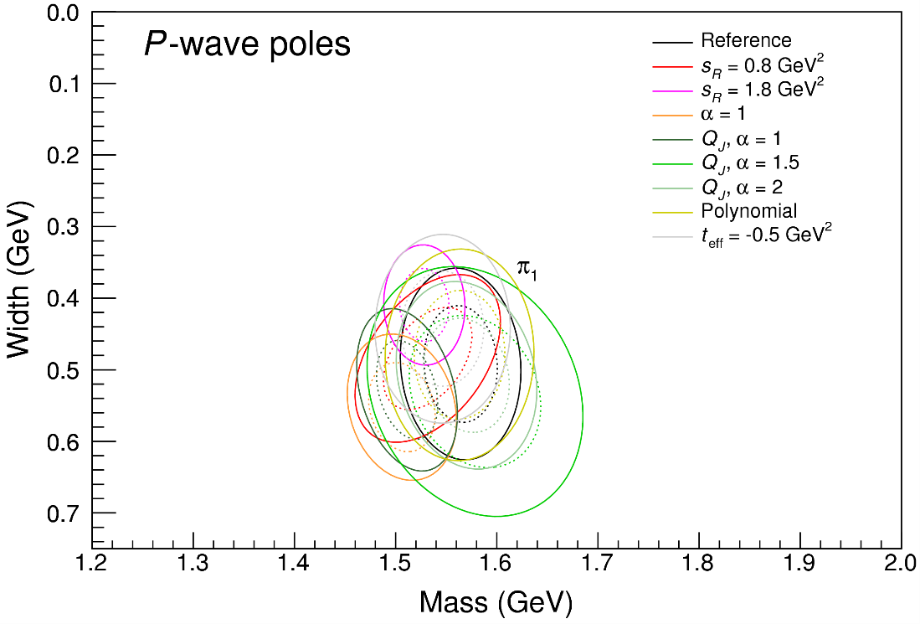
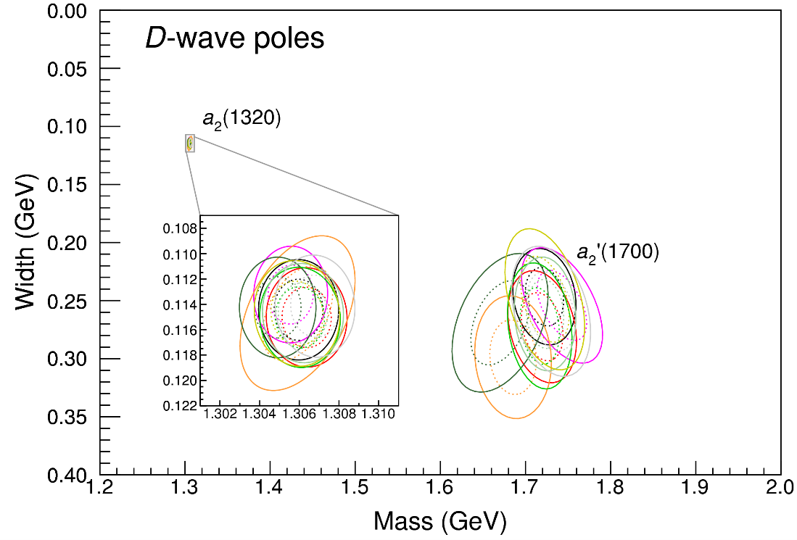
Systematic studies
For each class, the maximum deviation of mass and width is taken as a systematic error Deviation smaller than the statistical error are neglected Systematic of different classes are summed in quadrature
A. Pilloni – Theoretical review of light meson spectroscopy
Notes:
Controlla la parte su Regge

Slide 38
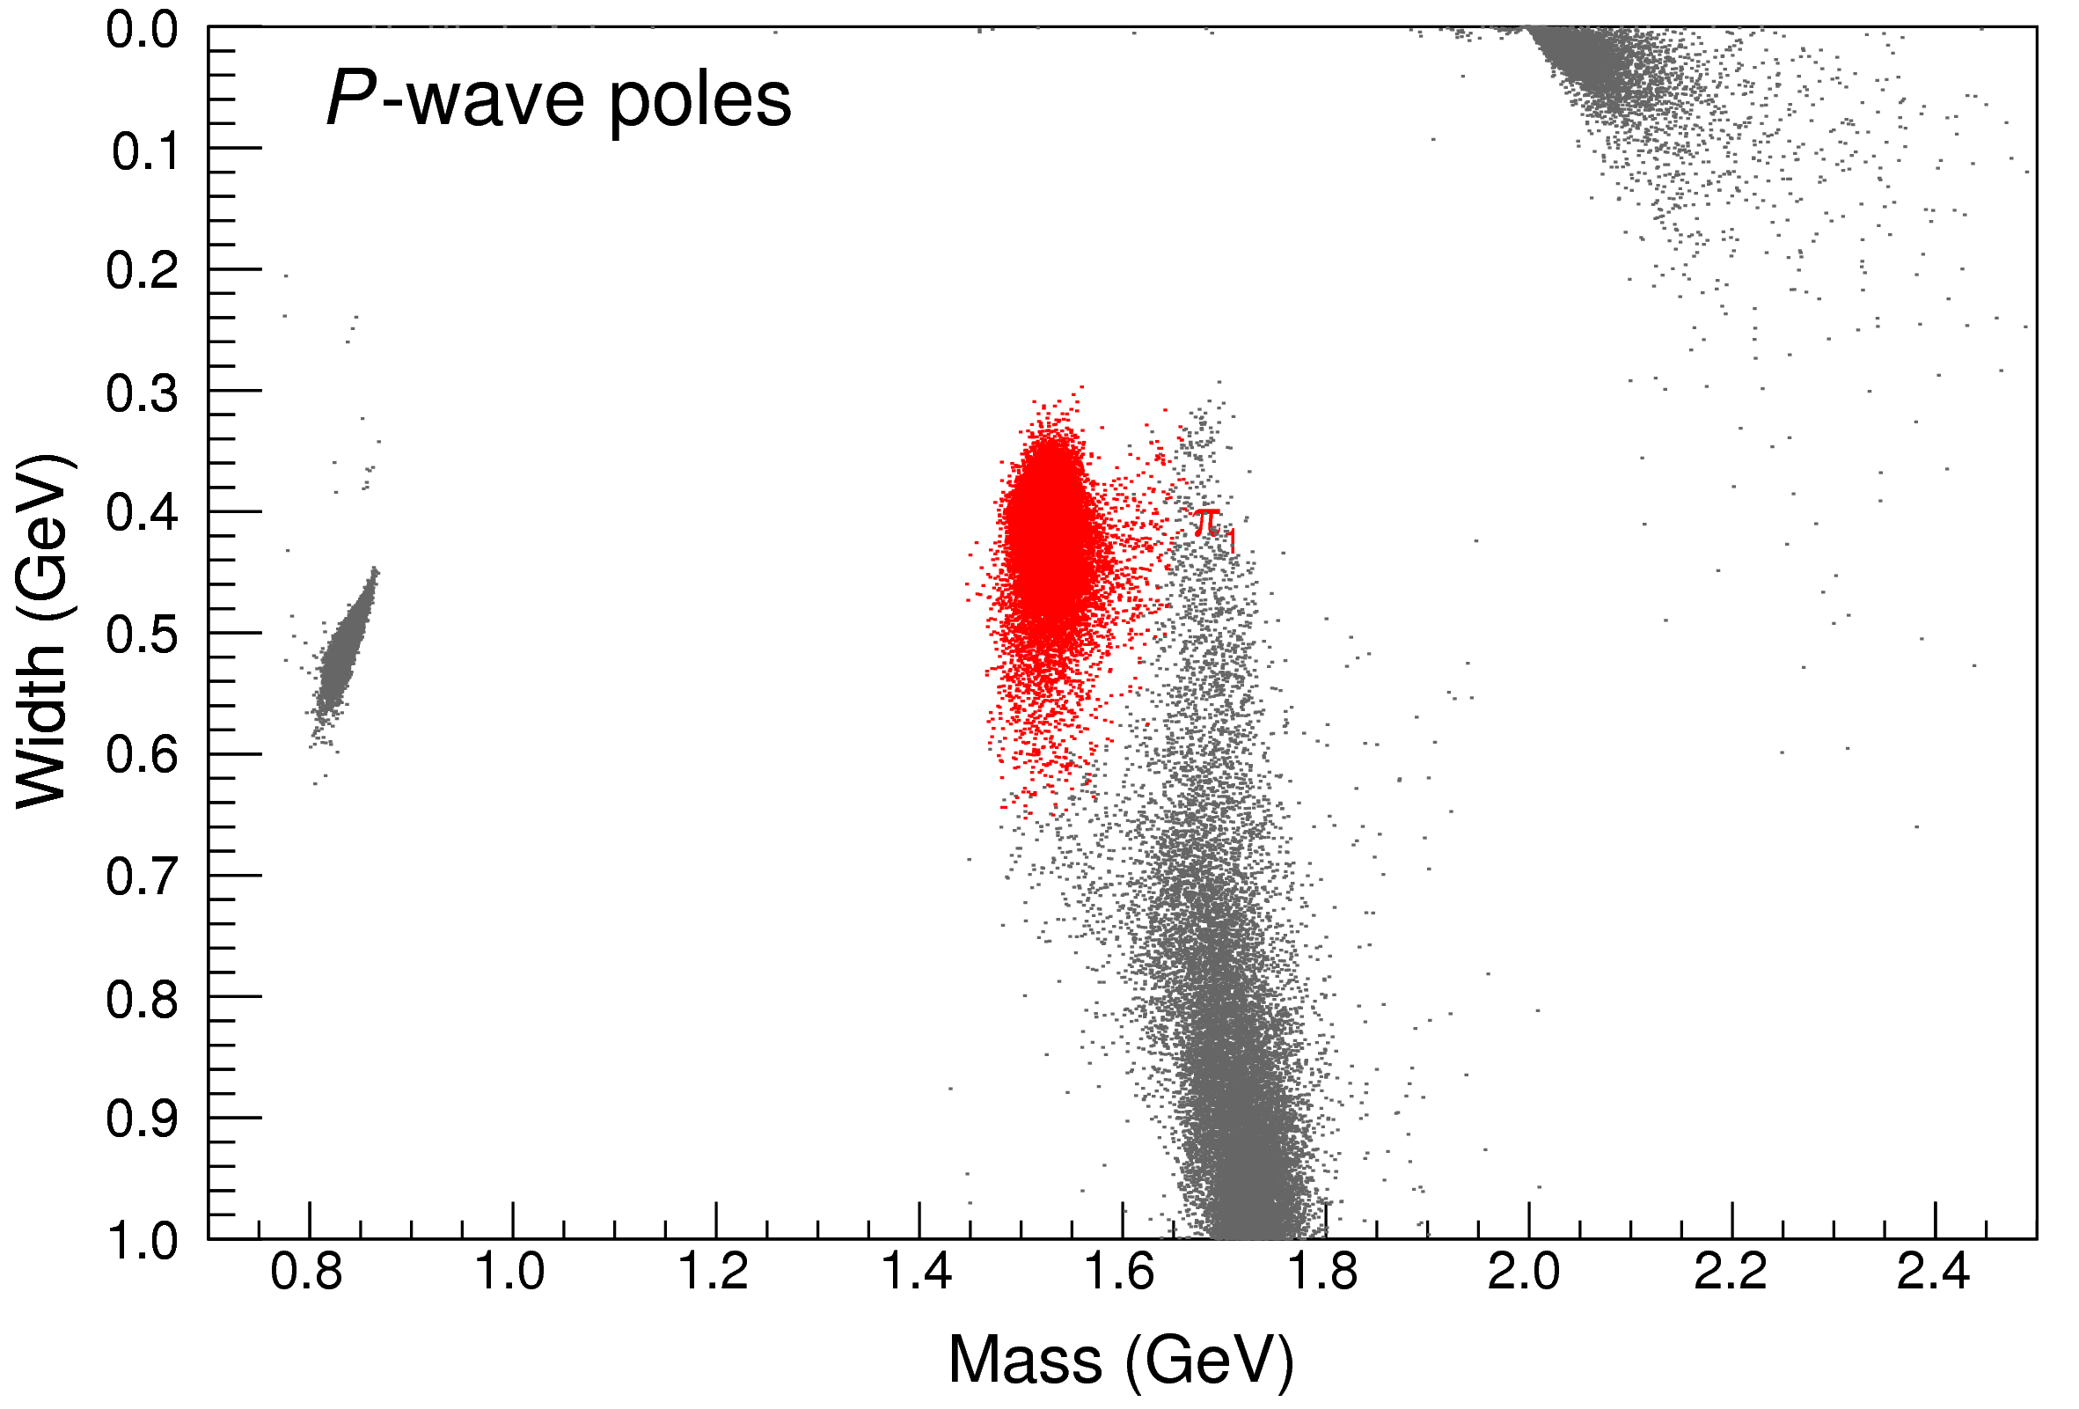
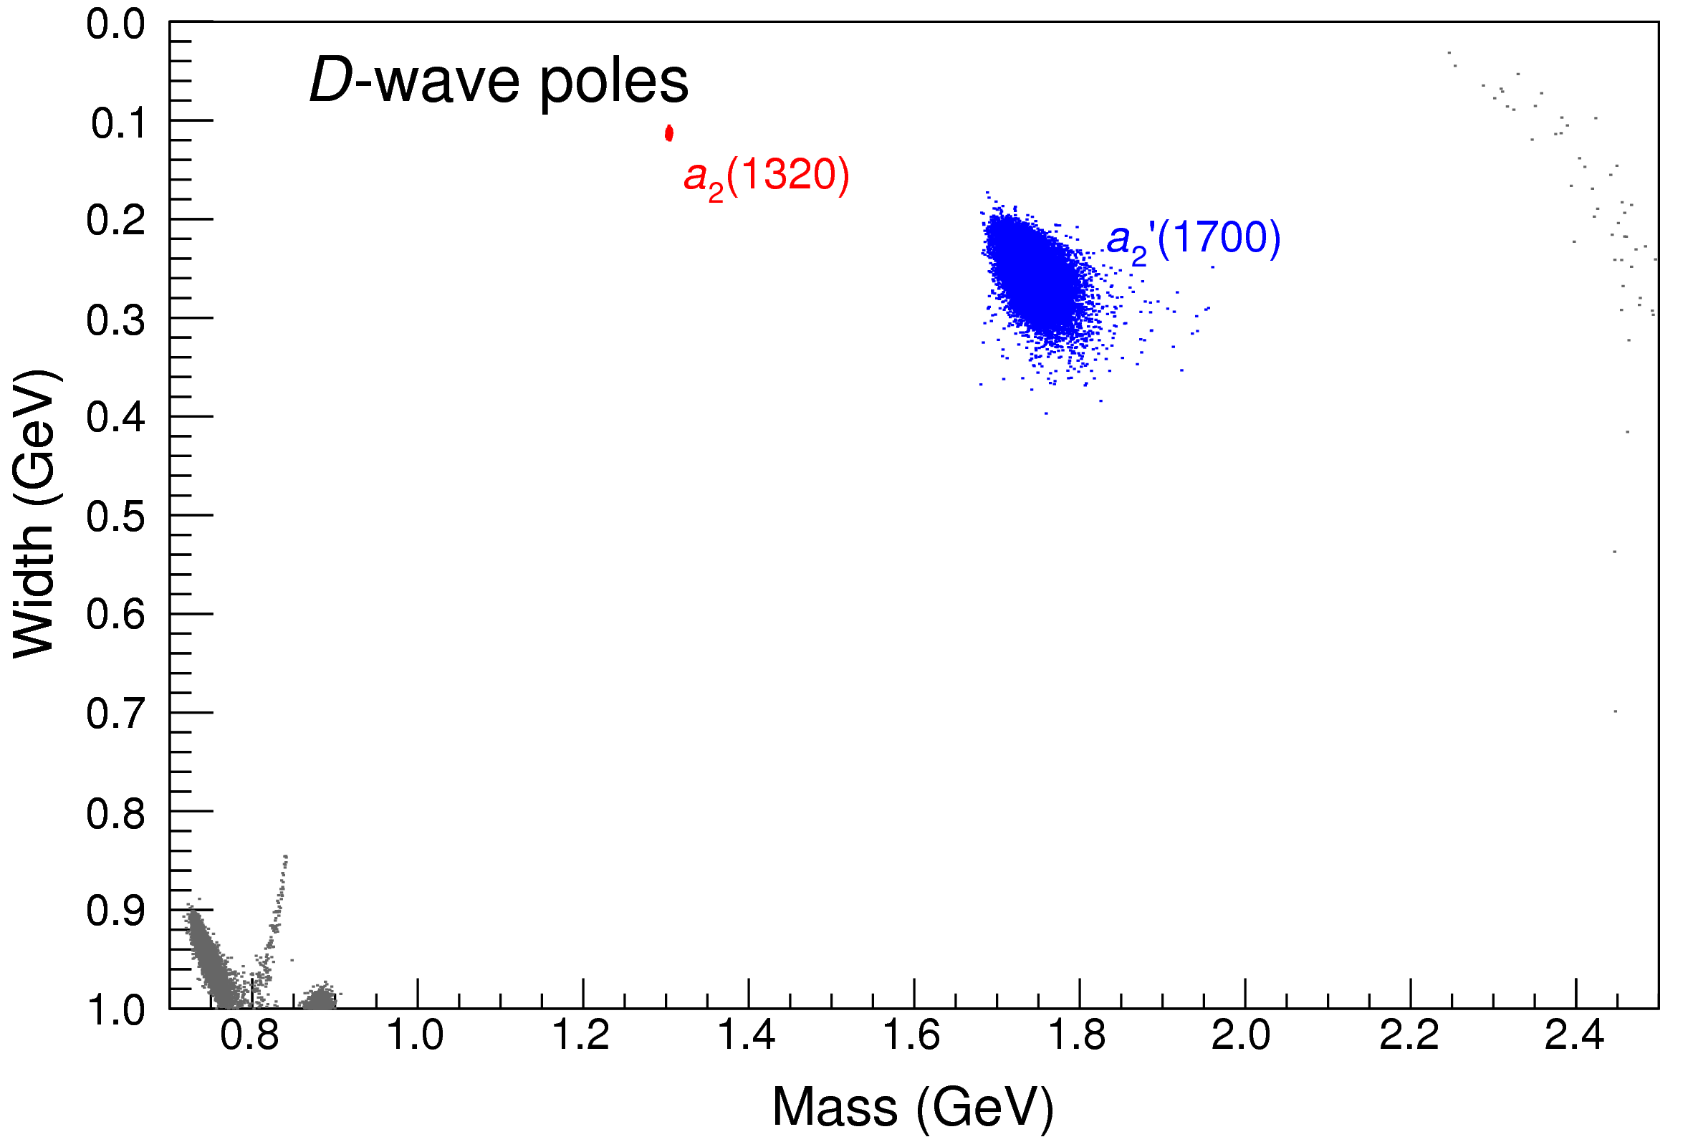
Bootstrap for $s_{R}=1.8 {\text{GeV}}^{2}$
Our skepticism about a second pole in the relevant region is confirmed:
It is unstable and not trustable
A. Pilloni – Theoretical review of light meson spectroscopy
Notes:
Controlla la parte su Regge

Slide 39
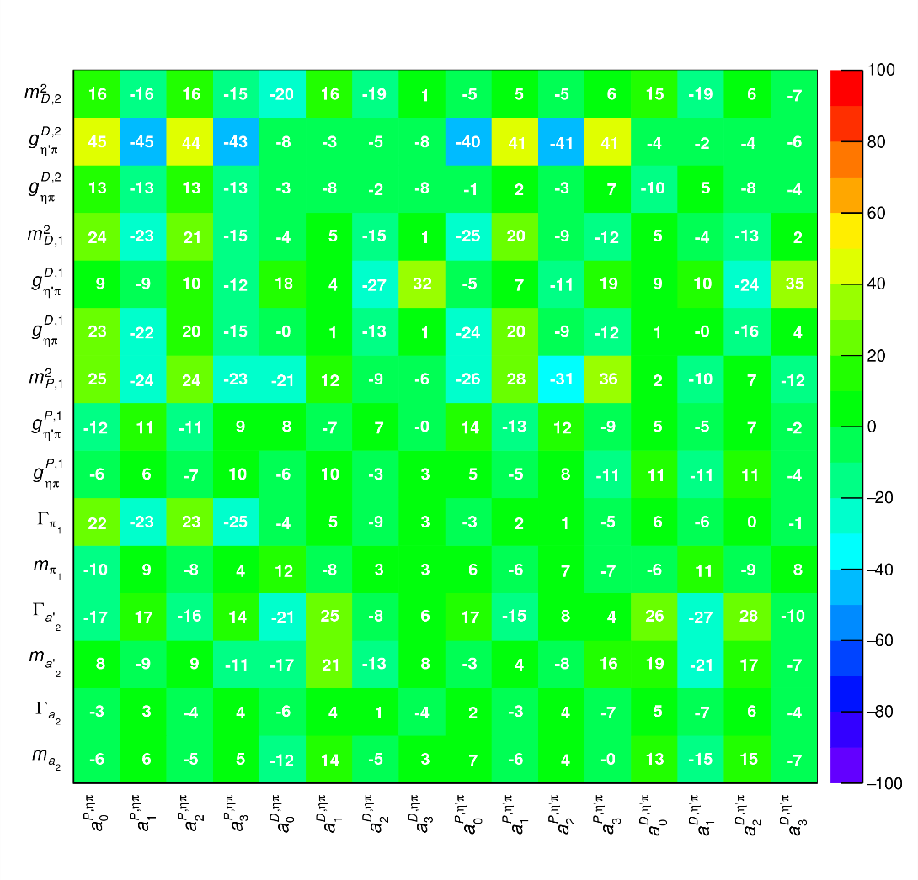
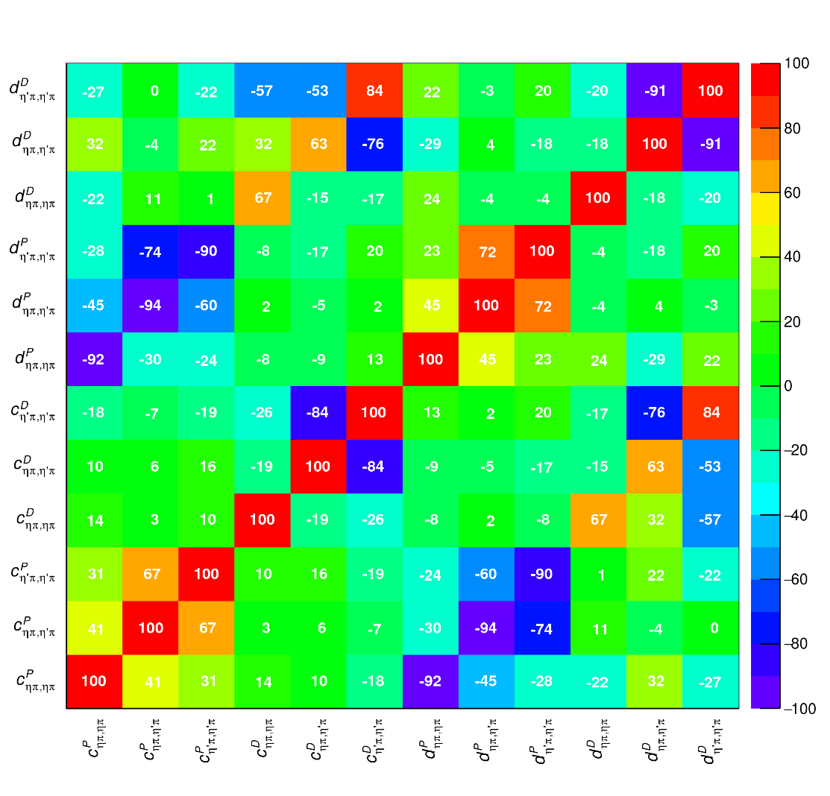
Correlations
Denominator parameters uncorrelated with the numerator ones ✓
Denominator parameters uncorrelated between P- and D-wave ✓
Production (numerator) parameters
K-matrix «bkg» parameters
K-matrix «pole» parameters
K-matrix «bkg» parameters
A. Pilloni – Theoretical review of light meson spectroscopy
Notes:
Controlla la parte su Regge

Slide 40
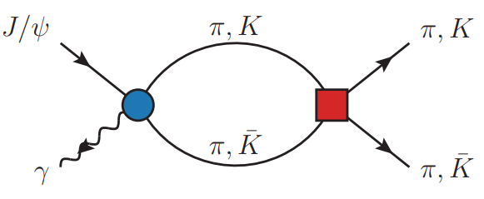
Amplitudes for $J/ψ→γ PP$
Rodas et al., EPJC 82, 1, 80
We build the partial wave amplitudes according to the $N/D$ method
$$n(s)$$
$$a\left(s\right)=\frac{n\left(s\right)}{D\left(s\right)}$$
$$D(s)$$
The $n\left(s\right)$ → background physics, process-dependent, smooth
The $D(s)$ contains all the Final State Interactions constrained by unitarity → universal
A. Pilloni – Theoretical review of light meson spectroscopy
Notes:
Controlla la parte su Regge

Slide 41
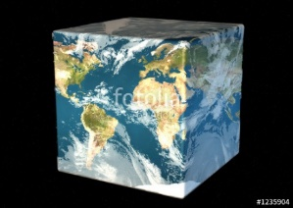
Exo(tic) Had(ron) TC
Funded in 2023 by DoE as a Topical Collaboration in Nuclear Physics
Hybrids from Scattering
Form factors
Lattice QCD
Aims at exploring all aspects of exotics (= hybrids at GlueX)
Quark level calculations
Lessons from EFTs
QCD
Studying details of production mechanisms of exotics at GlueX
Finite energy sum rules
Amplitude Analysis
Phenomenology
A. Pilloni – Theoretical review of light meson spectroscopy
Notes:
Controlla la parte su Regge

Slide 42
Coupled channel: the model
A. Rodas, AP et al. (JPAC) PRL122, 042002
Two channels, $i,k=ηπ, η^{′}π$ Two waves, $J=P,D$ 37 fit parameters
1 K-matrix pole for the P-wave
2 K-matrix poles for the D-wave
Left-hand scale (Blatt-Weisskopf radius) $s_{R}=s_{0}=1 {\text{GeV}}^{2}$
$α=2$, 3rd order polynomial for $n_{k}^{J}(s)$
A. Pilloni – Theoretical review of light meson spectroscopy
Notes:
Controlla la parte su Regge

Slide 43
How theorists think of experiments
All the information about hadrons is collected by the Particle Data Group
$$G$$
Changing beam and target, you can change the font
P
D
What theorists see…
What experimentalists present…
A. Pilloni – Theoretical review of light meson spectroscopy

Slide 44
Real(istic) conversations between theorists and experimentalists
T: How could you not find the XXX quantum numbers?
E: Well, you know, 5D fit, O(100) parameters, local minima, systematics…
T: You are not that good, are you?
T: You shouldn’t use Breit Wigners!
E: Gimme some better
T: I have an analytic unitary parametrization, but it works in a given mass window and only knows about energy dependence, you can’t add background terms to it…
E: Breit Wigners.
T: Stop using complex couplings!
E: HAHAHAHHAHAHAHAHAHHHAHAHAHA
A. Pilloni – Theoretical review of light meson spectroscopy
Notes:
2 slides su Zc, a Bes e a Belle
2 slide su tetraquark model: dall’hamiltoniana di Jaffe al calcolo delle masse
1 slide su molecular models, dove sono i carichi? (non in Tornqvist, si in Hanhart, vedere Braaten, citare Nefediev)
2 slides su decay channels, dove si dovrebbe vedere, e a seconda del modello, vedere qualche plot
1 slide su Y(4260), tetraquark? C’è lo strano (si vede la f0)
1 slide su Zc a cleo (anche il neutro)

Slide 45
Spectroscopy from peripheral production
Need to establish Regge factorization
Single Regge pole dominate
A. Pilloni – Theoretical review of light meson spectroscopy
Notes:
2 slides su Zc, a Bes e a Belle
2 slide su tetraquark model: dall’hamiltoniana di Jaffe al calcolo delle masse
1 slide su molecular models, dove sono i carichi? (non in Tornqvist, si in Hanhart, vedere Braaten, citare Nefediev)
2 slides su decay channels, dove si dovrebbe vedere, e a seconda del modello, vedere qualche plot
1 slide su Y(4260), tetraquark? C’è lo strano (si vede la f0)
1 slide su Zc a cleo (anche il neutro)

Slide 46
Options on the market
Quark-level calculations:
Quark models, pNRQCD, Hybrids, ...
Spectrum generally calculated as bound states of some potential
Decay rates as «overlap integrals» between two static configurations
Comprehensive picture ✓ Little scattering dynamics ✗
Hadron level calculations:
Microscopic models inspired to EFT + Unitarization
Compact states vs. molecules, triangles...
States as poles of scattering amplitudes
Couplings as residues at the poles
Scattering dynamics ✓ More case-by-case ✓✗
A. Pilloni – Theoretical review of light meson spectroscopy

Slide 47
Hybrid hunting
Constituent gluon (quasiparticle excitation), $J^{PC}=1^{+−}$, mass $∼1.0\text{−}1.5 \text{GeV}$
Look for a $π_{1}$ state with $J^{PC}=1^{−+}$
decaying into $\left\{\begin{matrix}η π \text{and} η^{′}π \\ ρ π→3π \\ b_{1}π→5π\end{matrix}\right.$
$$\overline{r}$$
$$\overline{g}$$
$$r$$
$$g$$
A. Pilloni – Theoretical review of light meson spectroscopy
Notes:
2 slides su Zc, a Bes e a Belle
2 slide su tetraquark model: dall’hamiltoniana di Jaffe al calcolo delle masse
1 slide su molecular models, dove sono i carichi? (non in Tornqvist, si in Hanhart, vedere Braaten, citare Nefediev)
2 slides su decay channels, dove si dovrebbe vedere, e a seconda del modello, vedere qualche plot
1 slide su Y(4260), tetraquark? C’è lo strano (si vede la f0)
1 slide su Zc a cleo (anche il neutro)

Slide 48
Amplitudes for $η^{(′)}π$
We build the partial wave amplitudes according to the $N/D$ method
Jackura, Mikhasenko, AP et al. (JPAC & COMPASS), PLB
Rodas, AP et al. PRL
$$a\left(s\right)=\frac{n\left(s\right)}{D\left(s\right)}$$
$$D(s)$$
The $D(s)$ contains all the Final State Interactions constrained by unitarity → universal
A. Pilloni – Theoretical review of light meson spectroscopy
Notes:
Controlla la parte su Regge

Slide 49
Amplitudes for $η^{(′)}π$
We build the partial wave amplitudes according to the $N/D$ method
Jackura, Mikhasenko, AP et al. (JPAC & COMPASS), PLB
Rodas, AP et al. PRL
$$a\left(s\right)=\frac{n\left(s\right)}{D\left(s\right)}$$
$$D(s)$$
$$n(s)$$
The $n\left(s\right)$ → background physics, process-dependent, smooth
A. Pilloni – Theoretical review of light meson spectroscopy
Notes:
Controlla la parte su Regge

Slide 50
Fit to $η^{(′)}π$
( data)
$$π_{1}\left(1400\right)?$$
$$a_{2}\left(1320\right)$$
$$a_{2}^{′}\left(1700\right)$$
$$π_{1}\left(1600\right)?$$
$$a_{2}\left(1320\right)$$
$$a_{2}^{′}\left(1700\right)$$
$$J^{PC}=1^{−+}$$
$$J^{PC}=2^{++}$$
A. Pilloni – Theoretical review of light meson spectroscopy
Notes:
Controlla la parte su Regge

Slide 51
Pole hunting
( data)
$$π_{1}$$
$$π_{1}$$
A. Pilloni – Theoretical review of light meson spectroscopy
Notes:
Controlla la parte su Regge

Slide 52
Final results
Agreement with Lattice is restored
That’s the most rigorous extraction of an exotic meson available so far!
A. Pilloni – Theoretical review of light meson spectroscopy
Notes:
Controlla la parte su Regge

Slide 53
Glueballs
The clearest sign of confinement in pure Yang-Mills The worst state to search in real life
Morningstar and Peardon PRD60, 034509
Gregory et al. JHEP1210, 170
A. Pilloni – Theoretical review of light meson spectroscopy

Slide 54
$J/ψ→γ π^{0}π^{0} and→γ K_{S}^{0}K_{S}^{0}$
We consider the $S$ and $D$ wave by BESIII to use the information about their relative phase.
The D-wave is populated by two almost elastic resonances: the $f_{2}(1270)$ and $f_{2}′(1525)$
$f_{2}(1270)$
$f_{2}′(1525)$
A. Pilloni – Amplitude analysis of $J/ψ→γ π^{0}π^{0}$

Slide 55
Same model as before
A. Rodas, AP et al. (JPAC) EPJC82, 1, 80 (2022)
Two/three channels, $i,k=ππ, KK$, $ρρ$ Two waves, $J=S,D$ 40-56 parameters
3 K-matrix pole for the S-wave
3 K-matrix poles for the D-wave
A. Pilloni – Theoretical review of light meson spectroscopy
Notes:
Controlla la parte su Regge

