Slide 1

EP-DT
Detector Technologies
Strategies for optimizing
the usage of greenhouse gas
in particle detection systems
R. Guida
CERN EP-DT Gas Systems Team

Slide 2
Outline
Greenhouse gases (GHGs) for particle detection
F-gas regulations
Strategies for optimizing GHGs usage: results, new projects and plans
  Recirculation systems
  Recuperation systems
  Ecofriendly gases
  GHGs disposal
Conclusions

Slide 3
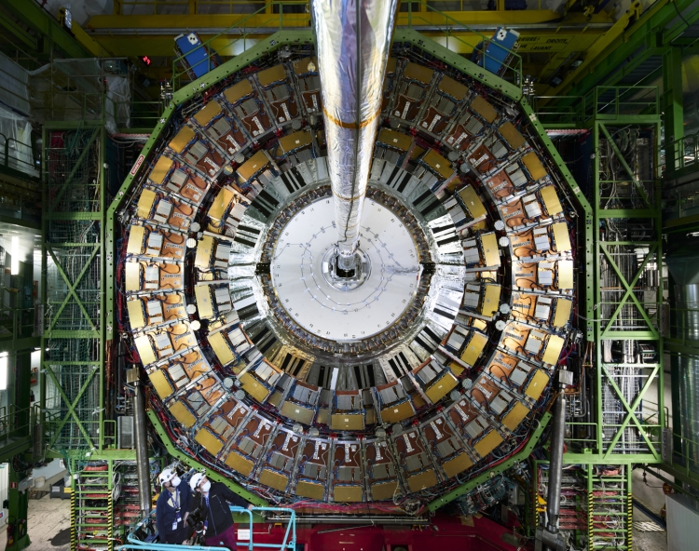
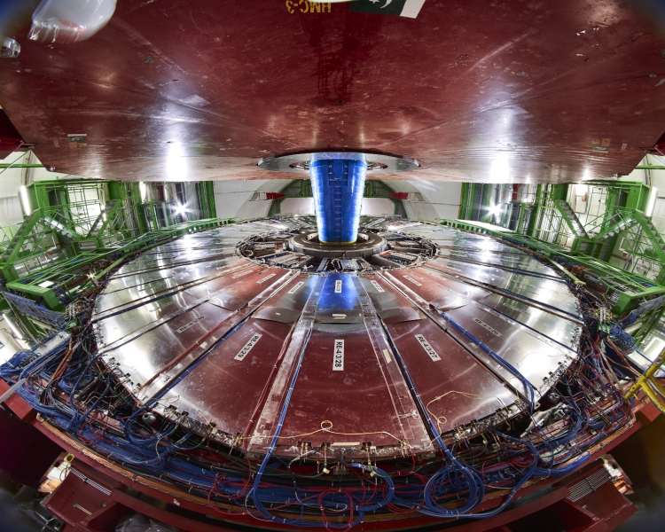
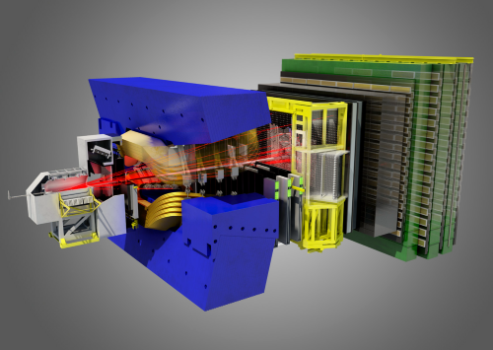
Gaseous detector technologies: examples from LHC experiments
Gaseous detectors are installed in all of the four main LHC Experiments and in many not-LHC facilities
Among gaseous detector systems, there are:
Muon systems:
located in the outermost region, covering large surface areas
Trackers:
located closer to the interaction point, usually operated in high-rate environments
Particle identification systems:
used to identify charged particle momenta
Detector technologies:
Triggering:
e.g., Resistive Plate Chambers, Cathode Strip Chambers, Drift Tubes
Tracking:
e.g., CSC, DT, GEM, MPGD
Particle identification:
e.g., RICH
CMS CSC
CMS RPC
RICH1
LHCb
RICH2

Slide 4
Gaseous detector systems at LHC
Gases are used as active medium in different research fields:
-ionization (proportional counters, GEM, RPC, …)
-light radiator (Cherenkov radiation, RICH)
-chemical reaction (CLOUD experiment)
-particle production (accelerators)
Gases can be
-very expensive:
operation budget is of the order of few MCHF (0.7 MCHF only for R134a)
-potentially dangerous for the environment:
typical example are greenhouse gases (GHG) like Freon.
A GHG is any gaseous compound that is capable of absorbing infrared radiation, thereby trapping and holding heat in the atmosphere (greenhouse effect).
Gas volume and type represent a very wide phase space:
-from few litres to several hundred cubic meters
-Xenon, Freon, CxHy, …
Very Large apparatus: detector volume from < 1 m³ up to several 100 m³
High mixture flow
Use of expensive and/or greenhouse gases
Operational costs issue
Optimization of gas usage: mandatory!
A lot of work already from the design phase

Slide 5
Gas mixtures for the LHC experiments
Depending on the purpose and the geometry of the detectors, different gas mixtures are required
Some detectors work with a single pure gas:
C₄F₁₀
  RICH1
Other detectors need mixtures with 2 up to 4 components
CO₂/Ar-CO₂/Ar/ CF₄ – CO₂/ CF₄
  CSC
  MWPC
  RICH2
  GEM
  DT
C₂H₂F₄/iC₄H₁₀/SF₆
  RPC
  MID
  TOF
Some of these gases are GREENHOUSE GASES (GHGs)
Notes:
Fare schema invece di lista → gas freccia e detector (esempio)

Slide 6
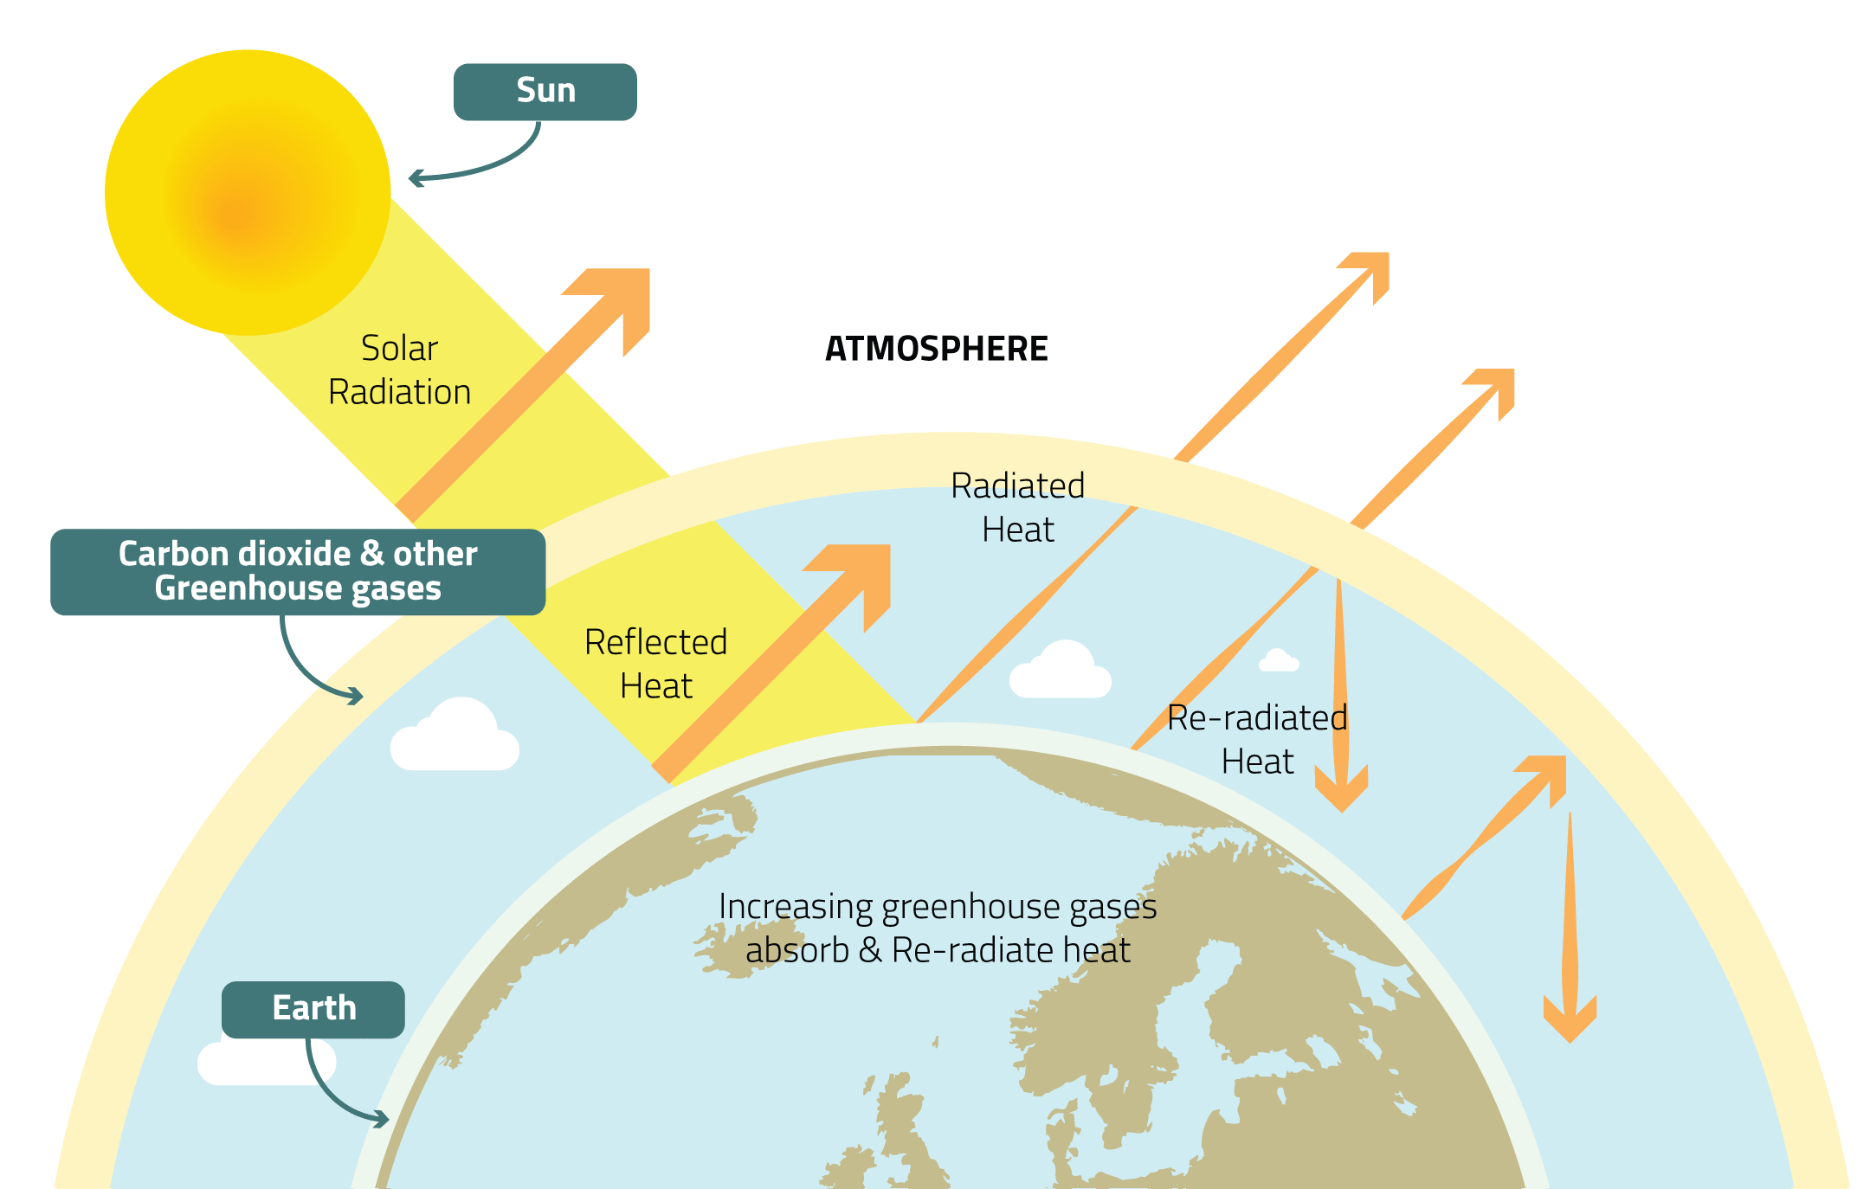
Global Warming Potential (GWP) and GHG emissions at LHC
Greenhouse Gases (GHGs) are gases in the earth’s atmosphere that trap heat.
Global warming potential (GWP) is an index to measure of how much infrared thermal radiation a GHG would absorb over a given time. It is expressed as a multiple of the radiation that would be absorbed by the same mass of carbon dioxide, which is taken as a reference gas.
Gas | Atmospheric lifetime | GWP_{100 years}
CO₂ | 50-200 years | 1
R-134a | 14 years | 1430
CF₄ | 50,000 years | 7390
C₄F₁₀ | 2600 years | 9200
SF₆ | 3200 years | 22800

Slide 7
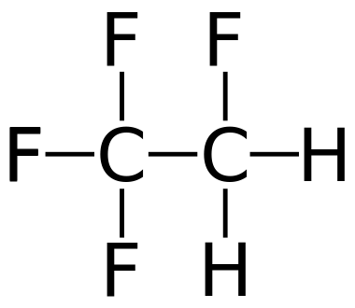
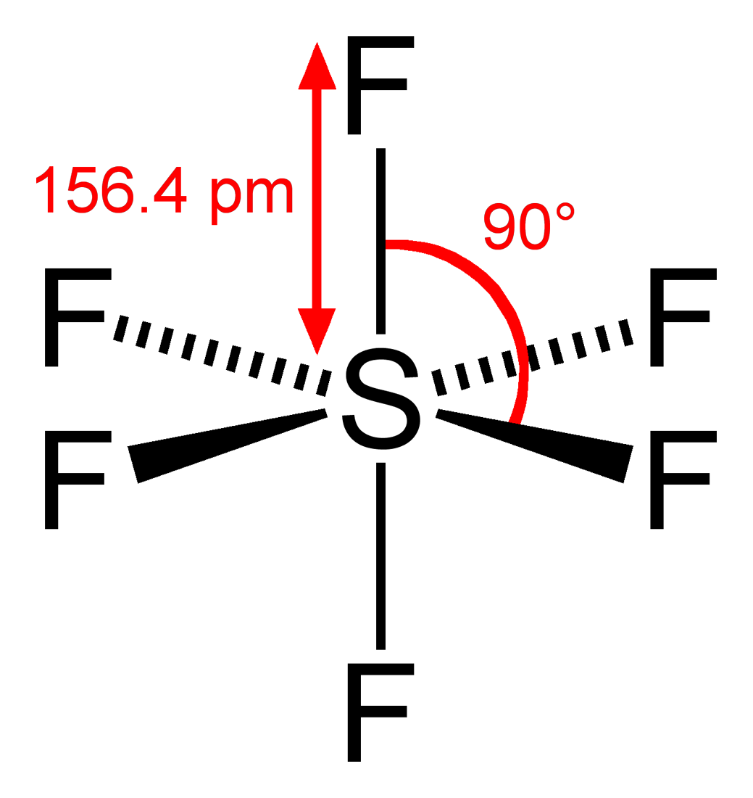
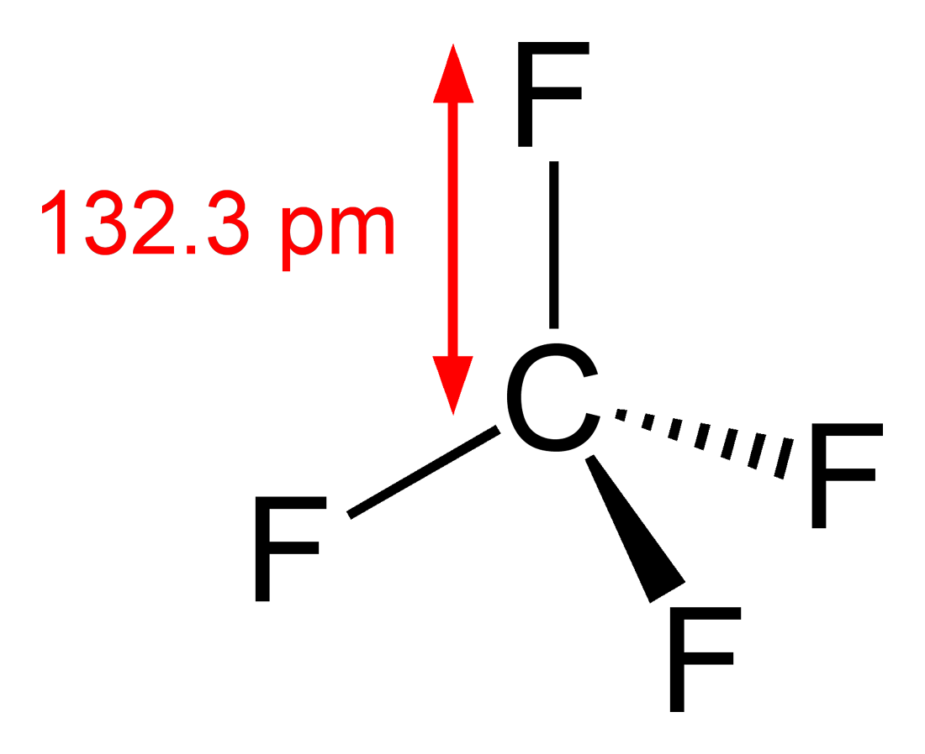
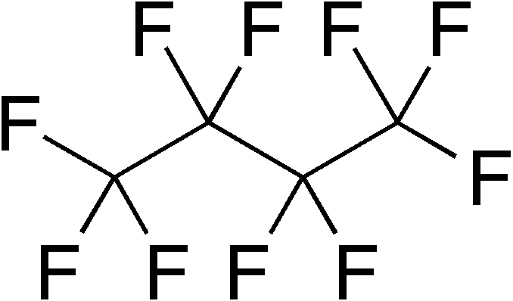
Gaseous detector systems at LHC
Nowadays increased attention on GHGs emissions: F-gas regulation aims in limiting emissions, GHGs availability, price, …
GHGs are used because needed to achieve specific detector performance and/or long-term stability
C2H2F4
GWP 1430
SF6
GWP 22800
CF4
GWP 7390
C4F10
GWP 8860
Containment of charge
Rate capability
limiting charge development
Cherenkov radiator
Resistive Plate Chamber (RPC)
Cherenkov detector (RICH)
Mitigation of aging phenomena
Time resolution
Cathode Strip Chamber (CSC)
Multi Wire Proportional Chamber (MWPC)
Gas Electron Multiplier (GEM)

Slide 8
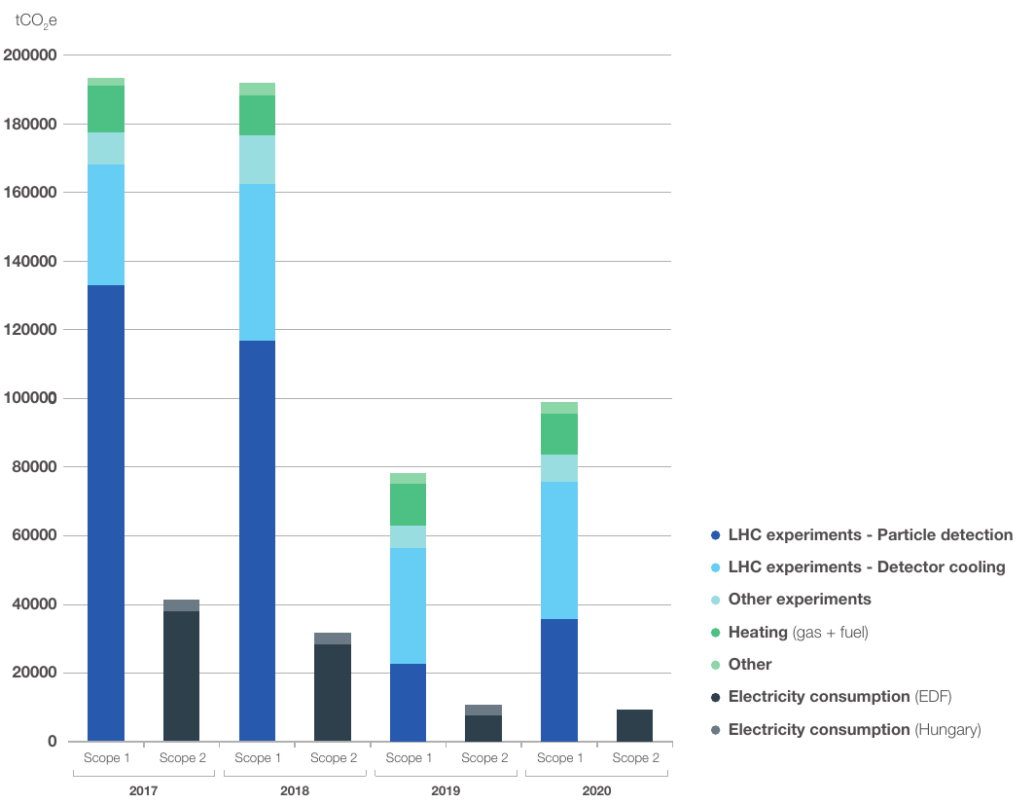
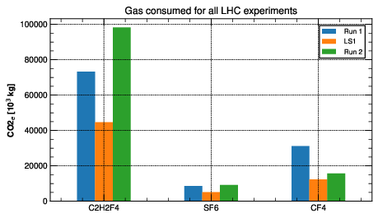
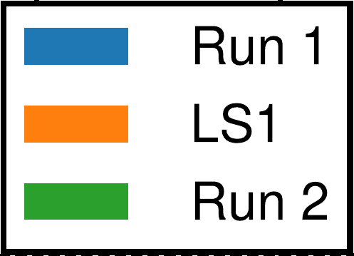

Greenhouse gas usage
CERN Environment Report 2019-2020
2021: CERN’s Year of Environmental Awareness.
CERN Environment workshop: 12 and 13 October 2022
CERN Environment Report 2021-2022
Total CERN emissions during 1 year of Run 2 ~ 200 000 tCO2e
~ 50% from particle detectors → mostly due to leaks and operation
C₂H₂F₄/R-134a biggest contributor → leaks from RPC detector
CF₄ → due to operation of CSC and RICH systems
SF₆ → Related to RPCs as R-134a
Emissions from
particle detection
tCO_{2e}
2017
2018
2019
2020
R-134a
SF6
CF4
Run2
LS2

Slide 9
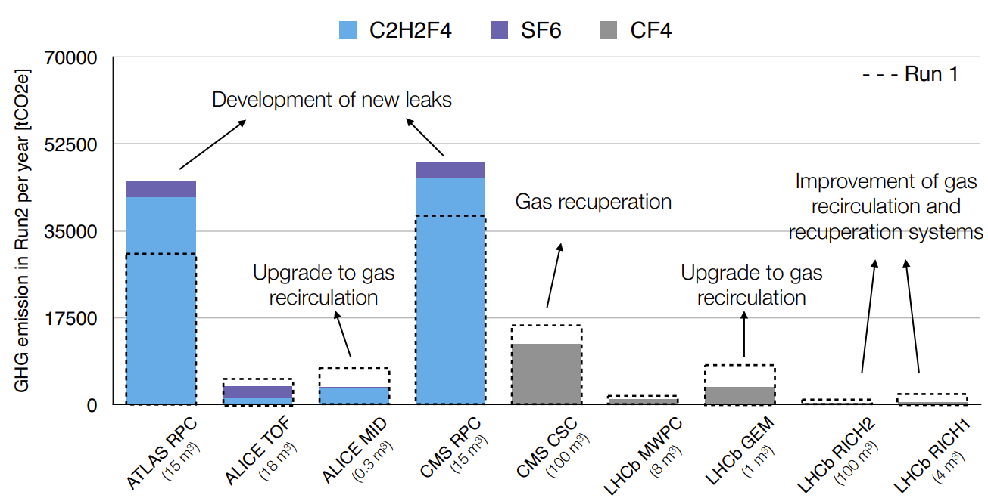
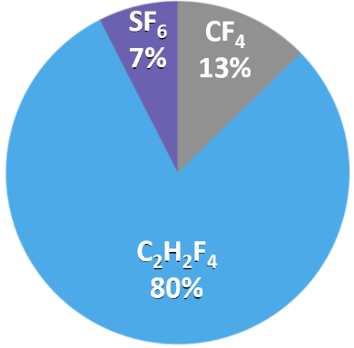
Gaseous detector systems at LHC
Of course, GHG usage in particle research is negligible wrt other activities.
However, GHG optimization is mandatory, and it can secure operation over the LHC run period and reduce costs.
-40% GHG emissions from Run 1 to Run 2 excluding ATLAS and CMS RPC systems
-25% GHG emissions from Run 2 to Run 3 excluding ATLAS and CMS RPC systems
New objective: -28% by 2024 wrt 2018 (Run2)

Slide 10
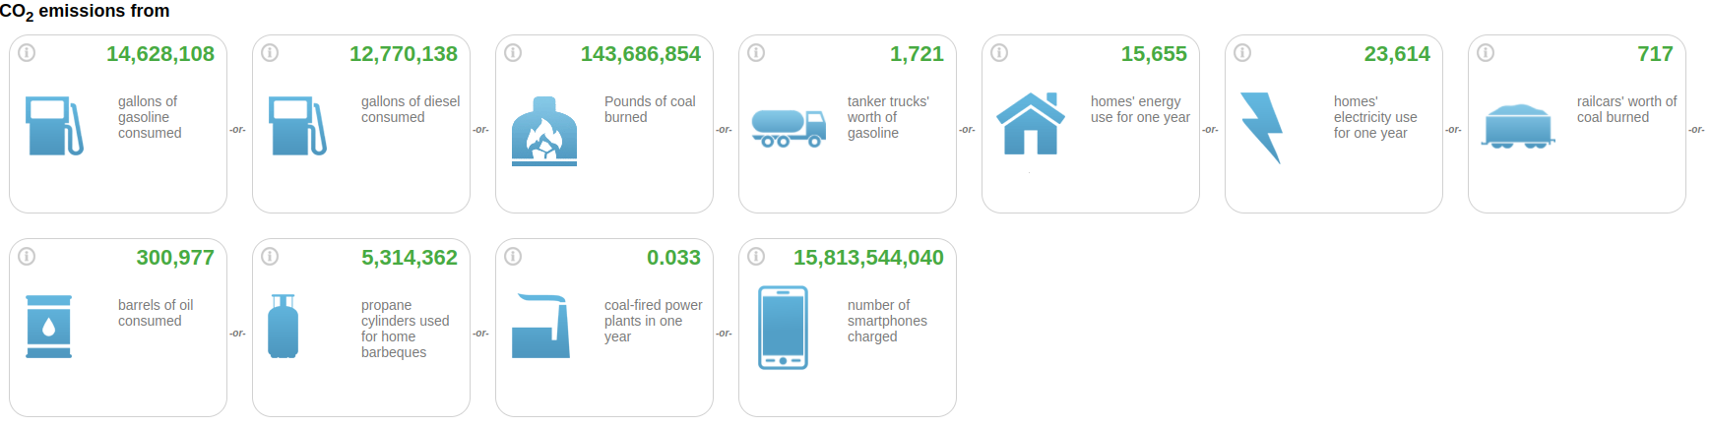
GHG emissions: a comparison
Run 2 emissions from F-gases ~ 130 000 tCO2e
Geneva emissions 2019 ~ 2 650 000 tCO2
Switzerland emissions 2018 ~ 39 637 007 tCO2e
CERN contribution ~ 5% of Geneva, 0.3 % of Switzerland GHG emissions
https://www.epa.gov/energy/greenhouse-gas-equivalencies-calculator

Slide 11
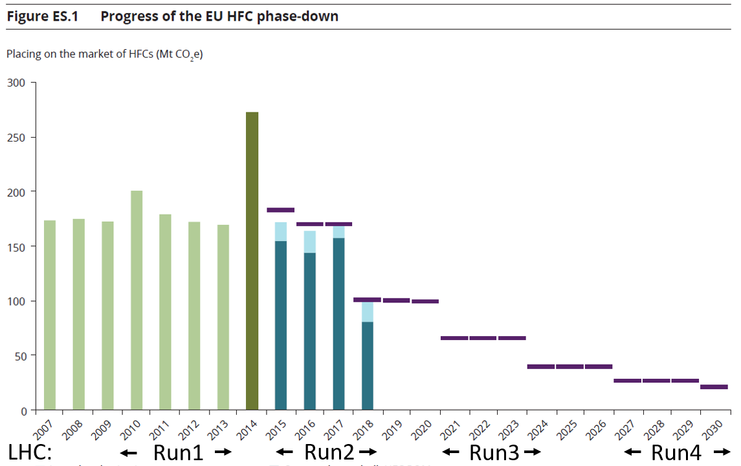
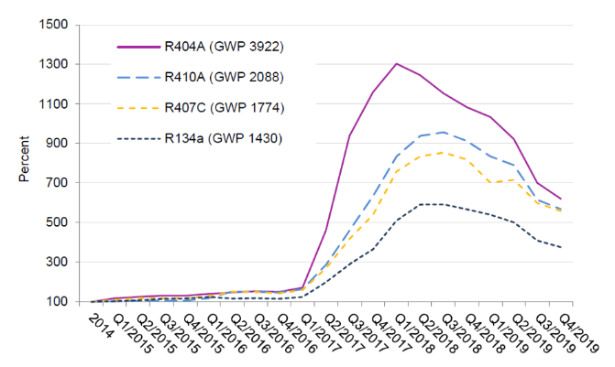
Greenhouse gas regulation
Due to the environmental risk, “F-gas regulations” started to appear. For example, the EU517/2014 is:
Limiting the total amount of the most important F-gases that can be sold from 2015 onwards. By 2030, it limits the use to 1/5 of 2014 sales.
Banning the use of F-gases in new equipment where less harmful alternatives are available.
Preventing emissions of F-gases from existing equipment by requiring checks, proper servicing and recovery of gases.
HFC phase down: effects on HFC availability and prices
Price fluctuations:
decrease due to industrial conversion to new low GWP gases
Reduction in availability over LHC operation
increase due to EU HFC phase-down/reduced availability
100%
93%
Today
63%
45%
31%
24%
21%
Today
Run3
Run4
Sources: European Environment Agency, Fluorinated greenhouse gases 2019 report
Öko Recherche report, March 2020 J. Kleinschmidt et al.
Goal: reduce F- gases consumption and emissions from particle detectors

Slide 12
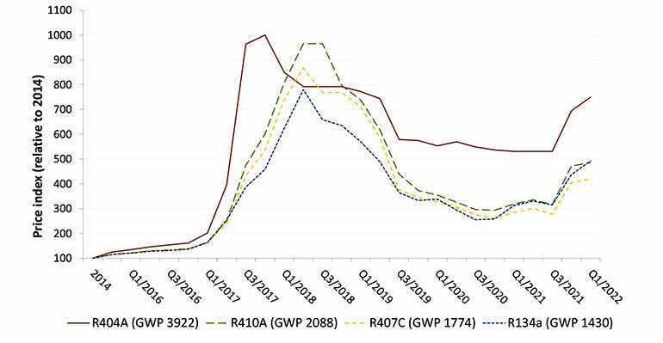
New F-gas regulation: from phase down to phase out
The new Regulation establishes the total elimination of HFCs by 2050
It is a major step towards climate neutrality
First goal: reduction of 55% GHG emissions by the end of this decade compared to 1990 levels
New restrictions also in the use of SF6 and especially for high GWP gases
It will result in a reduction in production and reduced quotas for F-Gas refrigerants, leading to an inevitable increase in prices for higher GWP refrigerants
    It will probably affect not-EU market
Important also to consider possible new regulation for all PFAS
EU F-gas 2015
Average purchase prices of the most commonly used HFC refrigerants
EU-2023 revision
increase due to EU HFC phase-down/reduced availability
decrease due to industrial conversion to new low GWP gases
LHC RUN 2
LHC RUN 3
LHC RUN 4
LHC RUN 5
LHC RUN 6

Slide 13
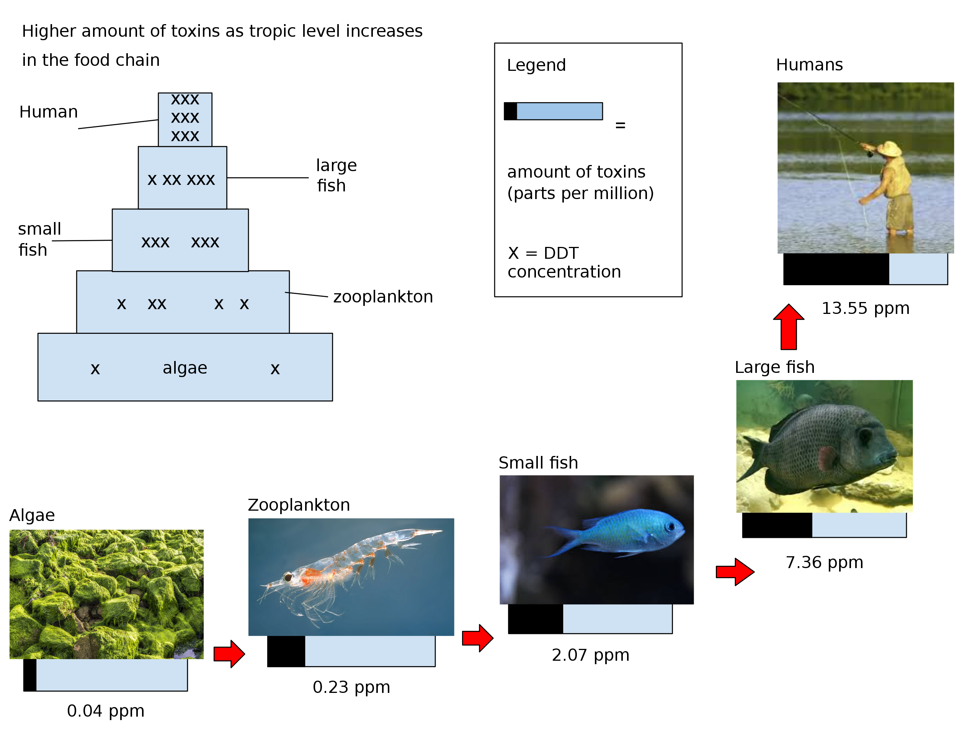
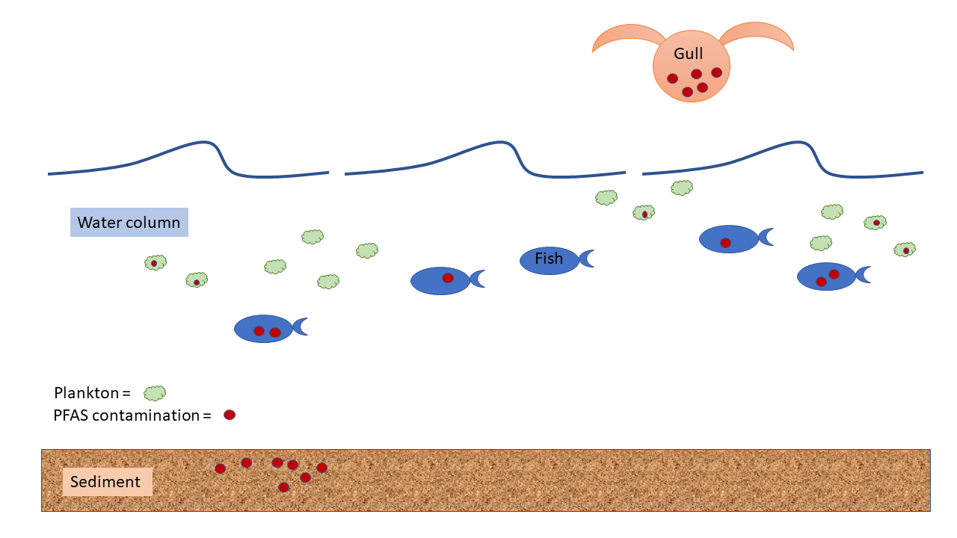
And now: PFAS - “forever chemicals”
PFASs: fluorinated substances containing at least one fully fluorinated methyl or methylene carbon atom (without any H/Cl/Br/I atom attached to it), i.e. with a few noted exceptions, any chemical with at least a perfluorinated methyl group (–CF3) or a perfluorinated methylene group (–CF2–) is a PFAS
PFASs play a key economic role for companies such as DuPont, 3M, and W. L. Gore & Associates because they are used in emulsion polymerization to produce fluoropolymers. They have two main markets: a $1 billion annual market for use in stain repellents, and a $100 million annual market for use in polishes, paints, and coatings. In 2022, 3M announced that it will end PFAS production by 2025.
Bioaccumulation and biomagnification

Slide 14
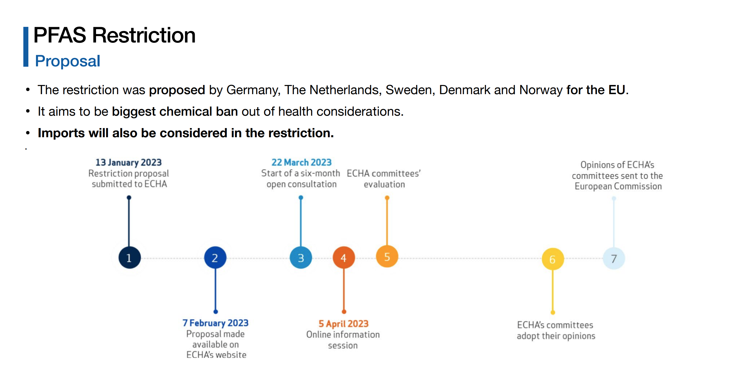
September 2023
Consultation

Slide 15
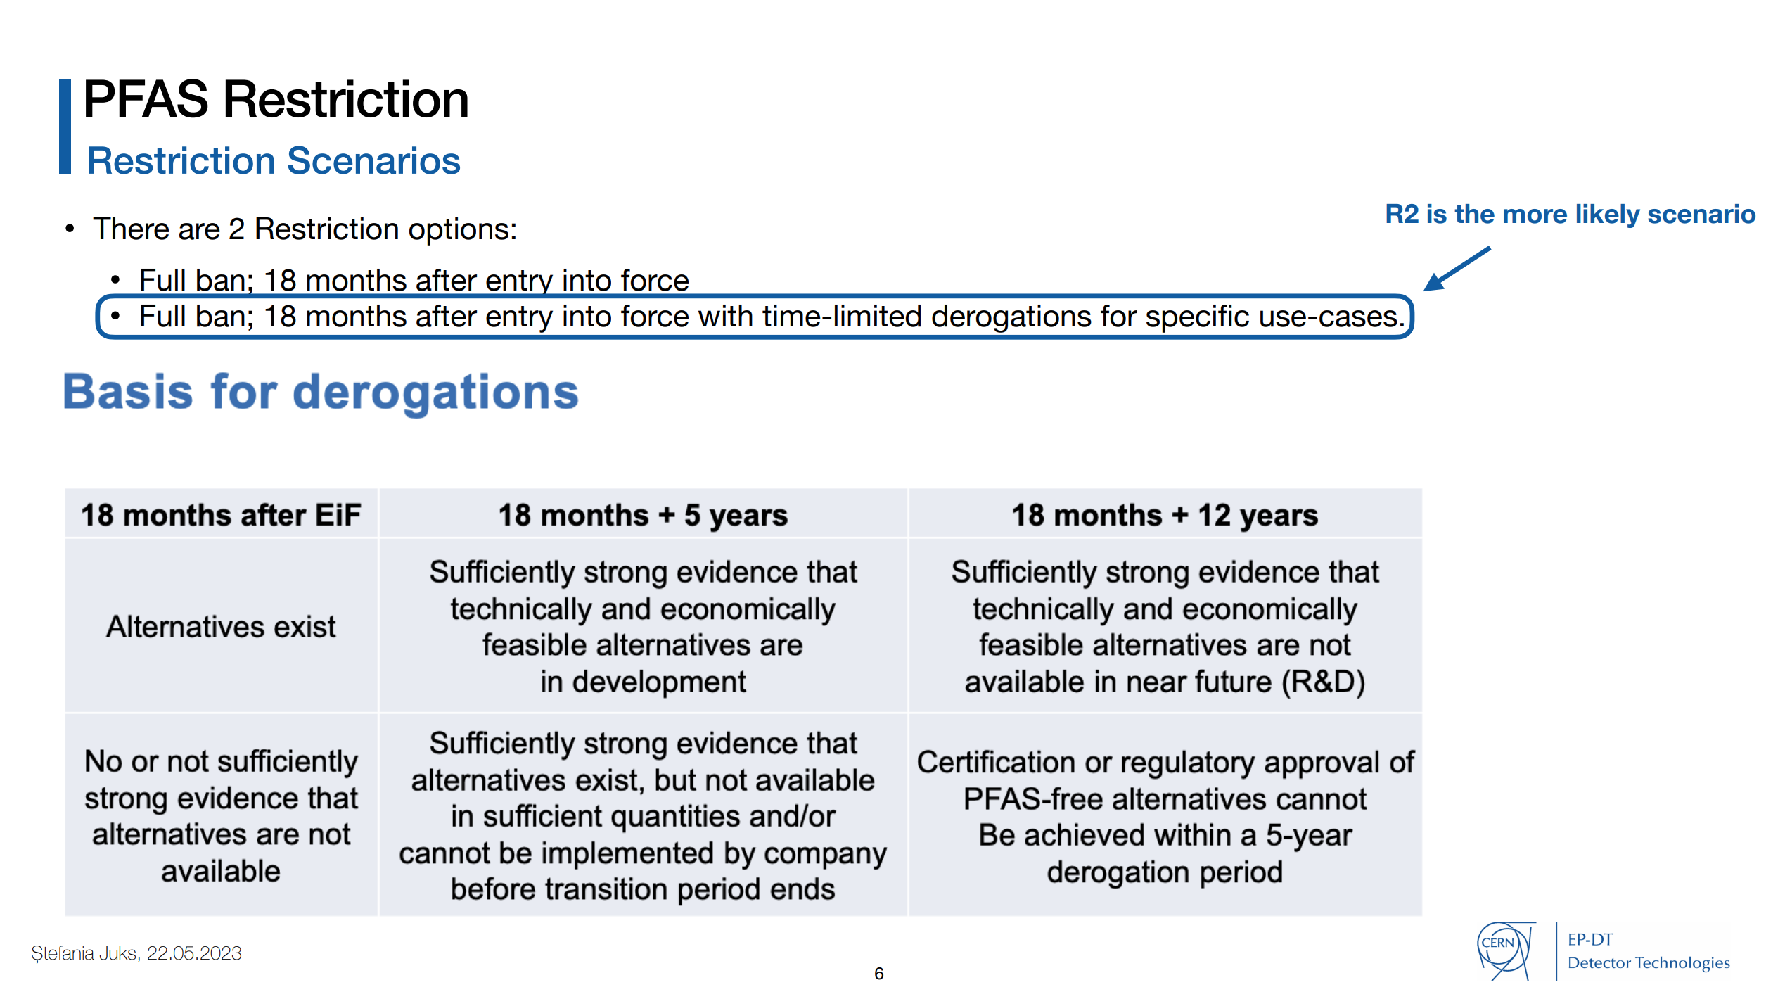

Slide 16
GHG Optimization: CERN Strategies
How to reduce greenhouse gas usage
Optimization of current technologies
Gas Recuperation
Alternative Gases
Gas disposal
Gas recirculation
Membrane separation
Pressure swing
Particular attention to operation
Improved controls and monitoring
Cryogenic/cold separation
GHGs destruction
New eco-friendly gases, HFOs, …

Slide 17
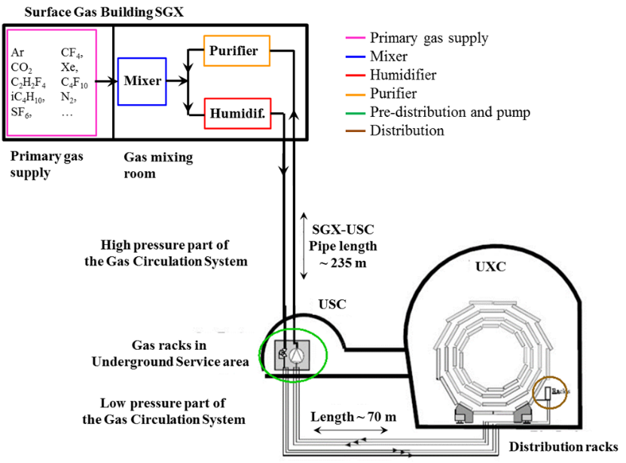
Gas mixture recirculation system
Gas systems extend from the surface building to service balcony on the experiment following a route few hundred meters long.
Primary gas supply point is located in surface building
Gas system distributed in three levels:
  Surface (SG)
  Gas Service room (USC)
  experimental cavern (UXC)
The gas systems were built according to a common standard allowing minimization of manpower and costs for maintenance and operation.
  Construction started early 2000
  Operational since 2005-2006
The CERN gas service team (EP-DT-FS, BE-ICS)

Slide 18
Gas systems: open mode
Basic gas system: Open mode operation
Gas mixture prepared and sent to the detector.
  → advantages: very simple to build and operate. No particular need of monitoring impurities.
  disadvantage: mixture is vented after being used, i.e. potential source of high gas consumption and high emissions
GAS MIXER
DETECTOR
EXHAUST

Slide 19
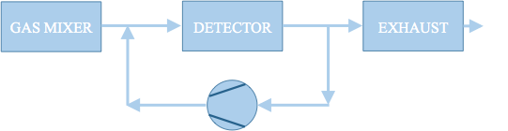
Optimization of current technologies: gas recirculation
All gas systems are designed to recirculate the gas mixture: average 90% gas recirculation → 90% reduction of consumption/emissions
Advantages:
- Reduction of gas consumption
Disadvantages:
- Complex systems
- Constant monitoring (hardware and mixture composition)
- Use of gas purifying techniques
The remaining 10% is what we started to address from LS1. It is needed to compensate for:
  Leaks at detector: 85 % (mainly ATLAS and CMS RPC systems)
  15% N₂ intake (CMS-CSC, LHCb-RICH1, LHCb-RICH2)
Two remaining open mode systems upgraded to gas re-circulations from Run1 to Run2:
ALICE-MTR: from Run1 to Run2: 75% GHG reduction
LHCb-GEM: from Run1 to Run2: 90% GHG reduction
  → For both detector systems: Original investment was totally paid back by gas cost saving during few years of operation
and laboratory setups:
2013: Development of "A portable gas recirculation unit" JINST 12 T10002
2020: Development of Gas recirculation systems for RPC detectors: from LHC experiments to laboratory set-ups - RPC2022

Slide 20
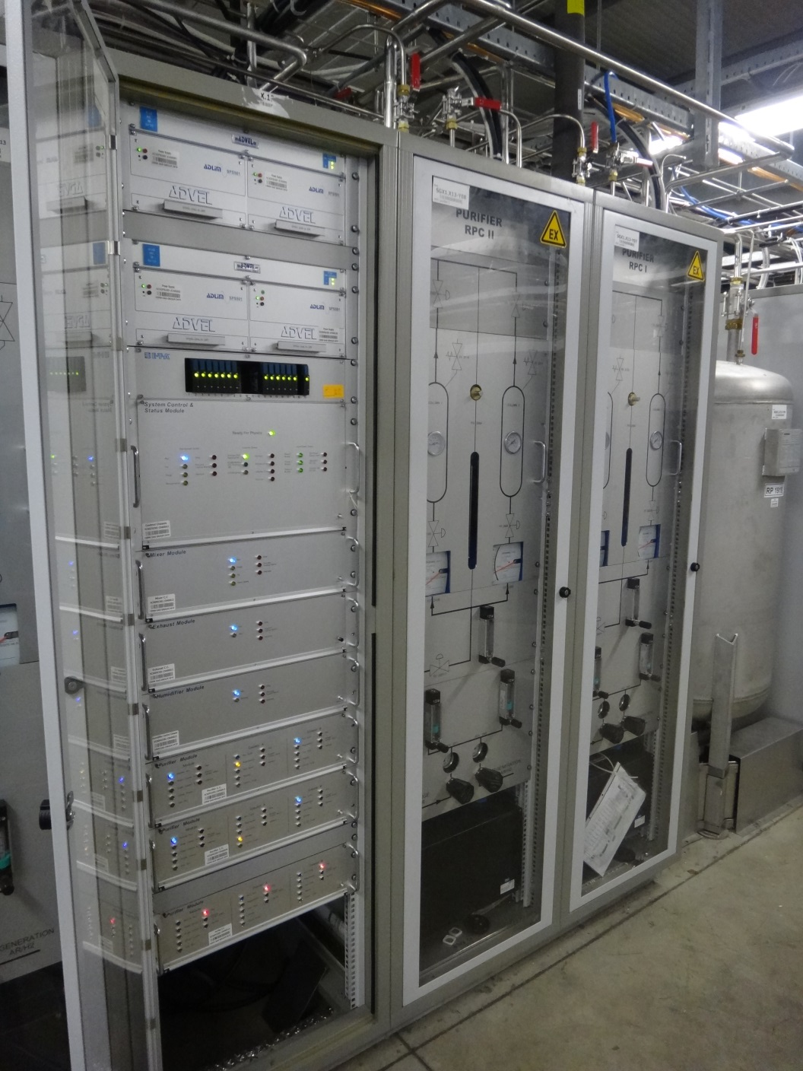
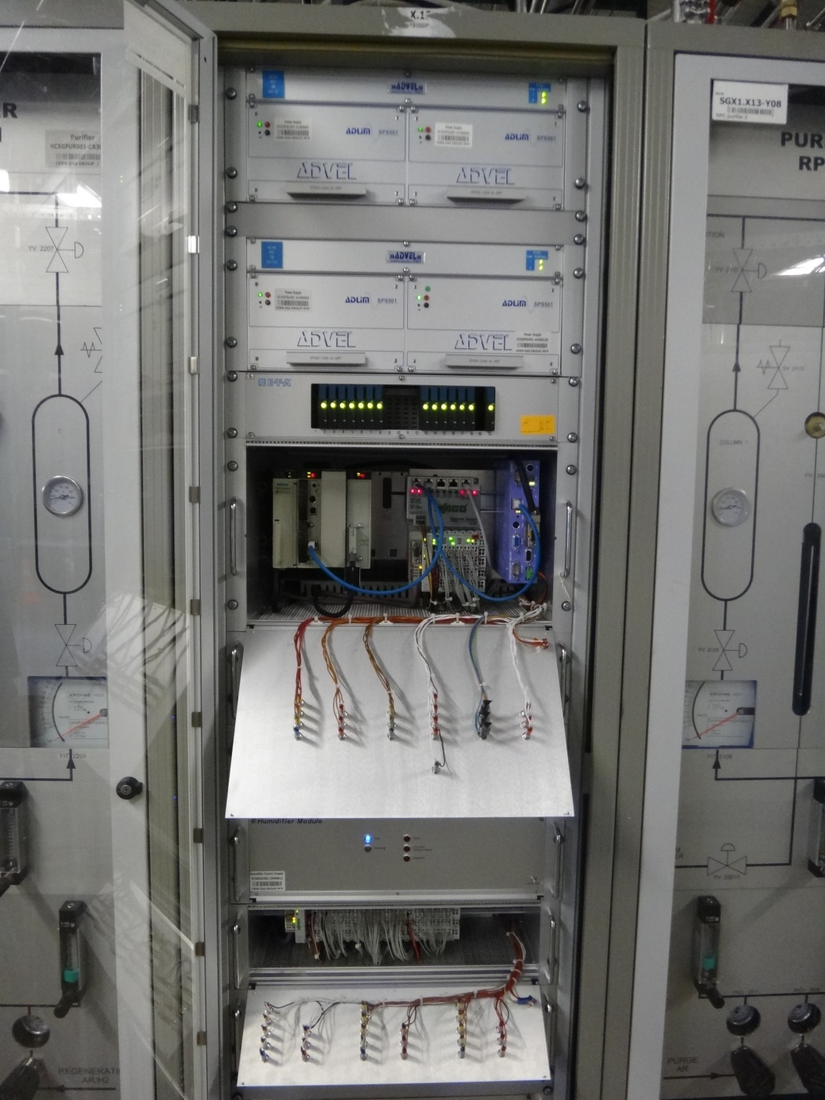
Gas system construction: modularity
Gas systems are made of several modules (building blocks): mixer, pre-distribution, distribution, circulation pump, purifier, humidifier, membrane, liquefier, gas analysis, etc.
Functional modules are equal between different gas systems, but they can be configured to satisfy the specific needs of all particle detector.
Implementation: control rack and crates (flexible during installation phase and max modularity for large systems)
Control rack
Control crate
(PLCs)
Modules crates
Profibus connection to control crate

Slide 21
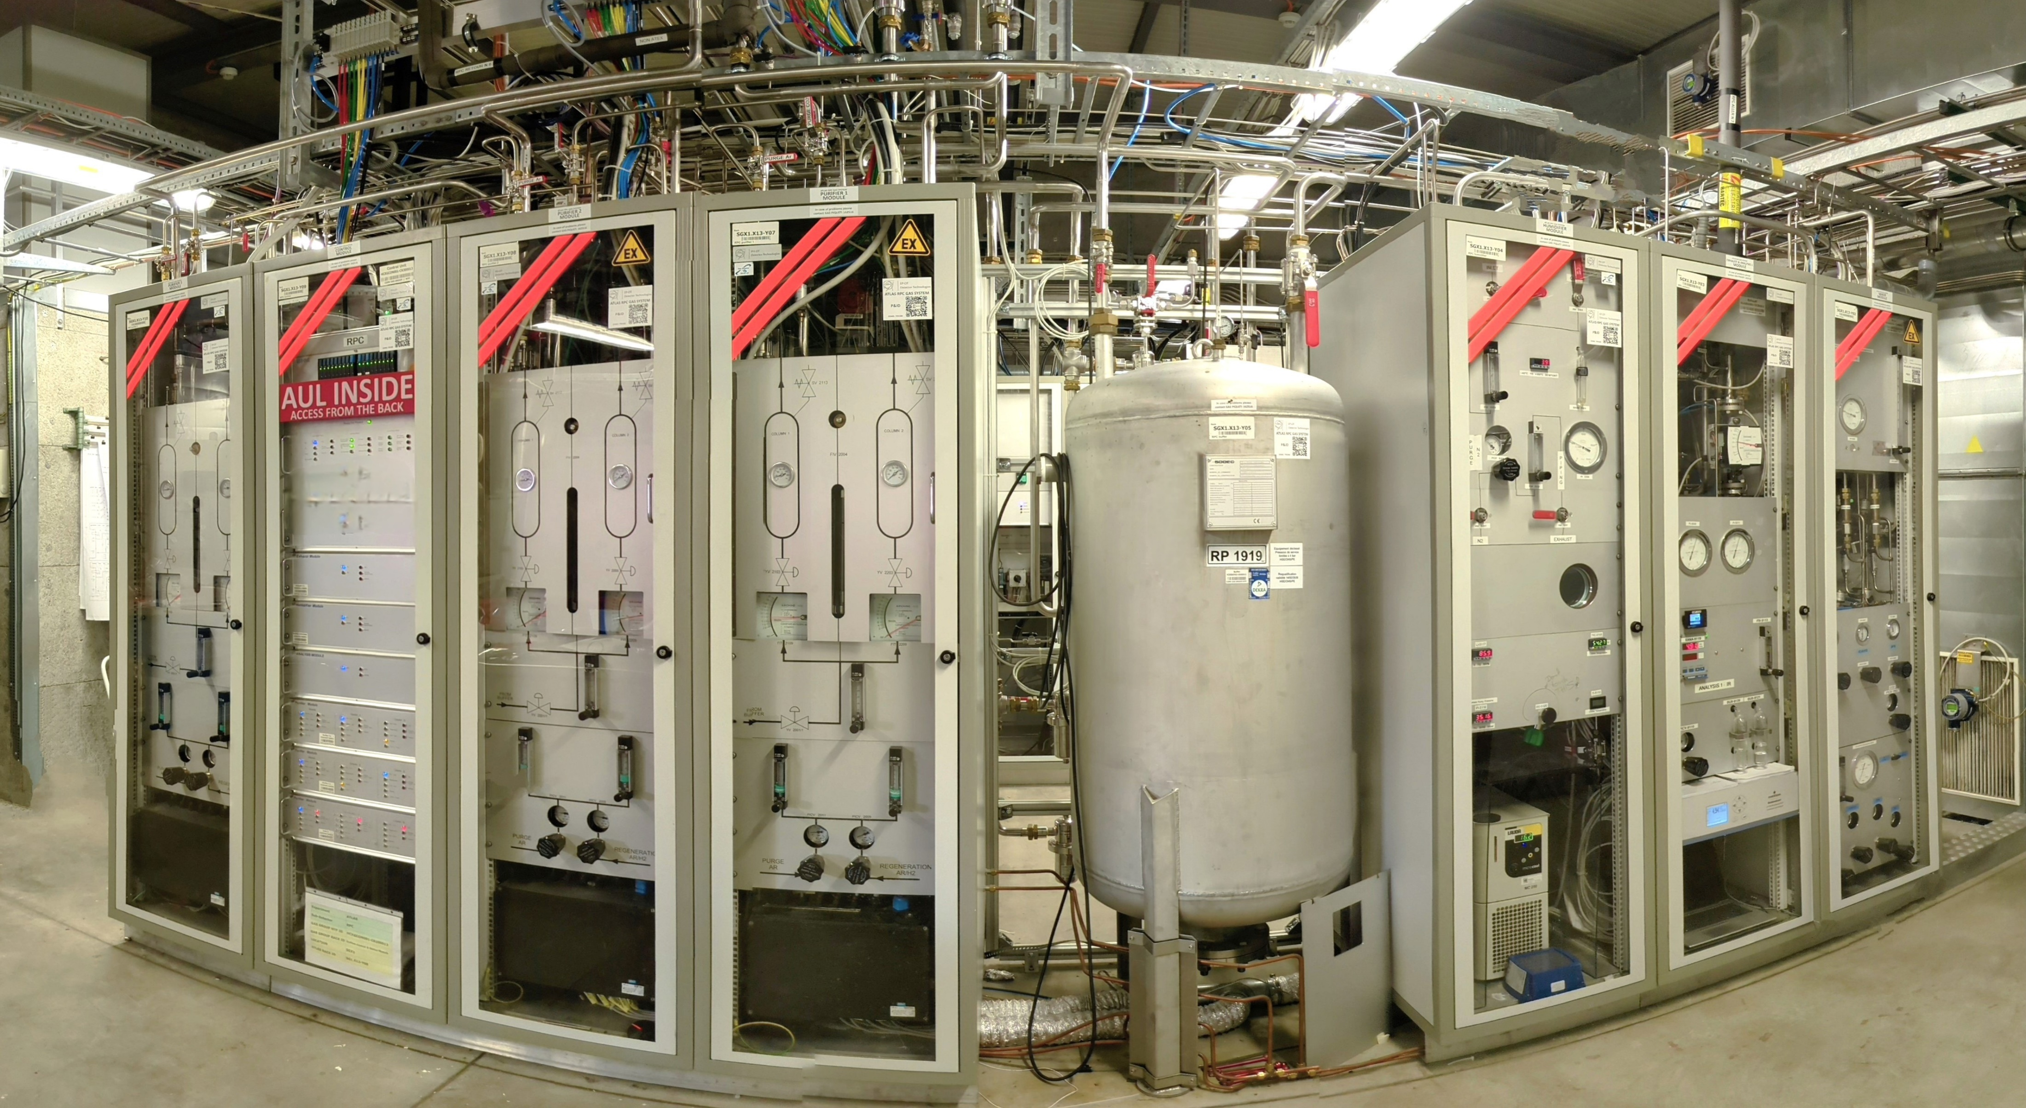
Gas system construction: modularity
Gas systems modules in surface building
Controls module
Purifier 2
High pressure buffer
Analysis
Purifier 1
Purifier 3
Humidifier
Mixer

Slide 22
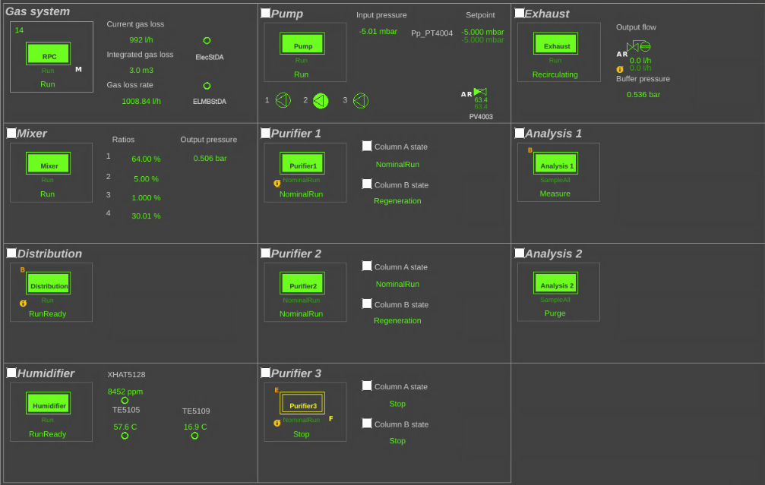
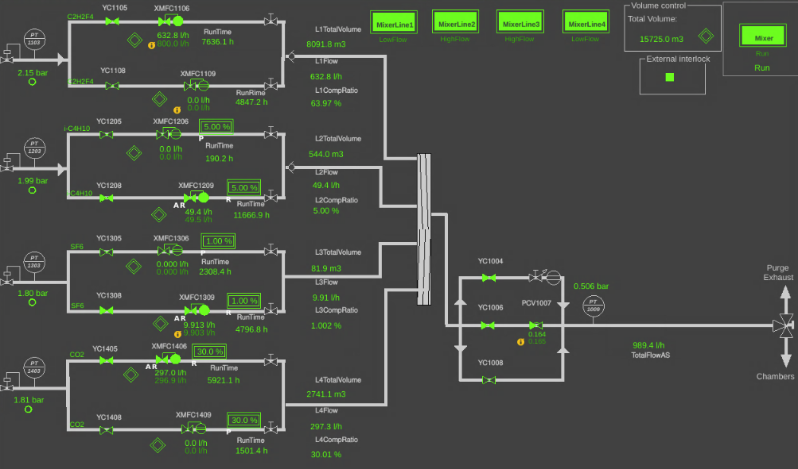
Gas system construction: modularity
View from software controls
Functional modules
Example: detail of mixer module

Slide 23
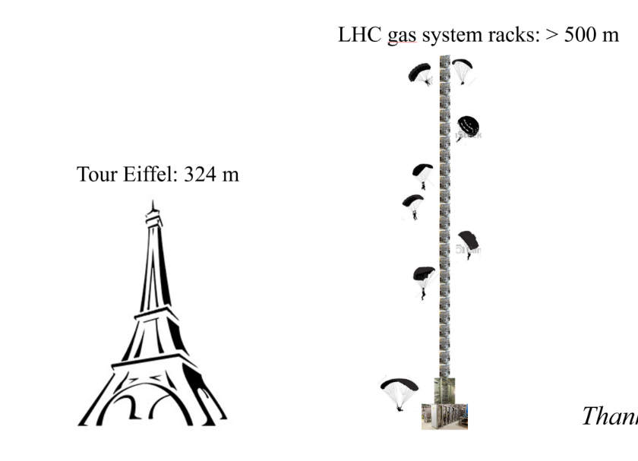
Gas mixture recirculation systems
Reliability
  LHC experiments are operational 24/24 7/7
  Gas systems must be available all time
Automation
  Large and complex infrastructure
  Resources for operation
  Repeatability of conditions.
Stability
  Detector performance are strictly related with stable conditions (mixture composition, pressures, flows, …)
Few numbers:
Construction started in 2000
Operational since 2005-2006
30 gas systems detectors at the LHC experiments
300 Universal Euroracks → x2 height of Eiffel Tower
60 PLCs
150 MFCs
4000 flow meters in distribution racks
~ 70 gas analyzers and 6 gas chromatographers
Per gas system:
  ~ 2-3 km pipes
  > 1000 connectors and 500 welds
  ~ 40 Pressure sensors
  ~ 10 Regulation valves
  < 0.1 l/h leak rate

Slide 24
Requirements and Quality Assurance
Gas systems (as detectors) are subject to severe requirements on material & gas for safe detector operation:
Mainly (if needed only) stainless steel pipe and components
Need to validate the gas system components (ageing test setup)
Documentation for QA and easy operation/maintenance follow up
Monitoring of gas system operation
Monitor of supply gases and mixture composition
Evaluation of operational cost
Flexible design to accommodate detector requirements/upgrades
Careful evaluation of
  resources for operation
  resources for maintenance activity
  Stability required
  Balance requirements vs safety (as much as possible)

Slide 25
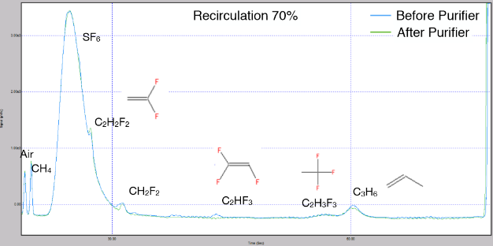
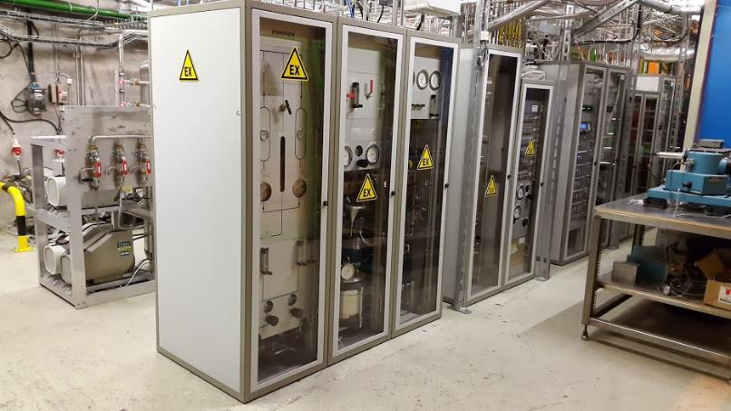
ALICE-Muon Trigger RPCs/MID
Mixture: C₂H₂F₄ 89.7%, SF₆ 0.3%, iC₄H₁₀ 10%
Detector volume: 300 liters (much smaller wrt ATLAS and CMS-RPC systems)
Therefore, originally designed in open mode → upgraded to gas recirculation in 2015
From Run1 to Run2:
75% GHG reduction
Original investment already largely paid back by gas cost saving during operation
RPC operated in slightly different conditions (higher pulse charge):
→ Impurities due to fragmentation of main gas components are visible
Closely monitored
Detector performance are not affected by gas recirculation
More details in
Gas mixture monitoring for the RPC at LHC (RPC2018)

Slide 26
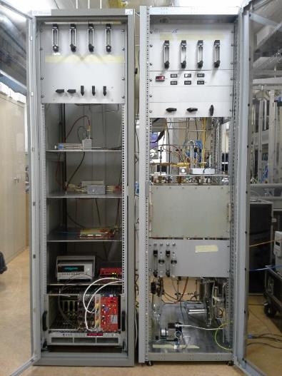
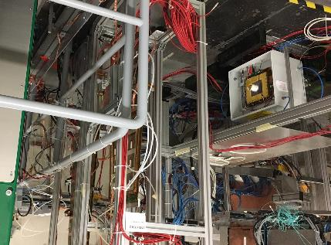
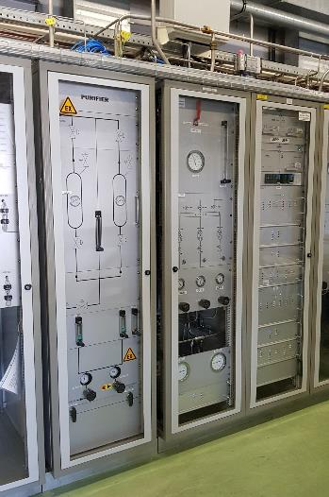
LHCb-GEM example
Mixture: CF₄ 40%, Ar 45%, CO₂ 15%
Detector volume: ~ 50 liters (but very high flow needed by the detector)
→ R&D for operation of large GEM detector systems with gas recirculation
From Run1 to Run2:
90% GHG reduction
2013: Development of small gas recirculation systems for R&D
Started test in lab with radioactive source (GEM never operated in recirculation before)
2016-…:
Validation continued at CERN Gamma Irradiation Facility
2016-…:
LHCb-GEM upgraded to gas recirculation
Gas mixture purification studies
"A portable gas recirculation unit" JINST 12 T10002
Original investment already largely paid back by gas cost saving during operation
LHCb-GEM detector operation became more stable thanks to less frequent replacement of CF₄ cylinders

Slide 27
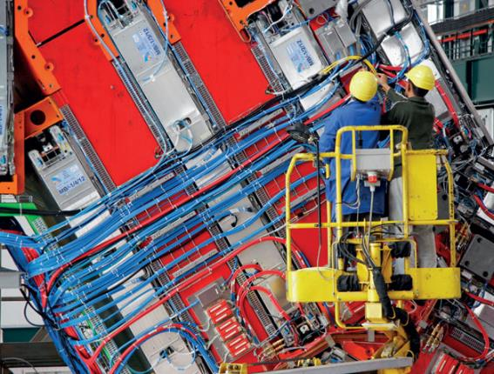
ATLAS and CMS RPC systems
Nowadays GHGs usage for particle detectors @ LHC is dominated by the large ATLAS and CMS RPC systems:
mixture recirculation is already almost at design level (85-90%) and today it is limited by leaks at detector level
Further optimization requires:
Fixing leaks at detector level
  Huge ongoing effort of RPC detector communities (ATLAS and CMS)
  but critical/fragile gas connectors are extremely difficult to access
  Good technical progress
Gas system upgrade to minimize any pressure/flow fluctuation
  Goal: new upgrades to cope with observed fragility of some detector components
  Positive effects already visible at end of Run2:
  Reduced leak developments at start-up
  Pressure regulation improved by 70%
Minimize impact of cavern ventilation (tested in collaboration with EN-CV)
Look for other external causes (vibrations, …)
Detector R&D to validate higher recirculation fraction
Tools to check detector and gas system tightness

Slide 28
Optimization strategies
Helps reducing gas emissions
Optimization of gas systems
Affects detector performances
Optimization strategy | Technical implementation | Goal | Examples
Gas recirculation | Mixture recirculation systems | Consumption reduction, detector performance | RPC, RICH, CSC, …
Flow, Pressure regulation | Automatic regulation, PID controllers | Detector stability, leak reduction | RICH detectors, RPC leaks
Software upgrades | Additional control features | Operation stability | All LHC gas systems during LS2 upgrades
Monitoring | HMI, Control panels, dashboards | Anomaly detection | Impurities intake, malfunctioning of gas component
Offline analysis | Data analysis | Deeper understanding of the dynamics | System startups, additional regulation valves when needed
Direct effects
Indirect effects

Slide 29
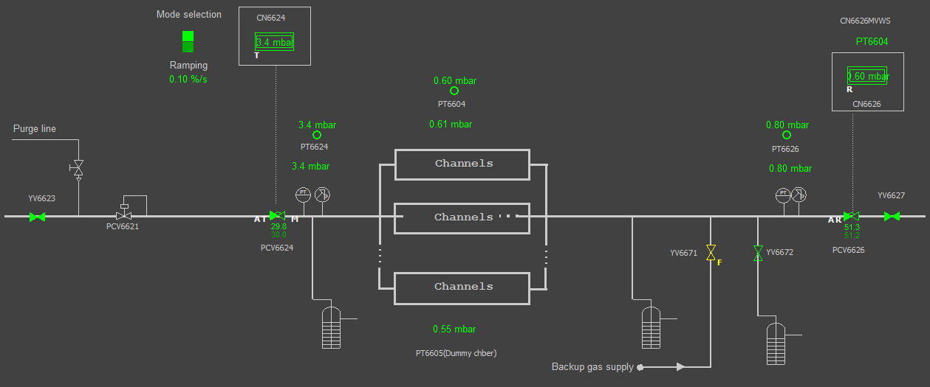
Optimization strategies - Examples: RPC Gas system upgrade
Goal: minimize any chamber pressure/flow fluctuation to cope with observed fragility of some detector components
from some 0.1 mbar to ~ 0.1 mbar: not an easy challenge
Example of upgrades on mixture distribution modules:
As slow as possible opening at input
New modules with regulation valves
New restart procedure
Additional regulation valves
Two sets of controls parameters (for start-up and run)
Pressure regulation by using Detector pressure or “reference/dummy chambers”

Slide 30
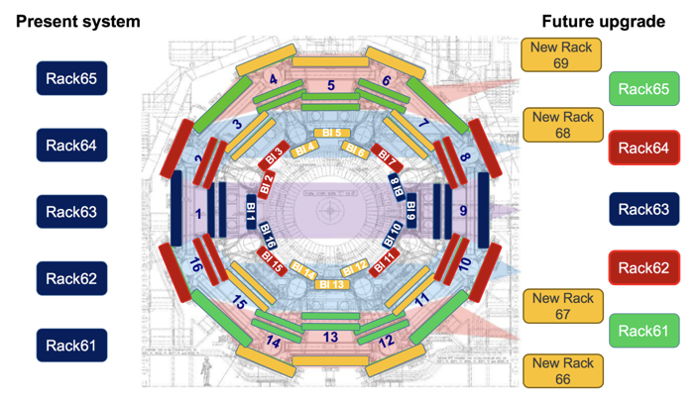
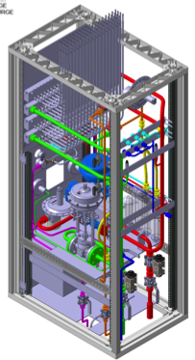
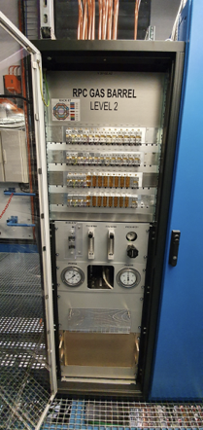
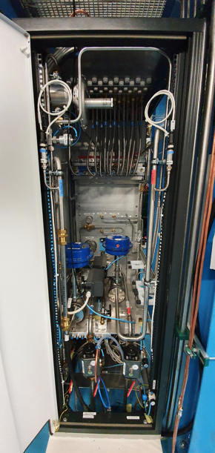
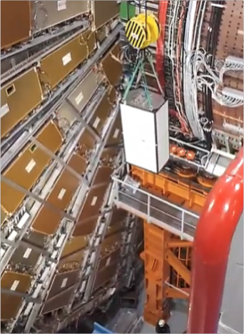
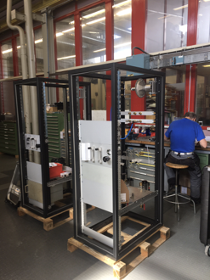
Optimization strategies - Examples: RPC Gas system upgrade
4 New distribution racks (i.e., from 5 to 9 modules):
To minimize hydrostatic pressure effect
for the addition of new channels needed for upgrade
Upgrade of existing racks:
to minimize any chamber/flow fluctuation from some 0.1 to ~0.1 mbar
From design to installation:

Slide 31
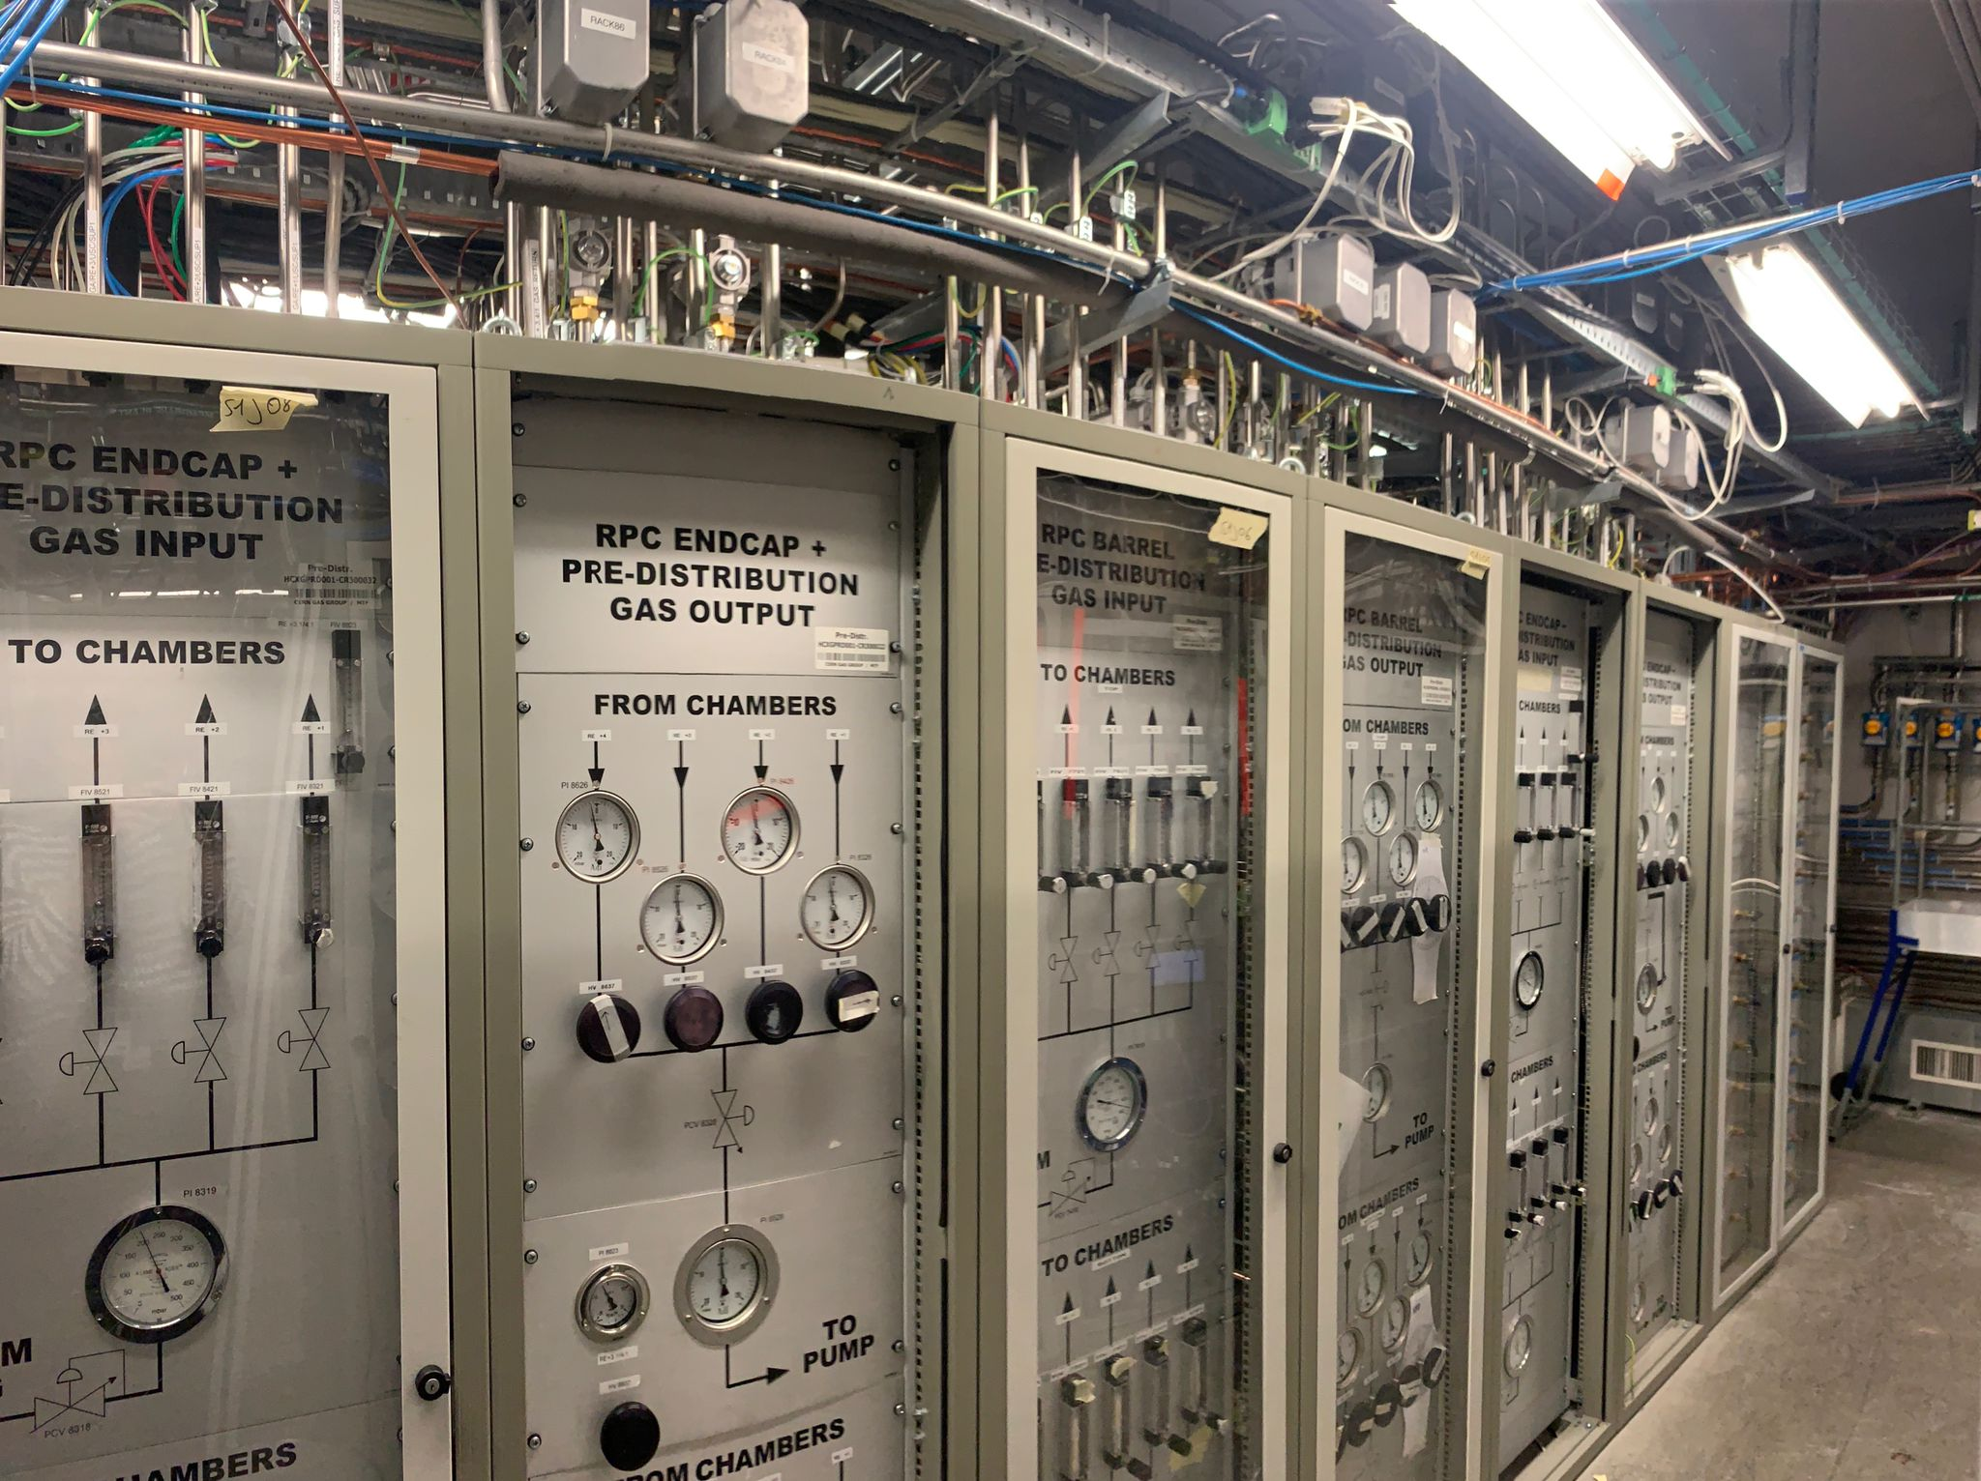
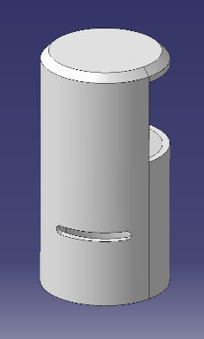
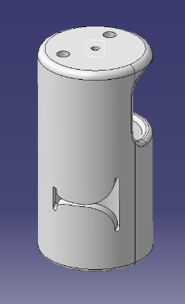
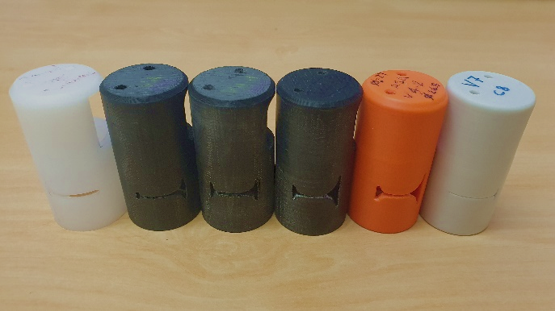
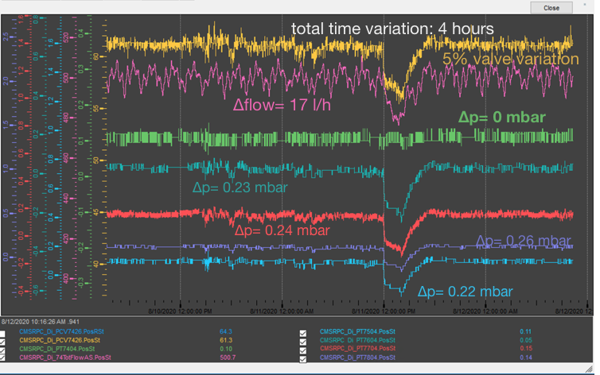
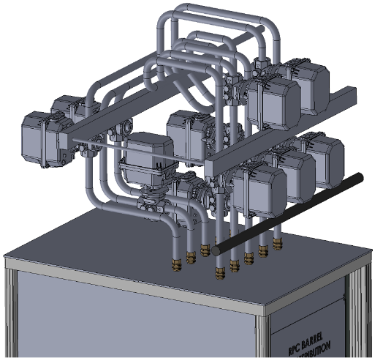
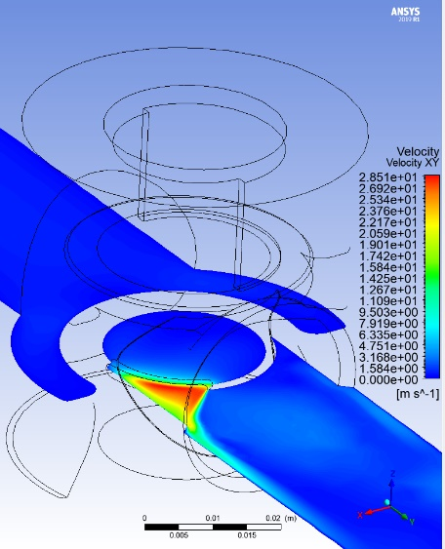
Optimization strategies - Examples: RPC Gas system upgrade
Many tests performed in laboratory and at CMS
One valve selected: ECONEX
Valve seats specific for distribution module:
  Different in BARREL and ENDCAP
  R&D to improve/design seat shape
Valves installed
M. Busato
with valve

Slide 32
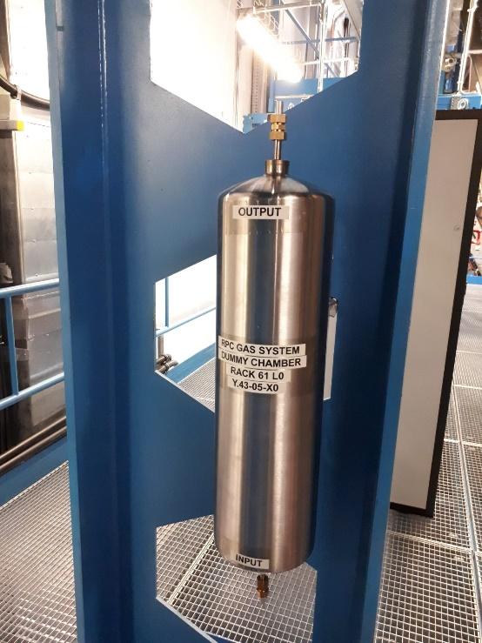

Optimization strategies - Examples: RPC Gas system upgrade
Detector pressure regulation was done using sensors at rack level:
Weight of hydrostatic column was not considered
Particularly critical during fill and emptying phases (due to changes in gas density)
Pressure sensors already present at detector level cannot be used due to risk of detector leak presence/development
Installation of volumes that simulates detectors (reference sensors/“dummy RPC”)
Extremely useful during detector filling after shutdown (when mixture hydrostatic pressure is changing significantly)
Minimize over-pressure at chamber level

Slide 33



Optimization strategies - Examples: RPC Gas system upgrade
Upgrade of purifier modules
Smoother change to run conditions:
modification of preparation for run phases
Run2:
Δ high pressure buffer ~70 mbar
Run3:
Δ pressure buffer ~30 mbar

Slide 34

“Lab size” gas systems
Sometimes lab test are using relatively high gas quantity if compared with large LHC systems:
example from GIF++ tests (RPC, CSC, GEM), test beam activities (CALICE RPC-SDHCAL), EEE telescope, …
Development of Recirculation system for laboratory applications
2013: Development of "A portable gas recirculation unit" JINST 12 T10002
~10 detectors
~100-200 l/h
One single rack can contain the full system
Control system based on simple PLC
Monitoring system based on Grafana
Possible to have some parameters controlled remotely
Few sensors
Five gas systems already produced and in use
20-30 kCHF

Slide 35


“Lab size” gas systems
Development of Recirculation system for ~1-2 detectors – 20-30 l/h
2019: Development of Gas recirculation systems for RPC detectors: from LHC experiments to laboratory set-ups - RPC2022
It should fit in a small box
Monitoring system based on RaspBerry PI and Grafana
Manual (optional remote) control
Limited number of electronic sensors
Very cheap components
1-2 kCHF

Slide 36
GHG Optimization Strategies
How to reduce greenhouse gas usage
Optimization of current technologies
Gas Recuperation
Alternative Gases
Gas disposal
Membrane separation
Pressure swing
Cryogenic/cold separation

Slide 37

Beyond gas recirculation: why?
Not always the recirculation fraction can be increased easily: two examples
Detector operation validated for ageing up to 90%
  What about recirculating more? (example RPC: only short test performed in the past (2011) up to 97-99%)
N2 intake by diffusion (example: CMS-CSC detector)
RPC: Gas recirculation and impurities in past test
Higher recirculation fraction:
97%
99%
94%
https://pos.sissa.it/159/029/pdf

Slide 38

Gas systems and recuperation
Possibility to recuperate a single gas component from exhausted mixture
Many LHC gas systems already with gas recuperation
Advantages:
- Further reduction of gas consumption
Disadvantages:
- Higher level of complexity
- Dedicated R&D
- Gas mixture monitoring fundamental
Ongoing R&D aims in testing the feasibility for new recuperation systems:
  R134a for ALICE-RPC, ATLAS-RPC, CMS-RPC, ALICE-TOF
and substantial improvements of existing systems:
  CF₄ for CMS-CSC, LHCb-RICH2
  C₄F₁₀ for LHCb-RICH1
Recuperation will be effective only if leaks at detector level will be reduced
R134a recuperation can drastically decrease GHG consumption
R&D costs for first R134a recuperation system can be potentially paid back with one year of operation

Slide 39



Gas separation techniques
MEMBRANE SEPARATION
PRESSURE & THERMAL SWING ADSORPTION (PSA & TSA)
DISTILLATION
ABSORPTION
DESORPTION
CMS CSC CF₄
LHCb RICH2 CF₄
Old LHCb RICH1 C₄F₁₀
CMS RPC R134a
CMS RPC SF₆
Old LHCb RICH1 C₄F₁₀
New LHCb RICH1 C₄F₁₀
CMS CSC CF₄
LHCb RICH2 CF₄
Notes:
Aggiungere absorber

Slide 40

Gas separation techniques: Membrane
Separation process is driven by →
Partial pressure gradient
Nature of membrane (chemical structure)
Permeability (P) → capability of gas molecules to permeate the membrane
Solubility (S) →thermodynamic parameter given the amount of penetrant absorbed by membrane
Diffusivity (D) → dependent on geometry of penetrant: if molecular size increases the coefficient decreases
Transport of gas is described by the solution-diffusion mechanism: → difference in thermodynamic activities existing across the membrane and interacting forces working between membrane material and permeating molecules
$$P=Diffusivity \left(D\right) ×Solubility (S)$$
Ability of a membrane to separate two molecules:
$$α=\frac{P_{A}}{P_{B}}$$
Permeability A
selectivity
Permeability B
Notes:
Aggiungere absorber

Slide 41


Gas separation: Thermal Swing Adsorption & Pressure Swing Adsorption
MS 3A
MS 4A
MS 5A
MS 13X
Crystalline metal aluminosilicates
having a three-dimensional interconnecting network of silica and alumina tetrahedra
Structure model of 4Å molecular sieve
THERMAL SWING ADSORPTION (TSA):
→ After the contaminants or target gas have been absorbed, the sieve bed is heated, usually flushing also a clean hot stream of pure gas, to regenerate the MS for reuse. Then it is cooled down to restart the process. Temperature regeneration is the most effective one.
PRESSURE SWING ADSORPTION (PSA):
→ gas feed stream fed to the sieve beds at high pressure and then the sieve bed pressure is reduced to regenerate the sieve and remove adsorbent contaminants or target gas. Vacuum regeneration is faster and it has the advantage of not overheating the material, avoiding break down processes. However, it is not always effective.
ABSORPTION
DESORPTION
Schematic view of an absorber module of gas system
Notes:
Aggiungere absorber

Slide 42

Gas separation techniques: Distillation
Method to separate two or more compounds based on differences in boiling points or volatility
The composition of vapor phase depend on the initial one of the liquid phase →
lighter (lower-boiling) component tend to concentrate in vapor phase
heavier (higher-boiling) component tend toward the liquid phase
Simple distillation → Can be used when the components have widely different boiling points (>100˚C)
Typical liquid-vapor plot
Fractional distillation → Subsequent vaporization-condensation event (called "theoretical plate"), and each event enriches the distillate in the lower boiling component. Specific packed columns are used for this purpose
Schematic view of a distillation column
Notes:
Aggiungere absorber

Slide 43





Monitoring of gas quality
Gas recirculation and gas recuperation systems imply the need to monitor:
quality of the recuperated gas and mixture circulating in the loop
uGC analysis
IR analysis
Detector based analysis
Notes:
Aggiungere absorber

Slide 44
Gas recuperation plants: two examples
Two examples:
CF4
R134a
Problem (why not 100% gas recirculation?)
Technical challenge
Developments
Results
Costs vs Advantages
Start with CF4 →

Slide 45


Gas Recuperation: the CF4 case
CMS-CSC CF₄ recuperation plant
From Run1 to Run2
up to 44% GHG reduction
Problem:
Too high N₂ concentration for gas recirculation due to diffusion leak from detector components
Technical challenge:
First plant built for CF₄ warm adsorption
A completely non-standard system
R&D started in 2009, Operation from 2012. Several technical and resource problems → Average efficiency 60-70%
More selective sieves or cryogenic separation considered in case of further upgrades

Slide 46



CSC CF4 Recuperation Plant: R&D studies
Membrane module
Challenge: use of membrane developed for CO2 separation to retain CF4
 | Model | Working flow | Specifications
Membrane 1 | CO-C10 | Up to 300 l/h | High thickness and density gradient
Membrane 2 | CO-C10A | Up to 300 l/h | High thickness and density gradient
Membrane 3 | CO-C10A | Up to 300 l/h | High thickness and density gradient
Membrane 4 | CO-410A | More than 600 l/h | High thickness and density gradient
Memb. Highly sensitive | CO-C07FS | Up to 300 l/h | Reduced thickness and density gradient
Feed
Retentate (positive pressure)
$ε$= $\frac{{\text{Φ}CF}_{4 retentate side }}{\text{Φ}{CF}_{4 feed}}$
Permeate (negative pressure)

Slide 47



CSC CF4 Recuperation Plant: R&D studies
Membrane module
Ar fraction in retentate is a contamination for recuperate CF4 → C07FS not good for our purpose
Increasing the feed flow, the recuperation efficiency increases for all the membranes tested
The general efficiency of membrane module increase with the feed flow → smoothing and stabilization of CSC exhaust flow

Slide 48


CSC CF4 Recuperation Plant: R&D studies
CF4 Absorber module
Last separation module of CF₄ recovery system
Molecular sieve 13X
Working principle: Pressure Swing Adsorption
4 steps at 4 different pressure values:
  Column filling (from -0.9 barg to -0.050 barg)
  Separation phase
  Venting of components not absorbed by MS (from -0,05 barg to -0.45 barg)
  Emptying of column (from -0.45 barg to -0.9 barg)

Slide 49
CSC CF4 Recuperation Plant: R&D studies
CF4 Absorber module
Many tests performed to find out the best pressure value to start the CF₄ recovery
Tradeoff between
quality of recuperated CF₄
and total recuperation efficiency
ANALYSIS CF₄ ABSORBER
CF₄ RECUPERATION EFFICIENCY
Before optimization
Ar 17.14%
CF₄ 80.95%
O₂ 460 ppm
N₂ 37625 ppm
After optimization
Ar 1.78%
CF₄ 97.16%
O₂ 173 ppm
N₂ 2646 ppm
Before optimization
45%
After optimization
66%

Slide 50



CSC CF4 Recuperation Plant: R&D studies
CF4 Absorber module
Problem with pump module
Problem with pump module
2023-2024 average
composition of the battery
Ar 11%
CF₄ 88%
N₂ 1.9%
O₂ 0.2%
The N₂ concentration is reduced by a factor 10 in the recuperation system
Considering that CF₄ (10% in the CSC mixture) is injected 50/50 fresh/recuperated, the N₂ reinjected in the mixer is $\frac{1}{200}$ of the initial concentration

Slide 51





Gas recuperation: monitoring quality of recuperated gas
Complexity of using a recuperated gas: mixture quality monitoring ensuring good composition and avoiding ageing
Quality of recuperated CF₄ is monitored: with GC analysis
Mixed injection of CF₄ 50% recuperated and 50% new
CO₂
Ar
Increased to about 95%
CF₄ New
CF₄ Recuperated
and with gas mixture monitoring: Single Wire Chambers
https://indico.cern.ch/event/1237829/contributions/5613877/

Slide 52
Gas recuperation plants
R134a example

Slide 53



Gas Recuperation: the R134a case
2018: Prototype0 tested in ATLAS-RPC (100 nl/h)
encouraging results, air/N2 and iC4H10/SF6 removed
2019: Prototype0 moved to CMS
2020: test restarted at CMS with CMS-RPC
R134a/iC4H10 form an azeotrope
simple separation thanks to difference in boiling points is not possible
2022: Good R134a quality, ~80% recuperation efficiency (limit due to azeotrope)
2023: installation of new Prototype1 for continuous operation
R134a, iC₄H₁₀, SF₆, …
Starting point mixture
95% R134a - 5% iC4H10
input
Vapour composition curve
Cold separation
R134a/iC4H10 remaining mixture is totally liquefied and it is sent to buffer at 5 °C:
azeotropic mixture is slowly heats up
liquid is enriched of pure R134a
vapour of azeotrope which escapes from exhaust
RPC
chiller
compressor
GC/MS
IR
liquid composition curve
GC

Slide 54


Gas Recuperation: the R134a case
Technical challenge: separation of an azeotropic mixture
Ideal mixture:
Two boiling termeratures (component1 and component2)
No other min/max for vapour and liquid curves
Azeotropic mixture:
In the boiling temperature vs composition plot is present a min or a max
iC₄H₁₀
«distillation» occours between
azeotrope and one of the two components
Separation efficiency cannot be 100%
R134a
azeotrope

Slide 55

Gas Recuperation: azeotrope
A common azeotrope
Water and ethanol is an other example of azeotrope
Azeotrope point at 95,57% w/w (molar fraction = 0.894) and temperature 78,17 °C.
By simple distillation is not possible to obtain pure ethanol.

Slide 56


Gas Recuperation: the R134a case
Azeotrope → mixture that exhibits the same concentration in the vapor phase and the liquid phase. This contrasts with ideal solutions with one component typically more volatile than the other
Slow heating of liquified azeotrope (orange curve)
and subsequent return in the cold buffer
allows to enrich the liquid of R134a and the vapor phase of iC₄H₁₀
Thermodynamic simulation

Slide 57

Gas Recuperation: the R134a case
Optimal configuration:
Filling rate → 200 l/h up to 600 l/h
Chiller Temp. → -36.2°C
Top buffer P →
  10 mbar (C1&C2), 35 mbar (C3)
Bottom buffer T → 20°C
Emptying rate → 600 l/h (air)
FLAMMABLE EXHAUST
Heat exchangers
Top Buffers
Bottom Buffers
Compressor module
80% of Recuperation Efficiency

Slide 58



Gas Recuperation: the R134a case
Effects of many parameters tested for one single columns and full system
Increasing feed flow, more gas is lost at the exhaust due to lower heat exchange
For the same reason, it increases decreasing chiller Temperature
Increasing chiller T, more azeotrope is exhausted and the quality of R134a improves

Slide 59


Gas Recuperation: the R134a case
When the pressure in the top buffer increases, also the recuperation efficiency increases
→ less gas is sent to the exhaust line and more is recuperated
The effect is having more iC₄H₁₀ in the recuperated R134a → lower quality
Tradeoff between the several parameters

Slide 60



Gas Recuperation: the R134a case
Many tests in different configurations were performed to find the best parameters for the plant:
Recuperated gas quality and efficiency can vary a lot from one configuration to another
If we inject 50/50 R134a fresh/recuperated, with a flow of 700 l/h,
we will inject:
500 ppm iC₄H₁₀

Slide 61

Gas Recuperation: the R134a case
View of R134a recuperation plant installed at CMS
Controls module
Chillers (-40 C & +10 C)
analysis modules
(gas chromatograph
and mass-spectrometer)
two cold trap separation modules
compressor
Storage and re-use

Slide 62


Gas Recuperation: the R134a case
View of software controls

Slide 63
Gas Recuperation: costs vs benefits
Positive effects – CF4 and R134a examples:
CF4 recuperation for CMS-CSC
10% CF4 in gas mixture ~ 70 l/h ~ 2200 kg/year ~ 100 kCHF/year (at current price)
With 65% or recuperation efficiency
→ 1400 kg/year CF4 saved ~ -60 kCHF/year ~ -10500 tCO2e/year
R134a recuperation for CMS-RPC
95.2% R134a in gas mixture ~ 700 l/h ~ 12t/year ~ 130 kCHF/year (at current price)
With 80% or recuperation efficiency
→ 12 t/year R134a saved ~ -130 kCHF/year ~ -18000 tCO2e/year
allowing to maintain constant operational cost and GHG emissions despite the increase in fresh flow required to cope with the increase of luminosity
In detector operation is less subject to market crisis affecting price and availability.
Indeed, the availability of recuperated gases can mitigate difficult situations when there is a shortage of fresh gas.
In 2022 when there was a major disruption of CF4 availability in Europe: the CMS-CSC detectors could be operated and therefore participate to the CMS data taking only thanks to the usage of recuperated CF4.

Slide 64


Greenhouse gas emissions
Reduction along years mainly due to more carefull operation, repairs of leaking detectors or disconnection.
Effects of R134a recuperation will be visible from 2024
Reduction along years thanks to CF4 recuperation

Slide 65
GHG Optimization: CERN Strategies
How to reduce greenhouse gas usage
Optimization of current technologies
Gas Recuperation
Alternative Gases
Gas disposal
New eco-friendly gases, HFOs, …

Slide 66

Possible alternatives to GHG gases
Not an easy task:
R&D started long time ago
Many institutes involved
ECOGas@GIF++ collaboration

Slide 67



Gases for particle detectors: RPC case
It is not the first time we are looking for “new” ecofriendly gases…and, probably, not the last
ODP
Ozone Depletion Potential
GHG
Greenhouse gases
“ECO” gases
Natural gases
R13B1
(CBrF3)
GWP 6900 - ODP 10
R134a
(C2H2F4)
GWP 1430 - ODP 0
and
3MTM NovecTM
and
GWP <10 - ODP 0
hydrocarbons
~20-30 years ago, it was the time to get rid of ODP gases
There was not the awareness on the use of GHGs
    Many gaseous detectors were conceived with use of GHGs
Now it is time to address the usage of GHG worldwide, including particle detectors
New concerns are already raising for the use of new “eco-friendly” gases, most of which are PFAS
GWP 1 - ODP 0

Slide 68



Possible alternatives to GHG gases
New eco-friendly liquids/gases have been developed for industrial applications as refrigerants and HV insulating medium…
→ many gases tested, but not straightforward for detector operation. Best options:
HFO-1234ze
(C3H2F4)
GWP 6
R134a (C2H2F4)
GWP 1430
HFO-1234yf
(C3H2F4)
GWP 4
flammable
?
CF3I
GWP 0.4
toxic
R14 (CF4)
GWP 5700
Very difficult challenge for already installed detectors where it is not possible to change of FEB electronics, HV system, etc
However, in any case to be considered
Long-term operation (to evaluate possible aging issues)
No flammability or toxicity of the gas mixture

Slide 69


Set-ups: laboratory and irradiation facility
Set-ups to test different types of gas mixtures and detectors: RPC, wire chambers, MPGD
Laboratory
Gas mixing unit
Gas mixing unit
  Gas mixture up to 6 components
DAQ
  CAEN Digitizer V1730: resolution 0.12 mV, sampling 500 MS/s
Gas analysis
  GC, MS and ISE
RPC
- 2 mm gap, high pressure laminate
- read-out strips 2 cm
DAQ
Data analysis for RPC
pulse charge, pulse height, time, etc.
efficiency, avalanche/streamer ratio, cluster size, time resolution
Gas Analysis
Gamma Irradiation Facility (GIF++)
¹³⁷Cs
Gamma source
  ¹³⁷Cs of 12 TBq —> 662 keV gamma
  Lead filters to allow attenuation factors (ABS) between 1 and 46000
Muon Beam
  100 GeV and 10⁴ muons/spill
  (core beam size 10 x 10 cm²)
Detectors tested up to to ~ kHz/cm²
Very similar DAQ, gas system and gas analysis of laboratory
Muon beam
RPCs

Slide 70


Alternatives for RPC gas mixture: R134a and SF6
~95%
Replacement of R134a with ~30-50% CO2 to lower GHG emissions
Detector performance slightly affected
Detector performance affected and long-term effects to investigate
C2H2F4
GWP 1430
+
From 0.3% up to 7%
“Forever chemicals”
Possible concerns for environment
CF3I
GWP 0.4
SF6
GWP 22800
Very good detector performance
+
3MTM NovecTM 5110
(CF3C(O)CF(CF3)2 )
GWP <1
3MTM NovecTM 4710
((CF₃)₂ CFCN)
GWP 2100
~5% iC4H10

Slide 71
Alternatives for RPC gas mixture: R134a and SF6
~95%
Replacement of R134a with ~30-50% CO2 to lower GHG emissions
Detector performance slightly affected
Detector performance affected and long-term effects to investigate
C2H2F4
GWP 1430
+
From 0.3% up to 7%
“Forever chemicals”
Possible concerns for environment
CF3I
GWP 0.4
SF6
GWP 22800
Very good detector performance
+
3MTM NovecTM 5110
(CF3C(O)CF(CF3)2 )
GWP <1
3MTM NovecTM 4710
((CF₃)₂ CFCN)
GWP 2100
~5% iC4H10

Slide 72



Mid-term solution: addition of CO2 to std gas mix
CO2 as mid-term solution for RPC to mitigate GHG emissions of LHC RPC systems
CO2 selected as best compromise
    He also good candidate but cannot use in experimental caverns
The addition of CO2 increases the streamer probability and broad the charge distribution
    Necessary to increase the SF6 concentration up to 1%
    Increase of currents of >15% under irradiation
Very good time resolution
    The CO2 reduce the mean free path
Long-term performance studies under gamma irradiation
    Up to now, no sign of performance degradation
Already in use in ATLAS RPC system since summer 2023

Slide 73
Mid-term solution: addition of CO2 to std gas mix
Positive effects:
Replacement of 30% R134a with CO2 brings a reduction of 14% of the tCO2eq emitted per year
mixture | GWP | tCO2e/year
R134a+iC4H10+SF6 | 1482 | 52373
CO2+R134a+iC4H10+SF6 | 1529 | 44784
 |  | -14%
In addition, the operational cost is lower
mixture | R134a used (kg/m3 gas mix) | SF6 used (kg/m3 gas mix)
R134a+iC4H10+SF6 | 4.3 | 0.02
CO2+R134a+iC4H10+SF6 | 2.91 | 0.065
 | -11 t/year | +356 kg/year
 | -115 kCHF | +13 kCHF | -102 kCHF/year -29% 1 year with std+CO2 mix ~ 250 kCHF
and detector operation is less subject to market crisis affecting price and availability

Slide 74
Alternatives for RPC gas mixture: R134a and SF6
~95%
Replacement of R134a with ~30-50% CO2 to lower GHG emissions
Detector performance slightly affected
Detector performance affected and long-term effects to investigate
C2H2F4
GWP 1430
+
From 0.3% up to 7%
“Forever chemicals”
Possible concerns for environment
CF3I
GWP 0.4
SF6
GWP 22800
Very good detector performance
+
3MTM NovecTM 5110
(CF3C(O)CF(CF3)2 )
GWP <1
3MTM NovecTM 4710
((CF₃)₂ CFCN)
GWP 2100
~5% iC4H10

Slide 75



Use of HFO in RPC detectors
HFO1234ze identified as possible replacement of R134a
Cannot replace 1:1 the R134a
    Too high w.p.: add He or CO2 to lower it
    The HFO and CO2 move the charge distribution towards higher values
    Currents increase seems to be dominated by the CO2
HFO brings a higher prompt charge content than R134a
The addition R-134a helps lowering the background currents and prevent w.p. to be too high
+2 kV
45% HFO + CO2
25% HFO + CO2
22 % HFO + 22% R134a + CO2
R-1234ze performance with CO2 (+ R-134a) with cosmic muons
45% HFO + CO2 (ECO1)
    Too high w.p. and high charge
25% HFO + CO2 (ECO3)
    Low GWP
    High charge content and presence of streamers. Higher currents
22% HFO + 22% R134a+ CO2
    Higher GWP
    Lower charge content than HFO only
    Possible compromise between performance and environment

Slide 76





RPC long-term studies with HFO gas mixtures
Long-term operation with eco-friendly mixtures under high background radiation: possible ageing effects to be investigated
Set-up at CERN Gamma Irradiation Facility (GIF++)
    12 TBq ¹³⁷Cs and H4 SPS beam line
Several RPCs under test from different experiments
Detector performance studies
    At different background radiations
    Three gas mixtures tested (ECO1,ECO2, ECO3):
    CO2 50-70% + HFO 45-25% with~5% iC4H10 and 1% SF6
Long-term performance studies under gamma irradiation
    Monitor of dark and ohmic currents
    Goal: to accumulate an equivalent charge of the HL-LHC Phase
¹³⁷Cs
RPC detectors
ECOGAS@GIF++
collaboration
Long-term irradiation
Test-beam performance
ECOGAS@GIF++ Collaboration
ECOGAS@GIF++ Collaboration
ECOGAS@GIF++ Collaboration
CMS
ECO2
CMS
ECO2:
35% HFO,
60% CO2
4% iC4H10,
1% SF6
ECO2
ALICE
Results presented in RPC2022 workshop

Slide 77
Alternatives for RPC gas mixture: R134a and SF6
~95%
Replacement of R134a with ~30-50% CO2 to lower GHG emissions
Detector performance slightly affected
Detector performance affected and long-term effects to investigate
C2H2F4
GWP 1430
+
From 0.3% up to 7%
“Forever chemicals”
Possible concerns for environment
CF3I
GWP 0.4
SF6
GWP 22800
Very good detector performance
+
3MTM NovecTM 5110
(CF3C(O)CF(CF3)2 )
GWP <1
3MTM NovecTM 4710
((CF₃)₂ CFCN)
GWP 2100
~5% iC4H10

Slide 78


SF6 alternatives
SF6 has a very high GWP and it contributes for ~5% in the GWP of RPC gas mixture
All SF6 alternatives tested in several concentrations as replacement of SF6 in standard gas mixture
3MTM NovecTM Dielectric fluids
Alternatives to SF6 for arc quenching and insulation applications
  Dielectric breakdown strength ~1.4-2 times that of SF6
Novec 4710 (GWP 2100)
  Very good performance but…
  It reacts with water: need further studies
Novec 5110 (GWP <1)
  Very low GWP but..
  Sensitive to UV radiation and higher wp
They are considered PFAS and 3M stopped to produce them
  Production is moving to China
Other alternatives
Looks for other gases not used only for HV plants
  Other electronegative gases could work
AMOLEA HFO1224yd (GWP <1)
  Good performance
CF3I (GWP 0.4)
  Good performance but toxic and mutagenic
C4F8O (GWP ~8000)
  Good performance at 1.5%
  1.5% C4F8O GWP equivalent to 0.5% SF6

Slide 79



SF6 alternatives
Streamer probability
  Decreasing with increase of concentration except for NOVE4710 where it is stable
Avalanche charge similar for all gases tested
Cluster size
  Lower for NOVECs and C4F8O
Very small concentration of NOVEC 4710, Amolea and CF3I are enough to obtain satisfactory performance
  But CF3I now discarded
Best streamer probabilities obtained with NOVEC gases
  Excellent dielectric strength
Streamer at w.p.
0.3% SF6: 0.4%
1.5% C4F8O: 1.8%
0.3% CF3I: 1%
2% NOVEC 5110: 0.7%
0.1% NOVEC 4710: 0.2%
0.3% HFO1224YD: 1.6%

Slide 80





Alternatives to SF6
10 F
7 F
6 F
3MTM NovecTM 5110
(CF₃C(O)CF(CF₃)₂ )
GWP <1 - Atm. lifetime 15 days
High boiling point: 27 C
Sensitive to UV radiation
Higher HV working point
3MTM NovecTM 4710
((CF₃)₂ CFCN)
GWP 2100 - Atm. lifetime 30 years
It may react with H2O
SF6
GWP 23900
3-4 F
8 F
3 F
Chemical inertness: extremely stable
Exceptionally long lived in the atmosphere
Excellent dielectric property
  SF6 x 2.5 than Air
Non-flammable and toxic
Gaseous form
No major reactions
  Ok with H2O, Cl and acids
>1.5% needed
No gain in GWP
toxic
AMOLEATM HFO-1224yd
(CF3-CF=CHCl)
GWP <1 - Atm. lifetime 20 days
CF3I
GWP 0.4
Atm. lifetime 6 days
C4F8O
GWP 8700
Atm. lifetime >3000 years
Presence of Cl (and recent worring experience at CMS to understood)

Slide 81





Not only detector performances….
Two factors identify the greenhouse gases and their effects on climate:
the radiative efficiency and lifetime in the atmosphere
The lower are the GWP and the lifetime, the easier is the creation of sub-products
HFO-1224yd
Degradation products:
TFA, CO2, HF, HCl
Do these sub-products have an impact on detector lifetime?
Three factors determine the atmospheric lifetime
Rain out
Water solubility
Oxidation
Reactivity with OH
Photolysis
UV absorbance
Hydrofluoric Acid (HF)
HFO produces much more HF than R134a in RPC detectors
Observation with ppm of HCFC:
Trifluoroacetic acid (TFA)
HFO1234ze is estimated to break down into TFA at less than 10%, whereas R-1234yf will break down into TFA at 100% (R134a at 21%)
TFA highly soluble: no formation of insoluble salts
Phytotoxic

Slide 82



Detector performances vs safety and long-term operation
Safety:
Safety first for LHC operation. Due to gas leaks and currents design:
Gas mixture must not be flammable
Gas components should not have high toxicity levels
Performance:
RPC short and long term performance shouldn’t be affected
Good quenching gases required for high rate capability
Radiation-hard gases required to minimize impurities affecting long term performances
CF3COOH (TFA):
a serious environmental concern (?)
Tradeoff between flammability and GWP. Lowering GWP by:
Replacing F with Cl or H:
  Shortens atmospheric lifetime
  Increases flammability limit
Adding C=C bound:
  Increases reaction with O₂
GWP is related to Infrared absorption over time. Low-GWP gases have short atmospheric lifetimes:
Water solubility → Rain out
OH⁻ reactivity → Oxidation
UV absorbance → Photolysis
Presence of Chlorine:
a warning from CMS bad experience
Environment:
GWP represents the main environmental concern
Studies ongoing: UV, water, long term effects on detector

Slide 83




Studies on F-gases properties: examples
NOVEC 5110
=O
NOVEC 4710
(CF3)2CFC≡N
(CF3)2CFCCF3
Rain out
water solubility (1ppmw)
Rain out
Water solubility (272 ppbw)
Oxidation
unreactive with OH
Oxidation
reactivity with OH radicals
Photolysis
Photolysis
transparent in near UV
strong absorbance in near UV (> 300 nm)
Gas under test
Data analysis
Agilent 8453 UV-visible Spectroscopy system
Bakelite RPCs use 40% relative humidity
Production of an amide from NOVEC 4710 + H2O
  Sub-products in the order of ppb
  Solid at room T with a melting point of 49°C
  The amide has appreciable vapour pressure at 60°C,
  it remains in gas phase at low concentrations
Tests on-going in laboratory
  Try to reproduce 3M tests
  Analysis at the output of an RPC

Slide 84



ATLAS and CMS - RPC upgrade programs: new detectors & FEB
New detectors for Run3 (ATLAS-BIS/BI)
Mixtures from ECOGAS@GIF
collaboration:
Triplet (3 single gaps; 1 mm gas gap)
Very effective Faraday cage allowing to operate with low noise and trigger on 2/3 coincidence
New FEB with new chip:
  Low noise
  Allowing threshold as low as 1 fC
→ from 30 to 3 pC per photon count
      Increased rate capability (x10)
      Low ageing (÷10)
3 independent singlets providing 3D+time
Combined σ_{t} 160 ps
ABS=22
Std mix
< 𝑛𝑝 >= 𝑙og(1/(1 − 𝜖))
New detectors for Run3 (CMS-iRPC)
double gap (1.4 mm gas gap)
new FEB:
  PETIROC2C re-designed
  Threshold < 50 fC
  TDC σt 20 ps
  TDC and detector σt ~ 160 ps
    → position resolution of ~1.6 cm
From:
CERN EP Seminar: Summary of RPC workshop
RPC 2022 workshop: Overview:
Exploring the performance limits of the new generation of ATLAS RPCs
XVI Workshop on Resistive PlaCMS iRPC FEB development and validation

Slide 85


Possible CF4 replacements
CF4 is used in different types of particle detectors to prevent aging, to enhance time resolution or because of its scintillation photon emission
CMS CSC studies
(K. Kuznetsova)
CF4 is a source of fluorine radicals to protect against anode ageing
  Now 10% CF4 in CSC gas mixture
Two possibile approaches to reduce GHG consumption (beyond the recirculation and recuperation systems)
  Decrease the CF4 concentration: preliminary results show that 5% could be safe for operation
  CF3I and HFO1234ze not best candidates
  Look for other alternatives to CF4 on-going
LHCb RICH studies
(S. Easo and O. Ullaland)
RICH detectors use either CF4 or C4F10
  Necessary for good refractive index
Replacement of C4F10 with C4H10
  Refractive index matches very well
  But C4H10 flammable
Replacement of CF4 with CO2
  Under investigation
Use of SiPM to reduce the chromatic error and increase the yield

Slide 86
GHG Optimization: CERN Strategies
How to reduce greenhouse gas usage
Optimization of current technologies
Gas Recuperation
Alternative Gases
Gas disposal
GHGs destruction
New eco-friendly gases, HFOs, …
Membrane separation
Pressure swing
Cryogenic/cold separation
Gas recirculation
Particular attention to operation
Improved controls and monitoring

Slide 87
GHG abatement system
Industrial system able to destroy GHGs avoiding their emission into the atmosphere have been considered
Abatement plants are employed when GHG are polluted and therefore not reusable.
However, PFCs are stable and difficult to abate
Carbon‐fluorine bond is the fourth strongest single bond
  Multiple C‐F bonds on the same carbon enhance stability
  C‐C or C‐H bonds are weaker and decrease stability
  S‐F bond is strong too
Stability is reflected in atmospheric lifetimes
Stability is closely related to ease of abatement
Fluorinated gas lifetime in atmosphere (years)
CF4 | 50000
C2F6 | 10000
SF6 | 3200
C3F8 | 2600
c‐C4F8 | 3200
NF3 | 740
CHF3 | 270
C2H2F4 | 14
CH2F2 | 5

Slide 88

GHG abatement system
Reaction of CF₄ to CO₂ and HF is very exothermic, but also requires a big push to break the very strong C‐F bonds
-This is why CF₄ abatement is so difficult
-Actual reaction is much more complicated than shown
Burn‐wet is the primary POU (point of use) abatement technology
Huge quantities of
O₂ and CH₄
needed to overcome E_{A}
Some 100 m³/day needed
Final product is HF!
One liter of CF₄ generates 4 liters of HF
Water treatment plant required!
Some m³/day wastewater produced
Small commercial systems for burn-wet exist but require heavy infrastructures:
CH₄+O₂ supply
Waste water treatment

Slide 89



GHG abatement system
Industrial system able to destroy GHGs: two options considered
Approximative cost of burner system: 130 kCHF

Slide 90

GHG abatement system
Waste water treatment plant
Sewage resulting from operation are compressed for disposal
Approximative cost of wastewater treatment system:
500 kCHF
The EnviroChemie “STEP” wastewater treatment plant
One already in operation at CERN and similar to what we would need

Slide 91
GHG abatement system
Found also companies available to take PFC/HFC based mixture for disposal:
but extremely expensive.
In addition, the GHGs disposal is not helping in the current market situation where availability decreases and price increase.
On the contrary, the advantages of gas recuperation plants are going beyond the reduction of GHG emissions and the economical aspects:
the availability of recuperated gases can mitigate difficult situations when there is a shortage of fresh gas.
In 2022 when there was a major disruption of CF4 availability in Europe: the CMS-CSC detectors could be operated and therefore participate to the CMS data taking only thanks to the usage of recuperated CF4.

Slide 92
Economic analysis: recovery vs abatement
 | Recovery systems |  |  | Abatement systems
gas potentially recovered (2012 -2025) | R134a (kg) | SF6 (kg) | CF4 (kg) | R134a (kg) | SF6 (kg) | CF4 (kg)
Beginning of operation | 2023 | ~2025 | 2012
 | 17200 | 96 | 6505 | 0 | 0 | 0
Money saved from gas recovered (kCHF) (2012 -2025) | ~500 |  |  | 0
Money spent for construction – CAPEX (kCHF) | 525 |  |  | 617
M&O (kCHF/year) | 15 |  |  | 16
Manpower (kCHF/year) | 60 |  |  | 84
Emissions (tCO2eq/year) | 39114 |  |  | 2600

Slide 93
Conclusions
GHGs usage in particle detectors
F-gas regulation
Due to the environmental risk, “F-gas regulations” started to limit the GHGs usage (EU case)
availability and price are today critical for old F-gases
Detector design
It is fundamental to look not only at detector performance but also at the infrastructure
New generation detectors should limit the risk of developing leaks
If detectors are tight, gas consumption can be limited thanks to gas recirculation and recuperation systems (useful not only for GHGs but also for any expensive gases)
Strategies for GHG usage optimization
Optimization of current technologies
Particular attention to gas system and detector operation
Gas systems upgrade beyond original design
Improved/higher gas recirculation

Slide 94

Conclusions
Gas recuperation plant
Gas recuperation will be effective only if leaks at detector level will be reduced
R&D costs for R134a recuperation system is well justified by running costs
R134a recuperation prototype0 is more complicated than expected but showed good performance:
  ~ 80% recuperation efficiency and good gas quality
Consolidation of existing plants (CF4, C4F10) ongoing:
  CMS-CSC-CF4 recuperation efficiency increased to 70%
  LHCb-RICH2-CF4 installed
  LHCb-RICH1-C4F10 design ongoing
New eco-gases
New low-GWP gases can easily break
  Sensitive to UV, humidity and oxidation
  HF, TFA sub-products are produced and their effects on long-term operation need to be evaluated
Missing cross-section to perform simulation studies
  Dedicated measurements needed
R-1234ze, NOVEC, … are currently the main fluorinated alternative but:
  For 2 mm gas gap RPC, the addition of a 4th mixture components (CO2, ?) is needed to maintain reasonable HV working point
  availability and price are still a matter of concern
  long term operation in high radiation environment to be studied
New generation detectors and electronics seems to be more compatible with new eco-friendly gases than old-generation 2 mm gas gap RPC
  Upgrades for LHC experiments (ATLAS and CMS RPC Phase2 upgrades)
Recuperation of R134a can drastically decrease GHG consumption

Slide 95
Conclusions
GHGs abatement/disposal
Commercial systems exist. Adopted when gases cannot be reused.
Heavy infrastructures required (CH4+O2 supply, Wastewater treatment)
Since availability/price can become a real problem in the future it is better to optimize consumption
Destruction in external companies: more expensive than Gas abatement system.
Additional challenge: finding right profile for resources for R&D and new recuperation plants operation:
Chemist, industrial chemistry engineer, engineer, physicist

Slide 96


Optimization of gas consumption
gas recuperation improvement:
CF₄: CMS-CSC
gas recirculation increased:
ALICE-RPC
LHCb-GEM
Today optimization challenge
gas recirculation:
ALICE-RPC
LHCb-GEM
run optimization:
LHCb-RICH1
LHCb-RICH2
gas recirculation for most detectors (gas systems design, 2000):
90% optimization => 90% reduction
gas recuperation:
CF₄: CMS-CSC
LHC-LS1
LHC-LS2

