Slide 1

Latest results from the MEG experiment: search for μ⁺→e⁺γ decay
Fabrizio Cei
University of Pisa and INFN
Pisa, 4th October 2011

Slide 2
Outline
Charged Lepton Flavour Violation
The MEG Experiment
- Apparatus
- Calibration system
Analysis procedure
Results
- 2009 preliminary (ICHEP 2010)
- 2009 revised + 2010
Future perspectives and possible upgrades
Summary and conclusions

Slide 3
Charged Lepton Flavour Violation

Slide 4
Charged Lepton Flavour Violation 1)
In the SM of electroweak interactions, leptons are grouped in doublets and there is no space for transitions where the lepton flavour is not conserved.
However, lepton flavour is experimentally violated in neutral sector (neutrino oscillations) ⇒ needed to extend the standard model by including neutrino masses and coupling between flavours.
cLFV indicates non conservation of lepton flavour in processes involving charged leptons.

Slide 5
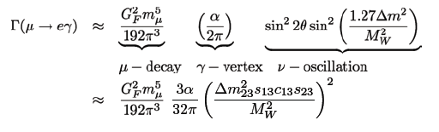
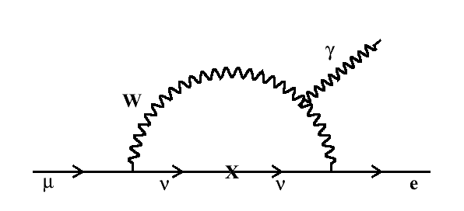
Charged Lepton Flavour Violation 2)
Including neutrino masses and oscillations in SM:
≈ 10⁻⁵⁴
Experimentally not measurable !
Huge rate enhancement in all SM extensions ⇒ predicted rates
experimentally accessible ! (Barbieri, Masiero, Ellis, Hisano ..)
SUSY
≈ 10⁻¹²
⇒ Observation of cLFV clear
evidence for physics beyond SM

Slide 6

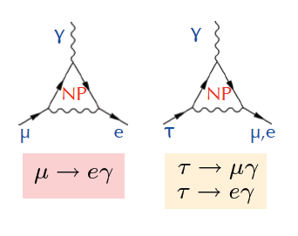
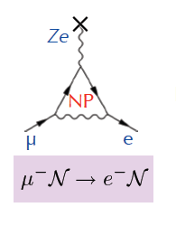
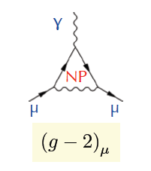
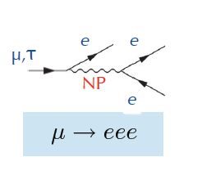
Charged Lepton Flavour Violation 3)
Several cLFV processes, sensitive to New Physics (NP) through
“new” lepton-lepton coupling
μ → e
conversion
Anomalous
magnetic
moment
μ, τ anomalous decays

Slide 7

Charged Lepton Flavour Violation 4)
Present Limit (2006):
SINDRUMII BR < 4.3 x 10⁻¹² (Ti)
BR < 7.0 x 10⁻¹³ (Au)
Future (2017 →):
Mu2E, COMET ∼ 10^{-(16÷18)}
Common Models
τ → μγ
τ → eγ
μ N→ eN
Present Limit (2011):
B-factories BR < 3÷5 x 10⁻⁸
Future (2015 →):
SuperB, SuperKEKB ∼ 1÷2 x 10⁻⁹
μ→eγ
μ → eee
(g – 2)_{μ}
MEGA BR < 1.2 x 10⁻¹¹
Superseeded by MEG !
Present Limit (2001):
MEGA BR < 1.2 x 10⁻¹¹
Running → 2013:
MEG ∼ few x 10⁻¹³
Present Limit (1988):
SINDRUM BR < 1.0 x 10⁻¹²
Future (2015 →):
Heidelberg ∼ 10^{-(15÷16)}
Present Result (2004):
BNL Δa_{μ} = (296±81) x 10⁻¹¹ (3.6σ)
Future (2015 →):
Fermilab: 3.6σ → 8σ
BNL Δa_{μ} = (296±81) x 10⁻¹¹ (3.6σ)
Hint for new physics ?
tan²(β) dependence

Slide 8
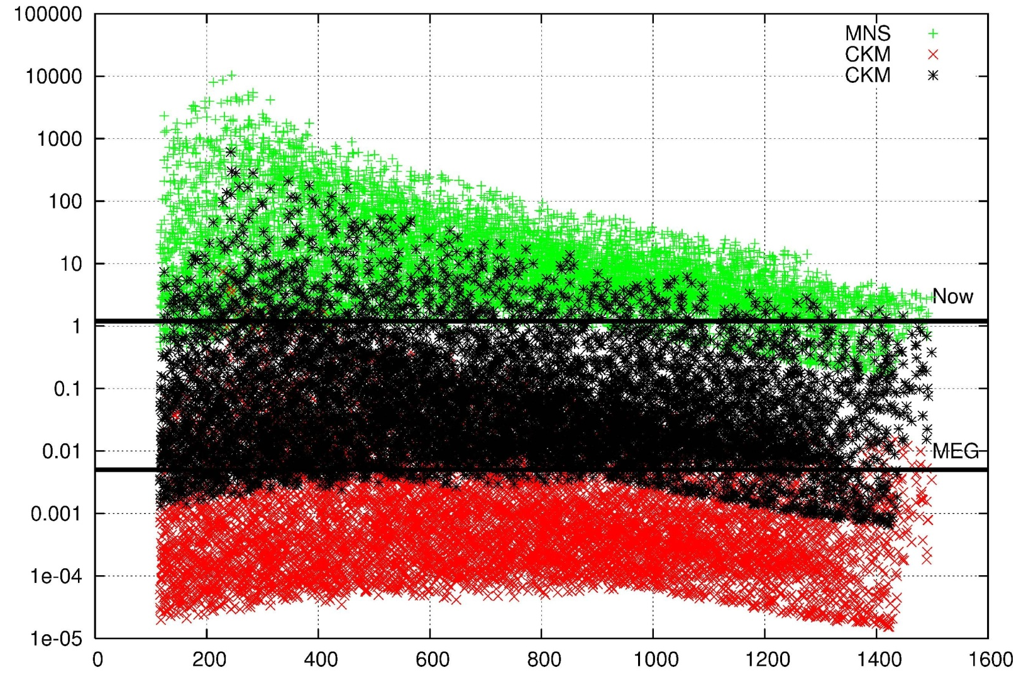
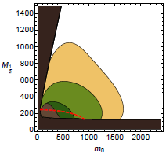
Charged Lepton Flavour Violation 5)
Strong impact of LFV searches in particle physics development:
beginning of lepton physics (Pontecorvo & Hincks, 1947);
universality of Fermi interaction ⇒ standard model (1955);
flavour physics (> 1960);
possibility to explore high mass SUSY scale (> 1000 TeV) and give insights about large mass range, parity violation, number of generations ... (now)
BR(μ → eγ)/10⁻¹¹
Examples of recent predictions
(L. Calibbi et al.,
Phys. Rev. D74, 011701, 2006)
(L. Calibbi et al.,
hep-ph 0909.2501
MEGA
MEG
MEG Goal
Super B
Babar+Belle
M_{1/2} (GeV)
MEGA
NEW MEG LIMIT 2011 !!!

Slide 9
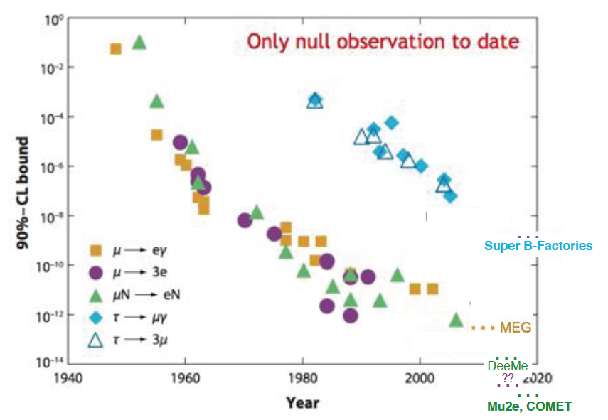
70 years of physics history ...

Slide 10
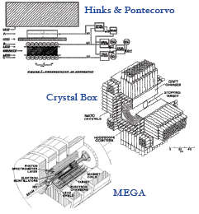
.. linked with improving technologies
Cosmic μ
BR < 0.1
Stopped π
μ beams
BR < 1.2 x 10⁻¹¹

Slide 11
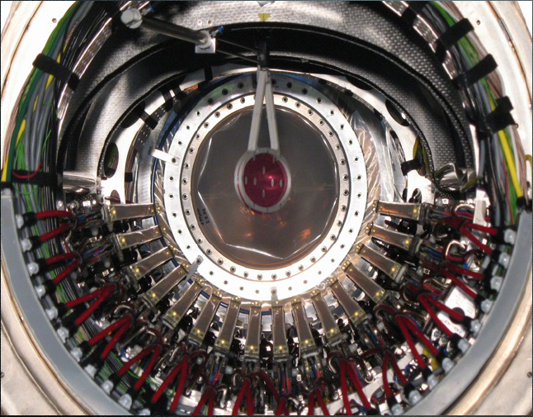
The MEG Experiment

Slide 12
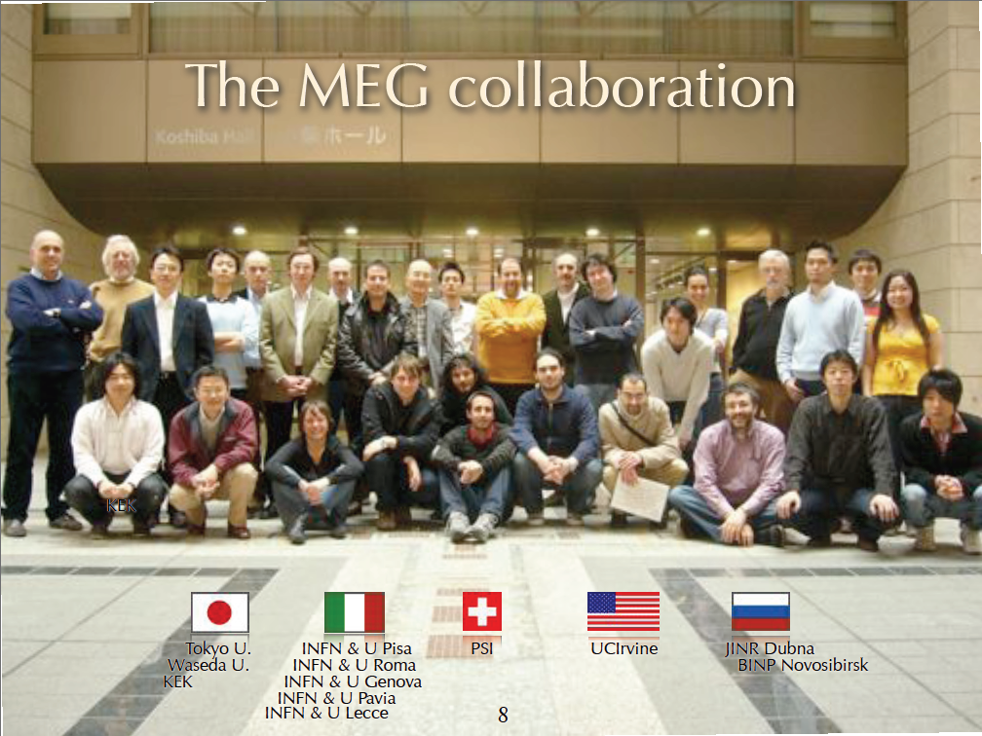
Part of

Slide 13
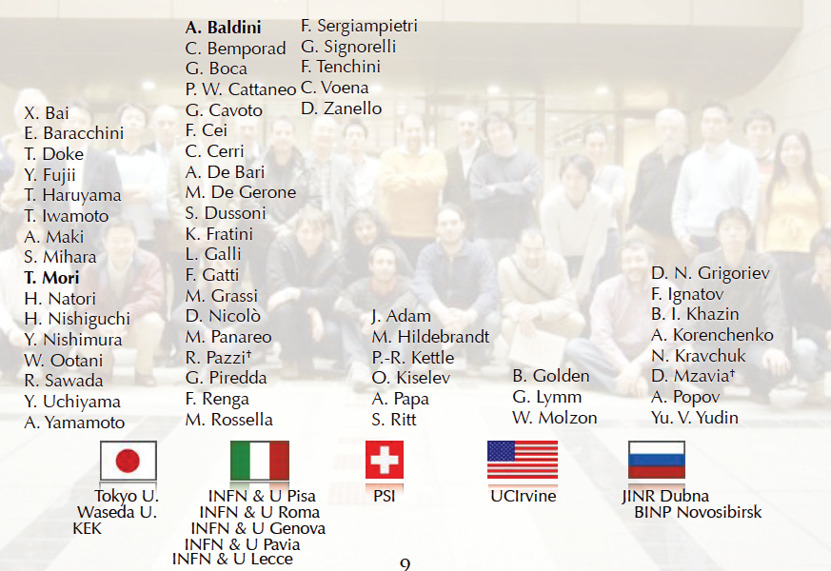

MEG people
∼ 60 physicists

Slide 14
μ → eγ signal vs bck 1)
signal
μ → e γ
background
accidental
μ → e ν ν
μ → e γ ν ν
ee → γ γ
eZ → eZ γ
physical
μ → e γ ν ν
(radiative decay)
e⁺ μ⁺ γ
ν
θ_{eγ} = 180°
E_{e} = E_{γ} = 52.8 MeV
T_{e} = T_{γ}
e⁺ μ⁺ γ
ν
ν
ν
e⁺ μ⁺
γ

Slide 15
μ → eγ signal vs bck 2)
R_{signal} = R_{μ} * BR(μ → eγ)
R_{RD} = R_{μ} * BR(μ → eννγ) ∼ 0.1 R_{acc}
R_{acc} ∝ (R_{μ})² * (ΔΘ)² * (ΔE_{γ})² * ΔT * ΔE_{e}
⇓
Muon rate to be used is a trade off between expected
number of signal events and background level;
Sensitivity is limited by accidental background;
High resolution detectors and a continuous beam
are mandatory.

Slide 16
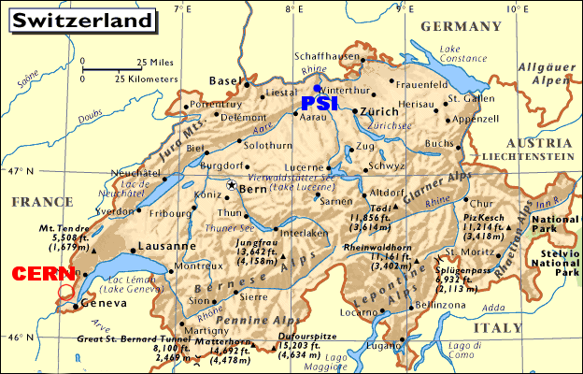
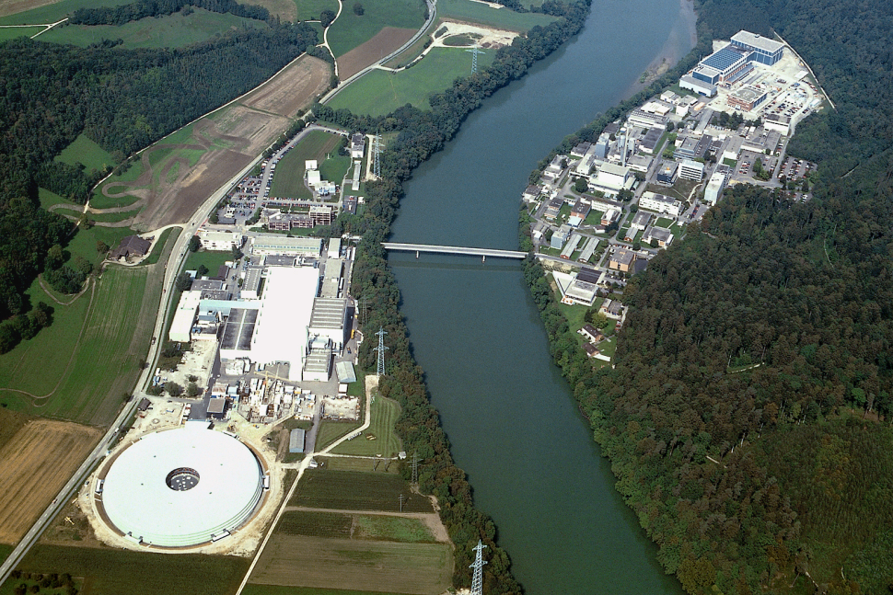
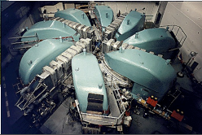
The Paul Scherrer Institute (PSI)
The most powerful continuous
machine in the world;
Proton energy 590 MeV;
Power 1.2 MW;
Nominal operational current 2.2 mA
(to be further increased).

Slide 17
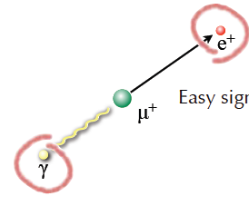
MEG Detection technique
Stopped beam of 3 x 10⁷ μ/sec in a 205 μm polyethilene target.
Liquid Xenon calorimeter for γ detection (scintillation).
Solenoid spectrometer (COBRA) & drift chambers for
e+ momentum measurement.
Scintillation counters for e+ timing.
Method proposed in
1998; PSI-RR-99-05:
10⁻¹⁴ possibility
MEG proposal in
2002: 10⁻¹³ goal
A. Baldini and T. Mori
spokespersons.

Slide 18
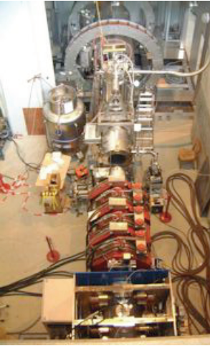
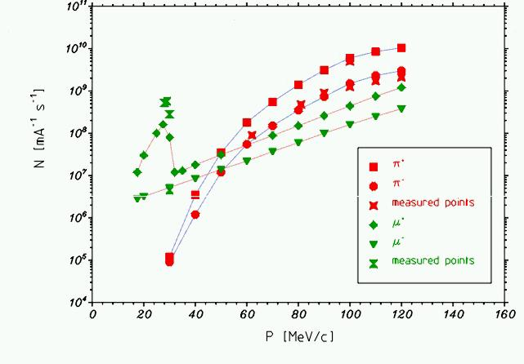
Beam line
PSI πE5 muon beam line. Optimized to produce
an up-to 10⁸ muons/s beam from pion
stopping on the surface of production target
(surface muons). Muon momentum 29.8 MeV/c.
We use a 3 x 10⁷ muons/s beam to reduce the accidental background.

Slide 19
Calibration system
MEG is a precision experiment;
High experimental resolutions are mandatory
(background level depends on resolutions);
Good detector performances must remain
stable for a ~ 3 year scale;
Electromagnetic calorimeter uses an innovative
technology;
⇒ Frequent and reliable calibration procedures
represent one of the fundamental quality factors
for MEG.

Slide 20
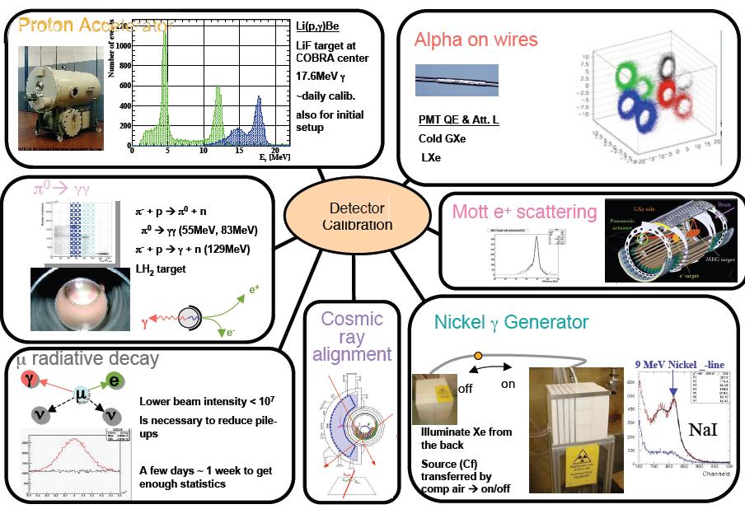
Overwiev of calibration tools

Slide 21
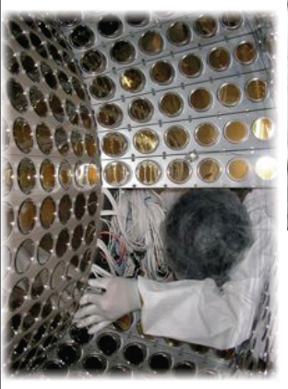
Liquid Xenon calorimeter
Refrigerator
H.V.
Signals
Cooling pipe
900 liters liquid xenon
detector, equipped
with 846 PMTs to collect
scintillation light.
Large LY and fast
response (4, 22, 45 ns).
Xenon purification
system in liquid and
gaseous phase to
remove impurities.
Vacuum
for thermal insulation
Liq. Xe
Al Honeycomb
window
PMT
Plastic
filler
1.5m

Slide 22
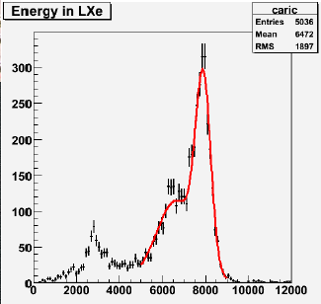
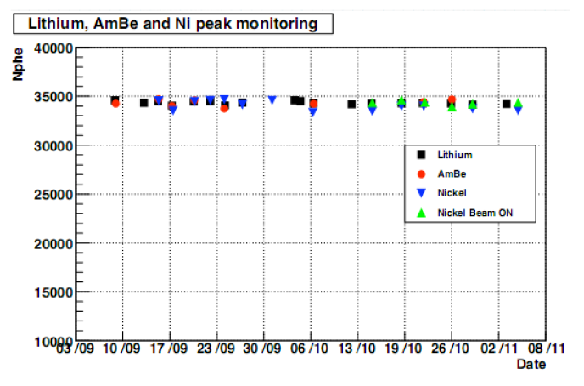
γ-energy scale monitoring
17.6 MeV γ-line from
p-induced reactions on Li
All systems working during 2010 run.
Energy scale known with 0.3% precision.
Full set of calibrations every three days;
∼ 3 hours/set.

Slide 23
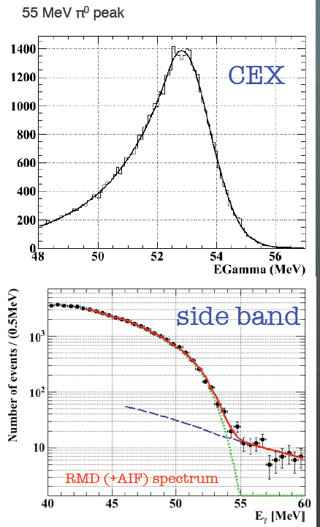
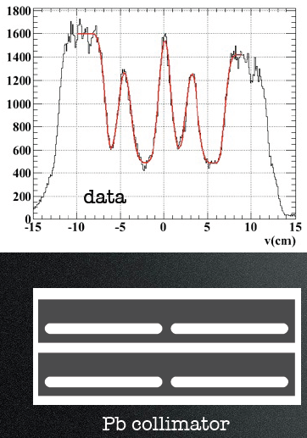
Absolute energy scale
55 MeV from CEX reactions in back-to-back coincidence with a NaI calorimeter (this year replaced by BGO: better resolution).
Verified by looking at photon distributions in out-of-time regions (time sidebands).
CEX data used also
to measure impact
point resolution by
means of slits in a
Pb collimator.
σ_{x} ∼ 5 mm

Slide 24
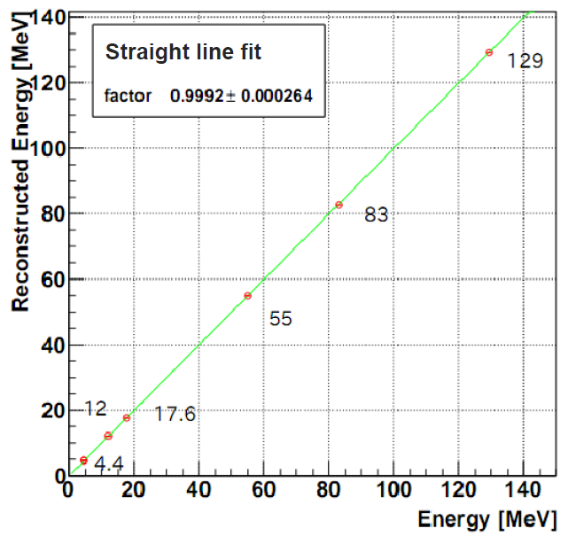
Energy scale linearity
γ’s from CEX
reactions
γ’s from CW
reactions
Fit compatible with
1 within 0.1%
γ from AmBe

Slide 25
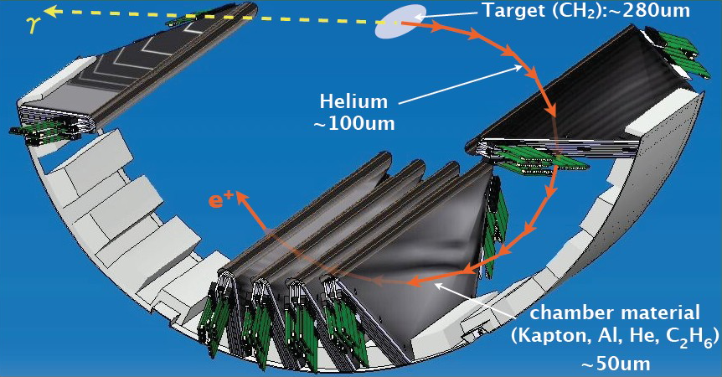
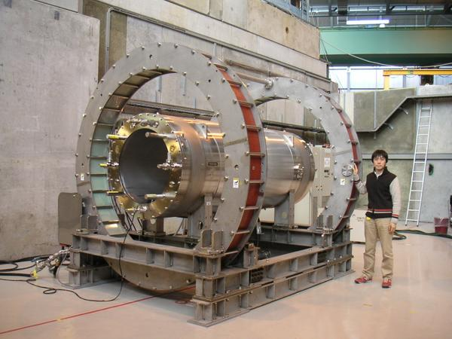
Drift Chamber system
Sixteen modules, each one formed by two staggered layers of plane wires
plus cathode foils for longitudinal
information.
Superconducting magnet (COBRA) with
a gradient field:
more efficient than a solenoidal field
in sweeping out positrons with small
longitudinal momentum;
bending radius almost independent
of the emission angle.

Slide 26
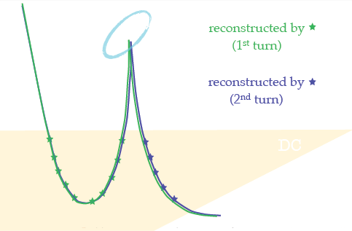
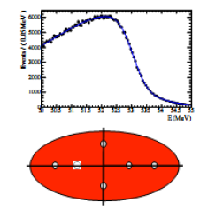
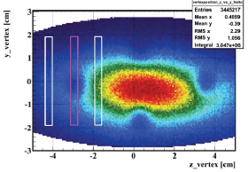
Spectrometer resolution measurement
Angular resolution evaluated by tracks
with two turns in the DC system,
treated as independent.
Momentum resolution measured by fitting the edge
of Michel spectrum and using the Mott calibration.
Muon decay vertex resolution
measured by identifying the
target holes in the positron
position distribution on target.

Slide 27
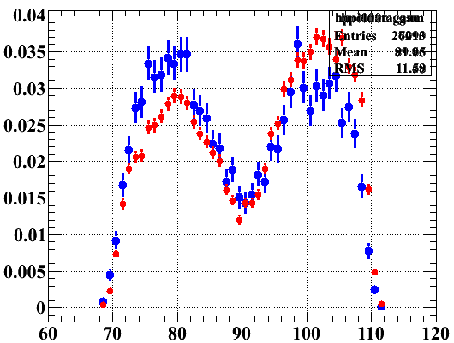
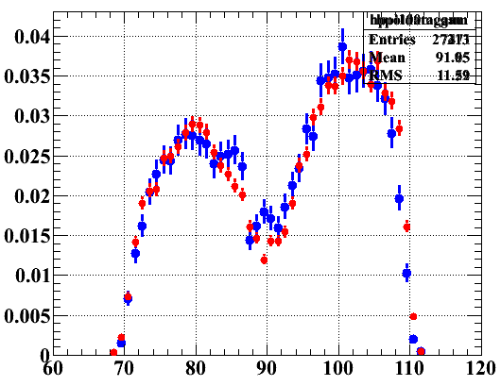
Measurement of muon polarization
Surface muons are fully polarized ⇒ energy/angle distributions of Michel e⁺ and γ’s from RD decay are modified. Depolarizing effects estimated < 10%.
RED: DATA
BLUE: MC,POL = 0
θ
RED: DATA
BLUE: MC,POL = 1
θ
By fitting positron energy distributions in angular slices we obtained:
<P> = 0.89 ± 0.04

Slide 28
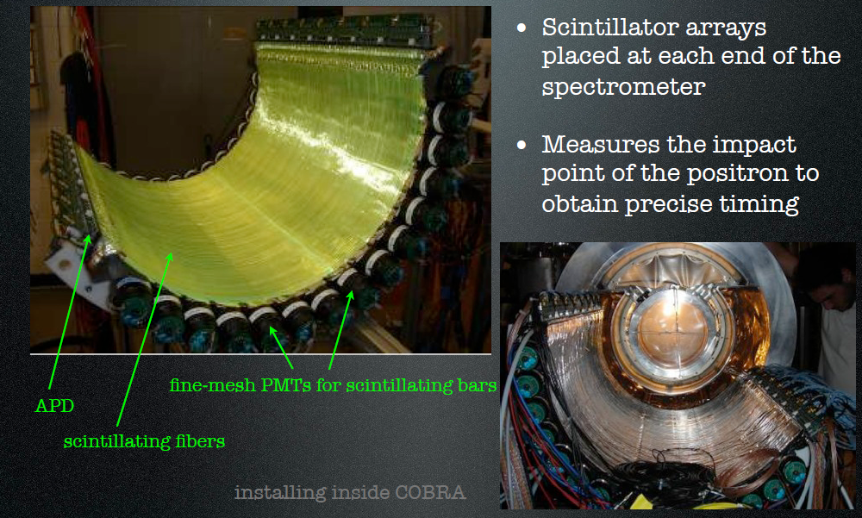
Timing counter
bars and fibers

Slide 29
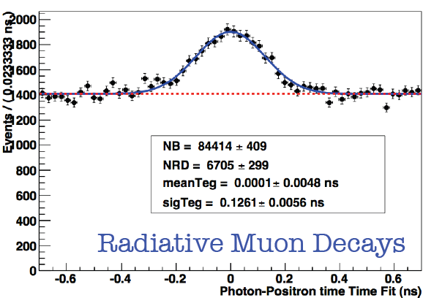
Positron-photon relative timing
Relative bar-bar and bar-LXe
sinchronization perfomed
py using p-induced reactions on
Boron (two photons emitted).
Monitored 1÷2/month.
Positron time measured by TC
and corrected for ToF using
DC track information.
Photon time measured in
LXe and corrected for ToF
from target to calorimeter
RMD peak seen in normal
runs and corrected by small
energy dependence.
Peak position stable within 20 ps

Slide 30
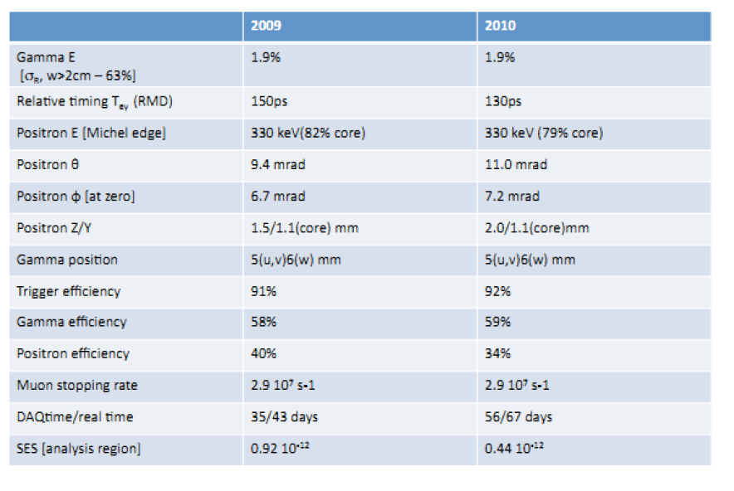
Summary of MEG performances

Slide 31
Analysis procedure

Slide 32
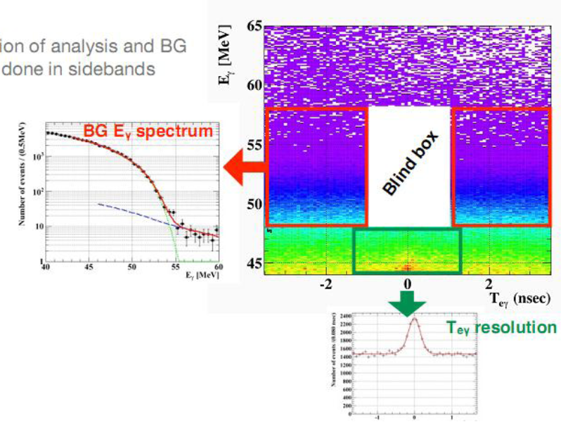
Blind + likelihood analysis
Signal and bkg optimization
done in sidebands
Timing sidebands
E_{γ} sideband
Events in the blind box (≈ 0.2%) are hidden
up to the end of optimization procedure

Slide 33
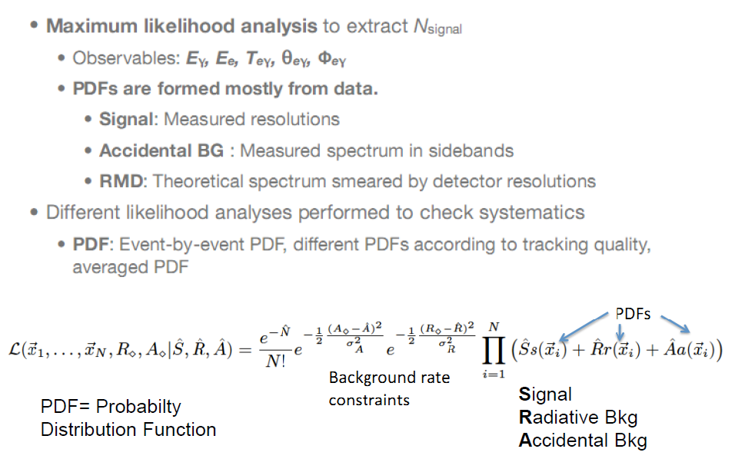
MEG likelihood analysis
The most dangerous
bck is measured !
Likelihood function

Slide 34
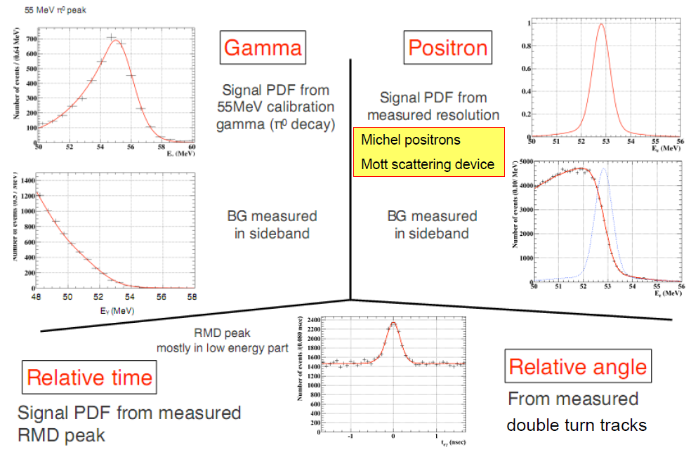
PDF’s

Slide 35
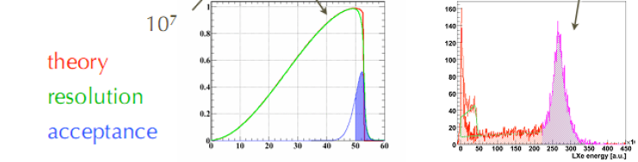
Normalization
where:
10⁷ pre-scaling
factor
TRG = 22: Michel events trigger (only DCH track required)
TRG = 0: MEG events trigger

Slide 36
Sensitivity evaluation
Expected sensitivity evaluated with two methods:
Toy MC assuming zero signal:
- generate 1000 independent samples of events using
bck and RD pdf’s (systematic effects not included);
- upper bound on number of signal events evaluated
for each sample;
- average of upper bounds.
Fit to events in the timing sidebands:
- applied same fitting procedure used for data in the
signal region.

Slide 37
Results

Slide 38
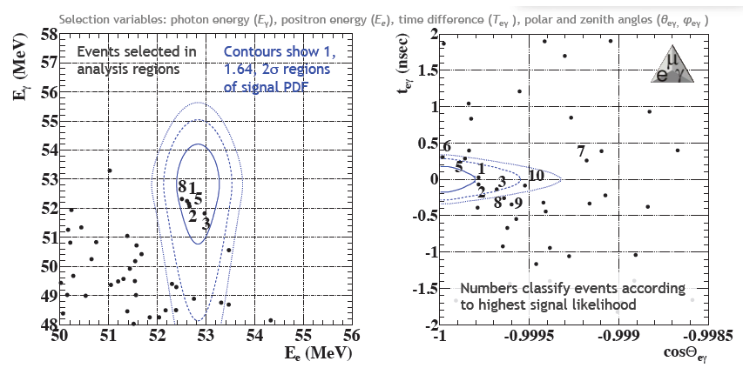
Preliminary 2009 results
Presented at ICHEP2010
and other conferences
Ranking variable

Slide 39
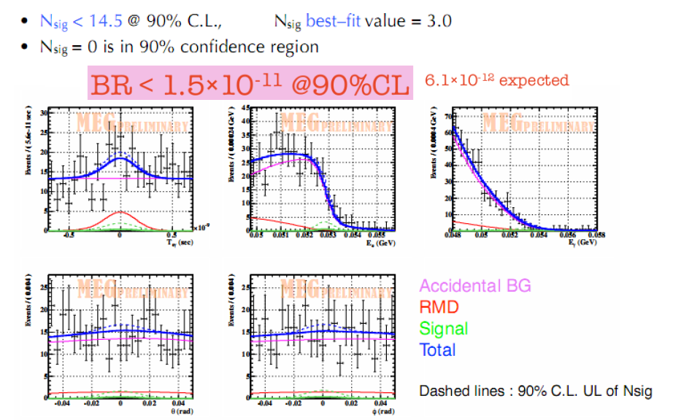
Unbinned maximum likelihood fit

Slide 40
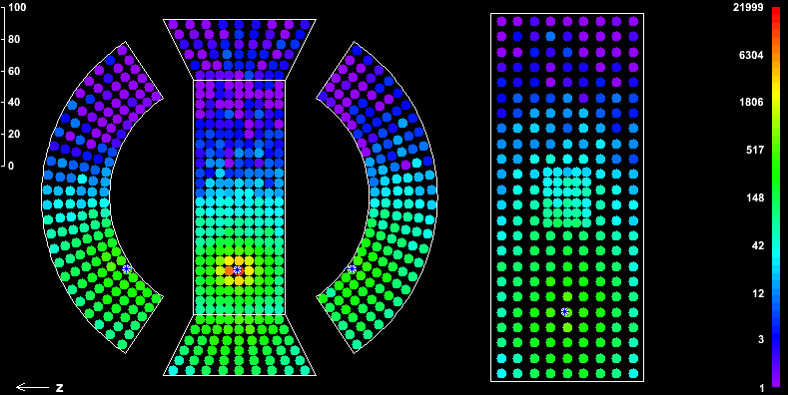
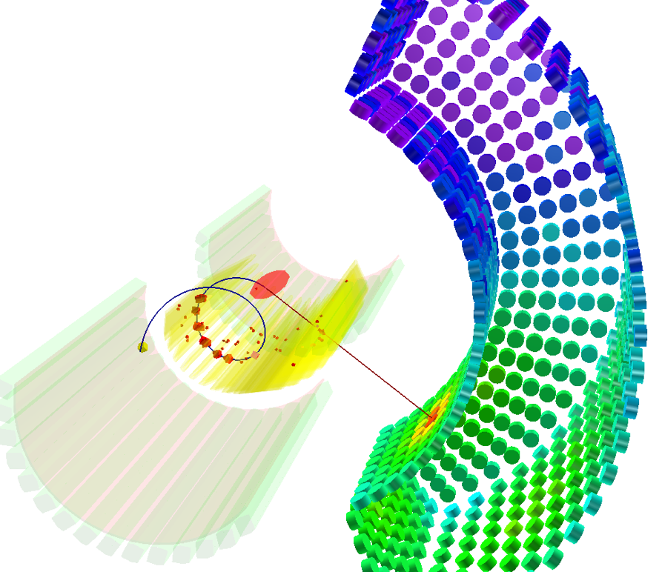
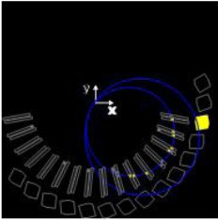
Picture of an interesting event
Nothing strange for
highly-ranked events
Randomly distributed
in detector acceptance
Correct detector behaviour
when events were recorded

Slide 41
Analysis improvements 1)
Better understanding of the spectrometer:
- optical survey for global alignment;
- relative alignment by using cosmic rays and millipede algorithm (CMS);
- relative spectrometer-target alignement by using reconstructed holes
in the target;
- geometrical correlation between positron momentum and angular
error taken into account.
Better evaluation of the DCH/calorimeter relative alignment.
Usage of the background measured in the sidebands in the likelihood
Feldman-Cousins statistical method + profile likelihood for estimating
the confidence intervals.
Combination between data of different years (2009-2010).

Slide 42
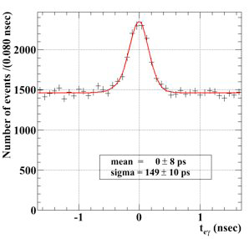
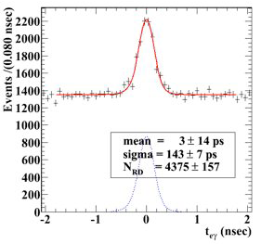
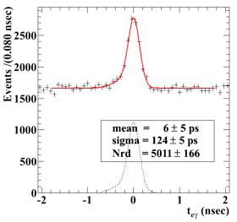
Analysis improvements 2)
Relative LXe-TC timing:
- waveform digitizer upgrade in 2010
more precise track reconstruction
2009 preliminary
2009 re-analysis
2010

Slide 43
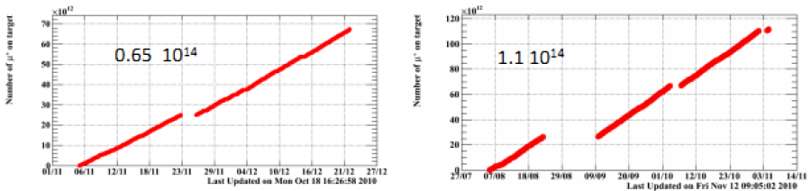
Data sets for 2009 & 2010
Muons on target 2009
Muons on target 2010
Statistics for 2010 about twice that for 2009
Stable detector conditions
(LXe, DC, TC)
Optimized degrader
Improved electronics timing
Slightly lower DC efficiency
because of higher noise.

Slide 44
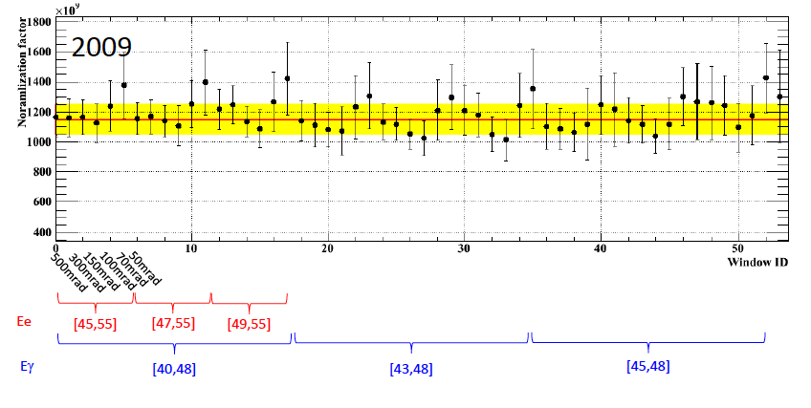

Radiative decay stability
Different energy
and angular windows

Slide 45

Updated 2009 results 1)
Events numbered by rank
Blue lines: 1, 1.64, 2 σ contours

Slide 46

Updated 2009 results 2)
Three independent
analyses performed by
different groups gave
consistent results.
Best Nsig: 3.0 → 3.4 ⇒ Best BR(μ → eγ) = 3.2 x 10⁻¹²

Slide 47

The highest rank event in 2009

Slide 48



2010 sideband analysis
Consistent with expected sensitivity: BR ≤ 2.2 x 10⁻¹²

Slide 49

2010 signal region analysis
No hints for excesses in signal region in both plots.

Slide 50

The highest ranked event in 2010

Slide 51

2010 maximum likelihood fit
Best fit NSIG = 0 if bounded, < 0 if not bounded.

Slide 52

2010 confidence level curve

Slide 53
2009-2010 combined 1)
In 2009 a fluctuation of 3 events above the background
was observed.
This fluctuation was consistent with zero signal events
at 8% probability.
Such a fluctuation disappeared in 2010.
Because of higher statistics of 2010 sample, the combined
limit was dominated by the 2010 data results. Then,
no lower bound at 90% C.L.

Slide 54


2009-2010 combined 2)
2009 + 2010
Profile likelihood curves
Factor five
improvement
wrt previous
limit !
Sensitivity 1.6 x 10⁻¹²; difference due to 2009 fluctuation.

Slide 55
Summary of MEG results
Data 2008:
Three months of data taking with low efficiency for DCH system and
varying xenon light yield depending on purification.
Useful for defining analysis procedures and algorithms.
Sensitivity: 1.3 x 10⁻¹¹; 90% CL Upper Limit: BR(μ→eγ) < 2.8 x 10⁻¹¹
Published in NP B834 (2010) 1 49 CITATIONS
Data 2009 + 2010:
Both DCH and Xenon light yield stable; improvements in timing waveforms
Sensitivity: 1.6 x 10⁻¹²; 90% CL Upper Limit: BR(μ→eγ) < 2.4 x 10⁻¹²
Approved by PRL; arXiv 1107.5547 16 CITATIONS in 2 months
Systematic errors: main contributions from relative angle offset, correlation in
positron kinematic variables, normalization. Global effect 2% on UL.

Slide 56

Impact of MEG result
Excluded by MEG
An example
MEG Upper Limit
G. Isidori et al., PRD 75 (2007) 115019

Slide 57

MEG press release
Percorso:ANSA > Scienza&Tecnica > Fisica & Matematica >
Si allontana il sogno della supersimmetria
http://www.ansa.it/scienza/notizie/rubriche/fisica/2011/09/26/visualizza_new.html_698338183.html
Si allontana il sogno della supersimmetria
Secondo la teoria ogni particella ha un partner che la
segue come un’ombra
Si allontana l'ipotesi che ogni particella che
osserviamo abbia una particella partner che la
segue come un'ombra dappertutto, e con essa
si allontana anche la possibilità che sia valida la
teoria della supersimmetria, che prevede il
fenomeno. L'esperimento Meg, coordinato
dall'italiano Alessandro Baldini dell'Istituto
Nazionale di Fisica Nucleare (Infn) di Pisa,
ha infatti ridotto la probabilità che esista
un processo fisico che possa validare la
teoria della supersimmetria. Il risultato è in
corso di pubblicazione sulla rivista
Physical Review Letters ….

Slide 58
Perspectives and possible upgrades

Slide 59

Perspectives
MEG Time Scale
Data taking for 2011 up to December: ∼ 5 months total, ∼ 4 for physics
Data taking for 2012: ∼ 8 months

Slide 60



Open space for NP
arXiv 1109.0731v1 [hep-ph]
It includes:
- ν oscillations
- LHC constraints
- Dark Matter searches
- (g-2)_{μ}
- B-physics

Slide 61

Up-to-date 2011 statistics
1.15 x 10¹⁴
Collected more muons than in 2010; still two months of data taking
Expected N_{μ}(2011) > (N_{μ}(2009) + N_{μ}(2010))

Slide 62

Sensitivity vs time
Expected final
sensitivity:
≈ 5 x 10⁻¹³

Slide 63

Trigger/DAQ upgrades 2008-2011
20% absolute
improvement
with respect to
2010 run
Fully efficient
DAQ system

Slide 64

Possible upgrades
Written document presented to CSN1;
some funds already assigned.
Active target (250 μm fibers) + APD/SiPM
“Short” term upgrades
(in 2012)
Beam spot reduction
Optimization of gas composition
Improvement of photon angle
energy resolution by
increasing PMT density
“Long” term upgrades
(RD + installation:
∼ 3 years)
New design of DCH system → improvement
in angle, momentum and timing resolution

Slide 65
Long-term upgrades 2)
Re-design of DCH system. Two options:
Conventional cylindrical drift chamber (“a la Kloe ”)
F. Grancagnolo, Nucl. Phys. B172 (2007) 25
R. Perrino et al., Nucl. Instr. and Meth. A98 (2009) 98
σ_{r} ∼ 50 μm, σ_{z} ∼ 300 μm
Reduction of multiple scattering
Much higher number of points ⇒ advantages in tracking
Chamber-TC: scintillating film (50 ÷ 100 μm) read by SiPM
σ_{r} ∼ 300 μm, σ_{z} ∼ 300 μm
Fast and compact detector; improvement in timing resolution
Compatible with high stopping muon intensities (∼ 10⁸/s).

Slide 66

Resolution goals
Variable Goal Reached

Slide 67
Conclusions
The MEG Experiment is running since 2008 in the search
for μ→eγ decay.
Analysis of data collected in 2009 & 2010 established an
Upper Limit on μ→eγ branching ratio of 2.4 x 10⁻¹² @ 90% CL.
This result represents a factor 5 improvement with respect to
the previous limit.
The result is already significant.
At the end of data taking, MEG will reach a sensitivity ≈ 5 x 10⁻¹³
A null result with this final sensitivity will be a strong constraint for
Super Sym Parameter space.
Studies are under way for possible upgrades of the experiment in
order to improve sensitivity by better detector resolutions.

Slide 68
Backup

Slide 69

Trigger digital system

Slide 70

Readout electronics
Waveform digitizing for all channels (pile-up rejection);
Custom Domino Sampling Chip designed at PSI;
2.5 GHz sampling speed @ 40 ps timing resolution;
Sampling depth 1024 bins;
Readout similar to trigger;

Slide 71

Positron variables correlation
Positron PDF takes into account correlations among angles and momentum
Geometrical effect due to target constraint
Very good agreement of data with model prediction

Slide 72

Space for NP 2)
H. Bachacou,
LP2011
Conference

