Slide 1
29/02/2024
Viene ridistribuita la tensione alle spire della FC dando 47 kV a quella che guarda il catodo e 1 kV a quella che guarda la GEM.
Il catodo viene posto a 50 kV
La GEM che guarda la prima spira viene settata a 3 kV
Nella simulazione elettrostatica viene considerate anche la GEM e il catodo.
Distanze:
GEM-Prima spira = 10 mm
Catodo – prima spira = 10 mm

Slide 2
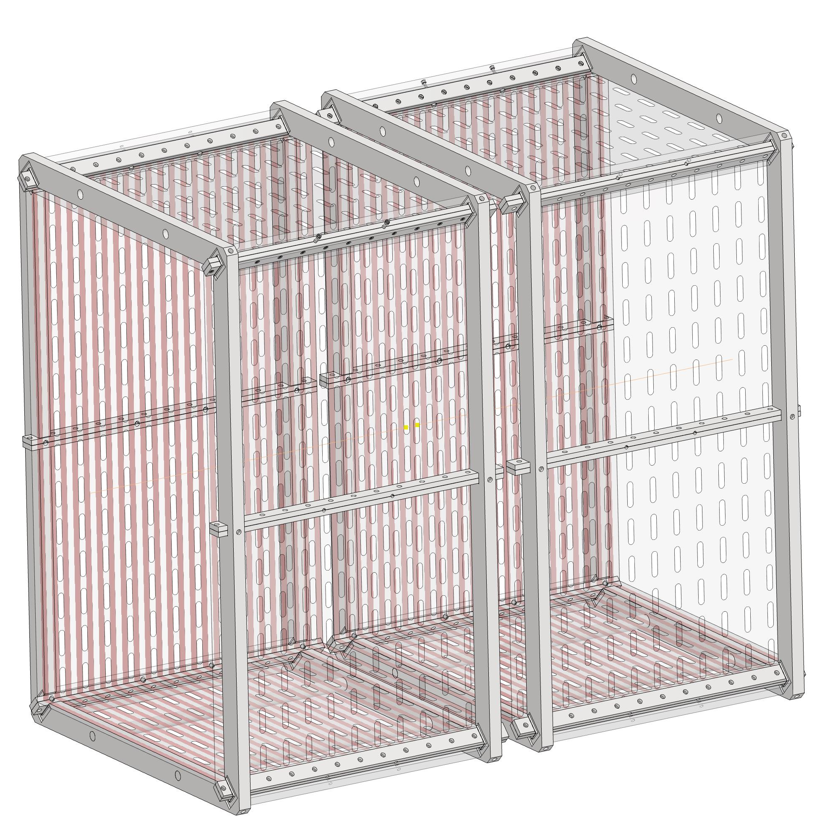
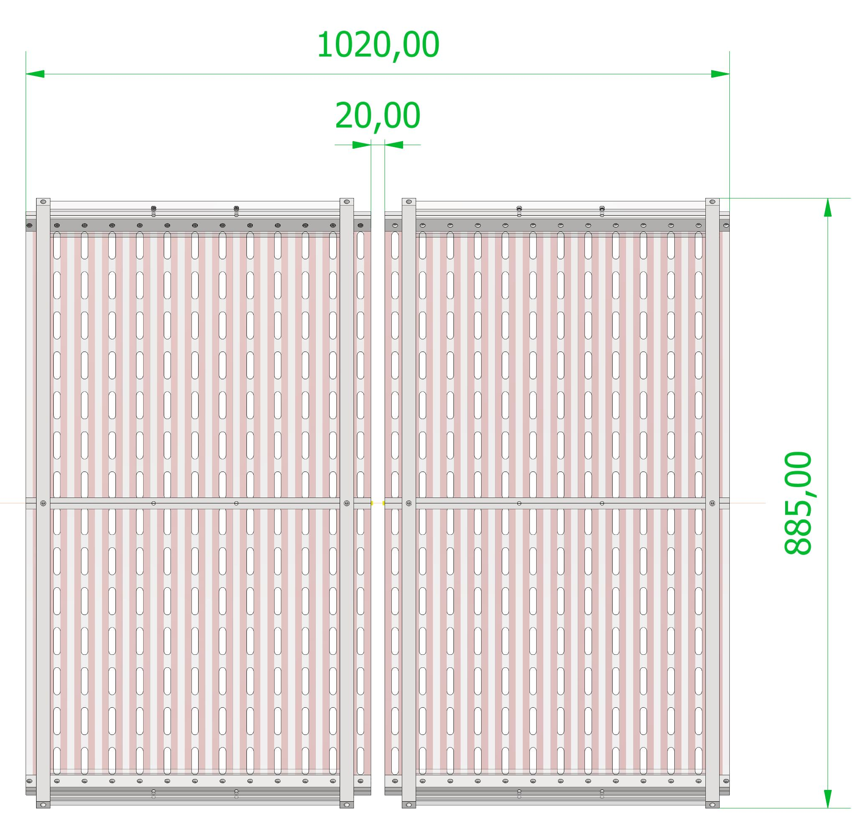
FULL - FC

Slide 3
FC: 47 kV to 1 kV
49 kV
50 kV
4 kV
3 kV

Slide 4
Voltage distribution in the FC
The first turn close to the Cathode is at 10 mm
The last turn distance from the GEM is 10 mm
The cathode is at 50 kV
The GEM is at 3 kV

Slide 5
Voltage distribution applied to the FC
The first turn close to the Cathode is at 10 mm
The last turn distance from the GEM is 10 mm
The cathode is at 50 kV
The GEM is at 3 kV

Slide 6
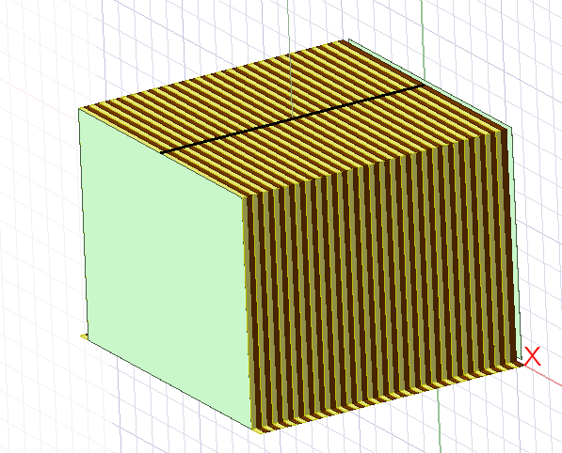
E field distribution between turns
The first turn close to the Cathode is at 10 mm
The last turn distance from the GEM is 10 mm
The cathode is at 50 kV
The GEM is at 3 kV

Slide 7
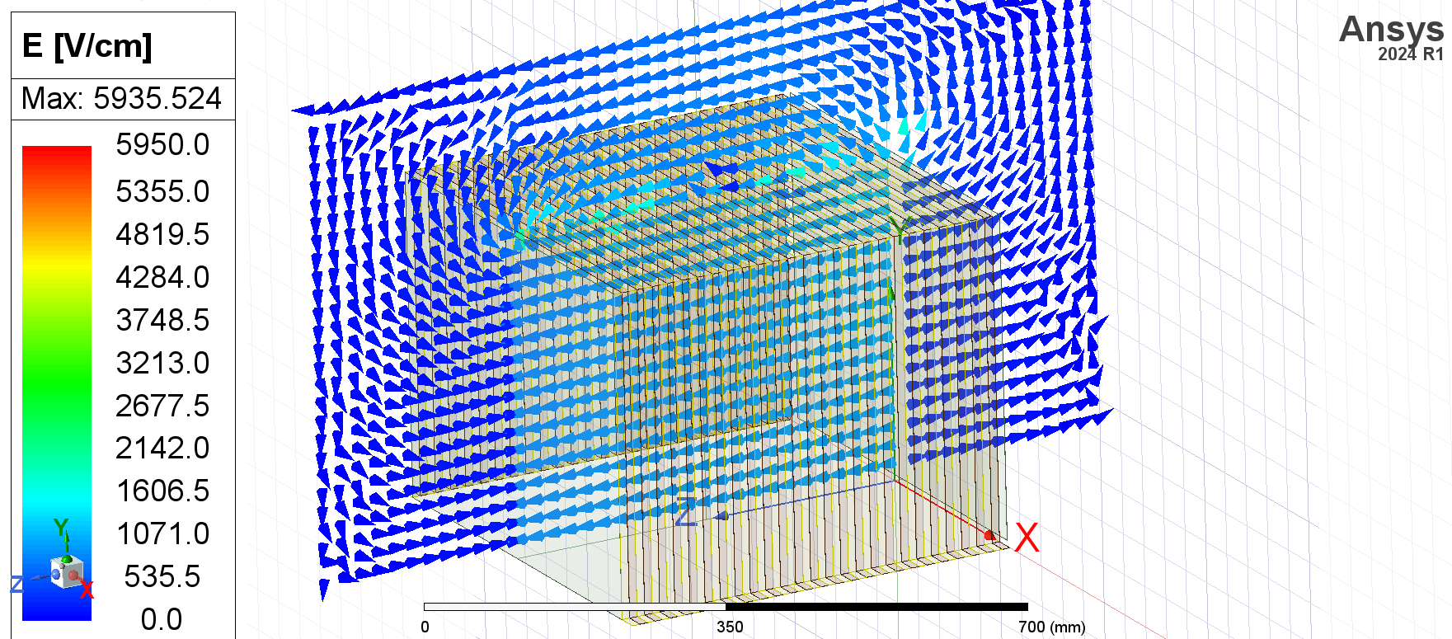
FC: 47 kV to 1 kV

Slide 8
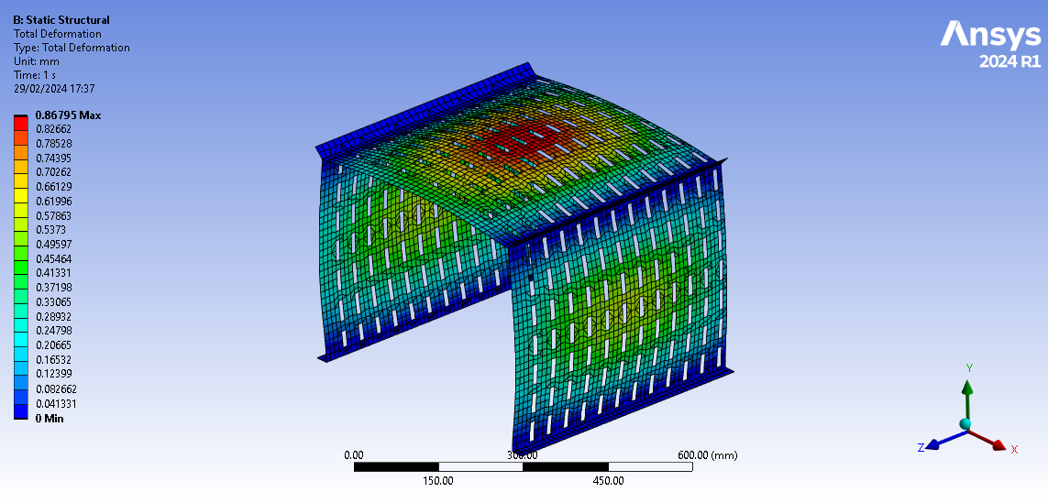
Top: Total deformation with E field only

Slide 9
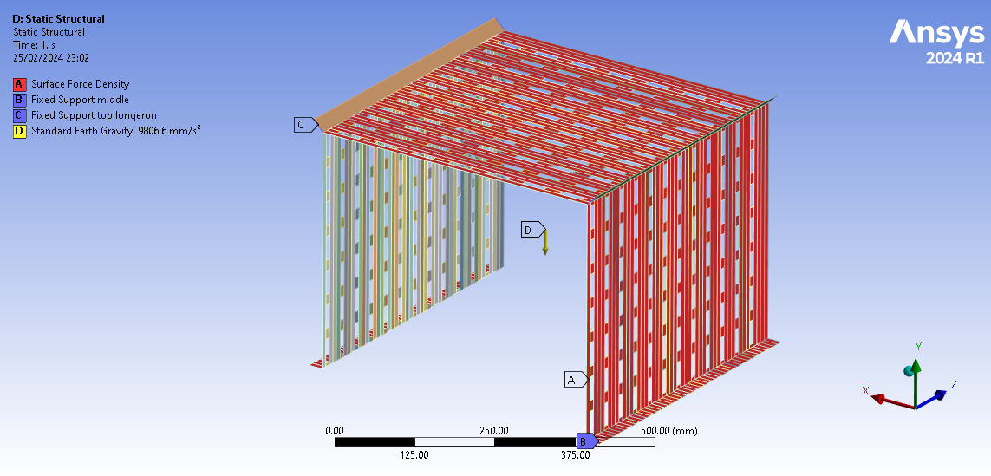
TOP: Loads = Gravity + E Field

Slide 10
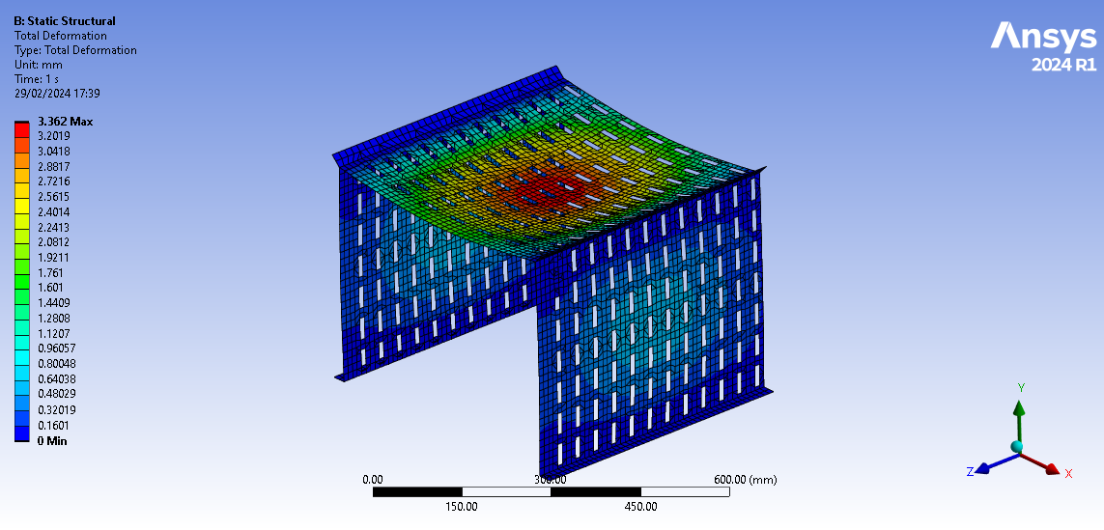
Top: Total deformation with Gravity + E Field

Slide 11
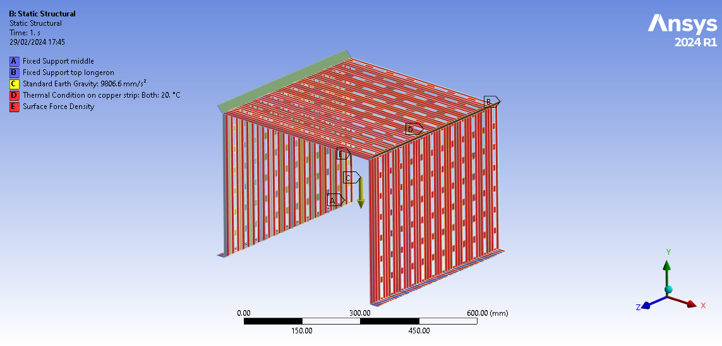
TOP: Loads with 20 N stretching

Slide 12
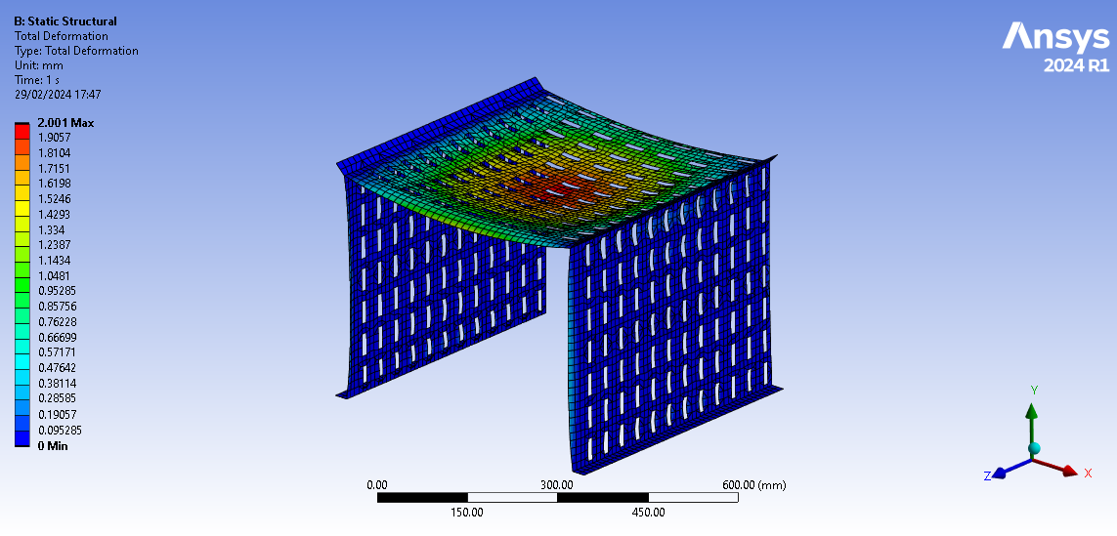
Top: Total deformation with Gravity + E Field + T

Slide 13
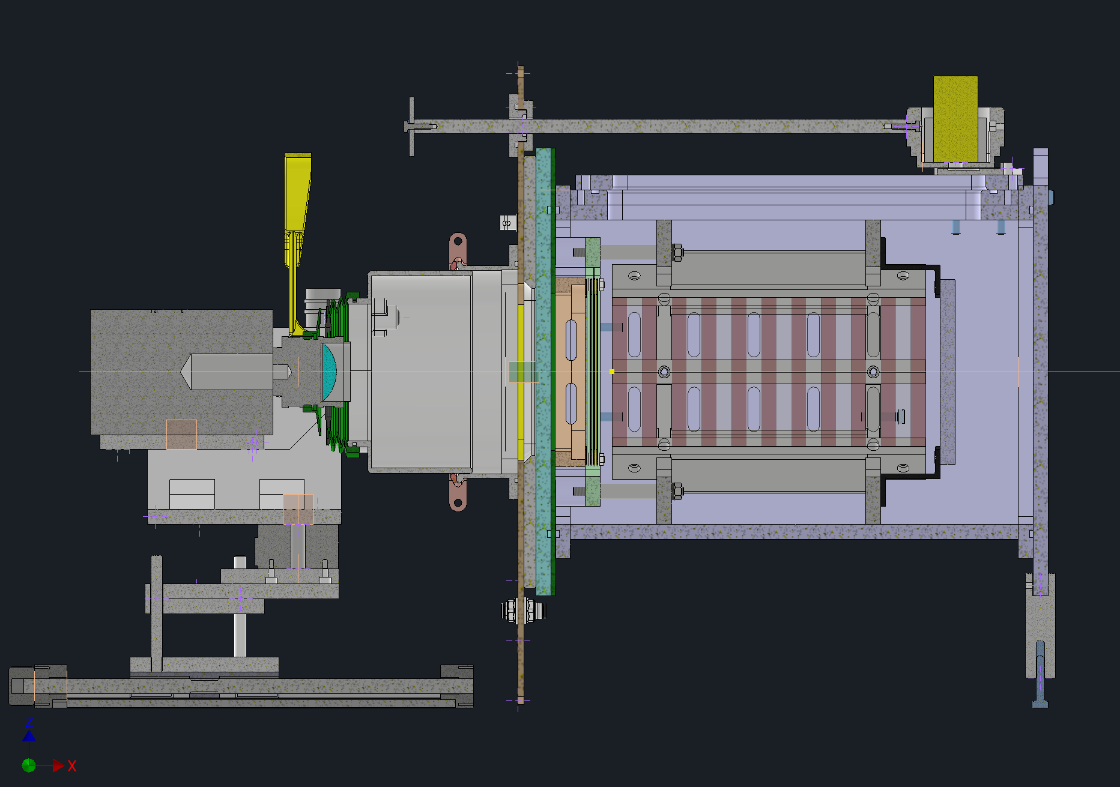
GIN: with the new FC

Slide 14
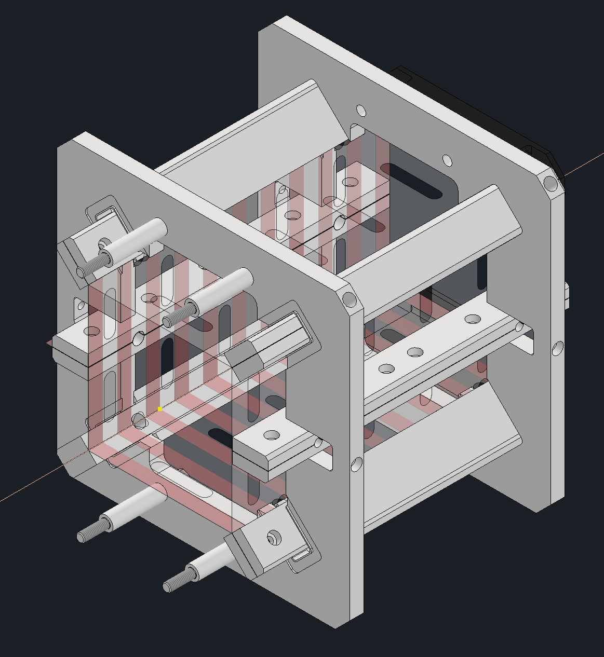
DRAFT: TO BE OPTMIZED BY DESIGERS

