Slide 1
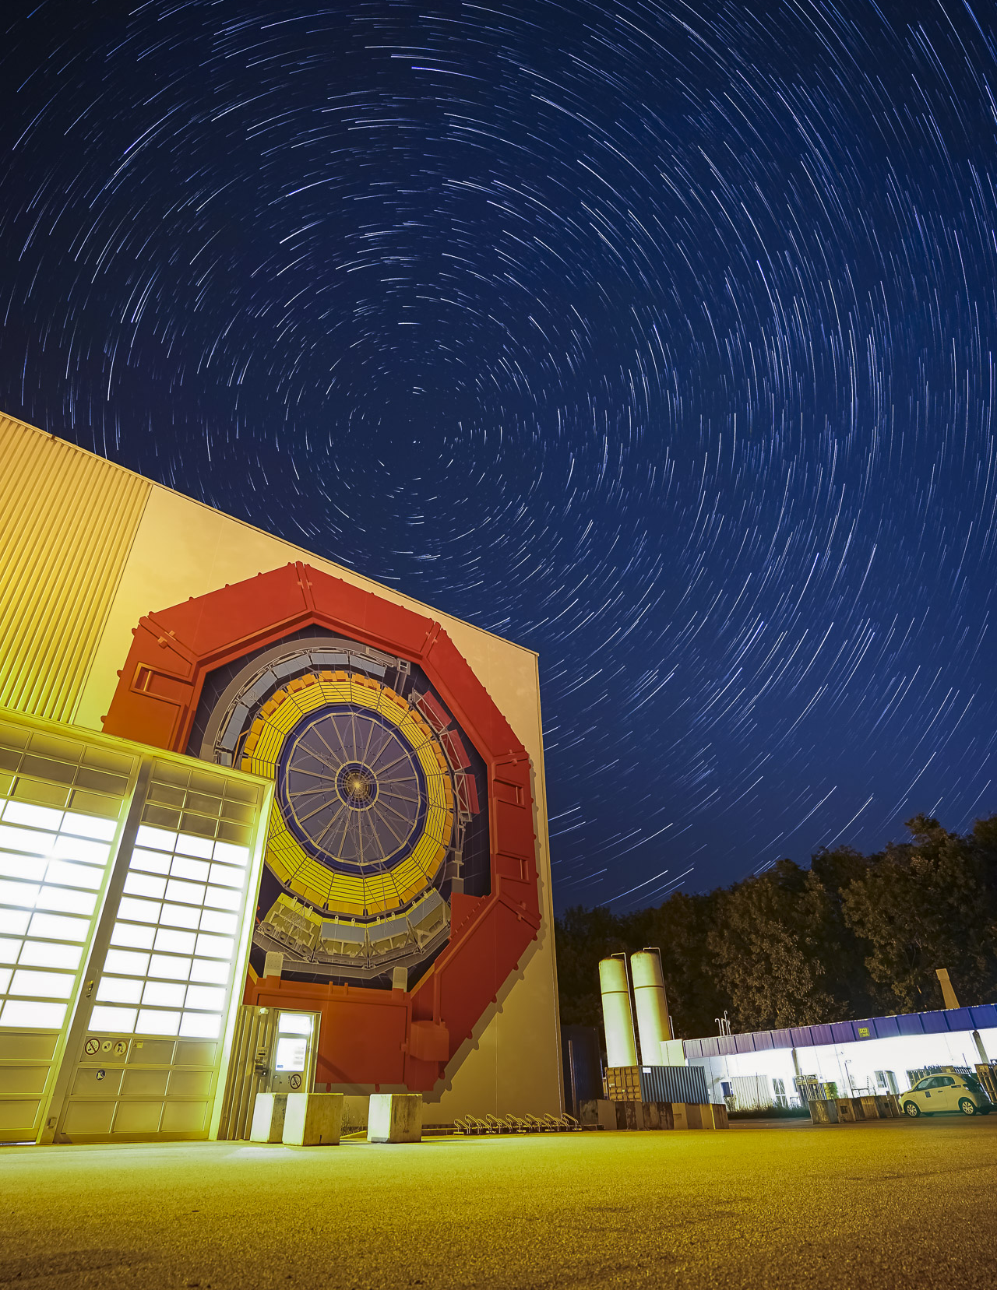
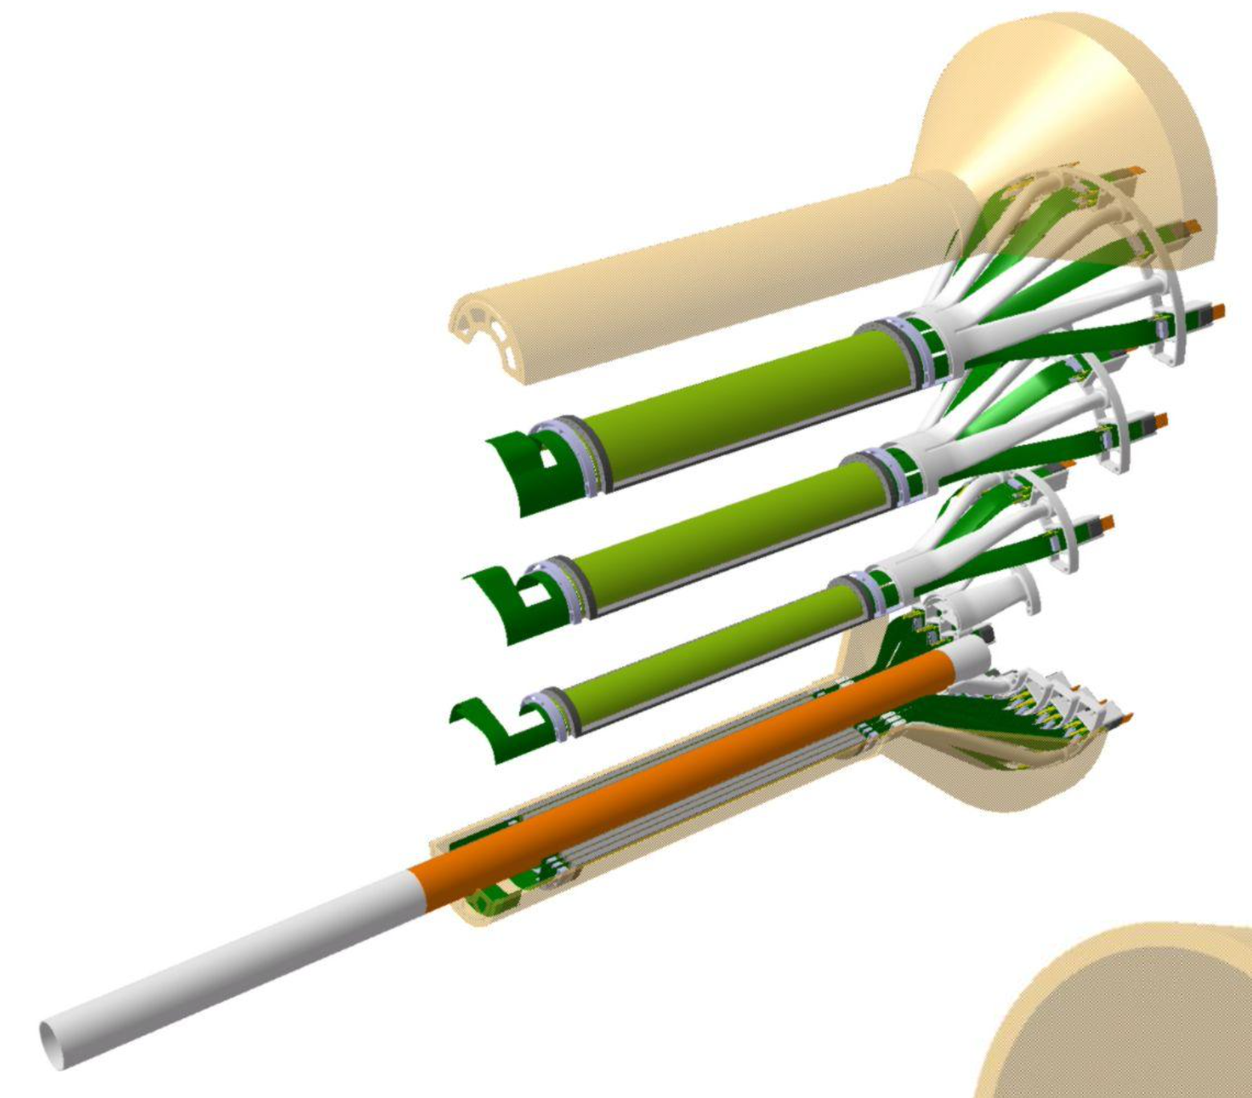
RD_FCC WP-Silicon Mini-workshop
Torino, 22-23 April 2024
ALICE ITS3 how to integrate a large dimension MAPS sensor in a bent configuration detector + ALICE3
Domenico Colella
University and INFN Bari
© Klaus Barth
RD_FCC WP-Silicon Mini-workshop | 22-23 April 2024 | Domenico Colella

Slide 2
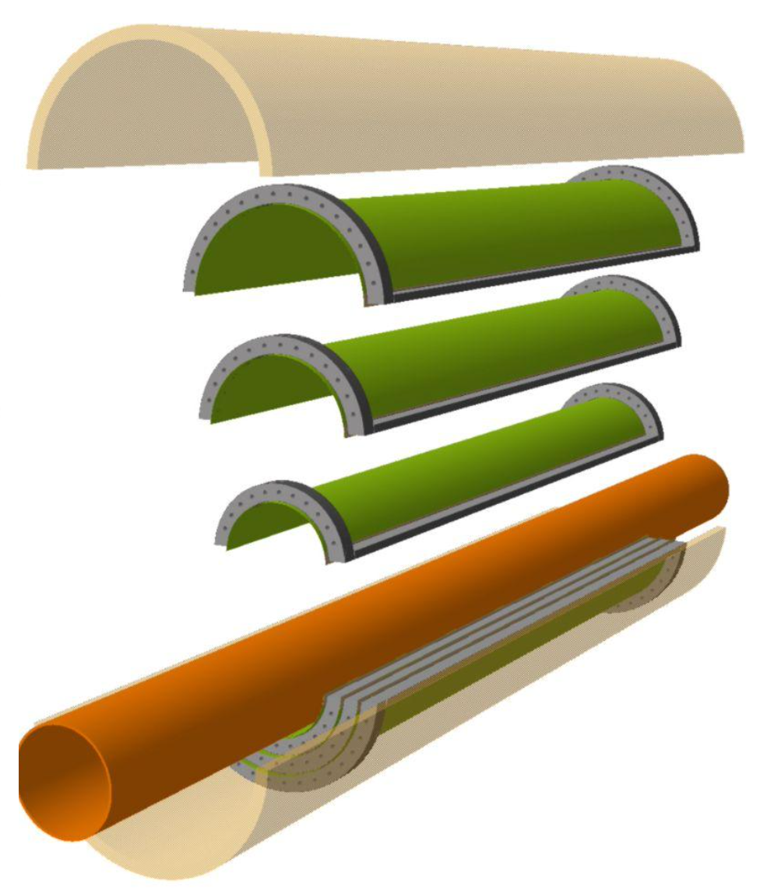
ITS3
RD_FCC WP-Silicon Mini-workshop | 22-23 April 2024 | Domenico Colella

Slide 3
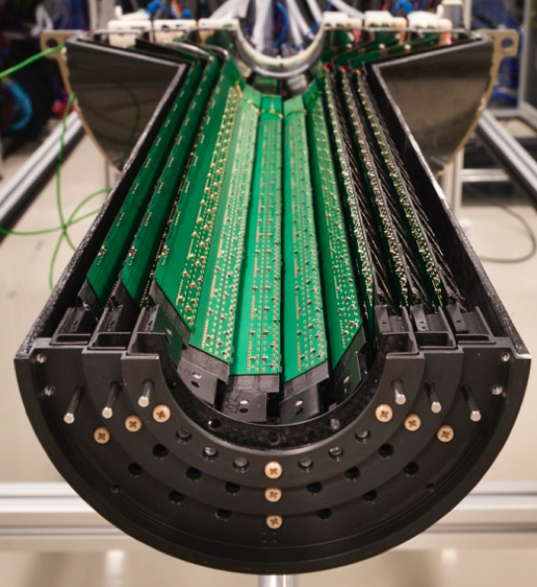
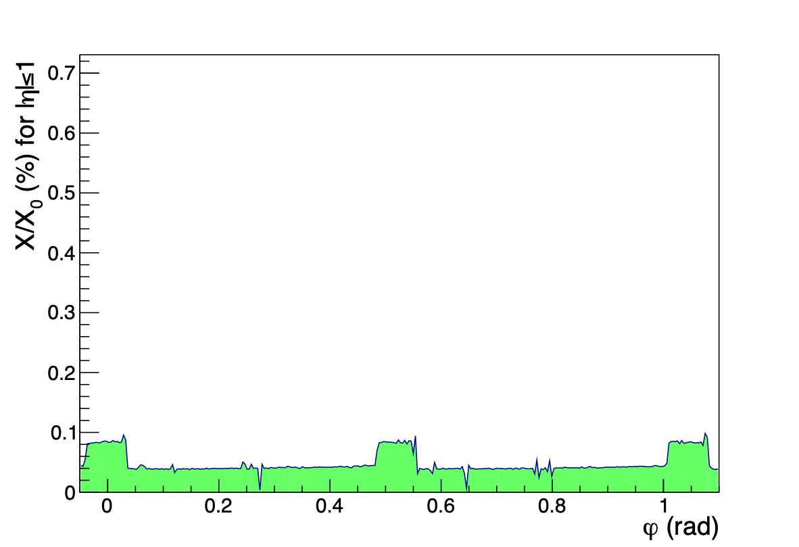
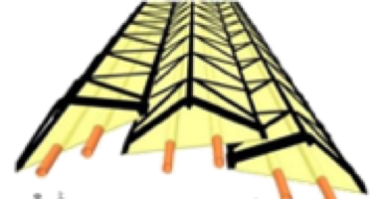
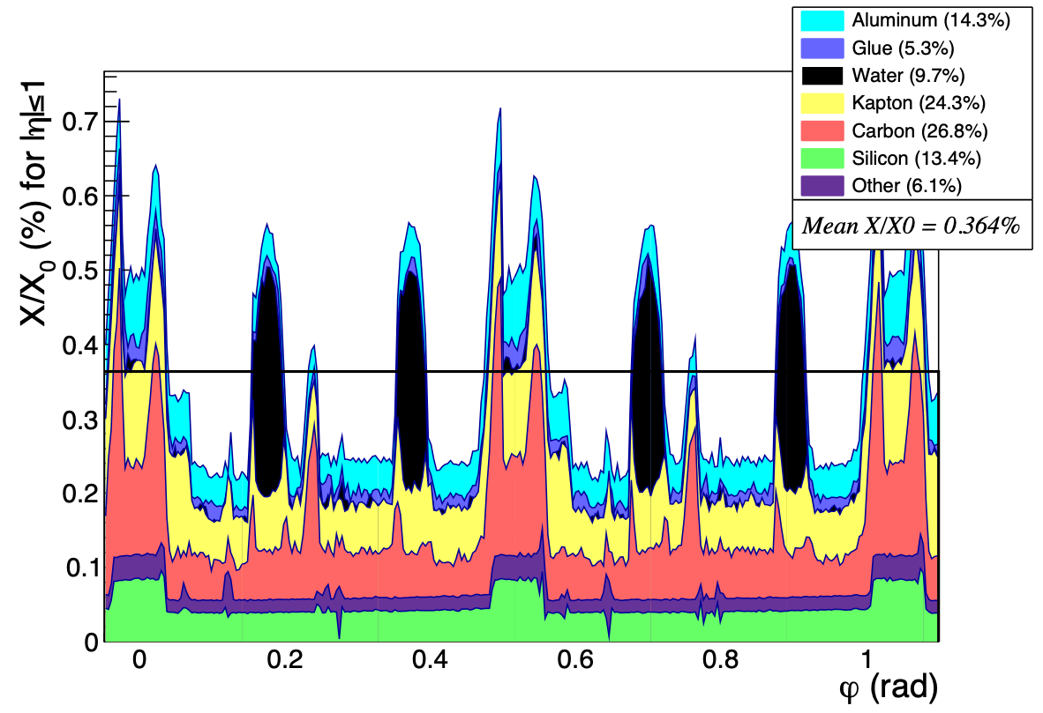
ITS3 detector concept
ITS3
ITS2-IB
Required improvements
Removal of water cooling → low flow air cooling
Removal of circuit board from the sensitive region
Removal of mechanical support from the sensitive region, profiting from increased stiffness of bent Si wafers
Inner-most layer (ITS2)
Inner-most layer (ITS2)
Mean X/X0 = 0.364%
Mean X/X0 = 0.05%
RD_FCC WP-Silicon Mini-workshop | 22-23 April 2024 | Domenico Colella

Slide 4
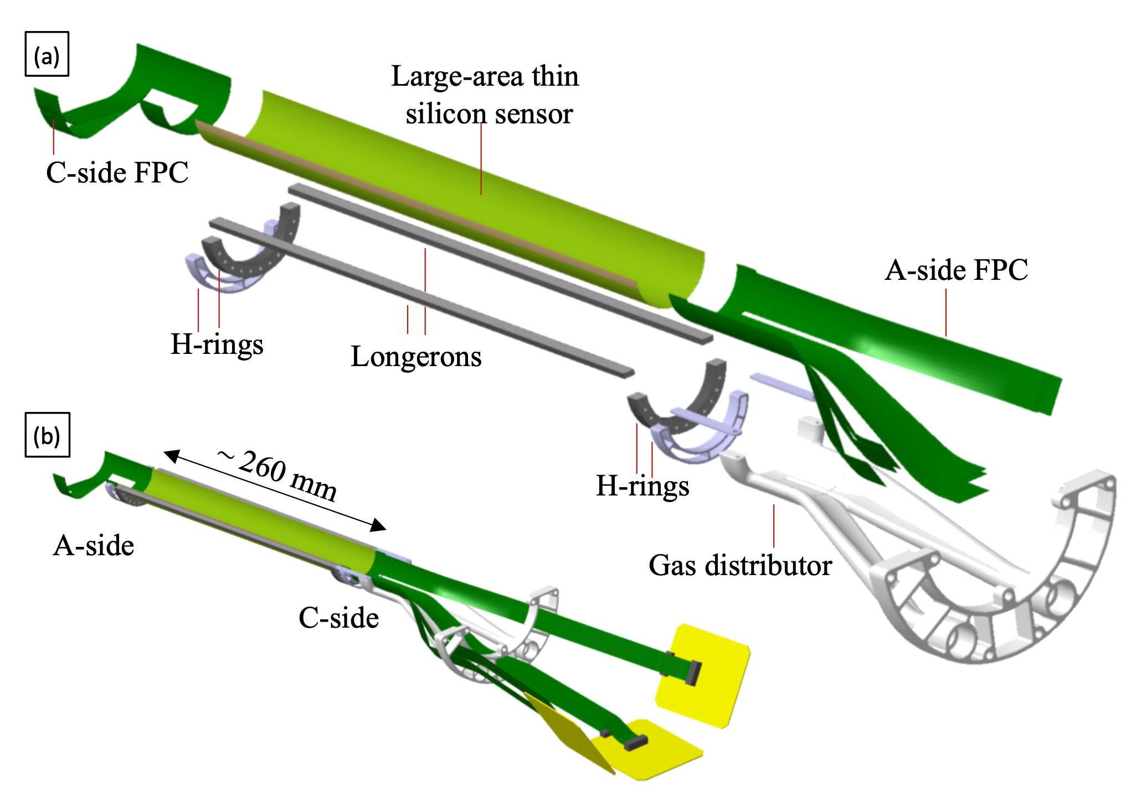
ITS3 detector concept
Key ingredients
Wafer-scale chips (up to ~28x10 cm), fabricated using stitching
Si MAPS sensor based on 65 nm technology
Sensor thickness ≤ 50 μm
Chips bent in cylindrical shape at target radii
Ultra light carbon foam structures
Air cooling
RD_FCC WP-Silicon Mini-workshop | 22-23 April 2024 | Domenico Colella

Slide 5
ITS3 detector concept
Key ingredients
Wafer-scale chips (up to ~28x10 cm), fabricated using stitching
Si MAPS sensor based on 65 nm technology
Sensor thickness ≤ 50 μm
Chips bent in cylindrical shape at target radii
Ultra light carbon foam structures
Air cooling
RD_FCC WP-Silicon Mini-workshop | 22-23 April 2024 | Domenico Colella

Slide 6
ITS3 detector concept
Key ingredients
Wafer-scale chips (up to ~28x10 cm), fabricated using stitching
Si MAPS sensor based on 65 nm technology
Sensor thickness ≤ 50 μm
Chips bent in cylindrical shape at target radii
Ultra light carbon foam structures
Air cooling
RD_FCC WP-Silicon Mini-workshop | 22-23 April 2024 | Domenico Colella

Slide 7
ITS3 detector concept
Key ingredients
Wafer-scale chips (up to ~28x10 cm), fabricated using stitching
Si MAPS sensor based on 65 nm technology
Sensor thickness ≤ 50 μm
Chips bent in cylindrical shape at target radii
Ultra light carbon foam structures
Air cooling
RD_FCC WP-Silicon Mini-workshop | 22-23 April 2024 | Domenico Colella

Slide 8
ITS3 detector concept
Key ingredients
Wafer-scale chips (up to ~28x10 cm), fabricated using stitching
Si MAPS sensor based on 65 nm technology
Sensor thickness ≤ 50 μm
Chips bent in cylindrical shape at target radii
Ultra light carbon foam structures
Air cooling
RD_FCC WP-Silicon Mini-workshop | 22-23 April 2024 | Domenico Colella

Slide 9
ITS3 detector concept
Key ingredients
Wafer-scale chips (up to ~28x10 cm), fabricated using stitching
Si MAPS sensor based on 65 nm technology
Sensor thickness ≤ 50 μm
Chips bent in cylindrical shape at target radii
Ultra light carbon foam structures
Air cooling
RD_FCC WP-Silicon Mini-workshop | 22-23 April 2024 | Domenico Colella

Slide 10
ITS3 detector concept
Key ingredients
Wafer-scale chips (up to ~28x10 cm), fabricated using stitching
Si MAPS sensor based on 65 nm technology
Sensor thickness ≤ 50 μm
Chips bent in cylindrical shape at target radii
Ultra light carbon foam structures
Air cooling
RD_FCC WP-Silicon Mini-workshop | 22-23 April 2024 | Domenico Colella

Slide 11
ITS3 detector concept
Key ingredients
Wafer-scale chips (up to ~28x10 cm), fabricated using stitching
Si MAPS sensor based on 65 nm technology
Sensor thickness ≤ 50 μm
Chips bent in cylindrical shape at target radii
Ultra light carbon foam structures
Air cooling
Beam pipe inner/outer radius (mm) | 16.0/16.5
IB Layer Parameters | Layer 0 | Layer 1 | Layer 2
Radial position (mm) | 18.0 | 24.0 | 30.0
Length of sensitive area (mm) | 280.0
Pseudo-rapidity coverage | ±2.5 | ±2.3 | ±2.0
Active-area (cm²) | 610 | 816 | 1016
Pixel sensor dimension (mm²) | 280 × 56.5 | 280 x 75.5 | 280 x 94
Number of sensors per layer | 2
Pixel size (μm²) | O (10 x 10)
The whole detector will comprise six chips and barely anything else!
RD_FCC WP-Silicon Mini-workshop | 22-23 April 2024 | Domenico Colella

Slide 12
ITS3 detector concept
Key ingredients
Wafer-scale chips (up to ~28x10 cm), fabricated using stitching
Si MAPS sensor based on 65 nm technology
Sensor thickness ≤ 50 μm
Chips bent in cylindrical shape at target radii
Ultra light carbon foam structures
Air cooling
This talk content:
Silicon bending
Carbon foam properties
Sensor cooling
Mechanical characterization
Interconnection
The whole detector will comprise six chips and barely anything else!
RD_FCC WP-Silicon Mini-workshop | 22-23 April 2024 | Domenico Colella

Slide 13
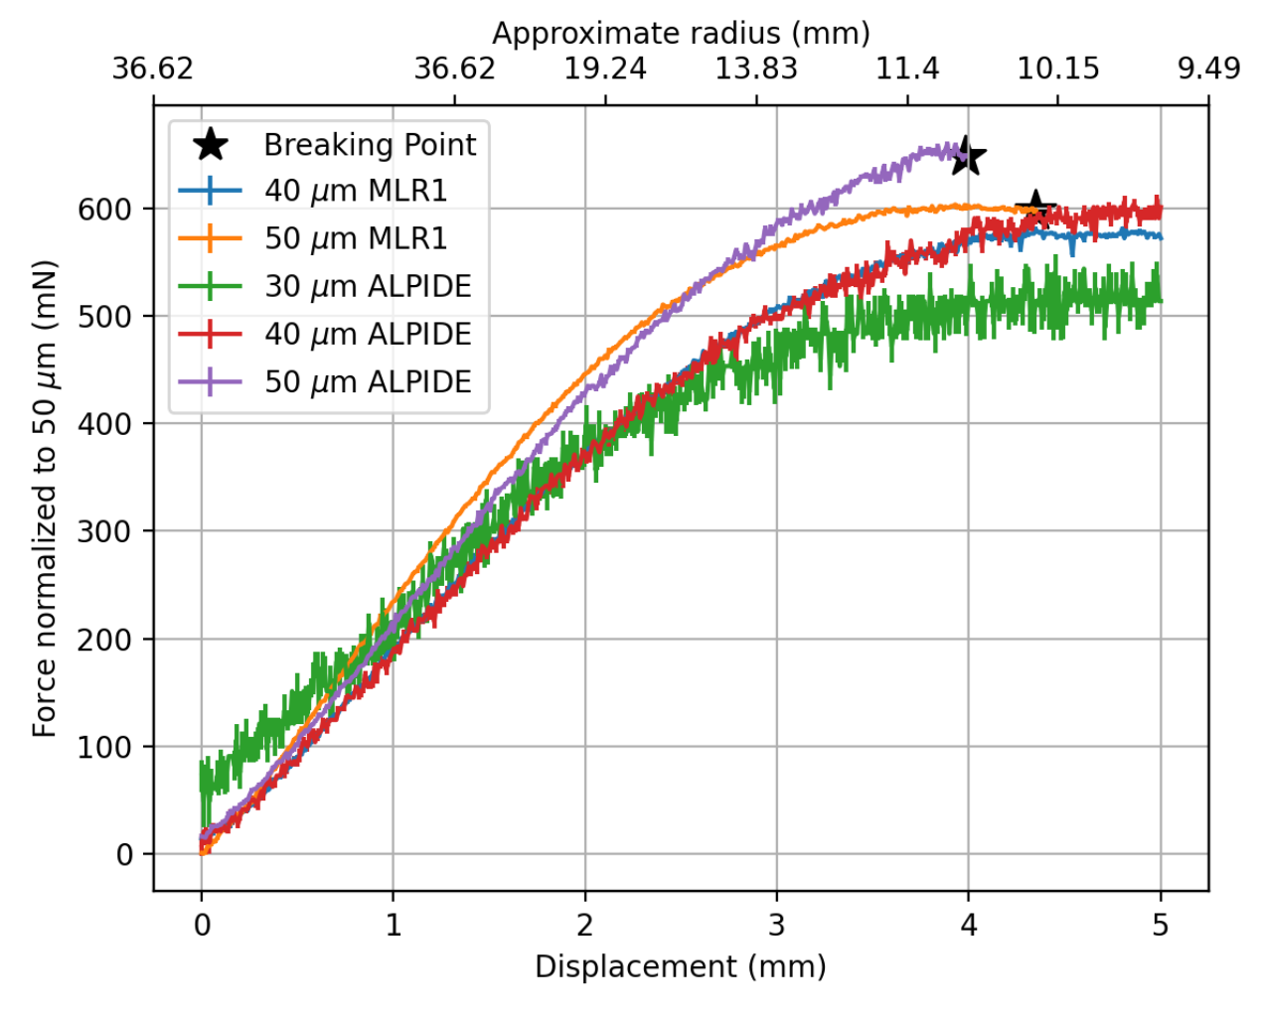
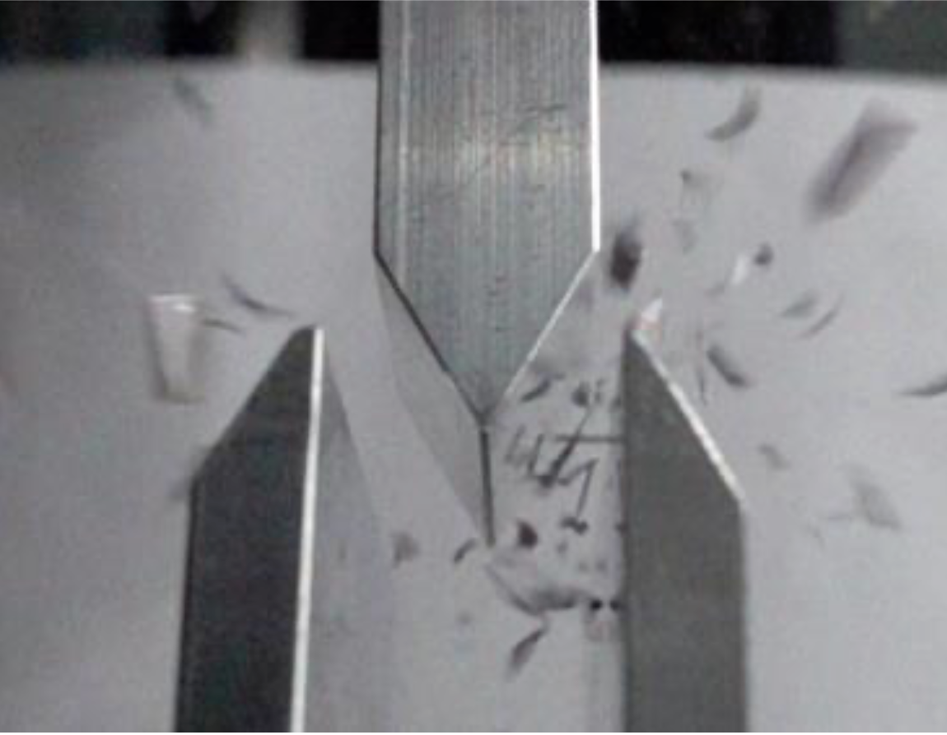
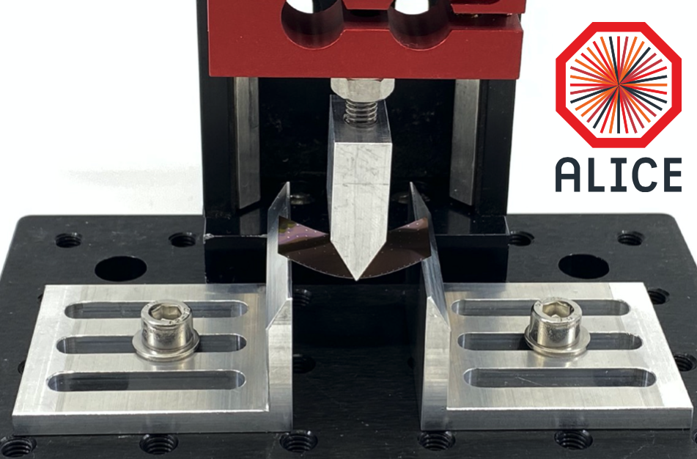
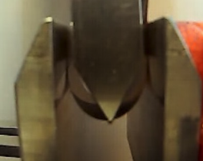
ITS3 R&D - Silicon bending
Three points bending force measurements:
MAPS ~50 μm thick are quite flexible
Large benefit from going thinner
Project goal thicknesses and desired bending radii achievable
50 $μm$
65 nm
180 nm
30 $μm$
Layer 0 radius
RD_FCC WP-Silicon Mini-workshop | 22-23 April 2024 | Domenico Colella

Slide 14
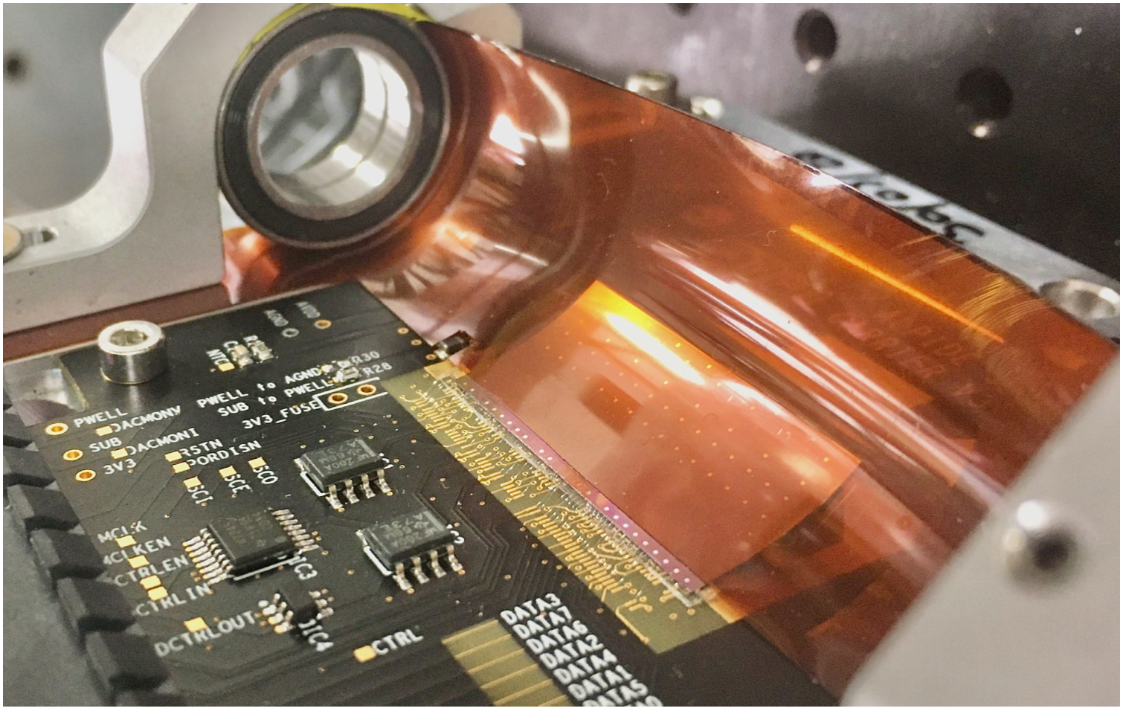
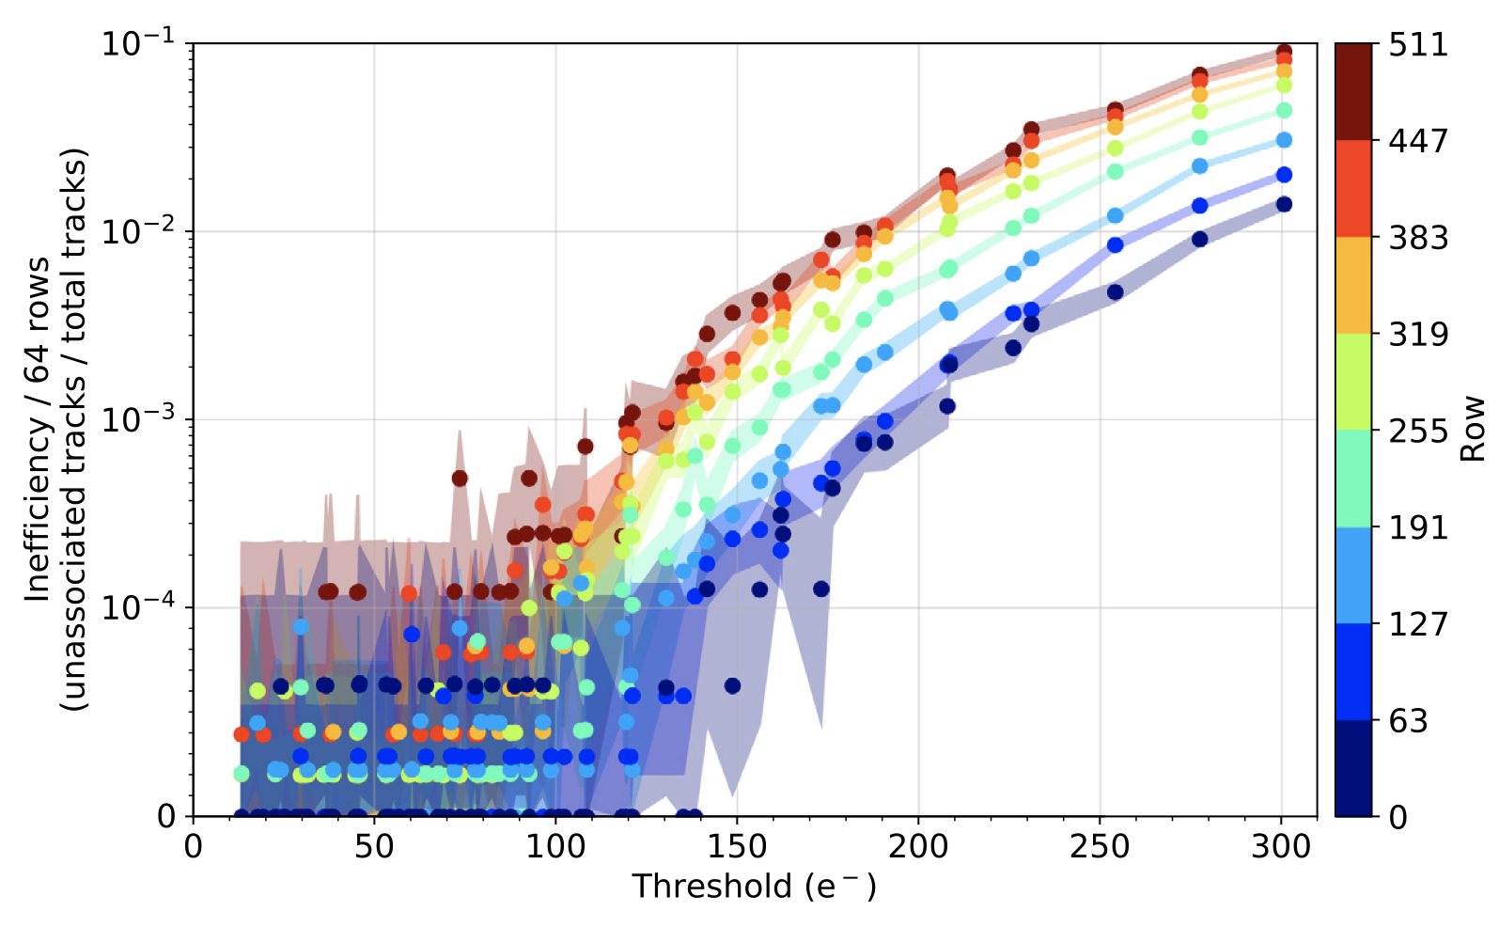
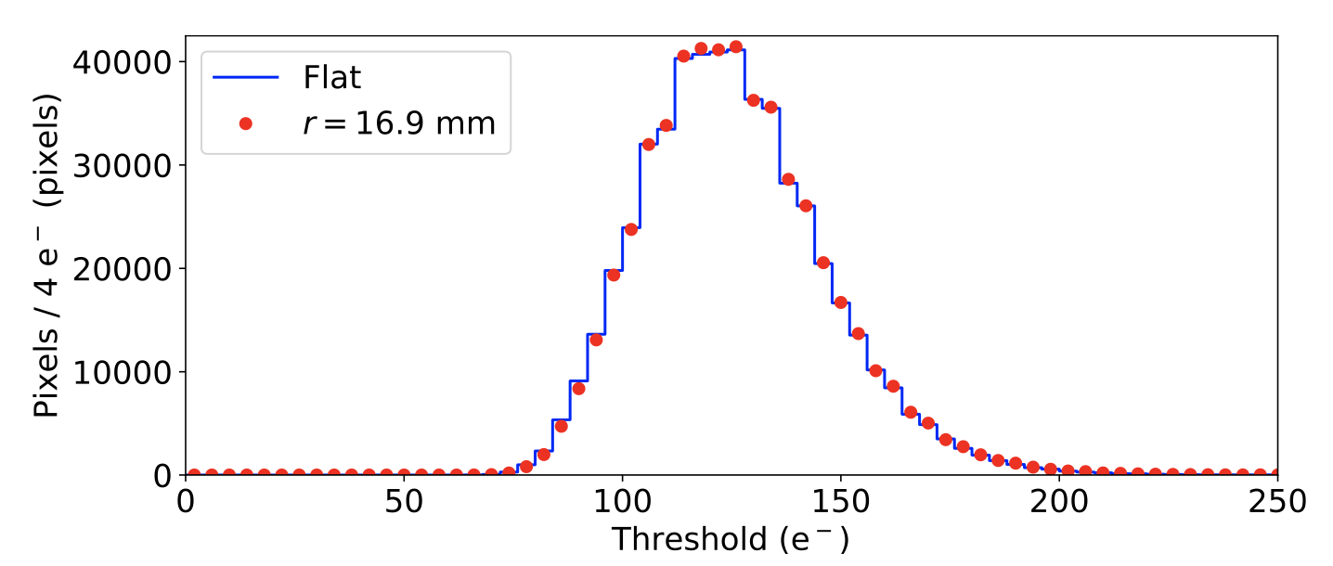
ITS3 R&D - Silicon bending
ALPIDE 180 nm
Laboratory and test beam measurements (Jun 2020) allow to conclude that chip (180 nm CMOS) performance doesn’t change after bending
Pixel matrix threshold distribution does not change when sensor is bent
Efficiency above 99.9% at a threshold of 100 e⁻
https://doi.org/10.1016/j.nima.2021.166280
https://doi.org/10.1016/j.nima.2021.166280
Nominal operating point
RD_FCC WP-Silicon Mini-workshop | 22-23 April 2024 | Domenico Colella

Slide 15
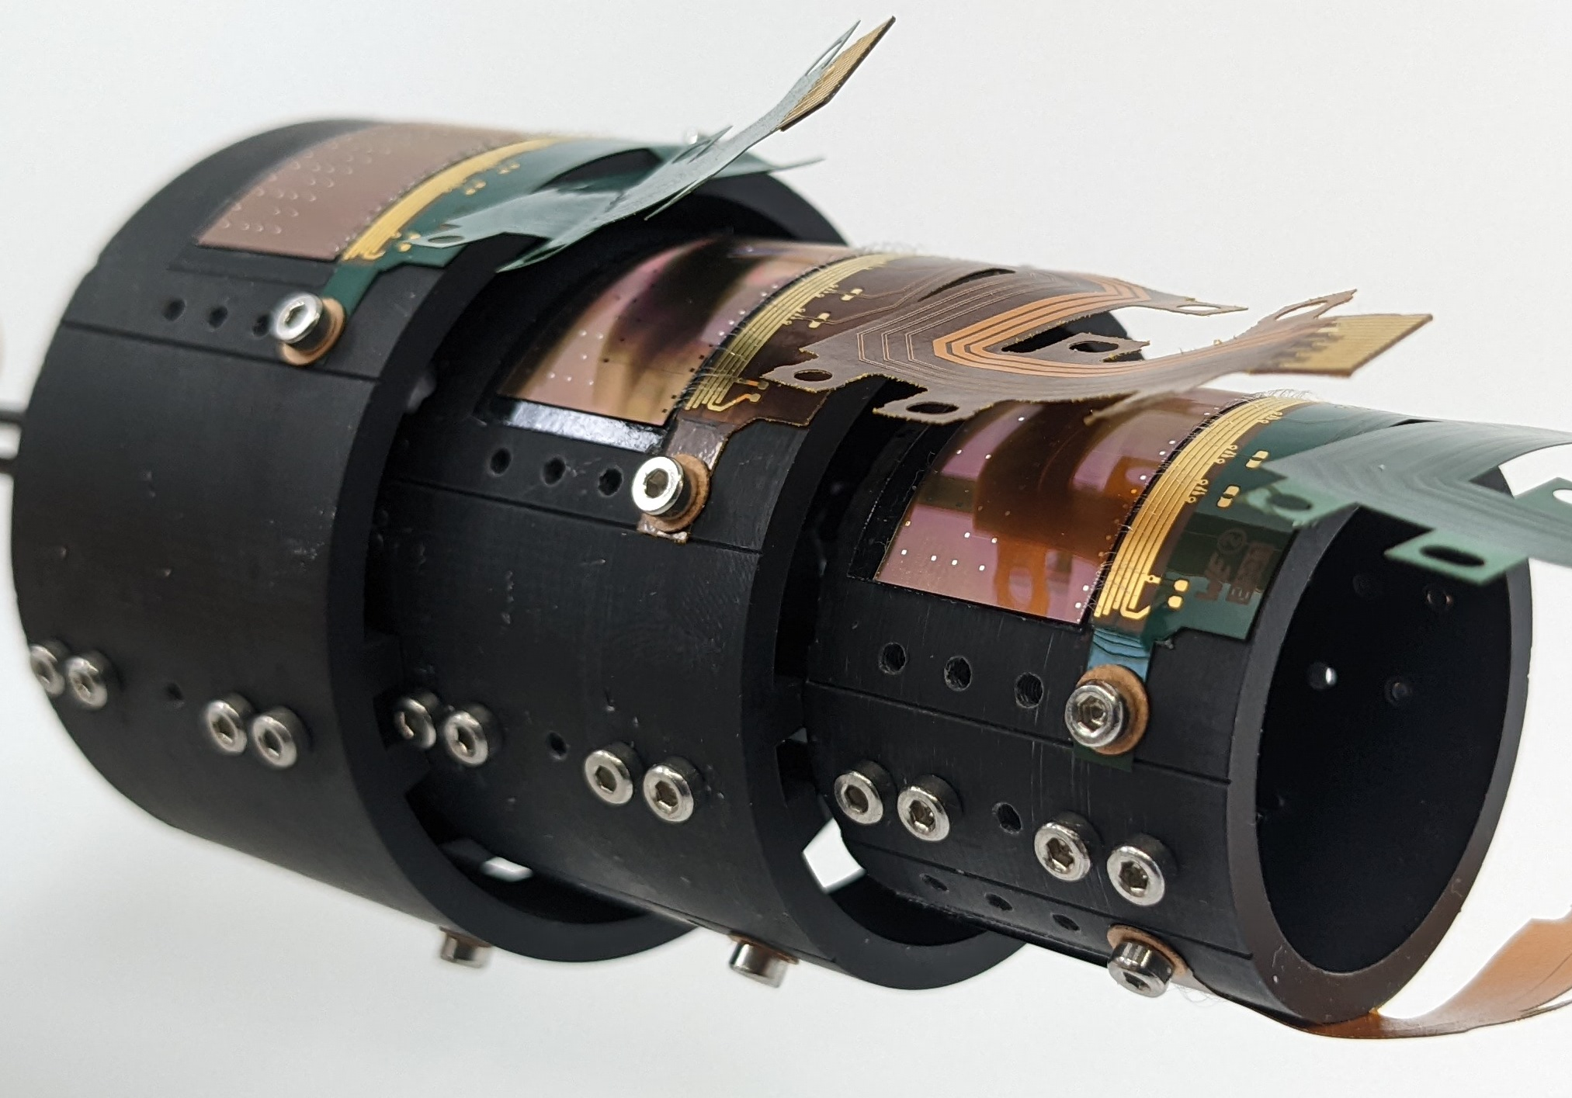
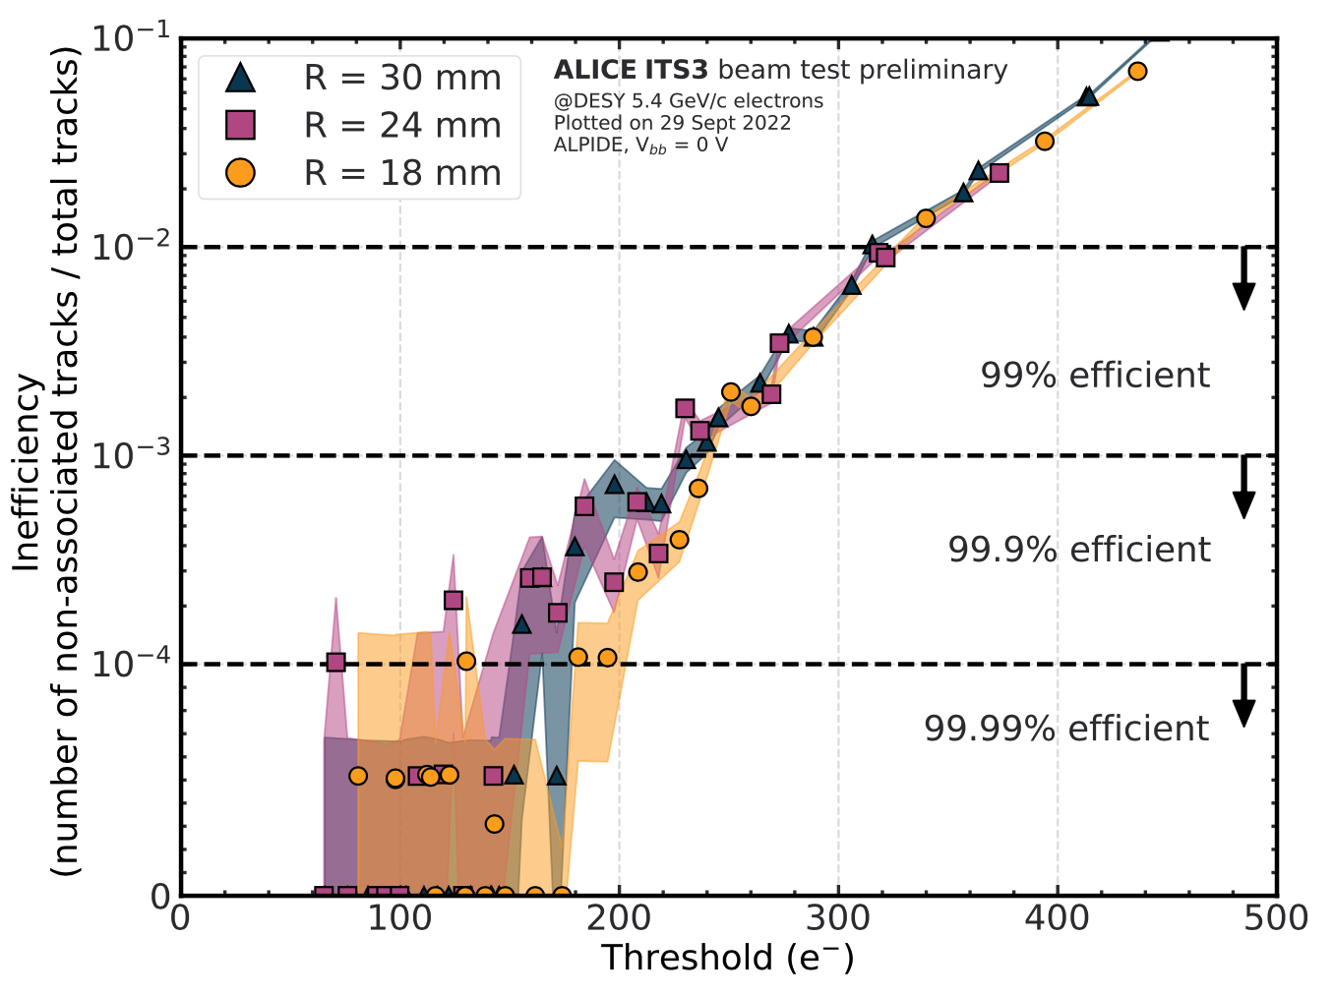
ITS3 R&D - Silicon bending
μITS3
180 nm
Laboratory and test beam measurements (Jun 2020) allow to conclude that chip (180 nm CMOS) performance doesn’t change after bending
Pixel matrix threshold distribution does not change when sensor is bent
Efficiency above 99.9% at a threshold of 100 e⁻
Nominal operating point
RD_FCC WP-Silicon Mini-workshop | 22-23 April 2024 | Domenico Colella

Slide 16
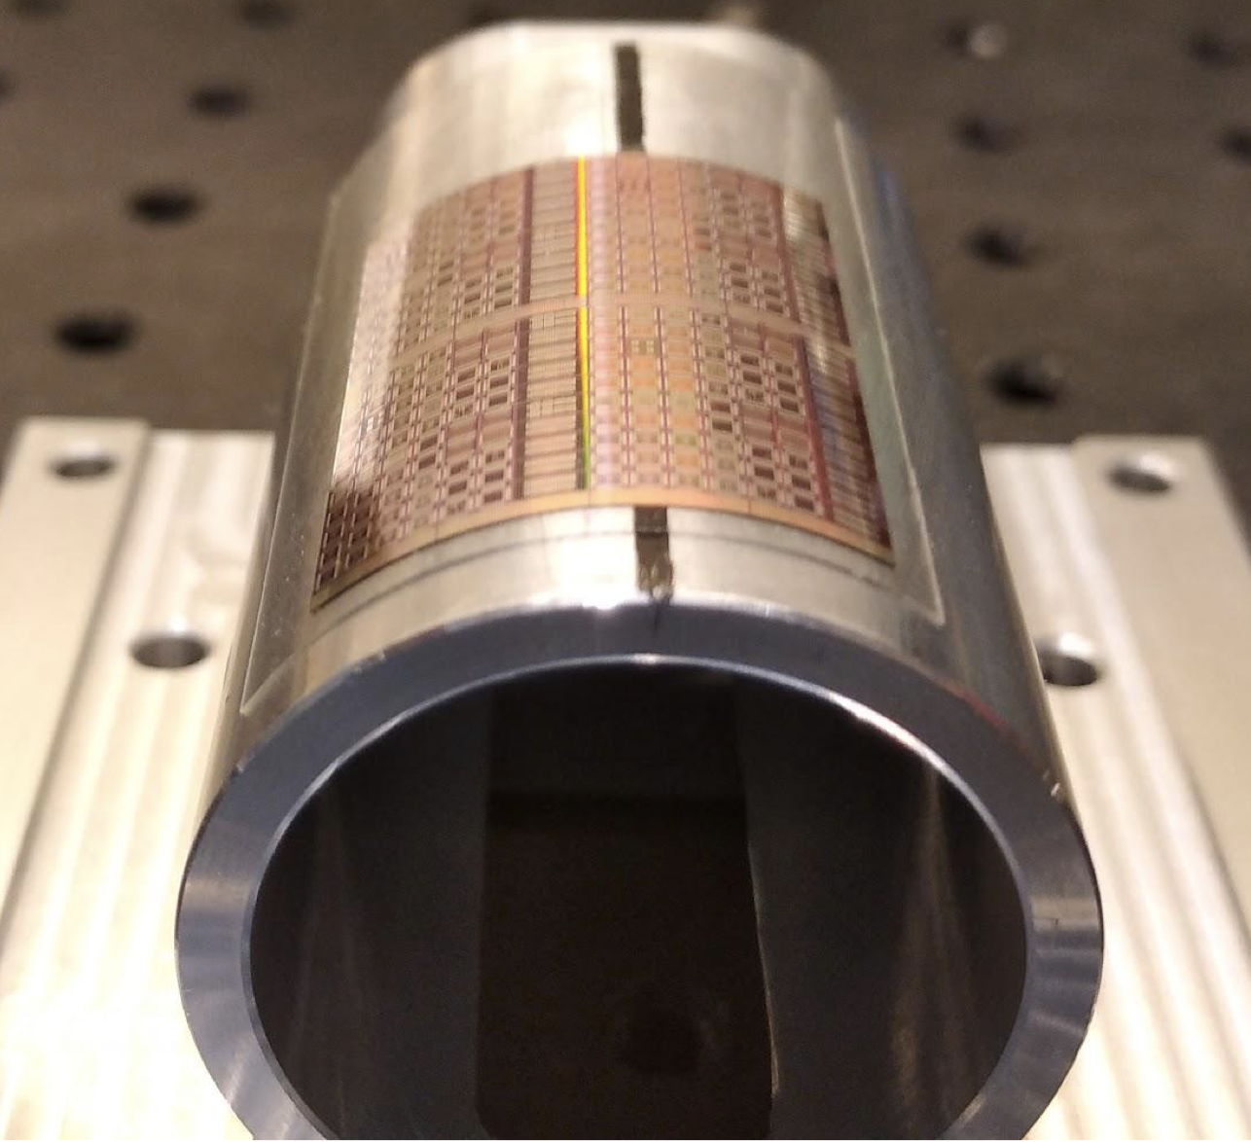
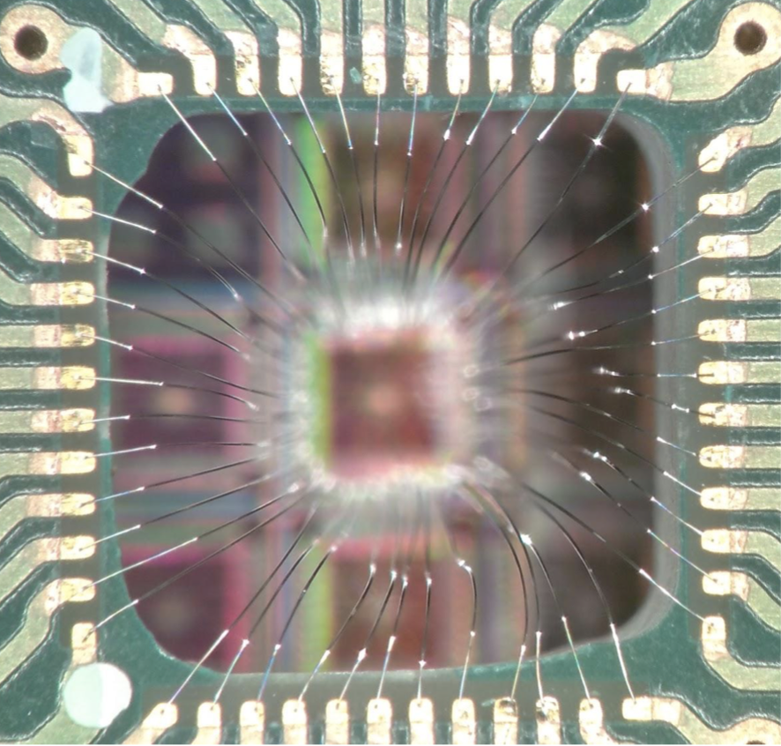
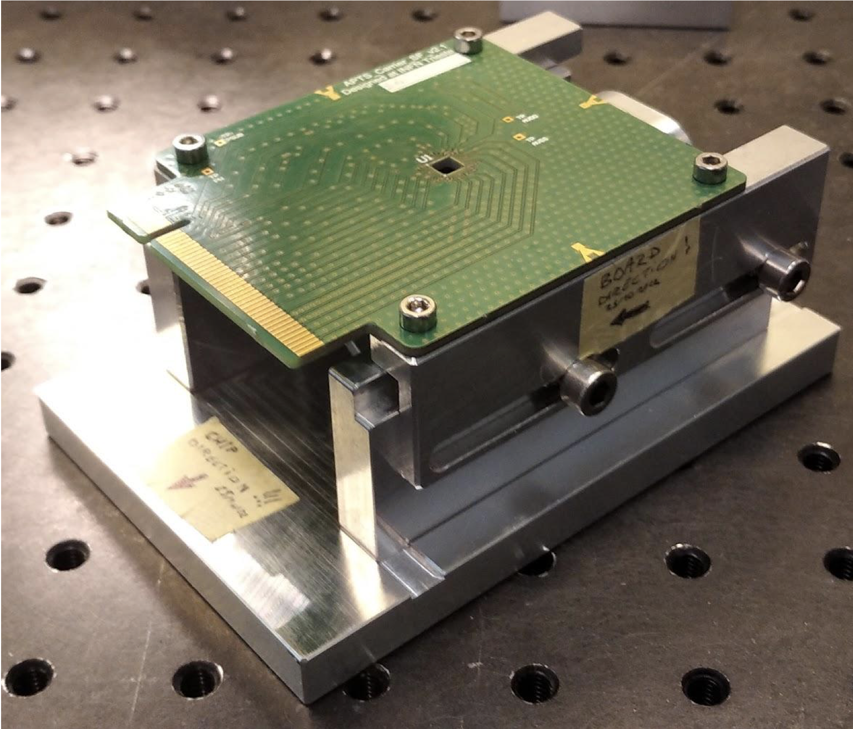
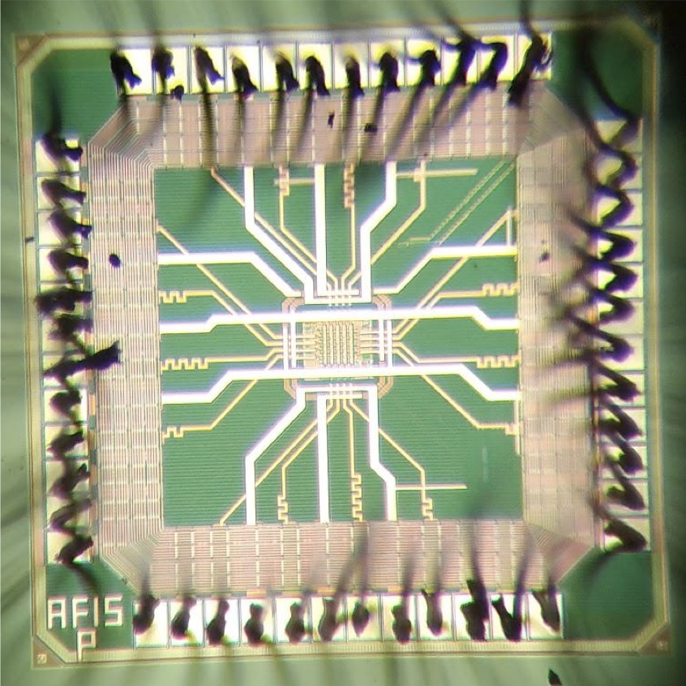
ITS3 R&D - Silicon bending
Ongoing at INFN Trieste
Comparison between flat and bent MLR1 (65 nm CMOS) sensors ongoing
Bending procedure developed and proximity board adapted to bent configuration
Few samples prepared and under measurements in laboratory with ⁵⁵Fe source
MLR1 reticle
Board
Sensor
RD_FCC WP-Silicon Mini-workshop | 22-23 April 2024 | Domenico Colella

Slide 17
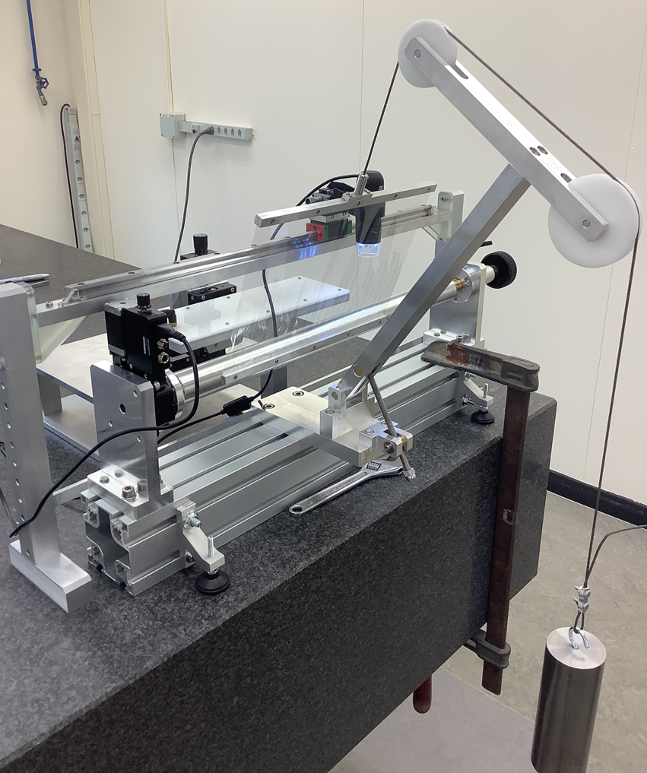
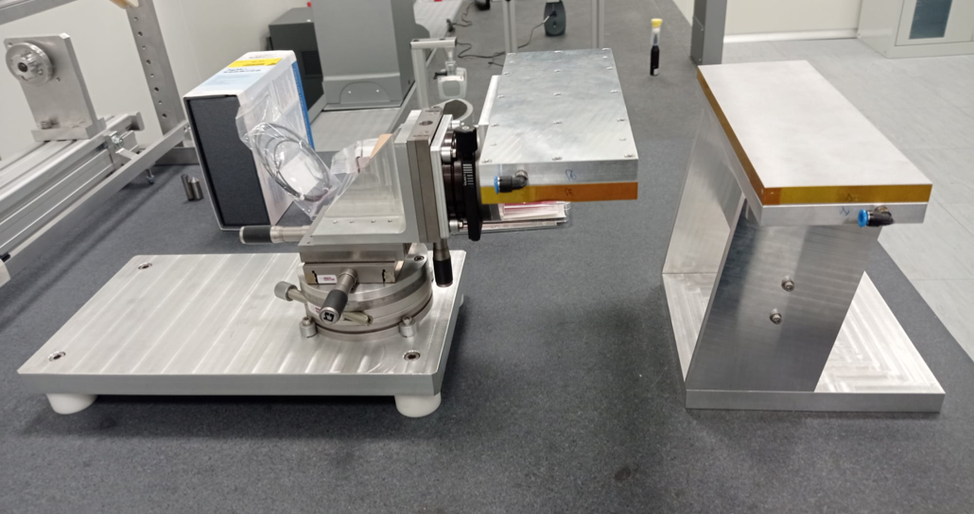
ITS3 R&D - Silicon bending
Ongoing at INFN Bari
Large dimension silicon bending procedure
Bending tool: tensioned mylar foil wrapping around cylindrical mandrel
RD_FCC WP-Silicon Mini-workshop | 22-23 April 2024 | Domenico Colella

Slide 18
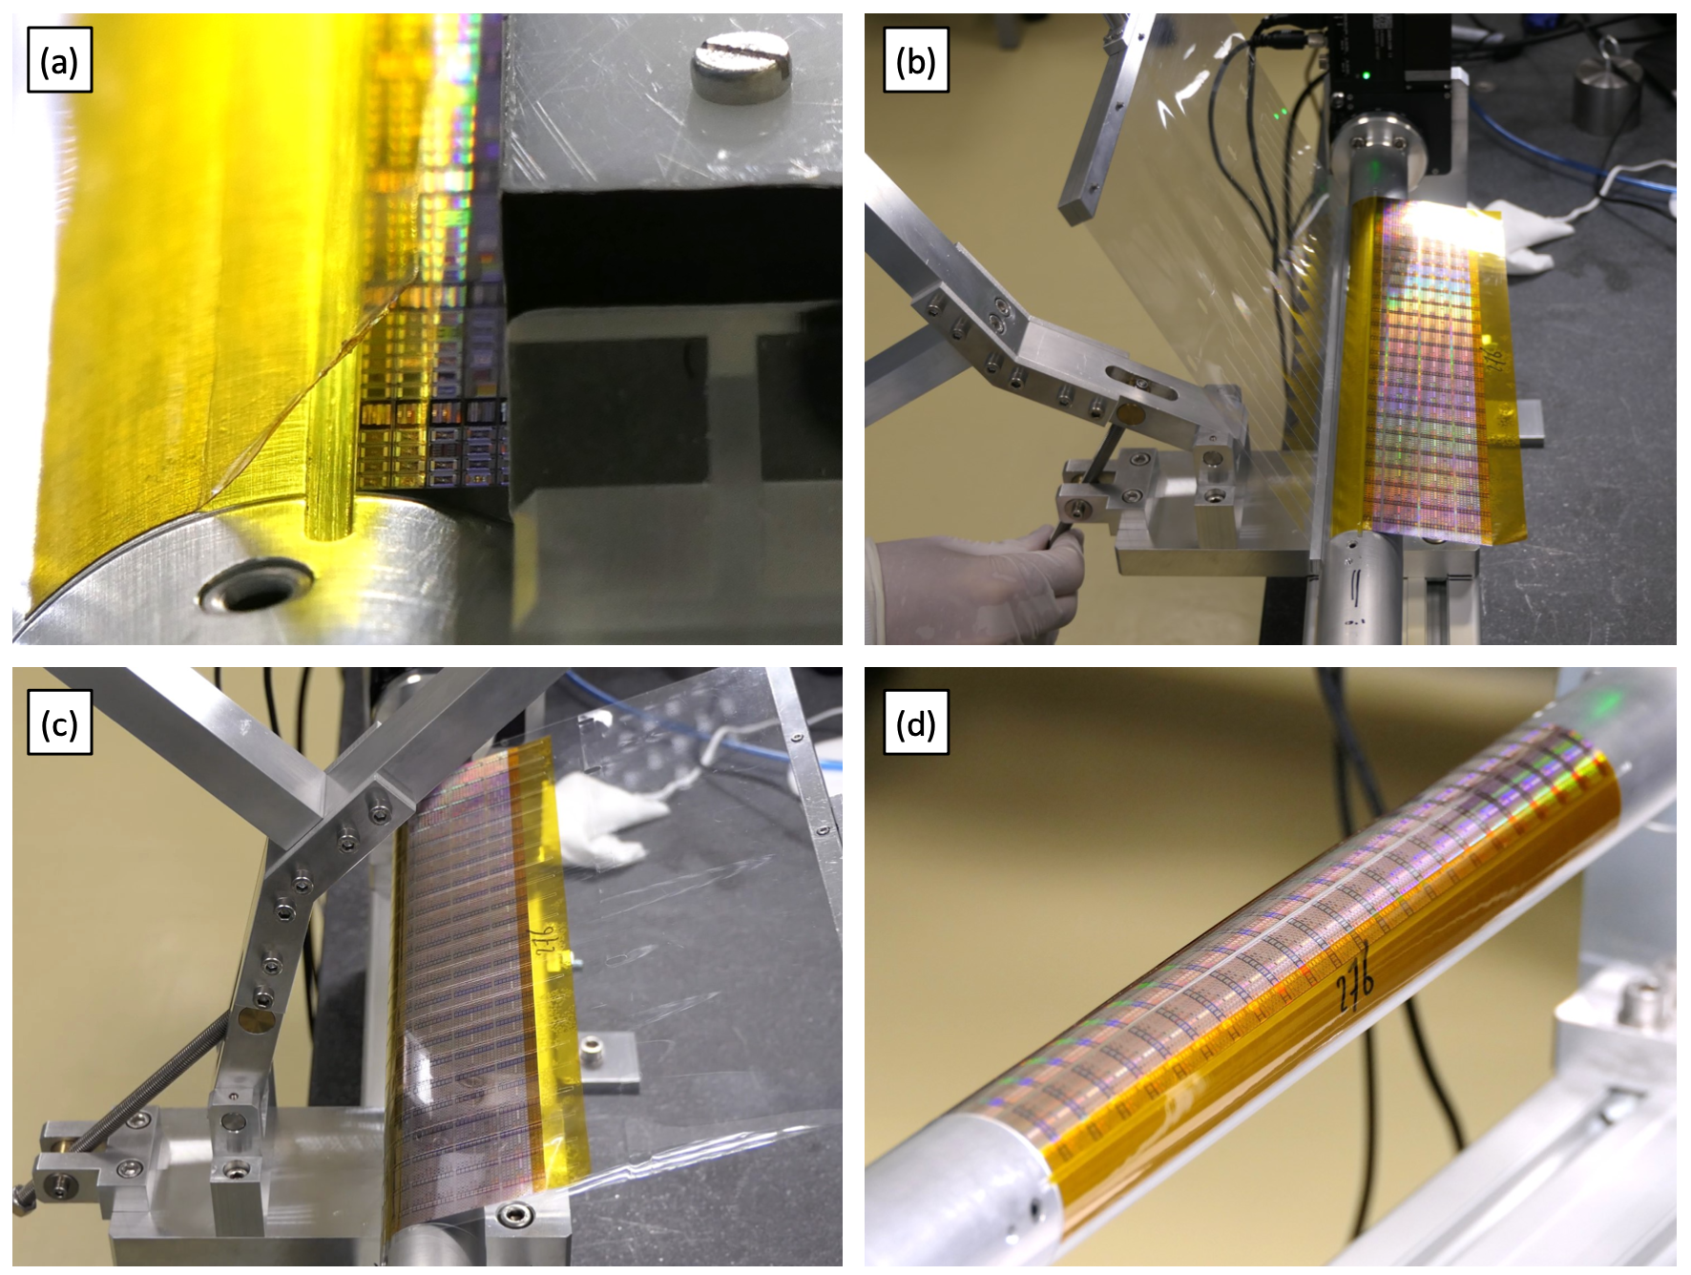
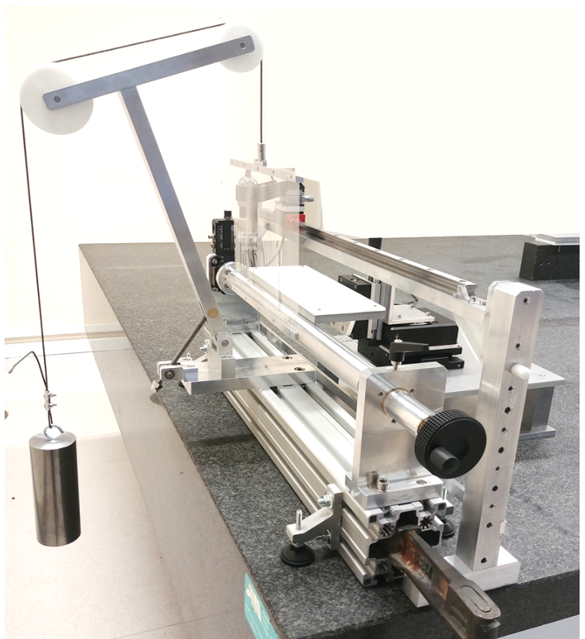
ITS3 R&D - Silicon bending
Ongoing at INFN Bari
Large dimension silicon bending procedure
Bending tool: tensioned mylar foil wrapping around cylindrical mandrel
RD_FCC WP-Silicon Mini-workshop | 22-23 April 2024 | Domenico Colella

Slide 19
ITS3 R&D - Silicon bending
Ongoing at INFN Bari
Large dimension silicon bending procedure
Bending tool: tensioned mylar foil wrapping around cylindrical mandrel
@CERN
40 μm thick MRL1 super-matrix
RD_FCC WP-Silicon Mini-workshop | 22-23 April 2024 | Domenico Colella

Slide 20
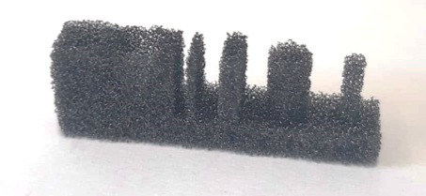
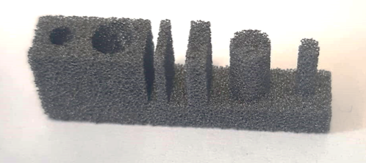
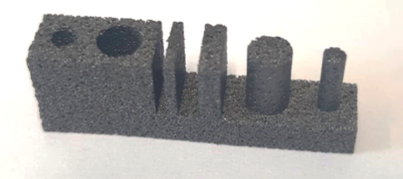
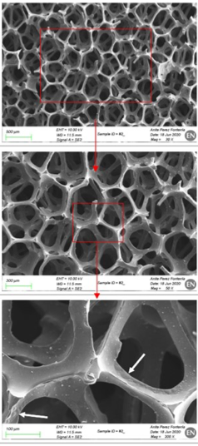
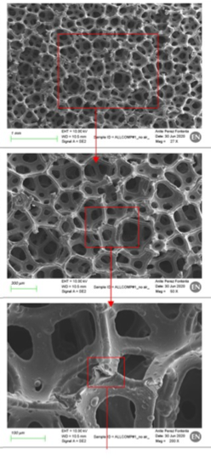
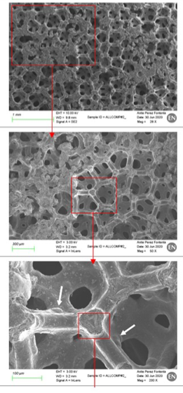
ITS3 R&D - Carbon foam properties
Silicon sensor kept in position by:
Longerons Support structures
Half-rings Support structures and cooling radiator
ERG Duocel (RVC)
ALLCOMP LD (K9)
Carbon foams characterised for machinability and thermal properties
ERG DUOCEL (RVC)
0.06 kg/dm³ 0.033 W/m∙K
ALLCOMP LD (K9)
0.2-0.26 kg/dm³ >17 W/m∙K
ALLCOMP HD
0.45-0.68 kg/dm³ 85-170 W/m∙K
RD_FCC WP-Silicon Mini-workshop | 22-23 April 2024 | Domenico Colella

Slide 21
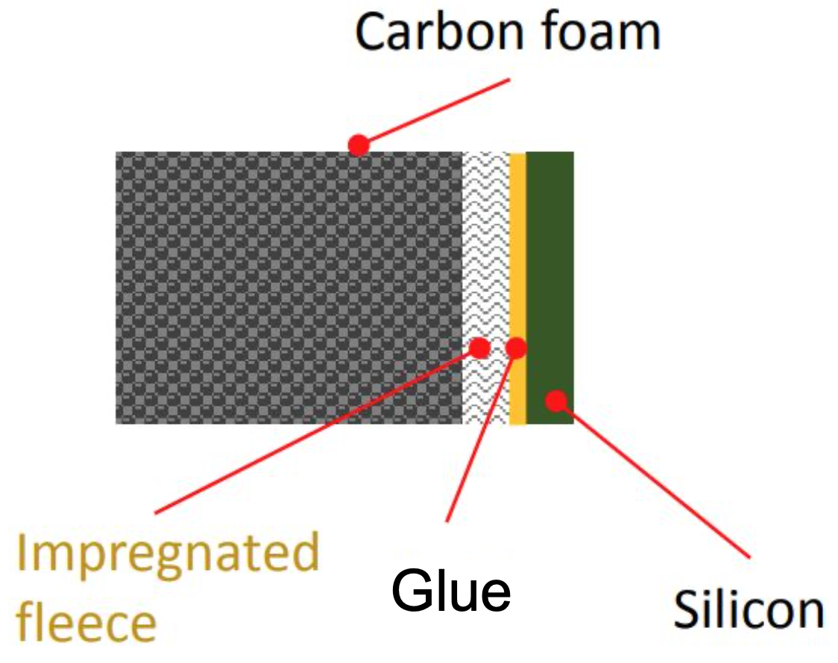
ITS3 R&D - Carbon foam properties
Carbon fleece veil (120 μm thick) between silicon and carbon foam used to:
Control the glue thickness
Reduce thermal contact resistance
Reduce carbon foam footprints on the silicon
X-ray scan of Engineering Model 2 (EM2)
Cylindricity granted within 0.05 mm using the half-ring
RD_FCC WP-Silicon Mini-workshop | 22-23 April 2024 | Domenico Colella

Slide 22
ITS3 R&D - Sensor cooling
Thermal characterization setup
dummy silicon equipped with copper serpentine simulating heat dissipation in matrix (25 mW/cm²) and end-cap (1000 mW/cm²) regions
8 PT100 temperature sensors distributed over the surface of each half-layer
airflow from A-side to C-side
Dummy beam pipe
Cover
Flow distributors
C-side
A-side
CYSS
RD_FCC WP-Silicon Mini-workshop | 22-23 April 2024 | Domenico Colella

Slide 23
ITS3 R&D - Sensor cooling
Thermal characterization setup
dummy silicon equipped with copper serpentine simulating heat dissipation in matrix (25 mW/cm²) and end-cap (1000 mW/cm²) regions
8 PT100 temperature sensors distributed over the surface of each half-layer
airflow from A-side to C-side
Dummy beam pipe
Cover
Flow distributors
C-side
A-side
CYSS
Comparison between CFD simulations and experiments
Layer 0 - End-cap
C-side
Layer 0 - Matrix
A-side
Temperature sensor position and nomenclature
Conclusion
with an average airflow free-stream velocity between the layers of about 8 m/s, the detector can be operated at a temperature of 5 degrees above the inlet air temperature
temperature uniformity along the sensor can be also kept within 5 degrees
RD_FCC WP-Silicon Mini-workshop | 22-23 April 2024 | Domenico Colella

Slide 24
ITS3 R&D - Mechanical characterization
Short-term position stability of the sensor over time affected by
thermoelastic expansion caused by short-term temperature fluctuation
airflow
RD_FCC WP-Silicon Mini-workshop | 22-23 April 2024 | Domenico Colella

Slide 25
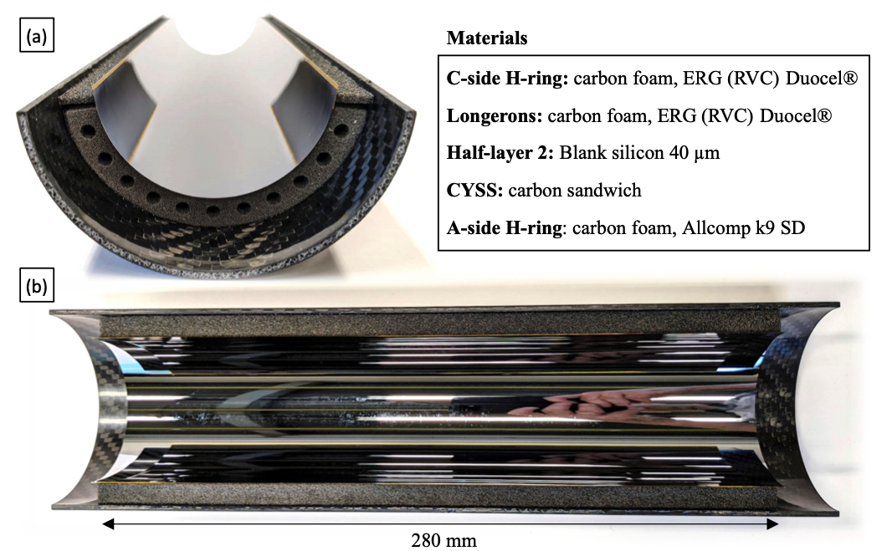
ITS3 R&D - Mechanical characterization
Short-term position stability of the sensor over time affected by
thermoelastic expansion caused by short-term temperature fluctuation
airflow
Thermoelastic expansion setup
differential thermoplastic expansion among different components could introduce failures
final grade material half-layer assembly in climate chamber (up to 36ºC by steps of 2 ºC)
Conclusion
several thermal cycles for a total of 9h → assembly unaffected
further tests will be performed to investigate: rapid increase of the temperature and maximum failure temperature
RD_FCC WP-Silicon Mini-workshop | 22-23 April 2024 | Domenico Colella

Slide 26
ITS3 R&D - Mechanical characterization
Short-term position stability of the sensor over time affected by
thermoelastic expansion caused by short-term temperature fluctuation
airflow
No flow - Center
Vibration characterization setup
measurement of the out-of-plane vibrations of the half-layers
confocal chromatic displacement sensors → avoids perturbation to the airflow
8 m/s - Center
Conclusion
RMSairflow < 0.4 μm for L2 (largest sensor), smaller for L0 and L1
8 m/s - C-side
RD_FCC WP-Silicon Mini-workshop | 22-23 April 2024 | Domenico Colella

Slide 27
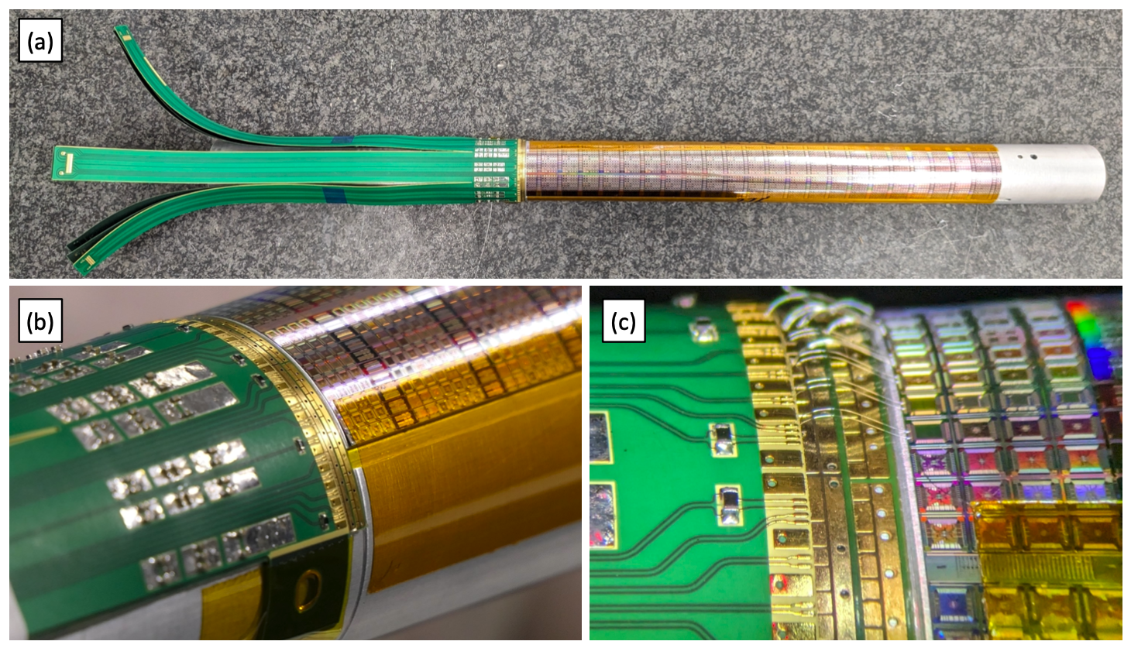
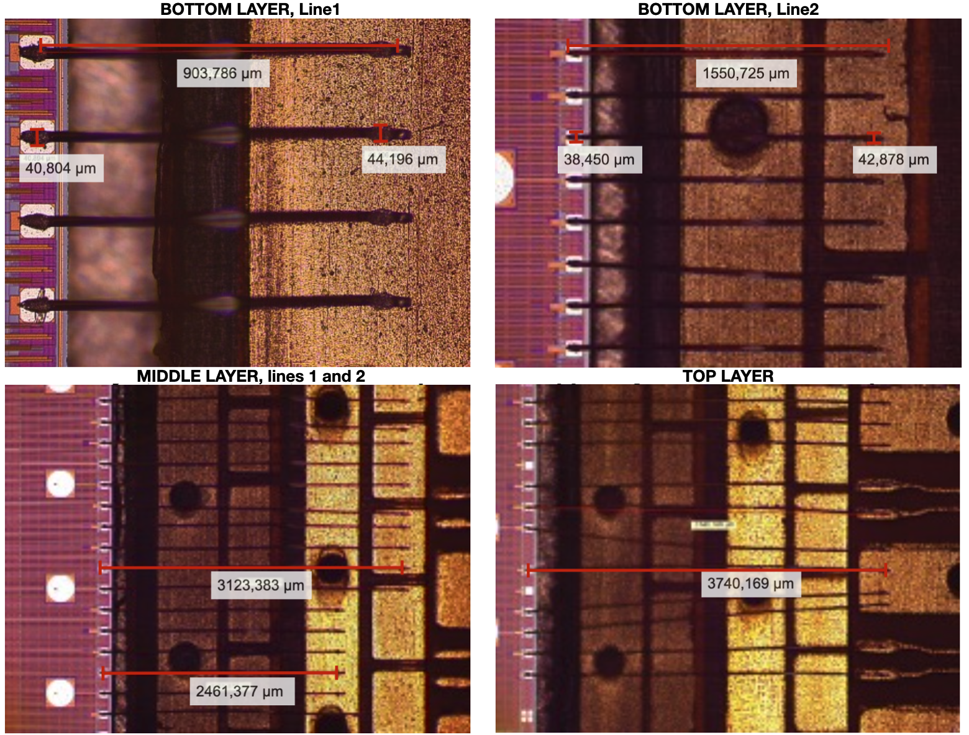
ITS3 R&D - Interconnection
Flexible printed circuits for communication and powering
placed outside the sensible area
three double copper layers flex, multi-strip shaped (15-30 cm long), connected in a merging area
interconnected via wire-bonding at the edge of the sensor verified
wire-bonds loops optimisation based on pull-force measurements
present setup (not final grade material): 6.6±0.3 g at ~900 μm pad-to-pad distance
Merging area
RD_FCC WP-Silicon Mini-workshop | 22-23 April 2024 | Domenico Colella

Slide 28
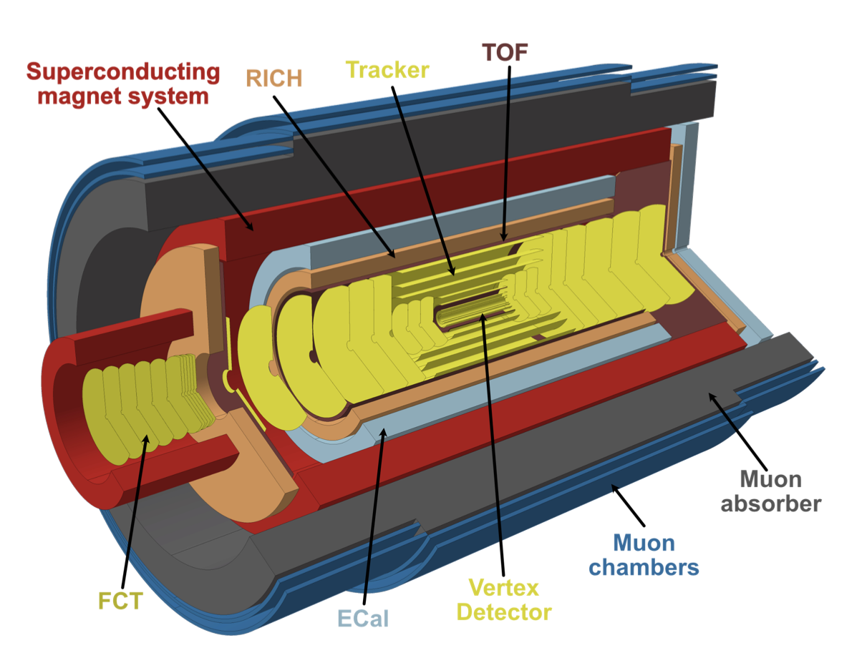
ALICE3
ALICE3: a silicon sensor based experiment
RD_FCC WP-Silicon Mini-workshop | 22-23 April 2024 | Domenico Colella

Slide 29
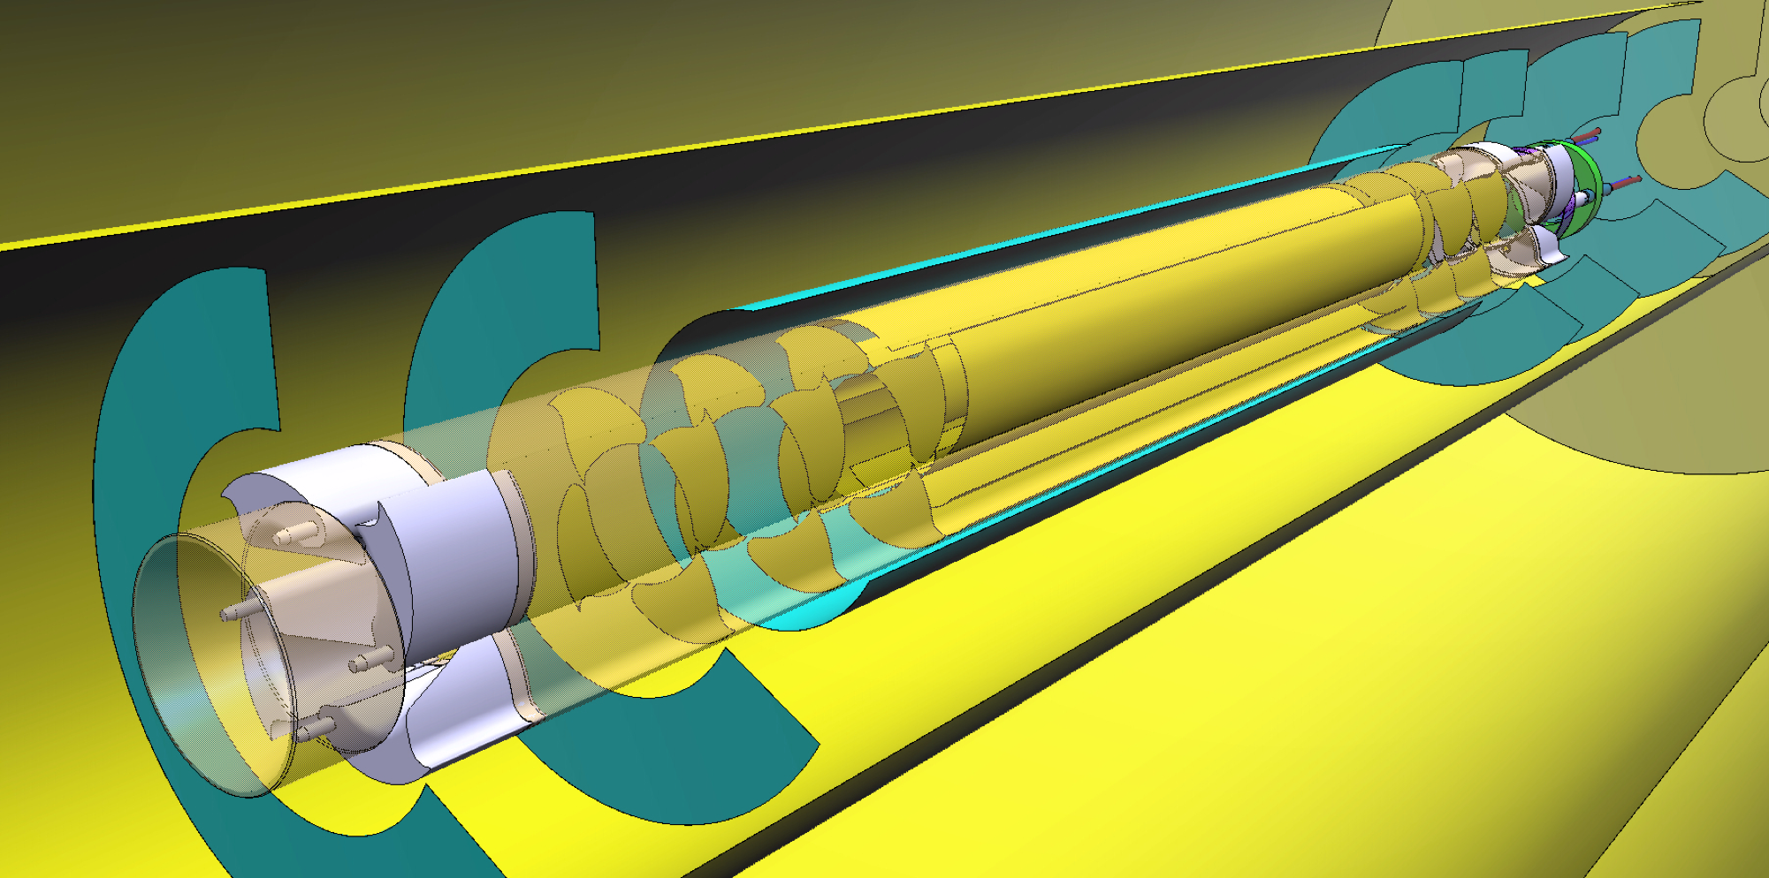
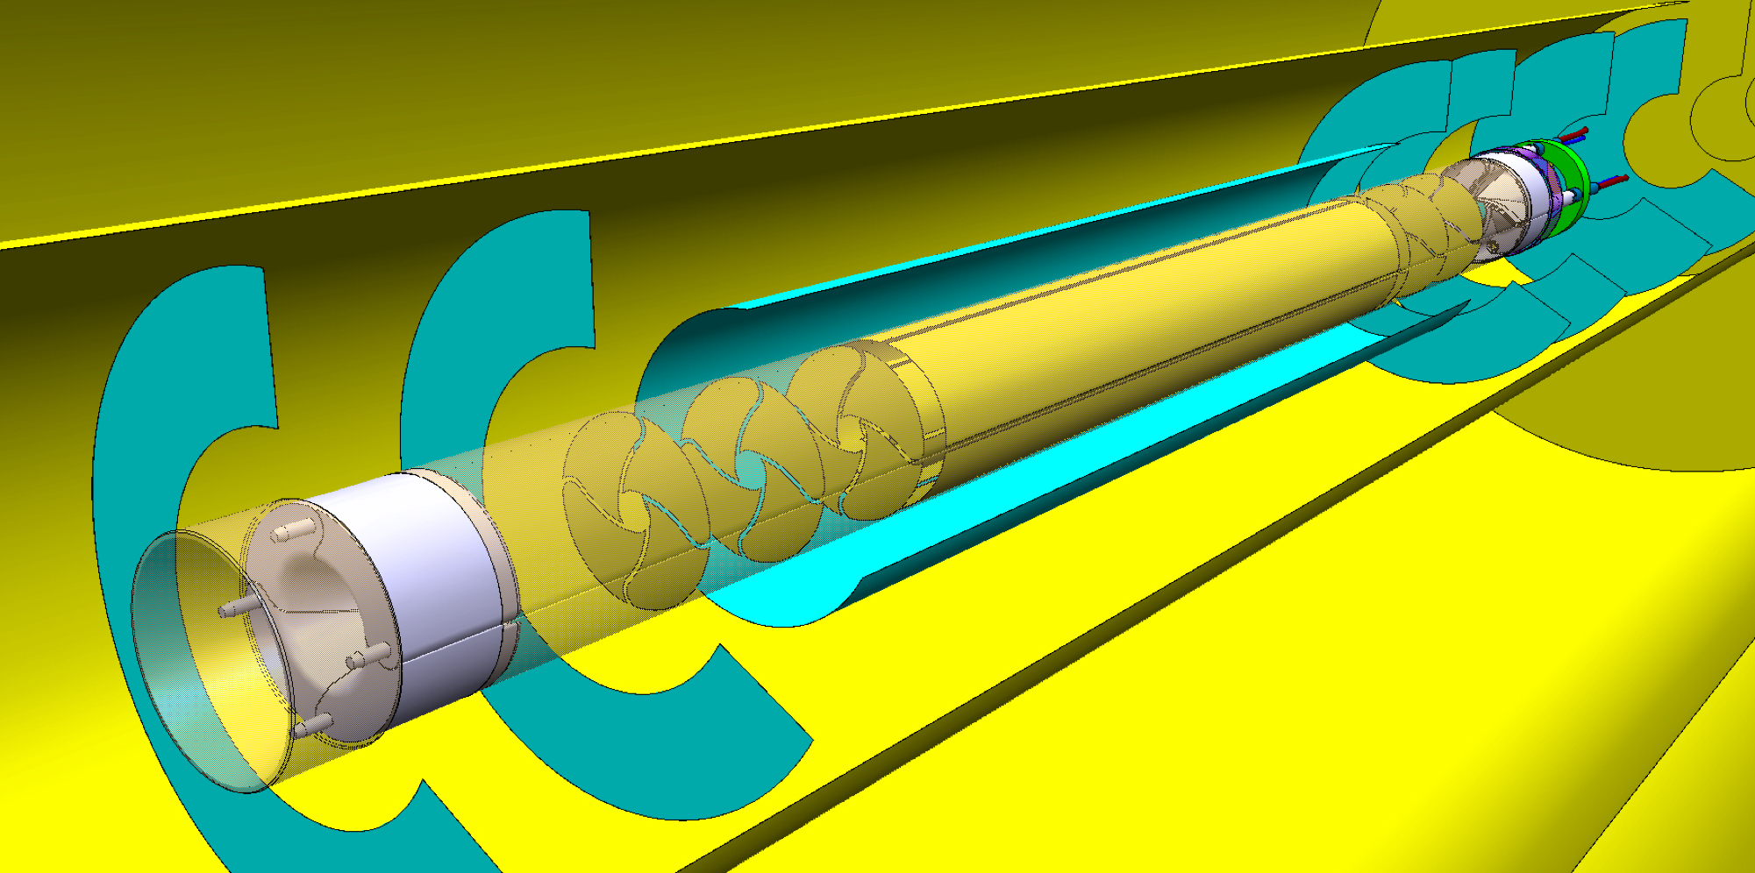
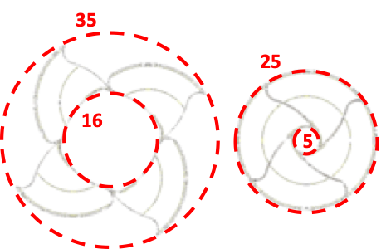
ALICE3 - IRIS
Based on wafer-scale, ultra-thin, curved MAPS
Basic requirements
radial distance from interaction point: 5 mm (inside beam pipe, retractible configuration)
unprecedented spatial resolution: ≈ 2.5 μm
unprecedented low material budget X/X0 (per layer): ≲ 0.1%
radiation tolerance: ≈ 10¹⁶ 1 MeV neq/cm² + 200 Mrad
hit rates up to: 94 MHz/cm²
R&D will largely leverage on the ITS3 developments and push improvements on a number of fronts
IRIS tracker - Open
IRIS tracker - Closed
RD_FCC WP-Silicon Mini-workshop | 22-23 April 2024 | Domenico Colella

Slide 30
ALICE3 - IRIS
4 x Petals
Single petal
Sensors (Layers and disks)
Carbon foam and cold plate
Secondary vacuum case
RD_FCC WP-Silicon Mini-workshop | 22-23 April 2024 | Domenico Colella

Slide 31
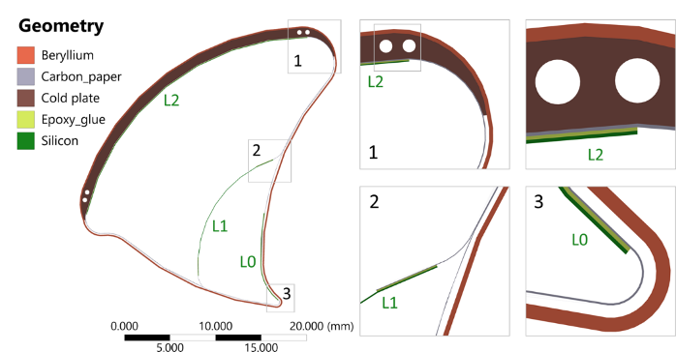
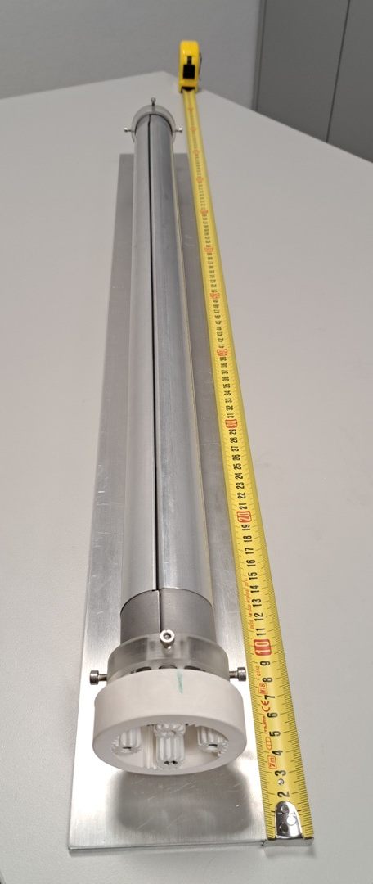
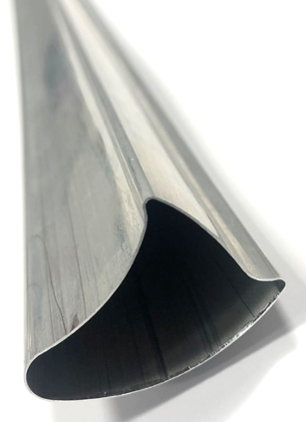
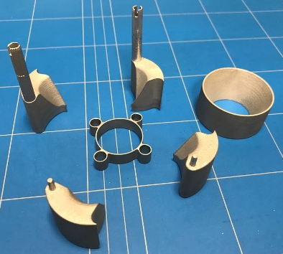
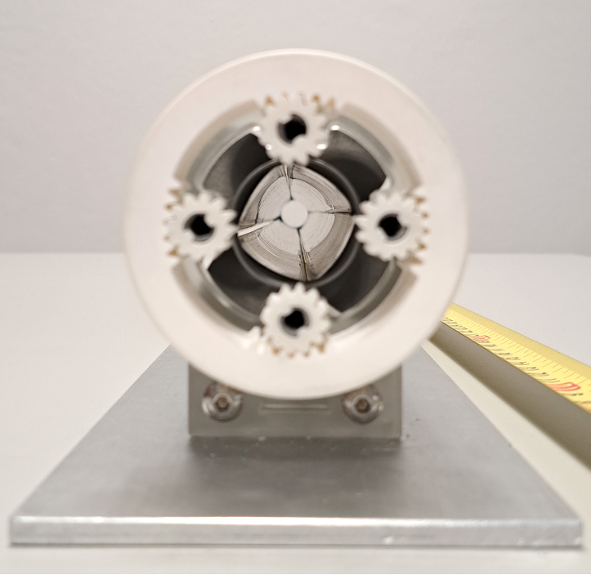
ALICE3 - IRIS
800 mm long
0.33 mm wall
Al 5083
Petal case
bread board model
3D printed Aluminium
AlSi10Mg
RD_FCC WP-Silicon Mini-workshop | 22-23 April 2024 | Domenico Colella

Slide 32
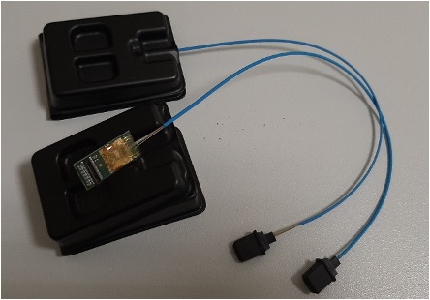
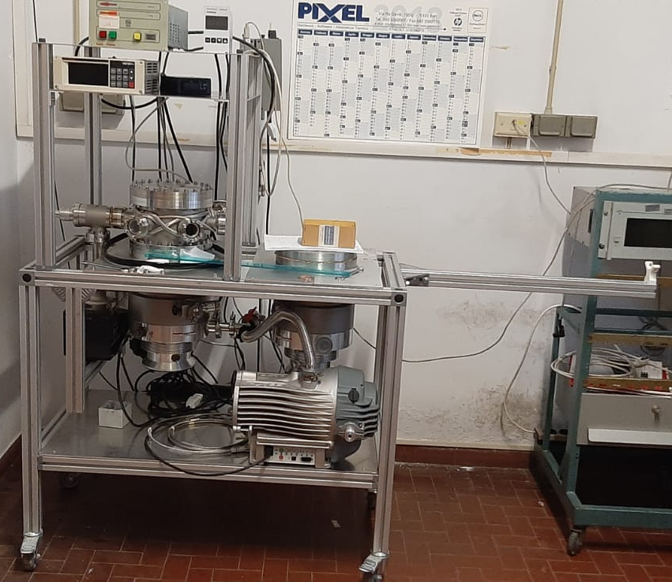
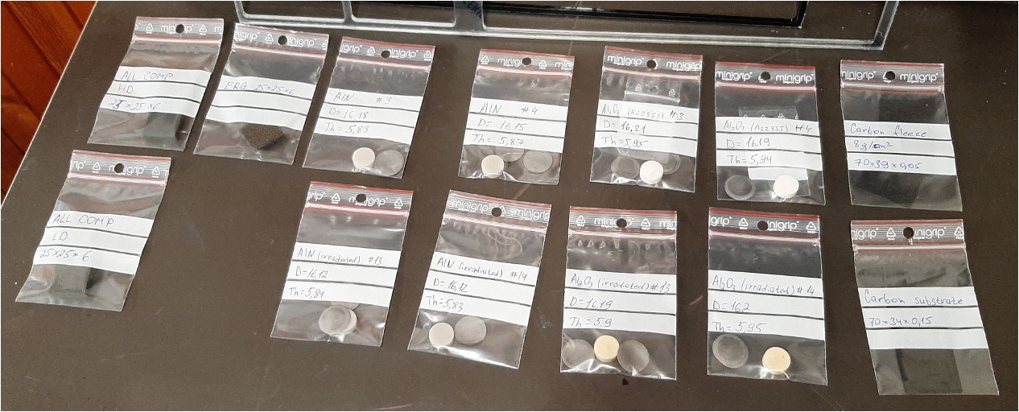
ALICE3 - IRIS
Outgassing studies at INFN Bari
Carbon (LAYPUS) Substrate of the cold plate
Carbon Fleece of the cold plate
Carbon foam All comp high density
Carbon foam All comp low density
Carbon foam ERG duocel
Optical Fiber with connector
NASA Epoxy
Si wafer
Wire bonded Si wafer
FPC
3D printed aluminium nitride (AIN) samples disks
Al2O3 samples disk: 3D printed alumina (Al2O3) samples disks
3D printed AlSi samples disks
RD_FCC WP-Silicon Mini-workshop | 22-23 April 2024 | Domenico Colella

Slide 33
ALICE3 - MIDDLE LAYER
Prototype by INFN Padova
RD_FCC WP-Silicon Mini-workshop | 22-23 April 2024 | Domenico Colella

Slide 34
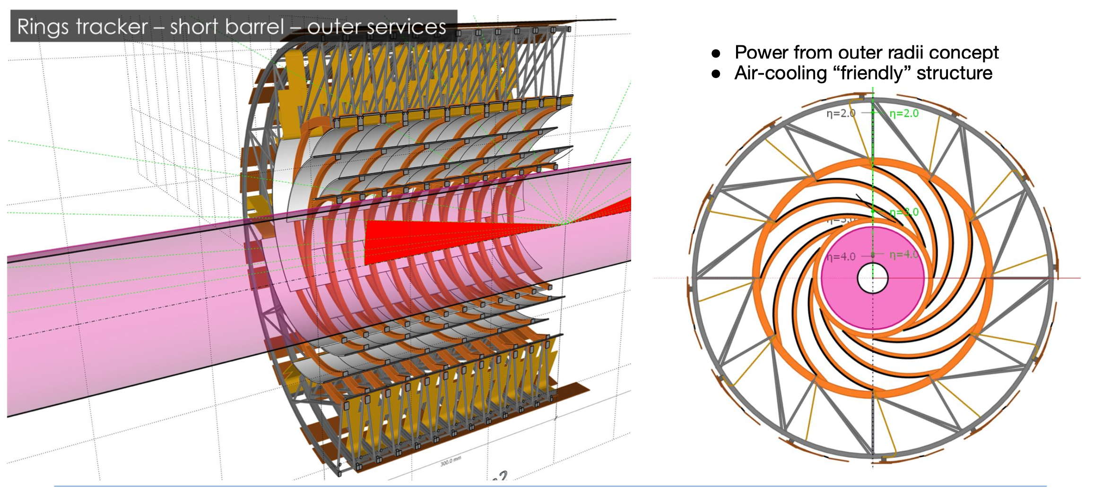
ALICE3 - MIDDLE LAYER
Prototype by INFN Padova
RD_FCC WP-Silicon Mini-workshop | 22-23 April 2024 | Domenico Colella

Slide 35
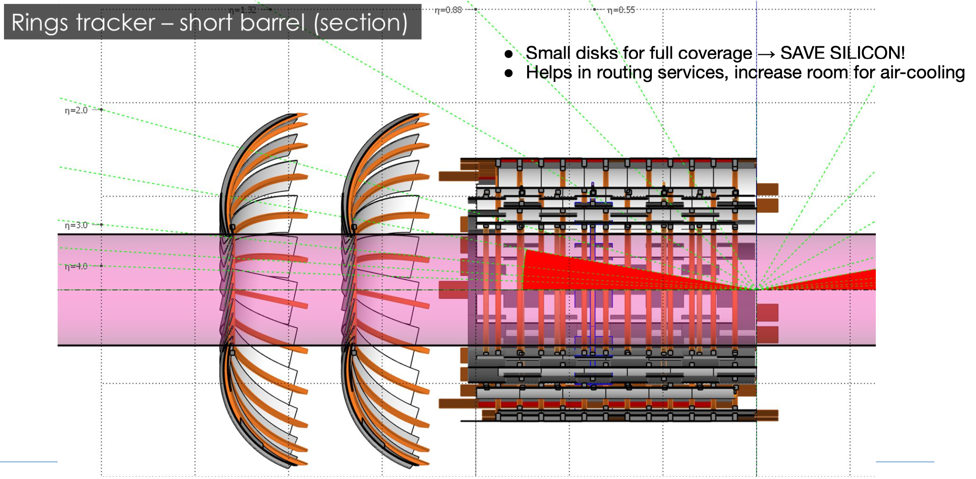
ALICE3 - MIDDLE LAYER
Prototype by INFN Padova
RD_FCC WP-Silicon Mini-workshop | 22-23 April 2024 | Domenico Colella

Slide 36
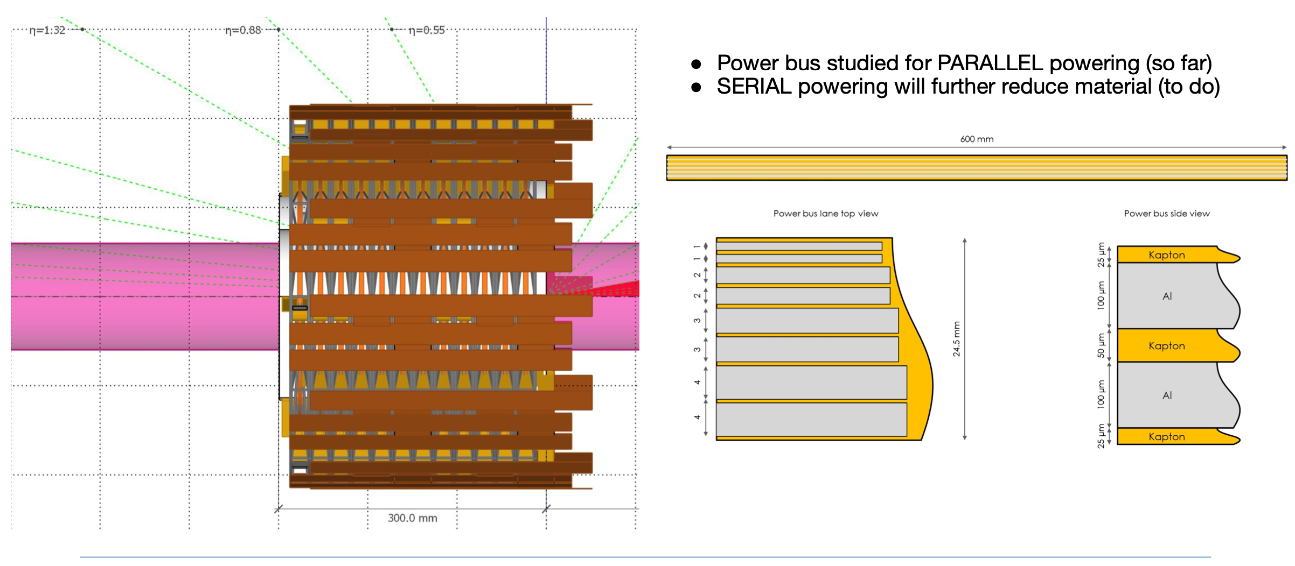
ALICE3 - MIDDLE LAYER
Prototype by INFN Padova
RD_FCC WP-Silicon Mini-workshop | 22-23 April 2024 | Domenico Colella

Slide 37
Backup
RD_FCC WP-Silicon Mini-workshop | 22-23 April 2024 | Domenico Colella

Slide 38
Backup
ALICE 2.1
Expression of Interest
LHCC 139 (Sep 2019)
Project setup (spring 2020)
Project leaders
Work packages conveners
Institutes joining
Letter of Intent
“The LHCC is impressed by the new concept for the ITS3…”
LHCC 142 (Jun 2020)
R&D kick-off (Dec 2019)
[ALICE-PUBLIC-2018-013]
https://cds.cern.ch/record/2644611
[CERN-LHCC-2019-018 ; LHCC-I-034]
https://cds.cern.ch/record/2703140/
“The LHCC congratulates the ITS3 groups for the successful start of the project.”
Oct 2018
Sep 2019
Sep 2019
Dec 2019
Spring 2020
Jun 2020
RD_FCC WP-Silicon Mini-workshop | 22-23 April 2024 | Domenico Colella

Slide 39
Backup - Interconnection
RD_FCC WP-Silicon Mini-workshop | 22-23 April 2024 | Domenico Colella

Slide 40
Backup - Super-ALPIDE project
Super-ALPIDE
18 not diced ALPIDE chips
dimensions close to the ones for L0 sensor
Goals
verify bending tools for large-size working chips
verify mechanical support alignment tools
develop wire-bonding over bent surface tools
develop first bent flex prototype (for powering and data streaming)
assemble first working large dimension bent sensor → by October 2023
RD_FCC WP-Silicon Mini-workshop | 22-23 April 2024 | Domenico Colella

Slide 41
Backup - Carbon foam properties
Air
Material
Carbon foam material budget study though particle deviation angle measurement
ALPIDE
Kink angle distributions at the scattering position
Preliminary
200M events @ 5.4 GeV (~300Hz rate)
RD_FCC WP-Silicon Mini-workshop | 22-23 April 2024 | Domenico Colella

Slide 42
Backup - Carbon foam properties
RD_FCC WP-Silicon Mini-workshop | 22-23 April 2024 | Domenico Colella

