Slide 1
IDEA VERTEX DETECTOR INTEGRATION
Filippo Bosi¹
G. Baldinelli², M. Boscolo³, F. Fransesini ³, S. Lauciani ³, F. Palla¹, C. Turrioni²
¹INFN Sezione di Pisa, Italy
²INFN Sezione di Perugia, Italy
³INFN Laboratori Nazionali di Frascati (RM), Italy
RD _FCC WP- SILICON MINI-WORKSHOP
TORINO
April 22-23, 2024

Slide 2
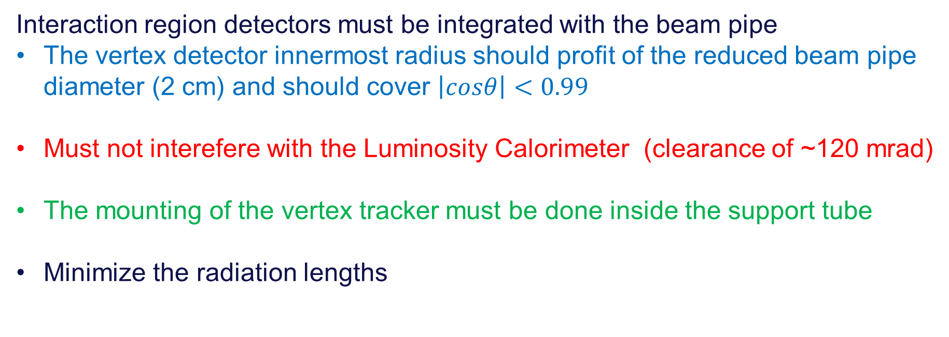
Requirements
RD _FCC WP- SILICON MINI-WORKSHOP
Interaction region detectors must be integrated with the beam pipe
  The vertex detector innermost radius should profit of the reduced beam pipe diameter (2 cm) and should cover $\left|cosθ\right|<0.99$
  Must not interefere with the Luminosity Calorimeter (clearance of ~120 mrad)
  The mounting of the vertex tracker must be done inside the support tube
  Minimize the radiation lengths

Slide 3
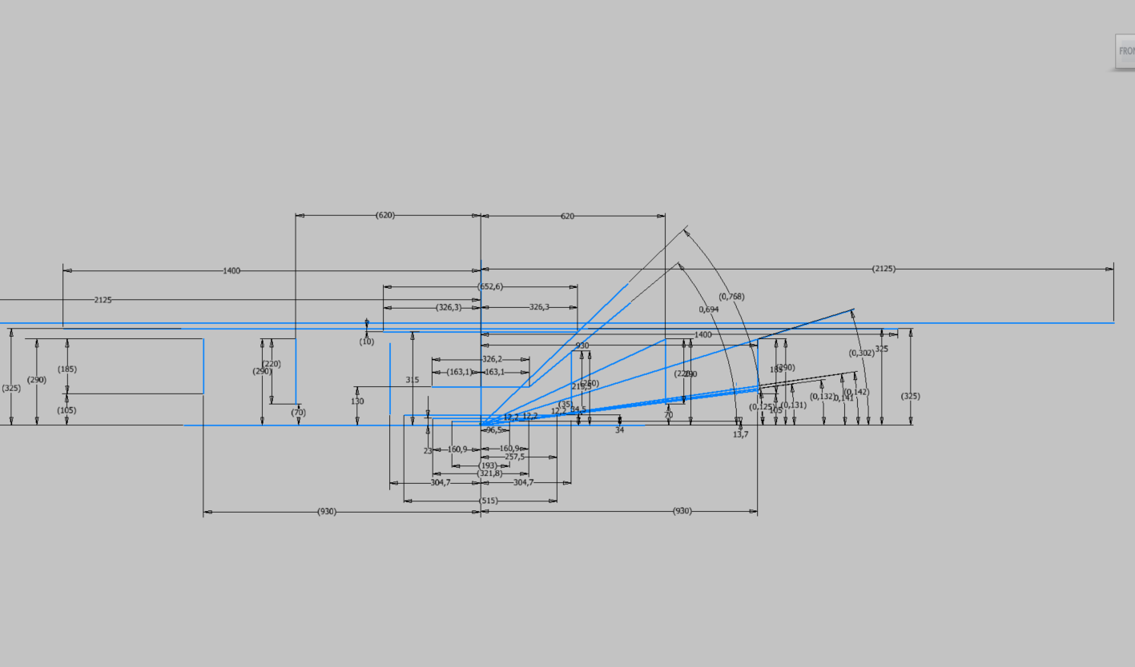
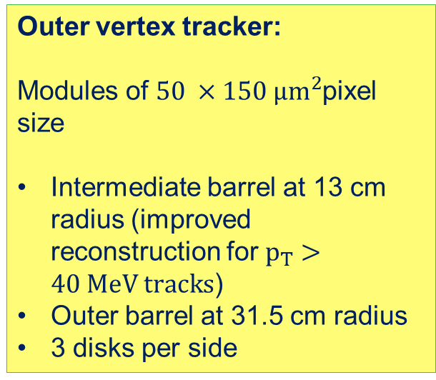
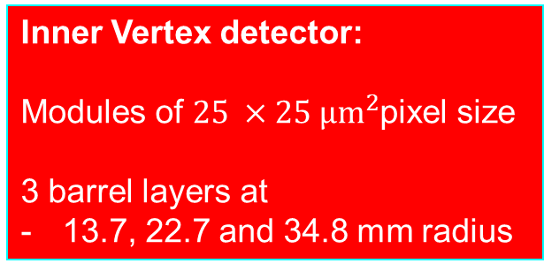
RD _FCC WP- SILICON MINI-WORKSHOP
Outer vertex tracker:
Modules of $50 ×150 µm^{2}$pixel size
Intermediate barrel at 13 cm radius (improved reconstruction for$p_{T}>40 MeV tracks$)
Outer barrel at 31.5 cm radius
3 disks per side
EXSTERNAL CILINDER
OUTER TRACKER
MEDIUM TRACKER
DRIFT CHAMBER
DISK 3
DISK 1
DISK 3
DISK 2
DISK 2
Inner Vertex detector:
Modules of $25 ×25 µm^{2}$pixel size
3 barrel layers at
13.7, 22.7 and 34.8 mm radius
DISK 1
INNER TRACKER

Slide 4
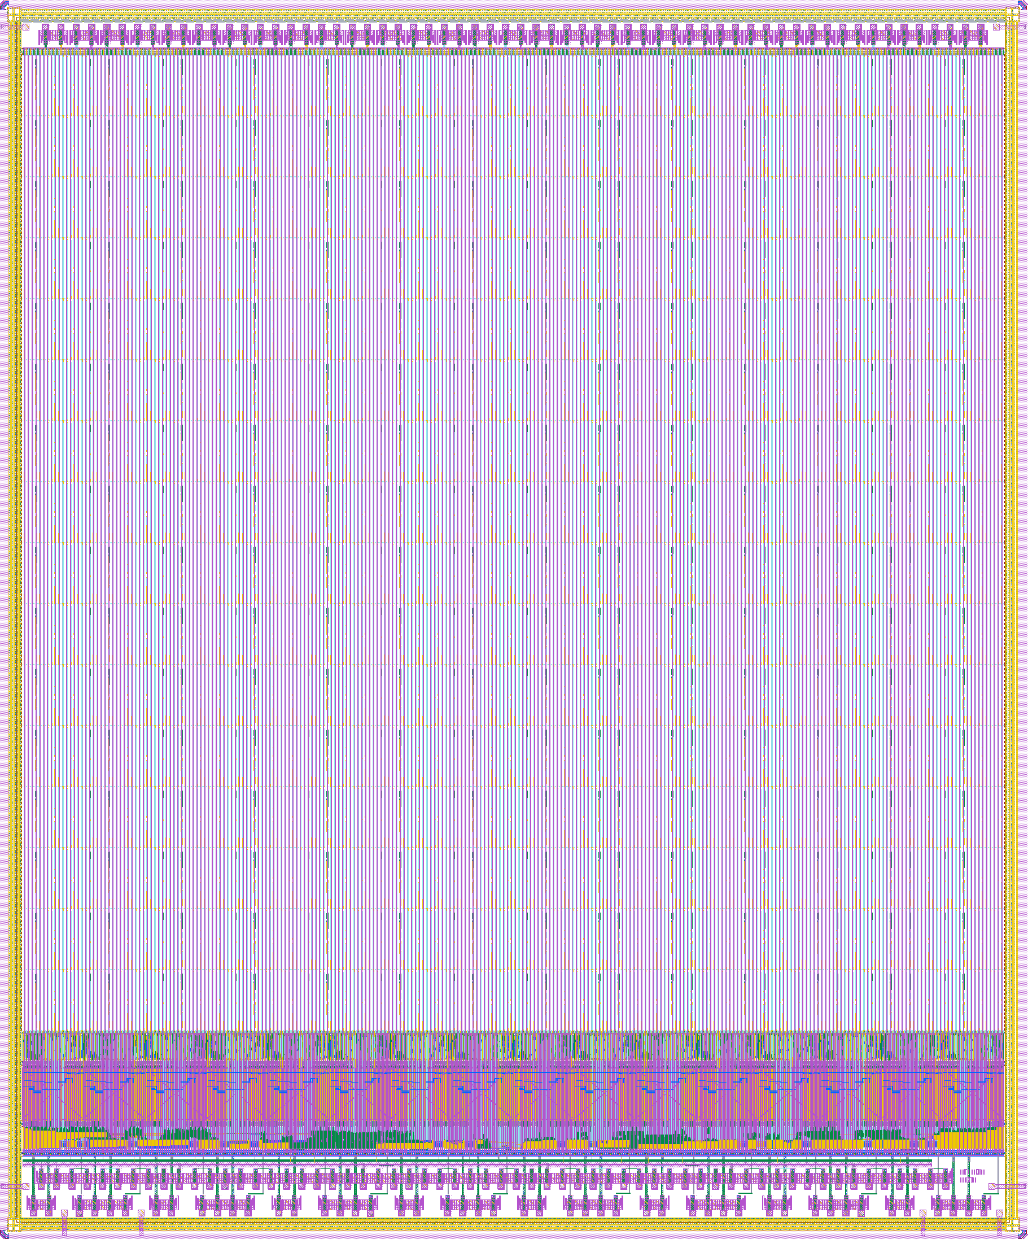
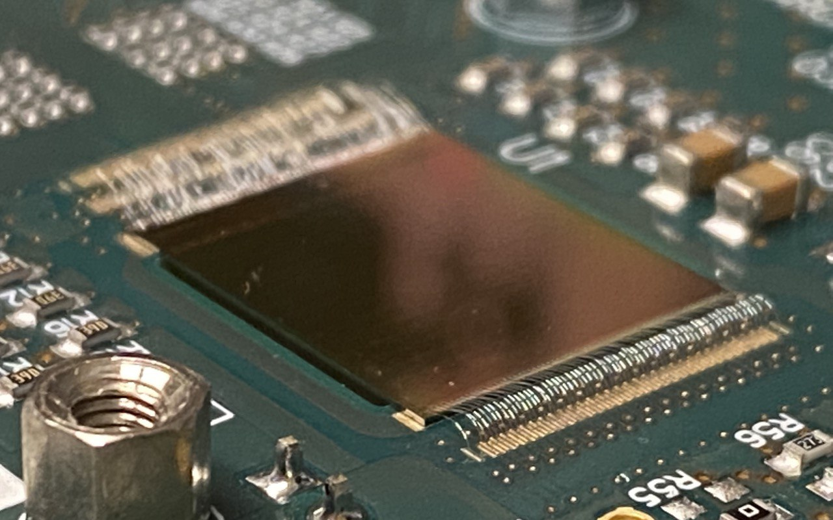
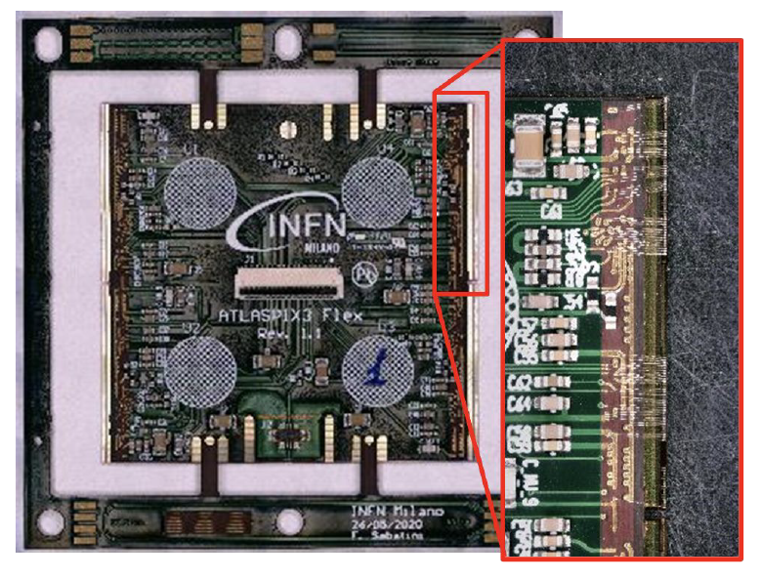
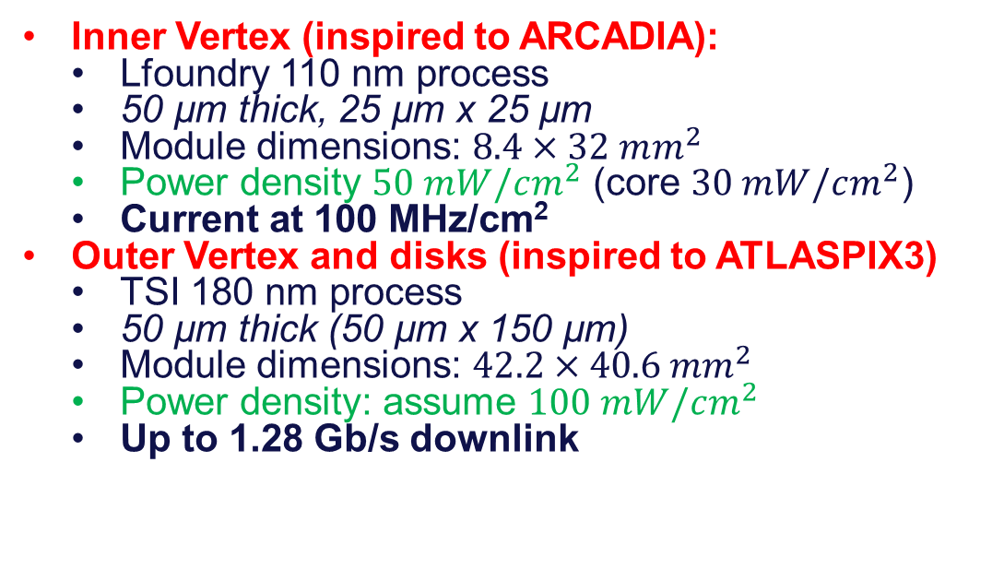
Sensors technology and dimensions
RD _FCC WP- SILICON MINI-WORKSHOP
Depleted Monolithic Active Pixel Detectors
  Inner Vertex (inspired to ARCADIA):
    Lfoundry 110 nm process
    50 µm thick, 25 µm x 25 µm
    Module dimensions: $8.4×32 mm^{2}$
    Power density $50 mW/cm^{2}$ (core $30 mW/cm^{2}$)
    Current at 100 MHz/cm²
  Outer Vertex and disks (inspired to ATLASPIX3)
    TSI 180 nm process
    50 µm thick (50 µm x 150 µm)
    Module dimensions: $42.2×40.6 mm^{2}$
    Power density: assume $100 mW/cm^{2}$
    Up to 1.28 Gb/s downlink

Slide 5
RD _FCC WP- SILICON MINI-WORKSHOP
Layer 1
15 overlapping staves of 6 modules each
Overlap to allow alignment ~500 µm
Pinwheel geometry: all modules at the same (smallest) radius
Power budget ~12 W
Total weight ~22 grams
Total thickness 0.25% X₀
Silicon: 0.053% X₀
Power and readout bus: 0.056% X₀

Slide 6
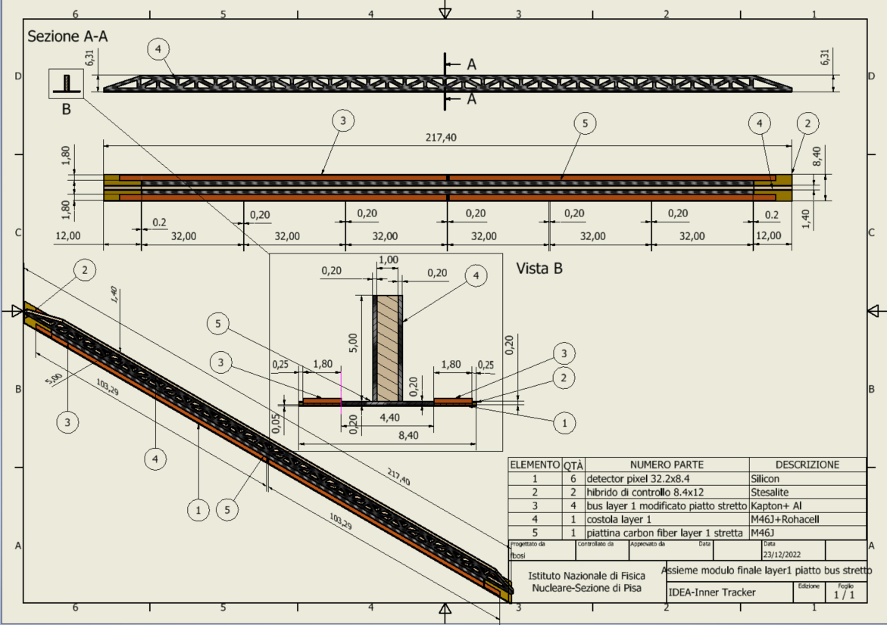
Layer 1 stave detail
Reticular lightweight support to provide stiffness
Thin carbon fiber walls interleaved with Rohacell
2 buses (data and power) 1.8 mm wide and 250 µm thick (50 µm Al, 200 µm kapton) per side
  Inspired to low mass hybrid R&D
Sensors facing interaction point w/o any other material in front
Readout chips either sides
Air cooled

Slide 7
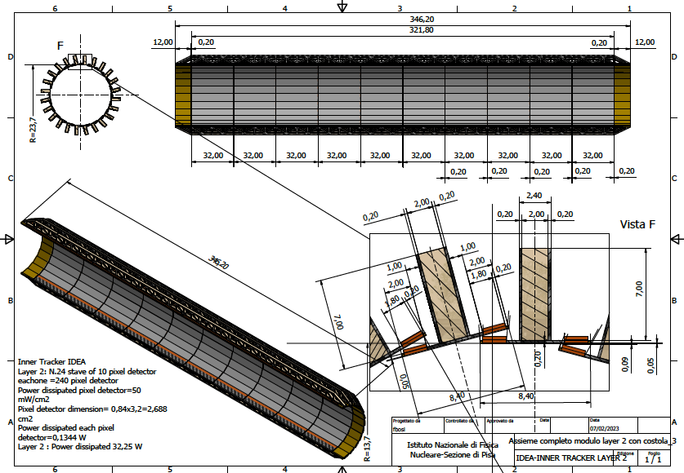
RD _FCC WP- SILICON MINI-WORKSHOP
Layer 2
24 overlapping staves of 10 modules each
Pinwheel geometry
Counter-rotated wrt layer 1 to mitigate charge-asymmetry effects in track reconstruction
Power budget
~32 W
Total weight ~63 grams
Total thickness 0.25% X₀

Slide 8
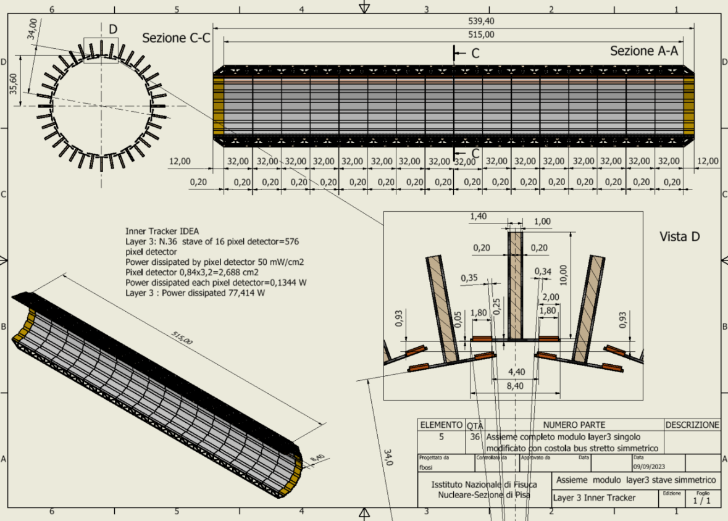
RD _FCC WP- SILICON MINI-WORKSHOP
Layer 3
36 staves of 16 modules each
Lampshade geometry.
Charge symmetric track reconstruction
Total weight ~150 grams
Total thickness 0.25% X₀
Power budget
~77 W

Slide 9
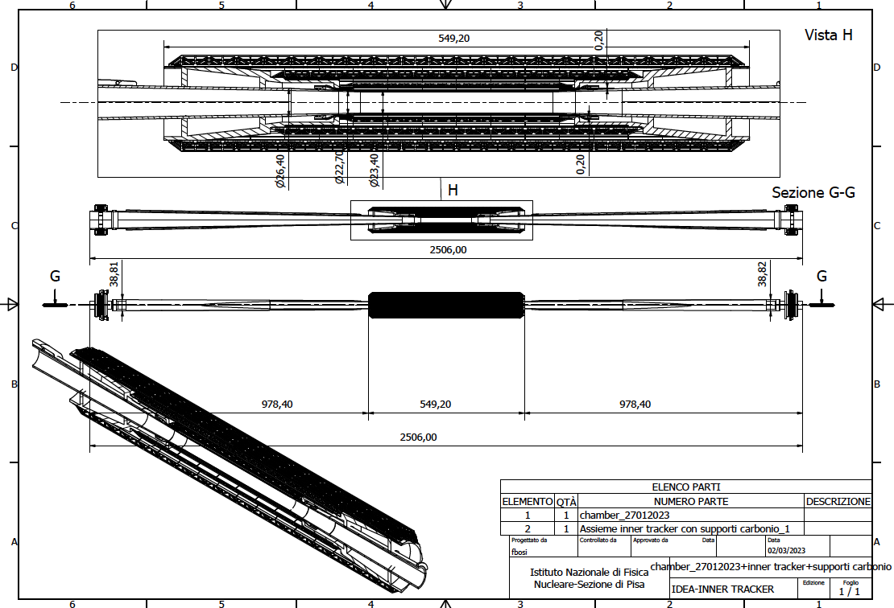
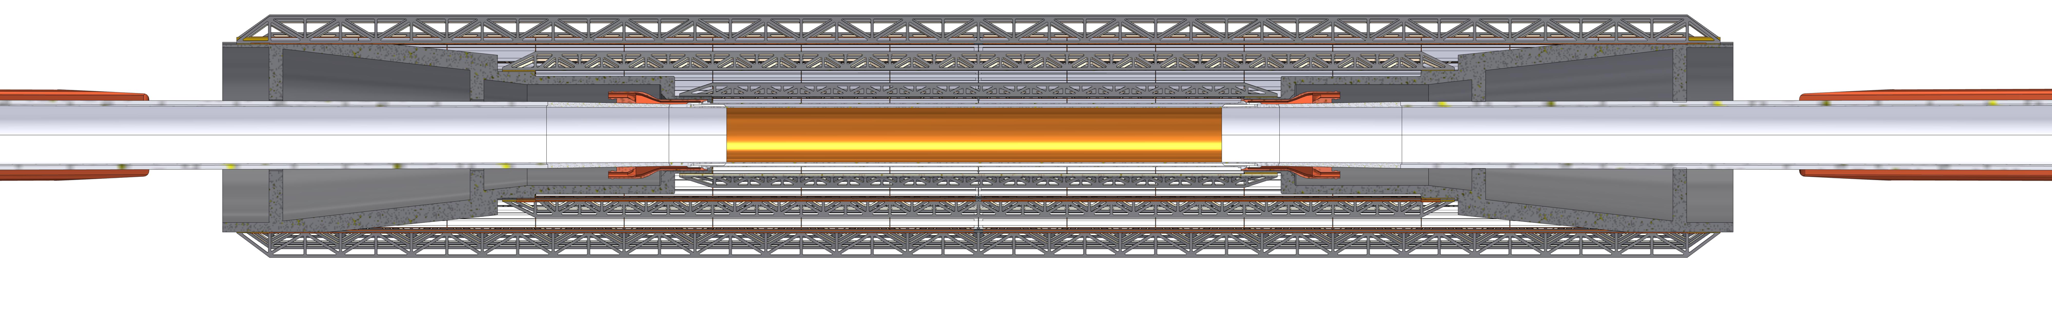
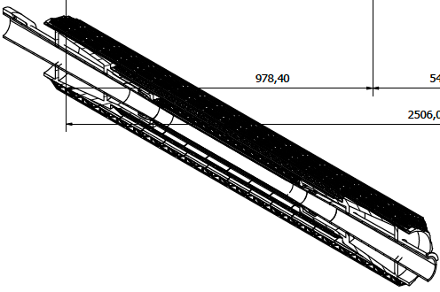
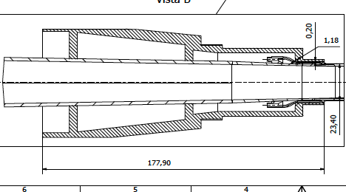
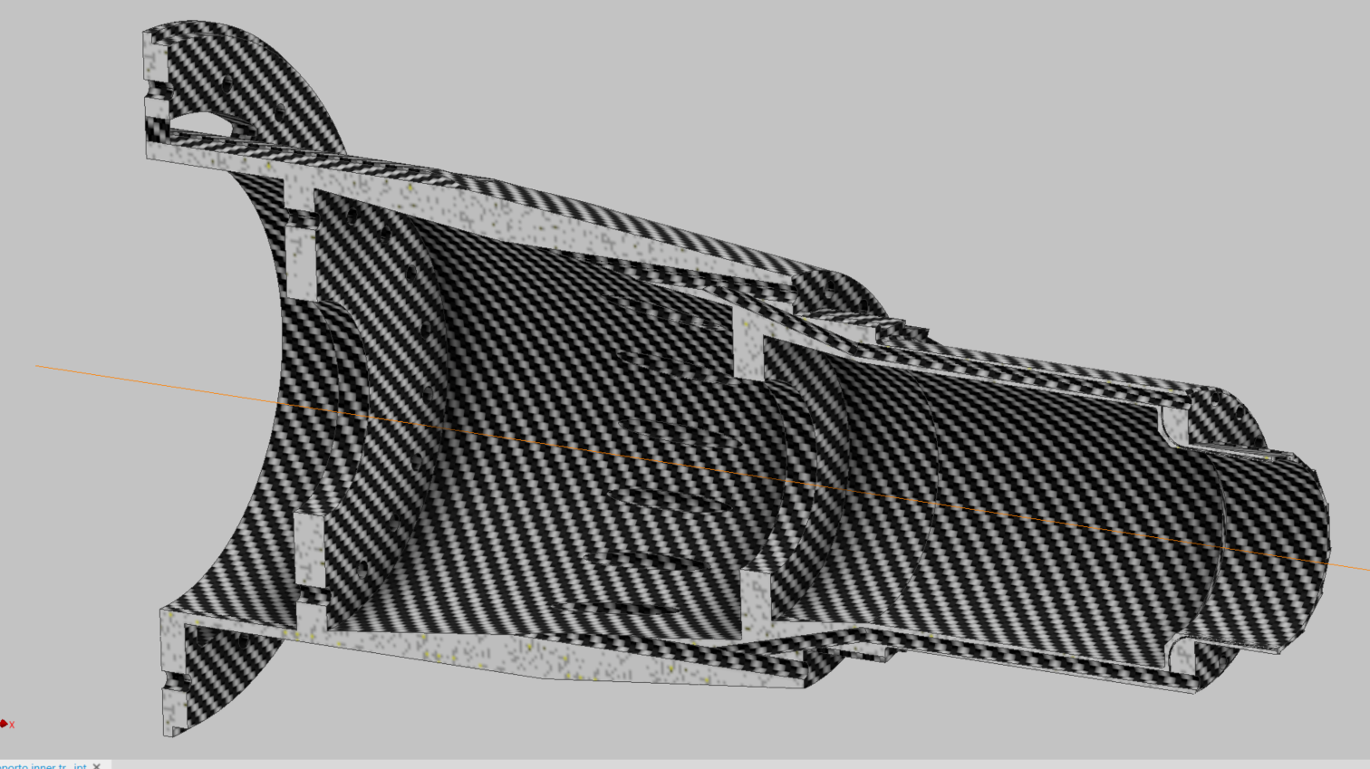
RD _FCC WP- SILICON MINI-WORKSHOP
Inner vertex detector is supported by a conical structures in carbon fiber on elliptical chamber
~450 grams
The support is engineered for air ducts and thermal isolation from the beam pipe during bakeout
Cooling Third layer
Cooling Second Layer
Cooling First Layer
Cooling Pipe

Slide 10
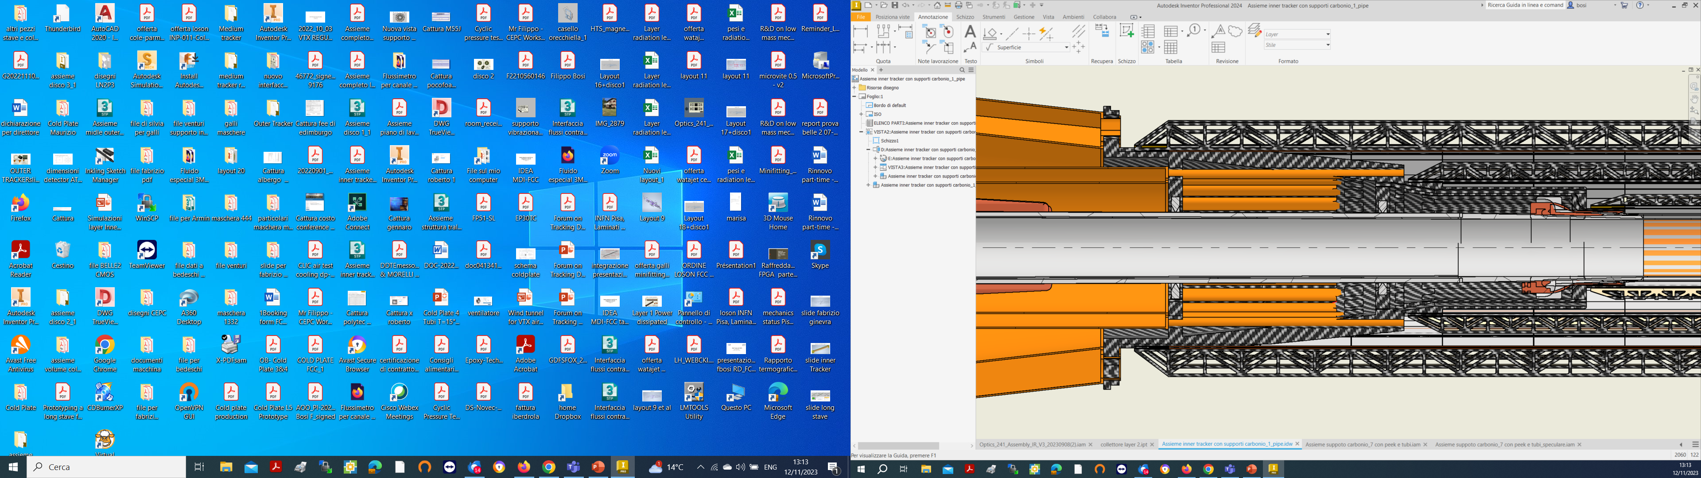
Inner Vertex support
RD _FCC WP- SILICON MINI-WORKSHOP
Anchored to the conical chamber
Air cooled
Thermally isolated from the beam pipe during bakeout, by peek supports
Cooling Third layer
Cooling Second Layer
Cooling First Layer
Cooling Pipe
Air Cooling
Paraffine for pipe cooling
Cables

Slide 11
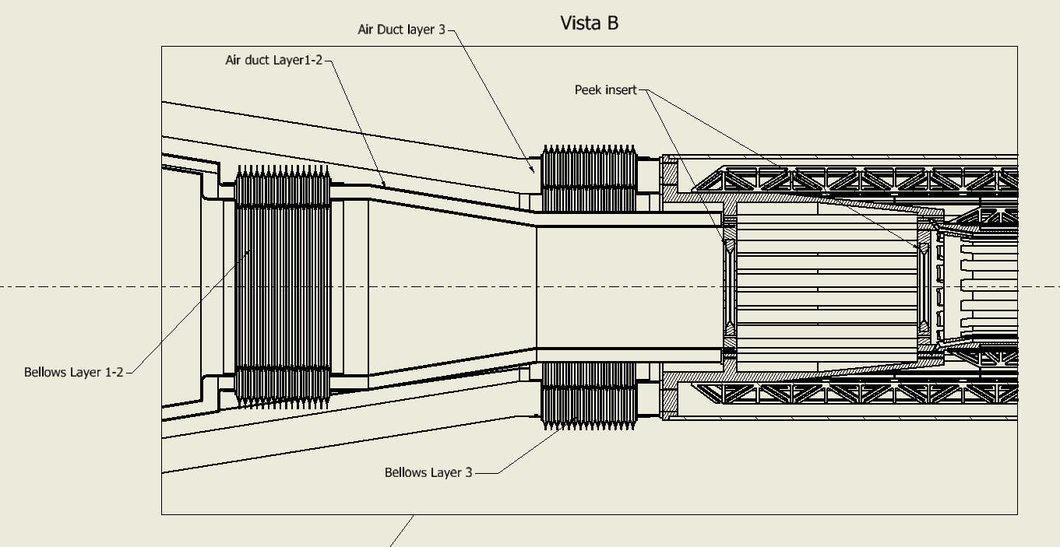
AIR COOLING DUCTS AND AND BELLOWS
RD _FCC WP- SILICON MINI-WORKSHOP
Contact with the beam pipe

Slide 12
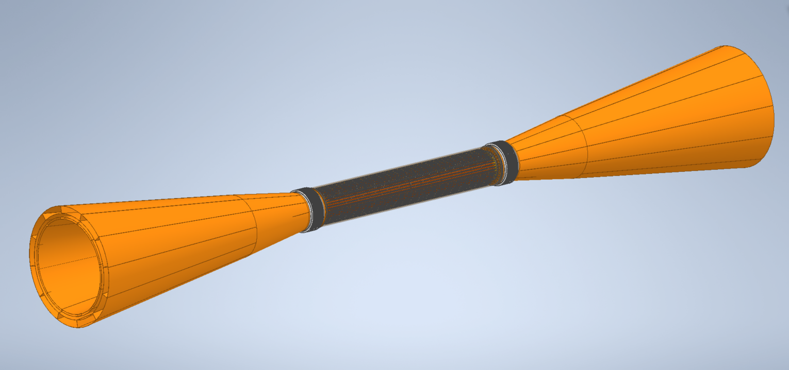
RD _FCC WP- SILICON MINI-WORKSHOP
Service cones for cooling and cables
Inner Tracker
Cone exit cable layer3-Cooling in layer3
Elastic connection
Cone exit cable layer2-1-Cooling in layer 2-1

Slide 13
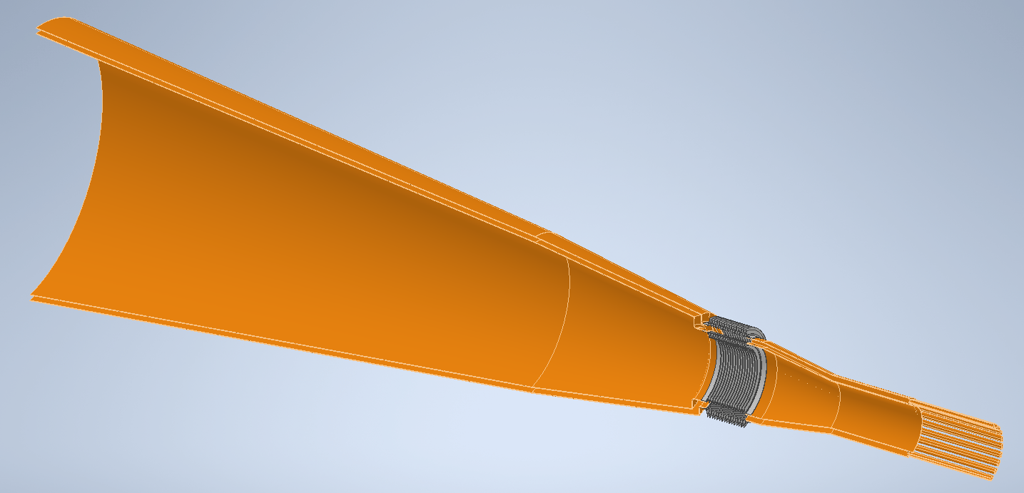
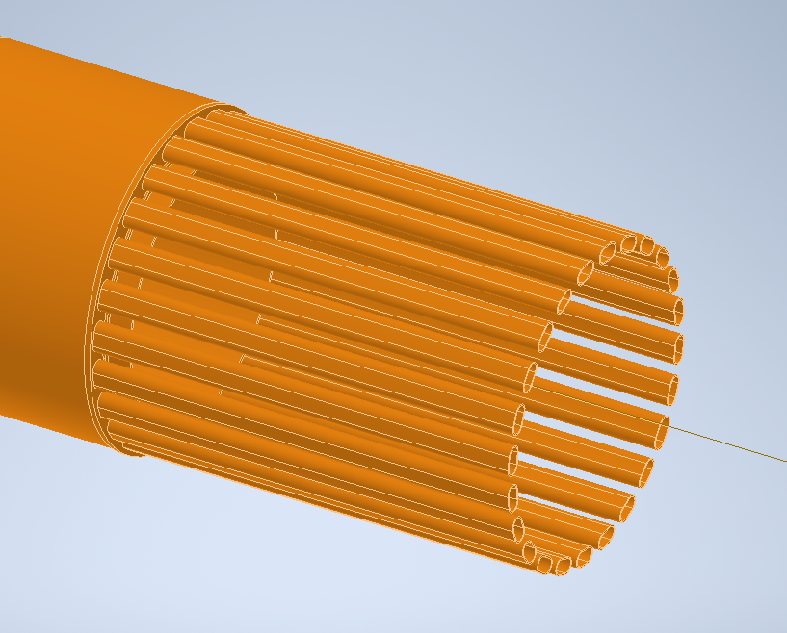
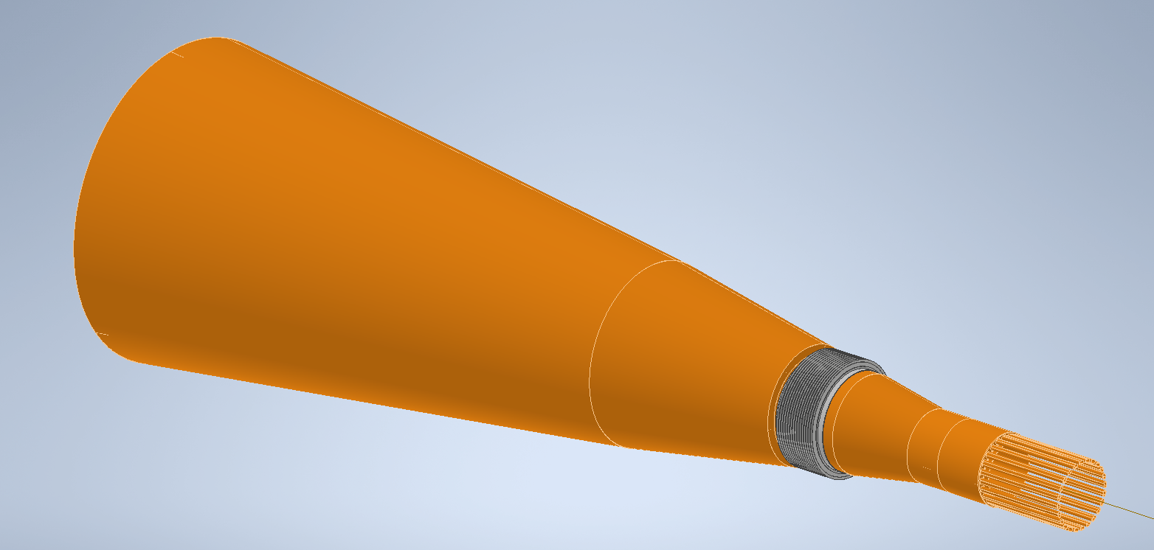
RD _FCC WP- SILICON MINI-WORKSHOP
Attack of the air cone to the support carbon fiber
Bellows
AIR COOLING CONE LAYER 1-2

Slide 14
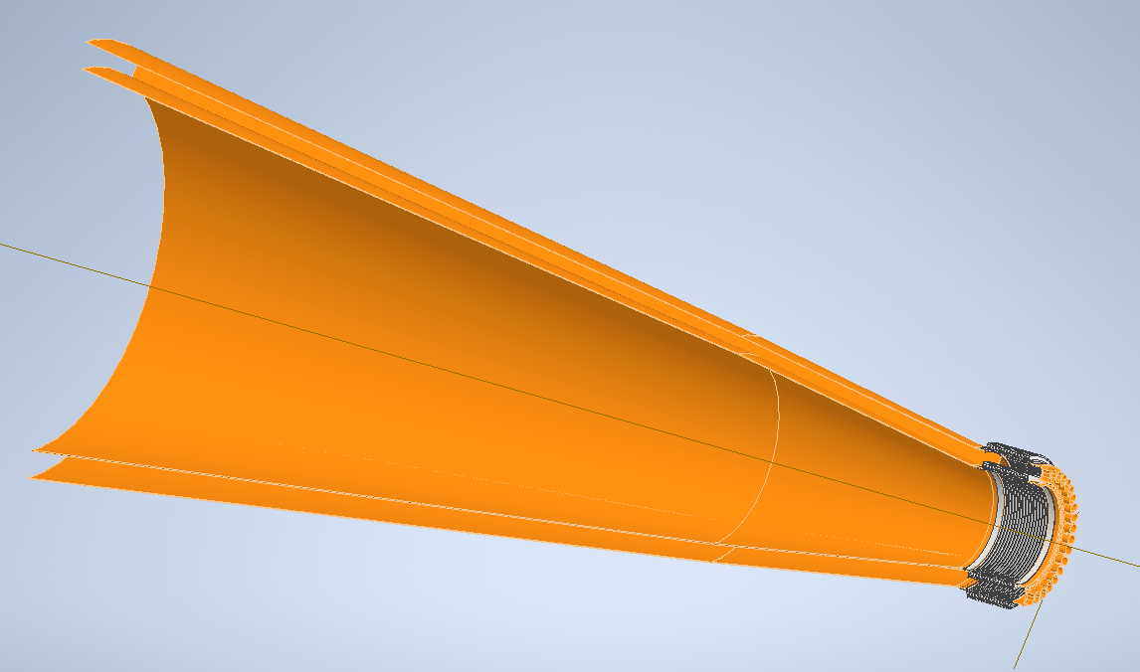
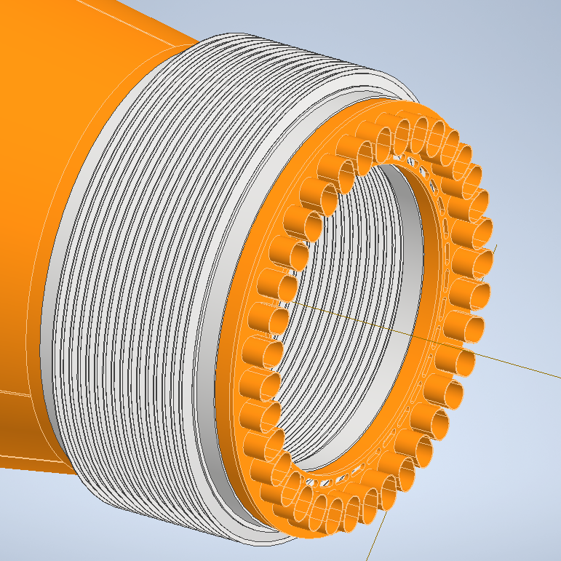
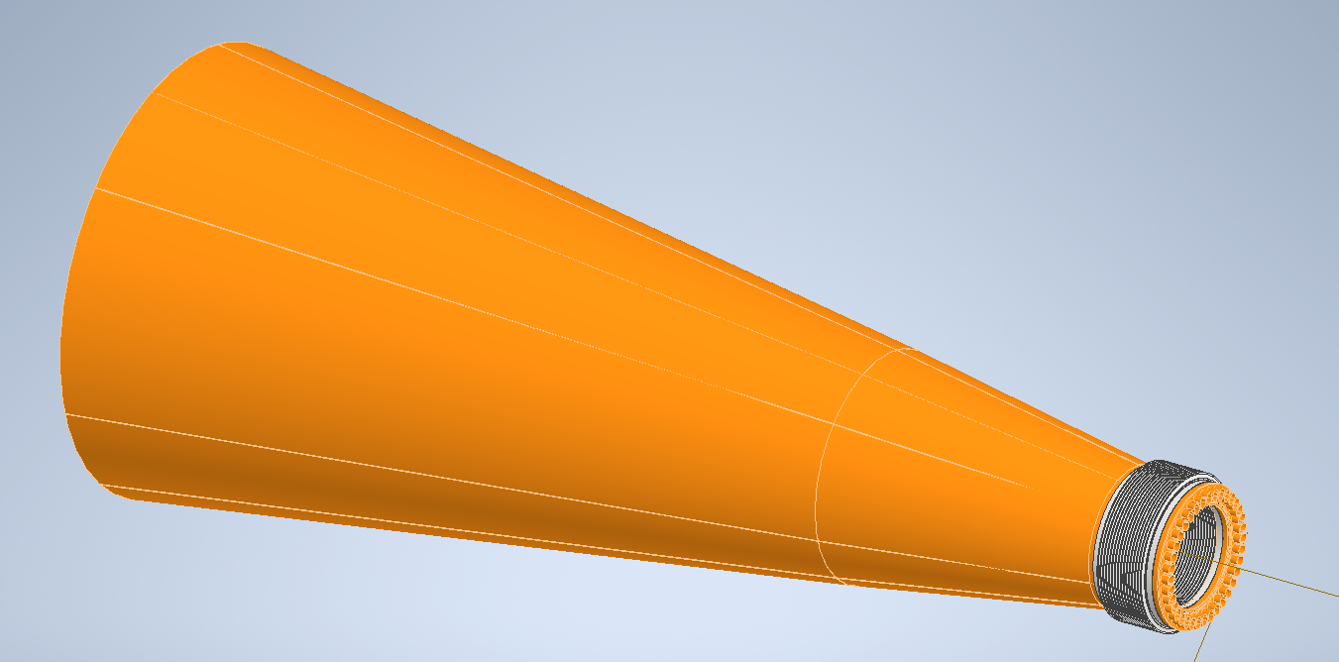
AIR COOLING LAYER 3
RD _FCC WP- SILICON MINI-WORKSHOP
Attack of the air cone to the support carbon fiber
Bellows

Slide 15
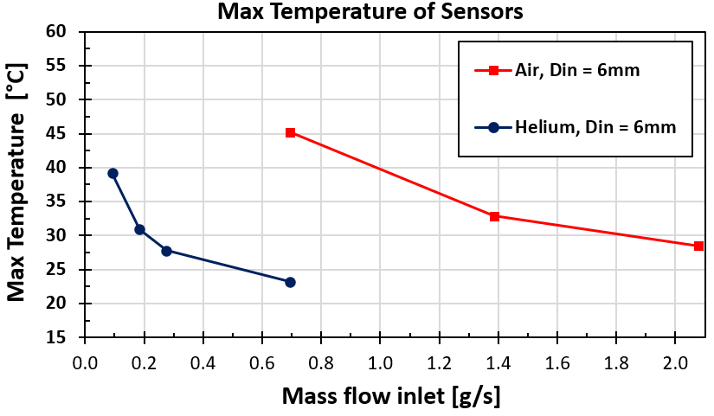
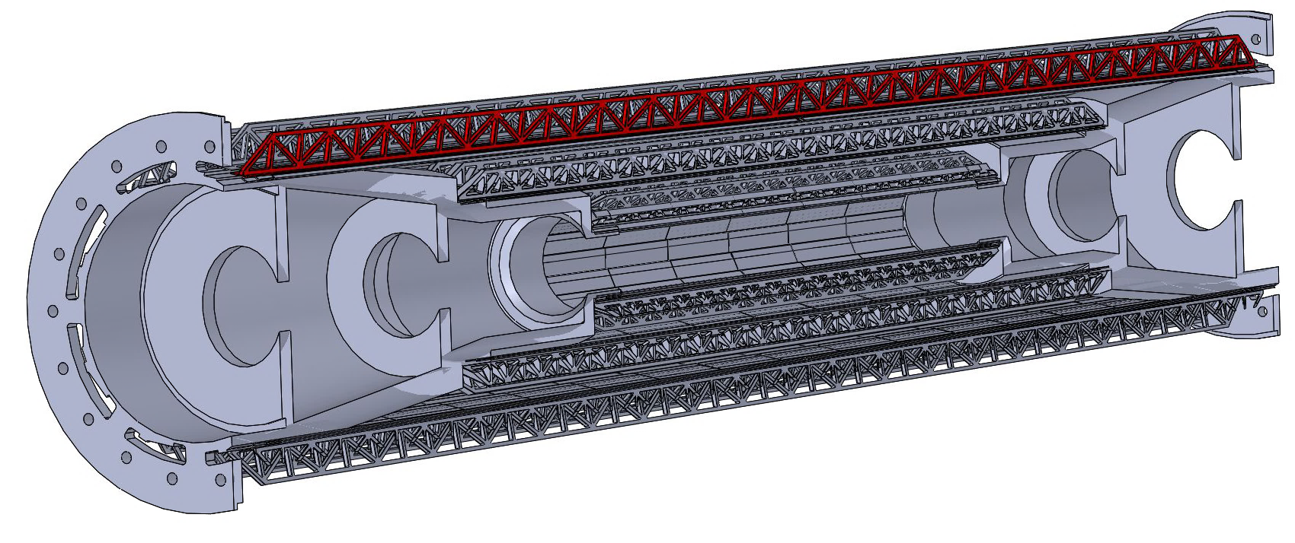
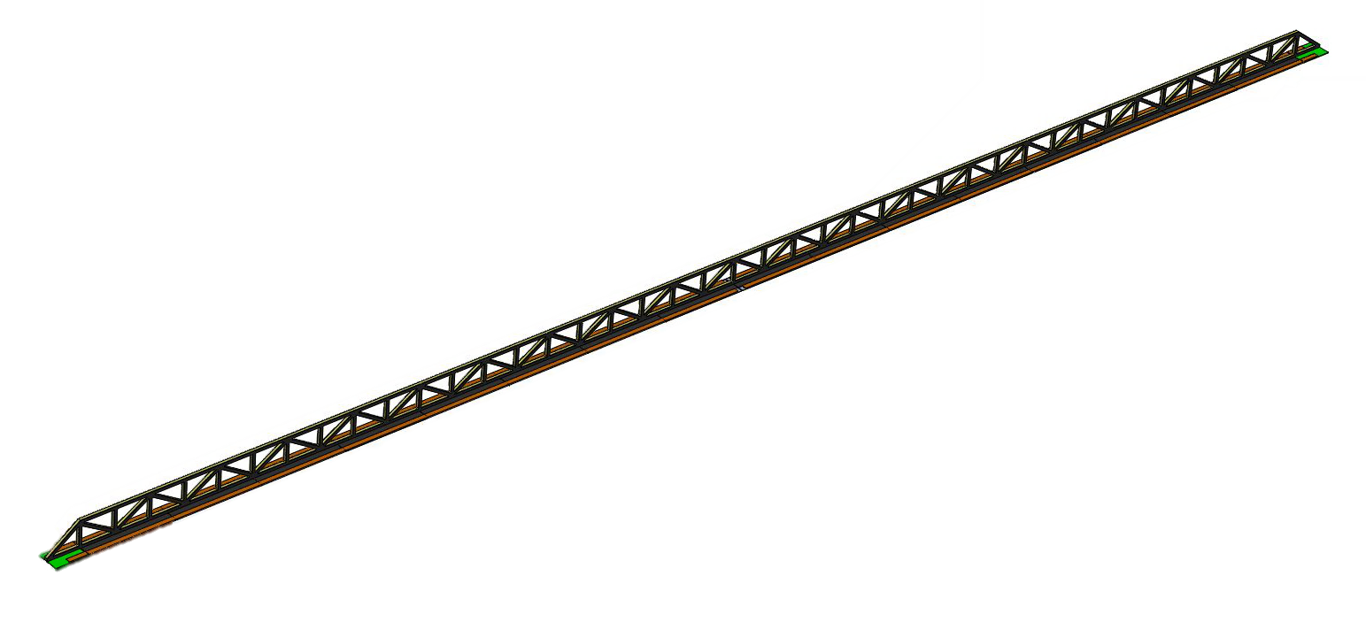
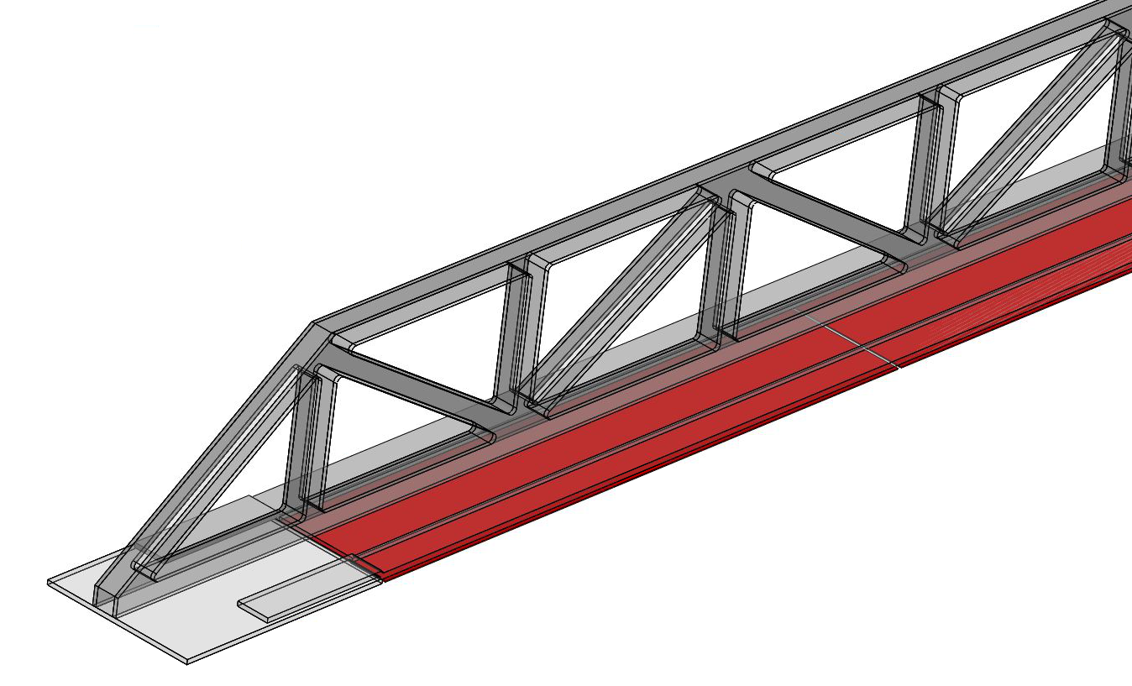
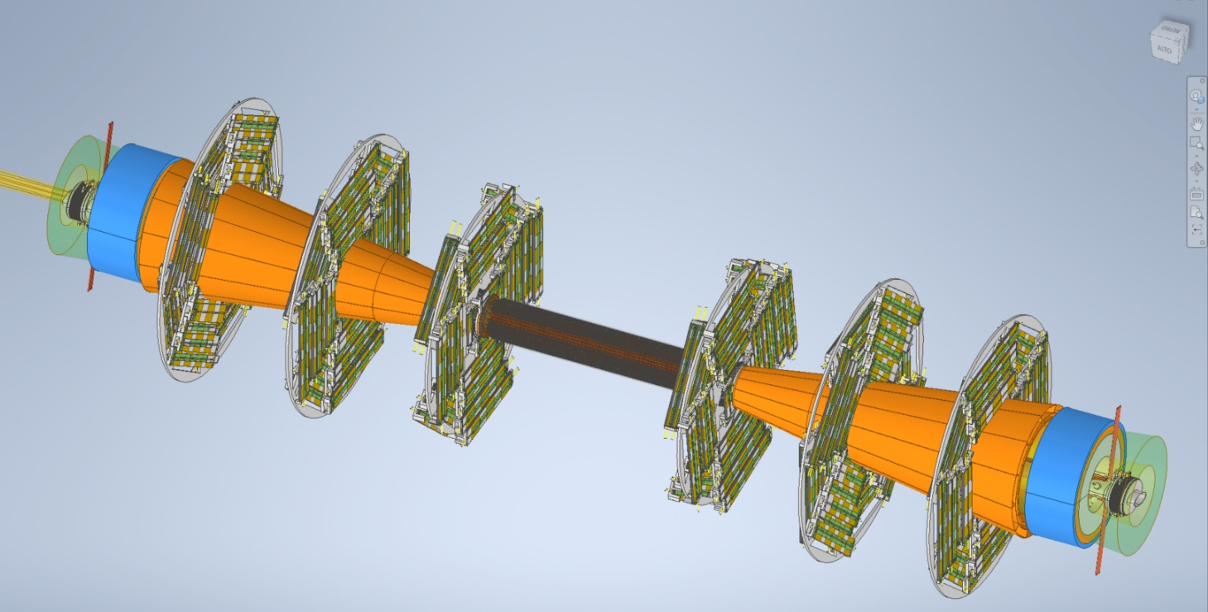
RD _FCC WP- SILICON MINI-WORKSHOP
Air cooling (simulations)
Air outlets
Air inlets
Air flow
Disk 3
Disk 2
Cooling with air/He flow along the detector.
  Air temperature: T_{air} = 15°C
  Max sensor temp on layer 3 (hottest one) ~25/30 ºC with He/Air.
  Vibrations studies ongoing
Disk 1
Inner Tracker

Slide 16
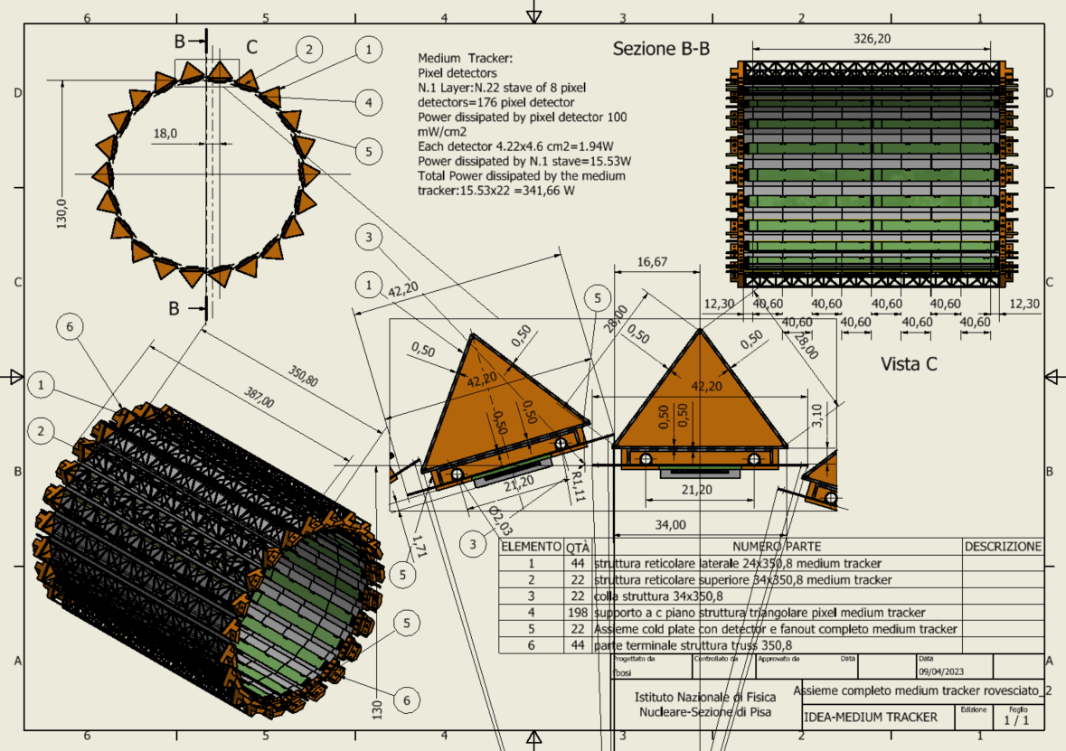
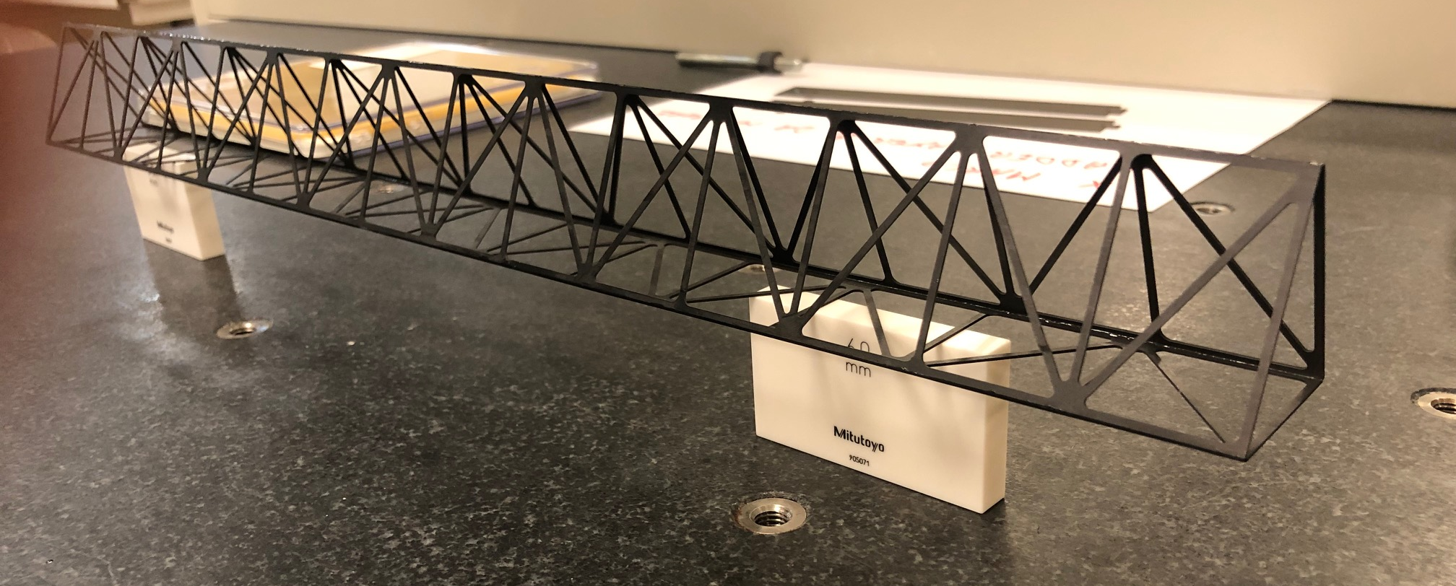
RD _FCC WP- SILICON MINI-WORKSHOP
Middle Barrel
At 13 cm radius
22 staves of 8 modules each.
Lightweight reticular support structure (ALICE/Belle-II like)
Readout chips either side
Power budget
~342 W
Total weight ~1 kg
Water cooled (2 pipes of 2 mm diameter)
Similar prototype
built @ Pisa
Outer barrel is similar but longer (see backup)

Slide 17
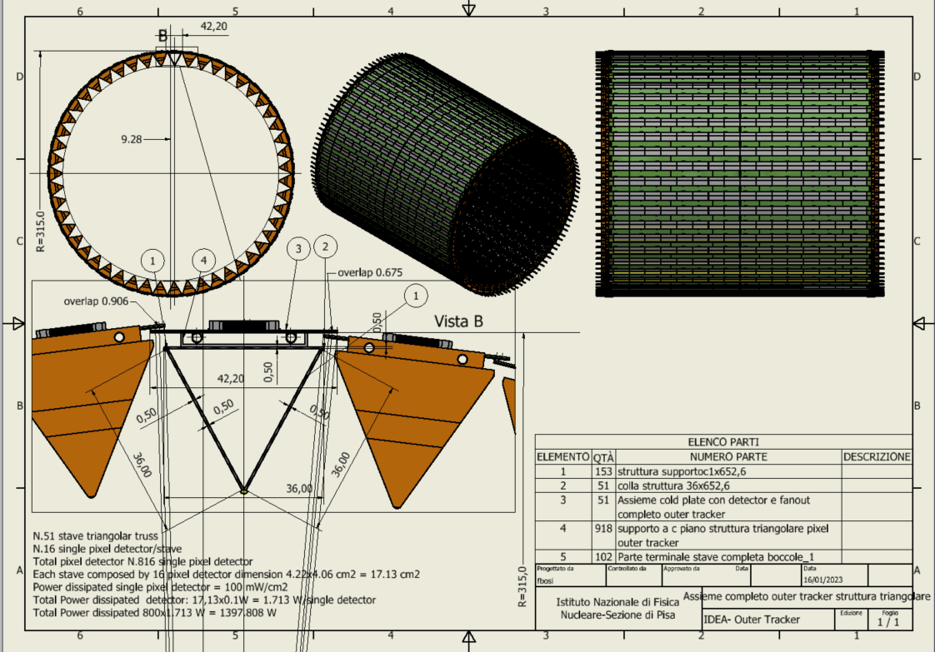
RD _FCC WP- SILICON MINI-WORKSHOP
Outer Vertex Tracker Barrel
At 31.5 cm radius
51 staves of 16 modules each
Lightweight reticular support structure (ALICE/Belle-II like)
Total weight ~3.7 kg
Readout chips either side
Power budget
~1400 W
Water cooled (2 pipes of 2 mm diameter)
Notes:
NB. Qui la struttura reticolare deve stare giù perché sennò non si riesce ad ottenere il raggio esterno più grande e vicino alla DCH.

Slide 18
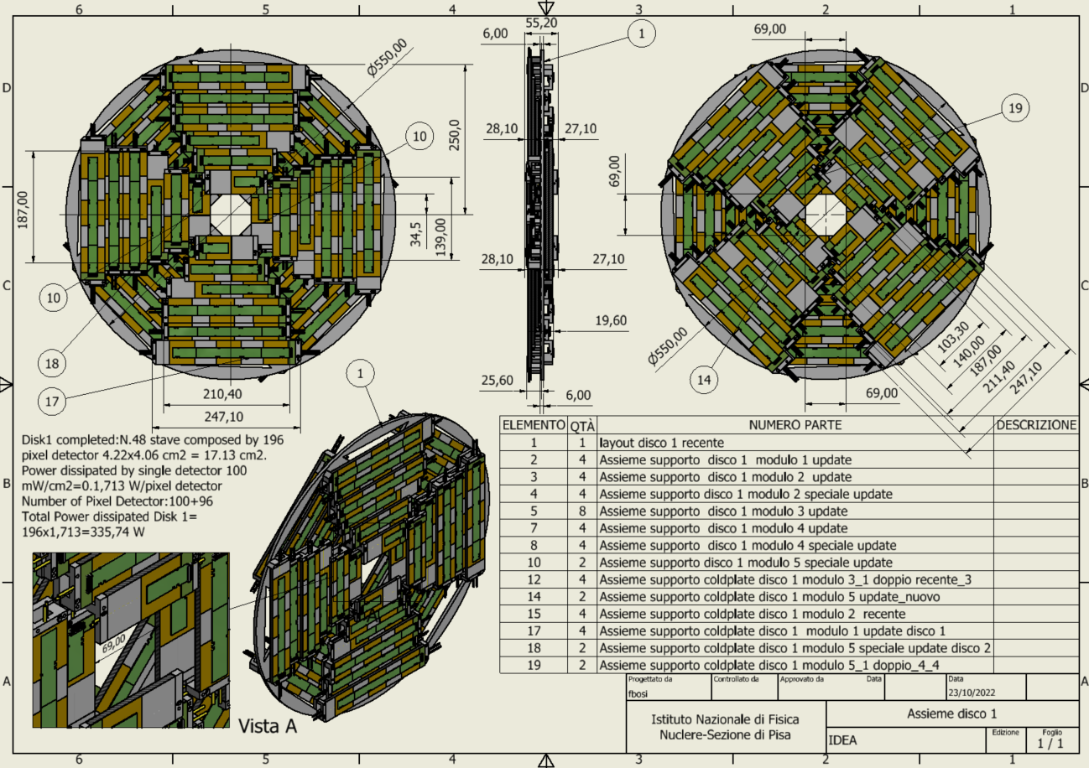
RD _FCC WP- SILICON MINI-WORKSHOP
Outer Vertex Tracker Disk 1
2 sides (front and back) each with 4 petals.
One petal is made of different staves of overlapping modules
Total modules per disk: 196
Total weight ~850 grams
Power budget ~ 336 W
Cooling using 1 water pipe (2 mm diameter)
Similar geometry for the other two disks

Slide 19
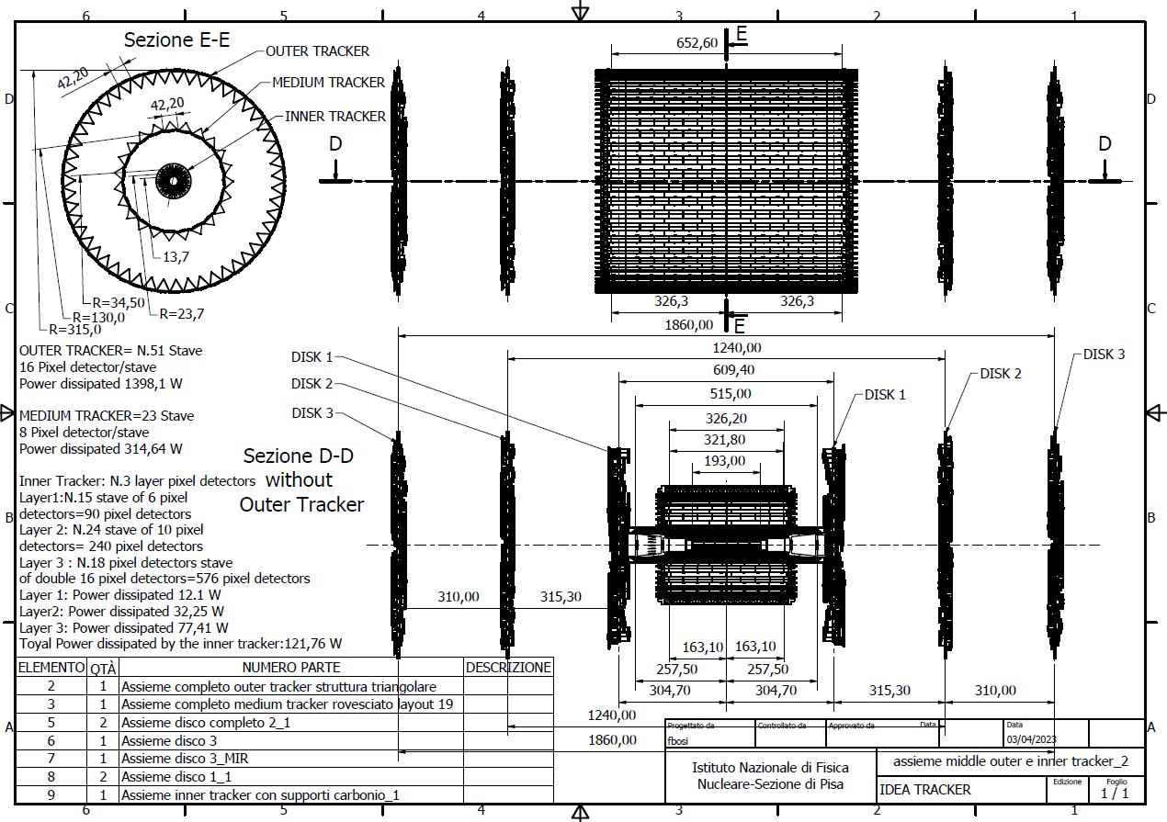
Overall layout and dimensions
RD _FCC WP- SILICON MINI-WORKSHOP

Slide 20
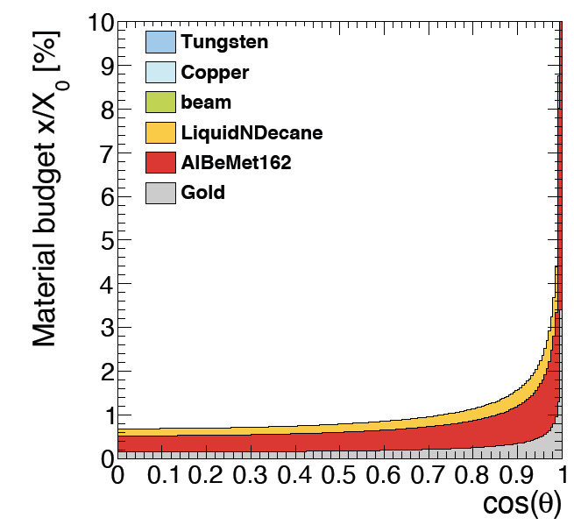
Simulated material budget
RD _FCC WP- SILICON MINI-WORKSHOP
In agreement with CAD estimates
Smaller X/X₀ wrt IDEA CDR estimates even including power and readout cables in the sensitive region
Silicon only ~15% of the total
Beam pipe
Inner Vertex only

Slide 21
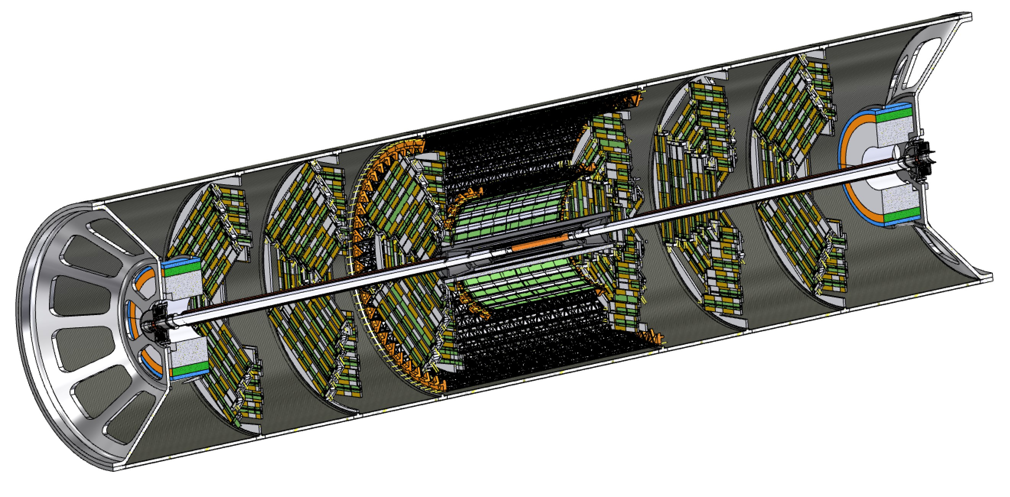
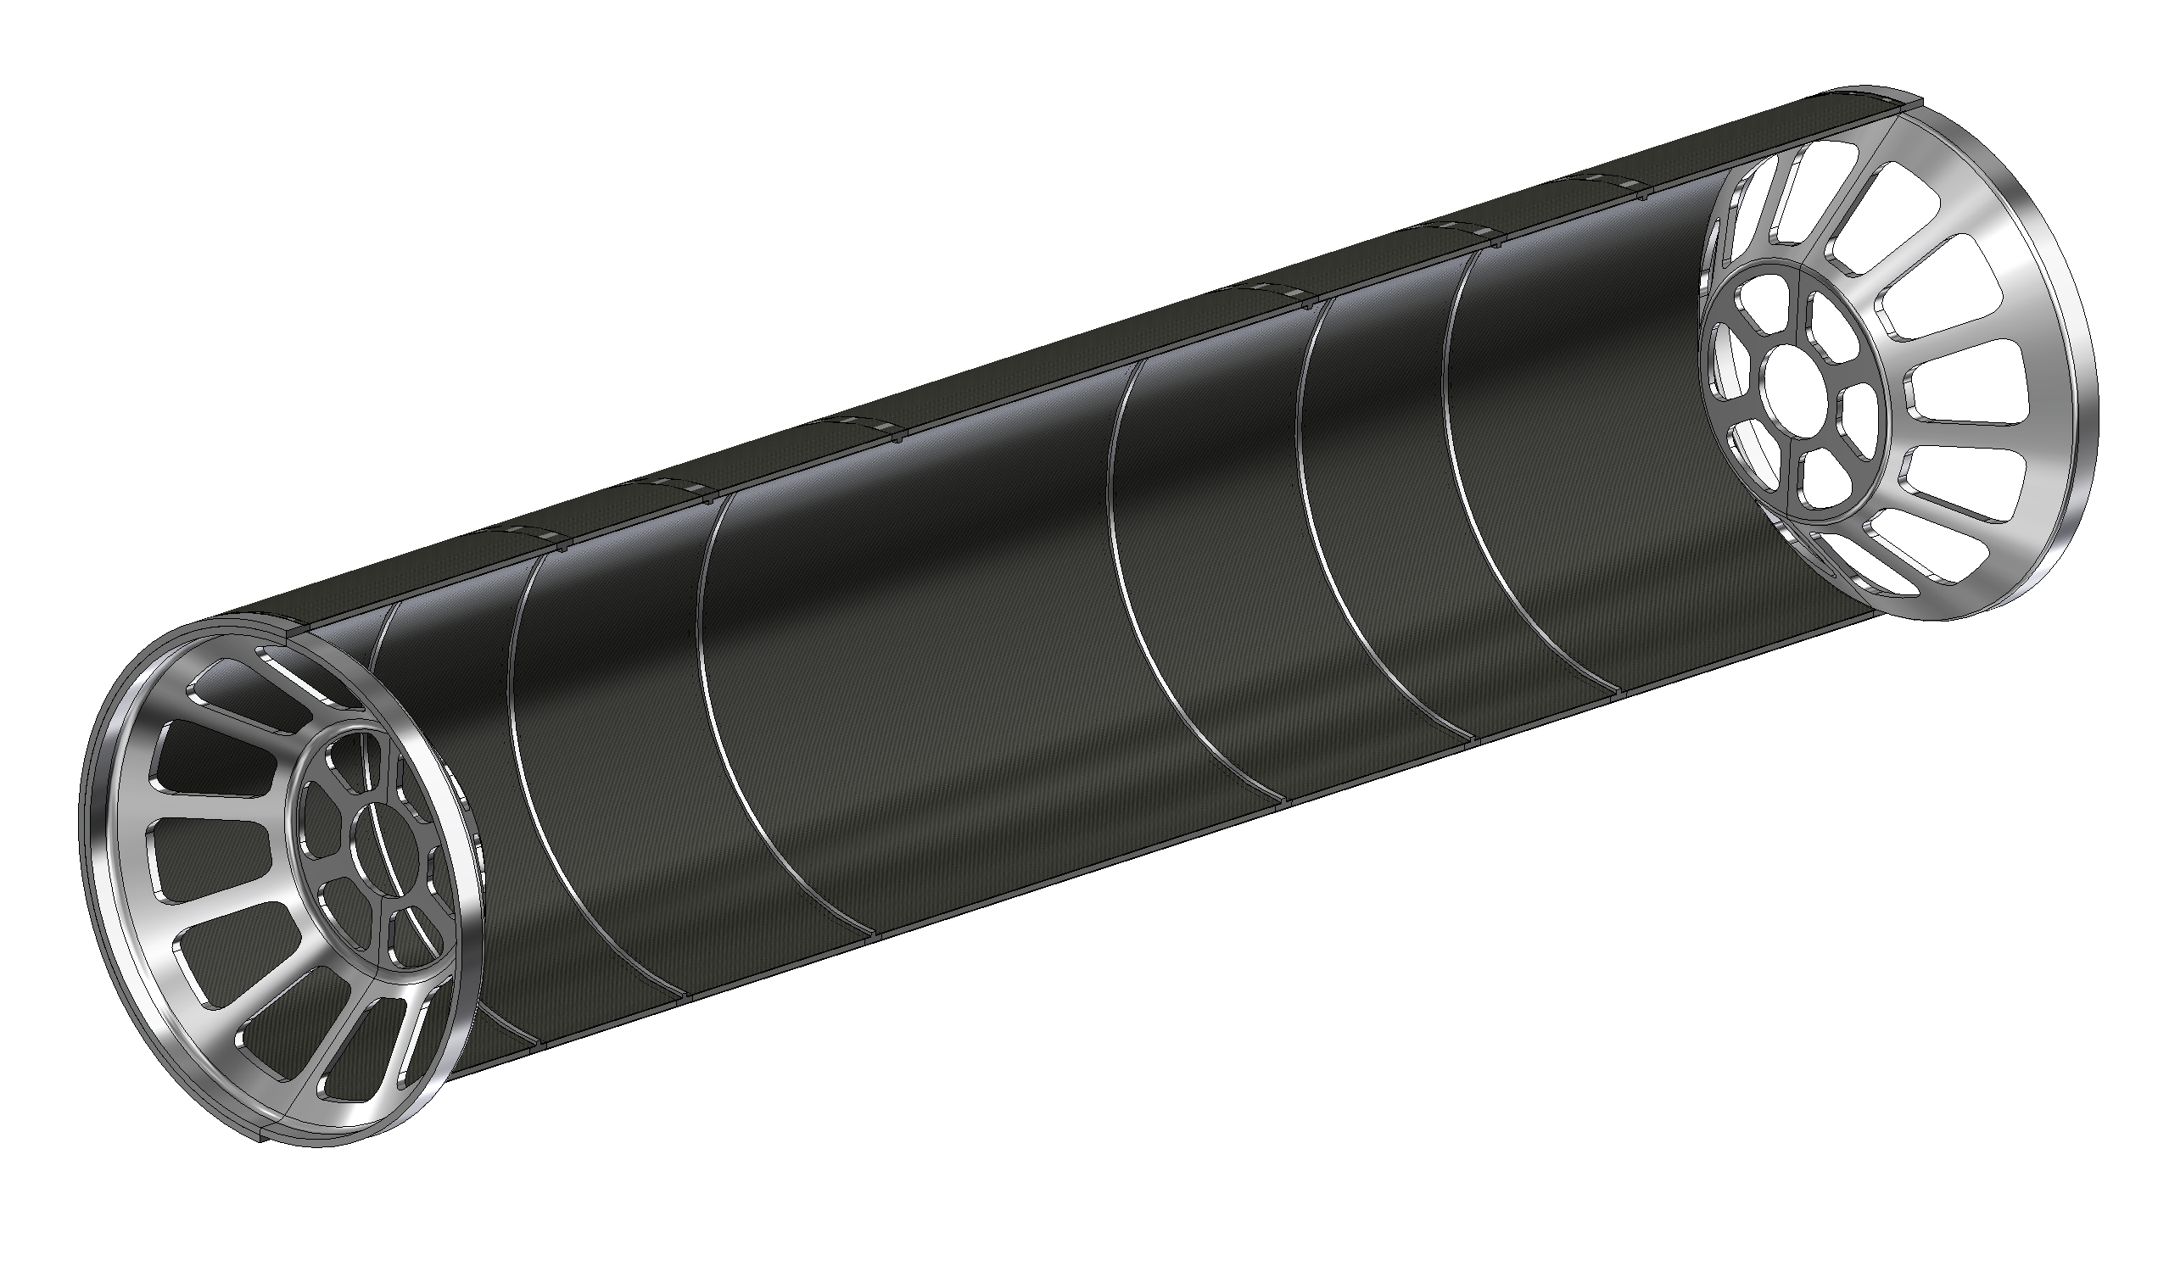
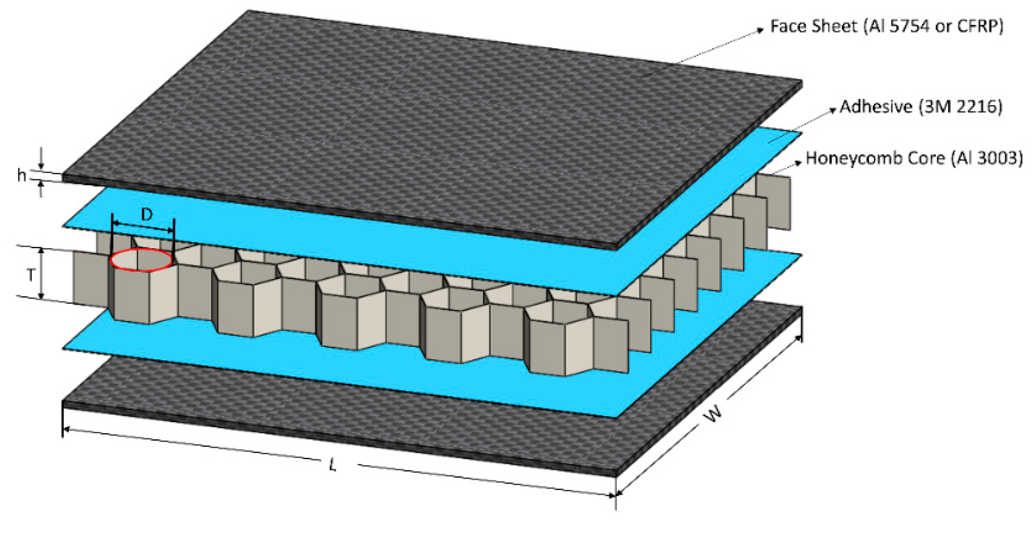
Support cylinder
All elements in the interaction region (Vertex and LumiCal) are mounted rigidly on a support cylinder that guarantees mechanical stability and alignment
  Once the structure is assembled it is slided inside the rest of the detector
    M. Boscolo, F. Palla, F. Fransesini, F. Bosi and S. Lauciani, Mechanical model for the FCC-ee MDI, EPJ Techn Instrum 10, 16 (2023). https://doi.org/10.1140/epjti/s40485-023-00103-7
Aluminium endcaps
Aluminium ribs
1mm CF + 4mm HC + 1mm CF

Slide 22
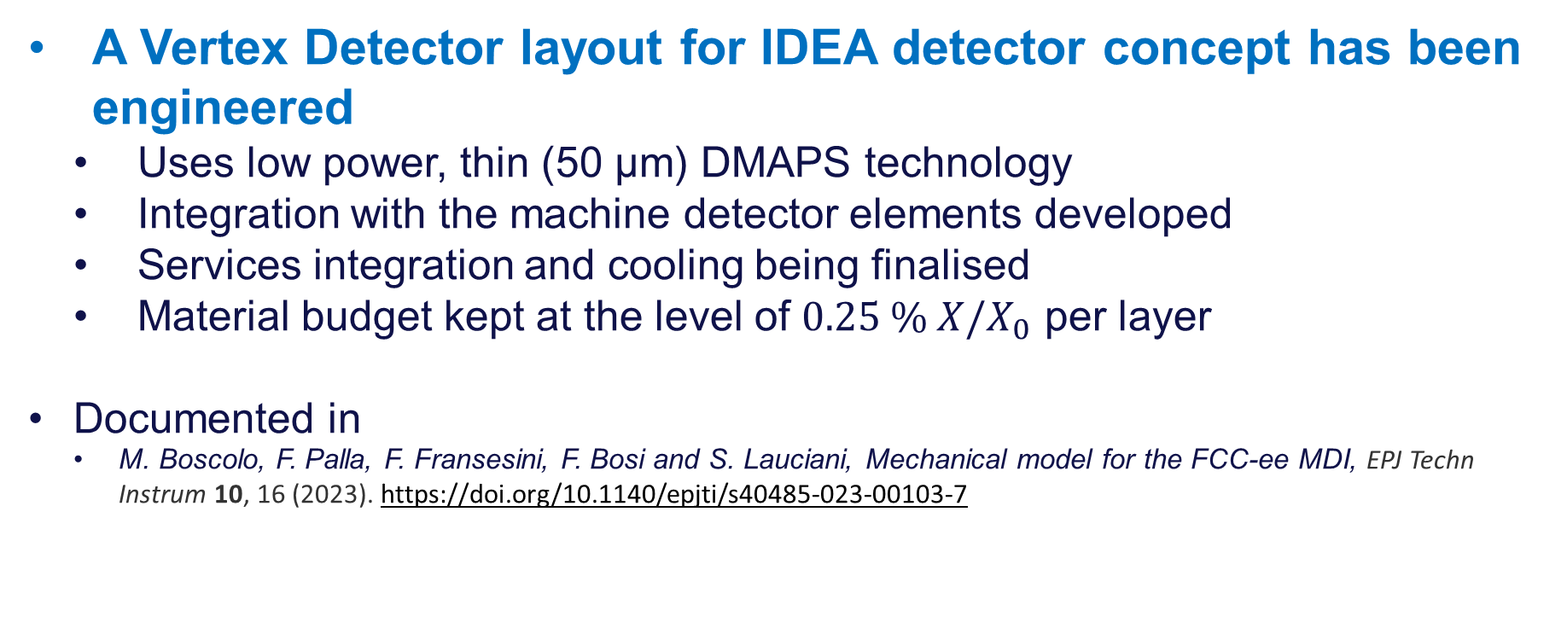
Conclusions
RD _FCC WP- SILICON MINI-WORKSHOP
A Vertex Detector layout for IDEA detector concept has been engineered
  Uses low power, thin (50 µm) DMAPS technology
  Integration with the machine detector elements developed
  Services integration and cooling being finalised
  Material budget kept at the level of $0.25 \% X/X_{0}$ per layer
  Documented in
    M. Boscolo, F. Palla, F. Fransesini, F. Bosi and S. Lauciani, Mechanical model for the FCC-ee MDI, EPJ Techn Instrum 10, 16 (2023). https://doi.org/10.1140/epjti/s40485-023-00103-7

Slide 23
Thank you for your attention.
23

Slide 24
Backup

Slide 25
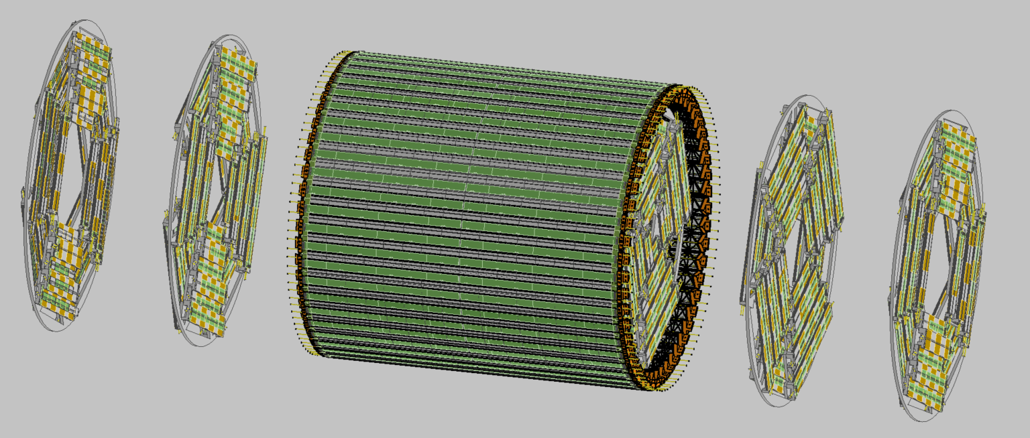
Outer Tracker and Disks
RD _FCC WP- SILICON MINI-WORKSHOP

Slide 26
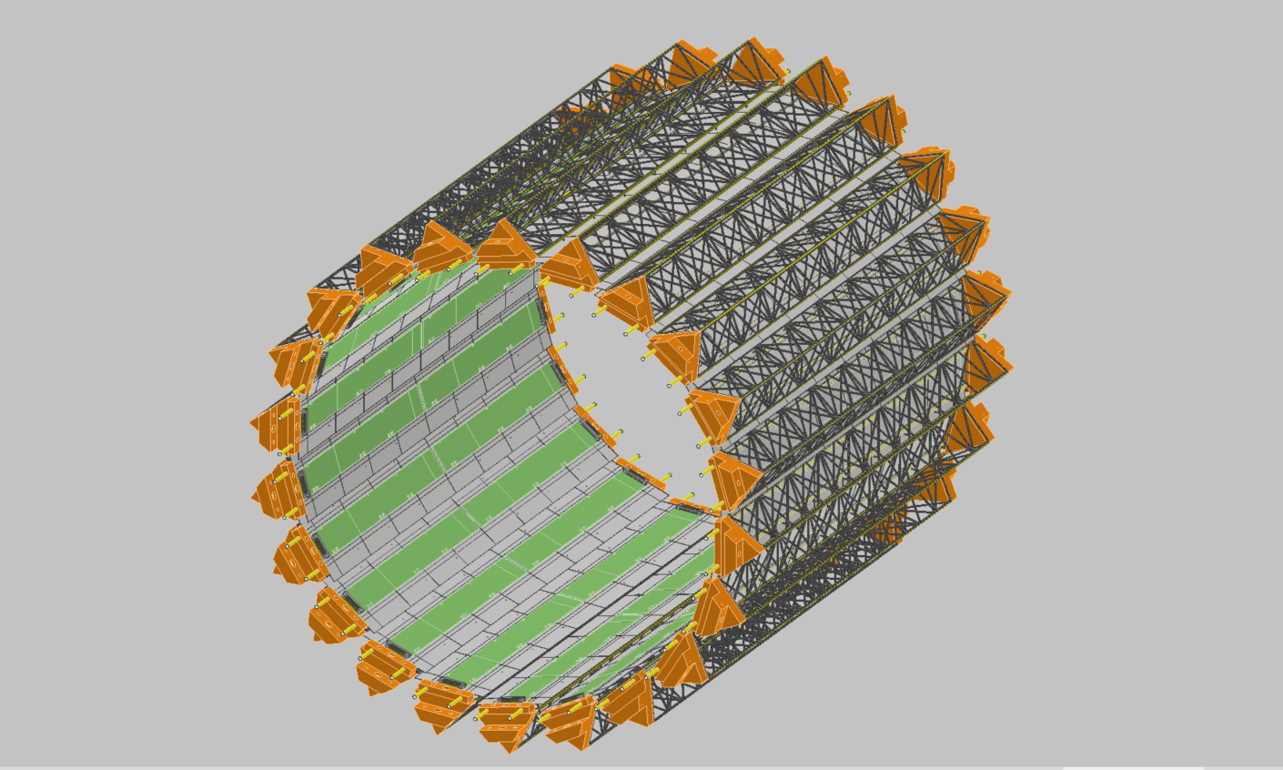
MIDDLE TRACKER
RD _FCC WP- SILICON MINI-WORKSHOP

Slide 27
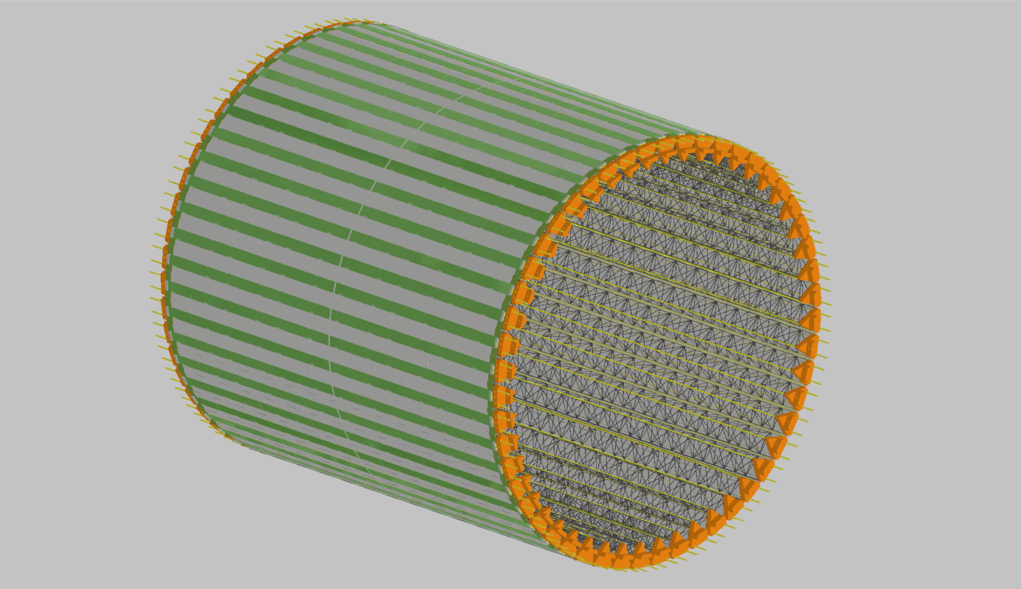
OUTER TRACKER
RD _FCC WP- SILICON MINI-WORKSHOP

Slide 28
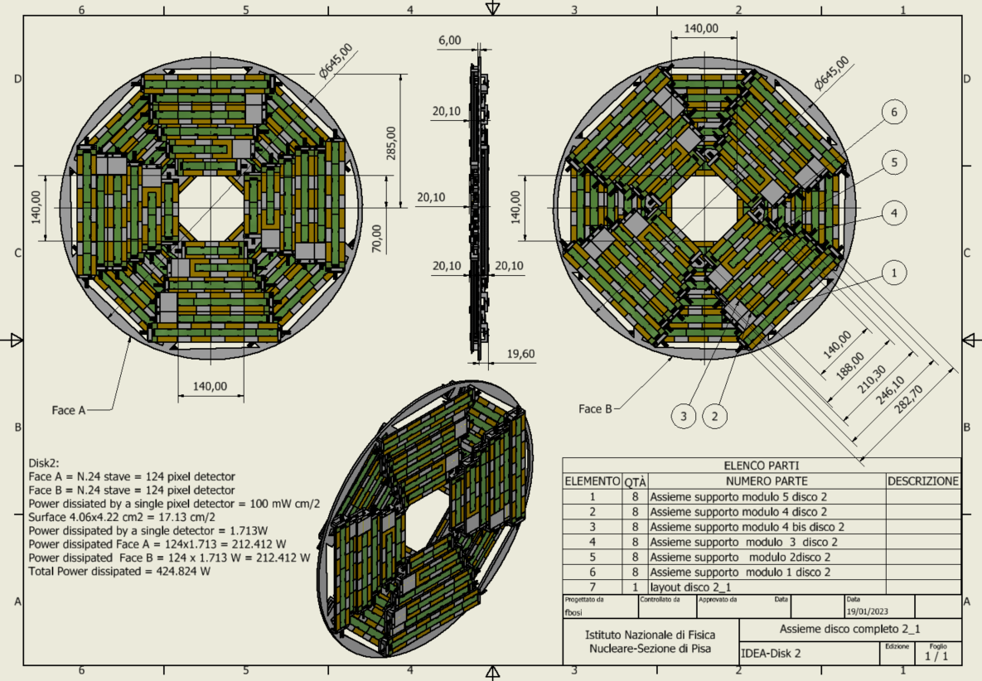
DISK 2
RD _FCC WP- SILICON MINI-WORKSHOP

Slide 29
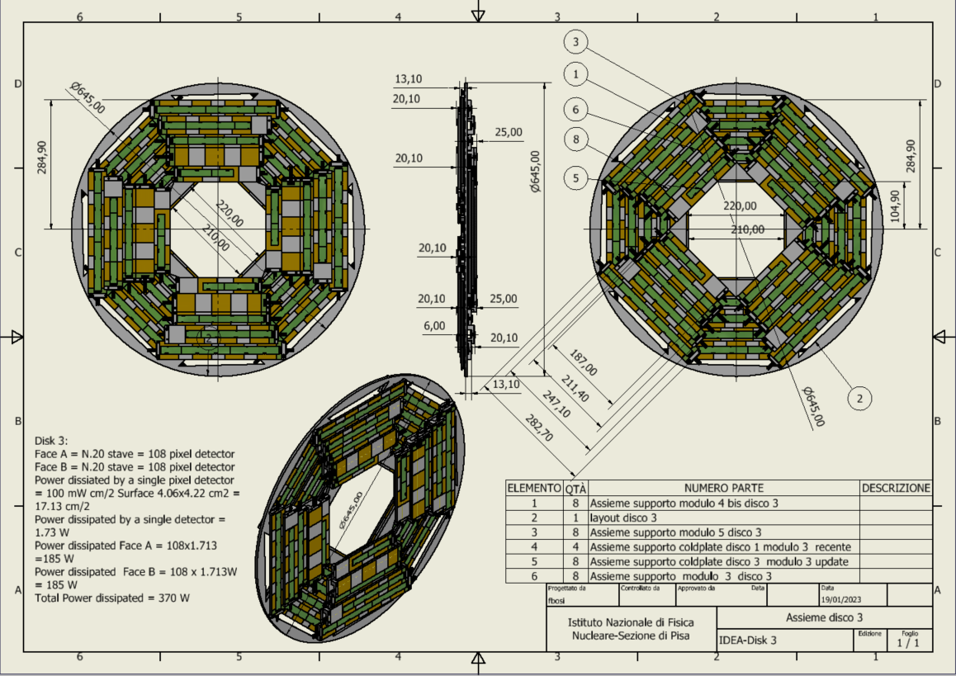
DISK 3
RD _FCC WP- SILICON MINI-WORKSHOP

