Slide 1
ALICE sensors R&D for ITS3 and ALICE3

Slide 2
Outline
ITS3 sensor status
ALICE3 sensor(s) planning and ideas
Summary and considerations

Slide 3
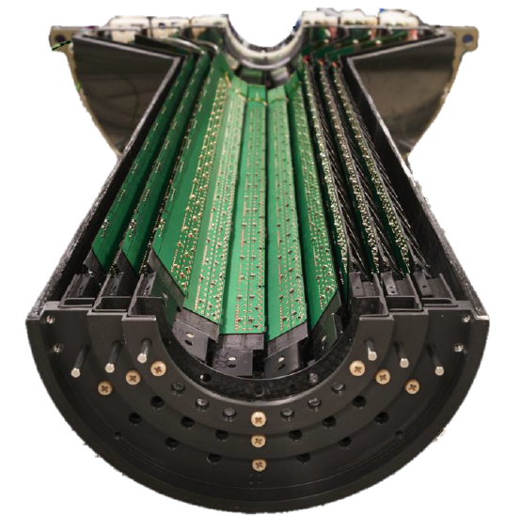
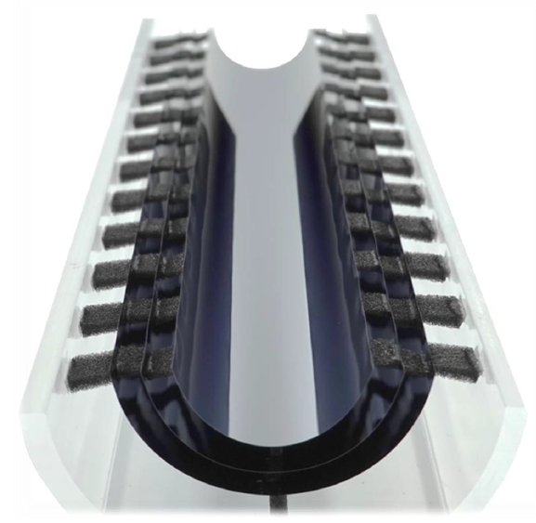
ITS3 overview
ITS2 Inner Barrel
ITS3
2026
Electrical bus, support structures, cooling have a large impact on material budget
ITS3 approach allows for the removal of the three elements

Slide 5
The (very) large ITS3 sensor

Slide 9
10 Gb/s perline

Slide 11
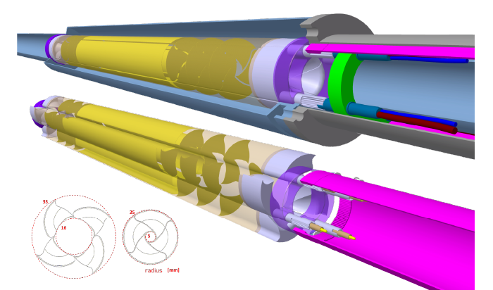
ITS3 toward ALICE3
ITS3
ALICE 3 Inner Tracker
2034

Slide 12
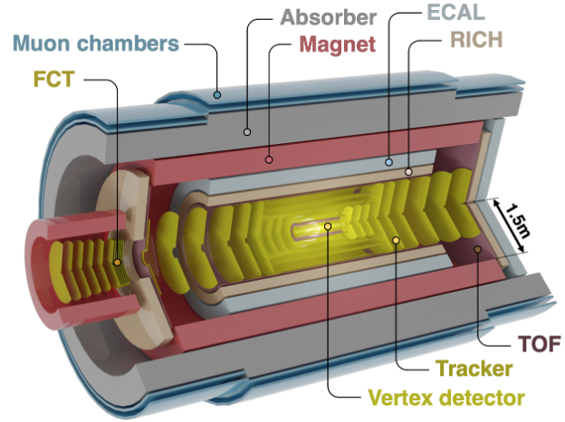
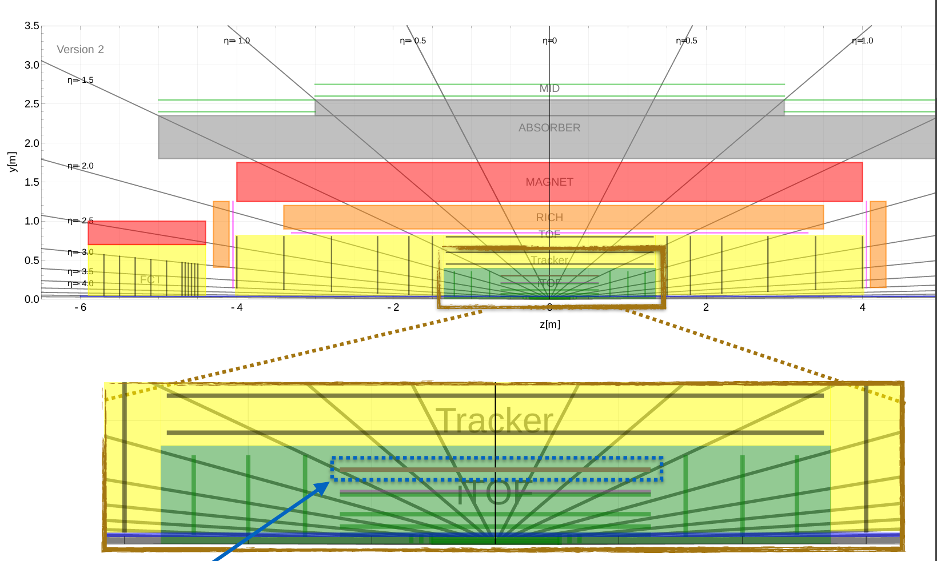
ALICE3 tracker overview – not only the Vertex!

Slide 13
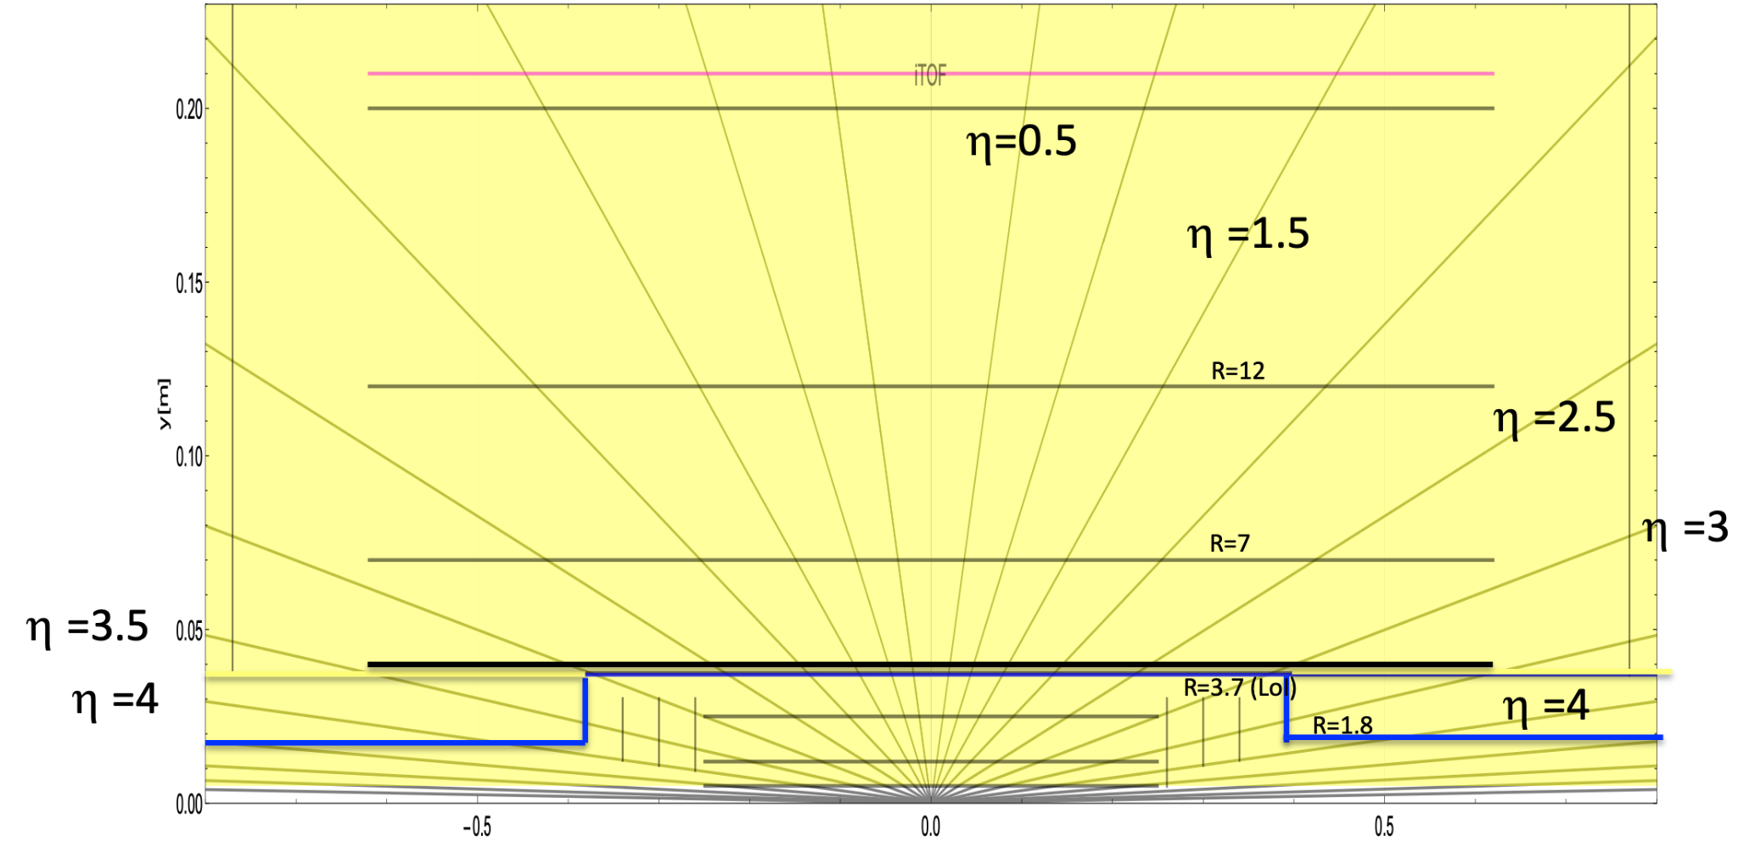
ALICE3 «middle» layers much likely ITS3
Middle layers

Slide 14
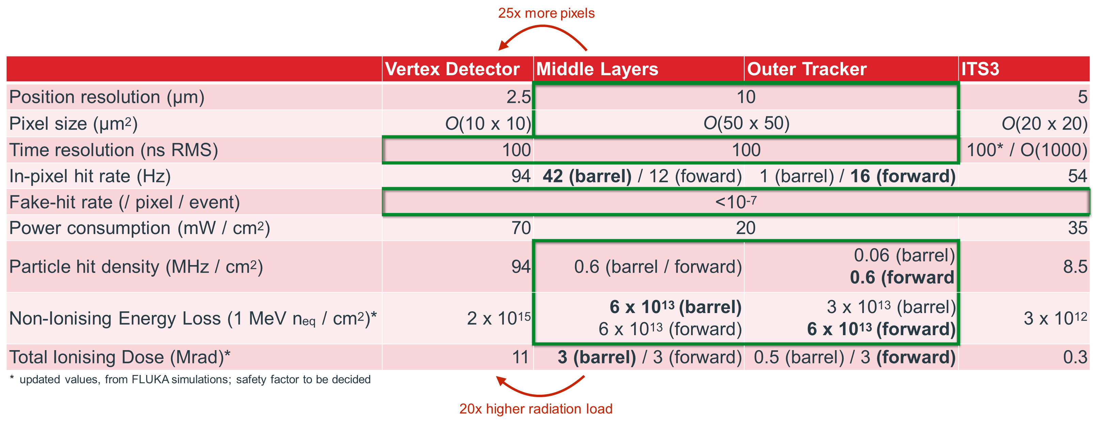
Requirements
VD and trackers need different trade off in terms of spatial resolution vs power consumption
Outer Tracker requirements driven by the forward disks ⇒ similar to Middle Layers
Flexible aggregation scheme which allows to reduce links (ML vs. OT barrel as well as small to large radii within disks)

Slide 15
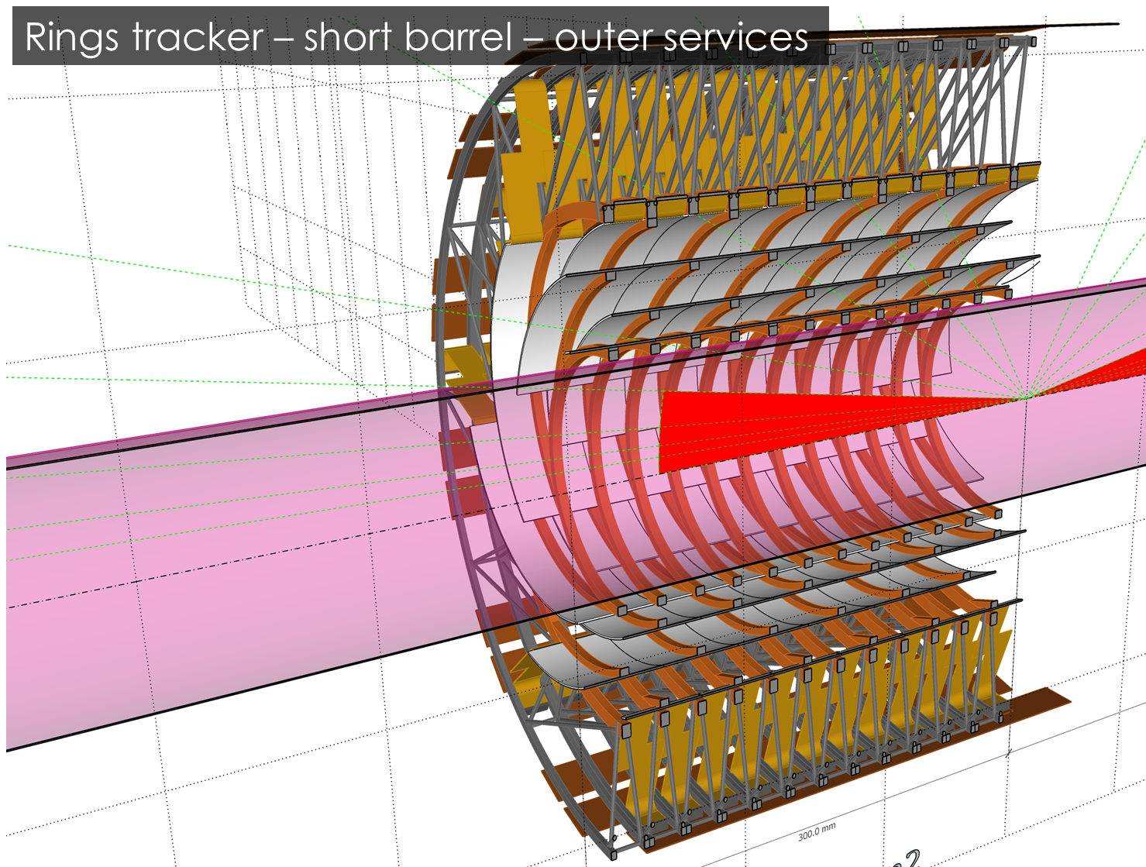
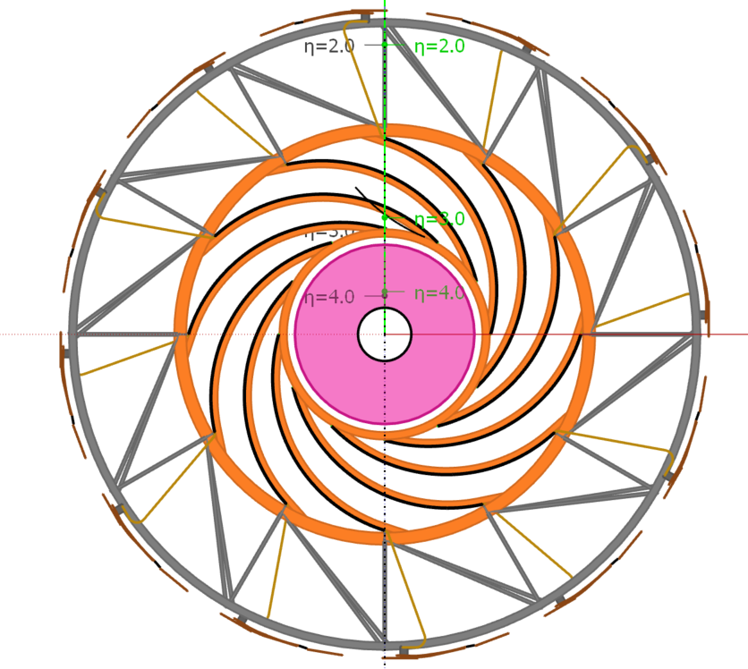
A new concept of low-material Middle Layers
Power from outer radii concept
Air-cooling “friendly” structure

Slide 16
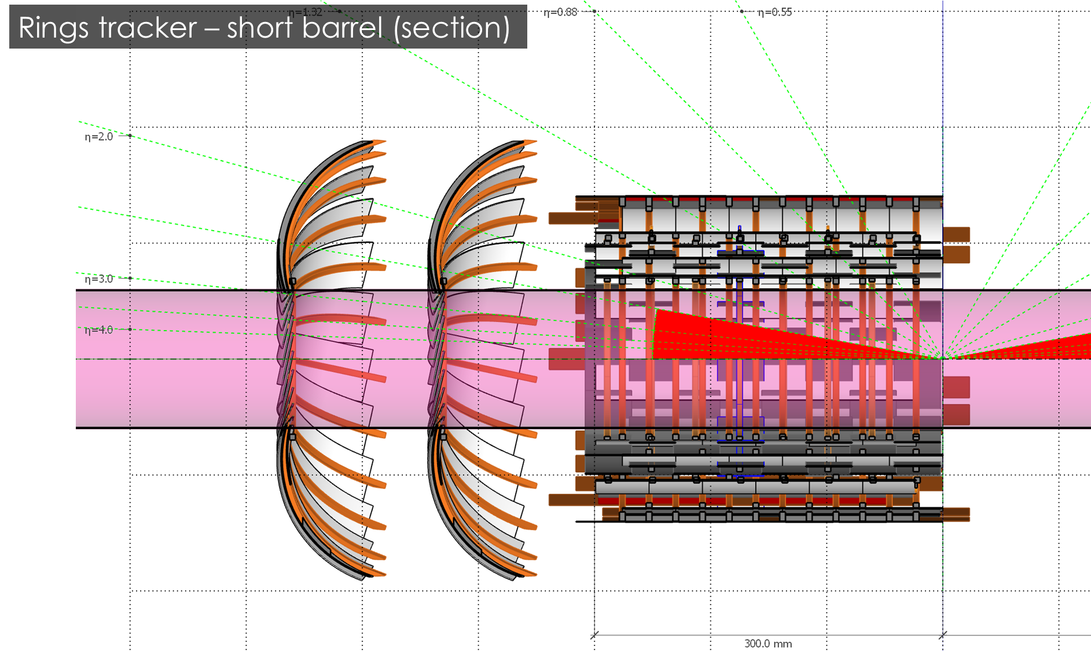
New Middle Layers concept: barrel and discs
Small disks for full coverage → SAVE SILICON!
Helps in routing services, increase room for air-cooling

Slide 17
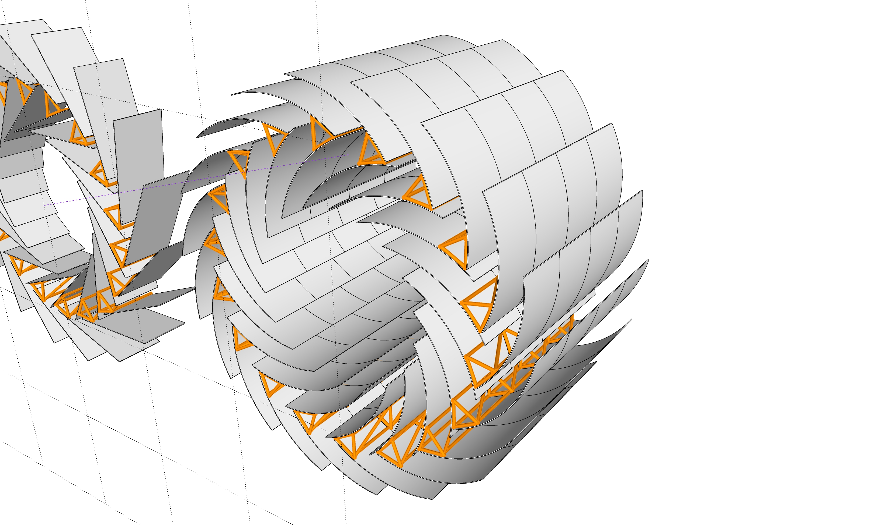
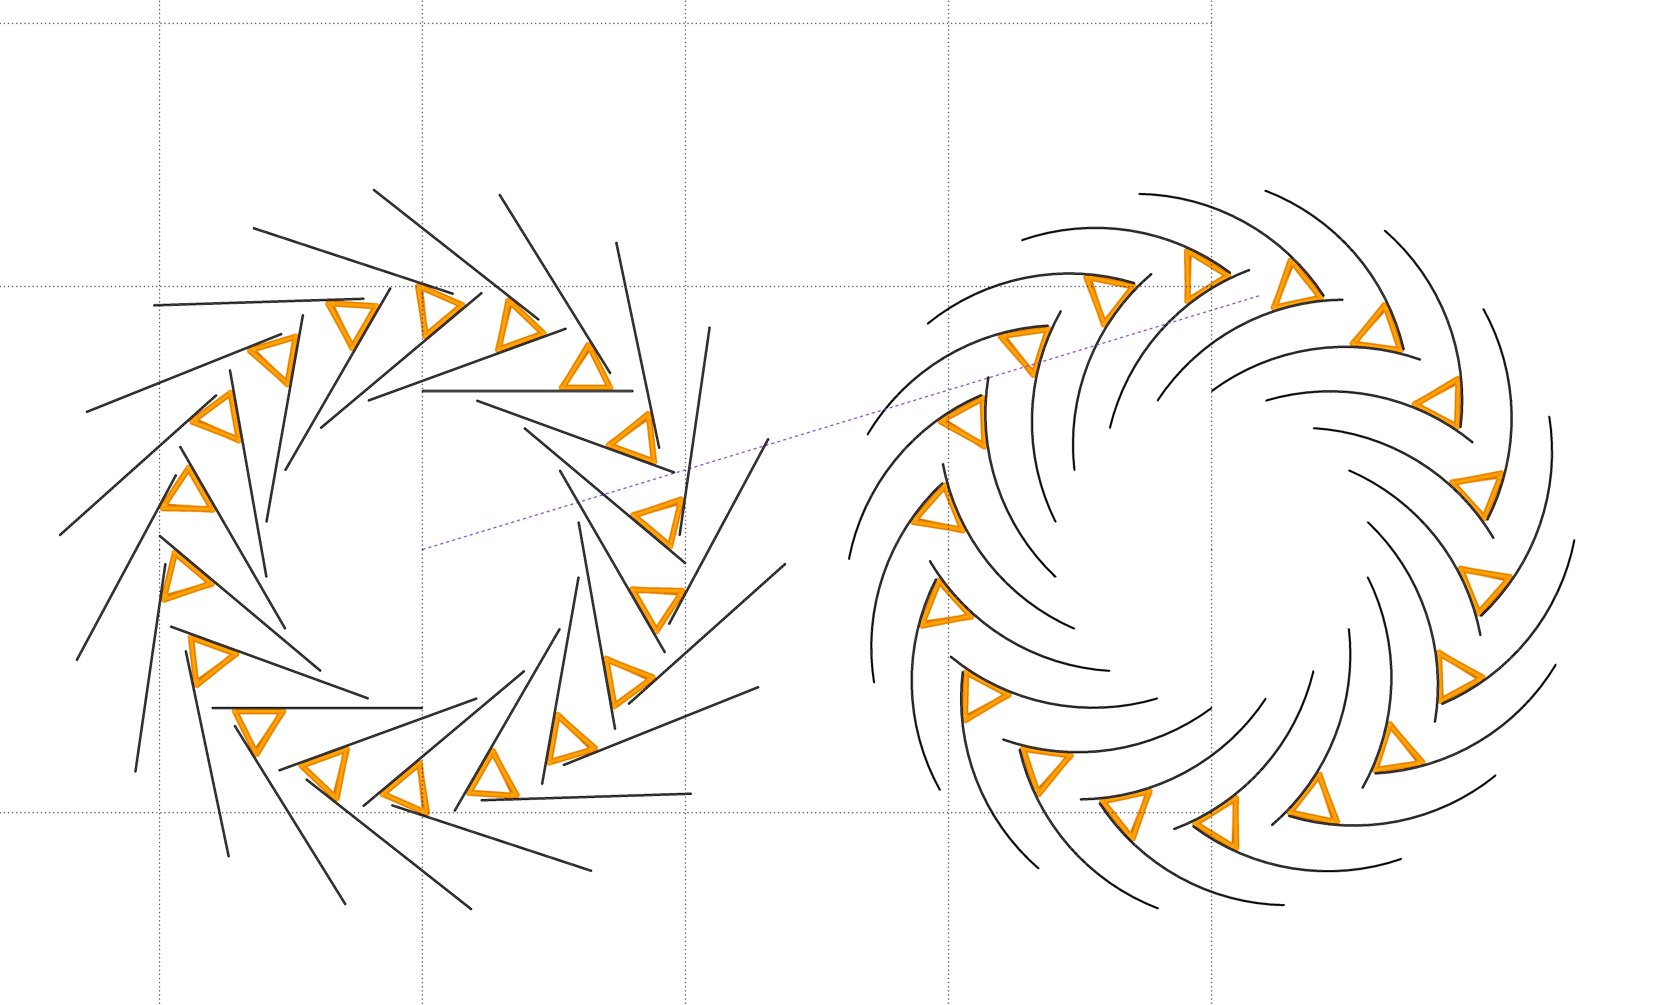
Further novelties being investigated…
Chevron geometry to improve hermeticity
More traditional stave approach

Slide 18
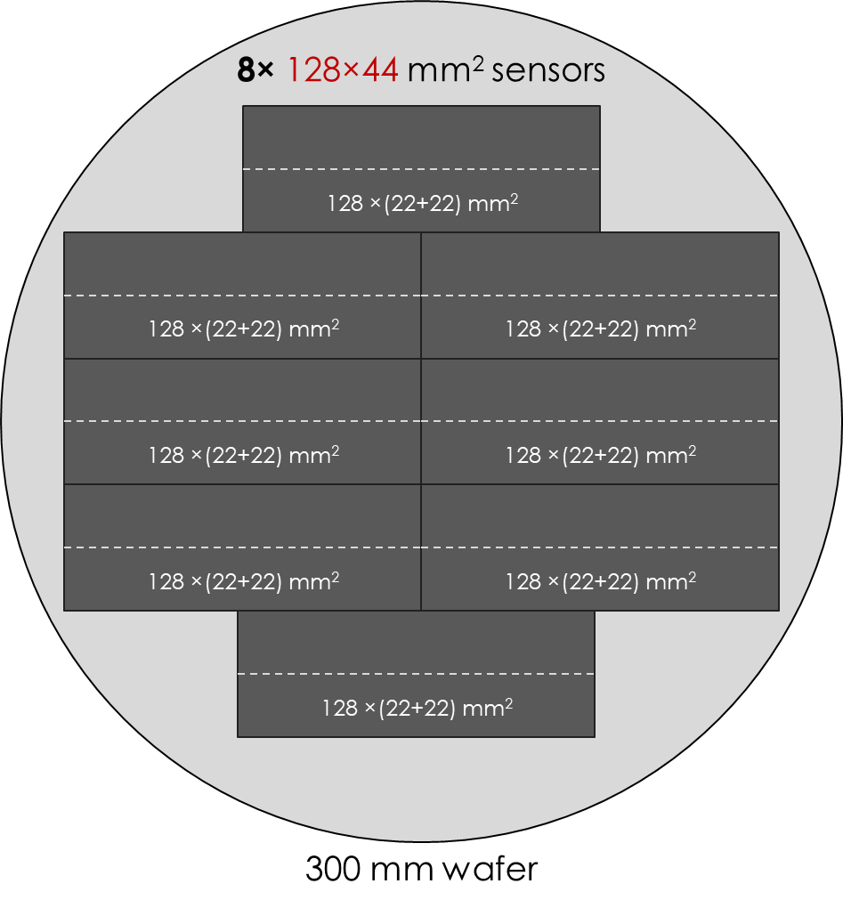
New concept(s): wafer and sensor quantities
About 80 wafers for the entire 3 layers here discussed
Yet very tentative, STRONG dependence on sensor design
Sensor size limited to 3 reticle sizes (108 mm)
Sensors are far from being defined: architecture, size, usage to be discussed and developed depending o the whole detector concept
Configuration (3 layers) | [cm²] | Sensors | Sns/Wfr | Yield | Wfrs
Long barrel, ALPIDE-like sensors | 25,200 | 4,200 | 64 | 80% | 80
Short barrel, flex sensors (needs disks) | 11,000 | 110 | 4 | 35% | 75
Short barrel (≅60 cm) | 10,138 | 180 | 8 | 35% | 65
Disks (4x) – blade version | 6,758 | 120 | 8 | 35% | 43

Slide 19
Outlook – ITS3 as step toward ALICE3
ALICE INFN groups are targeting both ITS3 and ALICE3, lesson learnt:
Stitching works, yet
Powering is an issue (as expected)
Single-sided sensors likely limited to about 10 cm max. length
65nm DMAPS sensors the likely choice for ALICE3 tracker sensors
Possibly a “limited” stitching works (e.g. 3 reticles) to improve yield
Innovative tracker geometry to simplify production and assembly
Target 10 mW/cm⁻² @ 10 MHz cm⁻² power consumption
Minimal material budget
Several groups already involved in this synergetic approach:
Cagliari, Torino, Bari, Padova, Trieste
Crucial aspects like services routing, cooling, power delivery and material budget will be carefully studied as next step

Slide 20
Backup

Slide 21
ALICE 3 Tracker sensor development plan
Bundle resources for the ALICE developments
=> common development that can serve both Vertex Detector (VD) and Trackers (ML/OT)
Common development resulting in two specifically optimised sensors for VD and ML/OT
  Matrix readout that can be scaled to meet different pixel pitches and occupancies
  Pixel matrix that can be adapted to different pitches allowing to optimise power consumption, spatial resolution and fake-hit rate
Versatile development targeting specifically ALICE needs
=> only viable path converging given the limited resources and very challenging timeline
Versatile approach makes development a good starting point for other applications

Slide 22
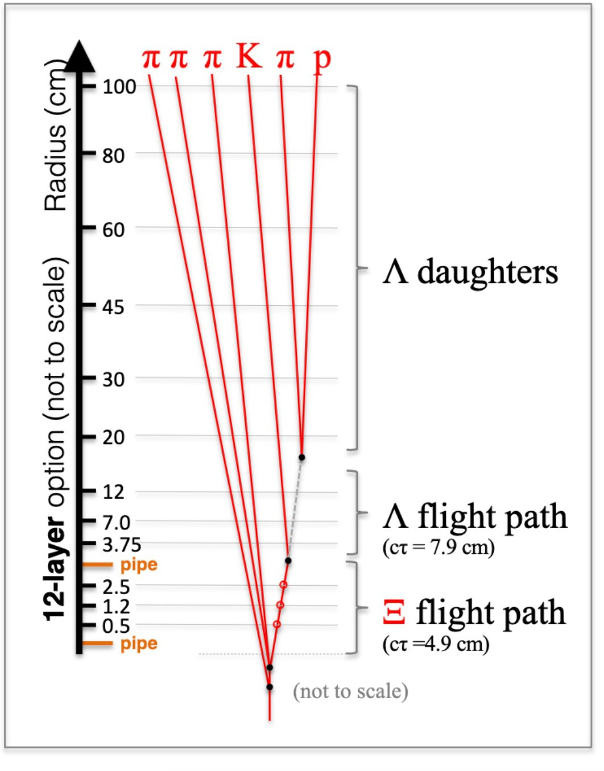
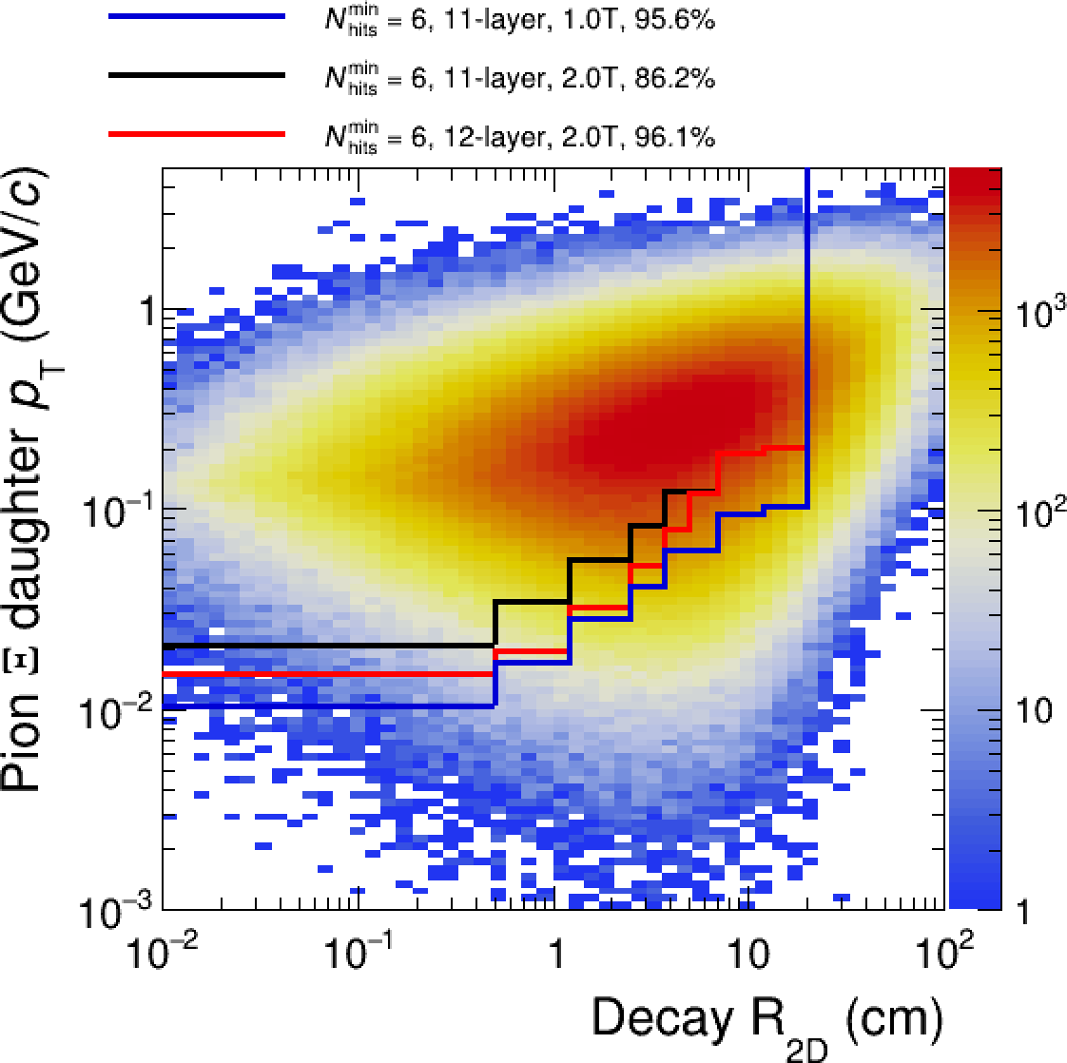
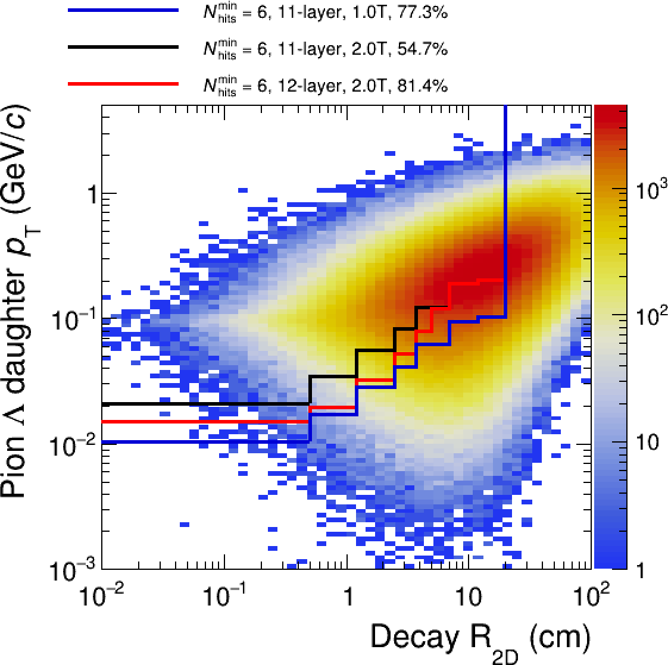
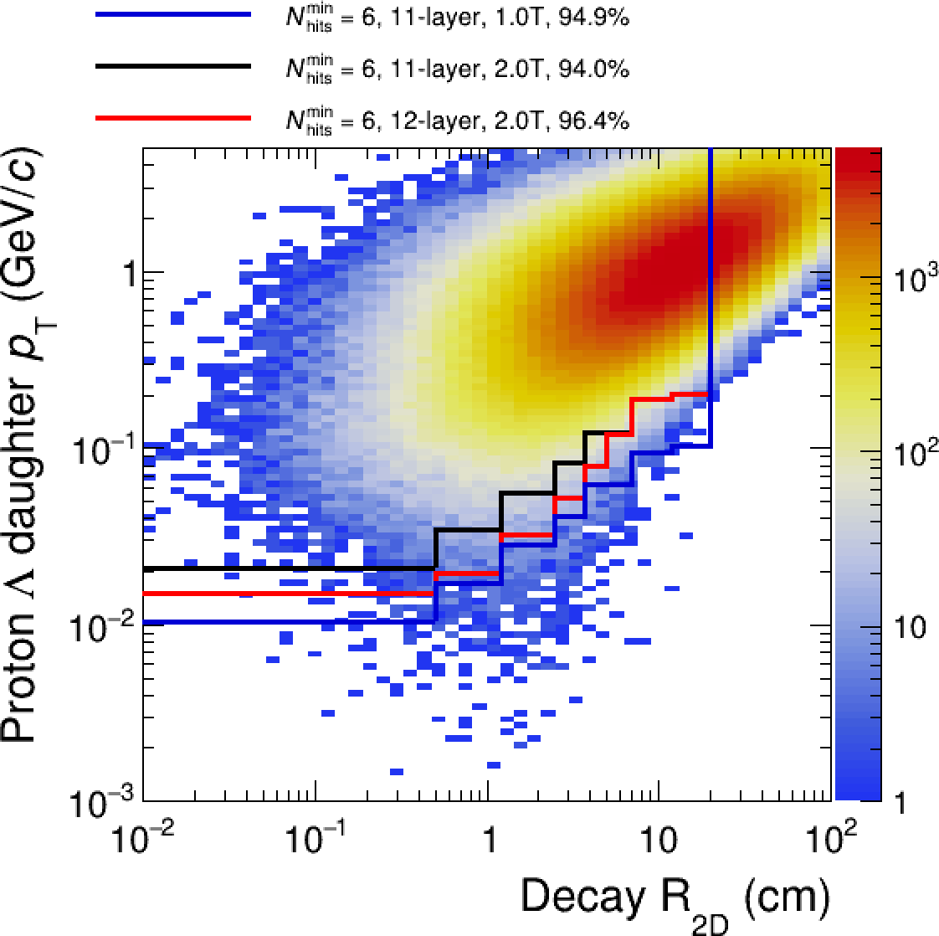
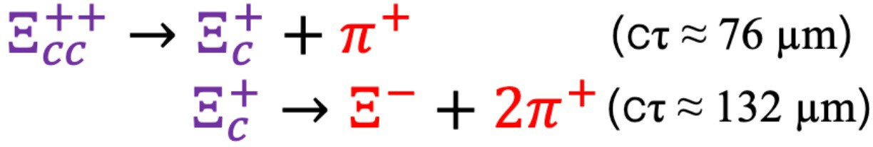
Impact of Bent Middle Layers (3-4) – first look /2
Multi-charmed baryons (Xi_{cc}, Ω_{cc}, …) through products’ Strangeness Tracking
  Pion from Xi and Pion+Proton from Lambda produced outside VD
  ML crucial as secondary vertex detector
    ML radius optimization to enhance Xi_{cc} acceptance is ongoing
    (David Chinellato)

Slide 23
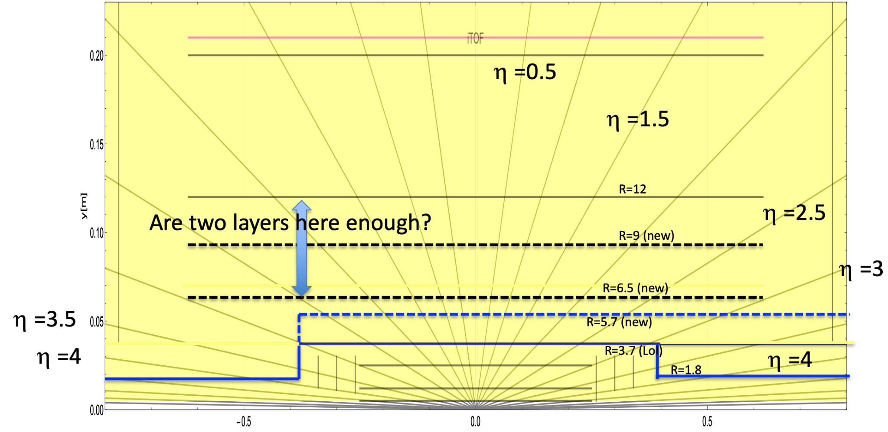
Updated envelope for ML (Feb 2024)

Slide 24
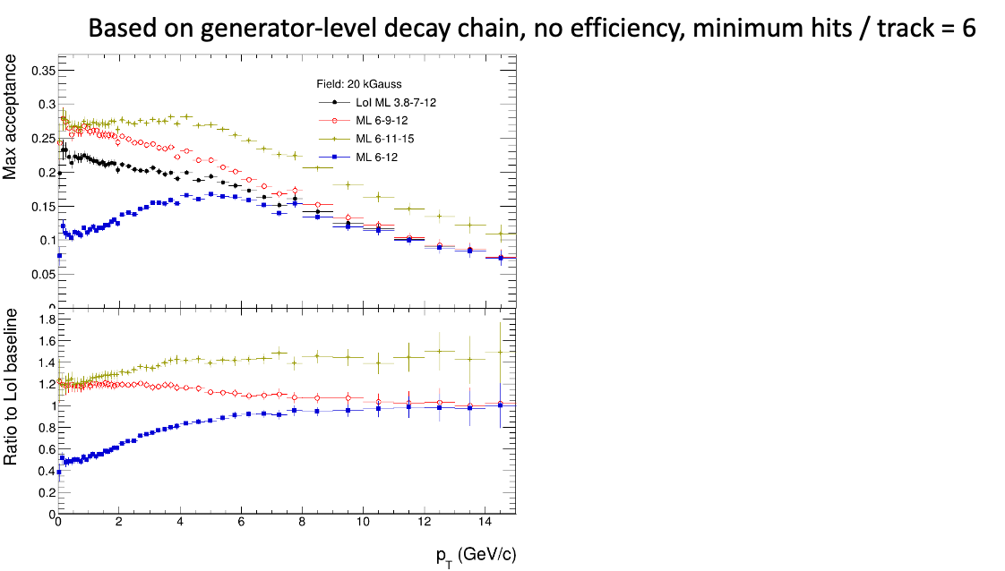
Two or three layers at 6.5<R<12 cm? → Three
With 2 layers only (R = 6 and 12 cm), the acceptance for 𝛯_{cc} drops by 50% at low p_{T}
With larger radii (R = 6, 11, 15 cm), the acceptance for 𝛯_{cc} increases by 50% at high p_{T}
David Chinellato

Slide 25
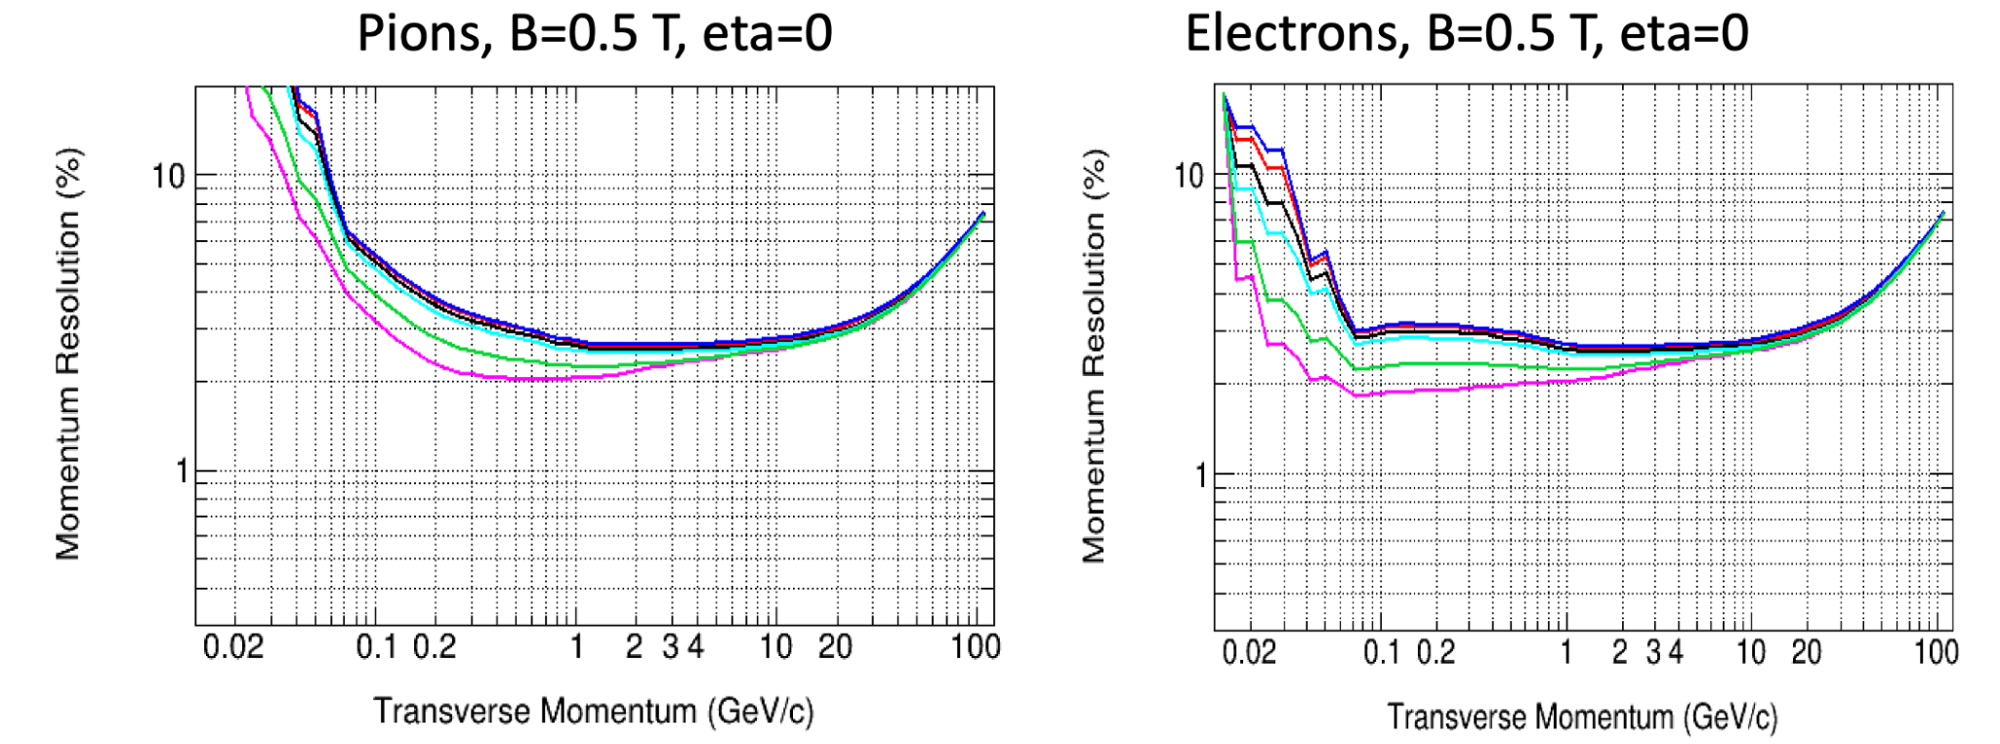
Impact of “ultralight” ML layers: p_{T} resolution
Low-p_{T} electrons and pions (B=0.5T, η = 0)
L3 (6.5cm), L4 (9cm), L5 (12cm) material budget: x/X₀= 0.05, 0.1, 0.3, 0.5, 1, 1.5%
  Relevant impact on momentum resolution for p_{T} < 200 MeV/c

Slide 26

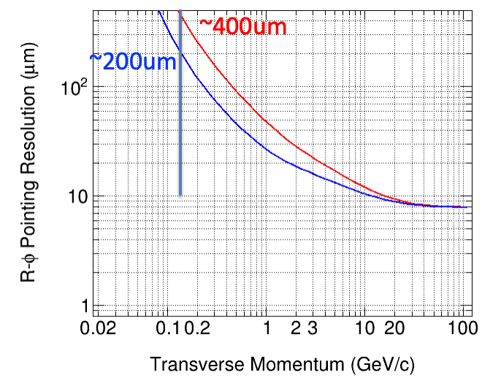
Impact of ultralight ML layers: strangeness tracking
Pointing resolution at L2 (R=2.5 cm)
  Pions from Xi
  Tracking w/o Vertex Detector
x/X₀ = 0.1 % on L3 and L4 improves pointing resolution at L2 by a factor ~2x @ 150 MeV/c

Slide 27
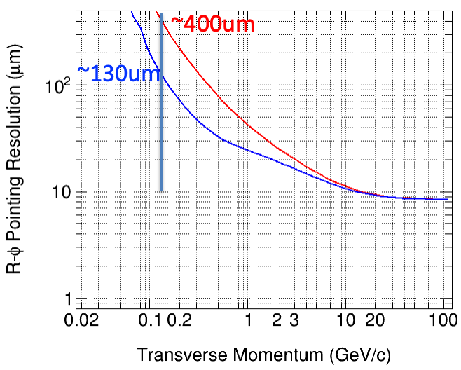
Impact of ultralight ML layers: strangeness tracking
Pointing resolution at L3 (R=6.5 cm)
  Pions from Xi
  Tracking w/o Vertex Detector
x/X₀ = 0.1 % on L4 and L5 improves pointing resolution at L3 by a factor ~3x @ 150 MeV/c

Slide 28
Strangeness Tracking: track-to-hit association on L2 or L3
Bachelor from Xi decay to be associated to the hit of Xi on L2 (R=2.5cm) [or L3 (R=6.5cm)]
  Simplified cases in which the Xi decays between L2 and L3 (or between L3 and L4)
The precision of the bachelor track determines the search area on L2 (or L3) = e.g. π (5 σ)²
The size of the search area is compared with the hit density in L2 (or L3) in central Pb-Pb (projected from ITS3 TDR)
 | Track-to-hit on L2 (baseline layout ML) | Track-to-hit on L2 (ultra-light ML) | Track-to-hit on L3 (baseline layout ML) | Track-to-hit on L3 (ultralight ML)
x/X0 | 1 % | 0.1 % | 1 % | 0.1 %
σ_{R−φ} [μm] @ p_{T} = 150 MeV/c | 400 | 200 | 400 | 130
Search area [mm²] | 12 | 3 | 12 | 1.5
Hit density [cm⁻²] @ matching layer in central Pb-Pb | 100 | 100 | 15 | 15
Hits in search road | 12 | 3 | 1.8 | 0.2

Slide 29
Low material Middle layers: L3-L4-L5
Still concept and investigation phase
  Medium size sensors with minimal supports
    Stitched sensor (about 4 × 8-12-16 cm²)
    Low power (≤ 20 mW cm⁻²), air cooling
    Wheels with blades (instead of staves) configuration
    Outer radii power bus and data links
    Power and data routed at R ≅18-20 cm (easier power density)
    Power/data routed radially toward/from the sensor modules
    Small disks
    Disks use the very same sensor module of the barrel
    Short barrel to simplify power and data delivery
    Small disks to ensure eta coverage
    Bent disks increase available service room

Slide 30
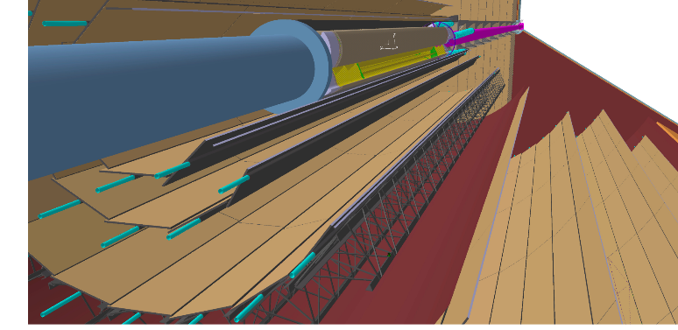
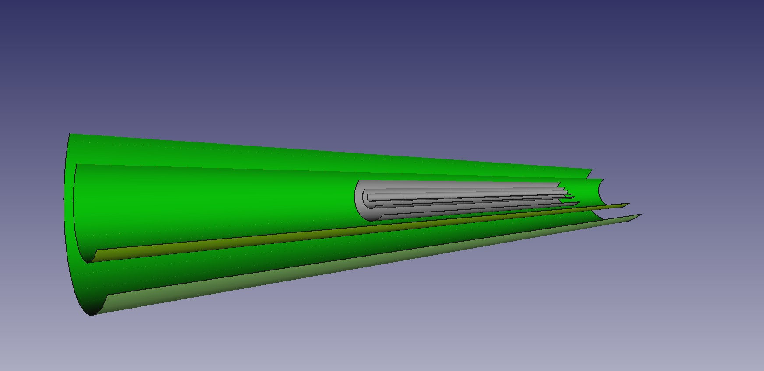
Options for Middle layers: L3-L4
Presented @ AUW’23 in Torino
LoI concept
  Traditional stave-based layout
    Same sensor as larger radius layers
    Mechanics, liquid cooling, interconnection bus
    1% X₀ for normal incidence
    Length = 124 cm
    Serial powering
    Coverage (L4): |𝜂| < 2.9
Possible optimised layout for L3-L4
  Flexible sensors with minimal supports
    Stitched sensor
    Added supports and I/O structures to cover the length
    0.1% X₀ for normal incidence
    Length = 100 cm (2x vertex layer length)
    Coverage (L4): |𝜂| < 2.7
Middle Layer layout - LoI concept
Middle Layer layout – Optimised layout

Slide 31
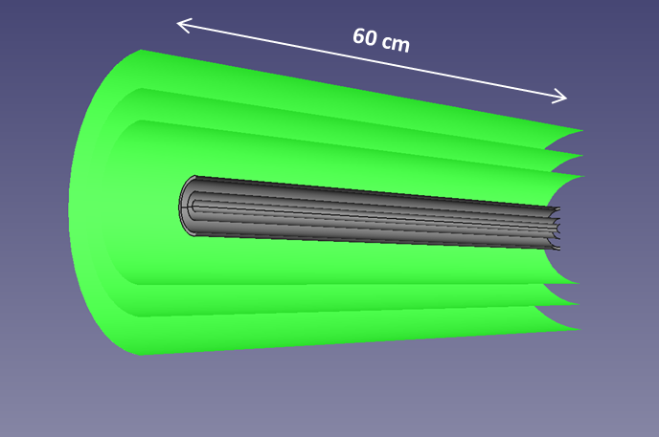
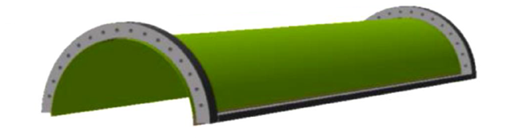
Bent ML: updated layout
100 cm
Layout update
2 layers
Radii: 3.8 cm, 7 cm
Length: 100 cm
Area: ~ 0.7 m²
ITS3-like approach with increased segmentation
3 layers
Radii: ~6.5, ~9, ~12 cm
Length: 60 cm
Area: ~ 1.1 m²

Slide 32
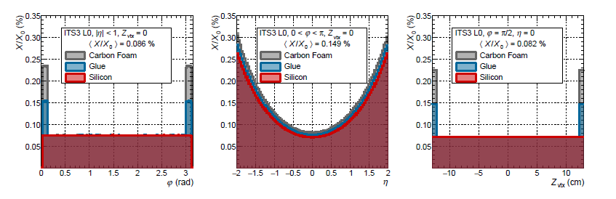
Low material Middle layers: L3-L4-L5
For reference: this is ITS3 L0 (6 cm x 25 cm)
The segmentation would need to be ported to 10 cm x 10 cm to consider the Half Rings and Longerons location
plus the routing of the services to be still developed-> goal is to achieve 0.1 on average.

Slide 33
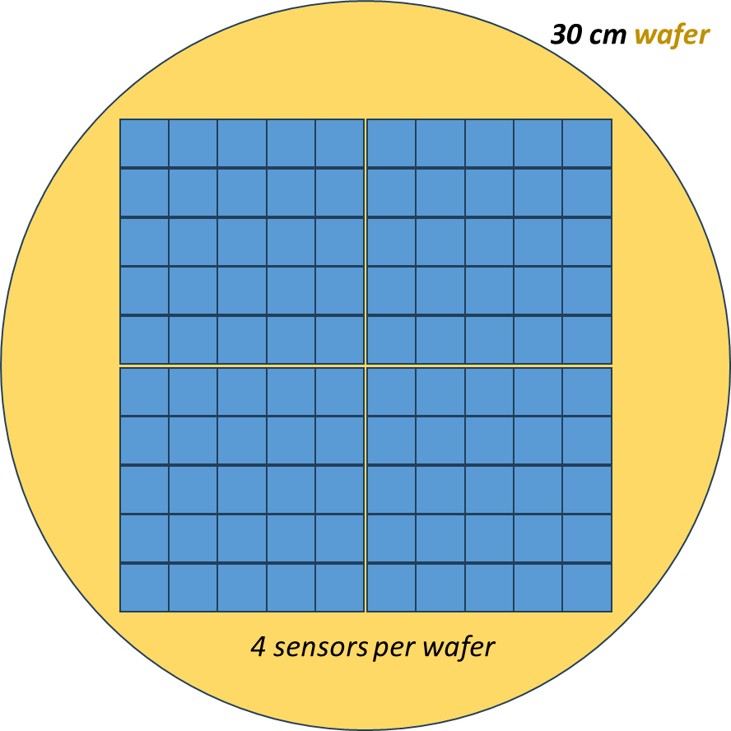
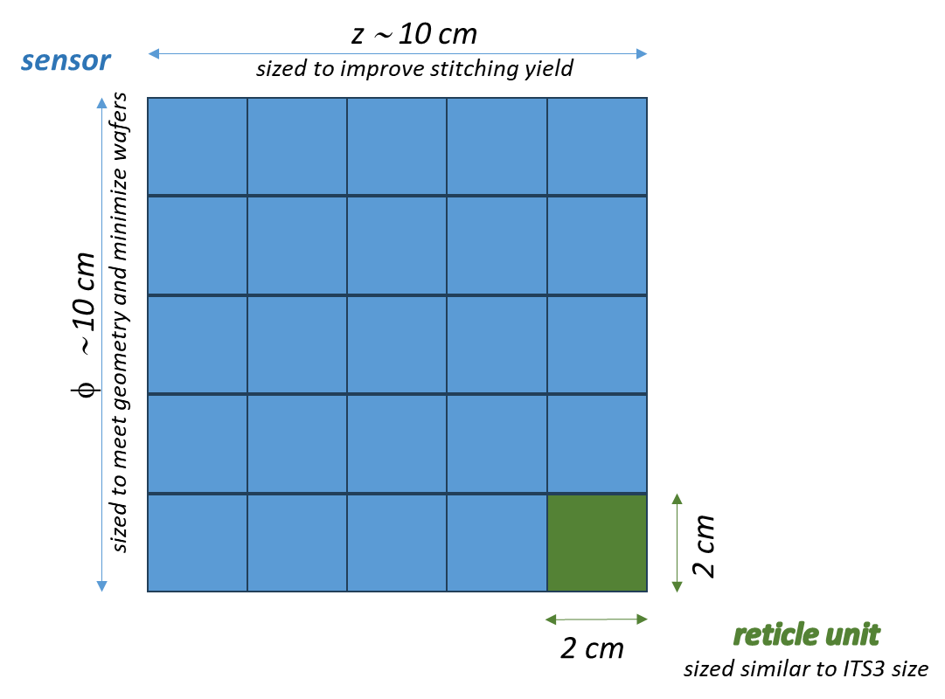
Bent option: tentative sensor segmentation
~110 sensors to cover ~1.1 m2 barrel area
~75 wafers (yield-corrected)
dimensions to be optimized

Slide 34
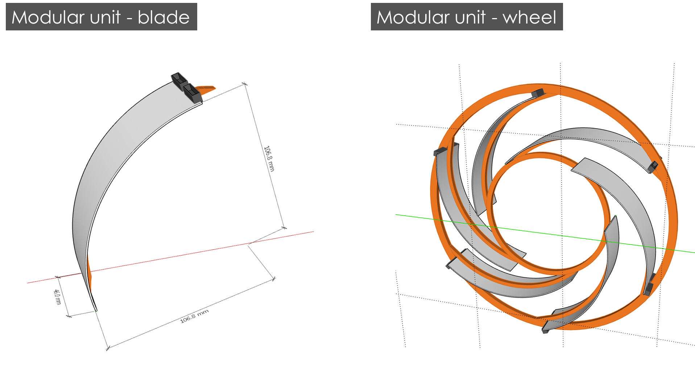
New Middle Layer concept: blade and wheel

Slide 35
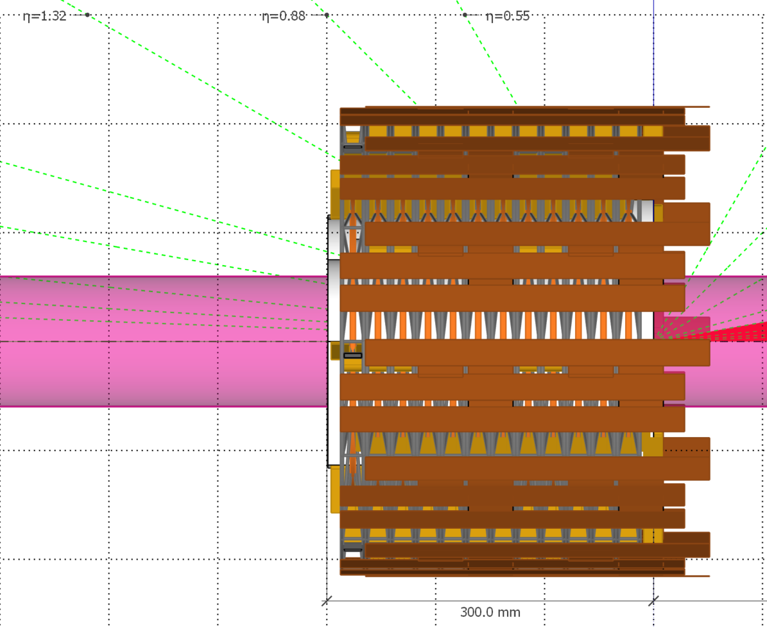
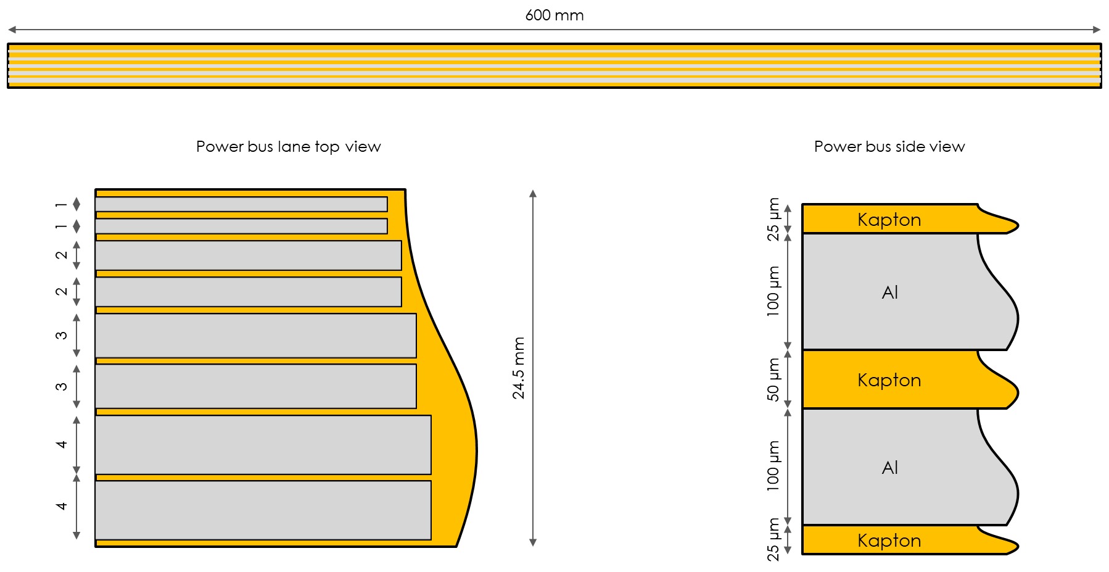
New Middle Layers concept: services routing
Power bus studied for PARALLEL powering (so far)
SERIAL powering will further reduce material (to do)

