Slide 1
Silicon detectors per idea
Attilio Andreazza e Fabrizio Palla
Torino 22 Aprile 2024

Slide 2
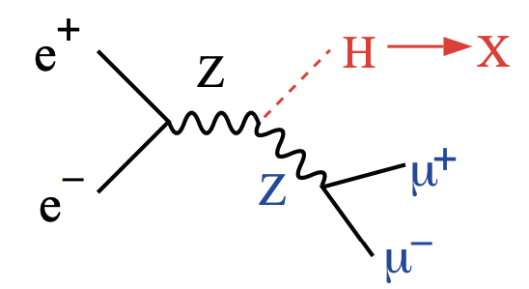
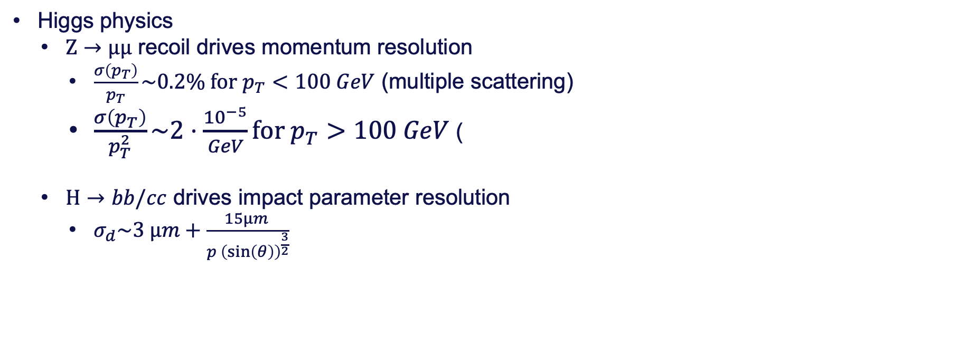
Physics requirements drive
Higgs physics
  $Z→µµ$ recoil drives momentum resolution
    $\frac{σ\left(p_{T}\right)}{p_{T}}\sim 0.2\% for p_{T}<100 GeV$ (multiple scattering)
    $\frac{σ\left(p_{T}\right)}{p_{T}^{2}}\sim 2⋅\frac{{10}^{−5}}{GeV}for p_{T}>100 GeV$ (
  $H→bb/cc$ drives impact parameter resolution
    $σ_{d}\sim 3 µm+\frac{15µm }{p {\left(\sin\left(θ\right)\right)}^{\frac{3}{2}}}$
Z physics drives occupancy and rate capabilities

Slide 3
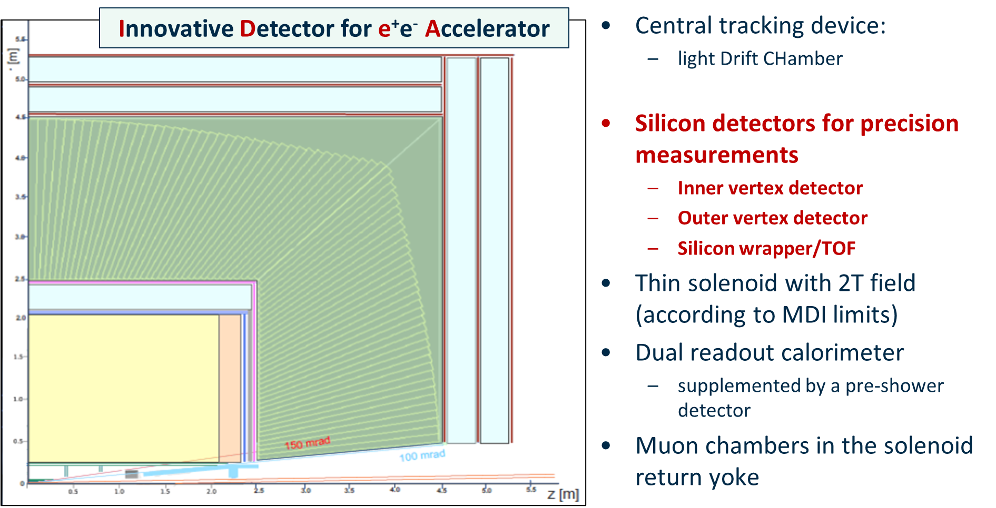

Slide 4
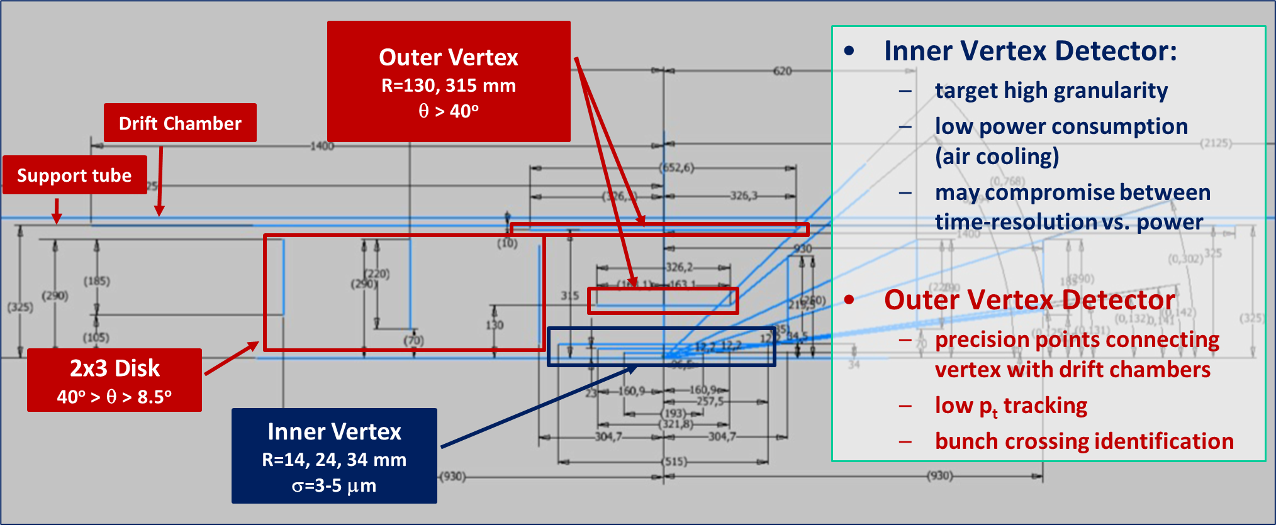

Slide 5
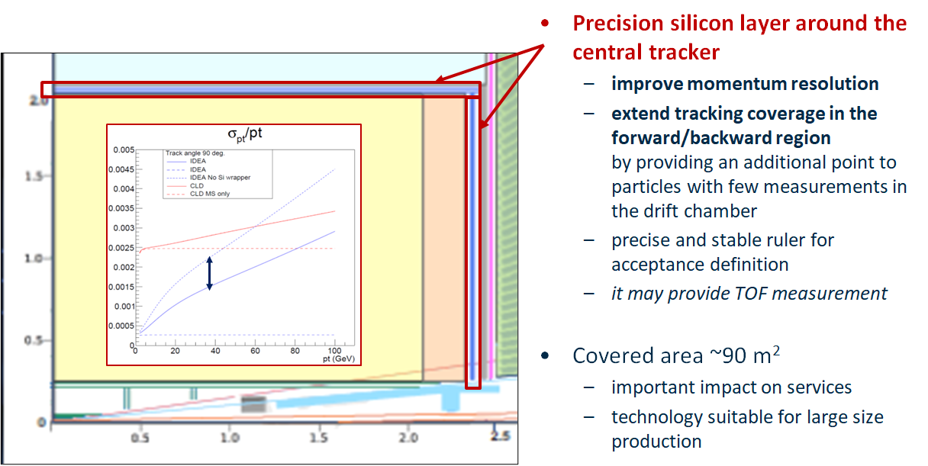

Slide 6
Specifiche vertex detector
Attilio Andreazza e Fabrizio Palla
Torino 22 Aprile 2024

Slide 7
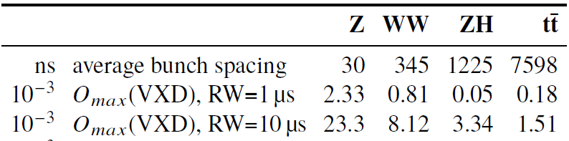
Backgrounds from machine – beamsstrahlung main one
Z
CLD
Courtesy: Andrea Ciarma, INFN-LNF

Slide 8
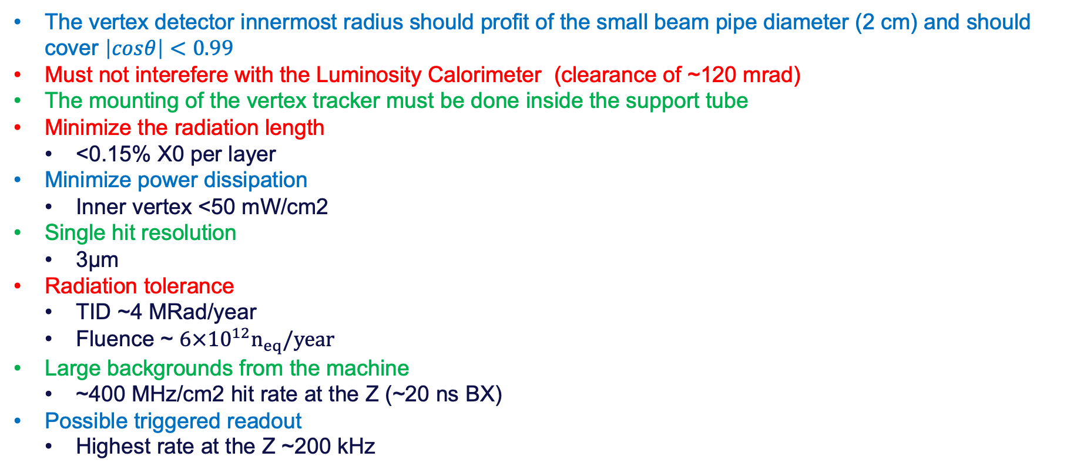
Requirements for inner and outer vertex detector
  The vertex detector innermost radius should profit of the small beam pipe diameter (2 cm) and should cover $\left|cosθ\right|<0.99$
  Must not interefere with the Luminosity Calorimeter (clearance of ~120 mrad)
  The mounting of the vertex tracker must be done inside the support tube
  Minimize the radiation length
    <0.15% X0 per layer
  Minimize power dissipation
    Inner vertex <50 mW/cm2
  Single hit resolution
    3µm
  Radiation tolerance
    TID ~4 MRad/year
    Fluence ~ $6×{10}^{12}n_{eq}/year$
  Large backgrounds from the machine
    ~400 MHz/cm2 hit rate at the Z (~20 ns BX)
  Possible triggered readout
    Highest rate at the Z ~200 kHz

Slide 9
Data rates issues (see F. Bedeschi talk at 7th FCC Workshop)
Largest data rates occur at the Z energy
Expected data rates per BX/module [cluster size 5]
    From machine backgrounds (Incoherent pair creation – safety factor of 3) ~ 19 hits/BX/module
    From collisions (200 kHz) ~ average ~<1 hit/BX/module
Inner layer ~400 MHz/cm² → ~25 Gb/s per module
  might be reduced if cluster size is only 2 – as measured for many MAPS
  ALICE3 hit rate ~100 MHz/cm² (pixel size 10µm x 10µm)
  2nd layer ~10x less data volume
Triggered readout: for 200 kHz the data bandwidth per module, rate is only 150 Mb/s
  Impact on physics?
All these depend on pixel pitch, thickness, R/O architecture, bias voltage.
  For a review see M. Winter talk at March 11 meeting

Slide 10
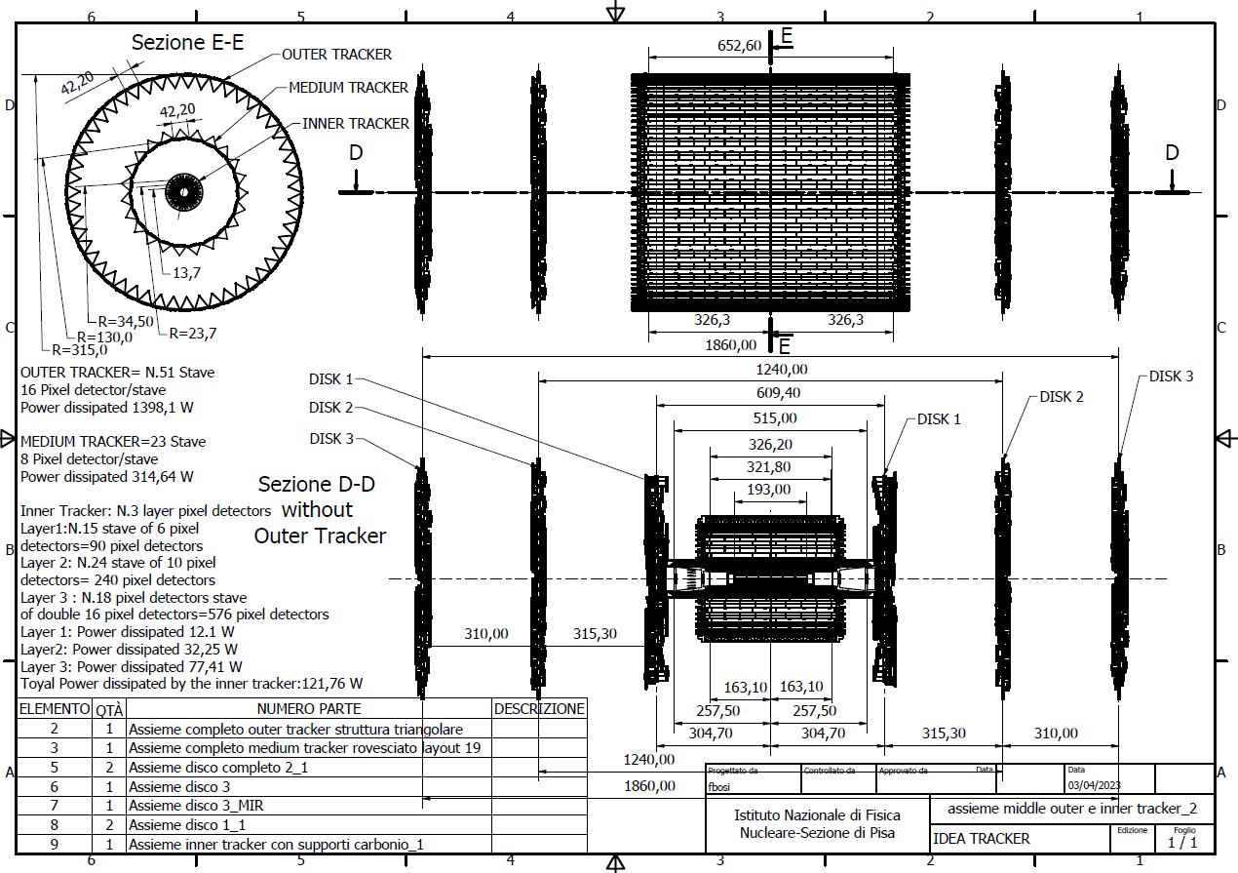
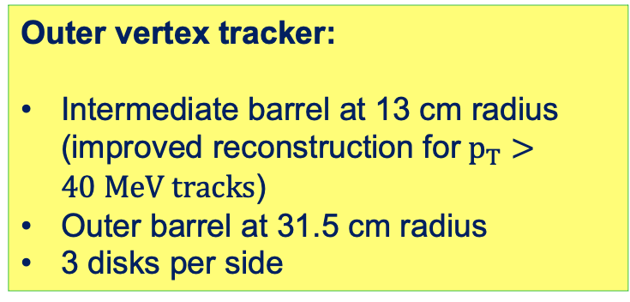
Mid-term feasibility study vertex detector layout
(aka “state of the art”)
(IDEA Detector Concept)
Outer vertex tracker:
Intermediate barrel at 13 cm radius (improved reconstruction for$p_{T}>40 MeV tracks$)
Outer barrel at 31.5 cm radius
3 disks per side
Inner Vertex detector:
3 barrel layers at
13.7, 22.7 and 34.8 mm radius

Slide 11
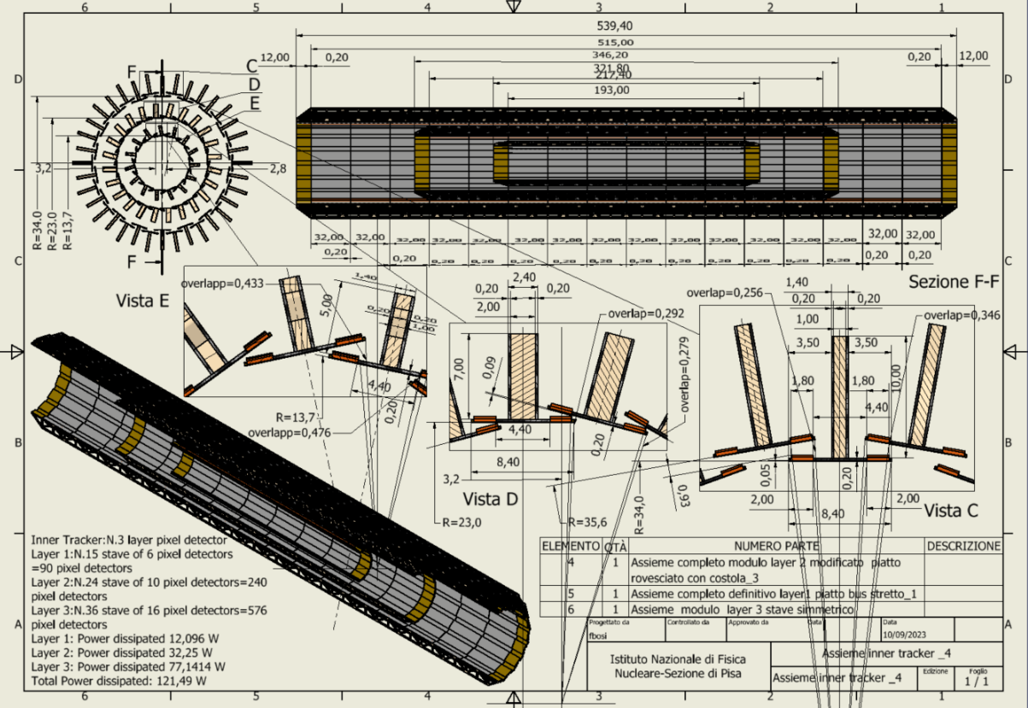
Inner vertex detector
Total thickness per layer ~0.25% X/X0​
Carbon Fibre ~60 %​
Silicon: ~20%​
Power and readout bus: ~20%
Layer # | Radius [mm] | No staves | No modules /stave | Total Length [mm] | Active Area [cm²] | Power [W]
1 | 13.7 | 15 | 6 | 217.40 | 241.92 | 12
2 | 23.7 | 24 | 10 | 346.20 | 645.12 | 32
3 | 34 & 35.60 | 36 | 16 | 539.40 | 1548.29 | 77

Slide 12
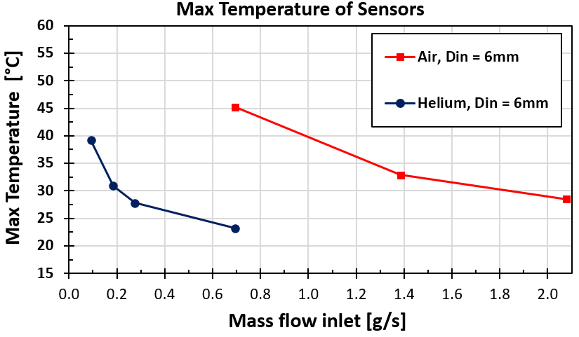
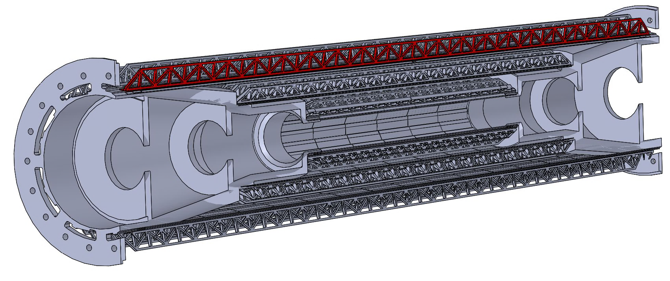
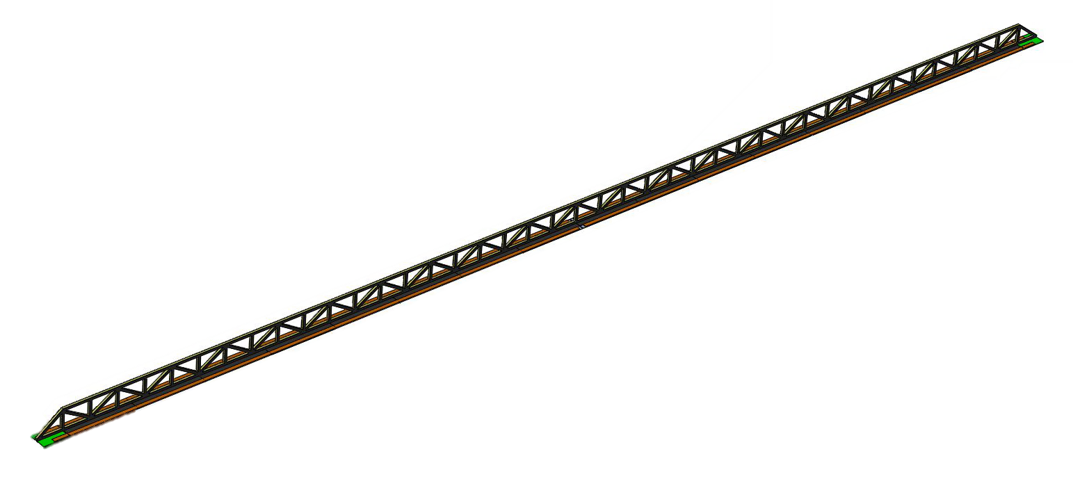
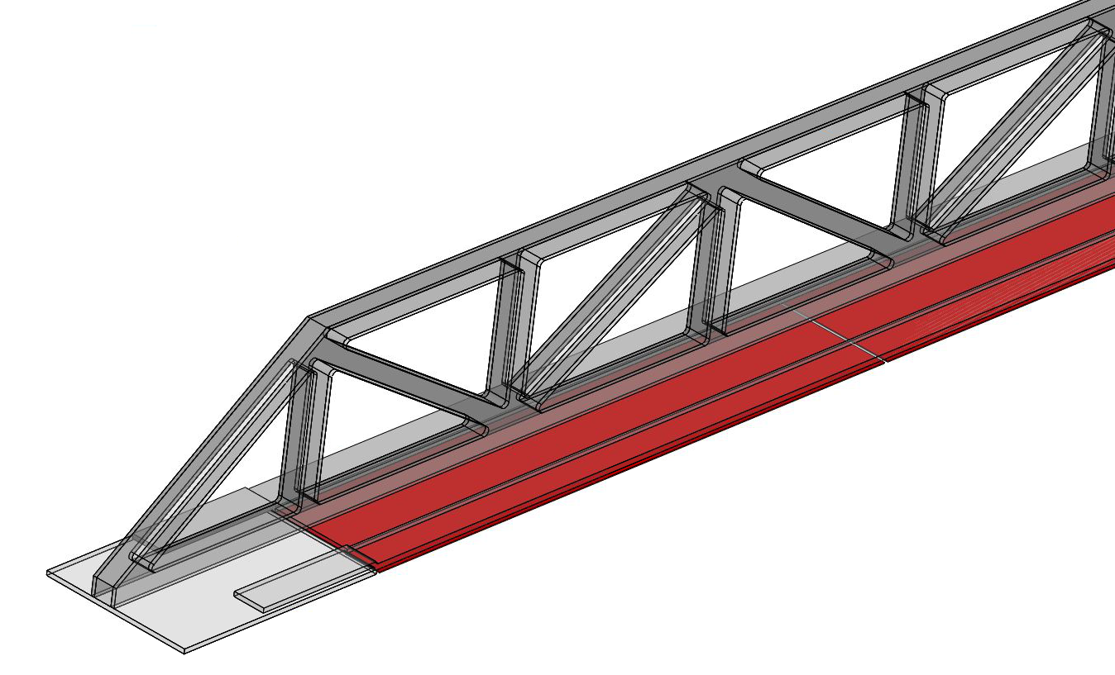
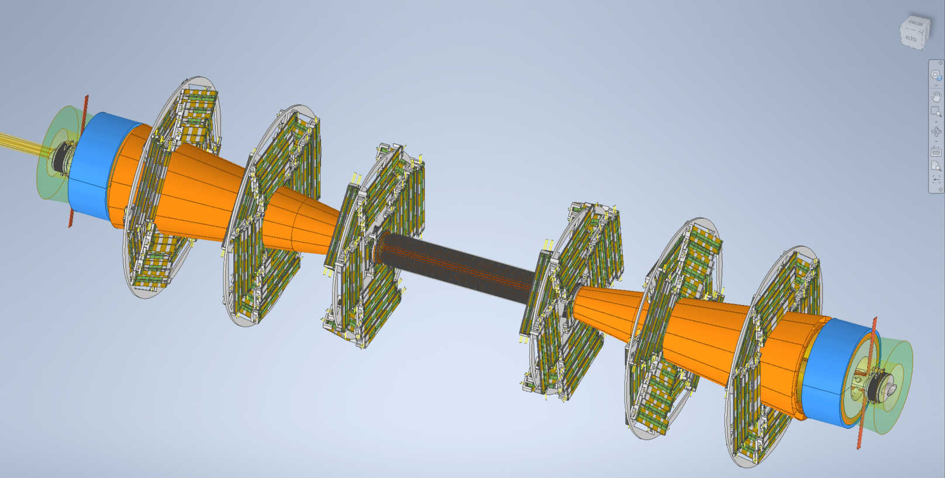
Air cooling (simulations)
Air outlets
Air inlets
Air flow
Disk 3
Disk 2
Cooling with air/He flow along the detector.
  Air temperature: T_{air} = 15°C
  Max sensor temp on layer 3 (hottest one) ~25/30 ºC with He/Air.
  Vibrations studies ongoing
Disk 1
Inner Tracker

Slide 13
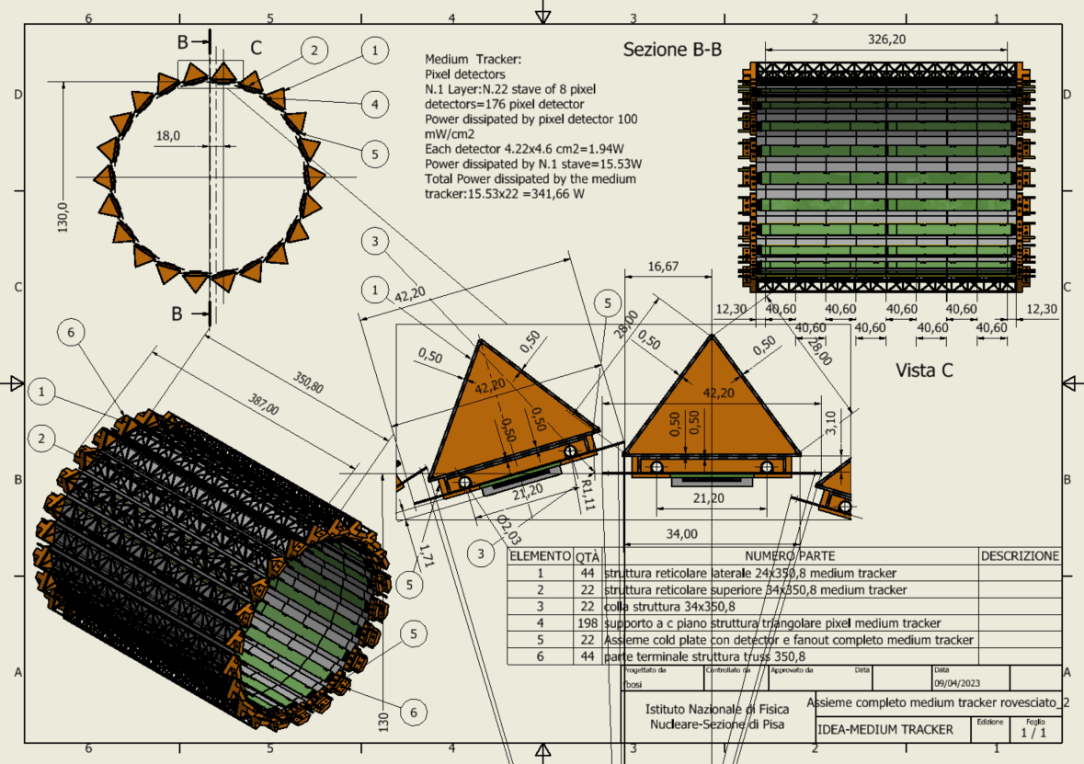
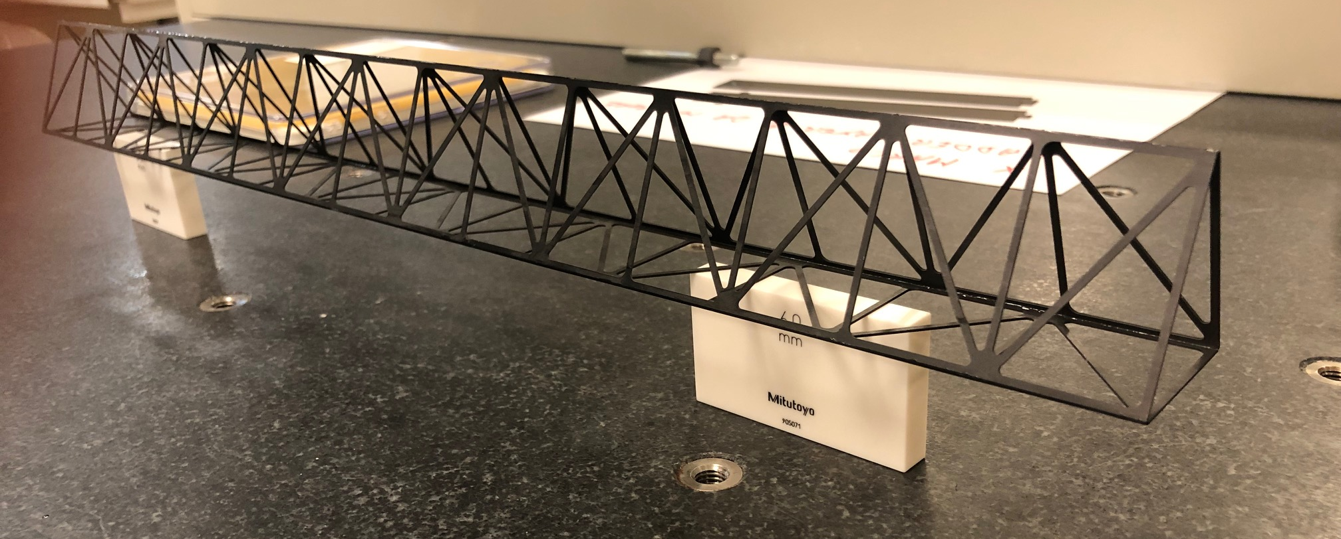
Middle Barrel
At 13 cm radius
22 staves of 8 modules each.
Lightweight reticular support structure (ALICE/Belle-II like)
Readout chips either side
Power budget
~342 W
Total weight ~1 kg
Water cooled (2 pipes of 2 mm diameter)
Similar prototype
built @ Pisa
Outer barrel is similar but longer (see backup)

Slide 14
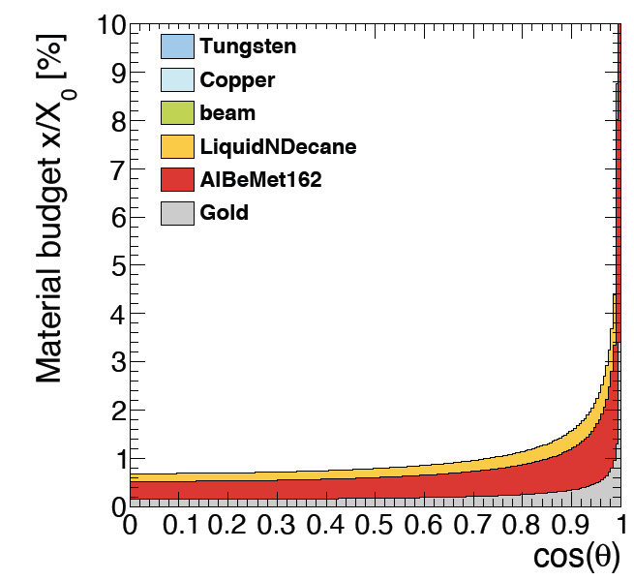
Simulated material budget
In agreement with CAD estimates
Smaller X/X₀ wrt IDEA CDR estimates even including power and readout cables in the sensitive region
Silicon only ~15% of the total
Beam pipe
Inner Vertex only

Slide 15
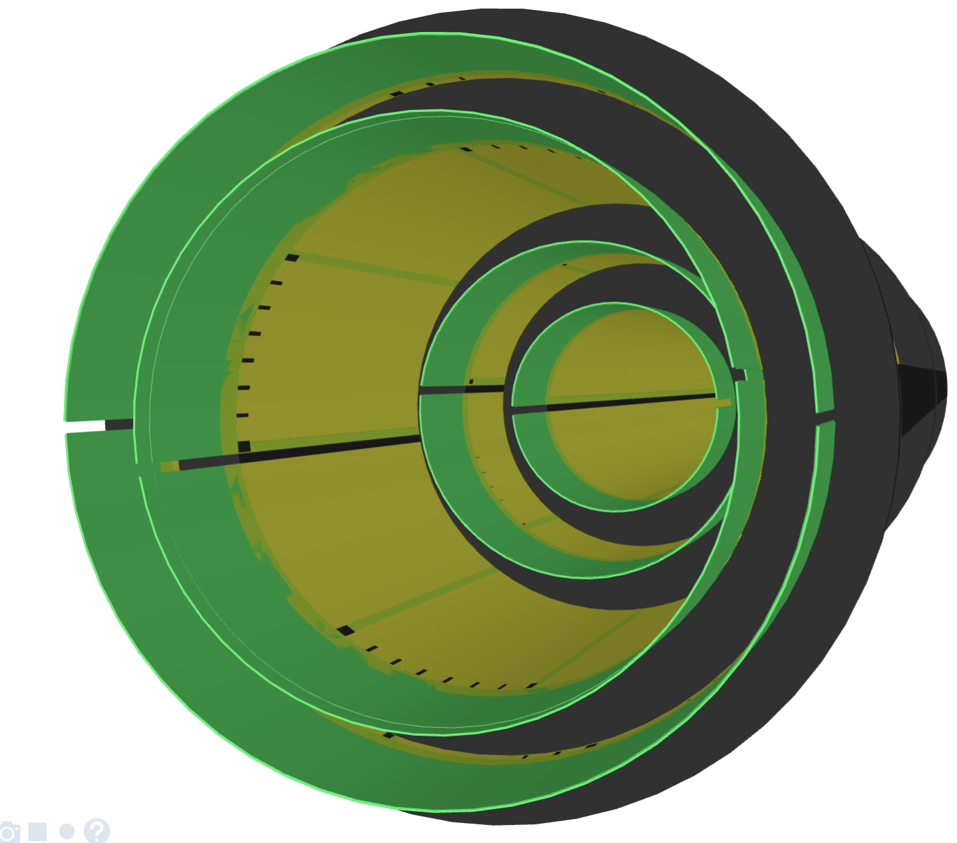
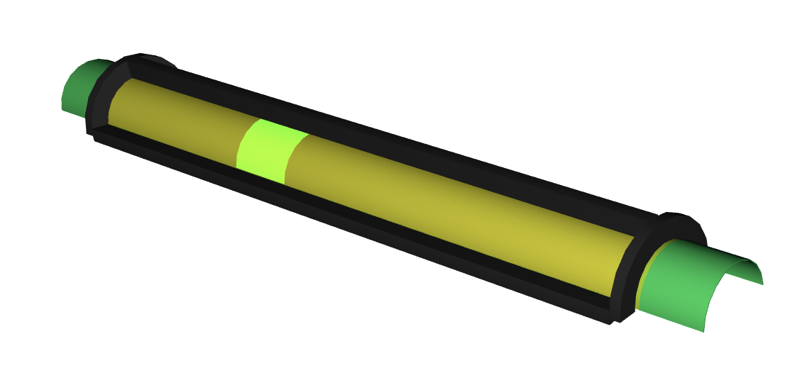
Novel approach inspired to ALICE ITS3
ongoing study in IDEA (not optimised)
Curved 50 µm thick silicon layers
4 layers @13.7, 20.23, 26.76 and 33.3 mm
Ring
Flex circuit
(power & R/O)
RSU
Longeron
216.7 mm active

Slide 16
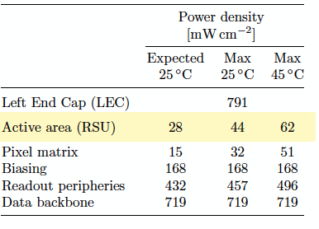
Same reticle for all layers
4.5
Layer | Radius (mm)
1 | 13.7
2 | 20.23
3 | 26.76
4 | 33.3
3
1.5
Layer 1
10x
20.52
20.52
12 x
Layer 2
Layer 3
21.666
21.666
9 x
Layer 1&2
Layer 3&4
Layer 4
Power dissipation in ITS3
(not necessarily the same for FCC-ee)
RSU~ 50 mW/cm² (depends on Temp.)
LEC ~ 700 mW/cm²
12”

Slide 17
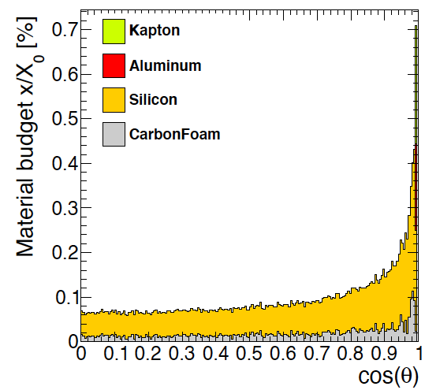
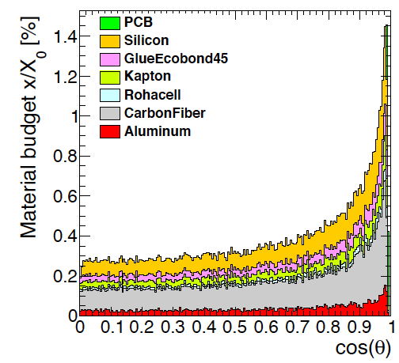
Preliminary
A. Ilg (UniZurich)
State of the art 1st layer
1st layer – curved vertex
Material budget reduction of a factor ~5
➔ m.s. term impact parameter resolution improves by more than a factor 2

Slide 18
Organizzazione di oggi
Baseline è utilizzare DMAPS per il vertex ed il silicon wrapper
  Per silicon wrapper allo studio anche RSD (sessione di domani) o "downgrade" a strip
Le sfide sono principalmente a livello di sistema, più che di sensore:
  Stitching
  Routing delle alimentazioni su grandi aree
  Data flow: chip-to-chip or array-to-array data transmission
  Readout architecture: triggered or data-push, frames, column drain...
  Services: power distribution, data links, cooling
  Il framework più rilevante sembra DRD7 (ed eventualmente 8) piuttosto che DRD3
Comunità INFN partecipa alle due tecnologie supportate da DRD7
  LF 110 nm (Arcadia) e TPSco 65 nm (ALICE, EIC...)
  Presentazioni da parte di queste comunità
  Alcune slide su altre tecnologie
Domande per la discussione
  Come sfruttare le sinergie tra le comunità RD_FCC, ALICE, BELLE2, EIC?
  È utile iniziare a sviluppare un chip specifico per FCCee? Che input servono?
  Quali attività comuni INFN proporre nei DRD3/7
  Come e dove cercare collaborazioni sul layout di IDEA

Slide 19
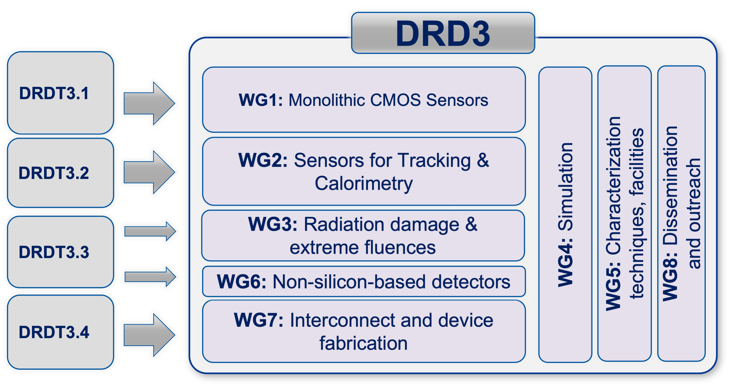
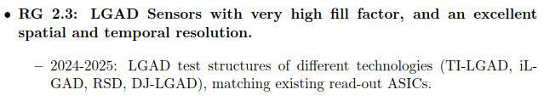
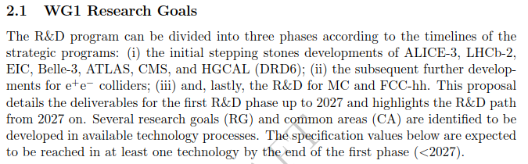
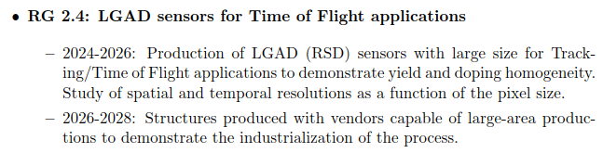
Attività RD_FCC in DRD3 e DRD7
Circulated draft of the DRD3 proposal and DRD7 letter of intent (attached to the agenda for completeness)
Very different approaches in the two communities:
  general interests of participating institutes in DRD3
  project proposals in DRD7
Mechanics and cooling originally in a specific DRD8, now actually included in the specifics DRDs
  not included yet in DRD3 proposal, but availability of institutes checked in a questionnaire
TSI180 is within the technology considered in DRD3.1
LGAD in RSD technology are considered for two research goals in DRD3.2

Slide 20
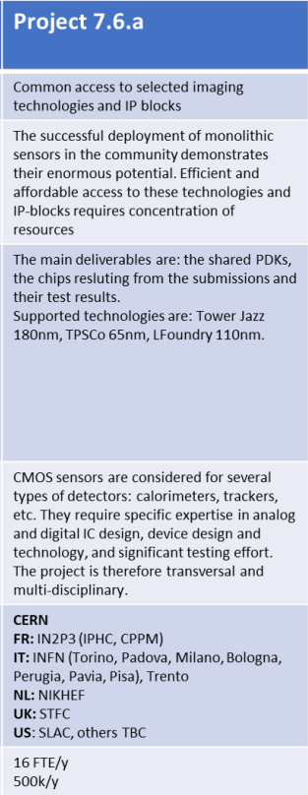
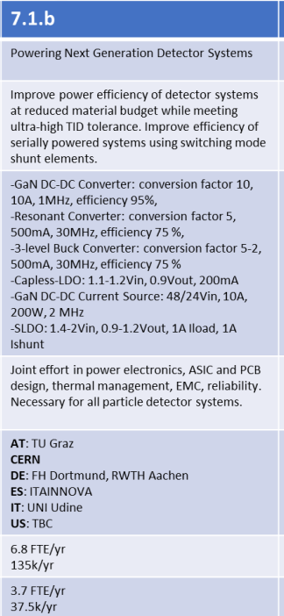
Attività RD_FCC in DRD3 e DRD7
Monolithic CMOS developments are shared between DRD3.1 (sensor development) and DRD7.6 (large systems)
  the LF110nm platform developed ARCADIA platform is one of the two technologies included in this project
  only competitor is the TowerJazz 65nm strongly pushed by CERN
Developments on power distribution are the subject of a DRD7.1 process
  Milano did not participate in the project definition, but matches the interest on SLDO
  Will need to understand exactly how DRD7 is planning the implementation of its projects

Slide 21
Altre tecnologie

Slide 22
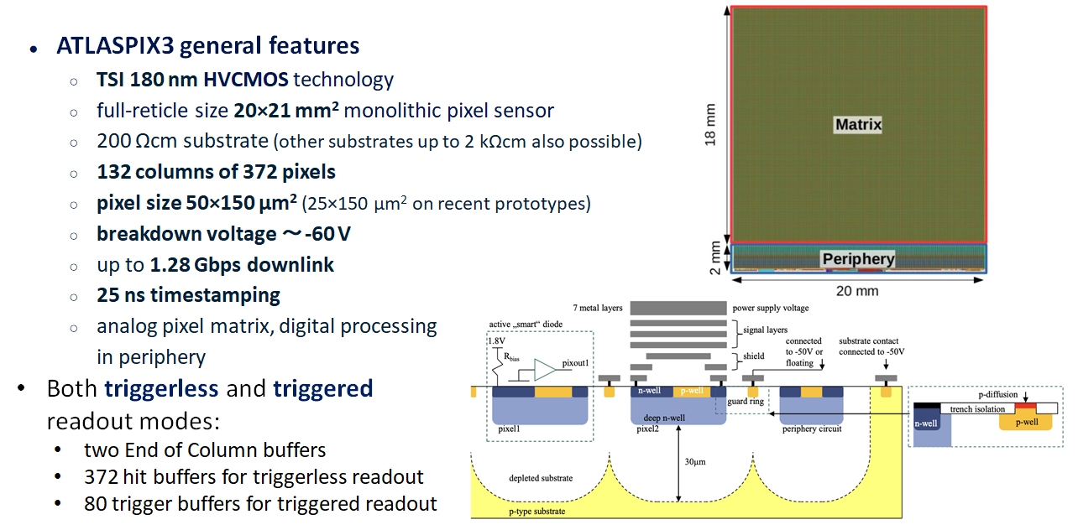

Slide 23
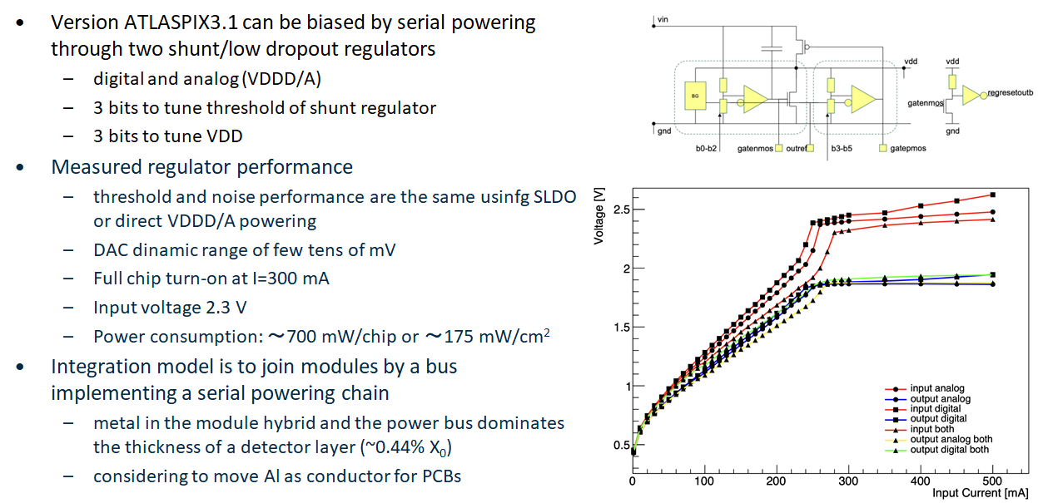
Serial powering operation dependent on the technology HV capabilities: find for Arcadia and HV technologies, difficult for TPSCo

Slide 24
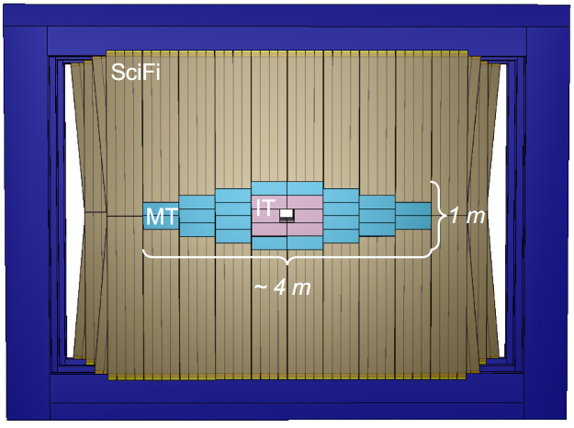
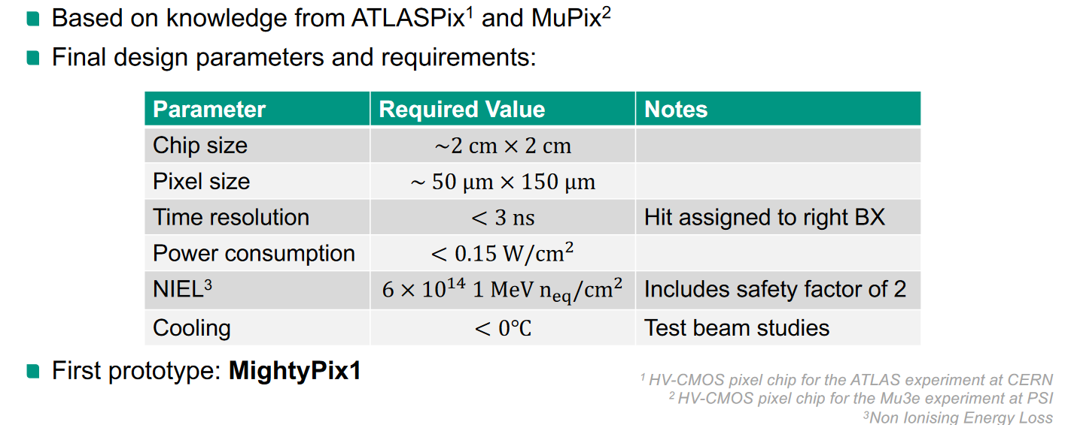
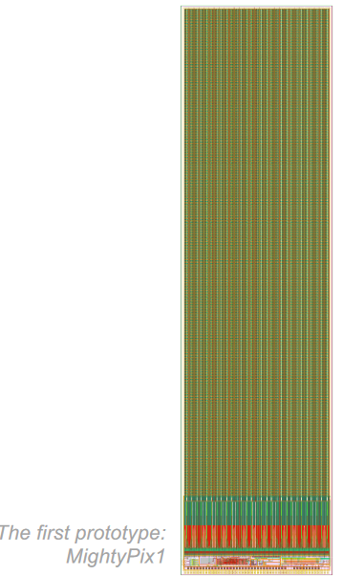
MightyPix: a detector for LHCb
LHCb MightyTracker upgrade: 18 m² of silicon pixels
S. Sherl at
TREDI 2023
fabricated in TSI 180 nm,
moving now (back) to AMS 180 nm

Slide 25
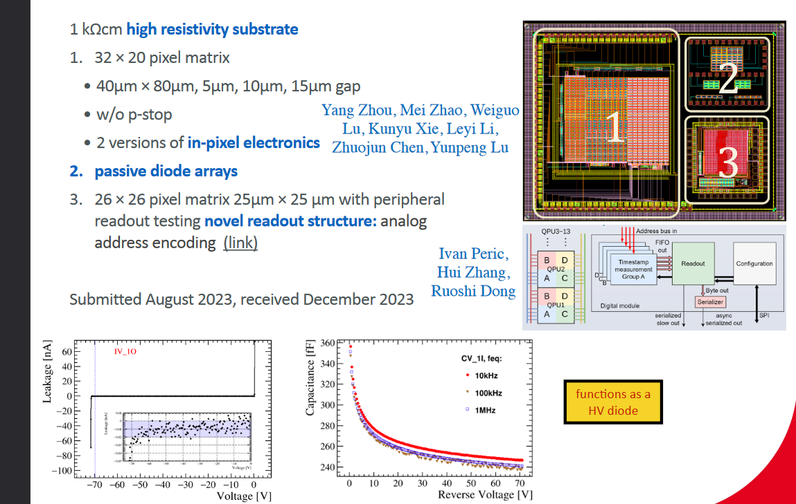
Coffee2 – 55 nm SMIC HV-CMOS process
H. Fox at CEPC European Workshop
Marseille 2024

Slide 26
Backup

Slide 27
Si tracker: system considerations
Complete system consists of 900'000 cm² area / 4 cm² chip = 225k chips (56k quad-modules)
  aggregation of several modules for data and services distribution is essential
  inner tracker will be 5--10% of this
Data rate constrained by the inner tracker
  average rate 10⁻⁴ - 10⁻³ particles cm⁻² event⁻¹ at Z peak
  assuming 2 hits/particle, 96 bits/hit for ATLASPIX3
  640 Mbps link/module (assuming local module aggregation) provides ample operational margin
  16 modules can be arranged into 10 Gbps fast links: 3.5k links
    can also assume 100 Gbps links will be available: 350 links
DAQ architecture
  triggerless readout will fit the data transmission budget but requires off-chip re-ordering of data
  triggered readout will be simpler and would also reduce the bandwidth occupancy
Power consumption
  ATLASPIX3 power consumption 150 mW/cm²
  600 mW/chip → 2.4 W/module → total FE power 130 kW
  additional power for on detector aggregation and de-randomizations ~2W/link

Slide 28
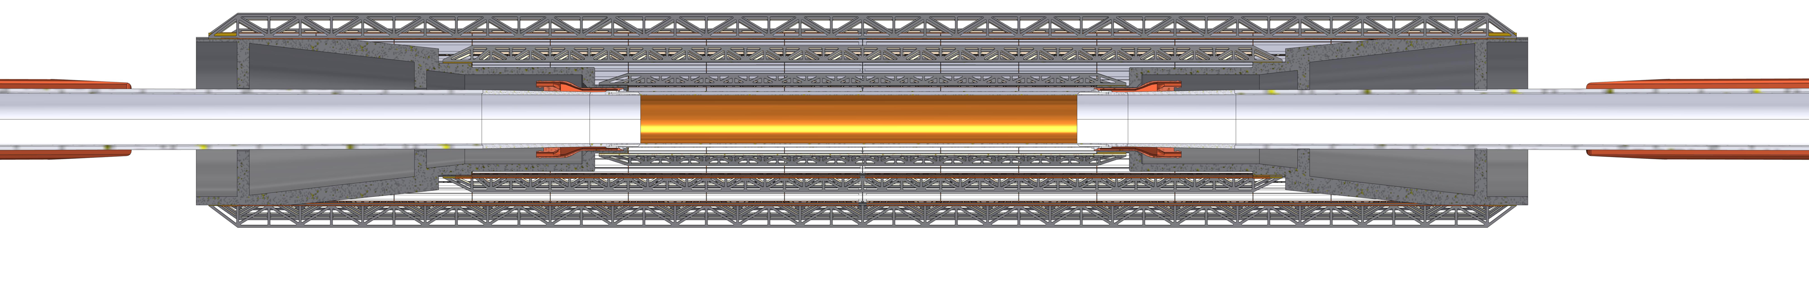
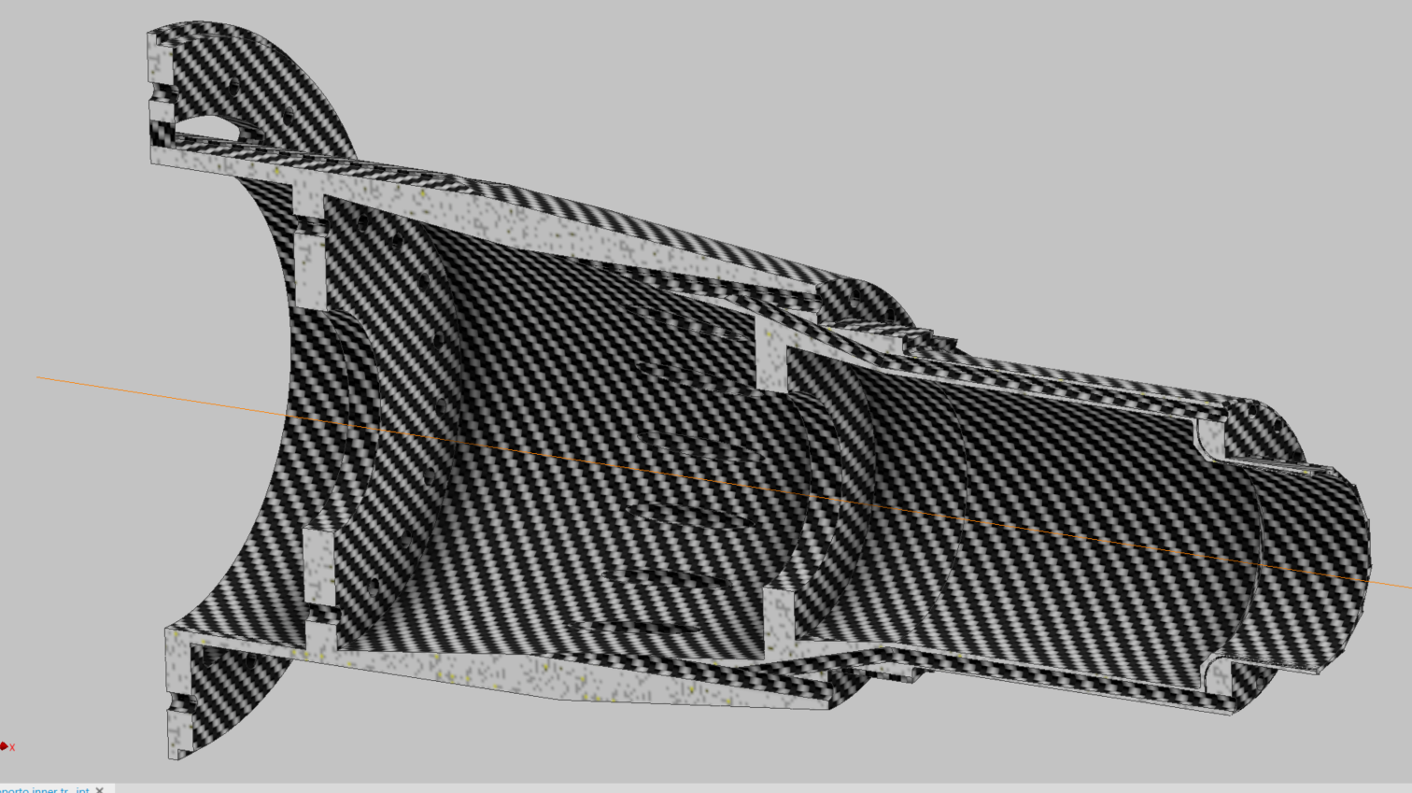
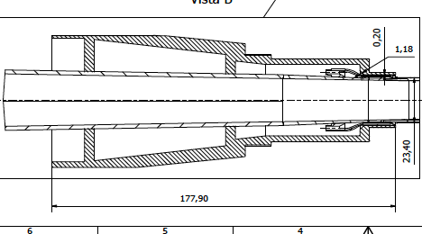
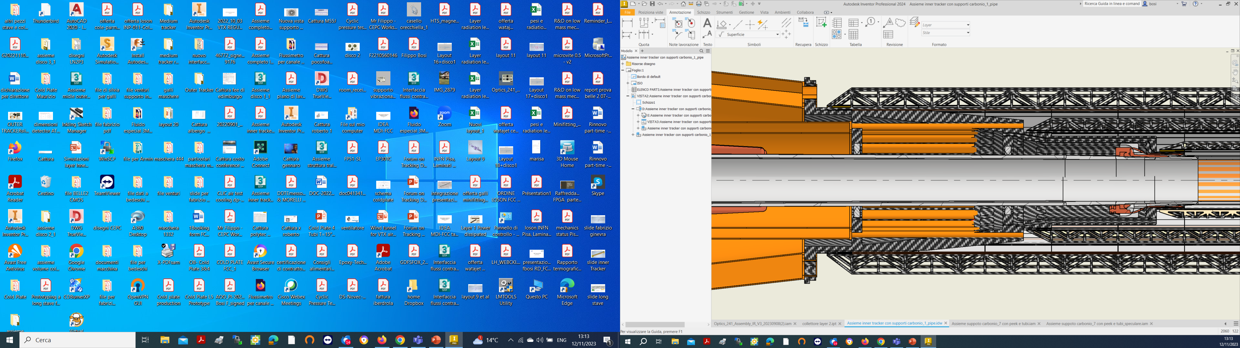
Inner Vertex support
Anchored to the conical chamber
Air cooled
Thermally isolated from the beam pipe during bakeout, by peek supports
Cooling Third layer
Cooling Second Layer
Cooling First Layer
Cooling Pipe
Air Cooling
Paraffine
Cables

Slide 29
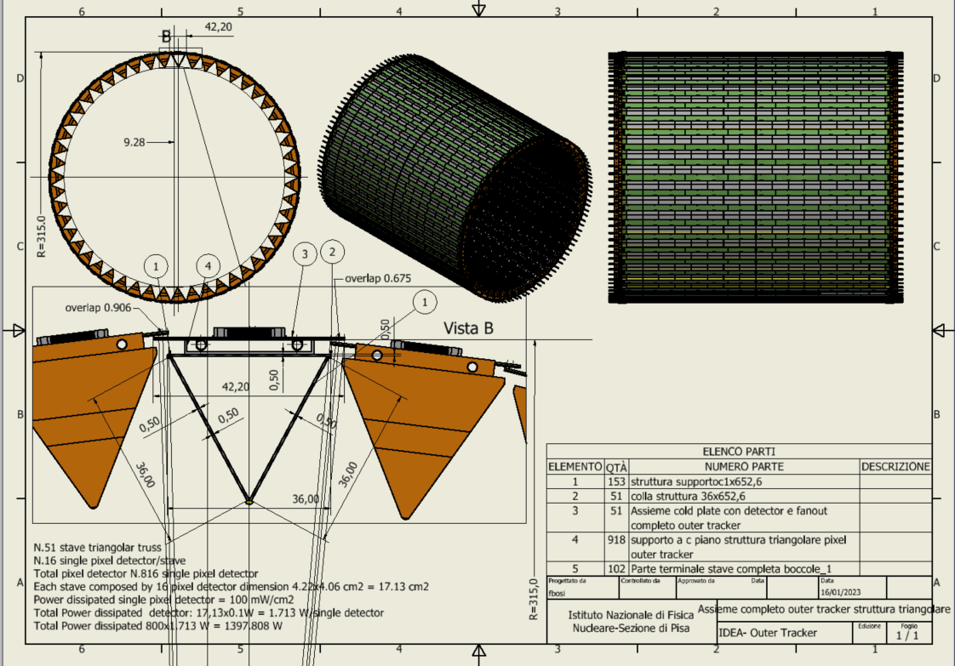
Outer Vertex Tracker Barrel
At 31.5 cm radius
51 staves of 16 modules each
Lightweight reticular support structure (ALICE/Belle-II like)
Total weight ~3.7 kg
Readout chips either side
Power budget
~1400 W
Water cooled (2 pipes of 2 mm diameter)
Notes:
NB. Qui la struttura reticolare deve stare giù perché sennò non si riesce ad ottenere il raggio esterno più grande e vicino alla DCH.

Slide 30
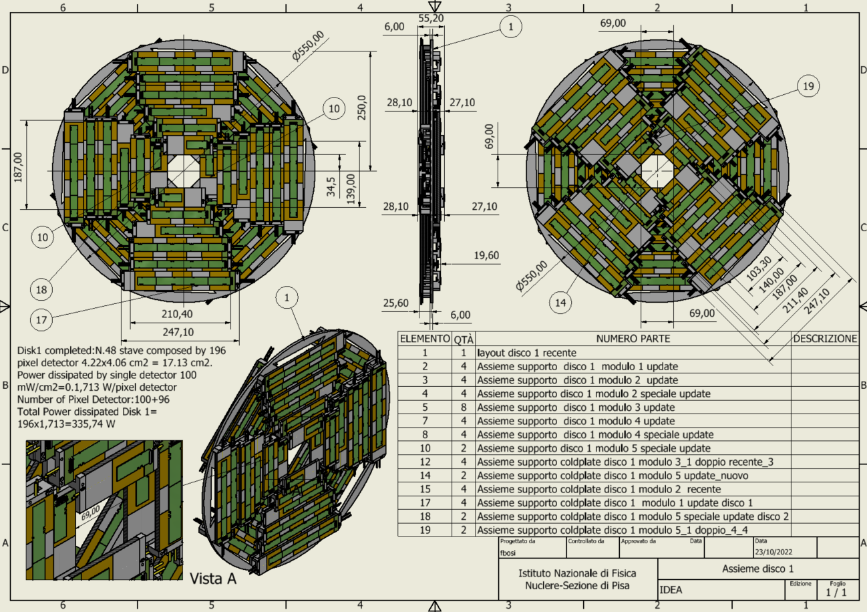
Outer Vertex Tracker Disk 1
2 sides (front and back) each with 4 petals.
One petal is made of different staves of overlapping modules
Total modules per disk: 196
Total weight ~850 grams
Power budget ~ 336 W
Cooling using 1 water pipe (2 mm diameter)
Similar geometry for the other two disks
To be modified to accommodate cooling cones

Slide 31
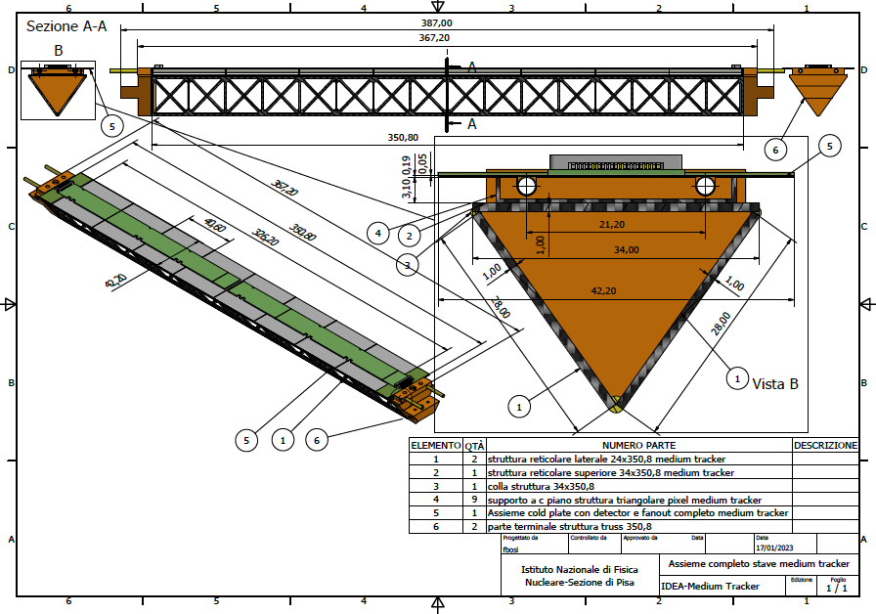
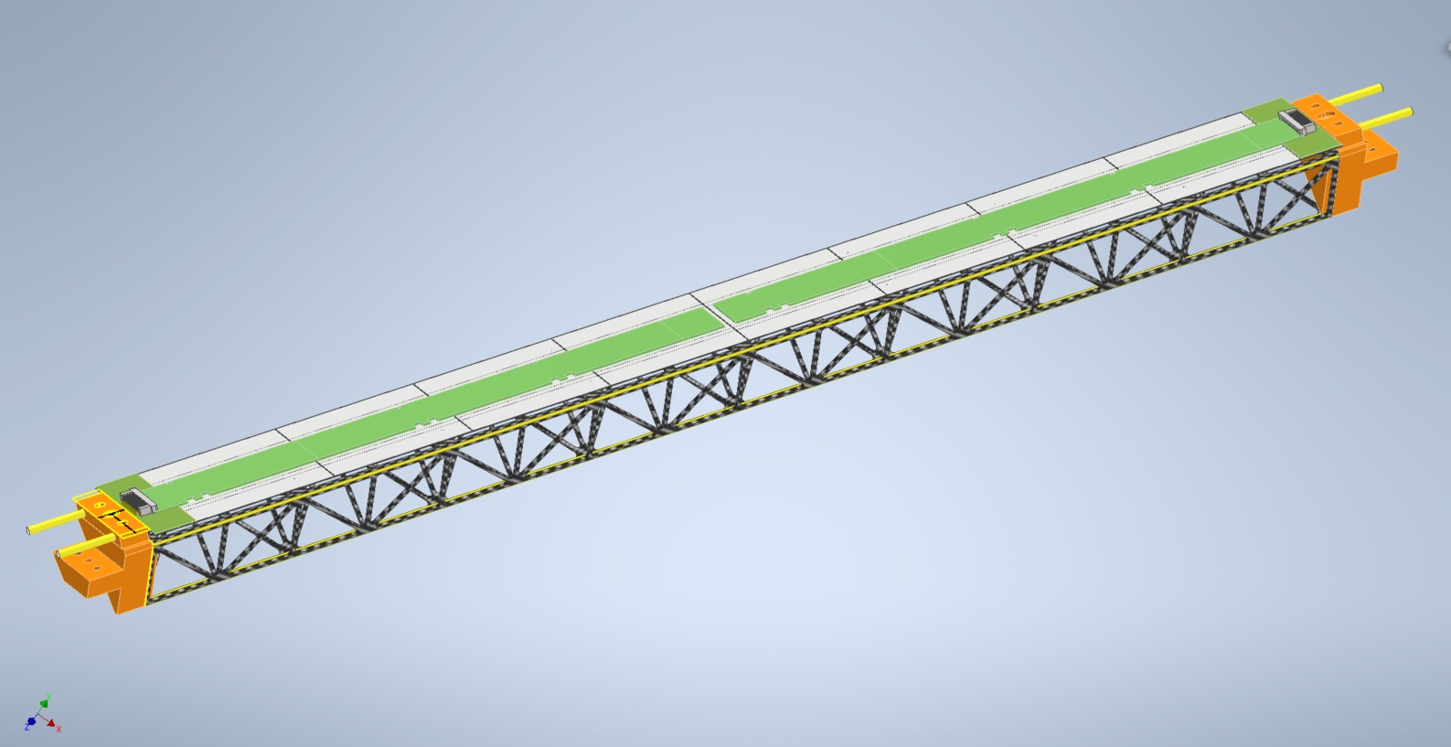
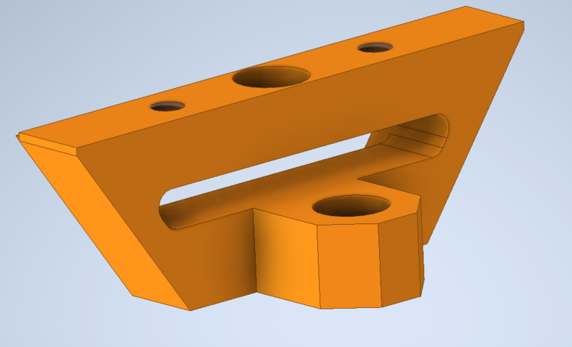
Stave detail
Shaped to minimize material at the end of the stave

Slide 32
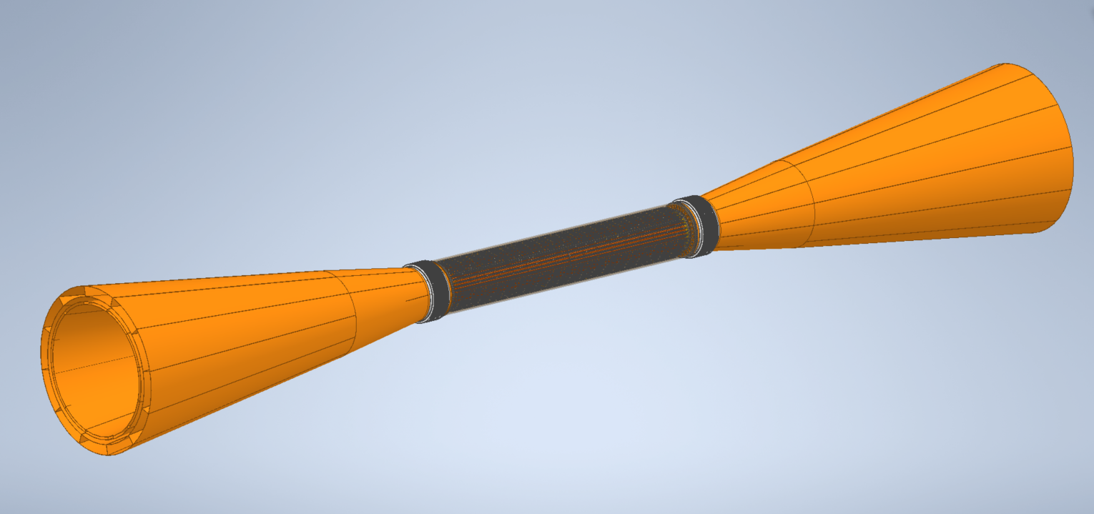
Service cones for cooling and cables
Inner Tracker
Cone exit cable layer3-Cooling in layer3
Elastic connection
Cone exit cable layer2-1-Cooling in layer 2-1

Slide 33
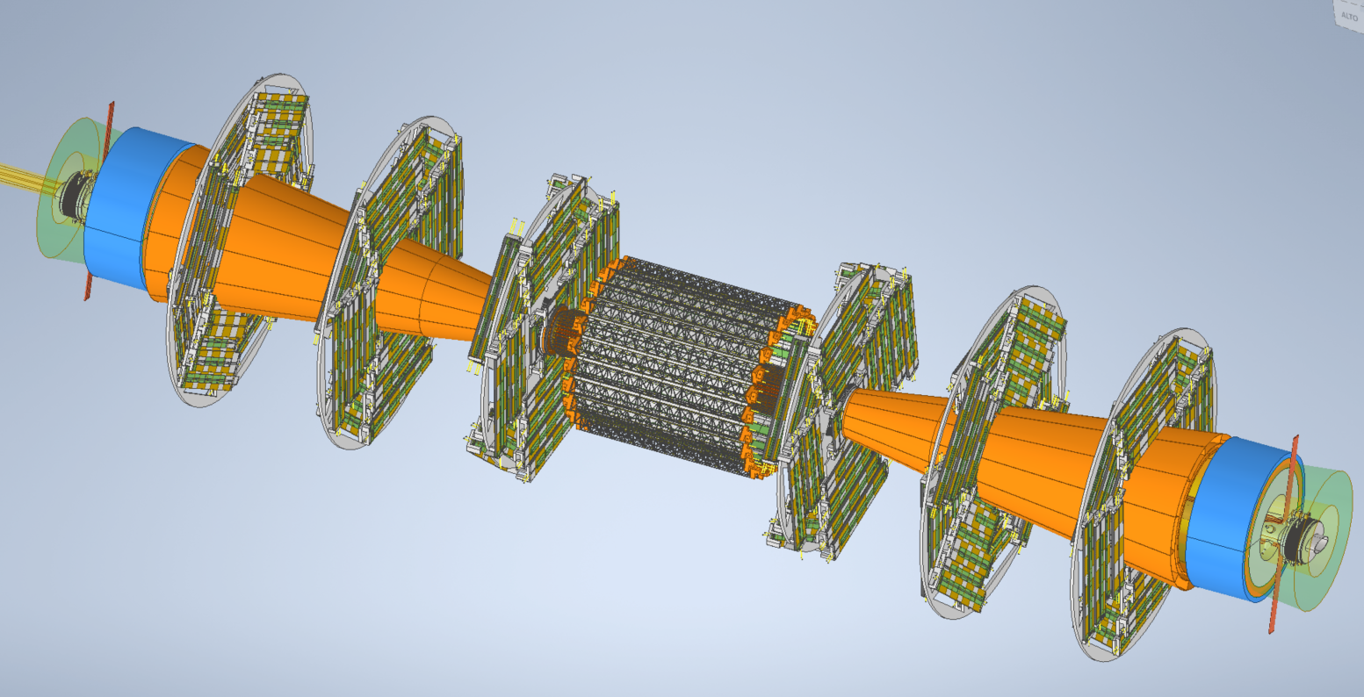
Middle Tracker

Slide 34
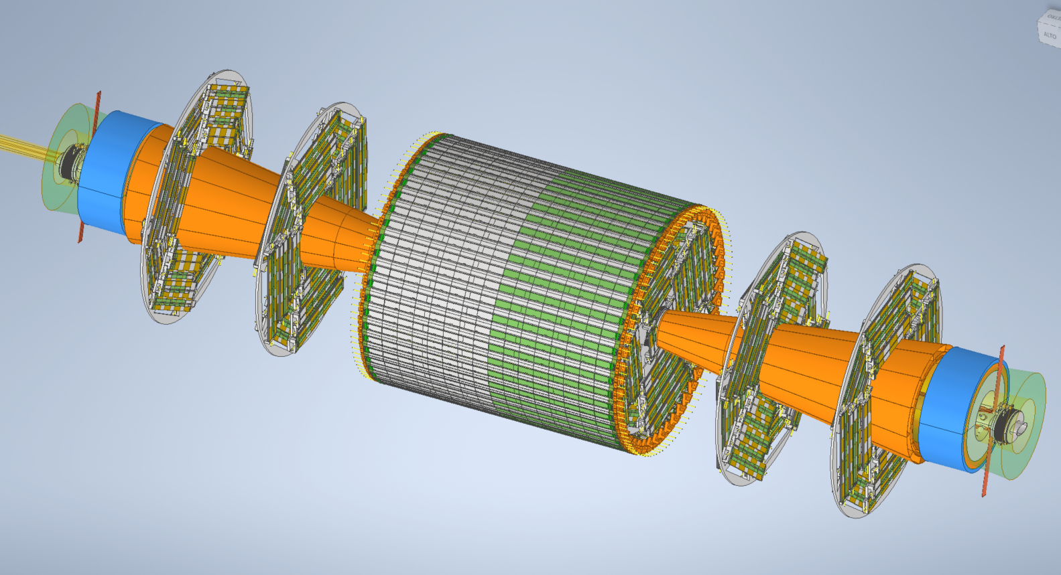
Outer Tracker

Slide 35
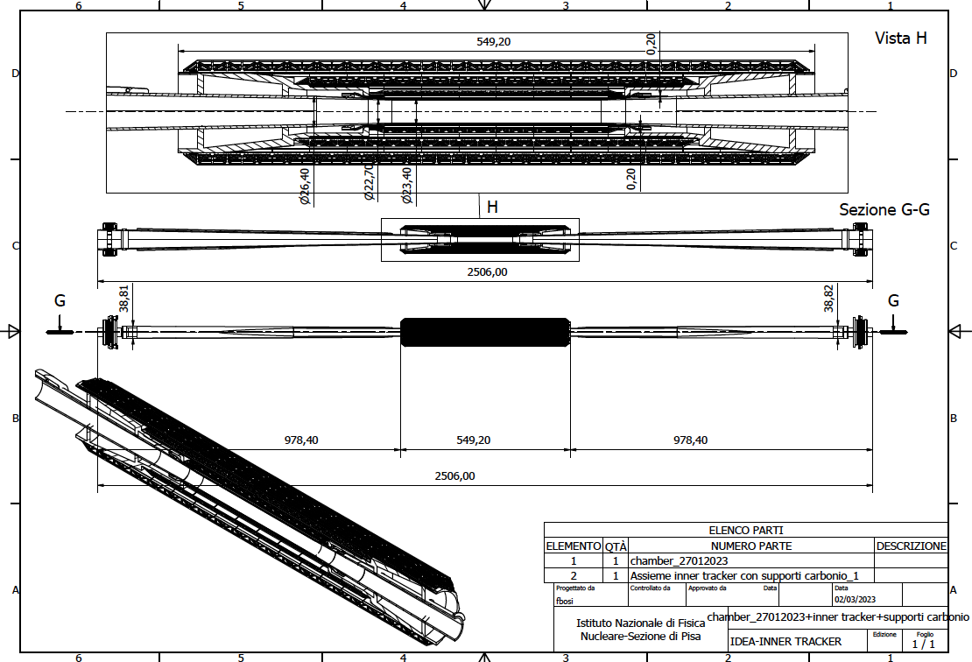
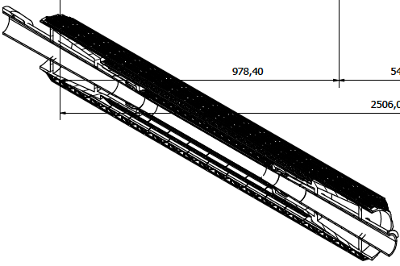
Inner vertex detector supporting conical structures on elliptical chamber
~450 grams
Engineered for air ducts and thermal isolation from the beam pipe during bakeout

Slide 36
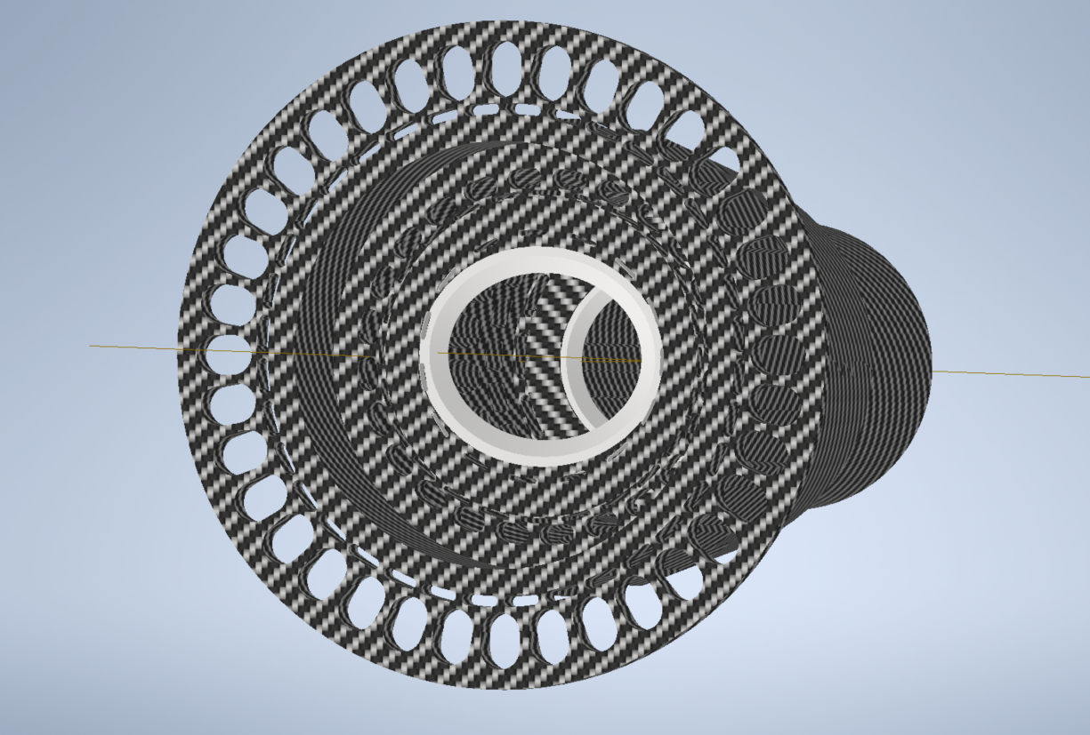

View from Lumical
Cable tunnel Layer 3
Air cooling Layer 3
Air cooling Layer 2-1
Cable tunnel Layer 2-1
Peek Insert 1
Peek Insert 2

Slide 37


Slide 38
Integration with beam pipe cooling manifold
Air Cooling
Cooling pipe paraffin
Cables

Slide 39
Disk 3
Disk 2
Disk 1
Disk 1
Inner Tracker
Disk 2
Disk 3

Slide 40

General integration

