Slide 1
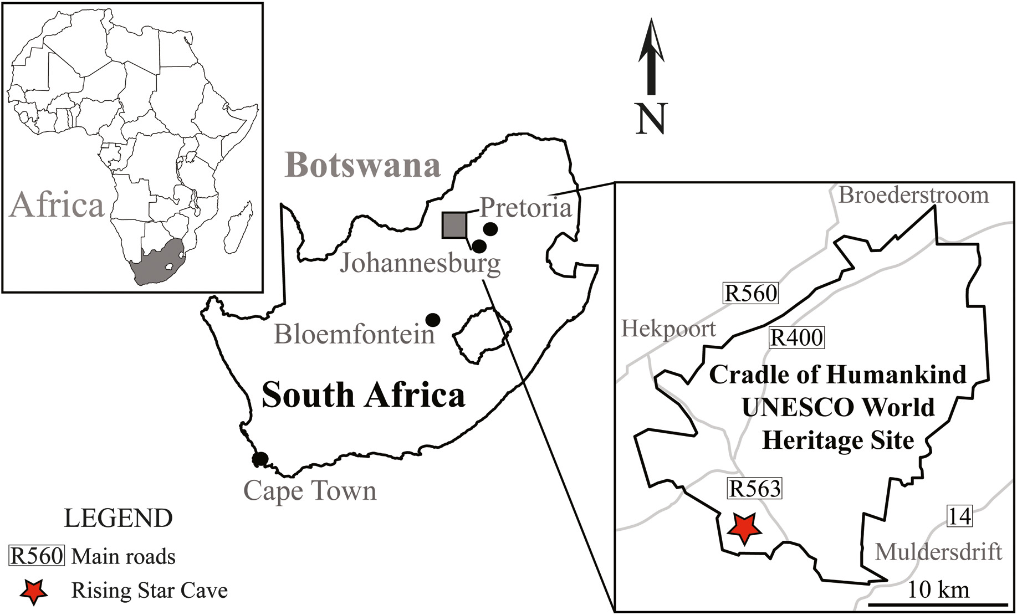
Muography in COHWHS
M. Bruschi - INFN Bologna (ITALY)
Meeting on March 13th 2024

Slide 2
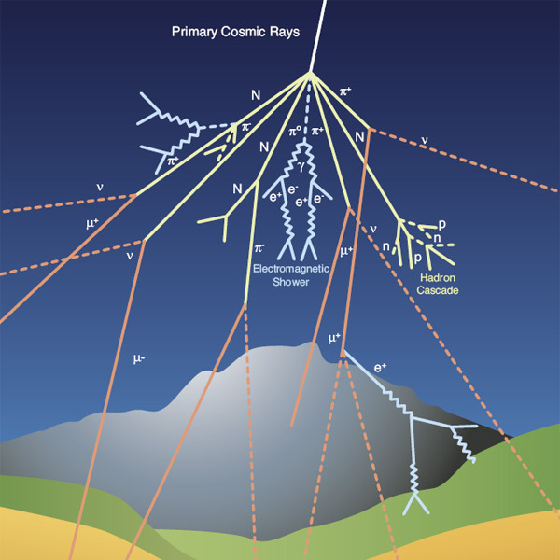
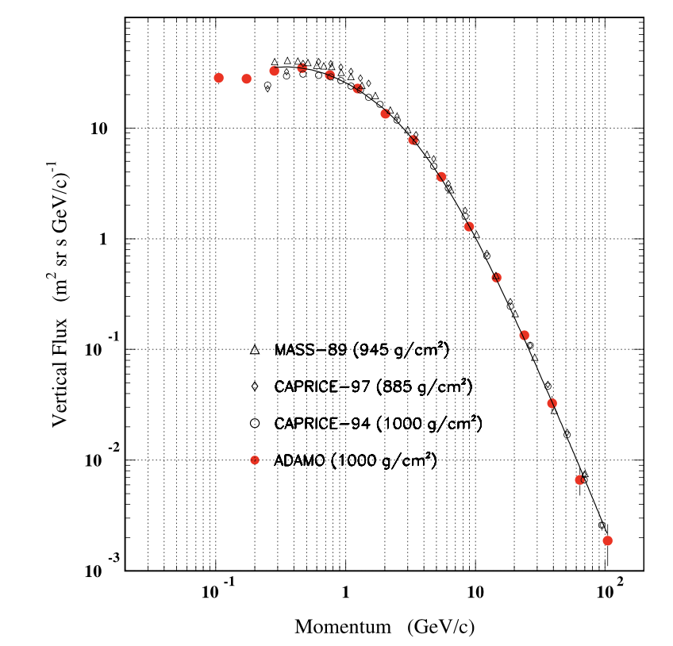
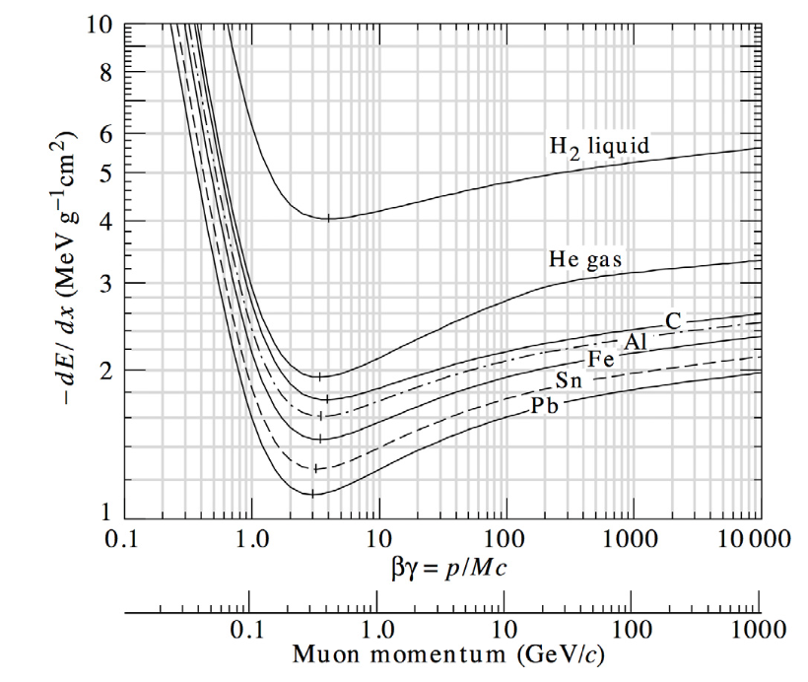
Cosmic rays cascades
Primary cosmic rays
85% protons
12% α particles
3% heavier particles
At altitudes between 15-20 km they interact in the atmosphere with nuclei initiating electromagnetic or hadronic showers
Secondary cosmic rays can survive enough to reach Earth’s surface
At the sea level, 80% of all the charged particles hitting the ground are MUONS
Typical flux of vertical muons: 1/cm²/min
The flux depends on the momentum and the zenith angle θ: I(θ)~I(θ=0) cos² θ at the sea level for muons momenta ~ 3 GeV

Slide 3
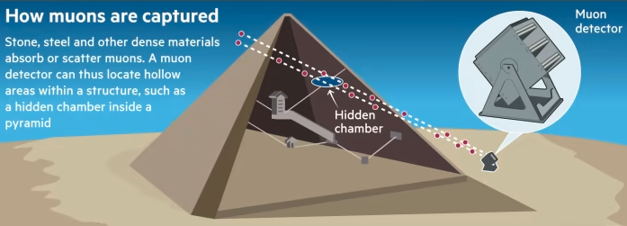
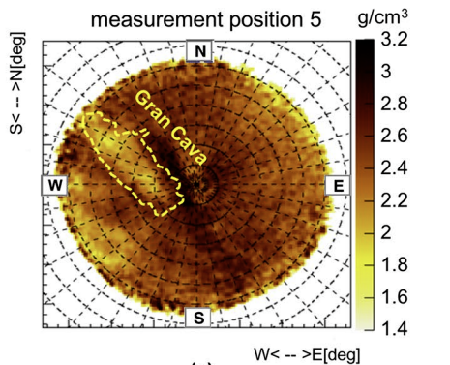
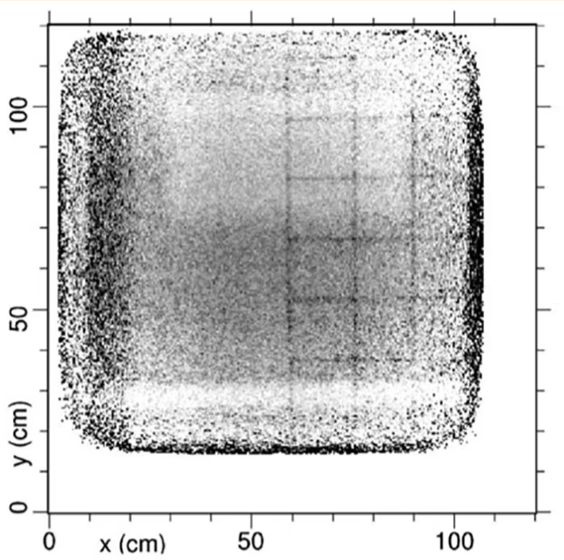
The principle of muography
Natural Imaging Agents
Unlike X-rays that require a source, muons are naturally and abundantly available.
Muons lose energy and get absorbed or deflected when passing through matter.
Capturing Shadows
Detectors placed on opposite sides of an object capture muons after they pass through.
Areas with denser material (like metals or rock) absorb more muons, casting a 'shadow' on the detector.
Creating an Image
By measuring the number of muons passing through different parts of the object, a 2D (or 3D using more detectors) image can be constructed.
Helps in revealing the internal structure without physically opening the object.
Needs comparison with MonteCarlo simulations
Example of muography inside the Temperino mine (Tuscany) by the Florence group(INFN and Uni.)
Areas of lower (hidden caves) or higher densities materials are visible
More about this in the following

Slide 4
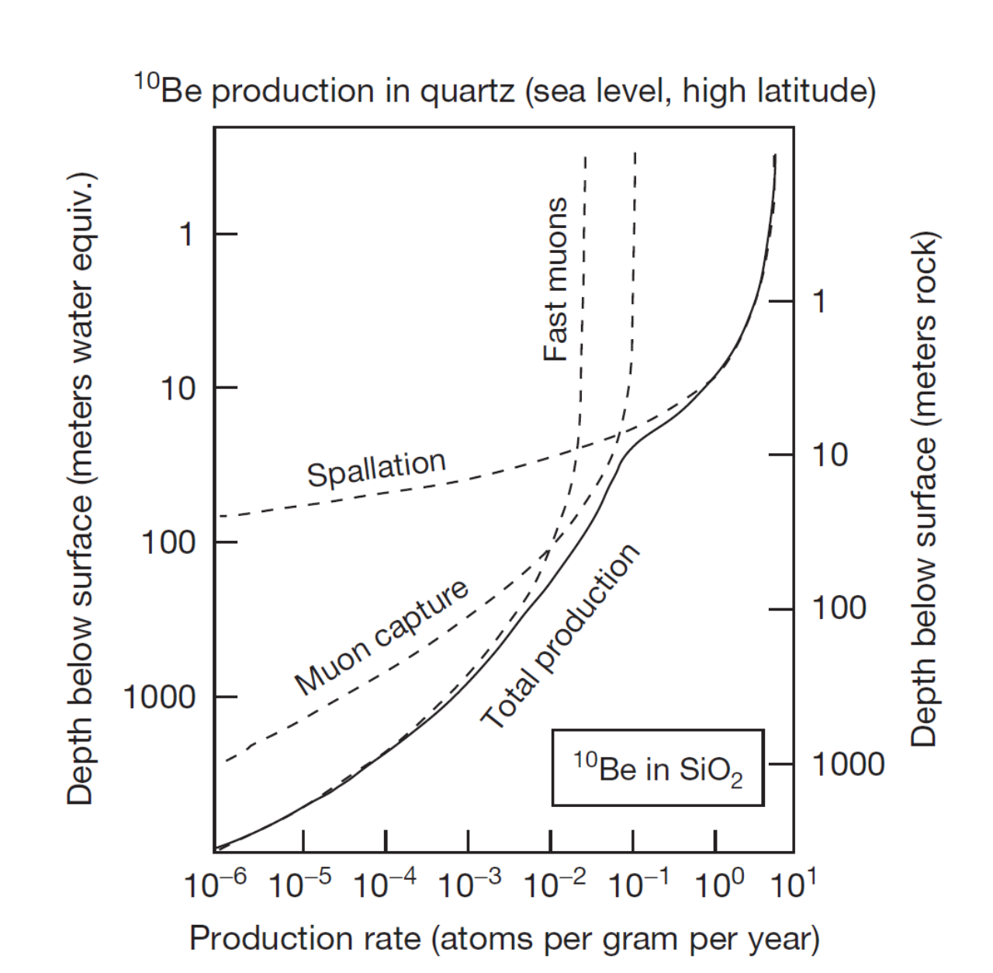
Muography and geodating
Cosmic rays products reaching the soil can produce nuclides
Spallation of high energy neutrons
¹⁶O(n,4p3n)¹⁰Be
²⁸Si(n,p2n)²⁶Al
Slow neutron capture
Slow μ⁻ capture
Fast muon interaction → BS – photons → photoneutrons (depth > 20m)
Measuring the relative abundance and the ratio of long-lived nuclides as ¹⁰Be (1.4 Myears) or ²⁶Al (0.71 Myears) is a commonly used technique for geodating
Experimental measurement of the muon fluxes (and spectra) at the surface and in cave are needed (together to MC modeling) to extract the dating
Measure initially proposed by Dr. T. Makhubela, Geology dpt. of Uni. of Johannesburg
Feasibility using only muon flux measurements on surface and in cave must be studied
Other groups interested
Univ of Johannesburg
INFN Bologna
Ithemba/Wits
Precision needed for dating must be assessed and then feasibility studies must be performed

