Slide 1
Muography in AFRICA The MUON-GATEWAY Project
M. Bruschi - INFN Bologna (ITALY)
Meeting on March 27th 2024

Slide 2
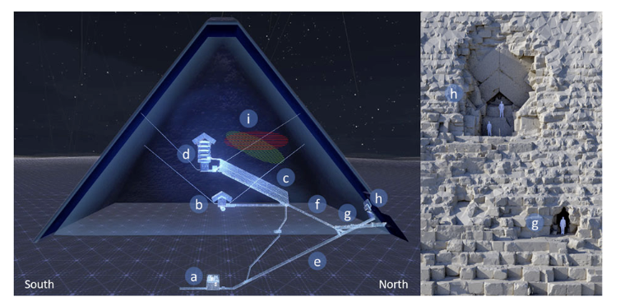
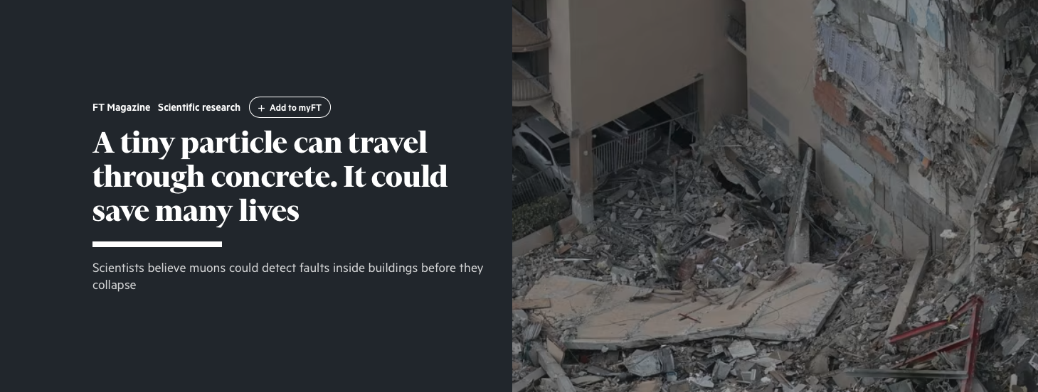
Muography applications
1955: Proposed by E. P. George to determine the thickness of snow layers on a mountain
Archaeology
from 1971: Search of unknown burial cavities in the Chephren pyramid (L. Alvarez and coll.)
Volcanology (lateral)
from 2003: Study of the internal structure of volcanoes (Tanaka and coll.)
Civil engineering and underground
imaging of concrete structures, bridges, monitoring of historical buildings, tunnel boring machines
Industrial
Process monitoring, Preventive maintenance, production optimization

Slide 3
MUON-GATEWAY project outline
Africa offers many possibilities to use muographic techniques
Mines (Gold and Diamonds) in South Africa
Copper Mines: Zambia and the Democratic Republic of Congo (DRC) are among the top copper producers globally, with significant copper belt regions.
Platinum Group Metals (PGM) Mines: South Africa holds the majority of the world's platinum group metals, including platinum, palladium, rhodium, and others, primarily located in the Bushveld Igneous Complex.
Iron Ore Mines: South Africa, Mauritania, and Liberia are significant iron ore producers, with large deposits being mined for domestic use and export.
Bauxite Mines: Guinea is a leading producer of bauxite, the principal ore of aluminum. Significant bauxite mining also occurs in Ghana and Sierra Leone.
Uranium Mines: Namibia and Niger have significant uranium mines, contributing a major portion of the world's uranium supply.
Coal Mines: South Africa has extensive coal mines, serving both the domestic energy market and significant exportation, especially to Europe and Asia.
Tin Mines: The DRC and Rwanda are notable for tin mining, crucial for solder in electronics manufacturing.
Coltan Mines: The DRC is the largest producer of coltan (columbite-tantalite), used in electronic devices for tantalum capacitors.
Nickel Mines: Madagascar and South Africa have significant nickel mines, used in producing stainless steel and batteries.
Chromium Mines: South Africa is the world’s largest chromium producer, essential for all stainless steel production.
Manganese Mines: South Africa, Gabon, and Ghana are leading producers of manganese, crucial for steel production and chemical applications.
Phosphate Mines: Morocco is the world's largest producer of phosphate, a critical component in fertilizer production.
Archeology: Rising Star system, sites in Gabon and Botswana, Pyramids ....

Slide 4
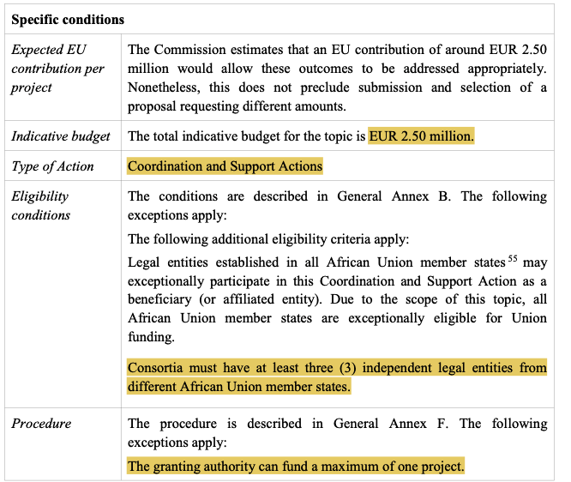
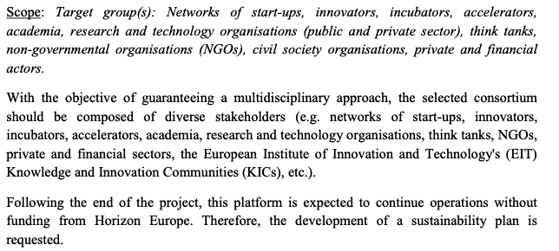
HORIZON-EIE-2024-CONNECT-01-01: The African Union-European Union Innovation Platform
Deadline: April 25th 2024 17:00
Link to the Call

Slide 5
Framework for the Research Initiative
Technology and Knowledge Transfer:
The European Union (EU), represented by the National Institute for Nuclear Physics (INFN), commits to providing the most advanced muography technology currently available.
Collaboratively, the INFN and affiliated European Universities will establish advanced training hubs within African Union (AU) Universities and research institutions. These centers will specialize in:
The design of diverse muographic measurement applications.
Comprehensive analysis of muographic data.
Expert interpretation of experimental results.
Network Implementation through Muography in COHWHS:
The project's centerpiece, Muography within the Cradle of Humankind World Heritage Site (COHWHS), has been selected for its potential to:
Generate significant scientific impact, garnering the attention and collaboration of both AU and EU academic and research communities.
Drive technological advancements to enhance existing muographic systems:
Adapting to the challenging conditions within the DINALEDI chamber.
Developing versatile field detectors capable of assessing cosmic muon flux relative to momentum variables.
This strategic initiative not only fosters international cooperation but also propels technological innovation and scientific discovery
Broad Socioeconomic Advantages for the AU Region:
Job Creation: Establishment of skilled positions in muography application and data analysis.
Resource Development: Leveraging muography to strategically enhance resource management and extraction in the mining sector.
Tourism Boost: Potential discovery of historical and paleontological sites, increasing tourist interest and economic activity
Advantages for EU Start-Ups:
Market Expansion: Providing muography technology to the AU project opens new markets for EU start-ups, fostering growth and international collaboration.
Innovation Showcase: Demonstrates the capability and advancement of EU-developed muography techniques in diverse applications.
Strategic Partnerships: Establishes long-term partnerships with AU institutions, setting the stage for future joint ventures and research initiatives.

Slide 6
Innovazione e Impatto Socioeconomico del Progetto MUON-GATEWAY nel Contesto UE-AU
Trasferimento di Tecnologia e Conoscenza:
L'Unione Europea (UE), rappresentata dall'Istituto Nazionale di Fisica Nucleare (INFN), si impegna a fornire la tecnologia di muografia più avanzata attualmente disponibile.
Collaborativamente, l'INFN e le Università Europee affiliate istituiranno centri di formazione avanzata presso le Università e gli istituti di ricerca dell'Unione Africana (AU). Questi centri si specializzeranno in:
La progettazione di diverse applicazioni di misurazione muografica.
Analisi comprensiva dei dati muografici.
Interpretazione esperta dei risultati sperimentali.
Implementazione della Rete tramite la Muografia nel COHWHS:
Il fulcro del progetto, la Muografia all'interno del Sito Patrimonio dell'Umanità Culla dell'Umanità (COHWHS), è stato selezionato per il suo potenziale di:
Generare un impatto scientifico significativo, attirando l'attenzione e la collaborazione delle comunità accademiche e di ricerca AU ed EU.
Promuovere avanzamenti tecnologici per migliorare i sistemi muografici esistenti:
Adattamento alle condizioni impegnative all'interno della camera DINALEDI.
Sviluppo di rivelatori di campo versatili capaci di valutare il flusso di muoni cosmici in relazione alle variabili di momento.
Questa iniziativa strategica non solo promuove la cooperazione internazionale ma anche spinge l'innovazione tecnologica e la scoperta scientifica.
Vantaggi Socioeconomici per la Regione AU:
Creazione di Lavoro: Stabilimento di posizioni qualificate nell'applicazione della muografia e nell'analisi dei dati.
Sviluppo delle Risorse: Utilizzo della muografia per migliorare strategicamente la gestione delle risorse e l'estrazione nel settore minerario.
Incremento del Turismo: Potenziale scoperta di siti storici e paleontologici, aumentando l'interesse turistico e l'attività economica.
Vantaggi per le Start-Up UE:
Espansione del Mercato: Fornire la tecnologia muografica al progetto AU apre nuovi mercati per le start-up UE, favorendo la crescita e la collaborazione internazionale.
Vetrina dell'Innovazione: Dimostra la capacità e il progresso delle tecniche muografiche sviluppate nell'UE in applicazioni diverse.
Partnership Strategiche: Stabilisce partnership a lungo termine con le istituzioni AU, preparando il terreno per future imprese congiunte e iniziative di ricerca.

Slide 7
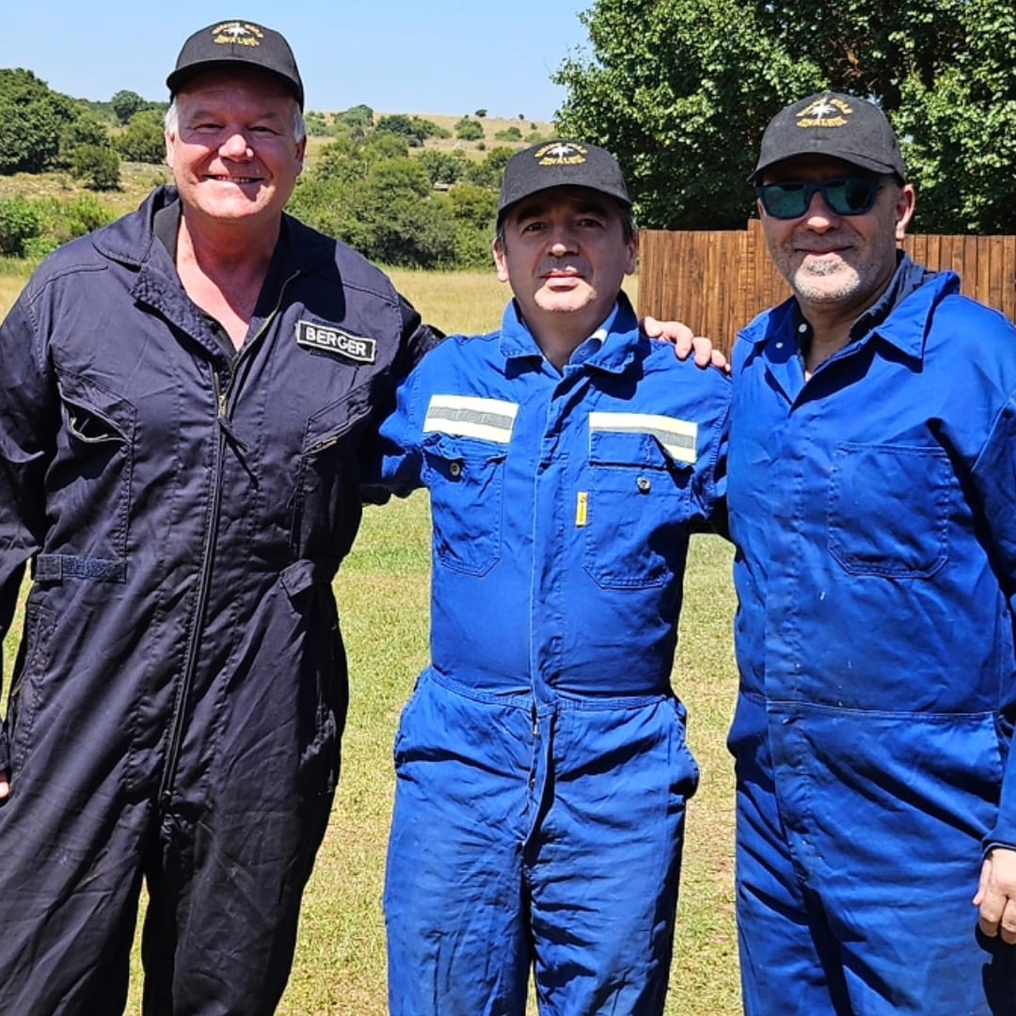
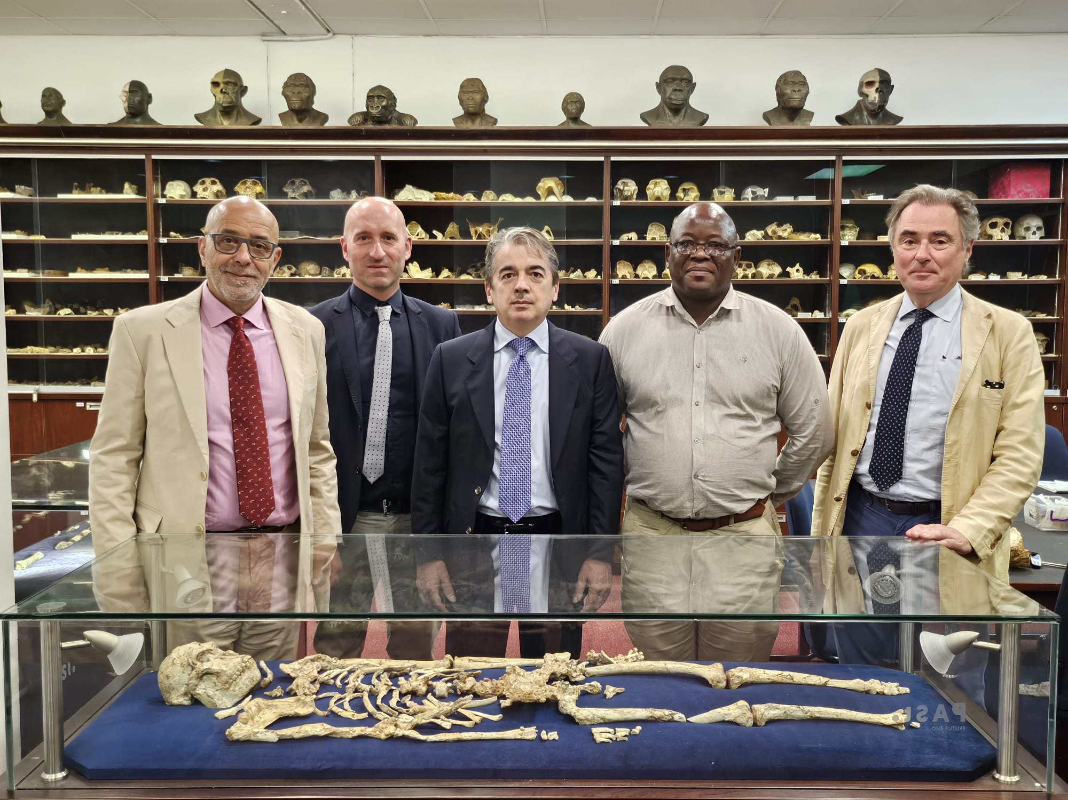
Present interested groups composition
INFN
Supported by the directors of Bologna, Firenze and LNL: E. Scapparone, G. Passaleva, F. Azaiez
Bologna
MB, B. Giacobbe, M. Sioli
Firenze
R. D’Alessandro, L. Bonechi
Big world experts in palaeontology, archaeology and anthropology express a strong interest to participate
Prof. Lee Berger (NG), Prof. John Hawks (Wisconsin Uni.), Prof. Tracy Kivell (MPI)
Regular meetings started since October 2023

Slide 8
WP structure (3Y, Preliminary)

Slide 9
Costs [€] , assuming 3Y duration
EU contracts (650 k)
2 Postdoc Contracts: 250 k
2 Definite Time employees: 300 k
2 PHD students: 150 k
AU Contracts (500 k)
Geodating – PHD student UJ: 50 k
+ other contracts (~450 k)
Travels (EU to AU): 400 k
6 people, 4 times per year, 14 days each time
Flights: 6x4x3k ~ 70k
14 days x 0.2 k ~ 3k x 24 ~70k
New Detector for muography: 150 k
New Detector for muon tomography: 300 k
Muography lectures, seminars, dissemination 100 k:
100 k
in-kind from NG, ESHE
+ 10 % Overhead (Consortium Resp, Project Admin)
Total ~ 2.3 M

