Slide 1

Chapter 6
Beam Physics
C. Vaccarezza on behalf of the WA1 team

Slide 2
Main Topics
Meeting w Ferrario Giannessi outcome
  Reference WP: e-beam 1 GeV, 4 nm, 30 pC , Comb Scheme.
  No All RF WP in TdR
  Layout:
    VB layout completed, jitter study completed (1-2 %), overall length = 63.8 m +1m wall
    Mask layout completed, jitter study by April 15th 2024, overall length = 64.7 +1m wall
  Magnets specs ready for Linac, in progress for Plasma chamber, ready for Tline.

Slide 3
Machine Setup for VB based WoP1
Cathode Laser System
 | Witness | Driver
Charge [Q] | 30 | 200 | pC
Time delay [Δ𝑡] | - 4.8 | 0 | ps
Laser Spot size [σ_{r}] | 175 | 300 | µm
Laser Pulse length [σ_{t}] | 0.30 | 0.30 | ps
Magnets
S-band Photoinjector - Peak Field
Type | B_{max} (T) | Length (m) | Energy (MeV)
Gun Solenoid | 0.3 | 2 coils (SABINA like) | -
Acc. Structures solenoids | 0.035, 0.075 | 4triplets,3triplets (SABINA like),0,0 | -
X-band Linac
Type | g_{max} (T/m) | Length (m) | Energy (MeV)
Type A | 10 | 0.010 | 100 - 350
Type B | 13 | 0.015 | 330 - 550
Type C | 16 | 0.020 | 550
PMQ in | 280 | 0.005,0.009,0.005 | 550
RF Gun
RF Peak Voltage [V] | 120 | MV
RF Phase [φ] | -30 | Deg
S-band Accelerating Sections
RF Voltage (on average) [V] | 20,19,20,35 | MV
RF Phase [φ] | -92,-84,-25,-10 | deg
X-band Accelerating Sections
RF Voltage (on average) [V] | 24 | MV
RF Phase [φ] | -10 | deg

Slide 4
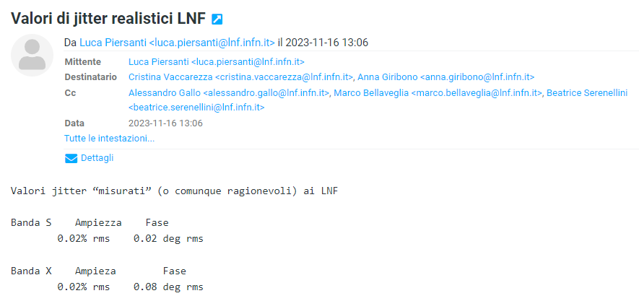
Tabella jitter usati nelle simulazioni (PSI close)
RF Gun (rms)
RF Voltage [ΔV] | ± 0.02 | %
RF Phase [Δφ] | ± 0.02 | deg
S-band Accelerating Sections (rms)
RF Voltage [ΔV] | ± 0.02 | %
RF Phase [Δφ] | ± 0.02 | deg
X-band Accelerating Sections (rms)
RF Voltage [ΔV] | ± 0.02 | %
RF Phase [Δφ] | ± 0.10 | deg
Cathode Laser System (max)
Charge [ΔQ] | ± 1 | %
Laser time of arrival [Δ𝑡] | ± 0.02 | fs
Laser Spot size [Δσ] | ± 1 | %
➜New communication?

Slide 5
Beam parameters @plasma injection (w/o X-band cavity)
 | Witness |  | Driver
 | Without errors | With errors | Without errors | With errors
Charge | 30.00 | 30.00 ± 0.33 | 200.00 | 200.00 ± 2.00 | pC
Energy | 537.18 | 537.19 ± 0.31 | 539.29 | 539.29 ± 0.30 | MeV
Energy spread | 0.712 | 0.711 ± 0.003 | 0.92 | 0.92 ± 0.001 | ‰
Bunch length | 19.88 | 19.97 ± 0.32 | 205.87 | 205.55 ± 0.87 | fs
I_{peak} | 1873 | 1643 ± 99 | - | - | kA
Δt | 0.494 | 0.494 ± 0.044 | - | - | fs
ε_{nx,y} | 0.562 | 0.562 ± 0.007 | 4.18 | 4.22 ± 0.15 | mm mrad
σ_{x,y} | 1.5 | 1.52 ± 0.18 | 5.85 | 5.89 ± 1.07 | µm
β_{x,y} | 4.3 | 4.5 ± 1.1 | 8.8 | 9.1 ± 3.3 | mm
α_{x,y} | 1.2 | 1.2 ± 0.25 | 1.65 | 1.65 ± 0.30
* Errors are intended as rms quantities

Slide 6
Beam parameters @ph. Exit
Beam parameters | without X-band all jitter |  | with X-band all jitter
 | Witness | Driver | Witness
<ε> (mm-mrad) | 0.5710 ± 0.0027 | 1.44 ± 0.0127 | 0.6602 ± 0.0194
<Bunch length> (fs) | 18.5 ± 0.30 | 214.6 ± 0.83 | 13.6 ± 0.35
<peak current> (A) | 1780 ± 102 | - | -
<E> | 124.78 ± 0.034 | 126.54 ± 0.032
<centroid distance> (ps) | 0.5031 ± 0.0045 | - | 0.5469 ± 0.0039

Slide 7
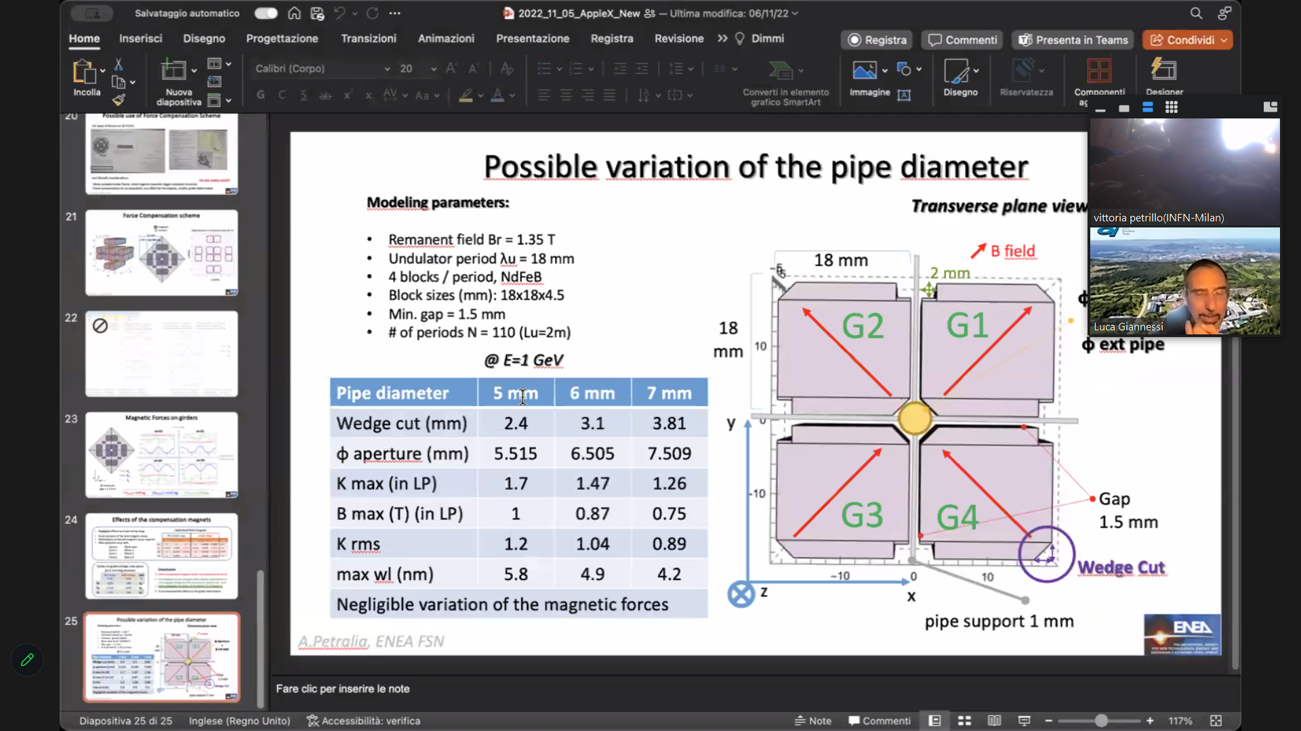
Courtesy of Alberto Petralia

Slide 8
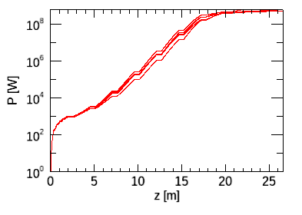
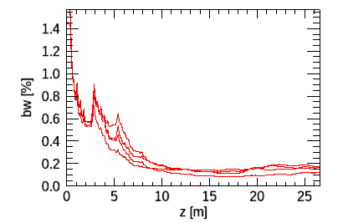
Pipe diameter=7 mm,
Ipothesis (to be controlled): wakefields are uneffective for this length
K_{max}=1.26 for circular polarization a_{w,max}=1.26
For Ε_{e}= 1.2 GeV, λ_{max}=4.22 nm
<E>=26 μJ
Electron beam considered
Energy | GeV | 1-1.2
Charge | pC | 30
Current | kA | 1.4-1.8
emittance | mmmrad | 0.8
Energy spread | % | 3.5-3e-4

Slide 9
Performance at various wavelengths with I_{peak}=1.8kA
K | E_e | lamda | <E> | L_sat | bw | size
1.26 | 1.2 GeV | 4.22 nm | 26 uJ | 20 m | 0.15% | 120 um
0.9 | 1 GeV | 4.22 nm | 15 uJ | 24 m | 0.15% | 120 um
K | E_e | lamda | <E> | L_sat | bw | size
1.15840 | 1.2 GeV | 3.822 nm | 25 uJ | 21 m | 0.11% | 120 um
0.8 | 1 GeV | 3.822 nm | 14.9 uJ | 24 m | 0.06% | 130 um
K | E_e | lamda | <E> | L_sat | bw | size
1. | 1.2 GeV | 3.26 nm | 18.5 uJ | 22 m | 0.09% | 120 um
0.631364 | 1 GeV | 3.26 nm | 0.26 uJ | >25 m | 0.06% | 130 um
K | E_e | lamda | <E> | L_sat | bw | size
0.8 | 1.2 GeV | 2.67 nm | 5.5 uJ | > 25 m | 0.09% | 120 um
0.387 | 1 GeV | 2.67 nm | 3.2 10^-4 uJ | >>25 | 0.2% | 170 um

Slide 10
Performance at various wavelengths with I_{peak}=1.4 kA
K | E_e | lamda | <E> | L_sat | bw | size
1.26 | 1.2 GeV | 4.22 nm | 20.5 uJ | 20 m | 0.15% | 120 um
0.9 | 1 GeV | 4.22 nm | 15.03 uJ | 25 m | 0.15% | 120 um
K | E_e | lamda | <E> | L_sat | bw | size
1.15840 | 1.2 GeV | 3.822 nm | 19.2 uJ | 22 m | 0.11% | 120 um
0.8 | 1 GeV | 3.822 nm | 8 uJ | >25 m | 0.06% | 130 um
K | E_e | lamda | <E> | L_sat | bw | size
1. | 1.2 GeV | 3.26 nm | 12.3 uJ | 24 m | 0.09% | 120 um
0.631364 | 1 GeV | 3.26 nm | 0.3 uJ | >25 m | 0.05% | 130 um
K | E_e | lamda | <E> | L_sat | bw | size
0.8 | 1.2 GeV | 2.67 nm | 0.54 uJ | > 25 m | 0.08% | 120 um
0.387 | 1 GeV | 2.67 nm | 2 10^-4 uJ | >>25 | 0.2% | 170 um

Slide 11
Conclusions
1.2 GeV permits to span from 4.22 nm down to 3 nm with 25-20uJ of output energy with Ipeak=1.8 kA
1 GeV permits to span from 4.22 to 3.7 nm with 15 uJ at Ipeak=1.8 kA.
With a current 1.4 kA, with 1 GeV saturation is never reached, even at 4.22 nm.
With a current 1.4 kA, with 1.2 GeV saturation is reached down to 3.26 nm, with output energy 20-1 uJ.

