Slide 1
Overleaf for TDR writing
F. Villa

Slide 2
Professional version (TDR chapter leaders & who requested to DR/DT/DA)
Mail from computing group =>
Join (if you have already an Overleaf account:
Make (add) the lnf mail as primary and remove the others
Unlink everything
Upgrade the account to pro
(optional) enable Single Sign-On authentication if you want to connect with INFN credentials/certificates (via the INFN portal)

Slide 3
TDR overleaf structure
1 TDR project for the complete version
27 projects, one for each chapter, with same file structure (with short names in bracket)
You should edit only the named chapter, when you have sections ready to be shown (i.e. to the review committee), send me a mail and I’ll copy the text and images in the complete project

Slide 4
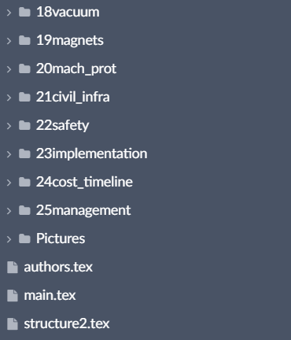
Project structure
What you should do:
Edit the chapter text file
Edit the bibliography
Add your images in the image subfolder img_[chaptername]
Change the chapter header image (fig_copertina_[chaptername].jpg)
Edit the Author list (scrolling down at the end of the list) with the people contribution to your chapter (I’ll merge all the names in the final author list, now the file contain the old CDR author list as an example of the format required)
What you should NOT do:
Edit the main.tex file
Add your own package in the strcure2.tex file (if you need any package, please contact me)
Add images in the Pictures folder (that folder contains only the images for front page and ToCs)
List of chapters
TDR preview
Chapter text
Chapter folder
Image subfolder
Bibliography file
Chapter text file
Front page images
Author list
Main file (with compiling commands only)
File containing the style commands only

Slide 5
Project structure: commands in the chapter text file
This part contains the chapter title and header figure, you shouldn’t modify or delete that part
This part contains the chapter text, you should write here
This part contains the instructions for generating the bibliography from the bib file, you shouldn’t modify or delete that part

Slide 6
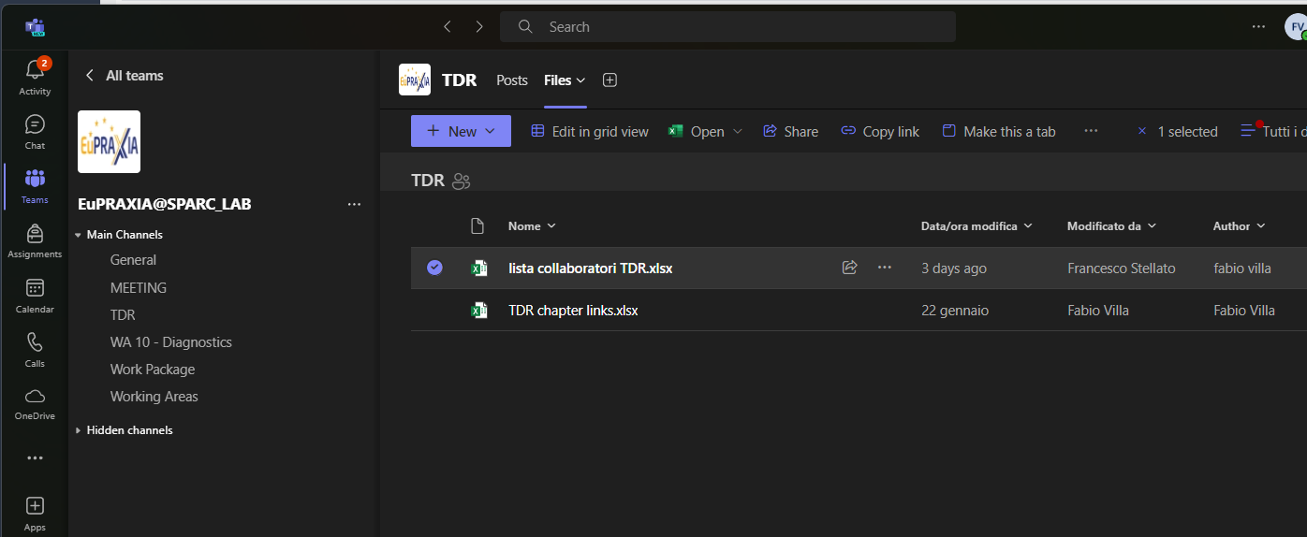
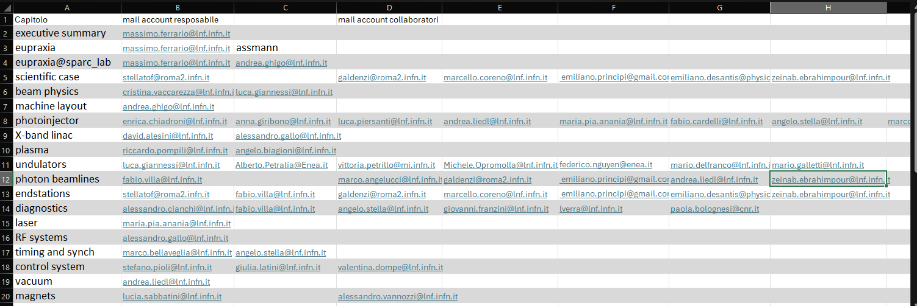
Sharing the projects
This function is reserved to the owner only (Fabio)
=> We have an Excel file where you can add the Overleaf account mails of your collaborators (premium or free accounts, INFN or other mails); I’ll add them

Slide 7
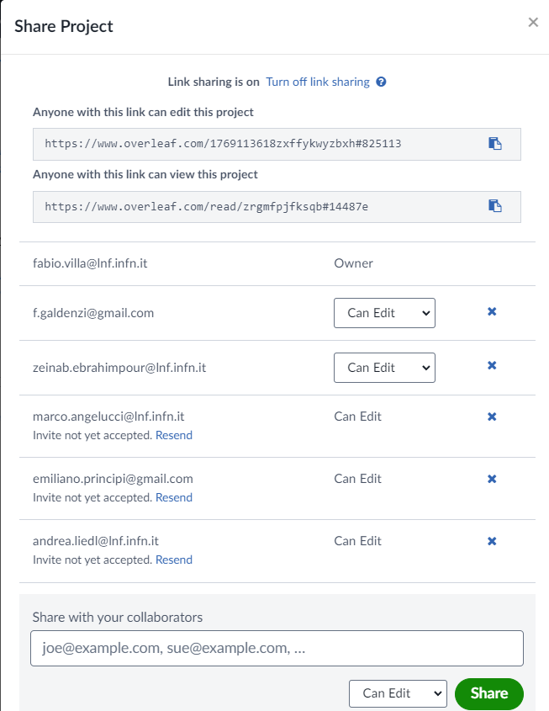
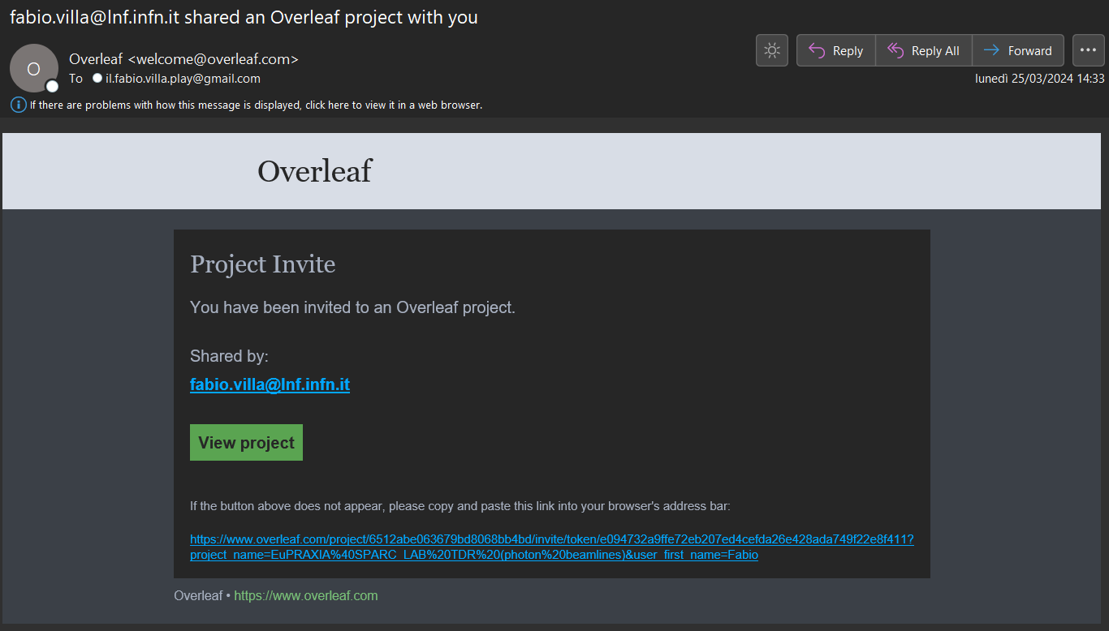
Sharing the projects
Overleaf send an invitation for each project (no title in the subject, so if you are involved in many projects, you should accept each invitation)
The access via the link is still viable (chapter link list in the second excel file in Teams folder)

Slide 8
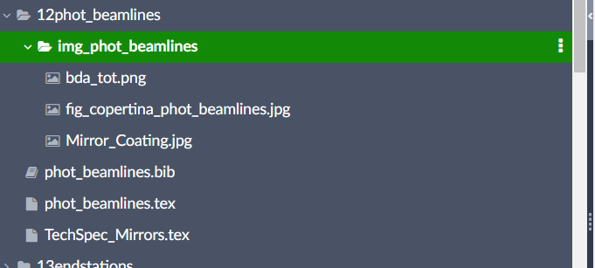
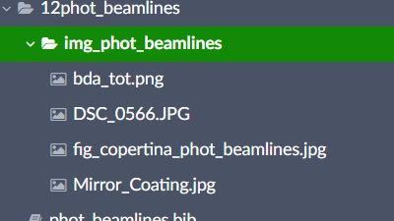
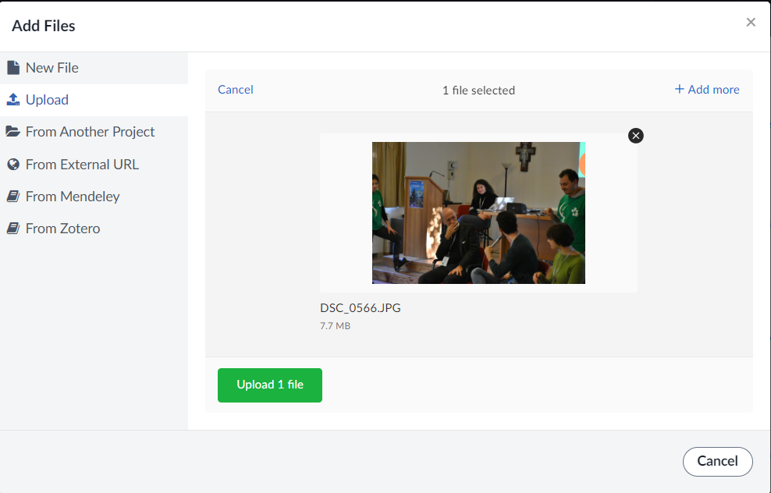
How to add images to your project
Drag&drop:

Slide 9
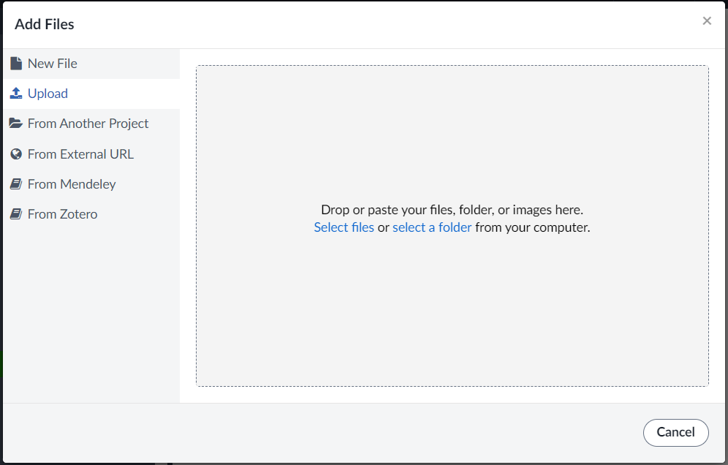
How to add images to your project
Drag&drop:
From the menu: (...)

Slide 10
How to add images to your project
Upload your image
Add command to the text:
Centering in the page (otherwise on the left)
Image location: [dimension] {folder//subfolder//name}
Latex commands for images environment
Caption: [short version for ToC]
{full caption}
Label (unique)
to be used to cite the figure

Slide 11
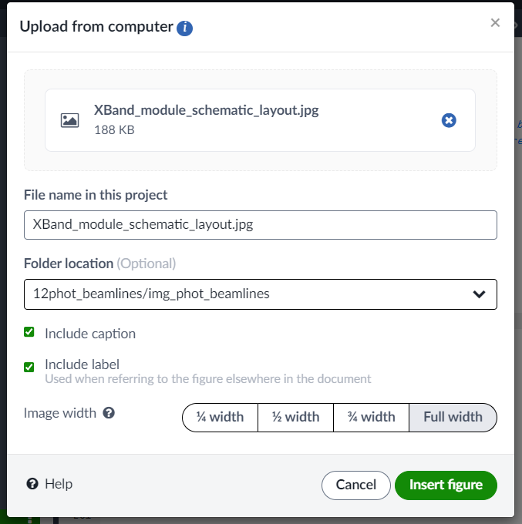
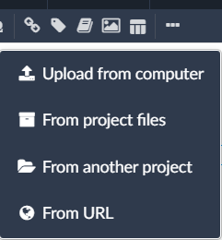
How to add images to your project
Upload your image
Add command to the text:
Drag or choose
Image name (as you want)
You must set the correct img folder
Tick for label and caption Choose the image width respect to the text area

Slide 12
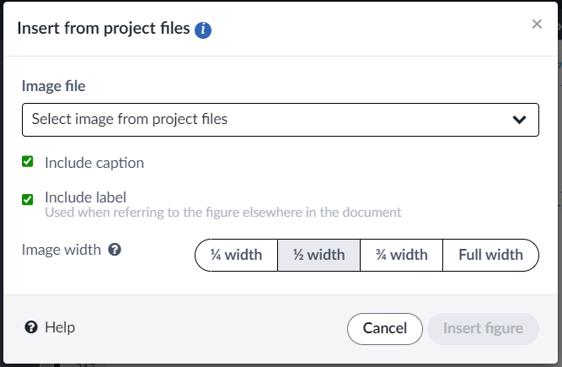
How to add images to your project
Upload your image
Add command to the text:
Choose the uploaded image
Tick for label and caption Choose the image width respect to the text area

Slide 13
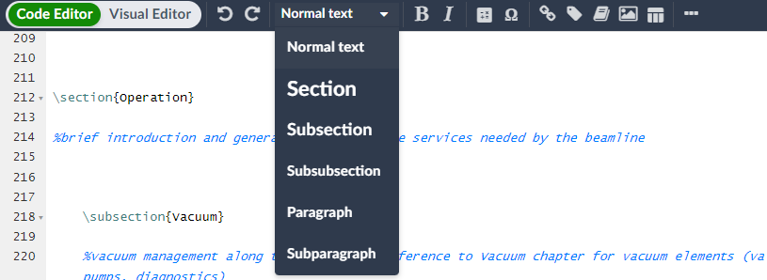
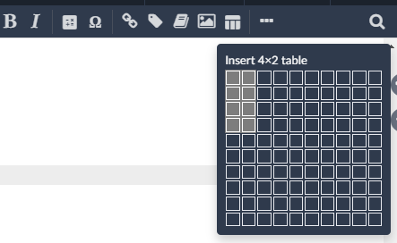
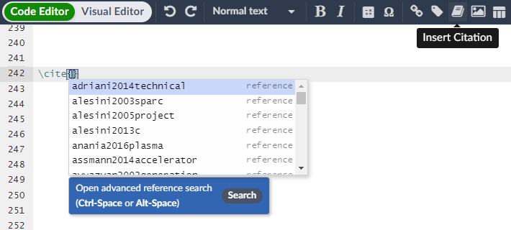
Other automation:
Sections
Reference
Table
Citation

