Slide 1
ITk Integration Lecce May - 9th – 2024 Emiliano Dané on behalf ITk Frascati collaboration

Slide 2
General items
The Clean Room is almost complete;
The Nitrogen plant is installed and under pressure test;
The climatic chamber now has a backup plant in case of bad-functional working of the air pressure plant. (some bottle of artificial air are connected to an automatic switch system in order to cover this item);

Slide 3
Things to do:
Define a detailed procedure for the ITk Assembly (together with UK and the coll.)
Check the compatibility of all the assembly tool (cabling, piping ecc..) with the Assembly tool
Make a repository for all the Assembly toolings
Find a solution for the Functional test in Climatic Chamber
Solution for the Shipping

Slide 4
1° attempt to go in detail for the assembly activities (focusing on weldings – S. Coelli)

Slide 5
 | Activity | Comment | Estimated Time
1 | HS positioning | Both the empty half shelves will be in position in the trolleys and test the mating in order to do the zero
2 | Pipe positioning | In Milan they are testing the insertion in 2 pieces: Inlet (1) and exhaust plus the by-pass (2) in order to make it easier. Pipe holders to define (not clear to me). Pipes goes everywhere.. they are not selfsustaining.
3 | by-pass welding | welding of the bypass with the pipes placed inside the HS (Is there enough room for the WH?)
4 | Leak or/and Pressure Test | re-working (socket baseline)
5 | 1st Manifold welding | Suggested by Simone: socket, Mechanical tool to hold the Welding Head. Procedure has to be tested.
6 | Cabling (Harness) insertion
7 | C-stifness positioning
8 | Half Ring positioning | in what order do we place the half rings? (could be from high z?)
9 | Pipe HR welding Exhaust | 2 weldings: Start with welding the Outlet. The U (exhaust) part is custom on place. First do the welding manifold side, then HR side. Suggested socket welding. Mechanical tool needed to hold the welding head.
10 | Leak or/and Pressure test | Not clear
11 | Pipe HR welding Inlet | 1 welding. Mechanical tool to hold the Welding Head
12 | Leak o Pressure test
13 | HR electrical connection
Only the HS part. (with S. Coelli)

Slide 6
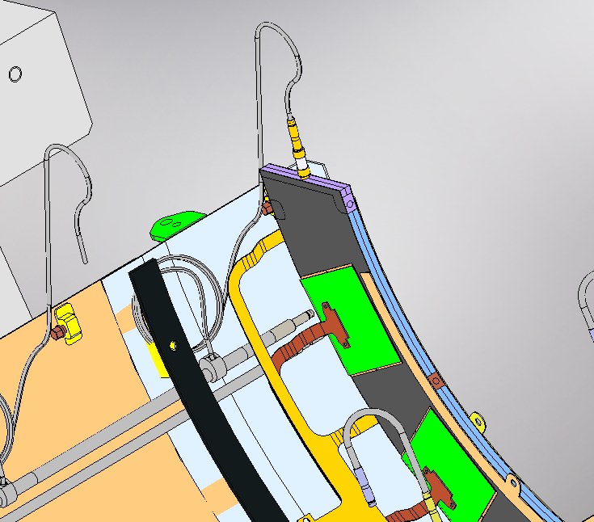
by-pass welding
Inlet
by-pass

Slide 7
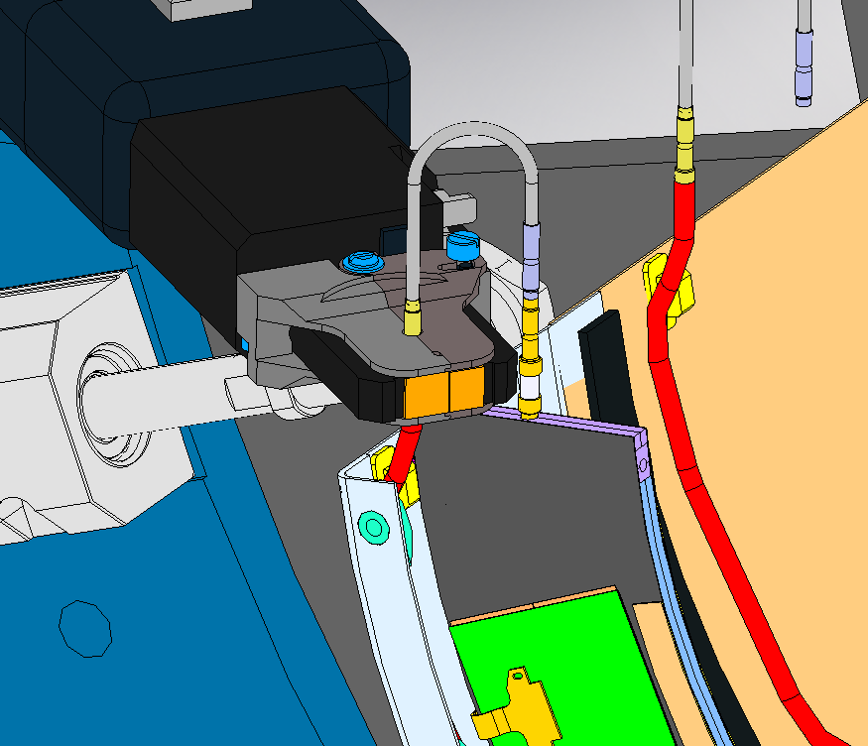
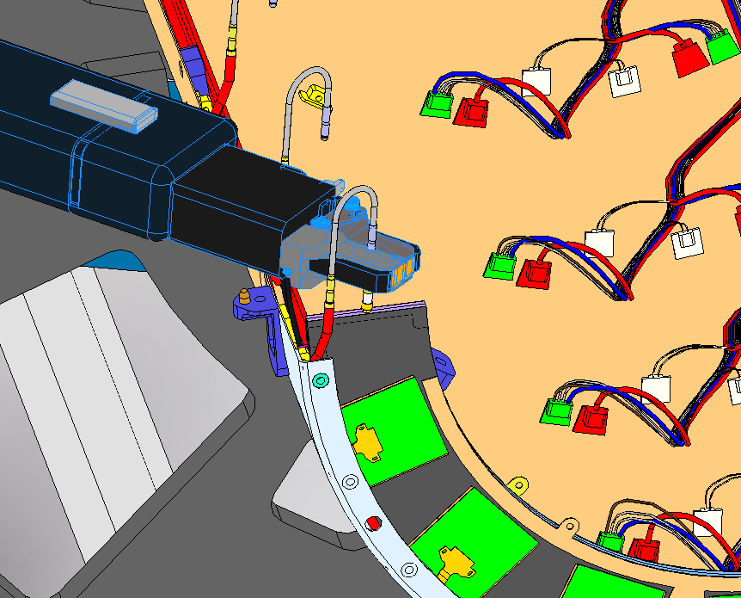
U customized
1° exhaust welding
2° exhaust welding

Slide 8
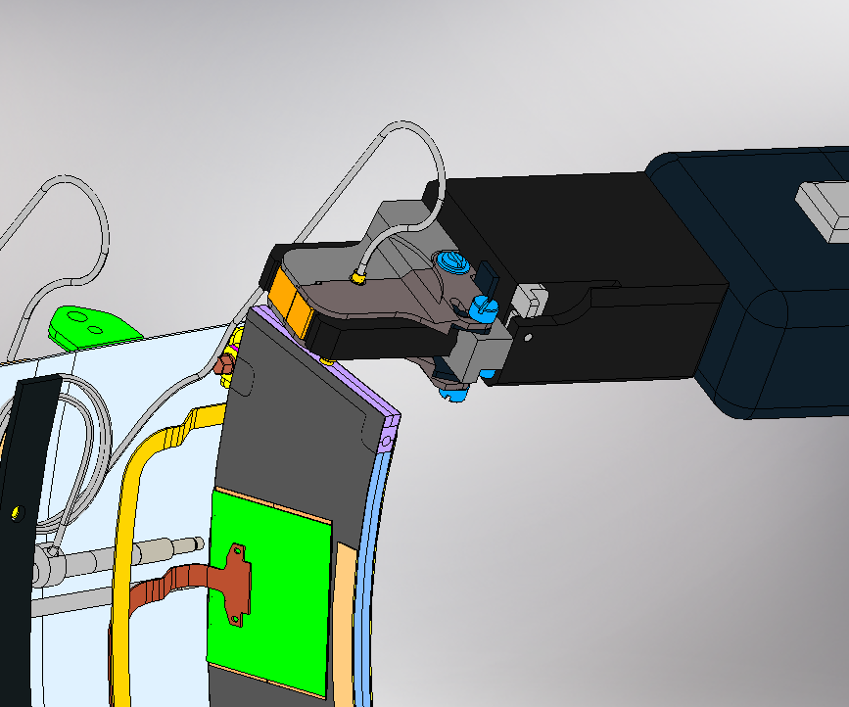
Swagelok Welding Head used in the model
Inlet Welding

Slide 9
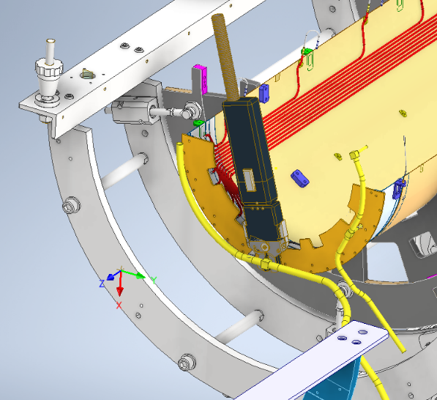
1° welding on manifold and test before the cabling insertion, just after the piping positioning
fitting
Maybe more confortable putting the Assembly tool in vertical
Only half Manifold is present at this level
The recovery could be done cutting, remove the entire piping, rework in workshop and restart the process or we can use another brand new one set of pipings

Slide 10
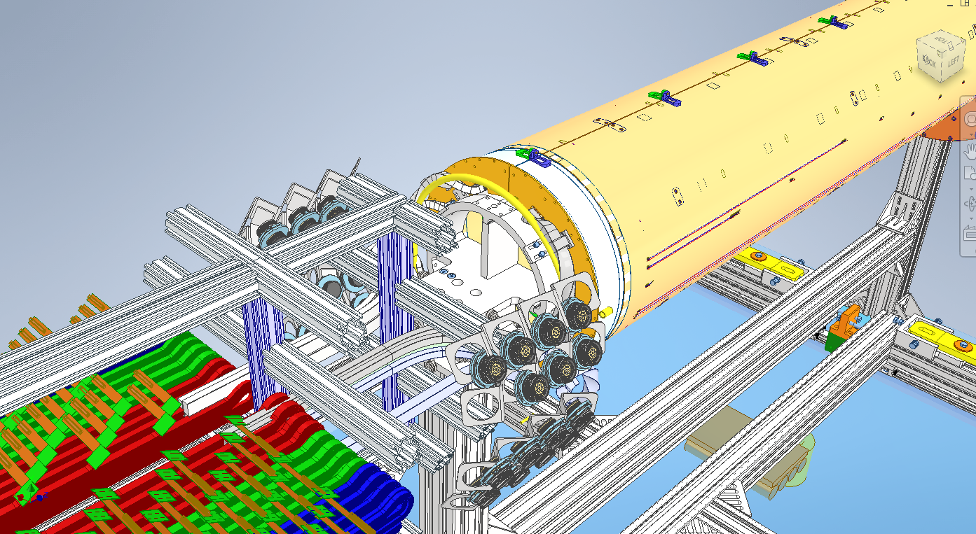
2nd welding after the mating of the layer
Removing this upper part of the trolley. we don't need at this level in order to have more room for the welding head
Here the recovery could be done by sleeves or reworking the pipes
I don't know the mapping of HV
in order to simulate the rooming available

Slide 11
Action (as mentioned by Simone):
Perform test in order to qulify the procedure assembly on aluminum prototype (in Milan).
Then with the CF prototype perform the test in Frascati. Not only for the welding but also to verify all the assemby steps.

Slide 12
Functional test in limatic Chamber

Slide 13
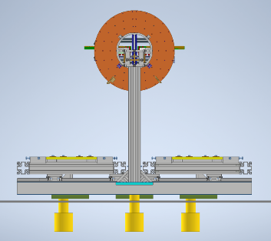
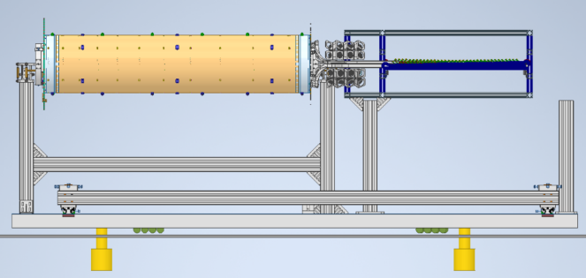
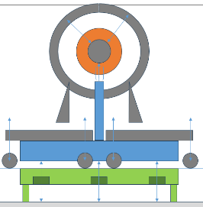
Functional Test in Climatic Chamber
Load cells
New platform
Floor
Under Study:
To do a platform and position it over the existing one in order to:
avoid to leave a big hole in the floor when system is moved to the CC
avoid 20cm of lifting (only few millimetrs)
same tool as in Liverpool
Passive and active pillars (only active shown in the pictures) passing through the existing platform
Embedded wheels or external spring wheels (not clear if it fits in CC)
To be checked
External spring wheels

Slide 14
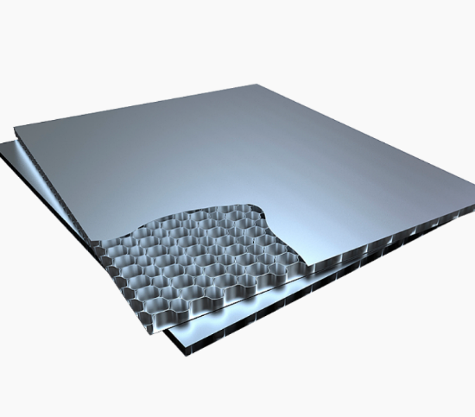
2 companies
https://www.cel.eu/
https://www.confimibergamo.it/cospal-compositer-srl.html

Slide 15
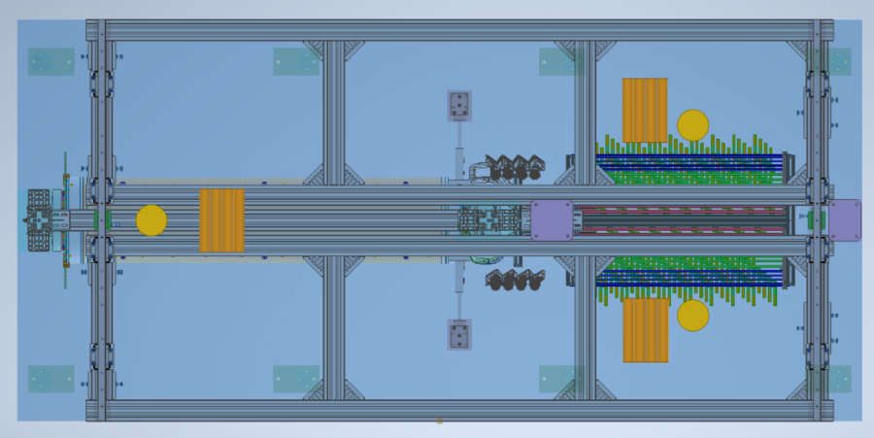
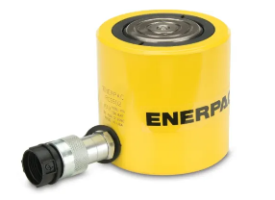
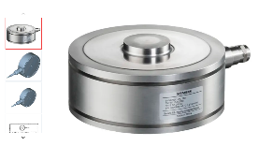
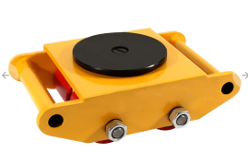
Cylindrical wheel trolleys
Lifting Jacks
Synchronized electric hydraulic jacks. We used a lot for the lifting of Kloe experiment.
Pivotable wheel
Calculation of center of mass in order to find the best jack's position limiting the stresses
Use of the load cells for the load transfer from the "Assemby position" to the jacks and then on the wheel trolleys

Slide 16
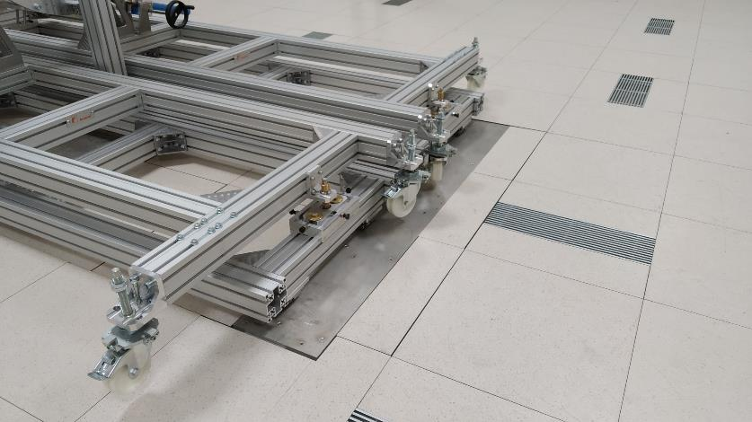
Shipping
The use of the new platform involves the lengthening of the bar and the addition of 2 wheels (one per side), which must be dismantled as soon as the trolley move out from the platform in order to fit in the Climatie Chamber.

Slide 17
Action:
Check the CAD model be consistent with real object;
in order to have a better knowledge of the assembly trolley we need to "play" with it, by using some fake or real Half Shell, not yet in Frascati
We started to think some solution. We have to converge soon in one direction;

Slide 18
Shipping

Slide 19
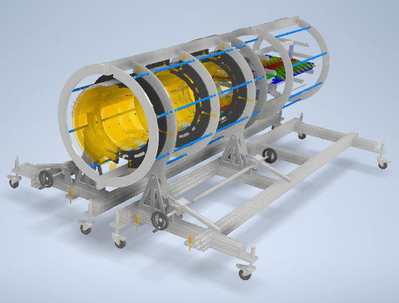
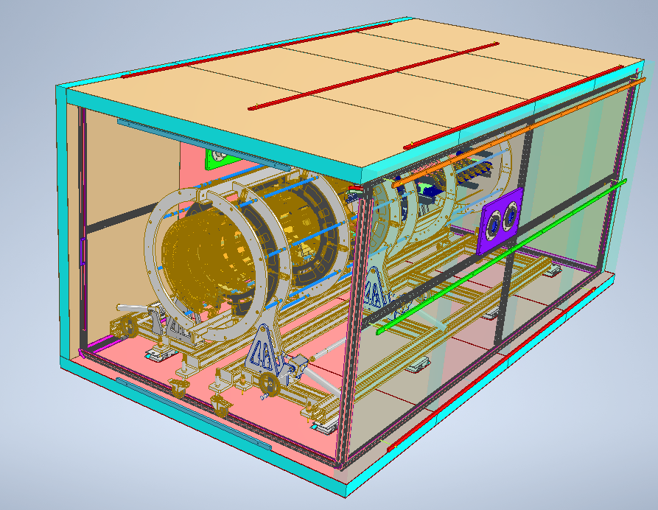
Wheels are out of the room of the box, so we have to mount the lateral and upper panel, after the fixing of the trolley on the basement.
A trolley easy to move with load on the rails and
compatible with the transport box.
Fixed to the dumped basement, remove the wheels.
Once in CERN and after the test the wheels are mounted back.

Slide 20
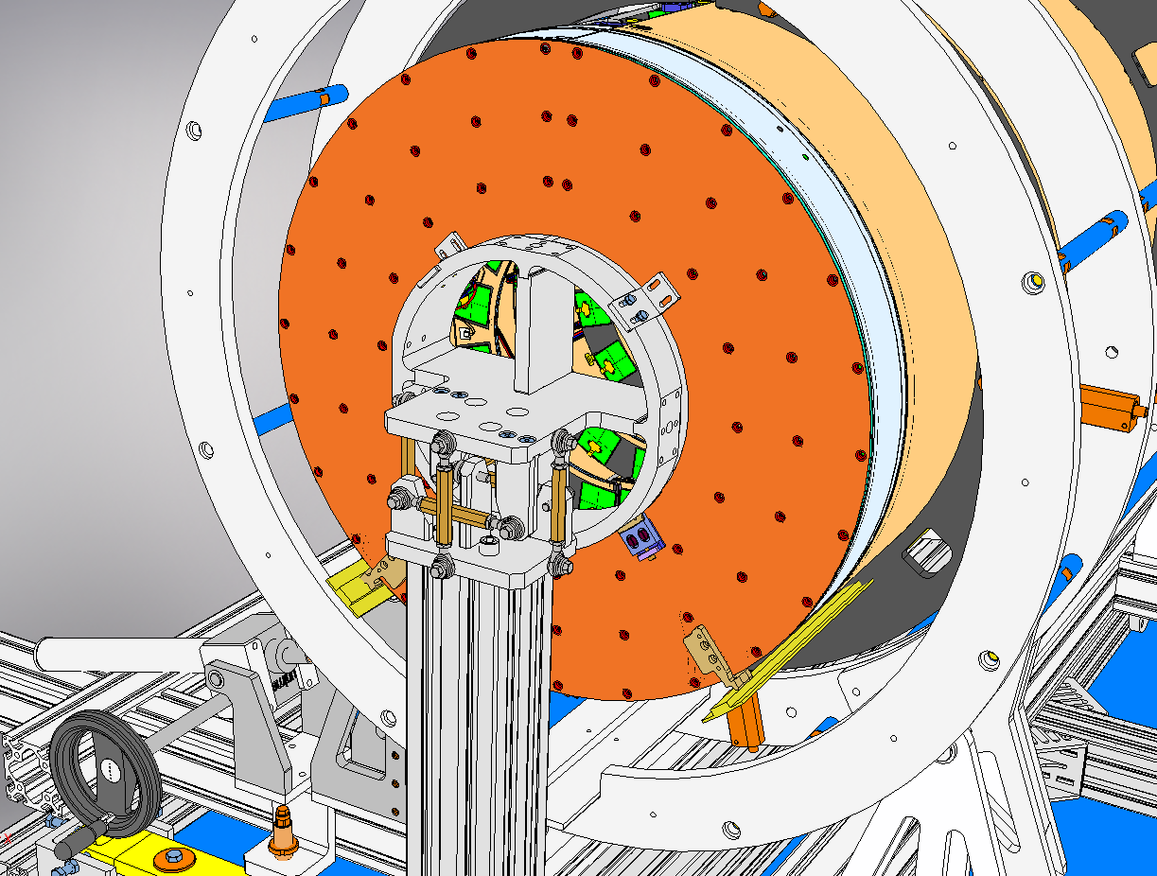
Not real rails – who is the contactfor the final design?
Design of the CF flange in order to include the rails, or think to have another support to holding them
Modification in order to have a system to swicth the load, from the Head to the rails.

Slide 21
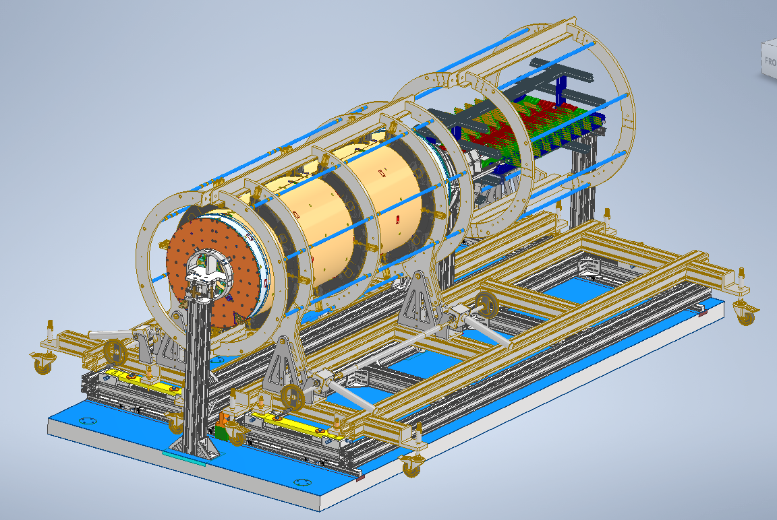
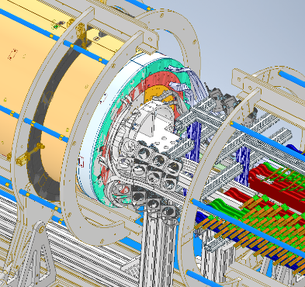
This is the situation after the L4 mating
Once the load is transferred to the rails the heads are removed

Slide 22
Action (very similar to the previous item):
Check the CAD model be consistent with real object;
in order to have a better knowledge of the assembly trolley we need to "play" with it, by using some fake or real Half Shell, not yet in Frascati
We started to think some solution. We have to converge soon in one direction;

