Slide 1
Update on ITS3 test beam analysis and Paper

Slide 2
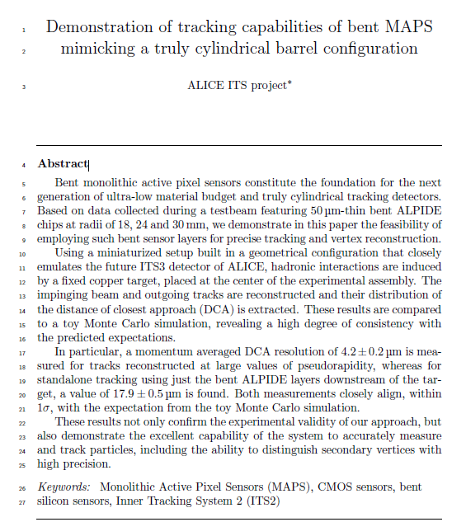
Paper is ready in a «V1.0» from January: https://www.overleaf.com/project/62e3a81f2237945e8bf920ad
a first internal revision was done and some fixes on text and figures were done
After we got some comment/feedback from Silvia and additional investigation are on going

Slide 3
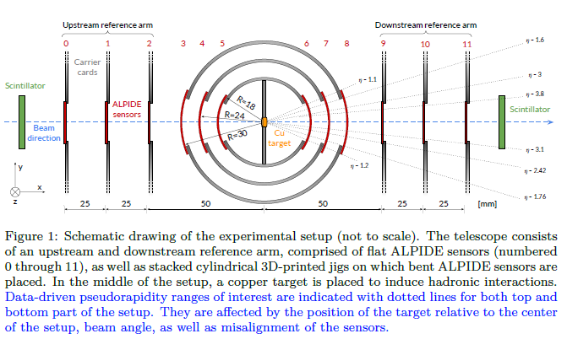
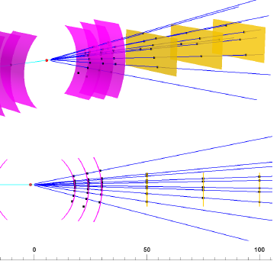
To clarify some discussions, main η ranges have been indicated
Update of the Event Display geometry, the detectors are placed in agreement with the alignment

Slide 4
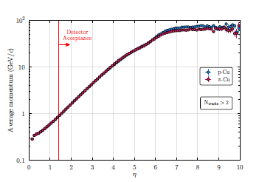
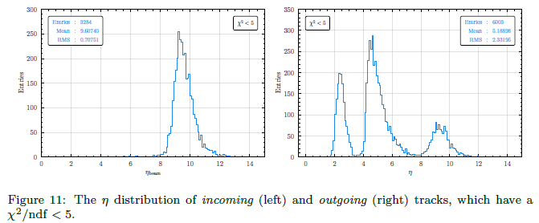
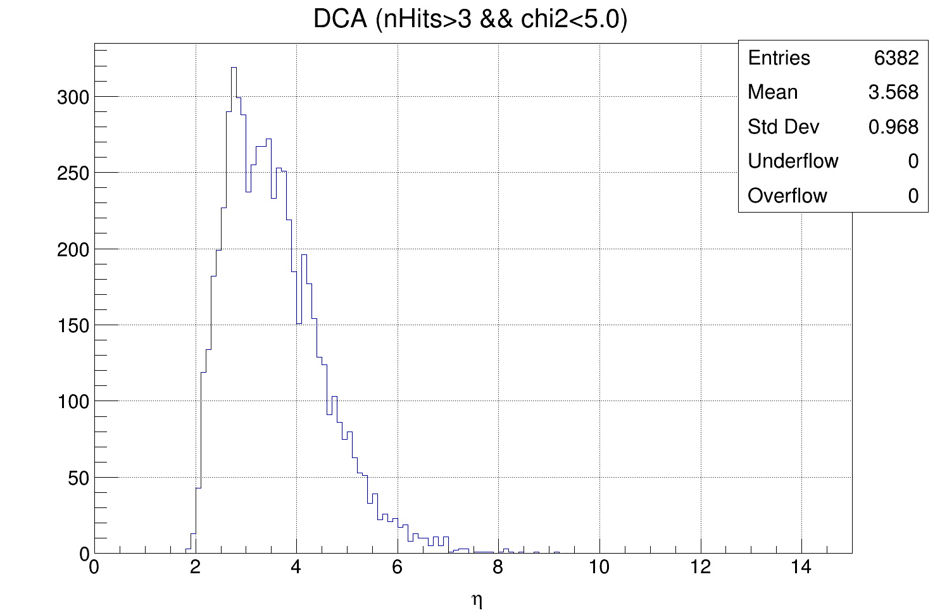
To better reproduce the real beam composition: PYTHIA simulation of the π component has been produced too
Some checks on the track η distribution have been performed. An updated of the text that explain this part will be done asap
ToyMC

Slide 5
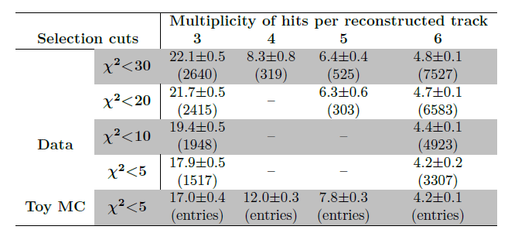
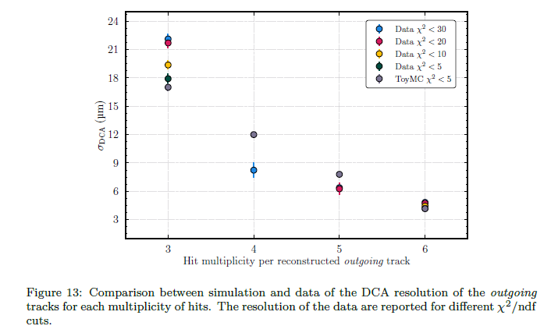
Tracker resolutions measurements even for the 3, 4 and 5 hits tracks can be done

Slide 6
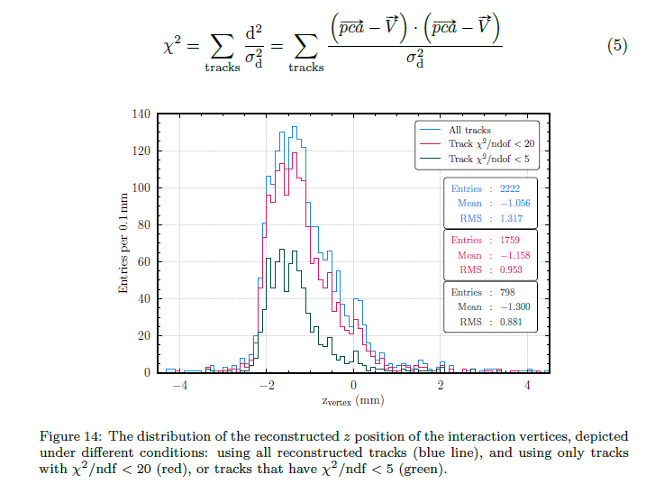
Vertex position measurement description has been included

Slide 7
Additional checks and activities on going
The large tracks Chi2 values are still an open question:
Check an update on Pattern Recognition (done)
Check on fitting function (done)
Check on the single hit residuals (on going)

Slide 8
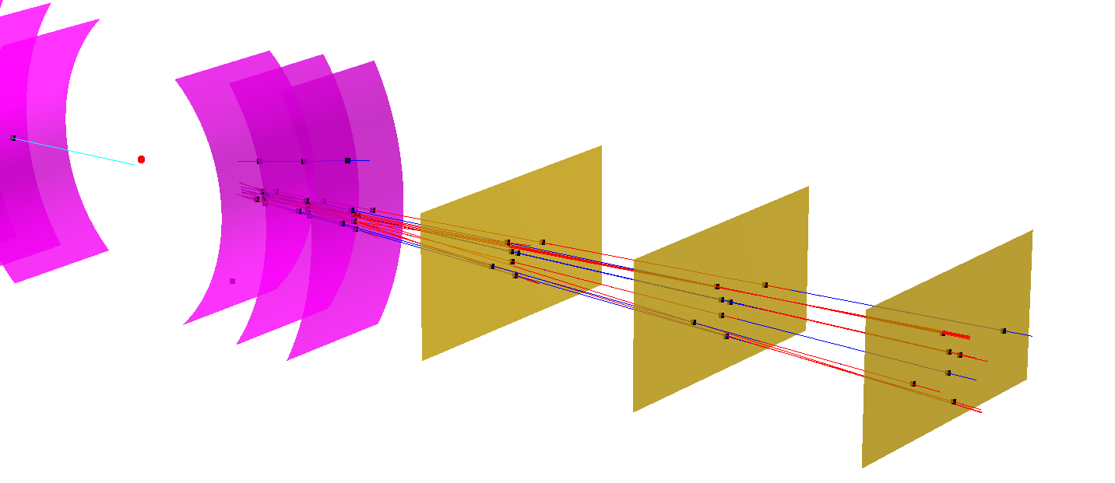
PR update
Since there was some missing tracks, the PR was suspected to be the source of the problem.
PR has been updated to find all possible tracks combination and then select the best ones:
Blue: selected tracks
Red: additional combinations

Slide 9
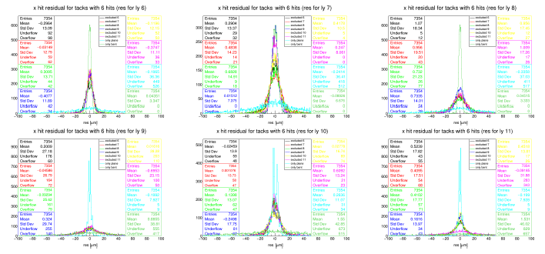
Check on the single hit residuals
After PR upgrade and fitting function check an investigation on single layer effect on the track quality is on going
X Residuals distributions per layers for Tracks with p-val>0 and nHit=6

Slide 10
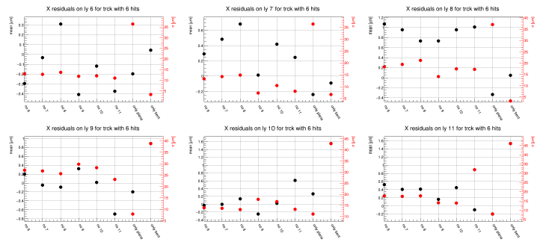
Check on the single hit residuals
After PR upgrade and fitting function check an investigation on single layer effect on the track quality is on going
X Residuals distributions per layers for Tracks with p-val>0 and nHit=6

