Slide 1



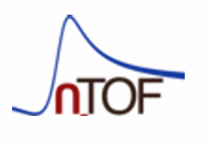


(n,cp) measurements at n_TOF for tritium breeding in nuclear fusion reactors
2025 September 28th - October 5th,
Monopoli (Bari) - Italy
Giulio Perfetto, Uniba and INFN sezione di Bari

Slide 2
Outline
Nuclear fusion and tritium breeding
The SINBA detector at n_TOF
Results of GEANT4 simulations

Slide 3
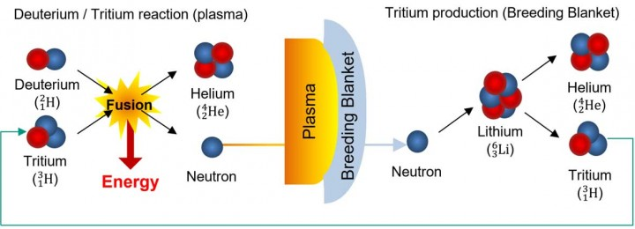
The Tritium cycle in fusion reactors
(14.2 MeV)
Tritium is radioactive and rare
Lithium (breeder) and Beryllium (neutron multiplier)
in the breeding blanket
Objective:
Tritium Breeding Ratio >1

Slide 4
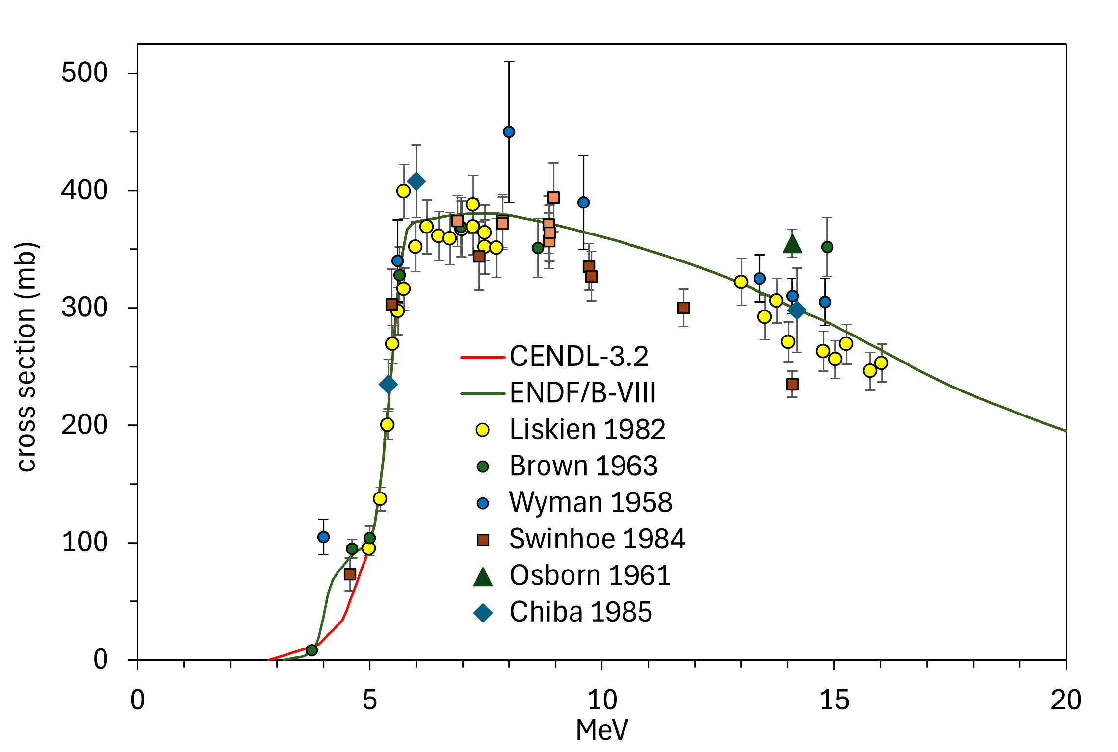

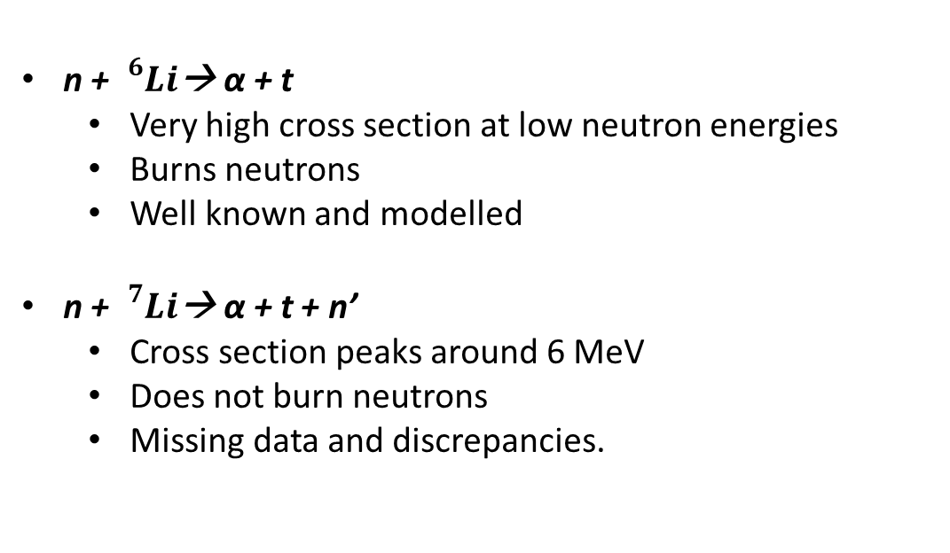
New measurements are essential to model the TBR accurately
$${}_{}^{7}{Li}\left(n,n^{′}t\right)α$$
Li produces Tritium through (n,cp) reactions: a nucleus capture a neutron and emits a light charged particle.
n + ${}_{}^{6}{Li}$→ α + t
  Very high cross section at low neutron energies
  Burns neutrons
  Well known and modelled
n + ${}_{}^{7}{Li}$→ α + t + n’
  Cross section peaks around 6 MeV
  Does not burn neutrons
  Missing data and discrepancies.
Neutron Energy
We have submitted a proposal to the INTC:
https://cds.cern.ch/record/2929615/files/INTC-P-739.pdf?version=1

Slide 5
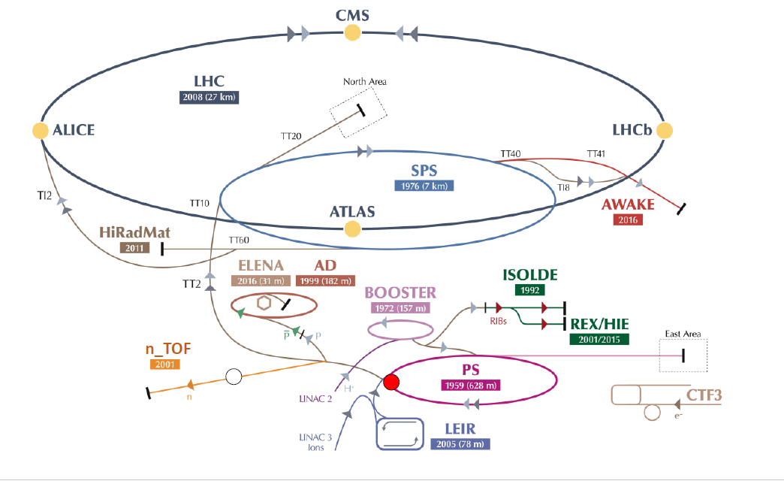
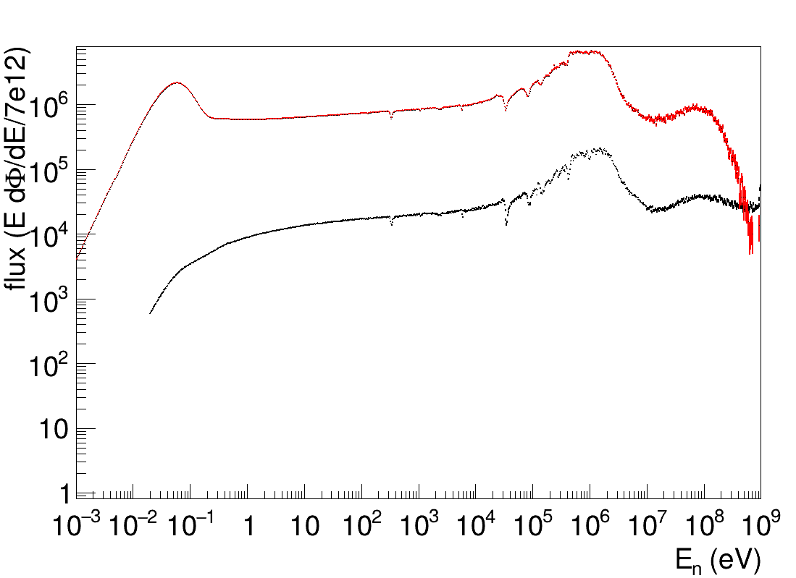
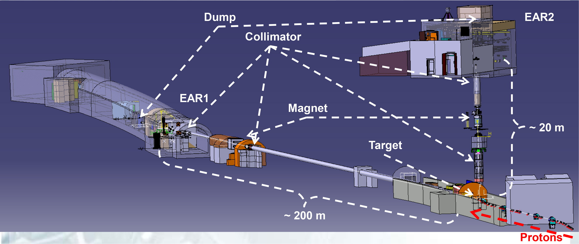
The n_TOF facility @CERN
Neutron beam, produced by spallation of protons.
Measurement of neutron-induced reactions cross sections.
Unique features: high intensity and neutron energy range from thermal to GeV → Suitable for new (n,cp) measurements
EAR2
EAR1

Slide 6
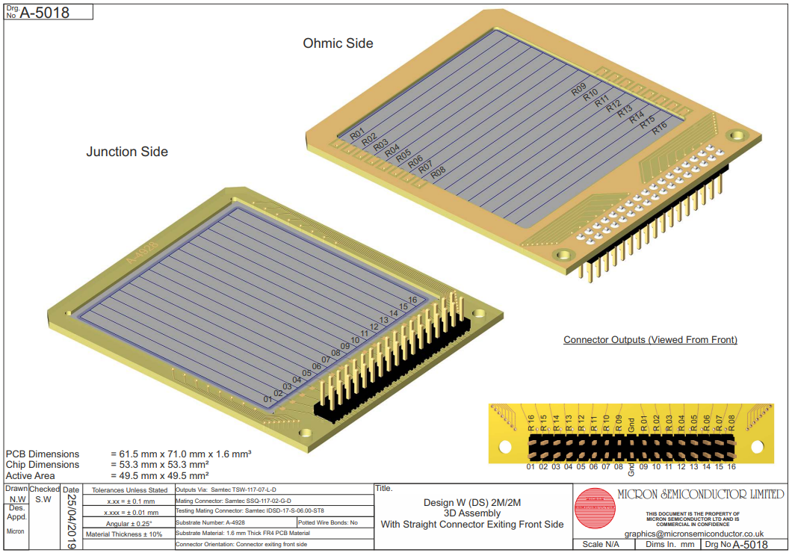
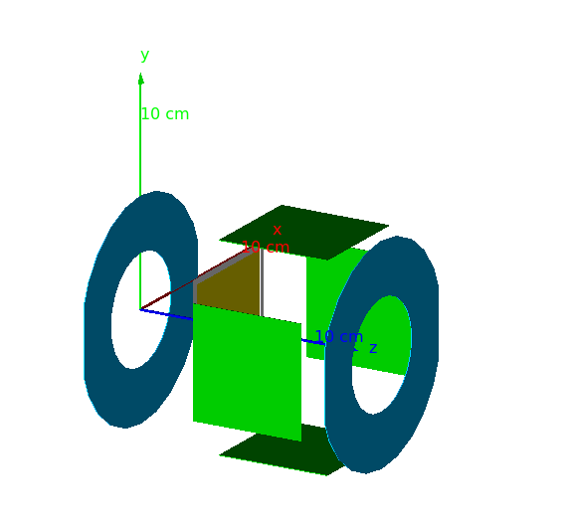
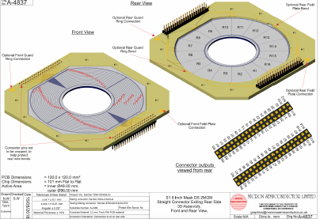
The SiNBa detector
The SIlicon Ntd Barrell detector: two double sided annular detectors and four squares, arranged in a cylindrical geometry.
Expected efficiency ≈ 35/40 %
Highly segmented:
Angular acceptance:
  20° - 35° forward
  130°-150° backward
  37°-78° square

Slide 7
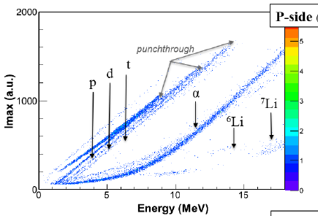

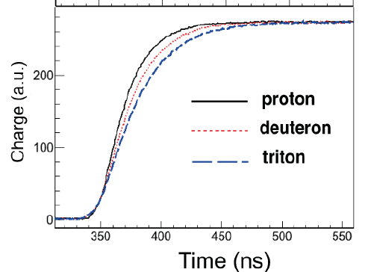
Innovative features of this measurement
Pulse Shape Discrimination + Digital Pulse Shape analysis
An example of different Pulse shapes and identification matrices. From Assié, M. et al, “Characterization of light particles (Z ≤ 2) discrimination performances by pulse shape analysis techniques with high-granularity silicon detector.”
This combination allows for the measurement of interactions across a wider neutron energy range compared with traditional techniques.

Slide 8
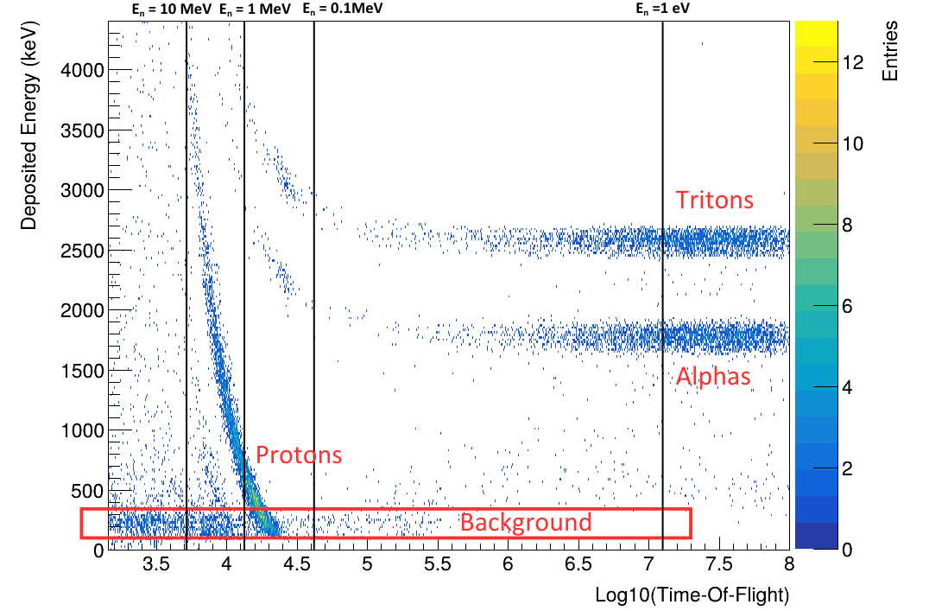
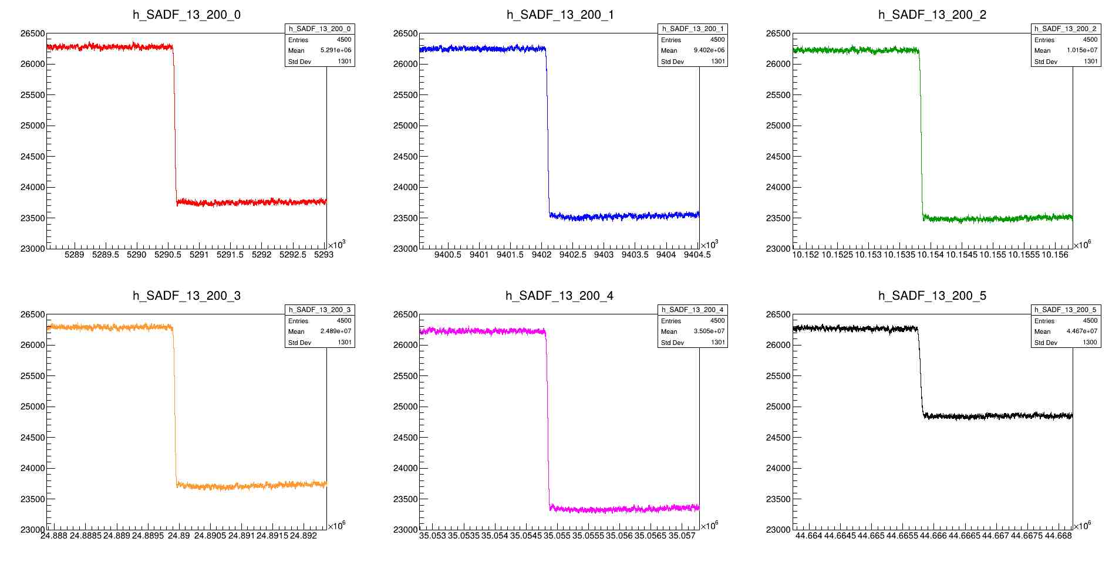
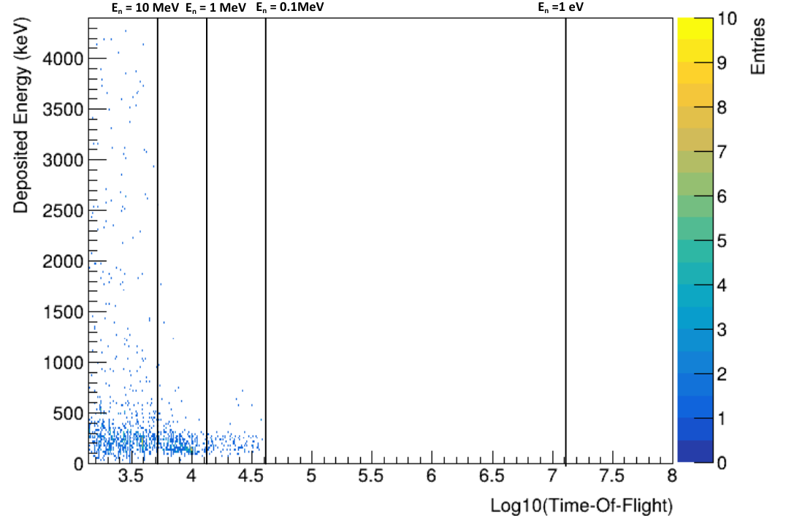
Preliminary Experimental test
LiF
Preamplifier signals
Empty
Noise ≈ 50 keV
Background ≈ 250 keV

Slide 9
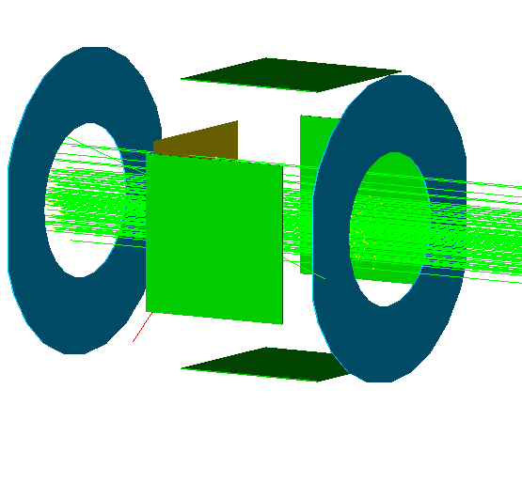
GEANT4 Simulation Results
Annular
Square
Sample
7 cm
5 cm
4 cm
Neutron
4.5 cm
Neutrons

Slide 10
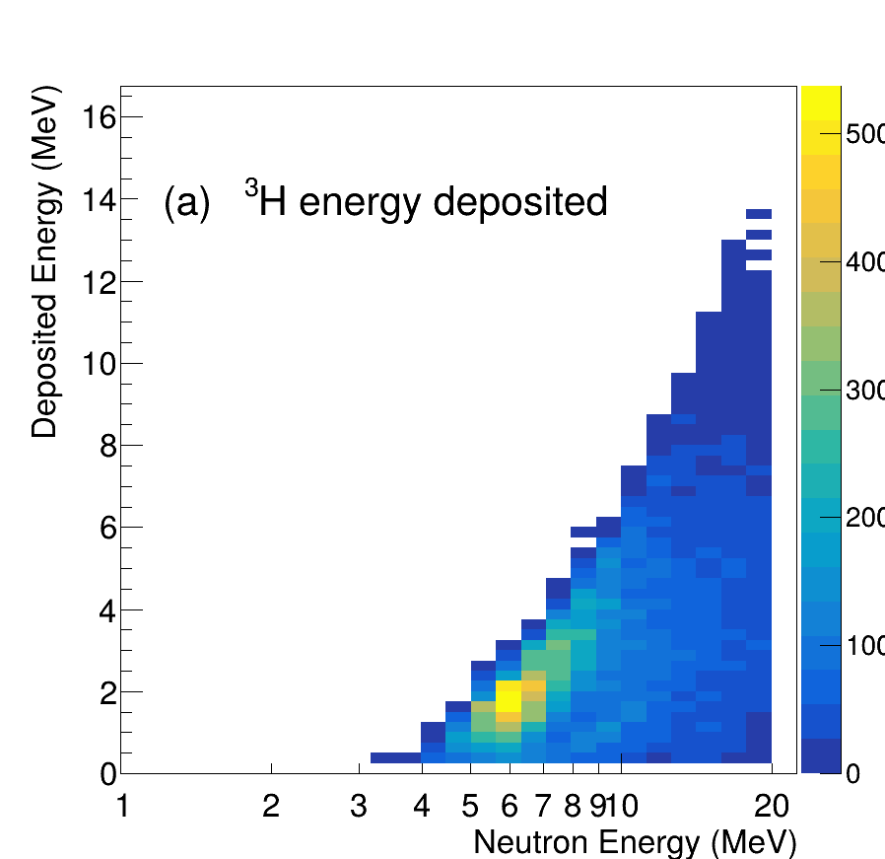
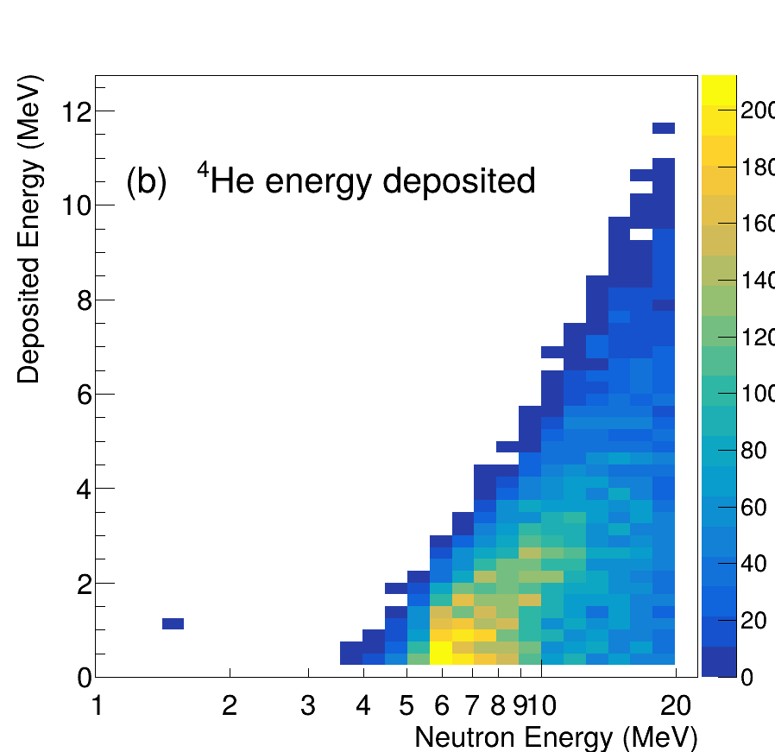
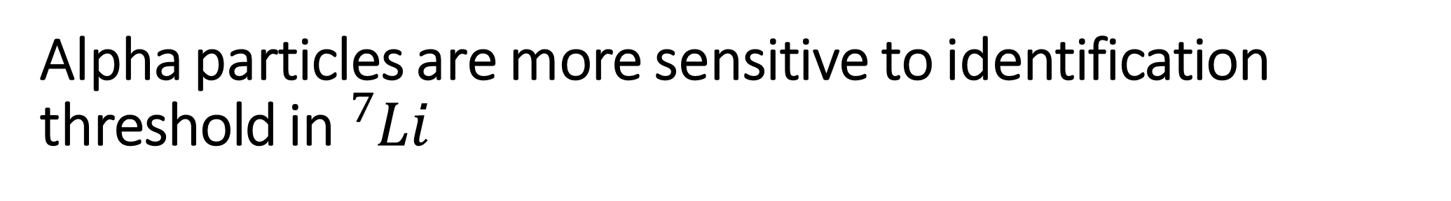
Alpha particles are more sensitive to identification threshold in ${}_{ }^{7}{Li}$
Efficiency corrections needed
2 MeV
2 MeV

Slide 11
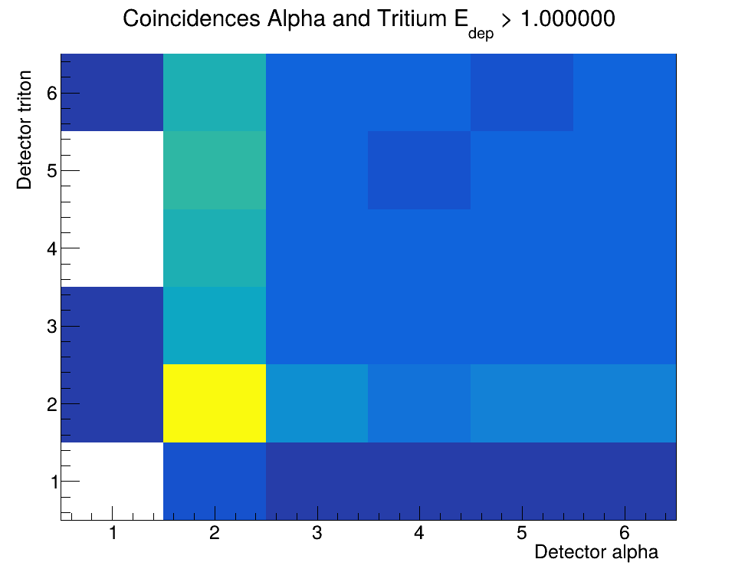
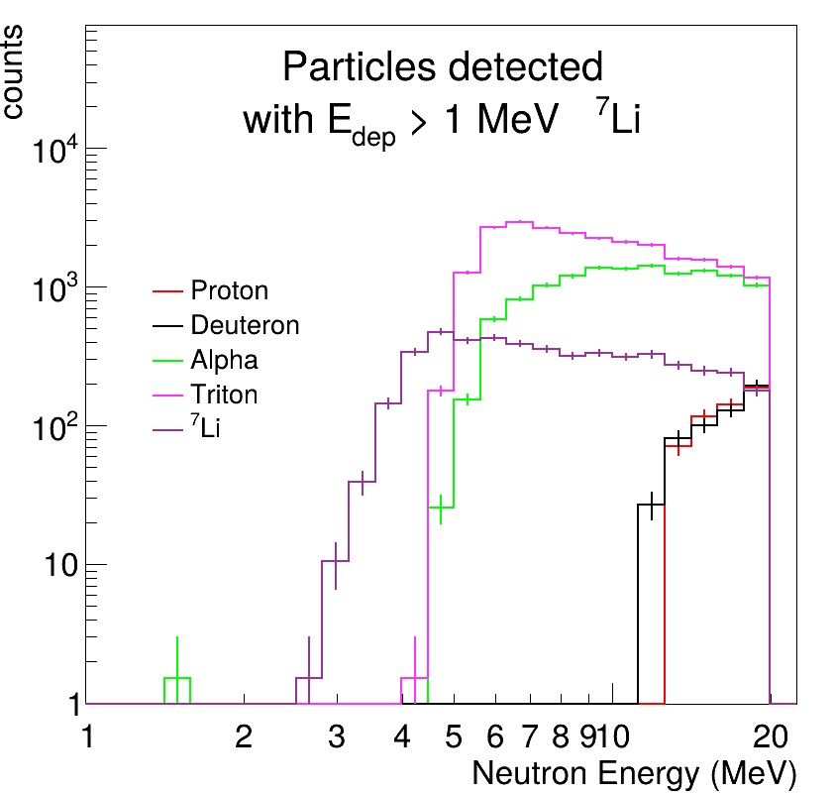


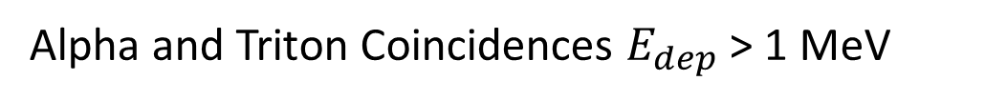
Background and coincidences in ${}_{ }^{7}{Li}:$ sample
Alpha and Triton Coincidences $E_{dep}$ > 1 MeV
S
FA
BA
BA
FA
S
¹H/²H are expected to be negligible < 14 MeV

Slide 12

Conclusions
Tritium breeding is essential for fusion, but key experimental data are missing.
We developed the SiNBA detector and MC simulations confirm its suitability for (n,cp) measurements.
A Proposal to the INTC was approved for Lithium, and an addendum for Beryllium was submitted.
First experimental test planned for end of 2025

Slide 13
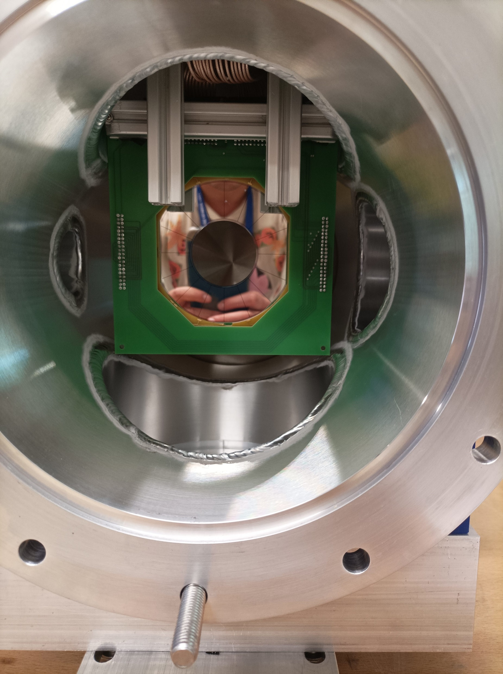
THANKS !
Giulio Perfetto
PhD Student, University of Bari & INFN Sezione di Bari
g.perfetto1@phd.uniba.it
Supervisor: Nicola Colonna
INFN Sezione di Bari & n_TOF Collaboration
nicola.colonna@ba.infn.it

Slide 14
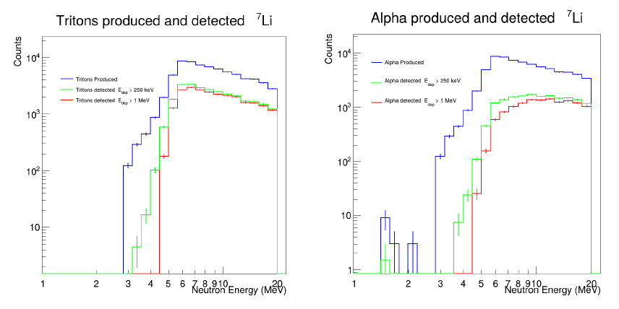

Slide 15
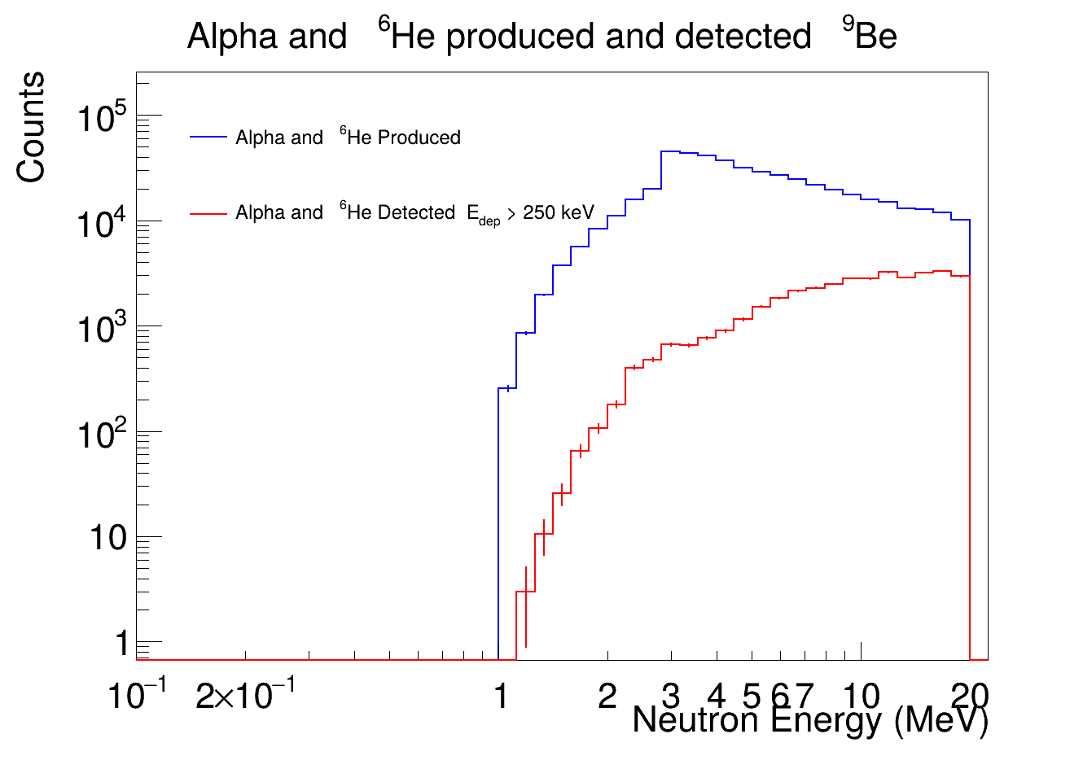

Slide 16
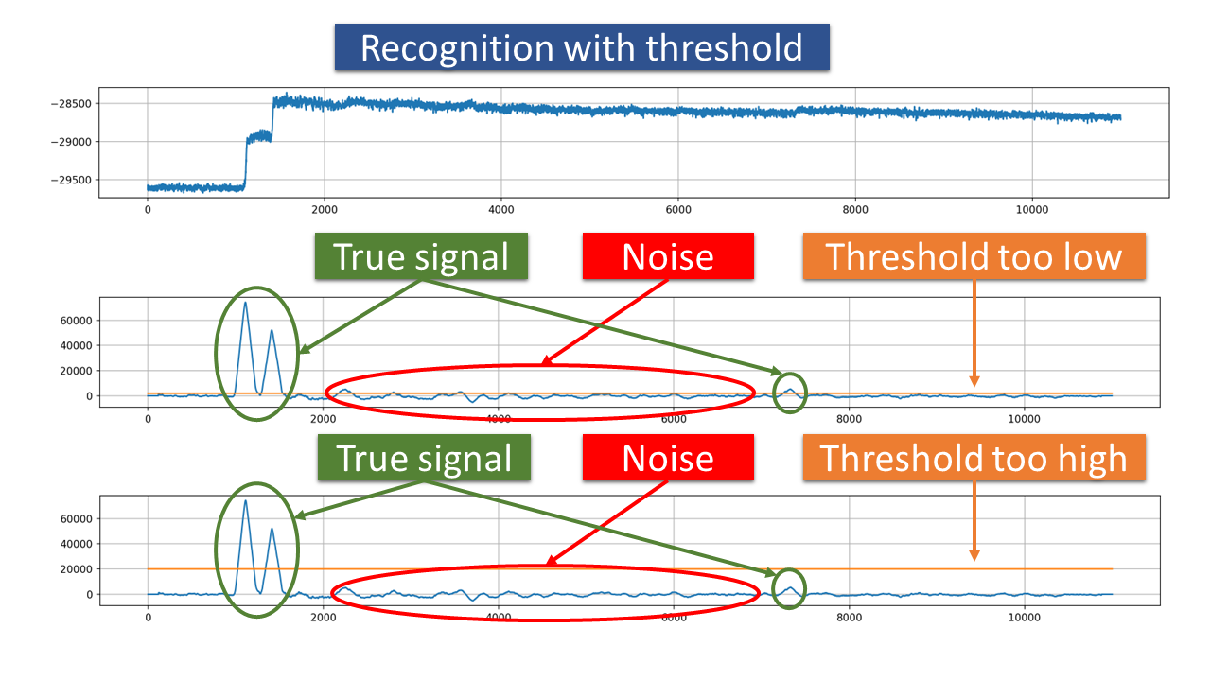
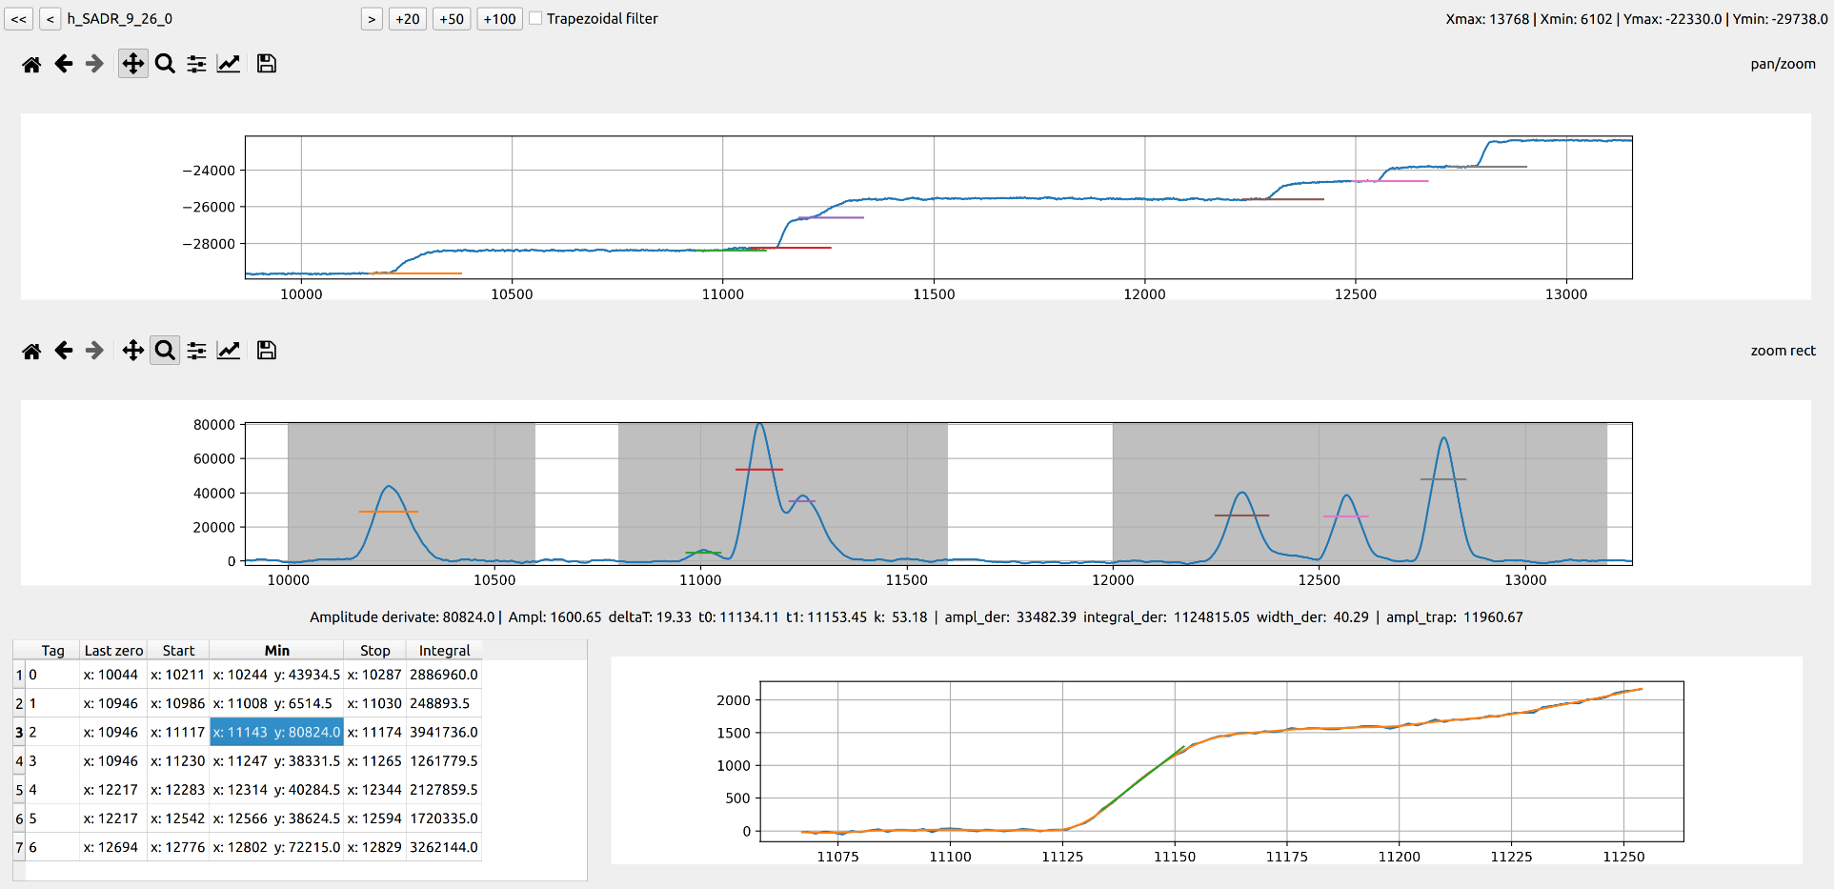
The ML algorithm
CNN
Traditional threshold-based techniques
Pulse discrimination with CNN and adaptive threshold
From G. Vecchio et al 2022 JINST 17 P09040, “Pulse identification and shape analysis by derivative-based peak detection using a Convolutional Neural Network”

Slide 17
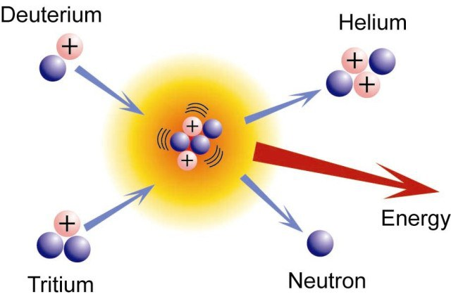
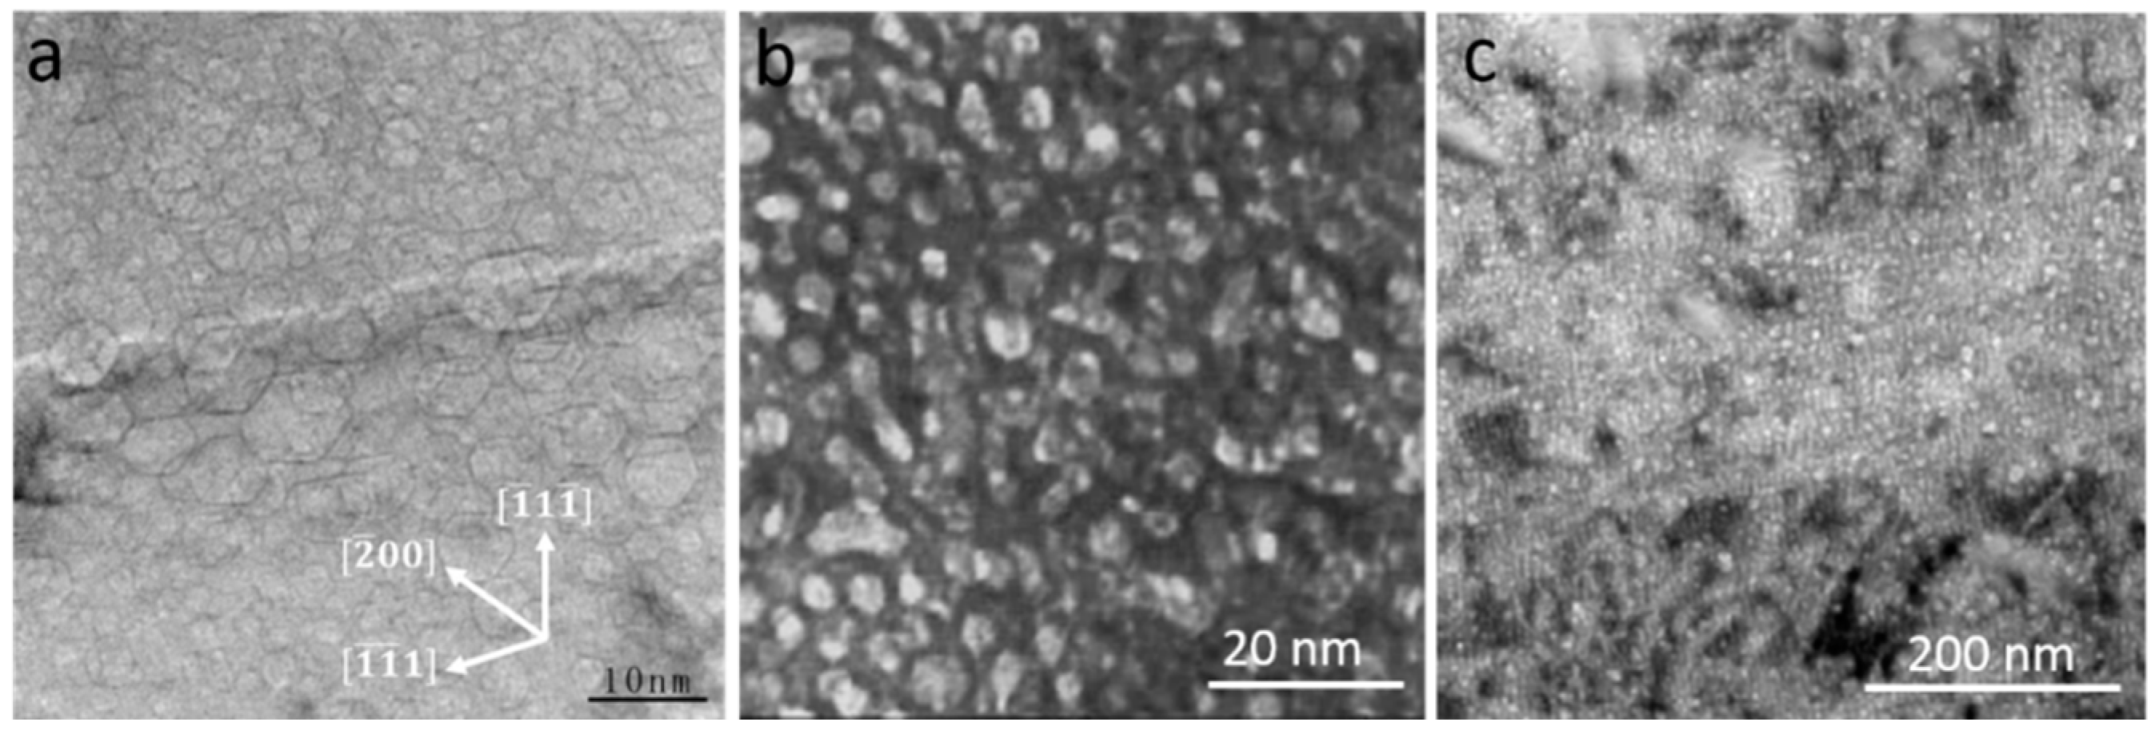
Neutron damage
TEM image of He bubbles in various metals. From Li,S. et al “Radiation-Induced Helium Bubbles in Metals”
Very troublesome. They cause formation of bubbles in material that severely alter the thermomechanical properties.
(n,cp) reactions: a nucleus capture a neutron and emits a light charged particle.
We are working on a proposal for the INTC related to this issue

Slide 18
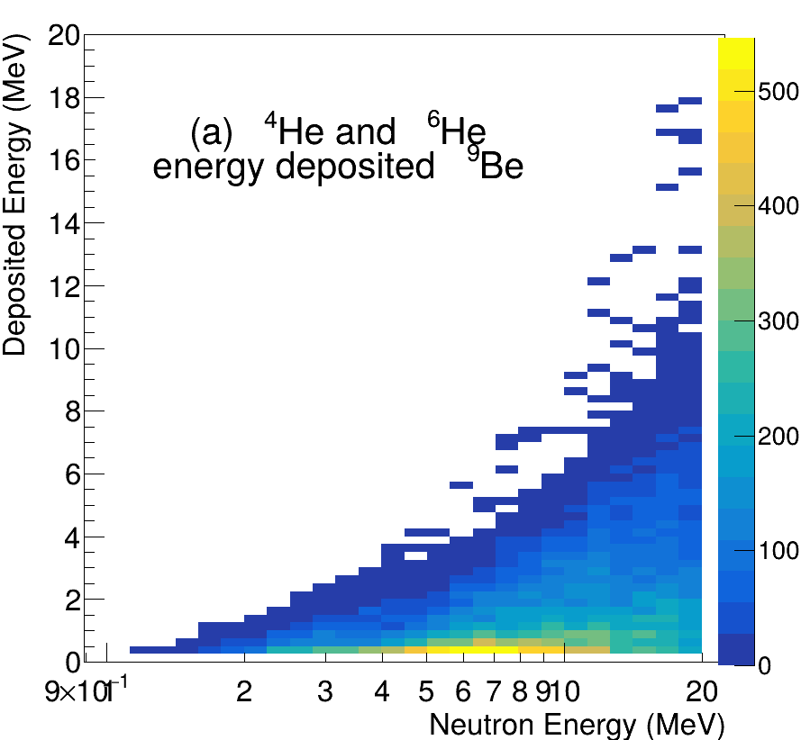
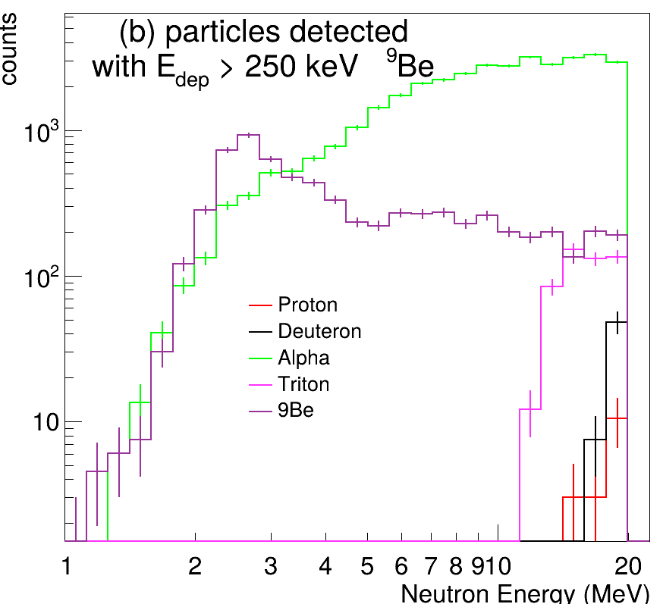

Identification and background for ${}_{}^{9}{Be}$ sample
PID threshold is not an issue
¹H/²H are expected to be negligible < 14 MeV

Slide 19
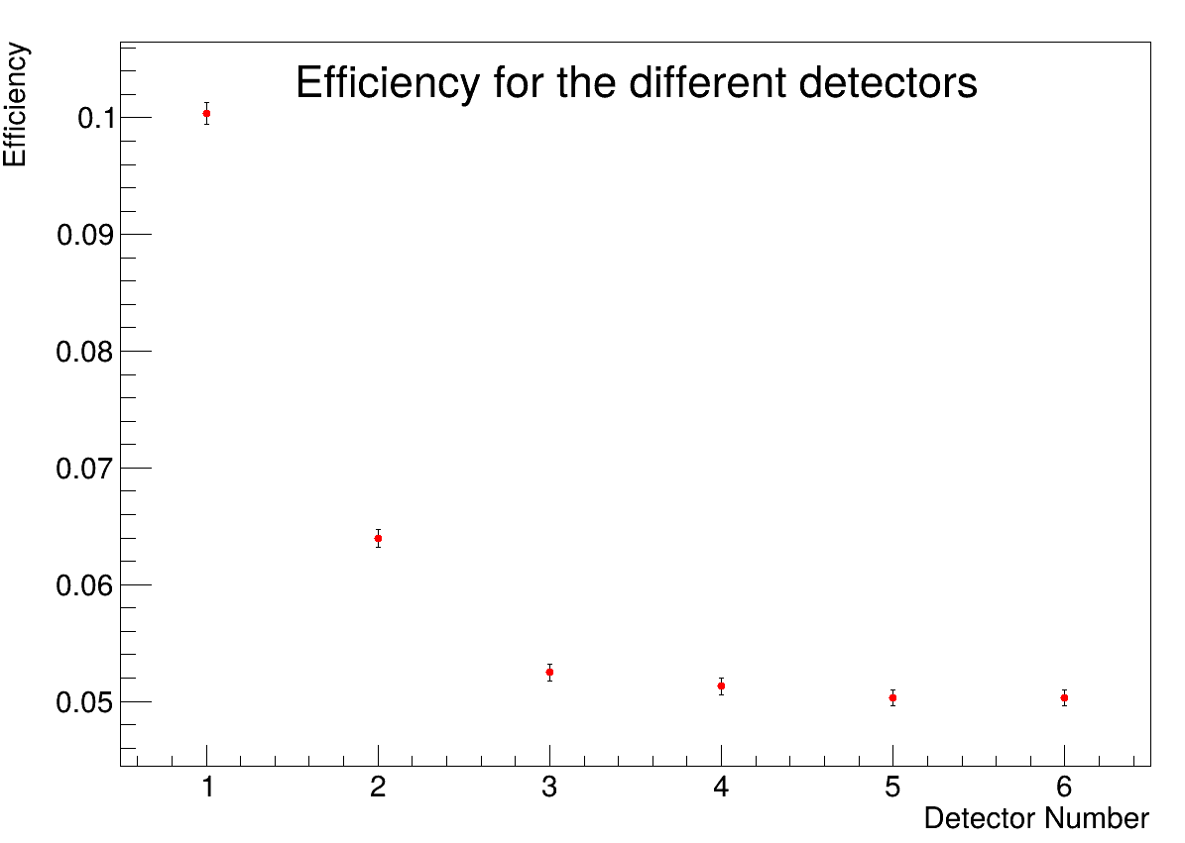
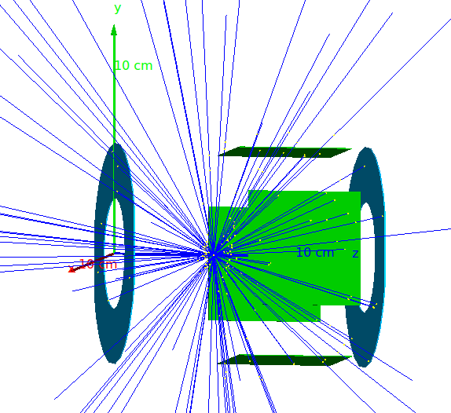
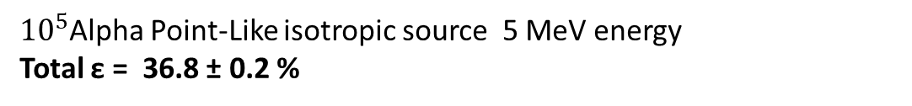
Detector Efficiency with Alpha Particles
backward
forward
Annular
Square
${10}^{5}$Alpha Point-Like isotropic source 5 MeV energy
Total ε = 36.8 ± 0.2 %

