Slide 1





Innovative Gamma-Ray Imaging Techniques for Environmental Applications
Antonio Zaccaro
XXXV International School "Francesco Romano"
October 4, 2025 • Monopoli (BA), Italia

Slide 2
Outline
Introduction
UAV Technologies for Environmental Monitoring
Overview
Comparison between Scintillators
Spectral analysis
Biological risk
Soil characterization

Slide 3


Environmental Radioactivity
What is its origin?
Is it dangerous to our health?
Decay of natural radionuclides
Accidents
Civil or military activities
7000 – 10 000 mSv
Death
1000 mSv
Symptoms of radiation poisoning
6,9 mSv
Computed Tomography (CT)
2,4 mSv
Average annual equivalent dose
0,5 mSv
Abdominal X-ray

Slide 4

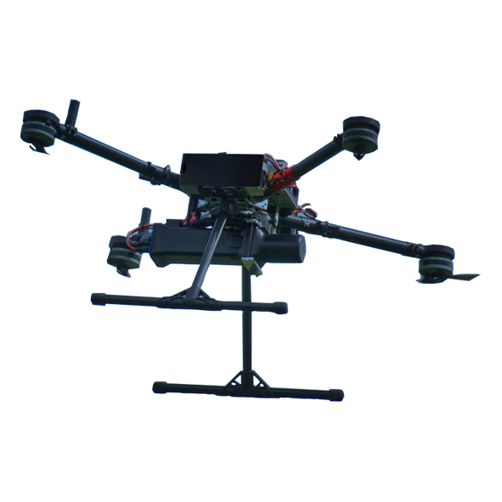
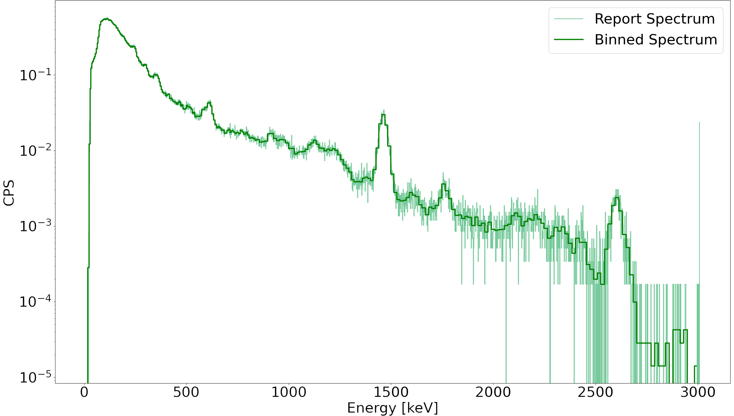




UAV for Environmental Monitoring
Biological risk assessment
Count rate
Soil characterization
Specific Activity
PCA
Gamma spectrum acquisition
Crystalline scintillators
Absorbed dose rate
$${}_{ }^{214}{Pb}$$
$${}_{ }^{40}K$$
$${}_{ }^{208}{Tl}$$
$${}_{ }^{212}{Pb}$$

Slide 5
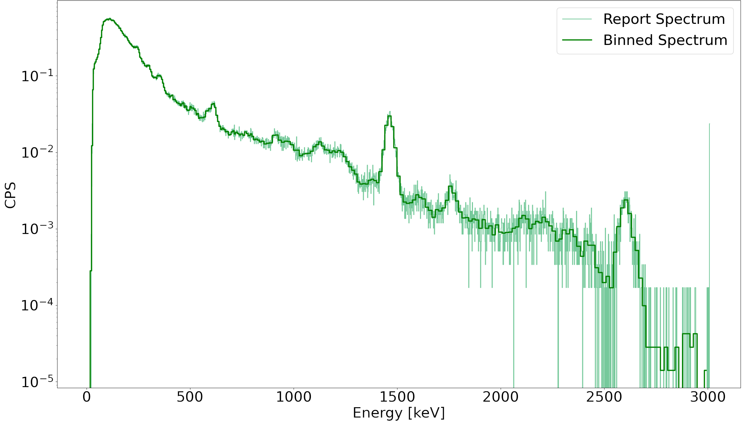
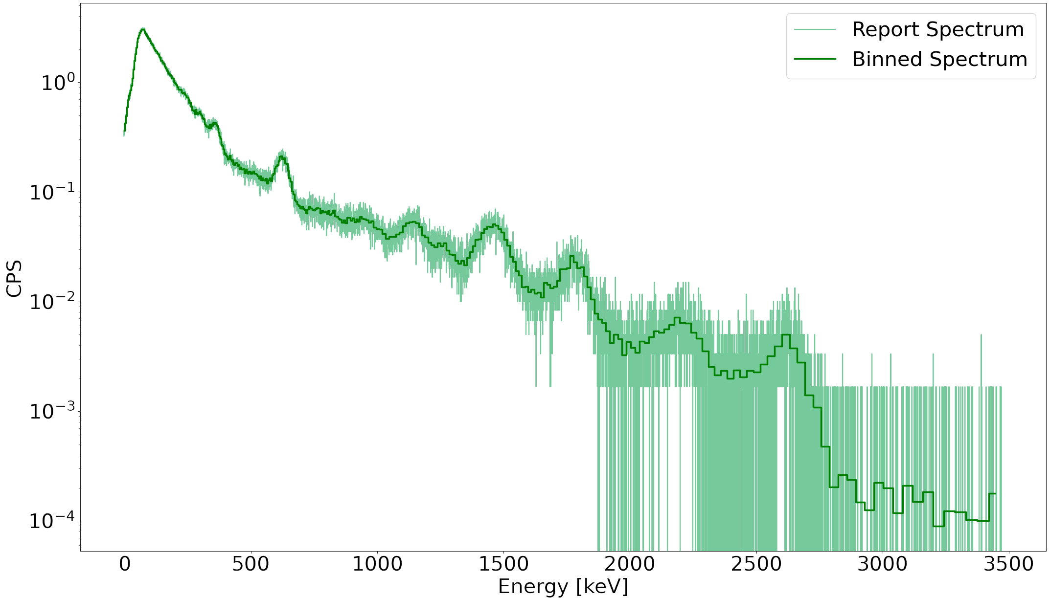









Comparison between Scintillators
$${CeBr}_{3}$$
$$NaI(Tl)$$
$${}_{ }^{214}{Pb}$$
$${}_{ }^{40}K$$
$${}_{ }^{214}{Pb}$$
$${}_{ }^{40}K$$
$${}_{ }^{208}{Tl}$$
$${}_{ }^{208}{Tl}$$
$${}_{ }^{212}{Pb}$$
$${}_{ }^{212}{Pb}$$

Slide 6
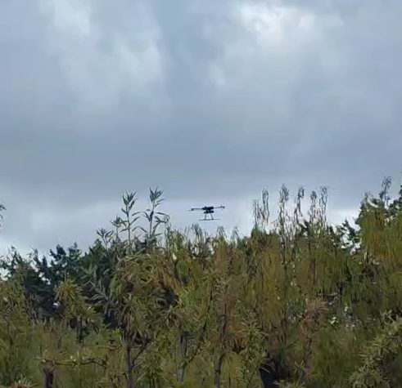
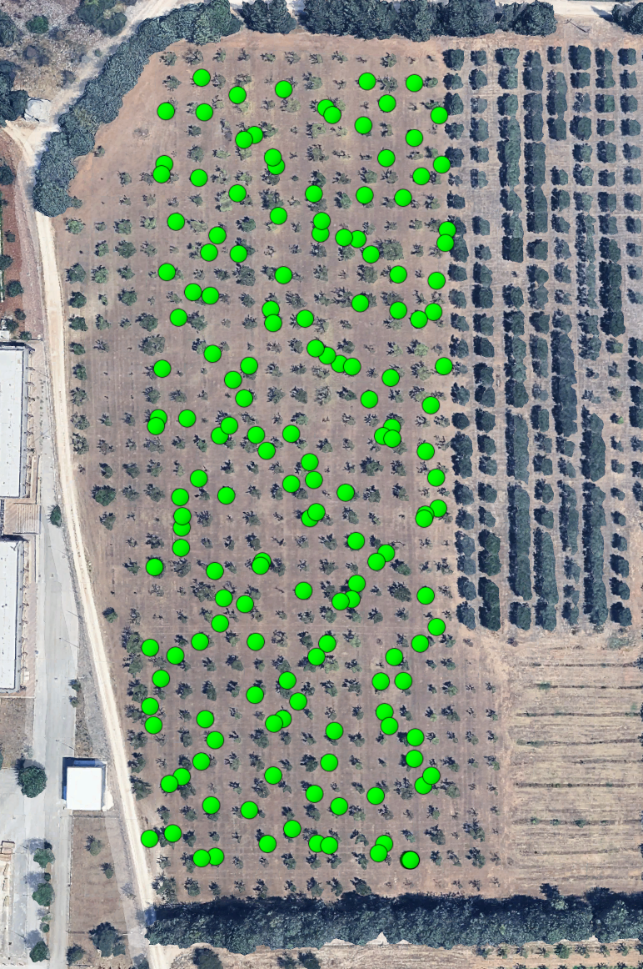
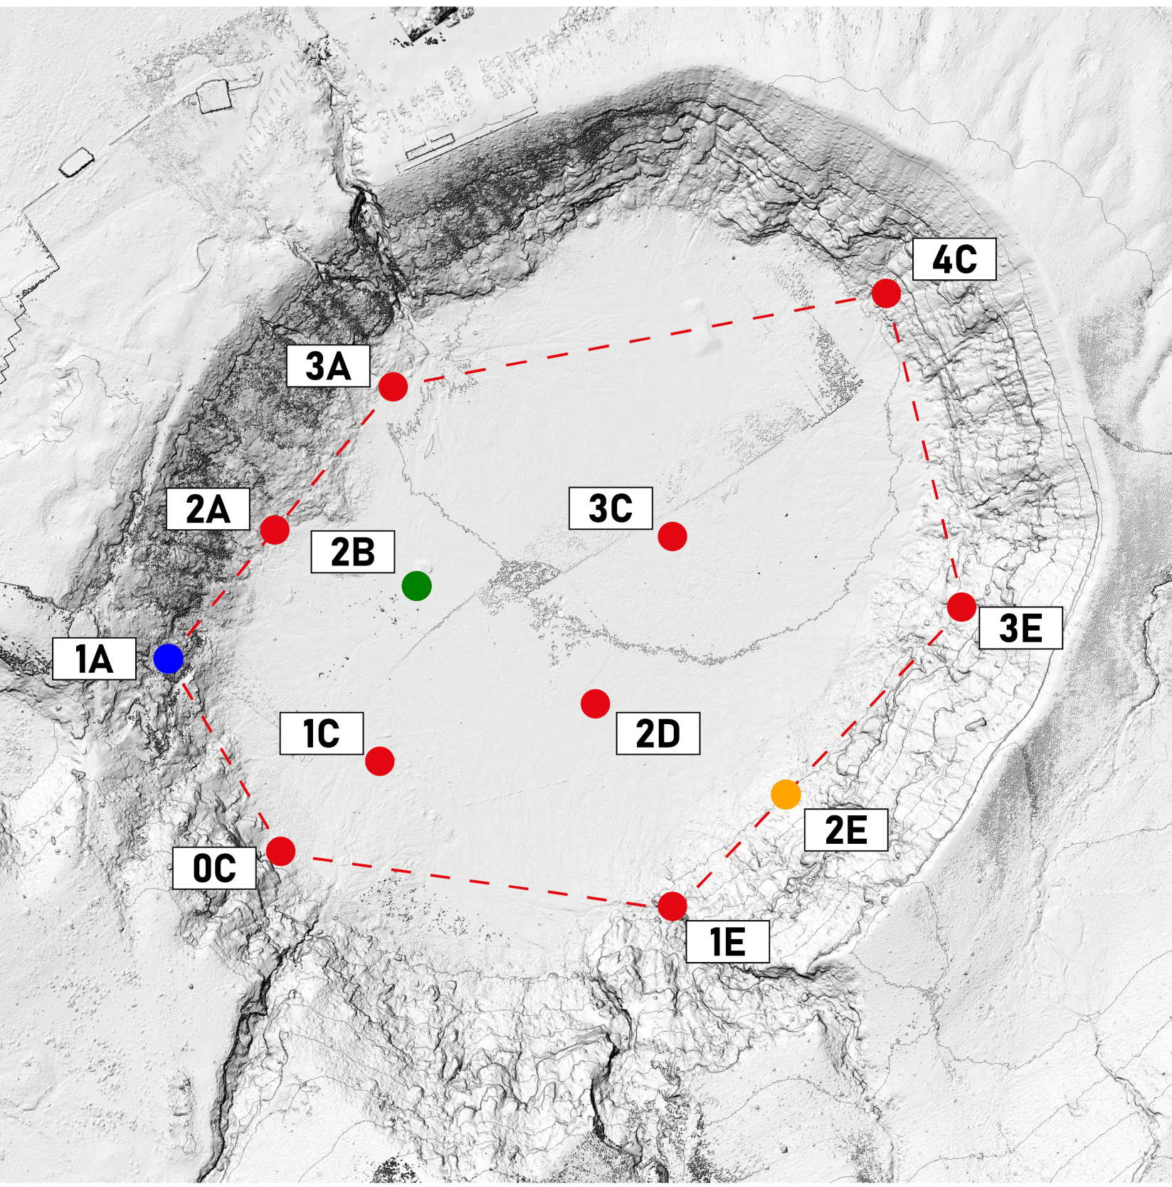
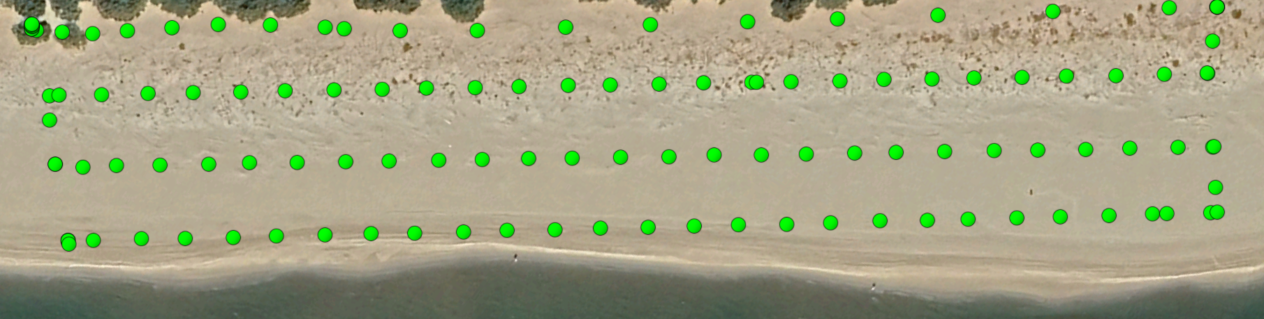
Key sites for Environmental Monitoring
Farmlands
Volcanoes
Coasts and shorelines

Slide 7
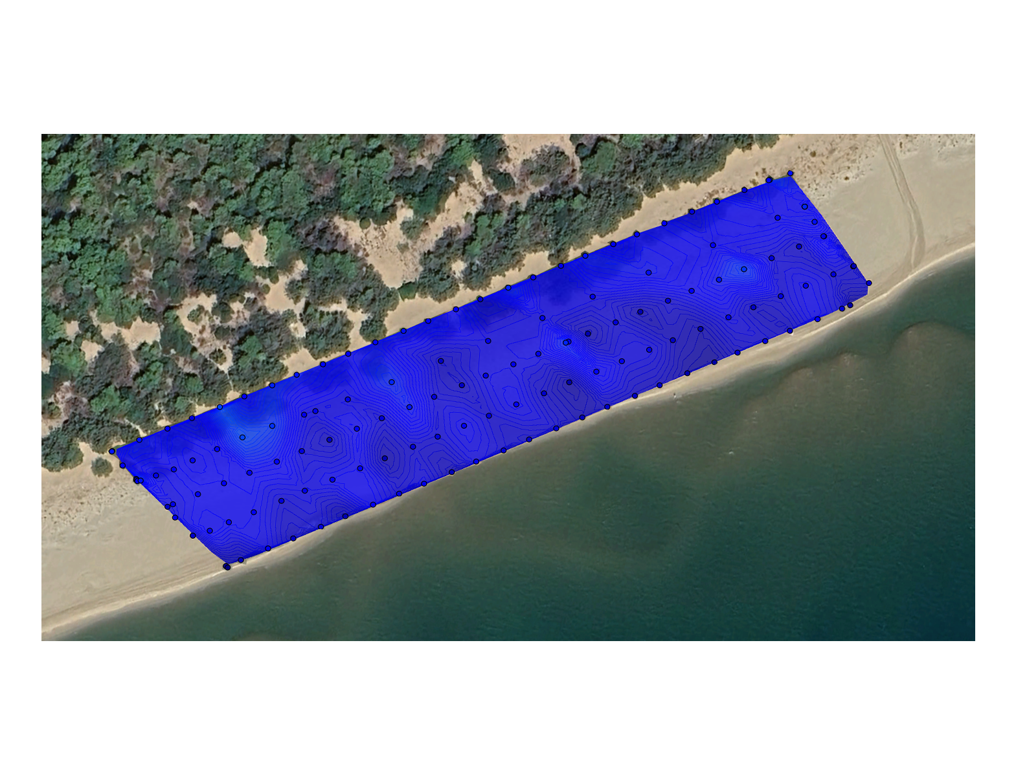
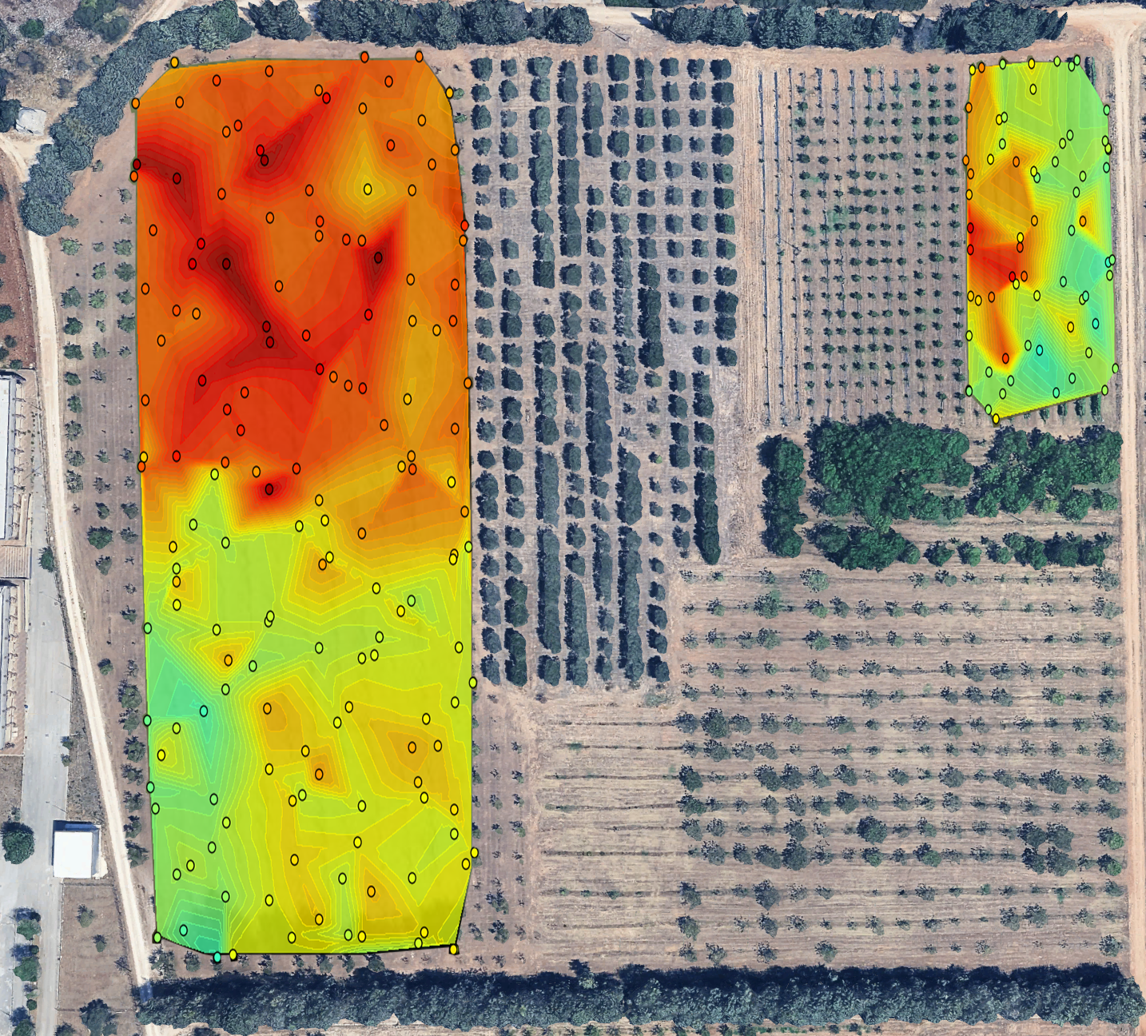
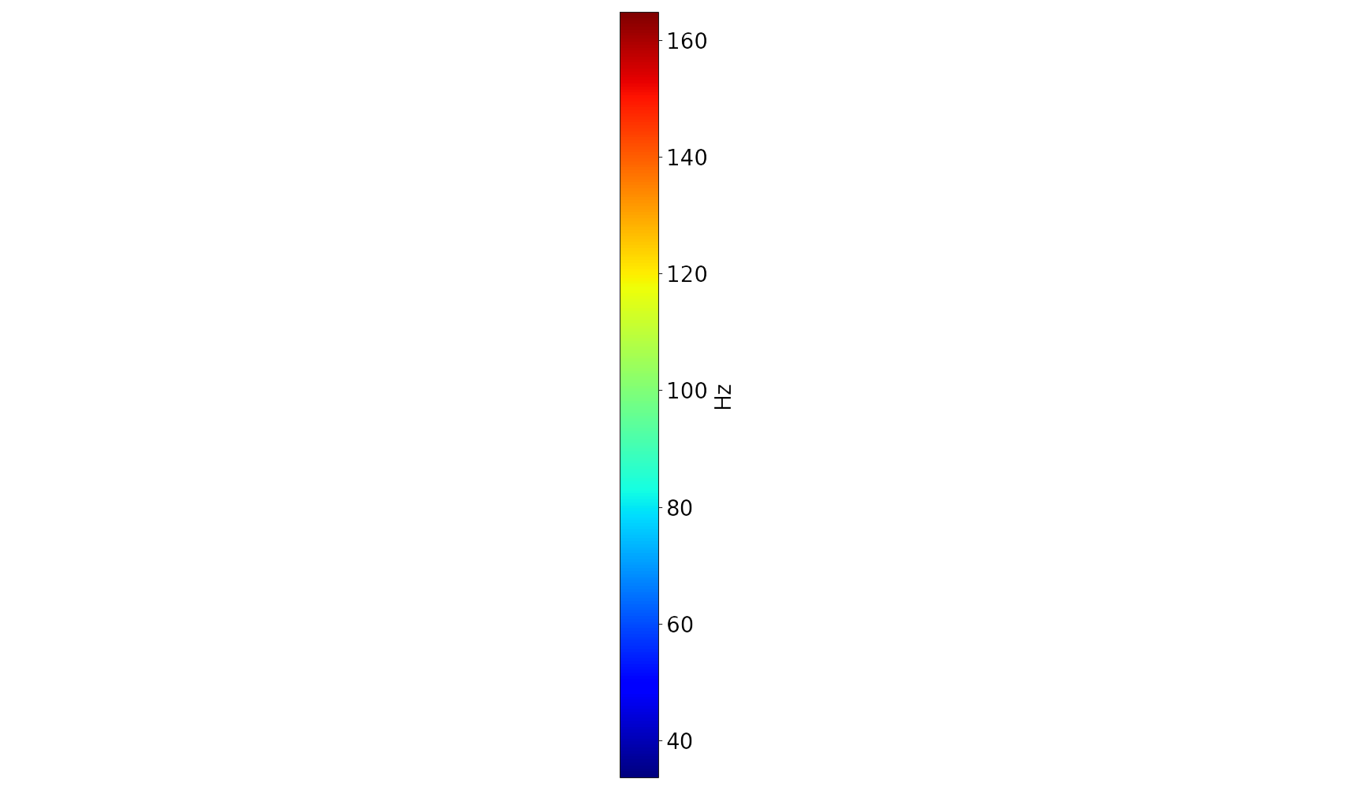

Biological Risk – Count Rate $[Hz]$
Valenzano (BA)
Castellaneta Marina (TA)
Fluctuating values in the range of $100 Hz$ to $160 Hz$
Stable values around $50 Hz$
Significant difference in gamma emission intensity

Slide 8
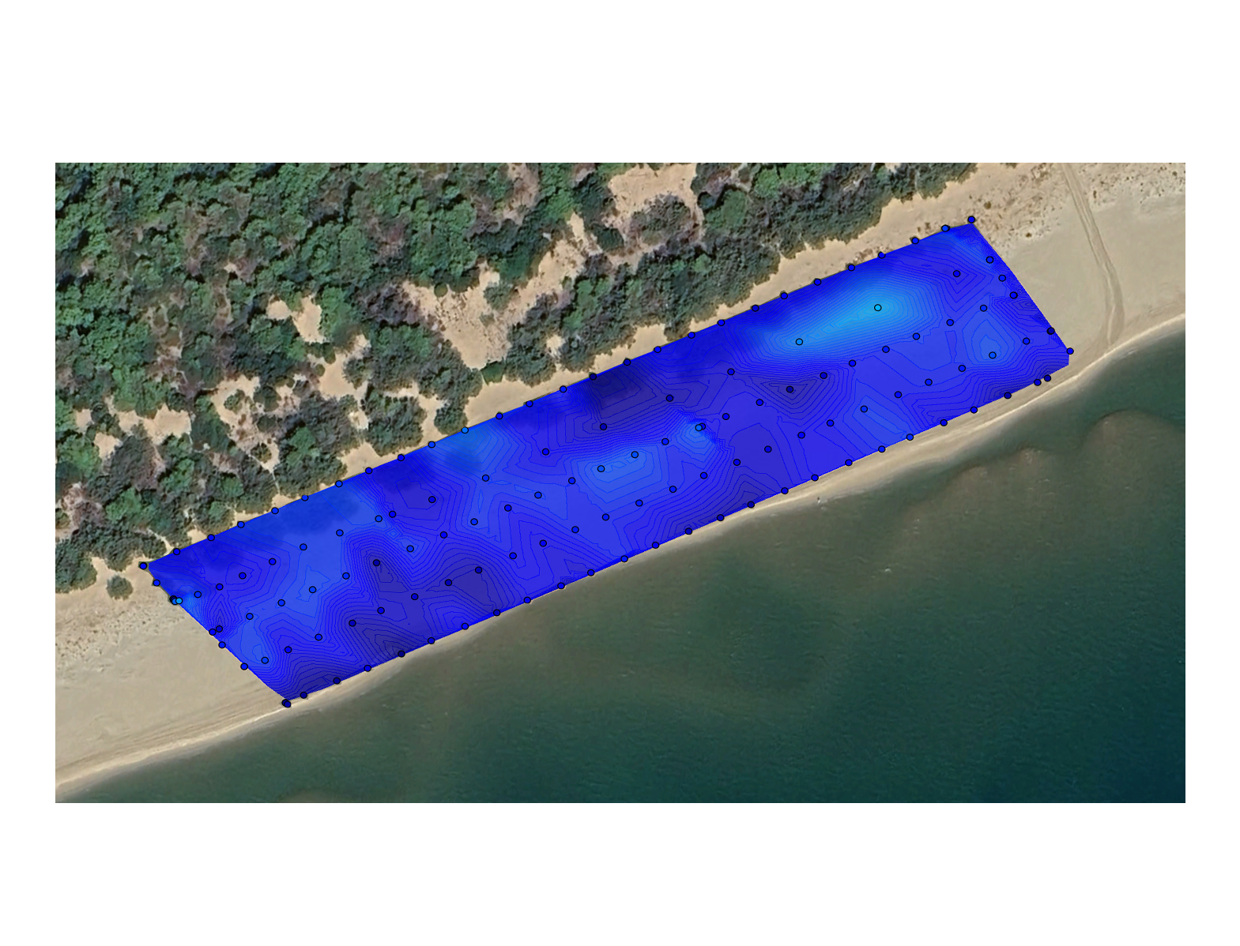
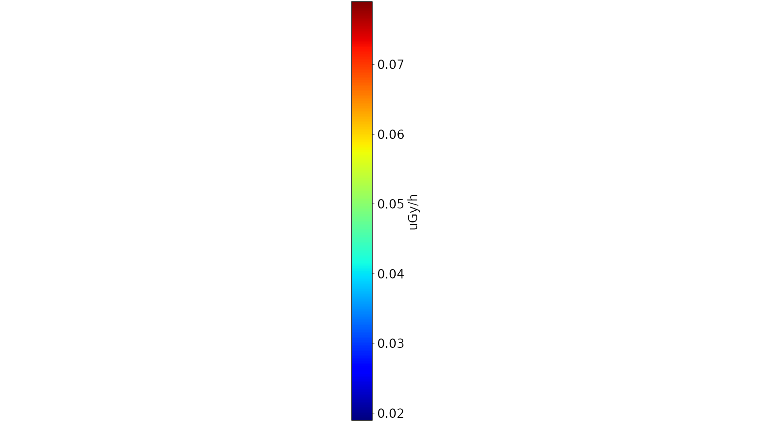
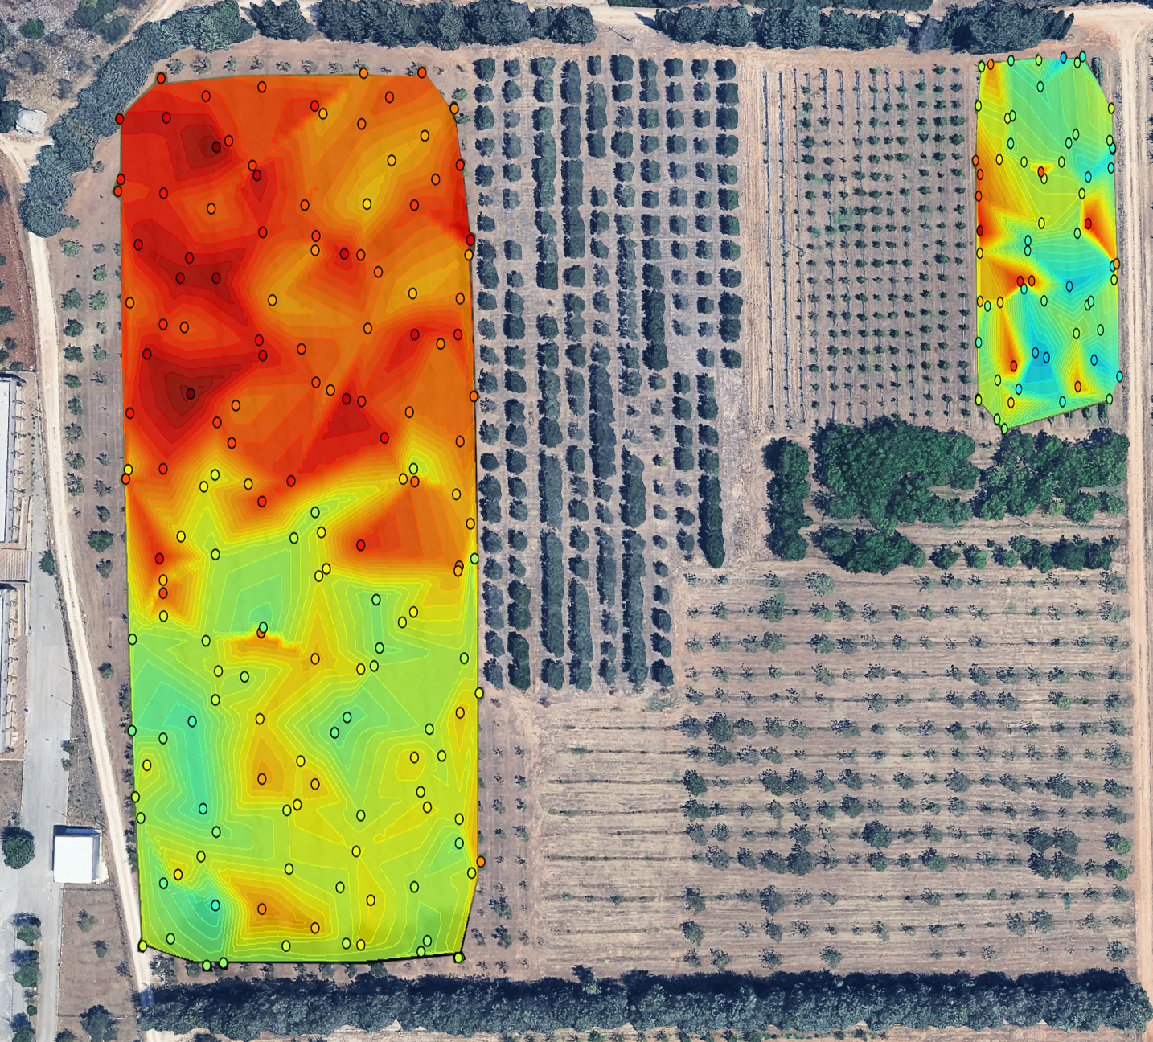

Biological Risk – Dose Rate $[nGy/h]$
Valenzano (BA)
Castellaneta Marina (TA)
Fluctuating values in the range of $50 nGy/h$ to $75 nGy/h$
Stable values around $25 nGy/h$
Dose rate values ​​within the ARPA attention threshold ($300 nGy/h$)

Slide 9
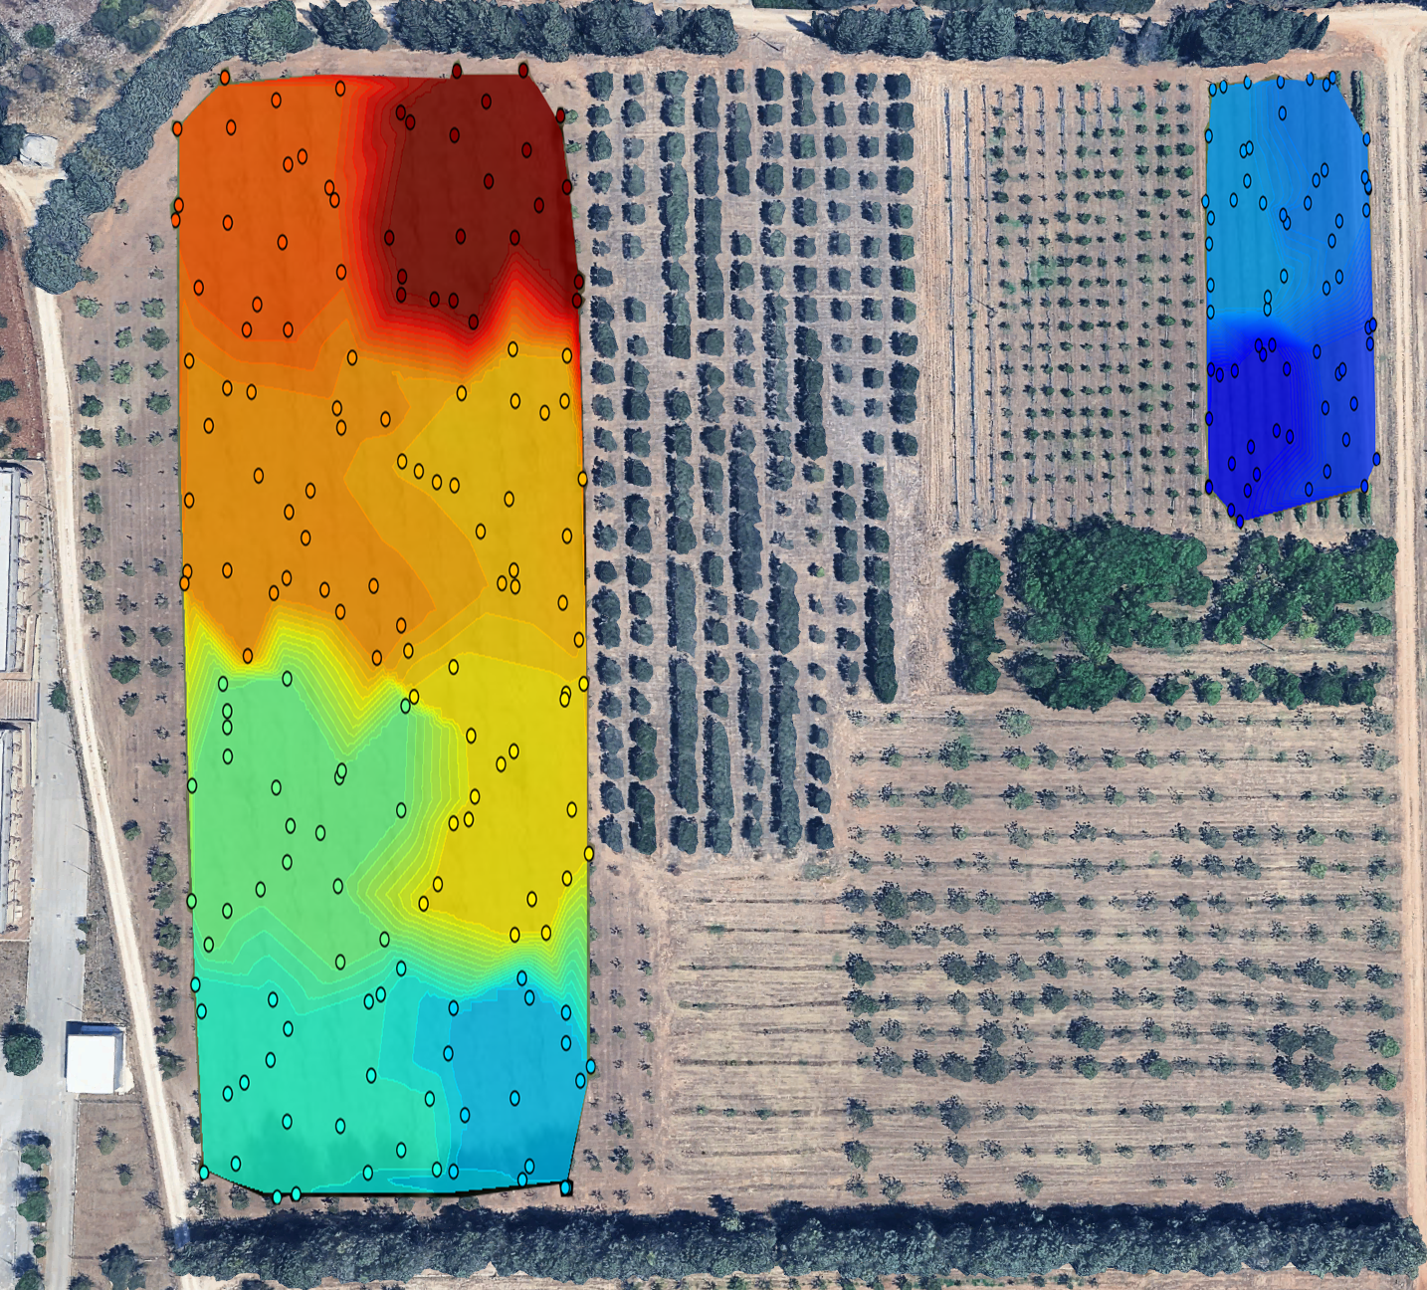
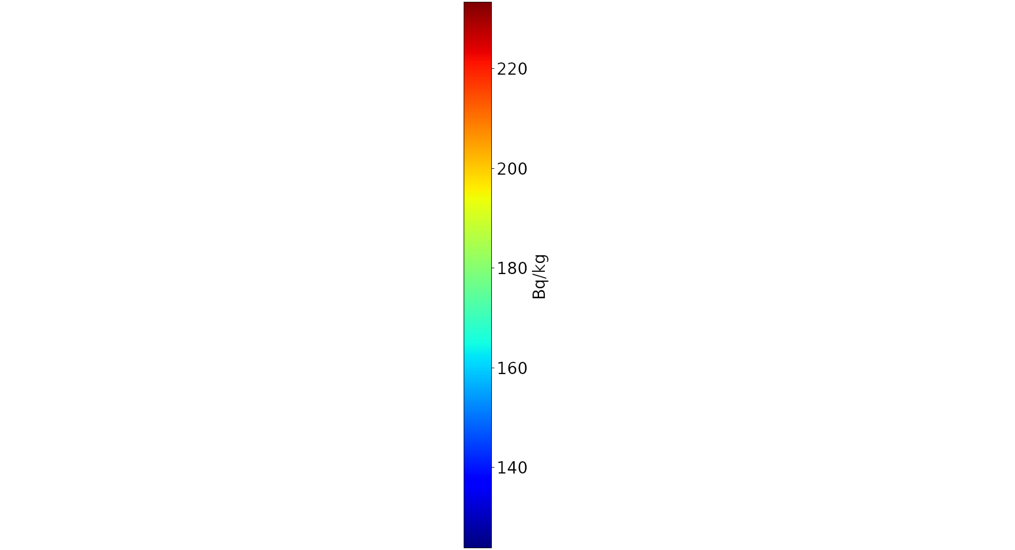
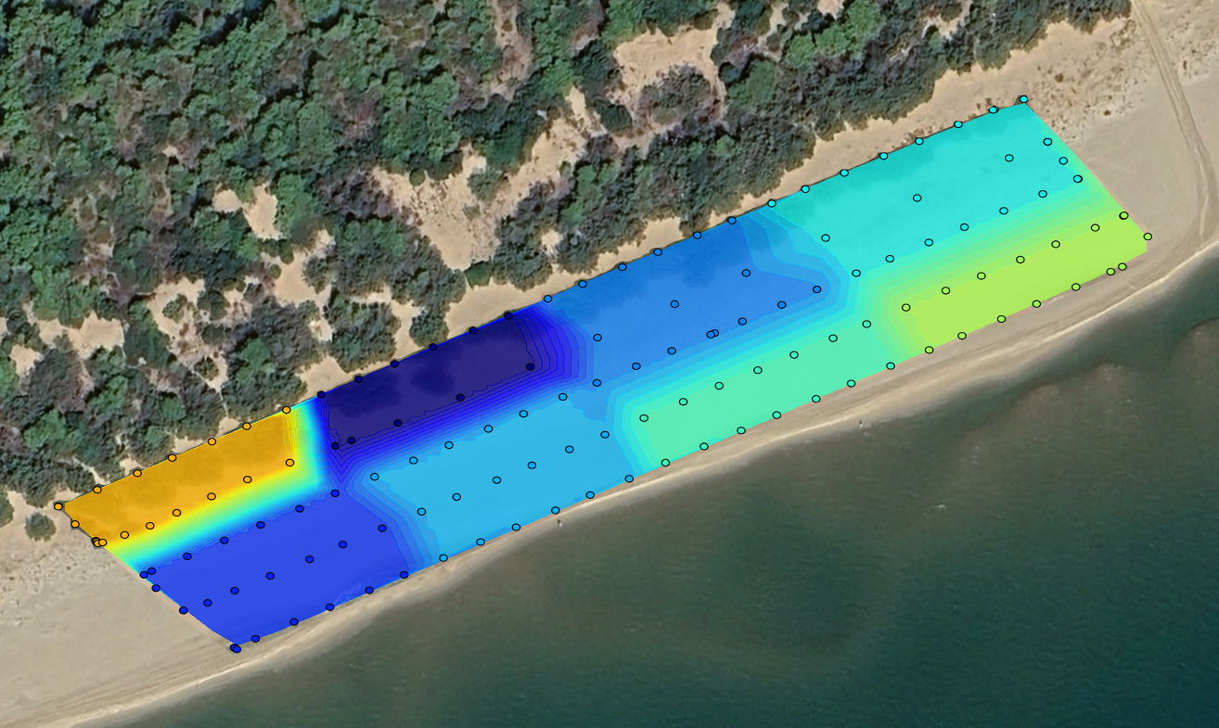
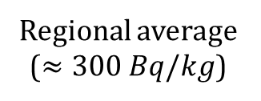



Specific Activity – ${}_{ }^{40}K$ $[Bq/kg]$
Valenzano (BA)
Castellaneta Marina (TA)
Limestone
Sand
Regional average ($≈300 Bq/kg$)
Clay
Potassium-based fertilizers
$$<$$
$$<$$

Slide 10
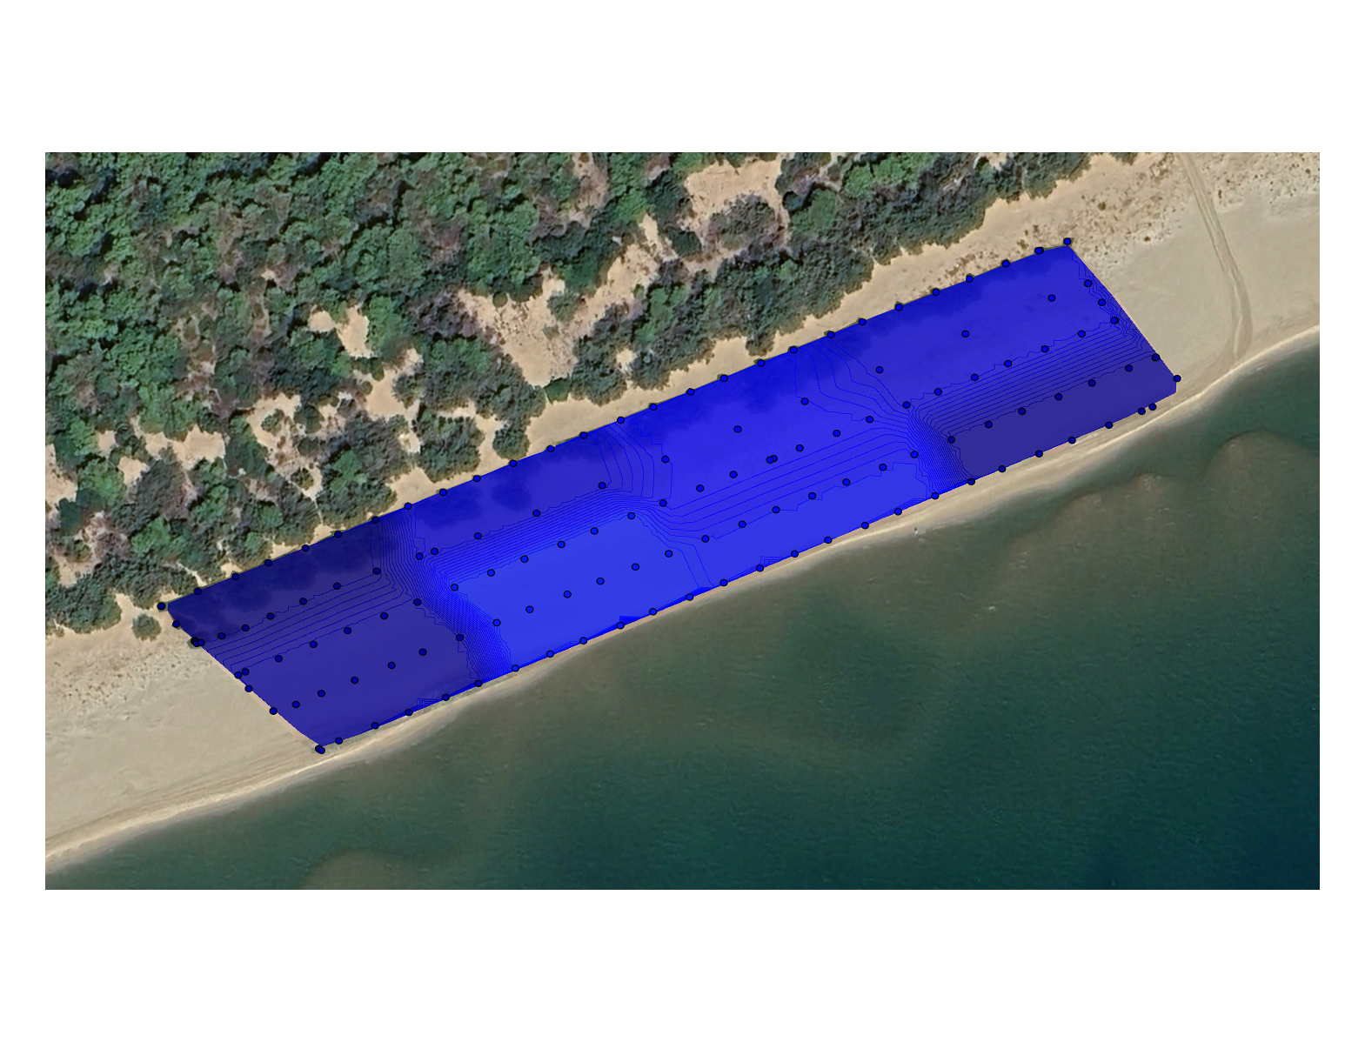
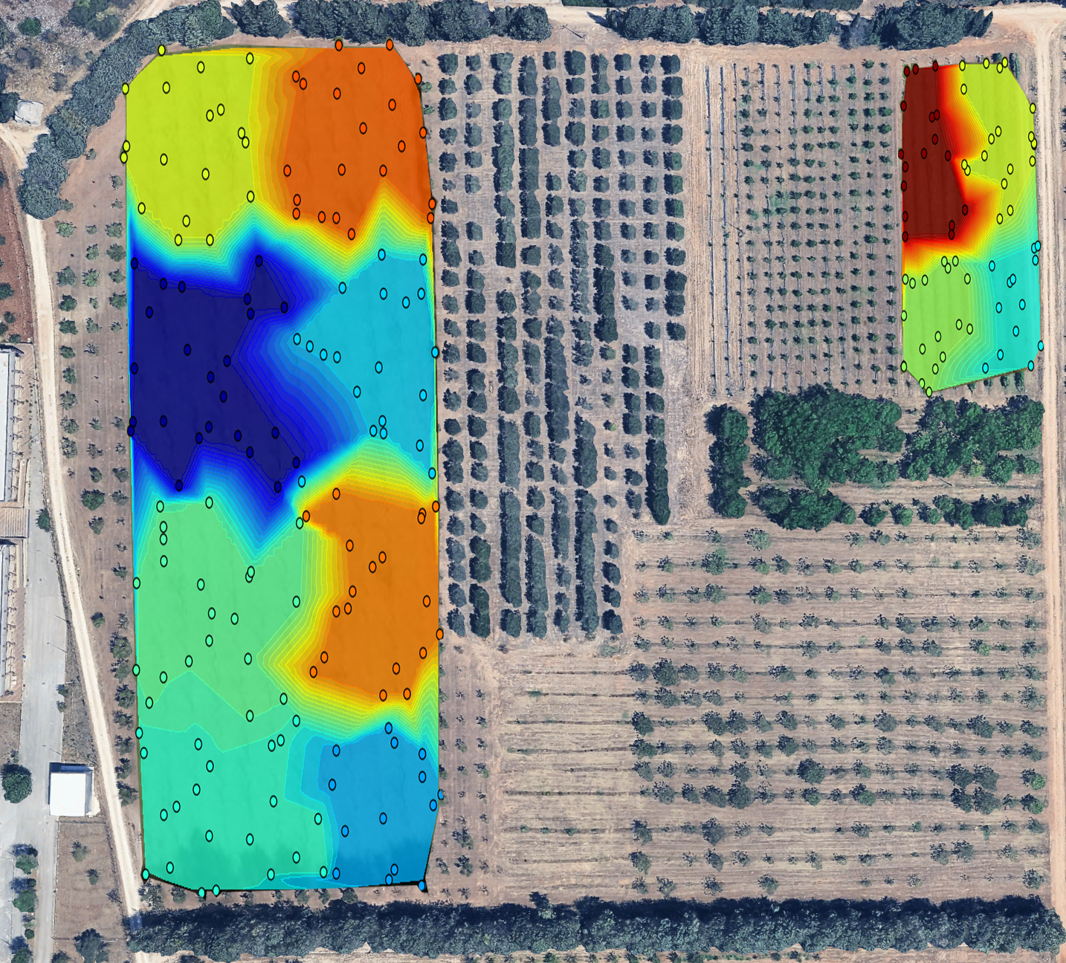
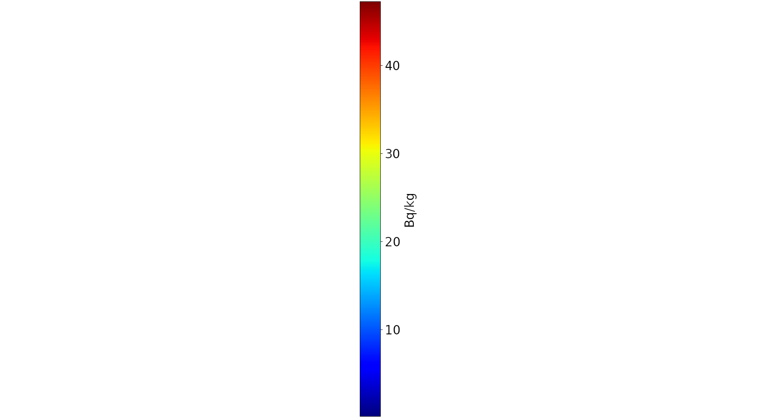



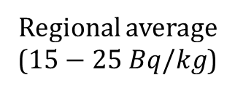
Specific Activity – ${}_{ }^{238}U$ $[Bq/kg]$
Valenzano (BA)
Castellaneta Marina (TA)
Carbonate rocks
Uranium mobility
Regional average
($15−25 Bq/kg$)
Granitic rocks
Phosphate-based fertilizers
$$<$$
$$<$$

Slide 11
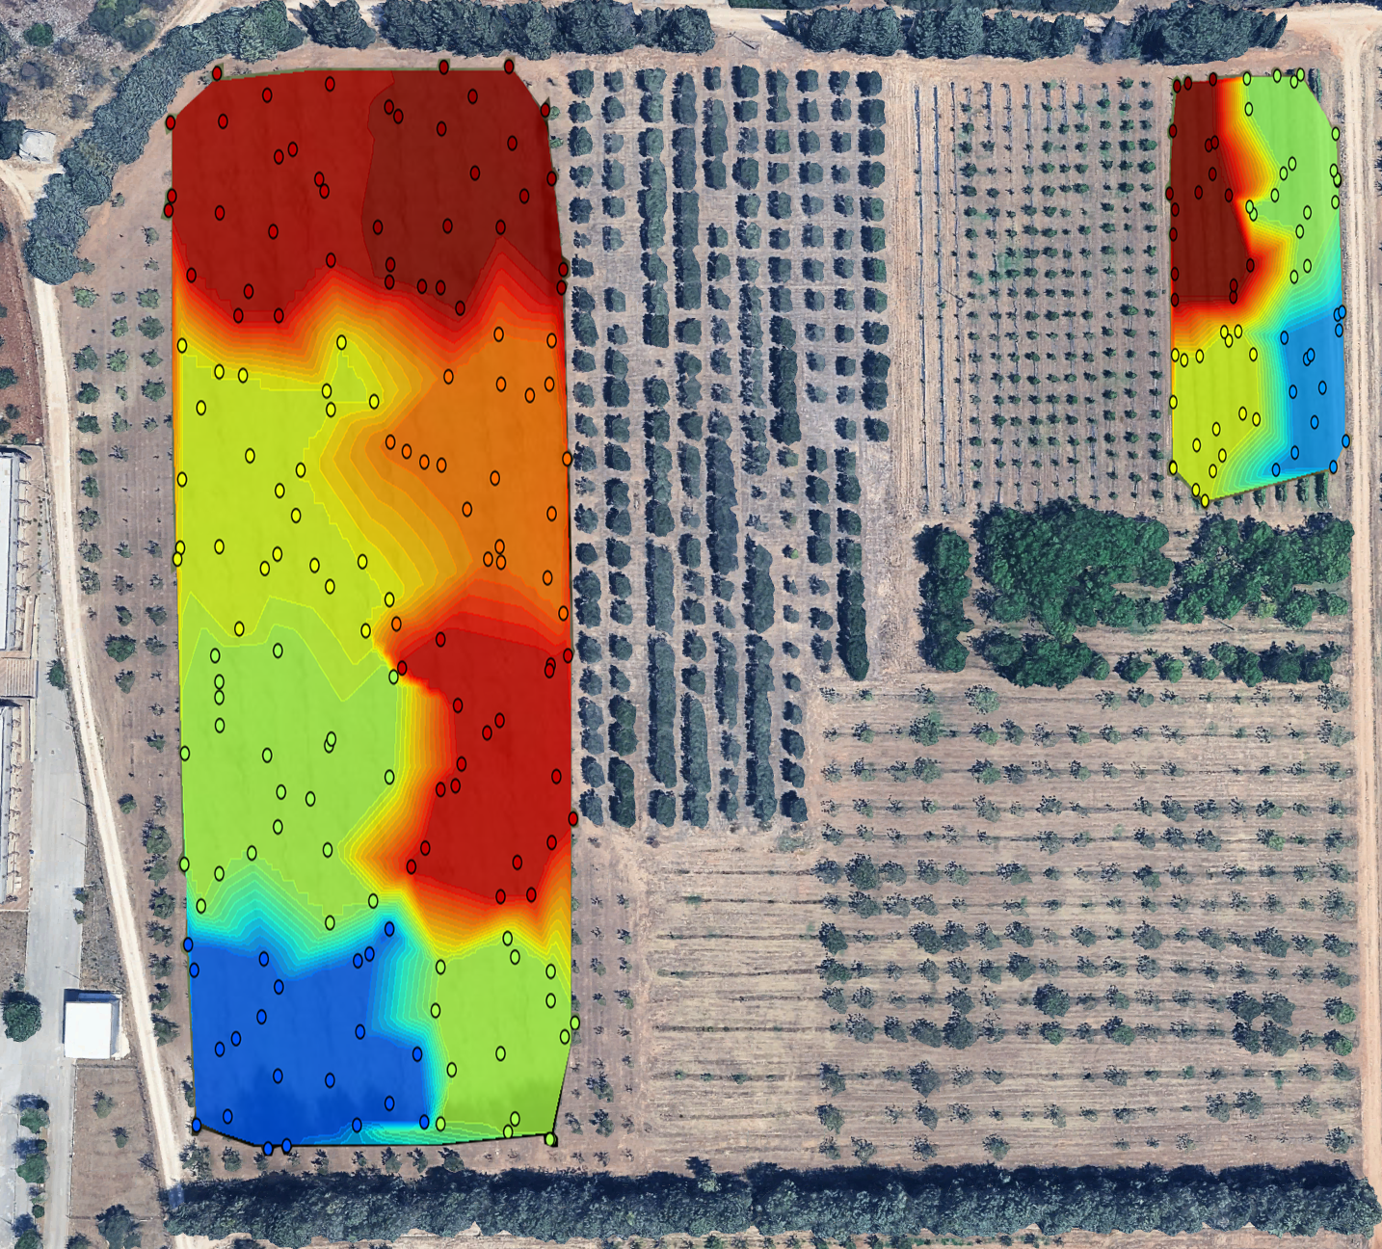
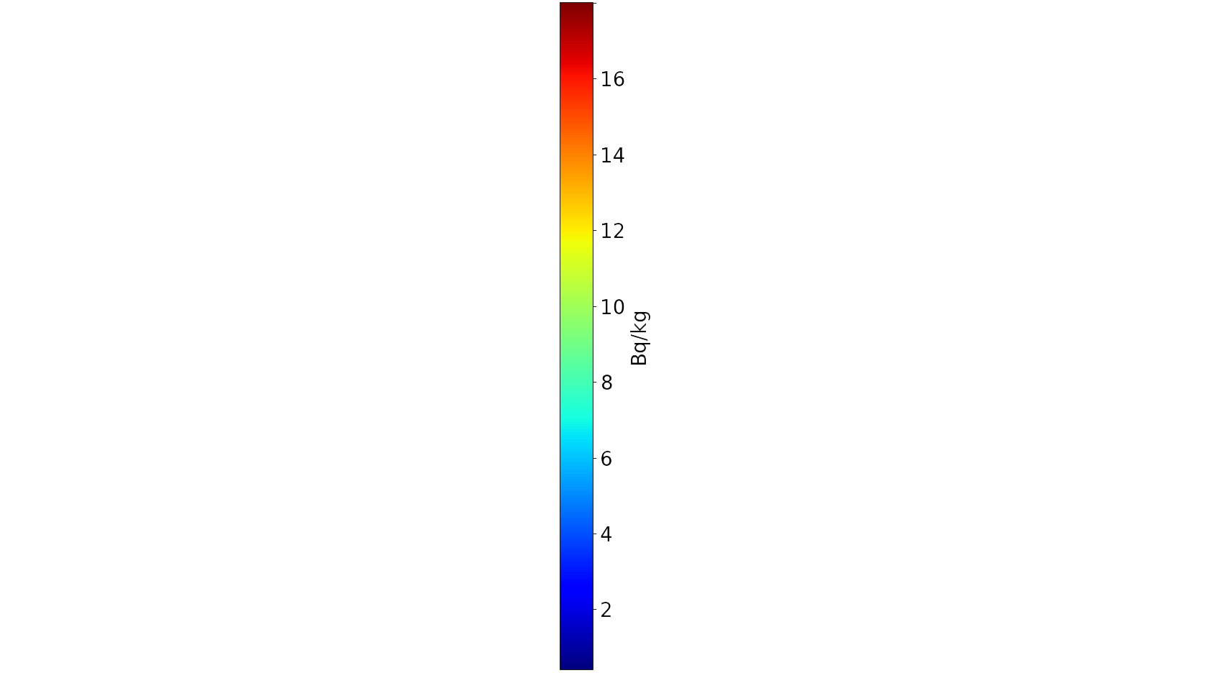
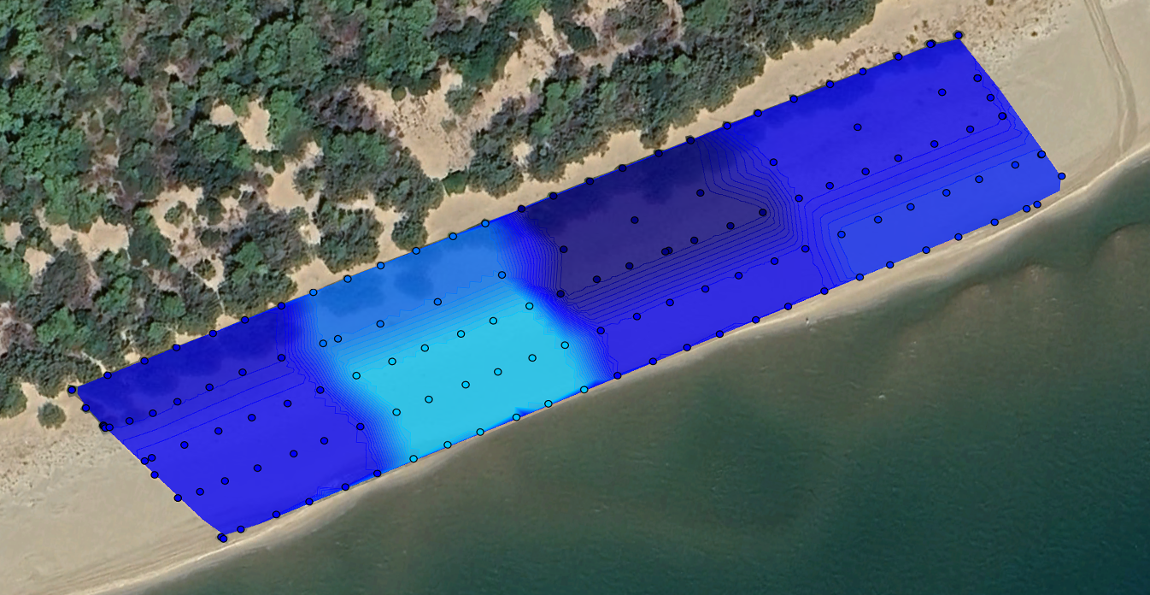
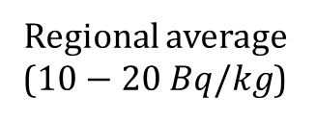



Specific Activity – ${}_{ }^{232}{Th}$ $[Bq/kg]$
Valenzano (BA)
Castellaneta Marina (TA)
Carbonate rocks
Fine sediments
Regional average ($10−20 Bq/kg$)
Clay
Acid igneous rocks
$$<$$
$$<$$

Slide 12
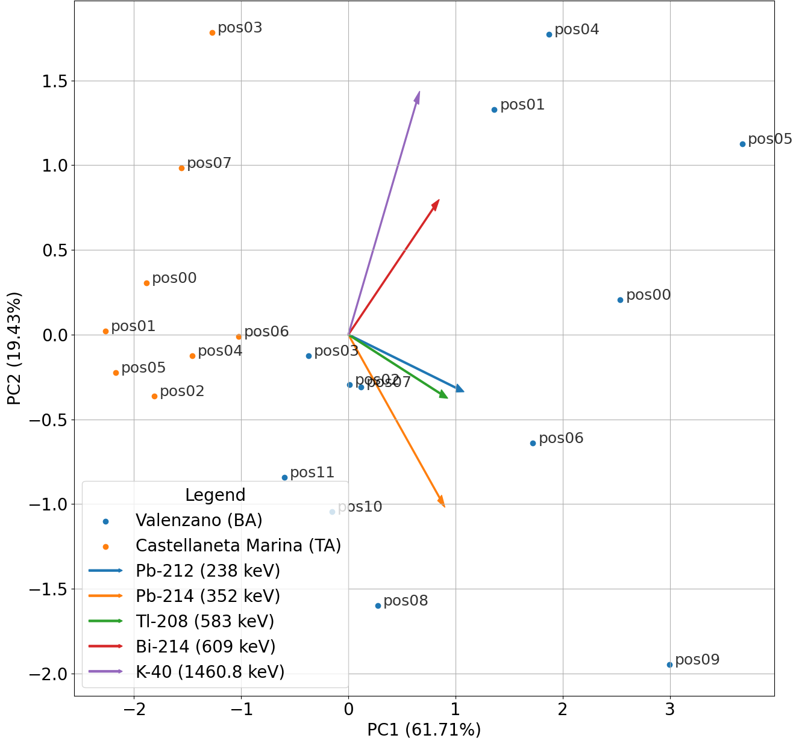
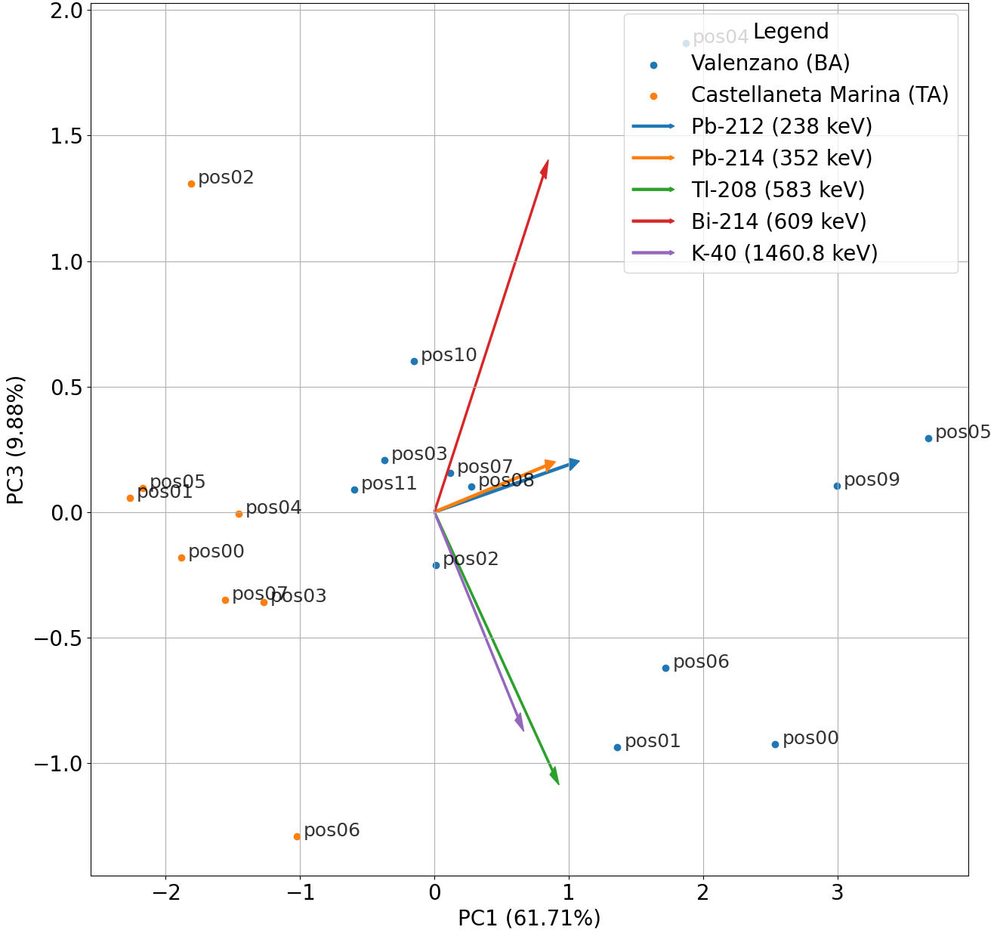
Principal Component Analysis (PCA)

Slide 13
Thank you for your attention

Slide 14
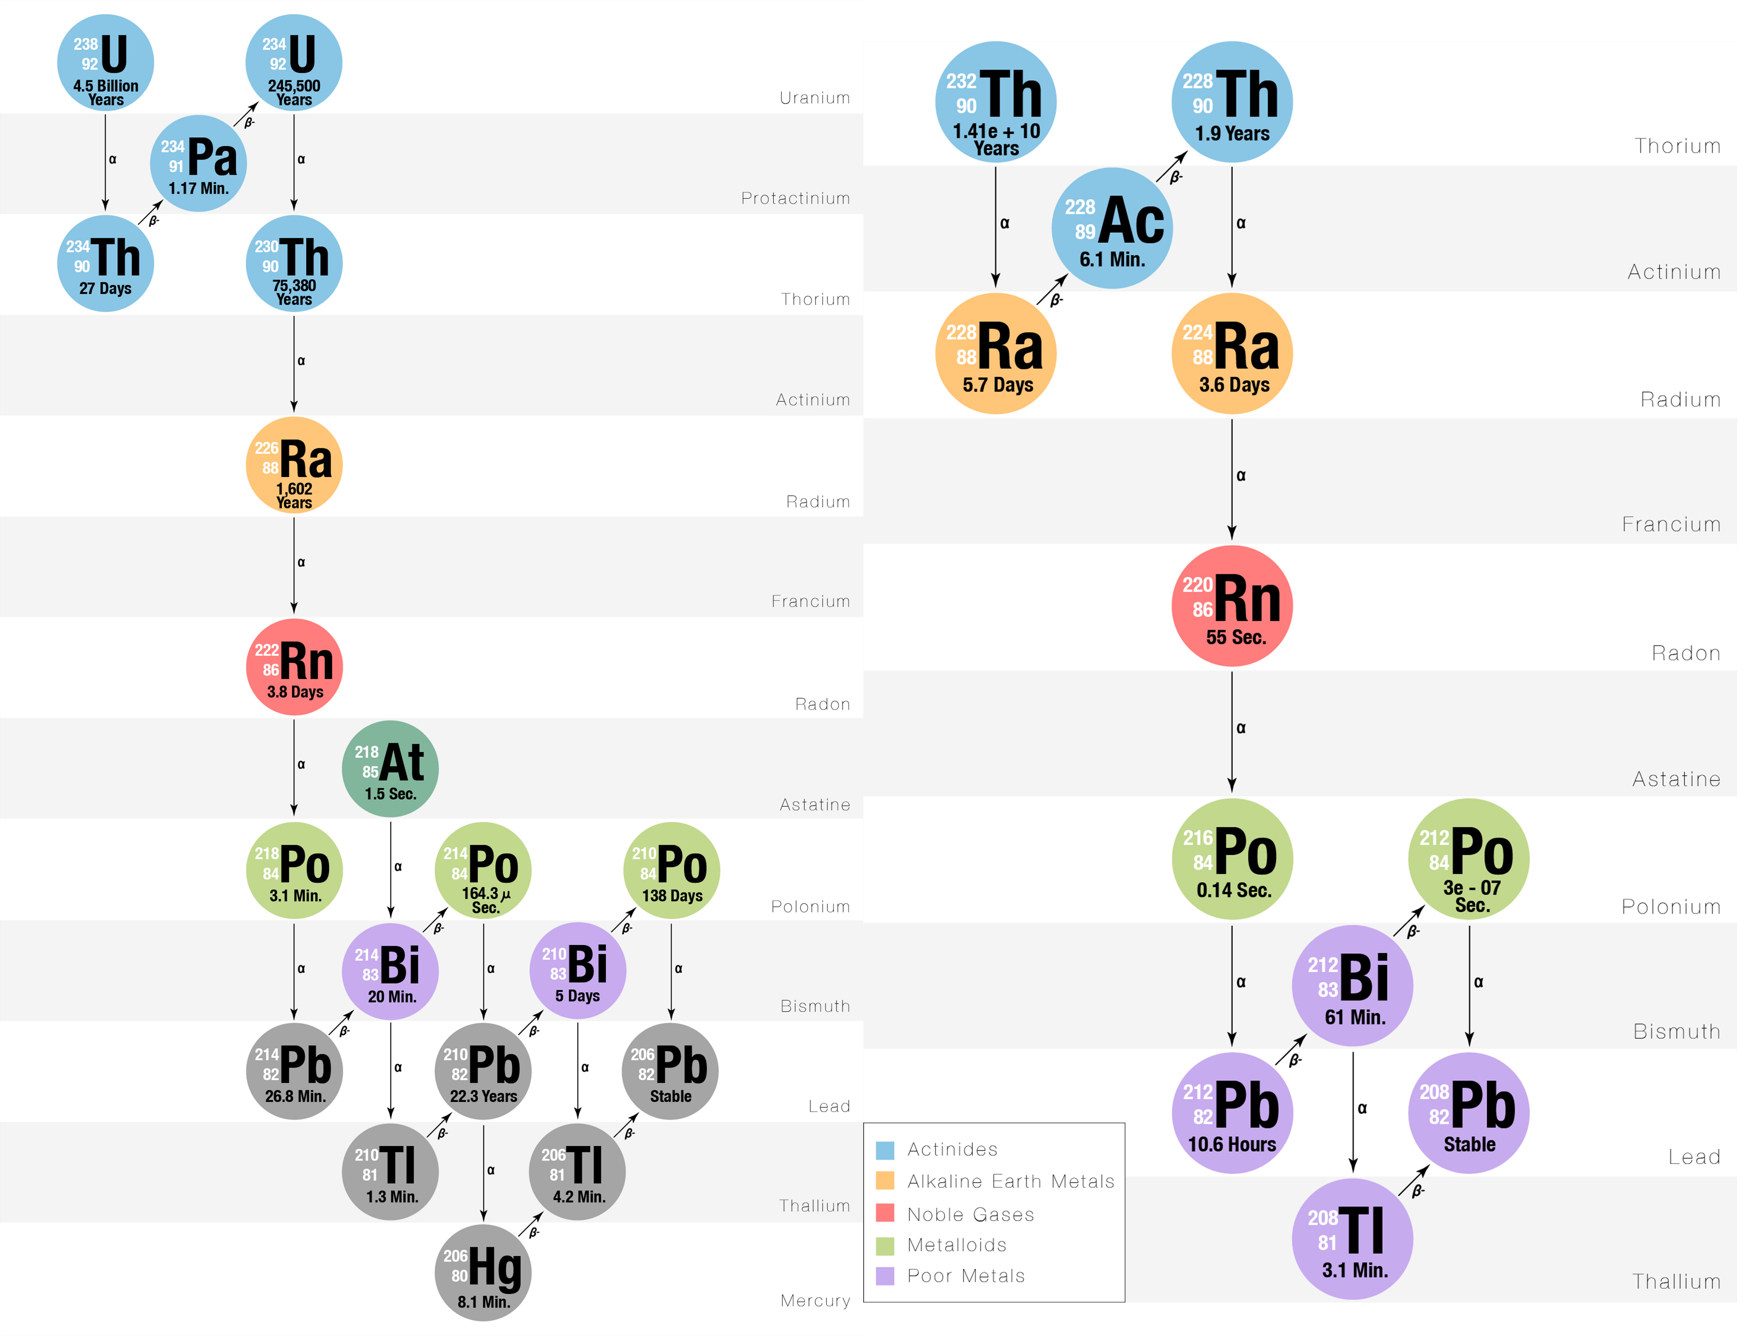


Most relevant Decay Chains
$${}_{ }^{238}U$$
$${}_{ }^{232}{Th}$$

