Slide 1
Double-γ decay process and its links with 2β0ν

Slide 2
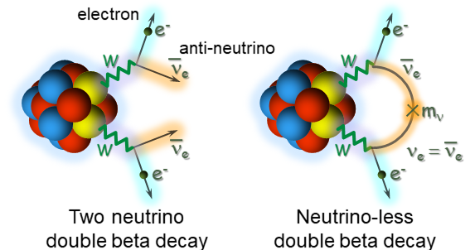
0νββ decay - role of Nuclear Physics
New Physics parameter
Phase space Factor
Nuclear Matrix Element (NME) brings the large uncertainties in DBD half-lifes

Slide 3
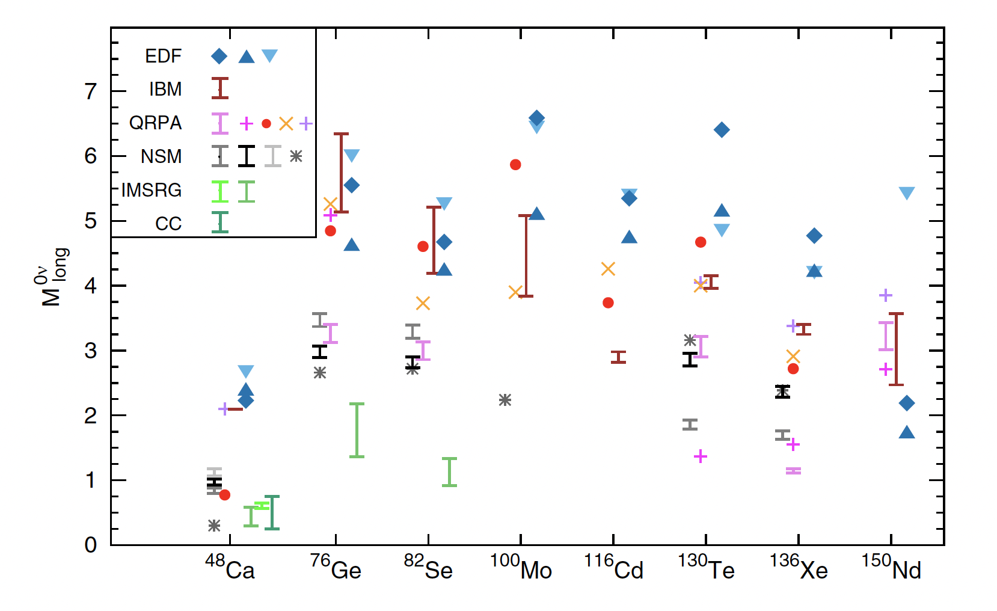
Theoretical NME
Theoretical Nuclear Matrix Elements (NME) disagree by more than a factor of 2. Maybe also quenching is needed.
In the case of ⁴⁸Ca the uncertainty in the M^{0v} → more than an order of magnitude in the T_{1/2}
Agostini, Benato, Detwiler, Menéndez and Vissani Rev. Mod. Phys 95 (2023).

Slide 4
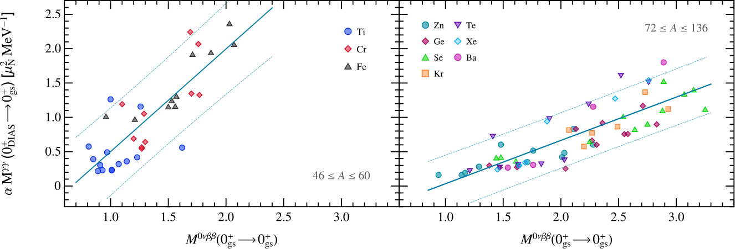
Correlation 2γ with 0νββ
Strong correlation between NMEs of 2ɣ-decays from DIAS to g.s. and 0νββ decays found.
The correlation holds if we consider M1M1 decays with equal-energy gammas.
[B. Romeo et al., Phys. Lett. B 827 (2022)]
Strong constraints on M^{0ν}

Slide 5
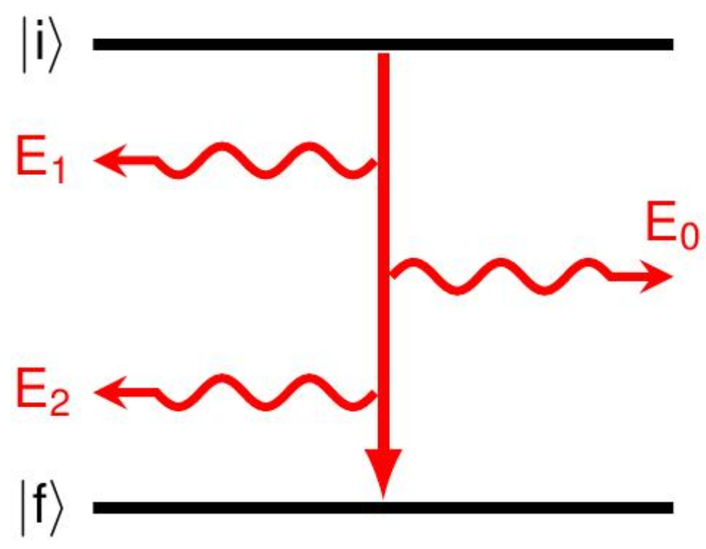
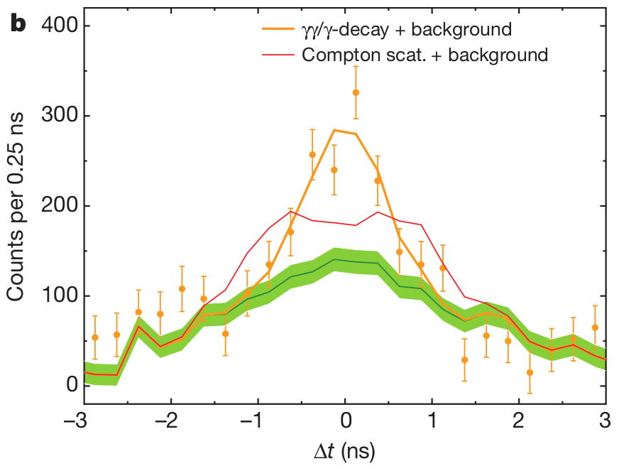
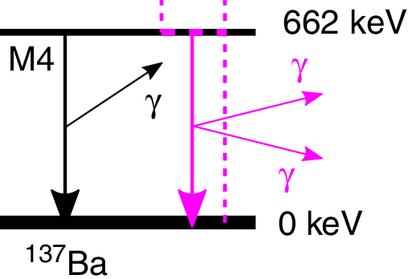
The double γ process
Second order EM
E₀ = E₁ + E₂
E₁, E₂ are continuous
In 2015, a Nature paper reported its observation in competition with single-gamma decay in ¹³⁷Ba: Γ_{ɣɣ}/Γ_{ɣ} ≈ 10⁻⁶
Using good time properties of scintillators
The two-photon decay process is a second order process in quantum electrodynamics (QED) → excited nuclear state emits two gamma-ray energy-quanta of continuous energy
Theoretically the γγ-decay process is treated as a second-order perturbation

Slide 6
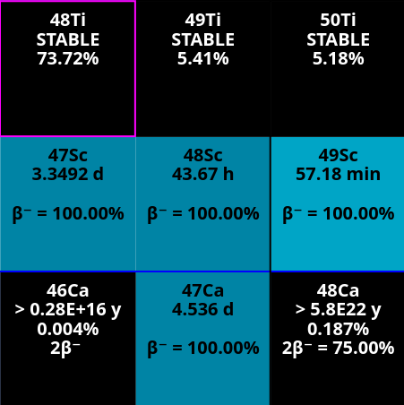
DIAS candidates: ⁴⁸Ti
Best candidate: ⁴⁸Ti → mimic 0νββ ⁴⁸Ca decay
2γ has the same initial and final states as in 2β0ν
The 17 MeV 0⁺ DIAS is known
Particle unbound, but particle decay is highly suppressed (isospin forbidden).
PROS
Difficult to populate (high energy 0⁺)
Extremely small double-gamma decay width:
Γ_{ɣɣ} / Γ_{tot} ≈ 10⁻⁸
CONS
Need to know the width of the T=4 state in ⁴⁸Ti
How to populate efficiently the 0⁺ (T=4)?
How to be sensitive to the 2γ?
??

Slide 7
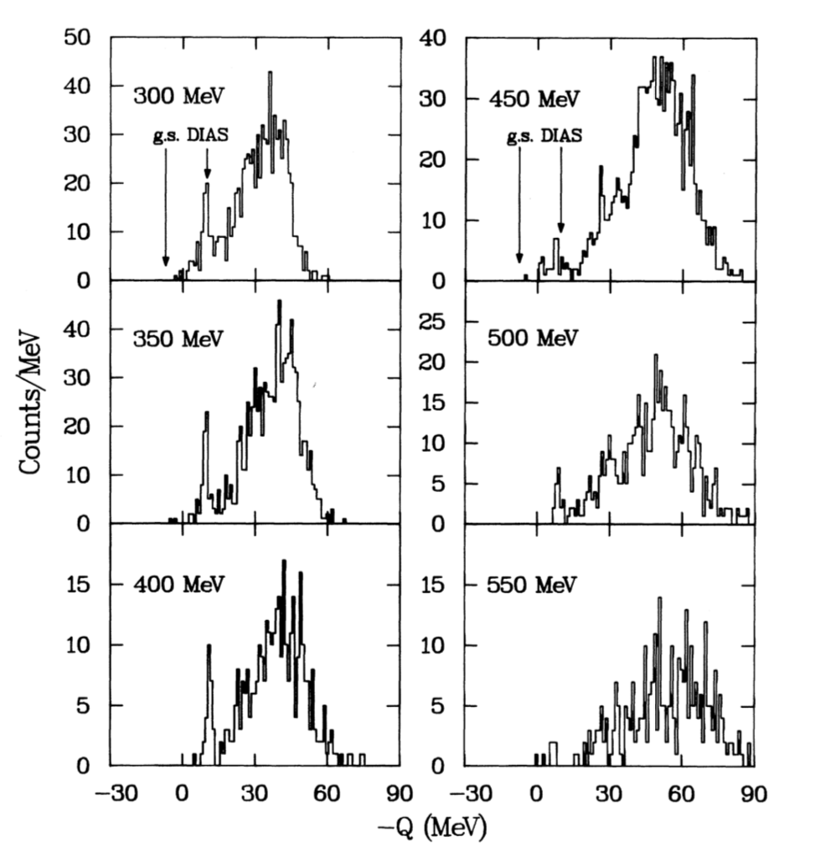
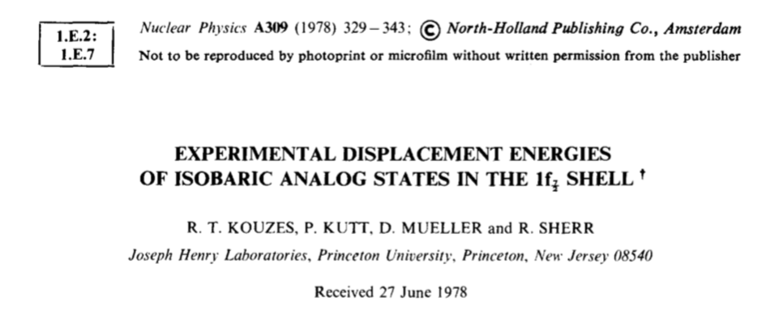
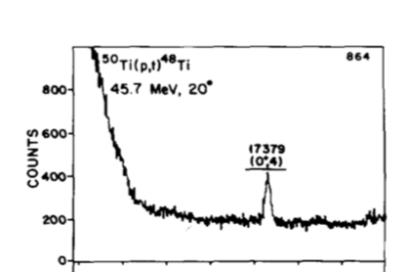
How to populate the DIAS - 2γ
⁵⁰Ti(p,t)⁴⁸Ti Q = -10.6 MeV ⁴⁶Ca(⁴He,2n)⁴⁸Ti Q = -8.36 MeV ⁴⁸Ca(³He,3n)⁴⁸Ti Q = -5.01 MeV
⁴⁸Ca(²⁰Ne,²⁰O)⁴⁸Ti Q = -6.50 MeV
…..
DCX ⁴⁸Ca(π+,π-)⁴⁸Ti
A.L. Williams PRC43 766 (1991)

Slide 8
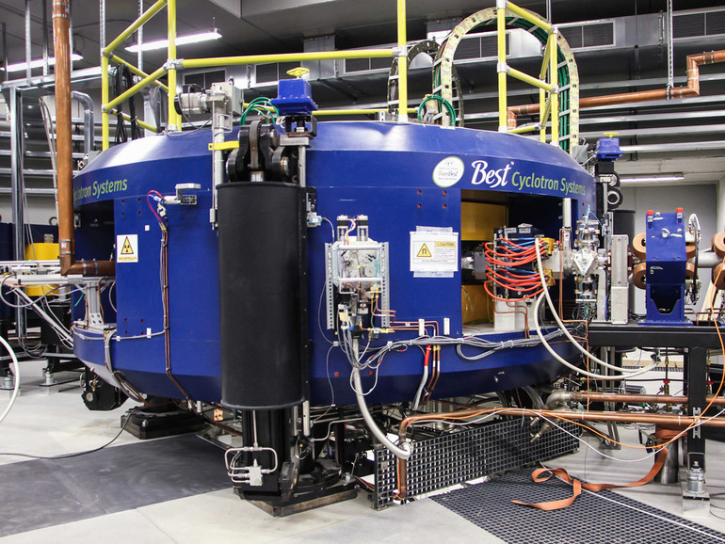
How to populate the DIAS - 2γ
Laboratori Nazionali di Legnaro (INFN)
SPES Cyclotron → 40-70 MeV - 200 μA of protons
~200 nb
⁵⁰Ti(p,t)⁴⁸Ti Q = -10.6 MeV

Slide 9
Fast scintillators simulations
Define setup & data processing
→ Maximise the 2ɣ detection efficiency
Analysis of simulation outputs
→ Isolate the M1M1 2ɣ decays,
identifying the competing processes
Step 1
Step 2
SETUP REQUIREMENTS:
Good efficiency
Small BR → little statistics expected
Good time resolution
Distinguish 2ɣ from competing processes
302 3.5”x8” cylindrical LaBr₃ in spherical configuration
ΔT = 880 ps
Detector face is 50 cm from target
Reaction chamber: radius 17cm, 2mm thick
Master thesis: D. Stramaccioni

Slide 10
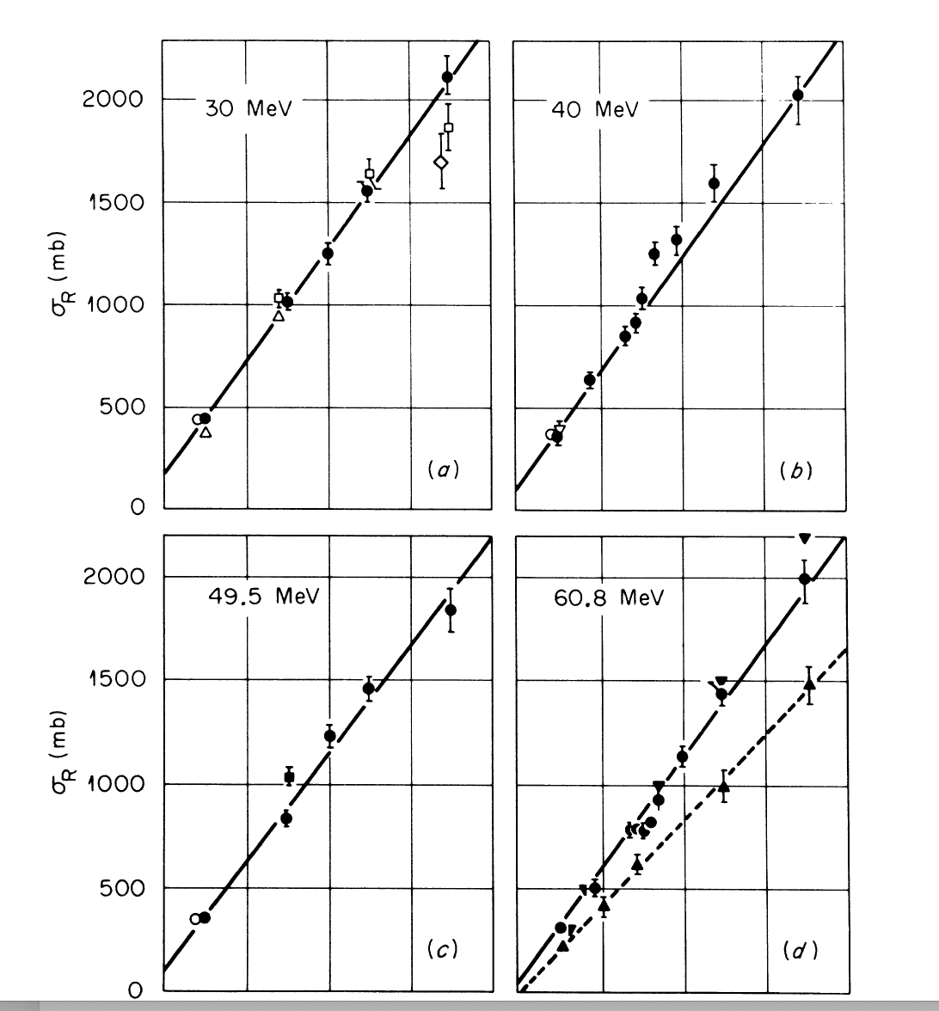
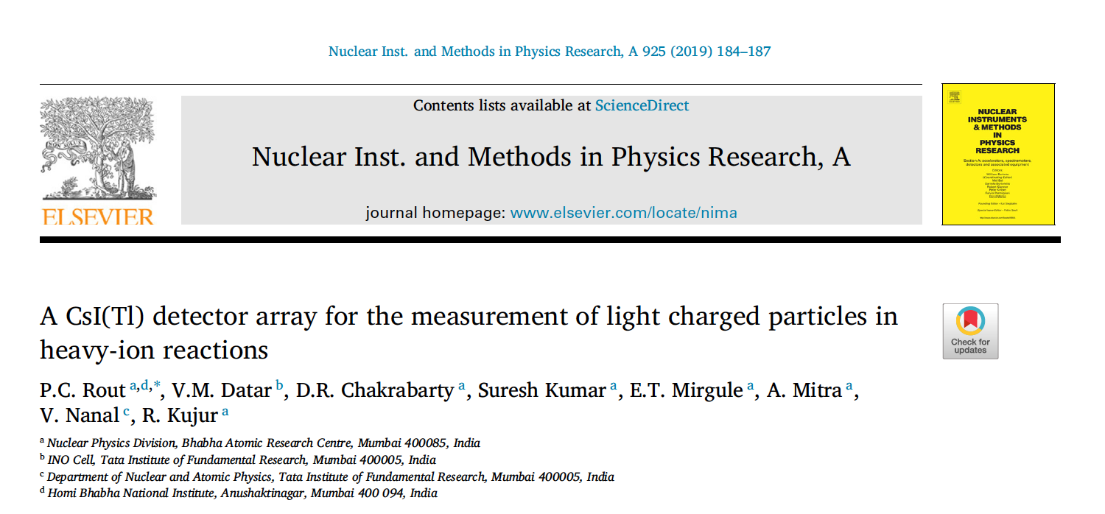
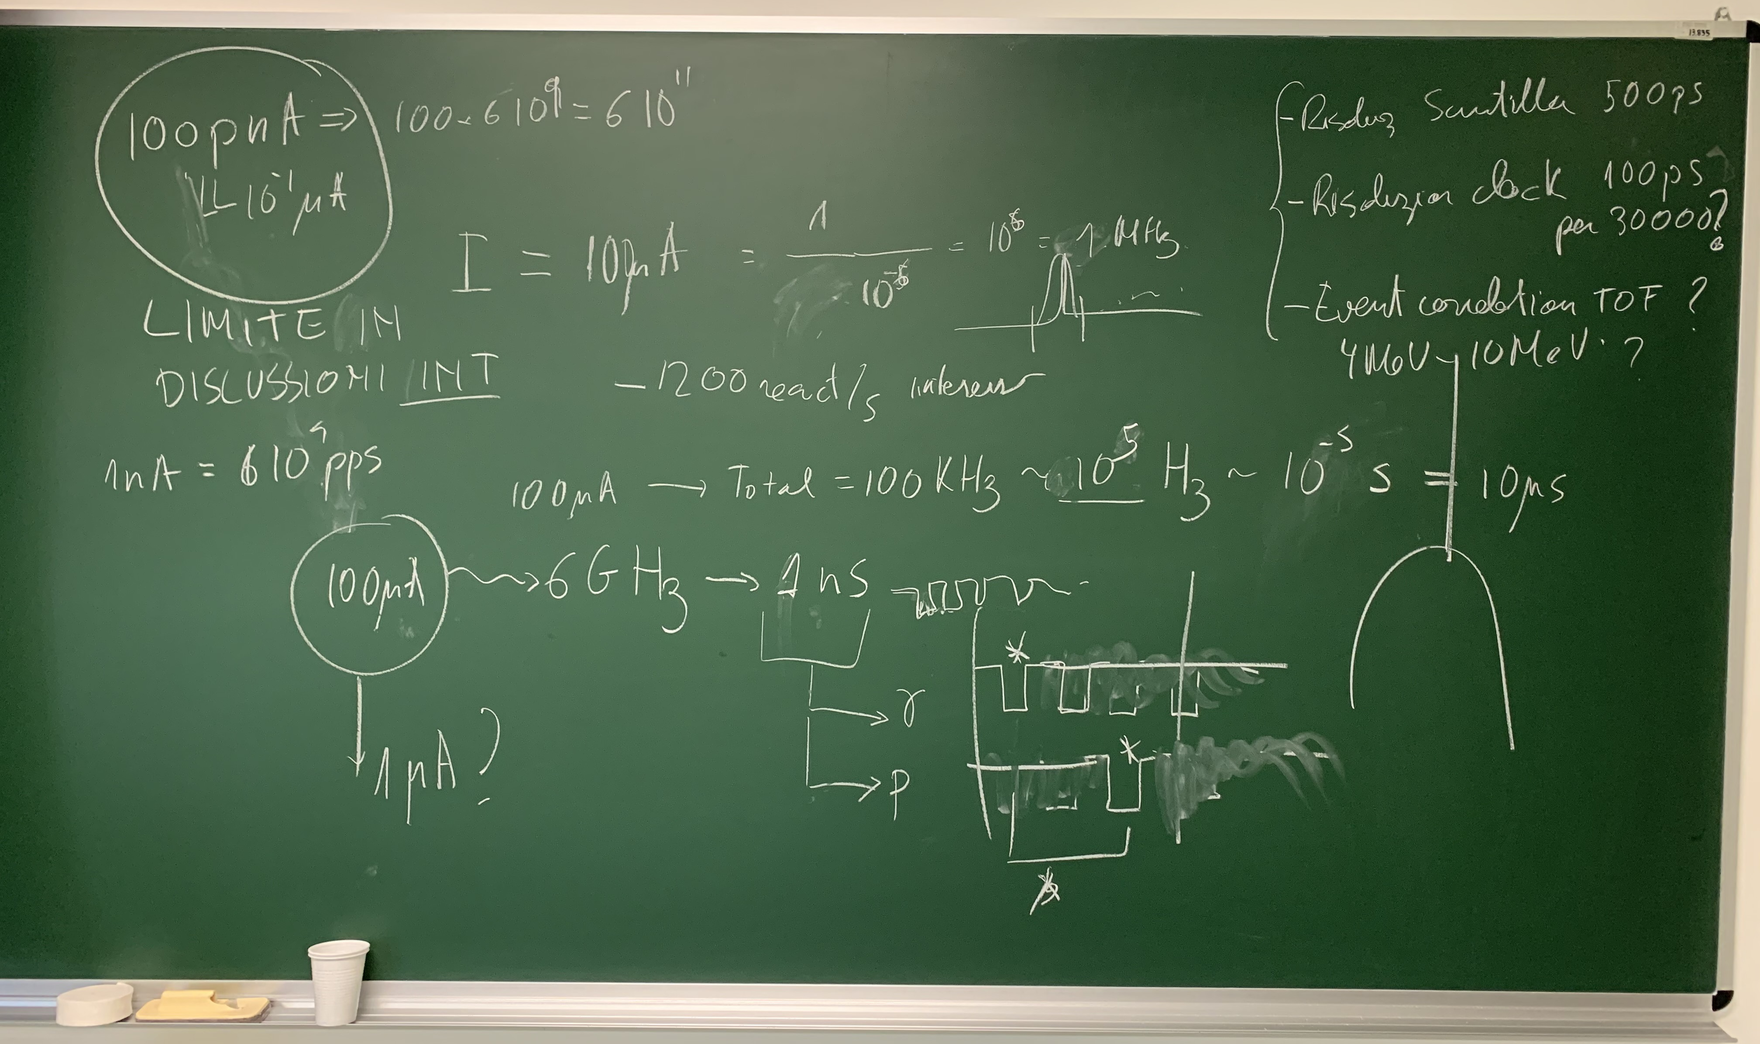
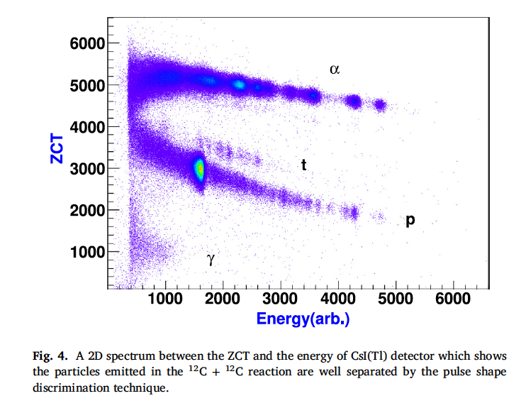
Large experimental challenges!
Laboratori Nazionali di Legnaro (INFN) SPES Cyclotron → 40-70 MeV – up to 200 μA of protons
Total XS = 900 mb
XS _{(DIAS/ALL)} ~ 10⁻⁷
CsI detectors for trition identification
Clock resolution 100 ps for more than 30000 channels!!

Slide 11
END

