Slide 1
New instruments for intense ADIGE stable beams
A premise: high-intensity stable beams require radically new instruments for cutting-edge physics ->
Given the manpower, such a development is easier if it is a multi-purpose intruments for both stable and unstable beams (timescale 2030)

Slide 2
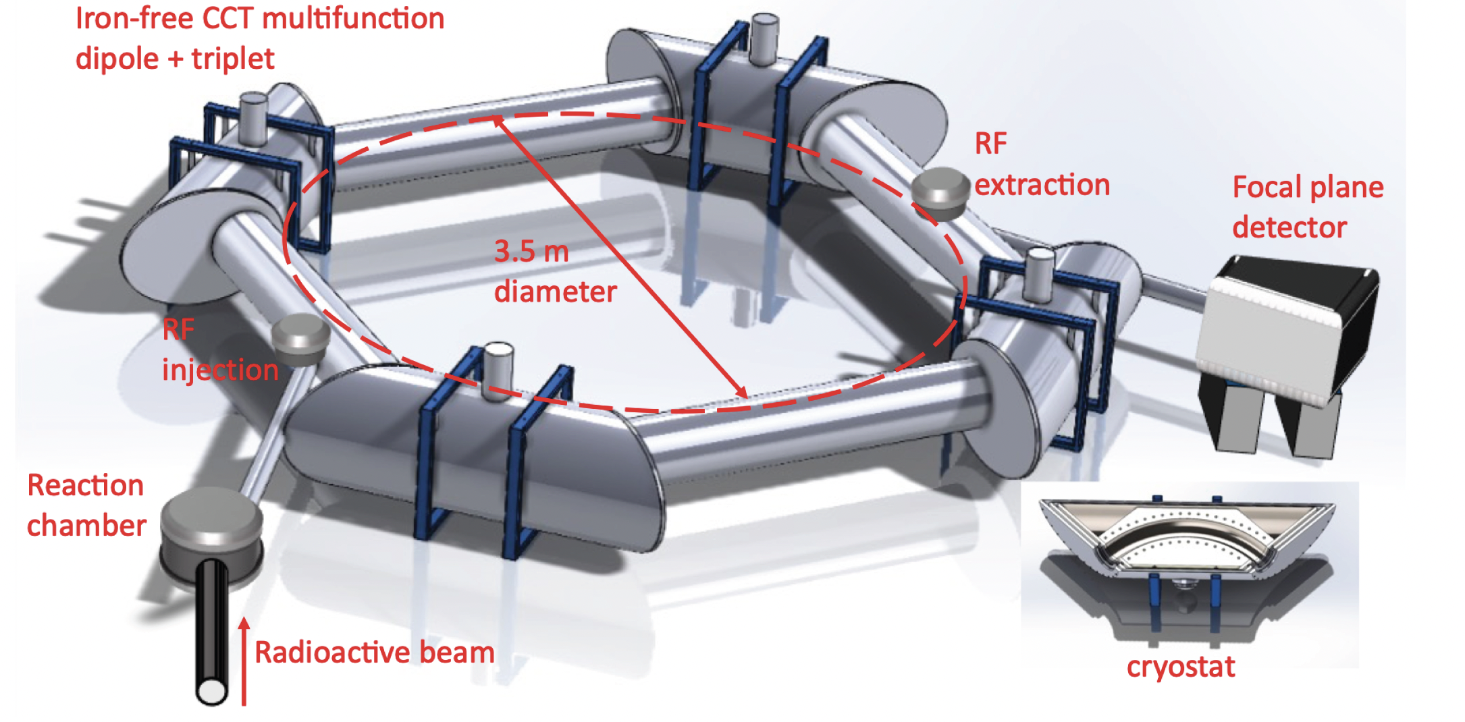
MULTIPORPOSE STORAGE RING with CCT SC magnets
Use with both stable and unstable beams
Zero degree spectrometer
for direct reactions with SPES beams
(no need for pure ISOL beams)
Mass spectrometer for reactions with
stable heavy ions with mass resolution
up to A=230
Accumulation ring for SPES beams
to boost luminosity
(n-capture reactions possible)

Slide 3
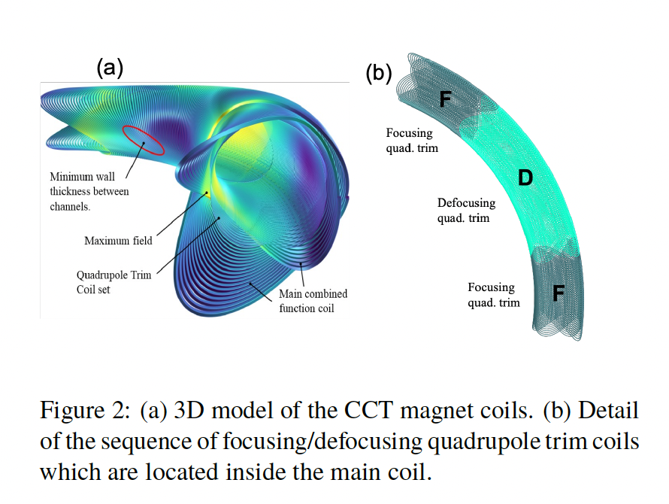
Innovative CCT (fusillo) magnets

Slide 4
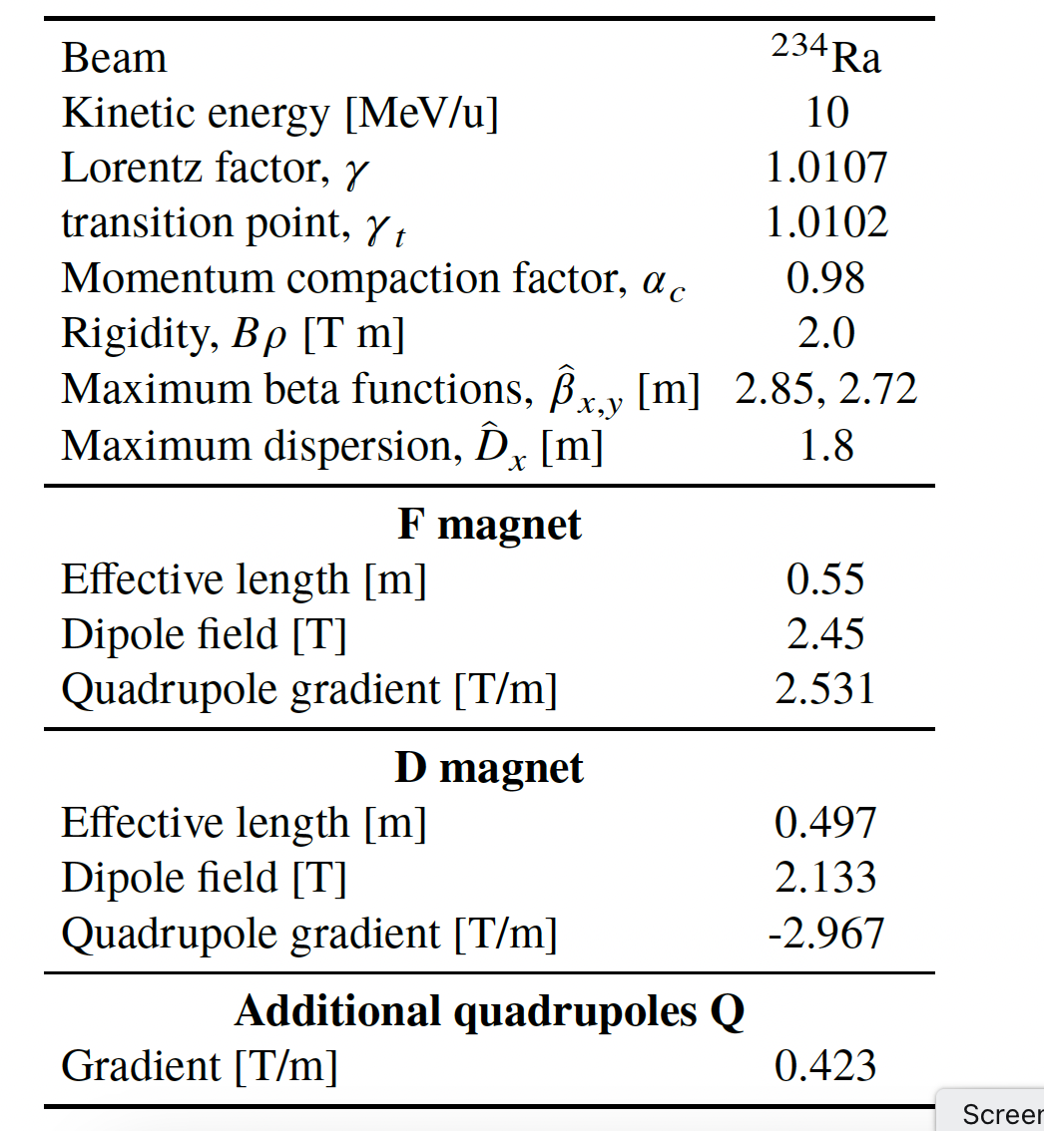
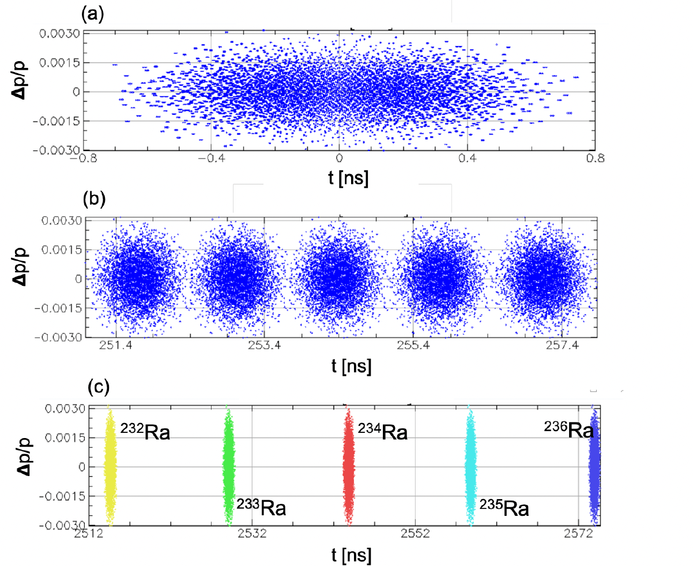
Reaction with accumulated beams
1 turn
10 turns

Slide 5
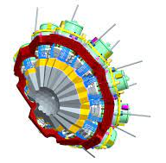
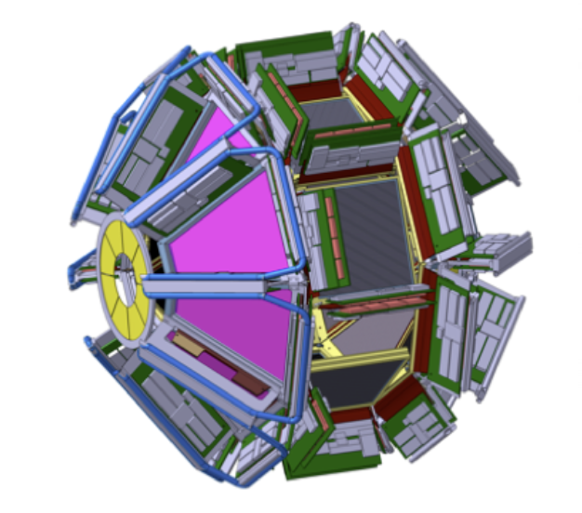
Reactions with secondary beams from STABLE beams
Secondary reaction
Primary beams 50-100 pnA
Primary target reactions with
𝜎~1 mbarn (fusion, quasi-fusion, fission, direct…)
Accumulation of reaction products in the ring
Secondary reactions: Coulex, direct, (p,p’)
1 𝜇s revolution time = 1000 beam passages in 1 ms !
Stable or radioactive beams
Example: ⁴⁸Ca(50 pnA)+²³⁸U (1mg/cm²) -> ⁵⁰Ca with 𝜎∼30 mbarn -> (1% RING acceptance) -> 220 ions/s accumulated (⁵⁰Ca t_{1/2}=14 s) -> after 1 s of accumulation beam of 2E8 ions/s for several seconds !

Slide 6
Neutron beams from stable beam
⁷Li 100 pnA -> 10⁷ neutron/s/cm²
Target 1.3 g/cm³
Up to 7⁺ in ⁸²Ge observed with 𝛾 𝛾
coincidences
5-6% 𝛾-ray efficiency (1 MeV)
Doing better ?
Higher currents (pulsed)
from Tandem/Adige?
Active fission target
(²³⁸U in liquid scintillator)
Gas-filled detector for FP
identification (thin target)
Inverse kinematics ²³⁸U beam
on a cryogenic D₂ target:
PRISMA-AGATA

