Slide 1

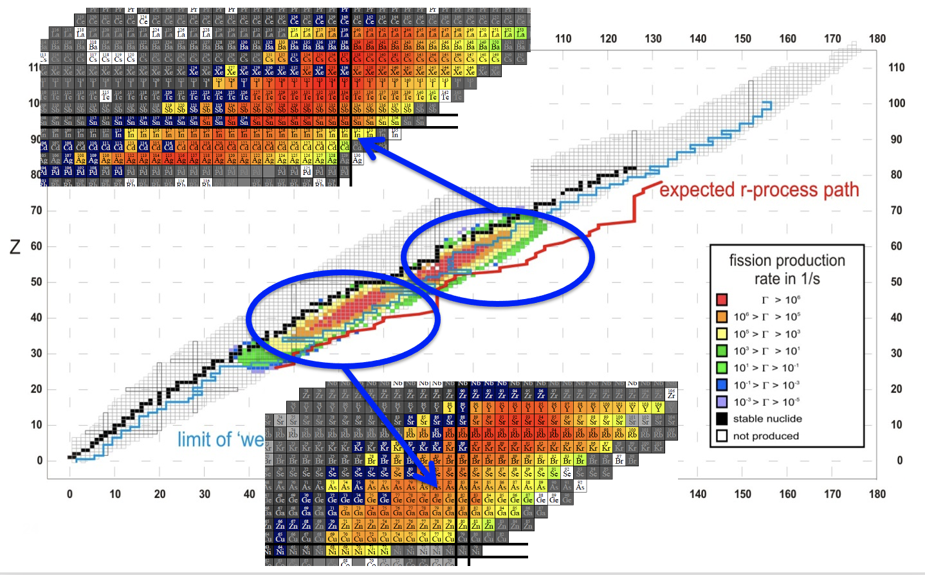
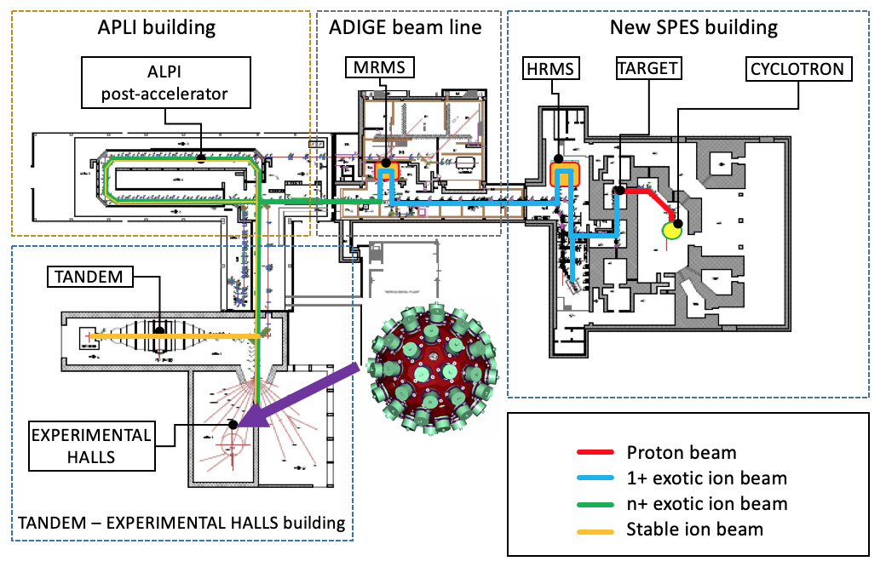
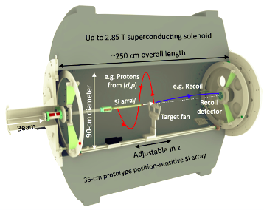
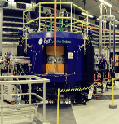
Decoupling the production and the Acceleration stages
Long lived rare isotope beams prodused in batch mode
An example: 85Kr s-process waiting point
40 MeV - 200 μA of protons → production of re-accelerated neutron-rich exotic beams 10¹³ fission/s in-target production, and re-acceleration at 10*A MeV (A=132)
ECR ion source
for pilote beams
Notes:
RIBS before SPES RIBS :
Decapling the production and acceleration stages:
Produsing long lived activity using the SPES cyclotron
Eventually chemical separation
Reacceleration using ADIGE

Slide 2
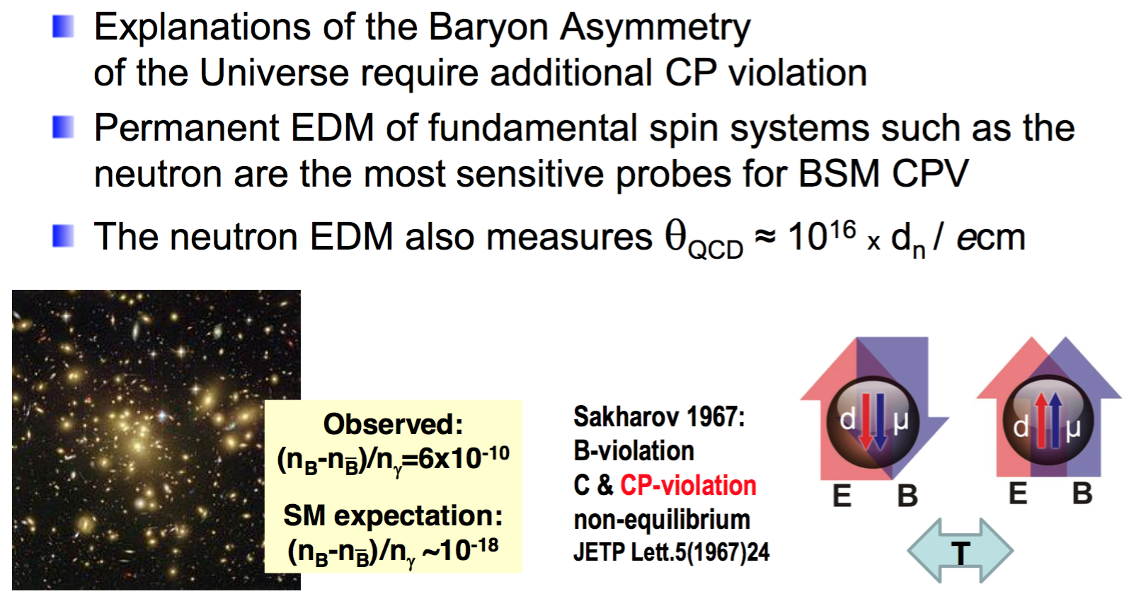
Nuclear Structure and EDM search
Explanations of the Baryon Asymmetry of the Universe require additional CP violation
Permanent EDM of fundamental spin systems are the most sensitive probes for bejond Standard Model CP violation
Axion like Dark Matter probe?
Notes:
Physics driven. Two examples:
Search for the best candidates for EDM search: Octupole deformed nuclei
Barion asymmetry requires CP violation
EDM is the most sensitive probe for CP violation
Allow also to probe light Axion like Dark matter

Slide 3
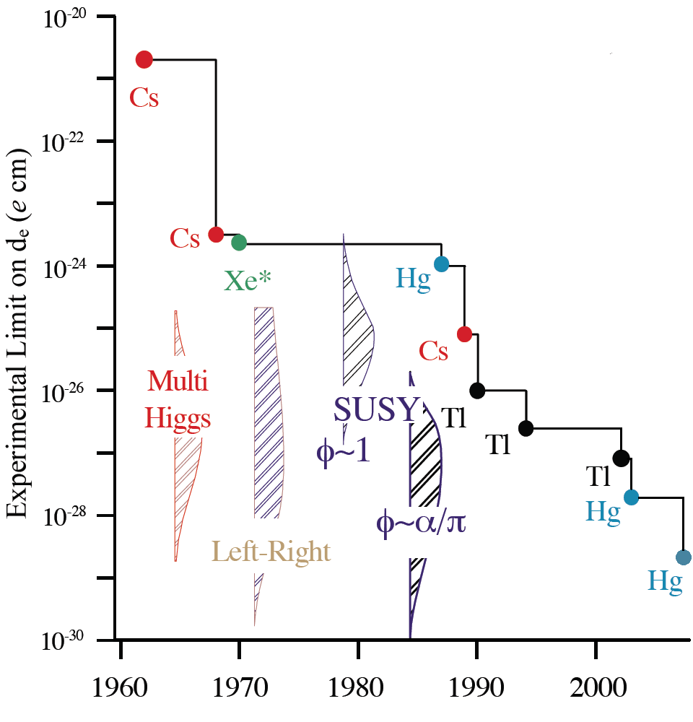
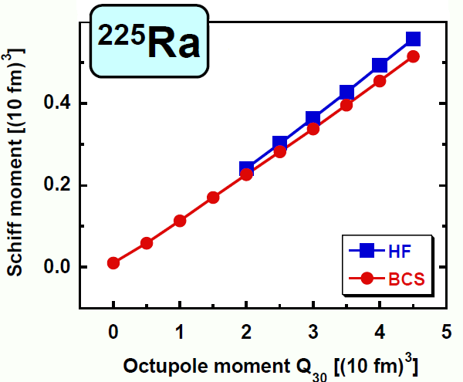
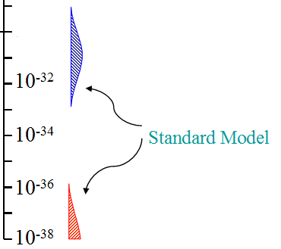
Octupole enhanced atomic EDM moment
V Spevak, N Auerbach, and VV Flambaum
PR C 56 (1997) 1357
related to Q₃
P,T-violating n-n interaction
Schiff moment:
energy splitting of parity doublet
J Dobaczewski (Trento, 2010)
Schiff moment enhanced by ~ 3 orders of magnitude in pear-shaped nuclei
Search candidates are odd-A Rn [TRIUMF ] and Ra [Argonne, Groningen/ISOLDE]
SKO_{L}
²²⁴Ra
Rn, Ra
n,p
Measure: Q₃ in even-A Rn, Ra
ΔE in odd-A Rn
e
Notes:
EDM moment proportional to Schiff moment

Slide 4


Octupole Enhancement
I
|+⟩
Ψ⁺ = ((1+α)|+⟩ +(1−α)|−⟩)/√2
Ψ⁻ = ((1−α)|+⟩ +(1+α)|−⟩)/√2
Ψ⁺ = (|+⟩ + |−⟩)/√2
Ψ⁻ = (|+⟩ − |−⟩)/√2
P, T
I
ΔE
|−⟩
S_{intr} ~ eZAβ₂β₃
S_{lab} ~ e Z A^{2/3} β₂ β₃²/ΔE
β_{2 ,} β₃ ∼0.1
Haxton & Henley; Auerbach, Flambaum & Spevak; Hayes, Friar & Engel; Dobaczewski & Engel
²²³Rn ²²³Ra ²²⁵Ra ²²³Fr ²²⁵Ac ²²⁹Pa ¹⁹⁹Hg ¹²⁹Xe
t_{1/2} 23.2 m 11.4 d 14.9 d 22 m 10.0 d 1.5 d
I 7/2 3/2 1/2 3/2 3/2 5/2 1/2 1/2
Δe_{th} (keV) 37 170 47 75 49 5
ΔE_{exp} (keV) -- 50.2 55.2 160.5 40.1 0.22
10⁵ S (efm³) 1000 400 300 500 900 12000 -1.4 1.75
10²⁸ d_{A} (e cm) 2000 2700 2100 2800 30000 -5.6 0.8

Slide 5
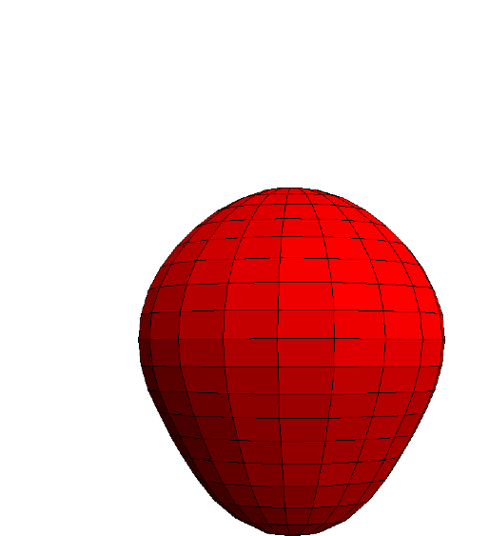
Octupole Enhancement
Cannot be transported with the present SPES infrastructure
-
HIE-ISOLDE for ²²³Fr ~ 2x10⁶ s⁻¹
SPES for ²²⁹Pa by ²³²Th(p,4n)
I ≈ 10¹⁶ atoms in 10 days
SPIRAL2 (Linag) for ²²⁹Pa by
²³²Th(p,4n)
+
+
-
30000 more
sensitive
then ¹⁹⁹Hg
+
²²⁹Pa
-
+
-
+
-
S_{intr} ~ eZAβ₂β₃
S_{lab} ~ e Z A^{2/3} β₂ β₃²/ΔE
β_{2 ,} β₃ ∼0.1
Haxton & Henley; Auerbach, Flambaum & Spevak; Hayes, Friar & Engel; Dobaczewski & Engel
²²³Rn ²²³Ra ²²⁵Ra ²²³Fr ²²⁵Ac ²²⁹Pa ¹⁹⁹Hg ¹²⁹Xe
t_{1/2} 23.2 m 11.4 d 14.9 d 22 m 10.0 d 1.5 d
I 7/2 3/2 1/2 3/2 3/2 5/2 1/2 1/2
Δe_{th} (keV) 37 170 47 75 49 5
ΔE_{exp} (keV) -- 50.2 55.2 160.5 40.1 0.22
10⁵ S (efm³) 1000 400 300 500 900 12000 -1.4 1.75
10²⁸ d_{A} (e cm) 2000 2700 2100 2800 30000 -5.6 0.8

Slide 6
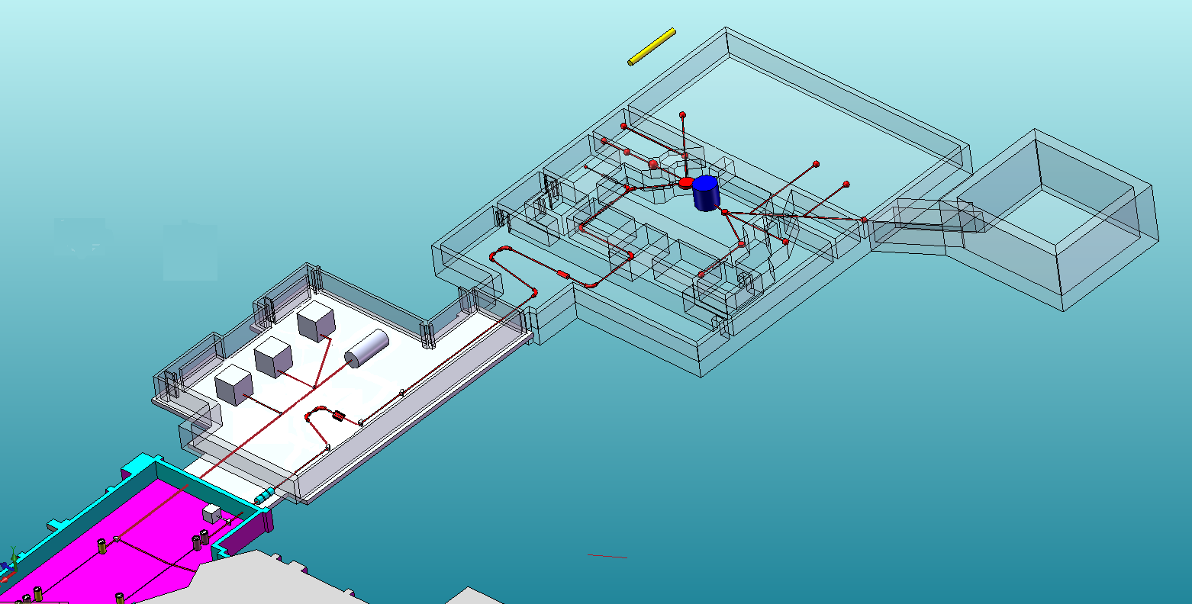
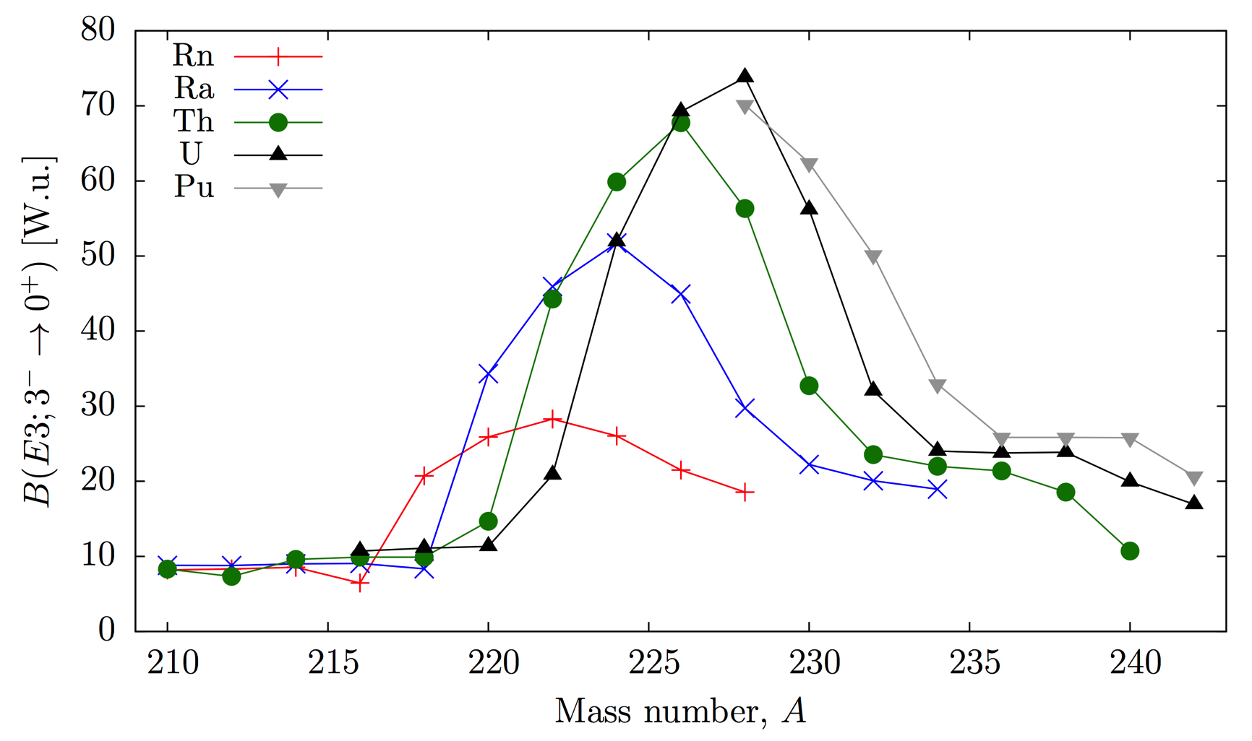

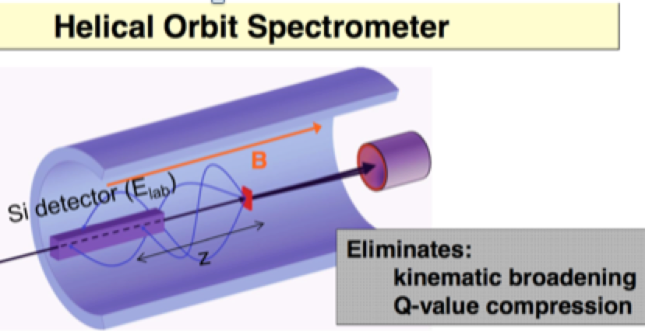
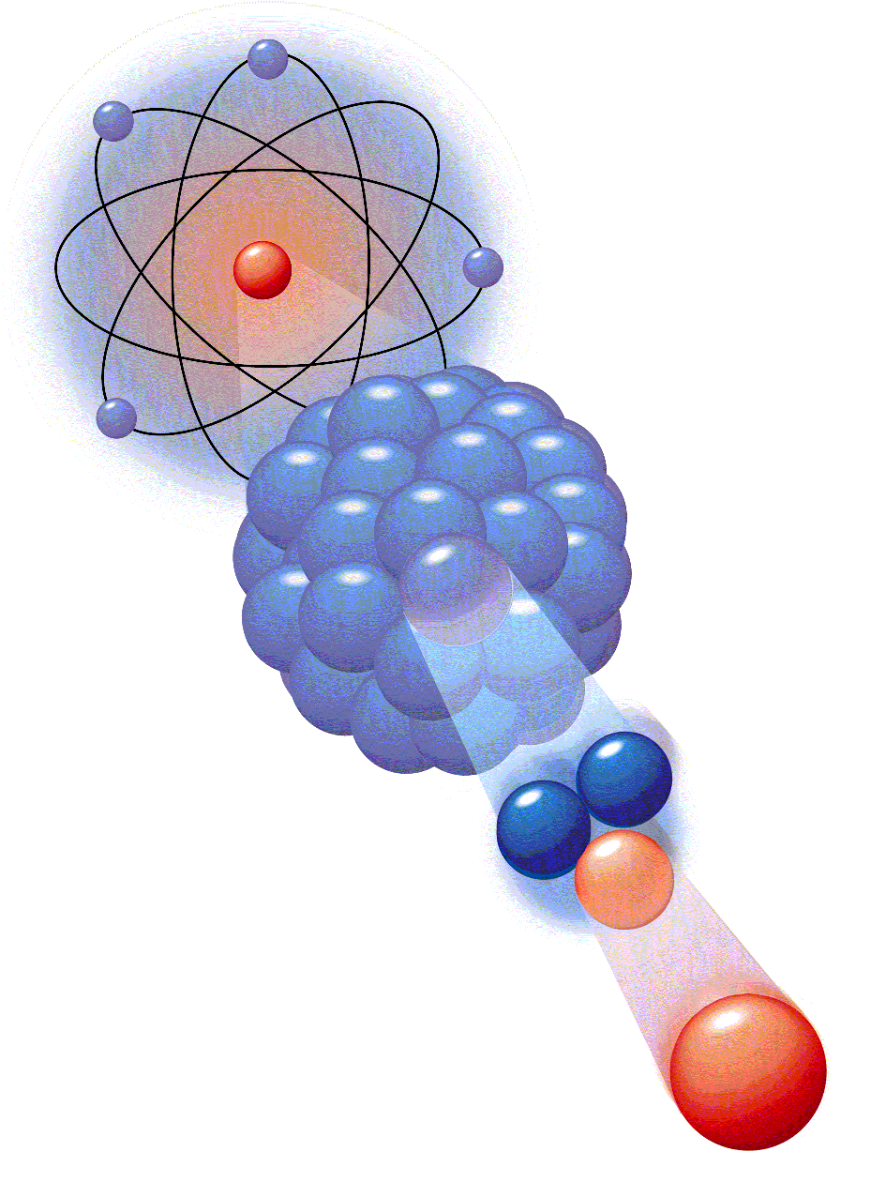
²²⁹Pa production at SPES?
[1] Robledo, L. M., & Bertsch, G. F. (2011). Phys. Rev. C, 84(5), 54302.
ThC_{x} target
HIE-ISOLDE for ²²³Fr ~ 2x10⁶ s⁻¹
SPES for ²²⁹Pa by ²³²Th(p,4n)
I ≈ 10¹⁶ atoms in 10 days
SPIRAL2 (Linag) for ²²⁹Pa by
²³²Th(p,4n)
+
-
+
-
30000 more
sensitive
then ¹⁹⁹Hg
+
²²⁹Pa
-
+
-
+
-

Slide 7
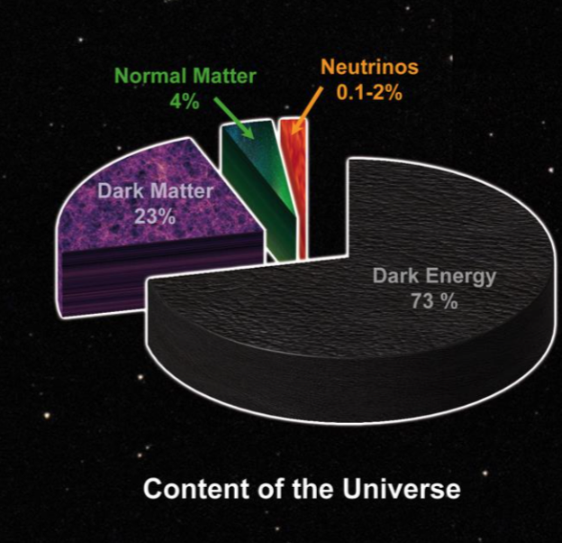
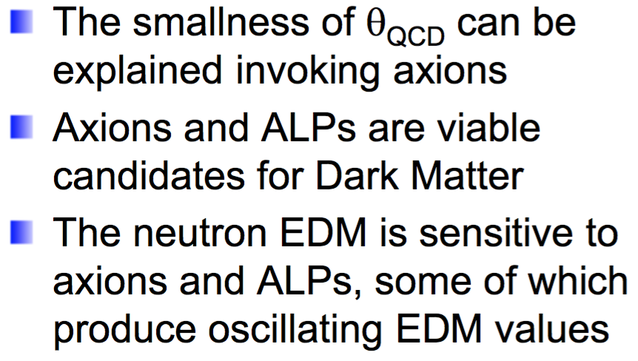
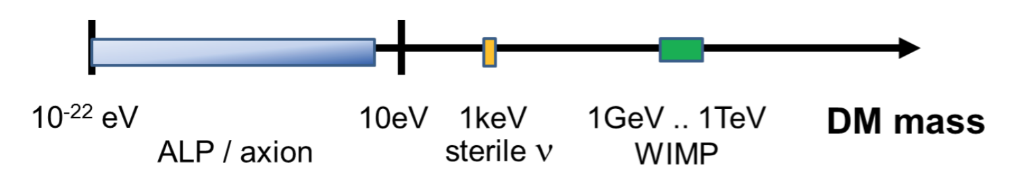
EDM and Axions
or Axions like particles
Notes:
Astrophysical and cosmological observations indicate that 26% of the total energy density and 84% of the total matter content of the Universe is dark matter, the identity and properties of which still remain a mystery. One of the leading candidates for cold dark Matter is the axion, a pseudoscalar particle which was originally hypothesised to resolve the strong CP problem of quantum chromodynamics (QCD). Low mass (ma<0.1 eV/c2) axions can be produced via non-thermal production mechanisms, such as vacuum misalignment in the early Universe coupling to the photon. Oscillating electric dipole moments of nucleons and atoms, and anomalous spin-precession effects, can be produced by the interaction of the axion dark matter field with gluons and fermions. The frequency of these oscillating effects is dictated by the axion mass and the effects scale linearly in a small interaction constant.

Slide 8
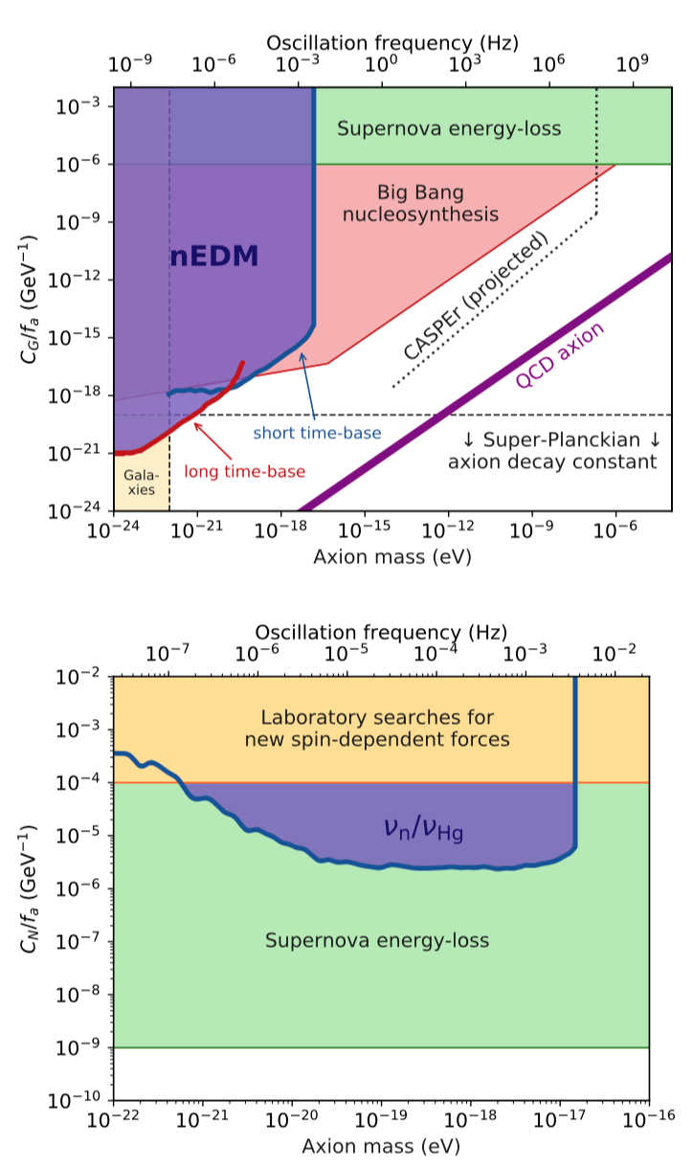
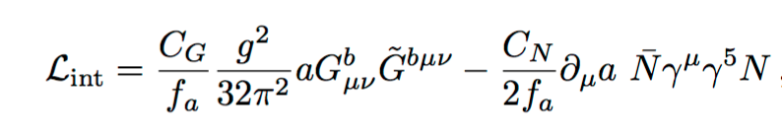
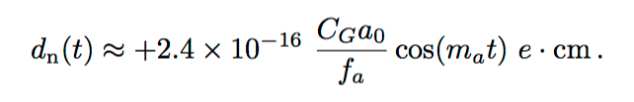

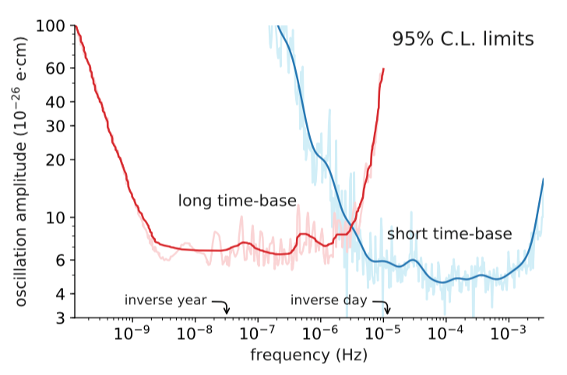
EDM limiting axions
Axion-Gluon and Axion-Nucleon
Search for axion-like dark matter through
nuclear spin precession in electric and
magnetic fields C. Abel et al. 2017
arXiv:1708.06367v1 (2017)
Nuclear species with large schiff moments
due to octupole enhancement can be used
to search for Axion-like Dark matter?
PSI results

Slide 9
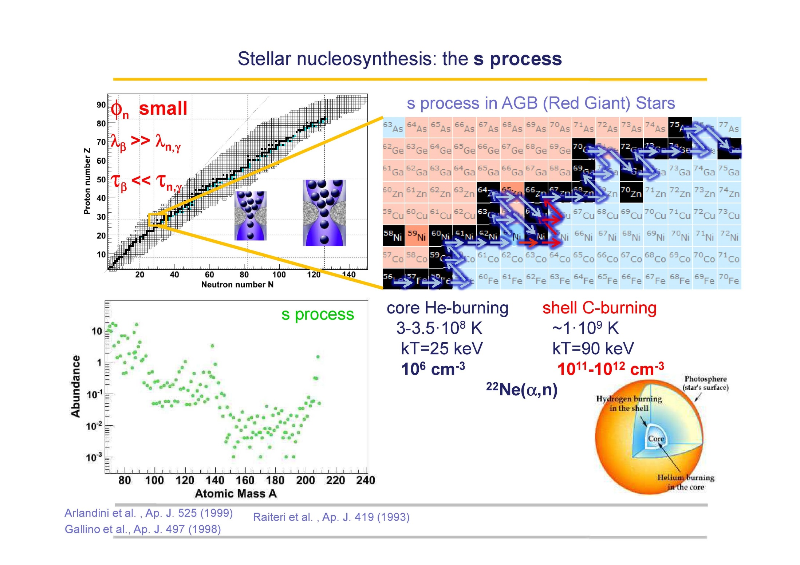
s-process nucleosynthesis and stellar n-flux
The branching is important for Rb and Sr abundances
It offers an estimation of the neutron density
Crucial for both main and weak component
Challenge present understanding!
At high neutron densities (5 x 10⁸ n/cm³⁾, 80% of the flux goes through ⁸⁵Kr producing ⁸⁶Kr, ⁸⁷Rb:
--> ⁸⁷Rb in AGB stars is an indicator of the neutron density!
In low-mass stars: ⁸⁸Sr produced
In massive AGB: ⁸⁷Rb
σ(⁸⁵Kr) = (55 ± 45) mb
Notes:
The proposal addresses the s-process nucleosynthesis and in particular is focused on the 80,82Kr nuclei. Those abundances are representative of the only s-processes since those nuclei are shielded from the rapid neutron capture process by their stable (or almost stable) isobars 80Se and 82Se(t1/2=10^20 y). Additionally the solar abundances of 80Kr and 82Kr are well characterized from chemical analysis of pre-solar grains thus allowing to extract reliable conclusions about the stellar conditions by comparing predicted abundances based on the stellar models and the 79Se(n,gamma) versus the measured abundances (in the pre-solar grains).

Slide 10
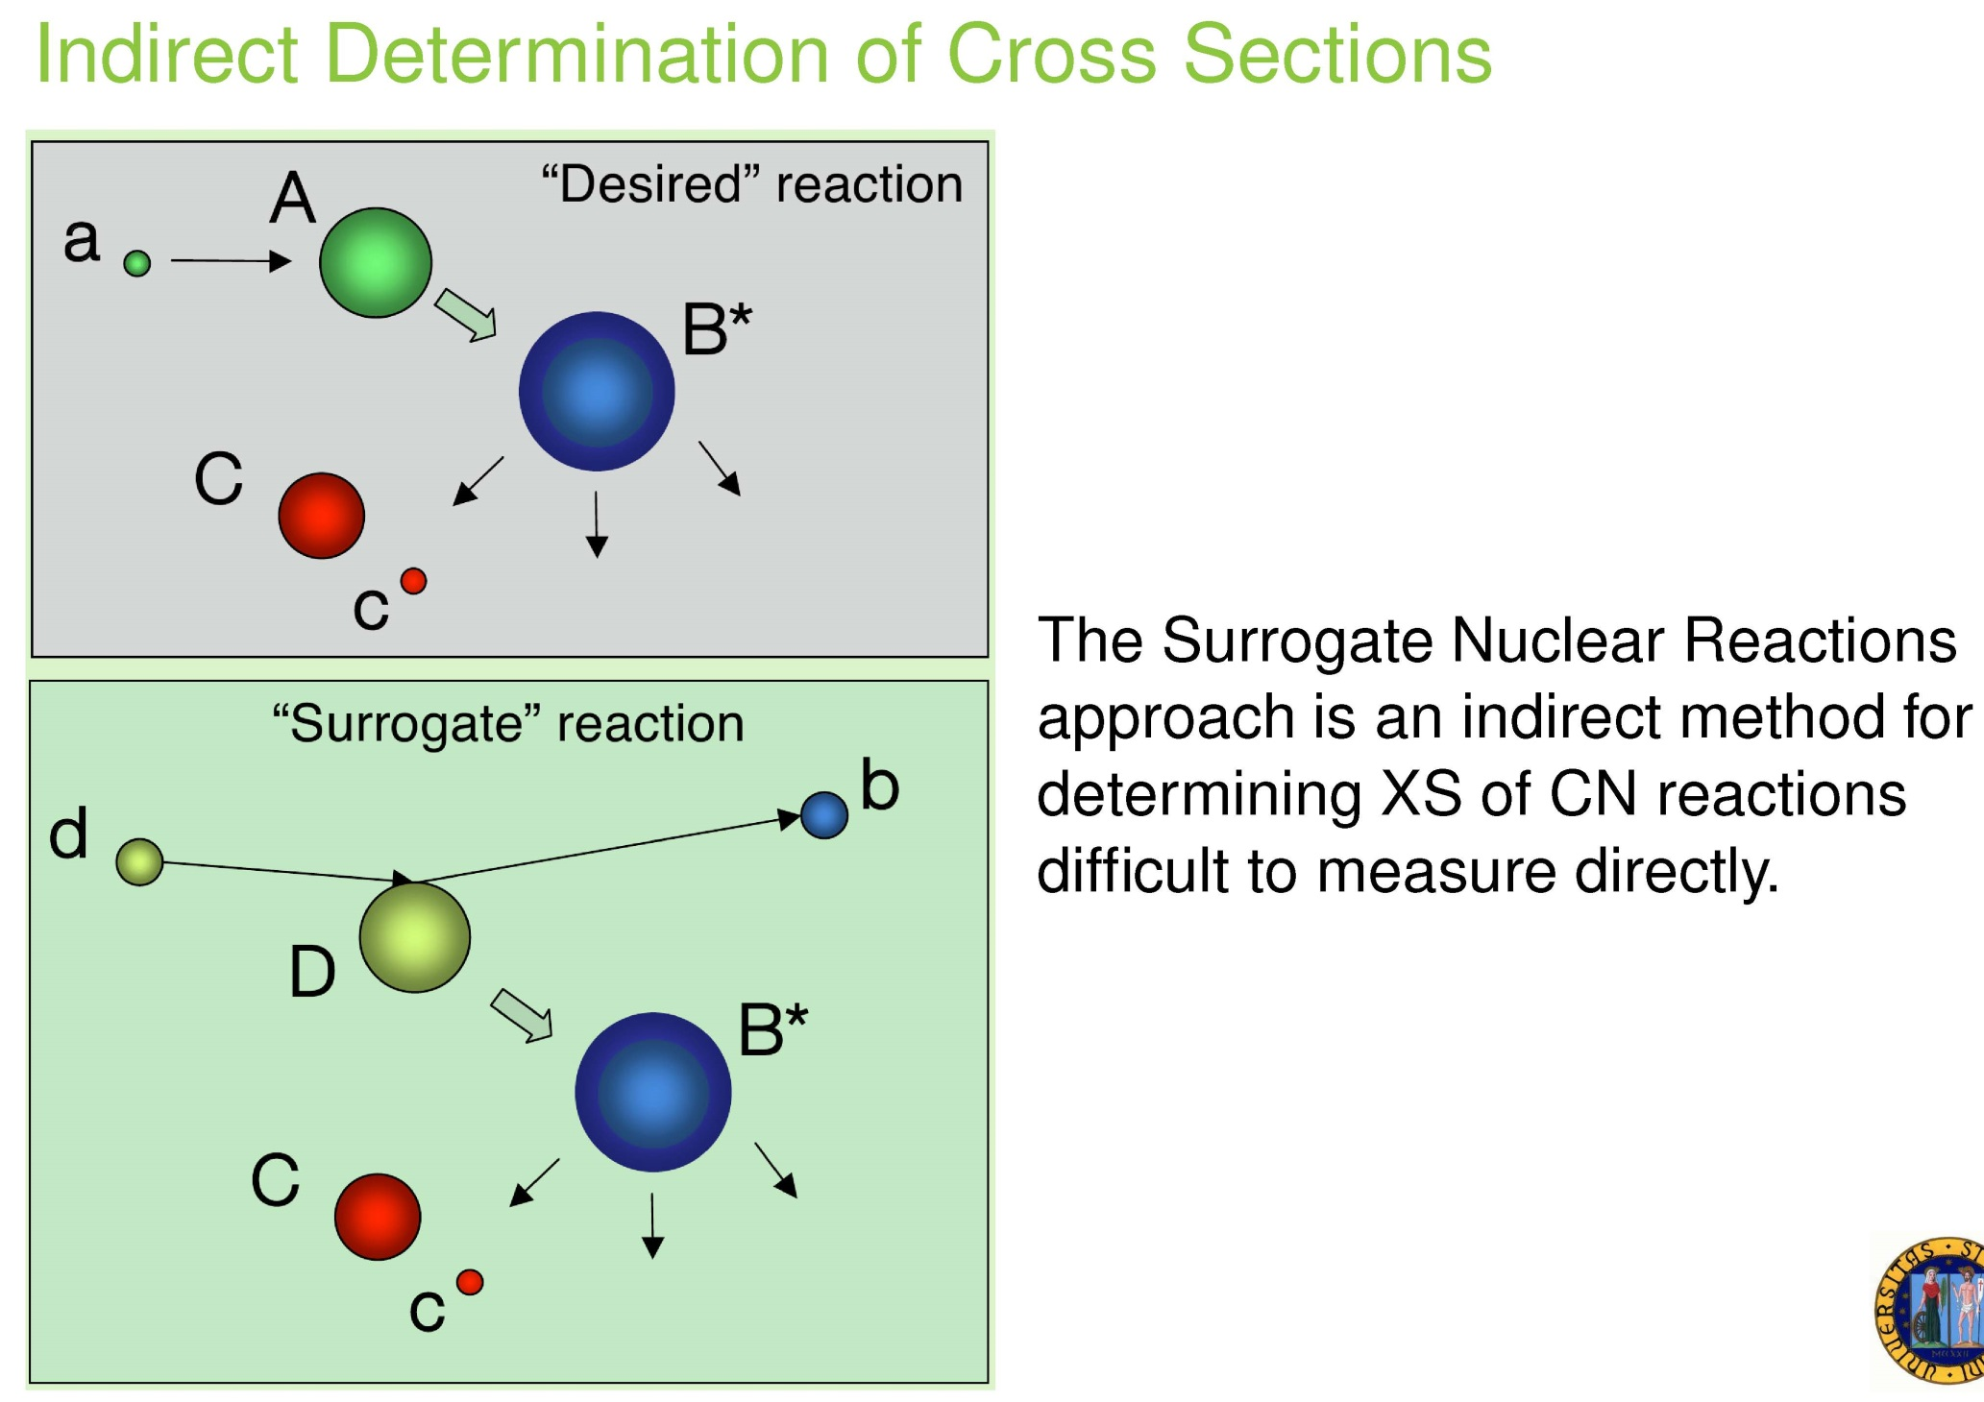
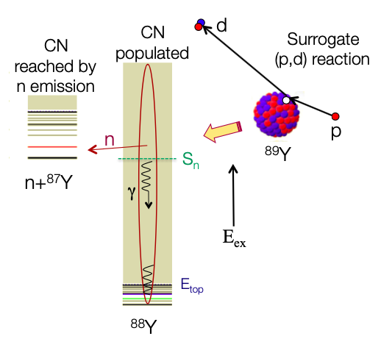
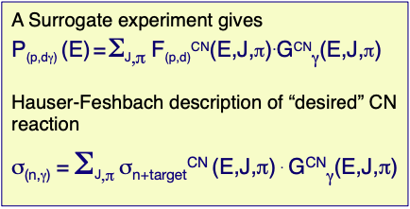
Surrogate Reactions
⁸⁶Kr
⁸⁶Kr
⁸⁶Kr

Slide 11
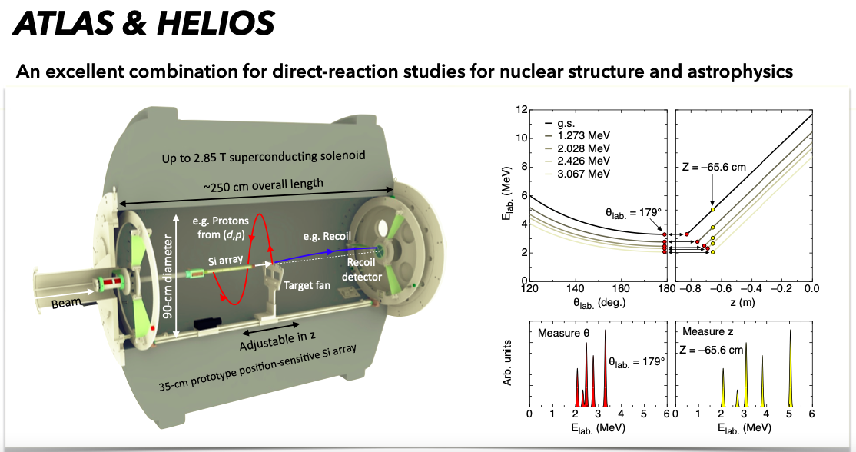

Slide 12
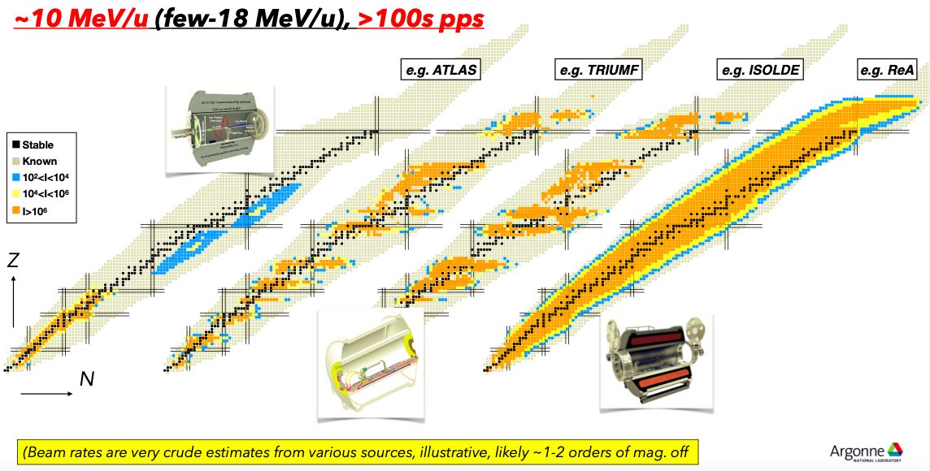

Slide 13
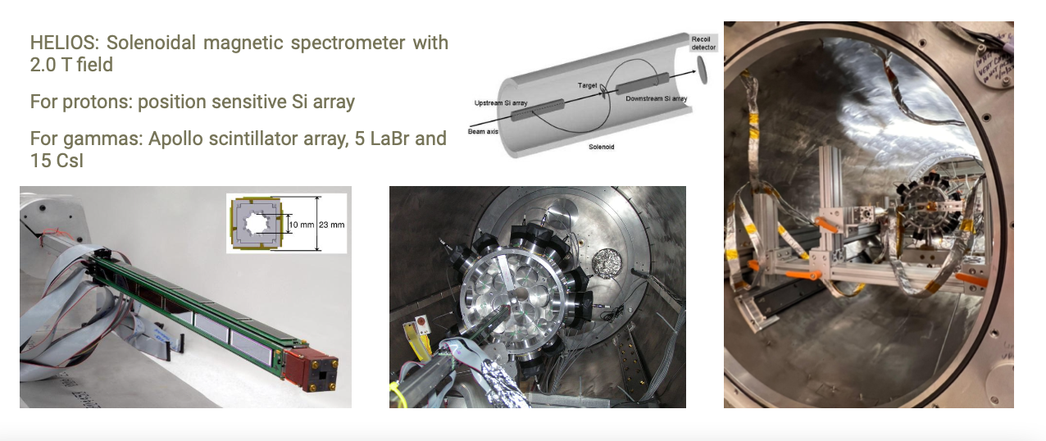
⁸⁵Kr(d,p𝛄)⁸⁶Kr for ⁸⁵Kr(n,𝛄) capture rate
⁸⁵Kr + CD₂ 10 MeV/n & HELIOS I=10⁶ pps

Slide 14
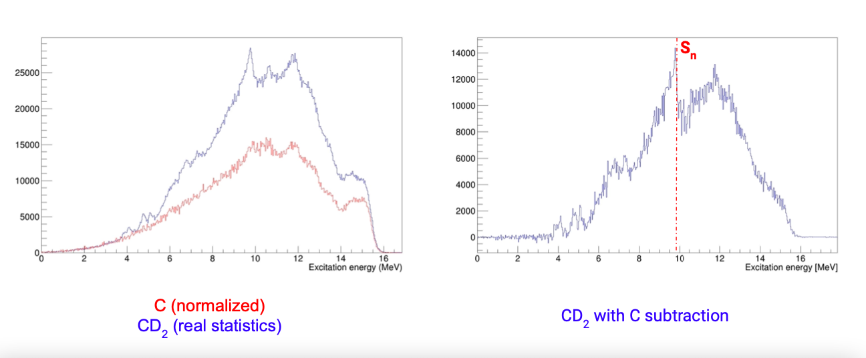
⁸⁵Kr (10 MeV/n) -> CD₂ I=10⁶ pps
Preliminary results

Slide 15
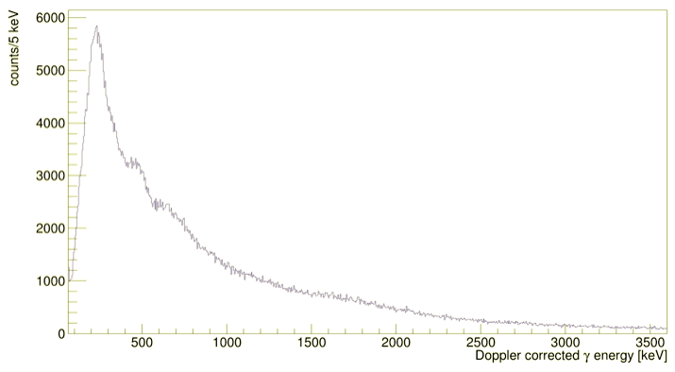
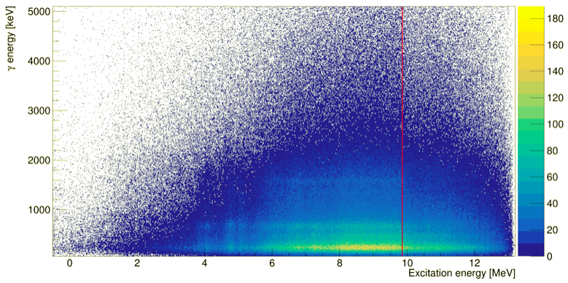
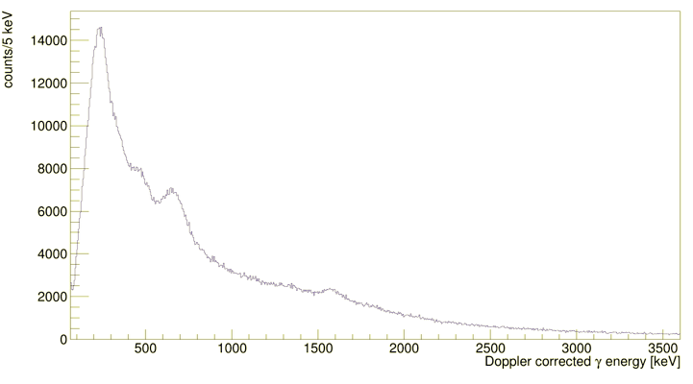
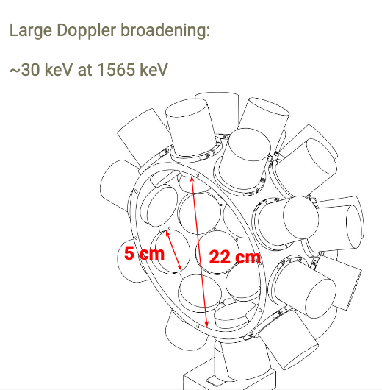

Sn
Preliminary resuts
𝛄 energy [keV]

Slide 16
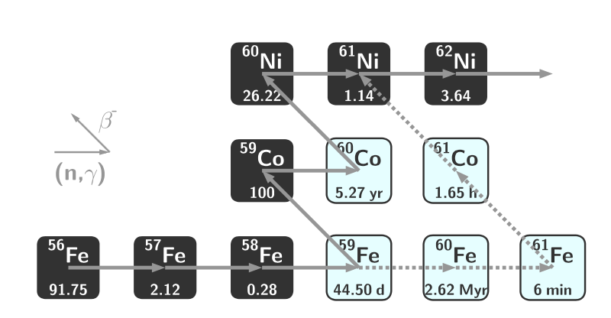
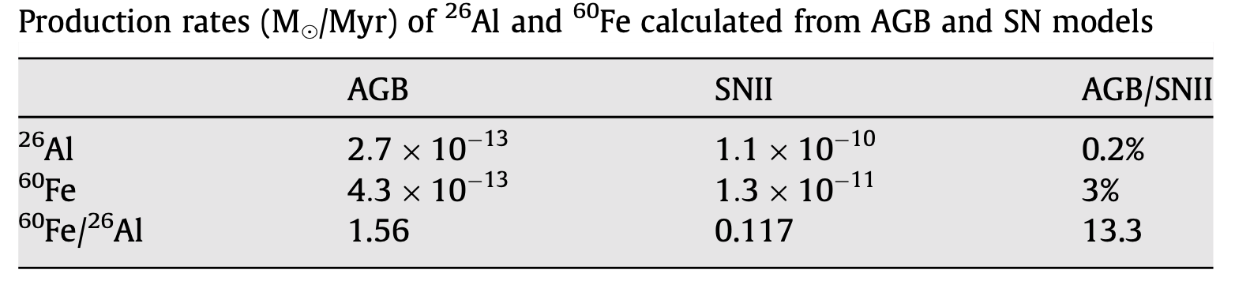
Perspective: Production of ⁶⁰Fe
The ⁶⁰Fe
⁶⁰Fe half life is 2,62•10⁶ y
A high ⁶⁰Fe/⁵⁹Fe would represent a smoking gun for stellar nucleosynthesis
Production source under discussion and several candidates have been proposed: AGB, supernova core-collapse ….
There is the need of two neutron capture especially passing through the ⁵⁹Fe that is a branching point due to its half life of 44.5 days. Observed in the galactic disk by INTEGRAL, in meteoritic solar grains and in oceanic sediments 100 million of years old.
Notes:
16

Slide 17
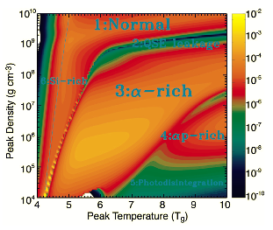
Batch Mode Beams: ⁴⁴Ti(alpha,p)⁴⁷V
⁴⁴Ti, ⁵⁶Ni, ⁶⁸Ge, ⁷²Se, ⁸²Sr, ⁸⁸Zr
Reaction used for the production:
⁴⁶Ti (p,p2n) ⁴⁴Ti T _{½} = 47.3y
⁵⁸Ni (p,p2n) ⁵⁶Ni T _{½} = 6.1d
⁷⁰Ge(p,p2n) ⁶⁸Ge T _{½} = 288d
⁷⁴Se (p,p2n) ⁷²Se T _{½} = 8.5d
⁸⁴Sr (p,p2n) ⁸²Sr T _{½} = 25.5d
⁸⁸Zr (p,p2n) ⁸⁸Zr T _{½} = 83.4d
Proton beam, energy of 40-45 MeV from LNL SPES cyclotron. I up to 100-200μA.
Ti production (color- coded) versus T and density in the supernova shock. Six regions appear where different nuclear rates play primary roles in determining the Ti yield

Slide 18
⁴⁶Ti(p,p2n)⁴⁴Ti T_{1/2}=47.3a
N(t) = 1.4 10¹⁶ atoms (10 days irradiation).
dN/dt = -λN(t) = 6.6 10⁶ Bq
Dose = 2.2 10⁻⁵ Gy/h
I=3 10⁷ ions/s on target (previous 10^4)
⁵⁸Ni(p,p2n)⁵⁶Ni T_{1/2}=6.1d
N(t) = 2.6 10¹⁵ atoms (10 days irradiation).
dN/dt = -λN(t) = 3.4 10⁹ Bq
Dose = 0.05 Gy/h
I=3 10⁶ ions/s on target (previous 10^4)
⁷⁰Ge(p,p2n)⁶⁸Ge T_{1/2}=288d
N(t) = 2.7 10¹⁷ atoms (10 days irradiation).
dN/dt = -λN(t) = 7.3 10⁹ Bq
Dose = 0.16 Gy/h
I=4 10⁸ ions/s on target (previous 10^4)
⁷⁴Se(p,p2n)⁷²Se T_{1/2}=8.5d
N(t) = 3.2 10¹⁴ atoms (10 days irradiation).
dN/dt = -λN(t) = 3.4 10⁹ Bq
Dose = 5.1 10⁻⁴ Gy/h
I=5 10⁵ ions/s on target (previous 10^4)

Slide 19
Radioactive beam estimates using a static target.
___________________________________________________________________________________________________________
⁴⁶Ti(p,p2n)⁴⁴Ti T_{1/2} =47.3 y I= 3 10⁷ ions/s on target
⁵⁸Ni(p,p2n)⁵⁶Ni T_{1/2} =6.1 d I= 3 10⁶ ions/s on target
⁷⁰Ge(p,p2n)⁶⁸Ge T_{1/2} =288d I= 4 10⁸ ions/s on target
⁷⁴Se(p,p2n)⁷²Se T_{1/2} =8.5d I= 5 10⁵ ions/s on target
⁸⁴Sr(p,p2n)⁸²Sr T_{1/2} =25.5d I= 7 10⁸ ions/s on target
⁸⁸Zr(p,p2n)⁸⁸Zr T_{1/2}=83.4d I= 7 10⁷ ions/s on target

