Slide 1


PANDORA
Alessio Galatà
on behalf of the PANDORA collaboration

Slide 2
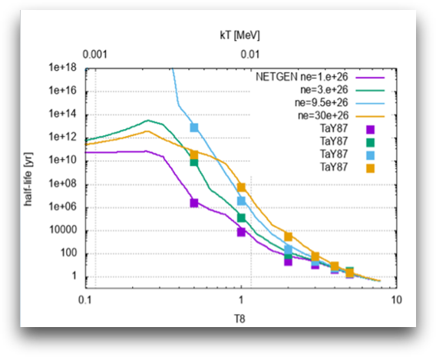
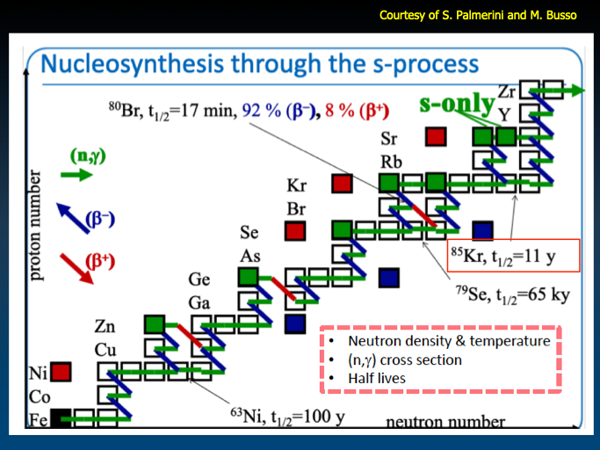
PANDORA main goal: Investigating β-radioactivity in a «stellar» environment
Make β-decay measurements in plasmas of astrophysical interest: many isotopes can change their lifetime of several order of magnitude when ionized!!
The effect is mainly driven by the opening of a new decay channel: the bound state beta decay
Takahashi et al. 1987, Phys Rev C 36, 1522.​
Direct implication on branching points in s-process nucleosynthesys chain competition of neutron capture vs β-decay
Isotope | T_{1/2} [yr] | E_{γ} [keV]
¹⁷⁶Lu | 3.78·10¹⁰ | 202.88 & 306.78
¹³⁴Cs | 2.06 | 795.86
⁹⁴Nb | 2.03·10⁴ | 871.09
COSMO-CHRONOMETER
reproduction of ¹³⁴Ba, ¹³⁶Ba s-only isotope yields
Solving the puzzle about the contribution of s-processing to ⁹⁴Mo: β-decay or binary stars

Slide 3
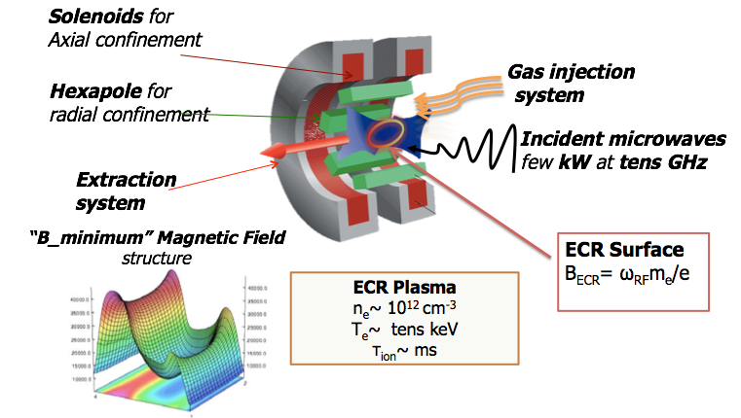
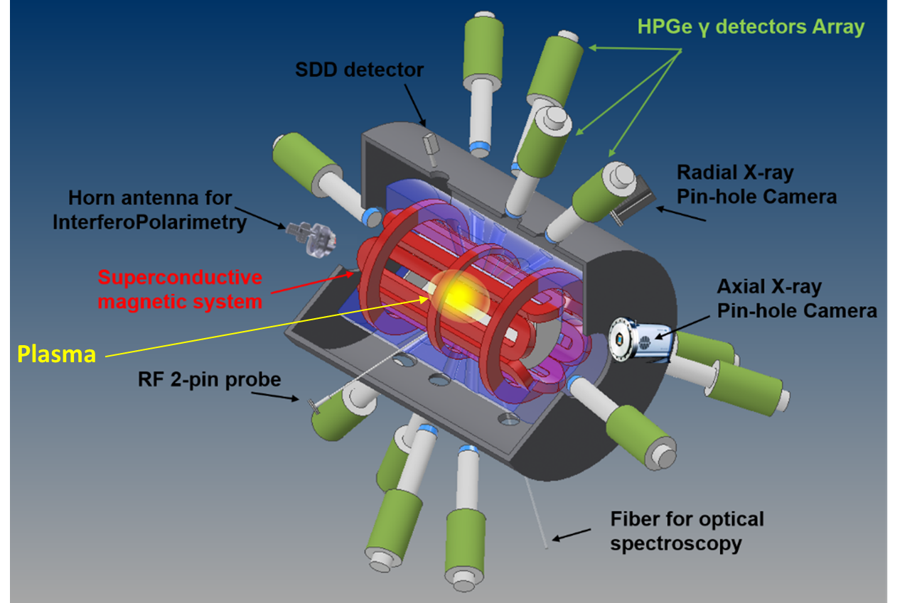
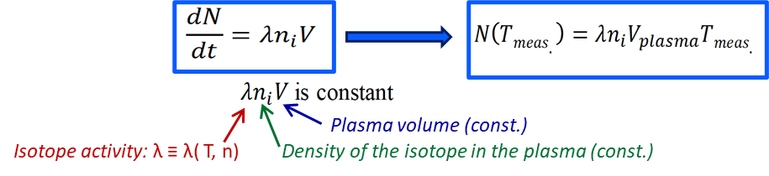



PANDORA CONCEPT
Electron Density: 10¹² – 10¹⁴ cm⁻³
Electron Temperature: 0.01 – 100 keV
Ion Temperature: ~ 1 eV
Ion Density: 10¹¹ cm-3 (this density relies to the radiactive isotope concentration in plasma)
PANDORA proposes an innovative experimental approach which includes 5 steps:
A buffer plasma is created from He, O or Ar up to density of 10¹³ cm⁻³ by Electron-Cyclotron-Resonance heating and confined by magnetic field;
The isotope is vaporized by proper ovens into the chamber to be transformed into plasma-state (with a given relative abundance of buffer vs isotope densities)
The plasma is maintained in MHD equilibrium for days or even weeks: the number od decays per unit of times can be written as:
While the isotopes decay, the confined daughter nuclei emit γ-rays of hundreds of keV, which are detected by a HPGe detector array;
In-plasma radioactivity can be correlated to plasma parameters monitored by an innovative non-invasive multi-diagnostics setup;
First Physics Cases
Isotope | T_{1/2} [yr] | E_{γ} [keV]
¹⁷⁶Lu | 3.78·10¹⁰ | 202.88 & 306.78
¹³⁴Cs | 2.06 | 795.86
⁹⁴Nb | 2.03·10⁴ | 871.09

Slide 4
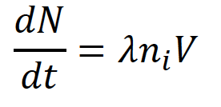
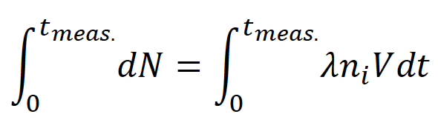
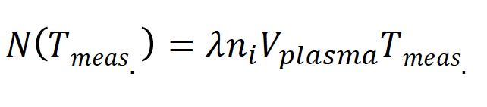
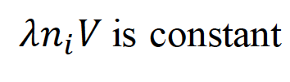
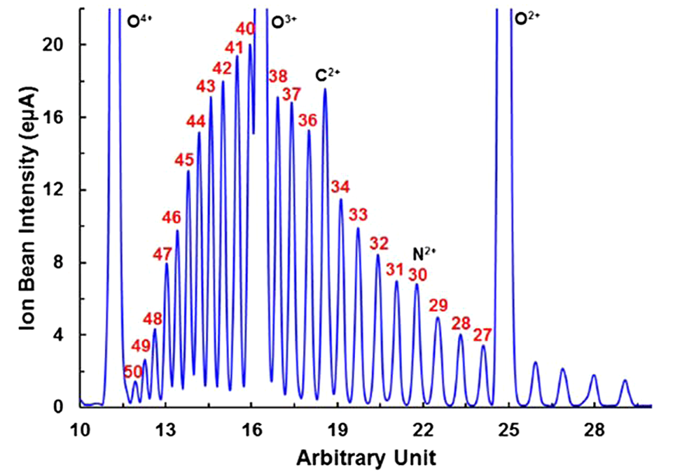
PANDORA: EXPERIMENTAL APPROACH
Plasma volume (const.)
Density of the isotope in the plasma (const.)
τ=1/λ
Isotope activity
Δq/2
<q>
Δq/2
N
t
<q>

Slide 5
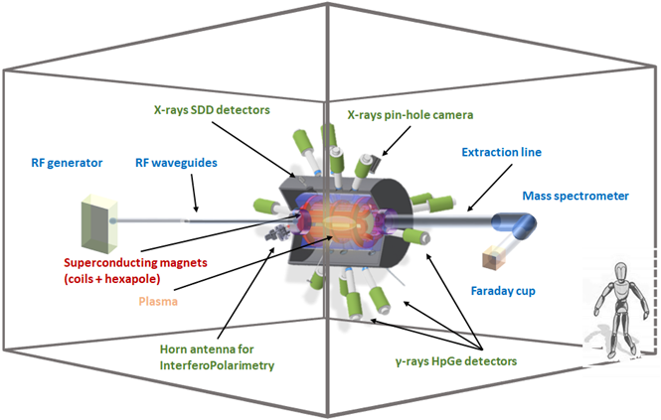
PANDORA: THE FACILITY
P
A
N
D
O
R
A
Superconductive Magnetic Trap
High temperature and ionization state plasmas confinement;
Plasma Diagnostics System
Plasma enviroment characterization;
Improvement of plasma stability;
HPGe γ-detectors Array
β-decay detection by γ-rays tagging;
TO FULFILL THE GOAL IT WILL BE NECESSARY
To confine ions for a sufficient time (Trap)
To measure the gamma rays emitted by the decay product (HPGe detectors)
To correlate the eventual variation of τ with plasma parameters (diagnostics)
To efficiently inject radioactive species (Injection system)
To be able to model the confining plasma (simulations)

Slide 6
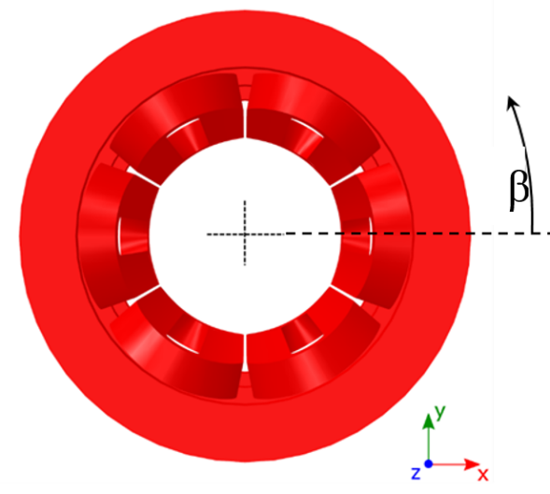
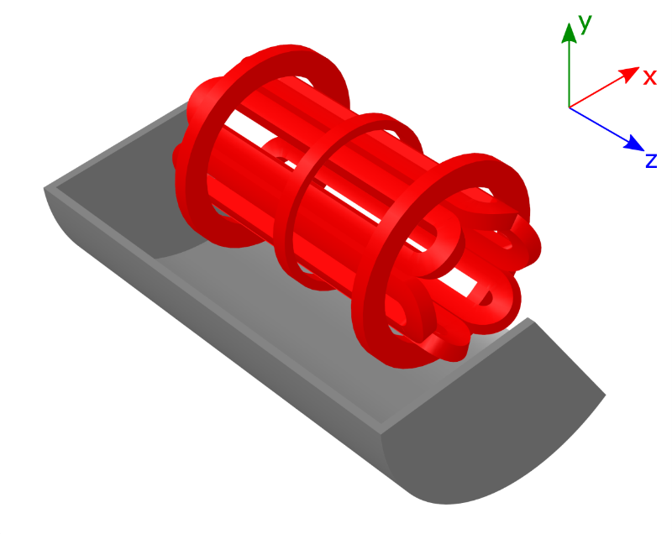
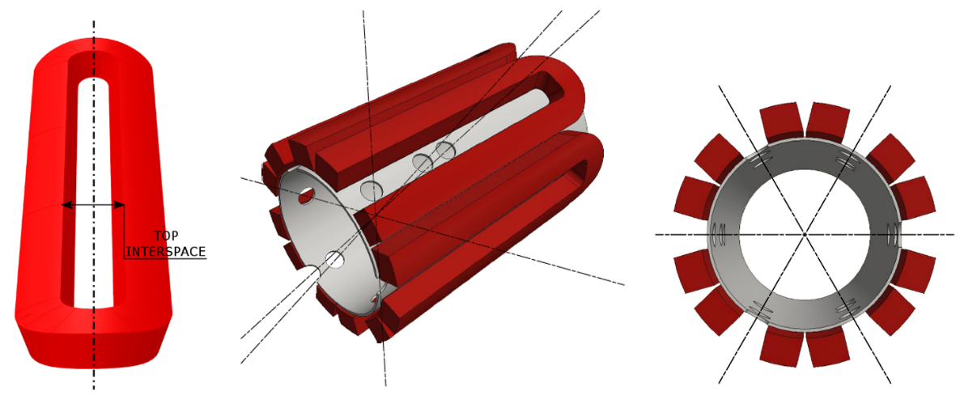
MAIN SUBSYSTEMS: PLASMA TRAP
CONRIBUTION OF LNL WITH M. MAGGIORE AS CONSULTANT
The magnetic system, fully superconductive, consists of:
#3 axial coils that generates the axial magnetic field;
#6 hexapole coils that generates the radial magnetic field.
MAGNETIC FIELD REQUIREMENTS
B_{inj} max @ z = - 350 mm | 3 T
B_{inj} operative range | 1.7 T – 3 T
B_{ext} max @ z = 350 mm | 3 T
B_{ext} operative range | 1.7 T – 3 T
B_{min} @ z = 0 mm | 0.4 T
B_{hex} @ R_{CH_IN} = 140 mm | 1.6 T
Lhe | Free
Warm Bore radius | 150.5 mm
Distance between mirrors | 700 mm
Stray field (as above specified) | Less than 0.2 T
The PANDORA’s trap has been designed to operate at 18 + 21 GHz.

Slide 7
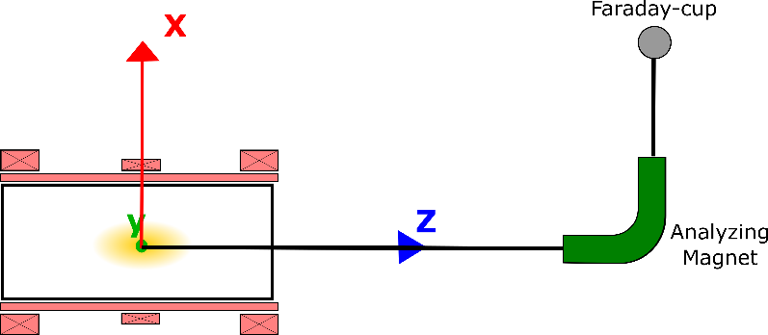
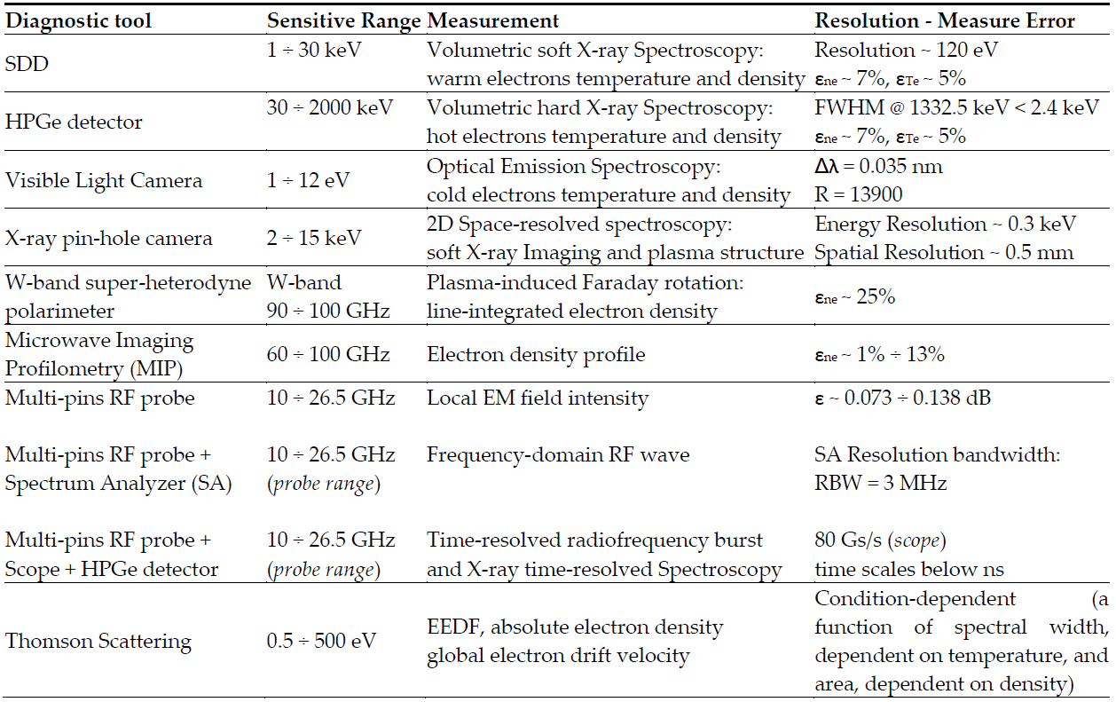
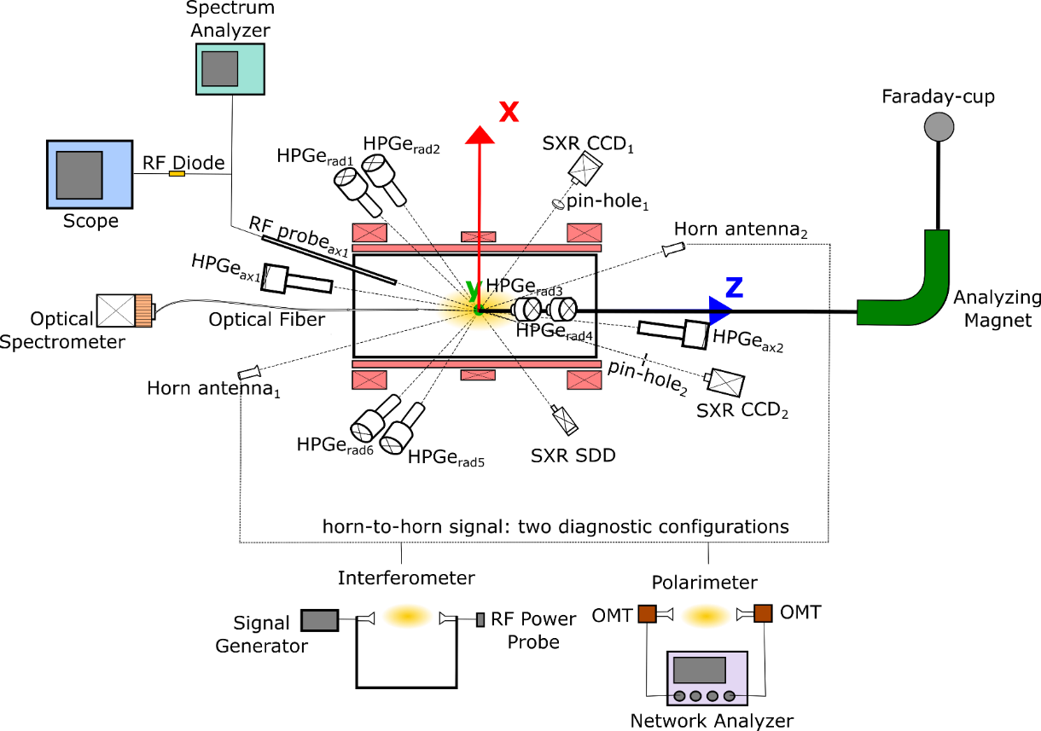
MAIN SUBSYSTEMS: DIAGNOSTICS
Typical Electron-Cyclotron-Resonance (ECR) ion source
Ext. Beam diagnostic
Analyzing Magnet + Faraday cup
PANDORA trap as facility for Nuclear Astrophysics studies
Online plasma multidiagnostic
2
16
1
2
1
1
2
2
2
1

Slide 8
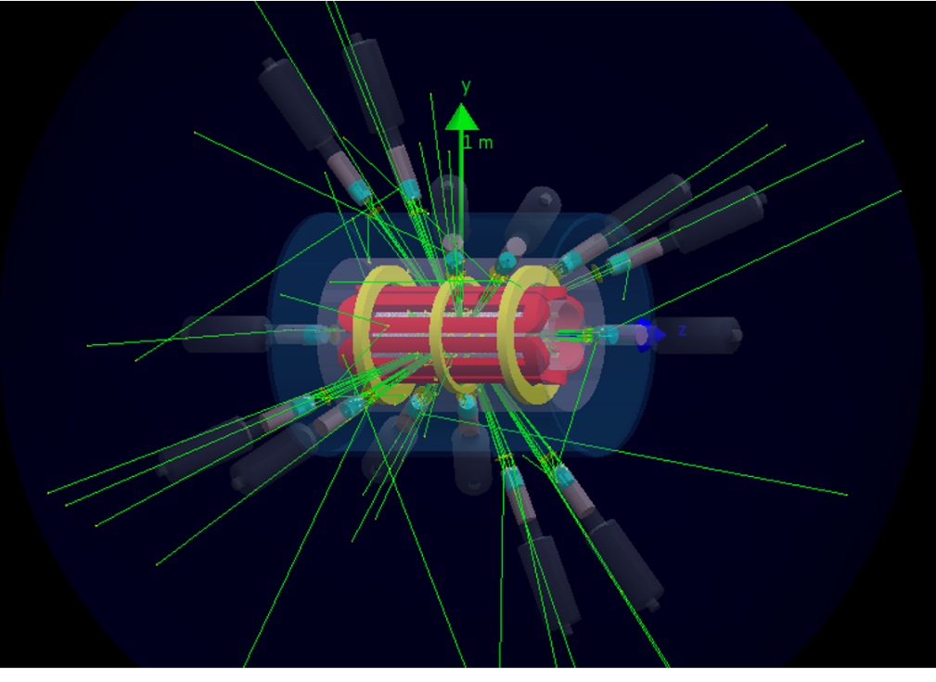

MAIN SUBSYSTEMS: HPGe DETECTORS
(LNS +LNL ACTIVITY)
Design of a array of γ-rays detectos and total efficiency evaluation
→ Evaluation of isotopes’s lifetimes measurability by a Virtual Experiment
Physics Cases
Isotope | T_{1/2} [ yr ] | E_{γ} [ keV ]
¹⁷⁶Lu | 3.78 · 10¹⁰ | 202.88 & 306.78
¹³⁴Cs | 2.06 | 795.86
⁹⁴Nb | 2.03 · 10⁴ | 871.09
The decay-products can be tagged by γ-rays coming out from the ‘‘radio-product’’
with typical energies between 200 keV and 1800 keV
Numerical simulation by GEANT4 according to a certain plasma model to design the array of detector and to estimate the total efficiency of the system

Slide 9
Partnerships and Organization
Nome Cognome | Ruolo | FTE
Alessio Galatà | T (RL) | 0,39*
Mario Maggiore | T | 0,2
Costantino De Angelis (UniBs) | R | 0,5
Andrea Locatelli (UniBs) | R | 0,2
Vincetti Luca (UniMoRe) | R | 0,5
5 sites at national level
* Superposition with EUROFUSION @ 0,11 FTE

Slide 10
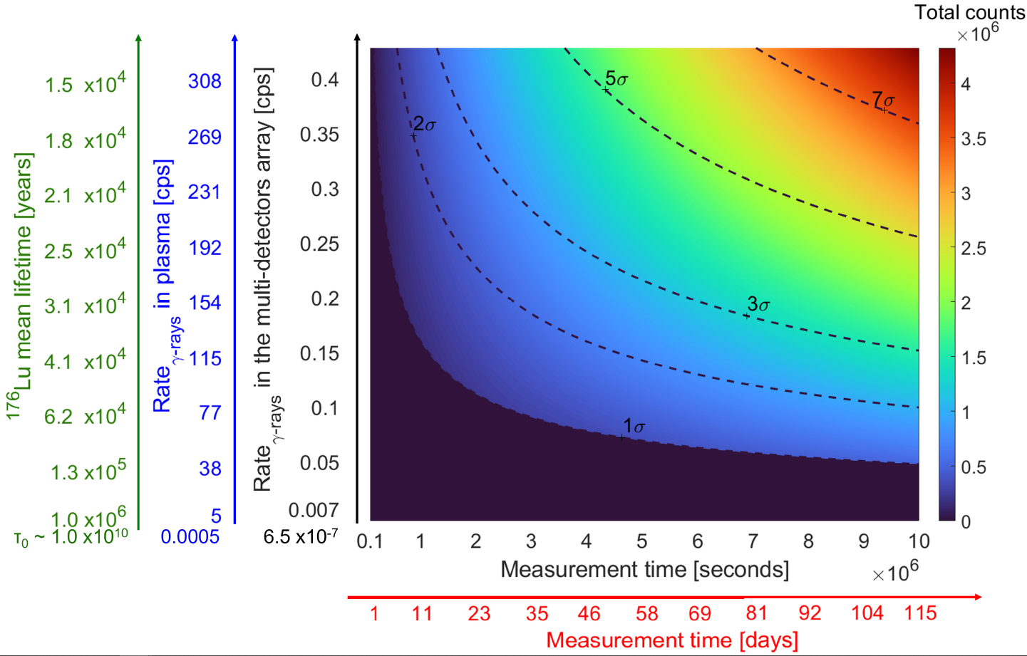
PANDORE: VIRTUAL EXPERIMENT
The green vertical axis reports a decreasing lifetime, starting from the lifetime of the neutral isotope (5,45·10¹⁰ years) to the values predicted by the theory and reachable in the PANDORA trap (the expected collapse of the lifetime is six order of magnitude for ¹⁷⁶Lu at a plasma temperature of ~10 keV).
The effective activity in plasma (assuming a plasma of 1500 cm³ in volume with a relative concentration of 1% of Lu with respect to the buffer density (10¹³ ions/cm³)—was estimated (blue vertical axis).
Including the efficiency of the HPGe detector array estimated by GEANT4 simulations, the counting rate of the detector array was evaluated (black vertical axis).
The x-axis indicates the measurement time.
Pseudocolors give the total number of counts at the peak of interest (i.e., the number of γ-rays emitted by Hf at Eγ=306.78 keV). The condition that the signal overcomes the 3σ background level defines the measurement time needed to have a 3σ significance.
Black dashed lines shown in the plot represent isosignificance contours at each given combination of expected activity and measurement time.
Simulation result for the physical case of ¹⁷⁶Lu
until 6 order of magnitudes
Τ₀=3.78 10¹⁰
Neutral ¹⁷⁶Lu
Similar curves have been obtained for ¹³⁴Cs and ⁹⁴Nb

Slide 11
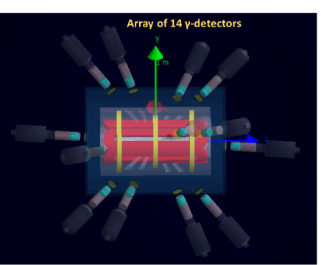
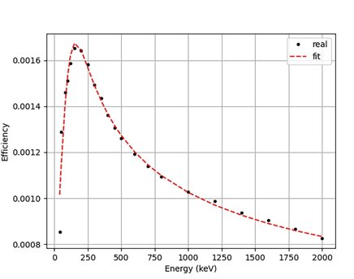
LNL CONTRIBUTION: HPGE detection system
The detection setup is made of an array of 14 HPGe detectors placed around the trap​
PANDORA-GAMMA Coll. Agreement signed in Oct. 2021 to use 16 HPGe detectors of GALILEO
Time window from 2023 till the end of 2025
It would allow to fully exploit PANDORA potentialities in the first experimental campaign
Know-how/expertise transfer started with joint activities between LNS-LNL.
Main issues carefully evaluated:
Photopeak detection efficiency (interplay between detector number and mechanical constraint)
Signal to noise ratio (high background self-generated inside the trap)
Magnetic field effects on HPGe charge collection

Slide 12
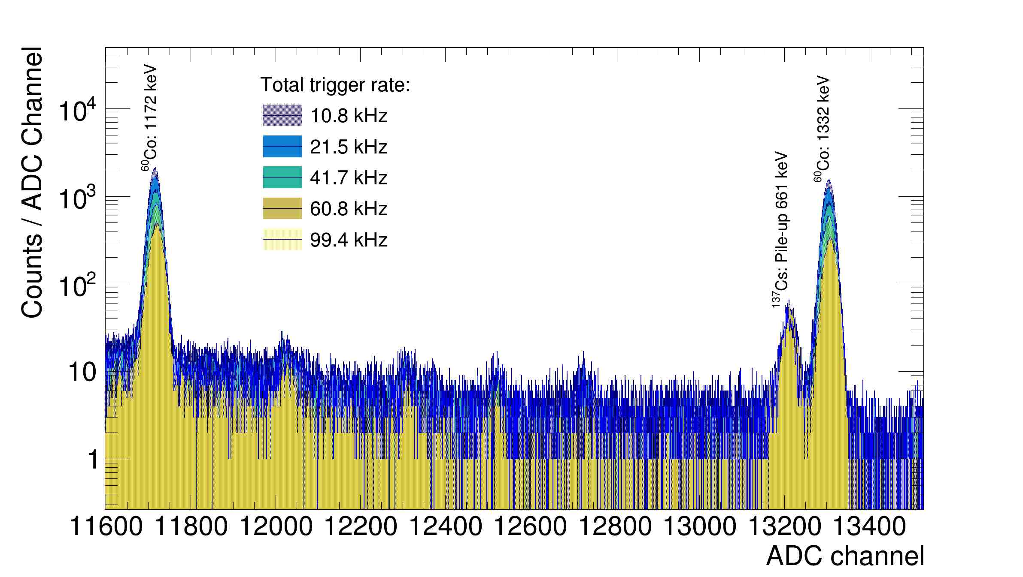
LNL CONTRIBUTION: HPGE detection system
Activities performed at LNL (A. Goasduff - GAMMA)
Development of a new pre-amplifier able to sustain high rates
First prototype tested and validated
Little worsening in HPGe energy resolution at high rates
High stability
Production of the new pre-amplifier funded by CSN3 → already delivered at LNL. Installation and test are in progress
First idea of DAQ based on XDAQ platform is under discussion
Relatively simple logic
HPGe readout chain based on CAEN VX1725S: 16 channels, 14 bit, 250 Msps
Rate capabilities tested up to 50 kHz on 12 channels

Slide 13
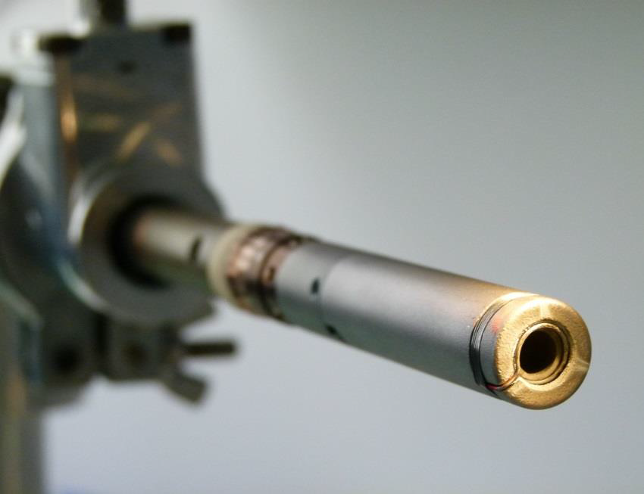
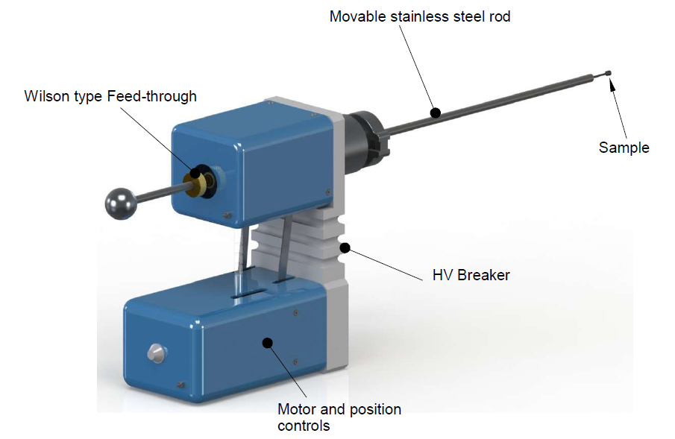
LNL CONTRIBUTION: ISOTOPES INJECTION
Isotope | τ₀[ yr ] | E_{γ} [ keV ] | τ[ yr ] | Meas. time | Quantity [mg] | Activity [MBq]
¹⁷⁶Lu | 5.45E10¹⁰ | 202.88 & 306.78 | 37222 | 100.35 [d] | 1.27E3 | 2.53E-3
¹³⁴Cs | 2.99 | 795.86 | 0.32 | 5.5 [h] | 2.24E-5 | 1.07
⁹⁴Nb | 2.93E10⁴ | 871.09 | 2.97 | 9.2 [h] | 7.73E-4 | 5.44E-3
  OVEN
      SPUTTERING
GSI OVEN
THE EFFICIENCY OF EACH TECHNIQUE HAS BEEN EVALUATED ON THE BASIS OF THE ESTIMATES MADE ON CONVENTIONAL ECR SOURCES

Slide 14
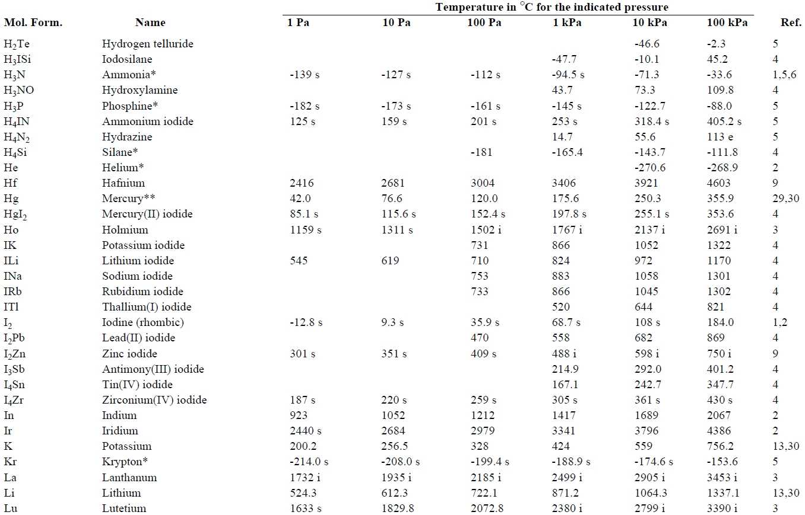
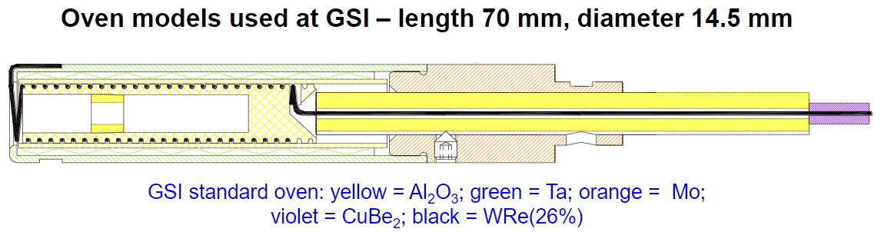
LNL CONTRIBUTION: ISOTOPES INJECTION
¹⁷⁶Lu
  AVAILABLE WITH AN ENRICHMENT OF ~74%
  AVAILABLE IN OXIDE FORM: WILL BE REDUCED IN METAL FORM BY IPHC WITHIN ERIBS-EUROLAB
  TECHNIQUE: OVEN
    NECESSARY TEMPERATURE: ~1600 °C (p=10⁻² mbar)
THIS VALUE ACTUALLY DEPENDS ON THE REAL PRESSURE OF THE TRAP AND THE DESIRED FLUX OF NEUTRALS

Slide 15
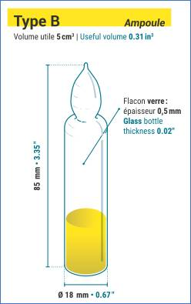
LNL CONTRIBUTION: ISOTOPES INJECTION
¹³⁴Cs
  AVAILABLE IN LIQUID SOLUTION (CsCl IN HCl)
  MAXIMUM ACTIVITY FOR EACH AMPOULE: 40 MBq (ENOUGH FOR THE EXPERIMENT)
  TECHNIQUE: OVEN
    SPECIFIC PROCEDURE

Slide 16
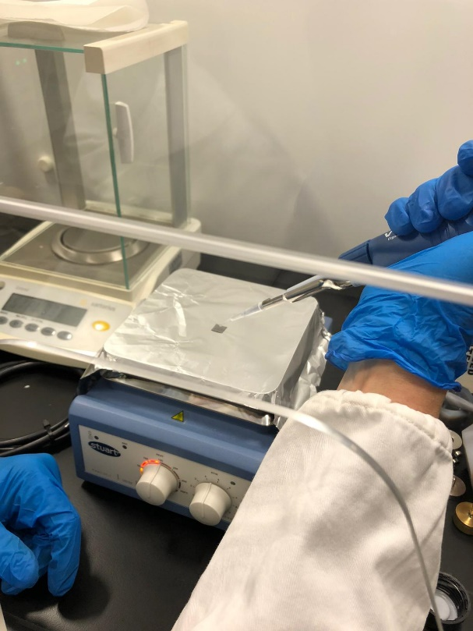
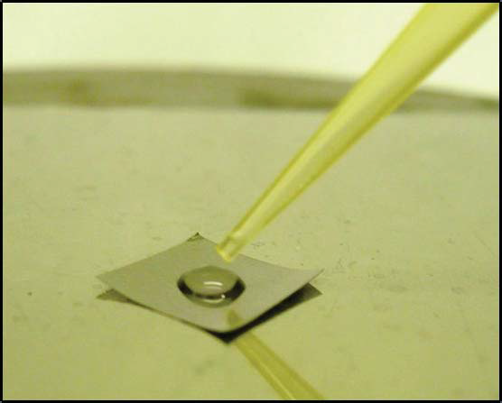
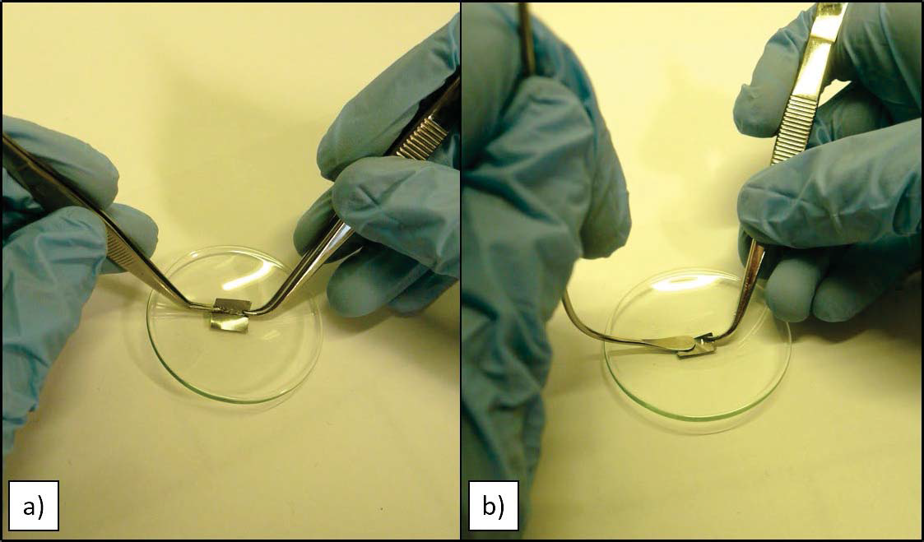
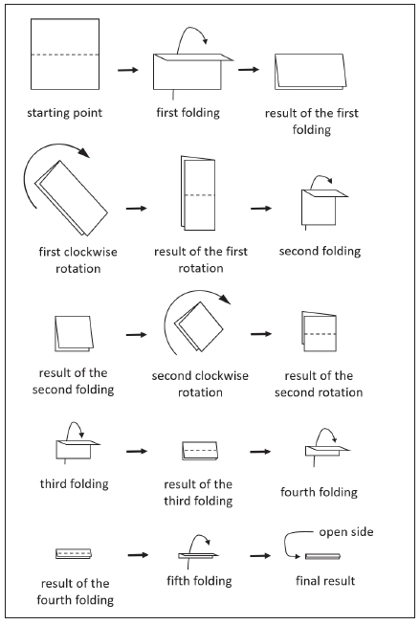
LNL CONTRIBUTION: ISOTOPES INJECTION
¹³⁴Cs preparation: mass marker technique
TAKE THE SOLUTION
DRY
WRAP IN A Ta FOIL
LOAD IN THE OVEN
INSTALLATION OF THE OVEN IN THE TRAP
SAME TECHNIQUE ADOPTED @ SPES

Slide 17
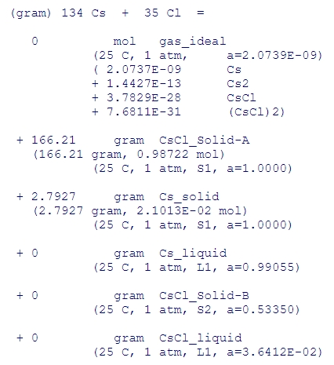
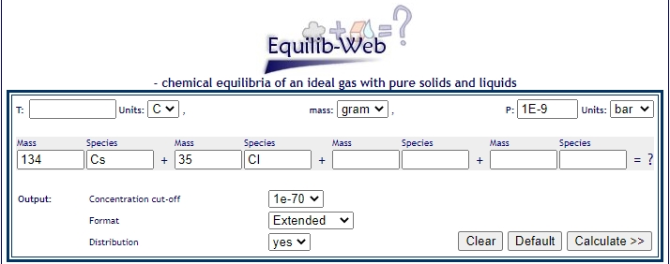
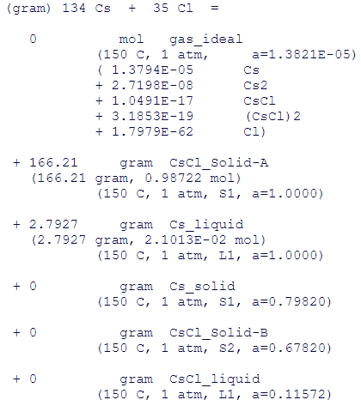
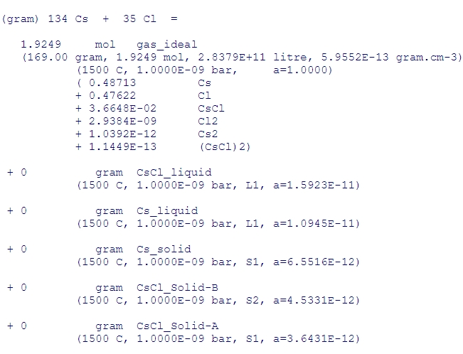
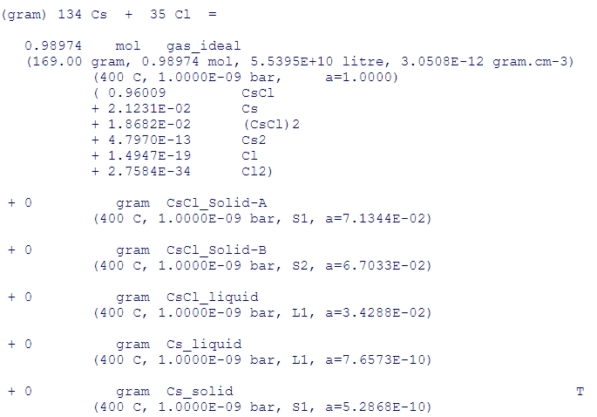
LNL CONTRIBUTION: ISOTOPES INJECTION
¹³⁴Cs evaporation
F*A*C*T - EQUILIB-Web (polymtl.ca)
DURING MANIPULATION (T=25 °C):
NO EVAPORATION
Pressure in the trap
DURING DRYING (T=150 °C):
NO EVAPORATION
HEATING AT 1500 °C: VAPORS OF Cs + VAPORS OF Cl
HEATING AT 400°C: VAPOURS OF CsCl

Slide 18
LNL CONTRIBUTION: ISOTOPES INJECTION
⁹⁴Nb
  AVAILABLE BY IRRADIATING A WIRE OF STABLE Nb @ ILL (~ 1mg, MORE THAN ENOUGH FOR THE EXPERIMENT)
  TECHNIQUE: SPUTTERING
  TESTS WITH STABLE Nb WILL BE CARRIED OUT TO FIND THE BEST WAY TO PRODUCE A SPUTTERING TARGET
    IT WILL BE MIXED WITH THE STABLE ISOTOPE
    IN PARALLEL IT WILL BE EXPLORED THE POSSIBILITY TO CREATE A MIVOC COMPOUND WITHIN ERIBS-EUROLAB (IPHC)

Slide 19
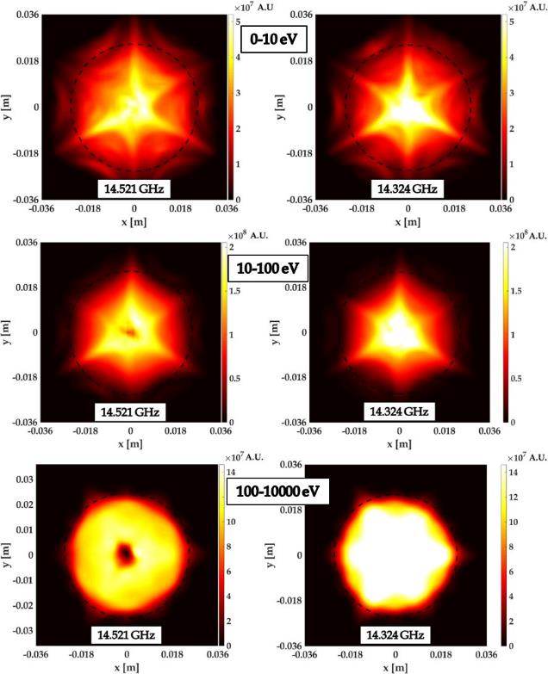
LNL CONTRIBUTION: NUMERICAL SIMULATIONS
(+LNS)
THEORY CONSIDERS STELLAR PLASMAS IN LTE BUT ECR ARE DEFINITEVLY NOT→NUMERICAL MODELING IS MANDATORY!!
PLASMA DENSITY AND ENERGY DISTRIBUTION
EFFECT OF THE EXCITATION FREQUENCY (FREQUENCY TUNING EFFECT)
14.521 GHz
14.324 GHz
PLASMA OF THE SPES-CB
PLASMA DENSITY

Slide 20
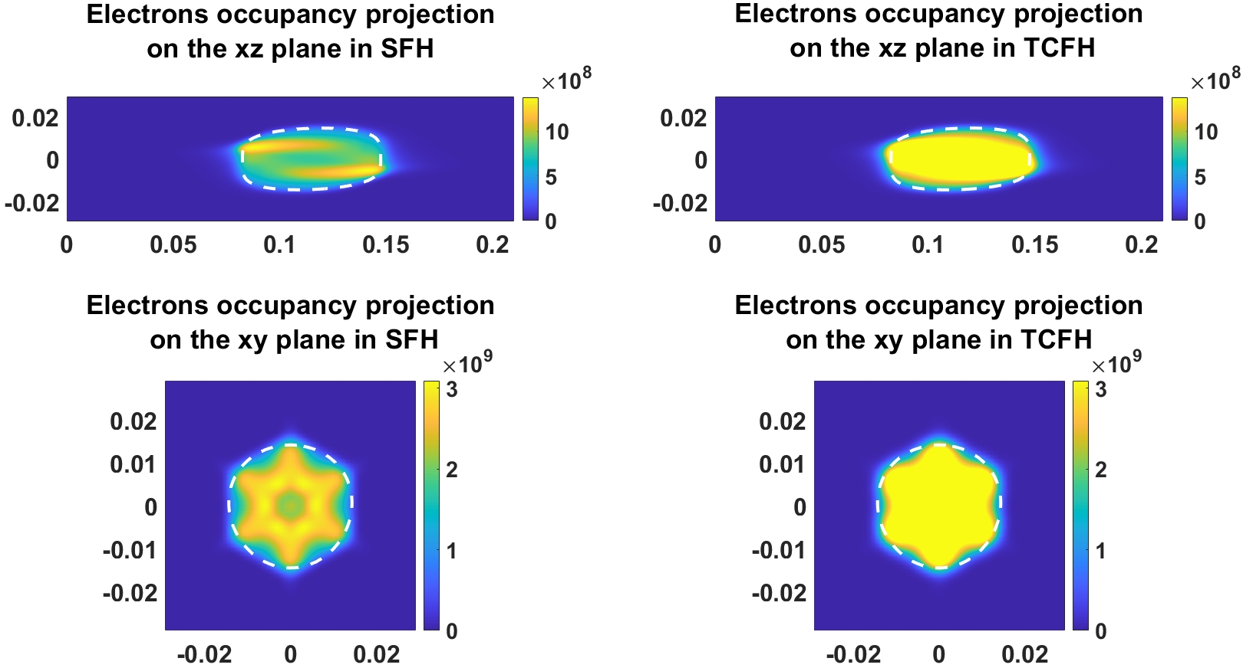
LNL CONTRIBUTION: NUMERICAL SIMULATIONS
(+LNS)
THEORY CONSIDERS STELLAR PLASMAS IN LTE BUT ECR ARE DEFINITEVLY NOT→NUMERICAL MODELING IS MANDATORY!!
EFFECT OF PLASMA HEATING BY TWO FREQUENCIES (TWO FREQUENCY HEATING)
FIRST NUMERICAL DESCRIPTION OF 2FH
ECR SOURCE @ ATOMKI

Slide 21
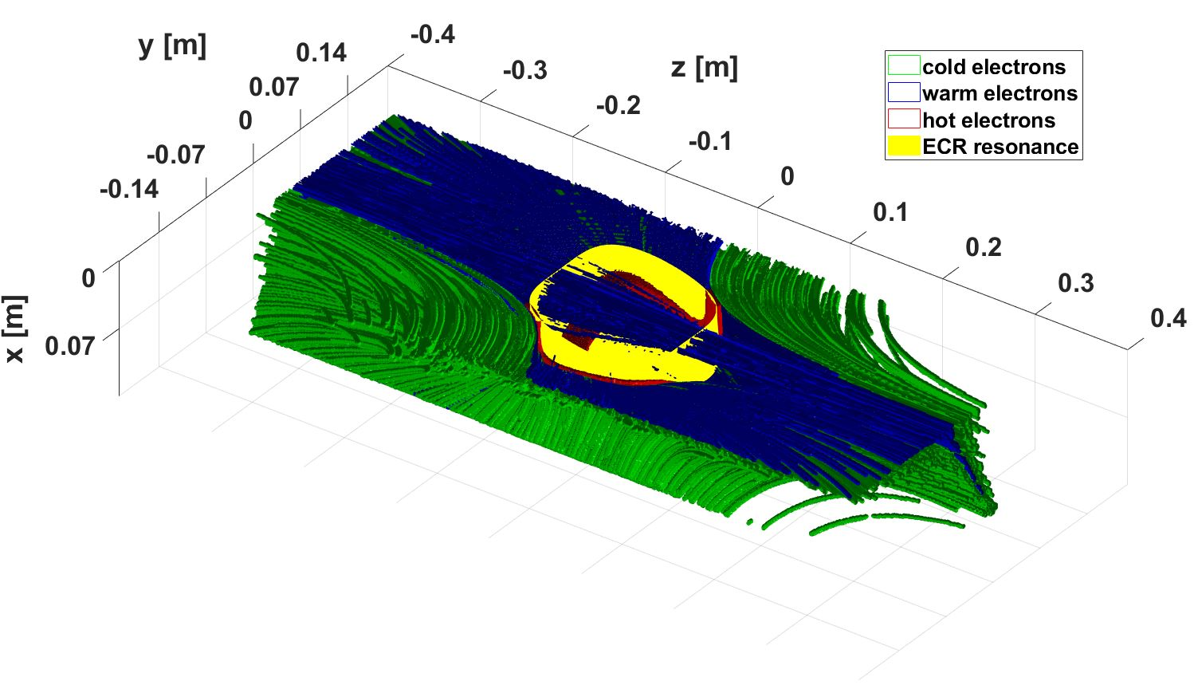
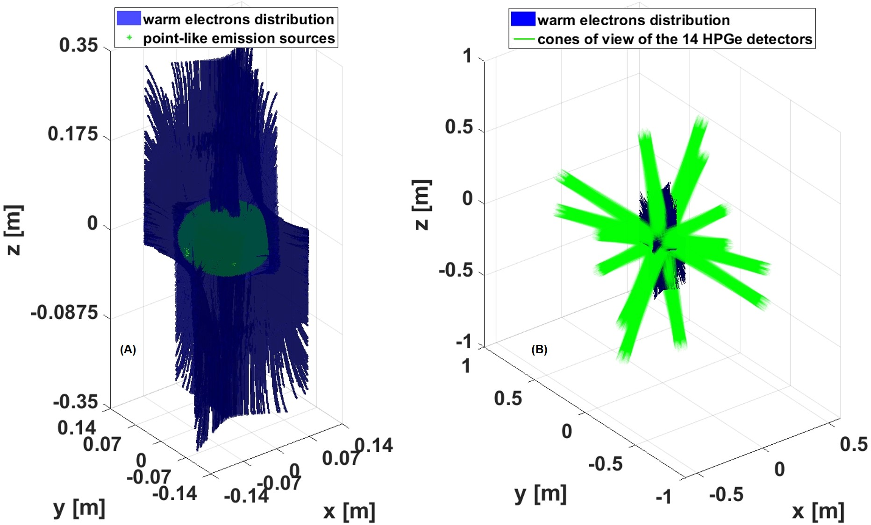
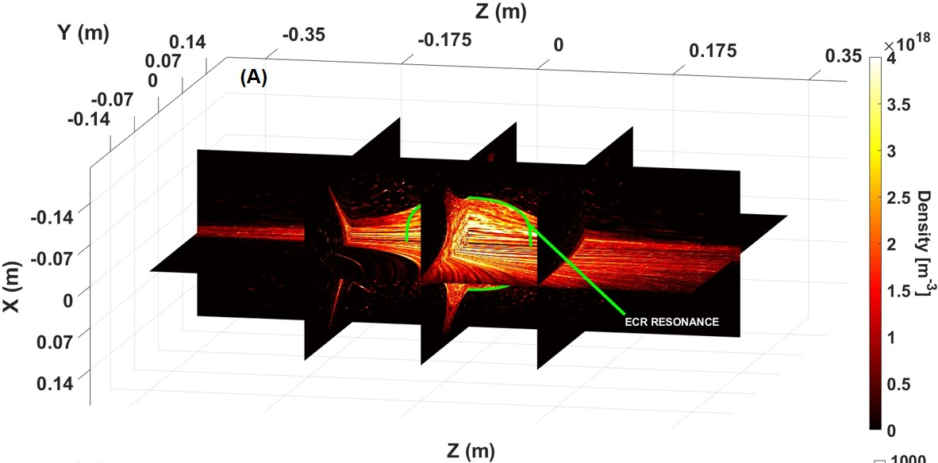
LNL CONTRIBUTION: NUMERICAL SIMULATIONS
(+LNS)
FIRST SELF-CONSISTENT CALCULATION OF A HIGH POWER, HIGH DENSITY PLASMA
Simulation of the distribution of the different electron populations in plasma
PANDORA PLASMA
Prediction of global electrons energy and density distribution
Density
HPGe detectors positioning vs. the warm electrons distribution !
Correct positioning

Slide 22
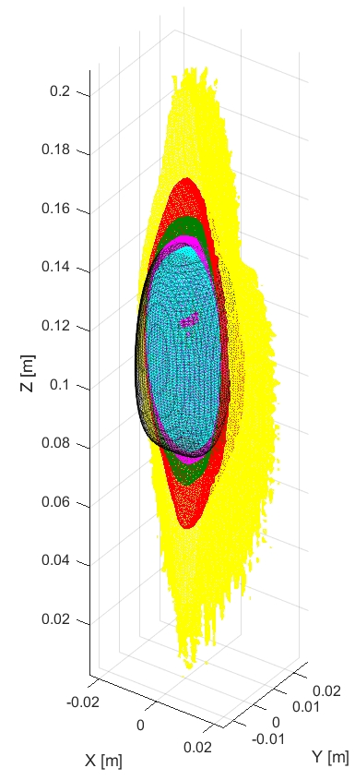
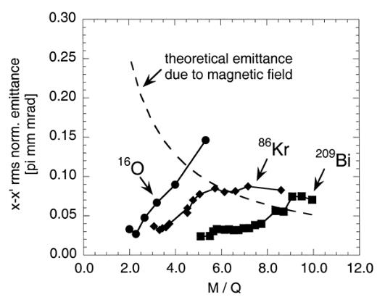
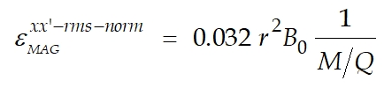
LNL CONTRIBUTION: NUMERICAL SIMULATIONS
(+LNS)
CALCULATION OF OXYGEN CSD
ELECTRON DENSITY AND ENERGY FROM PREVIOUS SIMULATIONS
EACH CHARGE Z MOVES IN APLASMA MADE OF CHARGES 1…Z-1
ONLY IONIZATIONS UP TO 5+(NO CEX)
Tspan=10*<τ_{ioniz}(z)>
O¹⁺
O²⁺
O³⁺
O⁵⁺
O4⁺
RESULTS AGREE WITH THE EXPERIMENTAL EVIDENCE OF PROGRESSIVE IONS CONCENTRATION ON AXIS
ECR RESONANCE

Slide 23
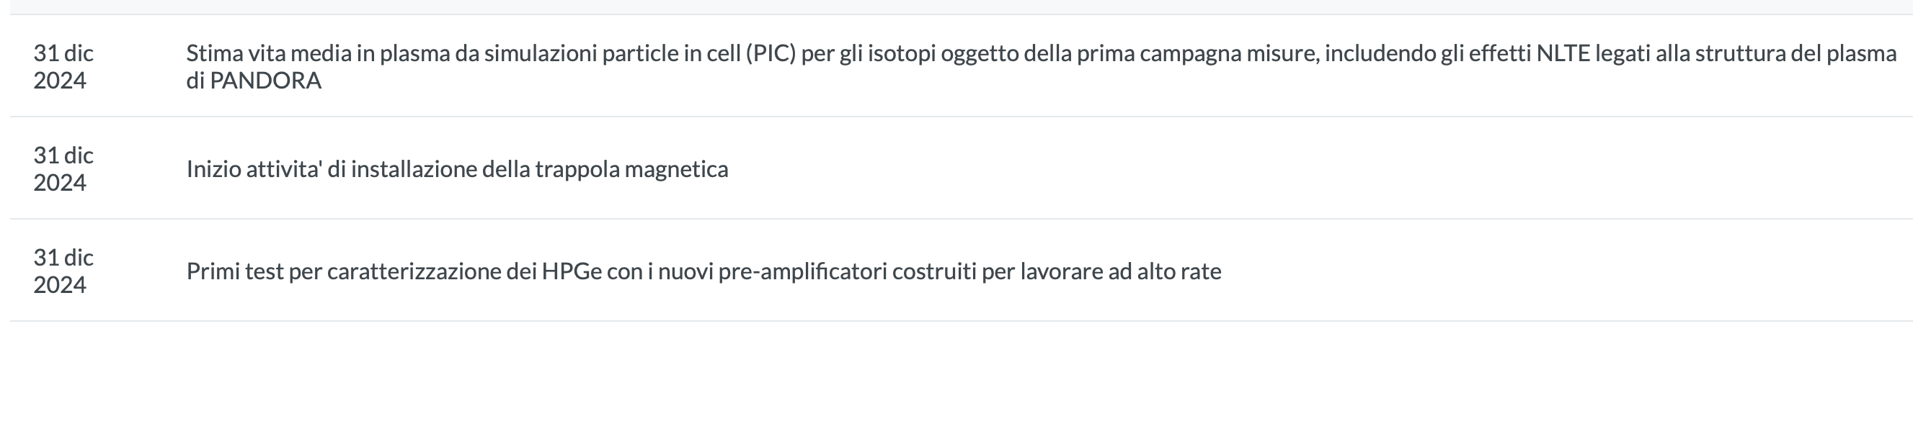
PANDORA: MAIN MILESTONES FOR 2024

Slide 24
SUMMARY
THE MOST COMPLICATED SUBSYSTEMS (TRAPS, HPGe DETECTORS) ARE UNDER CONSTRUCTOIN /DEVELOPMENT
THE PUBLICATION RATE IS ALREADY HIGH (SEE “CONSUNTVI” PAGE ON INFN PORTAL)
IF THE PROJECT WILL FULFILL THE GOAL THE IMPACT WILL BE SIGNIFICANT
LNL IS ONE OF THE “FOUNDER” OF THE COLLABORATION
LNL ROLE IS RECOGNIZED AND IMPORTANT IN KEY ASPECTS
THE PROJECT WILL BRING BENEFITS:
  KNOW-HOW ON A MAGNETIC TRAP THAT COULD BE TURNED INTO ONE OF THE MOST POWERFUL ECR SOURCE
  KNOW-HOW IN PLASMA DIAGNOSTIC, HOT TOPIC FOR EUROPEAN LABS USING ECR SOURCE TO DEDUCE LONG TERM BEAM STABILITY (ERIBS-EUROLAB)
  INCREASE LNL VISIBILITY NOT ONLY IN THE NUCLEAR PHYSICS COMMUNITY BUT ALSO IN THE FIELD OF ION SOURCES, COMPLEMENTARY WITH THE ALREADY ESTABLISHED ACCELERATORS DESIGN SKILLS

Slide 25
THANK YOU FOR YOUR ATTENTION

Slide 26
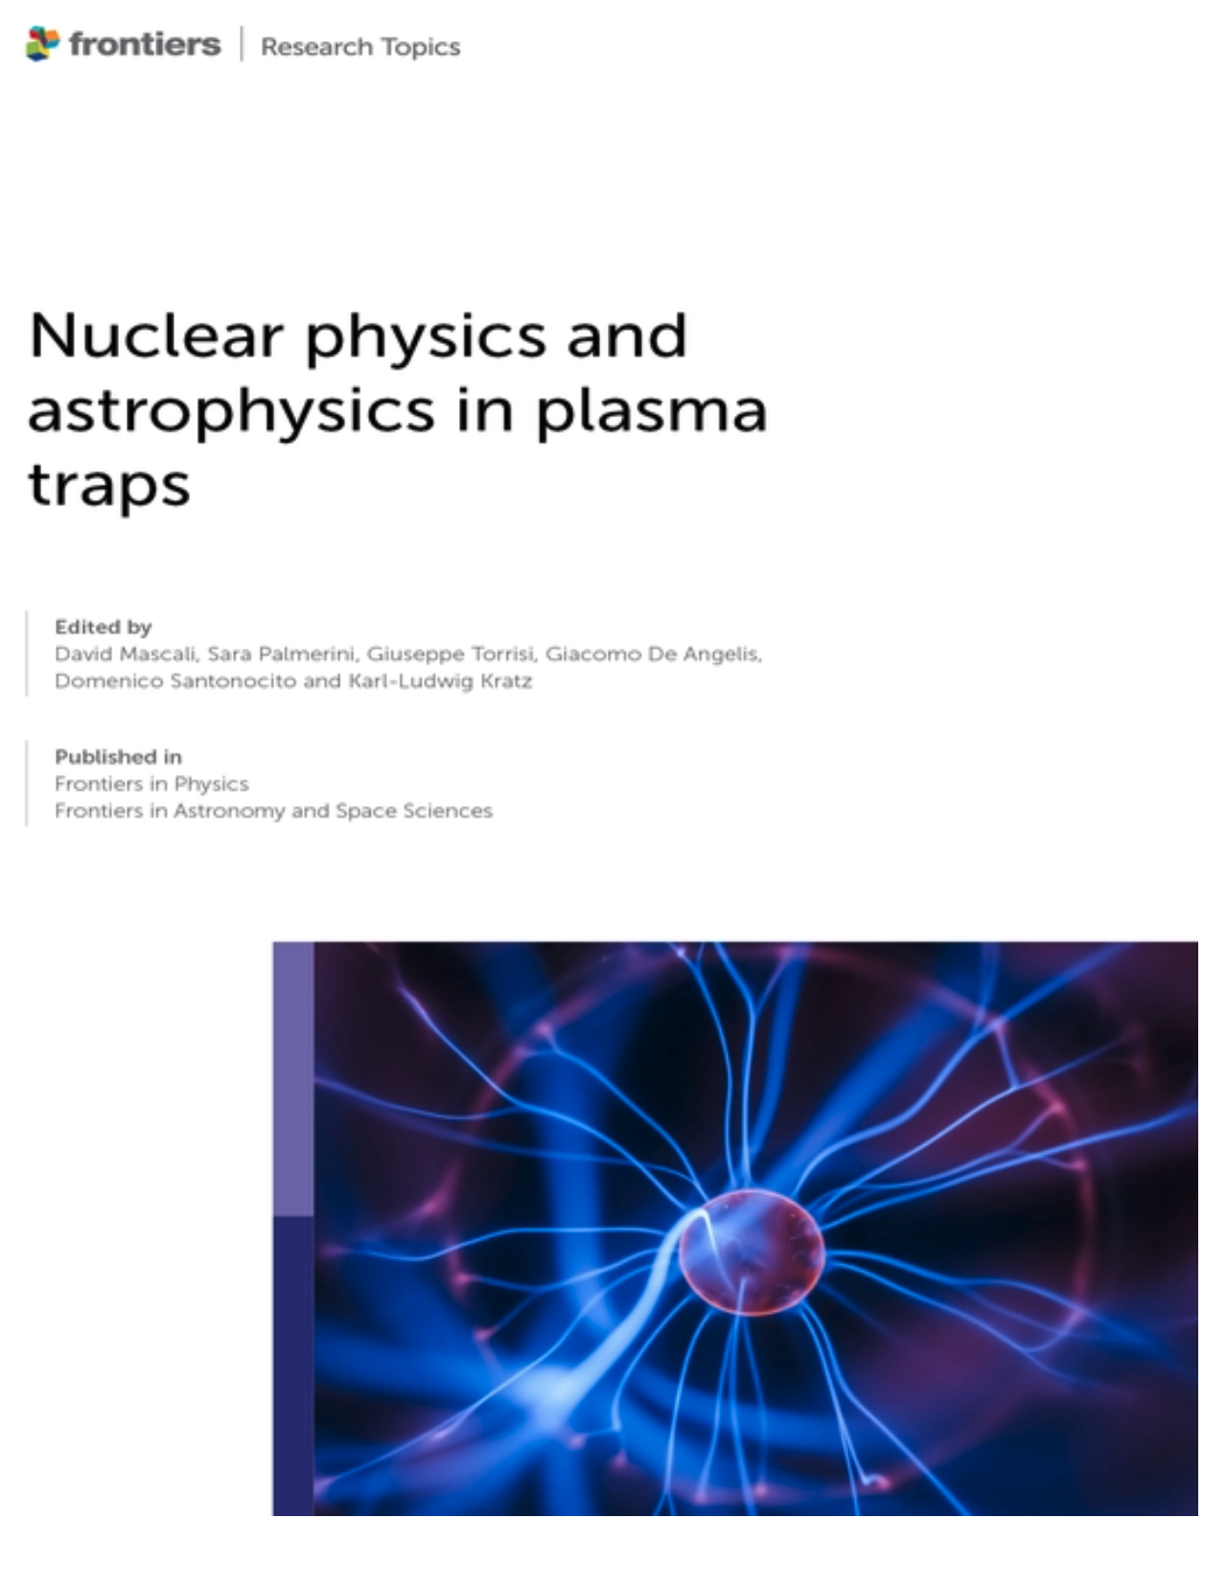
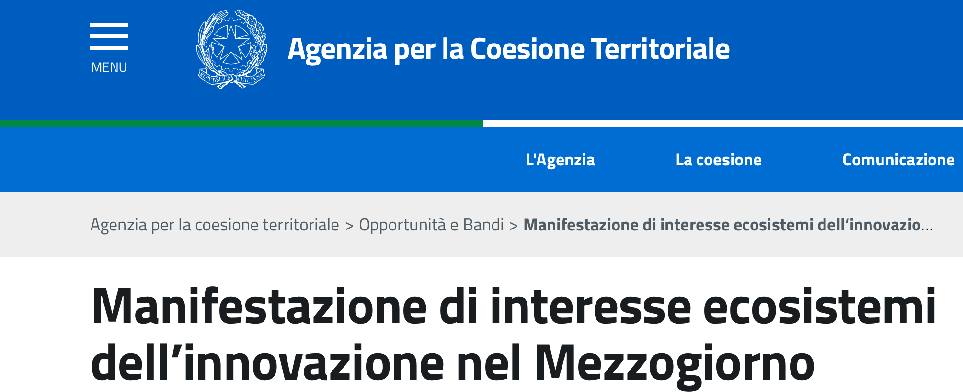
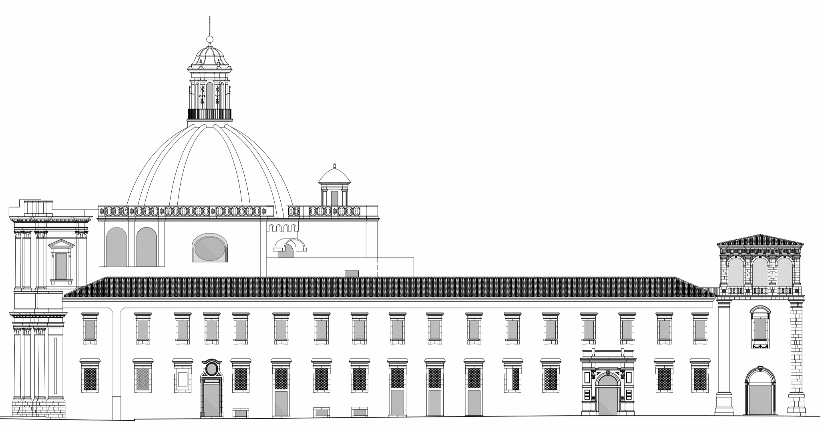
PANDORA Output
Publication of a special issue dedicated to PANDORA physics
People: 45 in Italy (including Researchers and Technologists)+25 abroad, for a total of 70. FTE = 21.83 (2022)
Publications (2022): 26
Talks: 34
MsD-thesis and PhD-thesis: 5
E-book now available!!
PANDORA for PNRR & DTT
Strong Synergies about detectors and diagnostics with the "Ecosistema dell'Innovazione" SAMOTHRACE (Spoke 5, leadership of WP5: David Mascali), with 1 RTD allotted.
Contribution to Spoke 3 of NQSTI partnership (1 RTD+1 CTER)
Synergy with DTT project: LNS plays an important role in e.m. heating & plasma diagnostics;
Leadership(PI: David Mascali) in the Simeto
Transdisciplinary Science Institute proposal (15.0 M€),
for an "Ecosistema dell'Innovazione nel Mezzogiorno
", supported by Agenzia per la Coesione
Territoriale.
Accepted but not yet funded:
wating for extra-budget
Mascali, D., Palmerini, S., Torrisi, G., De Angelis, G., Santonocito, D., Kratz, K.-L., eds.
(2023). Nuclear physics and astrophysics in plasma traps. Lausanne: Frontiers Media
SA. doi: 10.3389/978-2-83251-062-9

Slide 27
FTE
PANDORA PROJECT Participants
70 participants to PANDORA PROJECT from 34 departments/laboratories in Italy and Europe
PANDORA @LNS
27 (16 Res. + 11 Techn.) about 8.9 FTE (+ 4.17 FTE synergic)
LNS RESEARCHERS (%)
Di Donato Loreto 70?
Emma Giulia 0 + 50
Finocchiaro Giorgio 100
Gammino Santo 20
Isernia Tommaso 70?
La Cognata Marco 38 + 12
Mascali David R.N. 15 + 70
Mishra Bharat 100
Tecnologi LNS (%)
Bonanno Vincenza 25
Celona Luigi 15
Miraglia Andrea 50
Mauro Giorgio 8 + 70
Musumeci Mario 15 + 35
Naselli Eugenia 0 + 70
Pidatella Angelo 0 + 70
Rifuggiato Danilo 35
Russo Antonio 25
Schillaci Gaetano 20
Torrisi Giuseppe 18 + 50
Pavone Santi 25?
Pennisi Salvatore 20?
Reitano Riccardo 40?
Salerno Nunzio 40?
Santonocito Domenico R.N. 50
Sorbello Gino 40?
Spartà Roberta 20
Tumino Aurora 30
CDL_Luglio_2023
In red: researchers with association to LNS expired… under renewal!
??→ to be confirmed

Slide 28
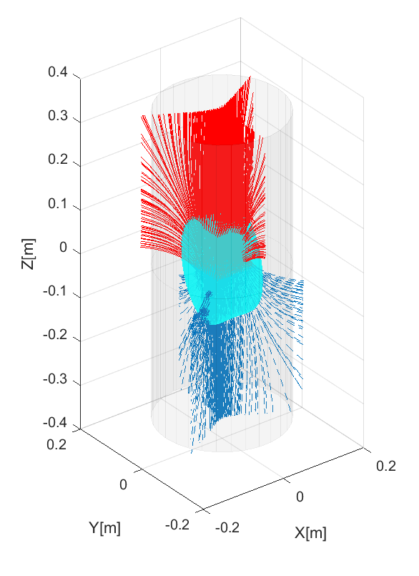

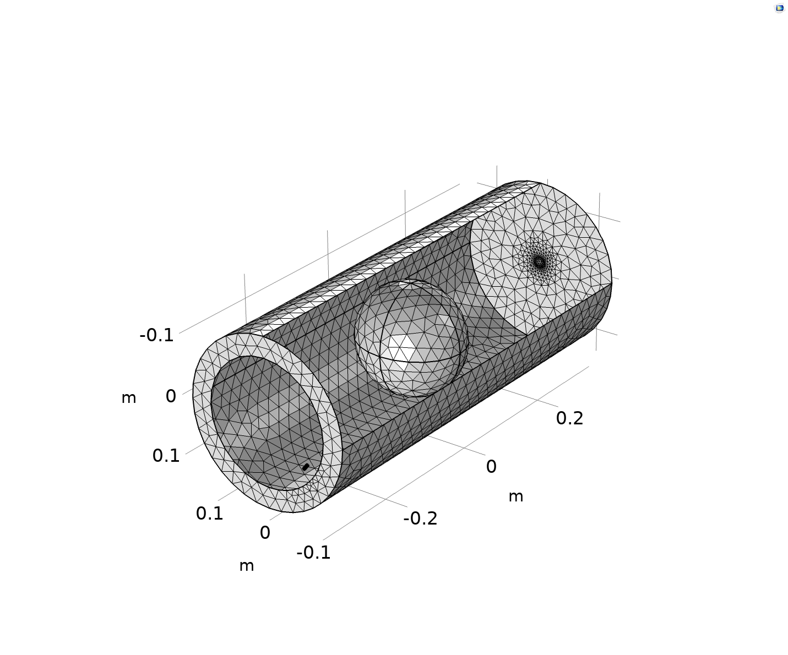







MAIN SUBSYSTEMS UPDATES: Plasma modelling - atom diffusion and transport in PANDORA trap
Study of deterioration of γ-ray signal-to-noise ratio from decaying ¹³⁴Cs neutrals deposited on chamber walls
Geometry of PANDORA trap and oven inlet
134-Cs deposition map on chamber wall
134-Cs neutral γ event from deposited in 12 h
Particle/s
log10(γ)
New simulations on metal injection via oven in ECR plasmas: study of overall efficiency in atom-to-ion conversion
Monte Carlo approach to study metal atom diffusion, ionization + charge exchange with ECR plasma, and ion transport
  Fraction of ionized: 47%
  Amount of deposited: 78%
  Updating residual map @ chamber in Tmeas = 12 h (continuous deposition vs. decay)
  Calculation of γ-rate emission: cumulative background noise to plasma self emission
Cs diffusion and ionization to 1+,
no transport
Cs diffusion and ionization to 1+,
Transport due to B-field
NEXT STEP: calculation of HpGe space-dependent detected neutrals noise

