Slide 1
LUNA3
Nuclear solid targets for the 2024-2025 experimental campaigns at LUNA400 and IBF.
Production and characterization at LNL.
Laboratori Nazionali del Gran Sasso, INFN, ASSERGI, Italy
GSSI, L'AQUILA, Italy
Laboratori Nazionali di Legnaro,LEGNARO, Italy
Institute of Nuclear Research (ATOMKI), DEBRECEN, Hungary
Helmholtz-Zentrum Dresden-Rossendorf, DRESDEN, Germany
University of Edinburgh, EDINBURGH, United Kingdom
Konkoly Observatory, Hungarian Academy of Sciences, BUDAPEST, Hungary
Università degli Studi di Bari INFN, BARI, Italy/*INFN Lecce, LECCE, Italy
Università degli Studi di Genova and INFN, GENOVA, Italy
Università degli Studi di Milano and INFN, MILANO, Italy
Università degli Studi di Napoli ”Federico II” and INFN, NAPOLI, Italy
Università degli Studi di Padova and INFN, PADOVA, Italy
INFN Roma1, ROMA, Italy
Università di Torino and INFN, TORINO, Italy
Osservatorio Astronomico di Collurania, TERAMO and INFN LNGS, Italy
Partecipants LNL
V. Rigato (RL) DT
M. Campostrini T-TD
C. Roncolato 1T
S. Canella 1T
S. Amphalop (IAEA fellow)

Slide 2
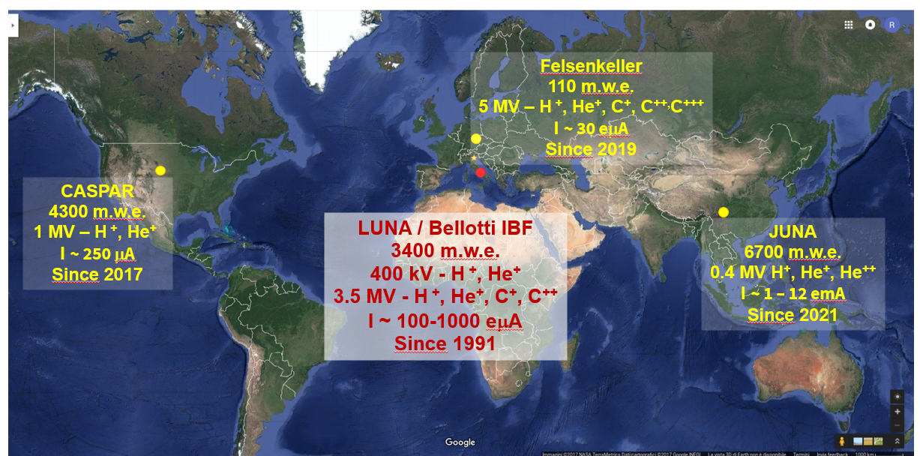


Underground laboratories for Nuclear Astrophysics

Slide 3
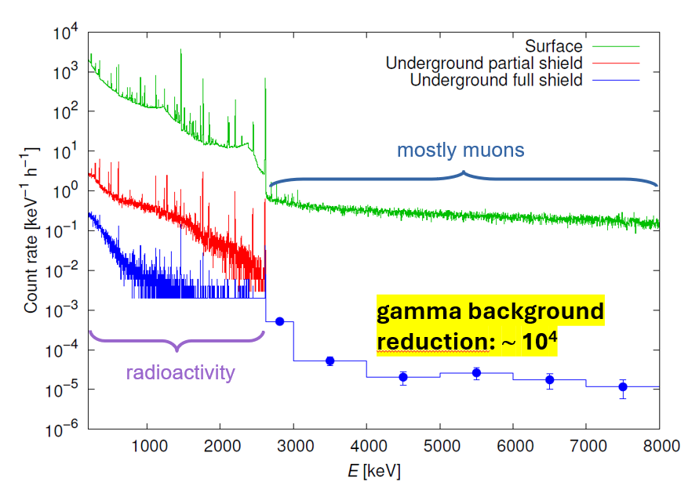
Gamma background reduction @ LNGS

Slide 4
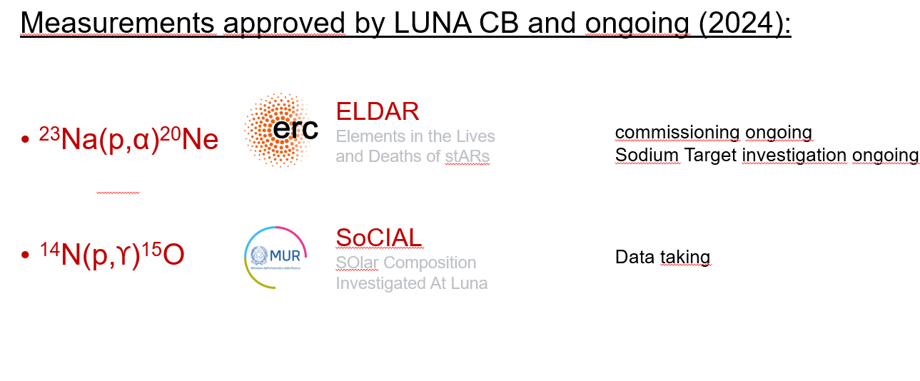
LUNA @ LUNA 400

Slide 5
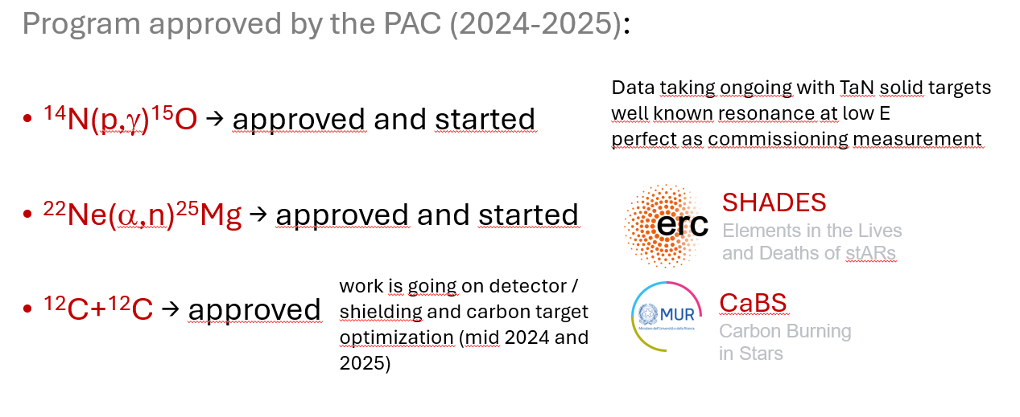
LUNA @ the new IBF of LNGS

Slide 6
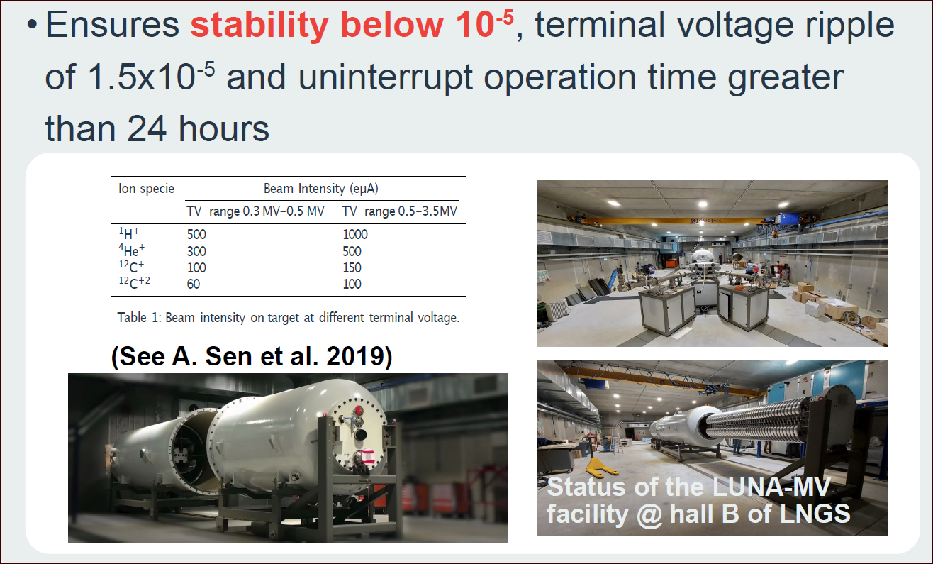
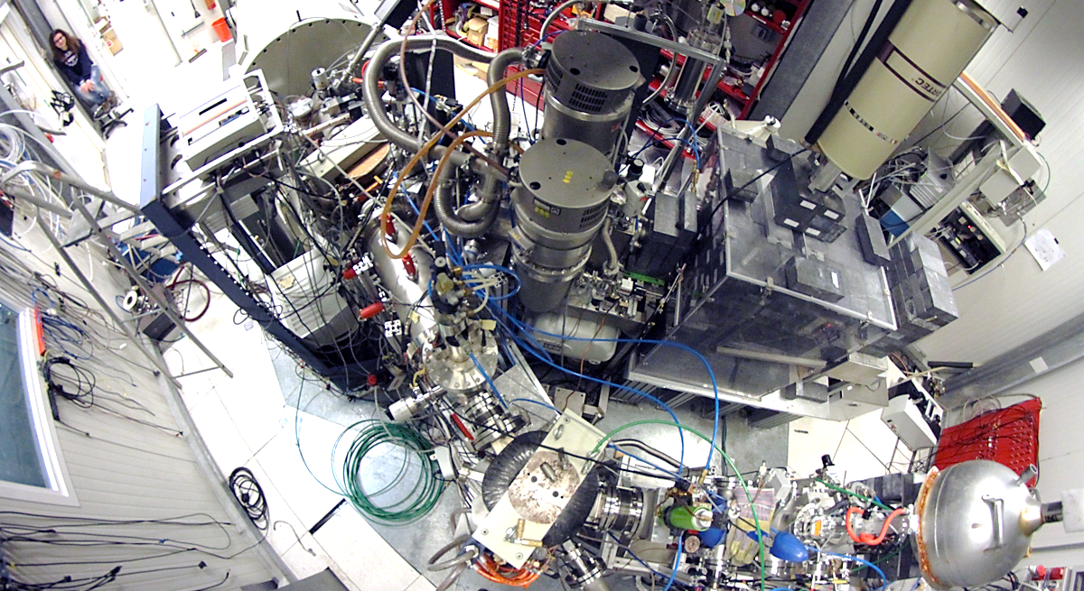
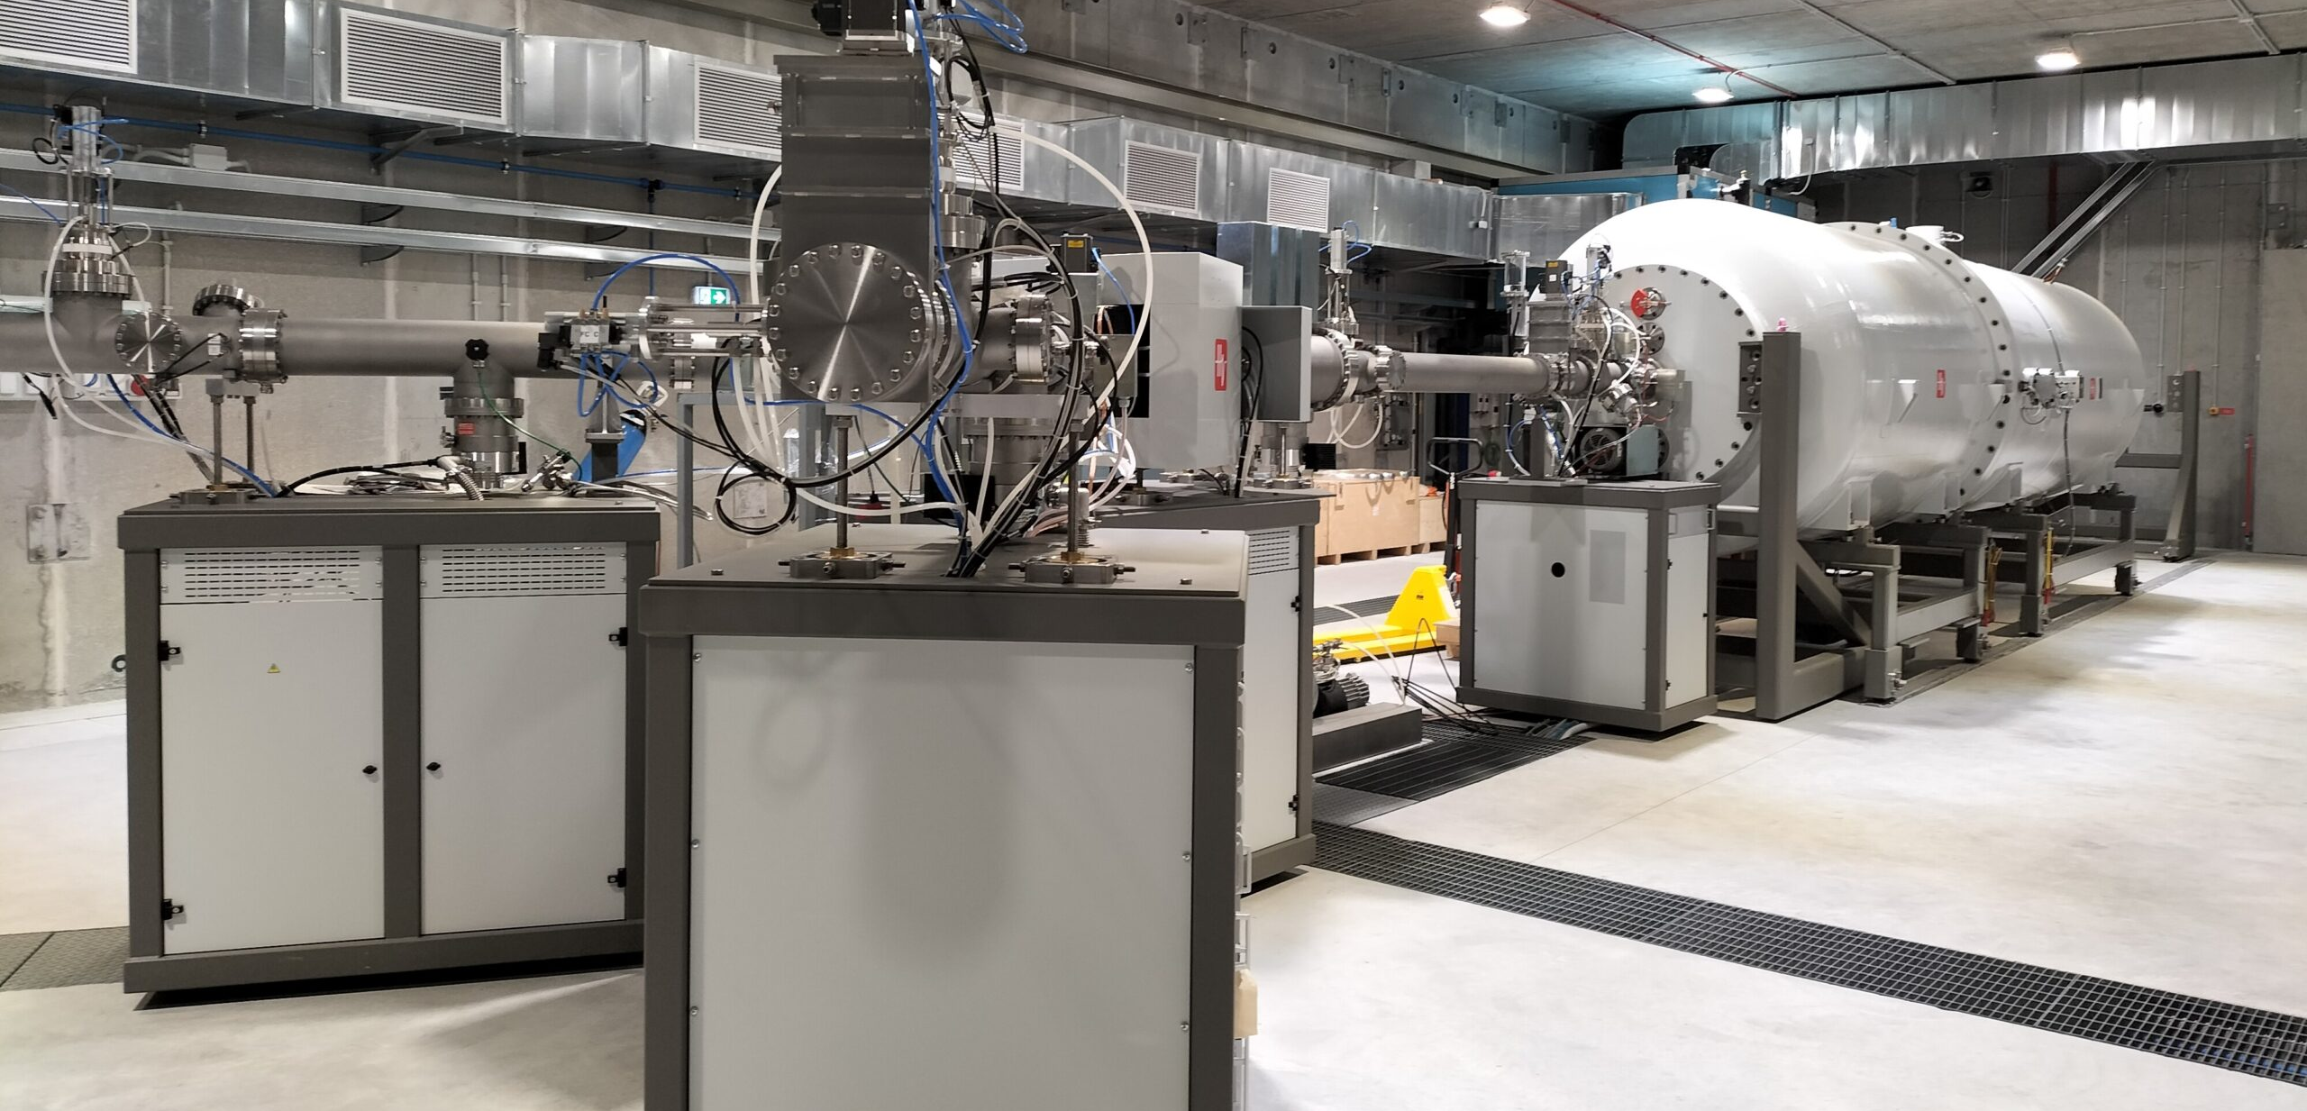
LUNA 400 and the the new IBF facility at LNGS
LUNA 400 kV
(2001-today)
LUNA-MV @ Bellotti IBF
(today-????)

Slide 7
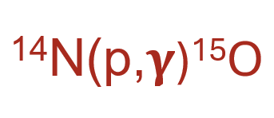

Slide 8
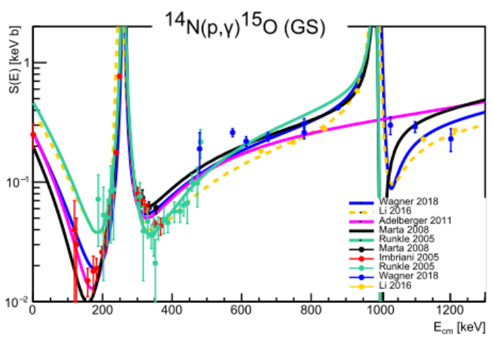
¹⁴N(p,𝛄)¹⁵O: the bottleneck of the CNO cycle
Goals of the high-energy experiment
non-resonant component
weak transitions (to ground state)
summing-in corrections
angular distribution
… all of this in a wide energy range!
LUNA-400
70-370 keV
LUNA-MV
300 keV-1.3 MeV

Slide 9
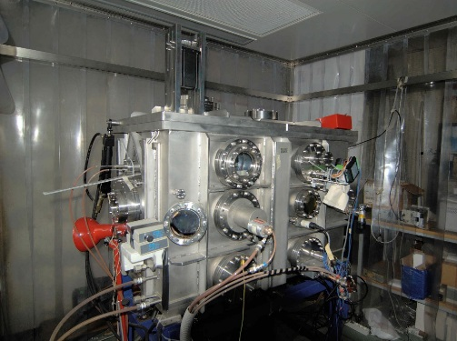
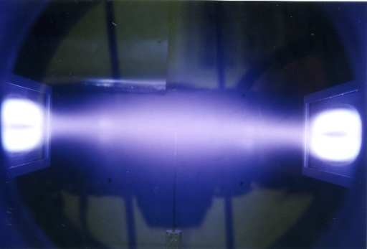
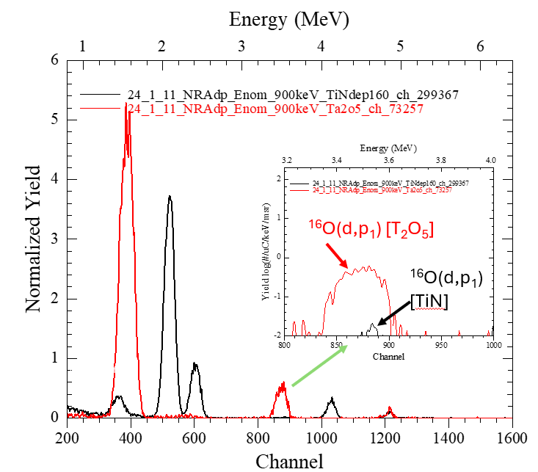
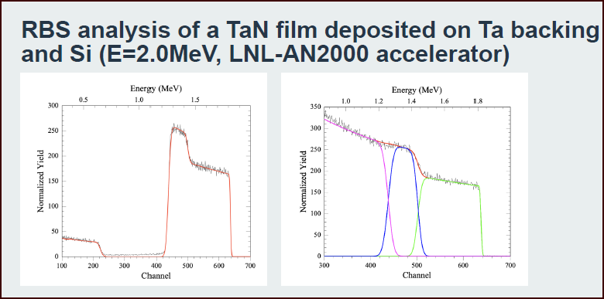
Thin Solid Targets
Ti⁽¹⁴⁾N and Ta⁽¹⁴⁾N and Ta (PVD)
  High purity
  High endurance/ lifetime under proton irradiation
  Low ion beam induced gamma background
CHARACTERIZATION
IBA (EBS, NRA (d,p), (d,α) @ AN2000 and CN)
SEM-EDS
AFM
PREPARATION (Lab. di fisica dei materiali)
  Reactive sputtering (¹⁴N isotopic. enriched gas)
  Plasma diagnostics, real time optical diagnostics
  HiPIMS, Pulsed DC plasmas

Slide 10
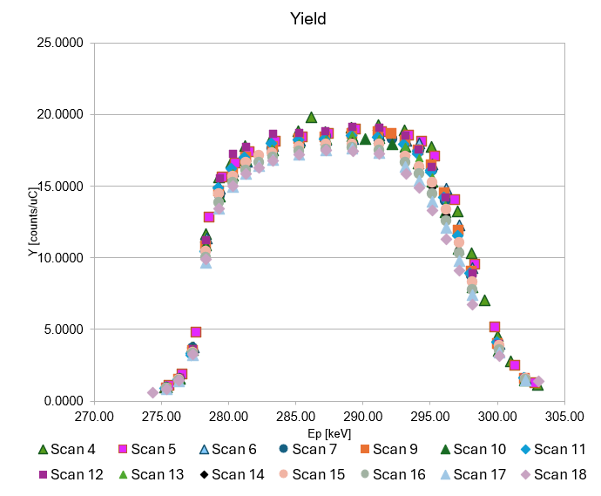
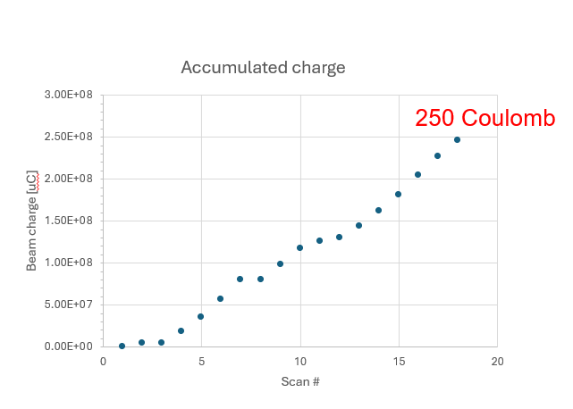
LUNA 400 dep 158_2056_3
TiN/Ta (developed at LNL, lifetime tests)

Slide 11
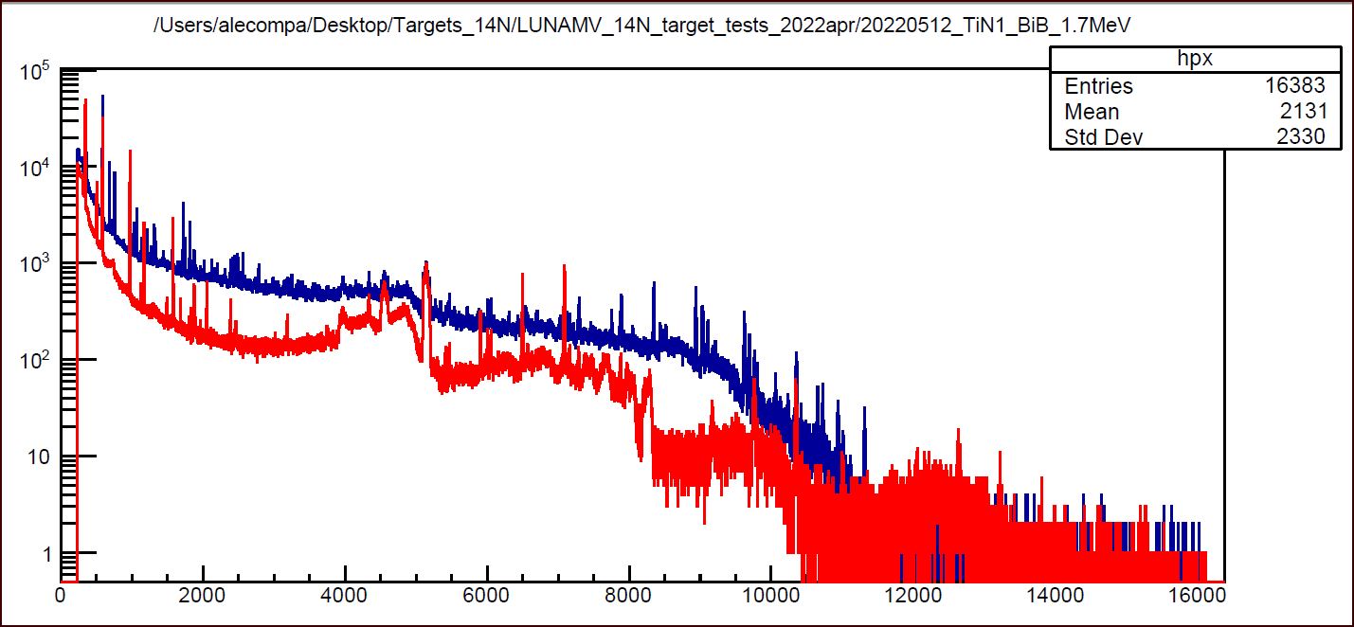
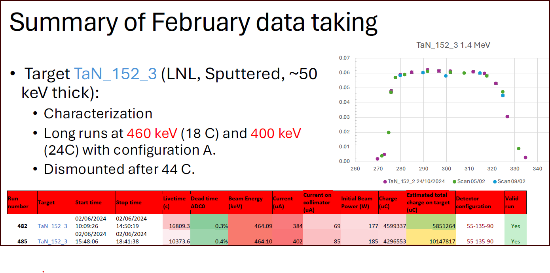
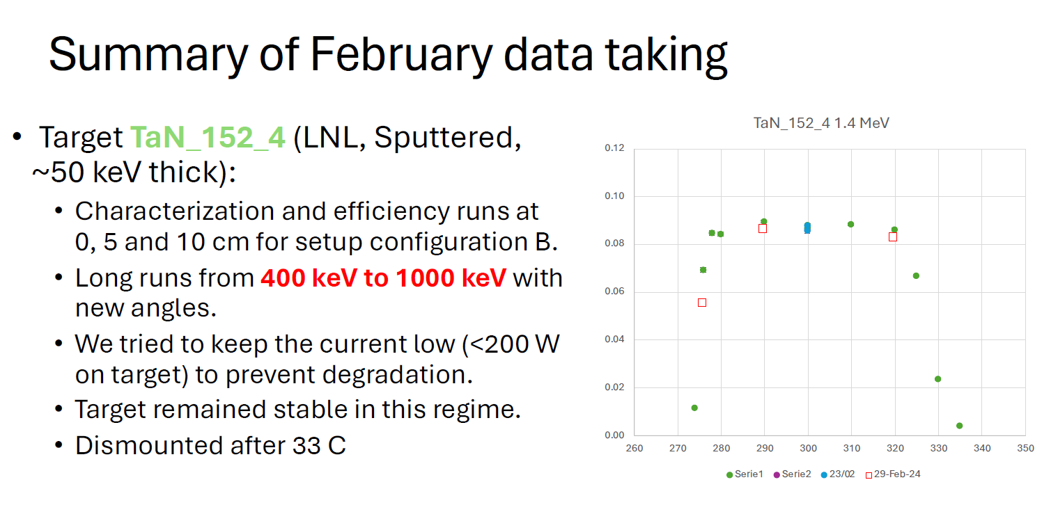
LUNA MV – running experiments
TaN/Ta coating developed at LNL
Reactive sputtering (14N isotopic. enriched gas)
Plasma diagnostics
HiPIMS, Pulsed DC
High density, high purity
Ep=1.7 MeV
TiN/Ta
TaN/Ta

Slide 12
¹²C+¹²C

Slide 13
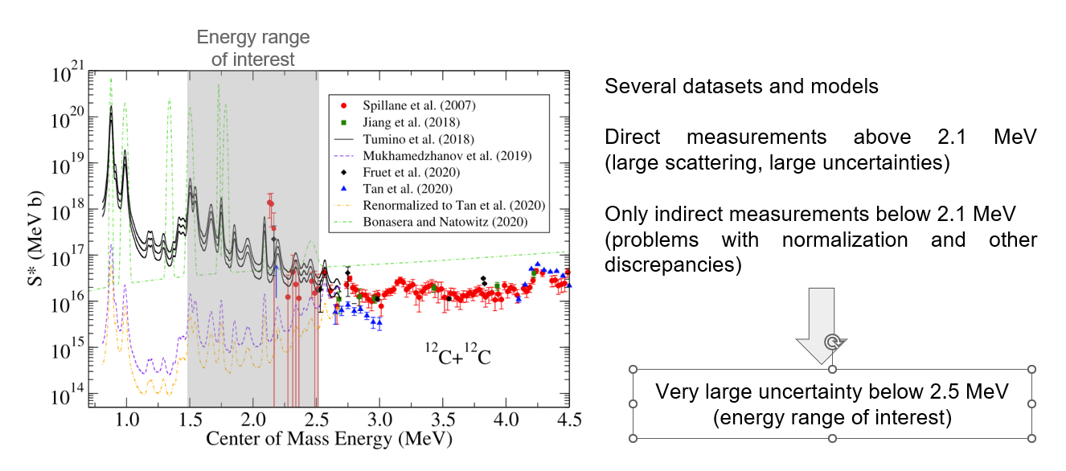
¹²C+¹²C: trigger of C burning in the stars

Slide 14
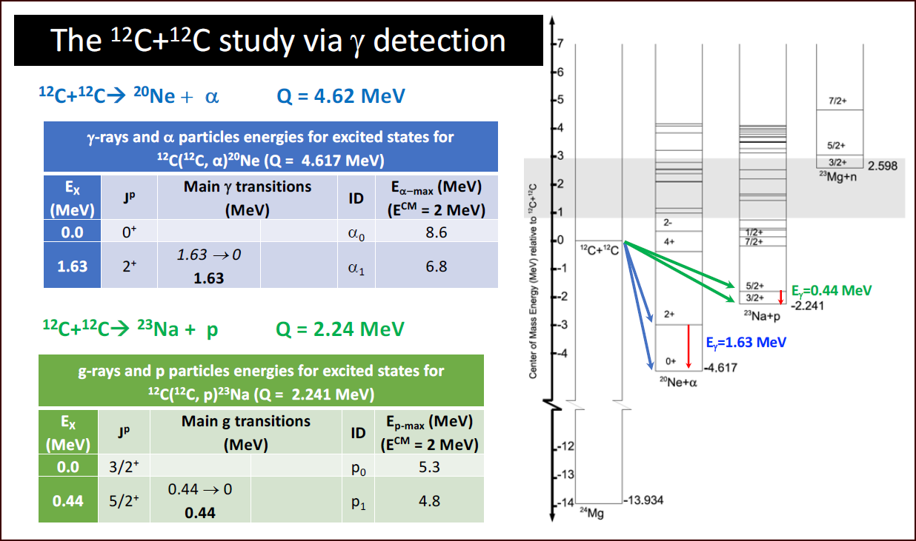
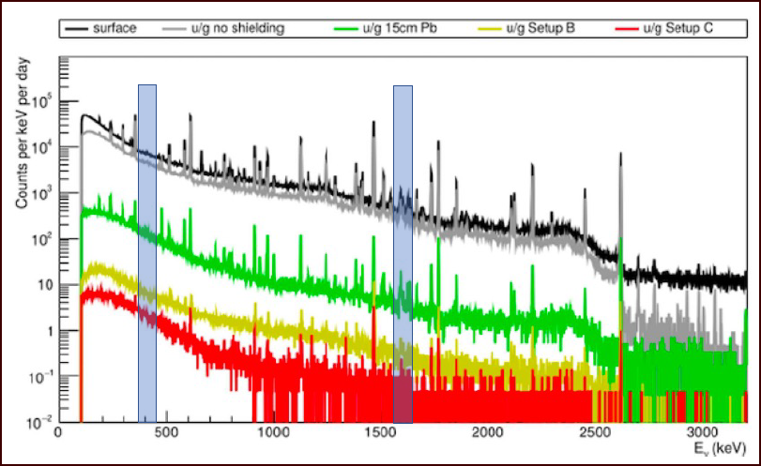
¹²C+¹²C: trigger of C burning in the stars

Slide 15
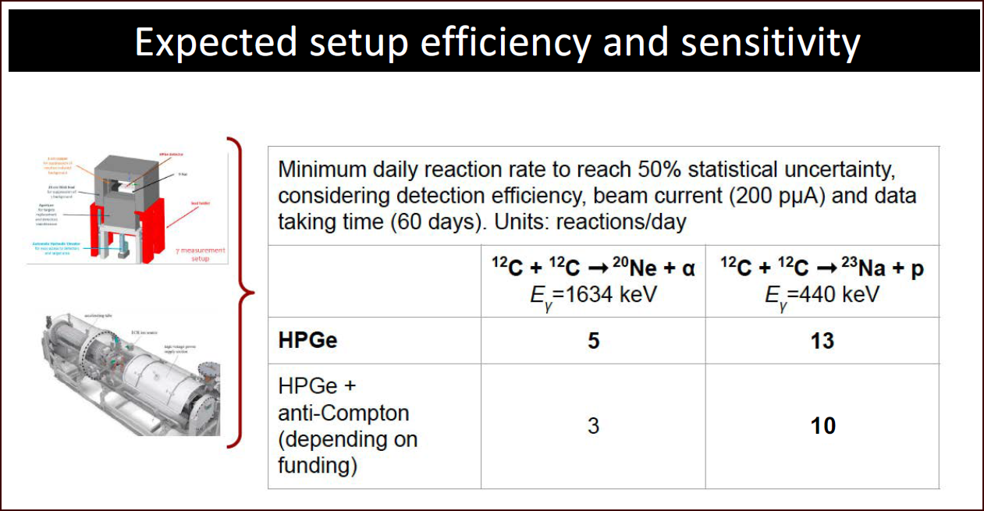
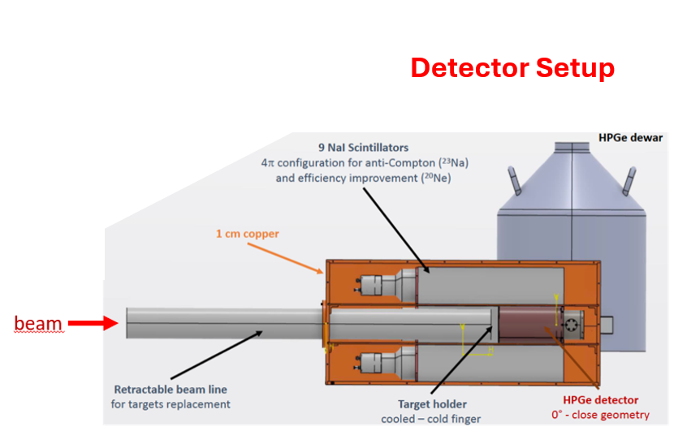
¹²C+¹²C: trigger of C burning in the stars

Slide 16
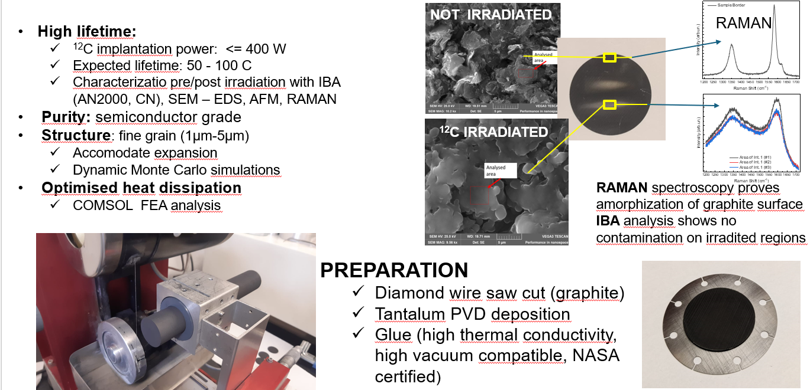
Carbon target development @LNL
NOT IRRADIATED

Slide 17
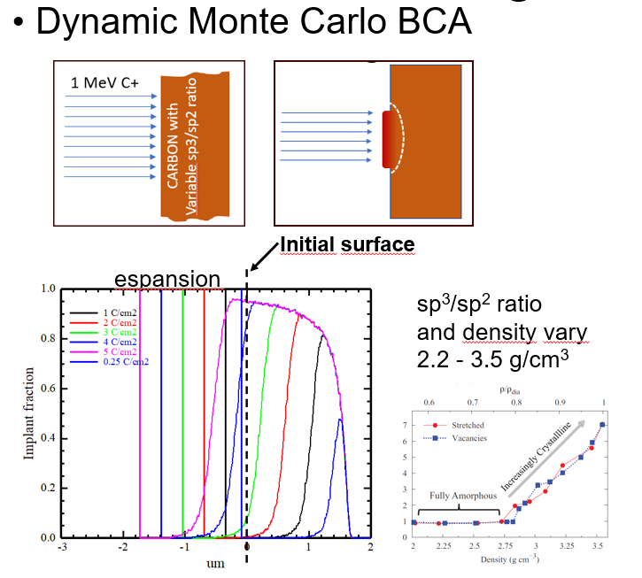
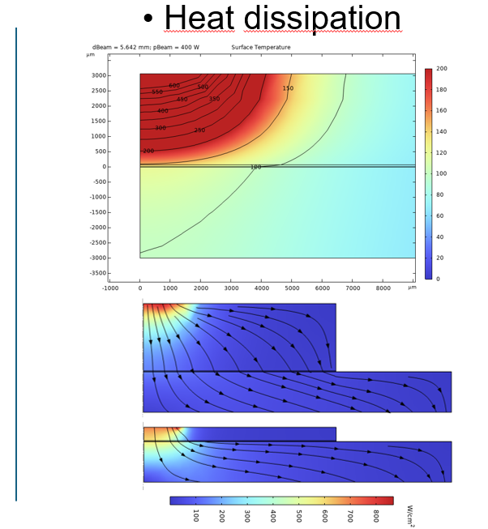
Target design

Slide 18
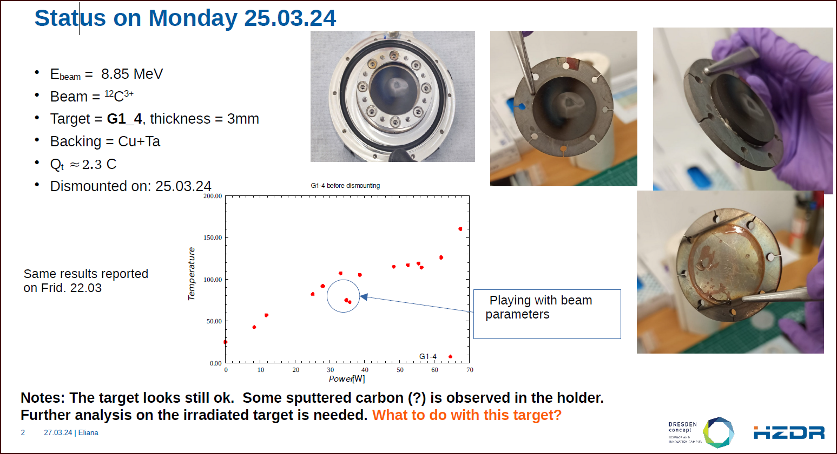
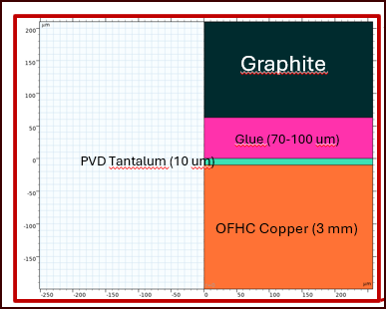
IRRADIATION TESTS @Felsenkeller (10-60 W, ¹²C)

Slide 19
²³Na(p,α)²⁰Ne

Slide 20
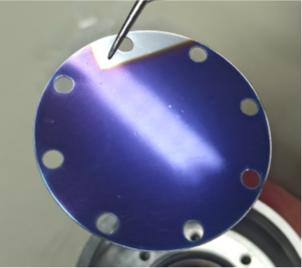
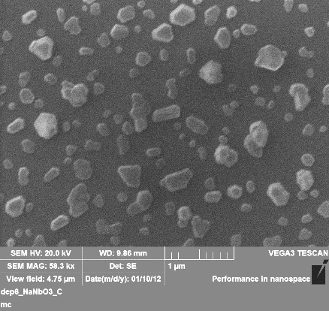
IRRADIATION TESTS @LUNA 400
Na_{x}Nb_{y}O₃
Sputtered Sodium Niobate target is best candidate for the experiment at LUNA400
Sodium Niobate target deposited on tantalum for ²³Na(p,α)²⁰Ne reaction
E_{p} = 311.63, Q = 11.5 C
Long run target stability
Deposition process optimization underway.
First endurance results are positive compared to evaporated sodium tungstate.
Irradiated Na_{x}Nb_{y}O₃ Target
20

Slide 21
Summary And Perspectives
LNL is committed to provide solid targets with specific features (endurance, purity, low BIB…) to the LUNA collaboration and participate to WP and Executive Board.
New materials solutions are under investigation for future experimental campaingns, including un-common alcaline species.
The specific experience and expertize is appreciated
Novel methods of preparation via pulsed (HiPIMS) plasma PVD
Characterization of physical properties
Simulation of material properties

