Slide 1



Nuclear Physics Mid Term Plan in Italy
LNL – Session
Legnaro (Pd), April 11th-12th 2022
Nuclear Physics Mid Term PLAN @ LNL
Summary & conclusions
Andrea Gottardo
Notes:
1

Slide 2
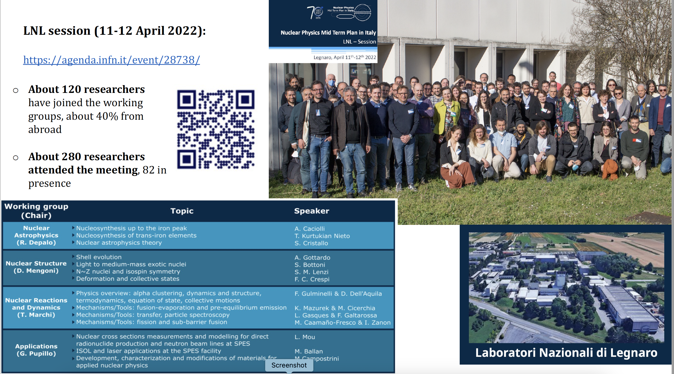
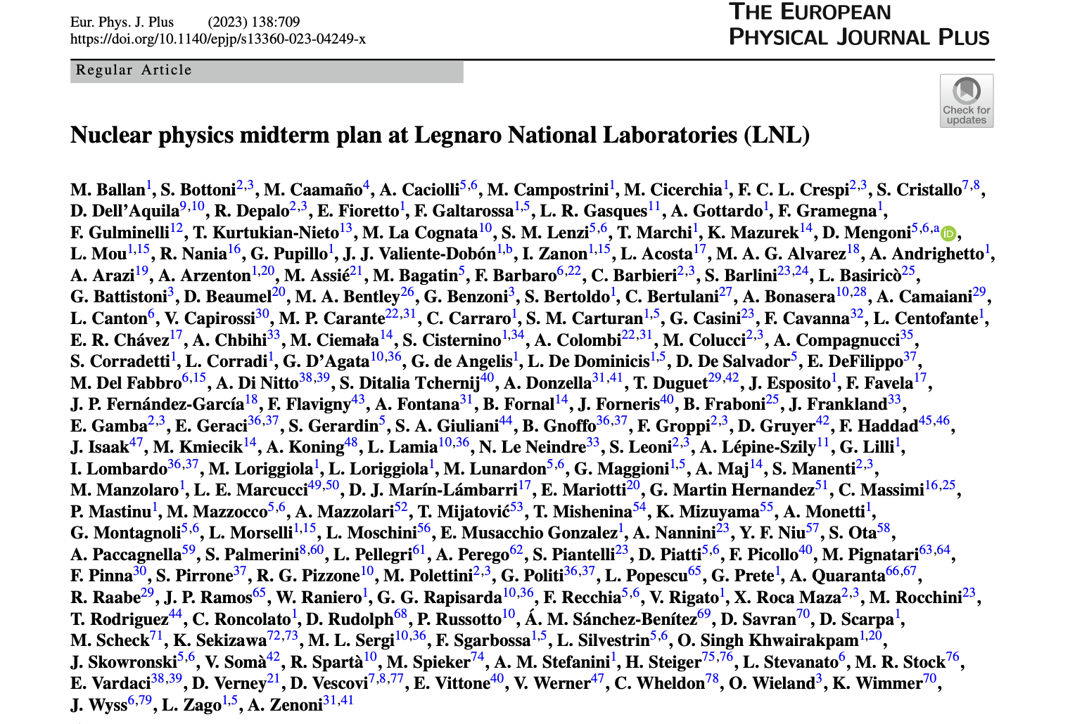

Slide 3

Nuclear Structure
3
Nuclear Structure
time ...
A
B
C
Light and medium mass exotic nuclei
𝛾 decay from near-threshold states
𝛾 decay from near-threshold states
Nucleon correlations and molecular orbitals
Particle decays from cluster states
Isoscalar Giant Monopole Resonance in light deformed nuclei
Proton excitations and 0+ states in Ar isotopes
N~Z nuclei
Isospin symmetry breaking, shape coexistence – lifetime measurements
Fundamental interactions (precision measurement of mirror beta decay branching ratios)
T=0 vs T=1 p-n pairing
Shell Evolution
New theory developments for shell structure
Shell-evolution around N=50: shape coexistence and gap reduction towards 78Ni
Shape coexistence and type II shell evolution around N=60 in Zr, Sr
Lifetimes after transfer reactions for interplay of deformation and single particle
Deformation and Collective modes
Shell-evolution at N=82 around 132Sn
GDR/GQR gamma+particle decay, Jacobi shape
PDR (alpha scattering inv. kin. with different stable nuclei and SPES beams) and PDR Beta Decay
Phase A: research activties/experiments almost ready to be performed
Phase B: other research still requiring some test and feasibility study
Phase C: research activities requiring R&D and/or development of devoted apparata/facilities of on-construction infrastructures

Slide 4
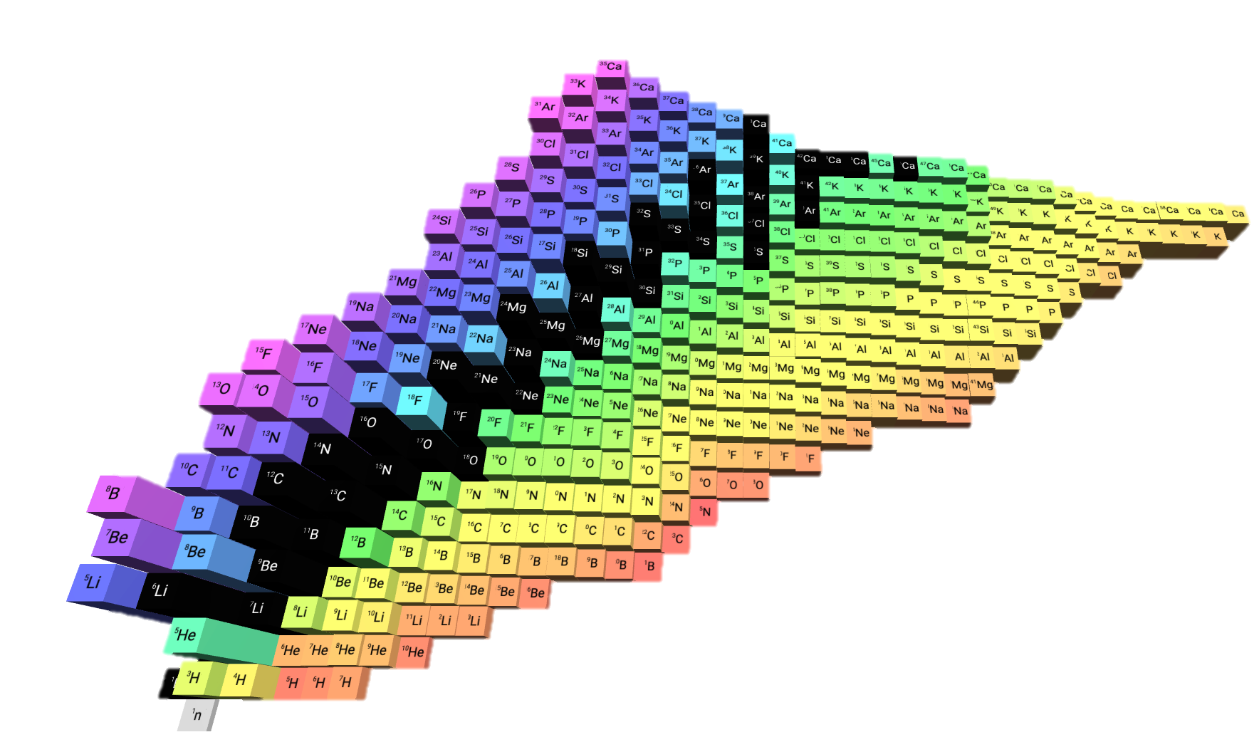
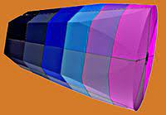

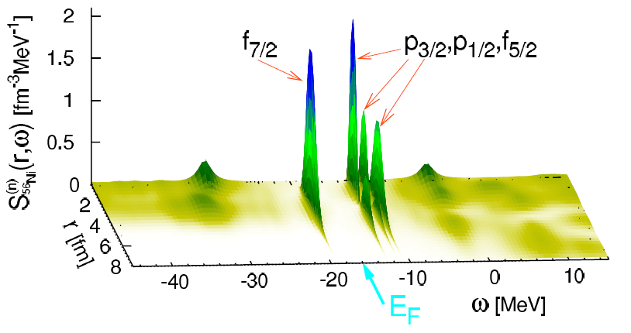
4
Light and medium-mass nuclei
Enormous progress in theory
Interaction
models
¹³²Sn, ¹³⁸Xe
(2020)
²⁰⁸Pb (2022)
Annu. Rev. Nucl. Part. Sci. 65, 457 (2015)
Nature Physics 12, 186 (2016)
Deep-inelastic reactions with ¹⁸O
Enormous leap forward in exp techniques
High-sensitivity to lifetime measurement thanks the tracking array tech
Discrimination among different models
M. Ciemała , et al.,
Phys. Rev. C 101, 021303(R) (2020)
Microscopic optical potentials
Nuclear spectroscopy
n-¹⁶O, total elastic cross section
Only mean-field
50% of 2p1h/2h1p correlations
S_{56Ni}(r,ω) [fm⁻³MeV⁻¹]
All of 2p1h/2h1p
Correlations
(but not enough)
3 SHELL
MODEL
1 SHORT
RANGE
CORRELATIONS
2 PARTICLE-VIBRATION
COUPLING
Idini, C. Barbieri, P. Navratil, Phys. Rev. Lett. 123, 092501 (2019)

Slide 5
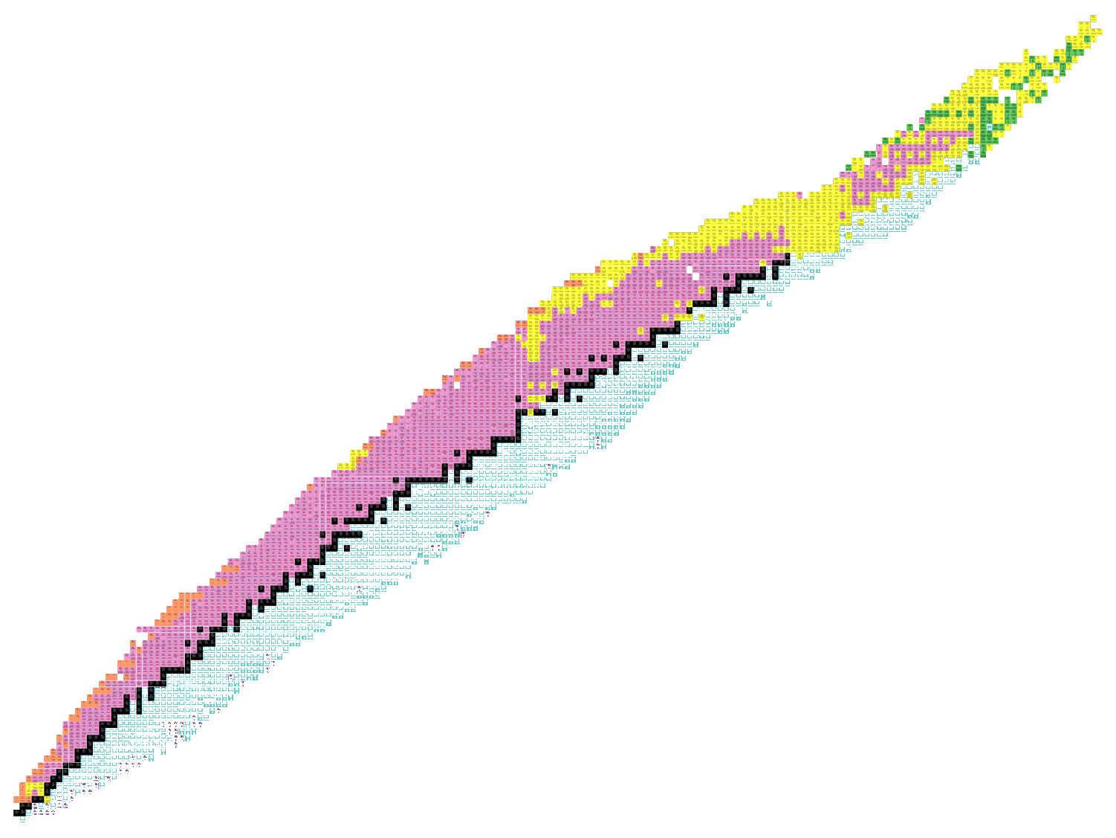
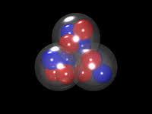
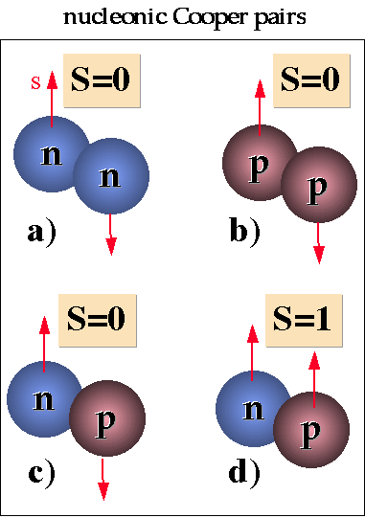
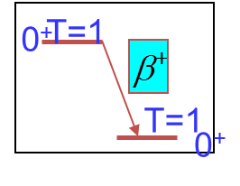
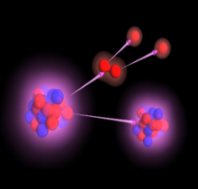
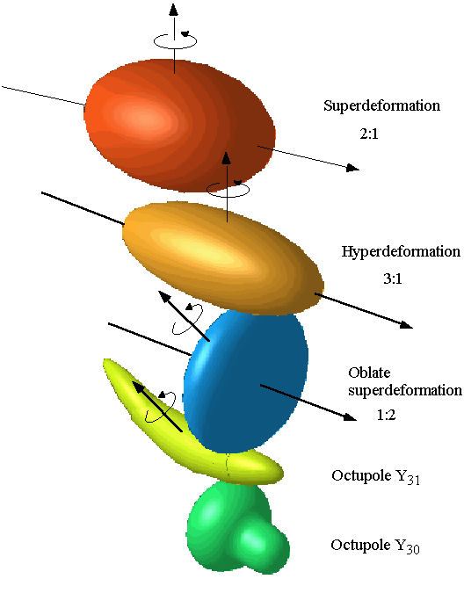
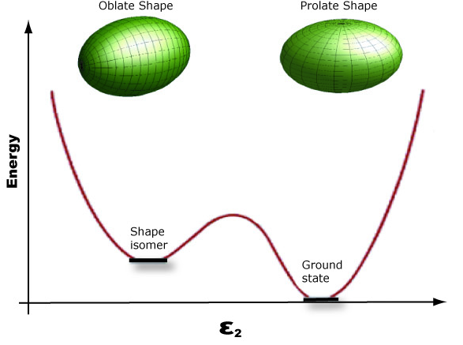
5
N~Z nuclei and isospin symmetry
alpha clusterization
p-n pairing
fundamental interactions
Richness of phenomena and perfect ground for pn interaction:
Short term opportunities with stable beams (quadrupole collectivity); MED+TED
Short and mid term (T=0 and quartetting)
Longer term SiC+TiC beam development (FI)
Isospin symmetry
breaking
N=Z
Coupling to
the continuum
Nuclear shapes
and coexistence
Nuclear Astrophysics
Precision measurements of the branching ratio and/or lifetimes at
the beta-decay station with SiC and TiC targets in SPES

Slide 6
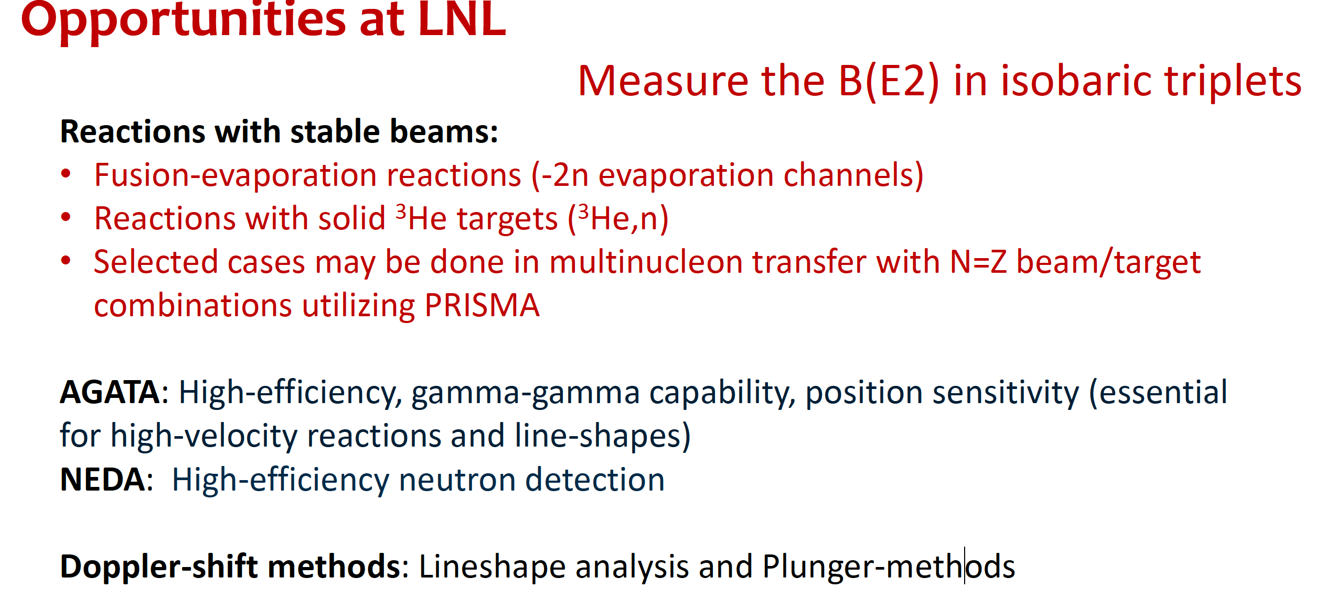

Slide 7
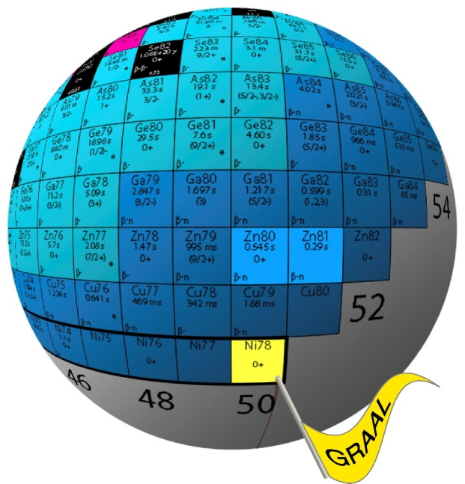
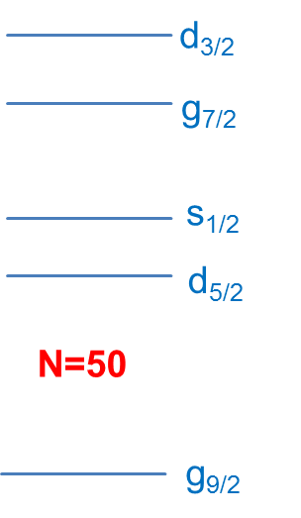

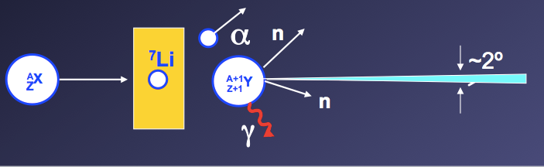
Shell evolution
Stable beams (fission): core-coupled states and intruders
1+ SPES beams
q+ SPES beams : lifetime (plunger or DSAM) after transfer (d,p) , (d,t), coulex on intruder states
Shell evolution around 78Ni​
Deformation and shape coexistence​
Shell evolution around 132Sn​​
7
Limit of observability
Courtesy of D. Verney
Similar approaches for the the regions around 132Sn (~2 order of magn. more intense than currently available at ISOL facilities) key nucleus for physics and astrophysics purposes
Also with higher-l transfer → alpha transfer
Error (MeV)
Need for precision measurements ..

Slide 8
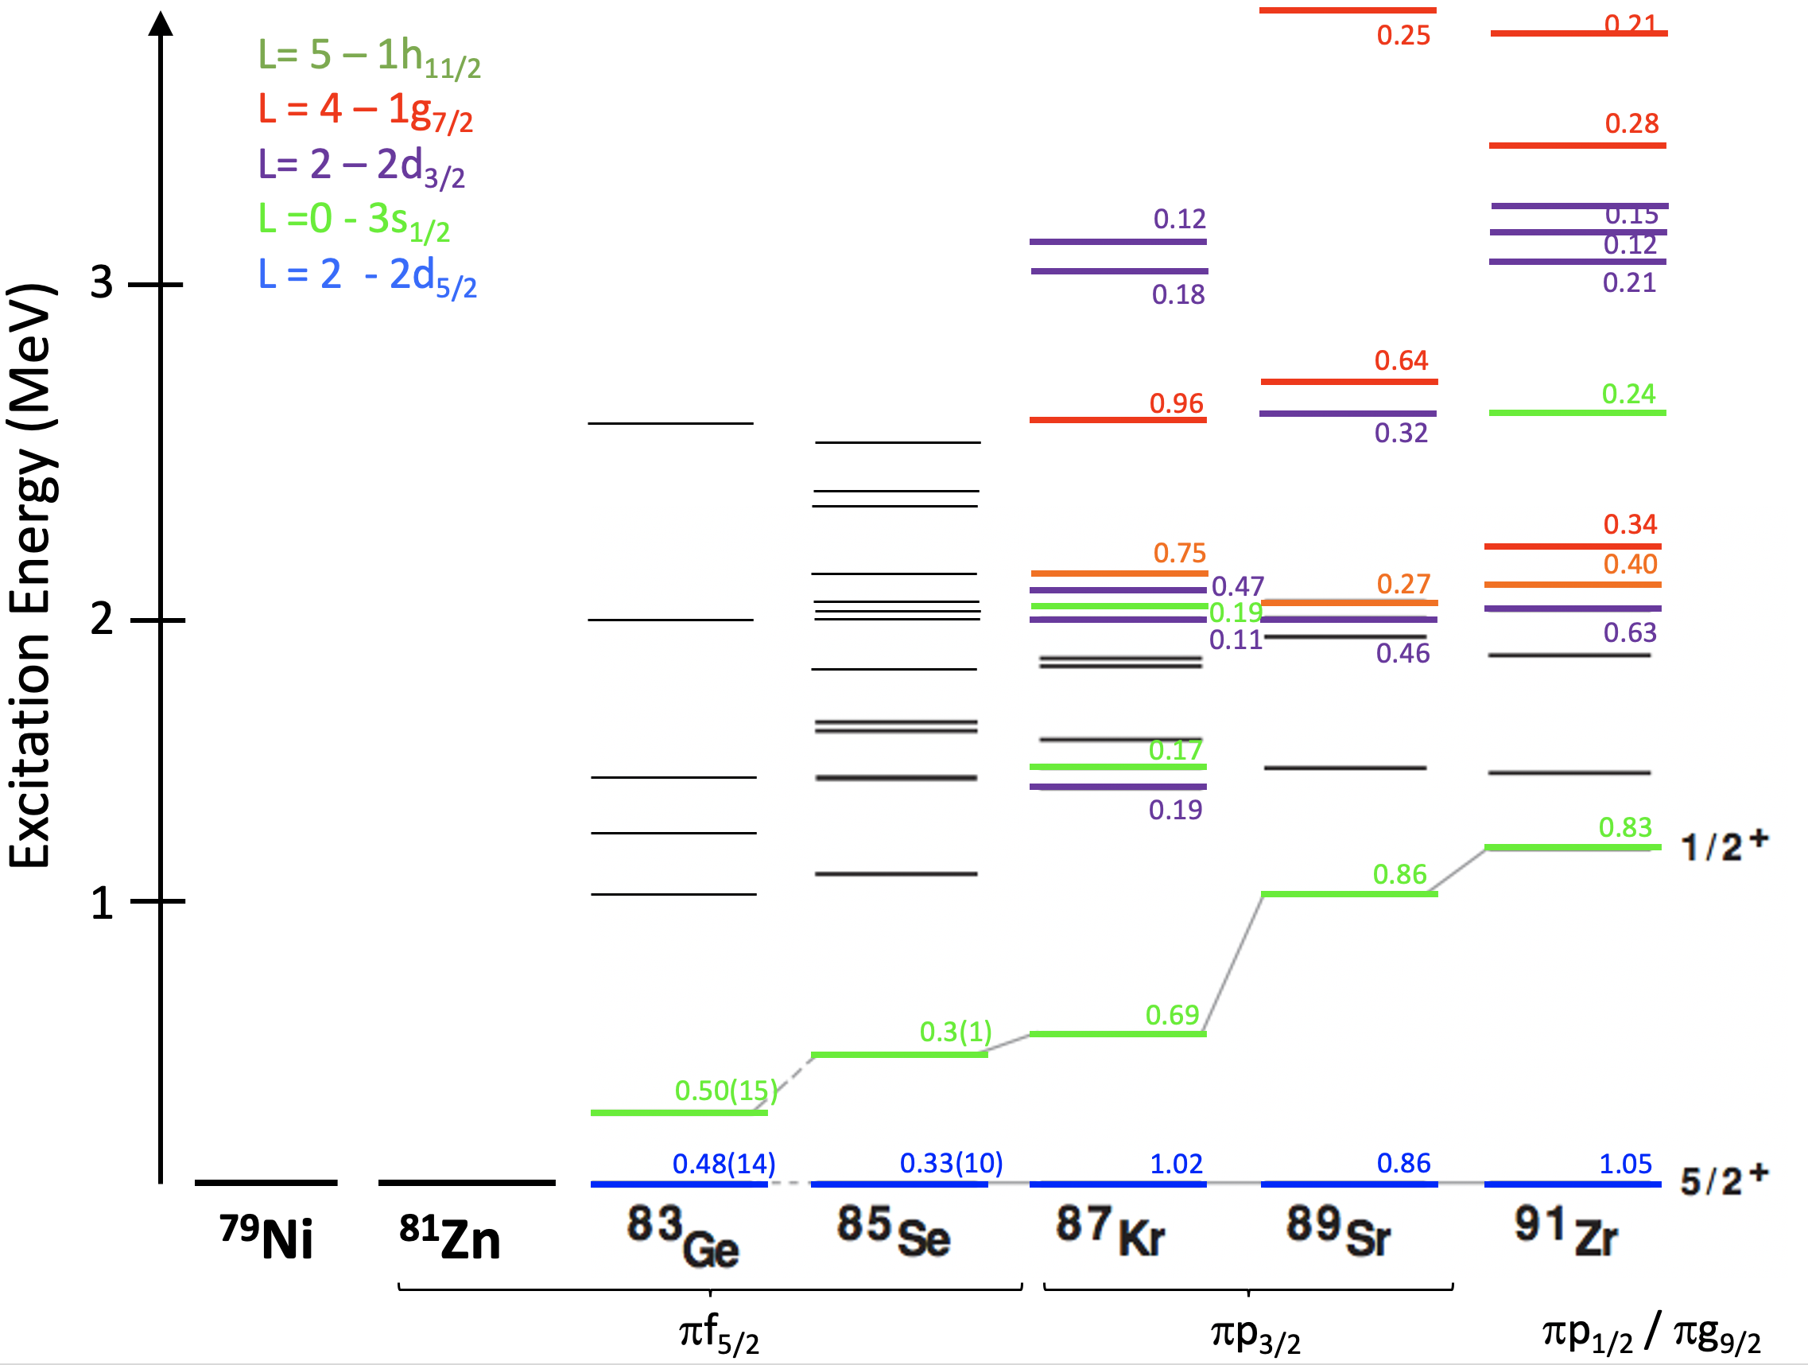
Shell evolution: Neutron Addition at/around N=50
Transfer reactions – F. Flavigny
Text
⁸⁰Ge
⁸¹Ge
⁸²Ge
⁸³Ge
⁸⁴Ge
⁸⁵Ge
⁸⁶Ge
⁸⁷Ge
⁸⁸Ge
⁸¹Ga
⁸²Ga
⁸³Ga
⁷⁹Zn
⁸⁰Zn
⁸¹Zn
⁸²Zn
⁸³Zn
⁸⁴Zn
⁷⁹Cu
Selectivity to n(gds)⁺¹ states
  → Natural: from sdg₇
Drift, spread of s.p. strength
  → Cross sections -> s.p. strength
Z=28
⁷⁸Ni
N=50
Neutron addition on N=50 : ⁸²Ge, ⁸⁰Zn(d,p)
g_{7/2}
g_{7/2}
d_{3/2}
d_{3/2}
s_{1/2}
s_{1/2}
d_{5/2}
d_{5/2}
50
(+1n)
50
28
g_{9/2}
28
g_{9/2}
Studies enabled by
new SPES beams
π
ν
π
ν
⁸²Ge (gs)
⁸³Ge: sp. states (5/2+,3/2+,7/2+)

Slide 9
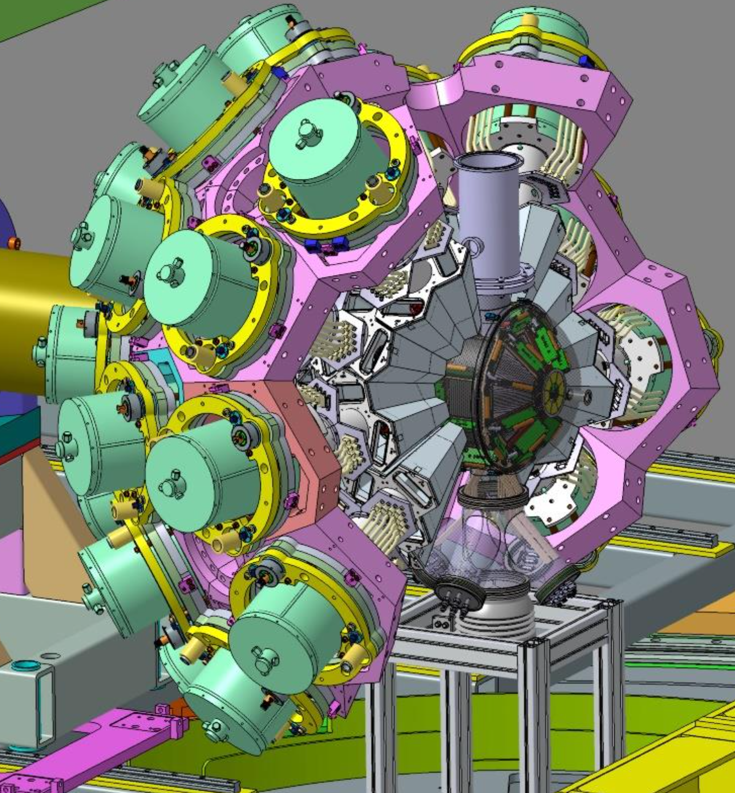
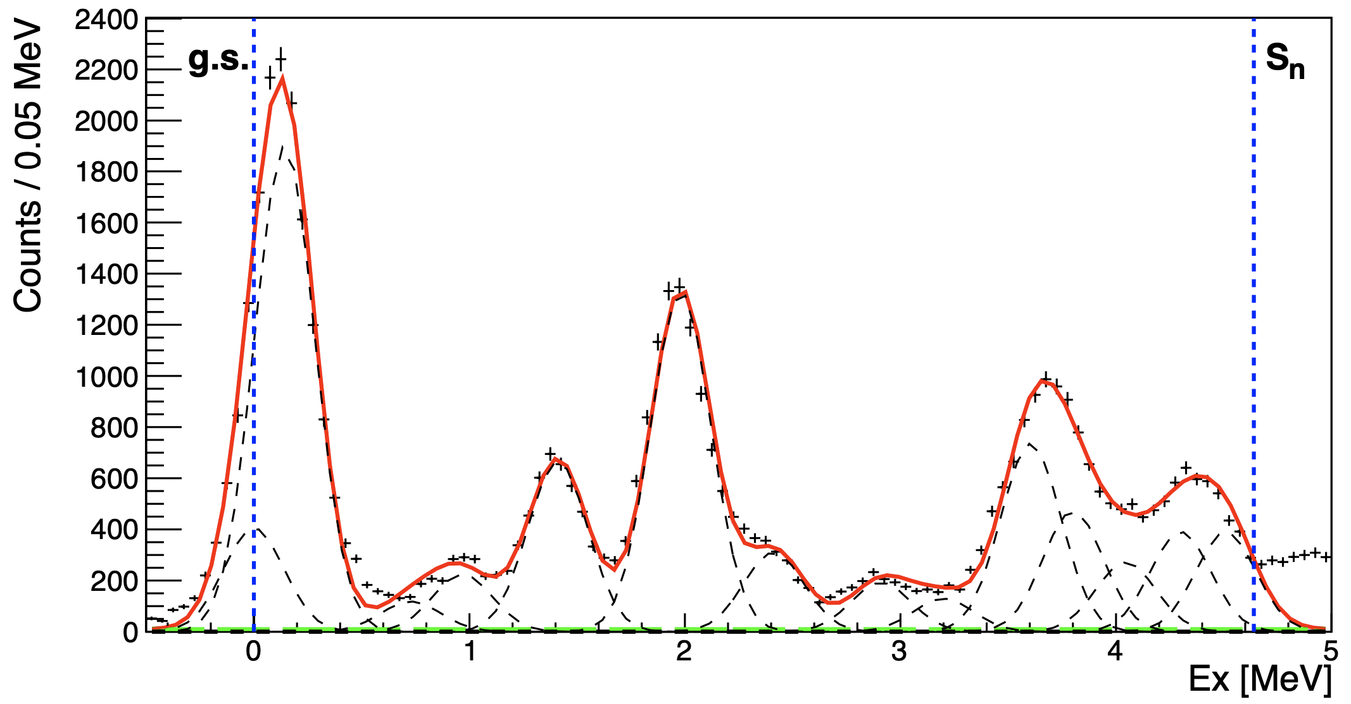
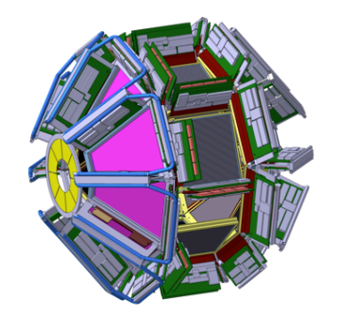
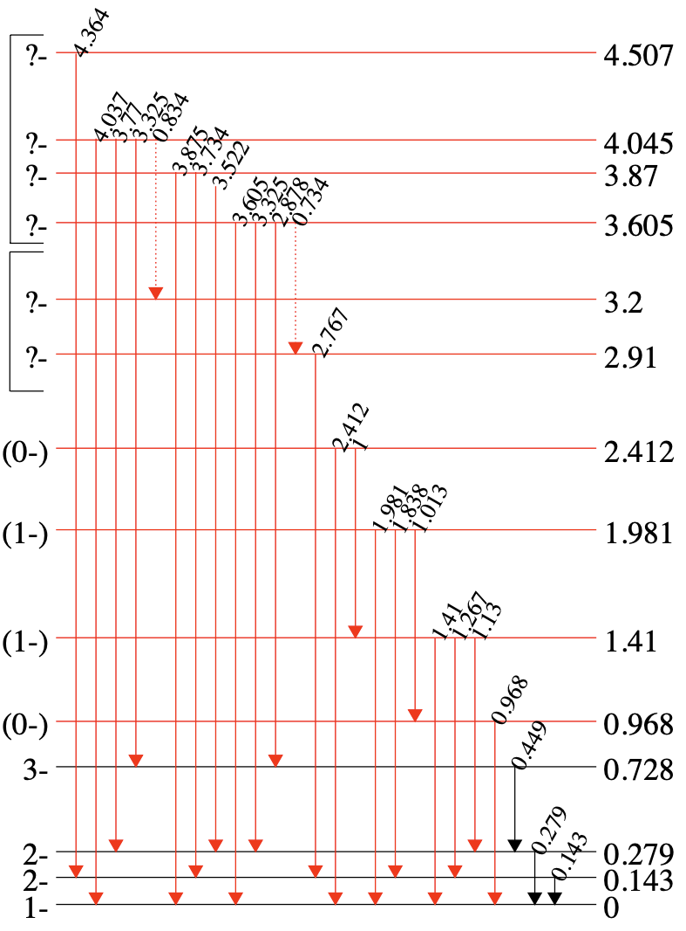


Transfer reaction studies: tools and technique
Transfer reactions – F. Flavigny
Andrea Gottardo
Text
GRIT + AGATA setup
Illustration of p-γ capabilities
Study of odd-odd ⁴⁸K from ⁴⁷K(d,p)
High density of states
Courtesy of C. Paxman (Univ. of Surrey)
GRIT prototype
(MUGAST) + AGATA @ GANIL
GRIT
4π Si array
Preliminary
Preliminary
High efficiency for particles and γ-rays
  (many reactions channels meas. simultaneously)
High granularity (strip pitch < 1 mm)
Large dynamical range
Special targets (Cooled ^{3,4}He cell, pure H, tritium)
PID using Pulse Shape Analysis techniques
New Integrated electronics
Preliminary

Slide 10
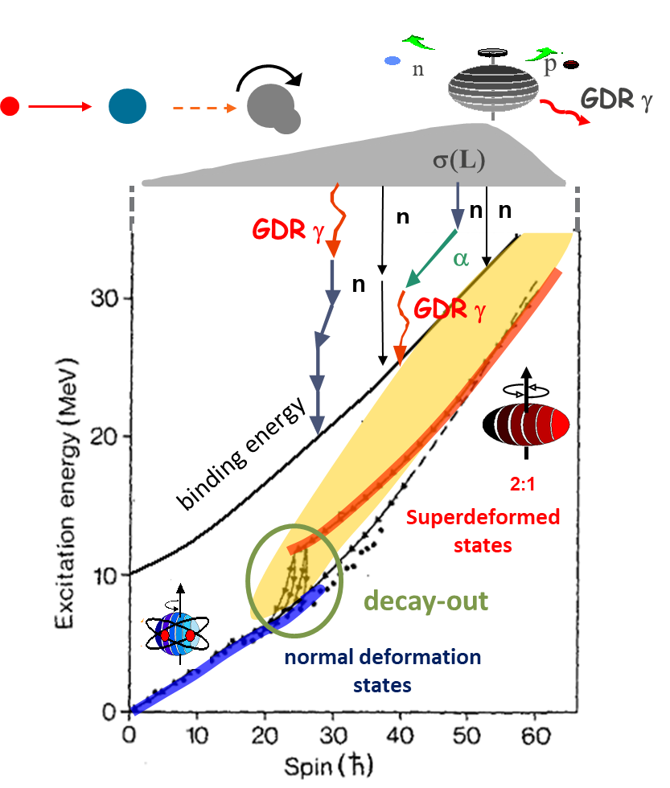
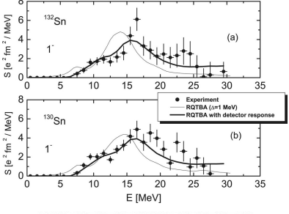
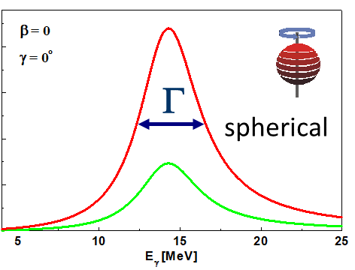
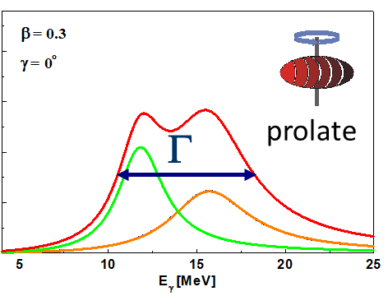
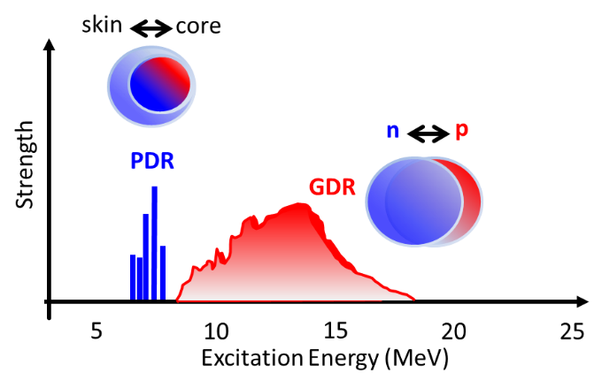
10
Deformation and Collective states
Simplicity from complexity and relevant implications on nuclear matter and astrophysics.
Isovector Electric Giant Dipole Resonance that can be understood as a density oscillation of neutrons against protons. This is also a perfect example of how a complex quantum system like the atomic nucleus can exhibit very simple collective configurations.
QRPA
GDR/GQR
Jacobi shape
Isospin mixing
Shapes and EOS consistently
X.Roca-Maza, N.Paar Rep Part and Nuc Phys. 101 (2018) 96
PDR,PQR, with stable, SPES 1+ and q+
(α,α’), (p,p’)
(d,p), (d,t)

Slide 11
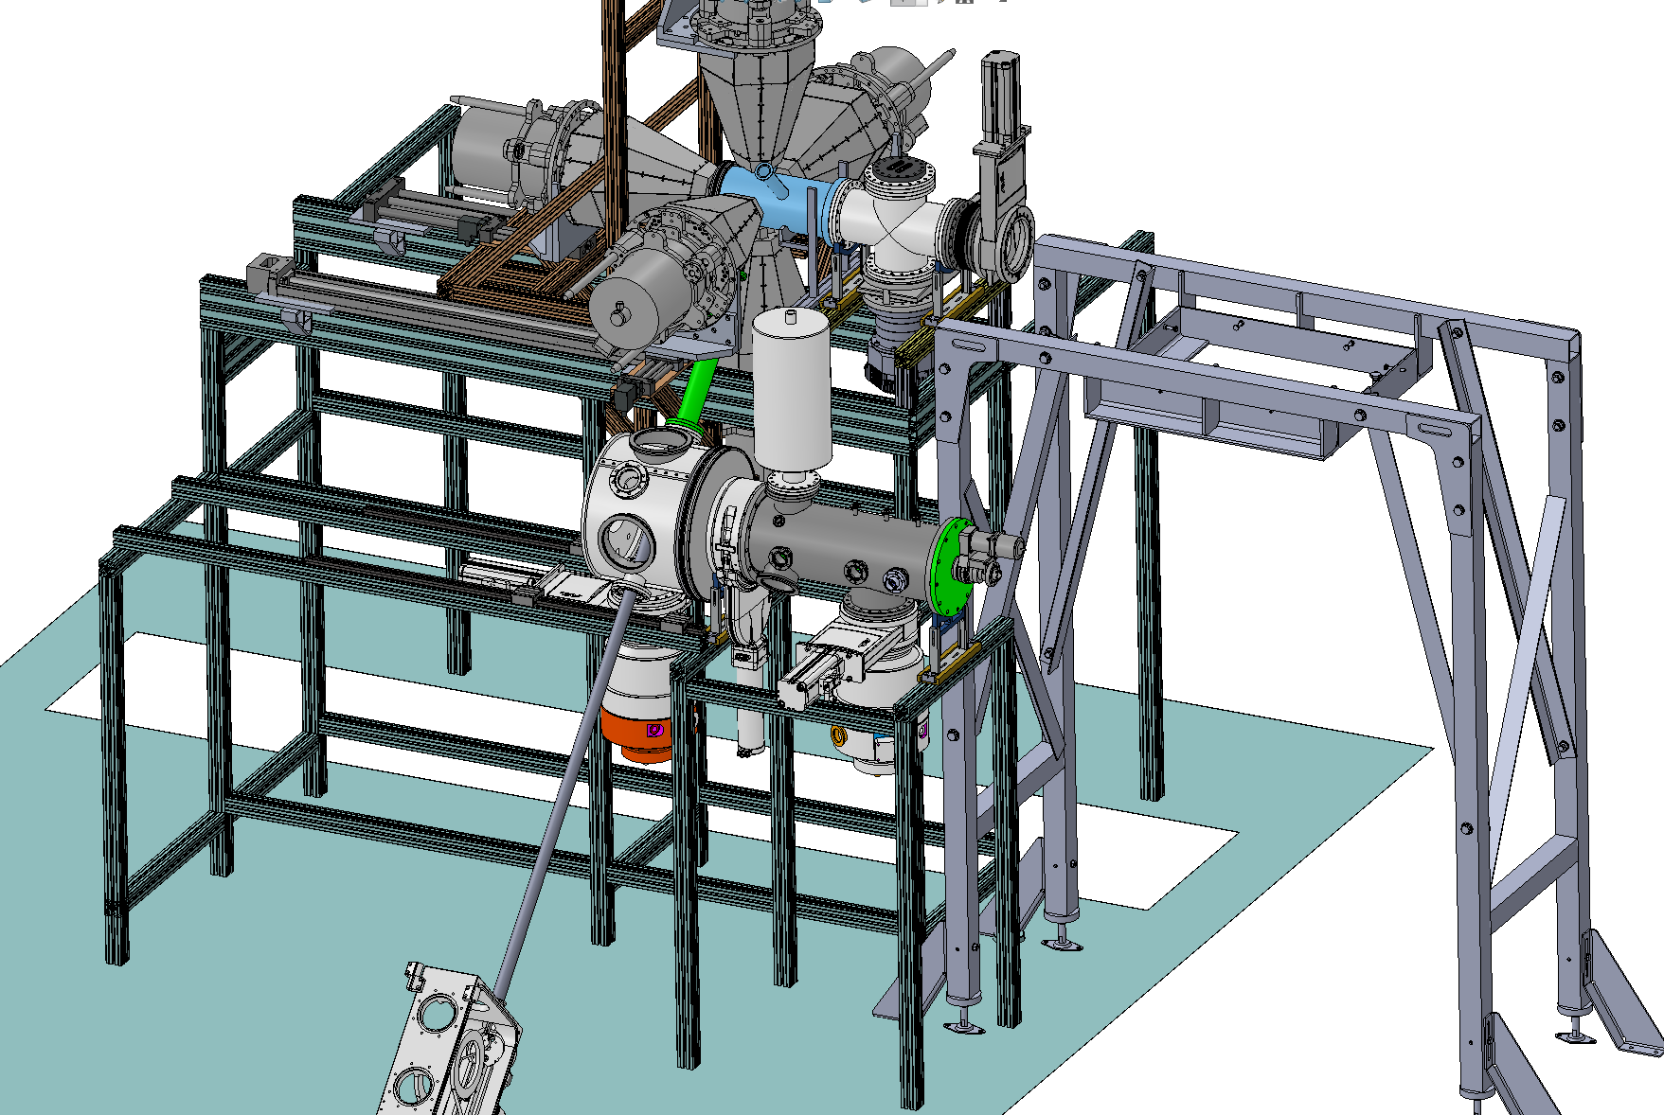
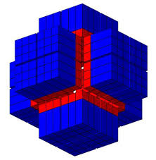
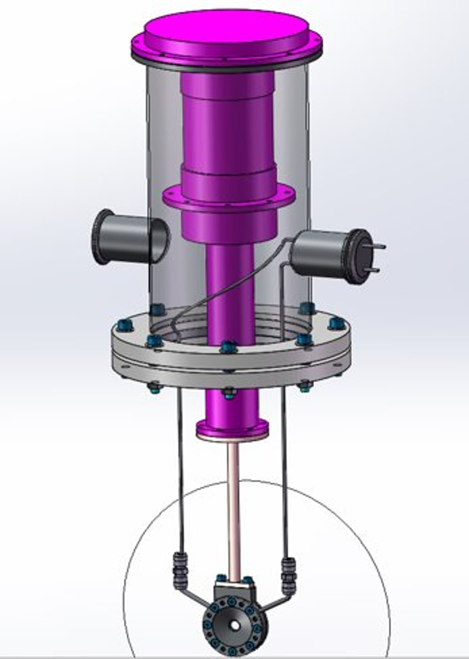
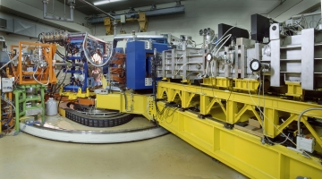

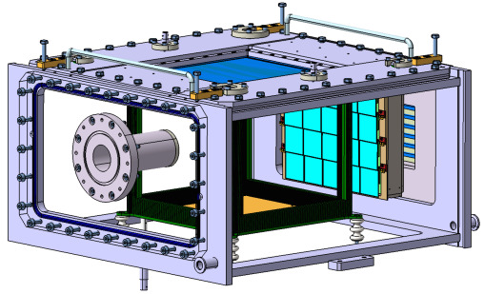
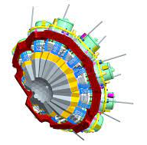
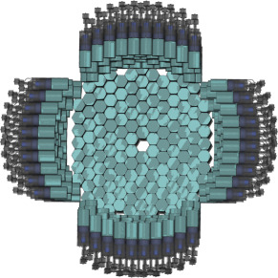
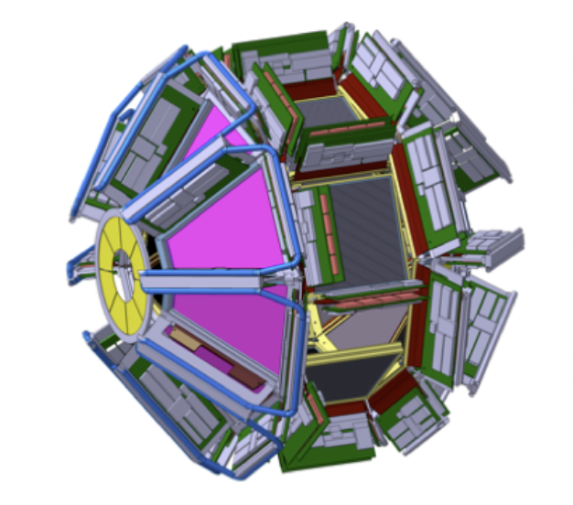
Instrumentation
11
PARIS
γ-rays
β-decay
station
CTADIR
cryogenic
target
PRISMA
heavy ions
Forefront contemporary nuclear structure needs ground-breaking integrated systems
ACTIVE
TARGETS
AGATA
γ-rays
NEDA
neutrons
GRIT
charged particles

Slide 12
Nuclear Reactions and Dynamics. Summary.
Nuclear Reactions
Readiness . . .
A
B
C
Fusion-evaporation
and pre-equilibrium emission
α-correlations and clustering in light and medium mass nuclei. Beams: ¹⁶⁻¹⁸O at 10 AMeV, light targets.
Isospin dependence of CN formation and decay. Beams: Kr, Sr, Sn.
onset of pre-equilibrium emission and clustering. Beams: ¹⁶⁻¹⁸O, ²²Ne at 18-20 AMeV.
α emission at high spins (deformation).
Beams: Ti, Ni at 10 AMeV.
Extension to SPES beams: Sn, Rb
Incomplete fusion, shell effects in quasi-fission
Direct
processes
Competition between transfer
and near-barrier fusion.
Links with nuclear structure and astrophysics: Asymptotic Normalization Constants, spectroscopic factors, halos.
(also low energy reactions at AN2000 and CN).
Future challenges with A.T. and GRIT
Future challenges:
6He beams from EXOTIC (12C)
9Be beams
MNT1: populating heavy nuclei in the region of Pb
MNT2: correlations in transfer (Sn+Ni in progress)
Fission
and
sub-barrier
fusion
Scan of neutron deficient systems at high excitation energy. Beams: Pb.
Actinides region: shell effects and reaction dynamics at low excitation energy.
Isomers measured at the focal plane of PRISMA.
The nucleus as a quantum effects with sub-barrier fusion
Electron-positron pair spectroscopy

Slide 13
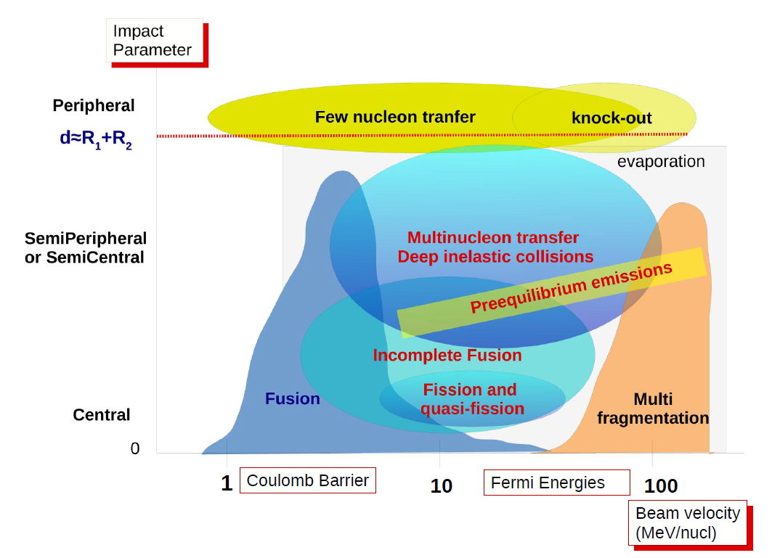
Nuclear Reactions and Dynamics. Highlights.
WG1. Fusion-evaporation and pre-equilibrium emission.
WG2. Direct processes, transfer and particle spectroscopy.
WG3. Fission and sub barrier fusion.
LNL
LNS
Nuclear Structure
Clustering

Slide 14
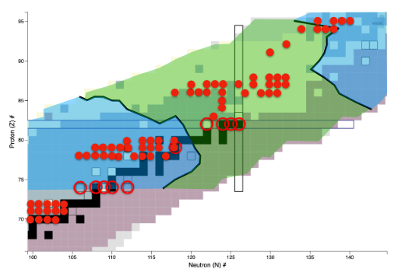
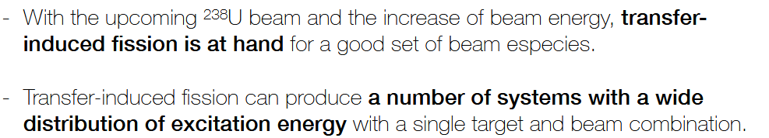
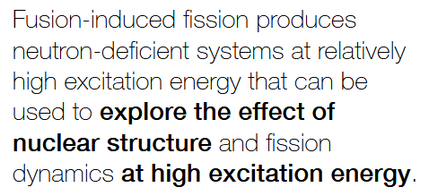
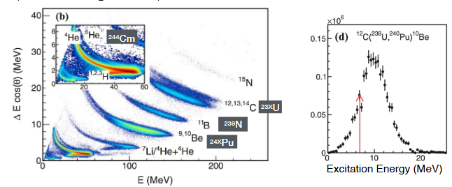

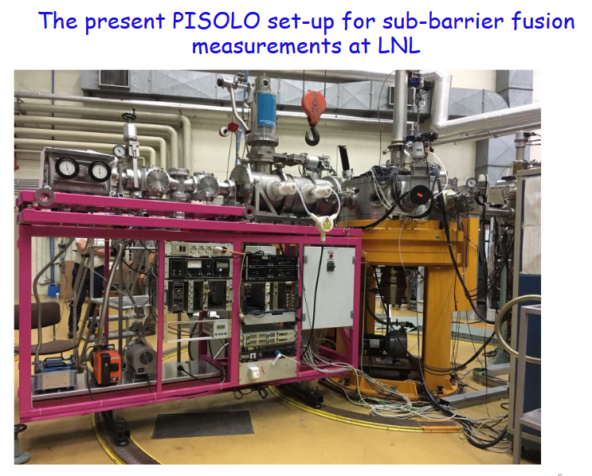
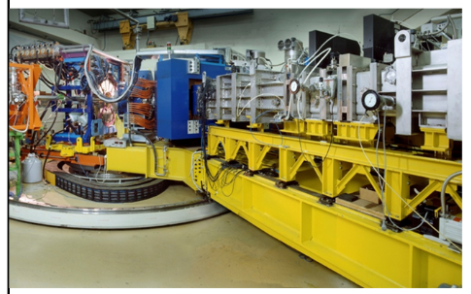
Fission and sub barrier fusion
Fission
A
B
Actinides region: shell effects and dynamics at low excitation energy (transfer-induced-fission, inelastic, etc.).
U beams and dedicated particle detectors are needed
Pb or lighter beams
State of the art detectors for both fission and sbb
C
Gamma-ray detectors at PRISMA focal plane would allow to study long-lived isomeric states.

Slide 15
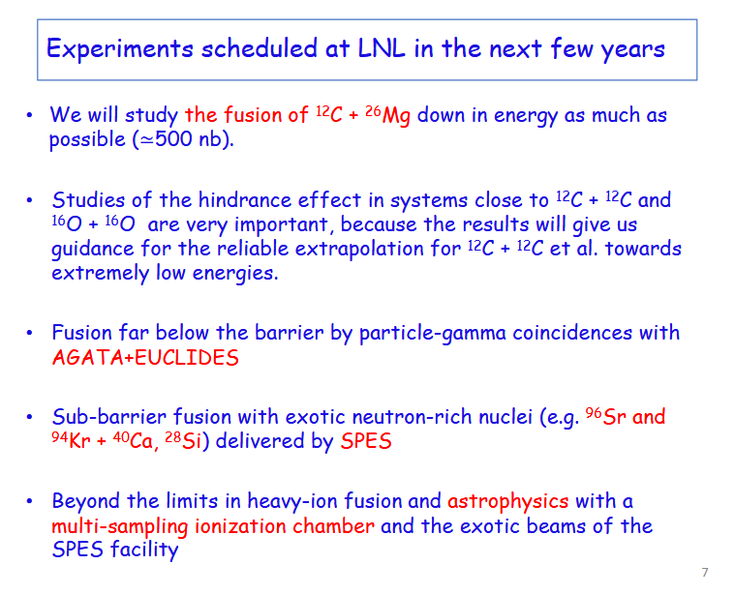
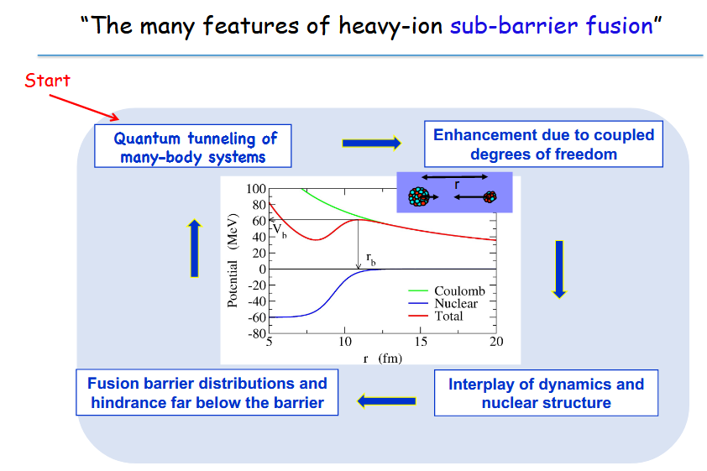
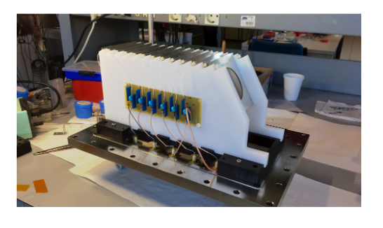
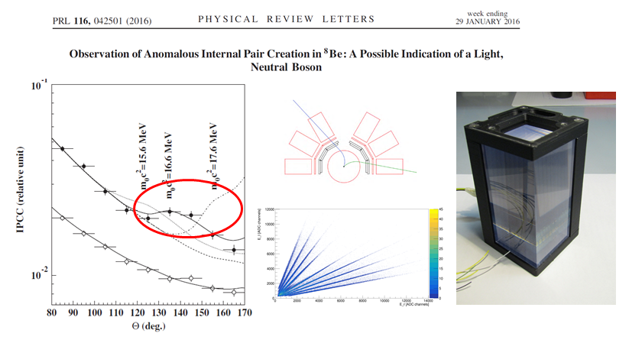
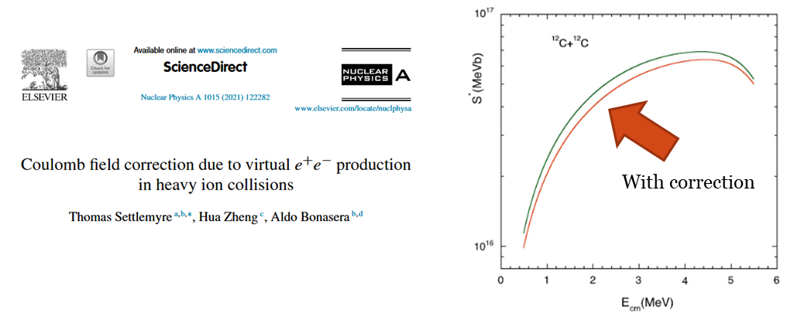
Fission and sub barrier fusion
Sub-barrier fusion
A
B
C
New physics

Slide 16
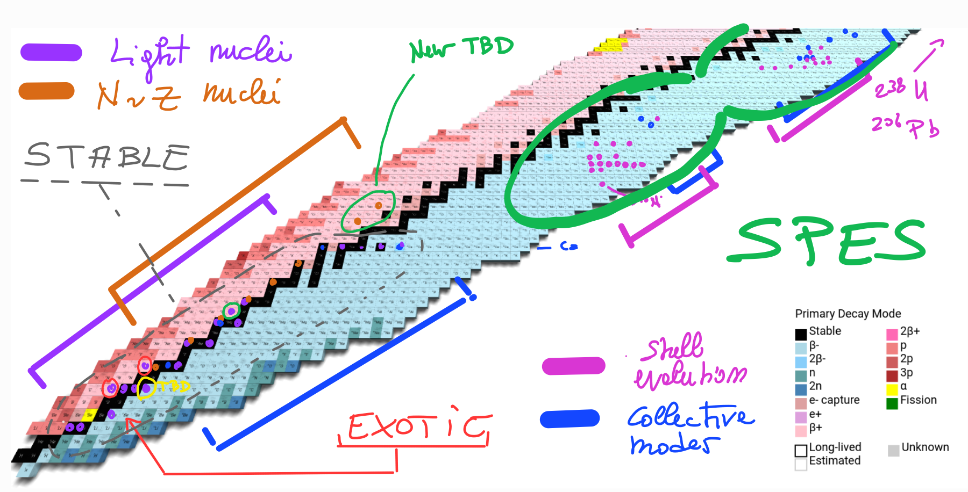
Beam distribution
16

Slide 17
Summary on Nuclear Astrophysics
Nuclear Astrophysics
Phase A
Phase B
Phase C
Indirect study of ¹⁴N(p,γ)¹⁵O reaction and the solar composition problem
Abundance of radioactive elements in our Galaxy: Constraining ²⁶Al
²⁶Al^{m}(n,p)²⁶Mg, ²⁶Al^{m}(n,α)²³Na, ²⁶Al^{m}(p,γ)²⁷Si
Nucleosynthesys
up to Fe
Big Bang Nucleosynthesis in the era of precision Cosmology:
p+d, d+d, ⁷Be(d,α)⁵Li
²⁴Mg excited states and impact on stellar carbon burning
Investigating the Hoyle state:
¹⁴N(d,α)¹²C; ⁴He(¹²C,¹²C*)⁴He; ⁹Be(α,n)¹²C; ⁴He(2n,γ)⁶He
¹⁶O+¹⁶O reaction study at deep sub-barrier energies
Decay properties of neutron-rich nuclei at the first r-process peak
Abundances of the elements at the first r-process peak: (α,n) reactions
Neutron capture cross sections for s-process via the surrogate reaction approach – batch mode
Nucleosynthesys
beyond Fe
Neutron capture cross sections for i-and r-process nucleosynthesis via surrogate reaction approach
Activation measurements of isotopes of interest for the s-process
Theory
Impact of new results on stellar evolution and nucleosynthesis
Sensitivity studies

Slide 18
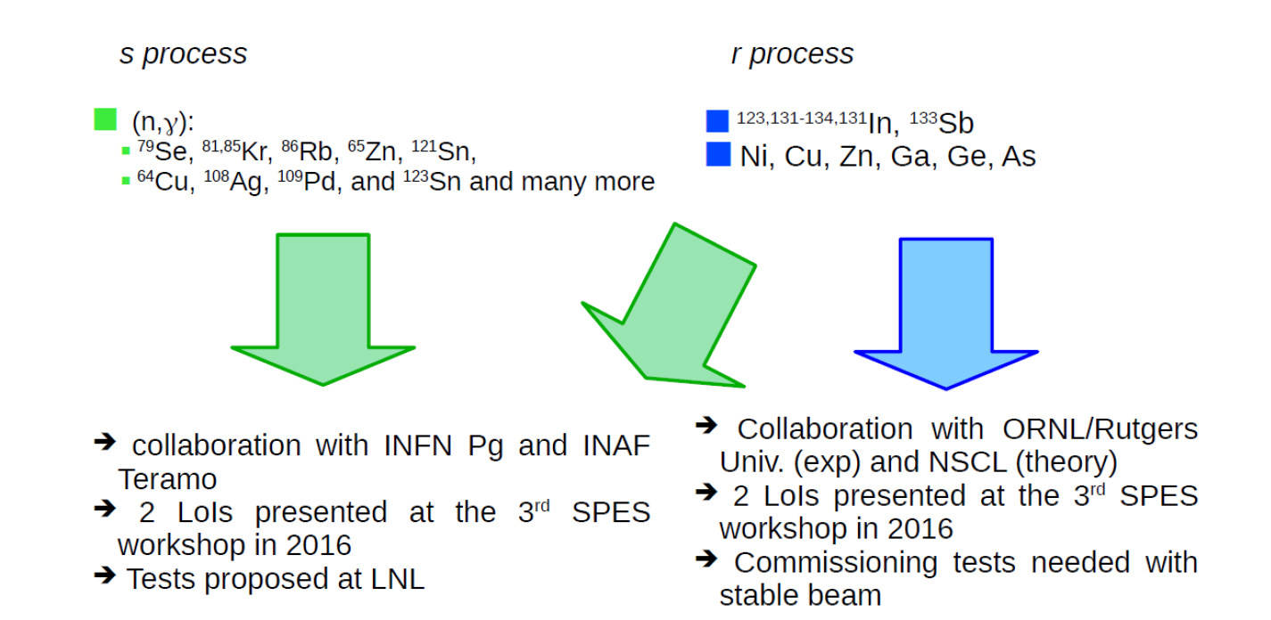
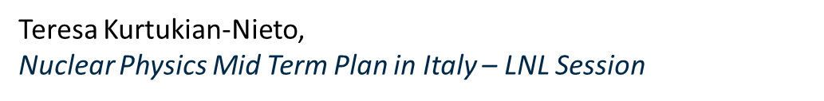
Summary on Nuclear Astrophysics

Slide 19
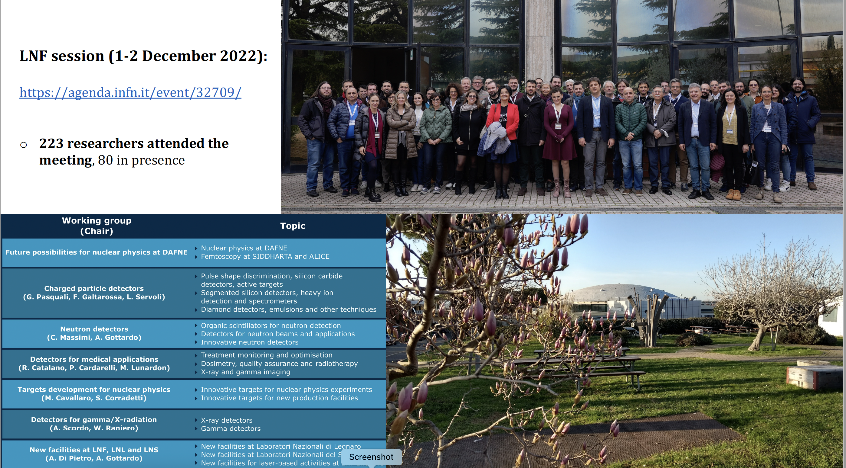

Slide 20
New experimental setups – Low energy
PHASE A : for definition of the item
PHASE B : development of a proposal document.
 | Sigla | Description | Timeline
LNL-Low01 | MR-TOF-MS | MR-TOF trap for mass measurements | A:2025 B:2026
LNL-Low02 | Laser | Collinear laser spectroscopy | A:2025 B: 2026 synergy with ALTO @IJCLab
LNL-Low03 | NMR | β-NMR e β-NQR | A:2026
LNL-Low04 | β-neutron | Resident neutron array for neutron spectroscopy | A:2023 B:2024-25
LNL-Low05 | b-DS | upgrade of b-DS and SLICES | A:2023 B:2024
Notes:
Qui dobbiamo rivedere le date che non corrispondono tra mia e tua presentazione

Slide 21



New experimental setups – Low energy
Setups for determination of ground-state properties
  Collinear Laser Spectroscopy
  New equipment for mass measurement (and beam study): MR-TOF-MS
Setups for β-decay :
  New equipment for β-decay studies: neutron detection arrays;
  TAS;
  Trap-assisted spectroscopy: b-DS after MR-TOF-MS

Slide 22
Multi-Reflection Time-Of-Flight Mass-Separator
Courtesy of T. Dickel
MCP
Purification setup
(double Penning trap, MR-TOF-MS, RI)
Decay setup
Beam from magnetic dipole
Separation in Z guaranteed
(can be isomerically purified)
RF
Injection
Trap
RF
Accumulation
Trap
+ Pure beams
+ Better determination of mother nuclei spin and parities
+ Better spin-parity assignment using GT selection rules
Lower transmission
Pulsed beam
E. Leistenschneider et al., PRL 120 (2018) 062503
M.P. Reiter et al., PRC 98 (2018) 024310

Slide 23


New experimental setups – Accelerated beams
PHASE A : for definition of the item
PHASE B : development of a proposal document
 | Sigla | Description | Timeline
LNL-Acc01 | GammaRIB | New resident $γ$-ray array | A:2023/24 B:2024/25
LNL-Acc02 | PRISMA gas filled | Gas-filled spectrometer | A:2024 B:2025
LNL-Acc03 | Solenoid | Solenoid for light particles after transfer reactions | A:2027 B:2028
LNL-Acc04 | SCHIR | SC Heavy ion recoil spectrometer | A:2028 B:2029
LNL-Acc06 | Ring | Accumulation ring for exotic nuclei | A:2028 B:long range

Slide 24



New experimental setups – Accelerated beams
Resident $γ$-ray array
  Galileo Phase III
Setups for heavy ions
  Prisma Gas-Filled
  Heavy-ion SC separator ring
Setup for light ions
  SC solenoid
Setup for exotic ion storage :
  Storage ring

Slide 25

Upgrade of the LNL resident γ-ray array
GALILEO @ LNL
LONG - term
Present Configuration (Phase II):
25 Compton-suppressed HPGe
10 triple-cluster CS
εγ = 4.5%, P/T ≈ 50%, no position sensitivity
Fixed geometry
Desired upgrade (Phase III):
Variable geometry
Position sensitivy 5-10 mm
εγ ≈ 10%, P/T ≈ 40 − 50
How to do it? Discussion on going (new detectors, detectors from GAMMAPOOL, geometry to be carefully studied via GEANT4, founding agencies, …)
Courtesy of M. Rocchini

Slide 26

Options to be investigated for ion detection at very forward angles
SHORT / MID - term
Courtesy of L. Corradi

Slide 27

Ion detection with gas-filled magnetic spectrometers
The option of using a magnetic spectrometer in a gas filled mode for deep inelastic processes has been studied and the results suggest that it is worth to pursue further developments
SHORT / MID - term
Courtesy of L. Corradi

Slide 28


Heavy ion recoil separator
20 cm
LONG - term
Superconducting storage ring:
Primary beam suppression < ~10⁻¹²
100 % transport efficiency
Mass resolution > 1/300
Large acceptance ~ 100 mrad
Gas-filled mode
Focal plane detector:
Position sensitivity ~ 1 mrad (scattering angle)
Particle identification (A, Z)
Eloss, Time of Flight, Pulse shape
Time resolution ~ ns
Energy resolution < 100 keV
Courtesy of I. Martel

Slide 30



Conclusions: Physics domain with SPES
SPES Low-Energy and Post-Accelerated
Physics Program, thanks to existing or short-term set-ups, is wide and has an impact in bridging towards next generation radioactive-beams facilities
Short-to-Mid Term (<2026) opportunities in enlarging the scope of the set-ups are already being developed
Mid-to-Long Term (>2026) proposed activities will complete the facility and introduce new physics to LNL (ground state properties)
Longer-term (>2030) projects to be evaluated to enrich further the physics program
However …. Time is running
Nuclear Physics and Astrophysics
SPES, HIE-ISOLDE, SPIRAL2, EURISOL-DF
EURISOL
Second generation
Today
Second generation

