Slide 1


From ADAMO to ACROMASS
Atmospheric Cosmic Ray Observatory using a
Magnetic Altazimuth Silicon Spectrometer
L. Bonechi
ACROMASS kick-off meeting
23 February 2024

Slide 2
International relevance of the ACROMASS proposal
Neutrino observatories (e.g. HyperK)
Muon radiography_
M. Honda et al., Reduction of the Uncertainty in the Atmospheric Neutrino Flux Prediction Below 1 GeV Using Accurately Measured Atmospheric Muon Flux, Phys. Rev. D 100, 123022 – Published 30 December 2019
M. Honda et al., Accuracy improvement of the atmospheric neutrino flux prediction using observed muon spectra at mountain altitude, Journal of Physics: Conference Series, 1468 (2020) 012190
Previous invitation in Japan for the Workshop for Atmospheric Neutrino Production in the MeV to PeV range
  This workshop focus on the atmospheric neutrino measurement and its flux calculation which are getting more important for precise oscillation analysis in the low energy region and as background estimation of neutrino astronomy.
  https://indico.cern.ch/event/781361/ (2019)
  https://indico.cern.ch/event/873509/ (2020-2021) → presentation of ADAMO and data 2004
  https://www-kam2.icrr.u-tokyo.ac.jp/event/14/ (2022)
Worlwide need of precise measuremets in wide ranges of momentum and angles, in different places and different altitudes, for the implementation of reliable simulations to be compared with angular distributions measured downstream of target volumes
e.g. the ECOMUG muon generator (developed by the Brescia/Padova group and based on the 2004 ADAMO data)
e.g. the ADAMO Ground Muon Generator developed in Florence
\\\

Slide 3
Why ADAMO and why upgrading to ACROMASS

Slide 4
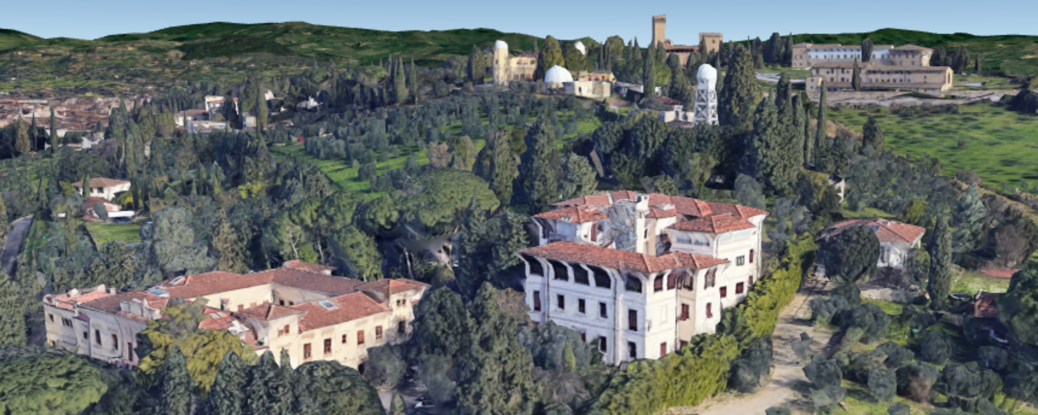


The ADAMO detector phase-1: 1998-2001
Firenze
Arcetri astronomycal
observatory
N
INO
«Garbasso» building
Old headquarters of the Department of Physics of the Florence University and INFN Unit
National Institute of Optics (INO-CNR)
WiZard PAMELA/ADAMO lab
$Lat: 43° {44}^{′} {56.9}^{′′} \text{N}$
Long: $11° {15}^{′} {06.73}^{′′} \text{E}$
Elev.: 148 m

Slide 5
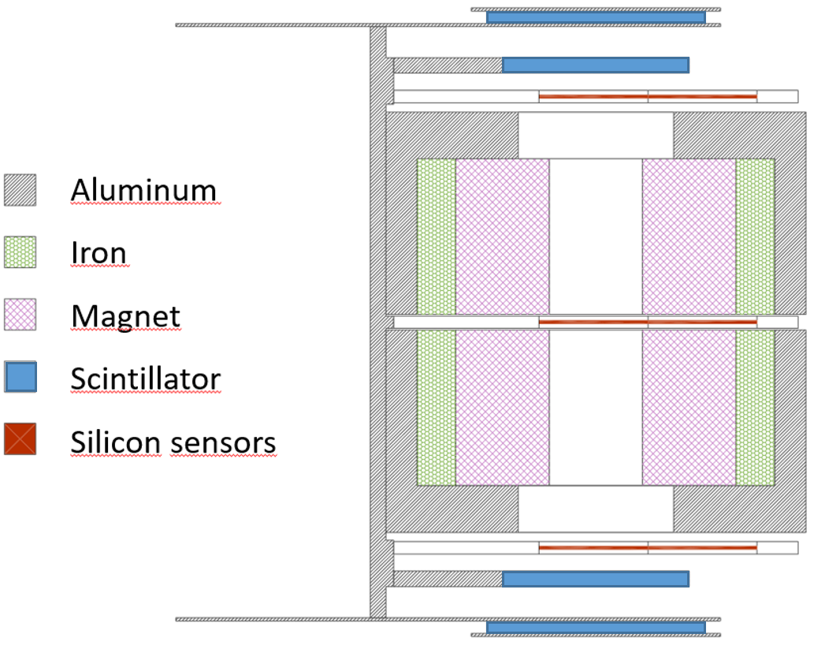
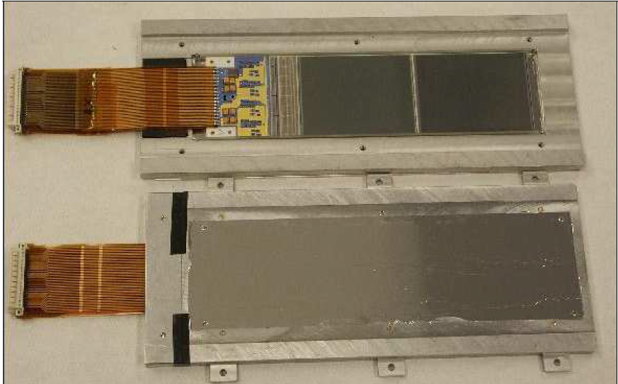
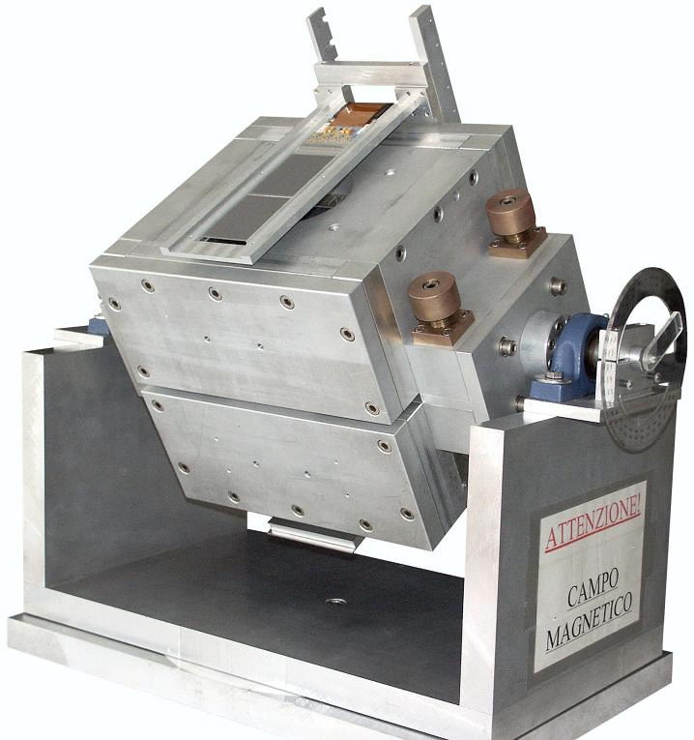
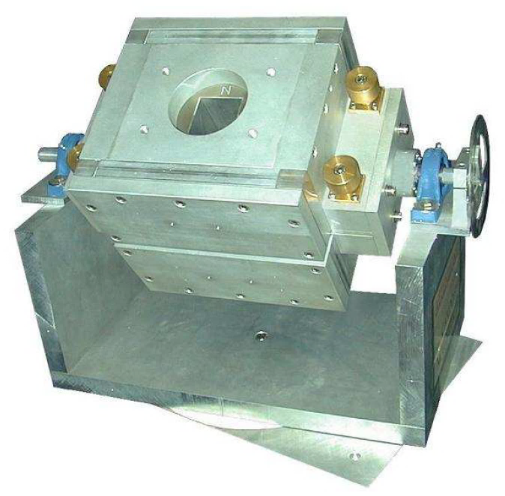
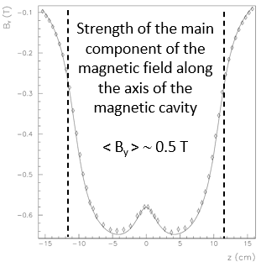
The ADAMO detector phase-1: 1998-2001
Test system of the spectrometer degined for the PAMELA satellite experiment
PAMELA μ–strip silicon tracking module
The apparatus
Tracker: 3 double sided microstrip silicon planes
Trigger system: 4 scintillator layers
Magnet: NdFeB alloy, 1.3T residual magnetization
Geometrical factor G_{F} = 1 cm² sr
MDR ∼ 650 GV/c
Double sided
300 μm thick
5.33 x 7 cm²
σ_{x} ∼ 5 μm
Magnetic cavity:
6 x 6 cm²; h = 21 cm
Manual
altazimuth mount

Slide 6
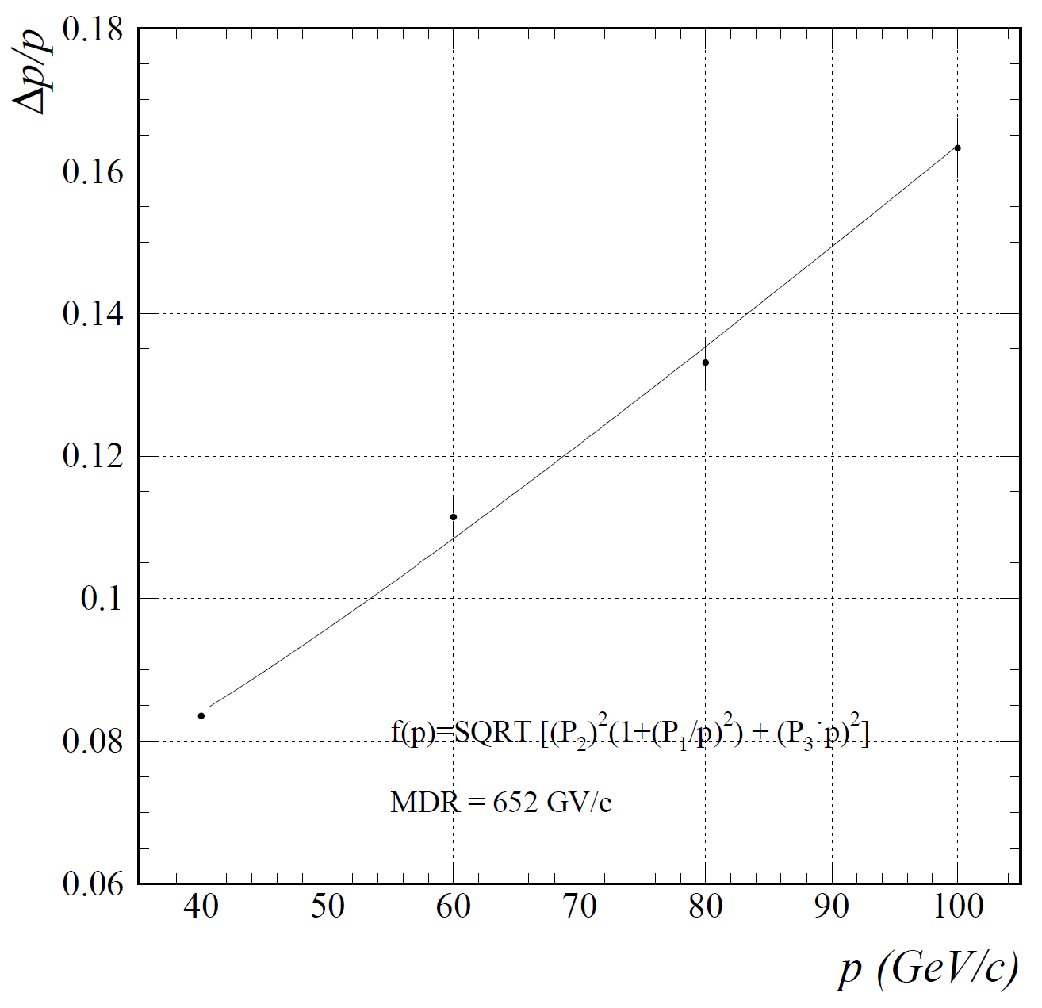
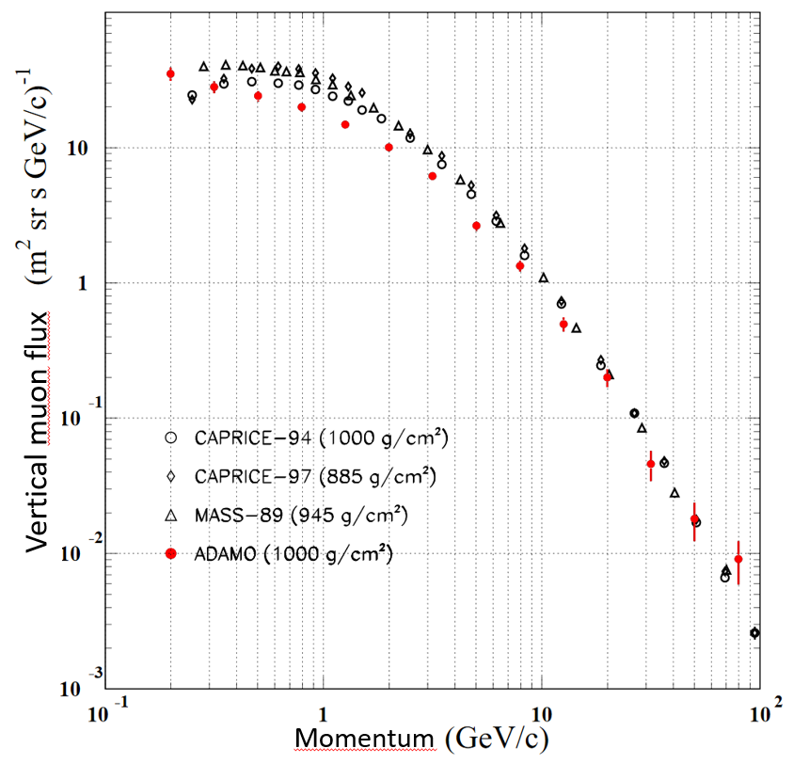
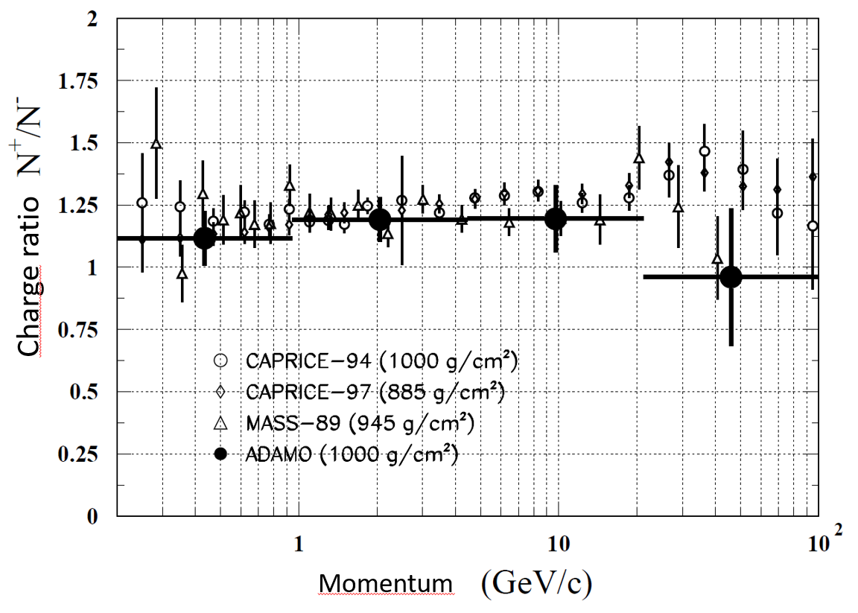
The ADAMO detector phase-1: 1998-2001
  Beam test: momentum resolution
  CR vertical momentum spectrum
  Muon charge ratio
CERN SPS
protons
Data taking period: 4-21 April 2000
Δt=5d 17h

Slide 7
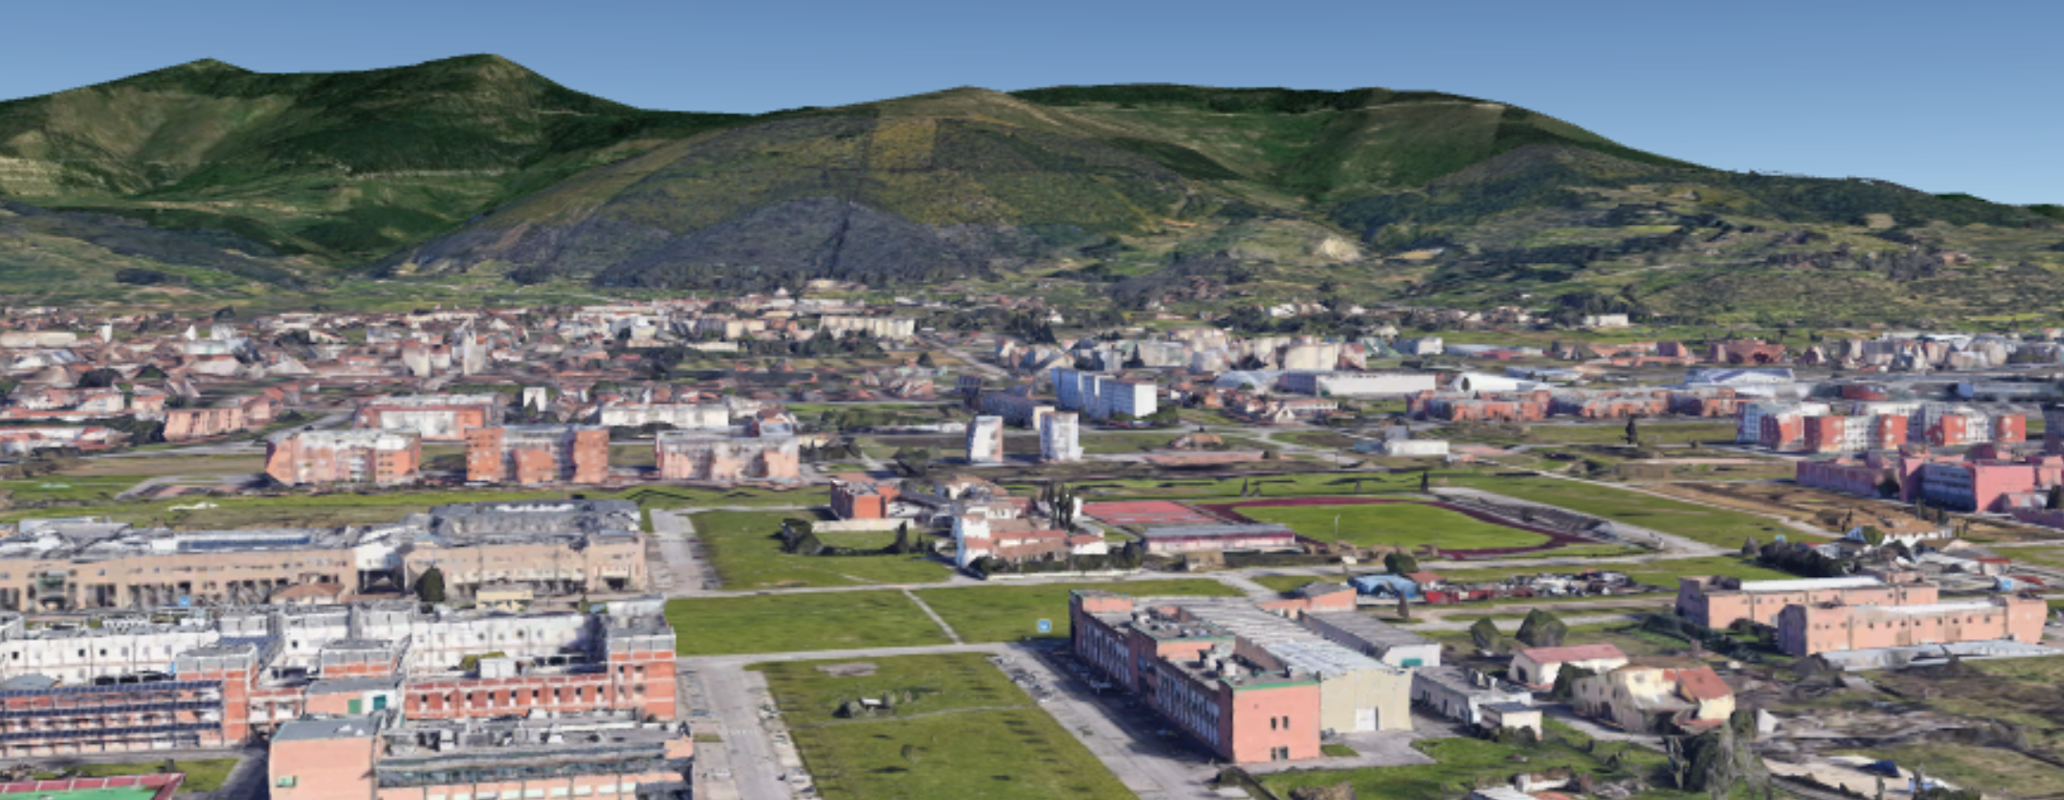
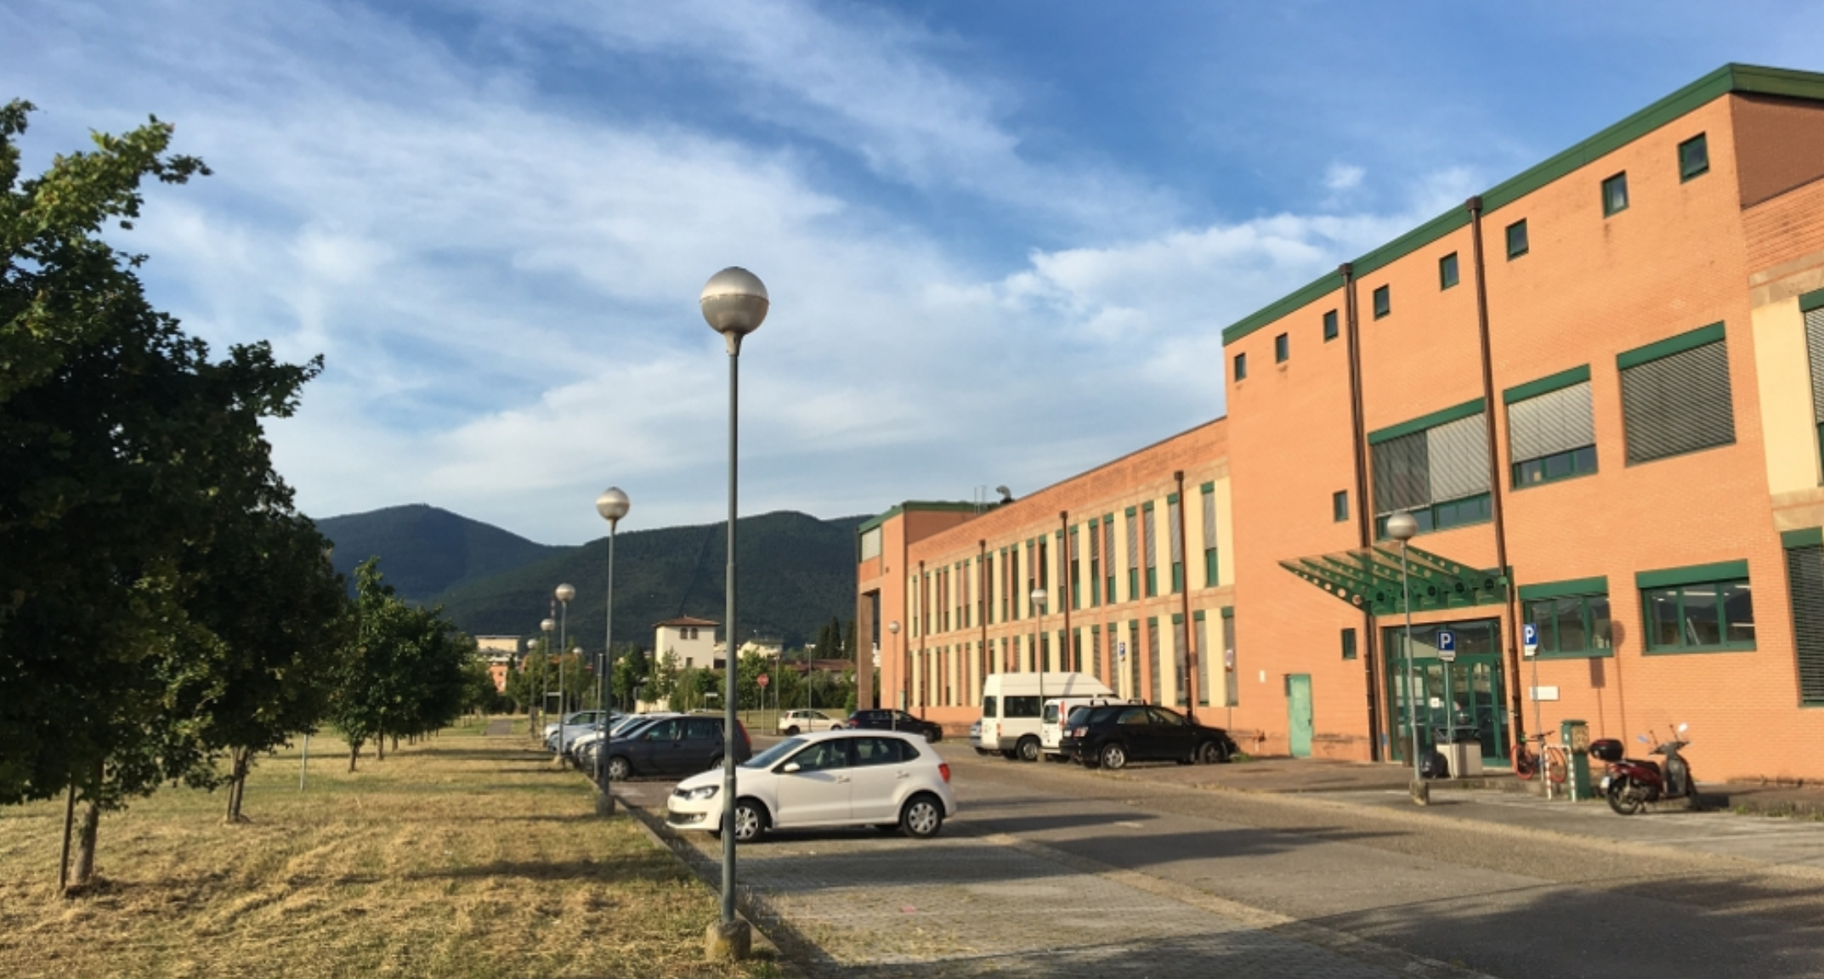


The ADAMO detector phase-2: 2002-2004
Scientific Campus of Sesto Fiorentino (Firenze)
Monte Morello (max hieght ∼ 930 m → 7° elev. from INFN)
Firenze
Sesto Fiorentino
Dept. of Chemistry
CUS
CNR
N
INFN
INFN Florence Unit
Experimental Physics Building
Dept. of Physics and Astronomy
of the Florence University
$Lat: 43° {47}^{′} {07.15}^{′′} \text{N}$
Long: $11° {11}^{′} {41.80}^{′′} \text{E}$
Elev.: 45 m

Slide 8
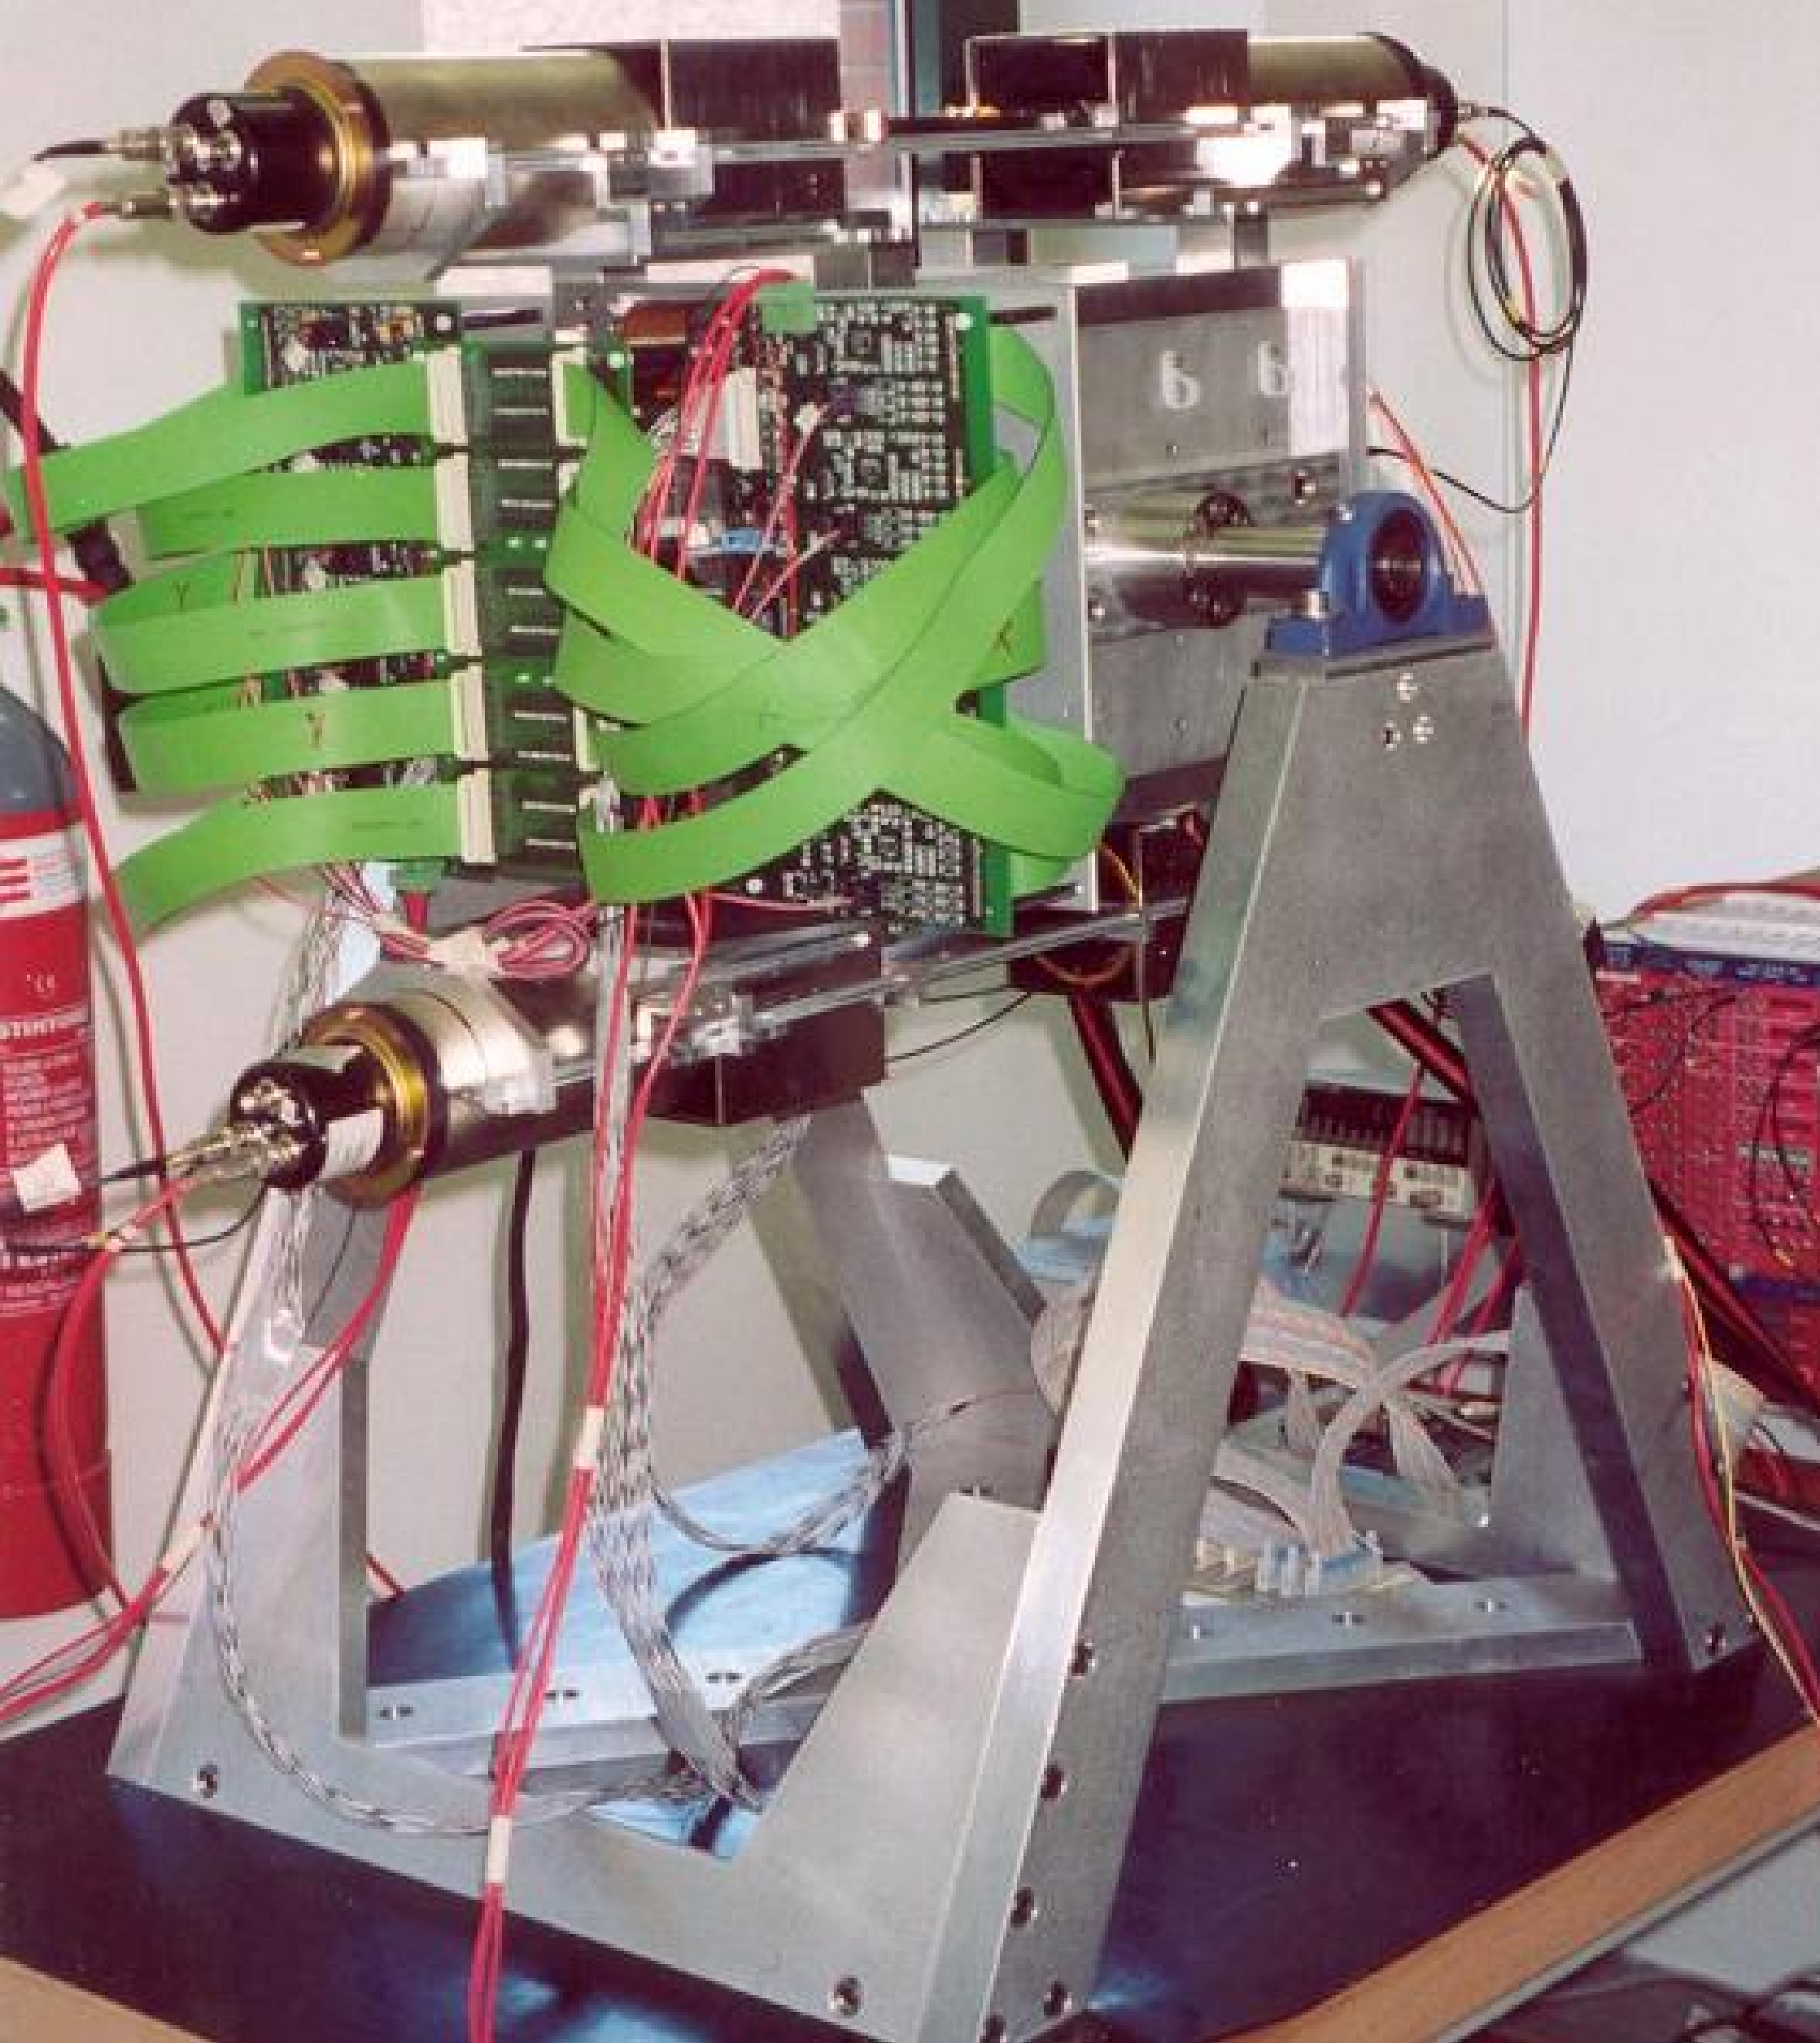
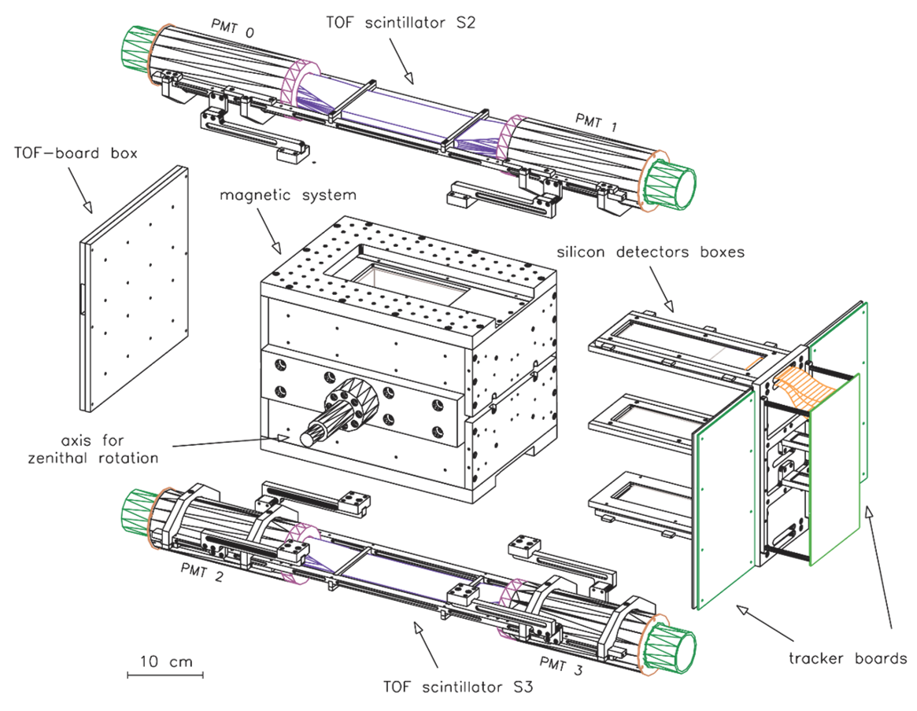
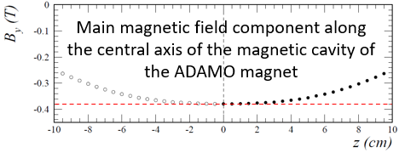
The ADAMO detector phase-2: 2002-2004
First upgrade: increase of the acceptance for cosmic-ray measurements
Re-assebling of the magnet
  → G_{F} = 6.7 cm²sr (old was 1 cm²sr)
MDR decrease: 650 → 250 GV/c
3 → 5 tracking planes
Mass: approximately 100 kg

Slide 9

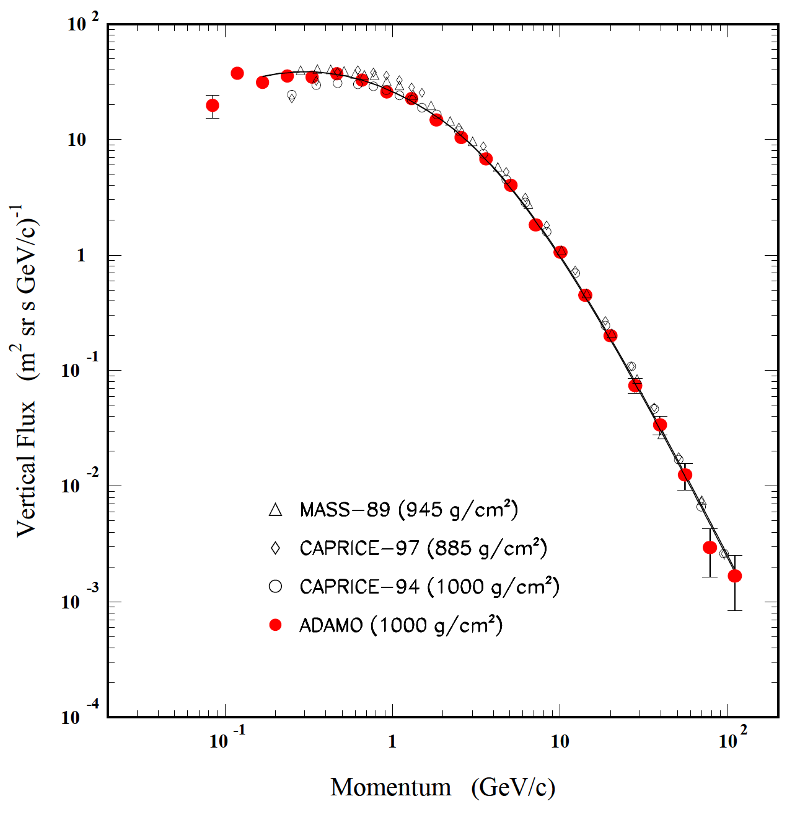
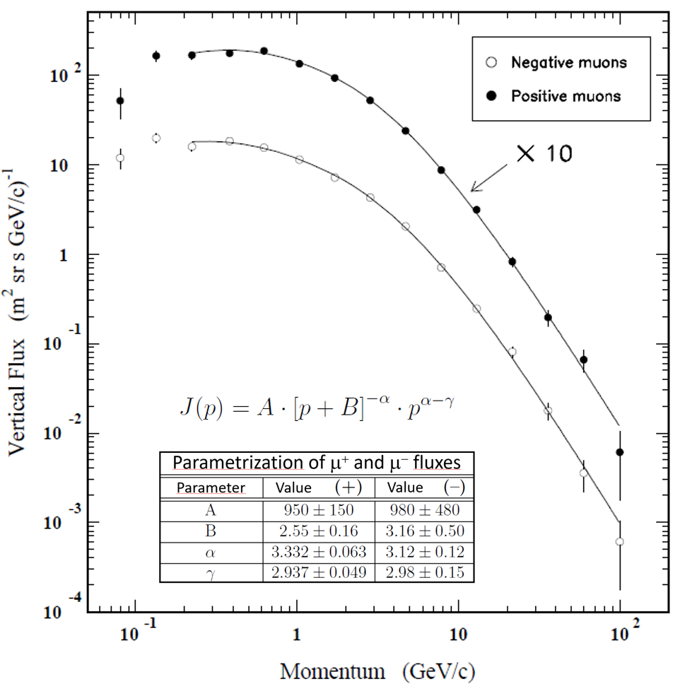
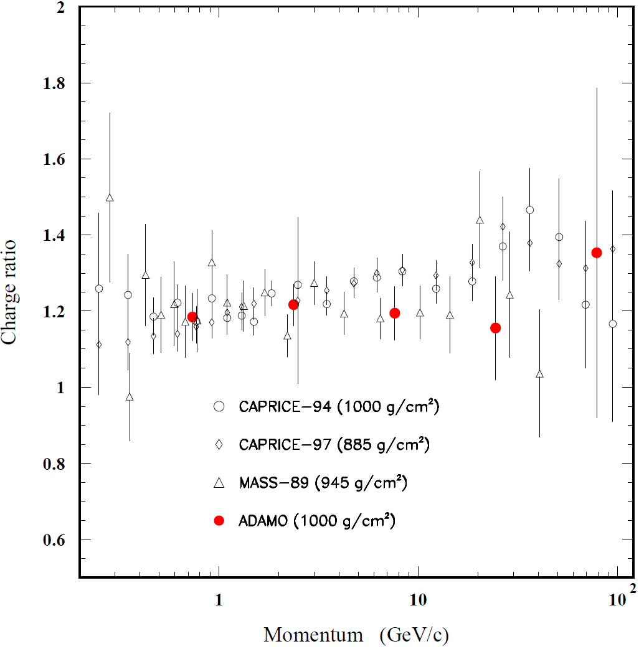

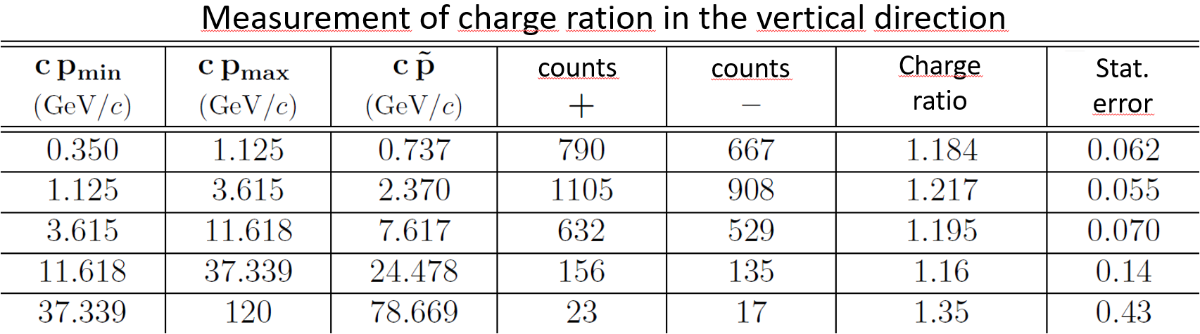
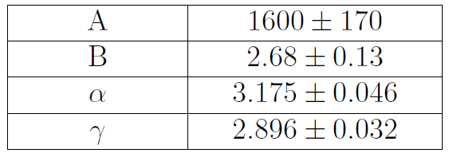

Measurements with ADAMO in phase-2
Cosmic ray vertical spectrum
Spectra of negative and positive cosmic rays
  Vertical charge ratio
$${Δt}_{\text{acq}}=2d 13h 47m 25s$$

Slide 10
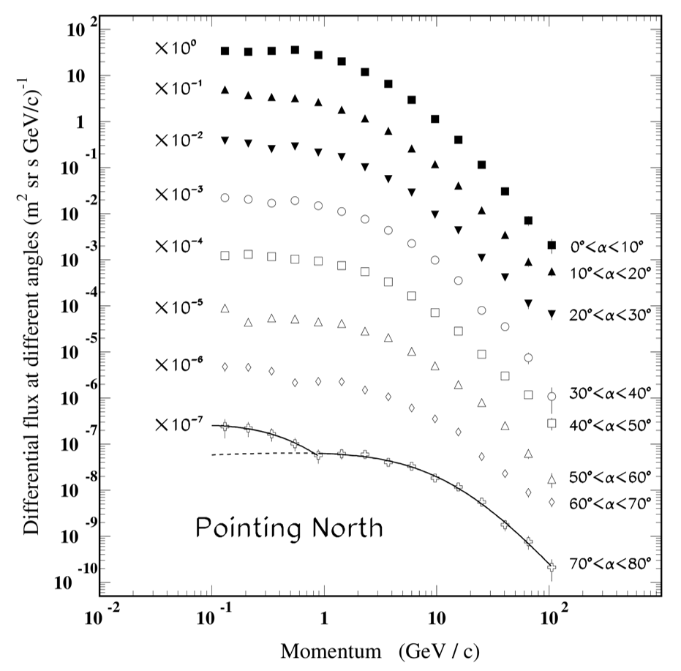
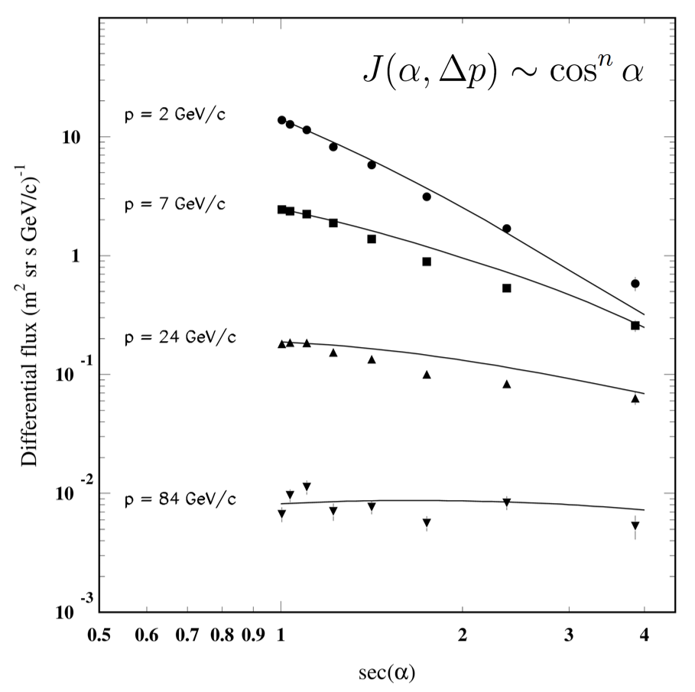
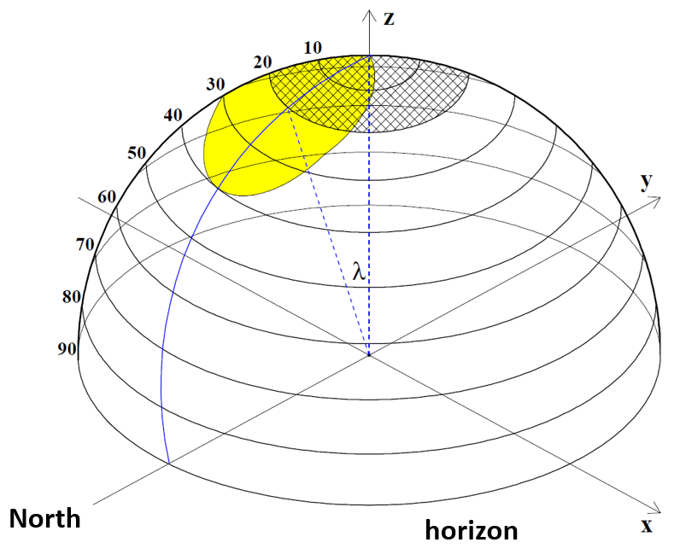
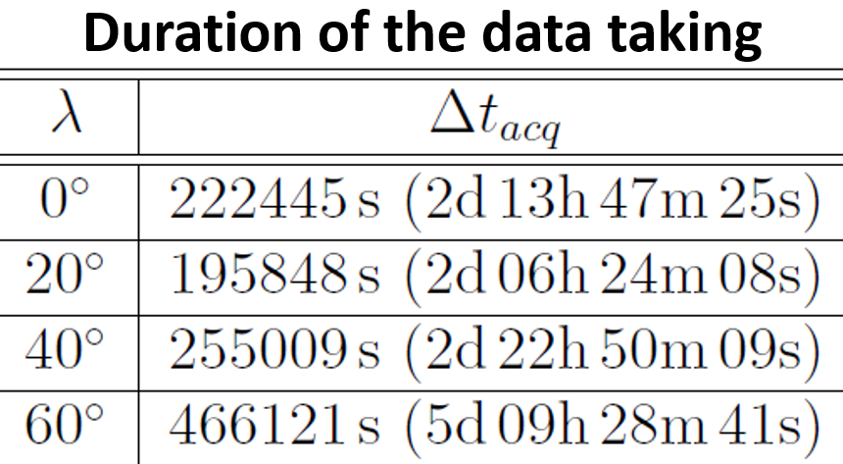
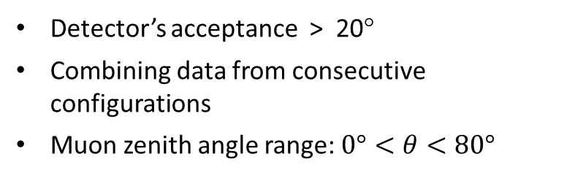
Measurements with ADAMO in phase-2
Data taking at 4 different detector’s orientations
Detector’s acceptance > 20°
Combining data from consecutive configurations
Muon zenith angle range: $0°<θ<80°$
Study of the muon spectrum dependence on the zenith angle
CR momentum spectrum in different intervals of the zenith angle
Zenith angle dependence of the CR flux at different momenta

Slide 11
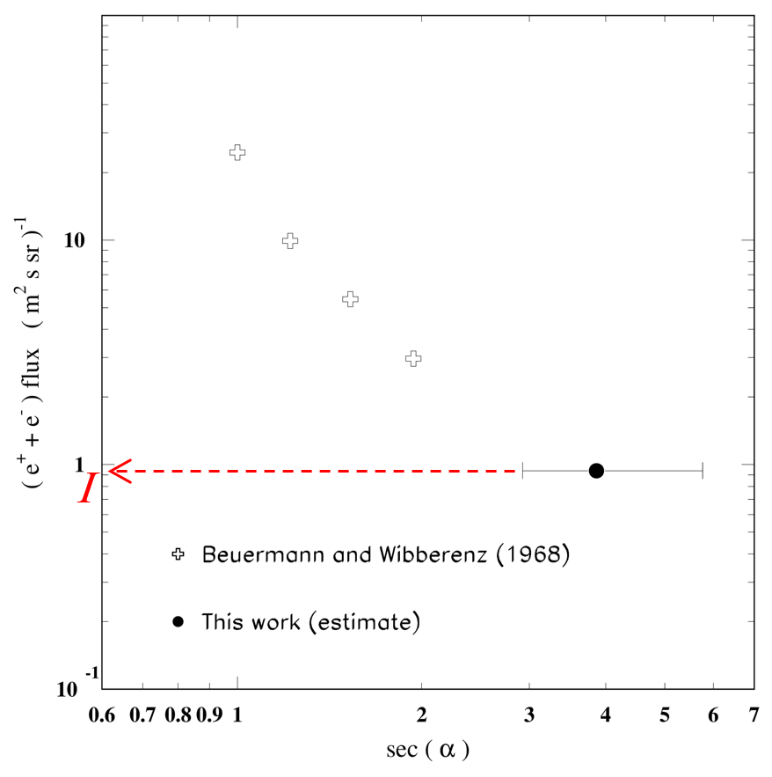
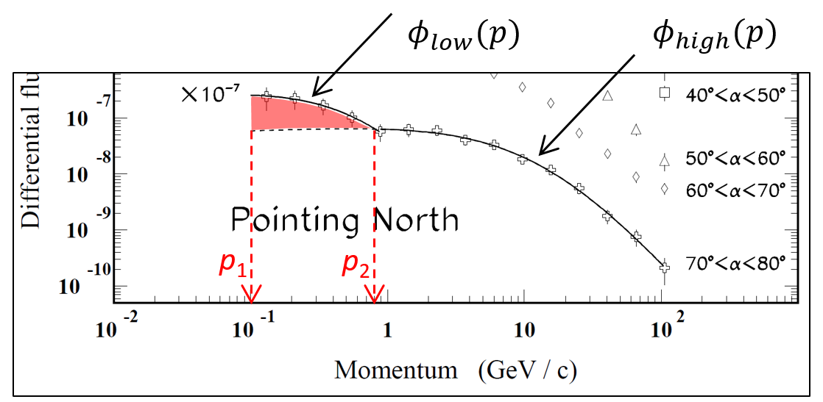

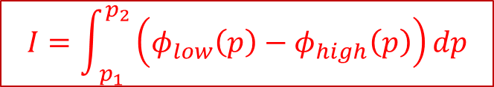
Measurements with ADAMO in phase-2
Study of the low energy region: probable contamination by $e^{+}/e^{−}$
Integration of the low energy «bump» appearing in the CR spectrum:
Interpretation of the low energy bump of the CR spectrum as due to electron contamination
$$I=0.94 {\text{m}}^{−2}{\text{s}}^{−1}{\text{sr}}^{−1}$$
$$I=\int_{ p_{1}}^{p_{2}}{\left(φ_{low}\left(p\right)−φ_{high}\left(p\right)\right)dp}$$
3.86

Slide 12
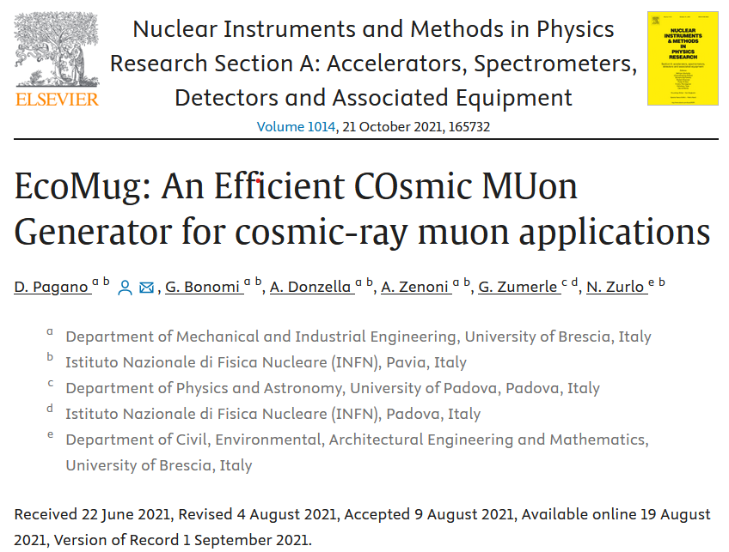
Measurements with ADAMO in phase-2
Current use of the ADAMO measurement
Muon generator developed in Florence
  Article in preparation…
EcoMug: muon generatorintegrated in a GEANT4 simulation developed by INFN and UNIV groups from Brescia, Padova and Pavia
  Implement generation on flat, cylindrical (with or without cover) and spheric surfaces

Slide 13
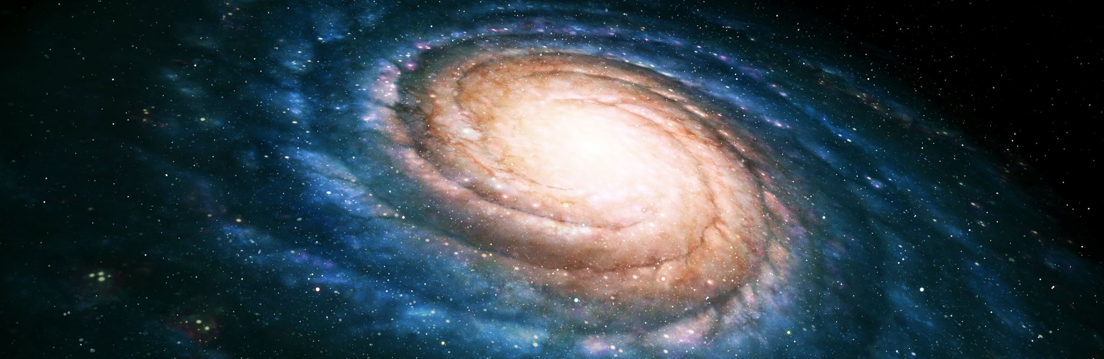

The ACROMASS project

Slide 14
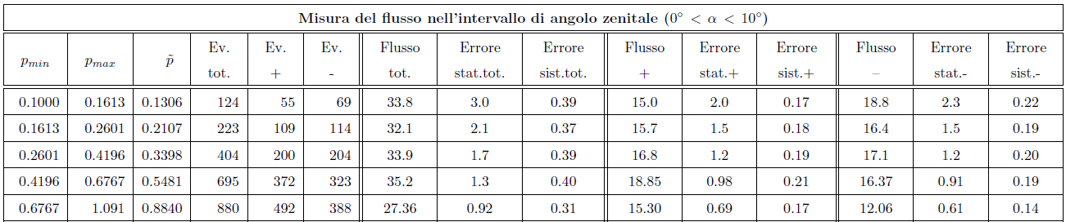
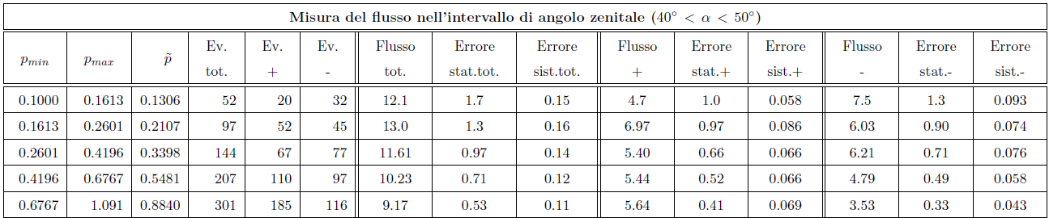
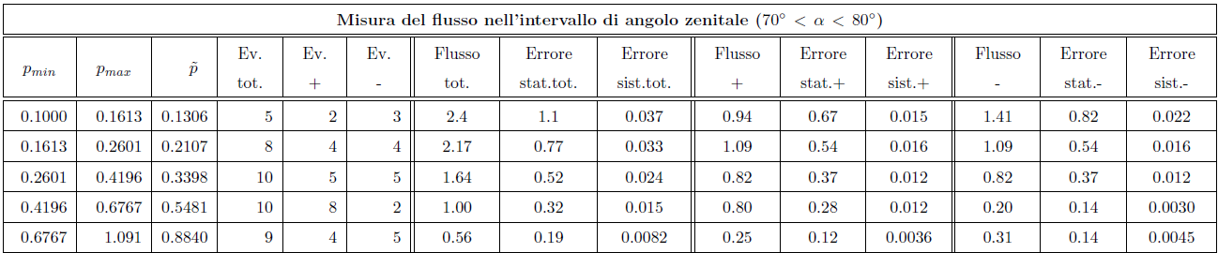





Preliminary estimation based on the ADAMO phase-2
Feasibility of the measurement with ACROMASS at low energy
$${Δt}_{\text{acq}} ∼ 2.5d$$
Statistics (VERTICAL):
To have 5% fluctuation in the bin 100-161 MeV/c:
Factor 3.2 (stat)
Factor 1/3 (altitude)
$${Δt}_{\text{acq}} ∼ 3d$$
$${Δt}_{\text{acq}} ∼ 3d$$
Statistics (INTERMEDIATE ANGLES):
To have 5% fluctuation in the bin 100-161 MeV/c:
Factor 7.7 (stat)
Factor 1/3 (altitude)
$${Δt}_{\text{acq}} ∼ 8d$$
$${Δt}_{\text{acq}} ∼ 5.5d$$
Statistics (HIGH ANGLE):
To have 5% fluctuation in the bin 100-400 MeV/c:
Factor 35 (stat)
Factor 1/3 (altitude)
$${Δt}_{\text{acq}} ∼ 2M$$

Slide 15

Extremely old DAQ system
  Difficult to repair/refurbish (too old electronic components)
  More than 50% based on cumbersome NIM and VME systems
Cumbersome and difficult to transport powering/trigger system
  NIM crate/modules + desktop power supplies)
Need sub-detectors for PID
  To remove the contamination from $e^{+}, e^{−}$ and p in the muon spectra…
  … but also to study the spectra of these more rare components
Old microstrip silicon sensors with several defects and some «bad» VA1 chips
  First production of the PAMELA experiment with implantation defects
    Solved for the successive production
  System worn over time
    Used since 1998 for ADAMO
    Used for several beam tests at CERN
    Used for many years for didactics (Laboratorio Subnucleare)
Current ADAMO configuration: main issues
23 February 2024
ACROMASS kick-off meeting - L. Bonechi (INFN Firenze)
15

Slide 16
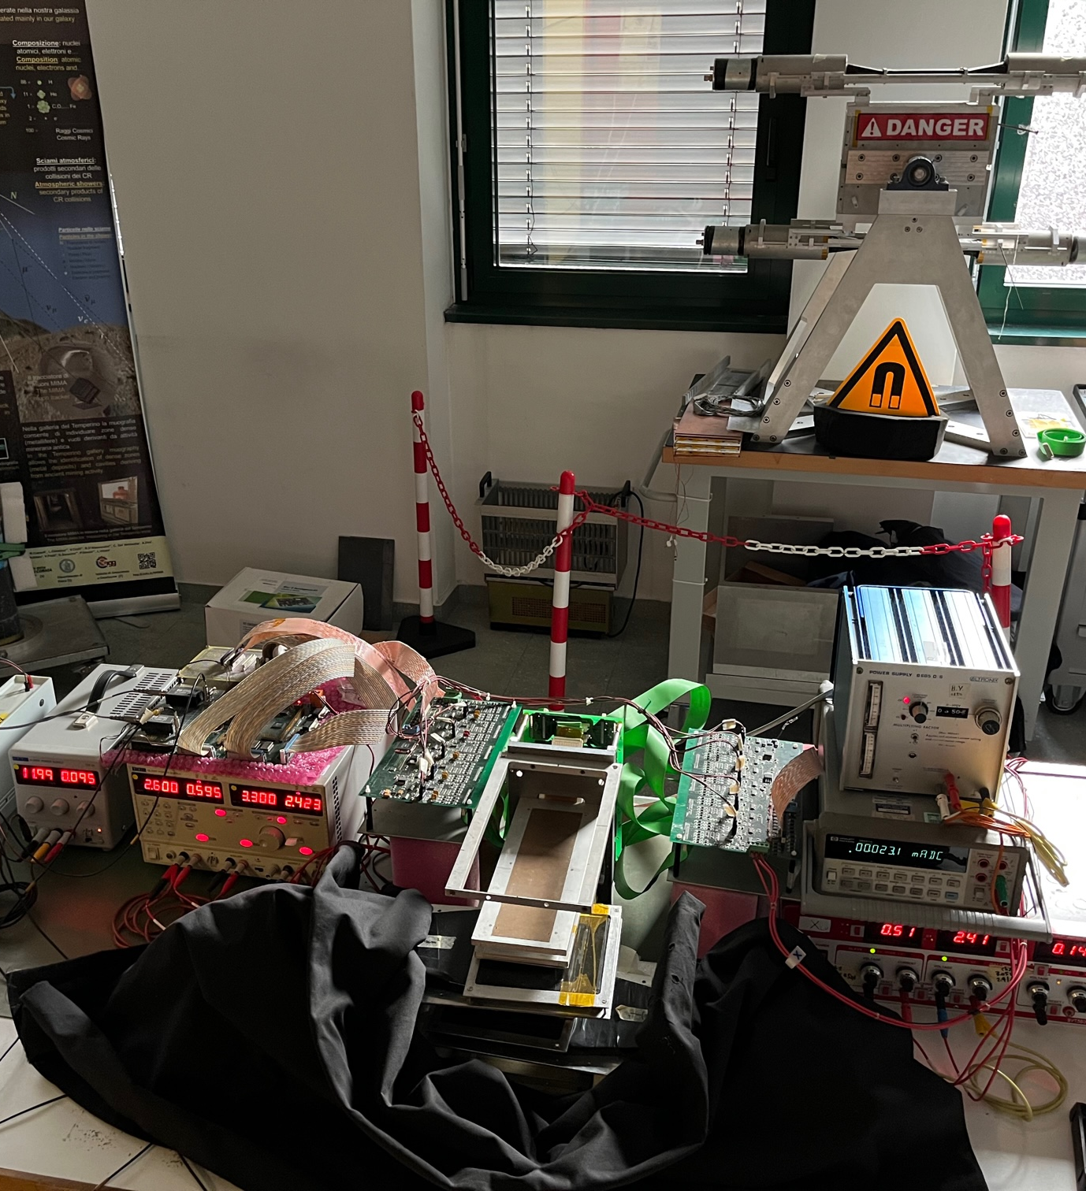
Current configuration
23 February 2024
ACROMASS kick-off meeting - L. Bonechi (INFN Firenze)
16

Slide 17
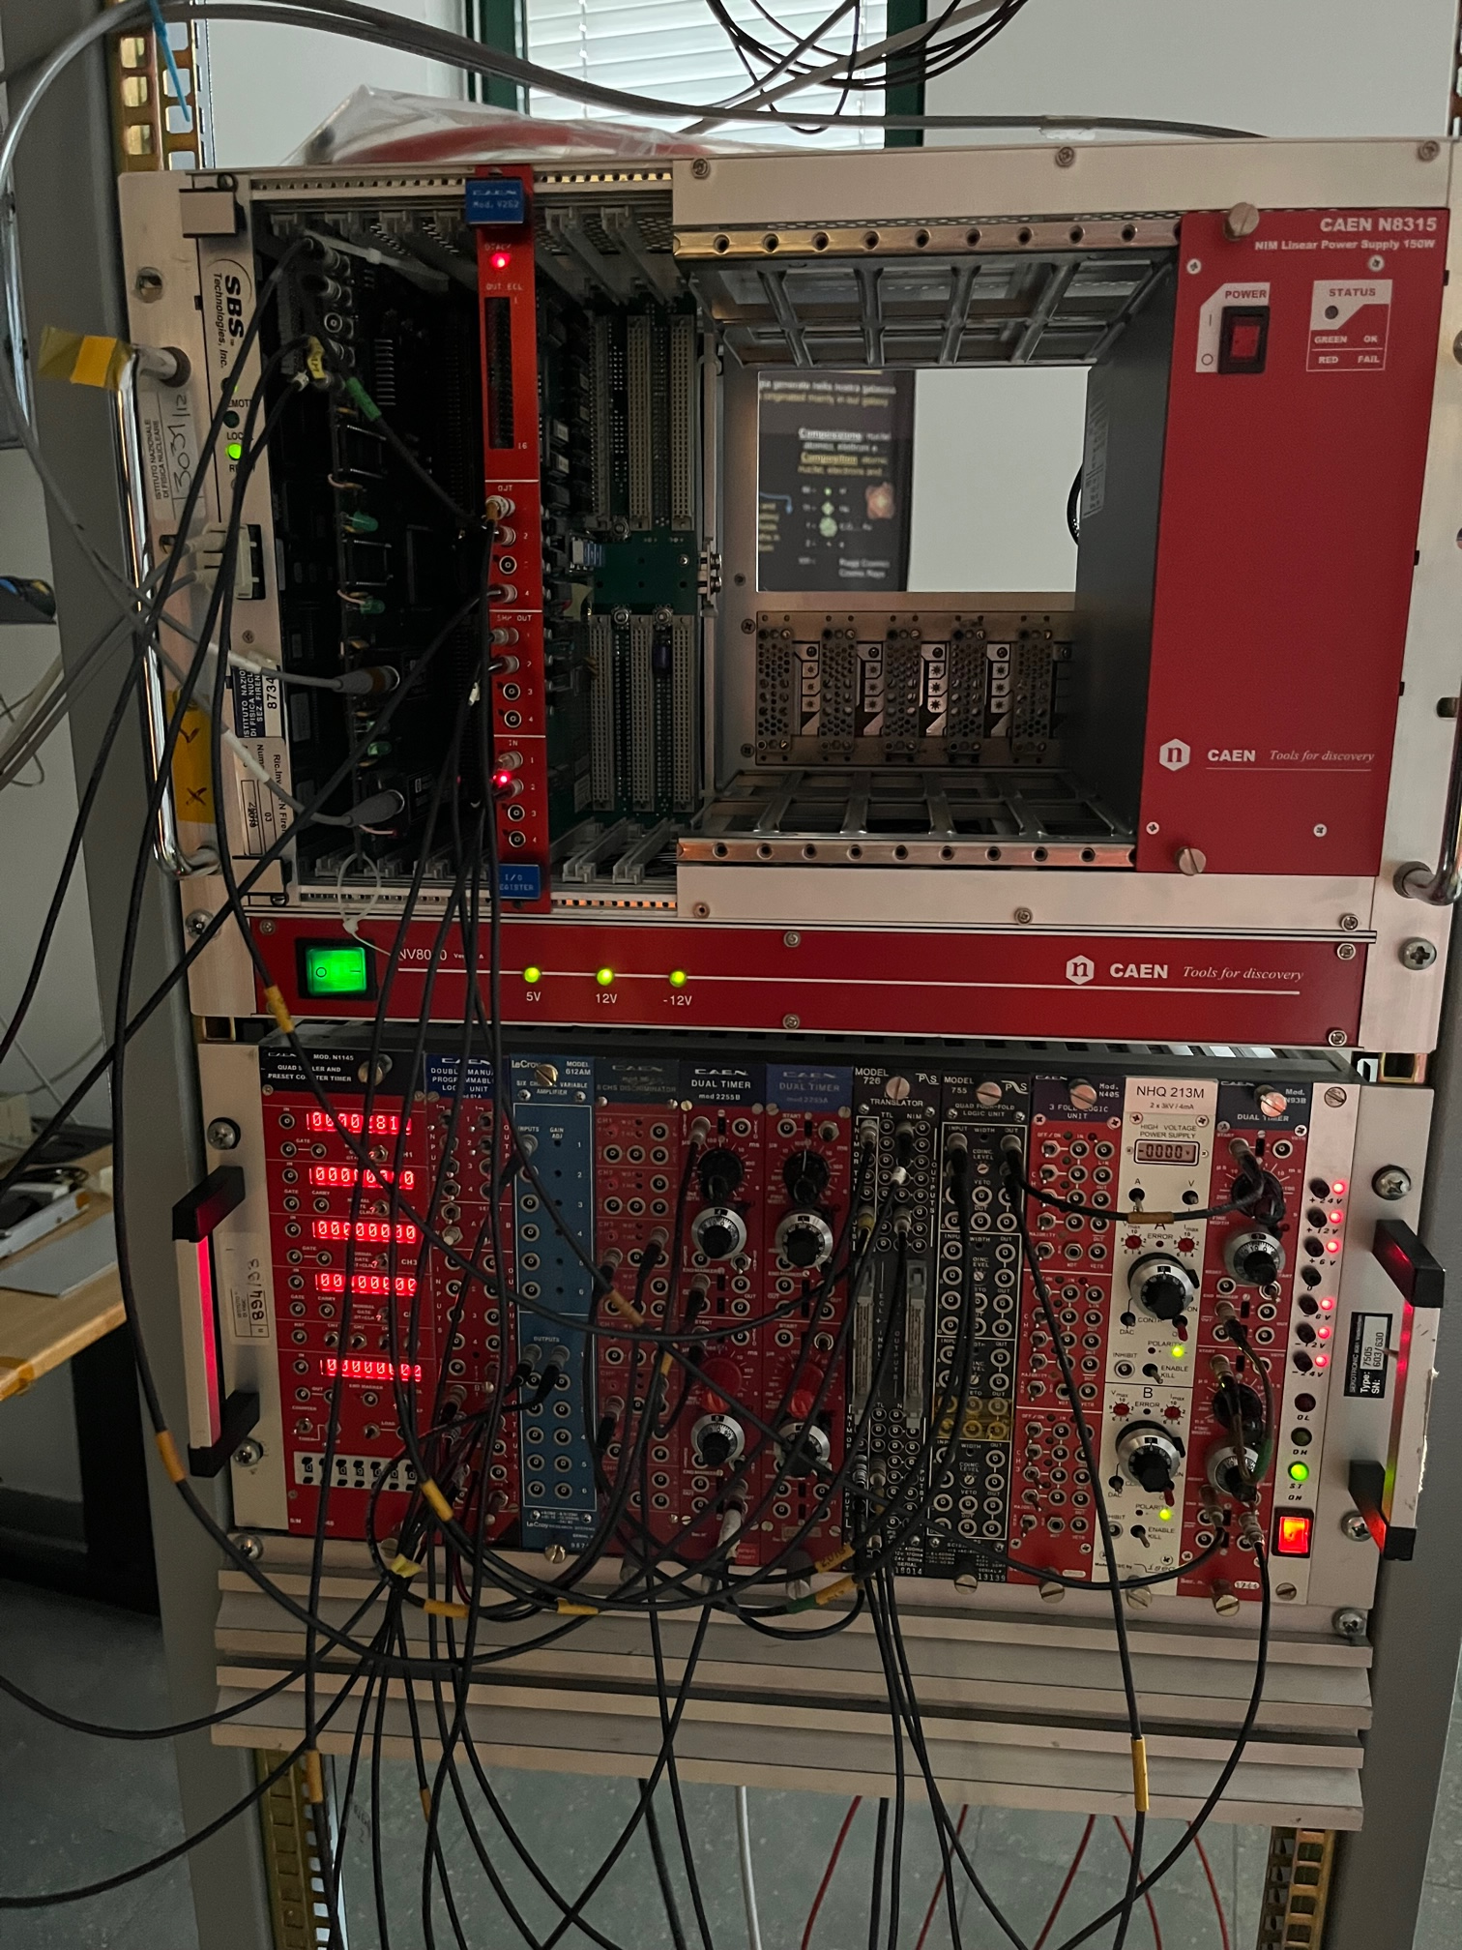
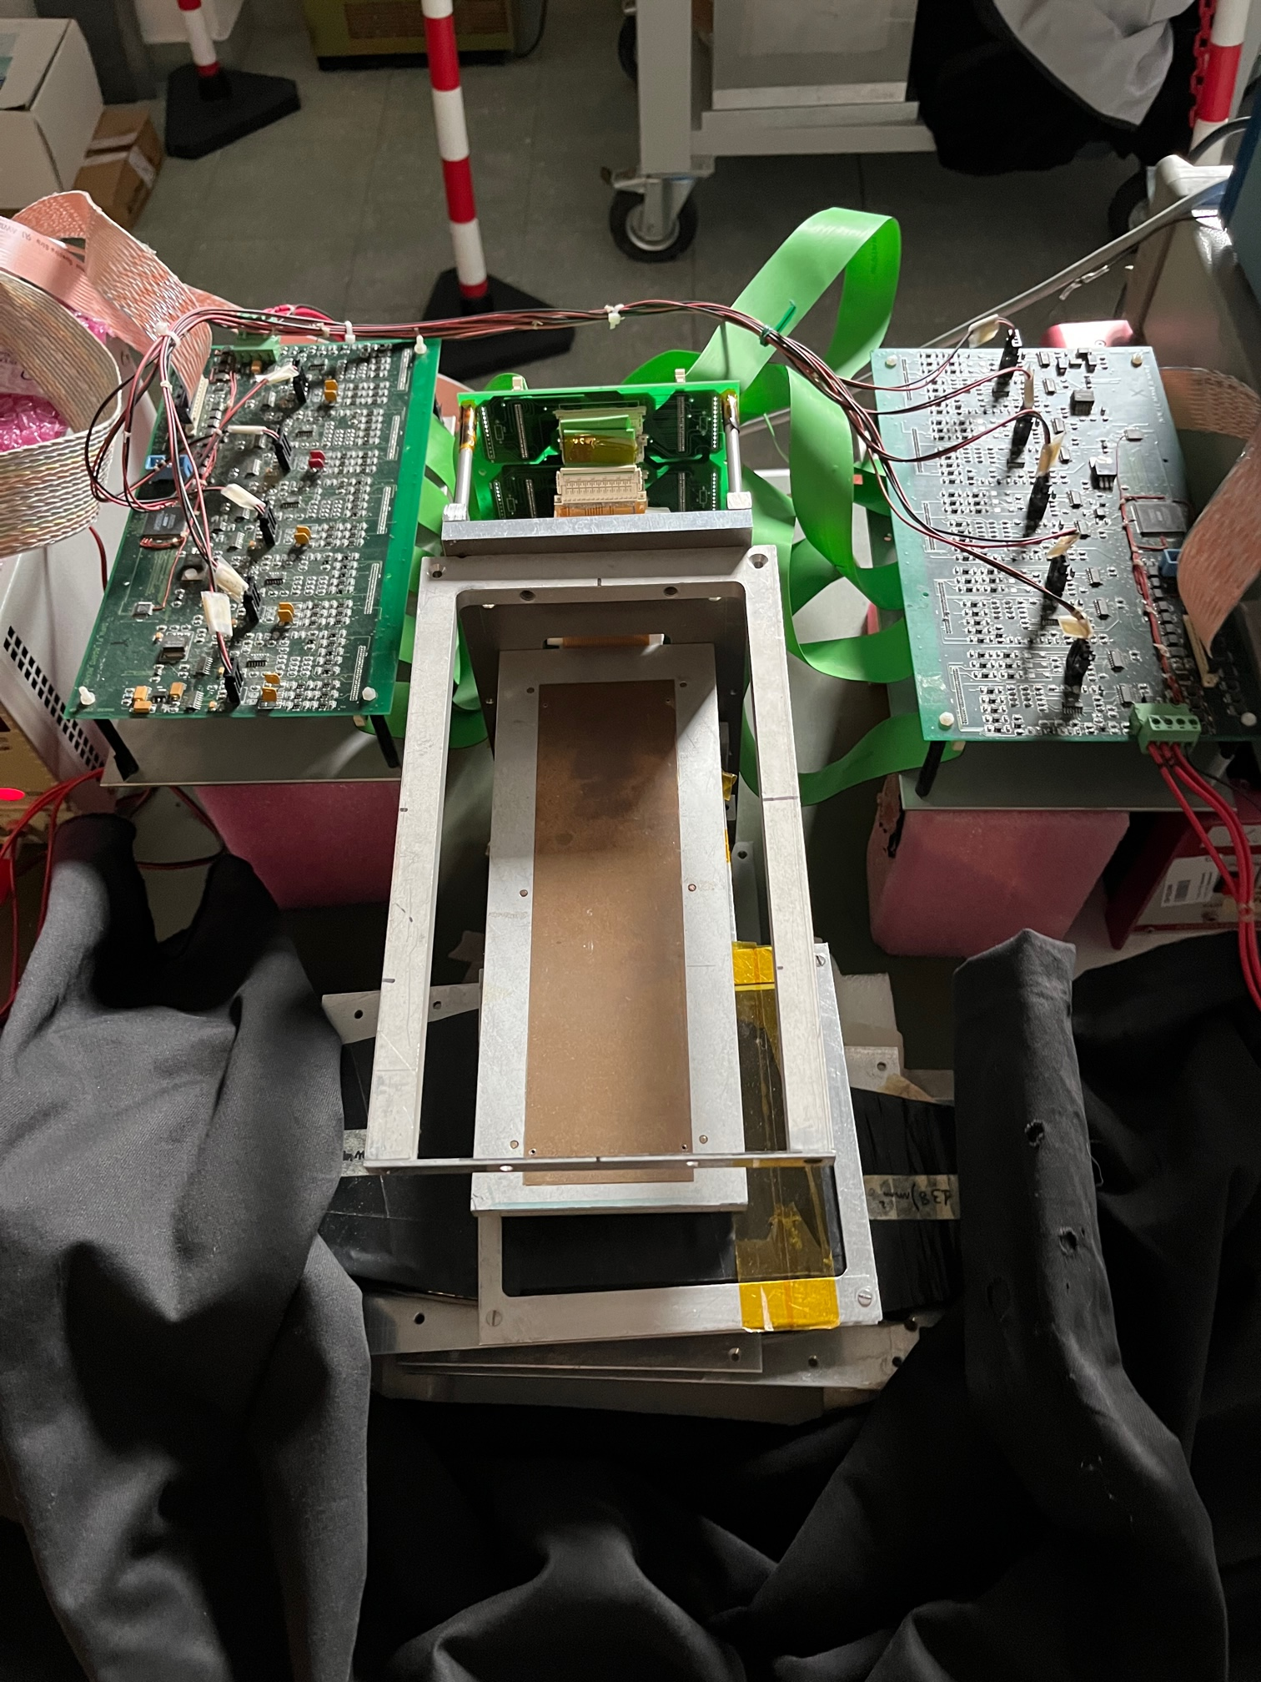
Current configuration (2)

Slide 18
Current configuration (3)
I/O register CAEN V262
Custom DAQ board
ADC board Y-side (ohmic side, GND=+80V)
ADC board X-side (junction side, GND=0V)
SBS interface
(VME→fiber→PCI)
Trigger/Veto
+ HV P.S.
Tracker
(Si μ-strip)

Slide 19
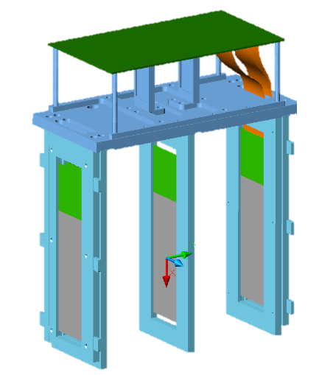
BLOCK SCHEME OF THE CURRENT CONFIGURATION: ADAMO
VME
crate
Trigger scintillator 1
ADC board – x side
(JUNCTION SIDE)
GND = 0 V
L.V. P.S. (desktop)
-2.5V (3A),
+2.5V (1A) floating
LHCf
board
S
BS
board
TRACCIATORE AL SILICIO
-
H.V. P.S. (desktop)
150V
(100 μA)
+
PCI
SBS
board
Custom DAQ board
(GuidoBoard)
PC STANDARD
DAQ
NIM
crate
Trigger
L.V. P.S. DESKTOP
5V (1A)
ADC board – y side
(lato ohmico)
GND = +HV
Trigger scintillator 2
-2.5V (3A),
+2.5V (1A) floating

Slide 20

Goal of the ACROMASS project
Replace some of the silicon tracking modules
1
Using spare sensors and hybrid circuits inherited from the PAMELA experiment
Subdetectors for PID (e,p,μ)
2
TOF system
E.M. calorimeter
… (Cherenkov?)
Semplification of the detector’s structure
3
New DAQ system
Small electronics’ box
Measure at high altitude
(3000-4500 m a.s.l.)
We plan to:
4
Test the apparatus intensively in lab.
Start contacts to schedule a measurement in a site at an altitude of about 4500 m a.s.l. (to be done later, as a new project)
Easy transportation
Easy installation
Implement a measurement in a site at an altitude of about 3000 m a.s.l.

Slide 21

Keypoints of the ACROMASS proposal
Upgrade of the ADAMO existing magnetic spectrometer
  Re-use the very expensive magnetic system
  Renew the silicon microstrip tracker
    Production of some new modules using PAMELA’s spare devices
Production of new subdetectors for PID
  Finalization of the new e.m. calorimeter developed for the thesis’ work of dr. S. Scordamaglia, and designed for PID over the full measurable momentum range
  Design and construction of a new trigger/TOF system for a better performance at momentum p < 1 GeV/c (thesis of G. Balloni)
New custom DAQ system
  Design and production of new DAQ and Slow Control boards
    Based on the Ethernet communication protocol
Beam tests at the PS/SPS facilities (CERN, Frascati,…?)
  Characterization and calibration at low and high energy
Measurement in the high mountains
  ∼3000-4500 m, as required for atmospheric muon neutrino studies

Slide 22
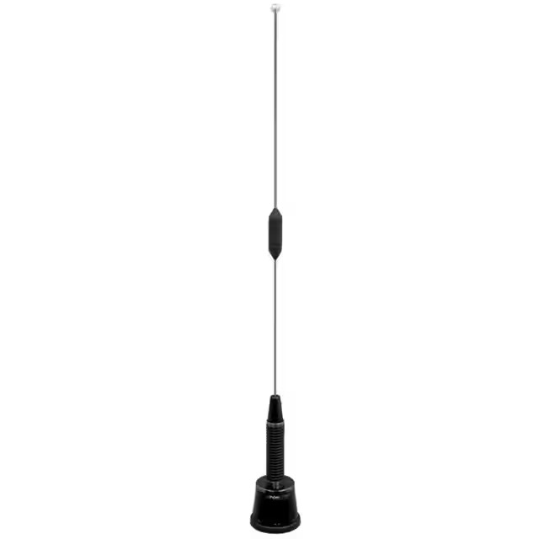
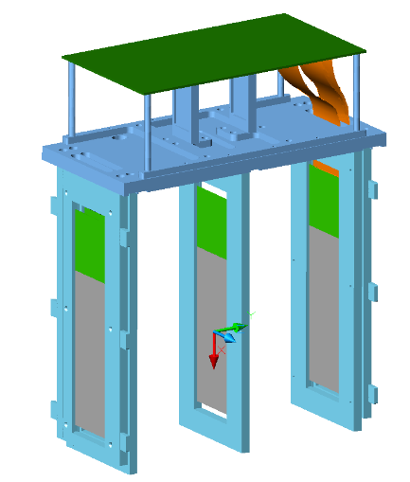
ACROMASS PROJECT: NEW CONFIGURATION
TOF / TRIGGER
(new: scint+fast sensors)
Antenna for
4g connection
SILICON TRACKER
(replacement of 2-3 ladders)
Portable DAQ and
S.C. System
(20 W totali)
TOF / TRIGGER
(new: scint+fast sensors)
E.M. CALORIMETER
(scintillator + SiPM)

Slide 23
Portable DAQ + S.C. System
Tracker
ADC boards
220V
LV P.S.
Sensors (t,p,h)
TOF/trigger
board
Small DAQ PC
ETH
Eth Switch
DC-DC
MEMORY ∼TB
Calorimeter QDC board
Radio-modem 4G
WIFI / GSM
The complete (low power) system will work with power mains (220V) or with photovoltaic panels
External ethernet or WIFI or 4G connection for remote control and data transfer (not mandatory)

Slide 24

On-going and To-Do: Time Of Flight

Slide 25
Tesi magistrale G. Balloni
SCOPO: sistema di discriminazione muoni/protoni fino a p = 1 GeV/c
PRESTAZIONI RICHIESTE: risoluzione temporale dt < 100 ps

Slide 26
Tesi magistrale G. Balloni
DESCRIZIONE:
Scintillatore plastico veloce + SiPM veloci
Tessere: (3 x 3 x 0.5) cm³
Superficie tot: (24 x 12) cm²
Canali di lettura: 4x8=32, SiPM veloci da (1-3) mm²
Piano aggiuntivo di scintillatore plastico per trigger
Test in corso:
SiPM Hamamatsu BLEMAB + scintillatore plastico standard
  Risoluzione finale TOF: 700 ps (obiettivo → 100 ps…)
Test successivo
SiPM con uscita fast + stesso scintillatore
DA FARE:
SiPM: già acquistati 70 pezzi
Acquisto degli scintillatori (?)
Preparazione di tutte le tessere
Progettazione/produzione della meccanica
Contenitore
Sistema di fissaggio al magnete
Alloggiamento della scheda di TOF sul magnete (?)

Slide 27
Tesi magistrale G. Balloni
Isolamento ottico tra le tessere di scintillatore

Slide 28
To-Do: tracciatore

Slide 29
Scheda DAQ silicio – versione 1 (Monica)
Sketch molto preliminare
IN/OUT
- alim
- eth
- trig in
- trig out
- ext reset
ADC
HV
DC-DC
ADC
FPGA
ADC
ETH
ADC
FPGA
ADC
LV
DC-DC
ADC
ADC
FPGA
ADC
ADC
BIAS
ADC

Slide 30
Piani di silicio
ORIGINALI DI ADAMO: 5
Da provare a riparare (Mirko)
NUOVI DA PRODURRE:
Nuovi frame in alluminio già prodotti: 4
  Da predisporre Mylar Al.
Moduli PAMELA già pronti (da testare): 1
Coppie di sensori pronte: 1
Ibridi a disposizione: 7
Sensori silicio ancora disponibili: 10-20
Jig e linee di vuoto per assemblaggio
  Attualmente conservati nel lab 31 (muografia)
  da preparare nella clean room → accordarsi con Mirko
Cavetti in kapton: modelli PAMELA o ADAMO
  Ci sono (in qualche lab…)

Slide 31
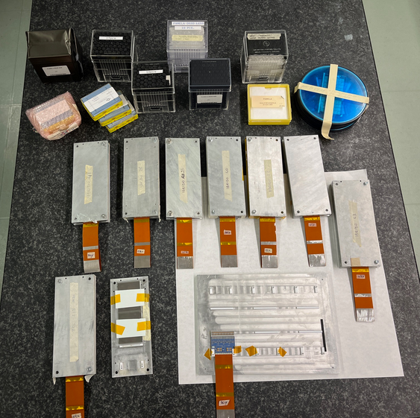
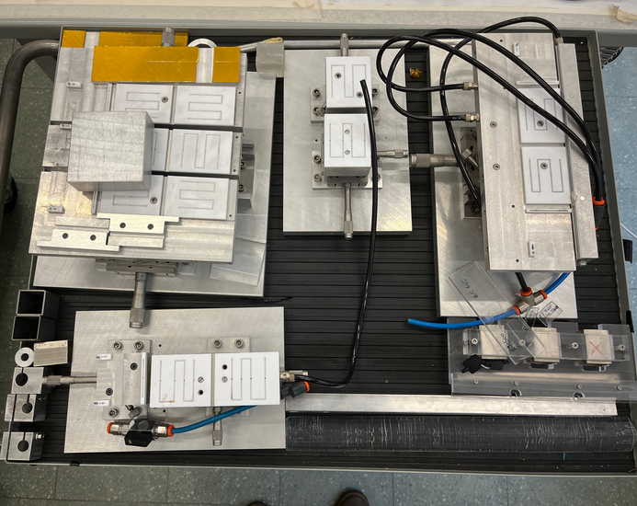

Slide 32
To-Do: calorimetro e.m.
23 February 2024
ACROMASS kick-off meeting - L. Bonechi (INFN Firenze)
32

Slide 33
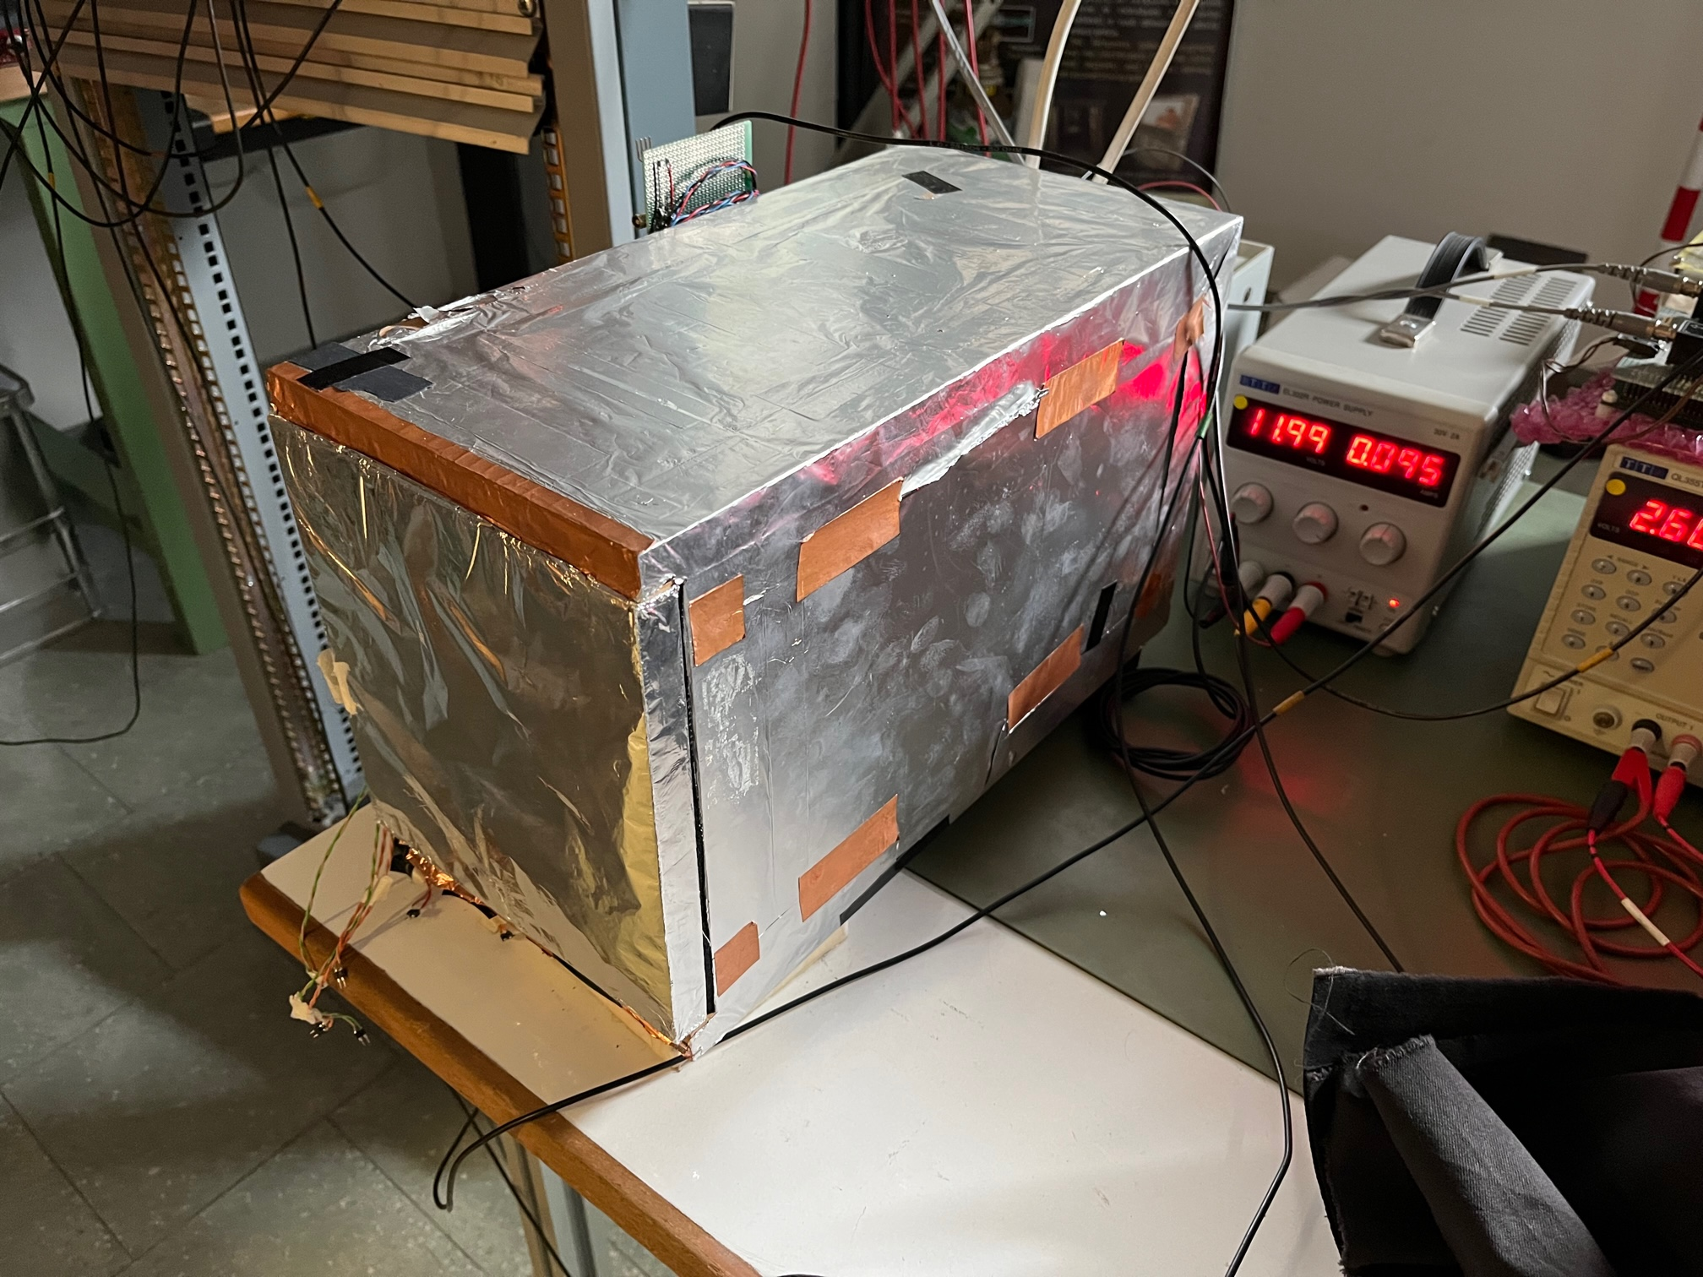
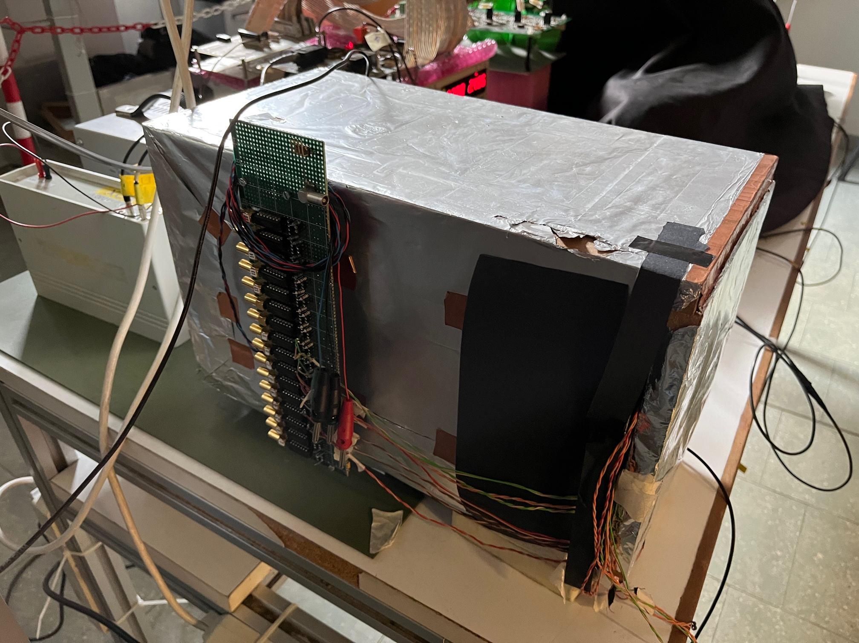
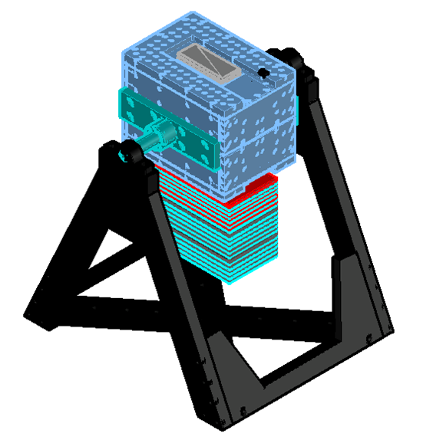
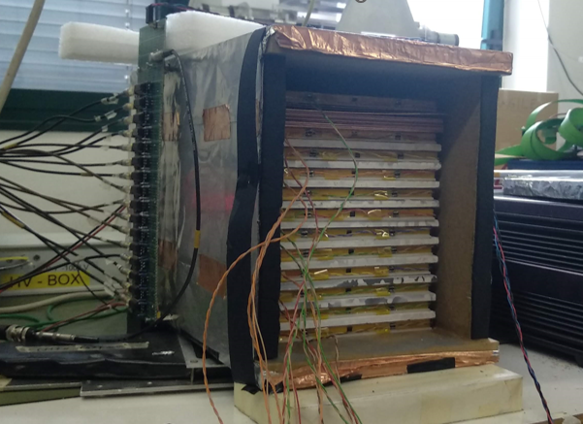
E.M. CALORIMETER

Slide 34
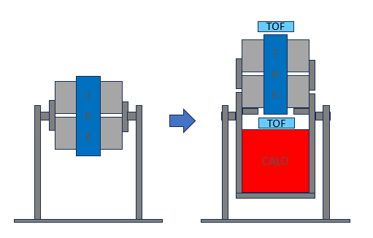
E.M. CALORIMETER
TOF
T
R
K
T
R
K
TOF
CALO

Slide 35
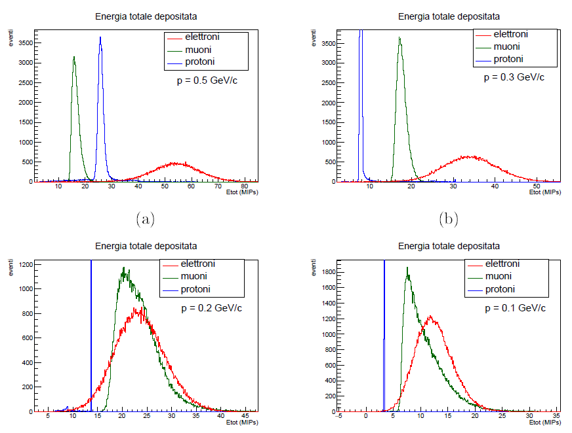
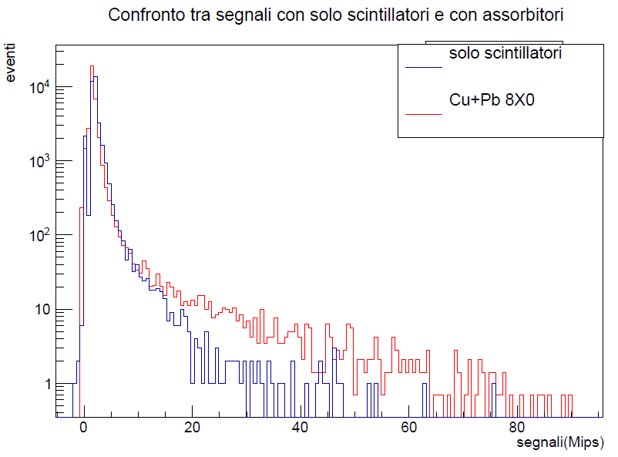
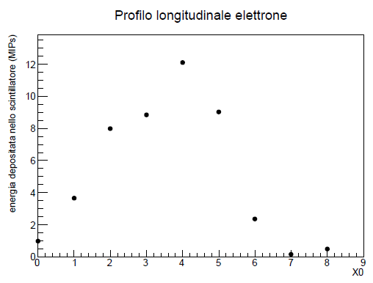
E.M. CALORIMETER – simulation and first tests
S. Scordamaglia, Sviluppo e costruzione di un calorimetro a campionamento per misure di raggi cosmici con l’esperimento ADAMO, tesi di Laurea in Fisica, Università di Firenze, A.A. 2020/2021
GEANT4 SIMULATION
Distribution of the energy deposit in layer 4+5

Slide 36
CALO: meccanica e DAQ
SIMULAZIONI
Determinazione della configurazione per ottimizzare la discriminazione a bassa energia
MECCANICA:
Progettazione box contenimento
  Deve poter alloggiare i 15-20 piani di scintillatore esistenti e gli spessori in Pb, Cu e W preparati nel corso della tesi magistrale di S. Scordamaglia
Modifica asse rotazione dell’intero rivelatore
  Per posizionare meglio il baricentro complessivo TRK+CALO
DAQ
Progettazione: scheda QDC 32ch (?)
  Front-end?
  Back-end: protocollo comunicazione ethernet → erditato da DAQ tracciatore

Slide 37

To-Do: software

Slide 38

Sviluppi software
SIMULAZIONI
  Spettrometro con campo magnetico
  Calorimetro
DAQ
  Tracciatore
  ToF
  Calorimetro
SLOW CONTROL
  Gestione e monitoraggio
  Analisi online dati raw
ANALISI
  Allineamento tracciatore
  Ricostruzione dell’impulso
  Discriminazione del tipo di particella
    Calorimetro
    TOF

Slide 39

Organizzazione del progetto

Slide 40
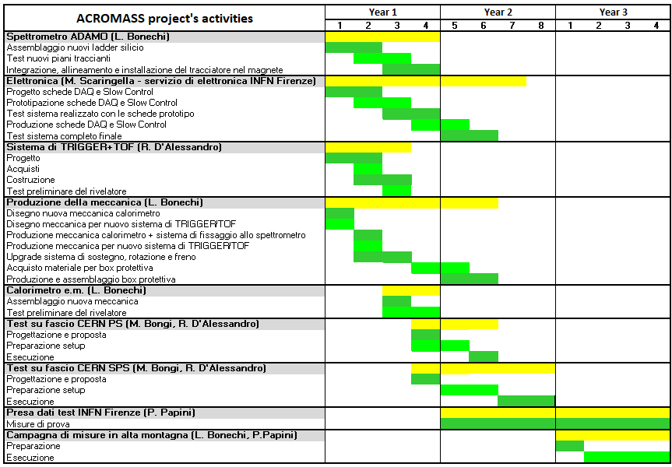
ACROMASS: activities and participants
Surname | Name | Contr. | Profile | Aff. | %
Bonechi | Lorenzo | Dip. | PR | CSN1 | 30
Bongi | Massimo | Assoc. U | PA | CSN2 | 50
Cialdai | Carlo | Dip. | PT |  | 10
D'Alessandro | Raffaello | Assoc. U | PO | CSN1 | 20
Frosin | Catalin | Assoc. U | R | CSN5 | 20
Papini | Paolo | Dip. | R | CSN2 | 10
Ricciarini | Sergio | Assoc. CNR | R | CSN1 | 10
Scaringella | Monica | Dip. | T |  | 10

Slide 41
Program of activities - ACROMASS
YEAR 1 (2024)
  Assembling and test of new silicon tracking modules
    spare material from the PAMELA experiment
  Design, prototyping and test of the DAQ and SC boards
    Based on the development of the new DAQ system of LHCf
  Design and development of the trigger/TOF system
  Production of the e.m. calorimeter’s mechanics
  Modification of the global mechanics
  Preparation of beam tests
YEAR 2 (2025)
  Production of the final version of the DAQ and SC boards
  Production of the protective box of the detector
  Test/monitoring measurements in lab
    test of the complete ACROMASS detector
  Beam tests
    Low energy (PS@CERN or BTF@LNF)
    High energy (SPS@CERN)
    Electrons
    Muons
    Protons
YEAR 3 (2026)
  Test/monitoring measurements in lab
  First measurement in the high mountains

Slide 42
Fase successiva ai 3 anni di progetto CSN5
23 February 2024
ACROMASS kick-off meeting - L. Bonechi (INFN Firenze)
42

Slide 43
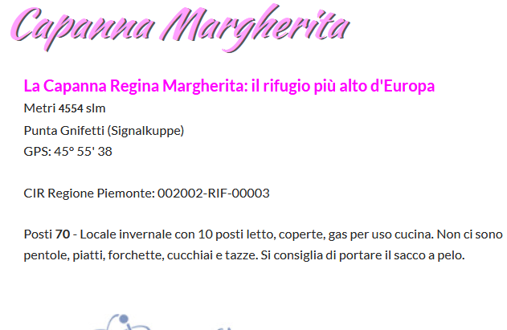

Obiettivo principale
Misure in alta quota: Capanna Margherita
  http://www.rifugimonterosa.it/it/web/capanna-margherita-7

Slide 44


Manifestazioni d’interesse
Giappone: Norikura Solar Observatory
2770 m a.s.l.
23 February 2024
ACROMASS kick-off meeting - L. Bonechi (INFN Firenze)
44

Slide 45



Manifestazioni d’interesse
Bolivia: Chakaltaya Observatory
5240 m a.s.l.
23 February 2024

Slide 46
Conclusioni – summary (?)

Slide 47
BACKUP

Slide 48

Interest for a precise study of μ spectra and angular distributions for neutrino physics research
Main points from the paper by Honda et al. (2019)
Knowledge of the $ν_{μ}$ flux, $φ_{ν_{μ}}$, for $E_{ν_{μ}}<1 \text{GeV}$ is important for a precision study of the neutrino oscillation parameters
The Honda SK and HK group uses a custom simulation based on Monte Carlo techniques to evaluate the $ν_{μ}$ flux at the altitude of interest
The hadronic interaction model(s) used in the simulation is(are) calibrated using existing data of the atmospheric muon spectra
  the best performance is obtained with measurements down to low momentum in the high mountains
Not many measurements are reported in the literature of the absolute atmospheric muon spectra, many of which date back to the 1960s and 1970s; in particular no systematic study of atmospheric muon spectra can be found, but usually the measurements are single measurements done at different locations/altitudes, in different momentum and angular ranges, with different detectors and in different phases of the solar modulation

Slide 49

Interest for a precise study of μ spectra and angular distributions for neutrino physics research
Main goals of ACROMASS (based on the paper by Honda et al., 2019)
GOAL 1: measurement of the muon spectra with a precision $\left|\frac{∆φ_{μ}}{φ_{μ}}\right|≤0.05$
GOAL 2: measurement of the muon spectra down to $p_{min}≈0.1 \text{GeV}/c$
GOAL 3: measurements to be carried out in the high mountains (3 - 4.5 km a.s.l.)
GOAL 4: study of the dependence $φ_{μ}\left(θ\right)$ in the high mountains (3 - 4.5 km a.s.l.)

Slide 50



Results reported on the Honda et al. (2019) paper
The lepton fluxes $φ_{L}$ in atmosphere are evaluated using an integral expression including the hadronic interaction model H, which describes the probability that a projectile particle interacts with an atmospheric nucleus producing a lepton L; the simulation is calibrate using the muon flux measured by BESS for $p_{μ}≳0.1 \text{GeV}$/c
Assuming the validity of H, random variations of H around the unmodified version are introduced to evaluate the effects on the estimation of the lepton fluxes
  A correlation between the variations of $φ_{ν}$ and $φ_{μ}$ is found
  If the energy $E_{ν}=1 \text{GeV}$ is selected the correlation is large for $p_{μ}≲1 \text{GeV}$/c and not negligible for $p_{μ}≲10 \text{GeV}$/c

Slide 51

Results reported on the Honda et al. (2019) paper
$\left|\frac{∆φ_{μ}}{φ_{μ}}\right|$ and $\left|\frac{∆φ_{ν}}{φ_{ν}}\right|$ follow a Gaussian distribution with some width
If we set a limit to the variation of the muon flux, $\left|\frac{∆φ_{μ}}{φ_{μ}}\right|<ε$, the width of the distribution of $\frac{∆φ_{ν}}{φ_{ν}}\left(ε\right)$ becomes smaller
If we normalize the distribution of $\frac{∆φ_{ν}}{φ_{ν}}\left(ε\right)$ to te case with unmodified interaction model, $\frac{∆φ_{ν}}{φ_{ν}}\left(ε→∞\right)$ we find a Gaussian with width $σ_{shrink}$
The dependence of $σ_{shrink}$ on ε can be fitted well with a function $σ_{shrink}= \sqrt{ζ_{0}^{2}+{\left(ζ_{1}∙ε\right)}^{2}}$ and we see that $σ_{shrink}$ decreases for small values of ε
  → If the model describes the muon flux with precision, then the model describes also the neutrino flux with precision
This means that if the simulation is calibrated in such a way to reproduce accurately the muon flux measured by a precision experiment, then the same simulation can describe accurately the neutrino flux as well

Slide 52



Results reported on the Honda et al. (2019) paper
Let’s consider the term $ζ_{0}$ in the expression of $σ_{shrink}$, which is a term that does not depend on how precisely the muon flux is known
If $ε≲0.05$ (the muon flux used for calibrating the simulation is know with 5% precision or less) then $σ_{shrink}≈ζ_{0}$
GOAL 1: measurement of the muon spectra with a precision $\left|\frac{∆φ_{μ}}{φ_{μ}}\right|≤0.05$
Fit function:
$$σ_{shrink}= \sqrt{ζ_{0}^{2}+{\left(ζ_{1}∙ε\right)}^{2}}$$

Slide 53

Results reported on the Honda et al. (2019) paper
If we set the constrain on the muon flux variation only for $p_{μ}≳1 \text{GeV}$/c instead of $0.1 \text{GeV}$/c, then $ζ_{0}$ increases and we have a worsening in the energy range of interest $E_{ν_{μ}}<1 \text{GeV}$
GOAL 2: measurement of the muon spectra down to $p_{min}≈0.1 \text{GeV}/c$
All previous considerations were obtained using the measurement by BESS at sea level in Tsukuba. Replacing this measurement with other measurements at different altitudes we have the following results:
  BESS, mount Norikura, 2770 m a.s.l. → reduction of the $ζ_{0}$ value (→ better performance)
  Hanle, India, 4500 m a.s.l. → further reduction of the $ζ_{0}$ value (→ best performance)
  BESS (balloon), near South Pole, ∼32 km a.s.l → increase of uncertainty (also poor statistics)
GOAL 3: the measurements must be carried out in the high mountains (3 - 4.5 km a.s.l.)

Slide 54

Results reported on the Honda et al. (2019) paper
Lepton production in atmosphere results mainly from collisions of secondary protons and neutrons with air nuclei and to a much lesser extent to the collision of mesons; introducing ±10% variations of the ratio between the numbers of the protons and neutrons responsible of the production of a) the sole muon component or b) the sole neutrino component, a variation < 3% is found for the fluxes → the effect on the lepton fluxes due to the uncertainty on the flux of projectiles producing leptons is small
An important contribution to the lepton fluxes uncertainties is due to the uncertainty of the hadronic interaction model on the scattering angle distribution of secondary particles
  An error of ±20% on the angle distribution determines a ±10% contribution on the neutrino fluxes
  To limit the uncertainty to 5%, $\left|\frac{∆φ_{ν}}{φ_{ν}}\right|<0.05$, it is necessary to know the scattering angle with a precision of 10%
A variation of the scattering angle distribution determines also a variation of the dependence of $φ_{μ}$ on the zenith angle θ. This happens at high altitude (4500 m), while this effect is negligible at sea level. A precise measurement of $φ_{μ}\left(θ\right)$ at 4500 m would allow to reduce the uncertainty on the angular distributions of secondary particles and therefore also on $φ_{ν}$.
GOAL 4: measurement of the dependence $φ_{μ}\left(θ\right)$ in the high mountains (3 - 4.5 km a.s.l.)

Slide 55
Principali problemi attuali e upgrade/attività previsti
Estratto email proposta inviata al Presidente di CSN5
1) elettronica di DAQ estremamente datata (difficile da riparare) e per il 50% basata su ingombranti sistemi NIM e VME
2) sistema di alimentazione ingombrante, in parte da banco e in parte NIM
3) mancanza di un sistema di identificazione del tipo di particelle
4) silici a microstrisce con molti difetti
in parte danneggiati dal lungo utilizzo come sistema ausiliario di tracciamento per test su fascio
realizzazione di un nuovo sistema di DAQ, basato sul protocollo GbE e su dispositivi commerciali facilmente reperibili
realizzazione di un nuovo sistema di alimentazione che permetta di operare ADAMO in un qualsiasi sito con la sola linea di alimentazione (220V/110V)
(entrambi i sistemi precedenti verrebbero gestiti da remoto mediante la connessione ad una rete wifi o ethernet e permetterebbero di ridurre notevolmente l'ingombro meccanico e il peso dell’apparato, operazione necessaria per poter operare lo strumento in maniera relativamente semplice e sicura in luoghi di alta montagna difficilmente accessibili)
realizzazione di alcuni nuovi piani traccianti, costituiti da parti spare di PAMELA, per migliorare le prestazioni dello spettrometro
completamento del calorimetro e.m. e finalizzazione dell'elettronica di readout
realizzazione di un sistema di TOF a scintillatore plastico per l'identificazione del tipo di particelle a bassi impulsi
realizzazione di una box protettiva per l’instlalazione all’aperto
test presso il PS del CERN per la caratterizzazione e la calibrazione dello strumento a basse energie
test presso SPS del CERN per la caratterizzazione e la calibrazione dello strumento ad alte energie
implementazione di misure in alta montagna (da definire sulla base di valutazioni in collaborazione con gli esperimenti interessati alla fisica dei neutrini atmosferici)
implementazione di misure a diverse latitudini/altitudini

Slide 56



Compilation of vertical measurements of muons
$e^{+}+e^{−}$ and proton contribution at ground level

Slide 57


Richieste finanziarie ACROMASS

