Slide 1
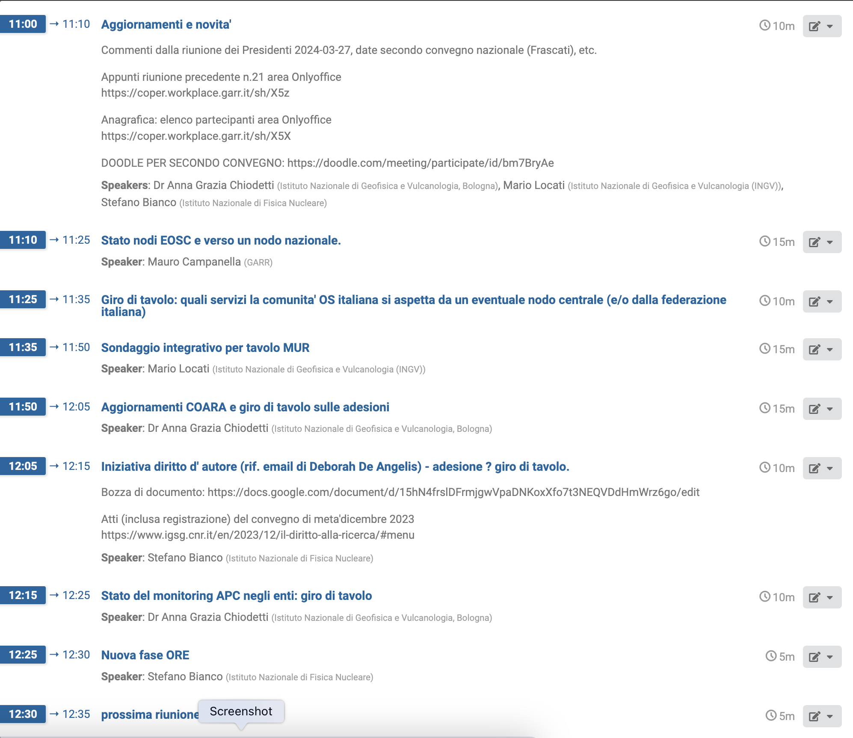
Open Science CoPER n.22 https://agenda.infn.it/e/coper.openscience/22 https://home.infn.it/conper/openscience.html
Stefano, Anna Grazia, Mario
20240404
https://blue.meet.garr.it/b/ire-pvz-eiz-ndq

Slide 2
appunti simultanei editabili su area Onlyoffice GARR
https://coper.workplace.garr.it/sh/X5p

