Slide 1
Studies on the dRICIH
Aerogel parameters optimization
Impinging angle on the detector scan
SiPMs intrinsic noise effects
Tiziano Boasso

Slide 2
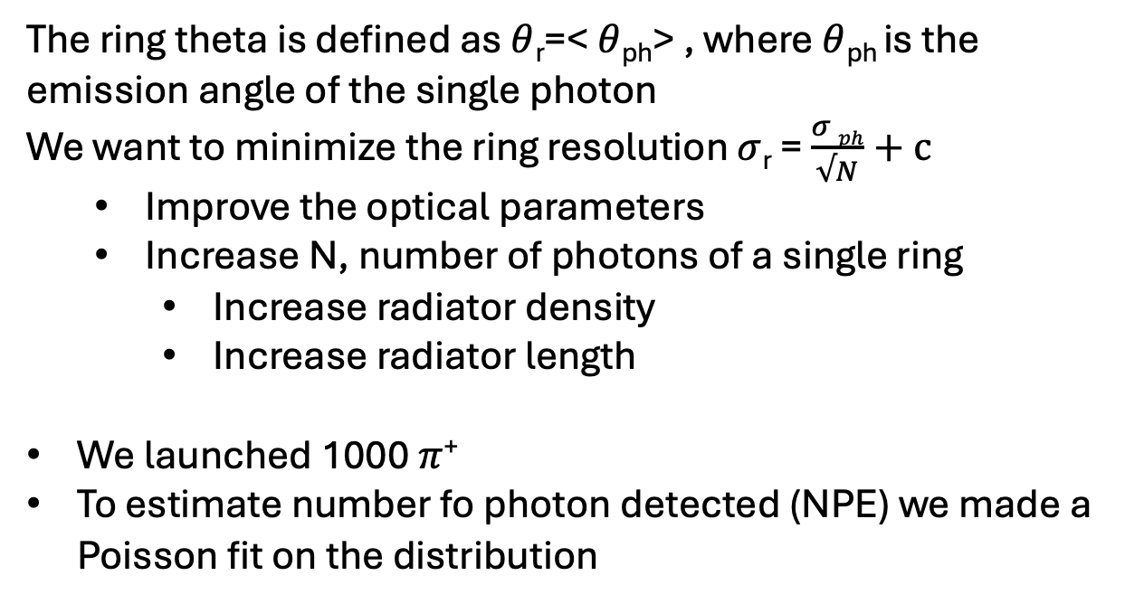
[1] Aerogel optimization
The ring theta is defined as $θ$_{r}=< $θ$_{ph}> , where $θ$_{ph} is the emission angle of the single photon
We want to minimize the ring resolution $σ$_{r} = $\frac{σ ph}{√N}+c$
  Improve the optical parameters
  Increase N, number of photons of a single ring
    Increase radiator density
    Increase radiator length
We launched 1000 $π$⁺
To estimate number fo photon detected (NPE) we made a Poisson fit on the distribution

Slide 3
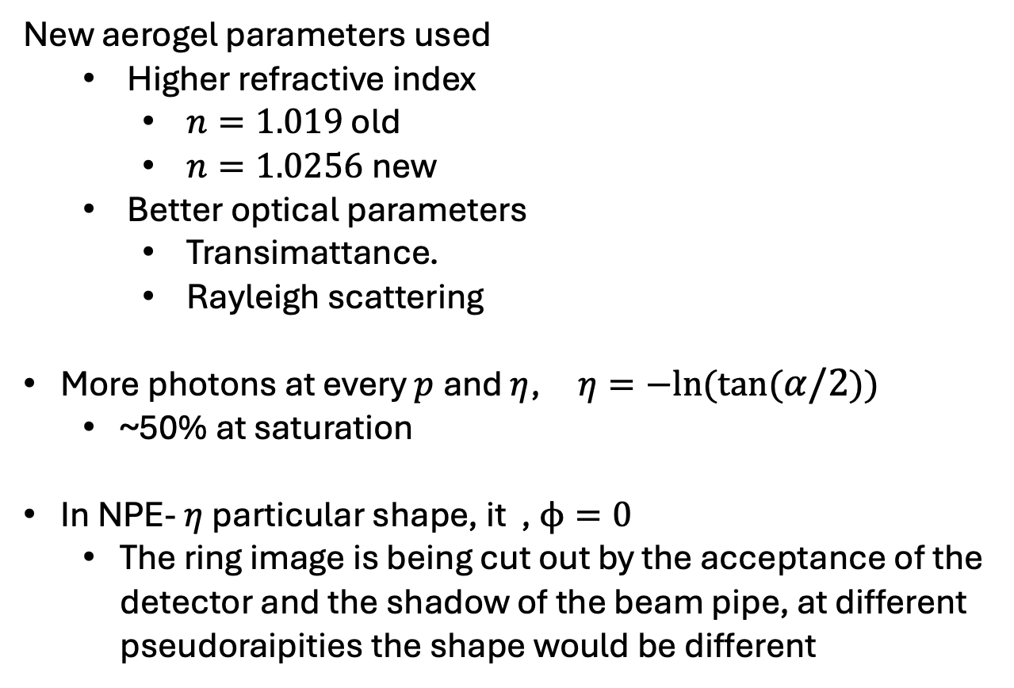
Optimization- NPE
New aerogel parameters used
  Higher refractive index
    $n=1.019$ old
    $n=1.0256$new
  Better optical parameters
    Transimattance.
    Rayleigh scattering
More photons at every $p$and $η$, $η=−ln⁡(tan⁡(α/2))$
  ~50% at saturation
In NPE- $η$particular shape, it , $ϕ=0$
  The ring image is being cut out by the acceptance of the detector and the shadow of the beam pipe, at different pseudoraipities the shape would be different

Slide 4
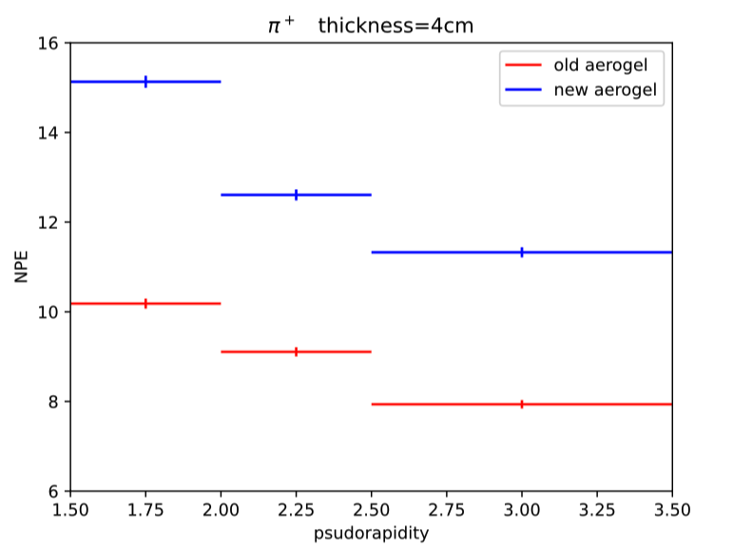
Optimization – NPE
Integrating in $φ$we still can see an improvement in NPE

Slide 5
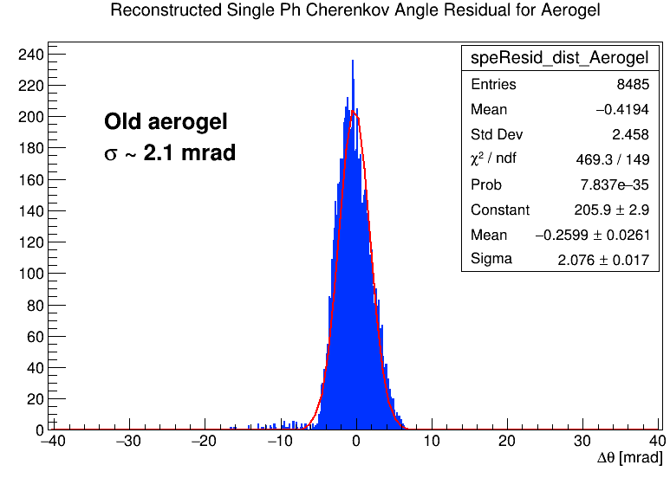
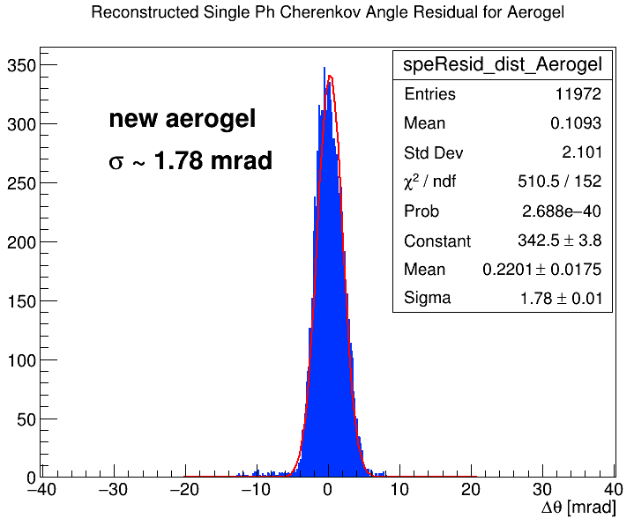
Optimization -spe resolution
The resolution on the single cherenkov photon is lower, due to better optical parameter
~15% improvment

Slide 6
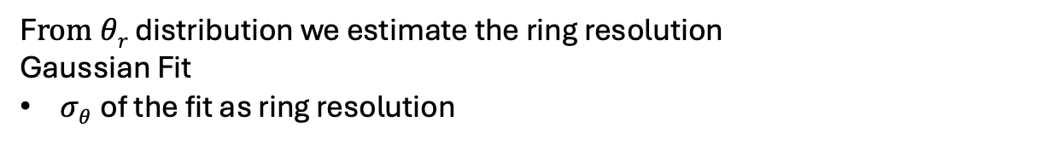
Optiization
F$rom θr$ distribution we estimate the ring resolution
Gaussian Fit
$σθ$ of the fit as ring resolution
Gas
Aerogel

Slide 7
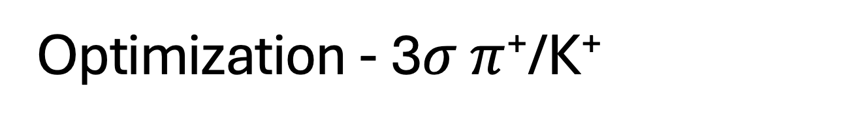
Optimization - 3$σ$ $π$⁺/K⁺
N$σ=\frac{|θπ−θK|}{(σπ+σK)/2}$
$θr$is the main value of a Gaussian fit on the ring angle distribution$s$
Larger operative range
Lower threshold due to higher refractive index
Better ring resolution at saturation ~15 GeV/c to 19 GeV/c of 3 sigma separation

Slide 8
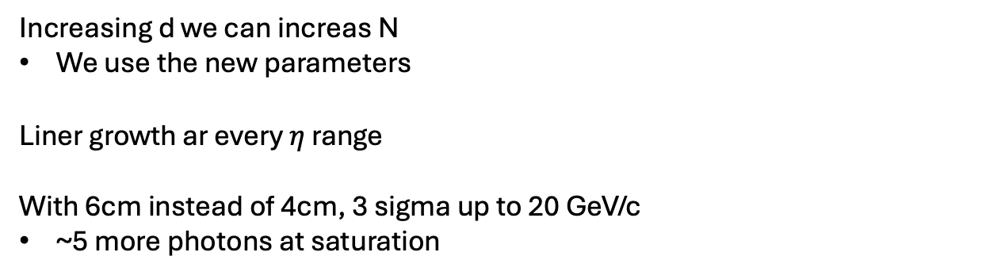
Optimization - Aerogel width d
Increasing d we can increas N
We use the new parameters
Liner growth ar every$η$ range
With 6cm instead of 4cm, 3 sigma up to 20 GeV/c
~5 more photons at saturation

Slide 9
Conclusione parte [1]:
We indicated better aerogel parameters

Slide 10
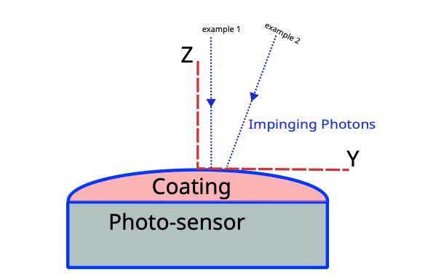
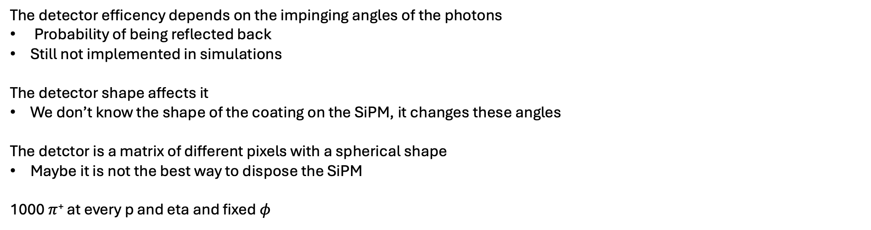
[2] Impinging angle
The detector efficency depends on the impinging angles of the photons
Probability of being reflected back
Still not implemented in simulations
The detector shape affects it
We don’t know the shape of the coating on the SiPM, it changes these angles
The detctor is a matrix of different pixels with a spherical shape
Maybe it is not the best way to dispose the SiPM
1000 $π$⁺ at every p and eta and fixed $φ$
3mm

Slide 11
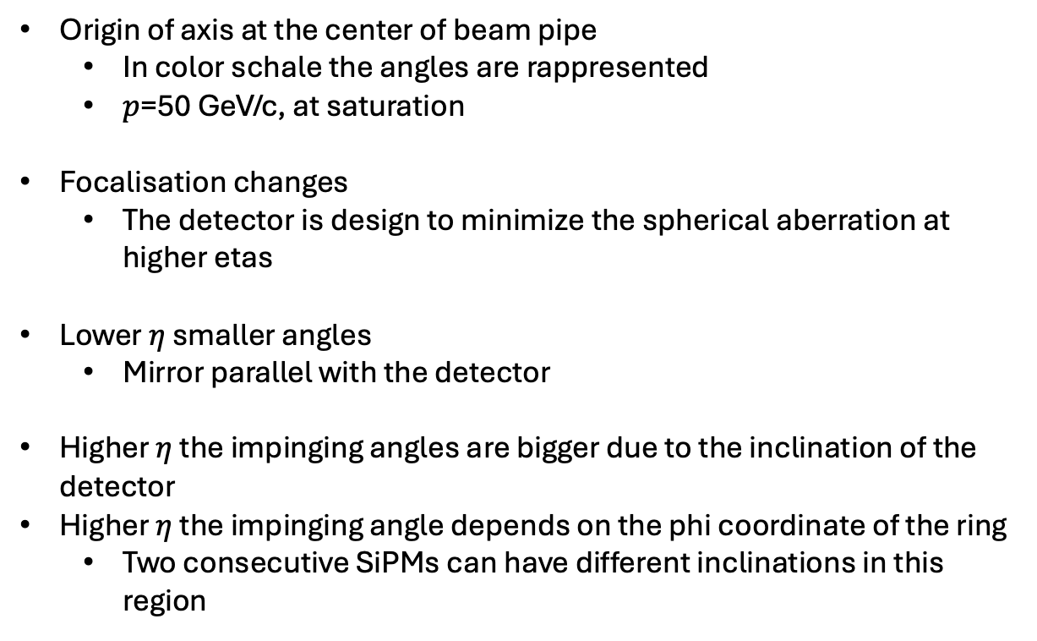
Impinging angles
Origin of axis at the center of beam pipe
  In color schale the angles are rappresented
  $p$=50 GeV/c, at saturation
Focalisation changes
  The detector is design to minimize the spherical aberration at higher etas
Lower $η$ smaller angles
  Mirror parallel with the detector
Higher $η$ the impinging angles are bigger due to the inclination of the detector
Higher $η$ the impinging angle depends on the phi coordinate of the ring
  Two consecutive SiPMs can have different inclinations in this region
Gas
Max angle =25
Aerogel
Max angle =40

Slide 12
Impinging angles

Slide 13
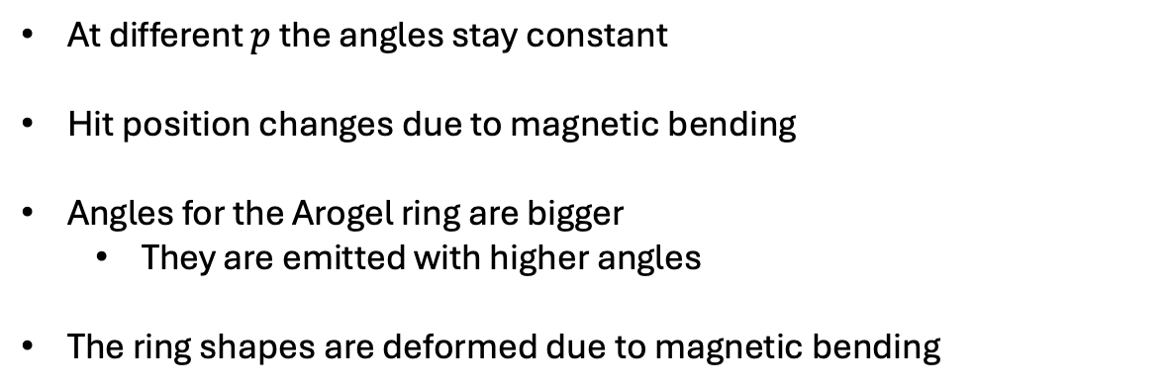
Impinging angles
At different $p$ the angles stay constant
Hit position changes due to magnetic bending
Angles for the Arogel ring are bigger
  They are emitted with higher angles
The ring shapes are deformed due to magnetic bending

Slide 14
Conclusions [2]:
It may be necessary to study how the efficency changes at different impinging angles

Slide 15
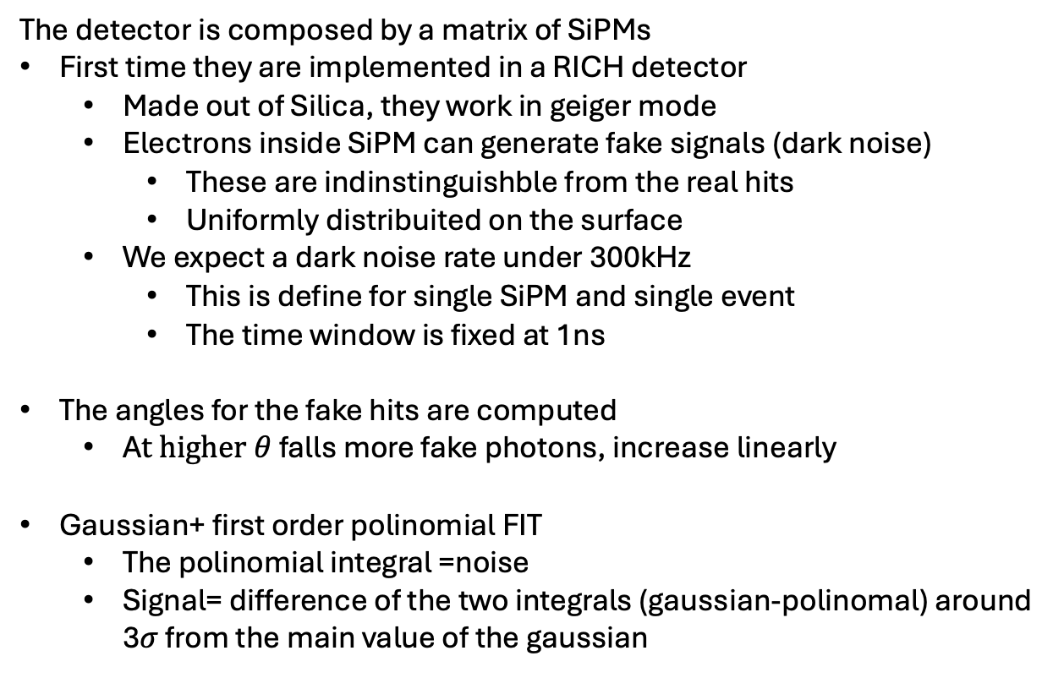
[3] Intrinsic noise in SiPMs
The detector is composed by a matrix of SiPMs
First time they are implemented in a RICH detector
  Made out of Silica, they work in geiger mode
  Electrons inside SiPM can generate fake signals (dark noise)
    These are indinstinguishble from the real hits
    Uniformly distribuited on the surface
  We expect a dark noise rate under 300kHz
    This is define for single SiPM and single event
    The time window is fixed at 1ns
The angles for the fake hits are computed
  A$t higher θ$ falls more fake photons, increase linearly
Gaussian+ first order polinomial FIT
  The polinomial integral =noise
  Signal= difference of the two integrals (gaussian-polinomal) around 3$σ$ from the main value of the gaussian

Slide 16
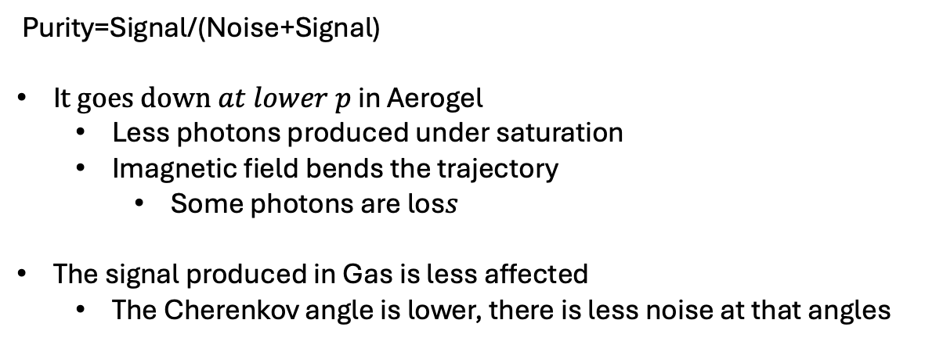
Rumore - purezza del segnale
Purity=Signal/(Noise+Signal)
I$t goes down at lower p$ in Aerogel
  Less photons produced under saturation
  Imagnetic field bends the trajectory
    Some photons are los$s$
The signal produced in Gas is less affected
  The Cherenkov angle is lower, there is less noise at that angles

Slide 17
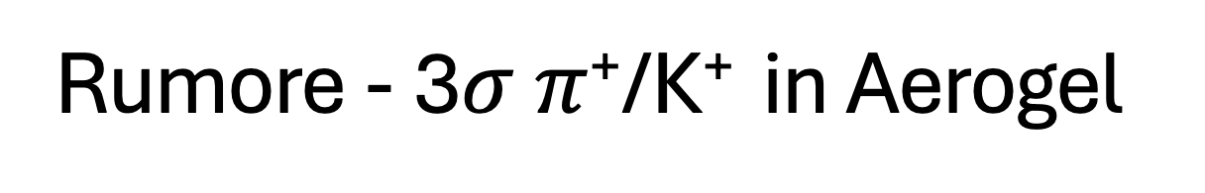
Rumore - 3$σ$ $π$⁺/K⁺ in Aerogel
The operative range decrease
~1Gev/c
Resolution increase
~25%

Slide 18
Conclusione parte [3]:
This is only the first study that estimate the effets of the itrinsic noise of the SiPM in dRICH. The performance is not much effected by it, and all the effects are compensated by the introduction of the new parameters

