Slide 1
Towards the september marine campaign and beyond
Pasquale Migliozzi
INFN - Napoli

Slide 2
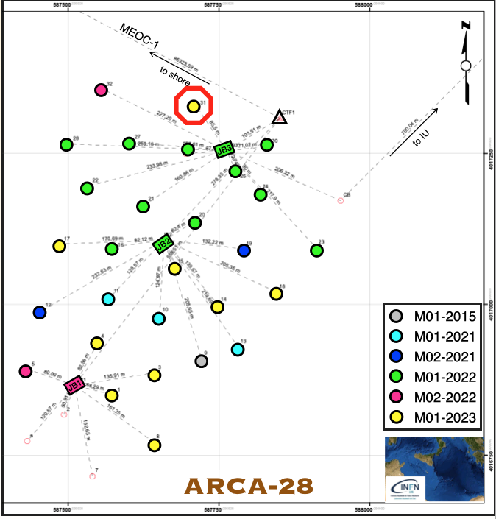
Status as 13th march
28 DU deployed
27 working and taking data (ARCA.DU0031 failure the 31st of December 0223)
Stable data taking

Slide 3
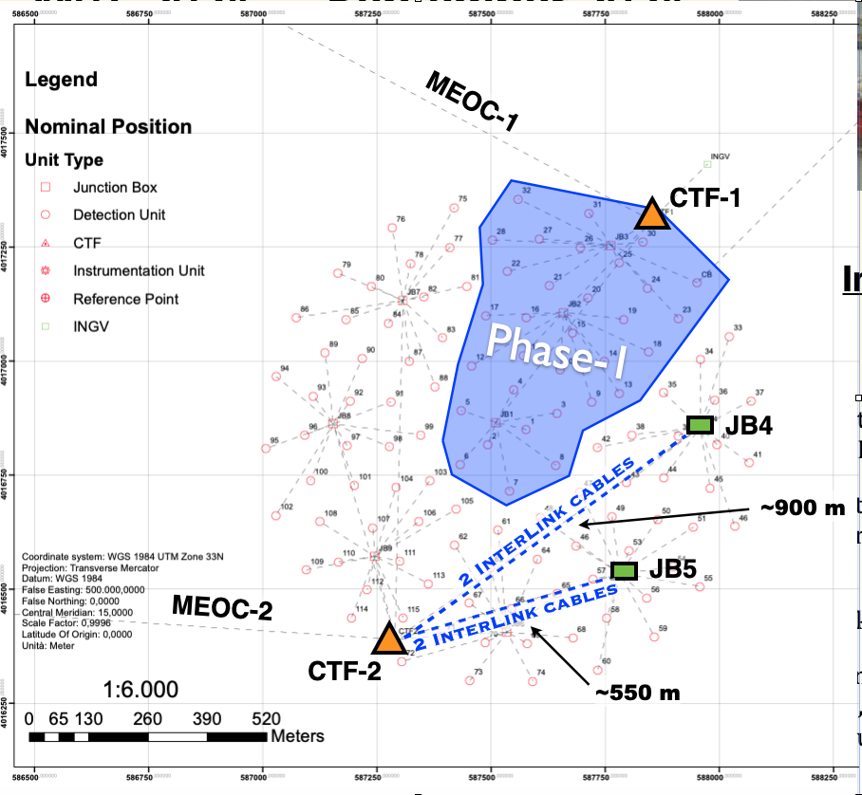
Next sea campaign: september 2024
Sea floor infrastructure
What will be deployed:
2 JB (JB4 and JB5)
4 interlink cables CTF2-JB
Criticalities:
None
First JBs in WWR mode

Slide 4
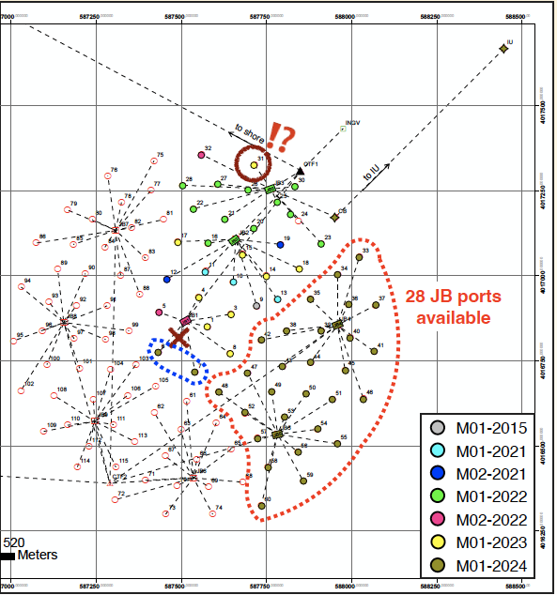
Next sea campaign: september 2024
DU et al.
What will be deployed:
Baseline 17 DU (WWRS)+ 2 DU – see next slide
4 tripods for the acoustic positioning
1 Calibration Base (CB) + Instrumentation Unit (IU)
Absolute positioning system
Recovery of ARCA.DU0031 (?)
Criticalities:
DU -> See next slides
Absolute positioning system -> Administration
Shore station upgrade -> Administration
First DUs in WWR mode

Slide 5
Assumption
For the following calculations we consider as ultimate date for DOM and BM production the 31st of May 2024
June and July will be devoted to the DU preparation
It is not excluded that 1 or 2 more DUs could be available, but let’s be conservative

Slide 6
DOM integration
Forecasts for the next marine campaign (deadline DOM production: 31 May 2024):
DOM already produced: 252 (14 DU)
(mostly Catania, Napoli with Athens and Erlangen contributions, special “guest” Nikhef that contributed with 72 DOMs)
DOM being finalized: 72 (4 DU)
DOM being integrated but "halted" (CLBs are missing): 36
DOMs granted: 324 (18 DU)
DOMs that could be easily finalized, if CLBs will become available: 36 (2 DU)
With no CLB problems and logistics without delays, we could arrive at the deadline with a maximum of 22 DU
DOM available for the september marine campaign 360 = 20 DU

Slide 7
BM integration
So far, the BM integration rate has been strongly limited by the availability of some electronic boards
5 BMs already integrated (1 QBM + 4) @Bari, Bologna, Caserta, LNS
4 BMs are being integrated (1 ready + 3 finalized by end of march)
Critical boards for additional 8 BMs will be available by the end of march
Current BM integration speed about 1 BM/month
8 additional BMs ready by the end of may
BM available for the september marine campaign 17 = 17 DU

Slide 8
DU Integration plans for the marine campaign
Refurbisment and investigation of DUs 42 and 66 (now 129) @LNS: Broadcast type
Present status as KM3NeT long term plan
Caserta*
* For some of the P1 Rome group contributed
LNS
Genova
DU42 in process 5
DU129 in process 5
DU102 in process 2
DU107 in process 1 done
DU111 in process 1 done
DU114
DU116
DU117 from Genova tbd P4&P5
DU100 (Q-DU) ready
DU103 ready
DU105 in process 4
DU108 in process 2
DU109 process 1 done
DU110 process 1 done
DU104 from Genova tbd P4&P5
DU112
DU113 from Genova tbd P4&P5
DU115
DU116 from Genova tbd P4&P5
DU104 in process 2 @Caserta
DU113 @Caserta
DU117 @LNS
DU available for the september marine campaign 17+2 = 19

Slide 9
Critical points for DU production
The logistics (transports) in the last three months has been a nightmare and introducde delays in the integration
It will continue to negatively interfere with the integration of DOM, BM and DU until the FOR funds are moved to INFN-Napoli to issue the tender
For DOMs: Electronics (CLB track phase, FPGA firmware, problems with the octopus board, etc.)
For DOMs: available space (this problem will be solved with the new labs in Catania 2 and Caserta, financed with PNRR funds)
For BMs: Electronics (CLBs issue, Glenair boards availability)
For DU: available space (can limit the production rate at the LNS site)
Tender bureaucracy is overwhelming all of us
The “nuovo codice degli appalti” is major step towards further waste of time: even purchases below 5k€ are becoming quite difficult

Slide 10
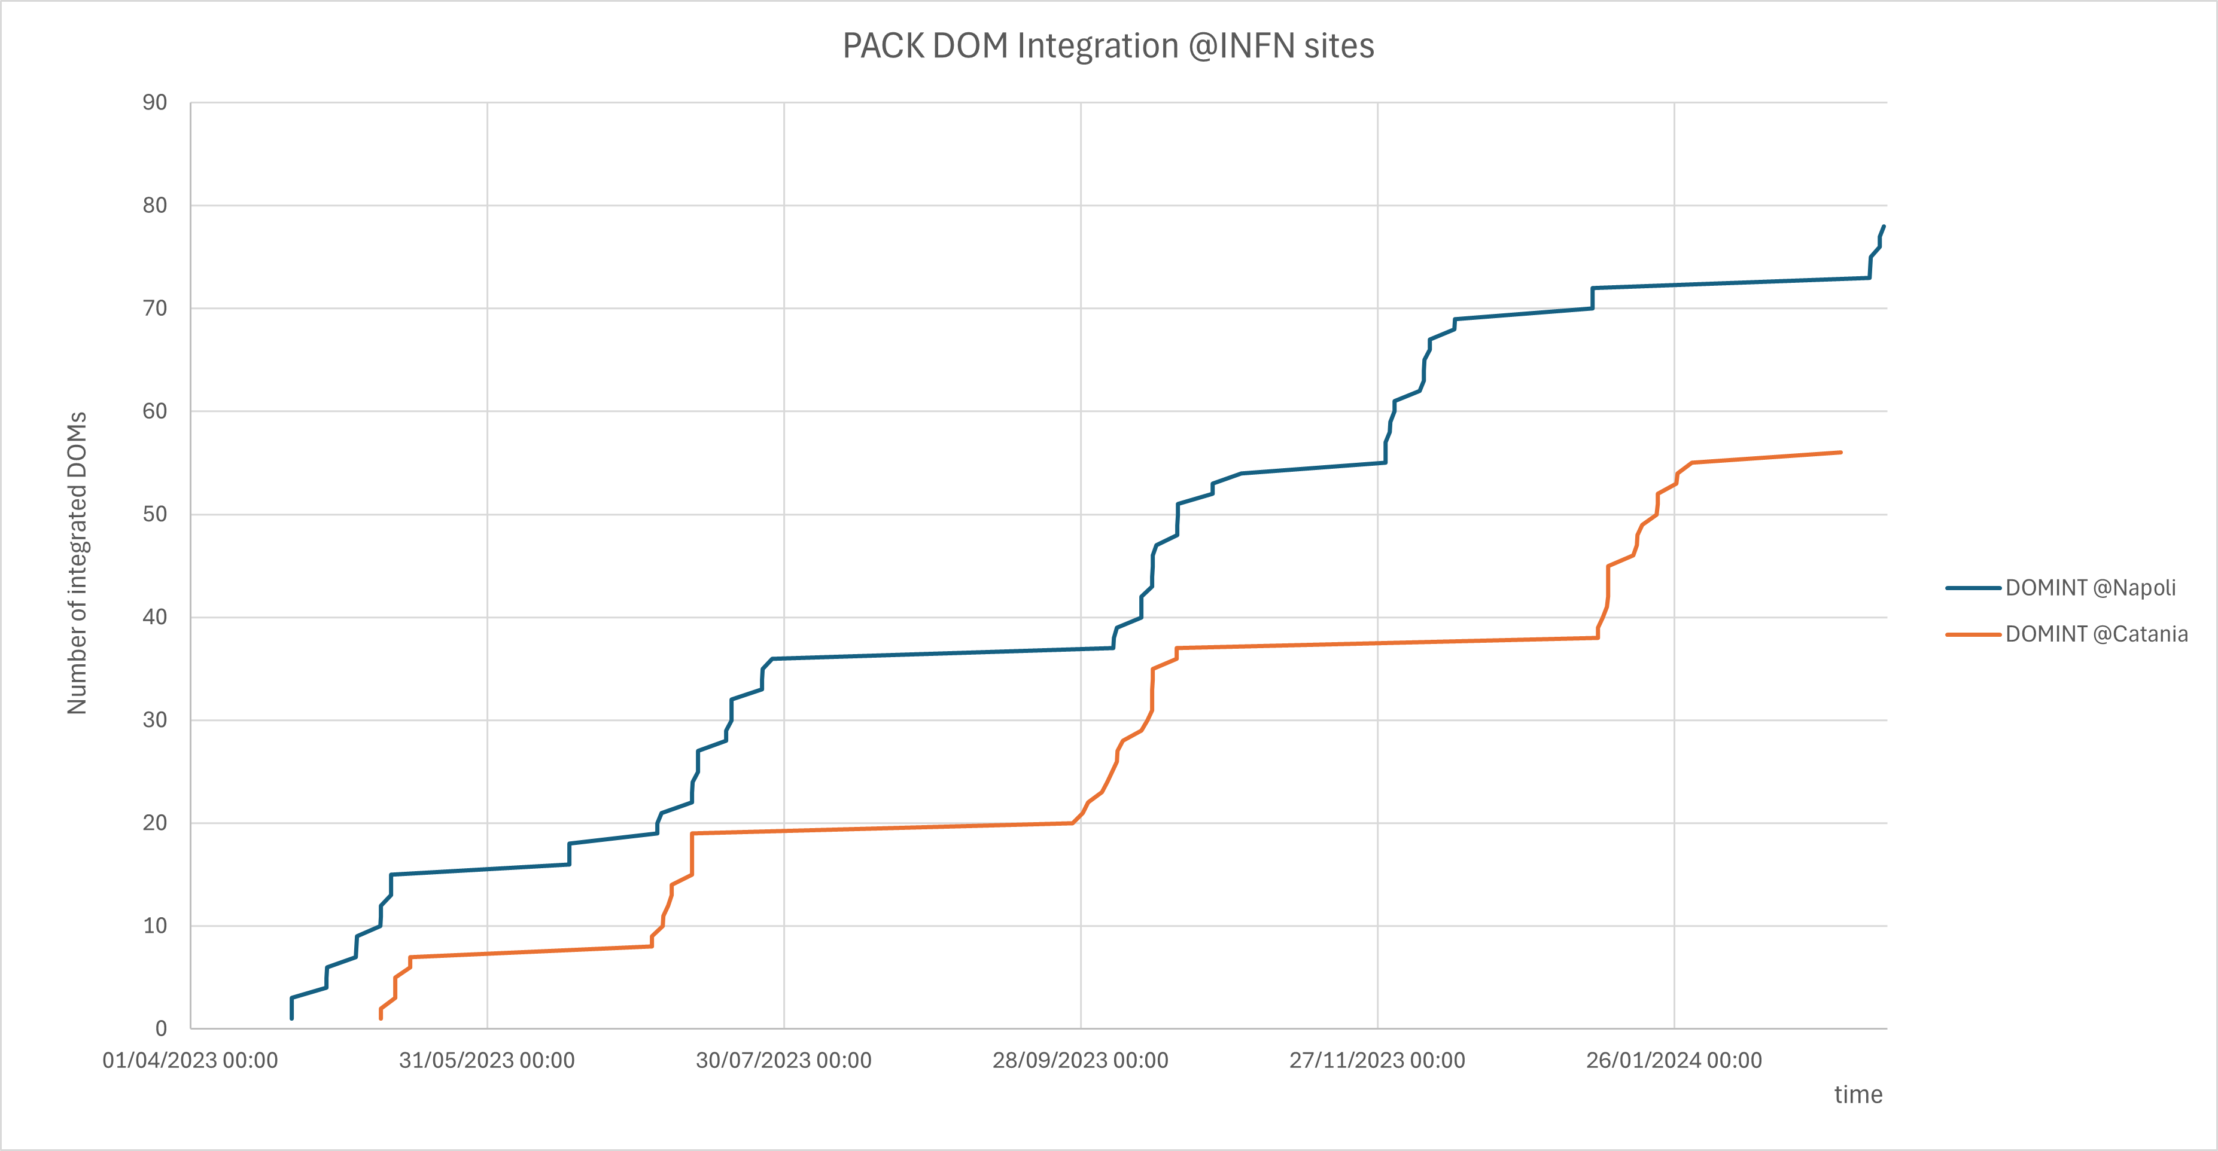
Impact of the various sources of delay on the DOM integration
Delays due to LOGISTICS
AUGUST
CHRISTMAS
Missing components
Refurbishment of ARCA Broadcast DOMs
Delays due to LOGISTICS

Slide 11
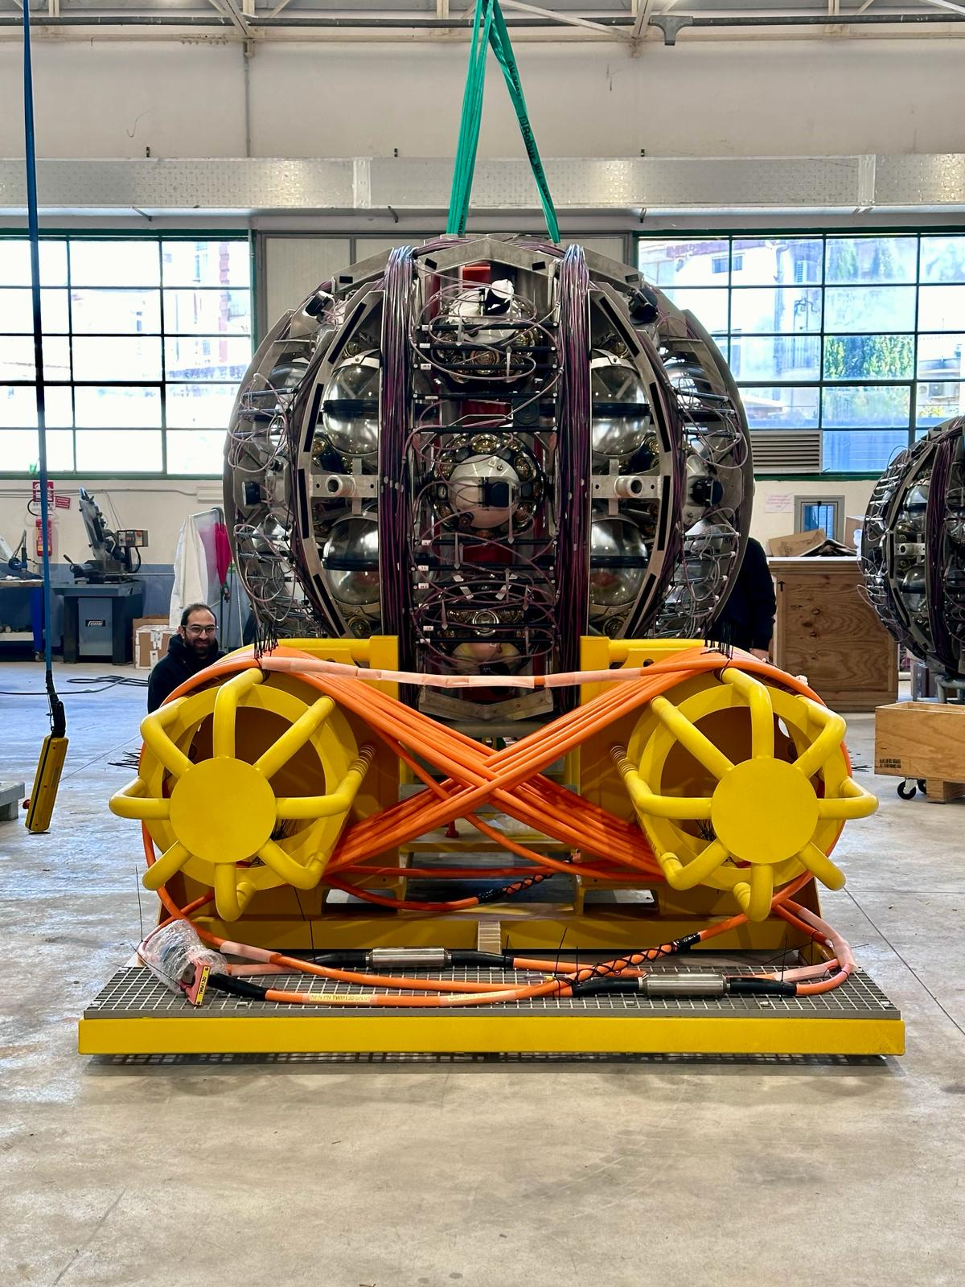
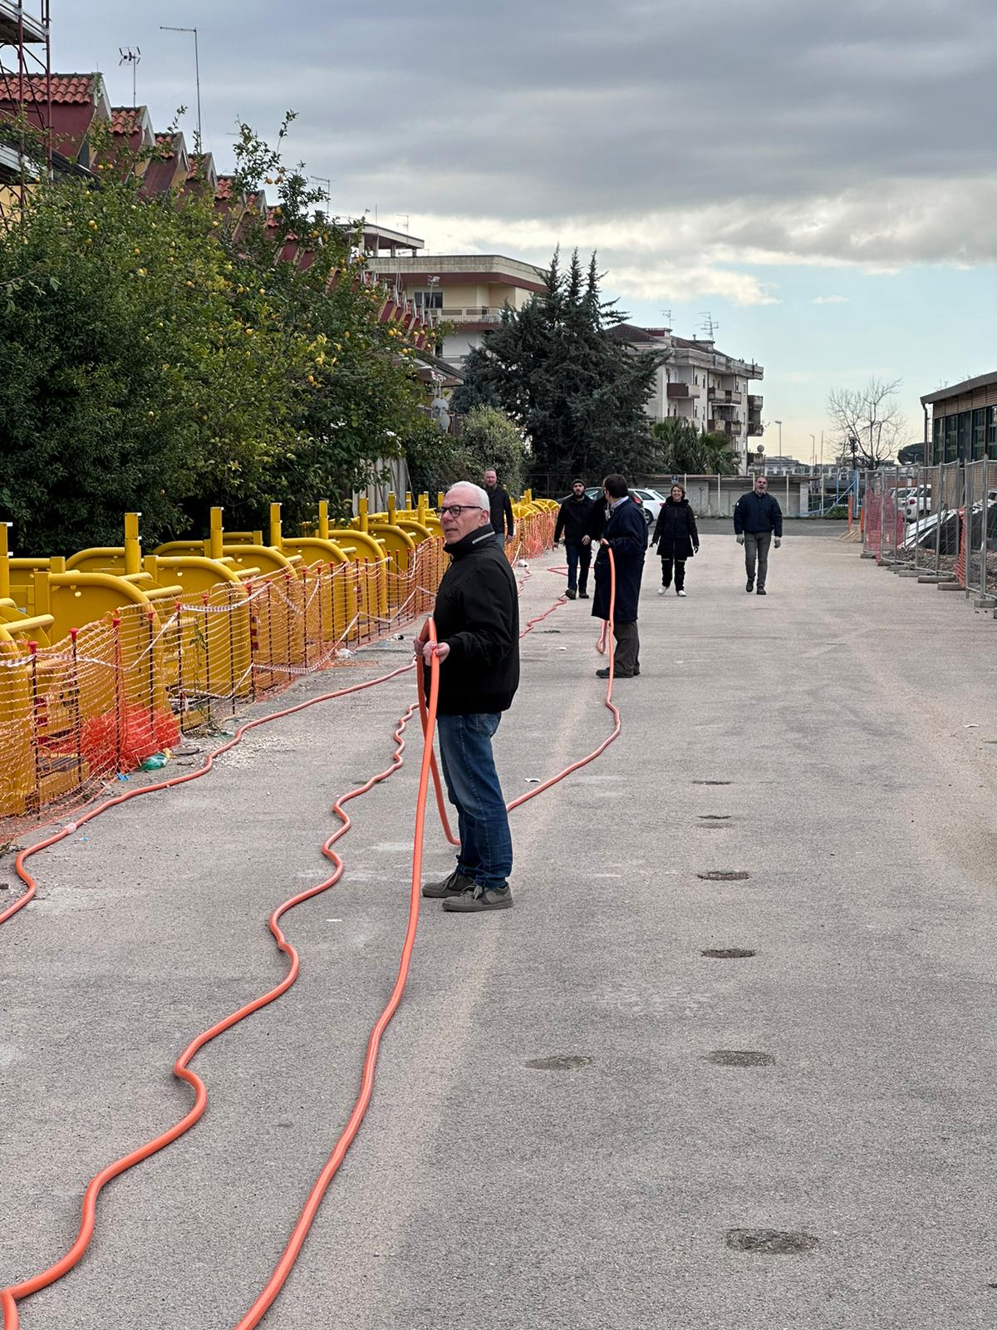
Limiting factor for the DU integration: space
DU production at Caserta
After the first 6 weeks a maximum of 4 DUs ready per month
PROCESS 1 (1W+2W oil filling)
PROCESS 2 (1W)
PROCESS 3 (1W)
PROCESS 4 (1W)
PROCESS 5 (1W)
PROCESS 1 (1W+2W oil filling)
PROCESS 2 (1W)
PROCESS 3 (1W)
PROCESS 4 (1W)
PROCESS 5 (1W)
PROCESS 1 (1W+2W oil filling)
PROCESS 2 (1W)
PROCESS 3 (1W)
PROCESS 4 (1W)
PROCESS 5 (1W)
PROCESS 1 (1W+2W oil filling)
PROCESS 2 (1W)
PROCESS 3 (1W)
PROCESS 4 (1W)
PROCESS 5 (1W)
Caserta DU integration capability: min 2.5 max 4 DUs/month
LNS DU integration capability: min 0.8 max 2 DUs/month

Slide 12
Critical points @LNS

Slide 13
Critical points @LNS

Slide 14
Possible limiting factors in the future
The impressive integration rates we have reached has been only possible thanks to
Post-docs hired with the CIR-PACK that decided not to apply for the PNRR technologist positions: have committed themselves to the mission of completing KM3NeT and not abandoning it after setting up the labs and bringing them up to speed
Technicians hired with KM3NeT4RR
This fall there is an important turning point: some contracts will end and there is the risk to stop (slowdown in the best case) the integration of some key components

