Slide 1



KM3NeT & KM3NeT4RR
G. CUTTONE
FOR THE KM3NET &KM3NET4RR COLLABORATIONS
INFN - LABORATORI NAZIONALI DEL SUD (ITALY)
Caserta 15/03/2024

Slide 2
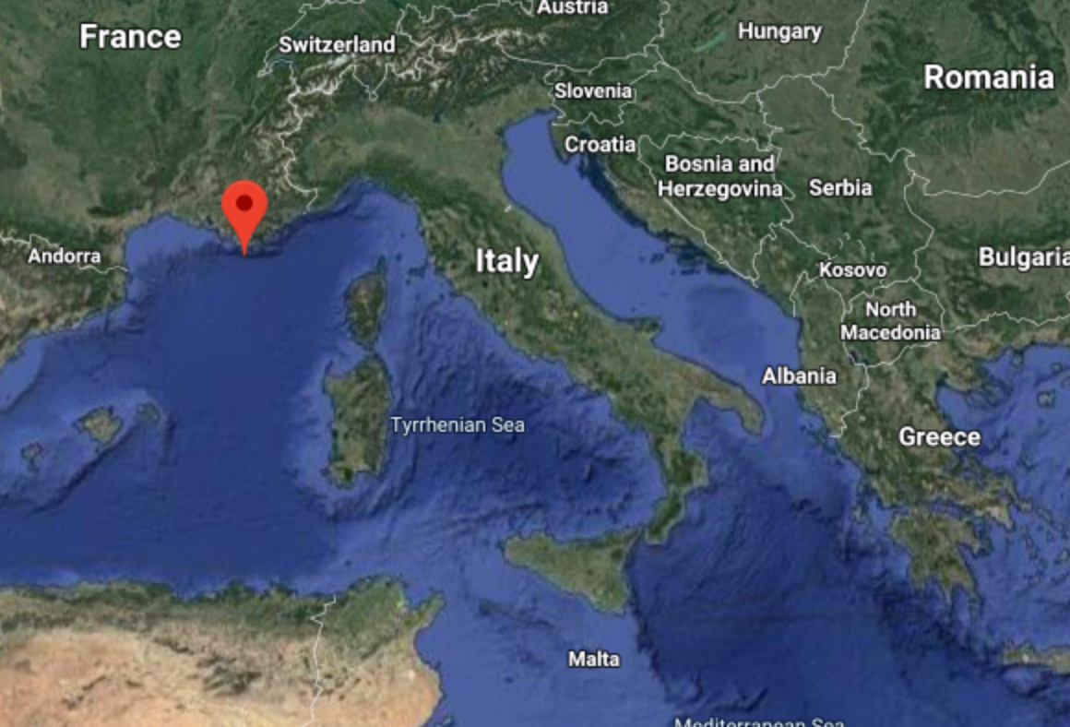

KM3NeT
1 collaboration 1 technology 👉 2 detectors
  ARCA (Astroparticle Research with Cosmics in the Abyss)
    observation of high energy (GeV ÷ PeV) neutrino sources 👉 a telescope offshore Capo Passero (Sicily-Italy) is in construction at a depth of 3500m. INFN Budget mainly from external funds
  ORCA (Oscillation Research with Cosmics in the Abyss)
    determination of the neutrino mass hierarchy 👉 a detector offshore Toulon (France) able to detect neutrinos of tens of GeV is in construction at a depth of 2500m
ORCA
Detectors in construction
ARCA

Slide 3
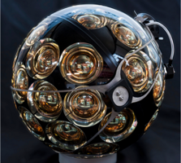
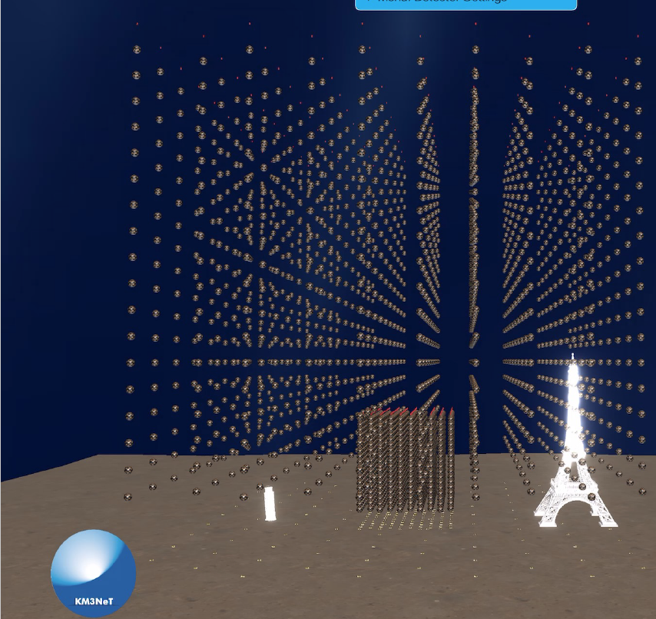
KM3NeT DETECTORS
Optical sensor
Detection Unit
Notes:
IC photocatode areas pow(((10./2.)*2.54),2)*3.1415*5160=2.6E06 cm^2
ARCA full photocatode areas pow(((3./2.)*2.54),2)*3.1415*18.*115.*2.*31.=5.8e06 cm^2

Slide 4

KM3NeT ORGANIZATION
Resource Review Board
Chair: S. Bentvelsen
Ethics Committee
Chair: TBD
Oversight
Financial Resource Manager
A. van Rijn
Scientific and Technical Advisory Committee
Chair: D. Bortoletto
Institute Board
Chair: U. Katz
Governance
GNN Liaison Officer: U. Katz
EU Liaison Officer: M. de Jong
QA/QC Manager: TBD
Early Career scientists: J. Mancsak/ J. Schnabel
Publication Committee: A. Margiotta/E. Tzamariudaki Conference Committee: C. Markou
Outreach Committee: M. Circella/G. De Wasseige
Open Science Committee: J. Schnabel/ R. Gracia
Management Team
Spokesperson/Chair: P. Coyle Site Manager KM3NeT-Fr: N. Lumb
Deputy Spokesperson: R. Coniglione Site Manager KM3NeT-It: S. Biagi
Technical Project Manager: M. Lindsey Clark. Site Manager KM3NeT-Gr: C. Markou
Physics & Software Manager: A. Heijboer
Equality, Diversity, Inclusion Committee
C. James/E. Tzamariudaki
Science Steering Committee
Project Office
Technical Steering Committee
Chair: A. Heijboer
Astronomy: D. Dornic/G. Illuminati
Oscillations: J. Brunner/J. Coelho
Dark Matter/Exotics: S. Gozzini/Y. Tayalati
Software/computing: K. Graf/M. Bouwhuis
Processing/DataQuality: L. Fusco/A. Domi
Simulations: C. Distefano
Cosmic Rays: R. Bruijn
Chair: M. Lindsey Clark
Procurement Manager: M. Circella
System Engineer: E.J. Buis/S. Henry
R.A.M.S Manager: TBD
Project Control Officer:TBD
Executive Management
Chair: P. Coyle/M. Lindsey Clark
Qualification: S. Henry
Power system: R. Cocimano/C.Nicolau*
Optical system: A. D’Amico
Calibration: D. Samtleben/R. Lahmann*
BM integration: I. Sgura
Det operations: A. Enzenhofer/P. Piattelli
* Deputy Coordinator
DU integration: D. van Eijk/C. Mollo*
Mechanics: E. Berbee
Electronics: D. Real/ D. Calvo*
PMT: P. Migliozzi
DOM integration: D. Vivolo
DAQ: T. Chiarusi
24/01/22

Slide 5
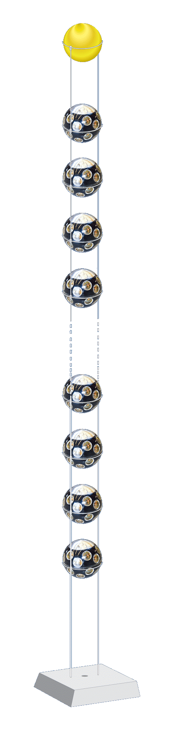
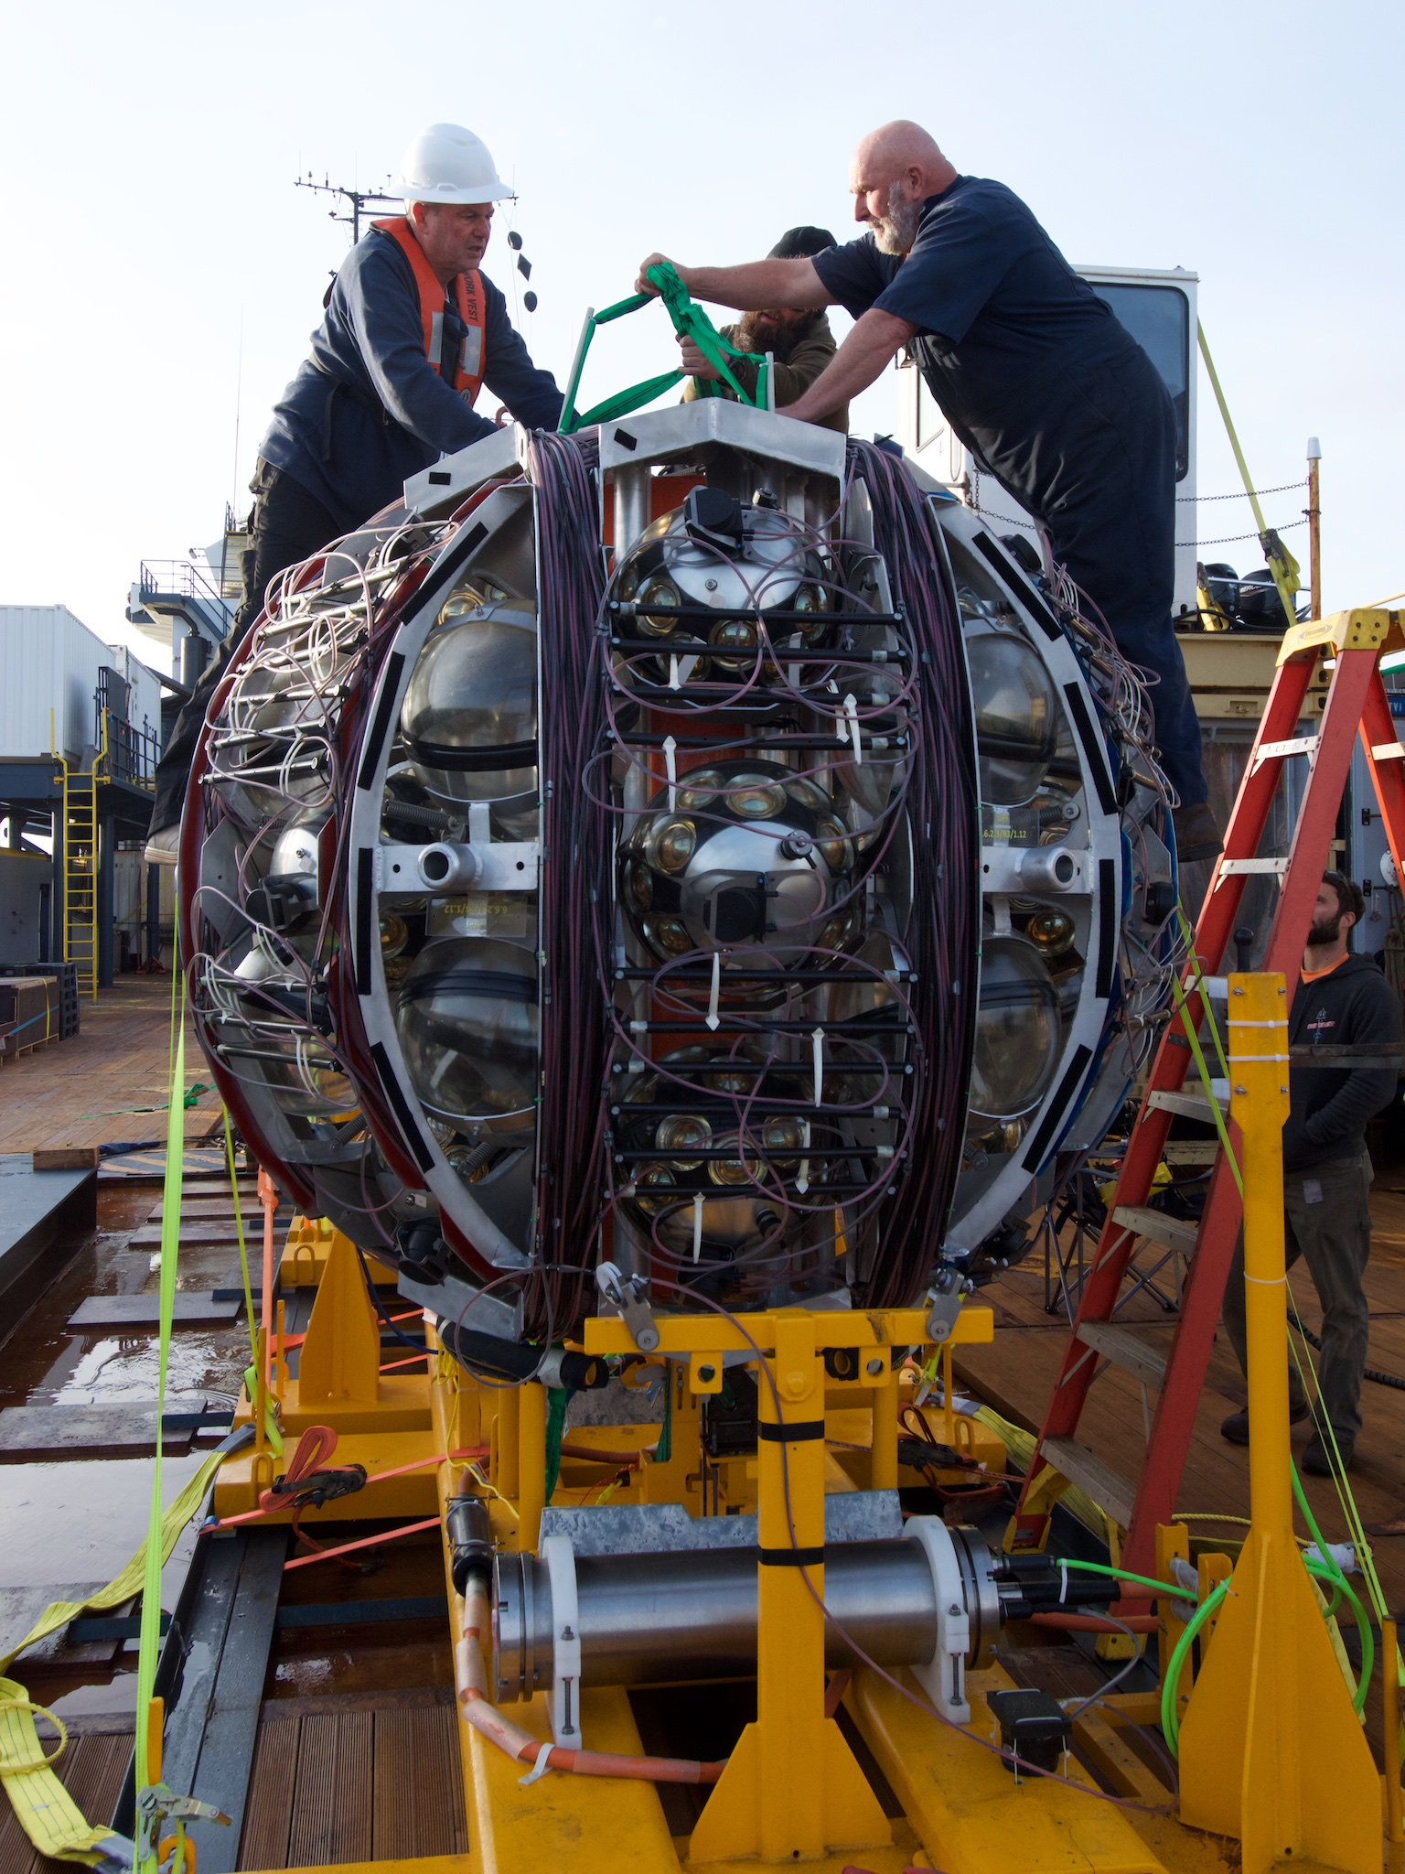
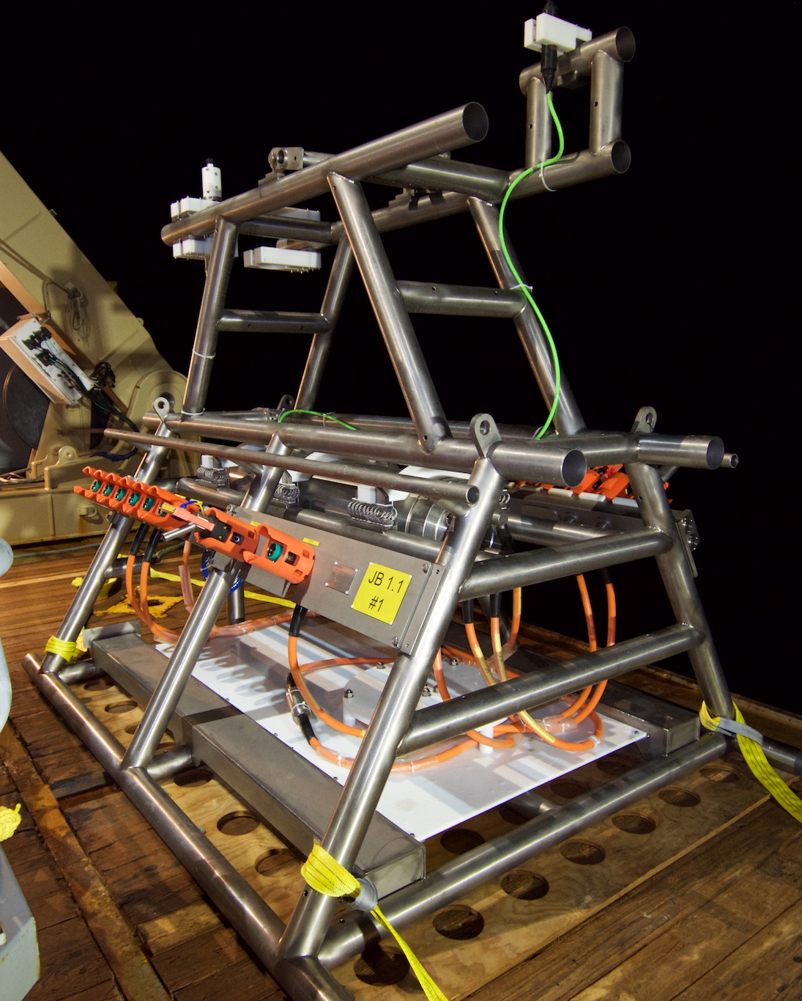
THE TECHNOLOGY
The basic elements:
  Optical sensors 👉 DOMs (Digital Optical Module)
  Strings 👉 DU (Detection Unit)
  Seafloor network 👉 Electro-optical cables and JBs (Junction Boxes)
JB
DOM
It is a 17” glass sphere with inside:
  31 3” PMTs (photocathode aerea ≃ 3 × 10” PMTs)
  LED and Piezo
  Front-end electronics -> FPGA
700 m / 200 m
LOM
Anchor
Base Module
DU
18 DOMs in a DU

Slide 6
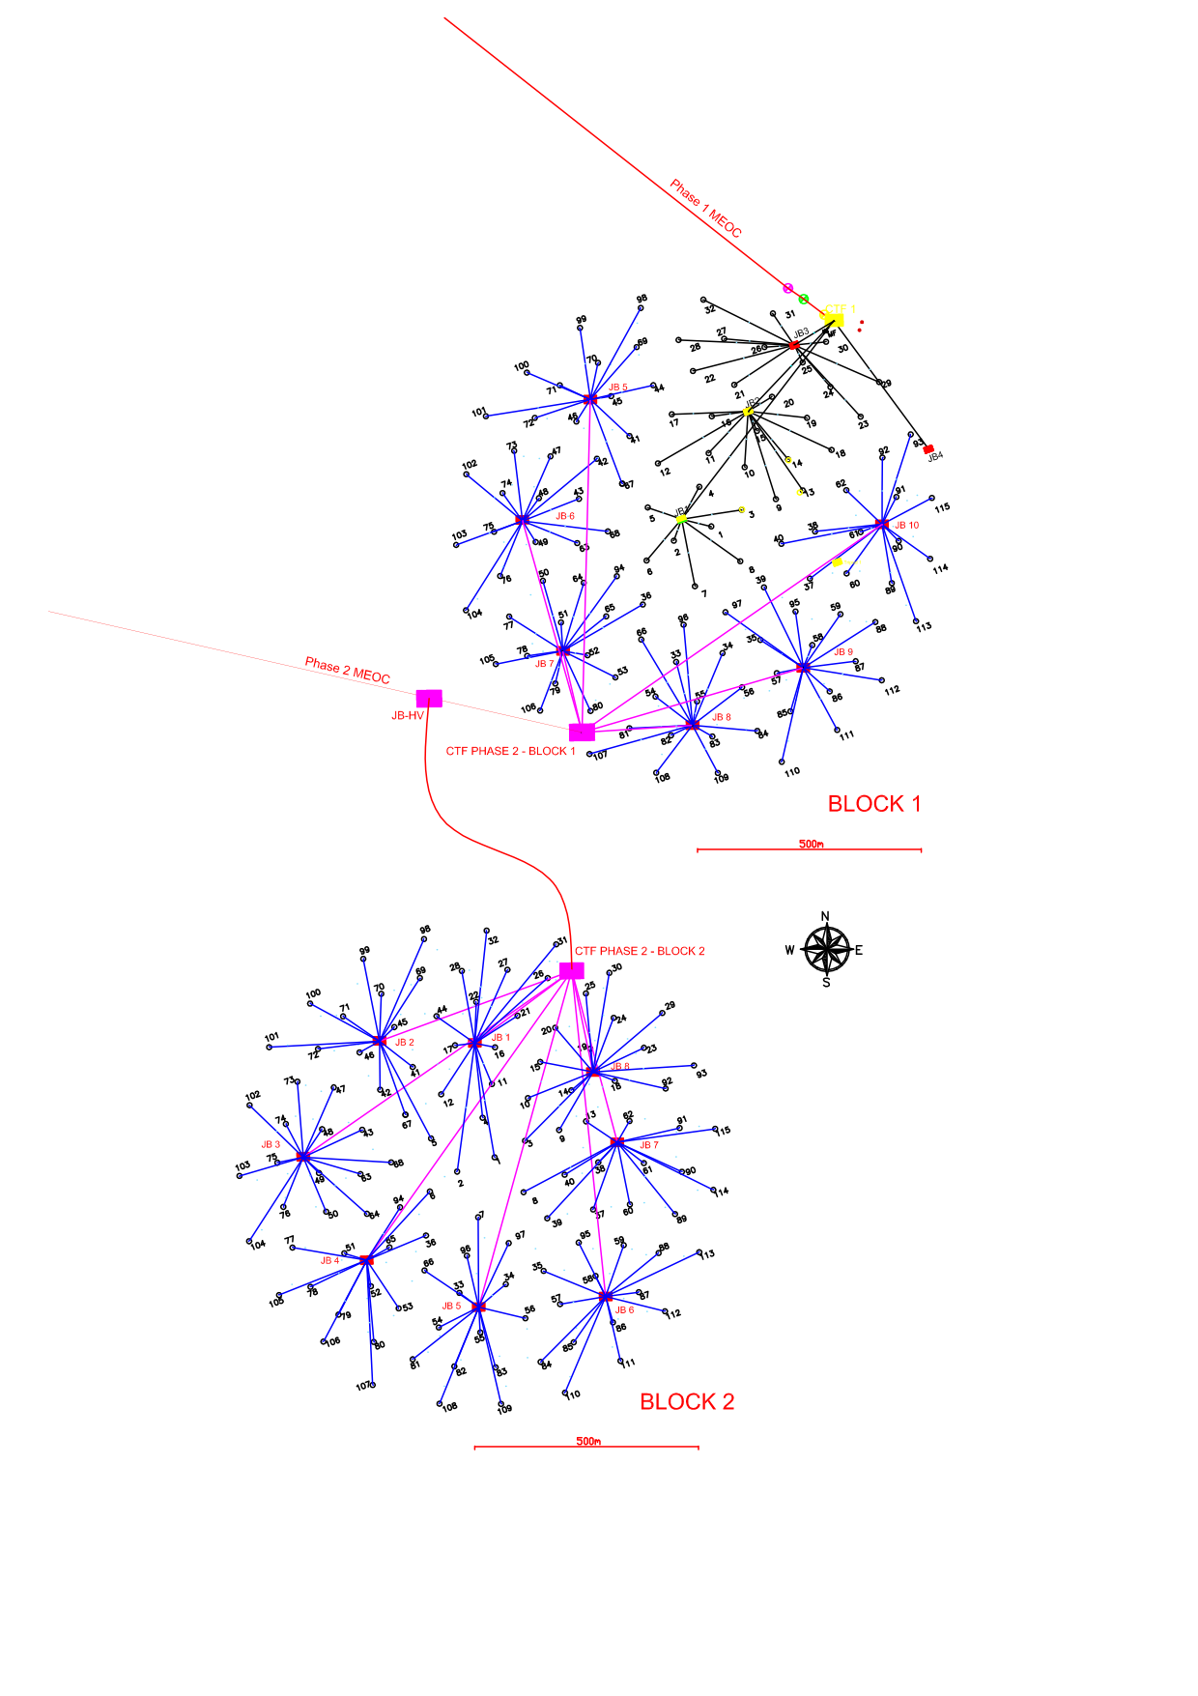
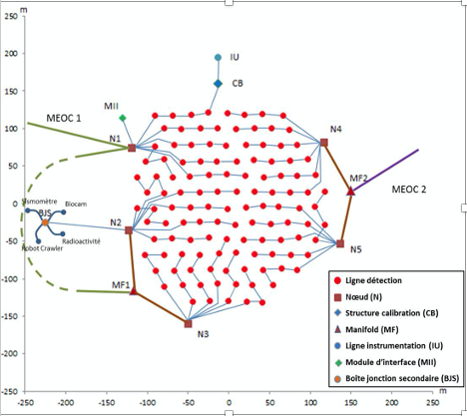
THE DETECTORS
ORCA
(France)
ARCA
(Italy)
Main electro-optical cable
Main electro-optical cables
JBs
JBs
Main electro-optical cable
200m
ORCA is composed of 1 building block of 115 DUs with 20 m DU interspacing and 9m inter DOM spacing (7 Mton)
ARCA is composed of 2 building blocks of 115 DUs each with 90 m DU interspacing and 36m inter DOM spacing (Total Volume ~ 1 km³)

Slide 7

Funding
75 ARCA DUs funded (IDMAR Sicilian Region Project+PACK MUR Project) 🡺 integration completed on July 2023
KM3NeT4RR started on dec 1° 2022 for 30 months
50 ARCA DUs funded+CTF3 and 7 JBs (1 from ITINERIS)
33 ORCA DUs funded 🡺 September 2022
New funding needed by ~early 2022 (solution is not yet available)
Thanks to KM3NeT4RR dedicated staff hired.
New MOU signed
KM3NeT AISBL is going to be realized as legal entity.

Slide 8
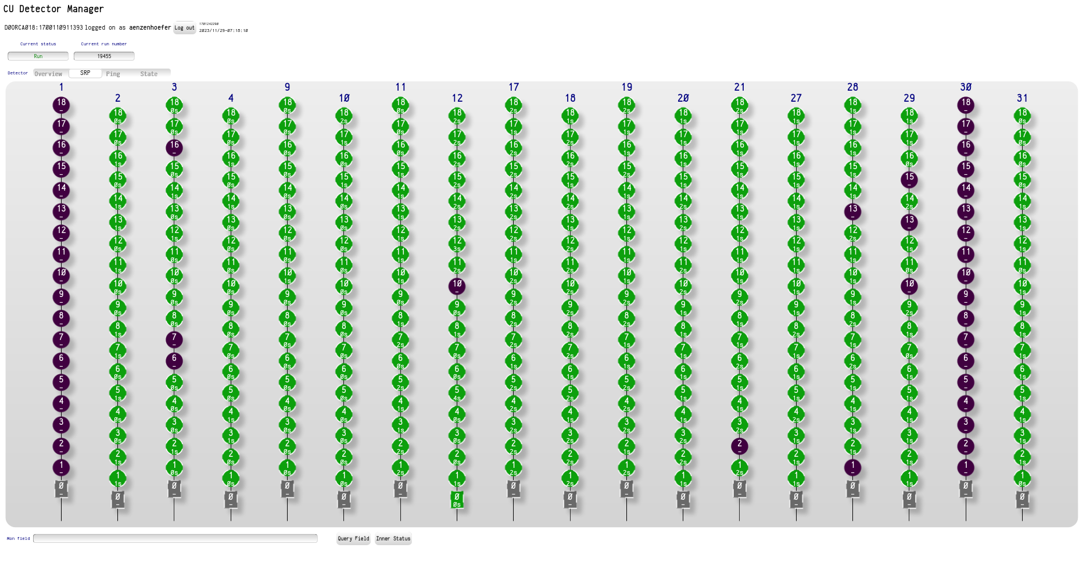
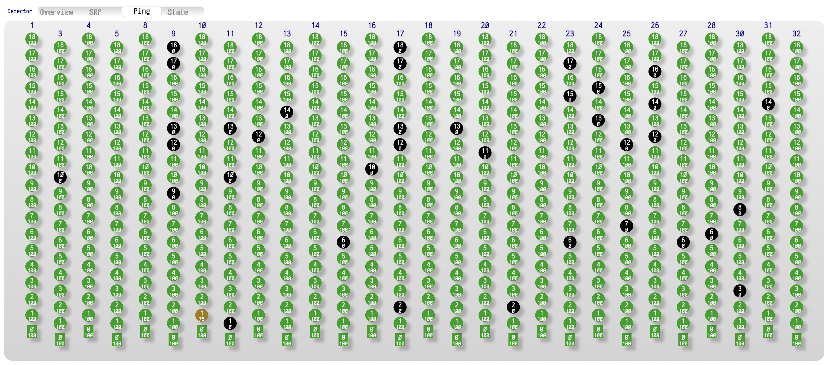
Current Status: 46 DUs deployed (44 operational)
ARCA28
ORCA18.5
07/11/22: +CTF
20/04/23: Lost DU38
19/05/23: Lost DU42
06/23: Sea op cancelled (boat unavailable)
09/23: -DU38, -DU42, +9DUs
9/24: +2DU, +2WRJB, +21-27WRDU
5/1/23: Lost 15/18 DOMs on DU36
4/23: +3DUs, +1RAB
4/23: +PreBJS
11/23 +DU89 (not connected)
Ready to go: +7DUs, +CU,
recover 2 DUs

Slide 9
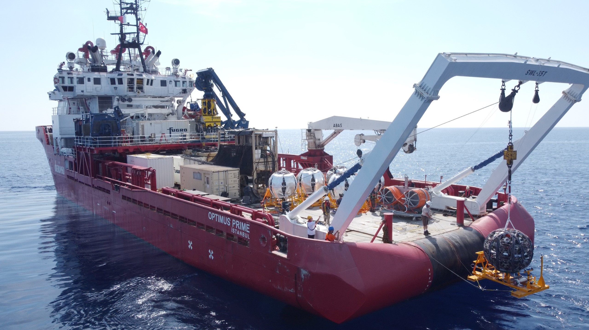
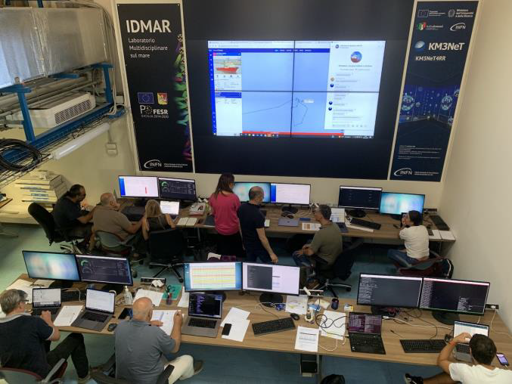
ARCA Sea Op: Sept 11-23, 2023
Two weeks, 2 hitches
-DU38, -DU42, +9 DUs
Optimus prime (Turkey)
Control room
Already Booked even for September 2024 Sea Ops.
New Contract with MTS assigned

Slide 10
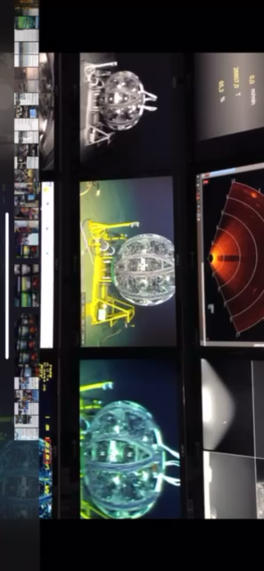
ARCA Sea Op: LOM release view on the boat

Slide 11
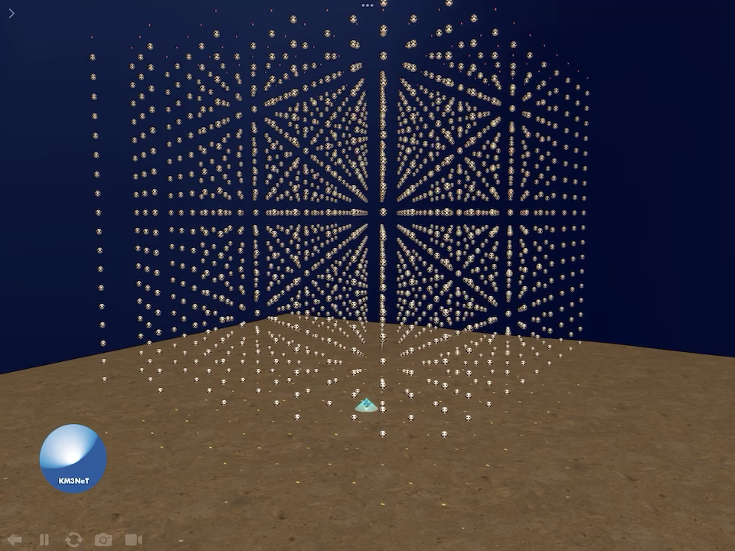
A Big Milestone: ARCA Phase 1 completed !

Slide 12
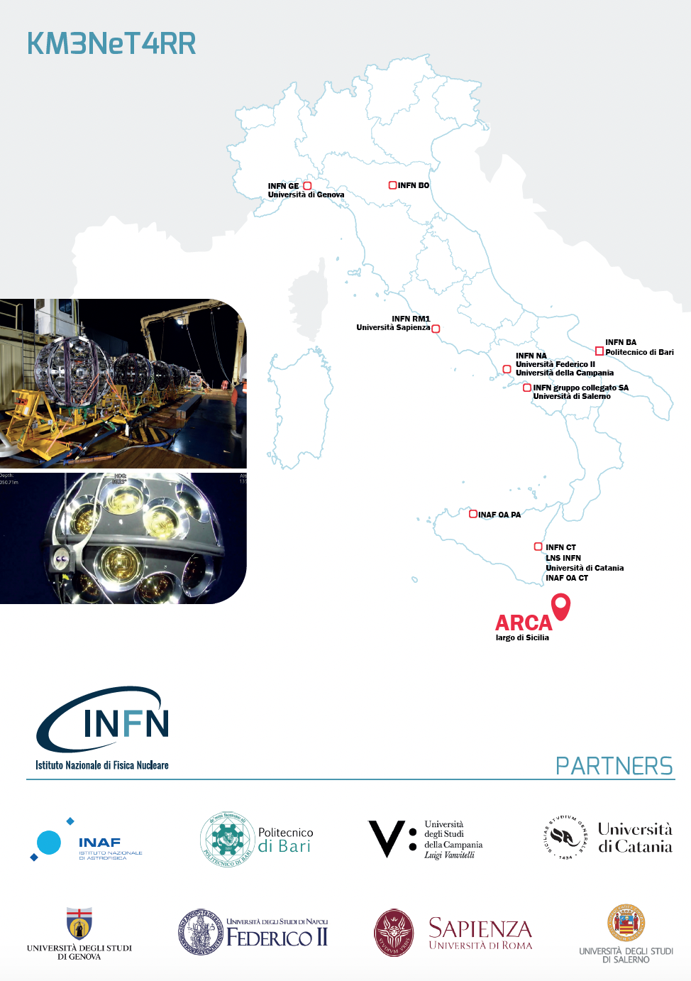
ETS: Mariangela Segreto
IN2P3 Nantes
KM3NeT4RR
The proposal has been possible because of Km3NeT is:
ESFRI RI
PNIR RI
Strategic RI for the Sicilian Region
Co-Applicants
INAF (OA-Catania and OA-Palermo)
Politecnico Bari
Università Campania
Università Catania (DFA - DEI)
Università Genova
Università Sapienza Roma
Università Salerno
Università Federico II Napoli
Budget 67.2 M€
(97% in Southern Italy)

Slide 13
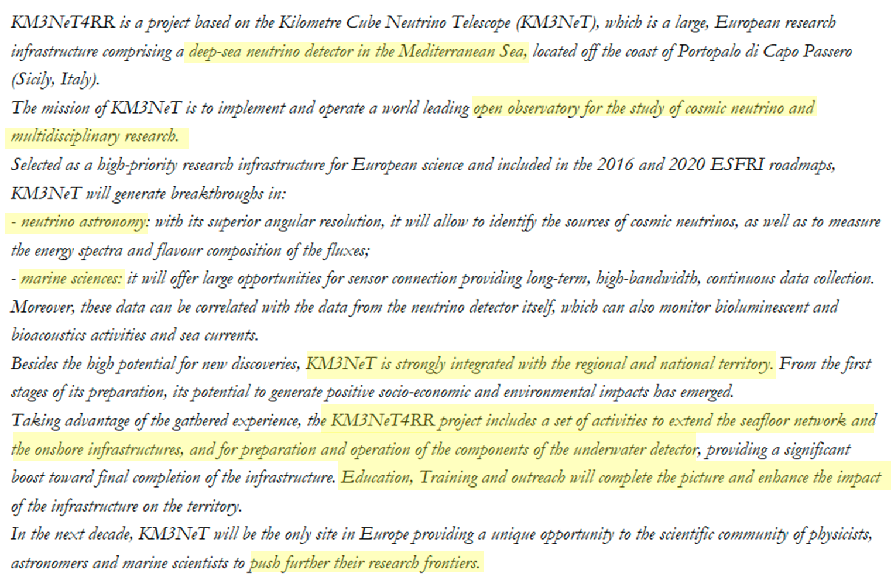
KM3NeT4RR – in a nutshell

Slide 14
KM3NeT4RR: KM3NeT for Next Generation EU (PNRR in Italy)
WP1– Management - In this WP the coordination and management of all project activities (technical, administrative, and financial) will be addressed.
WP2– Upgrading of the infrastructures. - To assure the reinforcement of the underwater infrastructure an adequate upgrade of all onshore laboratories is needed. The upgrade of the Capo Passero shore station, that hosts the Data Acquisition System and the control system of the subsea equipment is needed. Upgrades of the existing laboratories that are integration sites are also requested. This is needed to face the integration rate required by the project.
WP3 – Caserta upgrading - Selected INFN laboratories are devoted to the Detection Unit integration process. This activity requires a large laboratory with special equipment (overhead crane, customs made big instruments, ...). To increment the DU rate integration, the extension of the already existing laboratory located in Caserta is needed. This WP is devoted to the design and realization of this extension.
WP4 – Salerno upgrading -To increment the production rate of the Digital Optical Module the construction of a dedicated infrastructure at the University of Salerno for DOM integration is requested. Strengthening of the Database and test/reporting software is also requested.

Slide 15
KM3NeT4RR: KM3NeT for Next Generation EU (PNRR in Italy)
WP5 – Seafloor upgrading - An important part of the offshore IR is the seafloor network (Second CTF and 6 Jbs) that connects the Detection Units to the shore station and assure the inter-DU connection. The power/data are transferred to/from the infrastructure via main electro-optic cables connected to JBs. The extension of the existing seafloor network is the main activity of this WP.
WP6 – DU integrationt - The Procurement and construction of all the components of 65 Detection Unit of the ARCA detector is the aim of this WP.The increased size of the detector will allow an improvement of the detector sensitivity to cosmic neutrino fluxes, thus also increasing the importance of the detector in the multimessenger scenario.
WP7 – Multimessenger liasons. - This WP addresses items that are strictly related to the multimessenger activities. The upgrade to higher frequencies of an INAF radio telescope located near Noto (Sicily) is requested. Recent studies and some experimental evidence point out that high frequency radio emitting sources are good neutrino candidates thus making this upgrade and collaboration even more important. Follow-ups of sources in the radio and gamma emission band are also foreseen. Modelization of neutrino emission from other sources of cosmicneutrinos and activities for training of Phd students are also comprises in this WG.
WP8 – Education training and outreach - This WP addresses education, training and outreach activities paying particular attention to the development of the enterprise culture related to opportunities offered by the research infrastructure in the creation of added economical value and for the growth of our country and in particular of the southern regions.This will be achieved by means of innovative education and training rooms devoted to STEM valorization and to the multimessenger astrophysics and related technologies

Slide 16
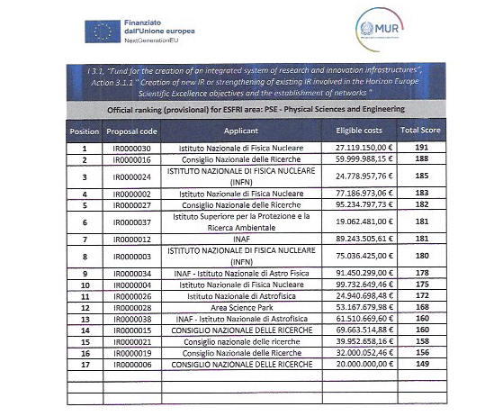
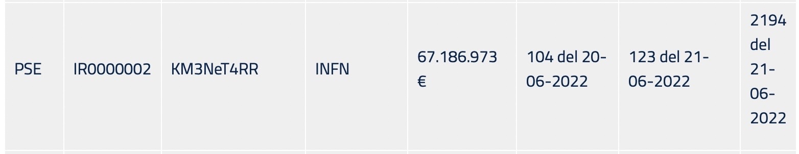

Slide 17
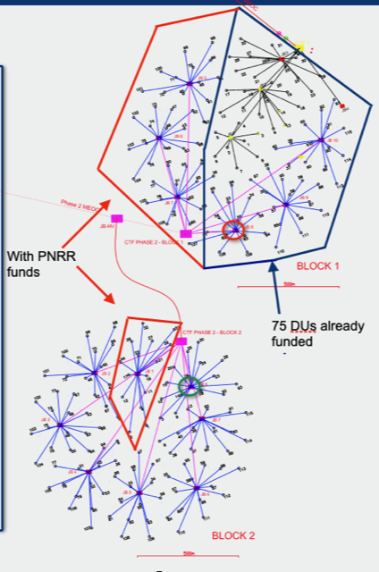
PNRR proposal successfully approved
ARCA Detector with Km3NeT4RR
KM3NeT4RR approved for 67.2 M€ :
55 DUs (Initial Request for 65 Dus)
The related sea floor infrastructure
(5 JBs + 1CTF + IL cables)
The reinforcement of INFN KM3NeT laboratories
Human resources
This funds will allow the completion of the first block and the construction of about 15 DUs of the second block of the ARCA detector.
Marine Ops will be funded by INFN
Another PNRR call for Environment (ITINERIS) includes 1JB

Slide 18
Total budget divided by geographical area and cost categories

Slide 19
Applicant / Co-applicant | % on total | TOTAL | a. Fixed term personnel specifically hired for the project | b. Scientific instrumentation and technological equipment, software licenses and patent | c. Open Access, Trans National Access, FAIR principle implementation | d. Civil infrastructures and related systems | e. Indirect costs, including running costs | f. Training activities
INFN | 88,3% | 59.330.290,48 € | 3.257.034,00 € | 52.136.835,61 € | 0,00 € | 55.000,00 € | 3.881.420,87 € | 0,00 €
INAF | 1,5% | 989.407,60 € | 425.700,00 € | 498.980,00 € | 0,00 € | 0,00 € | 64.727,60 € | 0,00 €
Poli-BA | 1,2% | 780.565,00 € | 125.040,00 € | 296.460,00 € | 0,00 € | 308.000,00 € | 51.065,00 € | 0,00 €
Uni-Campania | 5,2% | 3.512.583,16 € | 306.168,00 € | 183.000,00 € | 0,00 € | 2.684.000,00 € | 229.795,16 € | 109.620,00 €
Uni-CT | 0,5% | 329.200,48 € | 213.264,00 € | 0,00 € | 24.400,00 € | 0,00 € | 21.536,48 € | 70.000,00 €
Uni-SA | 2,6% | 1.726.697,52 € | 405.936,00 € | 0,00 € | 0,00 € | 1.207.800,00 € | 112.961,52 € | 0,00 €
Uni-Napoli | 0,3% | 231.389,64 € | 106.632,00 € | 0,00 € | 0,00 € | 0,00 € | 15.137,64 € | 109.620,00 €
Uni-Ge | 0,3% | 172.742,94 € | 106.632,00 € | 0,00 € | 0,00 € | 0,00 € | 11.300,94 € | 54.810,00 €
Uni-Sapienza | 0,2% | 114.096,24 € | 106.632,00 € | 0,00 € | 0,00 € | 0,00 € | 7.464,24 € | 0,00 €
TOTAL | 100,0% | 67.186.973,06 € | 5.053.038,00 € | 53.115.275,61 € | 24.400,00 € | 4.254.800,00 € | 4.395.409,45 € | 344.050,00 €

Slide 20
INFN – Budget divided by geographical area and cost categories

Slide 21
INFN - Budget divided by operating unit
Operating Unit INFN | % on total | TOTAL
INFN-BA | 14% | 9.696.472,65 €
INFN-BO | 1% | 798.025,26 €
INFN-CT | 14% | 8.867.415,28 €
INFN-GE | 0,2% | 192.908,16 €
INFN-LNS | 35% | 22.325.060,71 €
INFN-NA | 25% | 16.807.719,34 €
INFN-RM1 | 1% | 642.689,08 €
INFN – LNS also includes the cost for the Infrastructure Manager contract: S. Ciancio in place on April 1° 23

Slide 22
INFN - Budget divided by operating unit and cost categories
Operating Unit | TOTAL | a. Fixed term personnel specifically hired for the project | b. Scientific instrumentation and technological equipment, software licenses and patent | c. Open Access, Trans National Access, FAIR principle implementation | d. Civil infrastructures and related systems | e. Indirect costs, including running costs | f. Training activities
INFN-BA | 9.696.472,65 € | 299.304,00 € | 8.707.819,97 € | 0,00 € | 55.000,00 € | 634.348,68 € | 0,00 €
INFN-BO | 798.025,26 € | 213.288,00 € | 532.530,00 € | 0,00 € | 0,00 € | 52.207,26 € | 0,00 €
INFN-CT | 8.867.415,28 € | 299.304,00 € | 7.988.000,00 € | 0,00 € | 0,00 € | 580.111,28 € | 0,00 €
INFN-GE | 192.908,16 € | 99.768,00 € | 80.520,00 € | 0,00 € | 0,00 € | 12.620,16 € | 0,00 €
INFN-LNS | 22.325.060,71 € | 1.148.154,00 € | 19.716.388,72 € | 0,00 € | 0,00 € | 1.460.517,99 € | 0,00 €
INFN-NA | 16.807.719,34 € | 897.912,00 € | 14.810.236,92 € | 0,00 € | 0,00 € | 1.099.570,42 € | 0,00 €
INFN-RM1 | 642.689,08 € | 299.304,00 € | 301.340,00 € | 0,00 € | 0,00 € | 42.045,08 € | 0,00 €
(INFN – LNS also includes the cost for the Infrastructure Manager contract)

Slide 23
KM3NeT4RR – INFN personnel to be hired
Op. Unit | Profile | N. of Units | Activity | Estimated cost
INFN-BA | CTER | 3 | Detector Integration | € 299.304
INFN-BO | CTER | 1 | Det. Integration, site upgrade, test benches | € 99.768
INFN-BO | Tecnologo III | 1 | Test benches | € 113.520
INFN-CT | CTER | 3 | JB integration and test, detector integration | € 298.304
INFN-GE | CTER | 1 | Detector Integration | € 99.768
INFN-LNS | CTER | 9 | Shore station, detector integration | € 894.912
INFN-LNS | Tecnologo III | 2 | Seafloor network design and installation | € 227.040
INFN-NA | CTER | 9 | Site upgrade, detector integration | € 897.512
INFN-RM1 | CTER | 1 | JB integration and test | € 99.768
Uni-Vanvit | Technician | 2 | Detector integration | € 199.536
Uni-SA | Technician | 3 | Detector integration | € 299.304
Being in mass production and having all the procedures defined, new technicians has been inserted in the integration teams already working. FULLY IN OPERATION. Pay attention at each single contract conclusion.

Slide 24
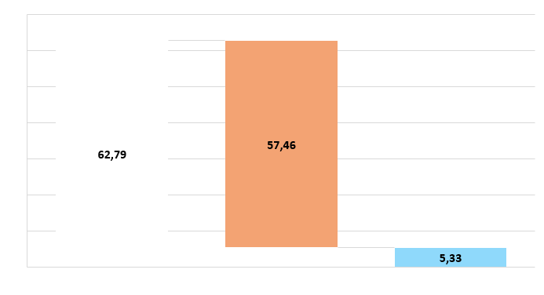
TOTALE COSTI DIRETTI
24
€M
Fonte: Decreto di ammissione al finanziamento 123 del 21-06-2022

Slide 25
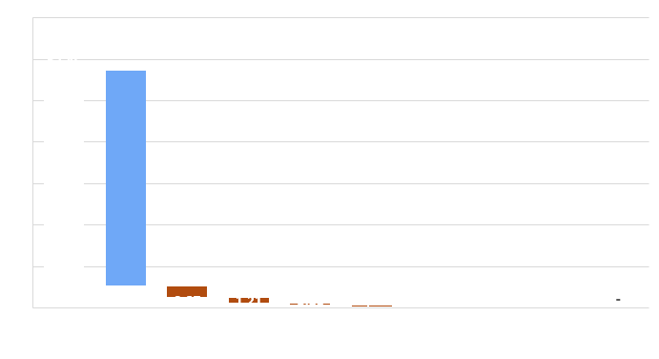
TOTALE AFFIDAMENTI PER COSTI DIRETTI PER ENTE
25
€M
Fonte: Decreto di ammissione al finanziamento 123 del 21-06-2022

Slide 26
TOTALE AFFIDAMENTI PER COSTI DIRETTI - INFN
26
€M
100%
80,2%
14,3%
5,1%
0,1%
0,3%
procedure sopra soglia
Nota: stato di avanzamento alla data del 13/03/2024 sulla base dei dati estratti da RDA e delle informazioni ricevute dai RUP

Slide 27
AFFIDAMENTI PER COSTI DIRETTI – INFN
SOPRASOGLIA
27
IMPORTO DELLE PROCEDURE
TOT €44,85M
NUMERO DI PROCEDURE
TOT #23
Nota: stato di avanzamento alla data del 13/03/2024 sulla base dei dati estratti da RDA e delle informazioni ricevute dai RUP

Slide 28
AFFIDAMENTI PER COSTI DIRETTI – INFN
SOTTOSOGLIA
28
IMPORTO DELLE PROCEDURE
TOT €7,35M
NUMERO DI PROCEDURE
TOT #87
Nota: stato di avanzamento alla data del 13/03/2024 sulla base dei dati estratti da RDA e delle informazioni ricevute dai RUP

Slide 29
AFFIDAMENTI PER COSTI DIRETTI
PARTNER
29
ACTIVITY WP | Uni-Vanvitelli | Uni-SA | Poli-BA | OACT | OAPa | Uni-CT-DEI | TOTALE
2.11 |  |  | 604.460 |  |  |  | 604.460
WP2 |  |  | 604.460 |  |  |  | 604.460
3.1 | 183.000 |  |  |  |  |  | 183.000
3.2 | 305.000 |  |  |  |  |  | 305.000
3.3 | - |  |  |  |  |  | -
3.4 | 793.000 |  |  |  |  |  | 793.000
3.5 | 854.000 |  |  |  |  |  | 854.000
3.6 | 671.000 |  |  |  |  |  | 671.000
3.7 | 61.000 |  |  |  |  |  | 61.000
WP3 | 2.867.000 |  |  |  |  |  | 2.867.000
4.3 |  | 1.207.800 |  |  |  |  | 1.207.800
WP4 |  | 1.207.800 |  |  |  |  | 1.207.800
7.1 |  |  |  | 401.380 |  |  | 401.380
7.2 |  |  |  |  | 97.600 |  | 97.600
WP7 |  |  |  | 401.380 | 97.600 |  | 498.980
8.1 |  |  |  |  |  | 94.400 | 94.400
WP8 |  |  |  |  |  | 94.400 | 94.400
TOTALE | 2.867.000 | 1.207.800 | 604.460 | 401.380 | 97.600 | 94.400 | 5.272.640
Fonte: Decreto di ammissione al finanziamento 123 del 21-06-2022

Slide 30
RECLUTAMENTI INFN
30
UO | RECLUTATO | DECORRENZA INCARICO | WP | ATTIVITA' | IO | DATA INIZIO | DATA FINE | MESI PARZIALI | MESI TOTALI
LNS | CIANCIO Sebastiano | 03-04-23 | 1 | 1.1 | 1.1 | 03-04-23 | 02-03-26 | 35 | 35
 | Anastasi Massimo | 02-01-23 | 2 | 2.1 | 2.1 | 02-01-23 | 30-11-23 | 11 | 11
 | Sciuto Davide | 01-12-23 | 2 | 2.6 | 2.6 | 01-12-23 | 30-11-24 | 12 | 12
 | ZITO Daniele | 15-05-23 | 2 | 2.1 | 2.1 | 15-05-23 | 14-11-23 | 6 | 24
 |  |  | 5 | 5.4 | 5.11 | 15-11-23 | 14-05-24 | 6
 |  |  | 5 | 5.7 | 5.17 | 15-05-24 | 14-11-24 | 6
 |  |  | 5 | 5.1 | 5.4 | 15-11-24 | 14-05-25 | 6
 | PLATANIA Luca | 15-05-23 | 6 | 6.14 | 6.20 | 15-05-23 | 14-05-25 | 24 | 24
 | FELICE Fabiano | 21-06-23 | 6 | 6.14 | 6.20 | 21-06-23 | 20-06-25 | 24 | 24
 | TANGORRA CASCIONE Riccardo | 17-07-23 | 6 | 6.14 | 6.20 | 17-07-23 | 16-07-25 | 24 | 24
 | COPPOLINO Lucio Mirko | 16-05-23 | 6 | 6.14 | 6.20 | 16-05-23 | 15-05-25 | 24 | 24
 | RICCERI Rita Domenica | 15-05-23 | 6 | 6.14 | 6.20 | 15-05-23 | 14-05-25 | 24 | 24
 | CAMMARATA Francesco | 15-05-23 | 6 | 6.14 | 6.20 | 15-05-23 | 14-05-25 | 24 | 24
 | CAVALLARO Bern. Maria Concetta | 15-05-23 | 6 | 6.14 | 6.20 | 15-05-23 | 14-05-25 | 24 | 24
NA | CASSESE Simone | 01-06-23 | 2 | 2.7 | 2.7 | 01-06-23 | 31-05-25 | 24 | 24
 | DE GIOSA Alessandro | 03-07-23 | 6 | 6.10 | 6.16 | 03-07-23 | 02-07-25 | 24 | 24
 | RUBINI Domenico | 03-07-23 | 6 | 6.10 | 6.16 | 03-07-23 | 02-07-25 | 24 | 24
 | DI CERBO Umberto Maria | 01-06-23 | 6 | 6.10 | 6.16 | 01-06-23 | 31-05-25 | 24 | 24
 | LIBRIZZI Emiliano | 01-09-23 | 6 | 6.10 | 6.16 | 01-09-23 | 31-08-25 | 24 | 24
 | OTRANTO Pietro | 01-09-23 | 6 | 6.10 | 6.16 | 01-09-23 | 31-08-25 | 24 | 24
 | TBD | TBD | 6 | 6.10 | 6.16 | TBD | TBD | 24 | 24
 | TBD | TBD | 6 | 6.10 | 6.16 | TBD | TBD | 24 | 24
 | TBD | TBD | 6 | 6.10 | 6.16 | TBD | TBD | 24 | 24
BA | MORGA Michele | 03-07-23 | 6 | 6.12 | 6.18 | 03-07-23 | 02-07-25 | 24 | 24
 | APRILE Ximenes Nicola Maria | 15-05-23 | 6 | 6.12 | 6.18 | 15-05-23 | 14-05-25 | 24
 | TATONE Francesca | 15-05-23 | 6 | 6.12 | 6.18 | 15-05-23 | 14-05-25 | 24 | 24
CT | CAFICI Emanuele | 01-06-23 | 5 | 5.6 | 5.15 | 01-06-23 | 31-05-24 | 12 | 24
 |  |  | 5 | 5.2 | 5.7 | 01-06-24 | 31-05-25 | 12
 | IMPERIALE Gianfranco | 01-06-23 | 5 | 5.6 | 5.16 | 01-06-23 | 31-05-24 | 12 | 24
 |  |  | 5 | 5.3 | 5.10 | 01-06-24 | 31-05-25 | 12
 | RICHICHI Giovanni | 03-07-23 | 6 | 6.9 | 6.15 | 03-07-23 | 02-07-25 | 24 | 24
BO | RAGONESI Salvatore | 04-09-23 | 2 | 2.3 | 2.3 | 04-09-23 | 03-03-24 | 6 | 24
 |  |  | 2 | 2.10 | 2.12 | 04-03-24 | 03-09-24 | 6
 |  |  | 6 | 6.13 | 6.19 | 04-09-24 | 03-09-25 | 12
 | BENFENATI Francesco | 15/05/23 | 2 | 2.10 | 2.12 | 15/05/23 | 14-05-25 | 24 | 24
RM1 | TUDORACHE Alexandru | 01-09-23 | 2 | 2.8 | 2.10 | 01-09-23 | 30-11-23 | 3 | 24
 |  |  | 5 | 5.8 | 5.19 | 01-12-23 | 31-08-25 | 21
 | Passaro Gianluca | 23-01-23 | 2 | 2.8 | 2.10 | 23-01-23 | 22-11-23 | 10 | 20
 |  |  | 5 | 5.8 | 5.19 | 23-11-23 | 22-09-24 | 10
 | PAESANI Daniele | 03-07-23 | 2 | 2.8 | 2.10 | 03-07-23 | 02-12-23 | 5 | 24
 |  |  | 5 | 5.8 | 5.19 | 03-12-23 | 02-07-25 | 19
GE | BARUZZI Alberto | 06-11-23 | 6 | 6.15 | 6.21 | 06-11-23 | 05-11-25 | 24 | 24

Slide 31
RECLUTAMENTI PARTNER
31
UO | RECLUTATO | DECORRENZA INCARICO | WP | ATTIVITA' | IO | DATA INIZIO | DATA FINE | MESI PARZIALI | MESI TOTALI
OACT | 1 Ricercatore III liv 30m - Loru Sara | 01-08-23 | 7 | 7.1 | 7.3 | 01-08-23 | 31-07-24 | 12 | 12
 | 1 Tecnologo III liv 30m - Alan Cosimo Ruggeri | 01-08-23 | 7 | 7.1 | 7.3 | 01-08-23 | 31-07-24 | 12 | 12
OAPa | 1 Ricercatore III liv 30m - Sabina Ustamujic Salihovic | 07-08-23 | 7 | 7.2 | 7.5 | 07-08-23 | 06-08-24 | 12 | 12
Poli-BA | 1 tecnologo 24m - Maria Francesca Bruno | 31-03-23 | 2 | 2.11 | 2.13 | 31-03-23 | 30-03-25 | 24 | 24
Sapienza | 1 RTDA 24m - Massimo Mastrodicasa | 09-06-23 | 7 | 7.6 | 7.10 | 09-06-23 | 08-06-26 | 36 | 36
Uni-Campania | 1 PHD 30m - Maria Rosaria Musone | 01-12-22 | 6 | 6.8 | 6.14 | 01-12-22 | 30-11-25 | 36 | 36
 | 1 PHD 30m - Maria Lucia Mitsou | 01-12-22 | 6 | 6.8 | 6.14 | 01-12-22 | 30-11-25 | 36 | 36
 | 1 RTDA 24m - Elia Lizeth Morales Gallegos | 01-05-23 | 6 | 6.8 | 6.14 | 01-05-23 | 30-04-26 | 36 | 36
 | 1 Tecnico 24m - Cinotti Pasquale | 01-12-23 | 6 | 6.8 | 6.14 | 01-12-23 | 30-11-25 | 24 | 24
 | 1 Tecnico 24m - Pizza Enrico | 01-12-23 | 6 | 6.8 | 6.14 | 01-12-23 | 30-11-25 | 24 | 24
Uni-CT-DFA | 1 RTDA 24m - Giovanna Ferrara | 01-03-23 | 7 | 7.5 | 7.9 | 01-03-23 | 28-02-26 | 36 | 36
 | 1 RTDA 24m - Iara Tosta E Melo | 01-03-23 | 7 | 7.5 | 7.9 | 01-03-23 | 28-02-26 | 36 | 36
Uni-GE | 1 RTDA 24m - Francesca Badaracco | OCT23 | 7 | 7.4 | 7.7 | OCT23 |  | na | na
 | 1 PHD 30m - Vittorio Parisi | Feb23 | 7 | 7.4 | 7.8 | Feb23 |  | na | na
Uni-NA | 1 RTDA 24m - Antonio Condorelli | 19-12-23 | 7 | 7.3 | 7.6 | 19-12-23 | 18-12-26 | 37 | 37
 | 1 PHD 30m - Veronica Oliviero | 01-01-23 | 7 | 7.3 | 7.6 | 01-01-23 | 31-12-25 | 36 | 36
 | 1 PHD 30m - Riccardo Maria Bozza | 01-01-23 | 7 | 7.3 | 7.6 | 01-01-23 | 31-12-25 | 36 | 36
Uni-SA | 1 RTDA 24m - Chiara Poirè | 27-03-23 | 4 | 4.4 | 4.7 | 27-03-23 | 26-03-26 | 36 | 36
 | 1 CTER 24m | CANCELLED | 6 | 6.11 | 6.17 | CANCELLED | CANCELLED | CANCELLED | CANCELLED
 | 1 CTER 24m | CANCELLED | 6 | 6.11 | 6.17 | CANCELLED | CANCELLED | CANCELLED | CANCELLED
 | 1 CTER 24m | CANCELLED | 6 | 6.11 | 6.17 | CANCELLED | CANCELLED | CANCELLED | CANCELLED

Slide 32
RICHIESTE FOE KM3-2023
Per queste specifiche voci si richiede quindi la assegnazione urgente ai:
• LNS sul programmatico “Km3net_it “ capitolo U3010102008 per €
1.100.000
• Sez. di Napoli sul programmatico “Attr. Serv. Base - Trasporti, Traslochi
E Facchinaggio capitolo” U1030213003 per € 300.000
Tale assegnazione trova già copertura sulla assegnazione FOE Progetti Internazionali 2023, già disponibile.

Slide 33
RICHIESTE FOE KM3-2024
OPERAZIONI MARINE DEL 26-27: € 2.400.000
TRASPORTI: € 500.000
 | Numero di pezzi (1 = "a corpo") | Costo unitario (IVA esclusa) | Costo totale (IVA esclusa) | Costo totale (IVA inclusa) | Costo totale (incluso contingencies)
Componenti per processo 4 (integrazione DU) | 1 | 23.400 € | 23.400 € | 28.548 € | 30.000 €
Idrofoni | 4 | 7.000 € | 28.000 € | 34.160 € | 35.000 €
Connettori per Idrofoni | 6 | 3.000 € | 18.000 € | 21.960 € | 22.000 €
Supporti per sistema acustico | 1 | 5.000 € | 5.000 € | 6.100 € | 7.000 €
Sfere in vetro (DOM) | 210 | 950 € | 199.500 € | 243.390 € | 250.000 €
Materiale per integrazione DOM | 1 | 8.000 € | 8.000 € | 9.760 € | 10.000 €
Sfere in vetro (galleggiamento LOM) | 24 | 600 € | 14.400 € | 17.568 € | 19.000 €
Componenti per integrazione DOM | 1 | 10.000 € | 10.000 € | 12.200 € | 15.000 €
Penetratori DOM | 24 | 550 € | 13.200 € | 16.104 € | 17.000 €
Gel ottico | 1 | 75.000 € | 75.000 € | 91.500 € | 95.000 €
Connettori elettro ottici | 11 | 7.500 € | 82.500 € | 100.650 € | 100.000 €
TOTALE |  |  |  | 581.940 € | 600.000 €

Slide 34
RICHIESTE FOE KM3-2025
OPERAZIONI MARINE DEL 26-27: € 2.400.000
TRASPORTI: € 500.000
2 Coppie Cavi Intelink CTF3-JB € 1.000.000
Si sottolinea che a fronte di una richiesta presentata sulla base dei costi complessiviprevisti a Gennaio 2022 (pari a circa 55 M€), e tenuto conto in particolare dell’impatto della Guerra Russo-Ucraina sulla disponibilità e sui costi del Titanio (materiale di elezione per connettori e rete di fondo), e più in generale dell’aumento dei costi, gli extra costi richiesti complessivamente fra 2023 e 2024 sono stati di circa 2 M€, pari a meno del 5% del costo complessivo di progetto PNRR.

Slide 35
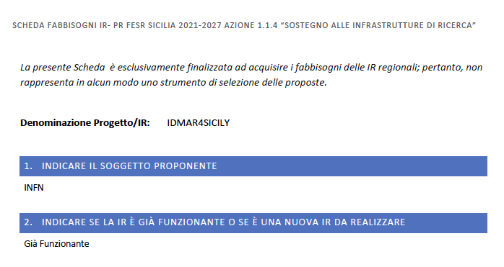
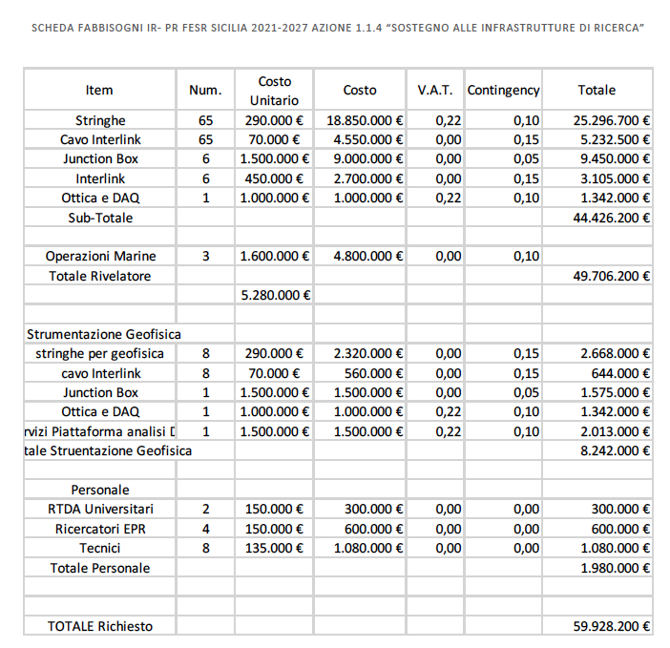
IDMAR4SICILY
(INFN,UNICT, UNIPA, INGV)
Bando previsto settembre 2024
Durata 3 anni
Intensità di finanziamento 80%

Slide 36
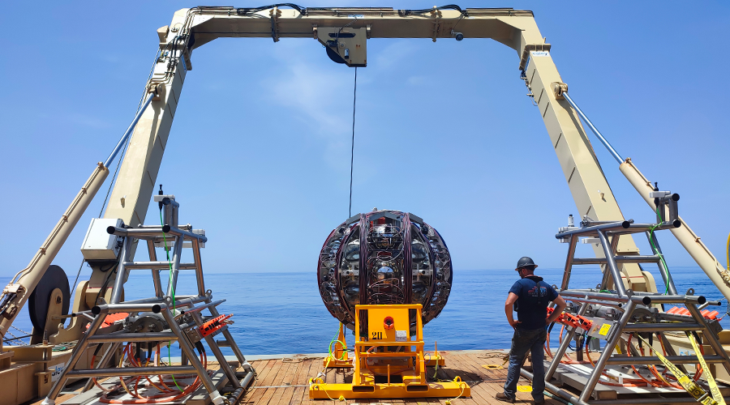
Thank You for your Attention from:
Km3NeT & Km3NeT4RR

