Slide 1
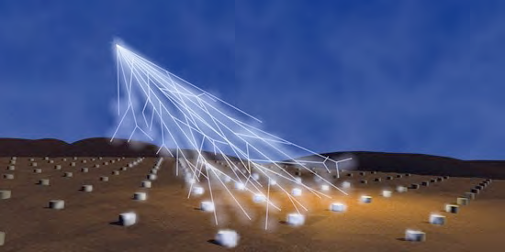
MAIANI 70
September 21-22, 2011
The Pierre Auger Observatory
Anulfo Zepeda
Cinvestav, Mex.

Slide 2
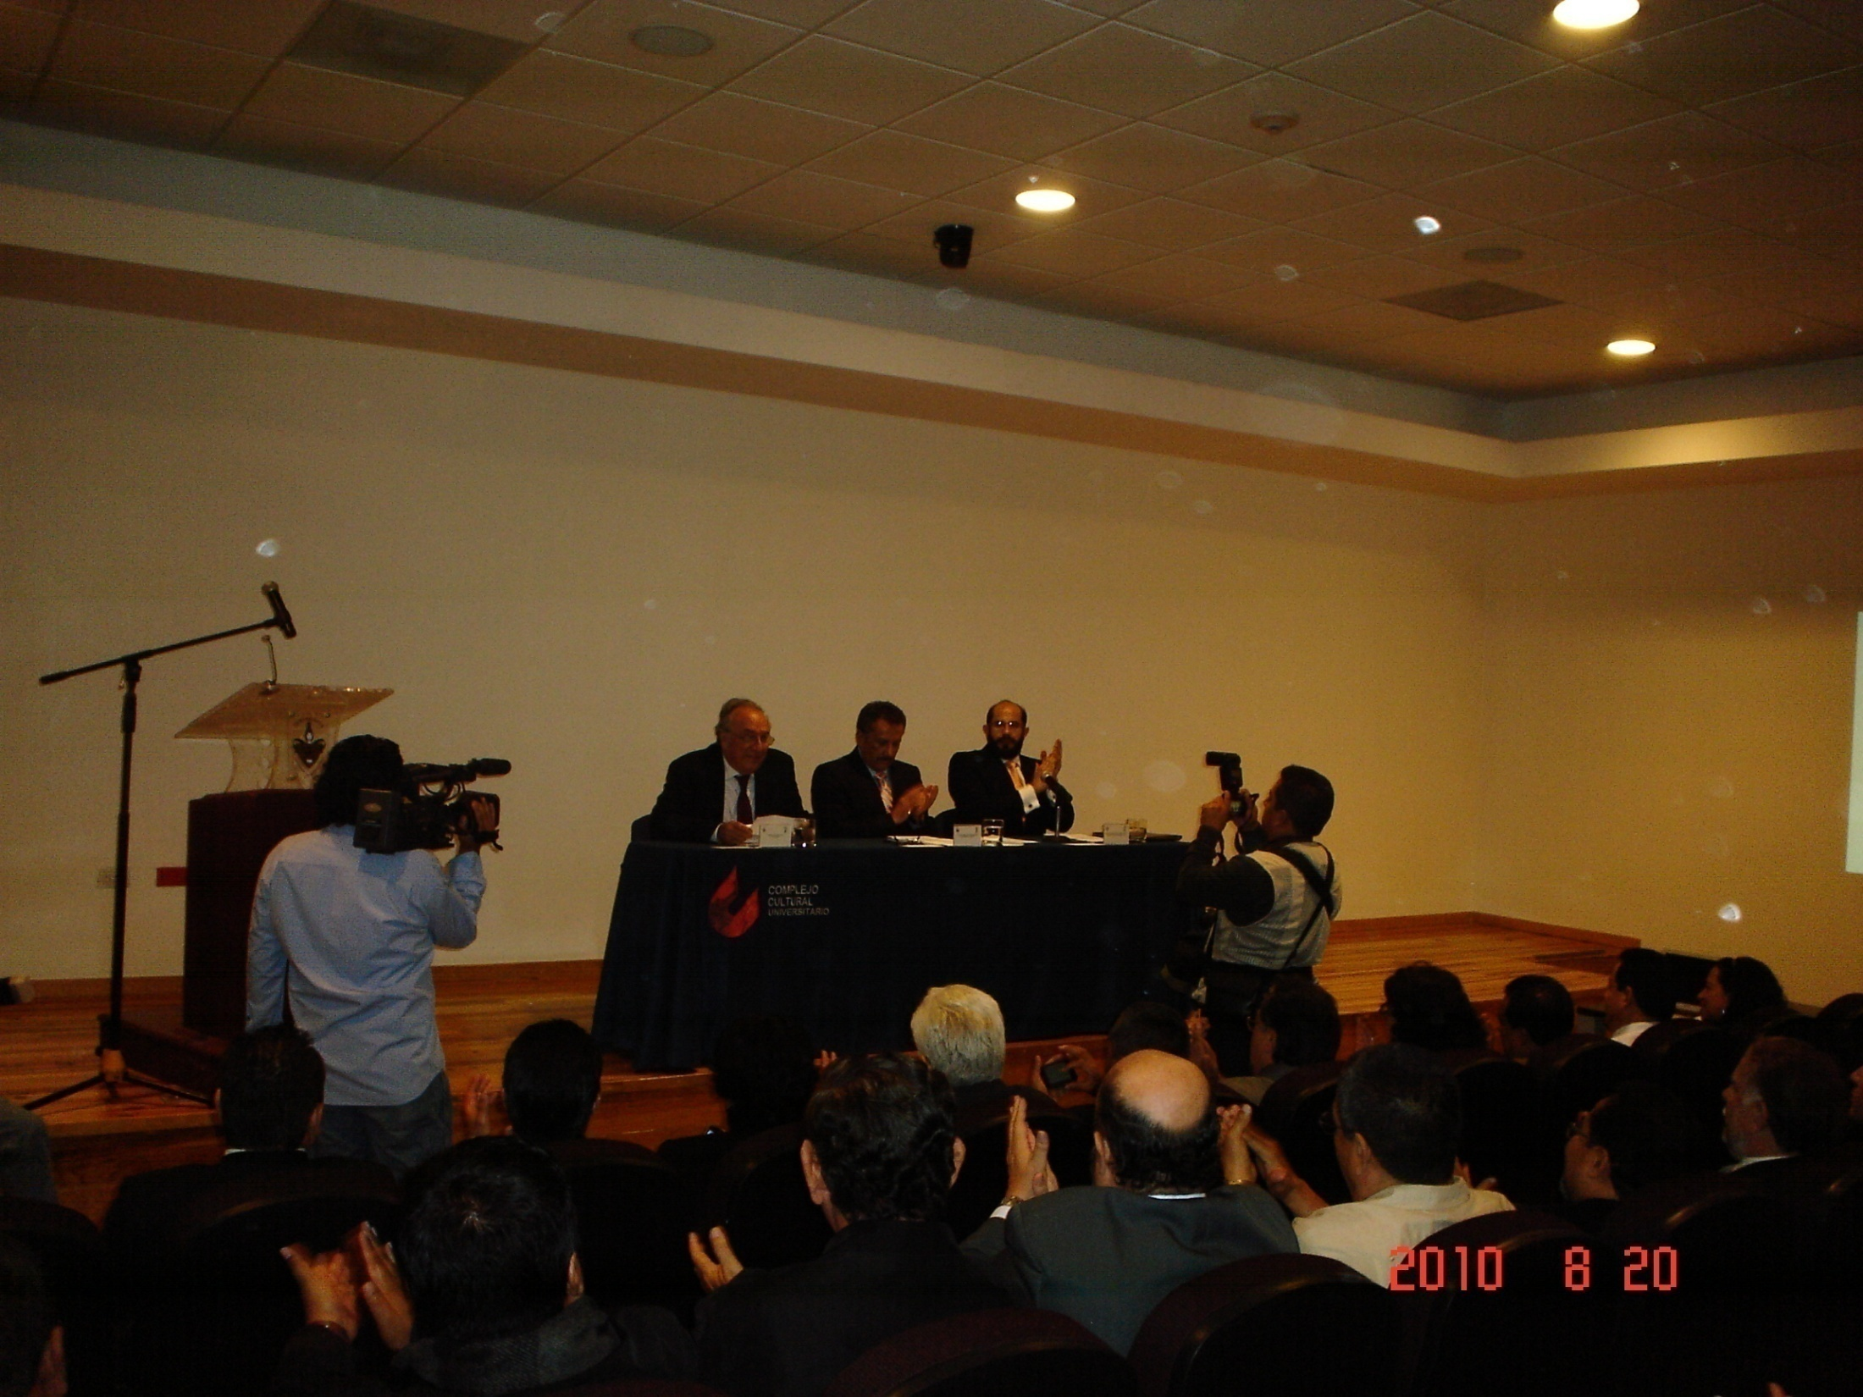
MAIANI 70
September 21-22, 2011

Slide 3

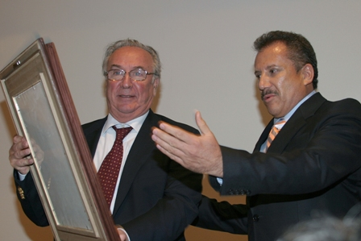
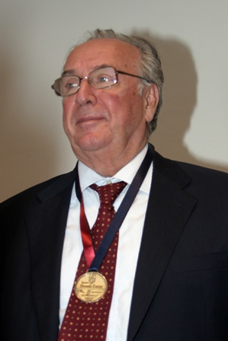
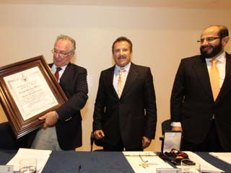
Honoris Causa from the Benemérita Universidad
Autónoma de Puebla to Prof. L. Maiani
The Rector of BUAP, Dr. Enrique Agüera Ibáñez sends his congratulations to Prof. Maiani

Slide 4



Other Mexican institutions, Cinvestav , Universidad Michoacana, UNAM, have also been benefited from their association with Prof. Maiani
Conferences
Seminars
Curses
International projects

Slide 5
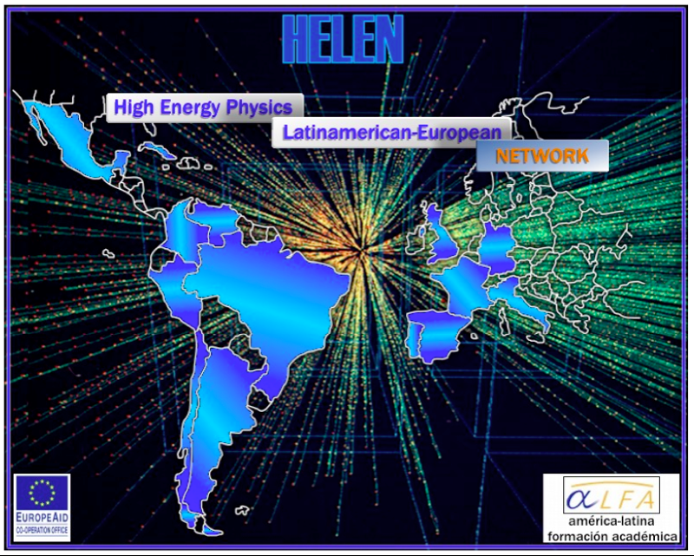
August , 2005 –August 2008

Slide 6
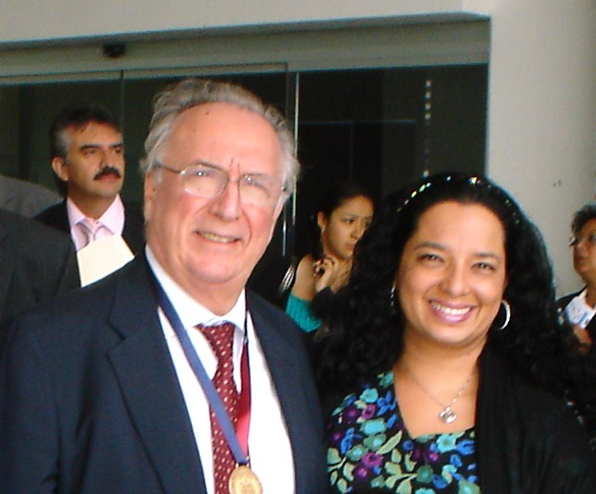
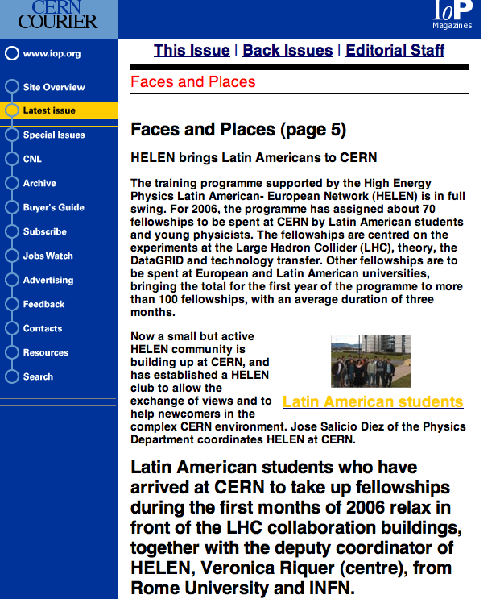
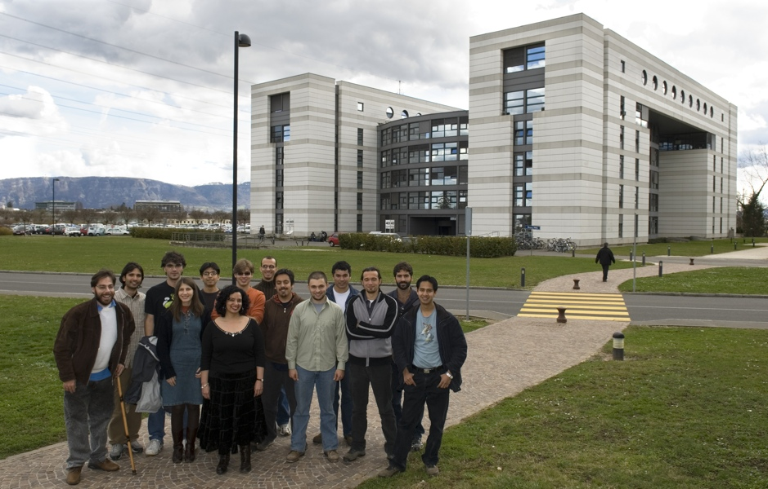
From 2005 to 2008 the participation of Mexico, other Latin American countries and several European countries, in the Pierre Auger Experiment, as well as in CERN experiments and other research teams, was made possible through the HELEN program, financed by the European Union and under the coordination of Luciano Maiani, and Veronica Riquer as deputy coordinator.

Slide 7














Argentina | Brazill | Chile | Colombia | Cuba | Mexico | Peru | Venezuela
Grants first year, first call
Latin America
4
1
1
1
3
1
1
1
1
1
1
6
3
3
1
21
1
1
1
21
3
1
2
2
7
2
1
2
1
1
3
1
4
1
3
1
1
1
2
1
1
1
CERN DESY France Italia Portugal Spain
Europe

Slide 8

Argentina | Brazill | Chile | Colombia | Cuba | Mexico | Peru | Venezuela
Second call
Latin America
1
2
1
1
1
1
6
3
2
9
2
8
2
1
1
2
3
1
1
1
6
1
1
1
1
CERN |  | France | Italia
DESY
Spain
TOTAL GRANTS 1st & 2nd Year: 347
LA to EU: 243
EU to LA: 64
LA to LA: 40
Europe

Slide 9
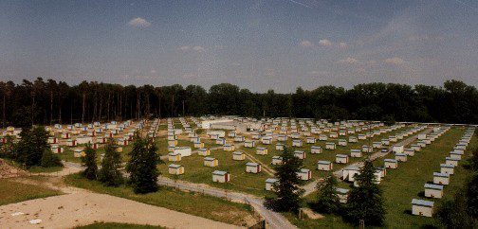
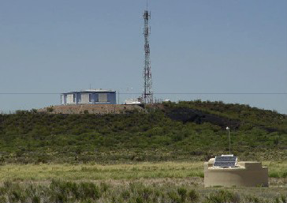
Cosmic
ray
flux
Energy
Notes:
9

Slide 10

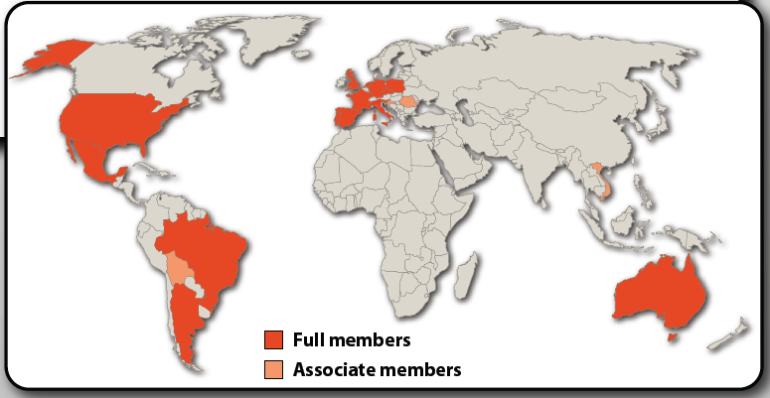
Pierre Auger Collaboration
~450 collaboration members in 19 countries:
Argentina Netherlands Bolivia*
Australia Poland Romania*
Brasil Portugal Vietnam*
Croatia Slovenia *Associated
Czech Republic Spain
France UK
Germany USA
Italy
Mexico

Slide 11
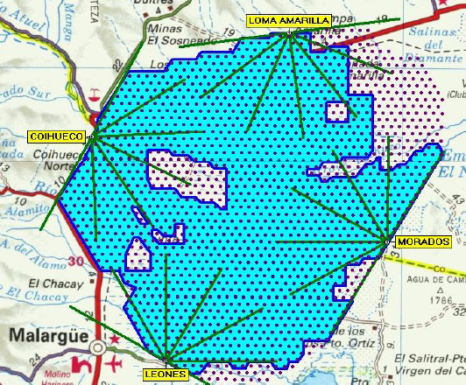
At the highest energies, only few cosmic rays arrive per km² per century ! to see some, a huge detector is required
THE PIERRE AUGER OBSERVATORY
SD 100% DC
FD 13% DC
1600 detectors over 3000 km² (triangular grid with sides of 1.5km)
and 24 telescopes
Notes:
11

Slide 12
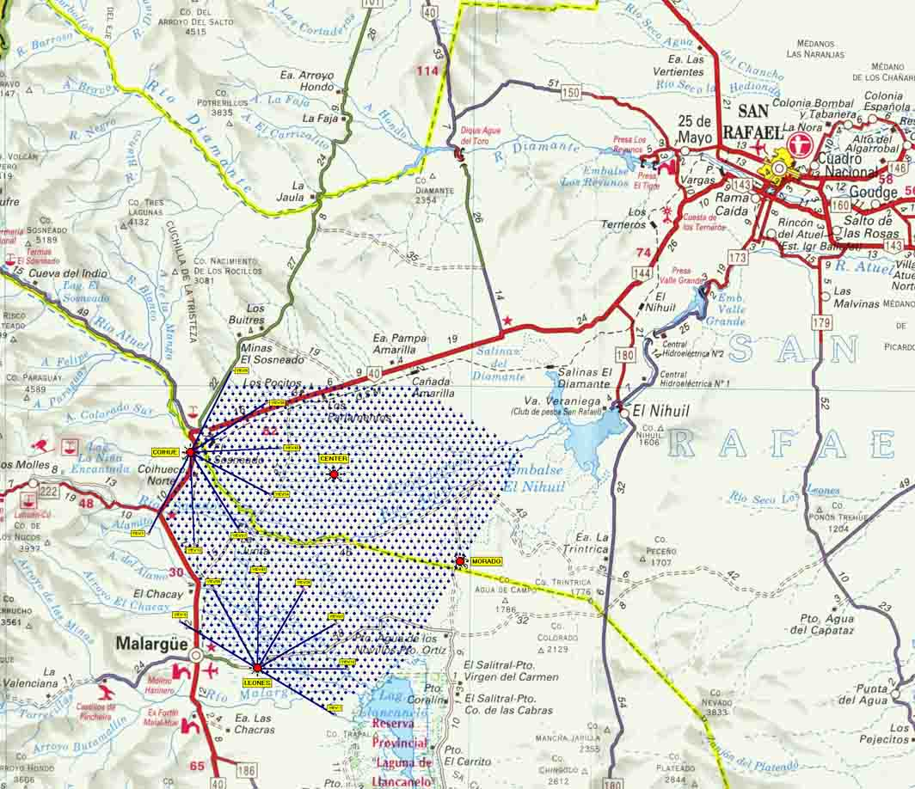

Pampa Amarilla
1300-1400 msnm
A. Zepeda
Notes:
12

Slide 13
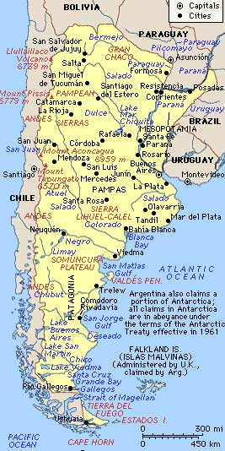
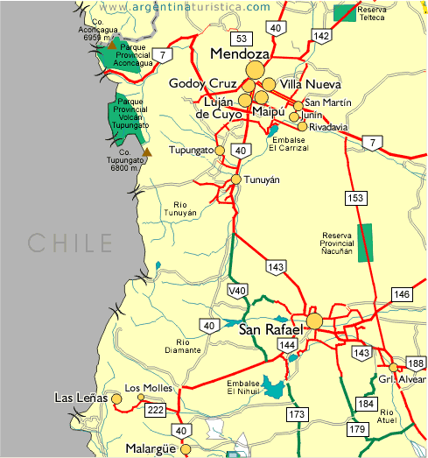
A. Zepeda
Notes:
13

Slide 14
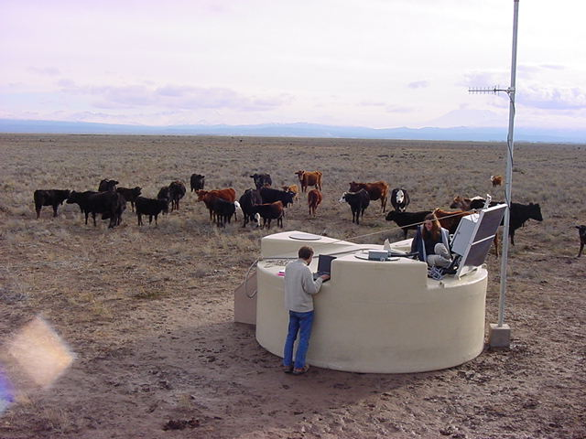
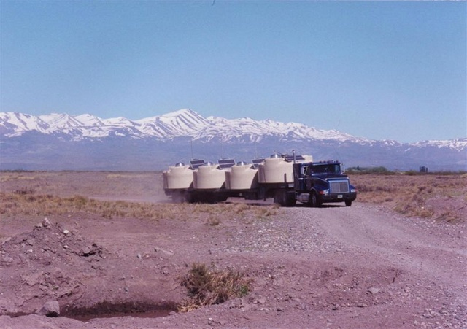
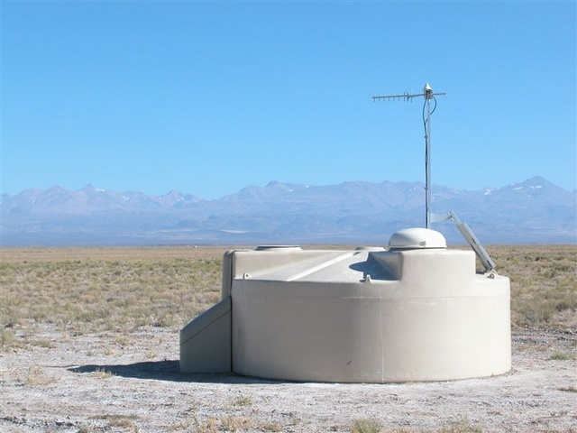
surface detector
Notes:
14

Slide 15
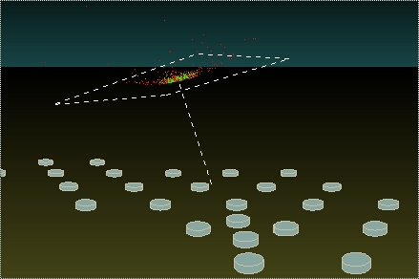
Notes:
15

Slide 16
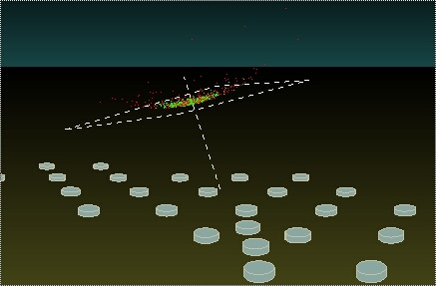
Notes:
16

Slide 17
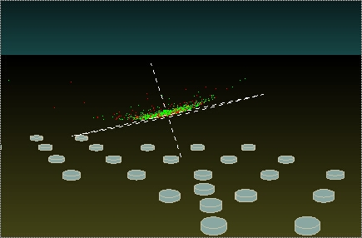
Notes:
17

Slide 18
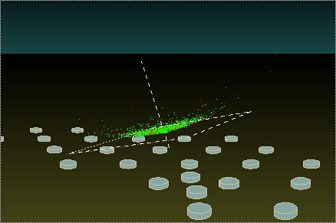
Notes:
18

Slide 19
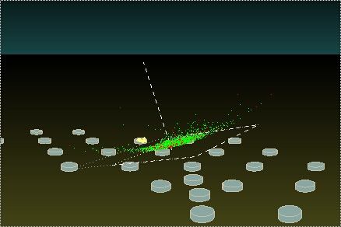
Notes:
19

Slide 20
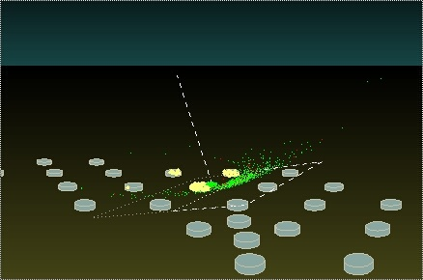
Notes:
20

Slide 21
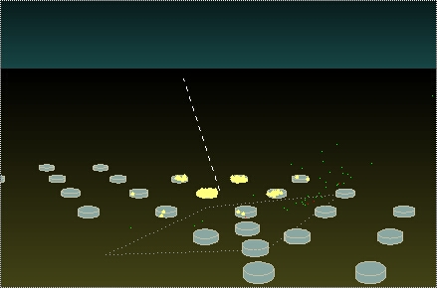
Notes:
21

Slide 22
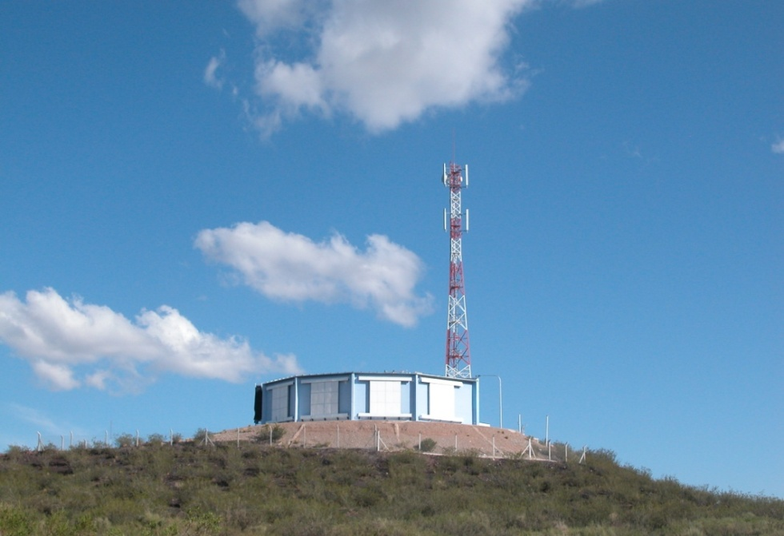
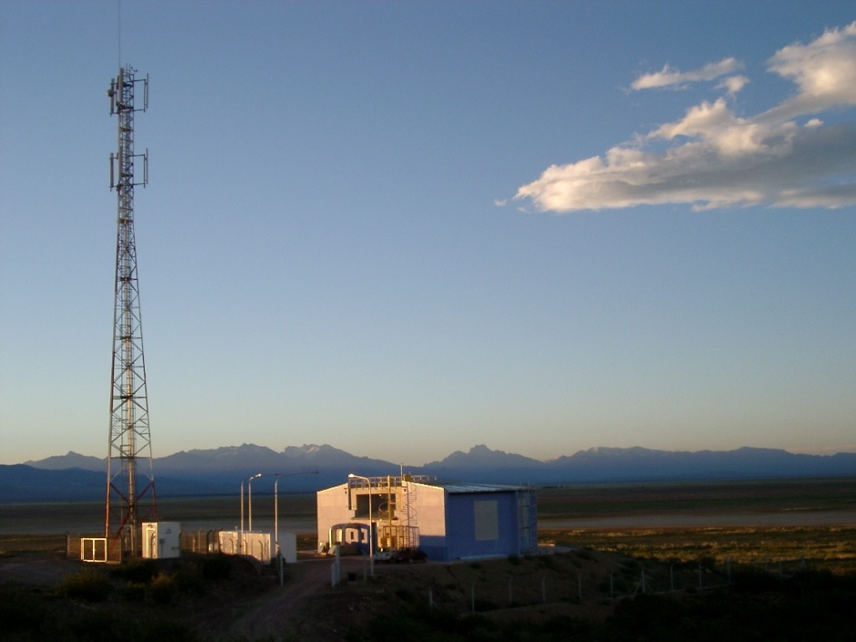
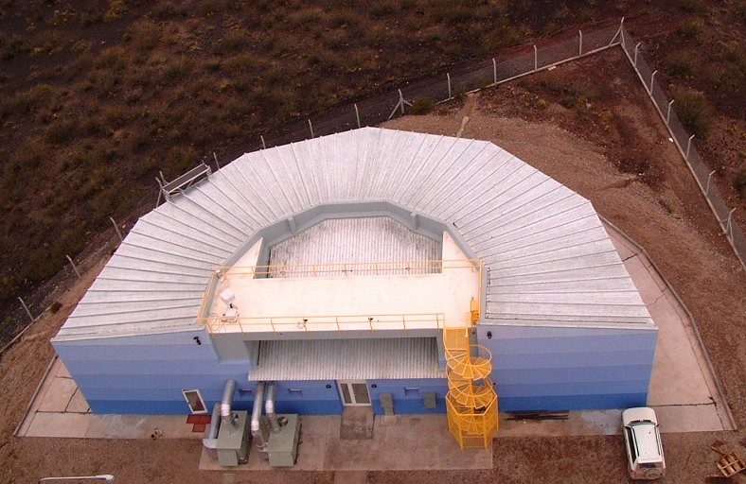
The Fluorescence Detector
Los Leones
Notes:
22
Here are three views of one of the fluorescence detector enclosures. From the top you can see each of the six – 30 degree segments that contain a telescope.
The tower is for communicating with the surface detector stations and to the Auger campus.

Slide 23
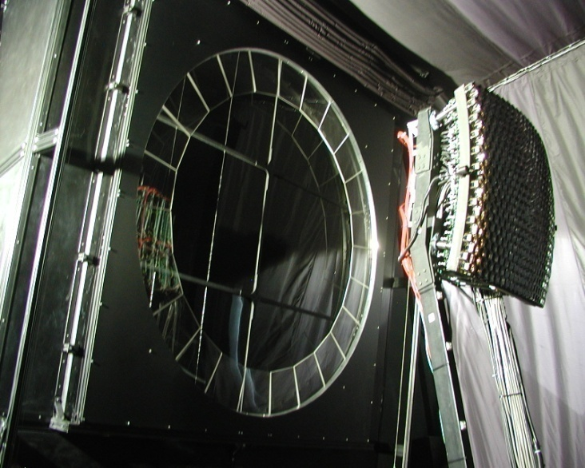
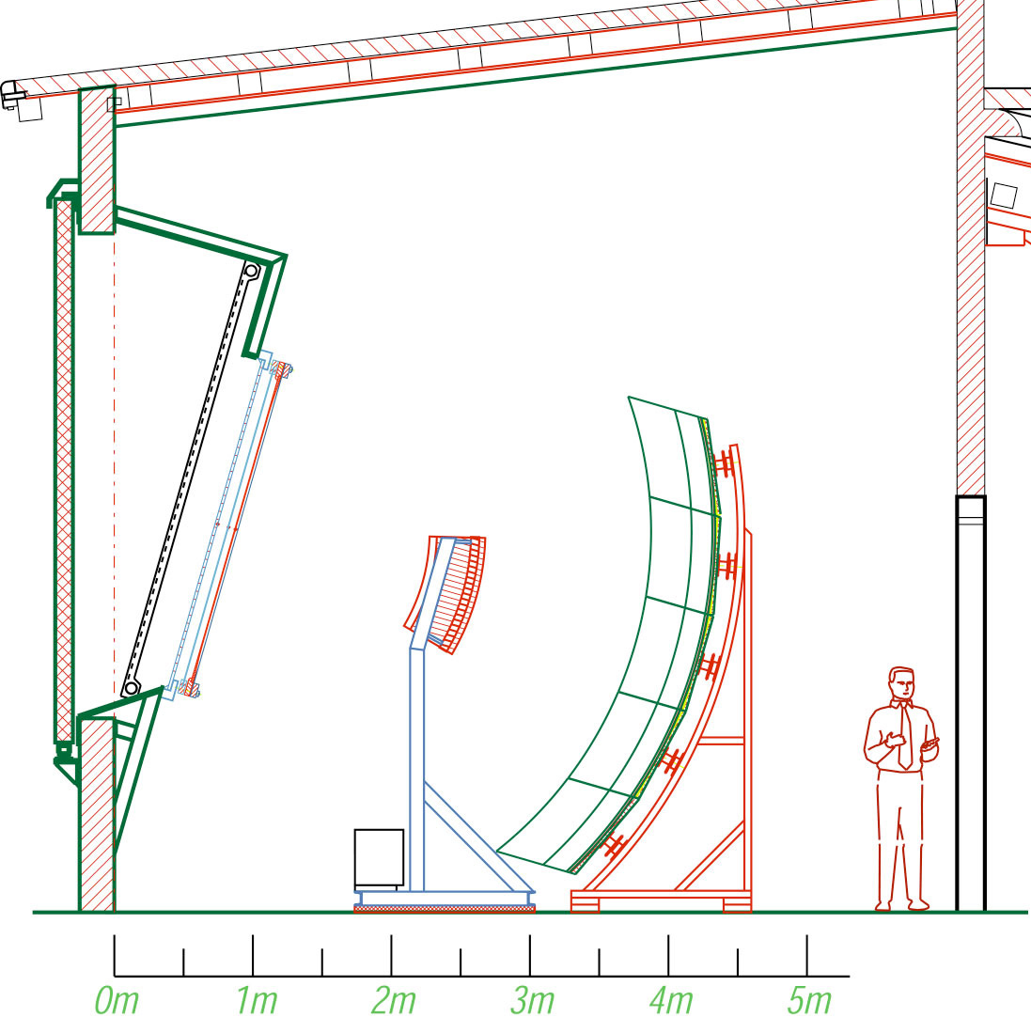
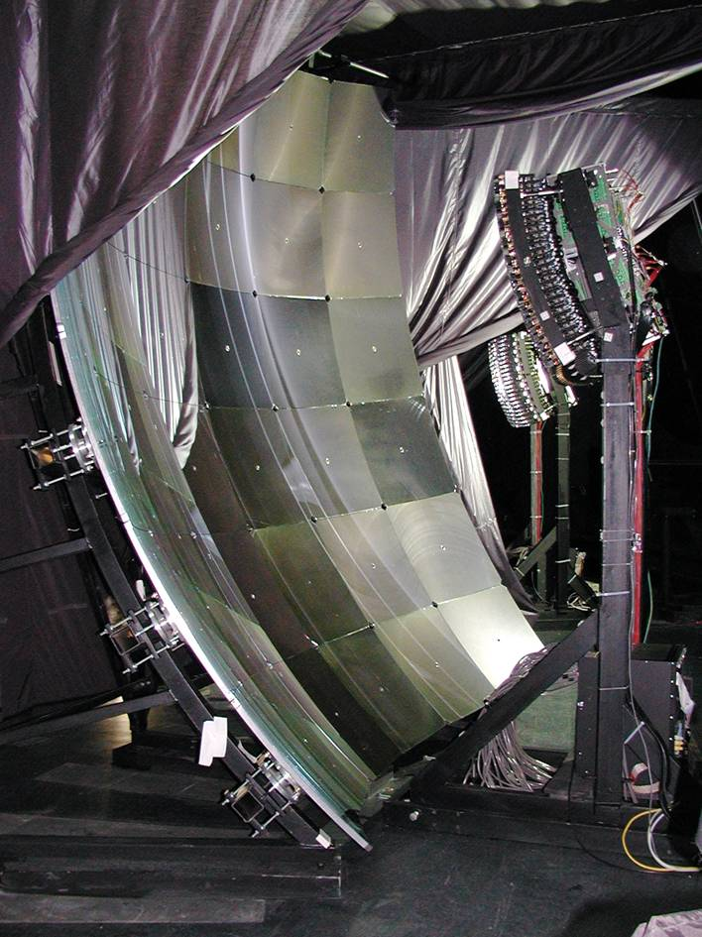
fluorescence detector inside
440 pixel camera
3.4 meter diameter segmented mirror
aperture stop, filter, corrector lens
Notes:
23

Slide 24
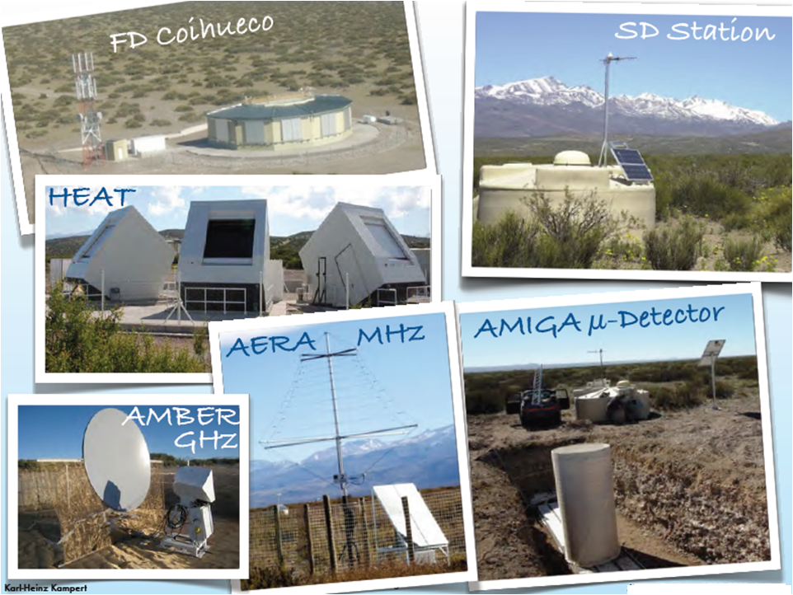

Slide 25
Auger News and Science
Results @ ICRC 2011 in a nutshell (1)
Exposure: 21000 km2 sr yr (+60% since Łódź)
• Status of Observatory and Enhancements:
- first data from infill array
- first data from HEAT
- first triple hybrid event: SD+FD+Radio
• Energy Spectrum
- improved statistics and reconstruction
- measured down to 3·10¹⁷ eV
• Hadronic Interactions
- first p-Air and pp cross-section at √s=57 TeV
- μ-deficit by factor of ~2 in all interaction models

Slide 26
Auger News and Science
Results @ ICRC 2011 in a nutshell (2)
• Hadronic Interactions
- first p-Air and pp cross-section at √s=57 TeV
- μ-deficit by factor of ~2 in all interaction models
• Anisotropies and Astrophysics
- update AGN correlation, multiplet searches
- first harmonic analyses
- first point source searches
- B-field and source density estimates
• Solar Physics, Atmospheric Phenomena
- Forbush decreases
- Observation of Elves
• Atmosphere, Operation and Performance

Slide 27
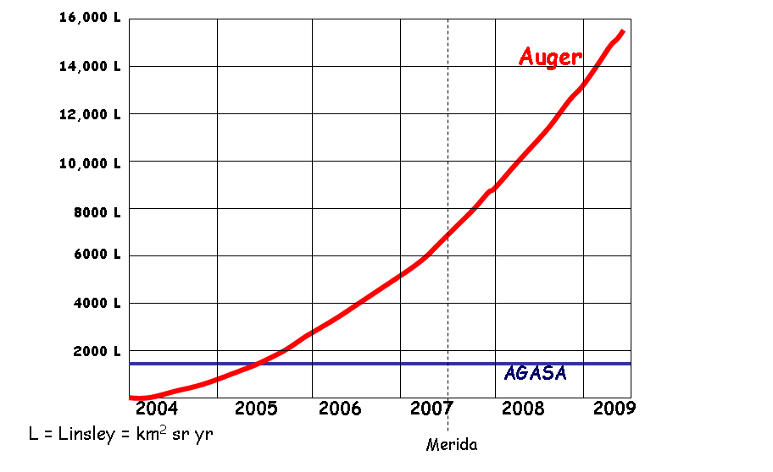
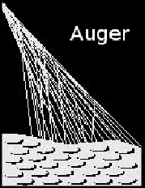

Exposure
Now 21,000 L
Since Mérida, the Auger exposure has doubled
2 years of full aperture
HiRes @ 100 EeV
HiRes @ 10 EeV
Now nearly ten times the AGASA exposure.
Suomijarvi
HE 0353
Sommers Lodz
27
Notes:
27

Slide 28
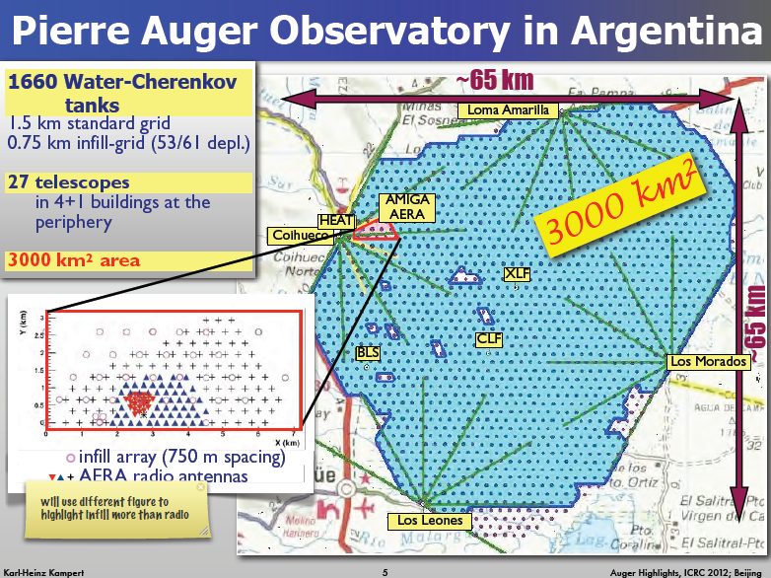

Slide 29
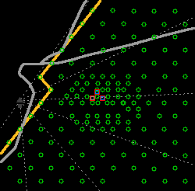
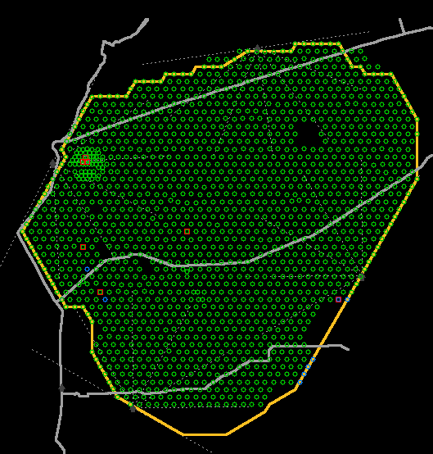
Deployment Status from CDAS file, as of September 17, 2011
LOMA AMARILLA
COIHUECO
Deployment Status from CDAS file
1643 tanks deployed
1641 tanks with water
1632 tanks with electronics
Color codes
grey = LS deployed
blue = LS filled with water
green = LS with electronics installed
red square = LS with bad altitude measured. Those LS are removed from acquisition.
MORADOS
LEONES

Slide 30
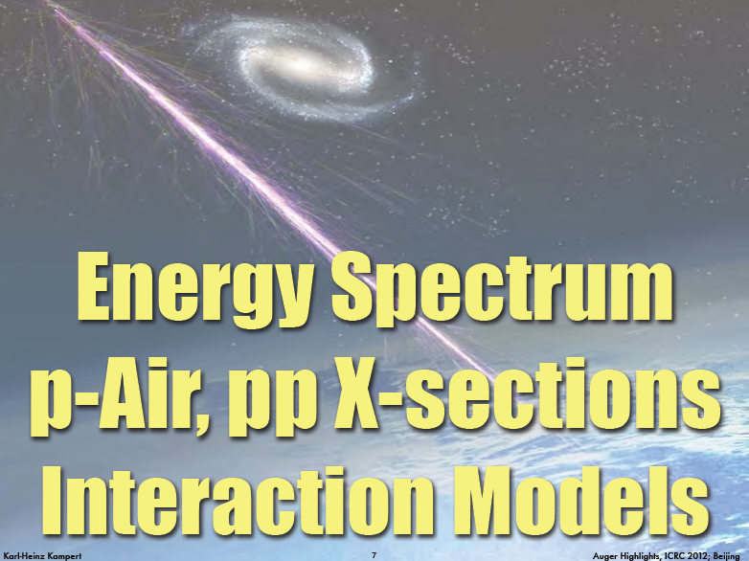

Slide 31
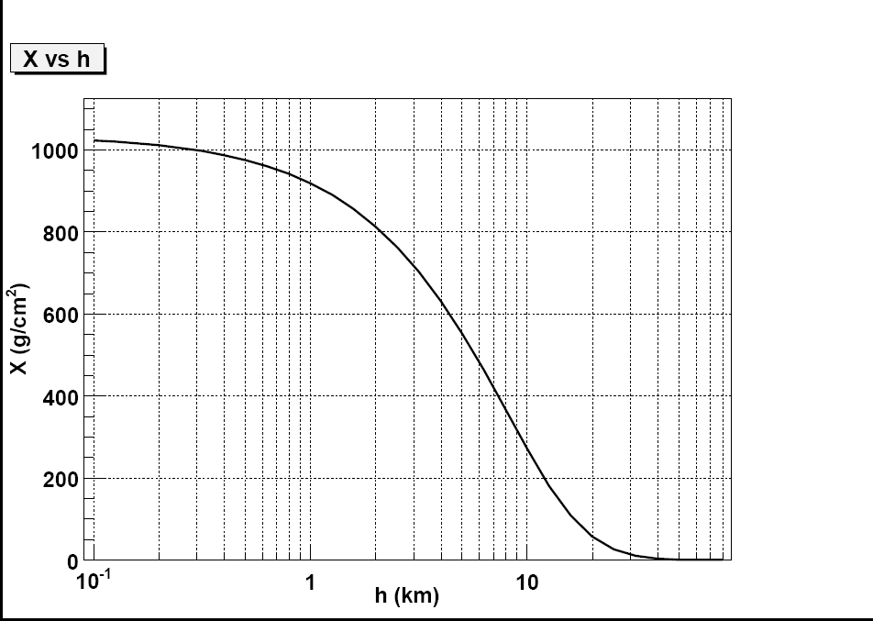
Slant Depth
At 0º
Notes:
31

Slide 32
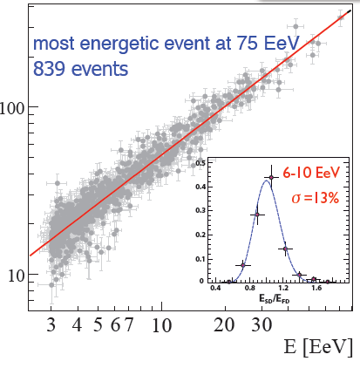
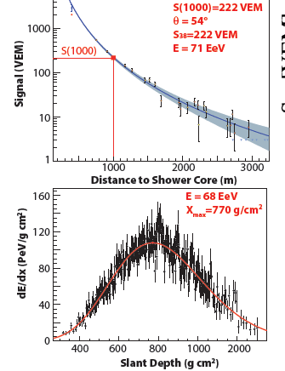


SD Energy Calibration by FD
SD
FD
Systematic uncertainty 7% (15%) at 10 EeV (100 EeV)
Total uncertainty of E-scale: 22% (dominated by Fl.-yield. 14%)

Slide 33
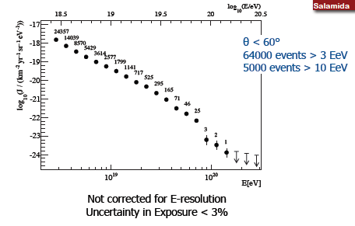
Surface Detector Spectrum
Notes:
59,586 events with E> 3EeV, 4790 events with E> 10EeV

Slide 34
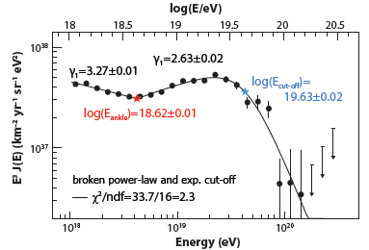
SD + Hybrid Combined Spectrum

Slide 35
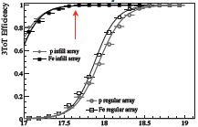
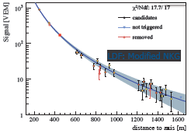
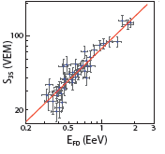
Towards Lower Energies with Infill-Array
750 m infill: fully efficient at 3·10¹⁷ eV and θ<55°
LDF: Modified NKG
Energy calibration again with FD
• event selection to assure an unbiased energy calibration
• strong quality cuts and fiducial field of view cuts
• 44 events with 0.3EeV < EFD < 2EeV
Notes:
Nishimura Kamata Greisen, Fldf(r)=(r/1000m)^B((r+700m)/(1700 m))^B

Slide 36
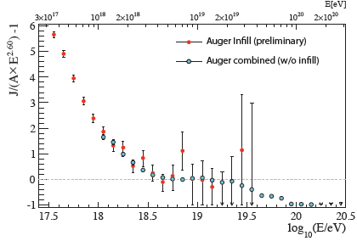
Preliminary Infill Energy Spectrum

Slide 37
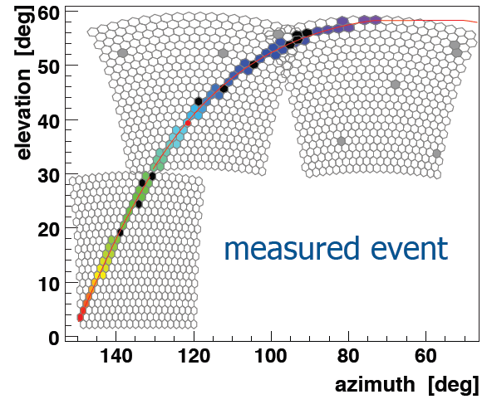
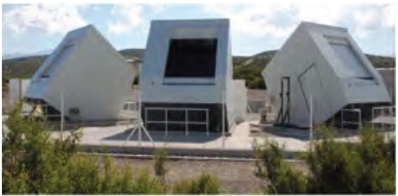




Next Step: HEAT
cross-calibration
gain more than a
factor 3 in # events
HEAT
Auger will cover all
energies above 10¹⁷ eV

Slide 38


p-Air & pp Cross-Section at √57 TeV
Tail of Xmax distribution
Inelastic cross-section
10¹⁸ eV < E < 10^{18.5} eV
tail dominated by protons
dN/dX_{max} ∝ exp (−X_{max}/Λ_{η})
Λ➙ σ_{p-Air}
by tuning models to
describe tail seen in data

Slide 39

p-Air Cross-Section
dominated by potential He contr.
σ_{p-Air}= (505 ± 22_{stat} (⁺²⁶ ₋₃₄) _{sys} ) mb
systematic uncertainties assume <0.5% photons and <25% He

Slide 40

p-p Cross-Section at √57 TeV
σ_{pp} = (90 ± 7_{stat} ⁽⁺¹⁸₋₁₁ )_{sys} ± 1.5_{Glauber}) mb

Slide 41


Slide 42
How we try to infer the variation of mass with energy
X_{max}
photons
< 2% above 10 EeV
protons
Data
Fe
Also tau-neutrino limit
Energy per nucleon is crucial
Energy
Notes:
42

Slide 43



Measurement of Longitudinal Shower Development
From the Fluorescence Detector:
• ⟨ X_{max} ⟩
• full X_{max}-distribution
• RMS(X_{max})
From the Surface Detector:
• azimuthal asymmetry
of the signal risetime: Θ_{max}
• time difference between μ and
shower plane ➙ ⟨ Xμmax ⟩

Slide 44




Comparison of Methods
Muon Production Depth
from timing differences
Shower Maximum from
asymmetry of rise times
Xmax from FD
RMS(Xmax) from FD

Slide 45

Xmax Distributions
With increasing energy:
- distributions become
Narrower
- deep Xmax tail
reduced

Slide 46


Xmax Distributions vs Models
• wide distribution
• well described with a
substantial fraction of protons
• narrow distribution
• compatible with significant
fraction of heavy nuclei

Slide 47
PROCESSES ON THE CMBR
Nucleus + γ (MBR)
→ N1 + N2 + p’s+n’s+π’s
lt losses about 2 nucleons per Mpc
⇒ For E ≥ 10 EeV only protons should be considered
Protons
If E ≥ 0.5 EeV
p + γ → p + e⁺ + e⁻
If E ≥ 50 EeV = 0.5 x 10²⁰ eV
p+γ → {
⇒ GZK cut off
Greisen – Zatsepin - Kuz’min (1966)
n’s, π+’s ⇒ ν’s
π° → 2γ γ + γ → e+e- ⇒ E_{γ} < 10¹⁴ eV

Slide 48


First Photon Limits using Hybrid Events
Photons characterised by:
• deep Xmax in FD
• small signal in SD
SD-signal
• Exotic Models disfavoured down to 1 EeV
• (optimistic) GZK in reach
6 background events
(compatible with expected nuclear background)

Slide 49

Update of Neutrino Limits
Search for
• up-going Earth-skimming showers
• down-going Neutrino showers
Search criteria
• young ν induced showers ➙ wide time distribution in tanks
• elongated footprint of inclined shower
• propagation speed of shower front at ground
sensitive to all flavors
no
candidates
found

Slide 50

Diffuse Neutrino Limits
Integral: k < 2.8·10^{–8} GeV cm² s^{–1} sr^{–1} from 1.6·10¹⁷ - 2.0·10¹⁹ eV (ν_{τ})
k < 1.7·10^{–7} GeV cm² s^{–1} sr^{–1} from 1.0·10¹⁷ - 1.0·10²⁰ eV (all ν)

Slide 51


Slide 52


Notes:
52

Slide 53


Update of Correlation with VCV-AGN
Astropart. Phys. 34 (2010) 314
AGN position
(3.1° circle)
event position
Update including June 2011
33±5%
Total: 28/84
P=0.006
Telescope Array:
8/20 = 40%
with iso-bkg = 24%

Slide 54

Far greater exposure is needed to
  Identify the class of sources via anisotropy
  Measure the spectra of bright sources or source regions
  Determine the particle type(s) above 55 EeV
  If protons, measure interaction properties above 250 TeV (CM)
  Determine the diffuse cosmogenic intensity of neutrinos and photons
  Detect cosmogenic neutrinos and photons
Sommers Lodz
54
Notes:
54

Slide 55
Summary
Rich Harvest of Data
Broad Science Program
Stable operation + Enhancements + Exp. Breakthroughs
• Calorimetric Energy Calibration by FD is Crucial
• Models underestimate Muon-Numbers by up to factor ~ 2
• First p-Air and pp Cross-Section much beyond LHC energies
• Consistent Composition Info from FD and SD
• Anisotropies still significant
• Photons and Neutrinos nearing GZK-regime ➙ verify GZK

Slide 56
ACKNOWLEDGEMENTS
Karl-Heinz Kampert for providing many slides
Rebeca Lopez for help in preparing this talk

Slide 58



Models Underestimate Ground Signals
Models underestimate
ground signals by ~ 1.5 - 2
independent tests e.g. using shower
universality yield the same results

Slide 59


Inclined Showers: Models Unterestimate μ-Number
• Inclined showers (62°-80°) dominated by muons
• show broken circular symmetry; accounted for by μ-map
• small EM contribution subtracted from signals ➙ Nμ
Models underestimate
μ-Number up to
factor of 2

Slide 60

Point Source Limits
fixed energy:
10¹⁷ - 10²⁰ eV
1.6·10¹⁷ - 2·10¹⁹ eV
E is a fn of
declination
<10¹⁷ eV
Sensitive to potential point sources of UHE
neutrinos in a broad range in declination.

Slide 61



Update on Cen A
Update including June 2011

Slide 62




Further Searches

Slide 63


Large Scale Anisotropy
Upper limit of
first harmonic in RA
A/S: drift motion due to regular field
Gal: diffuse motion due to turbulent field
C-G XGal: motion of the Galaxy with
respect to the CMB reference frame -
supposed to be the frame of extragalactic
isotropy
Phase Measurement
MC ➙ phase two times more sensitive than amplitude
smooth transition in RA from 270° to 90°

Slide 64


Slide 65




Solar & Environomental Physics with Auger
1660 water Cherenkov tanks
count 108 particles/min
15-minute average of the
scaler data are publicly
available at www.auger.org

Slide 66




Observation of Elves
interesting opportunity to
study the elve
evolution with an
unprecedented time
resolution

Slide 67





Birth of Super-Hybrid: SD+FD+Radio

Slide 68
Notes:
68

