Slide 1
muE1 simulations – from pion to muon
muEDM collaboration meeting :: Pisa :: 04./05.04.24

Slide 2
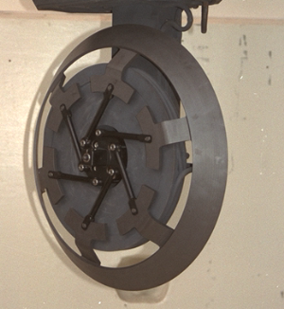
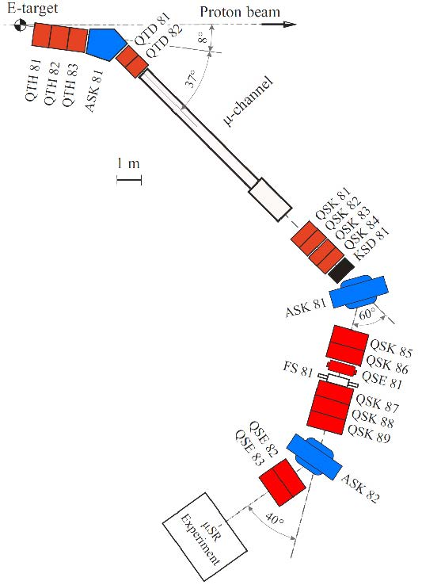
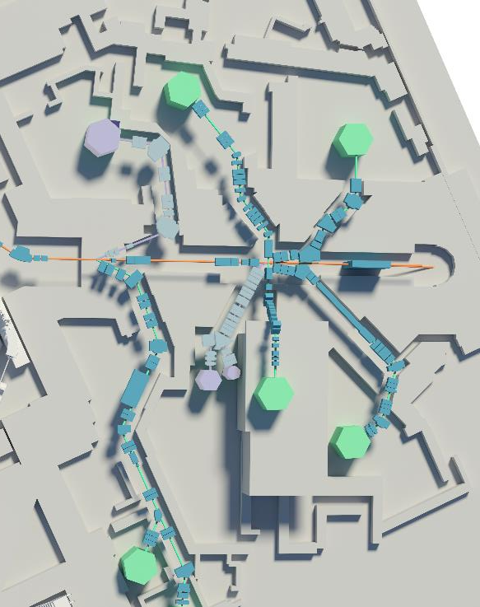


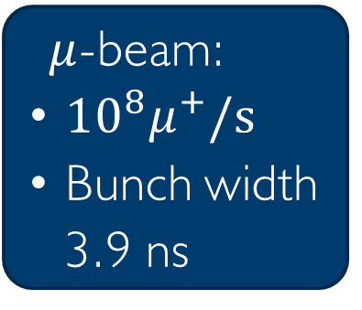

A search for a $μ$EDM at PSI
$$p_{π}=220MeV$$
p -beam
pion decay channel
(8m, 4-5T)
$μ$-beam:
${10}^{8}μ^{+}/s$
Bunch width
3.9 ns
$$p_{μ}=125MeV/c$$
$$μE1$$
muEDM

Slide 3
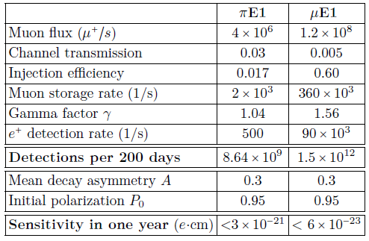
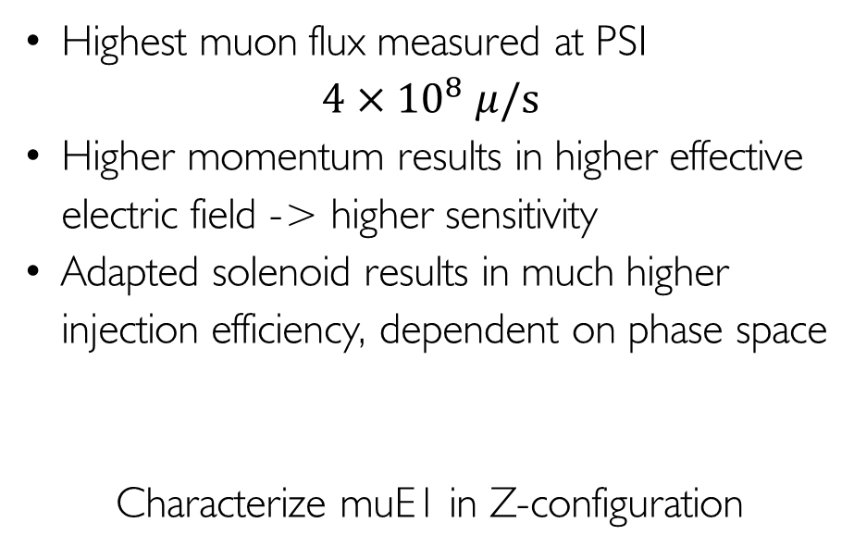
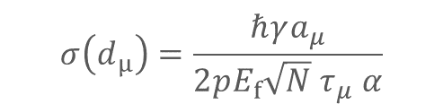
Why muE1? For higher sensitivity to EDM!
$$σ\left(d_{μ}\right)=\frac{ℏγa_{μ}}{2pE_{f}{\sqrt{N} τ}_{μ} α}$$
Highest muon flux measured at PSI
$4×{10}^{8} μ/s$
Higher momentum results in higher effective electric field -> higher sensitivity
Adapted solenoid results in much higher injection efficiency, dependent on phase space
Characterize muE1 in Z-configuration

Slide 4
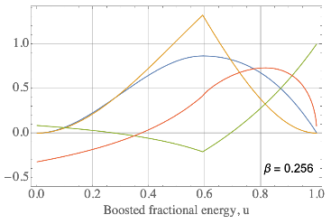
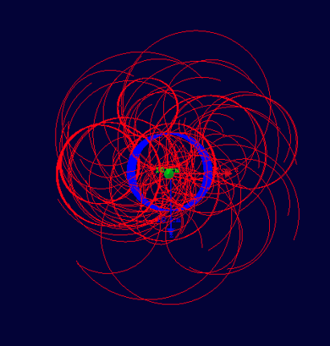
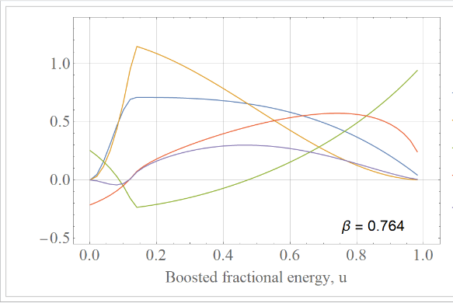
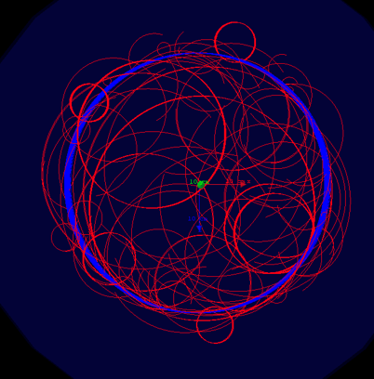


Going from phase I to phase II
Phase I
B-Field 3T
Momentum 28 MeV/c
Muon radius 31mm
Most positrons outside
Phase II
B-Field 3T
Momentum >125 MeV/c
Muon radius 141 mm
Most positrons inside
$≤3×{10}^{−21}$ ecm
$≤6×{10}^{−23}$ ecm

Slide 5
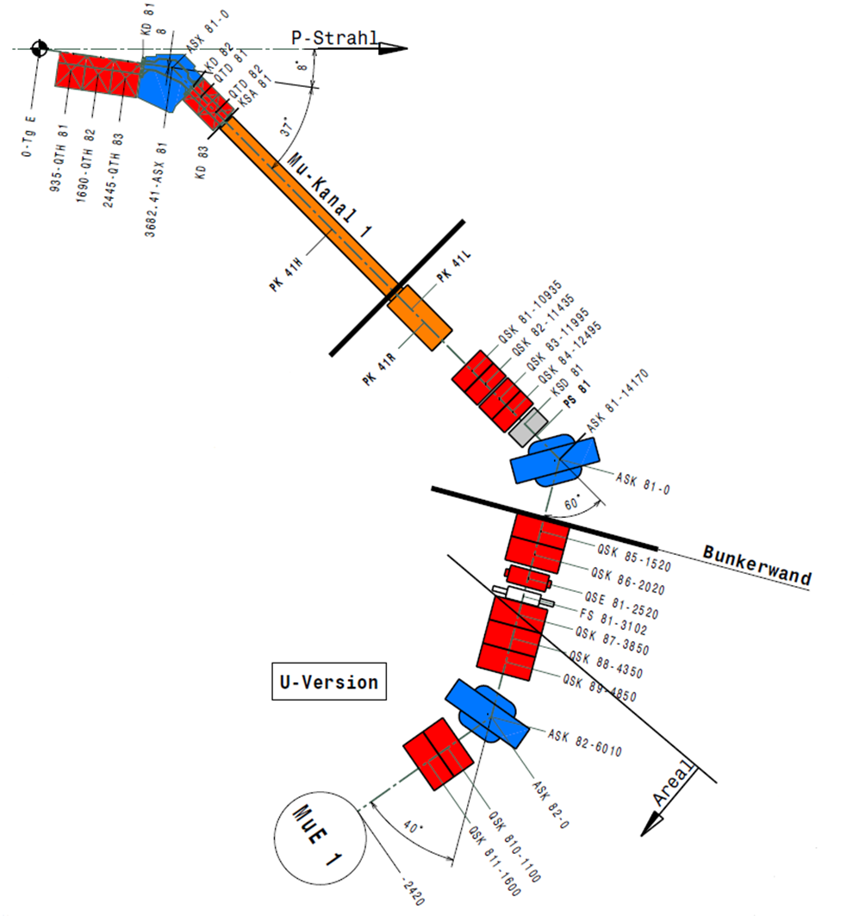
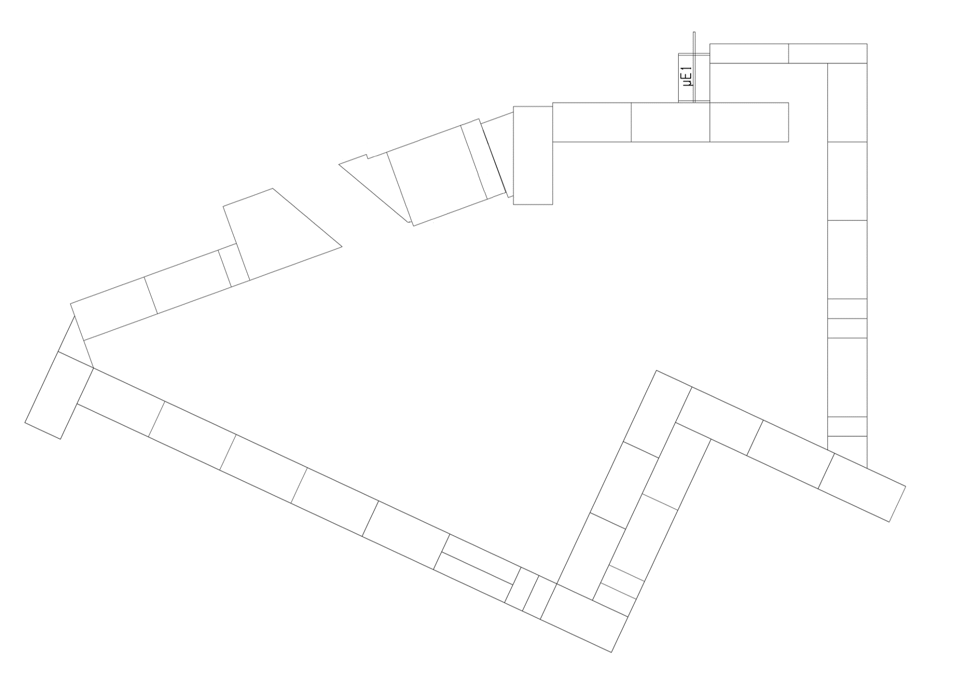
Current status of μE1
Long Decay channel:
    wider momentum range
      ~ 125 MeV/c
    Higher flux
    > 10⁷ μ-/s
    Extraction part:
      2 bending magnets and 13 quadrupoles
      Allow for optimizing for good beam properties
GPD (General Purpose Decay Channel Instrument),
    Enough space for a new bunch
    limited impact on the old application
GPD
Notes:
The current layout of the μE1 is given here. Initially, the pions generated from the production target are collected using a triplet of quadrupoles, and are momentum selected by the first bending magnet. The pions are then transported to a super conducting solenoid and decay into muons in flight.
At the exit of this channel, decay muons can be obtained with the maximum momentum of 125 MeV/c.
Compared to piE1, a broader spectrum and higher intensity of negative muons are available.
The decay muon is transported to experiment port through the following rather complex muon extraction system.
allow to select the momentum and 13 quadrupole magnets control the envelope of muon beam to get good properties. At present, the U-version beamline is operating for a μSR facility, GPD spectrometer. there is still space available in the experiment area for a new branch

Slide 6
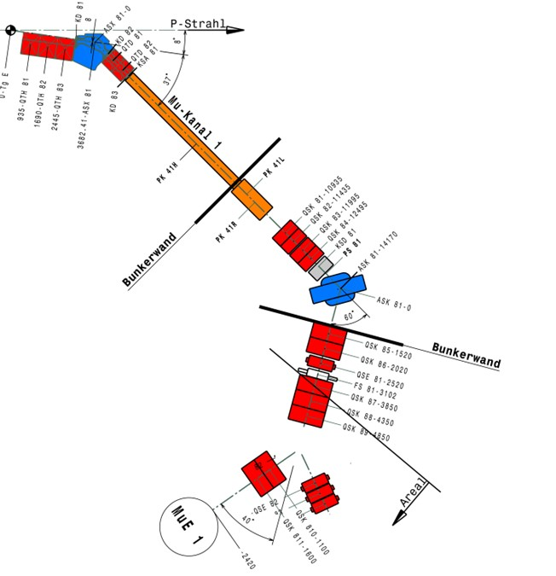
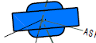
Current status of μE1
task 1
GPD
GPD
GPD
MIXE
task 2
Notes:
In our design, the last bending magnet is rotated by 20 degrees, and a new triplet or doublet of quadrupole magnets is added on this side to focus the muon to the sample area.
When a negative muon beam is required, we just operate the beam from GPD to this side. That will be easy.
Hence, the calculation task consists of two parts: designing the beam envelope on the right side for MIXE and refitting the beam optics of the left branch for GPD with the rotated bending magnet. If we want to proceed with any construction, it is important, however, to minimize any potential change to the existing μSR applications.

Slide 7
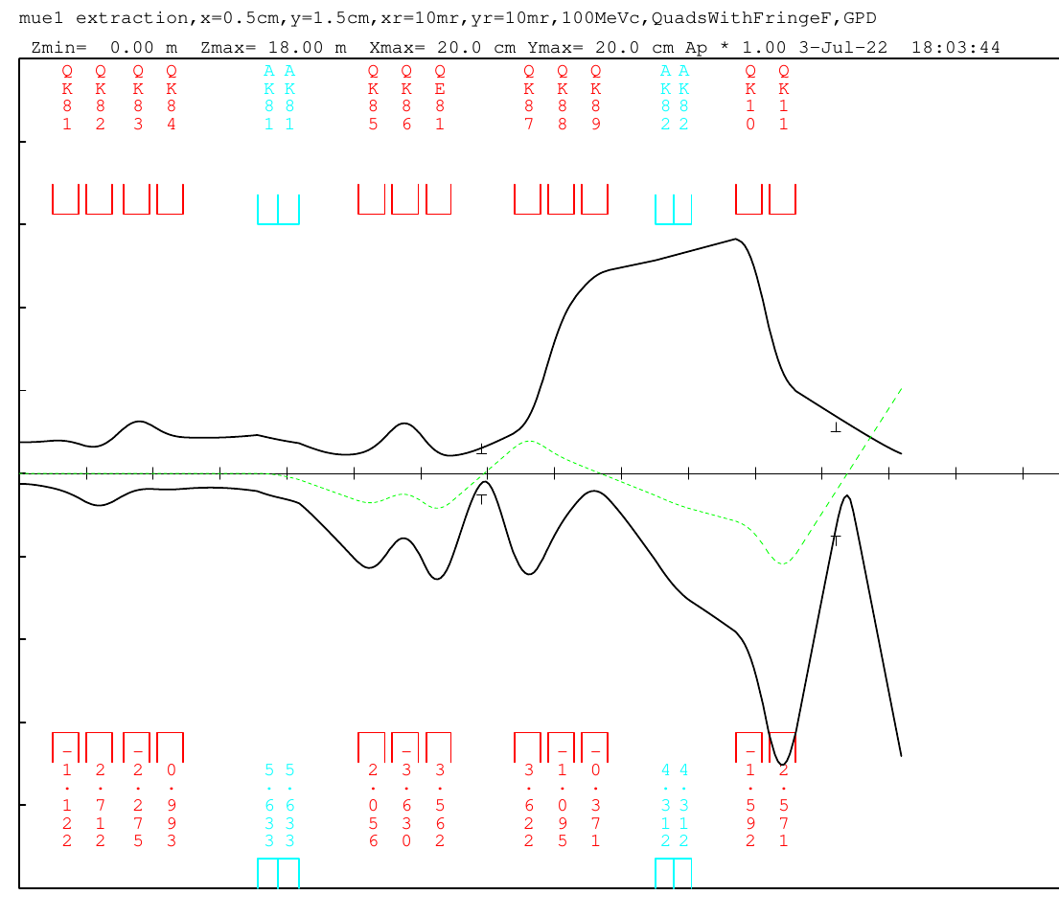
Current status of μE1
TRANSPORT calculation of beam envelope for GPD setting :
Δp/p = 3%, 1st order calculation
starting from the extraction of decay channel
Beam Properties at slit FS81 and GPD: beam size/ achromatic
20
16
12
8
FS81
GPD
4
FS 81
0
XY [cm]
15
4
S [cm]
8
GPD
12
16
20
Courtesy C. Cong
Notes:
Based on the previous research, The beam envelope calculations are carried out using the programs “TRANSPORT” with the current GPD settings. Since beamline settings from the production target to the muon decay channel are unchanged, the calculation is performed from the exit of the decay channel to the end. The lower half of the plot shows the horizontal beam envelope, and the upper half shows the vertical beam envelope.
To ensure minimal impact on the transmission of positive muons to the GPD, it is crucial to maintain the beam spot and achromatic beam at these two positions
Achromatic means the momentum dispersion of beamline is removed and all the particles will pass through the same trajectory.

Slide 8
Beam envelope calculation of μE1 with new layout
proton
proton
proton
40°
20°
Pole of ASK82
Pole of ASK82
GPD
40°
GPD
40°
40°
GPD
40°
40°
muEDM
muEDM
Courtesy C. Cong
Notes:
Now, we can go back to the design of new branch.
the sketches provide us more details about the change.
The red line is center of beam line.
As mentioned earlier, if we rotate this magnet by 20 degrees, a nearly symmetrical layout between the two sides will be created and provide enough space for both branches with a deflection angle of 40 degrees.
Specially, due to the trapezoidal magnet poles of dipole, the pole face rotations are completely different for each branch at the entrance and exit of bending magnet.

Slide 9
Beam envelope calculation of μE1 with new layout
proton
proton
Pole of ASK82
40°
20°
Pole of ASK82
GPD
40°
40°
GPD
40°
40°
muEDM
muEDM
Courtesy C. Cong
Notes:
Now, we can go back to the design of new branch.
the sketches provide us more details about the change.
The red line is center of beam line.
As mentioned earlier, if we rotate this magnet by 20 degrees, a nearly symmetrical layout between the two sides will be created and provide enough space for both branches with a deflection angle of 40 degrees.
Specially, due to the trapezoidal magnet poles of dipole, the pole face rotations are completely different for each branch at the entrance and exit of bending magnet.

Slide 10
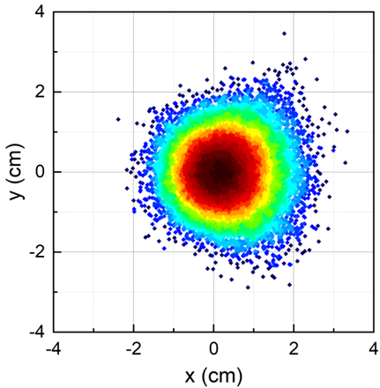
Beam envelope calculation of μE1 with new layout
For MIXE (straight ASK82): Calculations of beam envelopes, 2nd order calculation, Δp/p=3%
total opening of slit ~25 cm
big momentum dispersion ~4 cm
20
16
12
8
4
FS81
0
XY [cm]
15
4
S [m]
8
40°
12
MIXE
16
20
Courtest C. Cong
Notes:
The second part of design is to achieve a negative muon beam on the new branch with a narrow momentum distribution, which is required for MIXE technique.
In our plan, the slit FS81 with horizontal jaws is employed to manipulate the beam momentum width.
The total opening of the jaws is 25 cm.
So as the dashed line shown in the beam optics, a big momentum dispersion of 4 cm is generated at FS81 by the operation of the triplet in front.
And finally, an achromatic beam is obtained at the sample position. The muon distribution of the beam indicates the circle beam spot

Slide 11
Beam envelope calculation of μE1 with new layout
For muEDM (-20° ASK82): Calculations of beam envelopes, 2nd order calculation, Δp/p=3%
proton
15
12
9
6
3
40°
0
XY [cm]
15
3
S [m]
6
40°
9
muEDM
12
15
Courtesy C. Cong
Notes:
The second part of design is to achieve a negative muon beam on the new branch with a narrow momentum distribution, which is required for MIXE technique.
In our plan, the slit FS81 with horizontal jaws is employed to manipulate the beam momentum width.
The total opening of the jaws is 25 cm.
So as the dashed line shown in the beam optics, a big momentum dispersion of 4 cm is generated at FS81 by the operation of the triplet in front.
And finally, an achromatic beam is obtained at the sample position. The muon distribution of the beam indicates the circle beam spot

Slide 12
Transport results comparison
15
Two configurations of
ASK82 + 2 Quads
-- «tilted» by 20°
-- «straight»
12
9
6
3

Slide 13
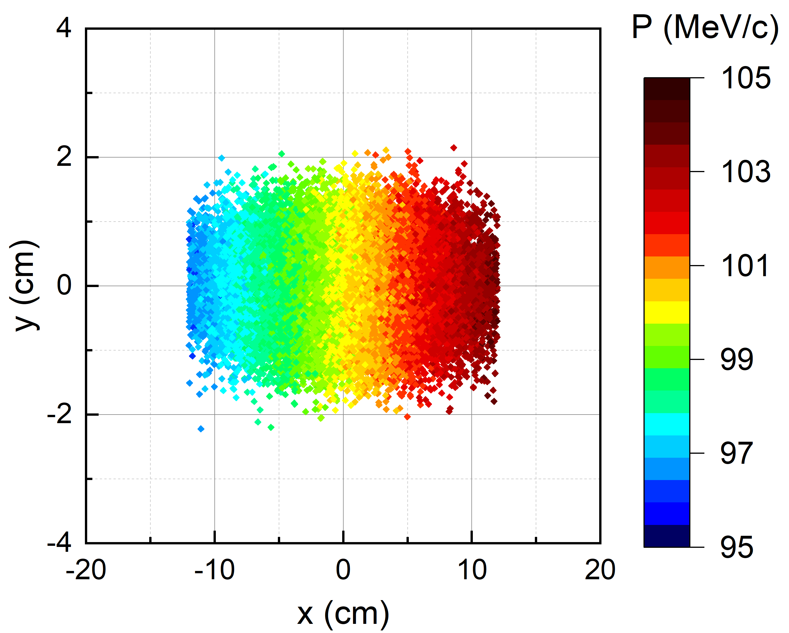
Beam envelope calculation of μE1 with new layout
For muEDM (straight ASK82): Calculations of beam envelopes, 2nd order calculation, Δp/p=0、1、2、3%
20
16
12
8
4
FS81
0
XY [cm]
15
4
Δp/p =1%
S [cm]
8
Δp/p = 2%
40°
Δp/p = 3%
12
MIXE
16
20
Courtesy C. Cong
Notes:
How can we control the momentum distribution with the optics?
basically, the momentum dispersion of a beam will cause that different parts of the beam to deviate from the desired path, resulting in a larger beam.
for example, the black line represents a beam optics with dp/p of 3%, while the red lines are dp/p = 0%, 1%, and 2%, respectively.
At the position of zero dispersion, that means dashed line is zero, all the lines overlap, indicating that muons follow the same path.
However, as we move towards the slit, the black envelope becomes much larger compared to the red envelopes.
This plot from TURTLE simulation represents the muon distribution on the slit.
The color of muon point corresponds to their momentum and the reference momentum is 100MeV/c.
The muons with different momentum will pass through different trajectories.
Therefore, the desired momentum distribution at the end of the beamline can be achieved by closing the jaws.

Slide 14
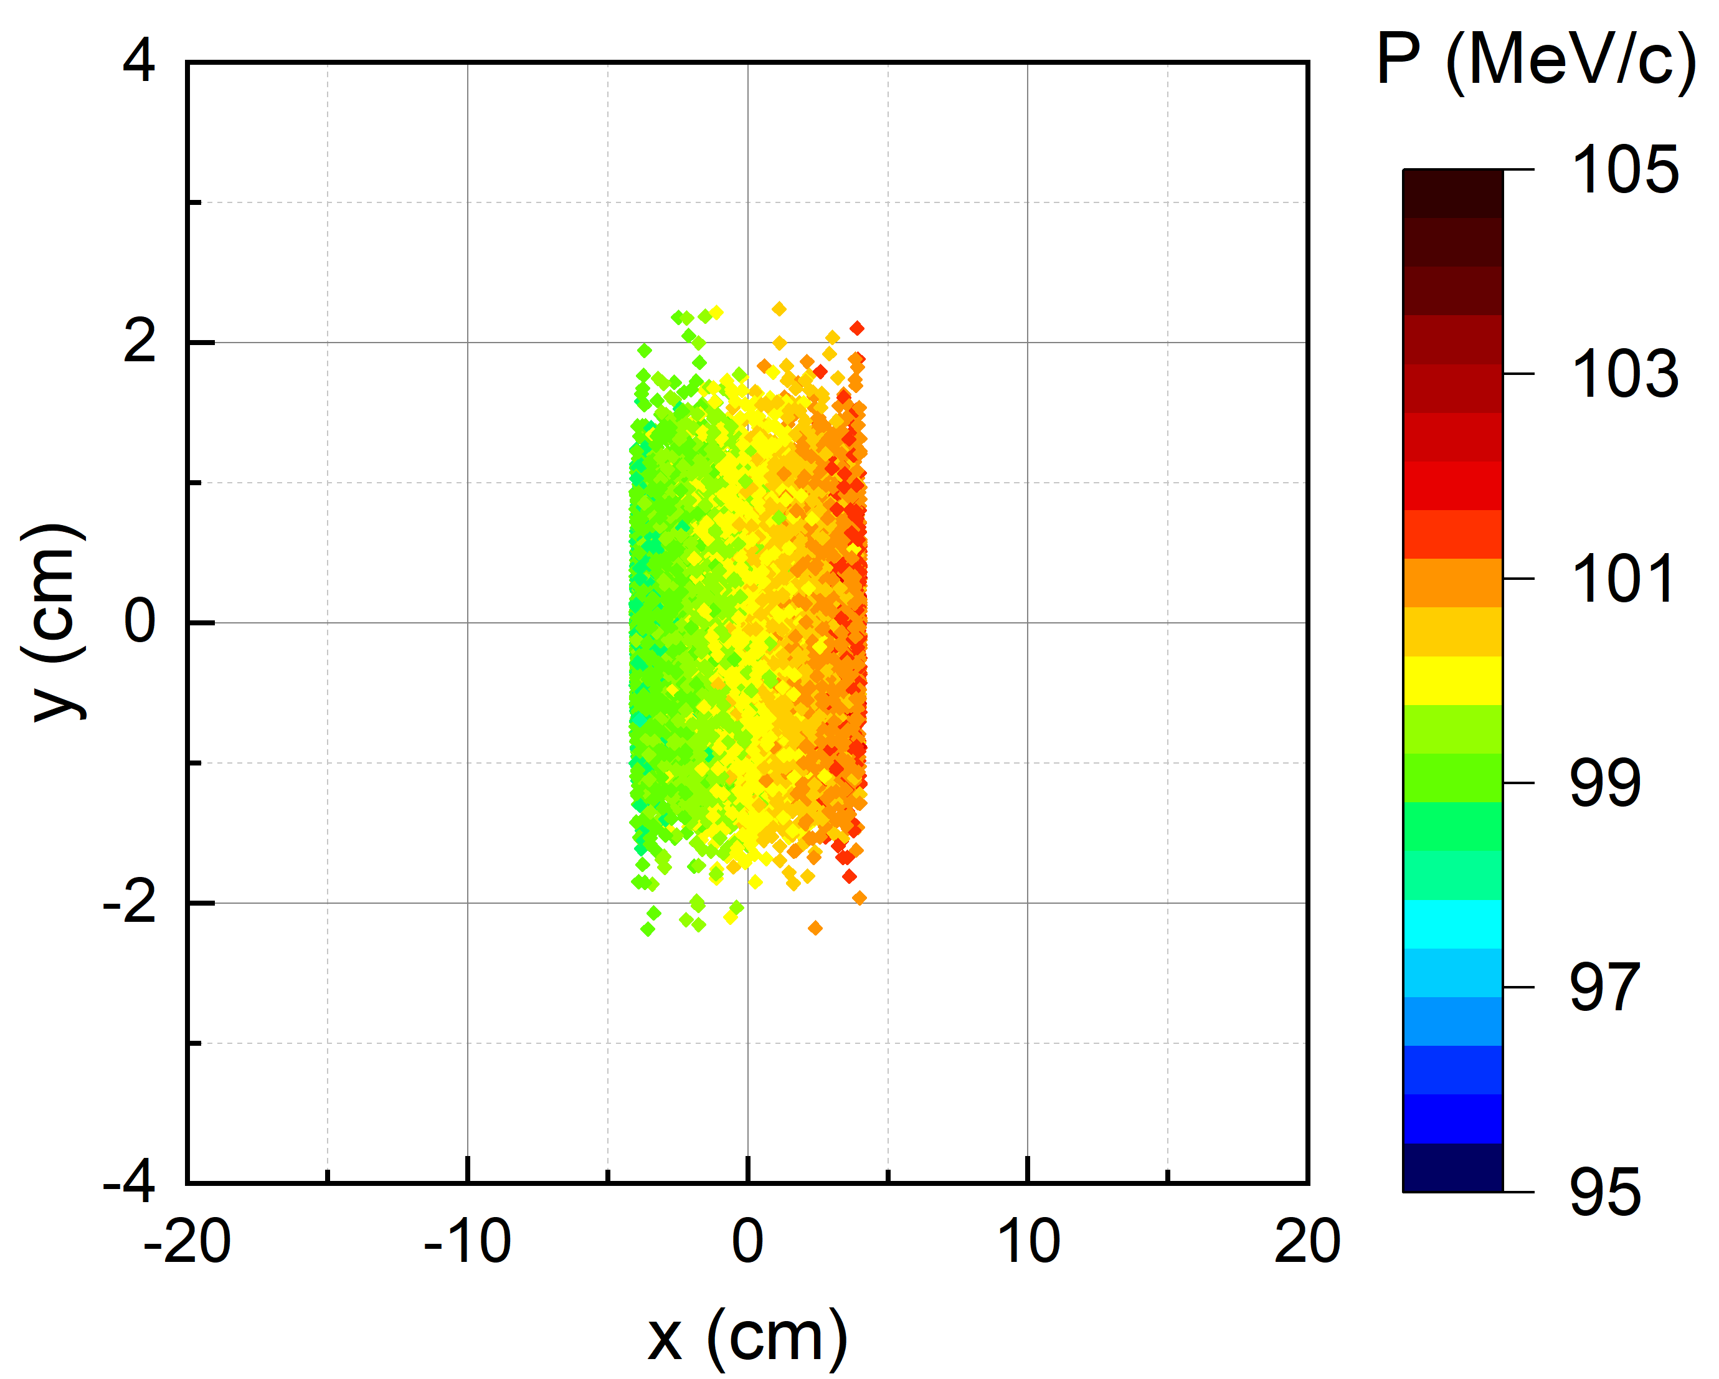
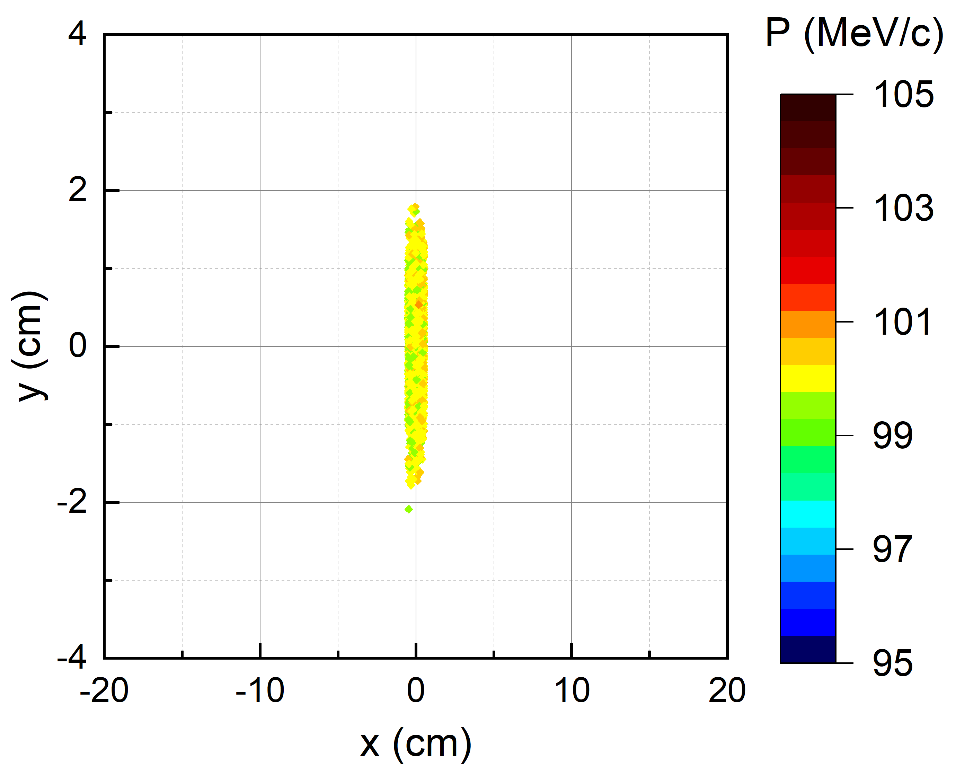
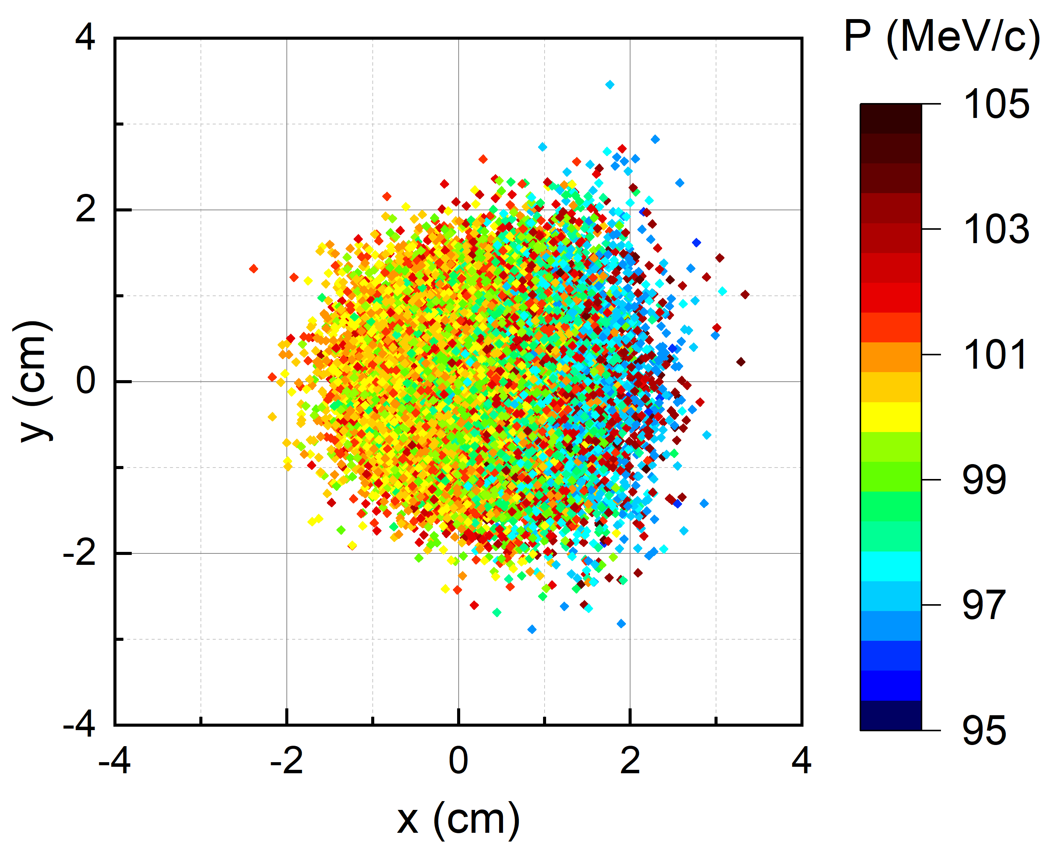
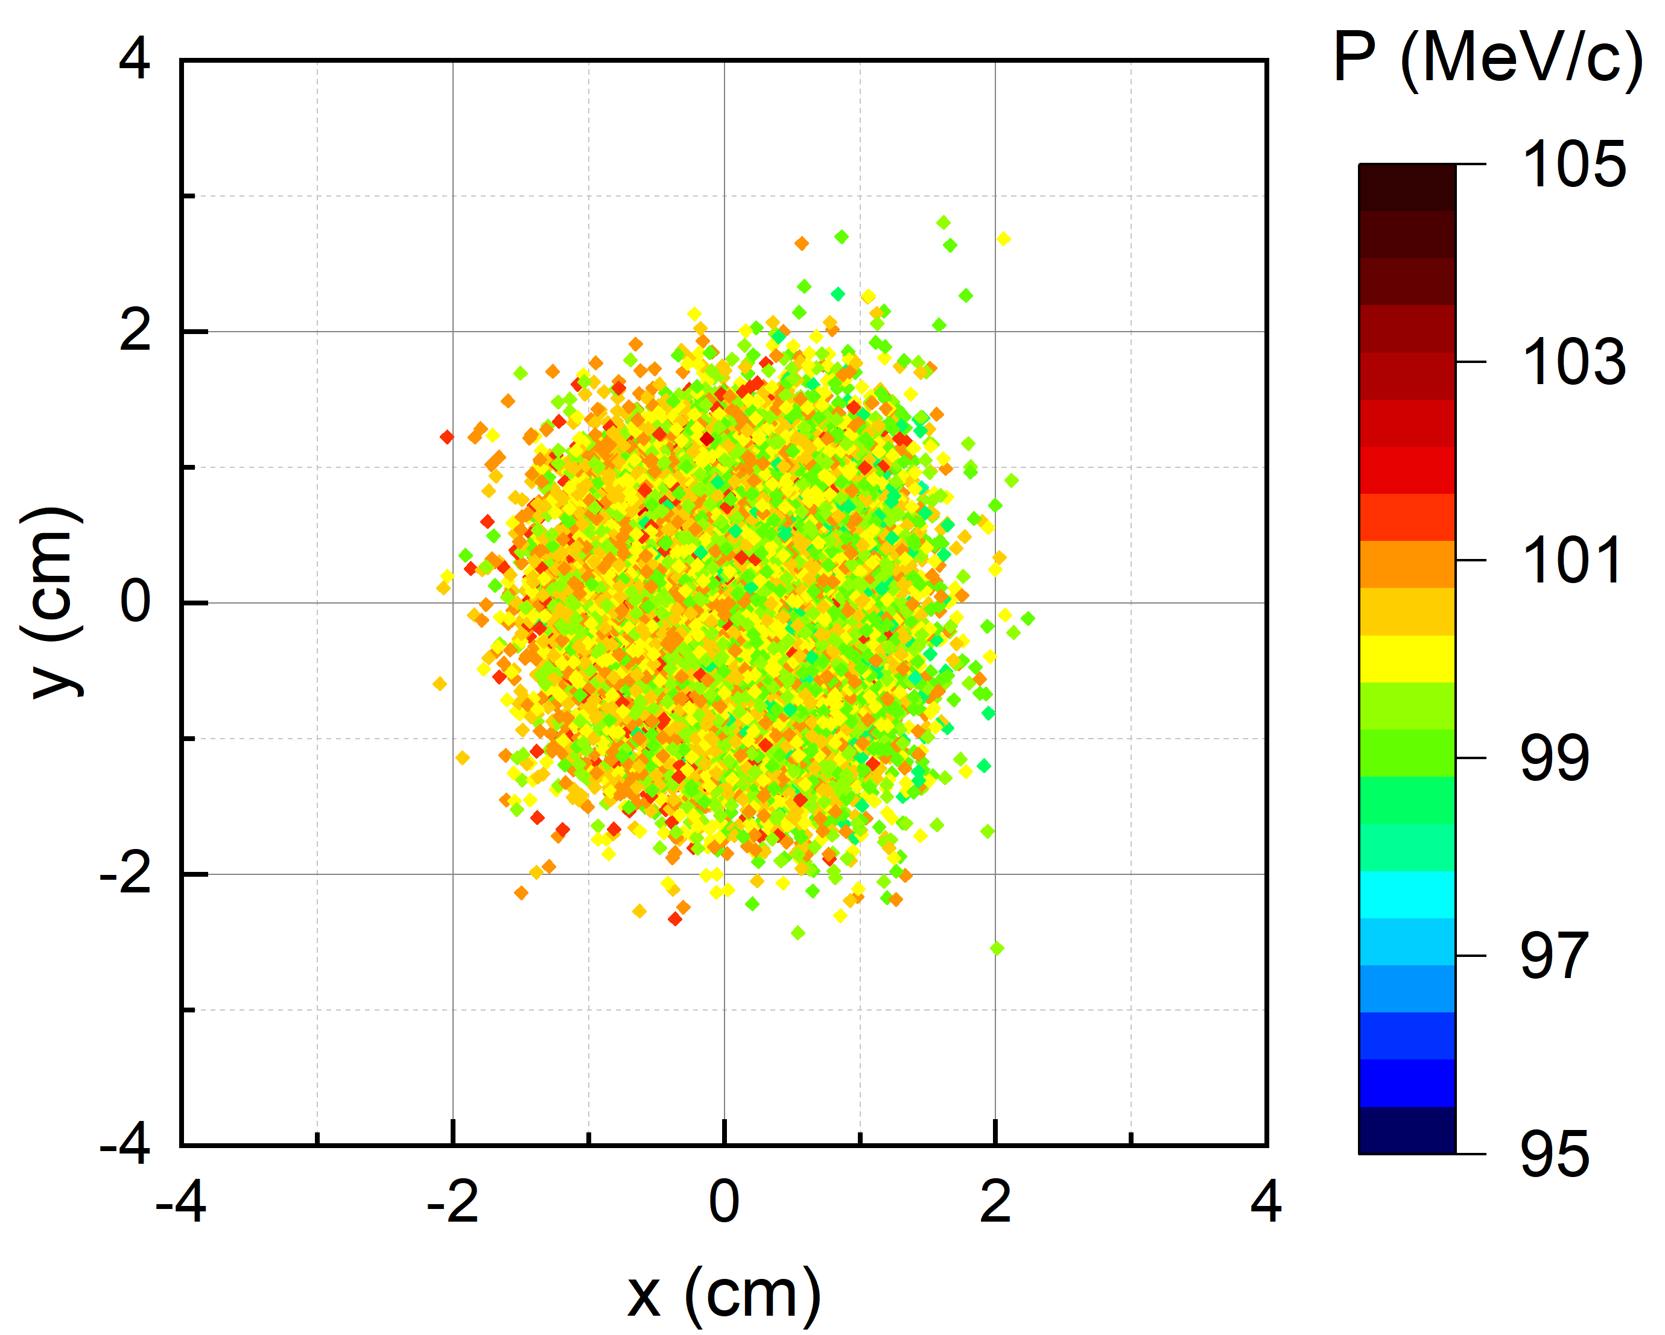
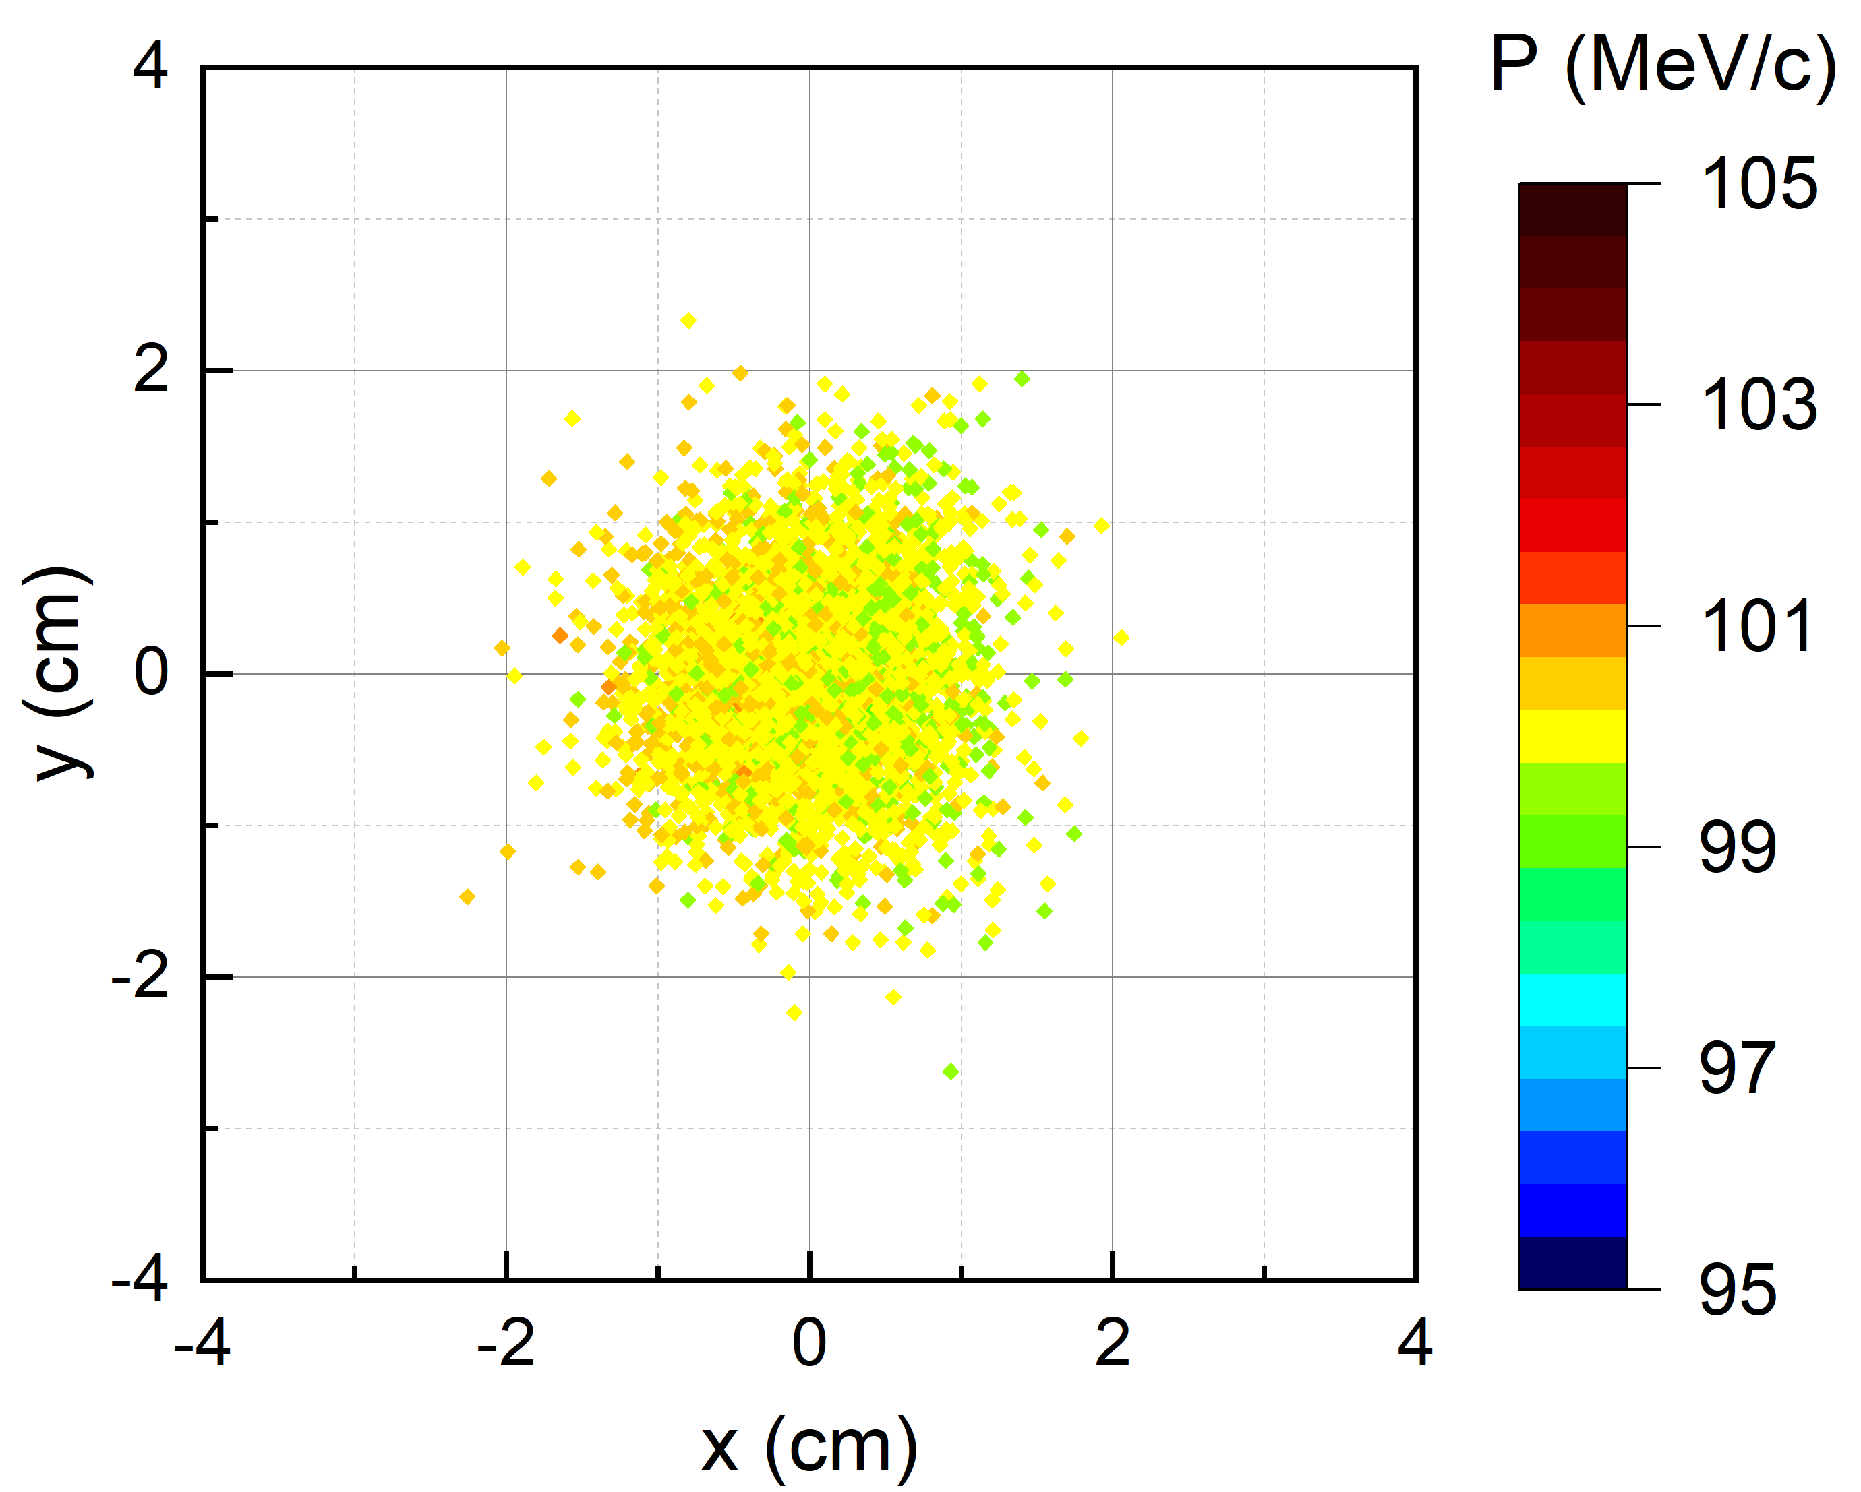
Beam envelope calculation of μE1 with new layout
For muEDM (straight ASK82): Calculations of beam distribution on slit and end separately, 2nd order calculation
Half opening of slit Δx=12 cm
Half opening of slit Δx=4 cm
Half opening of slit Δx=0.5 cm
FS81
40°
MIXE
Courtesy C. Cong
Notes:
Using the TURTLE program, we can simulate this process.
The top images show the beam distribution after silt and the bottom row is the beam distribution at the end of beam line.
Initially, when the slit is fully opened, the momentum distribution reaches the maximum value, as the slit narrows down,
the beam becomes more and more focused on a narrow range of momentum values,

Slide 15
Beam envelope calculation of μE1 with new layout
For muEDM (-20° ASK82): Calculations of beam envelopes, 2nd order calculation, Δp/p=3%
proton
15
12
9
6
3
40°
0
XY [cm]
15
3
S [m]
6
40°
9
muEDM
12
15
Notes:
The second part of design is to achieve a negative muon beam on the new branch with a narrow momentum distribution, which is required for MIXE technique.
In our plan, the slit FS81 with horizontal jaws is employed to manipulate the beam momentum width.
The total opening of the jaws is 25 cm.
So as the dashed line shown in the beam optics, a big momentum dispersion of 4 cm is generated at FS81 by the operation of the triplet in front.
And finally, an achromatic beam is obtained at the sample position. The muon distribution of the beam indicates the circle beam spot

Slide 16
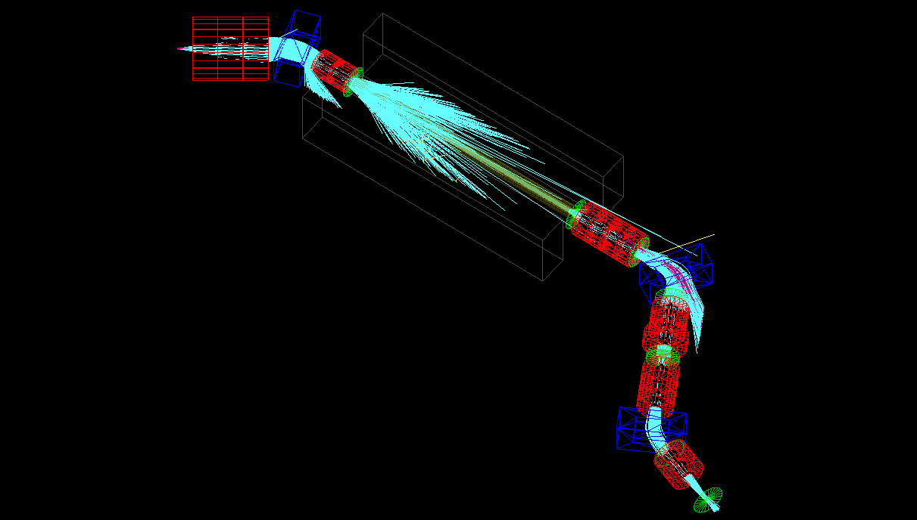


muE1 in G4beamline
$$π^{+}$$
$$μ^{+}$$
Concrete shielding
ASX81
Virtual detectors
Qudarupoles
Qudarupoles
ASK81
Caveats:
Idealised beam line
Many elements without fieldmaps
No quantitative predictions possible
Open Questions
Can we use the tof wrt to cyclotron frequency for particle identification?
What is the contamination of the muon beam after ASK82?
How does the phase space look after the
decay solenoid?
Decay solenoid
Qudarupoles
Qudarupoles
ASK82
final focus

Slide 17
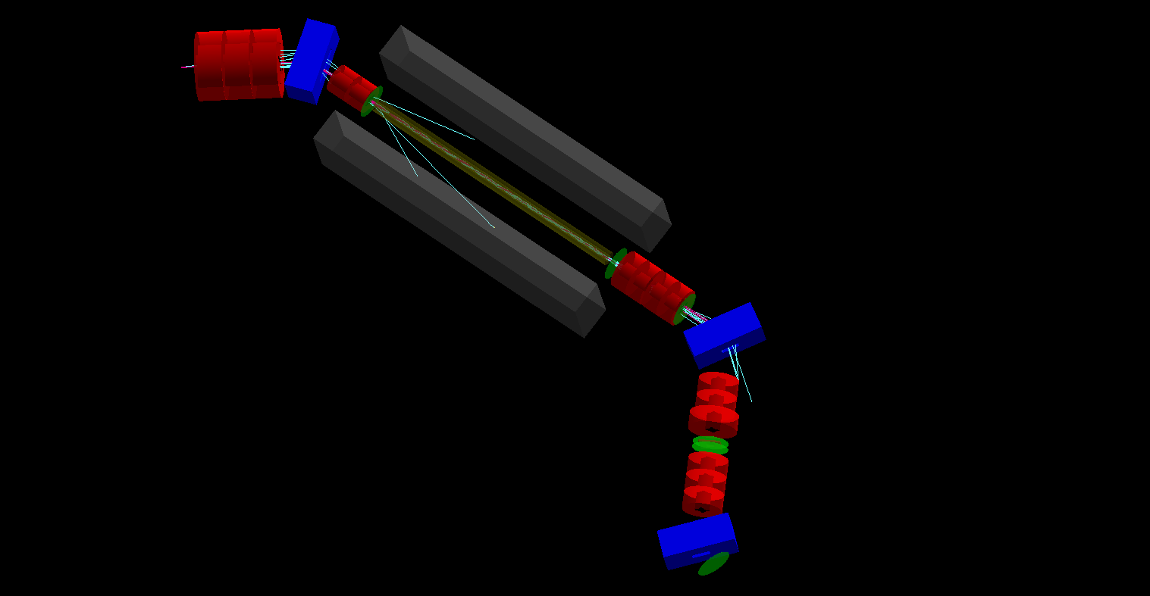

ToF study
Initial beam conditions for ToF study
Gaussian beam at d=100mm from Target E
  $dx×dx^{′}=10mm×6mrad$
  $dy×dy^{′}=10mm×6mrad$
  $P=220\left(4.4\right) MeV/c$

Slide 18
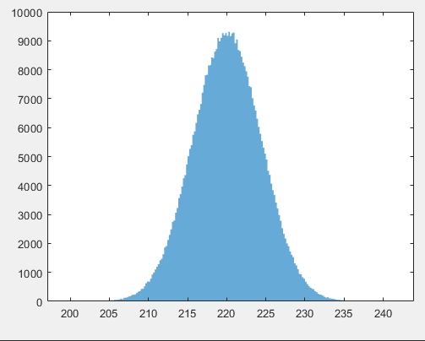
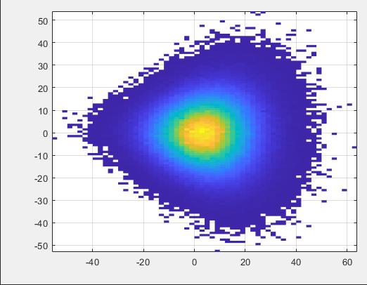
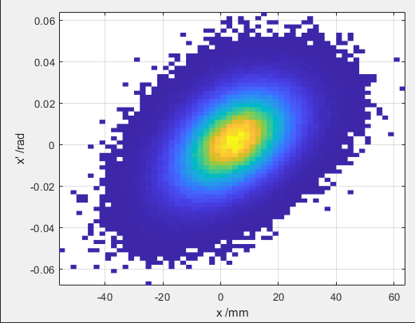
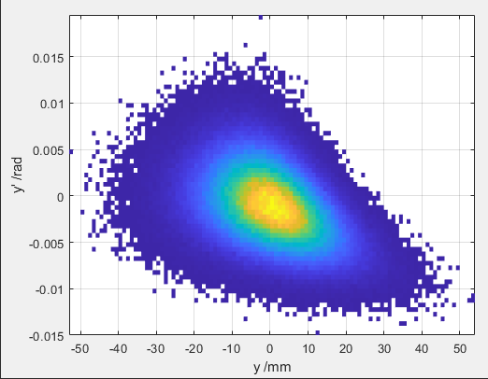





ToF study
$$π^{+}$$
$$π^{+}$$
$$π^{+}$$
Initial beam conditions for ToF study
Gaussian beam at d=100mm from Target E
  $dx×dx^{′}=10mm×6mrad$
  $dy×dy^{′}=10mm×6mrad$
  $P=220\left(4.4\right) MeV/c$
$$π^{+}$$

Slide 19
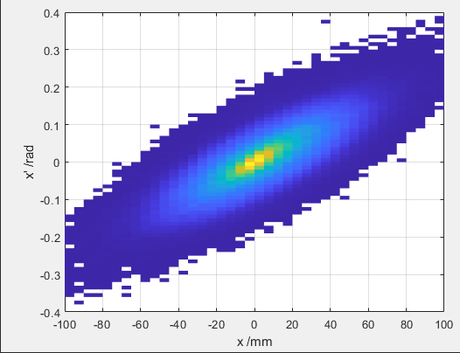
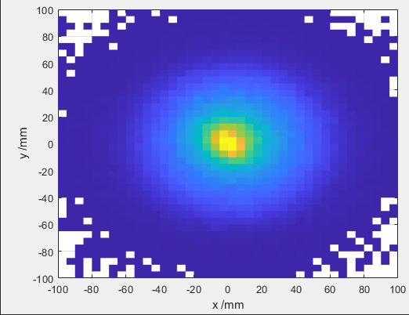
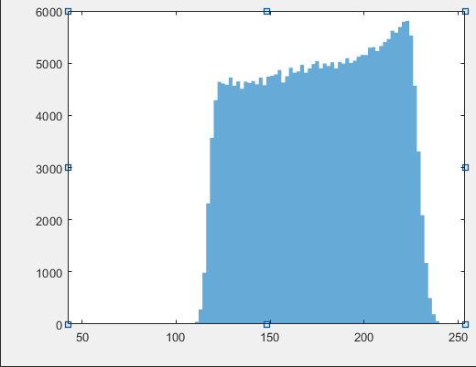
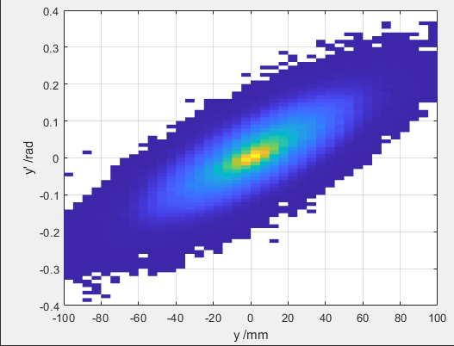




ToF study
$$μ^{+}$$
Initial beam conditions for ToF study
Gaussian beam at d=100mm from Target E
  $dx×dx^{′}=10mm×6mrad$
  $dy×dy^{′}=10mm×6mrad$
  $P=220\left(4.4\right) MeV/c$
$$μ^{+}$$
$$μ^{+}$$
$$μ^{+}$$

Slide 20
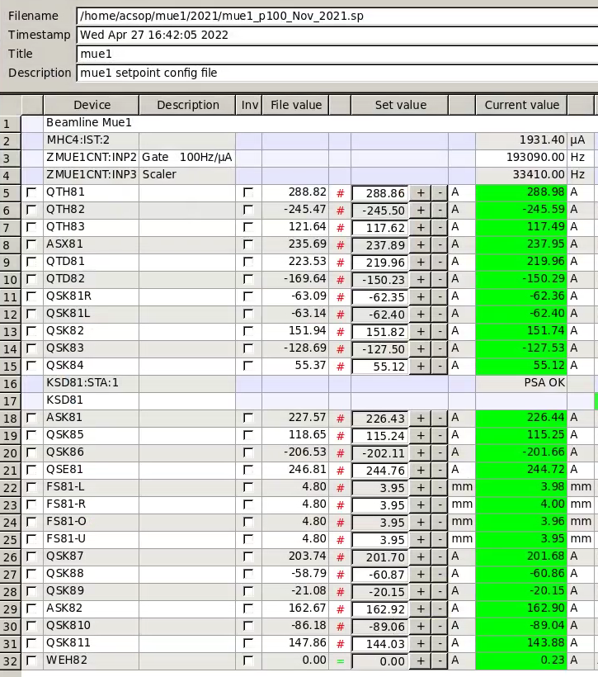
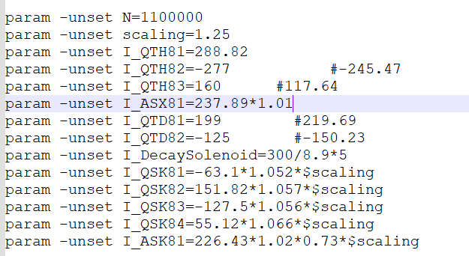
ToF study
$$μ^{+}$$
Initial beam conditions for ToF study
Gaussian beam at d=100mm from Target E
  $dx×dx^{′}=10mm×6mrad$
  $dy×dy^{′}=10mm×6mrad$
  $P=220\left(4.4\right) MeV/c$
$$μ^{+}$$
$$μ^{+}$$
$$μ^{+}$$

Slide 21
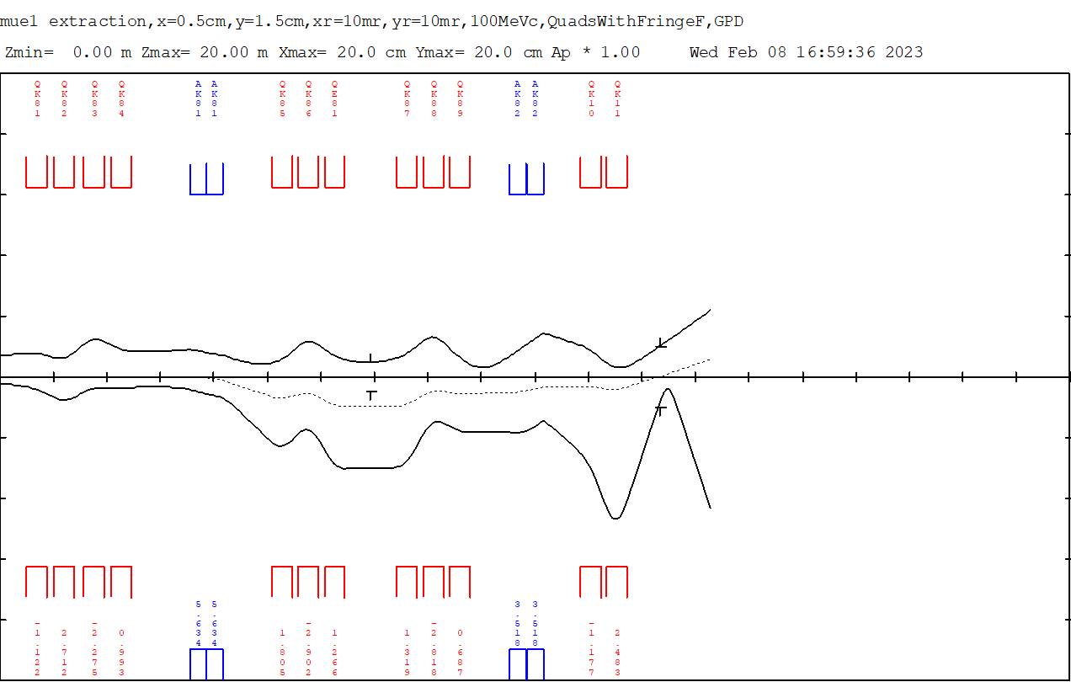
For muEDM:
The front section of the beamline is same to U-Version and the fields of QSK807 - QSK811 are varied in fitting.
In the beam optics below, the deflection angle at ASK82 is 40° as well and the momentum spread ΔP/P =3 %.
20
16
12
8
4
The triples on both sides of the slits are nearly symmetrical
The beam spot size is 2×2 cm at the sample.
The fields of quadrupoles are weaker than the fields in currenting setting.
The beam with a larger phase space is desirable
the deflection angle of ASK82 is adjustable
0
4
8
12
16
20

Slide 22
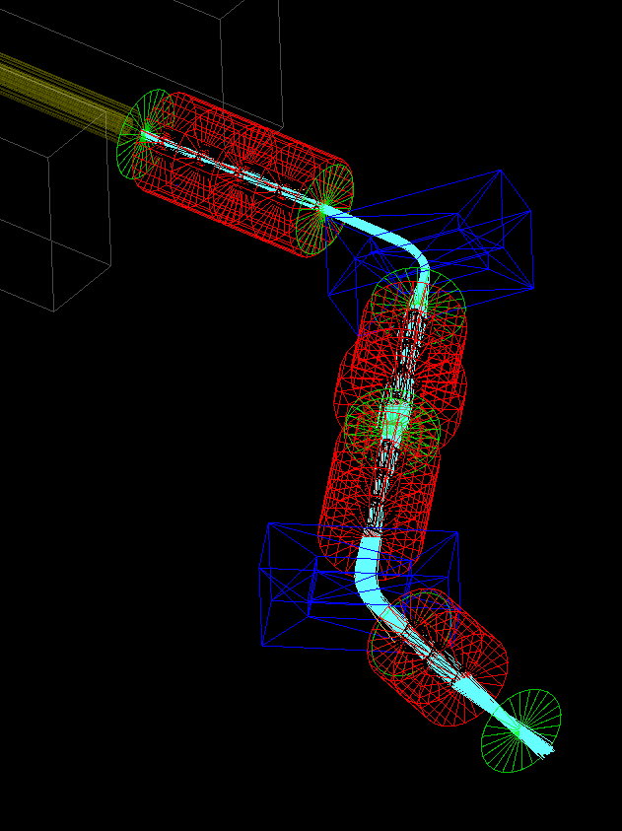
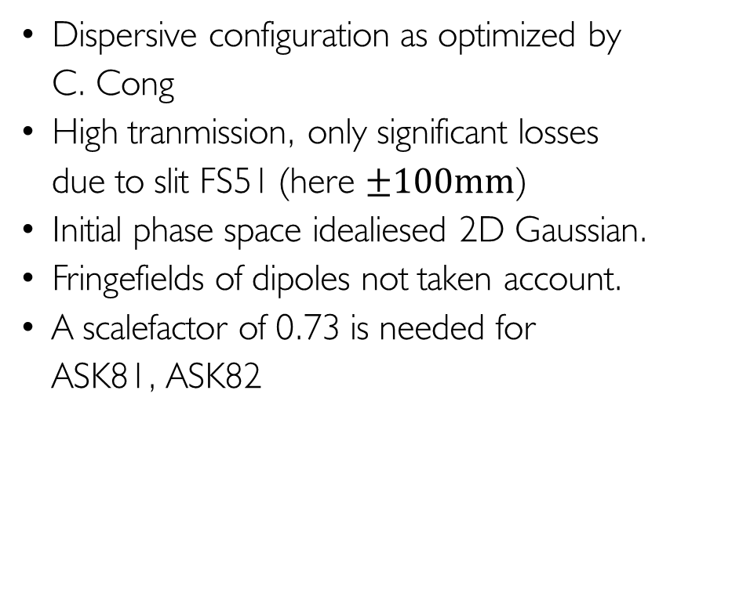
100 MeV/c
Dispersive configuration as optimized by
C. Cong
High tranmission, only significant losses
due to slit FS51 (here $±100mm$)
Initial phase space idealiesed 2D Gaussian.
Fringefields of dipoles not taken account.
A scalefactor of 0.73 is needed for
ASK81, ASK82

Slide 23
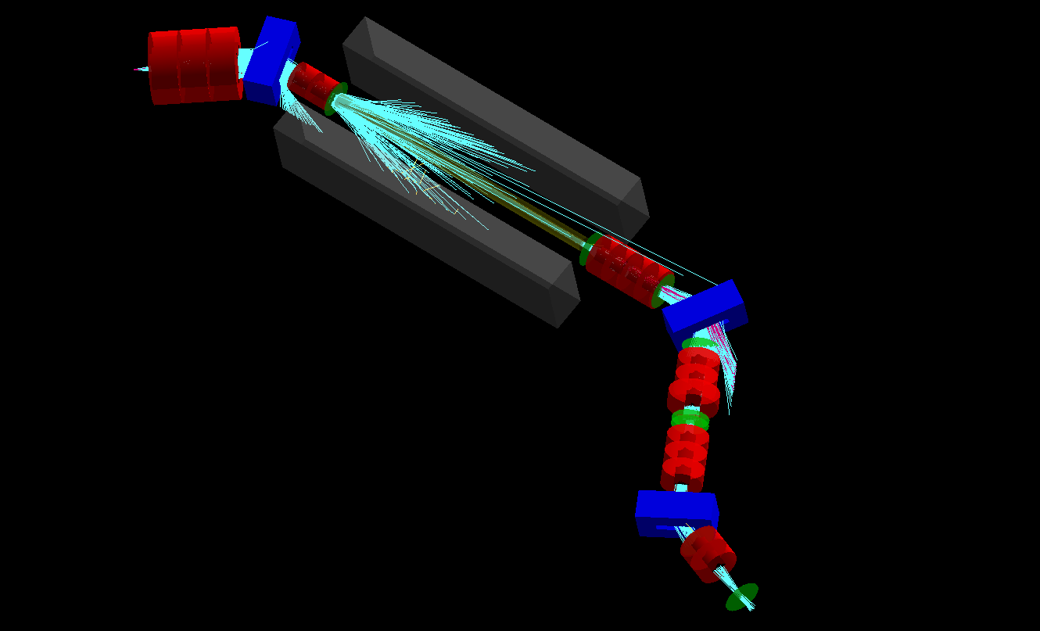
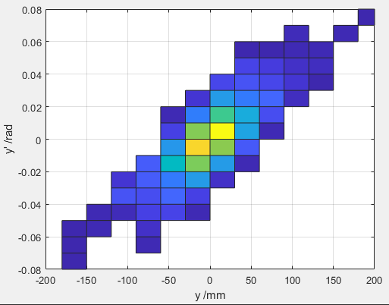
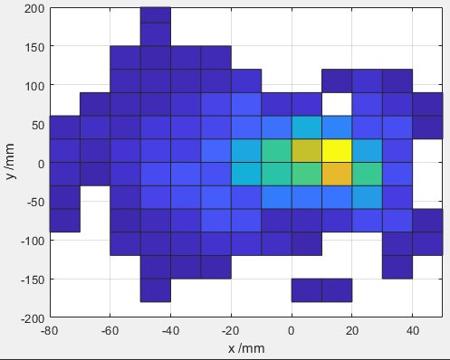
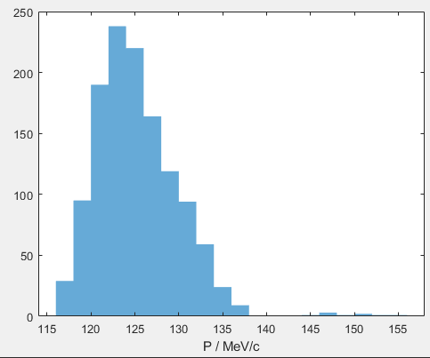
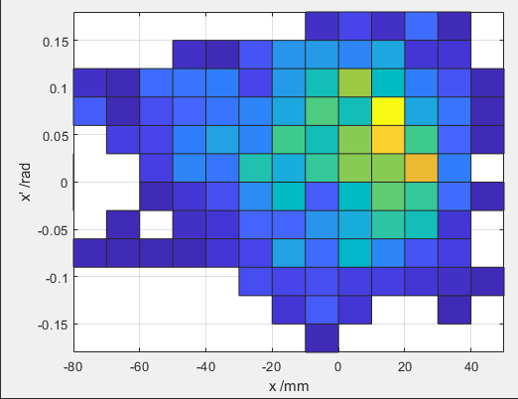

Full simulation for muons @ 125 MeV/c
  In 200000 pions:
  About four $e^{+}$ in 1250 detected $μ^{+}$

Slide 24
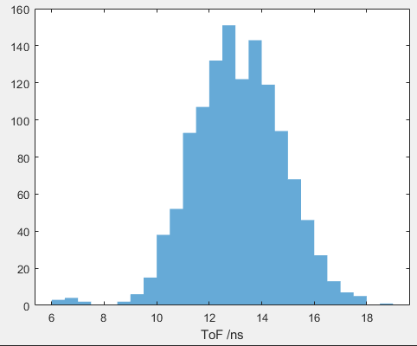

Full simulation for muons @ 125 MeV/c
  In 200000 pions:
  About four $e^{+}$ in 1250 detected $μ^{+}$
  Further improvement using field maps
  of ASK81 and ASK82
  Orientation of ASK 82 not yet decided

Slide 25
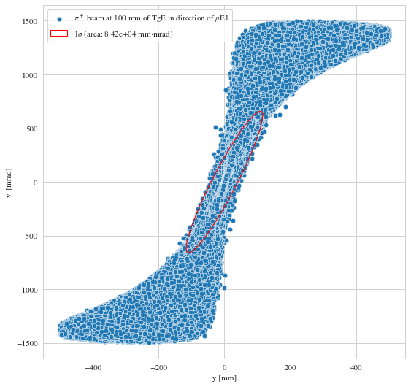
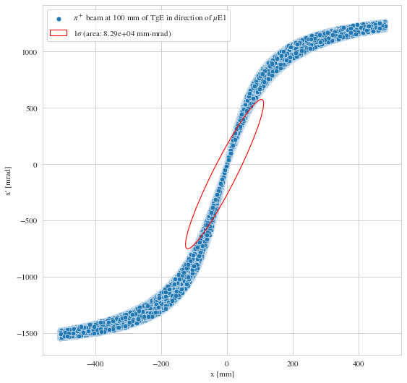


muE1 muon phase space after solenoid?
Current transport simulations assume a Gaussian distribution with
Simulations with gaussian injection phase space result in elliptic
muon phase space.
Simulated phase space from pion production not Gaussian!
$$μ^{+}$$
$$μ^{+}$$

Slide 26
Outlook
Definition of beamline Z-configuration for tests next week (only two Quads are prepared)
Simulations with actual input phase space next
Confirmation of dispersion free transport by G4Beamline
Measurement of the muE1 phase space as function of slit opening can confirm that we are measuring in dispersion free beam spot.

