Slide 1
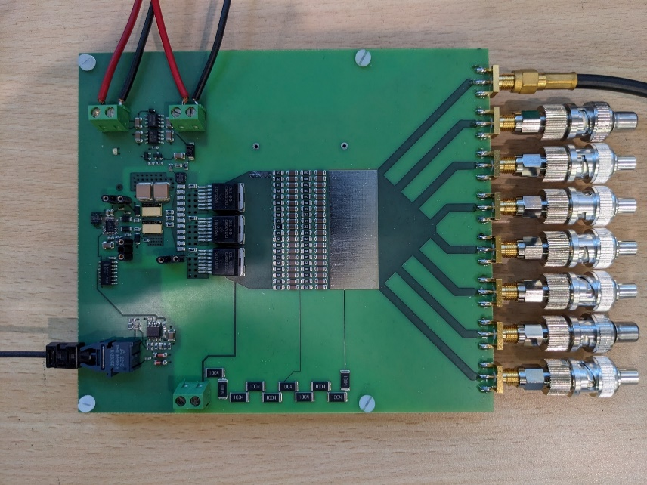
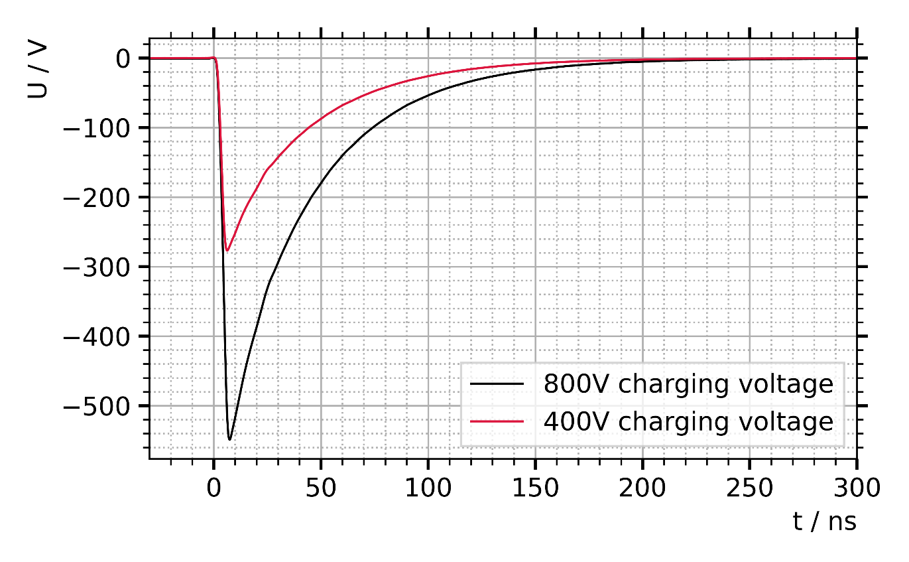
Developement towards a High Current Pulse Generator Concept
Martin Sack, Johannes Alt, Georg Müller (KIT)
Philipp Schmidt-Wellenburg, Timothy Hume (PSI)

Slide 2
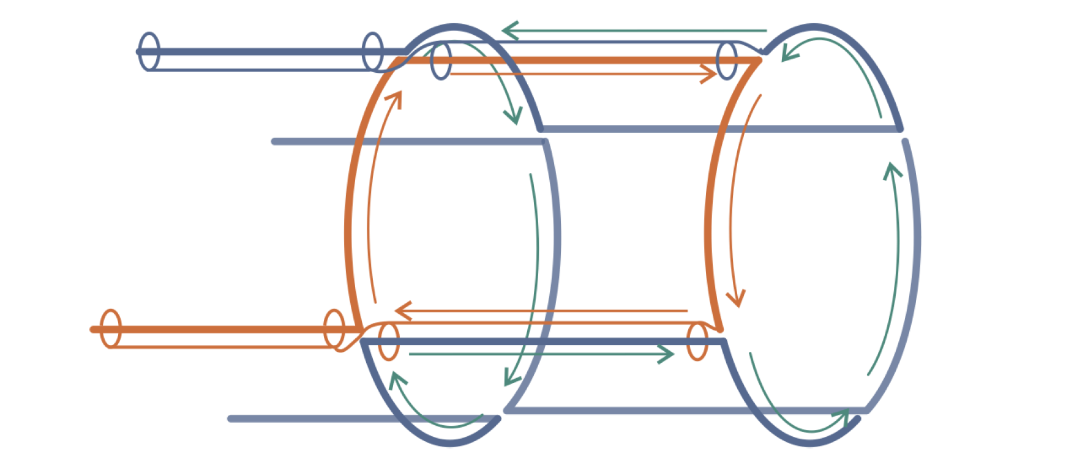
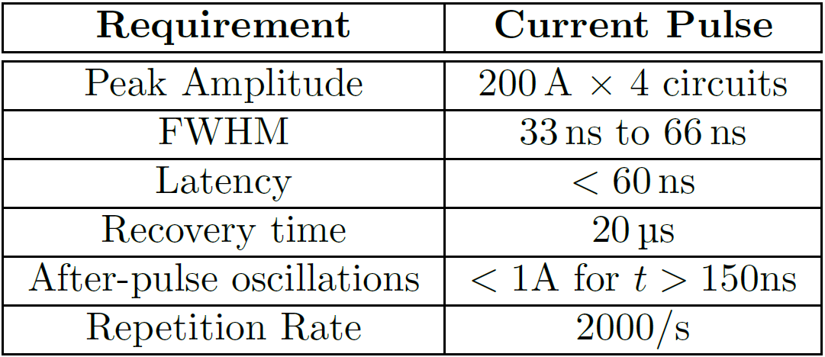
Muon Trap
Pair of two coils, each having one turn
Each coils set up of four quarter turns
Connection between both coils and to generator via four coaxial cables
Pulse and timing requirements apply

Slide 3
Muon Trap
Pulse circuit comprises the solenoid, the cable connection, and the pulse generator
Circuit model for the solenoid including the connecting cables:
Magnetic coupling between the four quarter turns of both coils
Resonant structures of the network require adequate damping elements
Balanced operation with negligible common mode current through the connecting cables is design goal
Pulse Generator

Slide 4
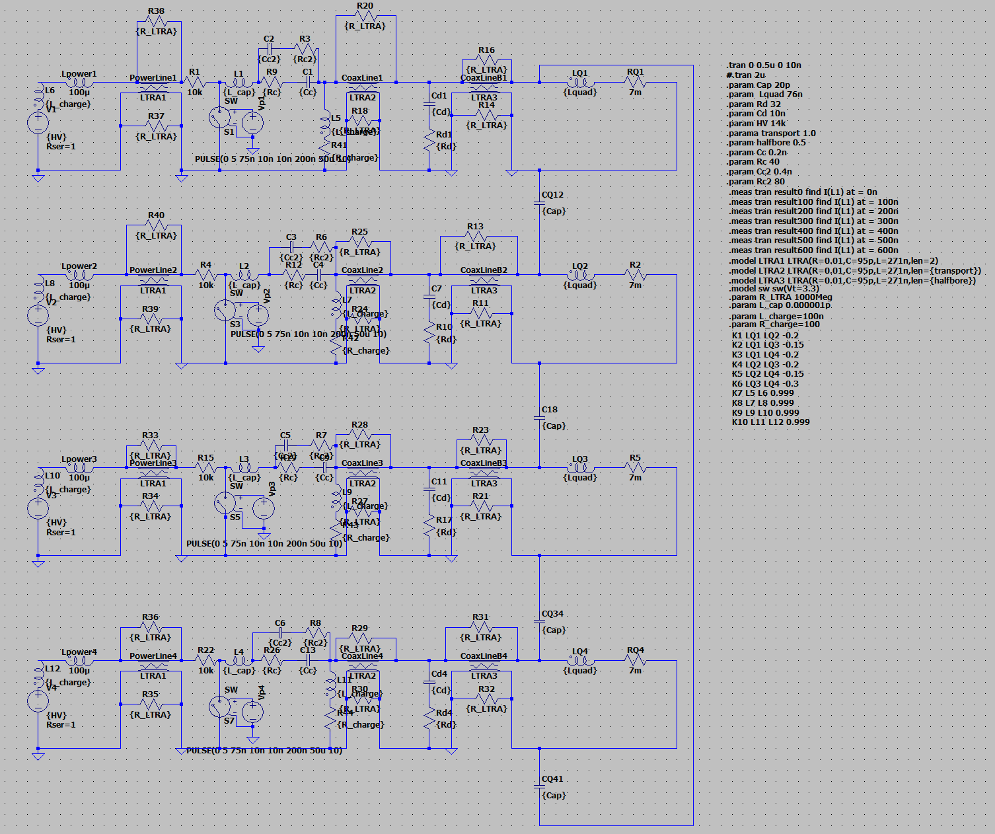
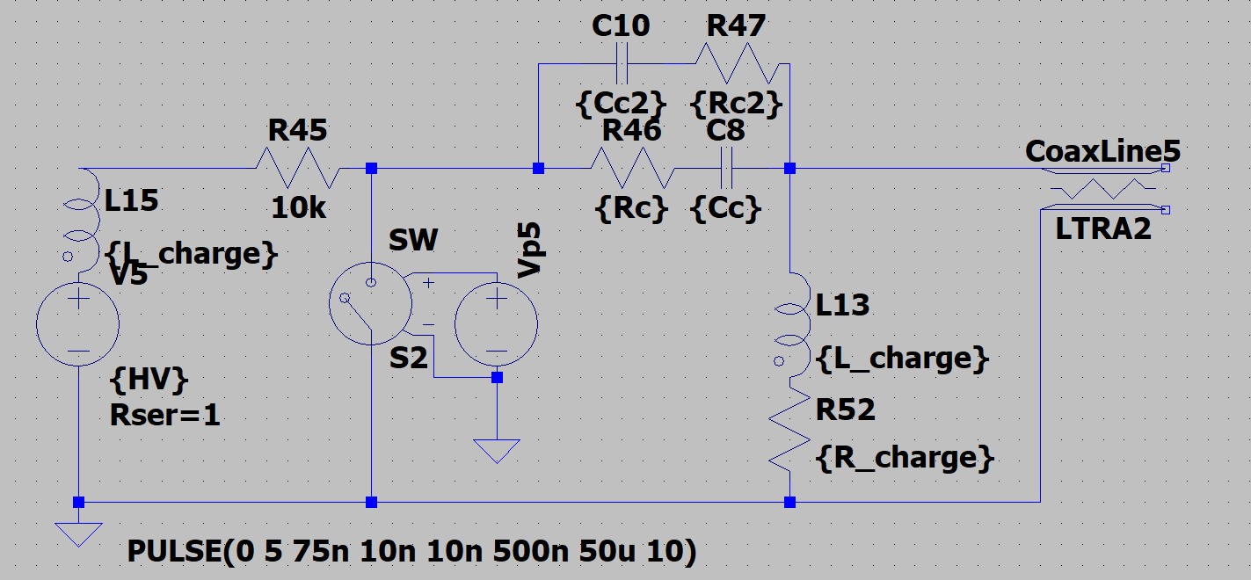
Pulse Generator Design
Detailed circuit model used for simulations
Pulse generator comprises Capacitive storage Damping resistors Fast closing switch
Passive pulse forming elements: Switch opens after complete discharge

Slide 5
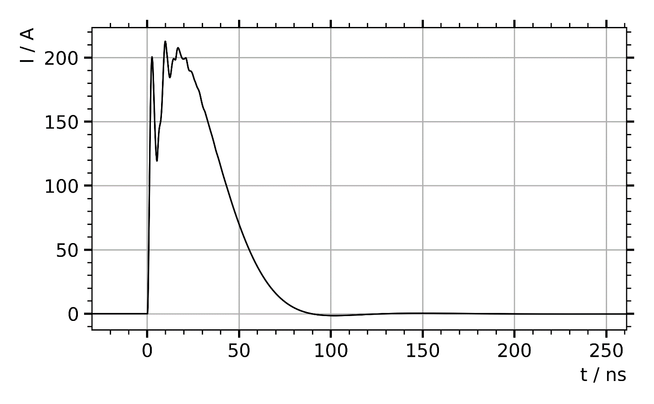
Pulse Generator Design: Ideal Conditions
Simulation results based on the assumption of an almost ideal pulse generator, i.e. without considering e.g. stray inductance, stray capacitance, and effects of travelling waves
Damping resistors included in the generator
Pulse shape meets the requirements

Slide 6
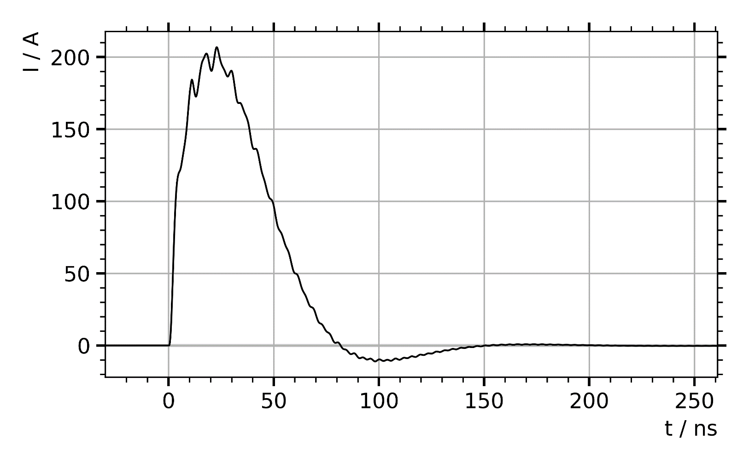
Pulse Generator: Series Inductance
Series inductance added to the generator model
Inductance of the generator results in oscillations
Limit according to the simulation (1 A @ t>150 ns): Inductance L_{S} = 200 nH for ¼ generator stack (200A)

Slide 7
Pulse Generator Design: Generator Topology
According to current state of design:
Output impedance of the generator: 12.5Ω (= 50Ω /4) (Interface to coil)
16 stages in series
8 modules per stage in parallel configuration
Current per module: 100 A
Module impedance: 6.25Ω (= 12.5Ω /16 stages∙8 modules per stage)
Voltage per stage: 800 V in total for 16 stages: 12.8 kV
Setup as one stack for 800 A or four separate stacks each for 200 A

Slide 8
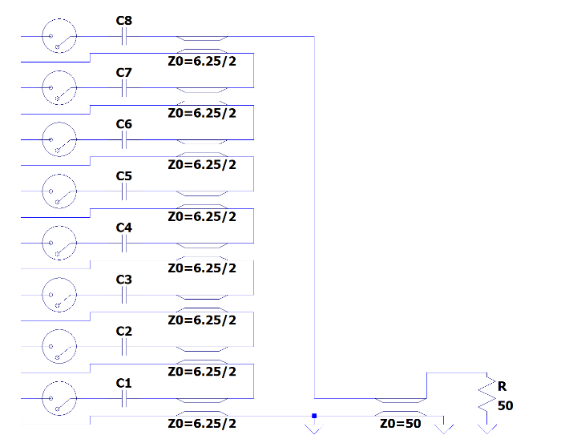
Pulse Generator Design: Genrator Concept
Circuit Properties
Circuit sensitive to series inductance of the generator
Connection of generator to coil via four 50Ω cables
Pulse circuit is not an impedance-matched design
Generator topologies under discussion:
Non-matched design
Stray inductance (L_{s}) and stray capacitances not matched to a characteristic impedance
Electrically short design approach
Limit for series inductance
Impedance-matched
generator design (*)
Impedance-matched design
Stray inductance and stray capacitance matched to fit to characteristic impedance
Generator acts as continuation of 50 Ω cables
Non-matched design may cause travelling-wave oscillations
(*) Paraliev M, Dordevic S:
Controlled impedance Marx topology to preserve the rise-time of the individual stages https://doi.org/10.1109/PPC47928.2023.10310979

Slide 9
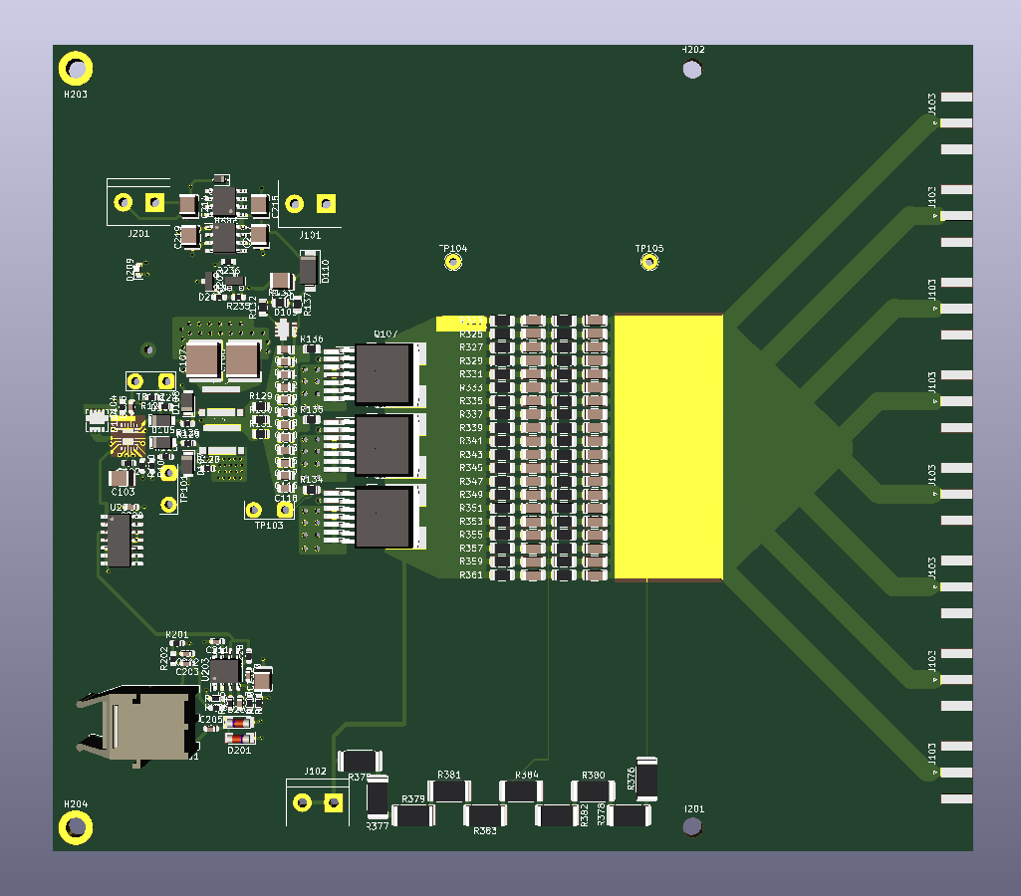
Design of one Module for Tests
Hardware tests as backup for simulation results and source for more detailed parameters
Module designed for I=100A and U=800V
Damping resistors included
Characteristic impedance: 6.25Ω
8 SMA connectors for controlled impedance tests
For electrically short connection: Possibility to cut off the 8 arms to the SMA conectors

Slide 10
Test Module: Measurement
Measurements with a stage voltage of 400V and 800V
Pulse shape: Exponential decay due to resistive load (RC circuit)

Slide 11
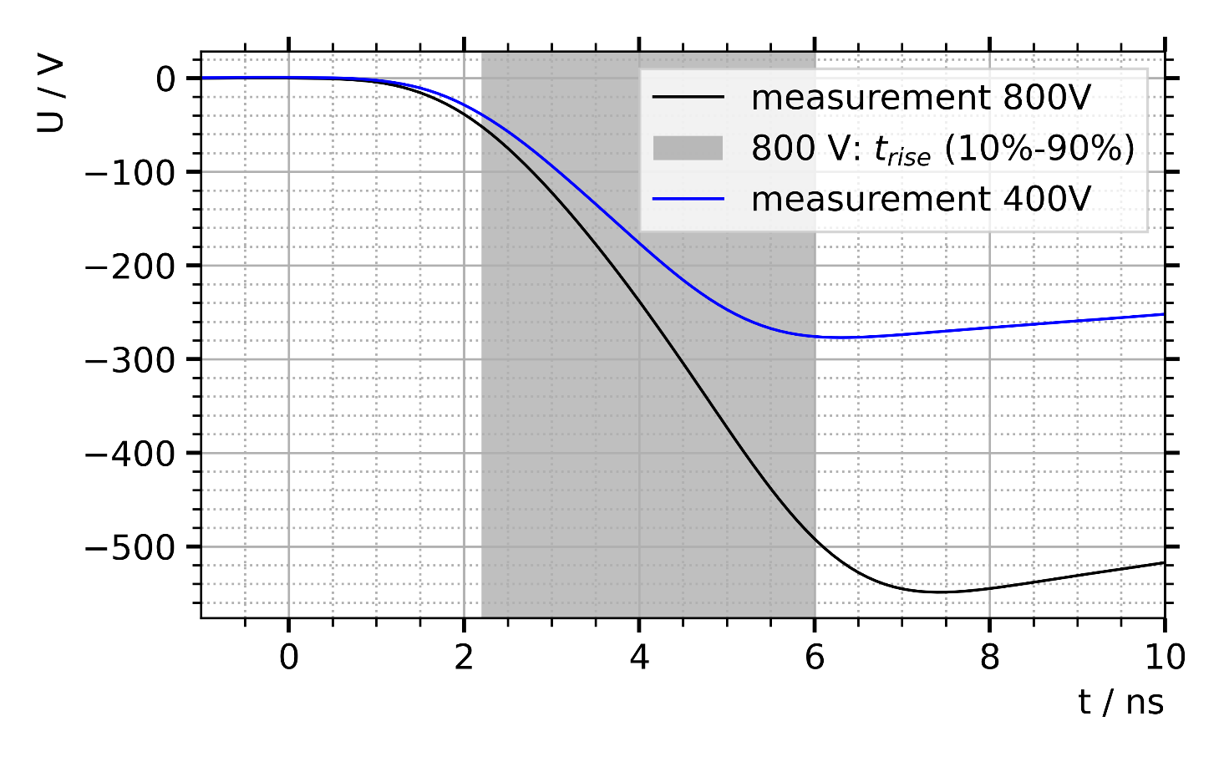
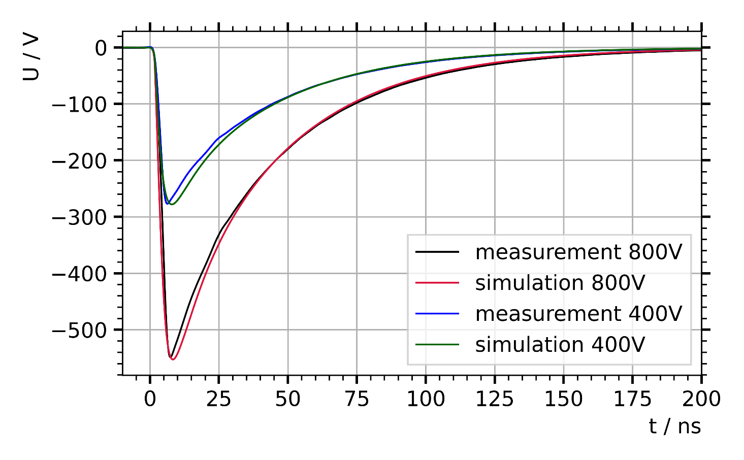
Test Module: Measurement
Measured pulse rise time (10% -> 90%): 3.0 ns @ 400 V 3.8 ns @ 800 V
Measured pulse parameters match well the simulation results
Circuit model includes estimated values for the rise time of the switch and the circuit inductance (model parameters are under investigation)

Slide 12
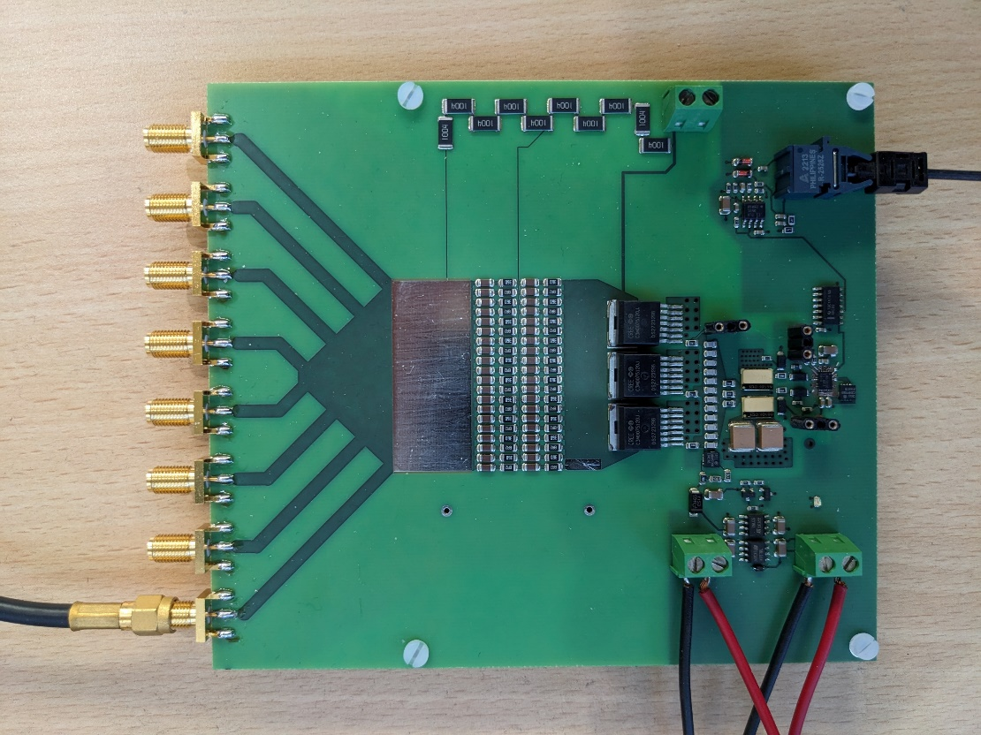
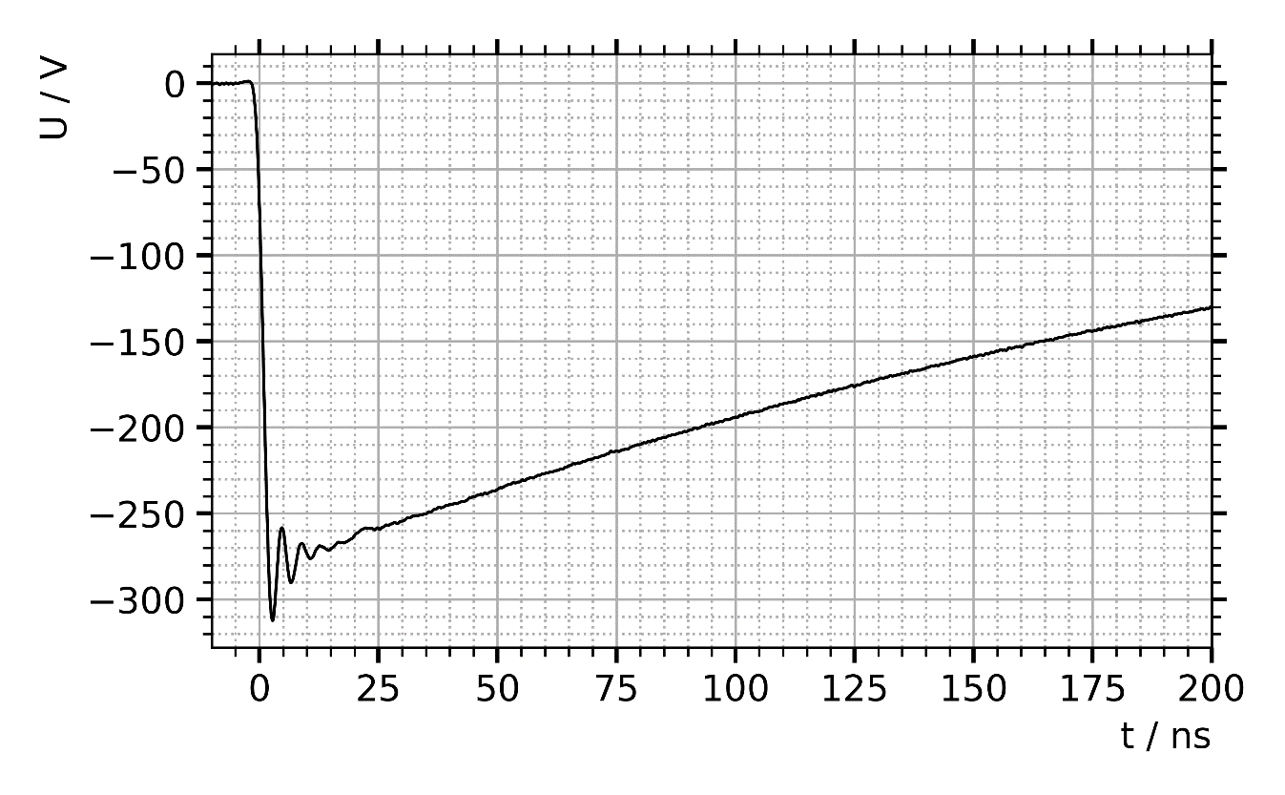
Test Module: Travelling wave Oscillations
Operation with non-matched load: Removing of seven 50Ω resistors causes travelling wave oscillations
Effect of wave propagation (transmission lines) to be added to the generator model
Absence of oscillations for matched load verifies impedance matching to 6.25 Ω (= 50Ω /8)

Slide 13
Outlook – Next Steps
More detailed modelling of the pulse generator module based on experiments and measurements (e.g. effects of travelling waves)
Measurements and simulations for the validation of the model
Decision about the generator topology based on simulations and measurements
Generator design

