Slide 1
First Stages on (XRF )Spectral Classification using Synthetic Datasets
1st AI-INFN FORUM
Fernando García-Avello Bofías, Bologna 2024

Slide 2
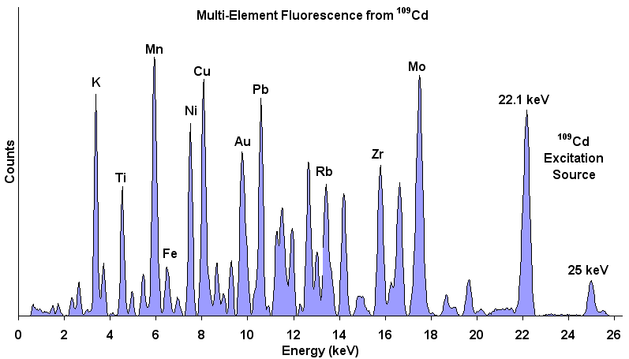
Motivation & Previous Similar Work
Previous (AI) Literature
Pigment Classification
Low Element selection
Semiquantitative (metals) (industry)
Astrophysical
Great Potential…but not so easy
XRF Information is elemental
Very Limited
Notes:
Just for contextualizing and motivitating the choice of this problem, first of all event though you can extract several information form the spectra such as the colour, the core information is the elemental information enclosed in the spectra. Regarding the application of AI into the field only very limited pigment classification has been done in CH context, (superresolution and so on. )...astrophysics has teh approach of getting the elements but not so much CH.

Slide 3
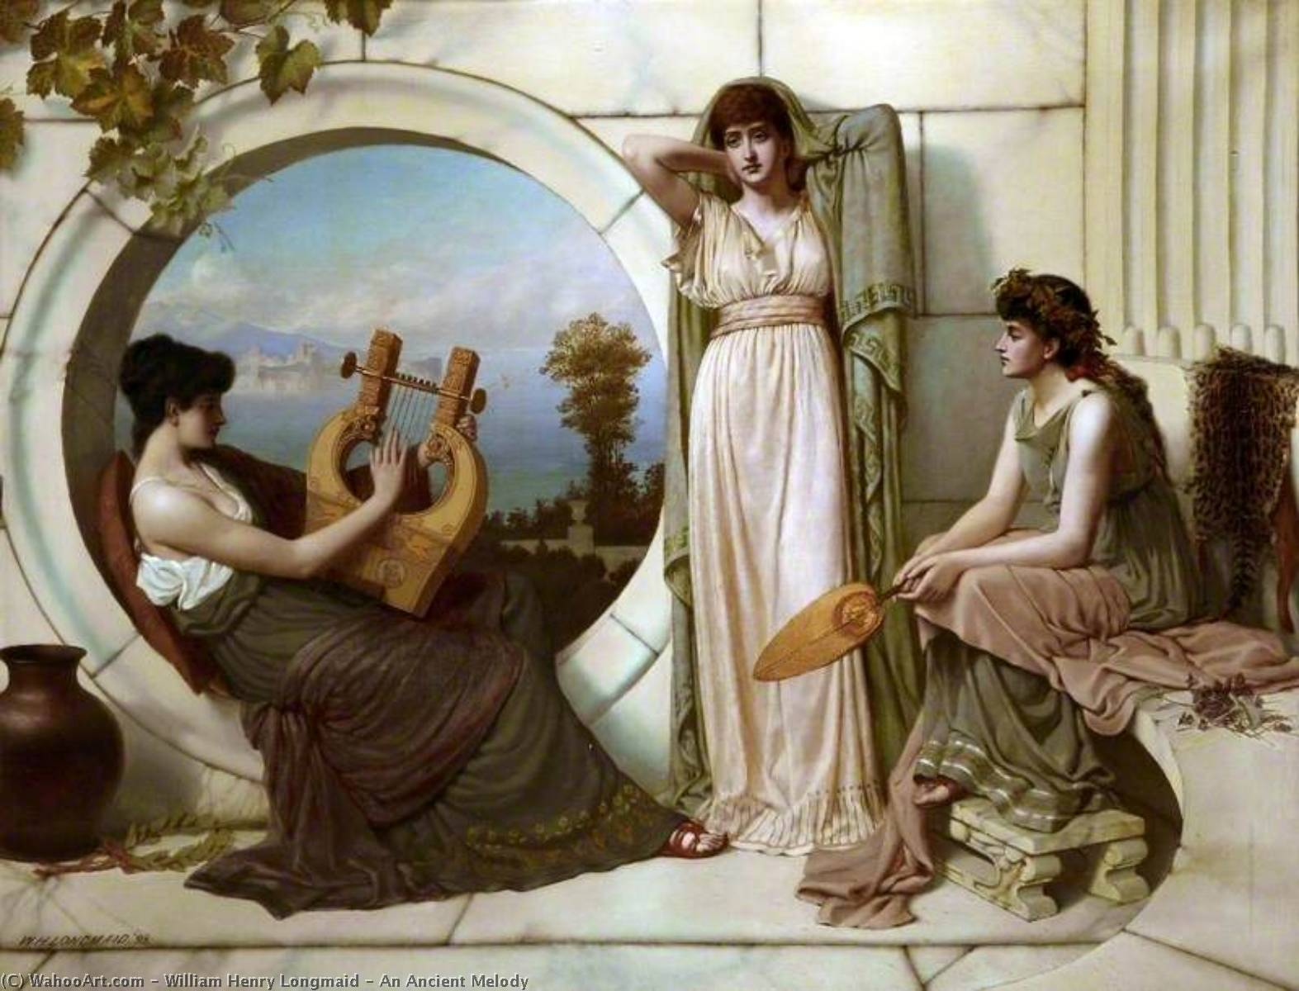
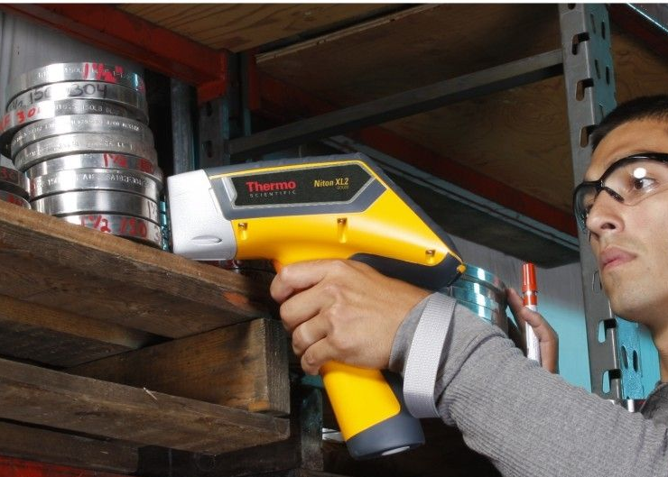
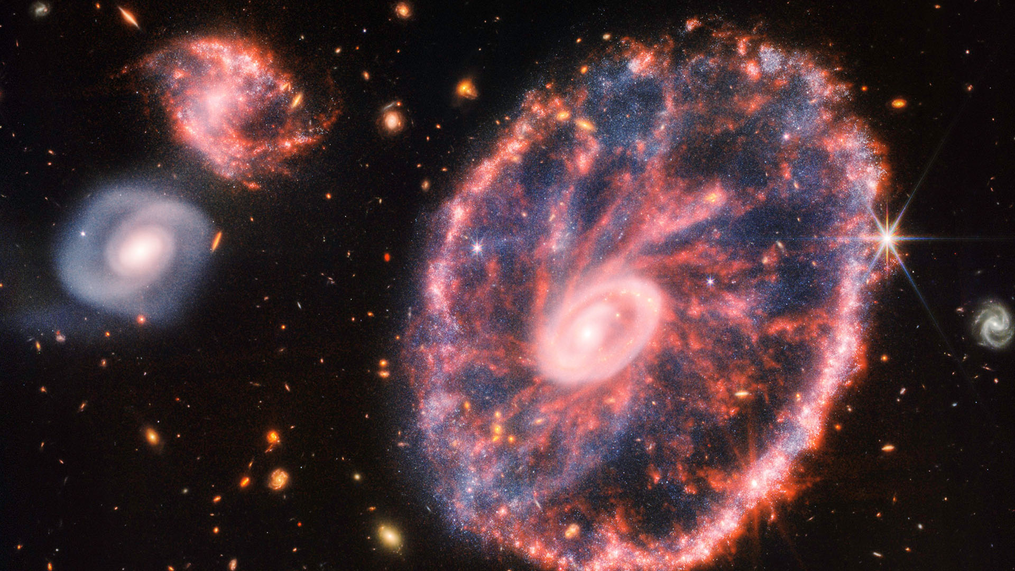
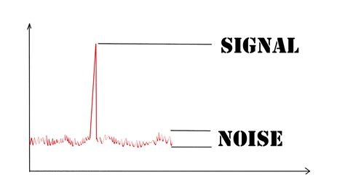
Handicaps:
Inner Complexity of CH:
Heterogeneity
2nd Order effects
Variability

Slide 4
Shared ML problems
Lack of Statistics
Great Variability
Underlying Structured Phenomena
Lack of Labelling

Slide 5
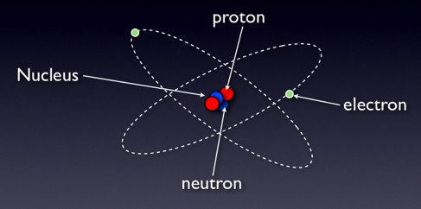
Point of View
Notes:
Physics is the common thing and it appears unveiled under certain particularities of each process.

Slide 6
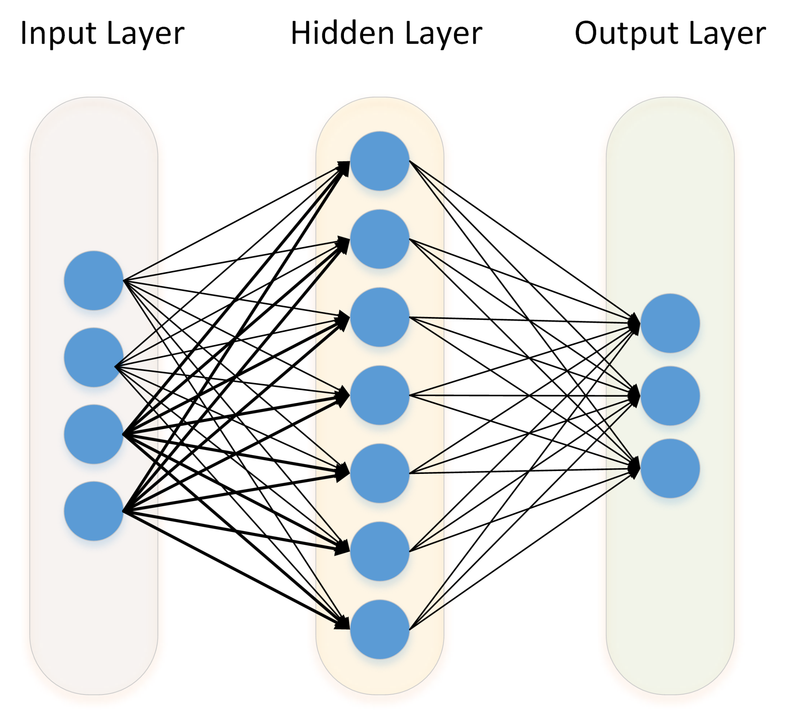
Pipeline
Synthetic Data Generation
Evaluation on Real world
Training AI algorithm
Notes:
This work is the result of an iterative process , where since the fundamental physical parameters are available the generation seemed possible (though not in its full complexity.)

Slide 7
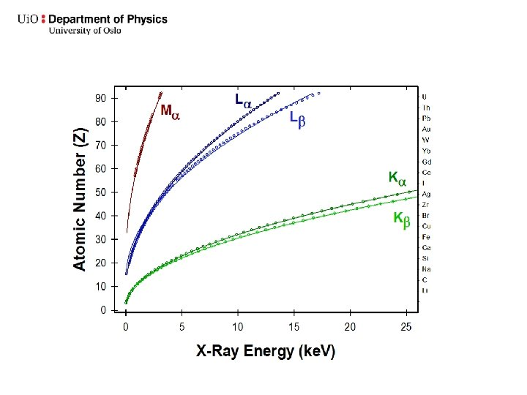
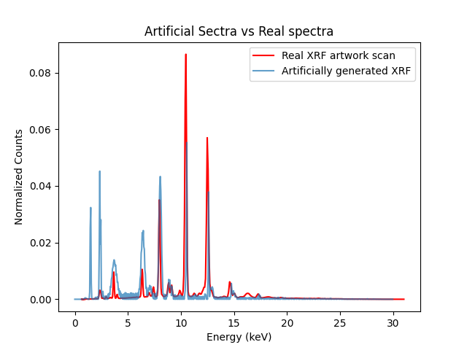
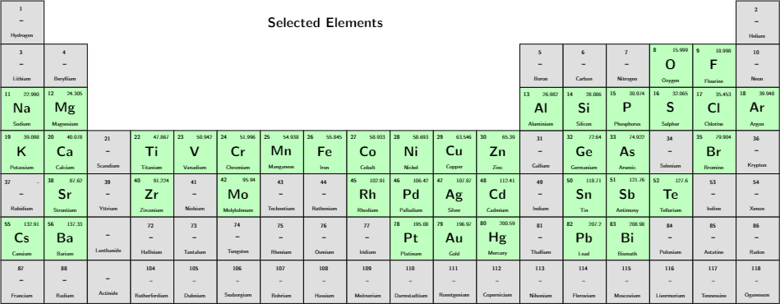
The problem
X: Input
Y : Output
Notes:
we are free to choose Y as elements, element lines, or concentrations. No specific reason to choose the elemental lines, they seemed like a middle step between choosing elements.

Slide 8
The problem
X: Input
Y : Output
Very Field Dependent,
Experimental Set up dependent,
Degeneracy of lines
And EXTRA PROBLEMS

Slide 9
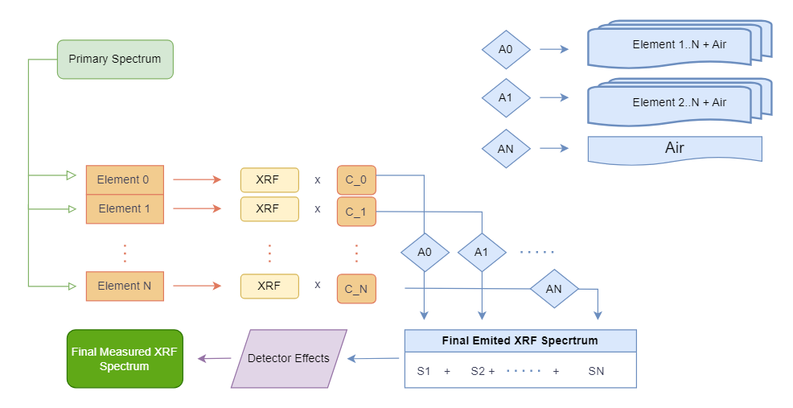
The Synthetic Generation
Bit of a problem to coordinate packages, dependencies, environments.
Exploiting Physics and Some heuristics (trying to reduce complexity)

Slide 10
The Synthetic Generation
Spectra Type | Size
Individual | 200 K
Pair | 400 K
Multi-Element | 600 K

Slide 11
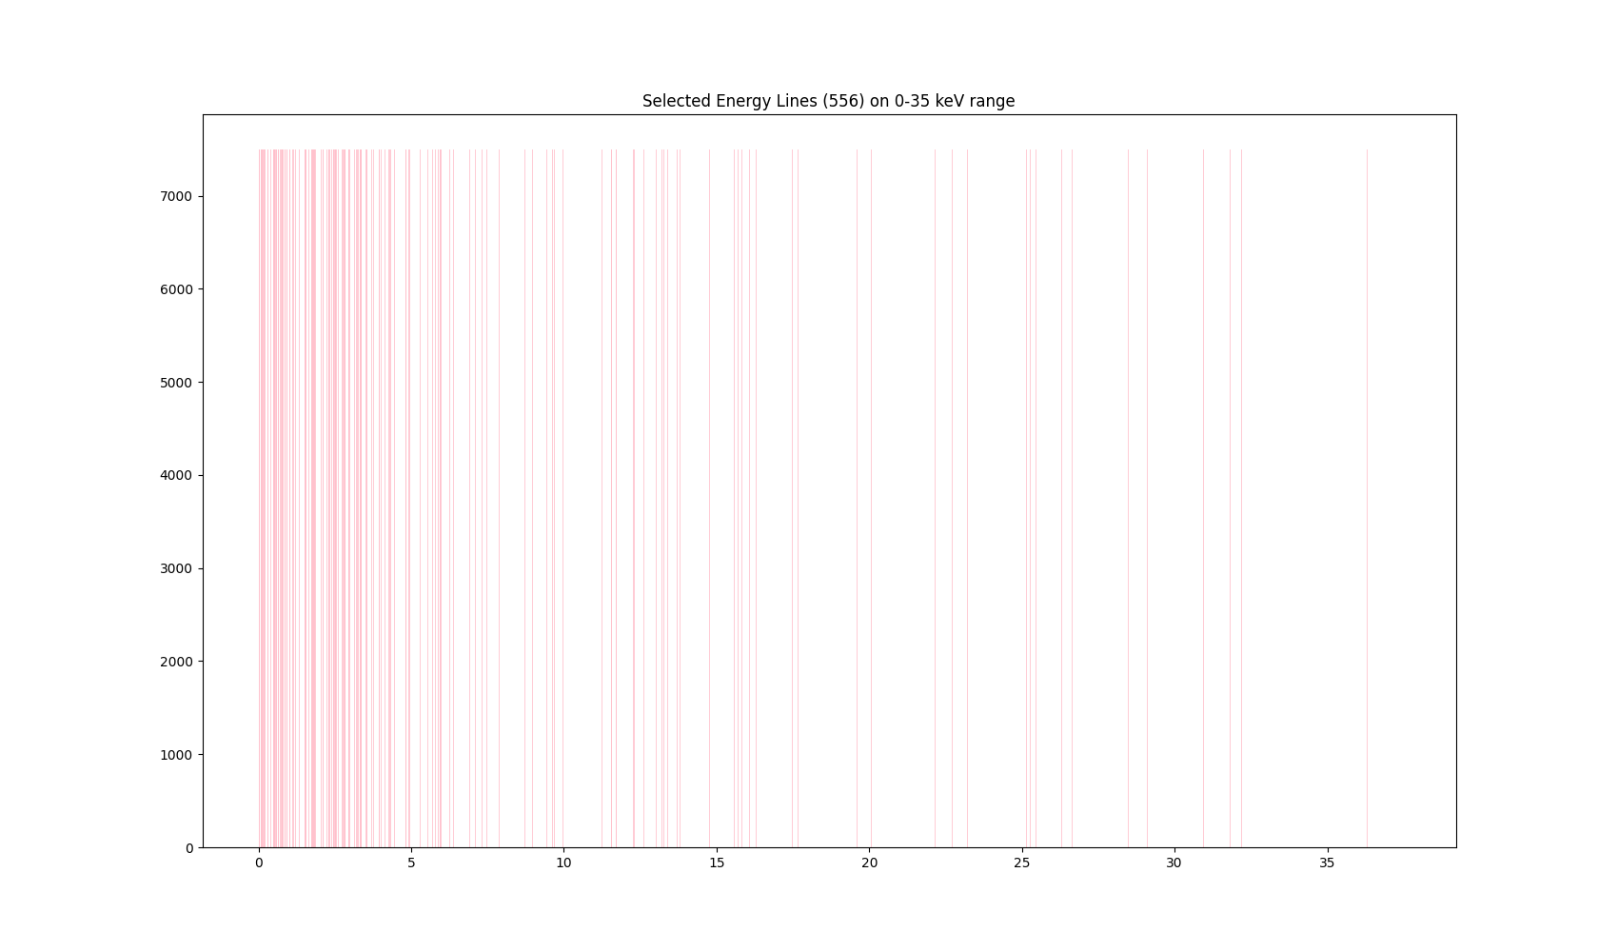
Dataset Characterization: Energetic Line Distribution (i.e. the TARGET)

Slide 12
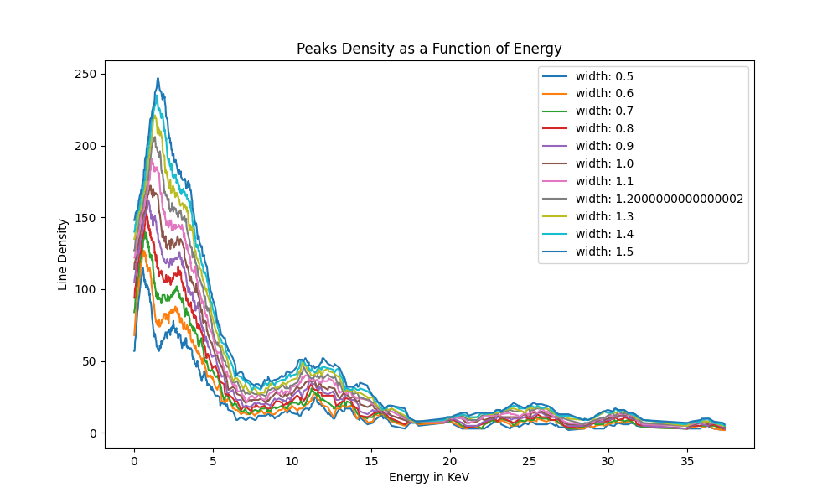
Dataset Characterization: Energetic Line Distribution

Slide 13
Discretize this continuum in some sense.
Overlap of lines in near and very far Zs

Slide 14
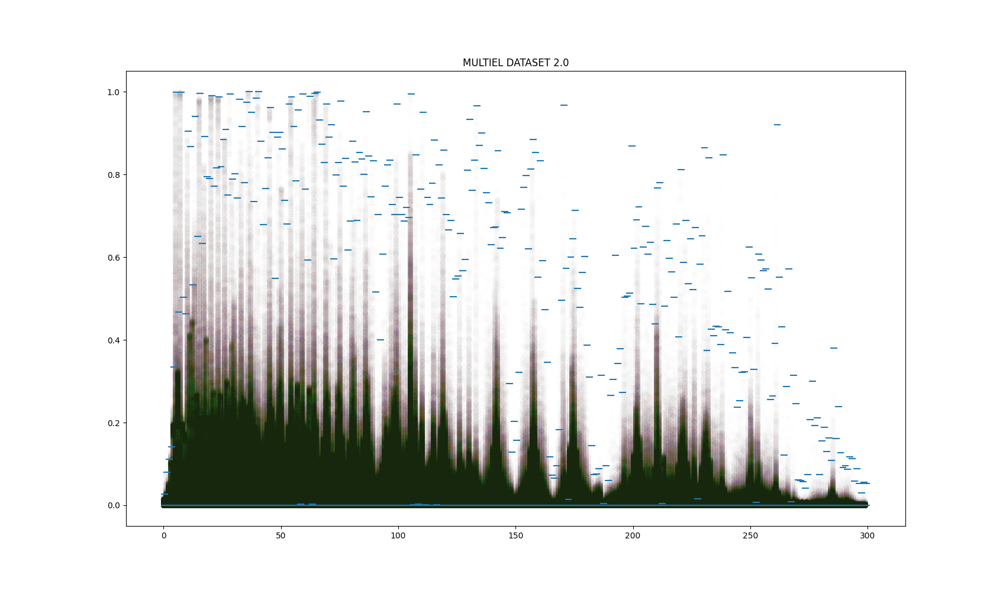
1 M Spectra on the same plot.

Slide 15
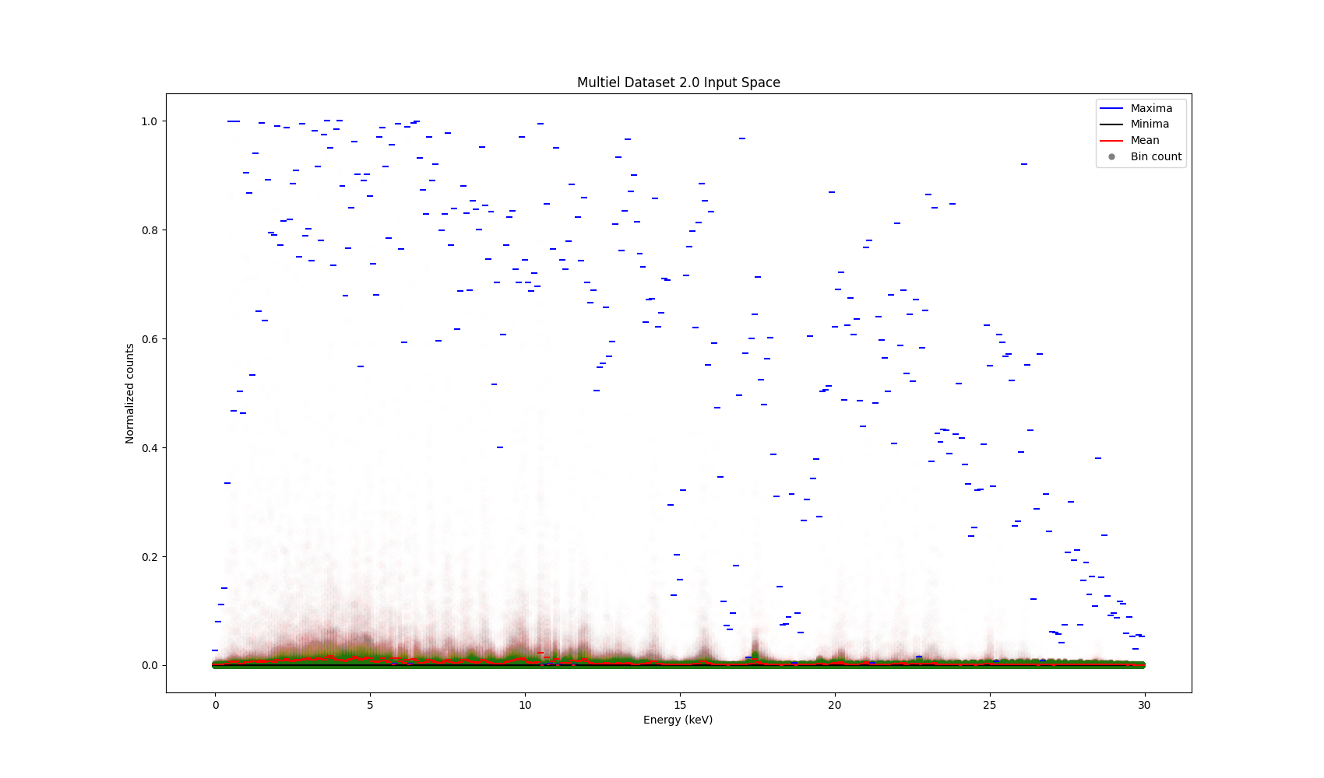

Slide 16
The intricacies, why the problem is not trivial?
Most important region suffers the biggest absorption and distortion
How much correlation remains ?
Lack of sufficient statistics
Experimental setup and composition variability (matrix effects, higher order radiations)
Local and global features needed to arrive at solution → local features change meaning with context

Slide 17
Complexity of the Problem: Information theory
Possible input space spectra ? 10^300
2 ^M different labelling combinations, M : 556, big number.
2^41 ≈ 10 ^12
2^556 ≈ 10 ^167
(2^13 ≈ 10 ^4)

Slide 18
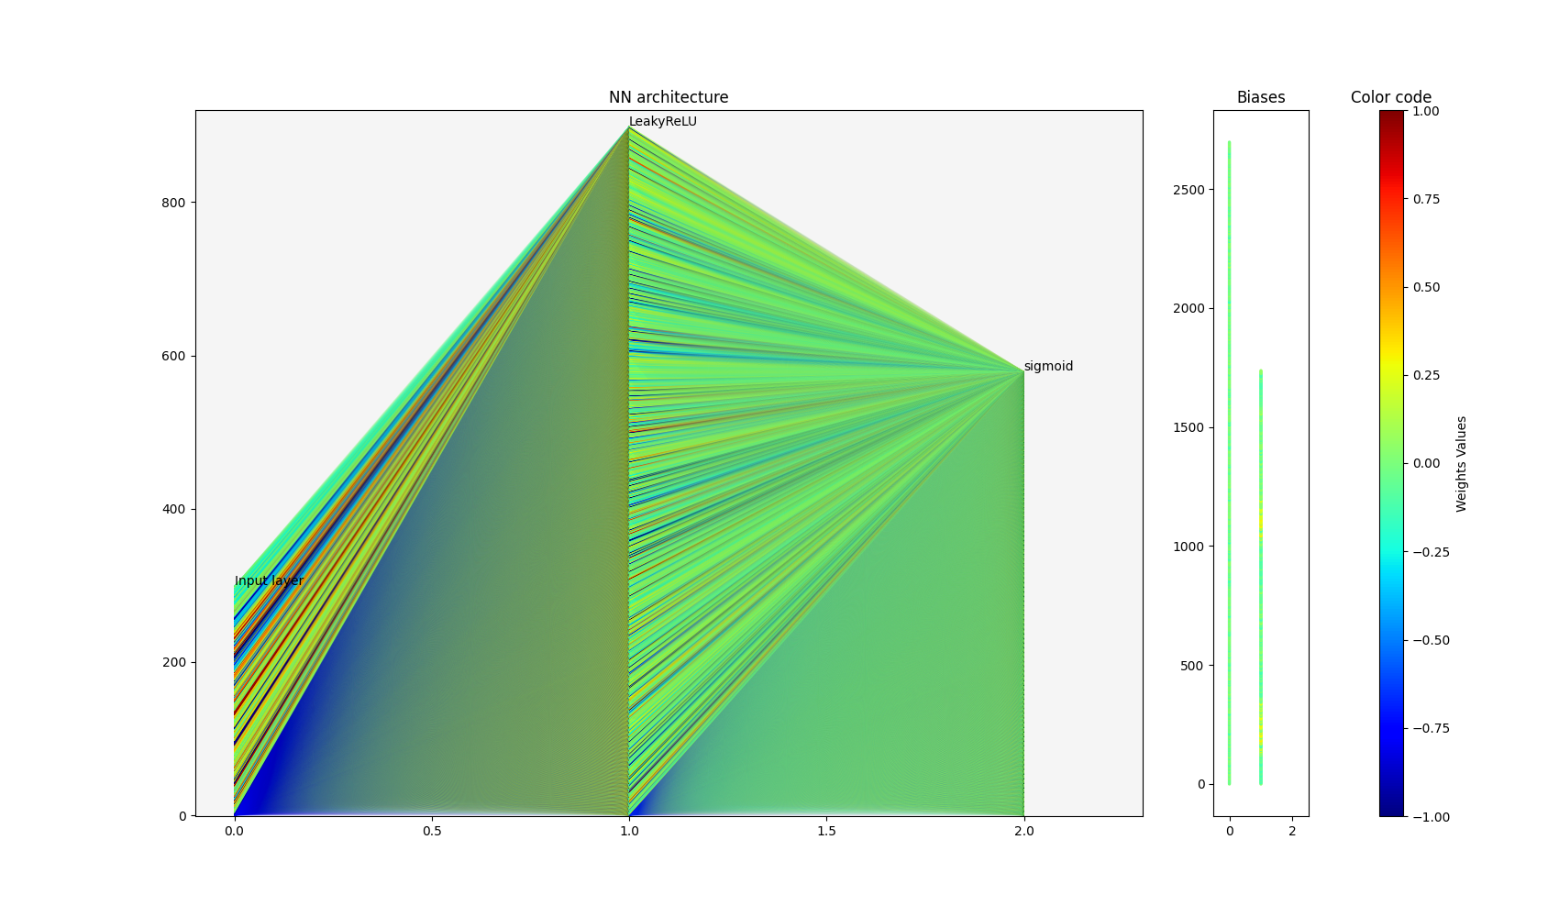
RESULTS: 1st classification-Simple MLP
works (relatively well) with real data (needs to generalize to more environments). Test on Aerosol Samples.

Slide 19
MLP Performance:
Dataset | Custom Score | Kappa Coeff | Sensitivity | Specificity | Guess-R | Recall | Precision
Synthetic XRF | -1.29 | 0.90 | 0.65 | 0.99 | 0.95 | 0.086 | 0.92
Aerosol | -0.47 | -0.05 | 0.26 | 0.98 | 0.47 | 0.69 | 0.94
 | Custom Score | Kappa Coeff | Sensitivity | Specificity | Guess-R | Recall | Precision
Maximum Possible values (Syn XRF) | -2 | 1 | 1 | 1 | 1 | 0.1318 | 1

Slide 20
Future work
Transformers (Attention)
Invertible Neural Networks (GLOW blocks)
Proper Auto Encoding of spectra
Domain Adaptation
Agnostic process (Non physical dependencies, mathematical process)
AI for Synthetic Generation ?
Multi-integration (PIXE…etc)

Slide 21
Transformers: (Mono-attention layer)
Dataset | Custom Score | Kappa Coeff | Sensitivity | Specificity | Guess-R | Recall | Precision
Synthetic XRF | -1.49 | 0.90 | 0.78 | 0.97 | 0.94 | 0.102 | 0.77
Aerosol | - | - | - | - | - | - | -

Slide 22
Pearson Correlation Coefficient
 | Synthetic | Aerosol
MLP | 0.76 | 0.27
Transformer | 0.78 | -

Slide 23
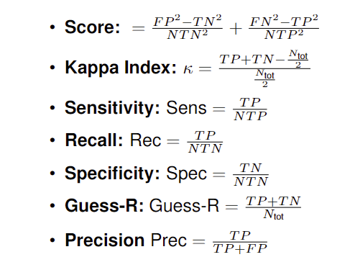
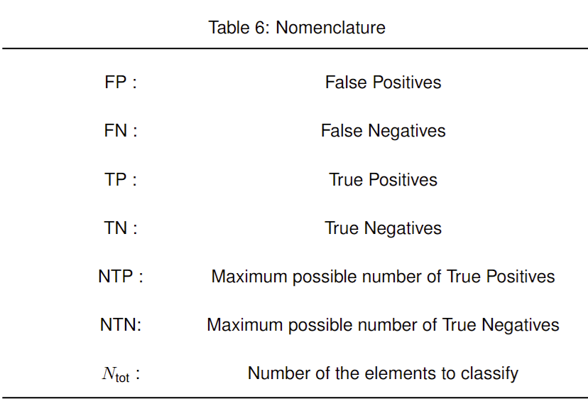
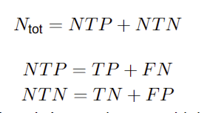
Notation

Slide 25
BACK Up Slides

Slide 26
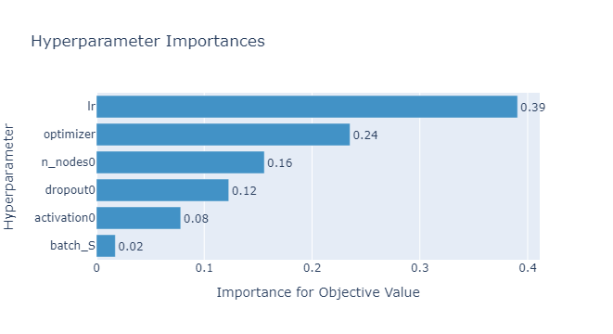
Suspicious

Slide 27
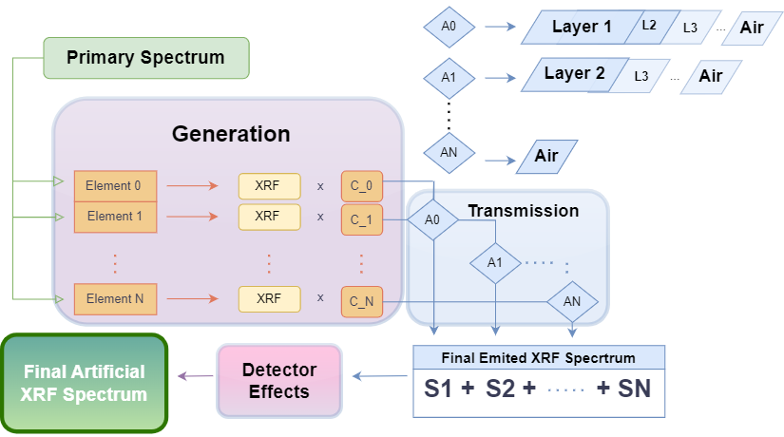

Slide 28
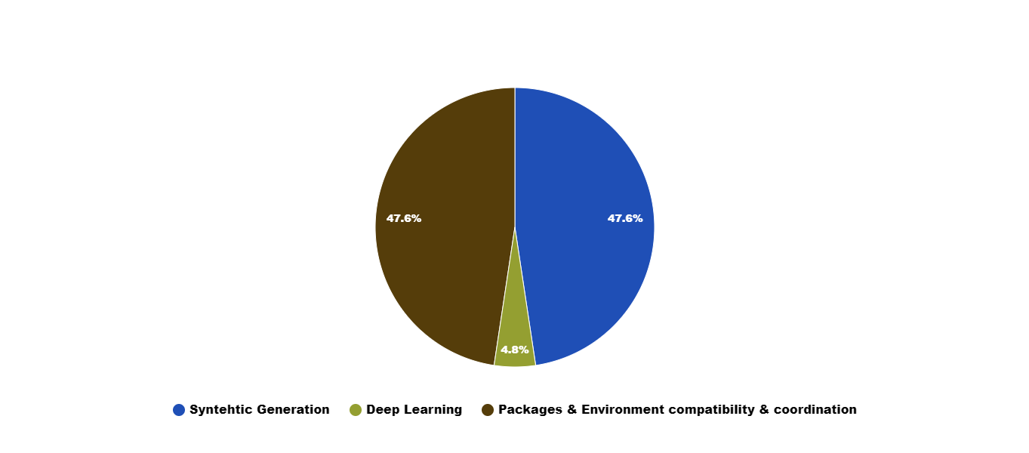

Slide 30
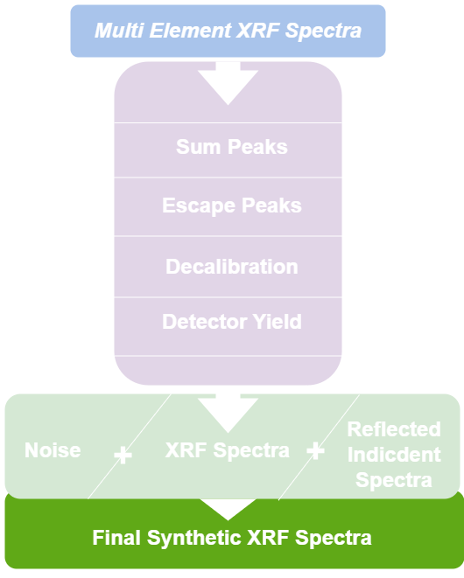

Slide 31
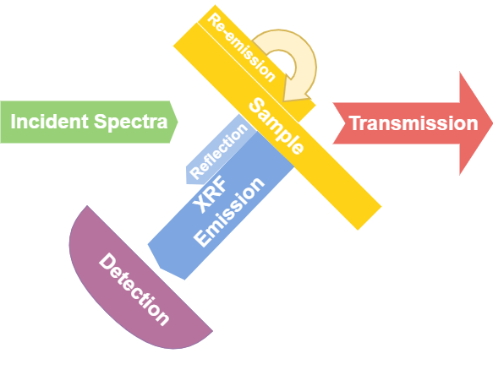

Slide 32
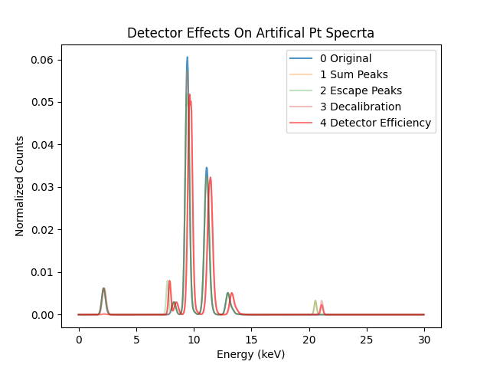

Slide 33
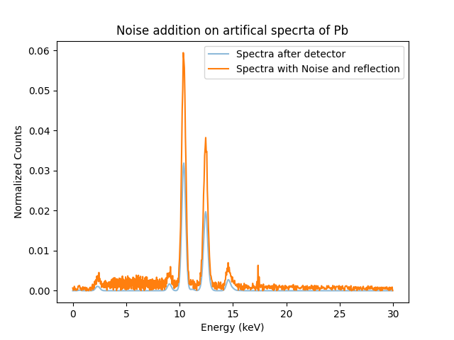

Slide 36
Aerosol Data: structurally different.

Slide 37
Classical ML Problems
lot of variability,
complexity,
lack of labelling
(ground truth)
Composition of spectra
Lack of data
Uncertainty
low SNR

