Slide 1
Use of a UNET network for identifying cavities in the mines
Andrea Paccagnella
Università di Firenze, Dipartimento di Fisica e Astronomia
Istituto Nazionale di Fisica Nucleare, Sezione di Firenze

Slide 2
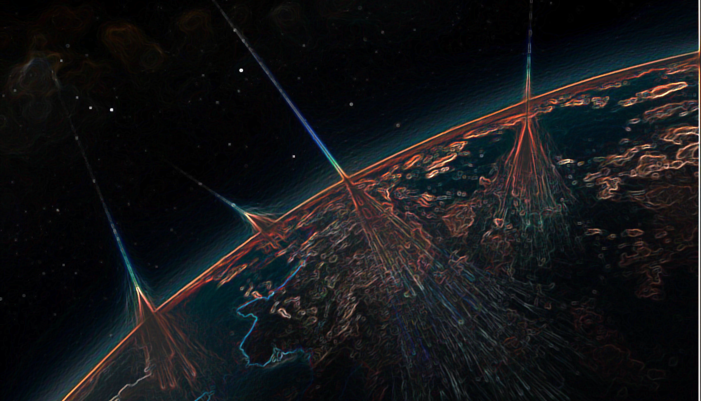
🌌 Introduction to Muography
Muon Cosmic Rays
Muon Technique
MIMA
🤖 Supervised Algorithms in Muography
Data Generator
UNet
Results
Future Work

Slide 3
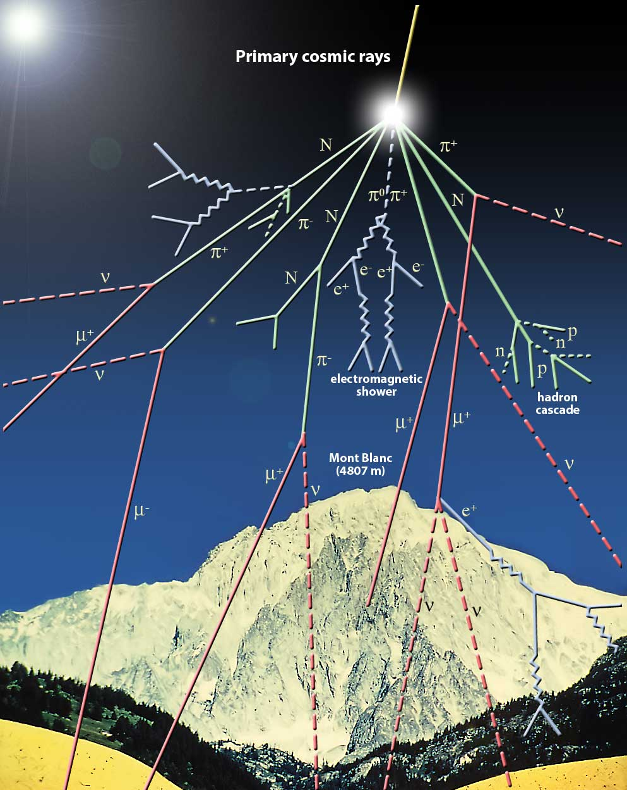
Cosmic Rays
Cosmic rays are divided into primary and secondary:
The primaries impact the atmosphere from space and originate mainly from outside the solar system:
98% nuclei:
87% p
12% He
1% other nuclei
2% $e^{+}$ and $e^{−}$
Secondaries are produced by the interaction of primaries with nuclei in the atmosphere:
X-ray, neutrons, mesons (such as pions and kaons), electrons and muons.
$m_{μ}\sim 105MeV/c^{2}\sim 200 m_{e}$
High penetrating power in the mater
Most abuntant particles on the ground
Life Time $τ_{μ}=2.2 μs$

Slide 4
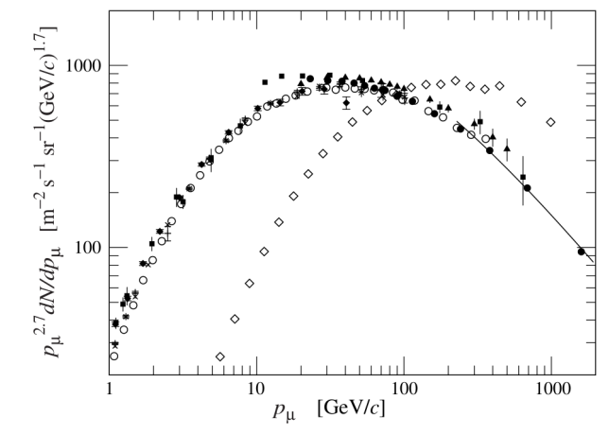
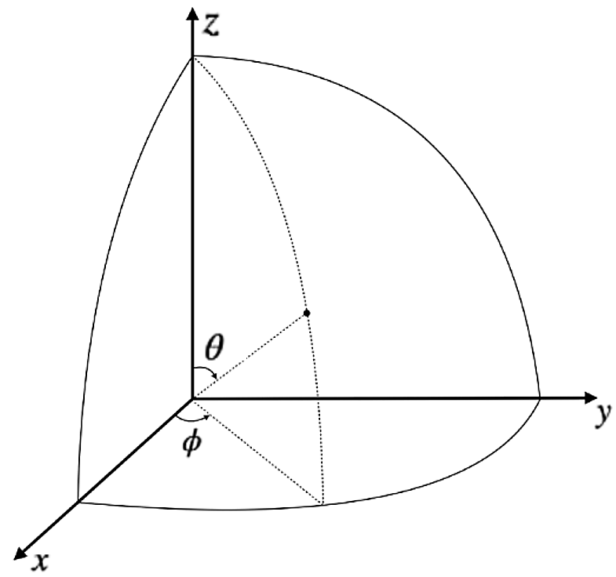
Atmospheric Muons
The Muon Flux at sea level in vertical it is approx $Φ=1/({cm}^{2}s)$
But this depends on the zenith angle and its energy
The flow decreases with the increase of $θ$ as $\cos^{2}θ$
$θ$: Zenith angle
$φ:$ Azimuth angle
$90−θ$: Elevation
The spectrum of muons at sea level for θ = 75 is indicated by the empty diamonds while the other markers refer to the muon spectrum for θ = 0. The average energy of muons increases as the zenith angle of origin increases. The ordinate is multiplied by $p_{μ}^{2,7}$ to compress the spectra.

Slide 5
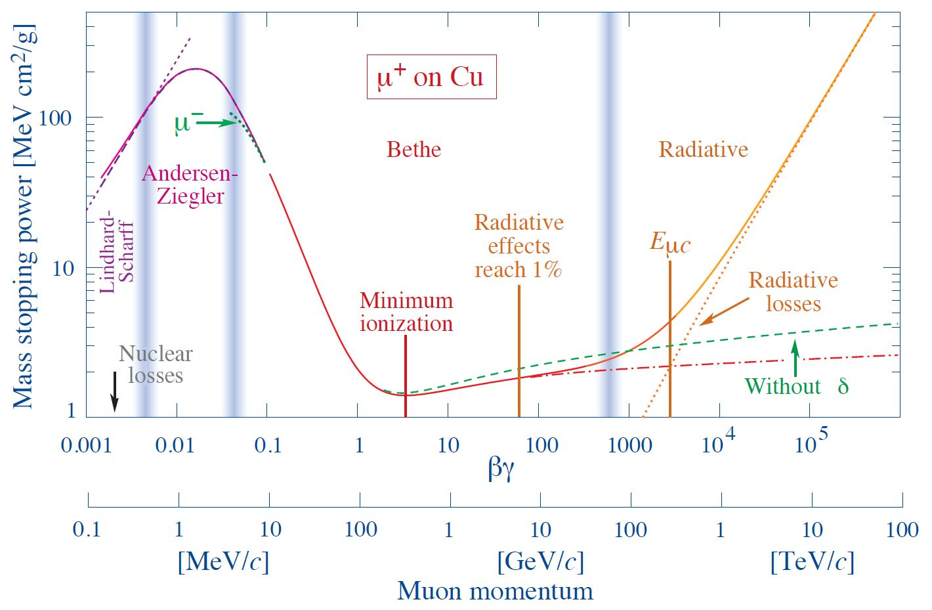
Muon-matter interaction
The interaction of muons with matter is described by processes which are dominant at different energies:
Atomic excitation and ionization (below 100GeV)
Radiative processes (over 100GeV)
The quantity that describes the energy loss of muons when they interact with matter is the Stopping Power:
$$−\left(\frac{dE}{dX}\right)=a\left(E\right)+b\left(E\right)E$$
$a\left(E\right)$ describes the energy loss upon excitation and ionization and is described by the Bethe-Block formula.
$b\left(E\right)E$ describes the loss of muon energy due to radiative effects, most of the muons involved in muon radiography are below 100 GeV.
Stopping power of muons in copper as a function of the kinetic energy. Our energy range of interest is between Minimum Ionization and 100GeV.

Slide 6
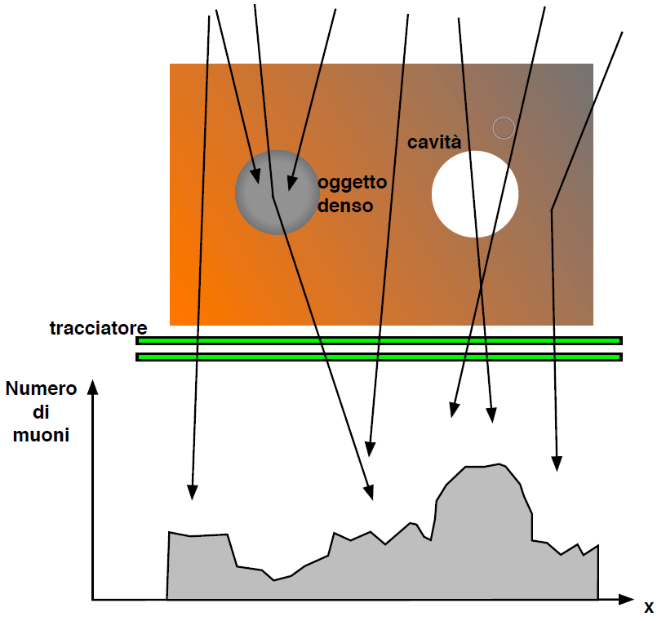
Muon Radiography
The muon radiography technique exploits the penetration capacity of muons present in cosmic rays to make radiography of very large targets.
This technique bases its operation on the energy loss of muons when they pass through a dense body.
Since muons are less likely to interact, stop and decay in low density matter than in high density matter, a larger number of muons will travel through the low density regions of target objects in comparison to higher density regions.
Muography is a non-invasive technique since it exploits natural radiation present on the entire surface of the earth and we are continuously traversed by these particles.
cavity
Dense
object
Detector
Number of muon
Notes:
To date, this is the sole technique that employs cosmic ray muons as a means of investigating relatively dense structures.
The methodology employed to generate a two-dimensional image of the inner structure of the target consists of three steps.

Slide 7
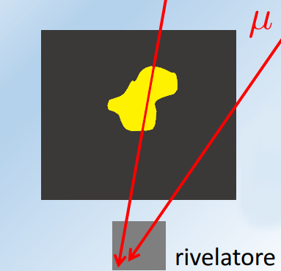
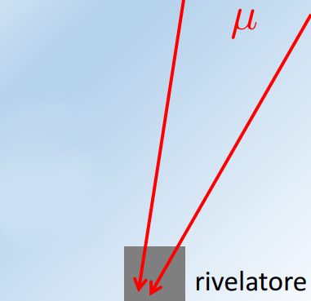
Muon Transmition technique
free-sky
Observing the number of counts in the presence of the target ($N_{target}(θ,φ)$).
Observing the number of counts without the target ($N_{target}(θ,φ)$), also called Free-Sky configuration.
Compare the measured transmission with that expected at a fixed density.
A muon with a given momentum $p_{min}$, before being stopped, will be able to cross on average a certain thickness of material to which we can associate an opacity X.
Fixed a certain angular direction $(θ,φ)$ and a certain opacity, the expected value of the flux transmitted through the target can be estimated as the integral from $p_{min}$ to infinity of the differential flux in that direction $Φ_{trasmitted}=\int_{p_{min}}^{∞}{dΦ(θ,φ)}dp$
target
Area to investigate
Detector
Detector
$$T_{measured}=\frac{N_{target}(θ,φ)}{N_{free−sky}(θ,φ)}∙\frac{t_{free−sky}}{t_{target}}$$
$$T_{relative}=\frac{T_{measured}}{T_{expected}}$$
> 1 Cavity?
<1 Dense Object?
=1 Match with simulation
Notes:
Muon Transmission radiography is based on the energy loss (and the eventual decay) of the muons when they interact with matter.
The methodology employed to generate a two-dimensional image of the inner structure of the target consists of three steps.

Slide 8
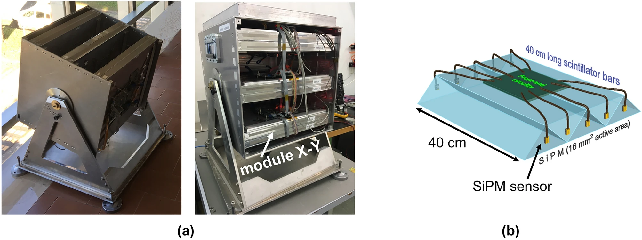
MIMA
MIMA (Muon Imaging for Mining and Archaeology)
Field: geology, archaeology and civil engineering.
Aluminium cover: (50 x 50 x 50) ${cm}^{3}$
Altazimuth orientation.
Six tracking planes organized in orthogonal pairs, forming three compact X-Y modules.
Active surface area of each plane: (40 x 40) ${cm}^{2}$
Resolution: 7 (mrad) $\sim 0.40 Deg$
Acceptance: 60 degrees.

Slide 9
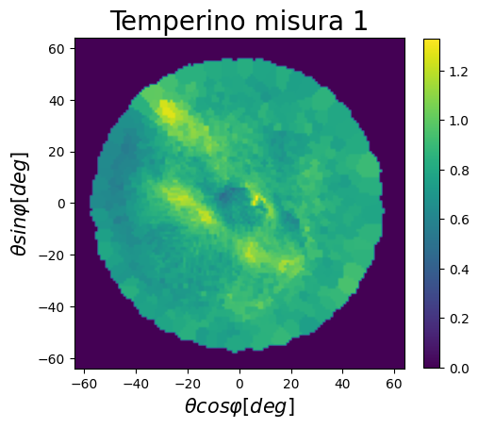
Temperino
MIMA detector was positioned inside the mine with a vertical orientation, namely at $θ=0^{°}$
Reference density with which the expected transmission was calculated: $2.65 g/{cm}^{3}$
Brighter areas = Higher relative transmission: region with a lower density than expected.
Darker areas = Lower relative transmission: regions with a higher density than expected.
Acceptance
Cone
Gran Cava
Our aim is to create a neural network that can predict and segment these cavities.
Gran Cava
MIMA
Measuring
Point
Cavity 2
Cavity 3
Notes:
For the following results, we consider the first measurement conducted at the Temperino mine as our main reference.

Slide 10
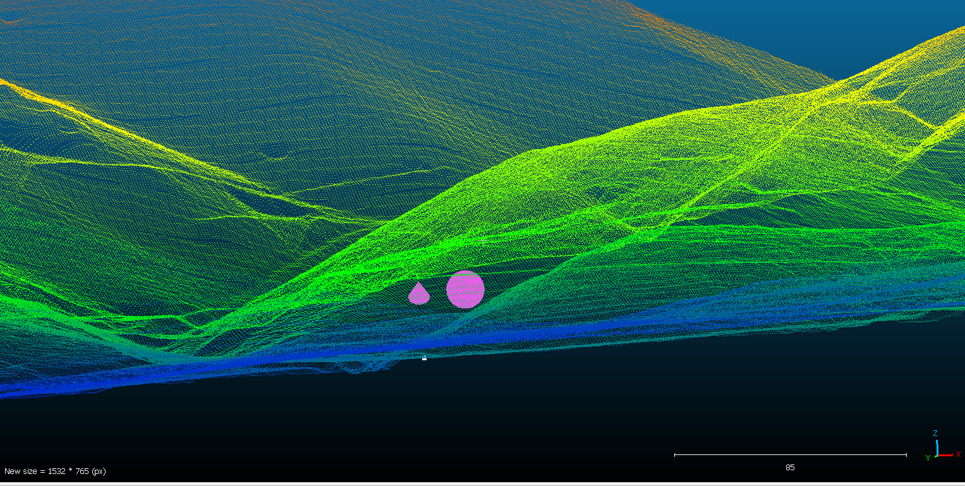
Data generation - Cavity
Through the Cloud software appears we created 1958 cavities.
We used the measurement conducted by the Florence group at the Temperino mines as reference. Using the mine’s LiDAR, artificial cavities were manually inserted in the position where MIMA was simulated.
MIMA
Cavity

Slide 11
Data Procesing
The idea was to simulate a two-month data collection for each measured transmission map but, for this first feasibility study, we considered a data taking with an infinite acquisition time. The instrumental errors of the detector (MIMA) have been added.
Images created:
25584 for training
6396 for validation
770 for testing

Slide 12
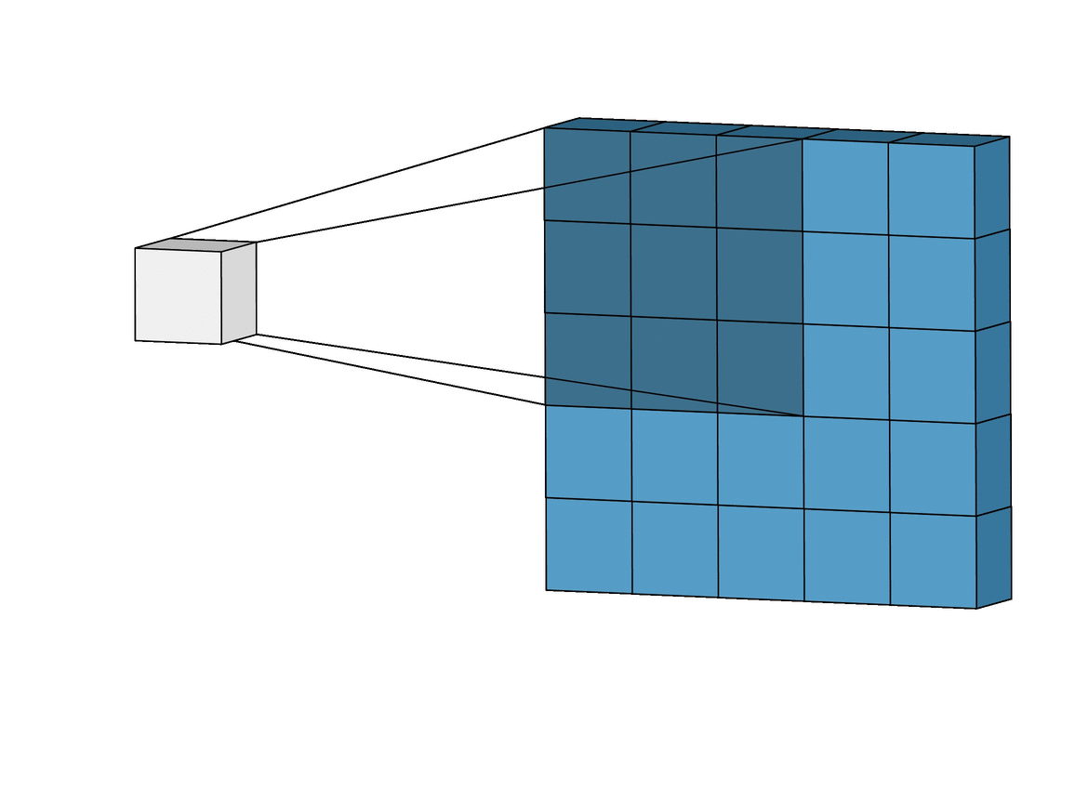
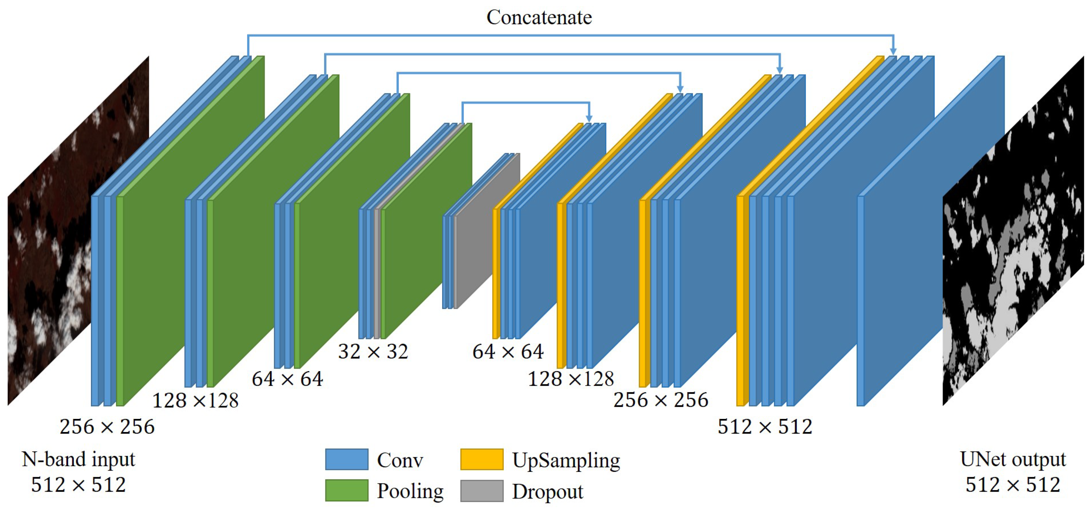
UNet
The U-Net is a CNN-based architecture designed to segment biomedical images.
Given an image as input, it is mapped into a vector space via an Encoder function based on a CNN architecture. The encoded vector is then reverse transformed using a second CNN-based function called Decoder. This is done to ensure that the network learns how to use image pixels to isolate anomalies.
The peculiarity of a UNet is that encoder and decoder layers are also connected to each other.
CNN

Slide 13
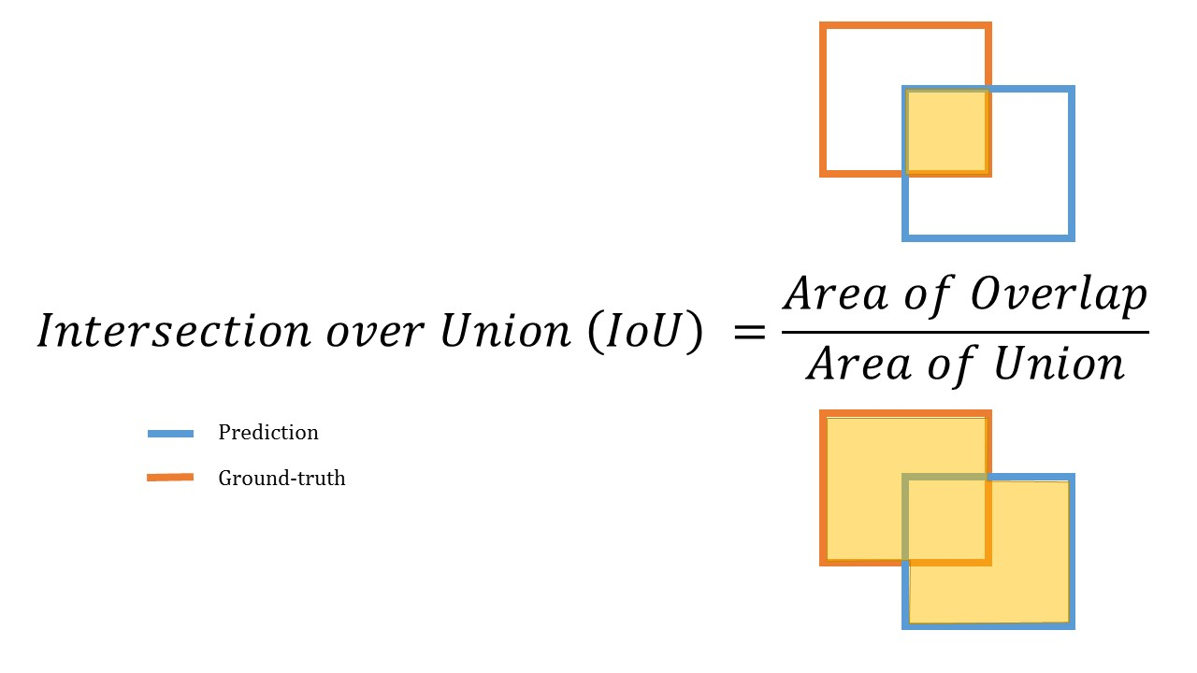
Loss e Metric
Loss = 1 – DSC
Metric: IoU; DSC
We decided to use a loss and metric that looked at the overall picture.
As loss we decided to choose 1 minus the Dice Similarity Coefficient (DSC), as this is more sensitive to errors when the dimensions of the segmented regions are very different.
Intersection over Union (IoU) was used to evaluate the metric and to test the network subsequently.

Slide 14
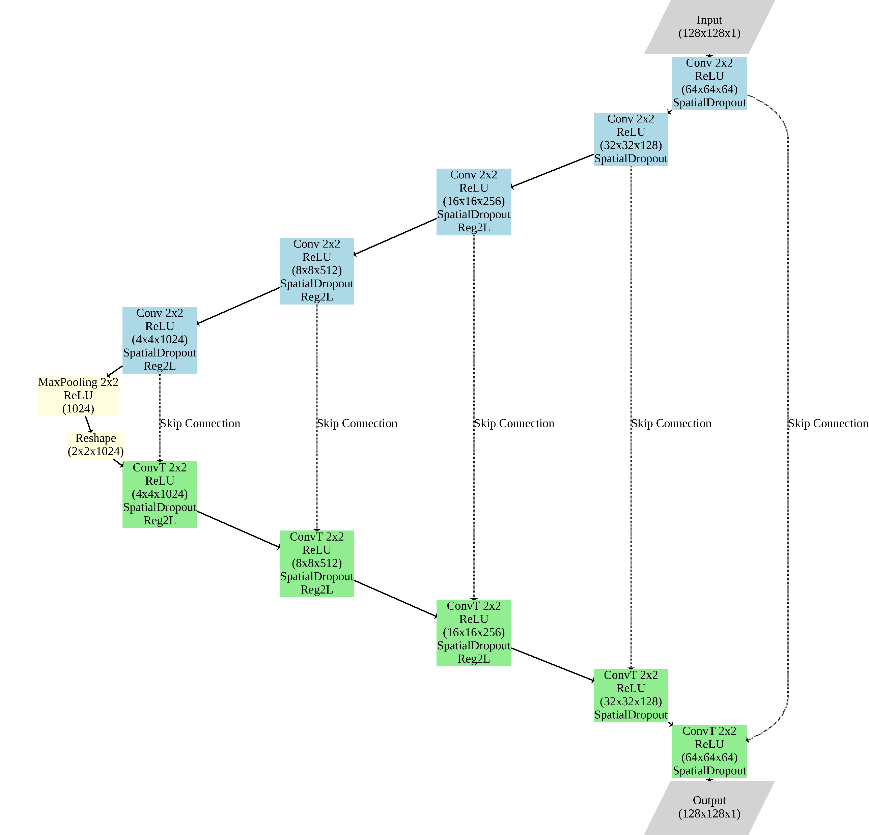
Network Structure
Learning rate: 1e-4
Spatial Dropout: 0.1
Regularization Coefficient: 1e-6
Epoch: 150
Batch Size: 50

Slide 15
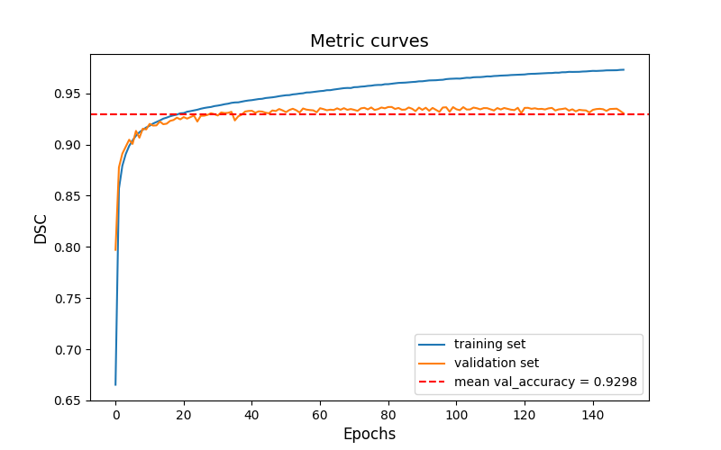
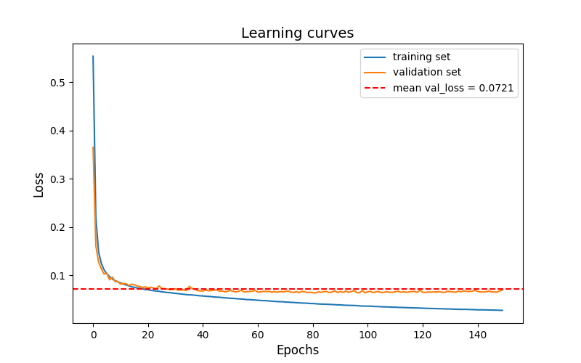
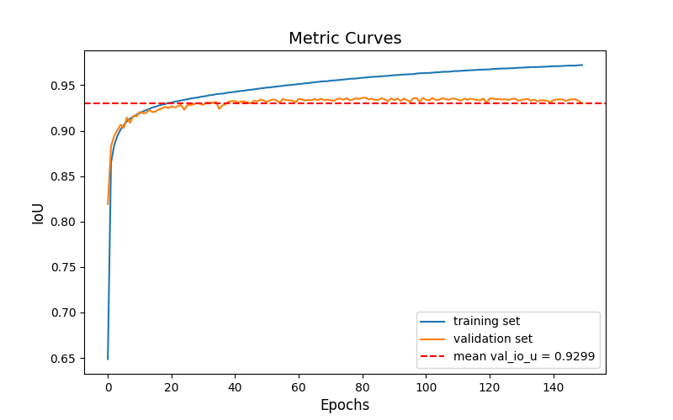
Results
As it can be seen in all three curves the phenomenon of overfitting is present. However, the validation samples are constant and the average values ​​are very good.

Slide 16
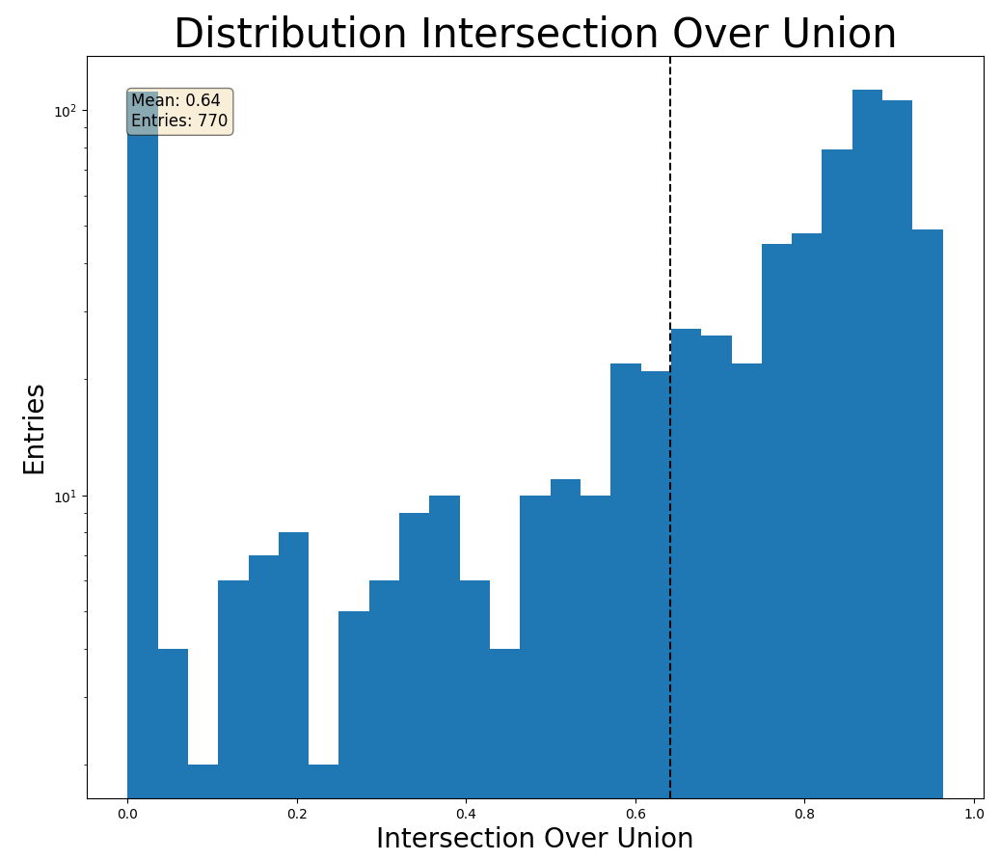
Test
770 muon radiographies were created to test the algorithm.
The cavities used to generate these radiographies were never seen by the network during the training phase.
For each network prediction we compared it with the truth map using the IoU metric described previously.
The peak at 0 is due to two factors: when the cavity is not present the metric has a value of zero, the cavities are very small and the network is unable to predict them.
If we ignore that peak we have an average of 0.7

Slide 17
Visual Test

Slide 18
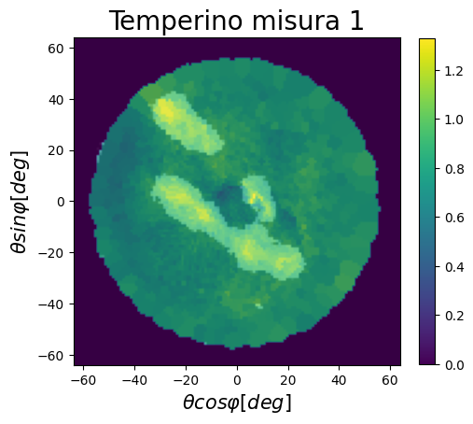
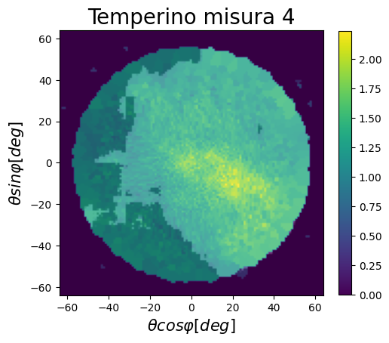
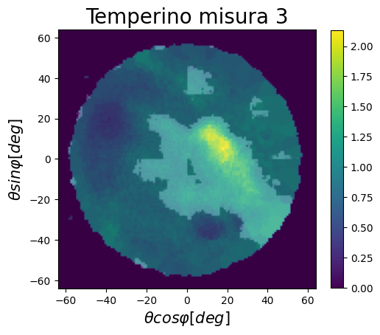
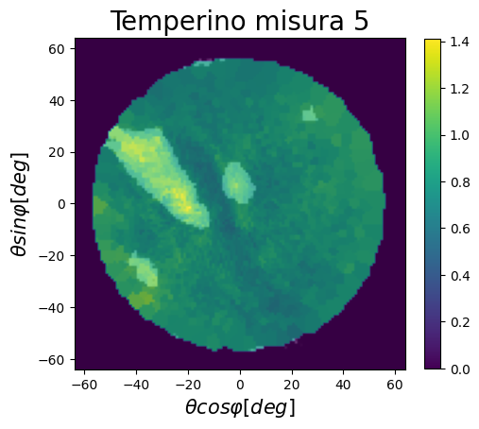
Real Measure
The relative transmission map for each measurement is shown and the network prediction is overlaid in white.
The network predicts cavities very well when they have a high contrast compared to the background area, as in the case of measurements 1 and 5.
While the network does not work precisely where the background it’s more uniform as in the case of measures 4 and 3.

Slide 19
Summary
Cavities created: 1985
Training images: 25584
Images for validation: 6396
Test images: 770
Measured transmission map generation time: 3 days
Time to pre-process data: 2h
Net training time: 3 - 4 hours
We are able to locate and contour cavities in most cases
Difficulties arise for very uniform regions (such as size 4 and 3 of the sharpener)
Future Works
Replicate measurements with different acquisition times.
Improve network structure where possible.
Finding the best hyperparameters for training (Baiesian approach).

