Slide 1
Single Photon Sources with Single Ion Implantation
V. Rigato
LNL 13-03-2024

Slide 2
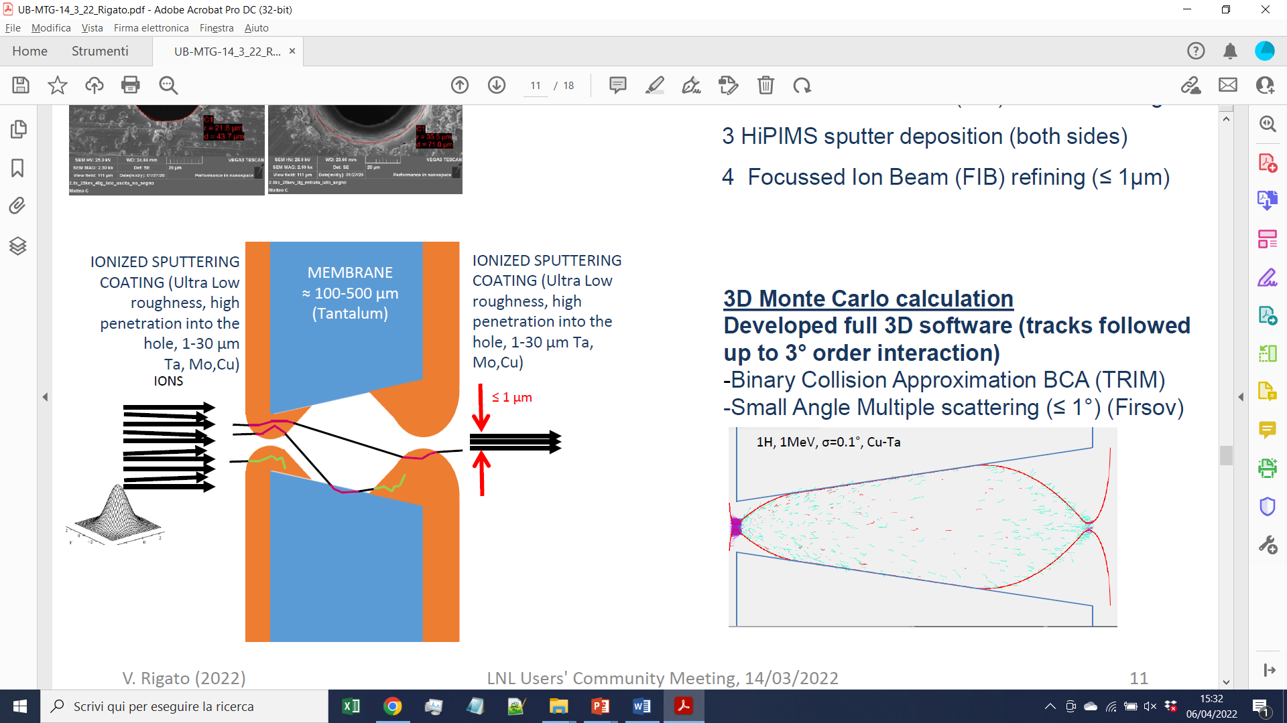
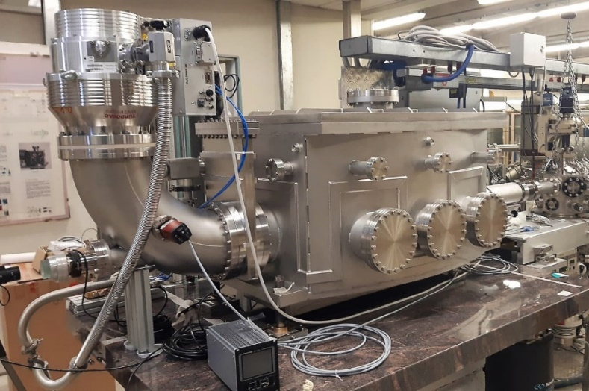
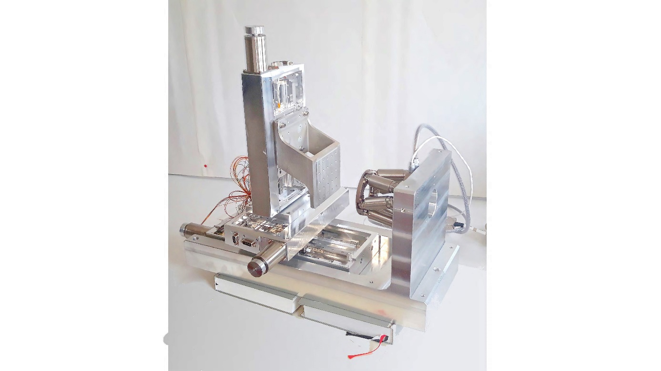
Research lines:
QUANTUM: Silicon Phonics, Single Photon Sources by Ion Implantation
DETECTORS: Detection of Single Ions, nanomaterials based new detectors ACCELERATORS: Single ion Handling, sub-Micrometer Precision Targeting with Ions, Deterministic Doping at Nanometer Level
1
ASIDI / QUANTEP
2
CSN5
MANIFOLD
PNRR
NQSTI S4
Scientific context
-) Defect Engineering with Ions
-) Nanomaterials Based Detectors
-) Single Ion Implantation & Detection
-) Integrated Silicon Photonics
-) Radiation Effects
PAC
SAPORI
PAC
GeNESIS
PAC
ASIDI
People LNL
Device Under Test (DUT) holder
X
Z
Sub-µm collimator holder
V. Rigato (DT)
M. Campostrini (T)
C. Roncolato (1T)
S. Amphalop (IAEA)
O. Omelnyk (AS)
S. Canella (1T)
Y
BEAM
ASIDI
double micro-collimator
AN2000 accelerator

Slide 4
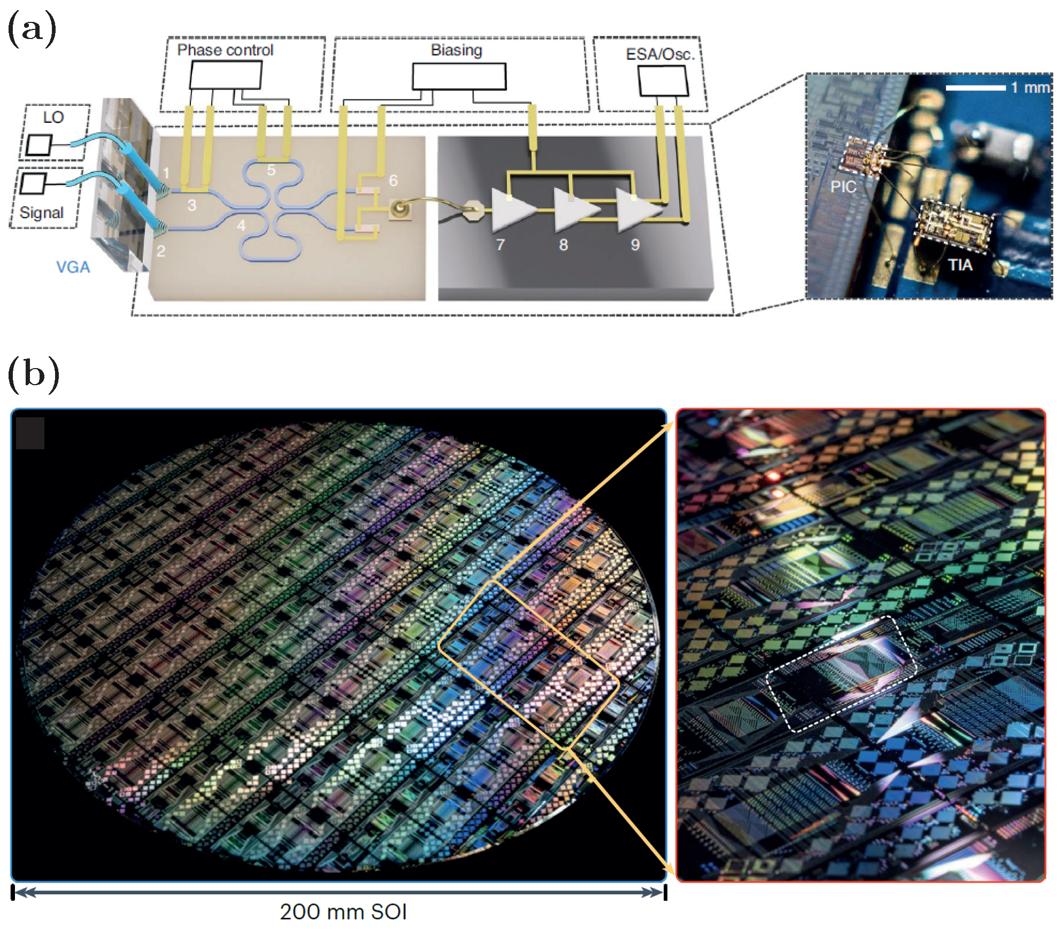
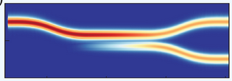
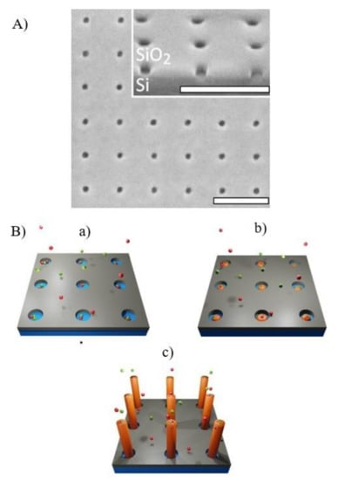
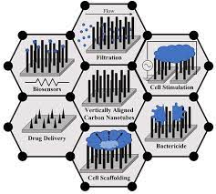
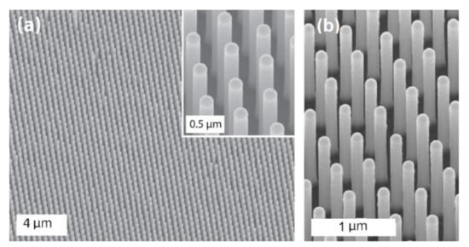
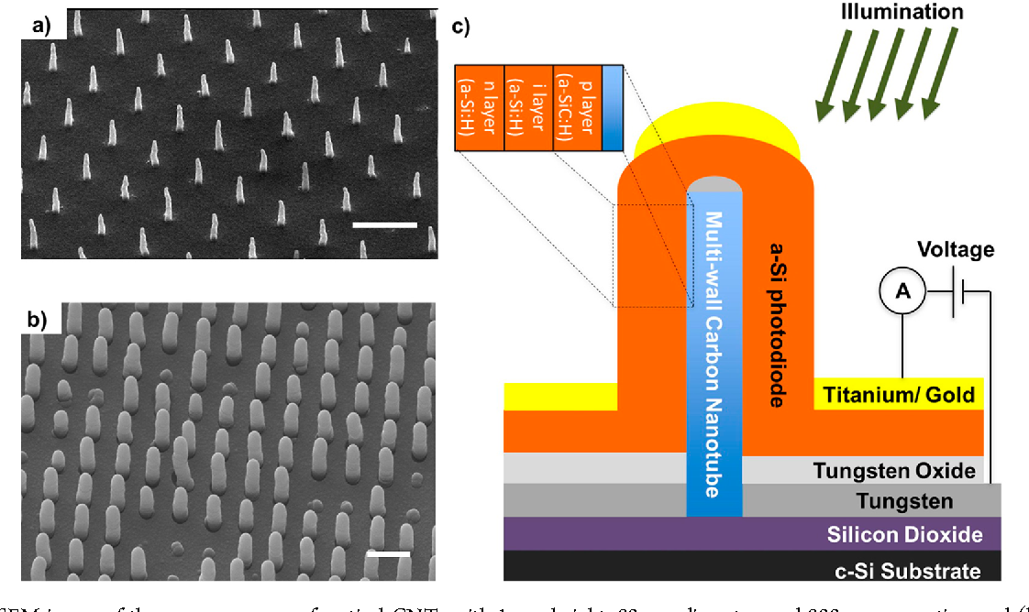
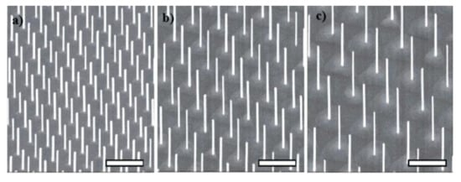
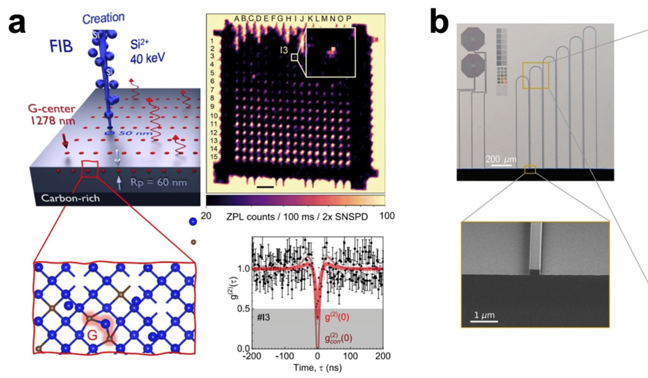
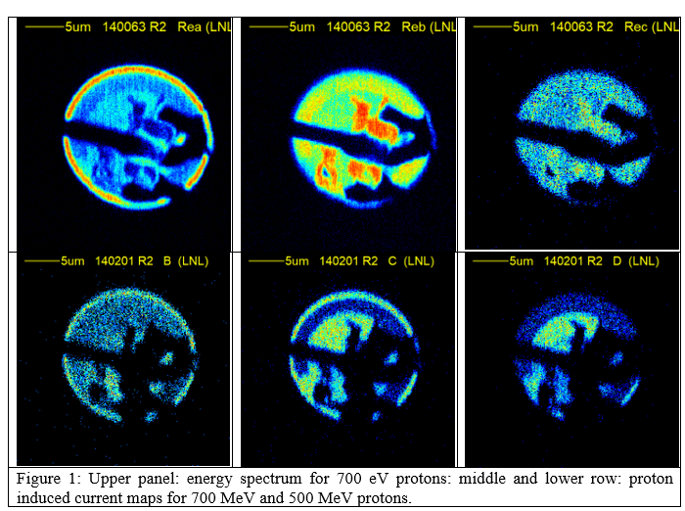
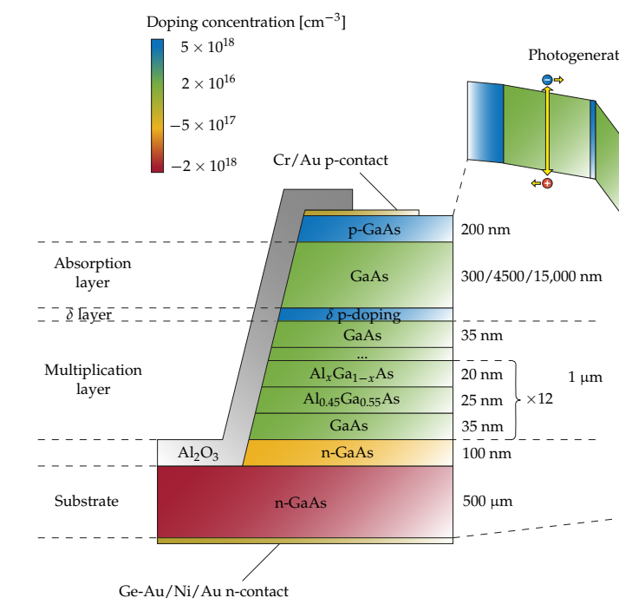
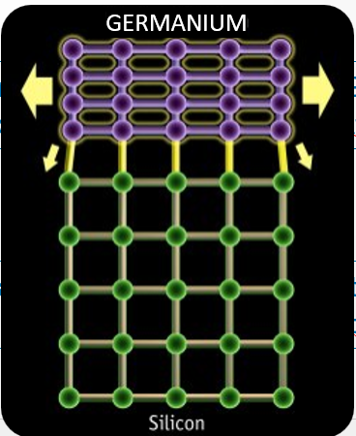
Objective of research
1
QUANTEP (2021-2024)
National Quantum platform for integrated silicon pothonics
Photonics 2024, 11(2), 188; https://doi.org/10.3390/photonics11020188
Appl. Sci. 2024, 14(1), 387; https://doi.org/10.3390/app14010387
2
MANIFOLD (2024-2026)
Development of a new concept ion detector based on 2D materials and nanotubes
3
Defect engineering with ion beams (new color centers in semiconductors, with properties for qubit, single photon sources in visible and IR telecommunication bands
PNRR NQSTI (2022-2026+)
PAC
SAPORI (2023-ongoing)
Development and characterization of novel GaAs SAM-APD detectors with PrOtons and 𝜶-paRtIcles
PAC
GeNESIS (2023-ongoing)
Germanium-based Novel single-photon Emitters for quantum photonicS using ion implantation and ISotopic control (Si, Ge)

Slide 5
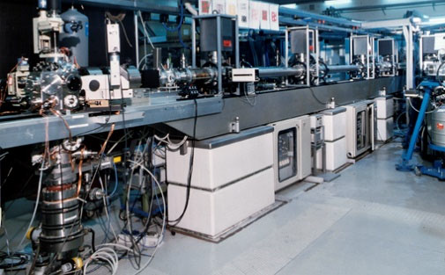
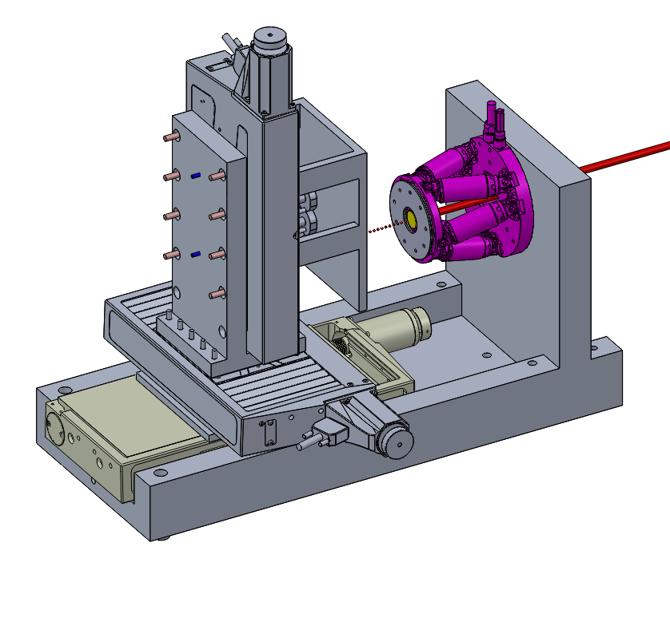
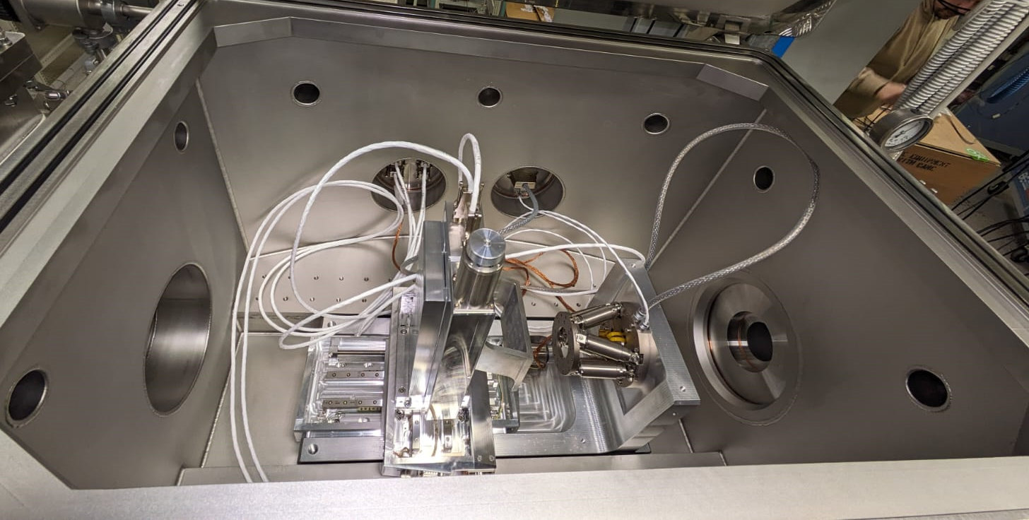
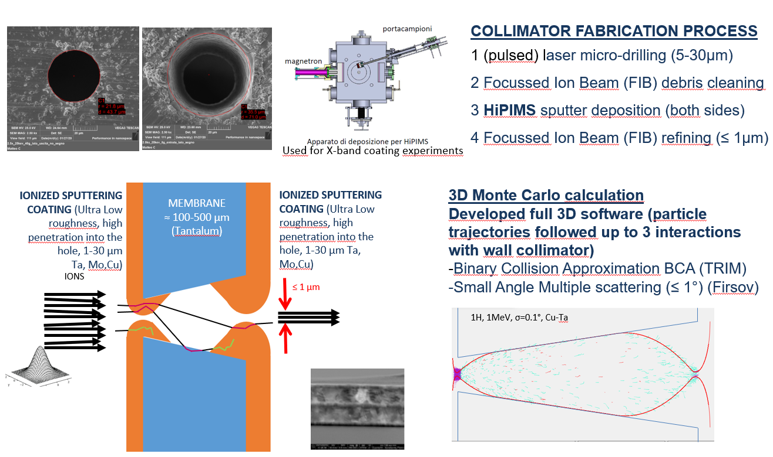
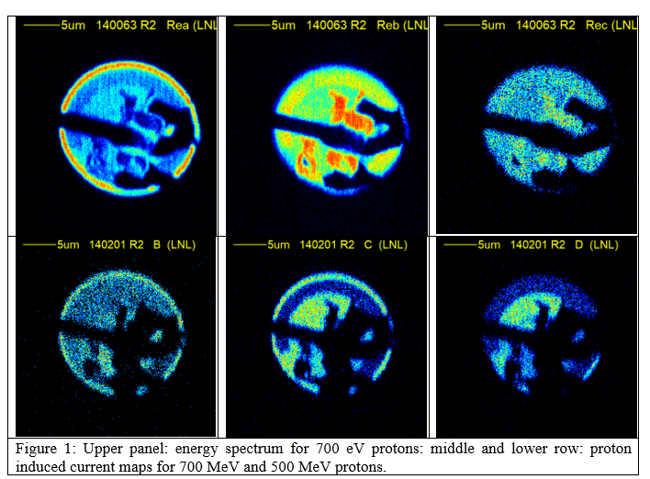
Expertise @LNL
AN2000
AN2000
Ion microprobe (with ultra rarefied ion beams)
Sub-µm beam collimation
Ionized sputtering for engineered-double microcollimator
Ion-solid interactions (theory and experiment)
Detector test and development
Single ion detection
DUT holder
beam
IONS
Object slits
Sub-micrometer engineered collimator
LABORATORIO di FISICA DEI MATERIALI
Collimation slits
SCAN
A
B
‘Oxford’ Triplet
A
Y
X
+ -
DUT
+ -
+ -
+ -

Slide 6














Collaborations
(LNL, LNS, PD, TO, PI,MI,PV,RM2,PG,TS)
Optoelectronic Research Center (UK)
Space Technology Institute (Australia)

Slide 7
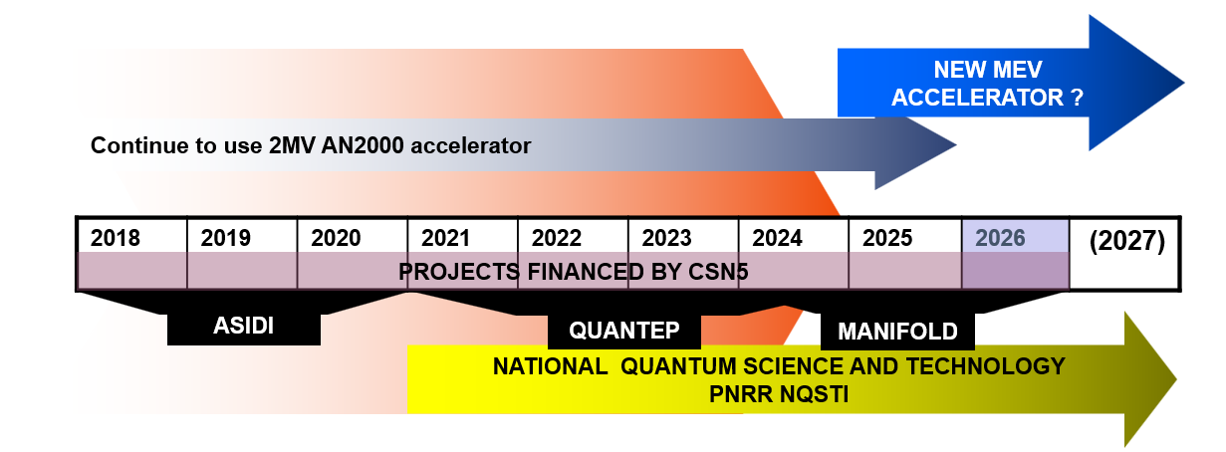
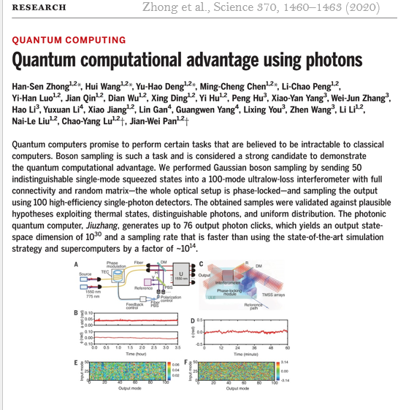
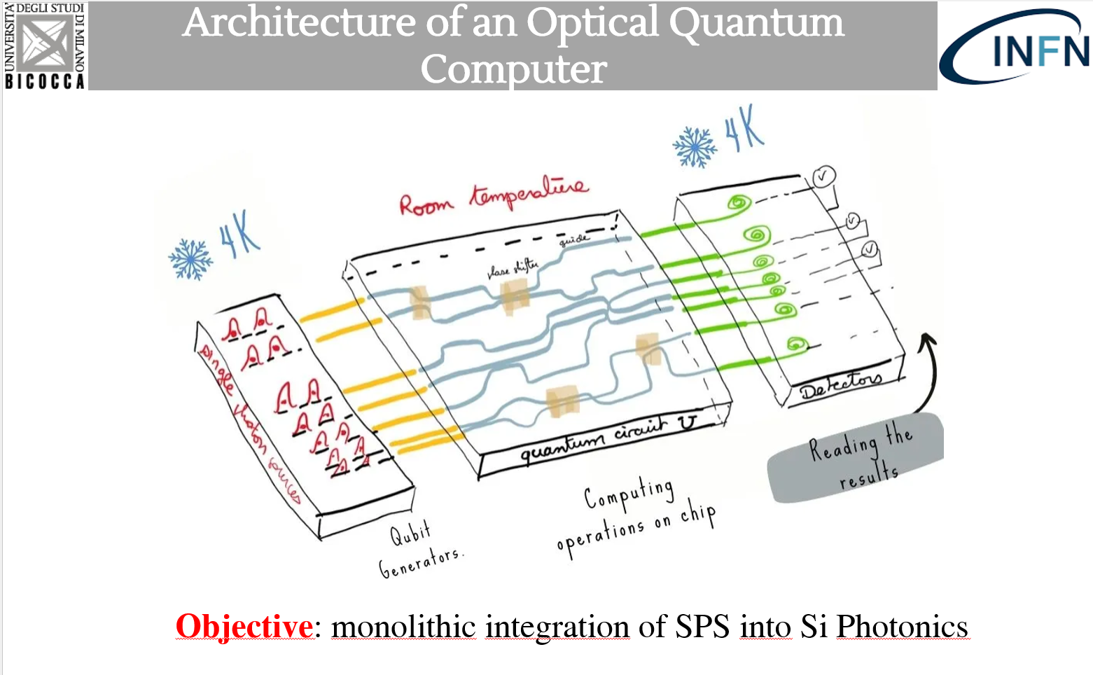
Future plan and possible applications

