Slide 1
1
OREO (ORriEnted calOrimeter)
Research line: Detectors
2
N3G (Next Generation Germanium Gamma Ray Detectors)
Scientific context: Radiation interaction with crystals
Radiation interaction with crystal is a powerful tool for detection. High quality crystal processing is a key know-how to produce reliable devices. HPGe is the purest semiconductor and allows to fabricate the most effective gamma spectroscopy detector. Crystalline scintillators show impressive properties for high energy particles detection.
How much can be improved the crystalline-based detection technology ?
3
LACE (TT) (Laser Annealing Coaxial dEtectors)
INFN - LNL
Walter Raniero
Chiara Carraro (Post-doc)
Daniel Napoli (Senior Associated)
P. Mastinu (* Neutron irradiation)
DFA with research assignment at LNL
Gianluigi Maggioni
Sara Carturan
Davide De Salvador (group leader)
DFA Semiconductor Physics group associated to LNL
S. Bertoldo (Post doc), F. Sgarbossa (RTDA)
E. Napolitani (Prof.) D. Valzani (PHD)
D. Fontana (PHD)

Slide 2
Scientific context – Channeling beam steering with Si and Ge crystals
SPS 120 GeV p beam
Counts (arb units)
0.3
De Salvador et al., Appl. Phys. Lett. 98 (2011) 134102
Guidi et al., Phys. Rev. Lett. 108 (2012) 1-4
Ge crystals
0.2
Deflection angle, θ (°)
0.1
(110) Si planes
100nm crystal
0
De Salvador et al., JINST (2018)
AN2000
2 MeV p beam
-0.1
-0.2
Thin Ge Crystals

Slide 3
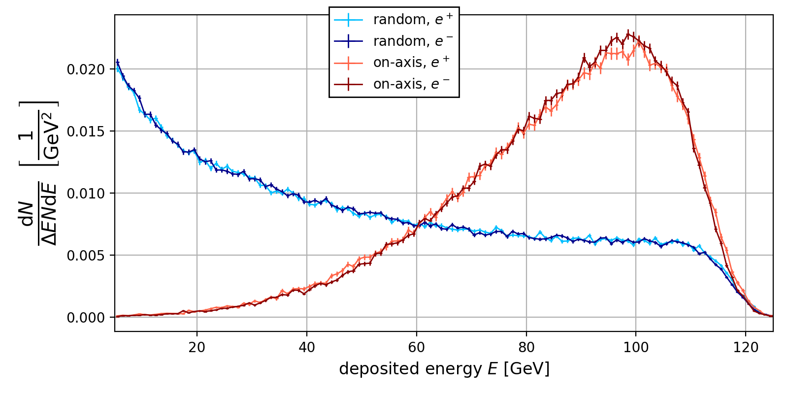
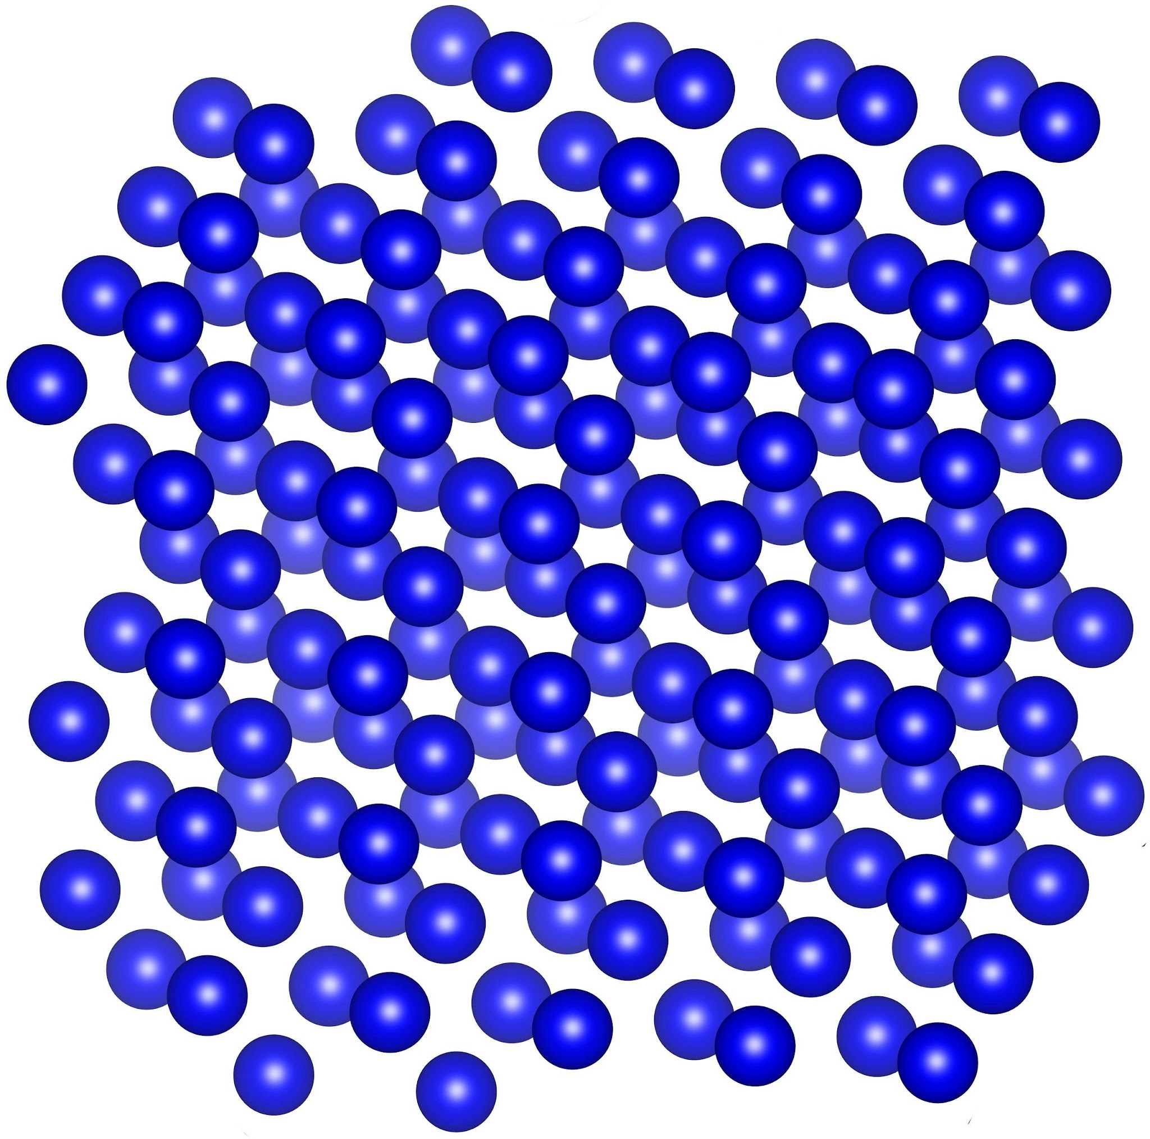
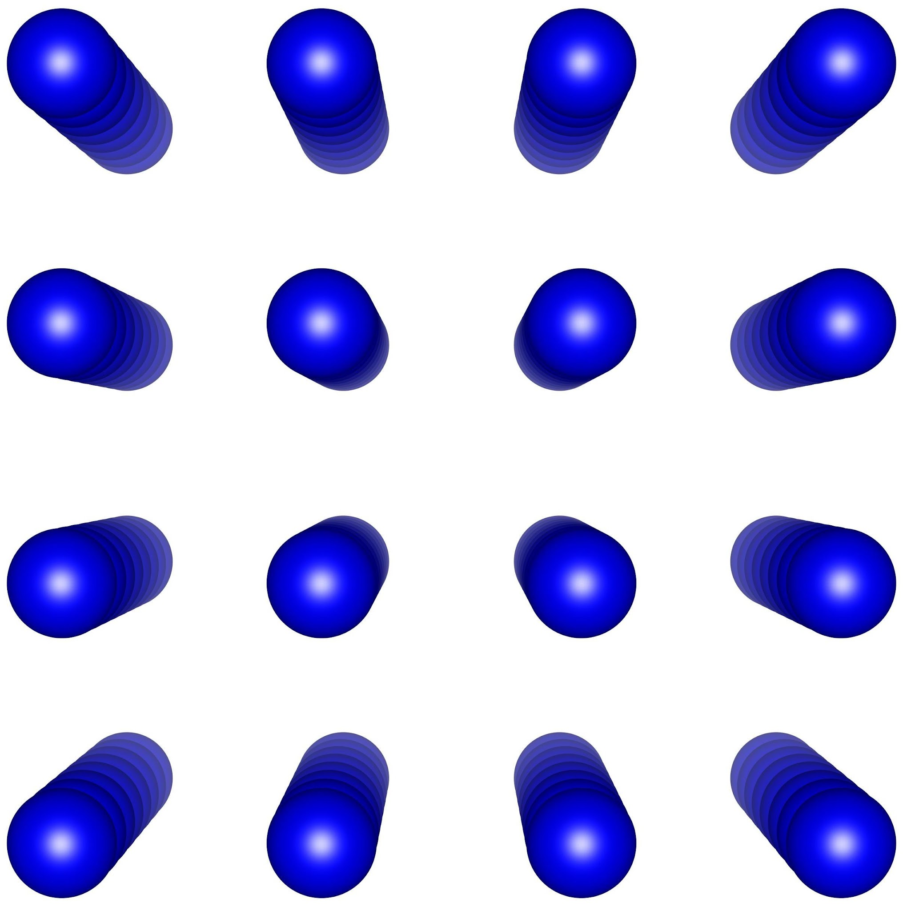
Scientific context – High energy innovative detectors
OREO
(Oriented Calorimeter)
Crystalline PWO Scintillators
120 GeV e-,e+ @ SPS Nord Area CERN
PWO: Lead Tungstate scintillator
​L. Bandiera et al., Phys. Rev. Lett. 121 (2018) 021603
OREO: High energy calorimeter based on oriented crystal – PI: Laura Bandiera (INFN Ferrara)

Slide 4
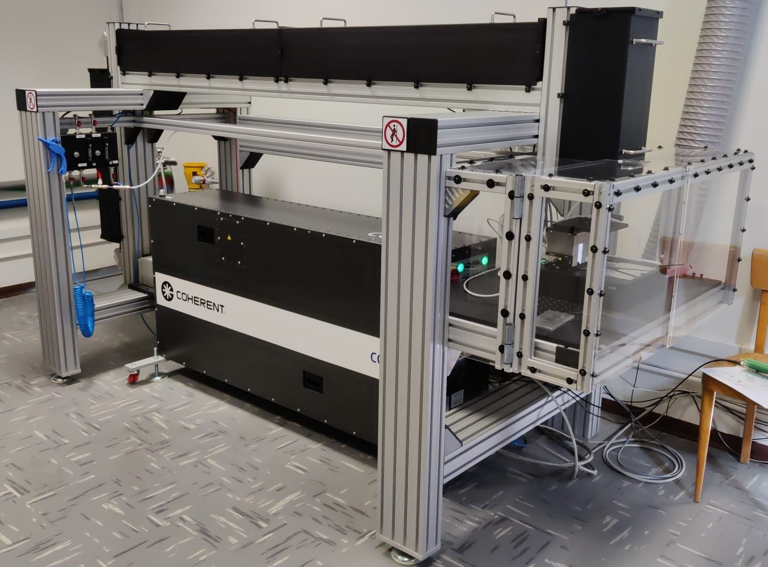
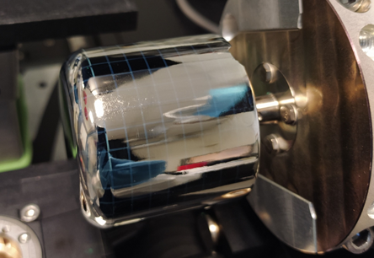

Scientific context – HPGe detectors
p⁺(B)
N3G
(Next Generation Germanium Gamma Ray Detectors)
Gamma spectroscopy
n-type HPGe bulk
n⁺(Li) [V-]
Neutrons
PLM (Pulsed Laser Melting)
E
Radiation Hardness
Protons
e
h
New n+ thin segmentable and stable contact
ϒ
Passivation

Slide 5
Scientific context – HPGe detectors
n⁺(Sb)
N3G
(Next Generation Germanium Gamma Ray Detectors)
Gamma spectroscopy
p-type HPGe bulk
p⁺(B) [V+]
Neutrons
PLM (Pulsed Laser Melting)
E
Radiation Hardness
Protons
h
e
New n+ thin segmentable and stable contact
ϒ
Passivation

Slide 6
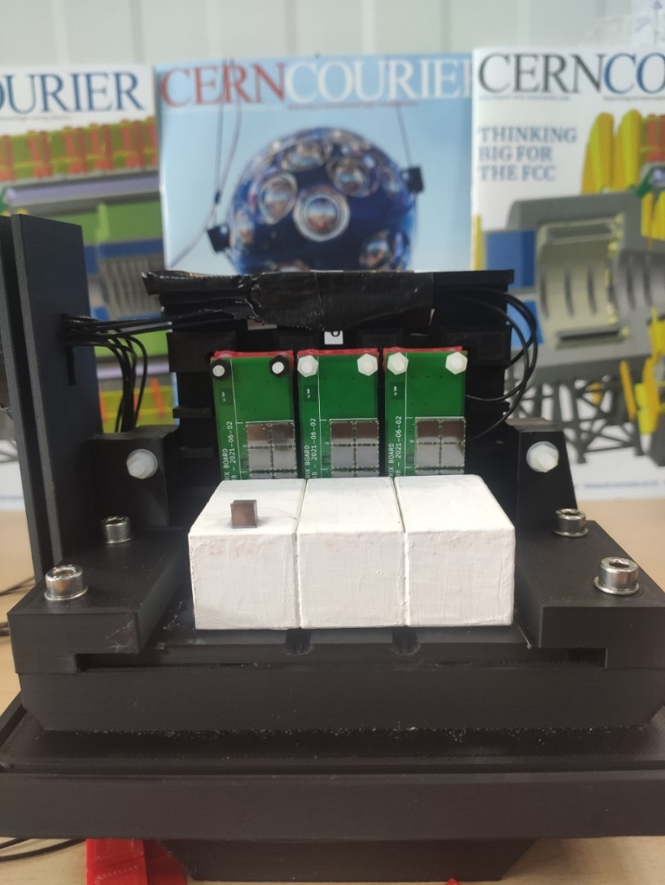
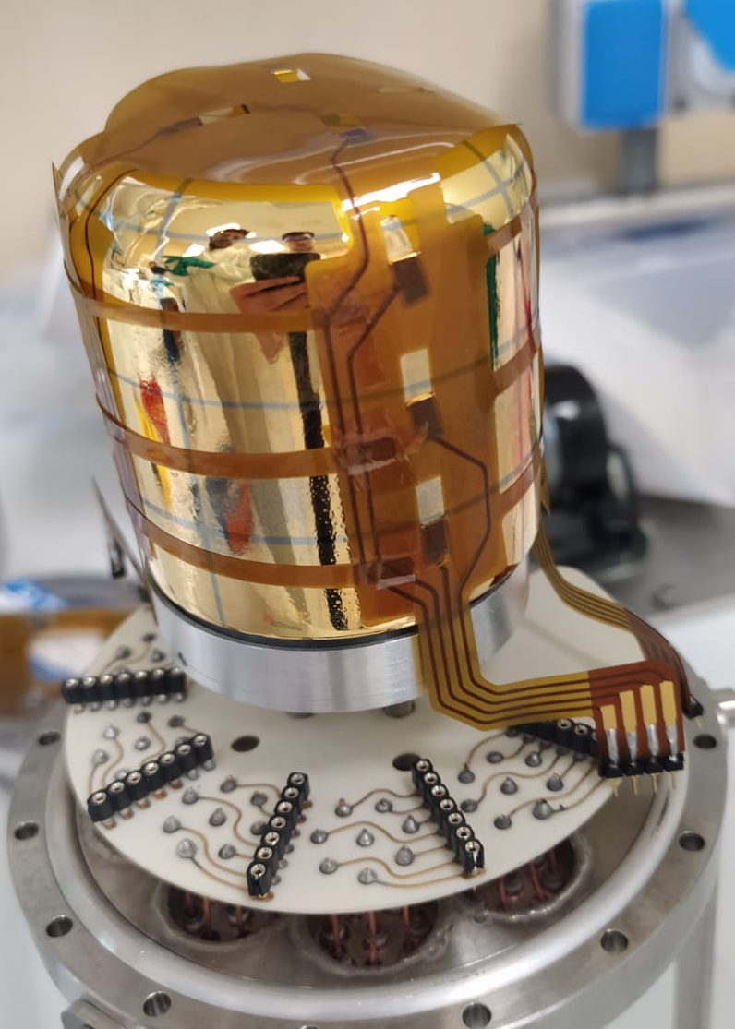

Objective of research
High energy calorimeter based on oriented crystal
PI Laura Bandiera (INFN Ferrara)
1
OREO
Exploit PLM for coaxial segmented p-type detectors
PI Davide De Salvador (LNL-DFA)
2
N3G
Explore technology transfer of PLM (MIRION)
PI Davide De Salvador (LNL-DFA)
3
LACE (R4I-TT)

Slide 7
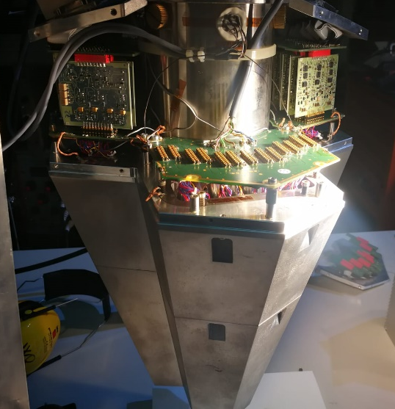
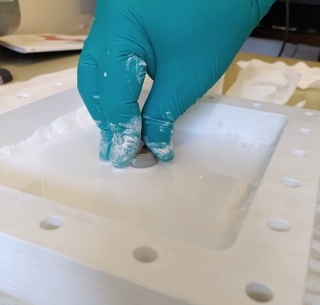
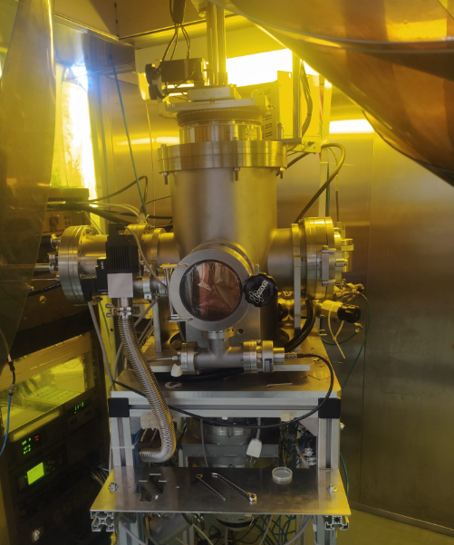
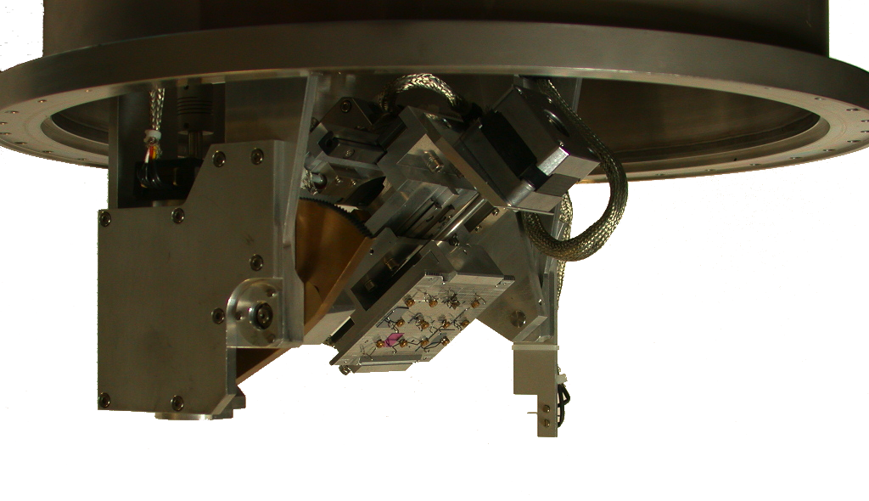
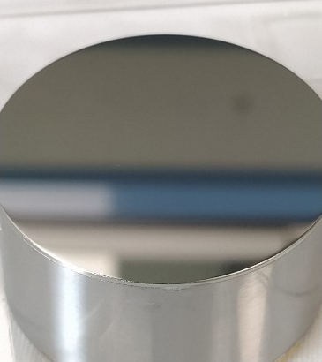
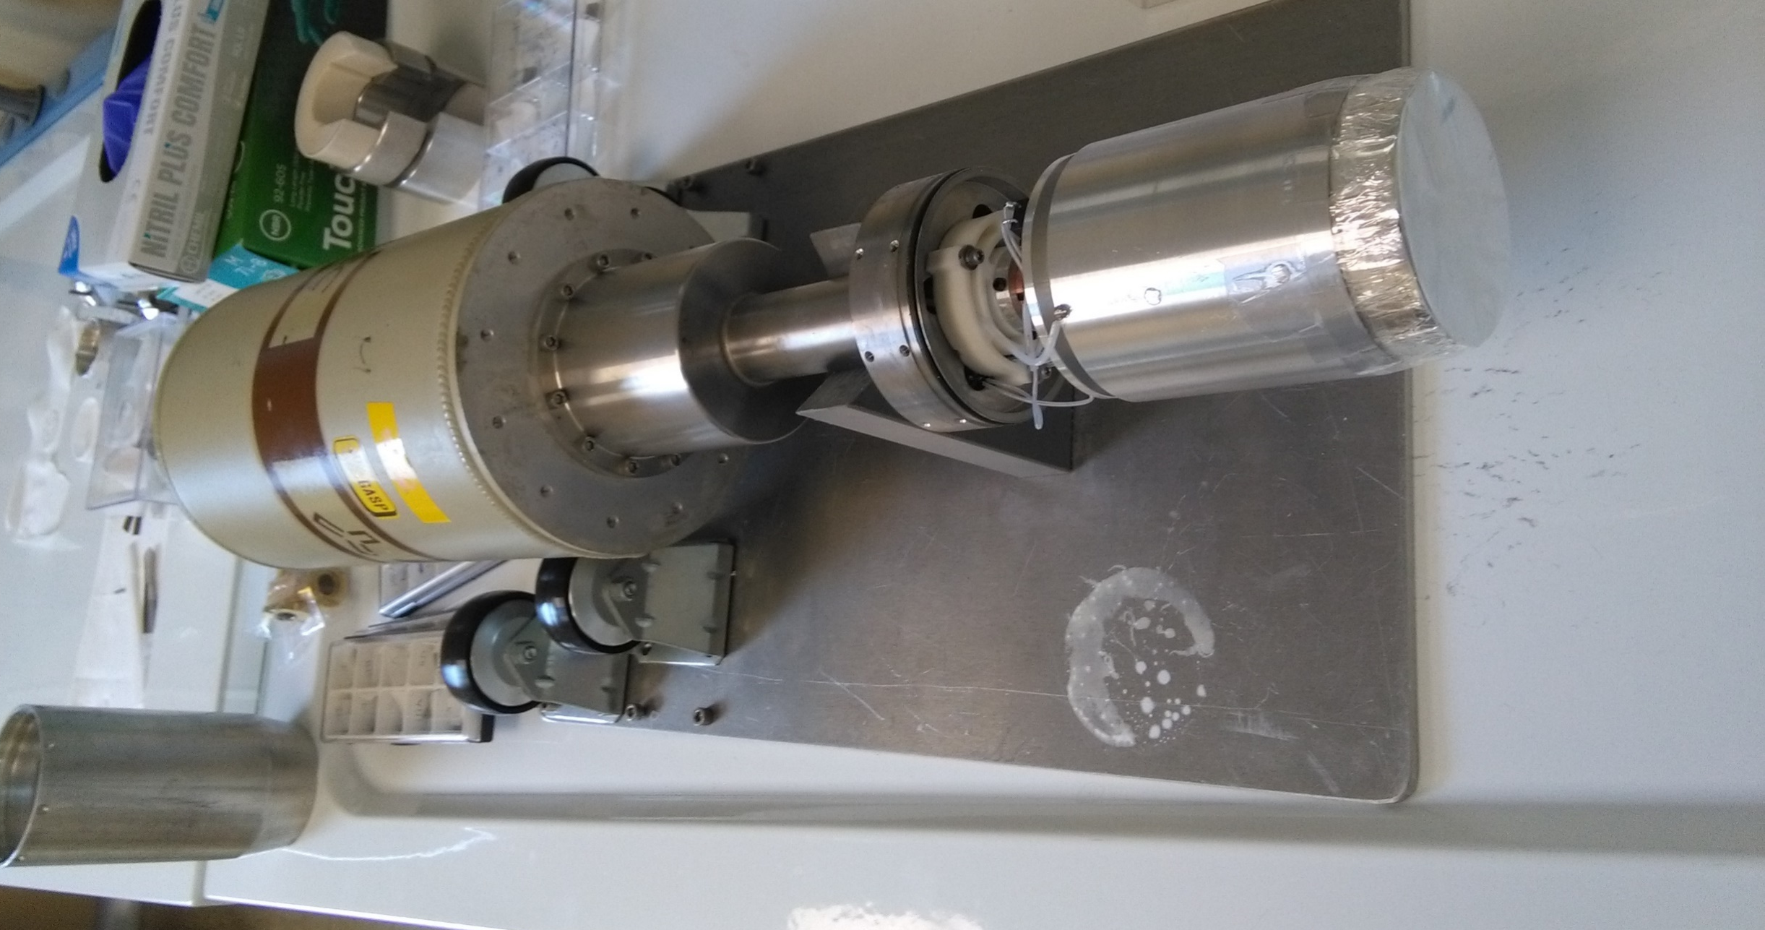
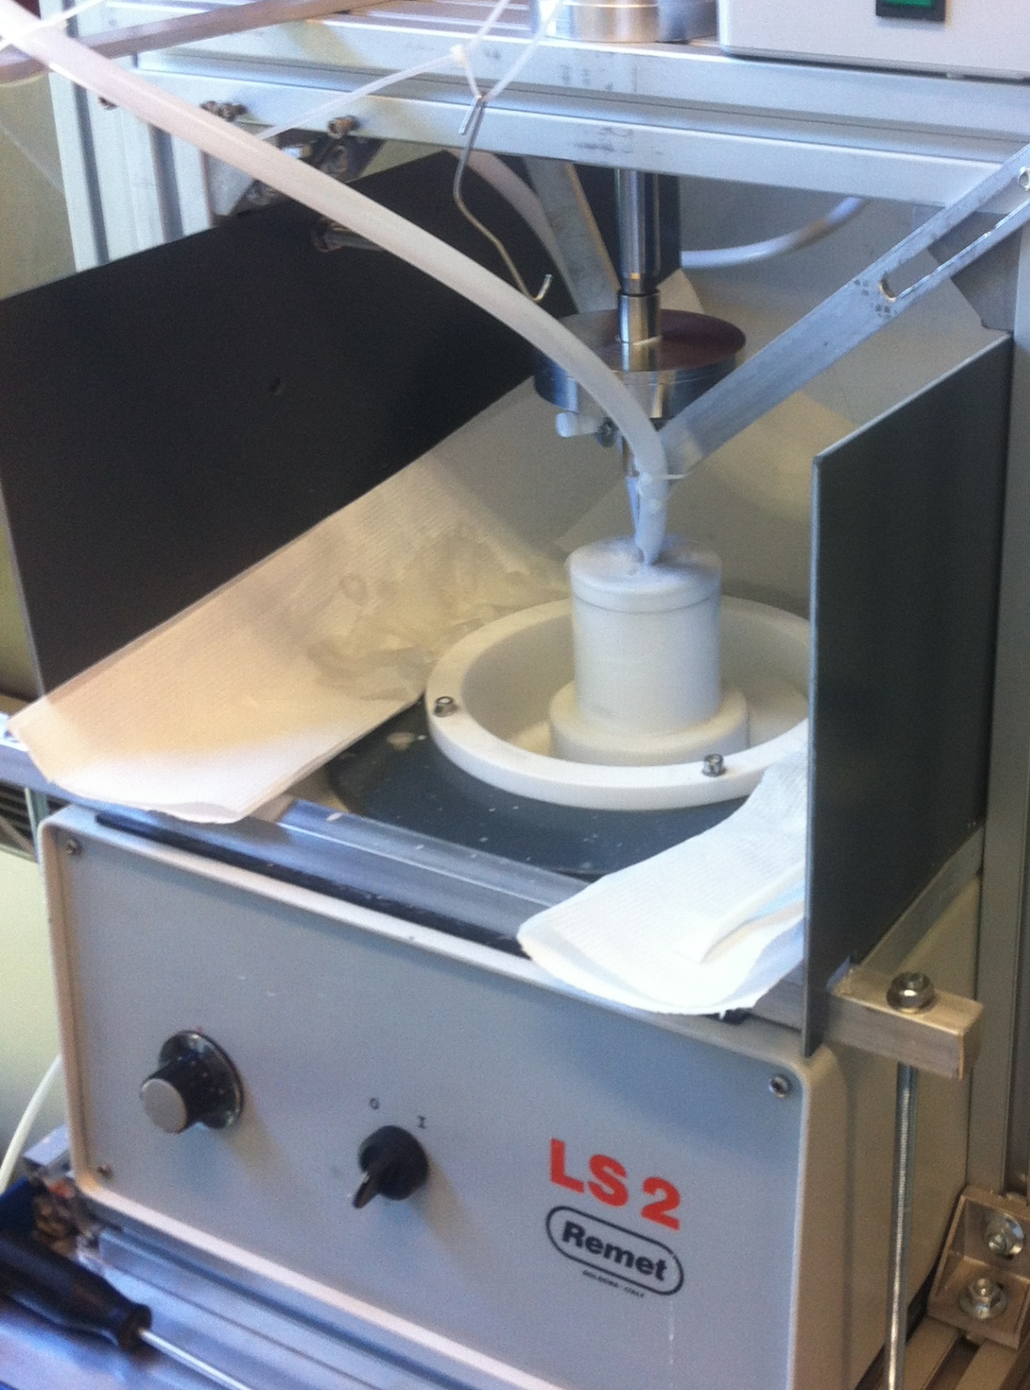
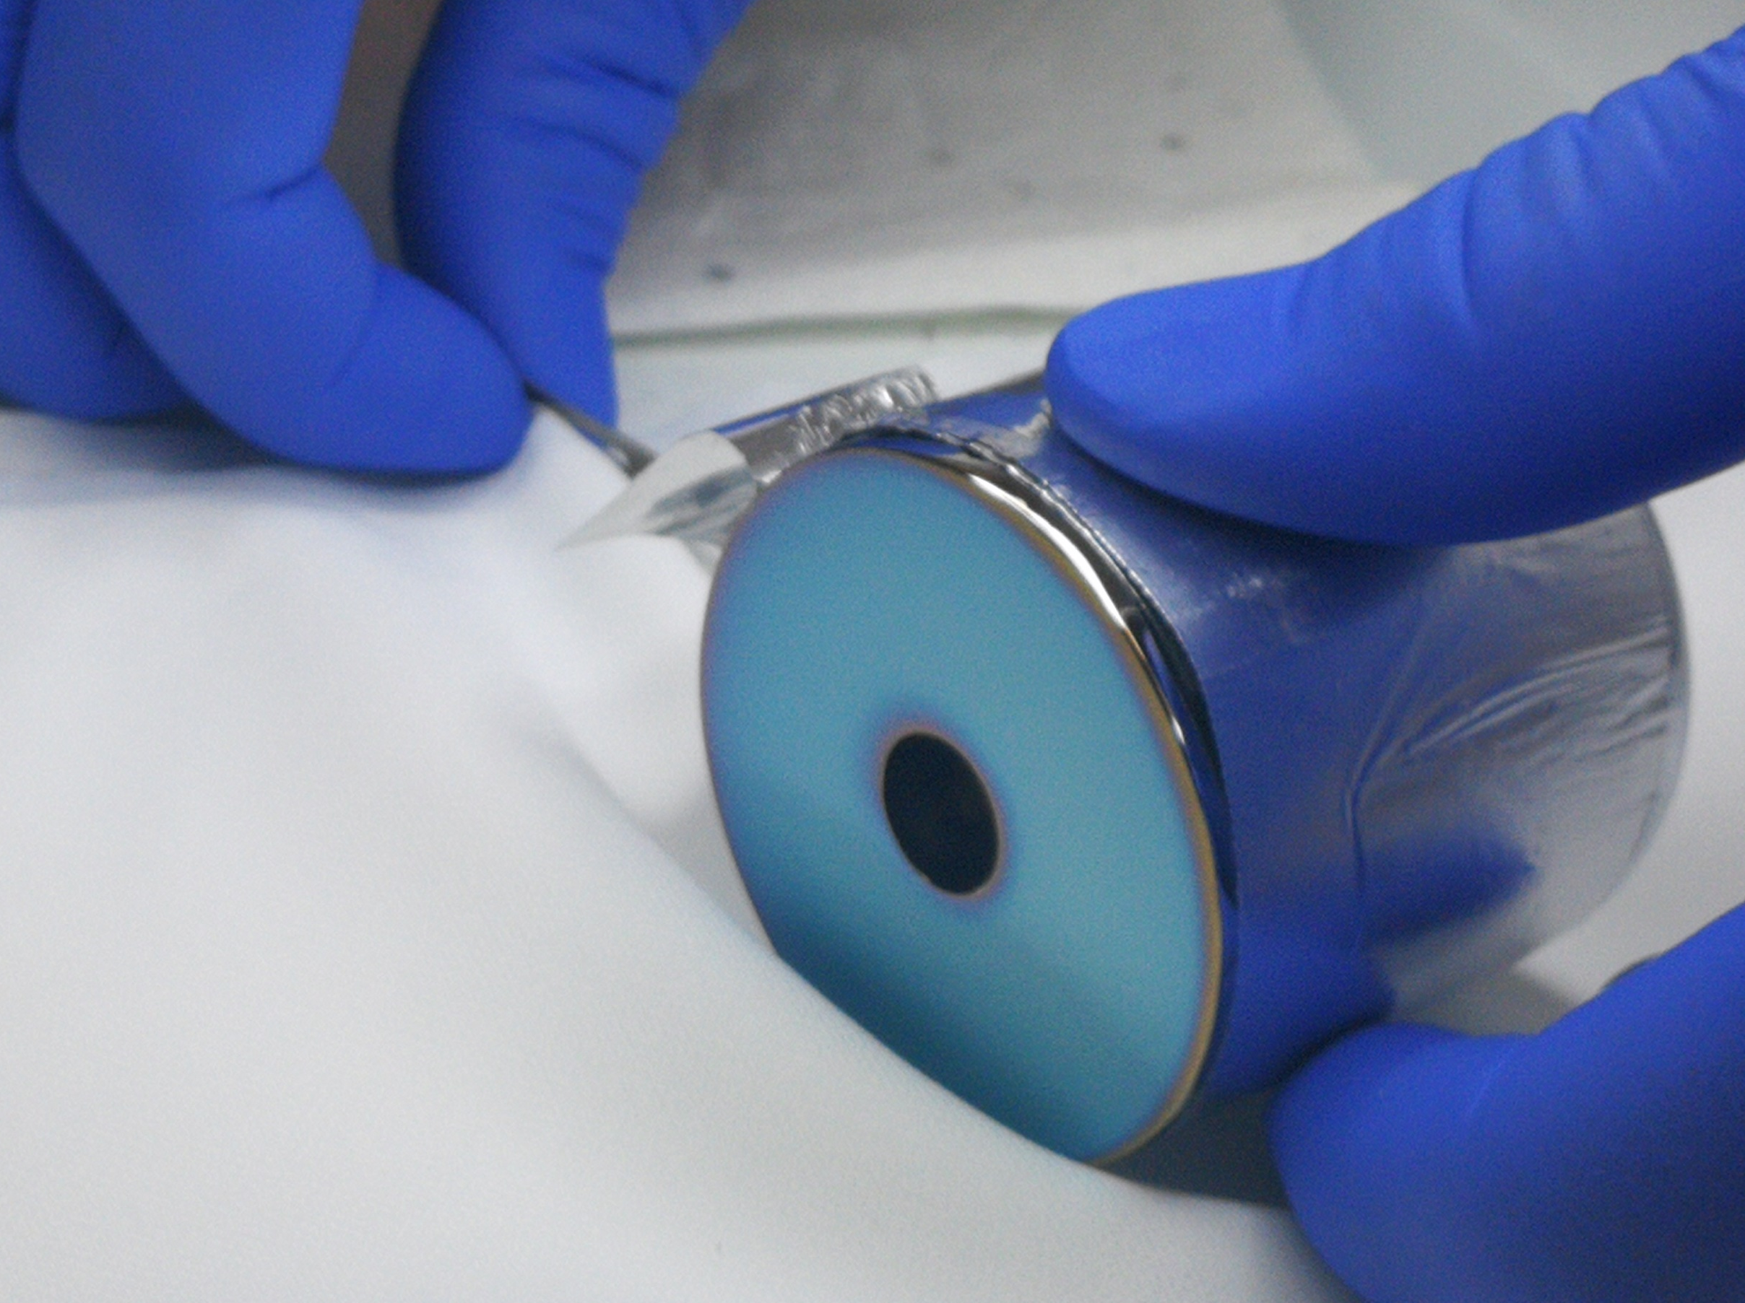
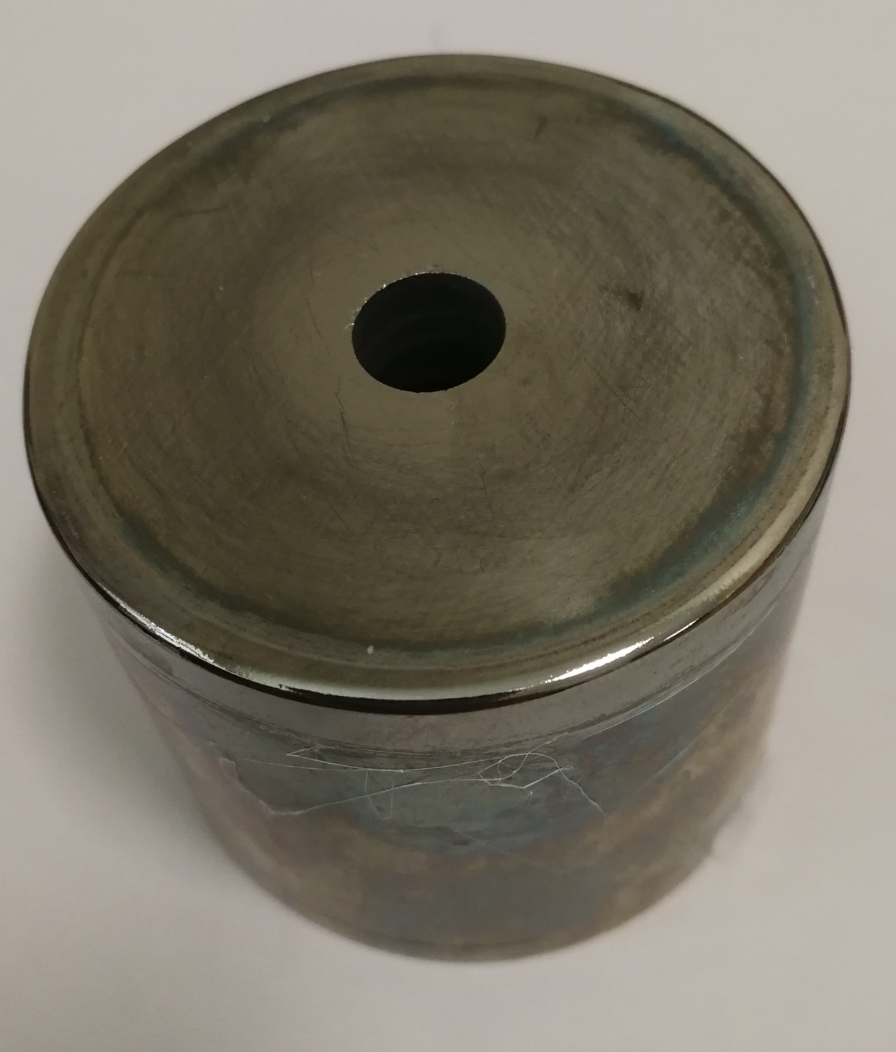
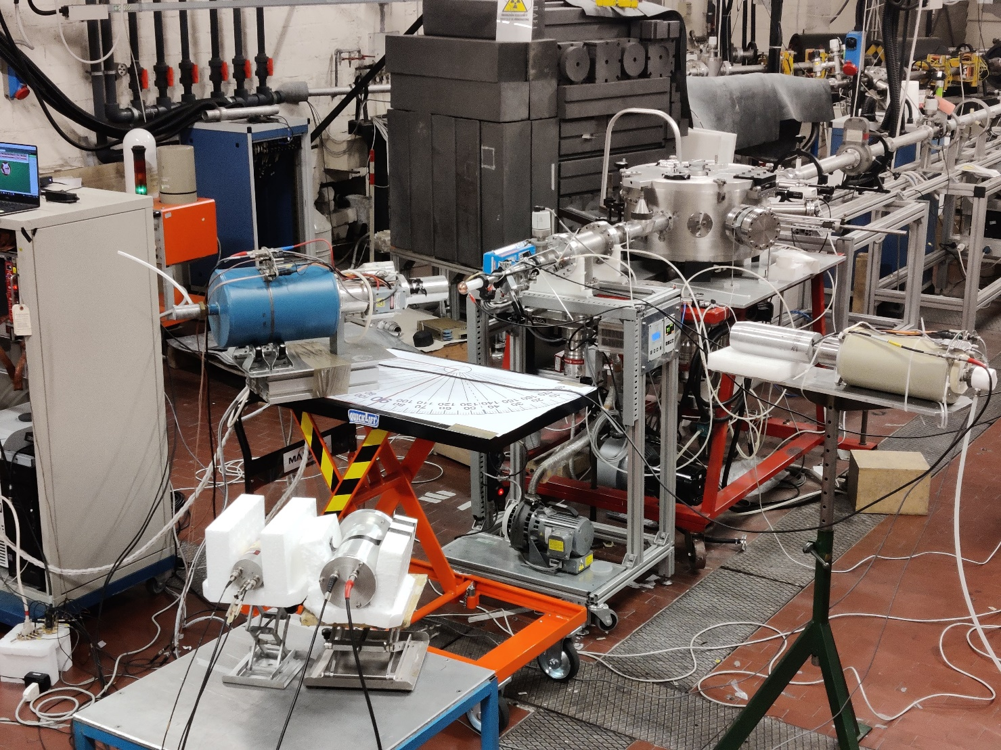
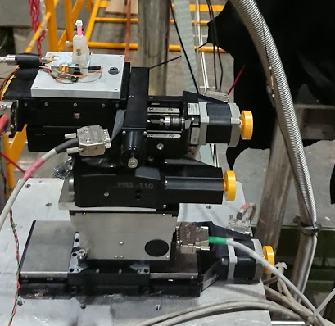
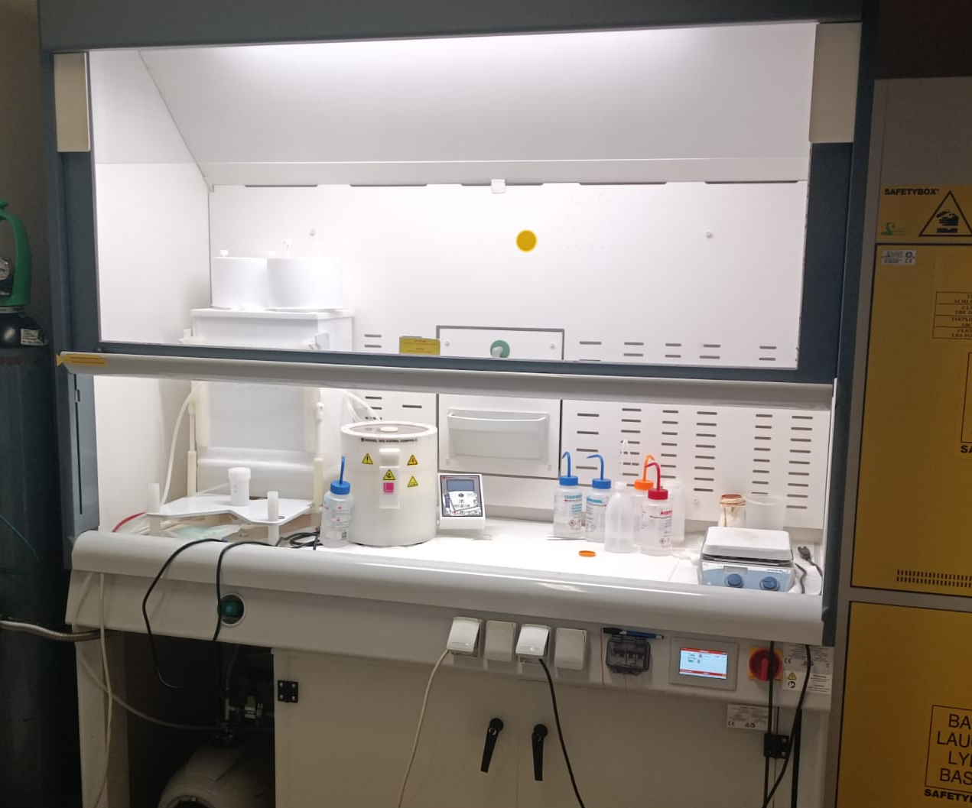
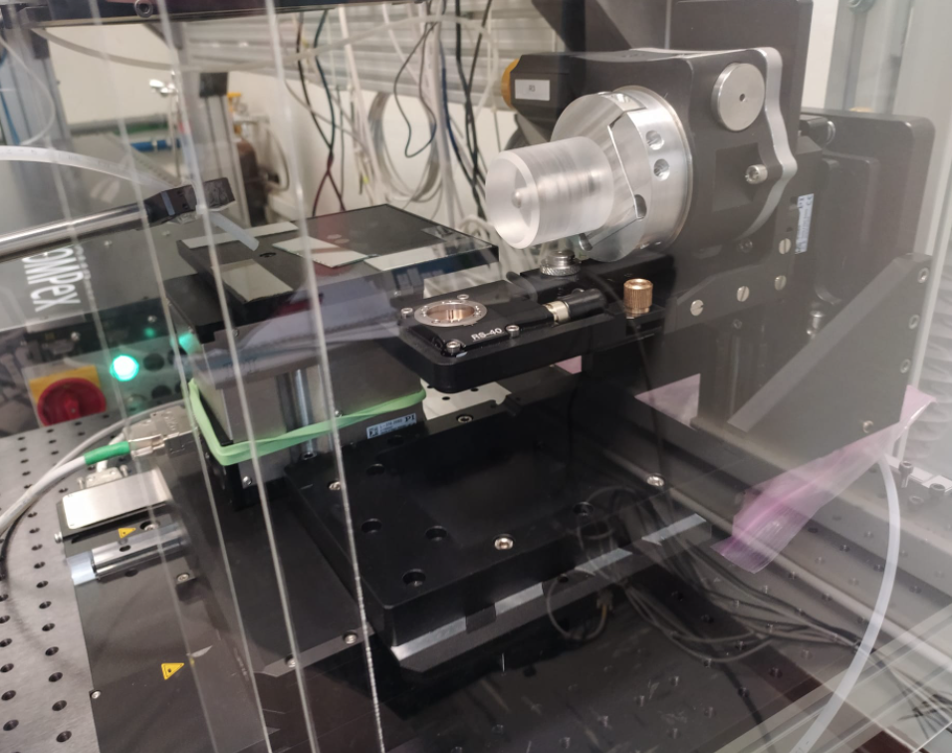
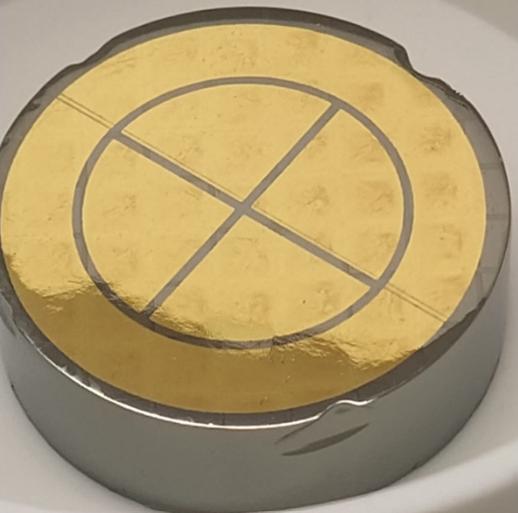
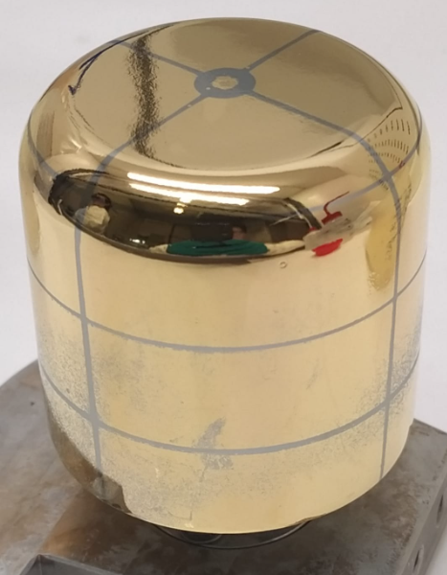
Expertise @ LNL + DFA Semiconductor Group
Crystal processing
(no contaminants)
Layer depositions
HPGe detectors
Crystal characterization RBS channeling @ AN/CN
Incapsulated
GASP
Neutron irradiation @ CN
Crystal precise orientation
PLM
Segmented HPGe

Slide 8

Stakeholder and international collaborations
IMATRA PROPOSAL EU-HORIZON-INFRATECH – “AGATA COMMUNITY”
21 EU institutions/companies,
10 M€ budget,
1.45 M€ for PLM-HPGe activity (sub task 2.1.1 di WP2)

Slide 9
3 years-plan and possible applications
PLM- HPGe detectors
High energy Channeling
Continuation of HPGe detector development and finalize the industrial applicability
Explore innovative geometries and applications:
  Planar detector for exotic ions detections
  Radiation hard detectors with fine segmentation for satellite applications
  Timing improvement for gamma high resolution spectroscopy with planar detectors (another possible EU call in 2025)
  Innovative segmentation exploiting PLM flexibility
Compact high energy particles and gamma detectors for satellite astrophysical application
Innovative positron source exploiting coherent interaction with crystals

