Slide 1
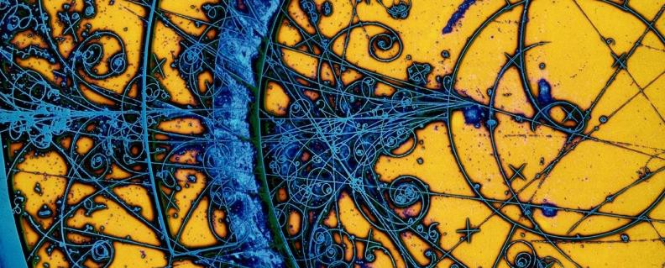
EPiSe
Epidermal Piezoelectric Sensors for cardiovascular function assessment
Duration: 3 years (2024/2026); Subcommittee: Interdisciplinary National Resp.: Antonino Proto (Local Resp., INFN-FE)
External research centers involved: Centro di Malattie Vascolari, UNIFE
Centro Studi Scienze Motorie e Sportive, UNIFE
Participating INFN units:
INFN-LNL, Local Resp.: Oscar Azzolini
INFN-LE, Local Resp.: Silvia Rizzato

Slide 2
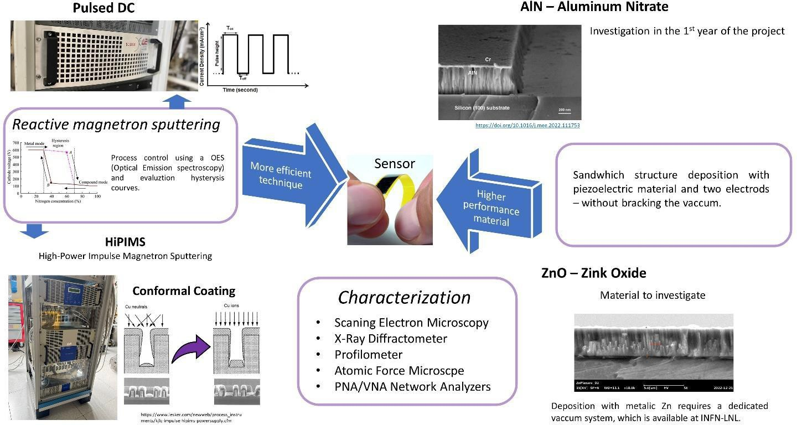
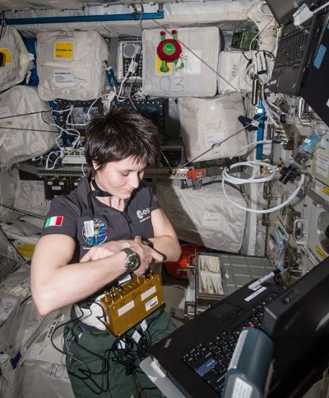
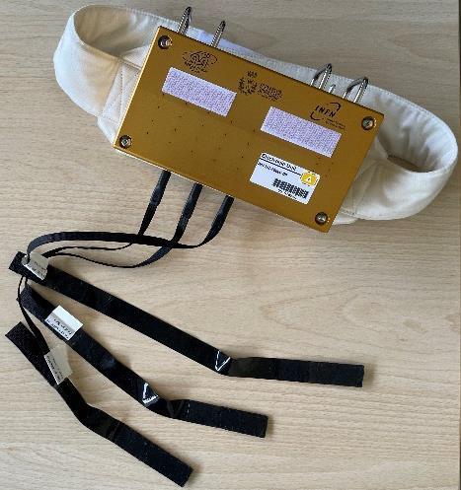
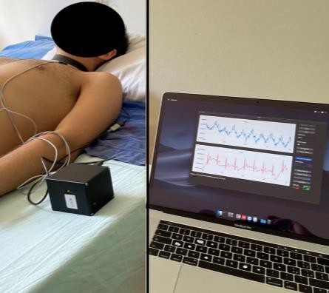
EPiSe Collaboration
INFN-FE → Eco-Fluidodinamics Lab.
INFN-LNL → Coating Lab and INFN-LE → Omnics Lab.
Development of electronics for both HW and SW.
Fabrication and characterization of the piezoelectric sensor.

Slide 3
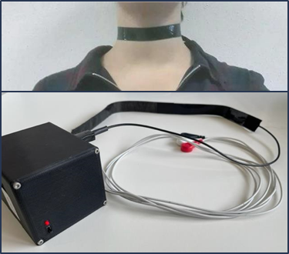
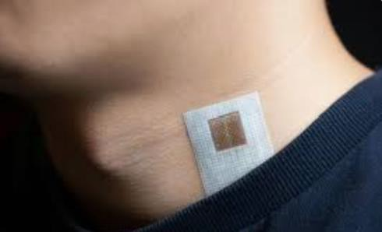
Goals
Study and implementation of an advanced technological solution for JVP monitoring toward Personalized and Preventive Medicine
design, development and tests
of an
Innovative Epidermal Electronic System
Scalable methodology for biocompatible piezoelectric thin film deposition, contacting, and sensor coating.
Miniaturized and low-power electronics; wireless connectivity, and intuitive user interface.
Calibration, in-vitro, with Eco-Fluidodinamica Lab’s instrumentation; and experimentation, in-vivo, with clinical partners
(UNIFE), under study protocol n°: 351/2023/Oss/AOUFe

Slide 4
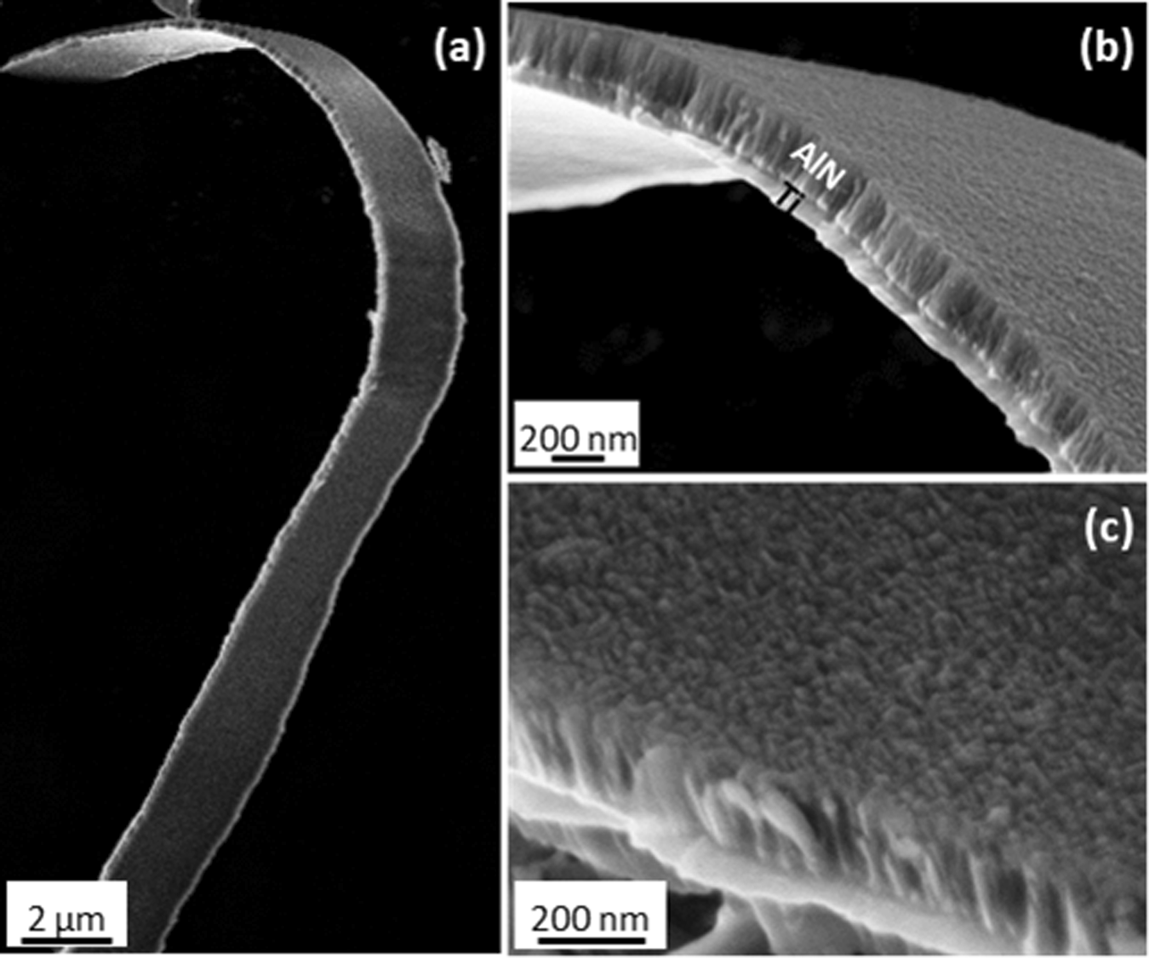
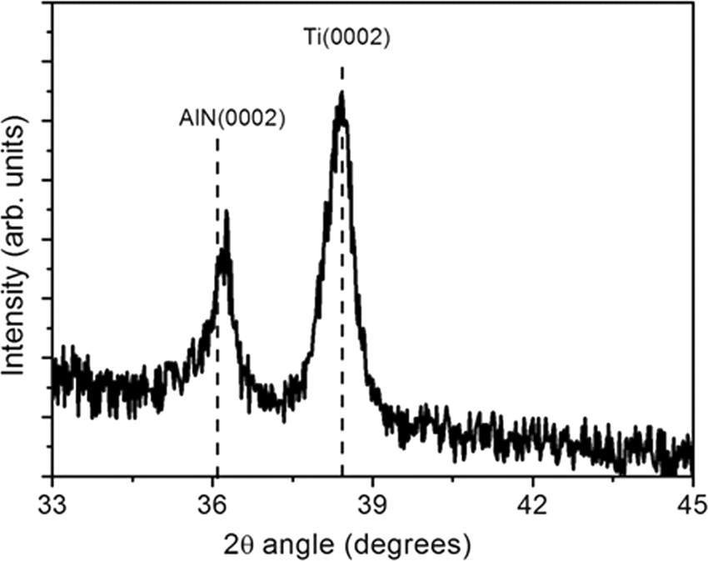
EPiSe @ LNL: AlN Piezoelectric Thin Films
AlN piezoeletctric thin film (200-500nm) flexible
Piezoelectric effect depends on the crystal orientation High = (0002)
HiPIMS technique: high density of the coating and high orientation
SEM images of a representative Ti/AlN bilayer sputtered on Kapton substrate (AlN film is 250 nm-thick), evidencing (a) the high flexibility of the film as well as (b,c) the cross-sectional and surface morphology.

Slide 5
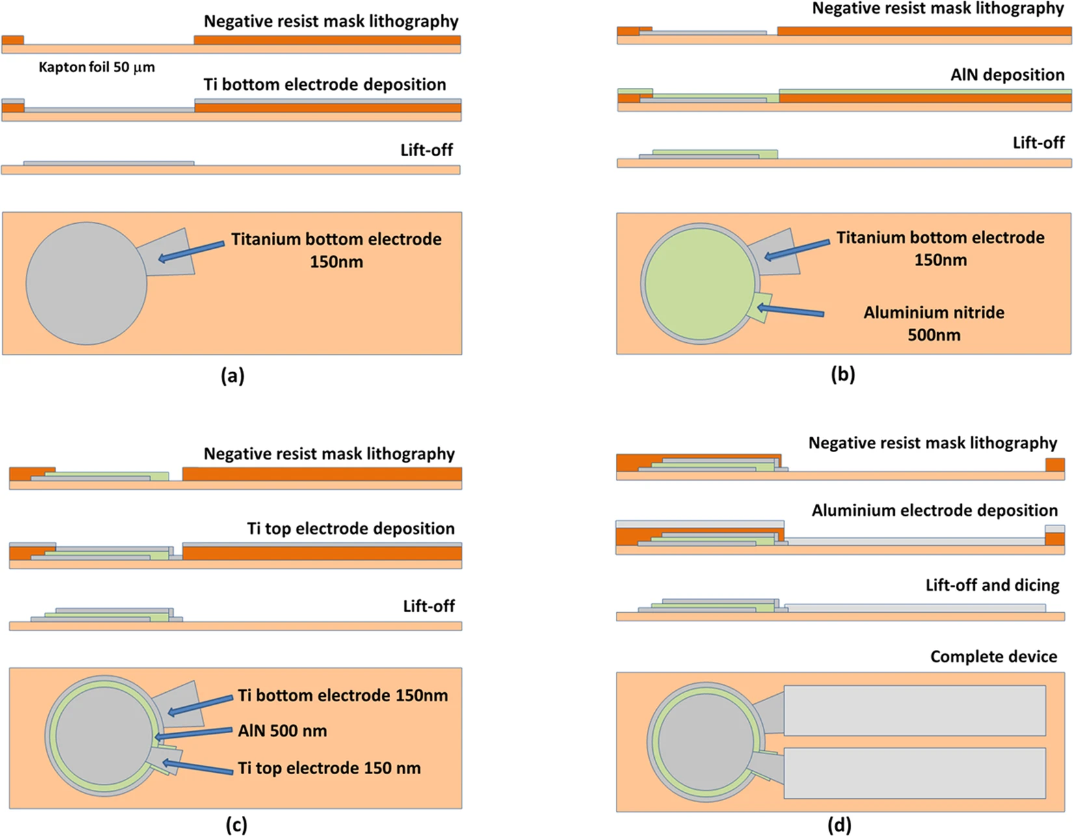
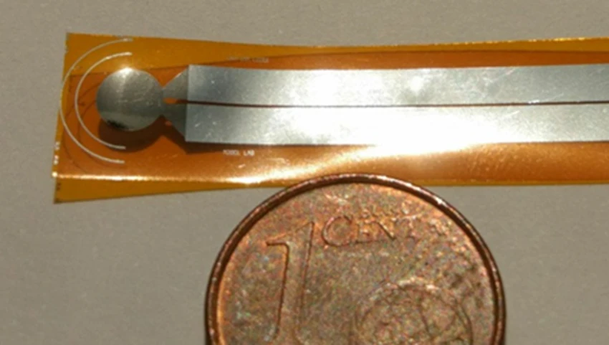
EPiSe Piezoelectric Sensor WorkflowThin
Ex. of a possible Piezoelectric Sensor

Slide 6
FTE Registry for 2024
INFN-LNL FTE
INFN-LE
FTE
INFN-FE FTE
Antonino Proto (Resp.) 0.70
Oscar Azzolini (Resp.) 0.15
Silvia Rizzato (Resp.) Giuseppe Maruccio
0.30
0.20
Alisa Kotiliarenko Lisa Centofante Liliana Mou Giorgio Keppel
0.40
0.30
0.10 Angela Leo
0.05 Anna Paola Caricato
Angelo Taibi Lucia Del Bianco Erica Menegatti Simona Mandini
0.30
0.10
0.60
0.10
Tot. 1.80
Anna Grazia Monteduro 0.20
0.20
0.10
Tot. 1.00
Tot. 1.00

Slide 7
HB²TF (2023-2025) call accelerators
The development of a High Brightness Beams Test Facility (HB2TF) at the INFN-LASA laboratory.

Slide 8
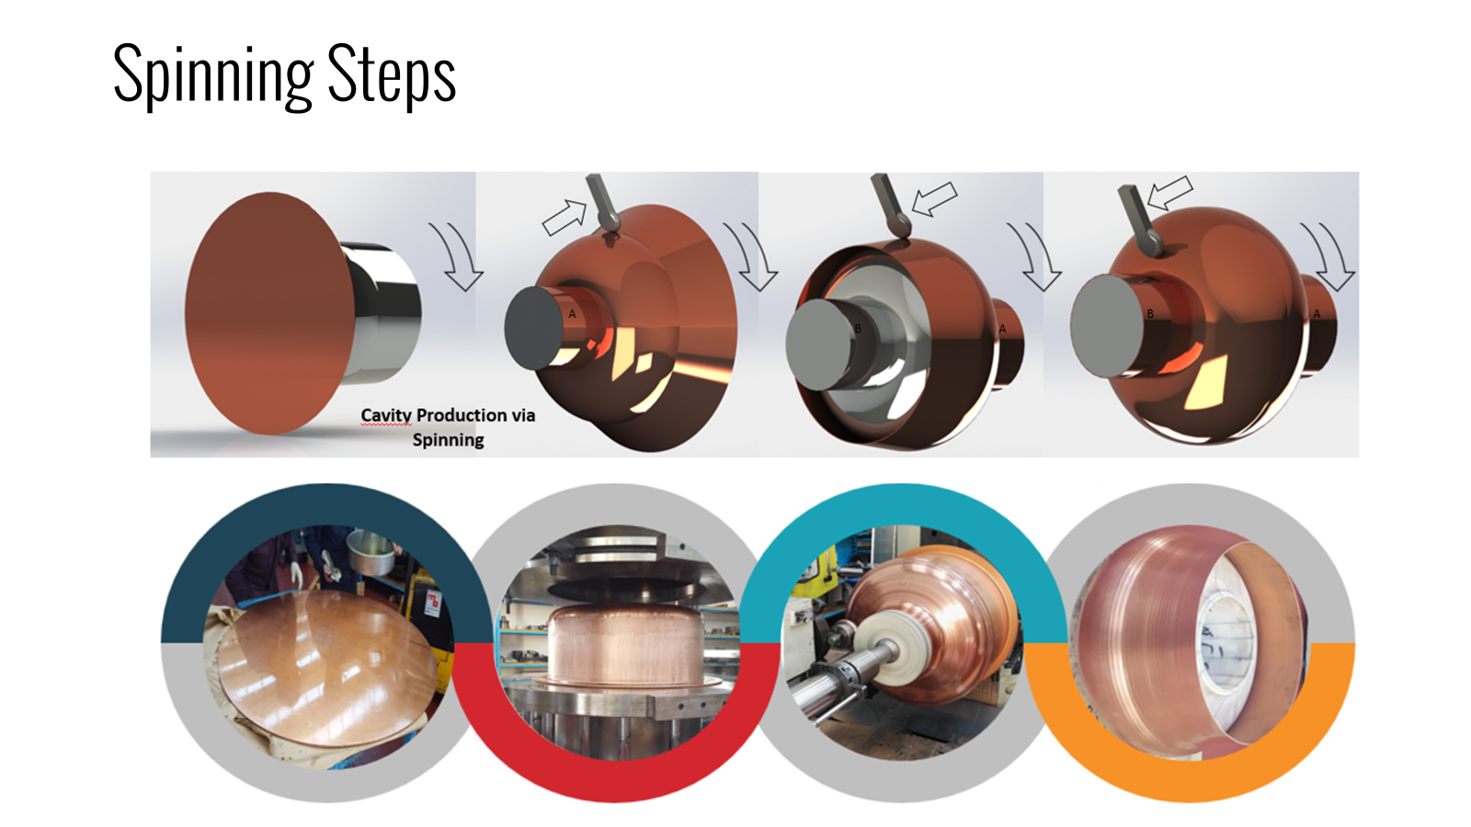
INFN UNITS
Milano
LNF
LNL
LNS
Bologna
Napoli
LNL FTE 2024
LNL Activities 2024
Support for the Commisioning of the two buncher cavities
Support for the Surface preparation
Unit | Name | FTE
LNL | Oscar Azzolini | 0,05
LNL | Marco Miglioranza | 0,10
 | TOT | 0,15

Slide 9
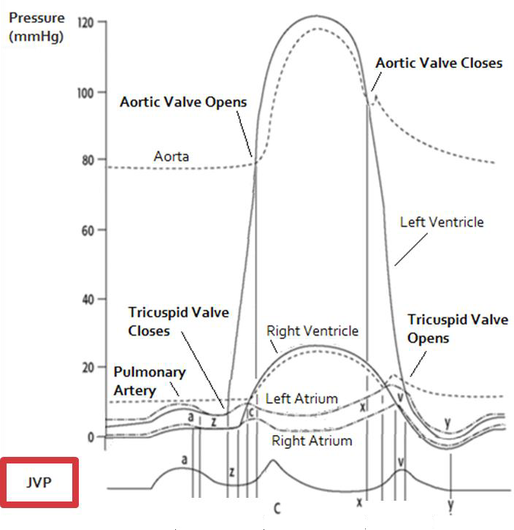
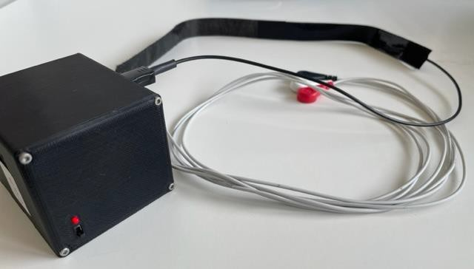
Scientific Background
Jugular Venous Pulse (JVP) is a fundamental predictive index in cardiovascular disfunction.
JVP is a suitable indicator to detect and follow the heart failure events and may be associated also with neurodegenerative disorders.
In clinical practice, JVP is assessed qualitatively. Its quantification can only be done invasively through central venous catheterization.
Ultrasound can also be useful for assessing JVP but is operator-dependent with
heterogeneous and inaccurate results.
Photoplethysmography and plethysmography are being investigated in research, but they require a specific experimental set-up and/or a healthcare operator.
INFN-FE developed a cervical plethysmography for JVP monitoring
WISE project (CSN5, Dr. Gadda, 2019-2021)
In a telemedicine context, an advanced, non- invasive, user-friendly technology, able to measure the JVP locally, can be provided by means of an EPIDERMAL, PATCH-LIKE SYSTEM!
however
it provides an integral measurement, collecting also motion artifacts
&
because of the presence of the cables, it is portable and not wearable.

Slide 10
WPs & Activity planning – Gantt Diagram
 | 2024 |  |  |  | 2025 |  |  |  |  |  | 2026
 | jan. - mar. | apr. - jun. | jul. - sep. | oct. - dec. | jan. - mar. |  | apr. - jun. | jul. - sep. |  | oct. - dec. | jan. - mar. |  |  | apr. - jun. | jul. - sep. | oct. - dec.
WP 1 | RI | RA1 |  |  |  | RA2 |  |  | RA3 |  |  |  | RA4 |  |  | RF
WP 2 |  |  |  | M2.1 |  |  |  |  |  | M2.2
WP 3 |  | M3.1 |  | M3.2 |  |  | M3.3 |  |  | M3.4
WP 4 |  |  |  |  |  |  |  |  |  |  |  | M4.1 |  |  |  | M4.2
WP1: project management (FE, LE, LNL)
WP2: coating and packaging (LNL, LE)
WP3: electronics and data analysis (FE)
WP4: validation and data collecting (FE)
In WP1, key events (internal to the research group) are defined as “Riunioni di Avanzamento” (i.e., progress meeting)

Slide 11
WP2 coating and packaging
(INFN-LNL & INFN-LE)
M2.1: fabrication of prototype sensor with AlN sensing element (12/’24)
M2.2: definition of sensor final version and the method of manufacturing thereof (12/’25)
TASKS:
Protocol definition for substrate and electrode development by lithography: 2024, Q1 - Q2 for the prototype version of the sensor; 2025, Q1 - Q2 for the optimized version of the sensor.
Protocol definition for material deposition by sputtering: 2024, Q1 - Q2 for the prototype version of the sensor; 2025, Q1 - Q2 for the optimized version of the sensor.
Planning the fabrication activity of the sensitive element: 2024, Q3 - Q4 for the prototype version of the sensor; 2025, Q3 - Q4 for the optimized version of the sensor.
Morphological, structural, electrical and piezoelectric characterization of the sensitive element: 2024, Q3 - Q4 for the prototype version of the sensor; 2025, Q3 - Q4 for the optimized version of the sensor.
Planning of FEA simulation procedures and mechanical tests to be performed on the packaged epidermal system: 2025, Q3 - Q4.

Slide 12
WP3 electronics and data analysis
(INFN-FE)
M3.1: defining the requirements and specifications of the epidermal system (07/’24)
M3.2: implementation of a JVP signal processing and analysis algorithm (12/’24)
M3.3: prototype of the electronic circuitry (07/’25)
M3.4: user interface software for reading data (12/’25)
TASKS:
Data collection (JVP signal) with devices from the Eco-Fluidodinamica Lab.: 2024, Q1 - Q2.
Development of an algorithm for filtering the acquired signal, and an algorithm for feature extraction: 2024, Q3 - Q4.
Defining the system hardware and software components for the epidermal system: 2024, Q3 - Q4.
Planning for prototype development and electrical testing: 2024, Q4.
Prototype circuitry development and electrical testing: 2025, Q1 - Q2.
Planning for the development of the epidermal system, including packaging: 2025, Q3 - Q4.
Results on the calibrated and validated epidermal system: 2026, Q1.

Slide 13
WP4 validation and data collecting (INFN-FE)
M4.1: assembly of the final epidermal system (03/’26)
M4.2: analysis of clinical trial results (12/’26)
TASKS:
Defining the instrumentation of the Eco-Fluidodinamica Lab. to calibrate the epidermal system: 2025, Q4.
Measurement planning to calibrate the epidermal system: 2025, Q4.
Evaluation of a possible amendment to the study protocol n°. 351/2023/Oss/AOUFe: 2025, Q4; 2026, Q1.
Definition of procedures for the proper use of the system in the clinic: 2026, Q1 - Q2.
Clinical data collection and analysis of results: 2026, Q3 - Q4.

Slide 14
Impact of research results
Opportunity to take advantage of a miniaturized, low-energy, non-invasive and non-ionizing epidermal system, capable of providing expendable information for the study of cardiovascular disease and, possibly, neurodegenerative disorders.
The epidermal system has versatile features for clinical use in Medicine and Telemedicine, thus being able to provide care to populations with mobility difficulties and for whom it is inconvenient to travel to hospital departments for consultation.
Positive spillover effects can also be had in terms of improved cardiovascular fitness, with a wider range of stakeholders who for different causes are forced to reduce mobility and exercise.
The results of the EPiSe experiment potentially predict the achievement of TRL greater than or equal to 4. Therefore, the spillover of technology transfer is hoped for the epidermal system proposed here.

